Slide 1



5th International Conference on Earth Science & Climate Change
Analysis of spatial distribution and temporal trend of soil moisture over the Tibetan Plateau from 1978 to 2013
Meng X., Lu S., Li R., Luan L., Ma Y., Li S.
Cold and Arid Regions Environmental and Engineering Research Institute,
Chinese Academy of Science

Slide 2
Outline
Background
Data and methods
Results and discussion
Conclusions

Slide 3
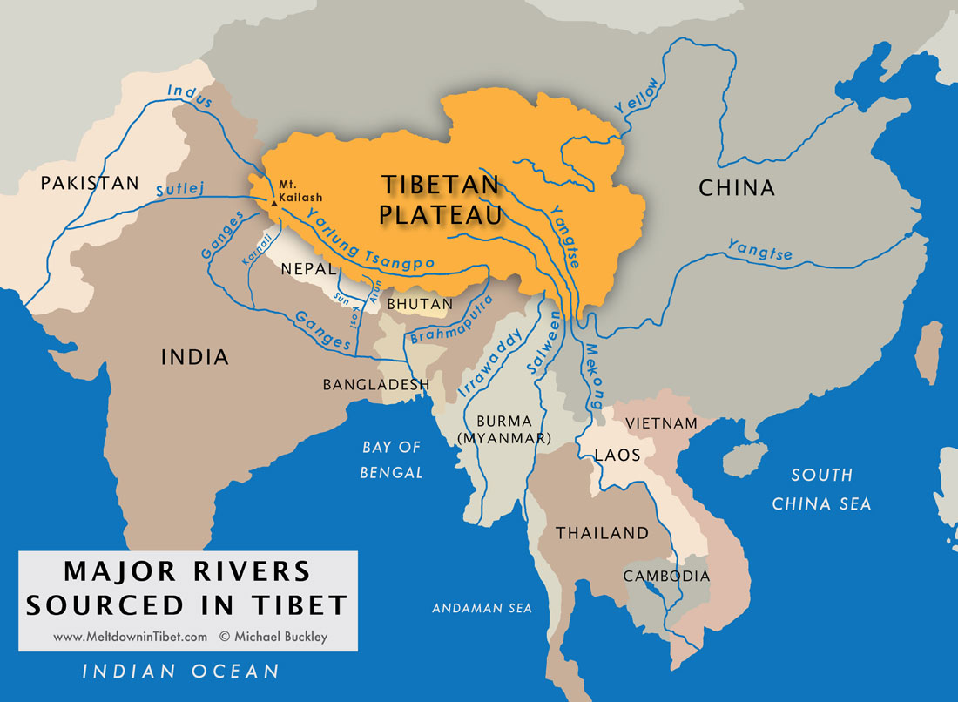
Background
The Tibetan Plateau is the headwater region of many international rivers such as the Yellow, Yangtze, and Mekong Rivers, and the northern TP provides water for more than a billion people and numerous ecosystems in China and Southeast Asia.

Slide 4

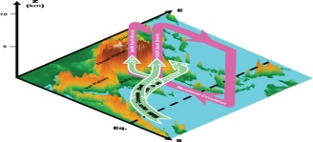
Background
(Wu et al., 2012)
The TP affects the South Asia Monsoon and East Asia Monsoon;
The Plateau Vortex over the TP often goes east and leads to rainstorm in the middle and lower reaches of the Yangtze River.
The Tibetan Plateau (TP) plays significant influence on regional and global climate through thermal and mechanical forcing

Slide 5
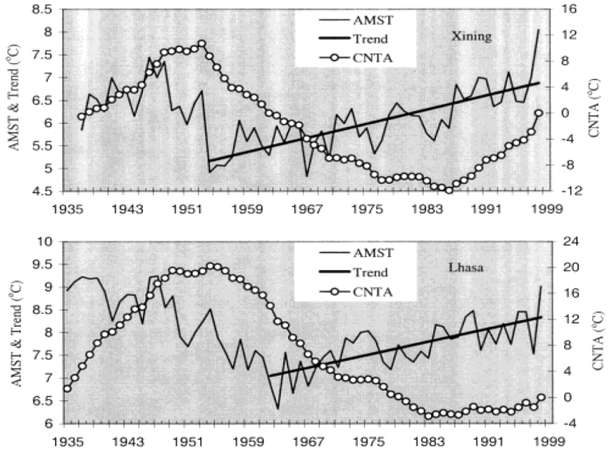
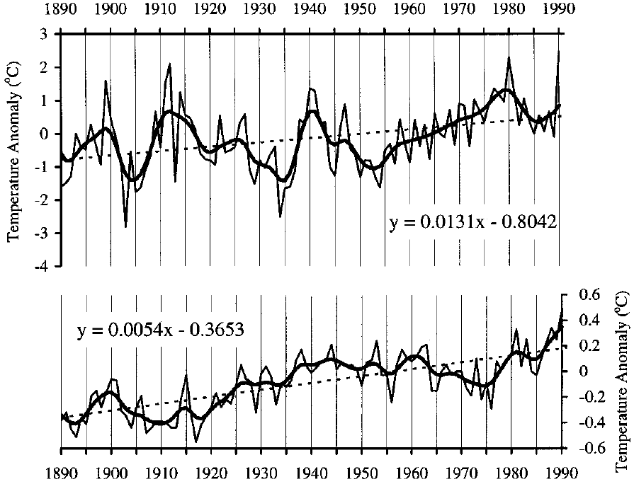
Background
Annual mean temperature anomalies (relative to a 1950-1979 reference period) of the station Natyn and the Northern Hemisphere average in the last 101 years
Air temperature changes in Xining and Lasha
（Liu and Chen, Int. J Climatol., 2000）
The TP is one of the most sensitive regions to response to global warming;
The raising rate of warming over the TP is almost two times than the Northern Hemisphere.

Slide 6
Background
Climate warming on the TP has been suggested by meteorological observation and ice core;
The warming over the TP seems more evident on the plateau than globally;
Previous studies suggested that global warming would have accelerated the hydrological cycle;
How the surface soil moisture responses to global warming?

Slide 7
Data and methods
Data | Sources | Time | Temporal resolution | Spatial resolution
Air temperature | China Meteorological Data Sharing Service System | 1961-2013 | Monthly | 0.5º*0.5º
Precipitation |  | 1961-2013 | Monthly | 0.5º*0.5º
 |  | 2008-2013 | Hourly | 0.1º*0.1º
Soil moisture | the European Space Agency's (ESA) | 1978-2013 | Daily | 0.25º*0.25º
Notes:
From the European Space Agency's (ESA)Water Cycle Multimission Observation Strategy (WACMOS) and Soil Moisture Climate Change Initiative (CCI) projects. hourly precipitation datasets merged with the Automatic Weather Station (AWS) observations and the Climate Prediction Center Morphing Technique (CMORPH) in a spatial resolution of 0.1ºin June in 2009.

Slide 8
Data and methods
Data | Sources | Time | Temporal resolution | Spatial resolution
Air temperature | China Meteorological Data Sharing Service System | 1961-2013 | Monthly | 0.5º*0.5º
Precipitation |  | 1961-2013 | Monthly | 0.5º*0.5º
 |  | 2008-2013 | Hourly | 0.1º*0.1º
Soil moisture | the European Space Agency's (ESA) | 1978-2013 | Daily | 0.25º*0.25º
the first purely multi-decadal satellite-based soil moisture product that spans over 35 years on a daily basis designed for climate application
Notes:
From the European Space Agency's (ESA)Water Cycle Multimission Observation Strategy (WACMOS) and Soil Moisture Climate Change Initiative (CCI) projects. hourly precipitation datasets merged with the Automatic Weather Station (AWS) observations and the Climate Prediction Center Morphing Technique (CMORPH) in a spatial resolution of 0.1ºin June in 2009.

Slide 9
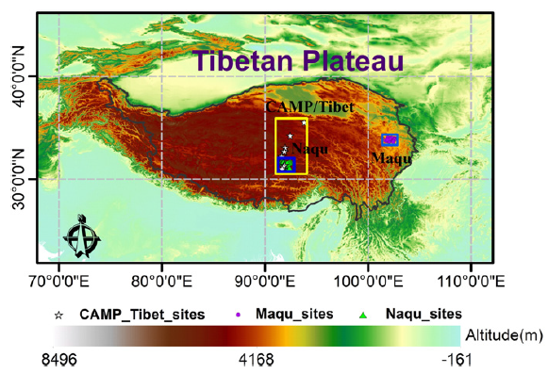
Data and methods
Observations
Zeng et al. (2015) evaluated several soil moisture products by using observations from three soil moisture net work on the TP.
(Zeng et al., RSE, 2015)

Slide 10
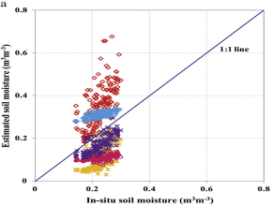
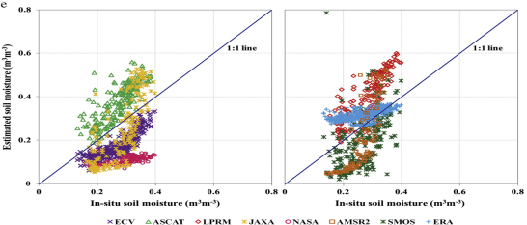
Data and methods
Evaluation
(Zeng et al., 2015)
The scatter plots shows that soil moisture product from ESV is the best.

Slide 11
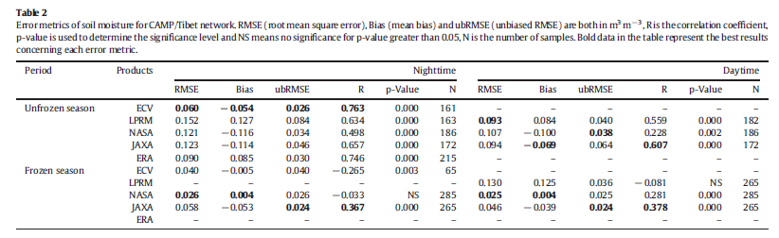
Data and methods
Evaluation
(Zeng et al., 2015)
RMSE, Bias, ubRMSE and R show that soil moisture product from ESV is the best.

Slide 12
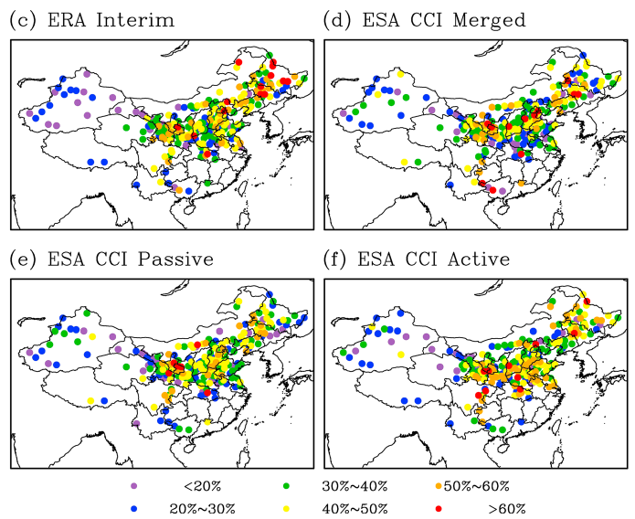
Data and methods
Percentage of detectable soil moisture drought (Yuan et al., 2015)

Slide 13
Data and methods
The bias of the ECV soil moisture product is still large.
the ECV soil moisture product can only detect less than 30% of short-term drought (month to seasonal) month at in situ station scale on the TP, showing that there are still uncertainties in the ECV soil moisture products when applying in different studies.
the influence of missing values when being applied in climate change research.

Slide 14
Data and methods
Methods
assess the hydrological consistency of the ECV soil moisture product to reflect the short-term response of soil moisture to precipitation.
The significance of statistical trends in soil moisture, air temperature, and precipitation time series were examined using the Mann-Kendell trend test and linear slope estimate.
The relationship between soil moisture and air temperature and precipitation were examined by using correlation and partial correlation analysis.

Slide 15
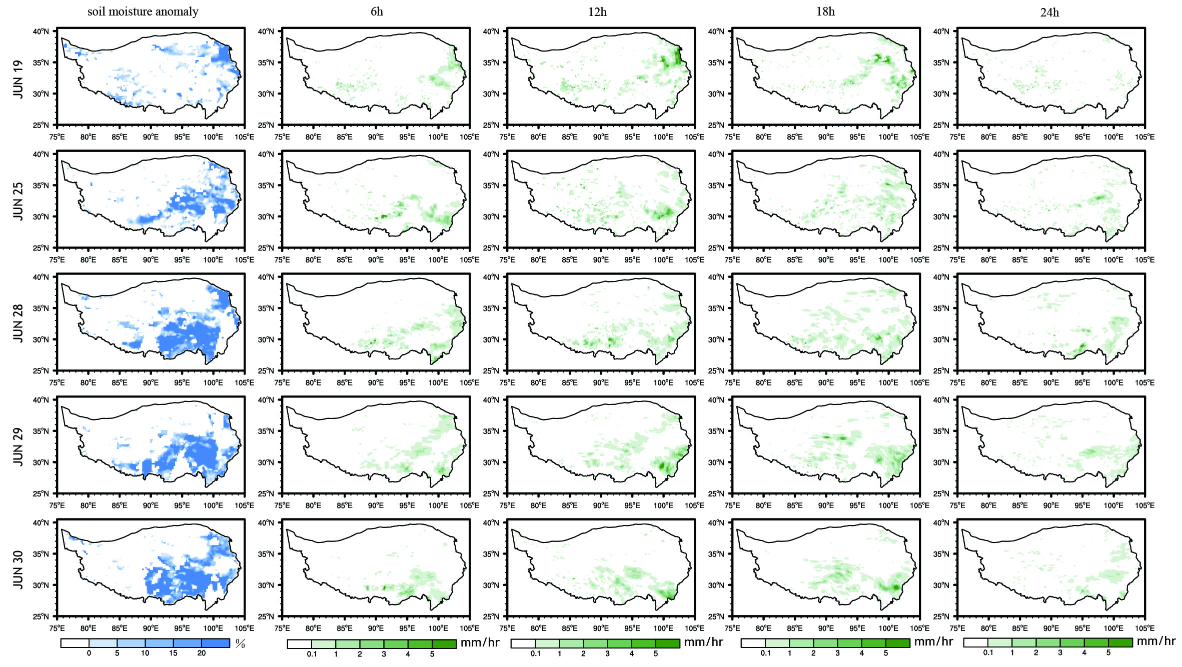
Results and discussion
Comparison of the ECV soil moisture anomaly for identified rain days during June 2009 over the TP.
The observed hourly rainfall amounts (instantaneous rain-rate) are shown for 6,12, 18 and 24 h preceding the ECV overpass time (08 a.m. LT).
Notes:
The observed hourly rainfall amounts (instantaneous rain-rate) are shown for 6,12, 18 and 24 h preceding the ECV overpass time (08 a.m. LT). Soil moisture anomaly is the difference between daily values and the monthly average, only showing a positive (wet) anomaly.

Slide 16
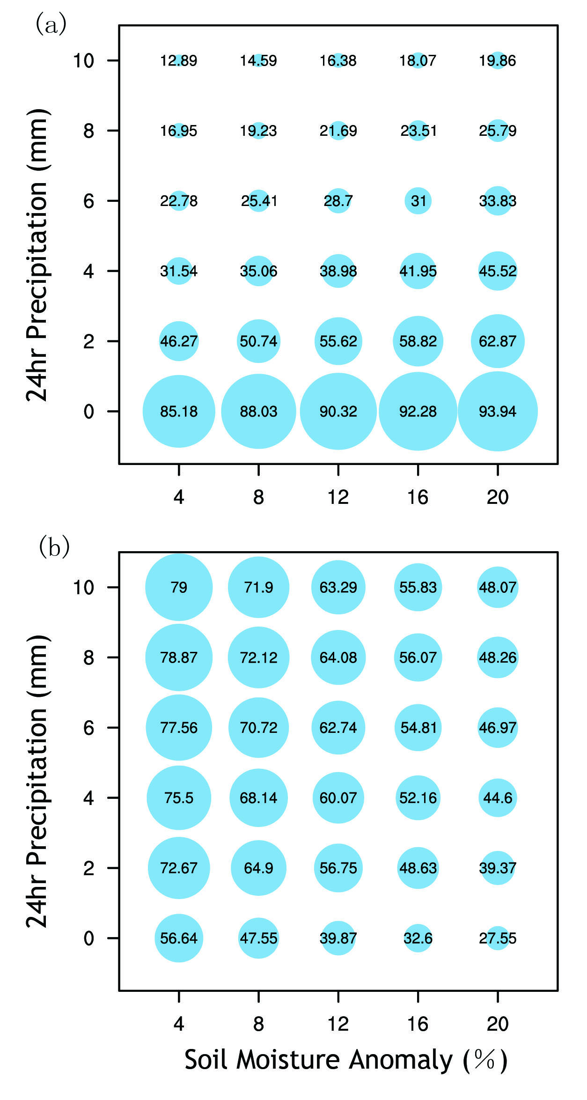
Results and discussion
Percentage of pixels satisfying a) the ECV soil moisture anomaly greater than some value x and having observed cumulative rainfall (24 h) greater than value y; and b) observed cumulative rainfall (24 h) greater than some value y and having an ECV soil moisture anomaly greater than value x.

Slide 17
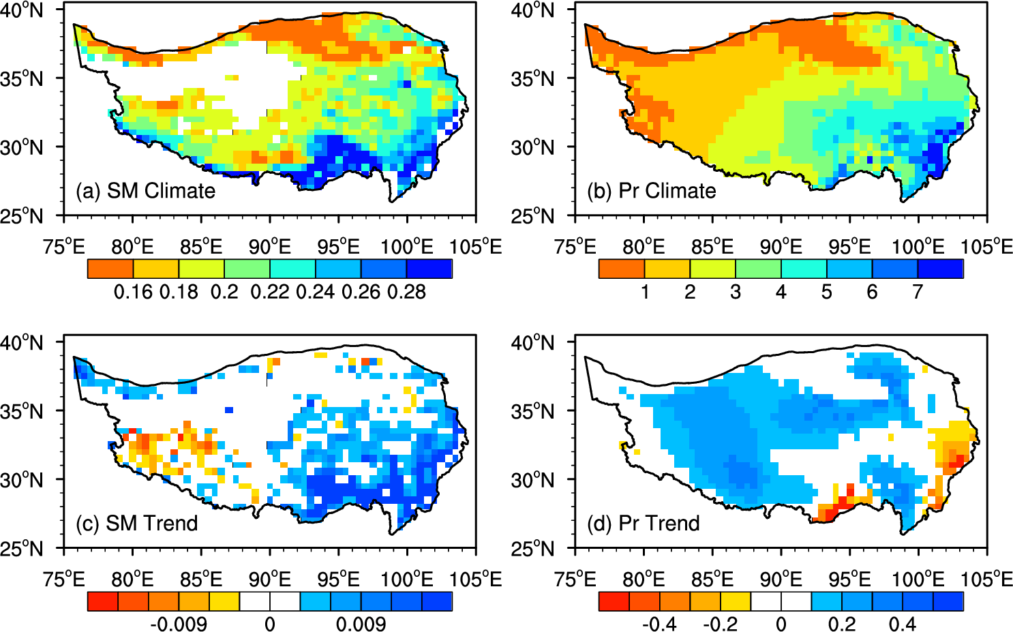
Results and discussion
Climatology and trend of summer soil moisture over the TP (1979-2013)
Notes:
It shows that soil moisture and precipitation have the same pattern, decreasing from southeast to northwest.
In most part of the TP, precip increases except southeast, but soil moisture increases in the most part, while
It decreases in the southwest.

Slide 18
Results and discussion
1/3 data
missing
Climatology and trend of summer soil moisture over the TP (1979-2013)
Notes:
It shows that soil moisture and precipitation have the same pattern, decreasing from southeast to northwest.
In most part of the TP, precip increases except southeast, but soil moisture increases in the most part, while
It decreases in the southwest.

Slide 19
Results and discussion
Climatology and trend of summer soil moisture over the TP (1979-2013)
Notes:
It shows that soil moisture and precipitation have the same pattern, decreasing from southeast to northwest.
In most part of the TP, precip increases except southeast, but soil moisture increases in the most part, while
It decreases in the southwest.

Slide 20
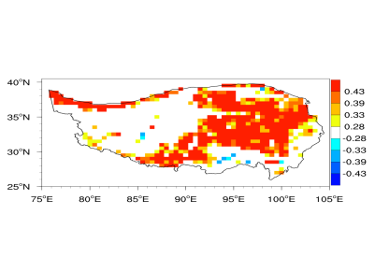
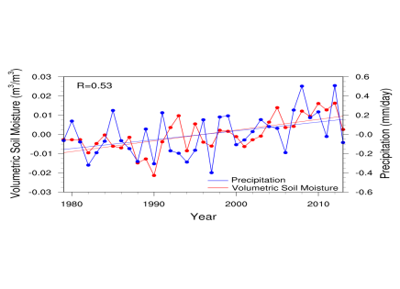
Results and discussion
correlation coefficient between soil moisture and precipitation (p<0.05)
Time series of soil moisture and precipitation anomaly
In the main part of the TP, correlation between SM and Pr is significant;
High correlation exists in the time series of soil moisture and precipitation anomalies.

Slide 21
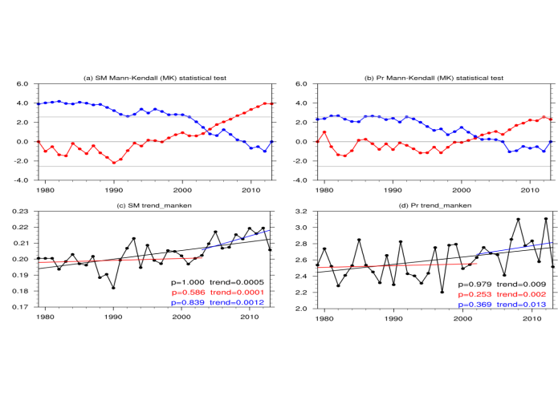
Results and discussion
SM
Pr
2003
2002
Mann-Kendell trend test of soil moisture and precipitation
Notes:
Abrupt of Soil moisture occurred in 2003, while it lags precip 1 year.
Soil moisture trends in the recent 10 years seems to be more significant than precipitation.
Although precipitation increases in the recent 10 years, it is not significant.
This shows that the increases of soil moisture may caused by not only precip,but also other contributors.

Slide 22
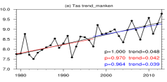
Results and discussion
SM
2003
Air Temperature
2002
Mann-Kendell trend test of soil moisture and precipitation
Notes:
Furthermore, air temperature increases significantly in the recent 10 years, which may lead to the increase of ET over the TP

Slide 23
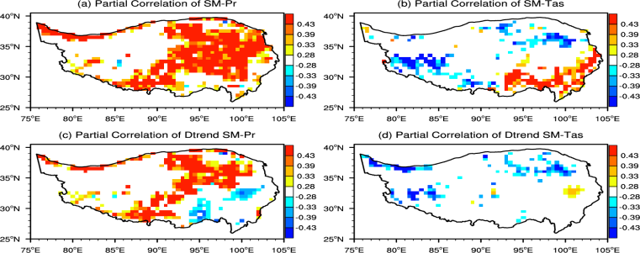
Results and discussion
Partial Correlation between soil moisture and precipitation and air temperature
Notes:
So, we did partial correlation analysis to see the relationship between soil moisture and air temperature.
The first line are partial correlation between SM and precip, and between SM and air temperature, with significance >95%.
The lower panels show the correlation after detrending. It shows that in most part, precip affects soil moisture much, while in the west and southeast, soil moisture may be affected by other factors.

Slide 24
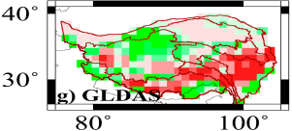
Results and discussion
P-E
(Gao et al., J. Climate 2015)
Partial Correlation between soil moisture and precipitation and air temperature
Notes:
Professor Gao studied the change of runoff over the TP, this picture show that runoff over the southeast decreases much comparing to the years before 1998, which may one of the reasons leading to the increase of soil moisture

Slide 25
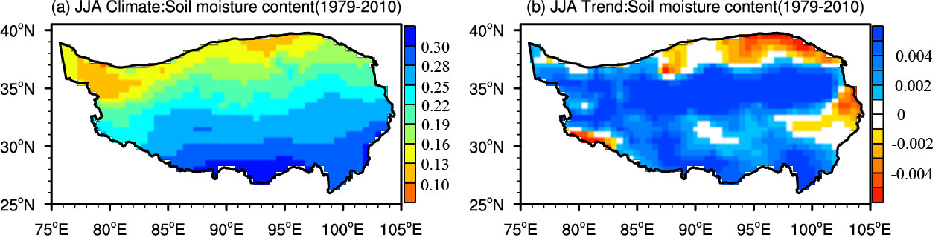
Results and discussion
Discussion
Climatology and trend of soil moisture in summer from 1979 to 2010 based on GLDAS Noah data .

Slide 26
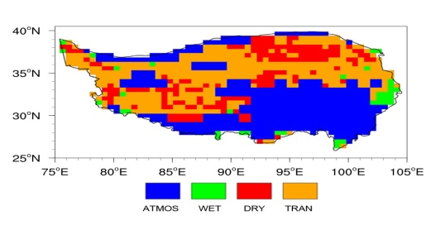
Results and discussion
Trend of soil moisture in summer over TP
Soil moisture-convective feedback over TP
We have found that SM can affect local convective Pr in positive and negative ways (right panel);
In the southwest and the north parts, where SM decreases, SM may affect Pr by negative way to slow down soil moisture decreases.
Notes:
Soil moisture can affect local convective precipitation in positive and negative ways.
The right panels shows the feedbacks of soil moisture influencing convective precip in summer over the TP.
It shows that in the southpart of the TP, it is atmospheric controlled region, which means that precipiaton is influenced by monsoon
But in the north part of the TP, where in the soil moisture trend it shows a decreasing trend, it shows the soil moisture-precipitation feedback is transition, which means both negative and positive feedback coexist.
We wound expected that soil moisture changes in this region will lead to convective precipitation response here.

Slide 27
Conclusions
The ECV soil moisture product has good consistency with precipitation, while it has large numbers of missing values in the west of TP;
Soil moisture in summer over the TP shows an increasing trend totally from 1979 to 2013, but it has spatial differences;
Soil moisture increases in most part over the TP, but slightly decreases in the northwest;
In most part of the TP, soil moisture in summer has high correlation with precipitation;
In the southwest and the north parts, where SM decreases, SM may affect Pr by negative way to slow down soil moisture decreases.

Slide 28



Thanks for your attention

