Slide 1
About OMICS Group
OMICS Group is an amalgamation of Open Access Publications and worldwide international science conferences and events. Established in the year 2007 with the sole aim of making the information on Sciences and technology ‘Open Access’, OMICS Group publishes 500 online open access scholarly journals in all aspects of Science, Engineering, Management and Technology journals. OMICS Group has been instrumental in taking the knowledge on Science & technology to the doorsteps of ordinary men and women. Research Scholars, Students, Libraries, Educational Institutions, Research centers and the industry are main stakeholders that benefitted greatly from this knowledge dissemination. OMICS Group also organizes 500 International conferences annually across the globe, where knowledge transfer takes place through debates, round table discussions, poster presentations, workshops, symposia and exhibitions.

Slide 2
OMICS International Conferences
OMICS International is a pioneer and leading science event organizer, which publishes around 500 open access journals and conducts over 500 Medical, Clinical, Engineering, Life Sciences, Pharma scientific conferences all over the globe annually with the support of more than 1000 scientific associations and 30,000 editorial board members and 3.5 million followers to its credit.
OMICS Group has organized 500 conferences, workshops and national symposiums across the major cities including San Francisco, Las Vegas, San Antonio, Omaha, Orlando, Raleigh, Santa Clara, Chicago, Philadelphia, Baltimore, United Kingdom, Valencia, Dubai, Beijing, Hyderabad, Bengaluru and Mumbai.

Slide 3
Oral Immunosuppressive Therapy to Prevent In-Stent Restenosis
Alfredo E Rodriguez, MD, PhD, FACC, FSCAI
Chair
Centro de Estudios en Cardiología Intervencionista (CECI)
Head Interventional Cardiology Department
Director
Cardiology Fellow Trainning Program
Otamendi Hospital
Buenos Aires School of Medicine
Buenos Aires, Argentina
European Pharma Congress – August 25-27, 2015 Valencia, España

Slide 4
Alfredo E. Rodriguez declares no conflicts of interest

Slide 5
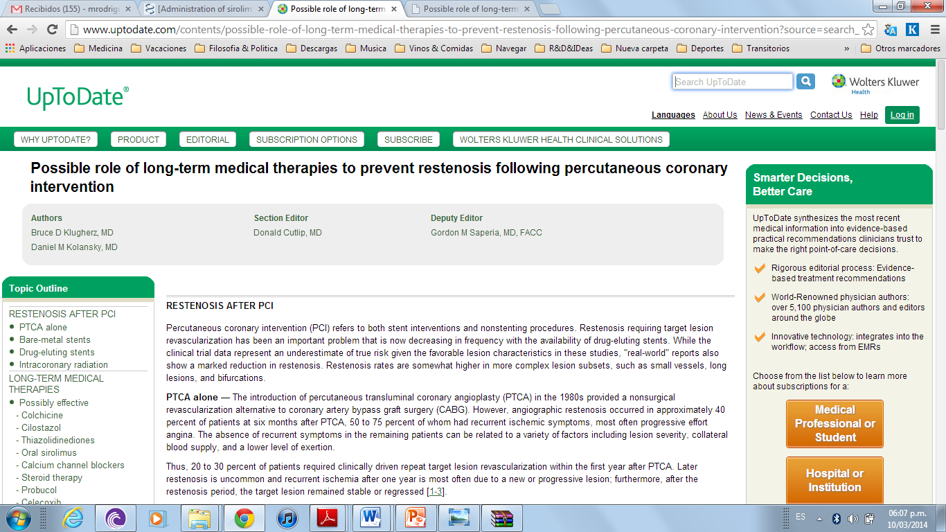
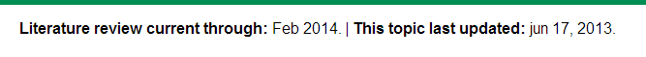
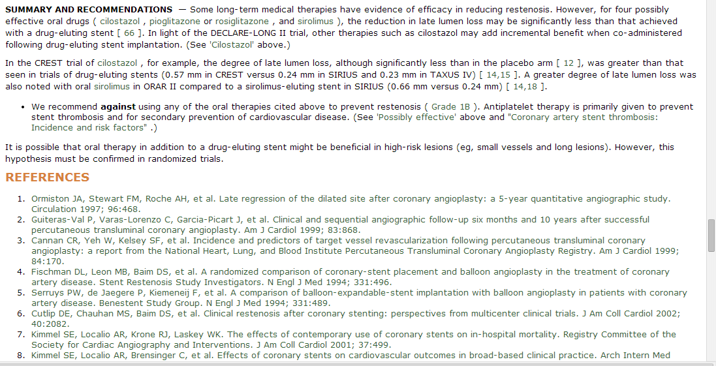

Slide 6
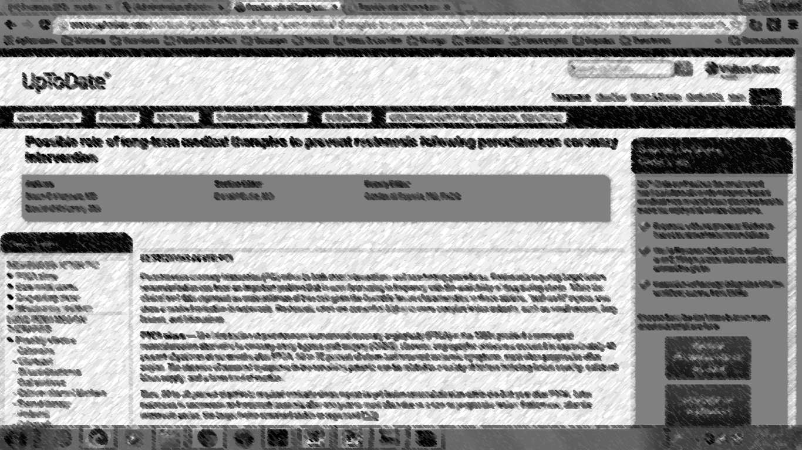
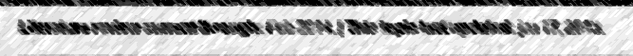

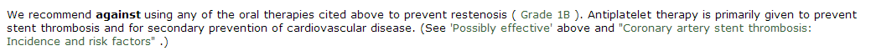

Slide 7
ORAL TREATMENT TO PREVENT RESTENOSIS
LACK of INFORMATION??

Slide 8
BACKGROUND
Marx SO et al. Rapamycin-FKBP inhibits cell cycle regulators of proliferation invascular smooth muscle cell. Circ Res 1995;76:412.
Poon M et al. Rapamycin inhibits vascular smooth muscle cell migration. J Clin Invest 1996;98:2277-83.
Burke SE. Neointimal formation after balloon-induced vascular injury in Yucatan minipigs is reduced by oral rapamycin. J Cardiovasc Pharmacol 1999;33:829-35.
Versaci F et al. Immunosuppressive therapy for the prevention of restenosis after coronary artery stent implantation (IMPRESS Study). J Am Coll Cardiol 2002;40:1935e1942.
Waksman R et al. Oral rapamune to inhibit restenosis in patients with multiple de novo coronary lesions requiring coronary stenting. J Am Coll Cardiol 2003;41 (Sullp A):74A-1198.
Rodriguez A et al. Pilot study with oral rapamycin in patients undergoing stenting in coronary arteries: Buenos Aires experience (ORAR trial). J Am Coll Cardiol 2003;41(Suppl A):82A-879 .
Rodriguez AE, Pilot study of oral rapamycin to prevent restenosis in patients undergoing Coronary stent therapy: Argentina Single-Center Study (ORAR Trial). J Invasive Cardiol 2003;15:581e584.
Waksman R et al. Oral rapamycin to inhibit restenosis after stenting of de novo coronary lesions: the Oral Rapamune to Inhibit Restenosis (ORBIT) study. J Am Coll Cardiol 2004;44: 1386e1392.
Hausleiter J et al. Randomized, double-blind, placebocontrolled trial of oral sirolimus for restenosis prevention in patients with in-stent restenosis: the Oral Sirolimus to Inhibit Recurrent In-stent Stenosis (OSIRIS) trial. Circulation 2004;110:790e795.
Rodriguez AE et al. Role of oral rapamycin to prevent restenosis in patients with de novo lesions undergoing coronary stenting: results of the Argentina single centre study (ORAR trial). Heart. 2005 Nov;91(11):1433-7
Rodriguez AE et al. Oral rapamycin after coronary bare-metal stent implantation to prevent restenosis: the Prospective, Randomized Oral Rapamycin in Argentina (ORAR II) Study. J Am Coll Cardiol 2006;47:1522e1529.
Xiao F et al. [Administration of sirolimus affects vein graft neointima hyperplasia]. Beijing Da Xue Xue Bao. 2006 Oct 18;38(5):515-8
Rodríguez AE et al. Percutaneous coronary intervention with oral sirolimus and bare metal stents has comparable safety and efficacy to treatment with drug eluting stents, but with significant cost saving: long-term follow-up results from the randomized, controlled ORAR III (Oral Rapamycin in ARgentina) study. Euro Intervention 2009;5:255e264.
Stojkovic S et al. Systemic rapamycin without loading dose for restenosis prevention after coronary bare metal stent implantation. Catheter Cardiovasc Interv 2010;75:317e325.
Cernigliaro C et al. Preventing restenosis after implantation of bare stents with oral rapamycin: a randomized angiographic and intravascular ultrasound study with a 5-year clinical follow-up. Cardiology 2010;115:77e86.
Ribichini F et al. Immunosuppressive therapy with oral prednisone to prevent restenosis after PCI. A multicenter randomized trial. Am J Med. 2011 May;124(5):434-43
Rodriguez AE et al. Randomized comparison of cost-saving and effectiveness of oral rapamycin plus bare-metal stents with drugeluting stents: three-year outcome from the randomized oral rapamycin in Argentina (ORAR) III trial. Catheter Cardiovasc Interv 2012;80:385e394.
Ribichini F et al. Long-term clinical follow-up of the multicenter, randomized study to test immunosuppressive therapy with oral prednisone for the prevention of restenosis after percutaneous coronary interventions: Cortisone plus BMS or DES veRsus BMS alone to EliminAte Restenosis (CEREA DES). Eur Heart J 2013 Jun;34:1740e1748.
Dasari TW et al. Systematic review of effectiveness of oral sirolimus after bare-metal stenting of coronary arteries for prevention of in-stent restenosis. Am J Cardiol. 2013 Nov 1;112(9):1322-7.
Deftereos S et al. Colchicine treatment for the prevention of bare-metal stent restenosis in diabetic patients. J Am Coll Cardiol 2013;61:1679e1685.
Rodriguez AE et al. Comparison of Cost-Effectiveness of Oral Rapamycin Plus Bare-Metal Stents Versus First Generation of Drug-Eluting Stents (from the Randomized Oral Rapamycin in Argentina [ORAR] 3 Trial). Am J Cardiol. 2014 Mar 1;113(5):815-21.

Slide 9
ORAL TREATMENT TO PREVENT RESTENOSIS
NEGATIVE RESULTS??

Slide 10
All ORAL TREATMENT TRIALS
Versaci F et al. Immunosuppressive therapy for the prevention of restenosis after coronary artery stent implantation (IMPRESS Study). J Am Coll Cardiol 2002;40:1935e1942.
Waksman R et al. Oral rapamune to inhibit restenosis in patients with multiple de novo coronary lesions requiring coronary stenting. J Am Coll Cardiol 2003;41 (Sullp A):74A-1198.
Rodriguez A et al. Pilot study with oral rapamycin in patients undergoing stenting in coronary arteries: Buenos Aires experience (ORAR trial). J Am Coll Cardiol 2003;41(Suppl A):82A-879 .
Brara PS et al. Pilot trial of oral rapamycin for recalcitrant restenosis. Circulation. 2003 Apr 8;107(13):1722-4.
Rodriguez AE, Pilot study of oral rapamycin to prevent restenosis in patients undergoing Coronary stent therapy: Argentina Single-Center Study (ORAR Trial). J Invasive Cardiol 2003;15:581e584.
Guarda E et al. Oral rapamycin to prevent human coronary stent restenosis: a pilot study. Am Heart J. 2004 Aug;148(2):e9.
Hausleiter J et al. Randomized, double-blind, placebocontrolled trial of oral sirolimus for restenosis prevention in patients with in-stent restenosis: the Oral Sirolimus to Inhibit Recurrent In-stent Stenosis (OSIRIS) trial. Circulation 2004;110:790e795.
Rodriguez AE et al. Role of oral rapamycin to prevent restenosis in patients with de novo lesions undergoing coronary stenting: results of the Argentina single centre study (ORAR trial). Heart. 2005 Nov;91(11):1433-7
Chaves AJ et al. Pilot study with an intensified oral sirolimus regimen for the prevention of in-stent restenosis in de novo lesions: a serial intravascular ultrasound study. Catheter Cardiovasc Interv. 2005 Dec;66(4):535-40.
Brito FS Jr et al. Efficacy and safety of oral sirolimus to inhibit in-stent intimal hyperplasia. Catheter Cardiovasc Interv. 2005 Apr;64(4):413-8
Rodriguez AE et al. Oral rapamycin after coronary bare-metal stent implantation to prevent restenosis: the Prospective, Randomized Oral Rapamycin in Argentina (ORAR II) Study. J Am Coll Cardiol 2006;47:1522e1529.
Xiao F et al. [Administration of sirolimus affects vein graft neointima hyperplasia]. Beijing Da Xue Xue Bao. 2006 Oct 18;38(5):515-8
Rodríguez AE et al. Percutaneous coronary intervention with oral sirolimus and bare metal stents has comparable safety and efficacy to treatment with drug eluting stents, but with significant cost saving: long-term follow-up results from the randomized, controlled ORAR III (Oral Rapamycin in ARgentina) study. Euro Intervention 2009;5:255e264.
Stojkovic S et al. Systemic rapamycin without loading dose for restenosis prevention after coronary bare metal stent implantation. Catheter Cardiovasc Interv 2010;75:317e325.
Cernigliaro C et al. Preventing restenosis after implantation of bare stents with oral rapamycin: a randomized angiographic and intravascular ultrasound study with a 5-year clinical follow-up. Cardiology 2010;115:77e86.
Ribichini F et al. Immunosuppressive therapy with oral prednisone to prevent restenosis after PCI. A multicenter randomized trial. Am J Med. 2011 May;124(5):434-43
Rodriguez AE et al. Randomized comparison of cost-saving and effectiveness of oral rapamycin plus bare-metal stents with drugeluting stents: three-year outcome from the randomized oral rapamycin in Argentina (ORAR) III trial. Catheter Cardiovasc Interv 2012;80:385e394.
Fernandes RW et al. Impact of stenting and oral sirolimus on endothelium-dependent and independent coronary vasomotion. Arq Bras Cardiol. 2012 Apr;98(4):290-8
Ribichini F et al. Long-term clinical follow-up of the multicenter, randomized study to test immunosuppressive therapy with oral prednisone for the prevention of restenosis after percutaneous coronary interventions: Cortisone plus BMS or DES veRsus BMS alone to EliminAte Restenosis (CEREA DES). Eur Heart J 2013 Jun;34:1740e1748.
Dasari TW et al. Systematic review of effectiveness of oral sirolimus after bare-metal stenting of coronary arteries for prevention of in-stent restenosis. Am J Cardiol. 2013 Nov 1;112(9):1322-7.
Deftereos S et al. Colchicine treatment for the prevention of bare-metal stent restenosis in diabetic patients. J Am Coll Cardiol 2013;61:1679e1685.
Rodriguez AE et al. Comparison of Cost-Effectiveness of Oral Rapamycin Plus Bare-Metal Stents Versus First Generation of Drug-Eluting Stents (from the Randomized Oral Rapamycin in Argentina [ORAR] 3 Trial). Am J Cardiol. 2014 Mar 1;113(5):815-21.

Slide 11
Positive Results
Versaci F et al. Immunosuppressive therapy for the prevention of restenosis after coronary artery stent implantation (IMPRESS Study). J Am Coll Cardiol 2002;40:1935e1942.
Waksman R et al. Oral rapamune to inhibit restenosis in patients with multiple de novo coronary lesions requiring coronary stenting. J Am Coll Cardiol 2003;41 (Sullp A):74A-1198.
Rodriguez A et al. Pilot study with oral rapamycin in patients undergoing stenting in coronary arteries: Buenos Aires experience (ORAR trial). J Am Coll Cardiol 2003;41(Suppl A):82A-879 .
Rodriguez AE, Pilot study of oral rapamycin to prevent restenosis in patients undergoing Coronary stent therapy: Argentina Single-Center Study (ORAR Trial). J Invasive Cardiol 2003;15:581e584.
Hausleiter J et al. Randomized, double-blind, placebocontrolled trial of oral sirolimus for restenosis prevention in patients with in-stent restenosis: the Oral Sirolimus to Inhibit Recurrent In-stent Stenosis (OSIRIS) trial. Circulation 2004;110:790e795.
Rodriguez AE et al. Role of oral rapamycin to prevent restenosis in patients with de novo lesions undergoing coronary stenting: results of the Argentina single centre study (ORAR trial). Heart. 2005 Nov;91(11):1433-7
.Brito FS Jr et al. Efficacy and safety of oral sirolimus to inhibit in-stent intimal hyperplasia. Catheter Cardiovasc Interv. 2005 Apr;64(4):413-8
Rodriguez AE et al. Oral rapamycin after coronary bare-metal stent implantation to prevent restenosis: the Prospective, Randomized Oral Rapamycin in Argentina (ORAR II) Study. J Am Coll Cardiol 2006;47:1522e1529.
Xiao F et al. [Administration of sirolimus affects vein graft neointima hyperplasia]. Beijing Da Xue Xue Bao. 2006 Oct 18;38(5):515-8
Rodríguez AE et al. Percutaneous coronary intervention with oral sirolimus and bare metal stents has comparable safety and efficacy to treatment with drug eluting stents, but with significant cost saving: long-term follow-up results from the randomized, controlled ORAR III (Oral Rapamycin in ARgentina) study. Euro Intervention 2009;5:255e264.
Stojkovic S et al. Systemic rapamycin without loading dose for restenosis prevention after coronary bare metal stent implantation. Catheter Cardiovasc Interv 2010;75:317e325.
Cernigliaro C et al. Preventing restenosis after implantation of bare stents with oral rapamycin: a randomized angiographic and intravascular ultrasound study with a 5-year clinical follow-up. Cardiology 2010;115:77e86.
Ribichini F et al. Immunosuppressive therapy with oral prednisone to prevent restenosis after PCI. A multicenter randomized trial. Am J Med. 2011 May;124(5):434-43
Rodriguez AE et al. Randomized comparison of cost-saving and effectiveness of oral rapamycin plus bare-metal stents with drugeluting stents: three-year outcome from the randomized oral rapamycin in Argentina (ORAR) III trial. Catheter Cardiovasc Interv 2012;80:385e394.
Fernandes RW et al. Impact of stenting and oral sirolimus on endothelium-dependent and independent coronary vasomotion. Arq Bras Cardiol. 2012 Apr;98(4):290-8
Ribichini F et al. Long-term clinical follow-up of the multicenter, randomized study to test immunosuppressive therapy with oral prednisone for the prevention of restenosis after percutaneous coronary interventions: Cortisone plus BMS or DES veRsus BMS alone to EliminAte Restenosis (CEREA DES). Eur Heart J 2013 Jun;34:1740e1748.
Dasari TW et al. Systematic review of effectiveness of oral sirolimus after bare-metal stenting of coronary arteries for prevention of in-stent restenosis. Am J Cardiol. 2013 Nov 1;112(9):1322-7.
Deftereos S et al. Colchicine treatment for the prevention of bare-metal stent restenosis in diabetic patients. J Am Coll Cardiol 2013;61:1679e1685.
Rodriguez AE et al. Comparison of Cost-Effectiveness of Oral Rapamycin Plus Bare-Metal Stents Versus First Generation of Drug-Eluting Stents (from the Randomized Oral Rapamycin in Argentina [ORAR] 3 Trial). Am J Cardiol. 2014 Mar 1;113(5):815-21.

Slide 12
ORAL TREATMENT TO PREVENT RESTENOSIS
Randomized Clinical Trials
(8/8 positive)
SIROLIMUS
Hausleiter J et al. OSIRIS TRIAL. Circulation 2004;110:790e795.
Rodriguez AE et al. ORAR 2 TRIAL J Am Coll Cardiol 2006;47:1522e1529.
Rodríguez AE et al. ORAR 3 TRIAL. Euro Intervention 2009;5:255e264.
Cernigliaro C et al. Cardiology 2010;115:77e86.
Stojkovic S et al. Catheter Cardiovasc Interv 2010;75:317e325.
PREDNISONE
Versaci F et al. IMPRESS TRIAL. J Am Coll Cardiol 2002;40:1935e1942.
Ribichini F et al. CEREA-DES TRIAL. Eur Heart J 2013 Jun;34:1740e1748.
COLCHICINE
Deftereos S et al. J Am Coll Cardiol 2013;61:1679e1685.
Systematic Review
(2/2 positive)
Dasari TW et al. Systematic review of effectiveness of oral sirolimus after bare-metal stenting of coronary arteries for prevention of in-stent restenosis. Am J Cardiol. 2013 Nov 1;112(9):1322-7.
Sardar P et al. Steroids for the prevention of restenosis in bare-metal stents--a systematic review and meta-analysis. J Invasive Cardiol 2012;24(3):98-103.

Slide 13
Rationality of OIM Therapies After BMS
#Notwithstanding the undisputed merits of DES to prevent restenosis, BMS have not been abandoned.
#Concerns about a higher risk of bleeding or noncompliance with the mandatory DAPT therapy suggest some relative contraindications to DES in PCI-patients with specific clinical and socioeconomic conditions.
#Despite socio economic considerations are more relevant in certain geographic areas, BMS
are still used in one fourth of patients receiving a PCI in the US and these patients are at high risk of restenosis.
Cassese, S, Rodriguez AE et al. Atherosclerosis. 2014 Dec;237(2):410-7

Slide 14
Drug Eluting Stents and Bleeding Risk with Long Term Use of DAPT

Slide 15
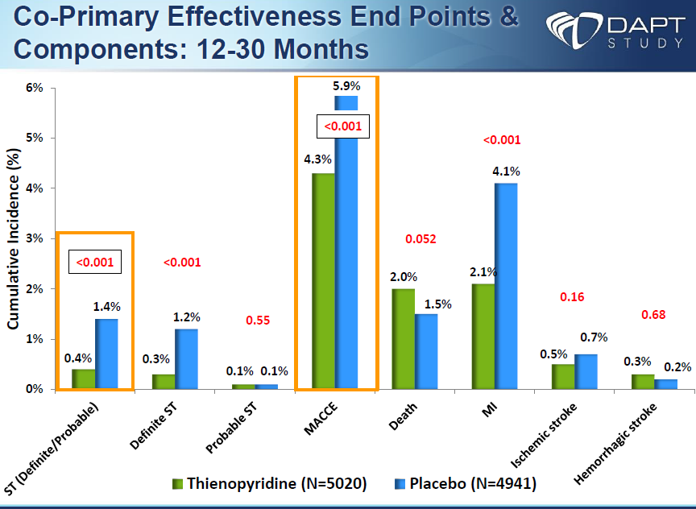
DAPT duration – DAPT Trial
L Mauri AHA NEJM , November 16, 2014,

Slide 16
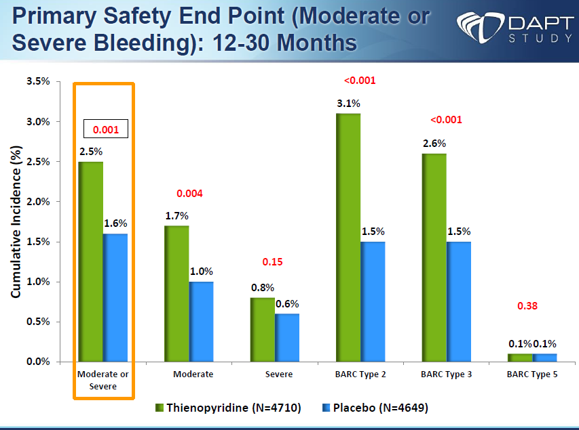
DAPT duration – DAPT Trial
L Mauri AHA ,NEJM, November 16, 2014,

Slide 17
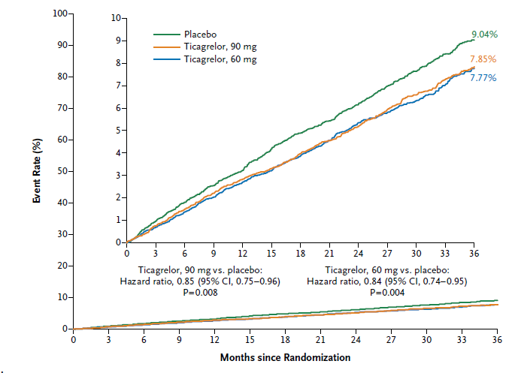
DAPT duration – PEGASUS TIMI 54 Trial
Kaplan–Meier Rates of Cardiovascular Death, Myocardial Infarction, and Stroke through 3 Years, According to Study Group.
M. Bonaca et al. N Engl J Med 2015;372:1791-800

Slide 18
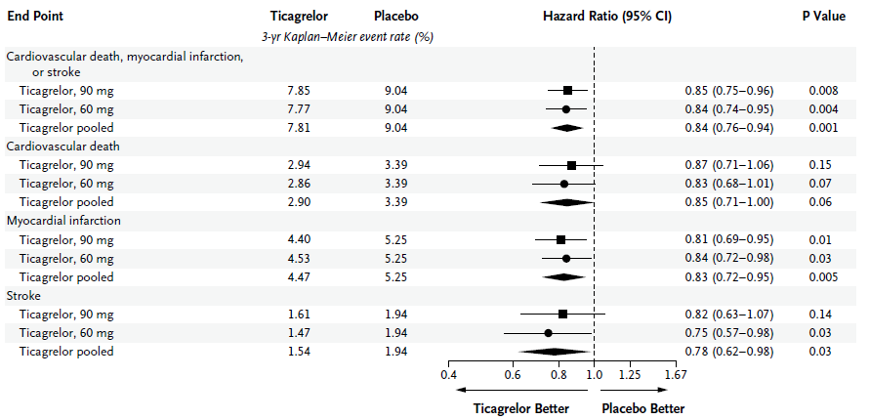
DAPT duration – PEGASUS TIMI 54 Trial
Hazard Ratios and Rates of the Primary End Point and Individual Components for Each Dose of Ticagrelor and for the Two Doses Pooled
M. Bonaca et al. N Engl J Med 2015;372:1791-800

Slide 19
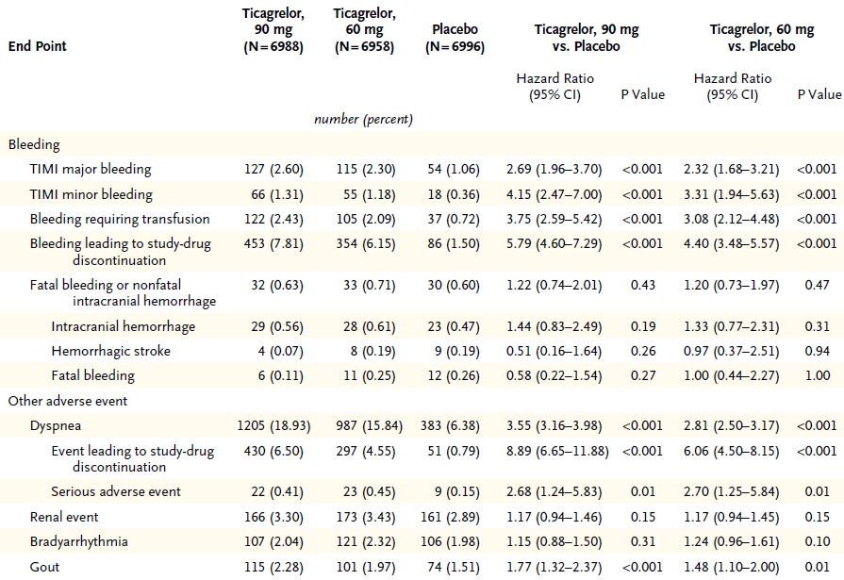
DAPT duration – PEGASUS TIMI 54 Trial
Safety End Points as 3-Year Kaplan–Meier Estimates
M. Bonaca et al. N Engl J Med 2015;372:1791-800

Slide 20
ORAL TREATMENT TO PREVENT RESTENOSIS
Randomized Clinical Trials
(8/8 positive)
SIROLIMUS
Hausleiter J et al. OSIRIS TRIAL. Circulation 2004;110:790e795.
Rodriguez AE et al. ORAR 2 TRIAL J Am Coll Cardiol 2006;47:1522e1529.
Rodríguez AE et al. ORAR 3 TRIAL. Euro Intervention 2009;5:255e264.
Cernigliaro C et al. Cardiology 2010;115:77e86.
Stojkovic S et al. Catheter Cardiovasc Interv 2010;75:317e325.
PREDNISONE
Versaci F et al. IMPRESS TRIAL. J Am Coll Cardiol 2002;40:1935e1942.
Ribichini F et al. CEREA-DES TRIAL. Eur Heart J 2013 Jun;34:1740e1748.
COLCHICINE
Deftereos S et al. J Am Coll Cardiol 2013;61:1679e1685.
Systematic Review
(2/2 positive)
Dasari TW et al. Systematic review of effectiveness of oral sirolimus after bare-metal stenting of coronary arteries for prevention of in-stent restenosis. Am J Cardiol. 2013 Nov 1;112(9):1322-7.
Sardar P et al. Steroids for the prevention of restenosis in bare-metal stents--a systematic review and meta-analysis. J Invasive Cardiol 2012;24(3):98-103.

Slide 21
1274 patients
Screened for inclusion in ORAR III
485 patients met clinical exclusion criteria:
AMI < 24 hours.
Participation in another trial.
Refuses to be included in the trial
Commorbidities
102 patients met angiographic exclusion criteria:
Target vessel size <2.5 mm (visual)
Chronic total occlusion
Non significant CAD
Diffuse CAD
ISR
487 patients excluded, unable for PCI with multiple DES
200 patients included in ORAR III RCT
OR+BMS 100 pts
1° Gen. DES
100 pts
Rodriguez AE et al. Am J Cardiol. 2014 Mar 1;113(5):815-21

Slide 22

Comparison of Cost-Effectiveness of Oral Rapamycin Plus Bare-Metal Stents Versus First Generation of Drug-Eluting Stents
5 years FU from ORAR 3 RCT
BACKGROUND
Results from one (EuroIntervention. 2009 Jun;5(2):255-6) and three years (Catheter Cardiovasc Interv 2012;80:385e394) of FU were published and showed that the strategy of OR plus BMS has no significant differences in MACE or TVR in comparison with DES therapy, although costs were significantly higher with DES.
Rodriguez AE et al. Am J Cardiol. 2014 Mar 1;113(5):815-21

Slide 23
Comparison of Cost-Effectiveness of Oral Rapamycin Plus Bare-Metal Stents Versus First Generation of Drug-Eluting Stents
5 years FU from ORAR 3 RCT
OBJECTIVES
To compare cost-saving results of OR plus BMS vs. DES treatments for de-novo coronary lesions and,
to evaluate the safety and efficacy of both, including MACE, TVR and TLR.
Rodriguez AE et al. Am J Cardiol. 2014 Mar 1;113(5):815-21

Slide 24
5 years FU from ORAR 3 RCT
METHODS
From January 2006 to September 2007 in three hospitals in Buenos Aires, Argentina, 200 patients pts were randomized either to OR (n=100) or DES (n=100). OR was given as a bolus of 10 mg the day before PCI followed by daily doses of 3 mg during the following 13 days.
DES group received clopidogrel for at least one year and OR group for one month. DES used in the trial were Paclitaxel (Boston Scientific), Sirolimus (Cordis) and Zotarolimus (Medtronic) eluting stents, all commercially available in Argentina. Follow Up angiogram was only clinically indicated.
Costs expressed in US dollars, included procedural, hospitalization, medications at hospital, repeat revascularization procedures at follow up and professional fees.
Clinical Exclusion Criteria were AMI in the last 24 hours, in-stent restenosis, previous PCI in the last six months and short life expectancy.
Rodriguez AE et al. Am J Cardiol. 2014 Mar 1;113(5):815-21

Slide 25
Comparison of Cost-Effectiveness of Oral Rapamycin Plus Bare-Metal Stents Versus First Generation of Drug-Eluting Stents
5 years FU from ORAR 3 RCT
The primary end point was to compare overall costs (included in-hospital and follow-up) of both revascularization strategies (OR and DES) at 1, 3 and 5 years follow-up. This was selected on the hypothesis of similar efficacy for both strategies.
Secondary end points included safety end points defined by a composite of death from any cause, myocardial infarction (MI) or stroke (MACE). Target Vessel Revascularization (TVR) and Target Lesion Revascularization (TLR) were analyzed separately as efficacy end points and were not included as part of the MACE definition.
Target vessel failure (TVF) was defined as cardiac death, MI and TVR.
Rodriguez AE et al. Am J Cardiol. 2014 Mar 1;113(5):815-21

Slide 26
5 years FU from ORAR 3 RCT
Baseline Clinical, Demographic and Angiographic Characteristics (cont)
Characteristics n (%) | OR+BMS (n=100 pts) | DES (n=100 pts) | P value
Age (years) | 62.1 +/- 10.1 | 63.4 +/- 10.6 | 0.30
Age > 65 years | 40% | 48% | 0.31
Male gender | 83 (83.0%) | 81 (81.0%) | 1.00
Hypertension | 69 (69.0%) | 72 (72.0%) | 0.93
Dyslipemia | 71 (71.0%) | 81 (81.0%) | 0.61
Current smokers | 21 (21.0%) | 17 (17.0%) | 0.67
Diabetes Mellitus | 24 (24.0%) | 33 (33.0%) | 0.36
Previous CVA | 2 (2.0%) | 2 (2.0%) | 1.00
Previous MI | 26 (26.0%) | 33 (33.0%) | 0.51
Previous Coronary Revascularization | 12 (12.0%) | 13 (13.0%) | 1.00
Unstable Angina (ACC/AHA class) | 62 (62.0%) | 56 (56.0%) | 0.74
Stent diameter (mm) | 2.78 +/- 0.4 | 2.76 +/- 0.4 | 0.66
MVD | 48 (48%) | 51 (51%) | 0.90
EuroSCORE | 3.63 +/- 2.7 | 3.41 +/-2.6 | 0.56
Diabetes Mellitus | 24 (24.0%) | 33 (33.0%) | 0.36
Rodriguez AE et al. Am J Cardiol. 2014 Mar 1;113(5):815-21

Slide 27
5 years FU from ORAR 3 RCT
Baseline Clinical, Demographic and Angiographic Characteristics (cont)
Characteristics n (%) | OR+BMS (n=100 pts) | DES (n=100 pts) | P value
N° of treated vessels | 131 | 142 | 0.70
N° of treated lesions | 158 | 170 | 0.75
N° of stents per patient | 1.71 | 1.76 | 0.91
Reference diameter < 2.5 mm | 36.1% | 28.2% | 0.32
Overlapping stents per vessel | 24.4% (32/131) | 14.8% (21/142) | 0.28
Stent length (mm) | 19.1 +/- 4.3 | 21.4 +/- 5.2 | 0.001
Stent diameter (mm) | 2.78 +/- 0.4 | 2.76 +/- 0.4 | 0.66
Reference diameter < 2.5 mm | 36.1% | 28.2% | 0.32
Overlapping stents per vessel | 24.4% (32/131) | 14.8% (21/142) | 0.28
Rodriguez AE et al. Am J Cardiol. 2014 Mar 1;113(5):815-21

Slide 28
COSTS during ORAR 3 RCT.
p<0.001
Rodriguez AE et al. Am J Cardiol. 2014 Mar 1;113(5):815-21

Slide 29
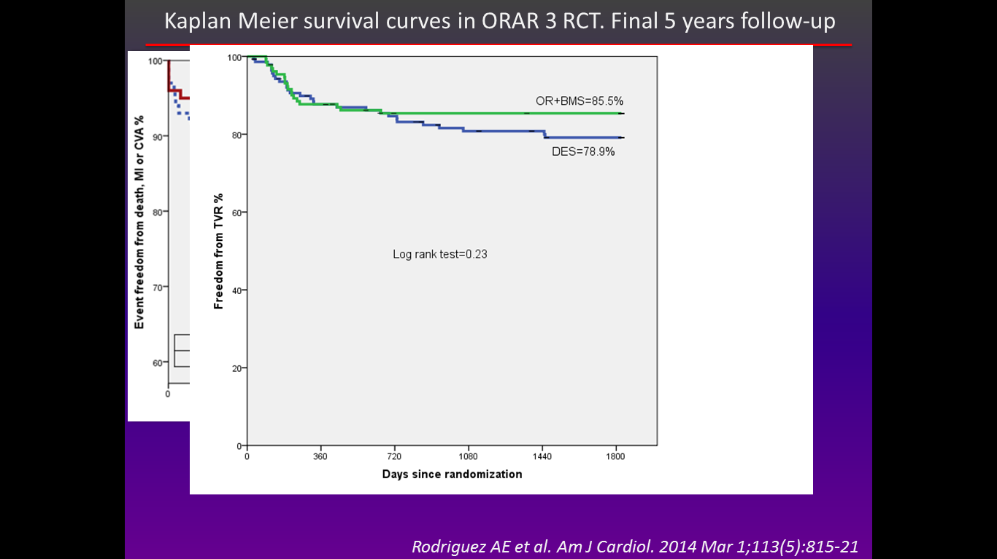
Kaplan Meier survival curves in ORAR 3 RCT
Rodriguez AE et al. Am J Cardiol. 2014 Mar 1;113(5):815-21

Slide 30
Event progression during ORAR 3 RCT
Incidence of clinical endpoints at 1 and 5 years of follow up
Event | OR+BMS n=100 (%) | DES n=100, (%) |  | RR | CI 95% |  | Chi²
 |  |  |  |  | Inferior | Superior
Death
0-1 years | 3 (3.0) | 7 (7.0) |  | 2.33 | 0.62 | 8.76 | 0.16
1-5 years | 3 (3.0) | 9 (9.0) |  | 3.00 | 0.83 | 10.7 | 0.06
0-5 years | 6 (6.0) | 16 (16.0) |  | 2.66 | 1.08 | 6.53 | 0.02
MI (Q and non Q)
0-1 years | 6 (6.0) | 9 (9.0) | 1.5 |  | 0.55 | 4.05 | 0.63
1-5 years | 0 (0.0) | 3 (3.0) | 4.0 |  | 0.45 | 35.1 | 0.36
0-5 years | 6 (6.0) | 12 (12.0) | 2.33 |  | 0.93 | 5.82 | 0.10
Death, MI and Stroke
0-1 years | 9 (9.0) | 15 (15.0) | 1.66 |  | 0.76 | 3.63 | 0.34
1-5 years | 3 (3.0) | 10 (10.0) | 3.33 |  | 0.94 | 11.75 | 0.08
0-5 years | 12 (12.0) | 25 (25.0) | 2.08 |  | 1.10 | 3.91 | 0.01
Rodriguez AE et al. Am J Cardiol. 2014 Mar 1;113(5):815-21

Slide 31
Event progression during ORAR 3 RCT
Incidence of clinical endpoints at 1 and 5 years of follow up.
Event | OR+BMS n=100 (%) | DES n=100 (%) |  | RR | CI 95% |  | Chi²
 |  |  |  |  | Inferior | Superior
TVF
0-1 years | 21 (21.0) | 23 (23.0) |  | 1.09 | 0.64 | 1.84 | 0.73
1-5 years | 5 (5.0) | 13 (13.0) |  | 2.6 | 0.96 | 7.02 | 0.08
0-5 years | 26 (26.0) | 36 (32.0) |  | 1.38 | 0.90 | 2.11 | 0.08
TLR
0-1 years | 11/158 (7.0) | 14/170 (8.2) |  | 1.18 | 0.55 | 2.52 | 0.84
1-5 years | 5/158 (3.1) | 16/170 (9.4) |  | 2.95 | 1.10 | 7.87 | 0.03
0-5 years | 16/158 (10.1) | 30/170 (17.6) |  | 1.74 | 0.98 | 3.07 | 0.05
TVR
0-1 years | 14/131 (10.6) | 15/ 142 (10.5) | 0.98 |  | 0.49 | 1.96 | 0.86
1-5 years | 5/131 (3.8) | 15/142 (10.5) | 2.78 |  | 1.04 | 7.46 | 0.02
0-5 years | 19/131 (14.5) | 30/142 (21.1) | 1.45 |  | 0.86 | 2.45 | 0.16
LATE CATCH-UP
after 1 year…
Rodriguez AE et al. Am J Cardiol. 2014 Mar 1;113(5):815-21

Slide 32
COSTS during ORAR 3 RCT.
US dollars | OR+BMS (100 pt) | DES (100 pt) | P
Initial Procedure
PCI procedure | 970.5 +/- 43.7 | 973.9 +/- 52.9 | 0.35
Stent (BMS or DES) | 596.3 +/- 304.6 | 2,623.7 +/- 1,397.4 | <0.001
Drugs# | 761.0 +/- 14.9 | 54.7 +/- 1.2 | <0.001
Professional fees | 603.5 +/- 17.2 | 605.2 +/- 19.0 | 0.52
Hospital fees | 1,502.9 +/- 637.0 | 1,459.5 +/- 1,199.3 | 0.74
Overall initial costs + taxes* | 5,365.5 +/- 876.0 | 6,921.5 +/- 2,251.4 | <0.001
Follow-up
Out of hospital to 1 year | 883+/- 2,111.8 | 1,594.5 +/- 2,338.2 | 0.02
1-5 years | 6,633 +/- 2,138.1 | 10,417 +/- 5,361.2 | <0.001
0-5 years** | 7,516.1 +/- 2,734.3 | 12,011.5 +/- 6,090.12 | <0.001
Rodriguez AE et al. Am J Cardiol. 2014 Mar 1;113(5):815-21

Slide 33
Causes of death in ORAR 3 RCT
OR+BMS (6 pt) | DES (16 pt)
Small cells carcinoma (1 pt) | Suicide
Sepsis post aortic valve replacement (1 pt) | Lung adenocarcinoma (2 pt)
Pneumonia (1 pt) | Sudden death (5 pt)
Lung adenocarcinoma (1 pt) | CVA (1 pt)
COPD and CRF (1 pt) | Post CABG (2 pt)
Sudden death (1 pt) | Post aortic valve replacement (1pt)
 | Colorectal cancer (2 pt)
 | Myocardial infarction (1 pt)
 | Pneumonia (1 pt)
Rodriguez AE et al. Am J Cardiol. 2014 Mar 1;113(5):815-21

Slide 34
Bootstrap analysis in patients with cardiac adverse events in both groups
ORAR 3 RCT
Rodriguez AE et al. Am J Cardiol. 2014 Mar 1;113(5):815-21

Slide 35
Clinical Outcome according to AGE in ORAR 3 RCT
 | Patients < 65 years |  |  | Patients ≥ 65 years
 | OR | DES | P | OR | DES | P
 | n=60 (%) | n=52 (%) |  | n=40 (%) | n=48 (%)
Death | 2 (3.3) | 5 (9.6) | 0.32 | 4 (10.0) | 11 (22.9) | 0.10
MI | 6 (10.0) | 6 (11.5) | 0.79 | 0 (0.0) | 6 (12.5) | 0.05
Death+MI+CVA | 8(13.3) | 11 (21.2) | 0.27 | 4 (10.0) | 14 (29.2) | 0.026
TVF | 16 (26.7) | 15 (28.8) | 0.79 | 10 (25.0) | 21 (43.8) | 0.06
TVR | 12/81 (14.8) | 12/69 (17.4) | 0.66 | 7/50 (14.0) | 18/73 (24.6) | 0.17
TLR | 9/97 (9.3) | 12/82 (14.6) | 0.26 | 7/61 (11.5) | 18/88 (20.5) | 0.14
Is here room for OIT??
Rodriguez AE et al. Am J Cardiol. 2014 Mar 1;113(5):815-21

Slide 36
Kaplan Meier survival curves in ORAR 3 RCT
Rodriguez AE et al. Am J Cardiol. 2014 Mar 1;113(5):815-21

Slide 37
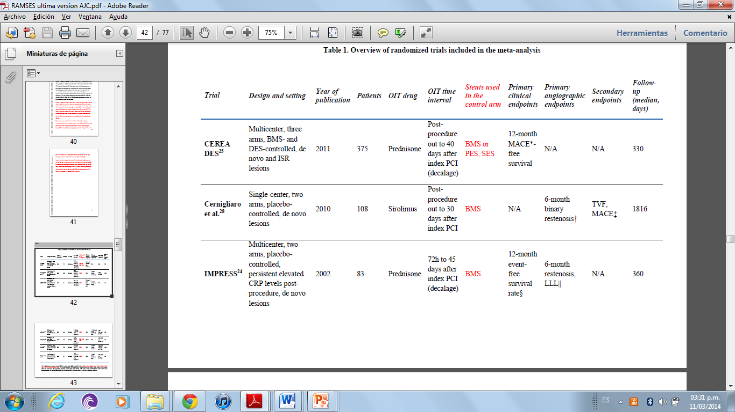
ORAL TREATMENT TO PREVENT RESTENOSIS
PREDNISONE Randomized Clinical Trials

Slide 38
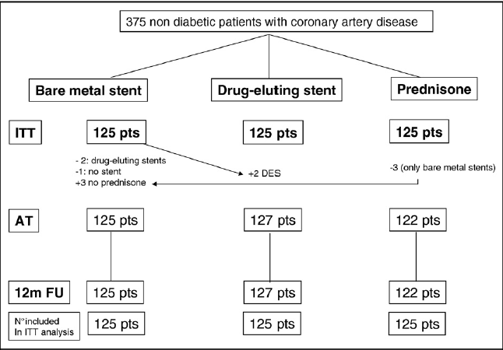
Long-term clinical follow-up of the multicenter, randomized study to test immunosuppressive therapy with oral prednisone for the prevention of restenosis after percutaneous coronary interventions: Cortisone plus BMS or DES veRsus BMS alone to EliminAte Restenosis (CEREA-DES)
Ribichini F et al. Eur Heart J. 2013 Jun;34(23):1740-8.

Slide 39
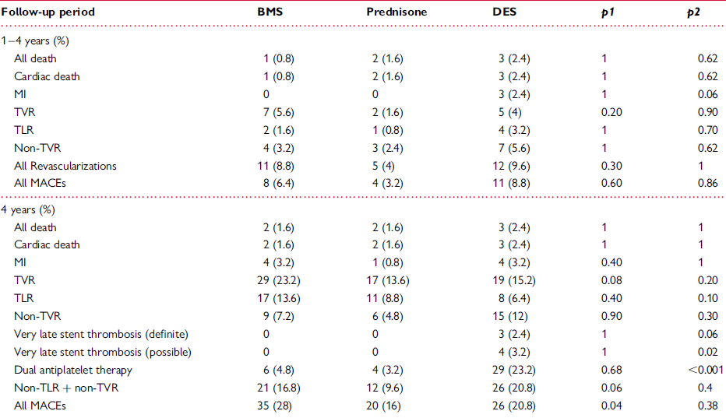

CEREA-DES
Long-term clinical events
Ribichini F et al. Eur Heart J. 2013 Jun;34(23):1740-8.

Slide 40
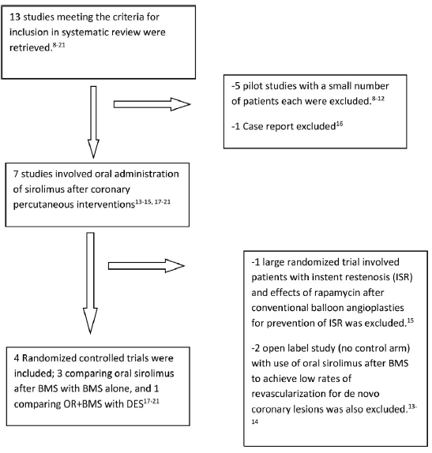
Systematic Review of Effectiveness of Oral Sirolimus After Bare-Metal Stenting of Coronary Arteries for Prevention of In-Stent Restenosis
Dasari T et al. Am J Cardiol 2013;112:1322e1327

Slide 41
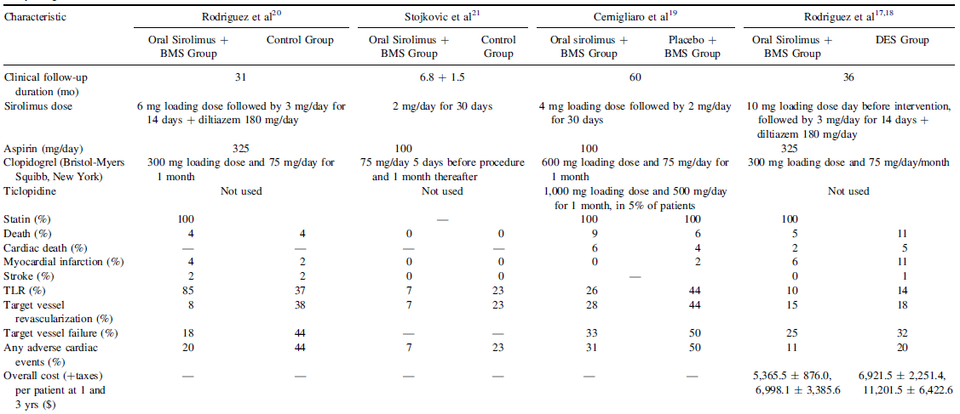
ORAL TREATMENT TO PREVENT RESTENOSIS
3 from 4 RCT with 30 months of FU or more
3 RCT → vs BMS
1 RCT → vs DES
Rapamycin oral dose
2-3 mg/day (14-30 days)
TVR
BMS
BMS
BMS
Dasari T et al. Am J Cardiol 2013;112:1322e1327

Slide 42
ORAl iMmunosuppressive therapy to prevent in-Stent rEstenosiS
(RAMSES) cooperation: a patient-level meta-analysis of randomized trials
Cassese S, De Luca G, Ribichini F, Cernigliaro C, Sansa M, Versaci F, Proietti I, Stankovic G, Stojkovic S, Fernandez-Pereira C, Tomai F, Vassanelli C, Antoniucci D, Serruys PW, Kastrati A, Rodriguez AE.
Atherosclerosis. 2014 Dec;237(2):410-7

Slide 43
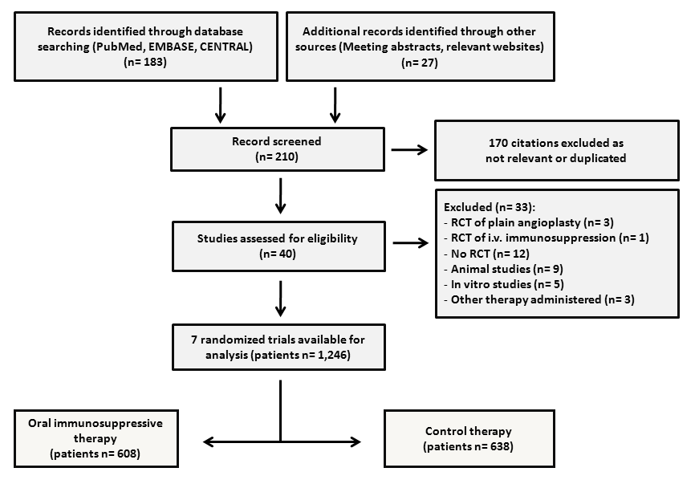
RAMSES meta-analysis
PRISMA flow chart for the trial selection process.
Cassese, Kastrati, Rodriguez et al. Atherosclerosis. 2014 Dec;237(2):410-7

Slide 44
RAMSES meta-analysis
Prednisone
IMPRESS
(41 vs 43)
5 RCT
OIT+BMS
Vs.
BMS
Cernigliaro et al
(54 vs 54)
ORAR II
(50 vs 50)
Stojkovic et al
(35 vs 37)
OSIRIS
(203 vs 102)
Rapamycin
1 RCT
OIT+BMS
Vs.
DES
RAMSES
population
Rapamycin
ORAR III
(100 vs 100)
1 RCT
OIT+BMS
Vs.
DES
Vs.
BMS
Prednisone
CEREA-DES
(125 vs 125 vs 125)
Cassese, Kastrati, Rodriguez et al. Atherosclerosis. 2014 Dec;237(2):410-7

Slide 45
RAMSES meta-analysis
Trial | Random sequence generation | Blinding of participants | Blinding of outcome assessment* | Description of incomplete outcome data | Sample size calculation | Trial funding
CEREA DES | Yes (computer-generated) | No | Yes (Independent CEC) | Yes (flow diagram) | Yes (superiority design) | Yes (Public health research grant)
Cernigliaro et al. | Yes (computer-generated) | Yes | Yes (Independent CEC) | Yes (flow diagram) | Yes (superiority design) | No (Investigator driven)
IMPRESS | Yes (computer-generated) | Yes | Yes (Independent CEC) | Yes | Yes (superiority design) | No (Investigator driven)
ORAR II | Yes (central random list) | No | Yes (Independent CEC) | Yes | Yes (superiority design) | No (Investigator driven)
ORAR III | Yes (central random list) | Yes | Yes (Independent CEC) | Yes (flow diagram) | Yes (non-inferiority design) | No (Investigator driven)
OSIRIS | Yes (central random list) | Yes | Yes (Independent CEC) | Yes | Yes (superiority design) | No (Investigator driven)
Stojkovic et al. | Yes | No | Yes (Independent CEC) | Yes | Yes (superiority design) | No (Investigator driven)
Assessment of risk of bias
Cassese, Kastrati, Rodriguez et al. Atherosclerosis. 2014 Dec;237(2):410-7

Slide 46
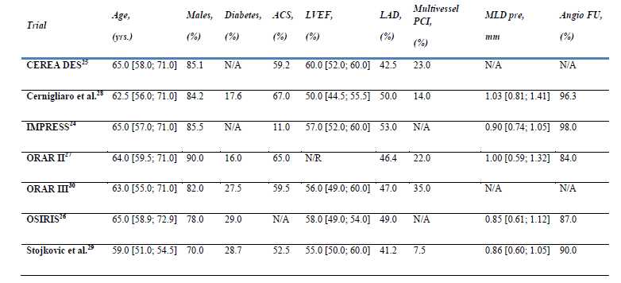
RAMSES meta-analysis
Characteristics of patients included in the meta-analysis stratified by trials
Cassese, Kastrati, Rodriguez et al. Atherosclerosis. 2014 Dec;237(2):410-7

Slide 47
End Points
#Primary endpoints were target lesion revascularization (TLR) and the composite of death/myocardial infarction (MI).
# Secondary endpoints were death, MI, stent thrombosis (ST) and in-stent late lumen loss at angiographic surveillance.
#All endpoints were evaluated according to per protocol definitions and events count was hierarchical, considering always the most severe event when more
than one occurred.

Slide 48
RAMSES meta-analysis
Cassese, Kastrati, Rodriguez et al. Atherosclerosis. 2014 Dec;237(2):410-7

Slide 49
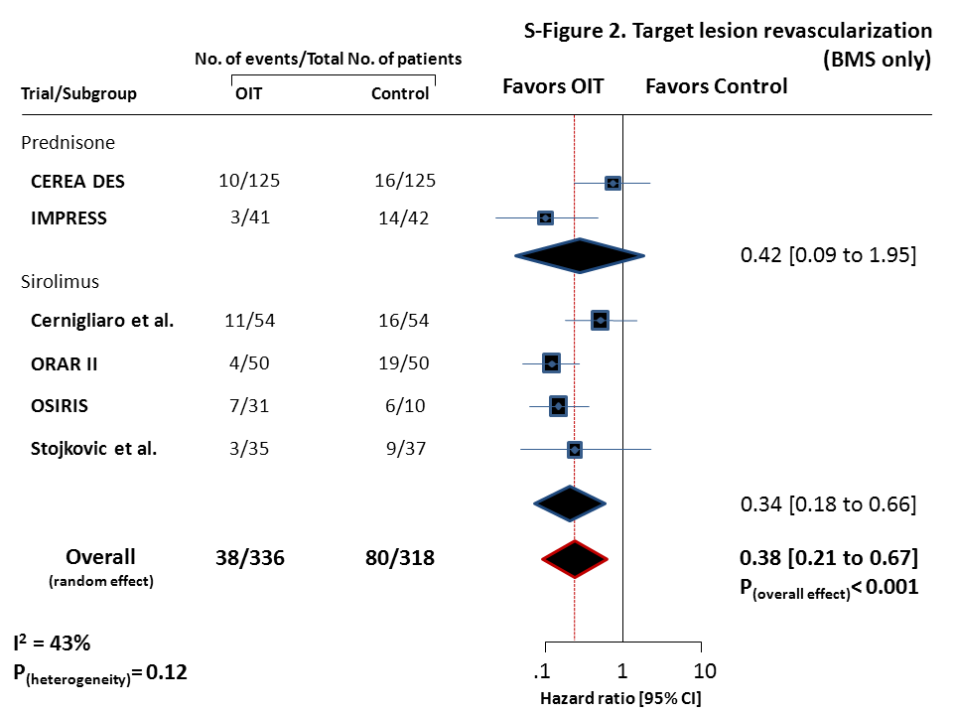
RAMSES meta-analysis
Analysis of TLR for BMS+OIT versus BMS
Cassese, Kastrati, Rodriguez et al. Atherosclerosis. 2014 Dec;237(2):410-7

Slide 50
RAMSES meta-analysis
Cassese, Kastrati, Rodriguez et al. Atherosclerosis. 2014 Dec;237(2):410-7

Slide 51
RAMSES meta-analysis
Cassese, Kastrati, Rodriguez et al. Atherosclerosis. 2014 Dec;237(2):410-7

Slide 52
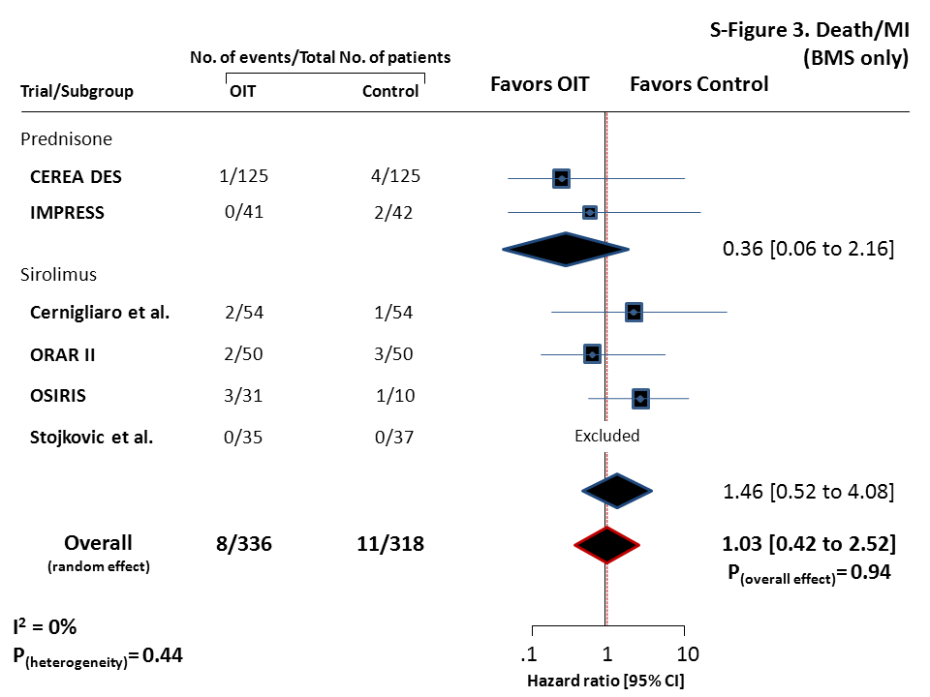
RAMSES meta-analysis
Analysis of death/MI for BMS+OIT versus BMS.
Cassese, Kastrati, Rodriguez et al. Atherosclerosis. 2014 Dec;237(2):410-7

Slide 53
RAMSES meta-analysis
Cassese, Kastrati, Rodriguez et al. Atherosclerosis. 2014 Dec;237(2):410-7

Slide 54
RAMSES meta-analysis
Cassese, Kastrati, Rodriguez et al. Atherosclerosis. 2014 Dec;237(2):410-7

Slide 55
RAMSES meta-analysis
Cassese, Kastrati, Rodriguez et al. Atherosclerosis. 2014 Dec;237(2):410-7

Slide 56
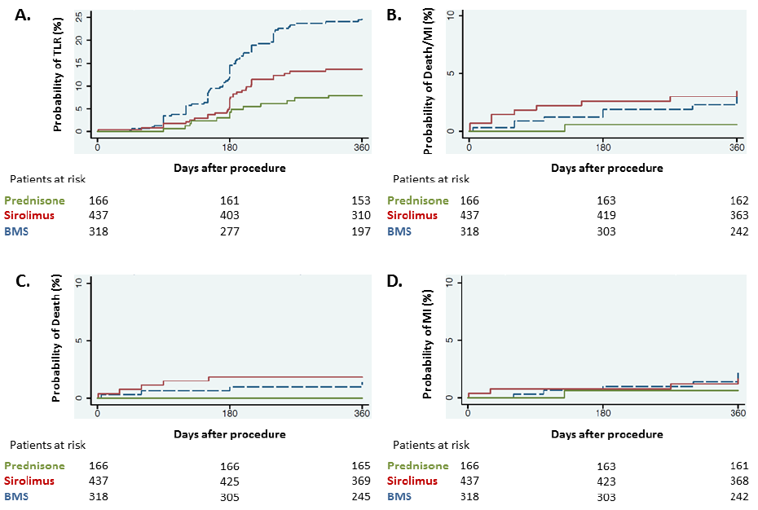
Survival curves for primary and secondary endpoints according to the treatment received (BMS+OIT [prednisone or sirolimus] or BMS).
Cassese, Kastrati, Rodriguez et al. Atherosclerosis. 2014 Dec;237(2):410-7

Slide 57
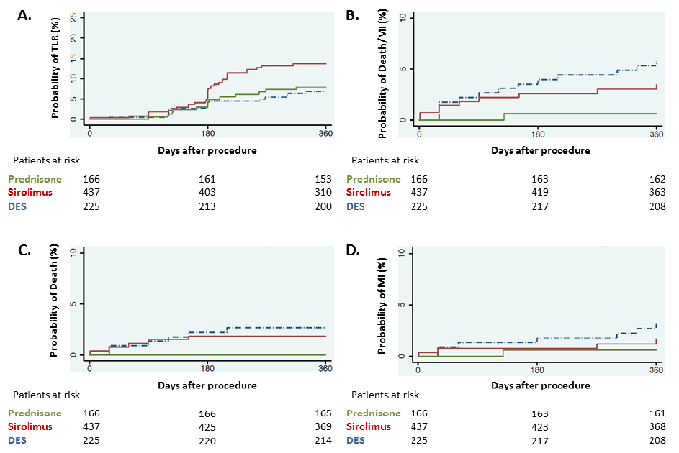
Survival curves for primary and secondary endpoints according to the treatment received (BMS+OIT [prednisone or sirolimus] or DES).
Cassese, Kastrati, Rodriguez et al. Atherosclerosis. 2014 Dec;237(2):410-7

Slide 58
RAMSES meta-analysis
Cassese, Kastrati, Rodriguez et al. Atherosclerosis. 2014 Dec;237(2):410-7

Slide 59
RAMSES meta-analysis
Cassese, Kastrati, Rodriguez et al. Atherosclerosis. 2014 Dec;237(2):410-7

Slide 60
RAMSES meta-analysis
TLR
Cassese, Kastrati, Rodriguez et al. Atherosclerosis. 2014 Dec;237(2):410-7

Slide 61
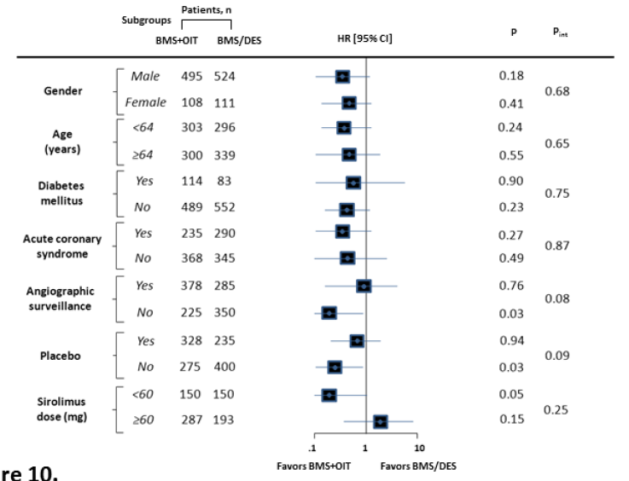
RAMSES meta-analysis
Death/MI
Cassese, Kastrati, Rodriguez et al. Atherosclerosis. 2014 Dec;237(2):410-7

Slide 62
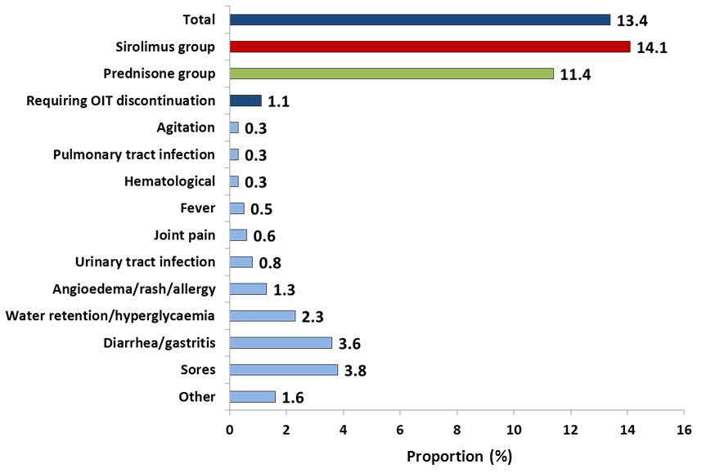
RAMSES meta-analysis
Side effects associated with OIT
Cassese, Kastrati, Rodriguez et al. Atherosclerosis. 2014 Dec;237(2):410-7

Slide 63
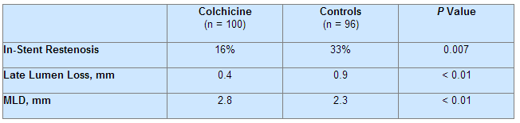
Colchicine Treatment for the Prevention of Bare-Metal Stent Restenosis in Diabetic Patients
Double blind, prospective, placebo controlled study included 196 diabetic pt treated with BMS randomly asigned to colchicine 0.5 mg (n=100) or placebo (n=96) twice daily for 6 months.
Angiography and IVUS to monitor restenosis 6 months after initial procedure.
Well ballanced demographic and angiographic baseline characteristics.
16% of adverse events in colchicine group (diarrhea or nausea) vs 7% in placebo.
Results at 6 months of FU
Deftereos S et al. J Am Coll Cardiol. 2013 Apr 23;61(16):1679-85.

Slide 64
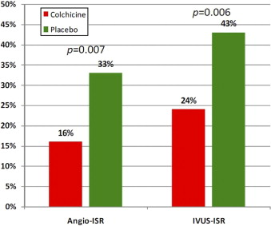
Colchicine Treatment for the Prevention of Bare-Metal Stent Restenosis in Diabetic Patients
Deftereos S et al. J Am Coll Cardiol. 2013 Apr 23;61(16):1679-85.

Slide 65
ORAL TREATMENT TO PREVENT RESTENOSIS
Pooled data from ORAR 3 (5 yrs FU) and CEREA-DES (4 yrs FU) Rapamycin/Prednisone+BMS vs Cypher, Taxus & Endeavor
 | OIT (225 p) | DES (225 p) | P value
Death | 8/225 | 19/225 | 0.02
MI | 7/225 | 16/225 | 0.04
TLR | 27/350 | 38/360 | 0.2
SET | 2/225 | 16/225 | <0.001
Very Late SET | 1/225 | 11/225 | 0.002
Ribichini F et al. Eur Heart J. 2013 Jun;34(23):1740-8.

Slide 66
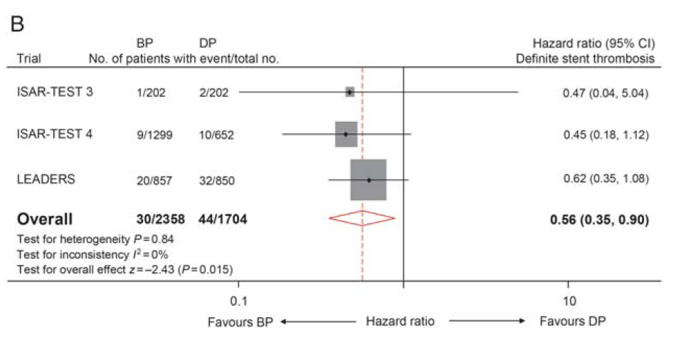
Stent thrombosis and new DES generations Biodegradable polymers
GG Stefanini, RA Byrne, PW Serruys et al.
Eur Heart J. 2012 May;33(10):1214-22

Slide 67
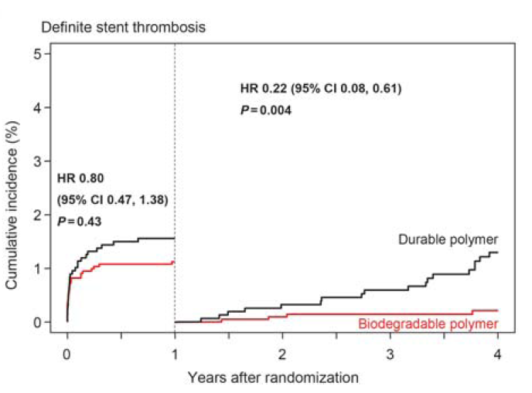
Stent thrombosis and new DES generations Biodegradable polymers
GG Stefanini, RA Byrne, PW Serruys et al.
Eur Heart J. 2012 May;33(10):1214-22

Slide 68
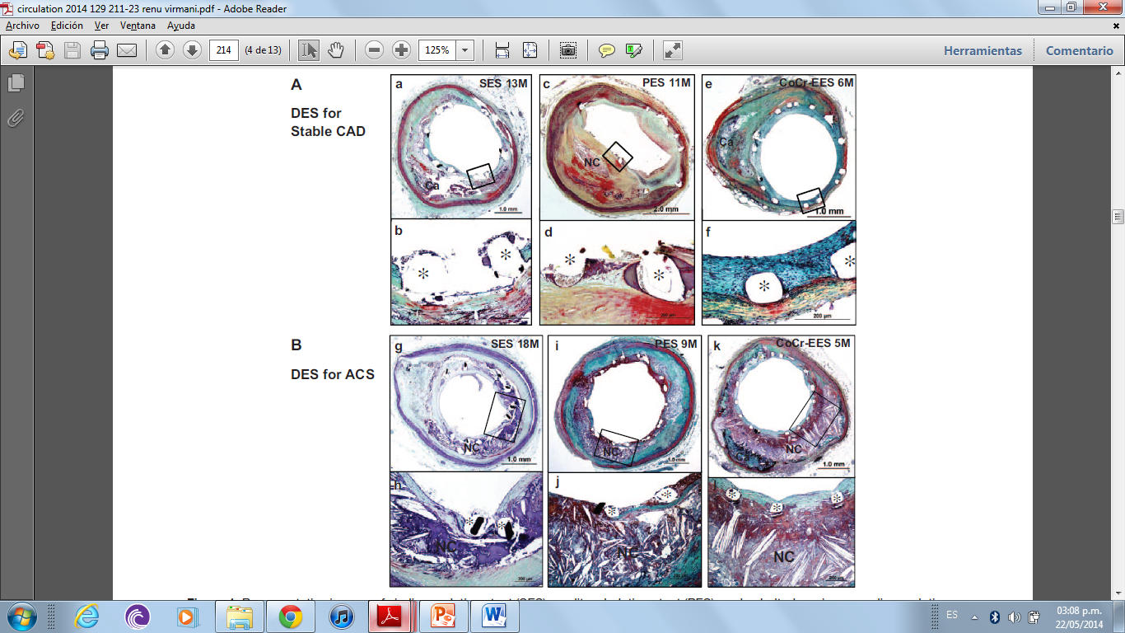
DES for Stable CAD
Neointimal growth, underlying fibroatheroma and uncovered struts with persistent peri-strut fibrin deposition
DES for ACS
F Otsuka, Finn A, Virmani R et al. Circulation 2014; 129:211-223

Slide 69
DES for Stable CAD
DES for ACS
Mild neointimal growth, focal uncovered struts and strut penetration into the necrotic core.
F Otsuka, Finn A, Virmani R et al. Circulation 2014; 129:211-223

Slide 70
DES for Stable CAD
DES for ACS
Patent lumen with stent struts surrounded by fibrin and an underlying necrotic core. Uncovered struts with fibrin deposition that overlie over necrotic core.
F Otsuka, Finn A, Virmani R et al. Circulation 2014; 129:211-223

Slide 71
DES for Stable CAD
DES for ACS
Mild neointimal proliferation and an underlying large NC. All struts are covered with a thin intima overlying the necrotic core.
F Otsuka, Finn A, Virmani R et al. Circulation 2014; 129:211-223

Slide 72
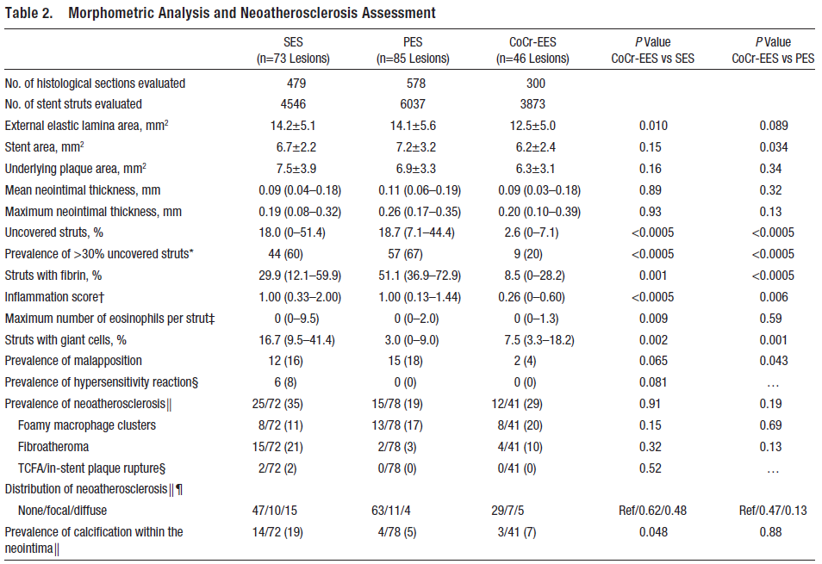
F Otsuka, Finn A, Virmani R et al. Circultation 2014; 129:211-223

Slide 73
Prevalence of Neoatherosclerosis
F Otsuka, Finn A, Virmani R et al. Circultation 2014; 129:211-223

Slide 74
Conclusions
In patients undergoing PCI with BMS, the use of OIT as compared with control therapy reduces target lesion revascularization with no impact on the composite of death/myocardial infarction or safety issues.
The advantage of OIT derives predominantly from the decreased risk of vessel renarrowing as compared to BMS alone.
Results of this meta-analysis cannot be directly applied to compare OIT plus BMS against current generation DES and additional studies are warranted. Furthermore, it remains unstudied whether OIT after stenting may have a role in the contemporary interventional portfolio with more safer third generation DES.
Finally, the cost-effectiveness of a strategy of OIT after stenting as compared with first-generation DES cannot be assessed with the present meta-analysis, since studies included were performed within different health care systems

Slide 75
Conclusions
1#.Notwithstanding that latest DES designs are significantly more safer than previous ones, BMS implantation during PCI have not been abandoned and are expected to grow in the next 5 years.
2#. Oral Immunosuppressive therapy (OI) after BMS implantation significantly reduced restenosis rates compared to BMS alone. The reduction was driven by less late lumen loss with OI.
3#. Taking into consideration the randomized data, rapamycin and prednisone appear to be the most promising in this setting. However, prednisone cannot be used in diabetics which limits its use.
4#. The use of oral agents to reduce restenosis should be considered in all patients with relative contraindications for DES implantation.
5#.We believe that the guidelines should be amended to include these agents in certain specific situations

Slide 76
CEREA-DES
Prednisone was administered at
1 mg/kg for the first 15 days
0.5 mg/kg from Day 16 to 30
0.25 mg/kg from Day 31 to 40.
In association to
gastro-protective therapy during the whole period of steroid treatment (proton pump inhibitor 20 mg twice daily);
20–40 mg/day of oral thiazide to reduce liquid retention and blood pressure and prevent calcium depletion
Ribichini F et al. Eur Heart J. 2013 Jun;34(23):1740-8.

Slide 77
RAMSES meta-analysis
Cassese, Kastrati, Rodriguez et al. Submitted

Slide 78
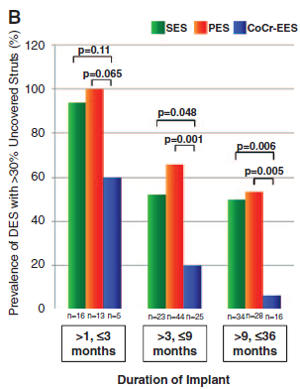
Prevalence of DES with > than 30% of uncovered struts among time.
F Otsuka, Finn A, Virmani R et al. Circulation 2014; 129:211-223

Slide 79
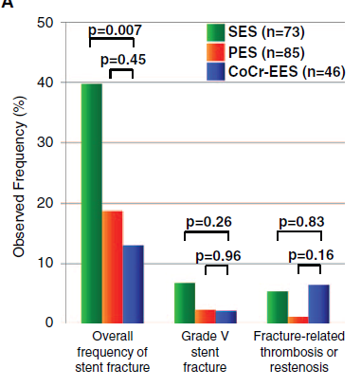
Observed frequency of overall fracture, type V (acquired transection with gap in stent body) and fractured-related stent thrombosis or restenosis.
F Otsuka, Finn A, Virmani R et al. Circulation 2014; 129:211-223

Slide 80
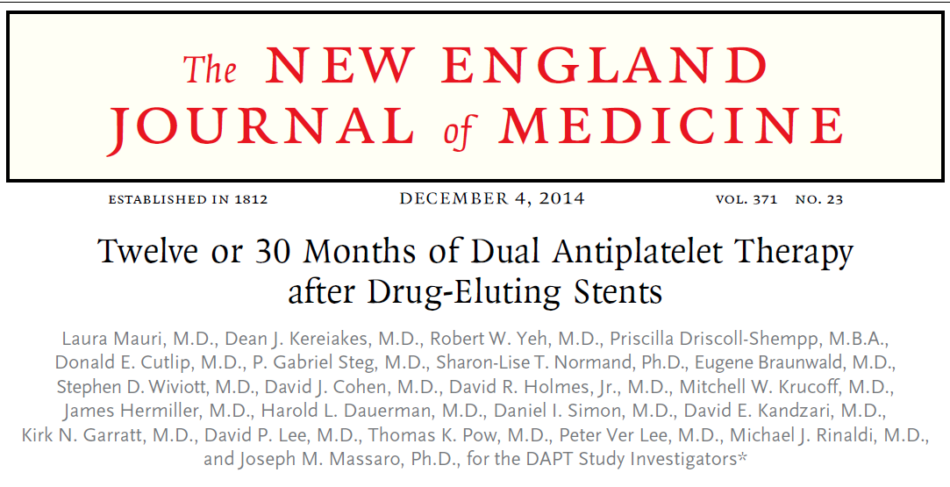

Slide 81
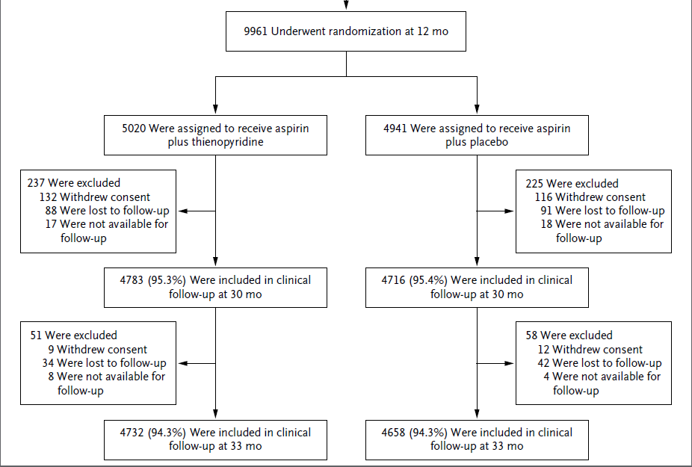
DAPT duration – DAPT Trial
L Mauri et al. N Engl J Med 2014;371:2155-66

Slide 82
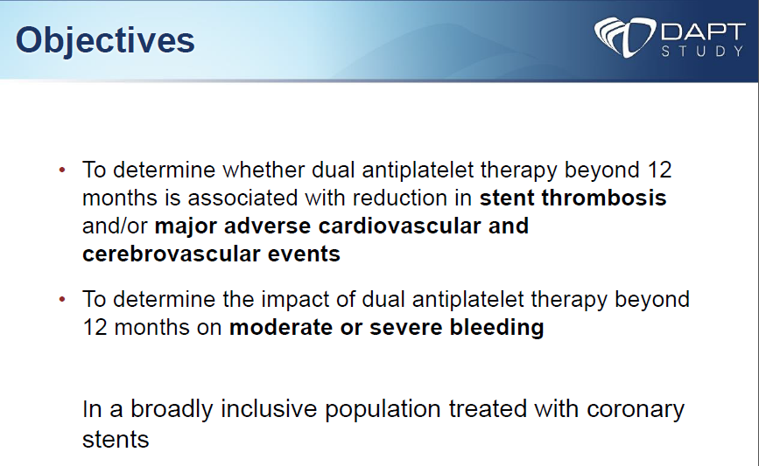
DAPT duration – DAPT Trial
L Mauri AHA Scientific Sessions 2014, November 16, 2014, Chicago, IL

Slide 83
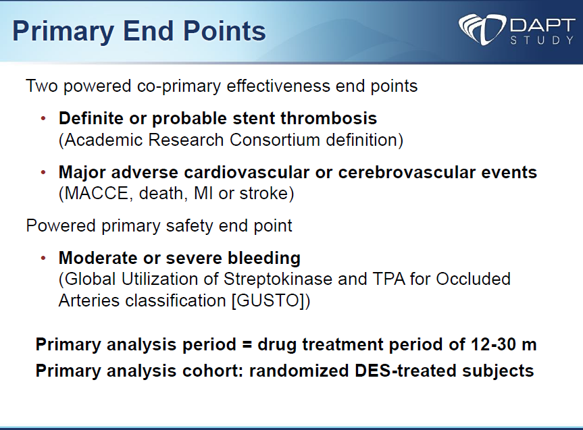
DAPT duration – DAPT Trial
L Mauri AHA Scientific Sessions 2014, November 16, 2014, Chicago, IL

Slide 84
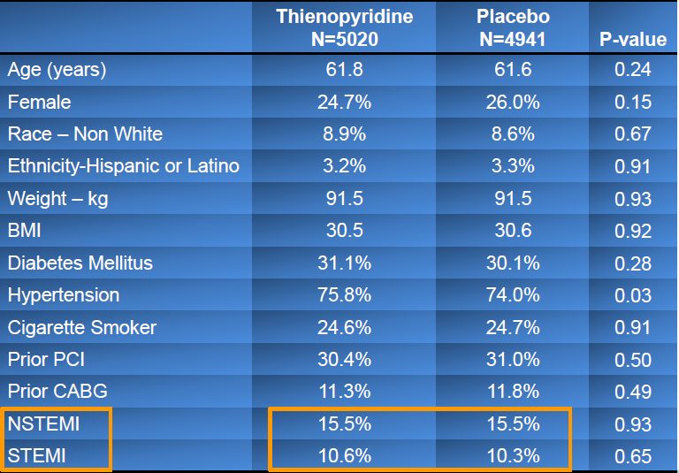
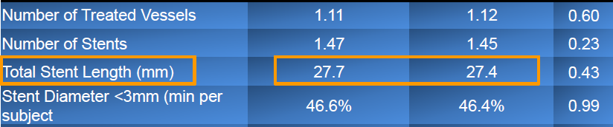
Baseline Characteristics
DAPT duration – DAPT Trial
L Mauri AHA Scientific Sessions 2014, November 16, 2014, Chicago, IL

Slide 85
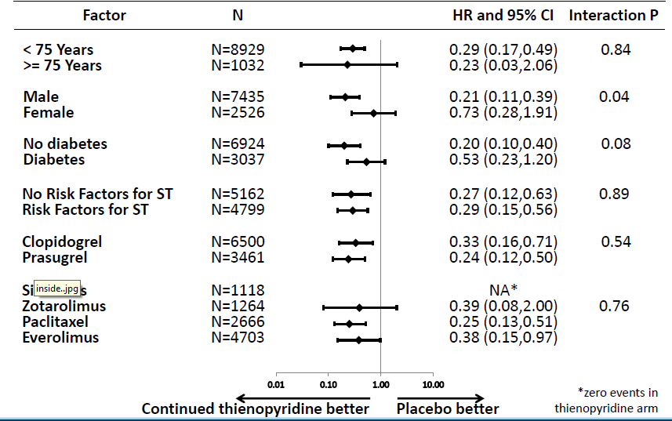

DAPT duration – DAPT Trial
Stent thrombosis
MACCE
L Mauri AHA Scientific Sessions 2014, November 16, 2014, Chicago, IL

Slide 86
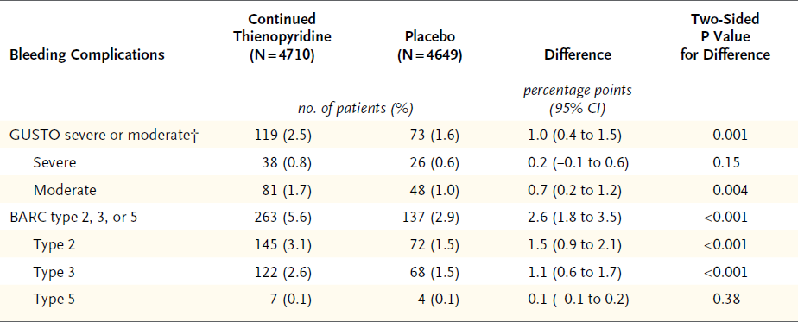
DAPT duration – DAPT Trial
Bleeding End Point during Month 12 to Month 30
L Mauri et al. N Engl J Med 2014;371:2155-66

Slide 87
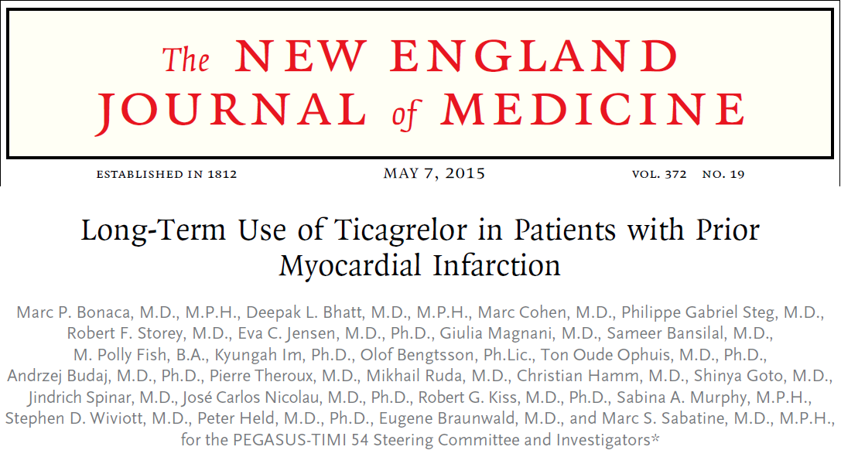

Slide 88
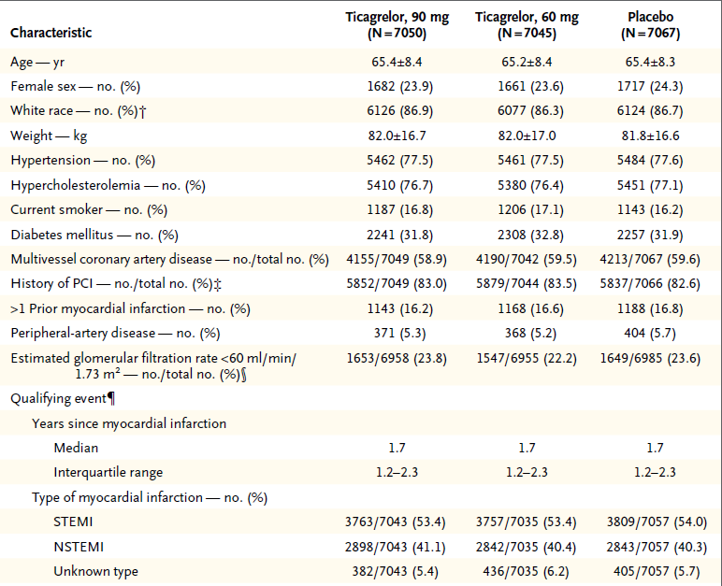
DAPT duration – PEGASUS TIMI 54 Trial
M. Bonaca et al. N Engl J Med 2015;372:1791-800

Slide 89
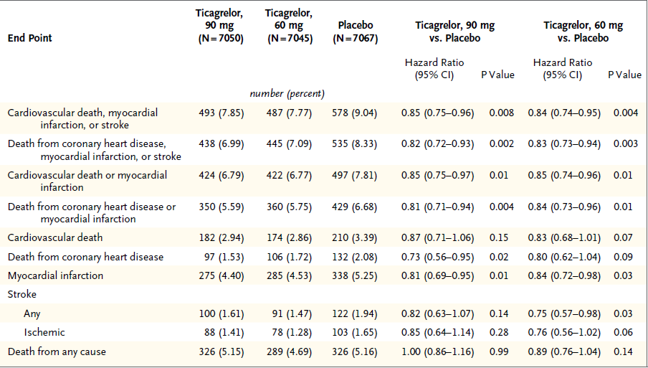
DAPT duration – PEGASUS TIMI 54 Trial
Efficacy End Points as 3-Year Kaplan–Meier Estimates
M. Bonaca et al. N Engl J Med 2015;372:1791-800

Slide 90
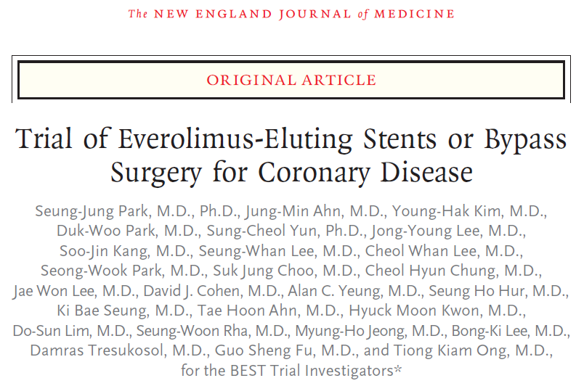

Slide 91
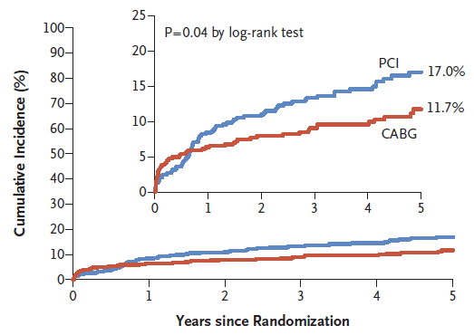
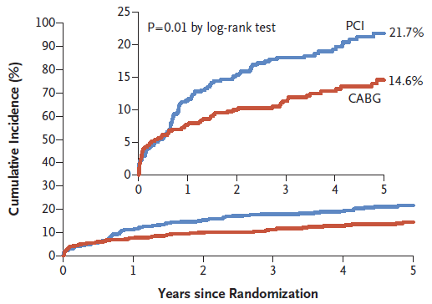
Death, MI or TVR
Death, MI, CVA or TVR
SJ Park et al. N Engl J Med 2015; 372:1204-1212

Slide 92
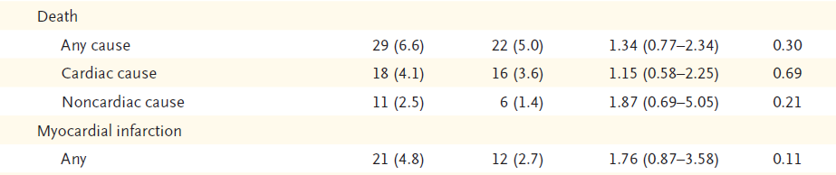
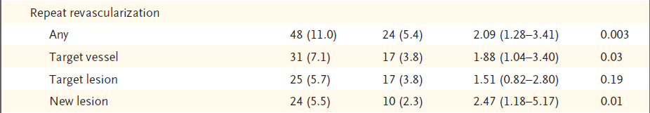
Long-Term Clinical End Points after Randomization, According to Study Group
SJ Park et al. N Engl J Med 2015; 372:1204-1212

Slide 93
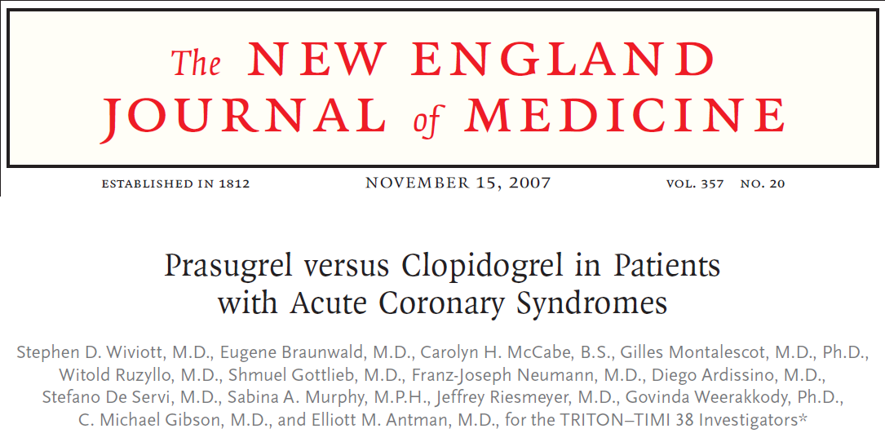

Slide 94


TIMI Bleeding End Points in the Overall Cohort at 15 Months TRITON TIMI 38 Trial
SD Wiviott et al. N Engl J Med 2007; 357:2001-2015

Slide 95


Slide 96


Safety of the Study Drugs
PLATO TRIAL
L Wallentin et al. N Engl J Med 2009; 361:1045-1057

Slide 97

Comparison of the incidence of dyspnea in patients treated with reversible P2Y12 inhibitors and patients treated with clopidogrel
Cattaneo M, Faioni EM.. Thromb Haemost. 2012 Dec;108(6):1031-6

Slide 98
First, some decisions to make…
Clinical setting
STEMI
Non STEMI ACS
Elective PCI
PCI complexity
Small vessels
bifurcations
Long lesions
Lack of intravascular ultrasound
Patients characteristics
Diabetics
Elderly
Renal failure
Comorbirities
DES choice
SES
EES
ZES
DES generation (s) …. and etc
Costs
Healthcare System
This will influence in dual antiplatelet therapy election and duration

Slide 99
Potential predisposing factors for stent thrombosis
Plaque rupture of adjecent lesion
Incomplete endothelization
Noncompliance with DAPT
Clopidogrel nonresponsiveness
Small vessels
Long lesions
Bifurcations
Lack of intravascular ultrasound guidance
Hypersensivity to drug or polymer
Diabetes
Renal failure
Low ejection fraction
Prior brachytherapy
Incomplete stent apposition
When using DES + long DAPT we must take in account some variables…
Colombo A and Gerber RT. Circ Cardiovasc Interv. 2008;1:226-232

Slide 100

Relationship between DAPT and thrombosis
Patients on DAPT
Thrombosis rate % with and without DAPT
Colombo A and Gerber RT. Circ Cardiovasc Interv. 2008;1:226-232

Slide 101


Death/MI or CVA Relative risk reduction for clopidogrel compared with placebo 26.9% (95% CI, 3.9% to 44.4%, p=0.02) (CREDO TRIAL)
Late stent thrombosis. TIMI 38 trial
AK Chhatriwalla and DL Bhatt. Circ Cardiovasc Interv. 2008;1:217-225

Slide 103
DES for Stable CAD
Neointimal growth, underlying fibroatheroma and All struts are covered with proteoglycan-rich neointima with absence of fibrin.
DES for ACS
F Otsuka, Finn A, Virmani R et al. Circulation 2014; 129:211-223

Slide 104
Let us meet again..
We welcome you all to our future conferences of OMICS International
4th Annual Conference on European Pharma Congress
June 18-20,2016, Berlin, Germany.
http://europe.pharmaceuticalconferences.com/

