Slide 1
About Omics Group
OMICS Group International through its Open Access Initiative is committed to make genuine and reliable contributions to the scientific community. OMICS Group hosts over 400 leading-edge peer reviewed Open Access Journals and organize over 300 International Conferences annually all over the world. OMICS Publishing Group journals have over 3 million readers and the fame and success of the same can be attributed to the strong editorial board which contains over 30000 eminent personalities that ensure a rapid, quality and quick review process.

Slide 2
About Omics Group conferences
OMICS Group signed an agreement with more than 1000 International Societies to make healthcare information Open Access. OMICS Group Conferences make the perfect platform for global networking as it brings together renowned speakers and scientists across the globe to a most exciting and memorable scientific event filled with much enlightening interactive sessions, world class exhibitions and poster presentations
Omics group has organised 500 conferences, workshops and national symposium across the major cities including SanFrancisco,Omaha,Orlado,Rayleigh,SantaClara,Chicago,Philadelphia,Unitedkingdom,Baltimore,SanAntanio,Dubai,Hyderabad,Bangaluru and Mumbai.

Slide 3
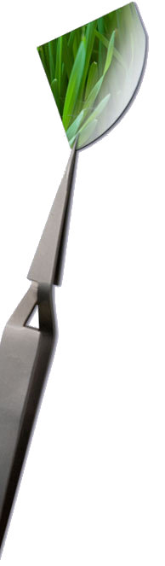

High performance, low dissipation QCL across the Mid-IR range.
08.09.14 / Alfredo Bismuto
3

Slide 4
Outline
Introduction
Mid-IR spectral range: applications
Alpes Lasers SA overview
Single mode sources
Fabrication process
QCLs for mass production (device length impact)
Impact of front reflective coating on short devices
DFB sources below 1W between 4.5-9.3 µm
High power DFBs
Conclusion and next steps
Alfredo Bismuto
08.09.2014
4

Slide 5
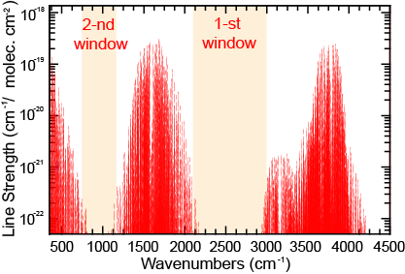
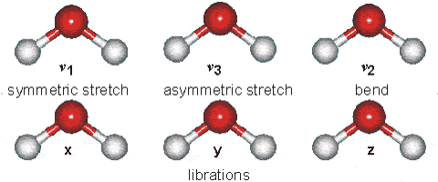
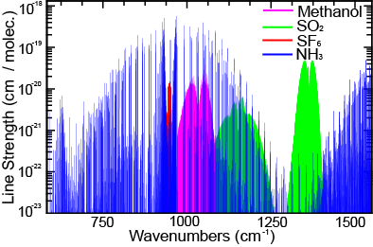
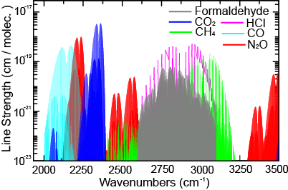
Mid-IR range (2-20µm)
H₂O abosorption
Strong molecular absorptions
(orders of magnitude bigger
than in the NIR-range)
  Isotopically
  sensitive
NO₂, CO,
CO₂, CH₄, NH₃,
CH₂CO, O_{3,} N₂O
HF, HCl
Alfredo Bismuto
08.09.2014
5

Slide 6

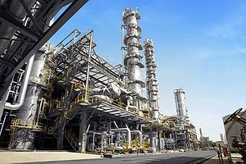
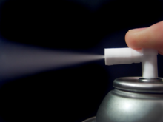
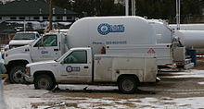
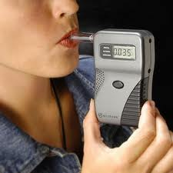
Applications
Enviromental gas monitoring
Atmospheric chemistry
Volcanic emissions
Urban and Industrial emission control
Industrial plants
Automobile and Aircraft emissions
Combustion process control
Rural emission measurements
Biochemical and Clinical diagnostics
Breath analysis (NO, CO, CH4, S)
Glucose level control (in-vivo)
Alfredo Bismuto
08.09.2014
6

Slide 7
Limitation and challenges
A killer application is still missing...why?
Laser sources
Low efficiency (~10%) compared to diode lasers (~50%)
High electrical dissipation (W_{el}>1W)
High electrical dissipation (W_{el}>1W)
Nb of lasers per wafers still low (long lasers & small wafers)
Fabrication is still expensive
Photonics
Difficult to do photonic integration
Optical elements expensive (lenses/windows/fibers)
Detectors less sensitive and more expensive
Alfredo Bismuto
08.09.2014
7

Slide 8


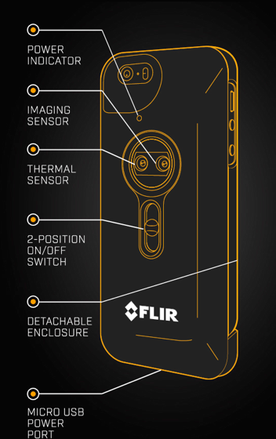
Horizon
Things are changing....
FLIR introduced the FLIRONE project
a IR camera compatible with the Iphone
The cameras should cost less than 350 $
Many big company are trying to develop
products in the IR
See also : http://www.flir.com/flirone/explore/
Alfredo Bismuto
8

Slide 9
Our company
Alfredo Bismuto
08.09.2014
9
Alpes Lasers
  founded in 1998
  21 employees (11PhD, 5 eng.)
  New product design team growing
  Fabless component manufacturer
  Widening products portafolio
  2400+ sold lasers

Slide 10
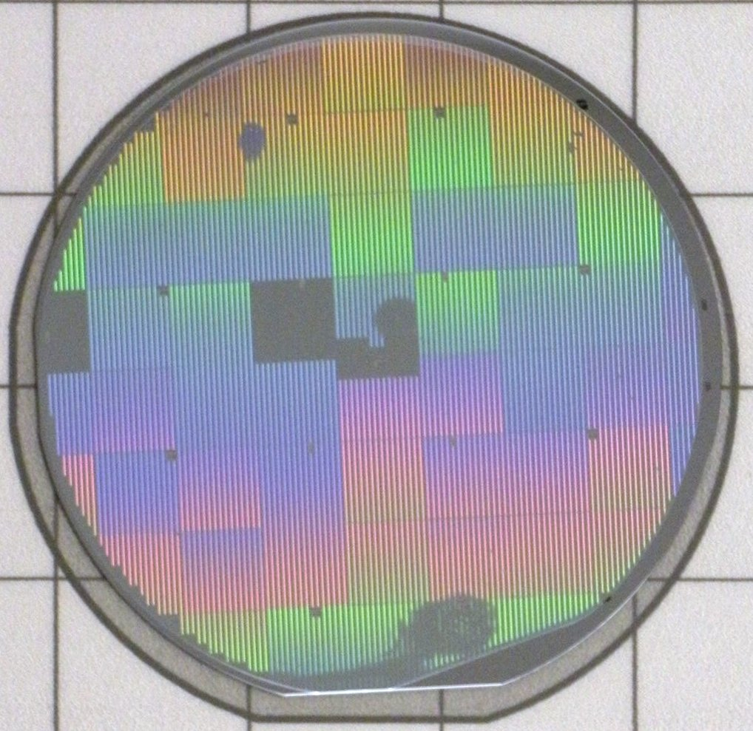
DFB technology
UV-lithography
DFB grating during fabrication
Proprietary design tool
  Gratings written by standard lithography from 4-12 µm
  Many different wavelengths can be fabricated at once
  Efficient device mounting
  Full 2''- wafer process
  Polyvalent production process
Alfredo Bismuto
08.09.2014
10

Slide 11
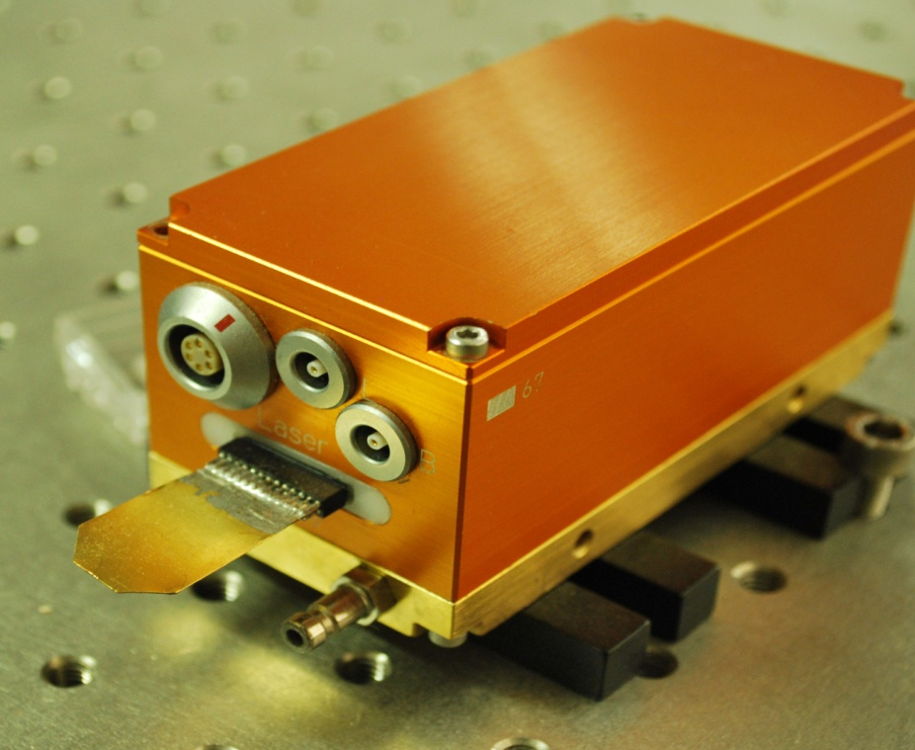
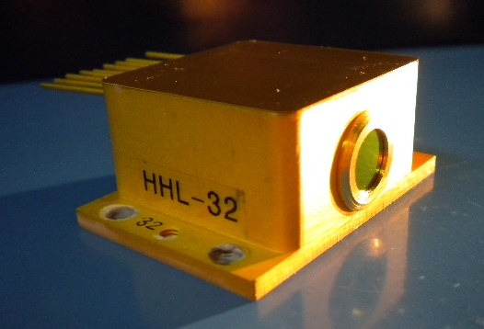
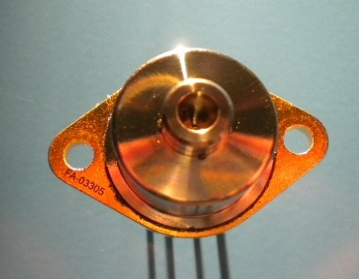
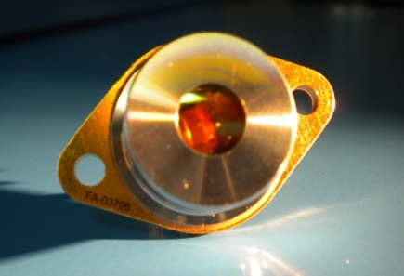
QCL subsystems
LLH
HHL-L
TO3-L
TO3-W
Used only in the initial testing phase
Alfredo Bismuto
08.09.2014
11

Slide 12
QCL subsystems
LLH
HHL-L
TO3-L
TO3-W
Used only in the initial testing phase
low consumption packages being
validated (TO5, etc.)
Alfredo Bismuto
08.09.2014
12

Slide 13
Outline
Introduction
Mid-IR spectral range: applications
Alpes Lasers SA overview
Single mode sources
Fabrication process
QCLs for mass production (device length impact)
DFB sources below 1W between 4.5-8 µm
Impact of front reflective coating on short devices
High power DFBs
Conclusion and next steps
Alfredo Bismuto
08.09.2014
13

Slide 14
Thermal budget in QCLs
Most of QCLs have 5-15 W of electrical dissipation
Up to 100 W are needed to control the temperature
Optical power levels of few mW sufficient for many
applications
Alfredo Bismuto
08.09.2014
14

Slide 15
Thermal budget in QCLs
Most of QCLs have 5-15 W of electrical dissipation
Up to 100 W are needed to control the temperature
Optical power levels of few mW sufficient for many
applications
Research goal:
  Low dissipation devices
  Short chips
  Still enough optical power for spectroscopy
Alfredo Bismuto
08.09.2014
15

Slide 16
Advantages of short devices
Low dissipation (Easy cw bar testing)
More devices per wafer
Alfredo Bismuto
08.09.2014
16

Slide 17
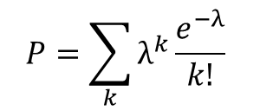
Advantages of short devices
Number of defects
Low dissipation (Easy cw bar testing)
More devices per wafer
Probability of defect (λ) follows a Poissonian law
Failure rate sensibly reduced with shorter lasers
$$P=\sum_{k}{λ^{k}}\frac{e^{−λ}}{k!}$$
Probability
of major defect
in the laser wg
Alfredo Bismuto
08.09.2014
17

Slide 18
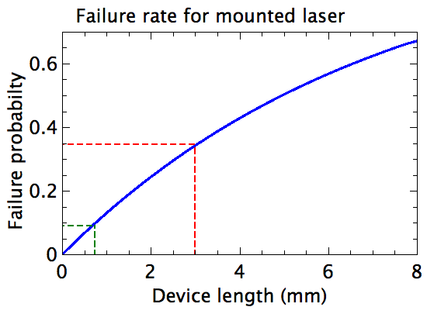
Advantages of short devices
Number of defects
$$P=\sum_{k}{λ^{k}}\frac{e^{−λ}}{k!}$$
Probability
of major defect
in the laser wg
35%
8%
Defect density estimated on the AL-Stock data (preliminary)
Alfredo Bismuto
08.09.2014
18

Slide 19
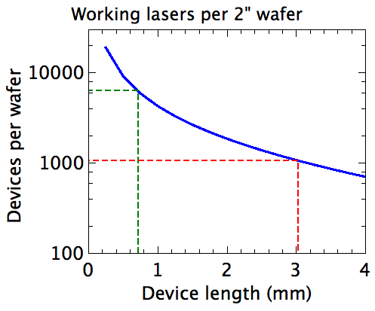
Advantages of short devices
Number of defects
Optical power levels of few mW sufficient for many applications
Low consumption
More devices per wafer
Probability of defect (λ) follows a Poissonian law
$$P=\sum_{k}{λ^{k}}\frac{e^{−λ}}{k!}$$
Probability
of major defect
in the laser wg
Doublefold impact on the number of chips/wafer
Alfredo Bismuto
08.09.2014
19

Slide 20
Optimizing reflectivity for short devices
Starting range 4.5 m and 5.5 m
Optimize the grating coupling to obtain both
low consumption DFBs and high power
DFBs on the same wafer
750 µm long devices, 3-4 µm wide
Back-facet HR coating
Partial front HR coating

Slide 21
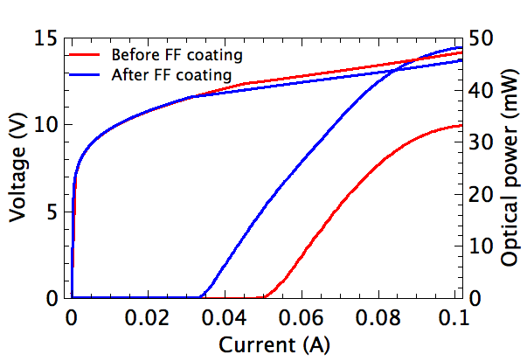
Front HR coating (dielectric)
Optical power
increases with
front coating
Before front
coating
No-lasing before
back-side coupling
λ = 4.5 µm
750 µm long devices
3 µm wide ridge

Slide 22
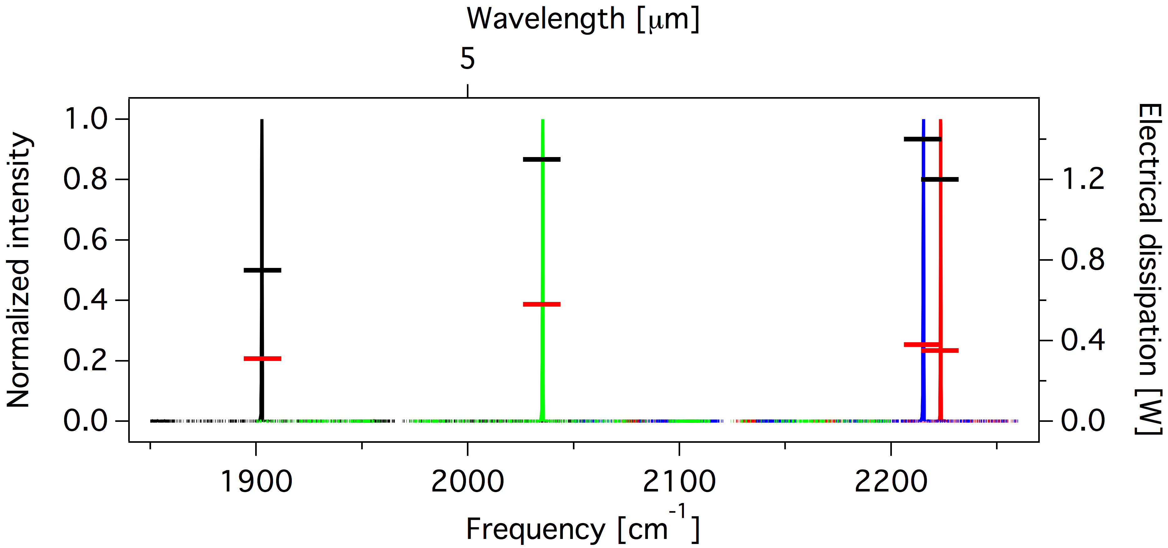
Low consumption devices
Max dissipation
Threshold
dissipation
    Dissipation at threshold as low as 0.3W
    Max consumption < 1.4W between 4.5m and 5.3m
Alfredo Bismuto
08.09.2014
22

Slide 23
Low consumption devices
    Dissipation at threshold as low as 0.3W
    Max consumption < 1.4W between 4.5m and 5.3m
Alfredo Bismuto
08.09.2014
23

Slide 24
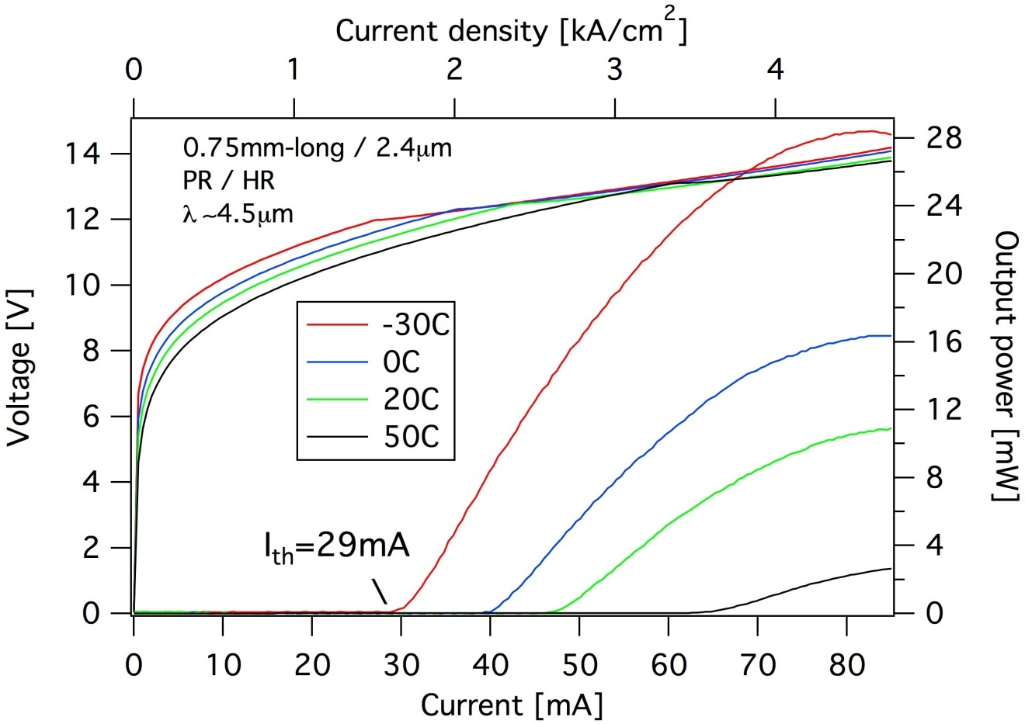
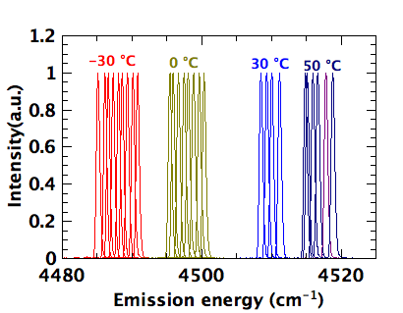
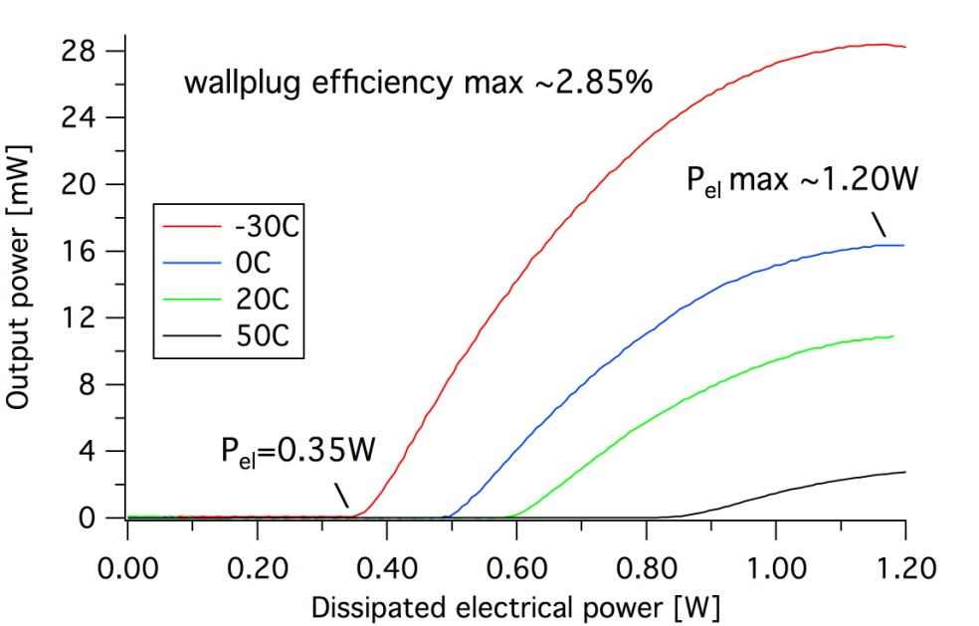
Low-dissipation DFB devices at 4.5 m
    very low threshold current : 29mA
    P_{el} max ~1.2W
    Single mode
Alfredo Bismuto
08.09.2014
24

Slide 25
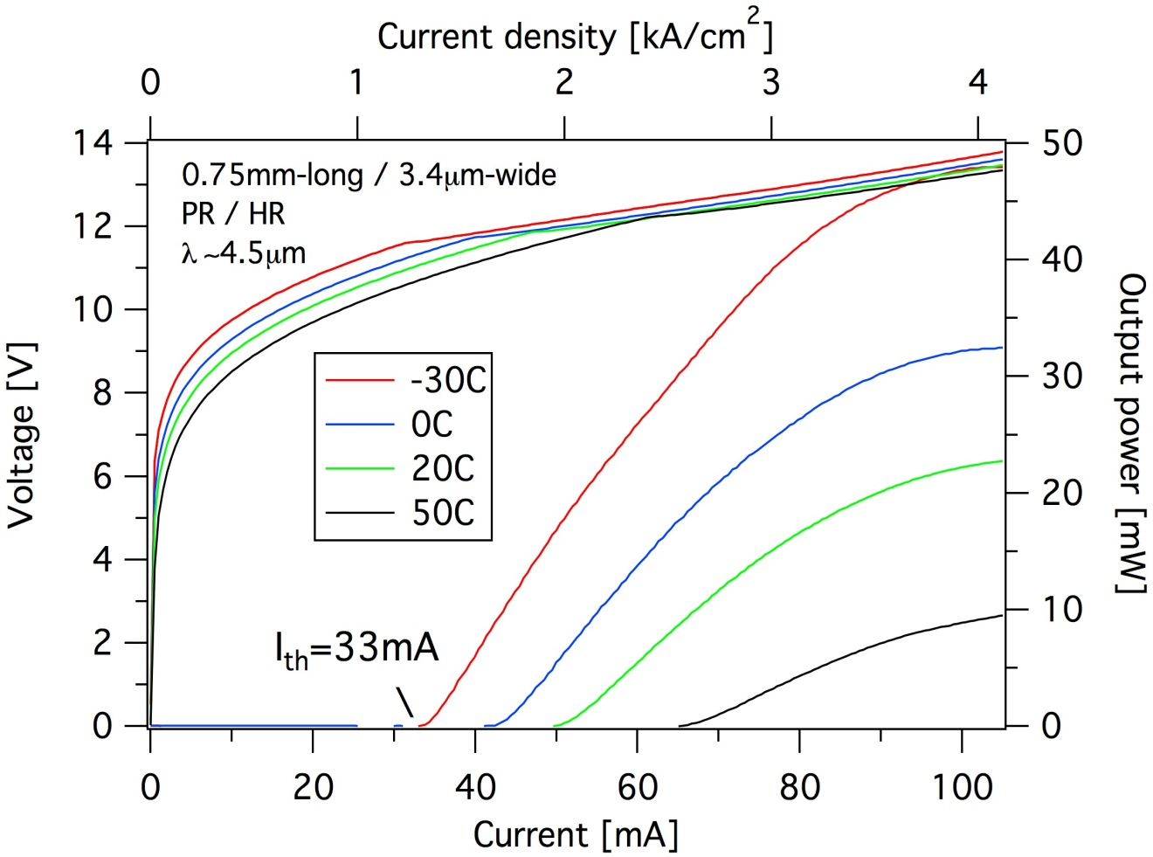
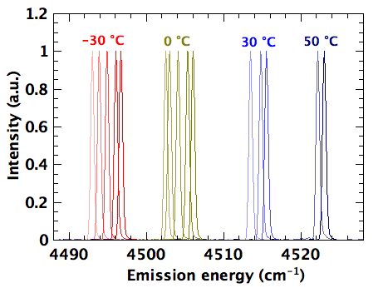
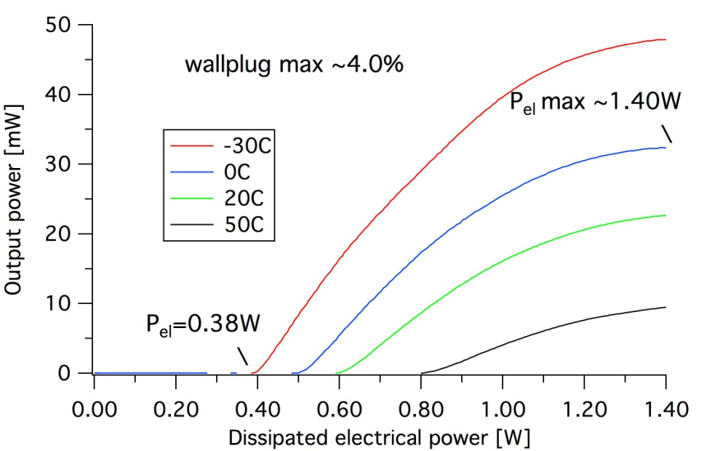
Low-dissipation DFB devices at 4.5 m
    opt power up to 48mW
    P_{el} max ~1.4W
    Single mode
Alfredo Bismuto
08.09.2014
25

Slide 26
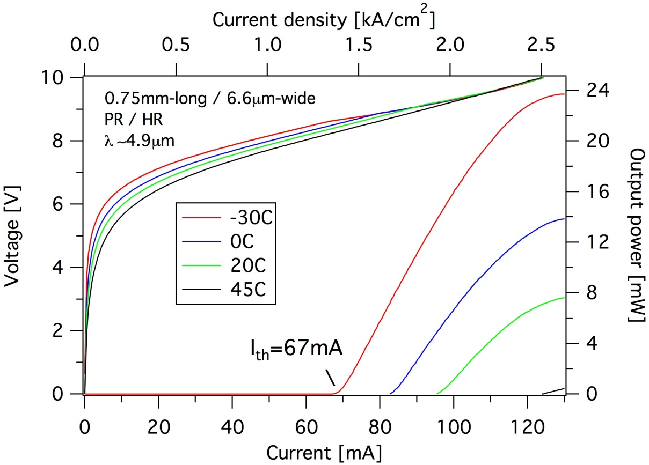
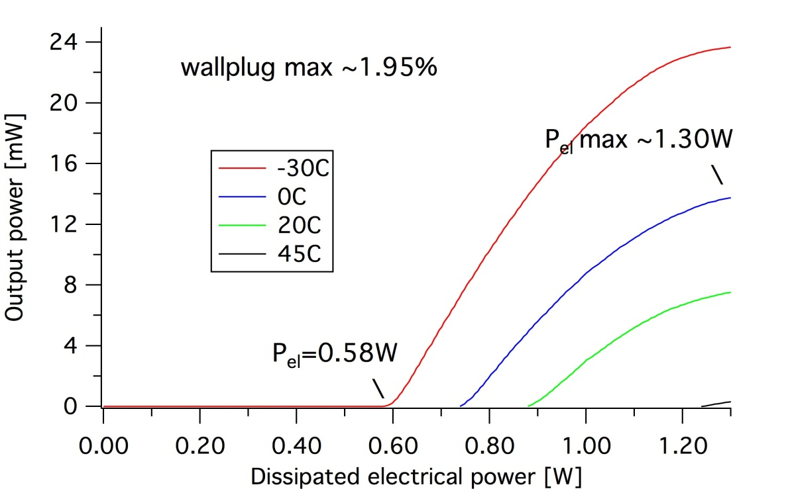
Low-dissipation DFB devices at 4.90m
Alfredo Bismuto
08.09.2014
26

Slide 27
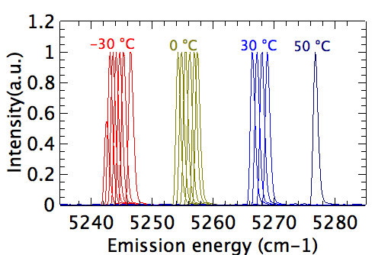
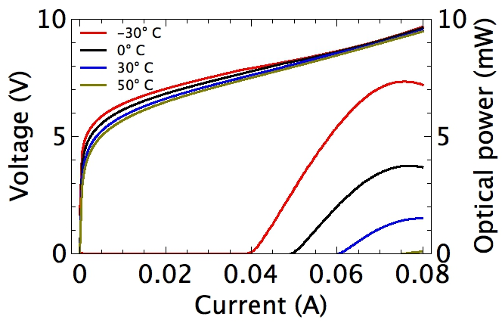
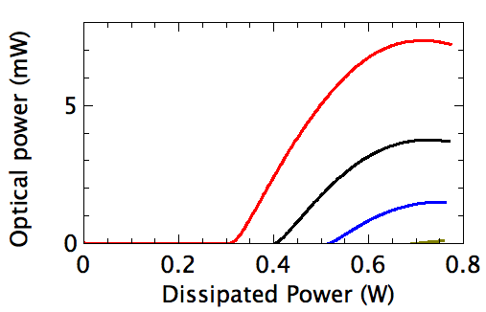
Low dissipation devices
Gain starving (too low doped structure)
Elctrical dissipation as low as 0.3 W
No cooling needed
Max dissipation 0.7 W
0.7 W
0.3 W
Alfredo Bismuto
14.07.2014
27
27

Slide 28
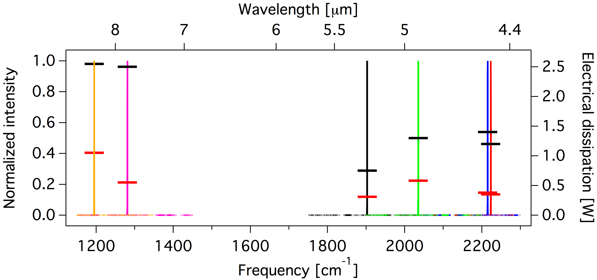
Low consumption devices
2-nd atmopheric window
    Max consumption < 2.6W between 4.5m and 8.4m
Alfredo Bismuto
08.09.2014
28

Slide 29
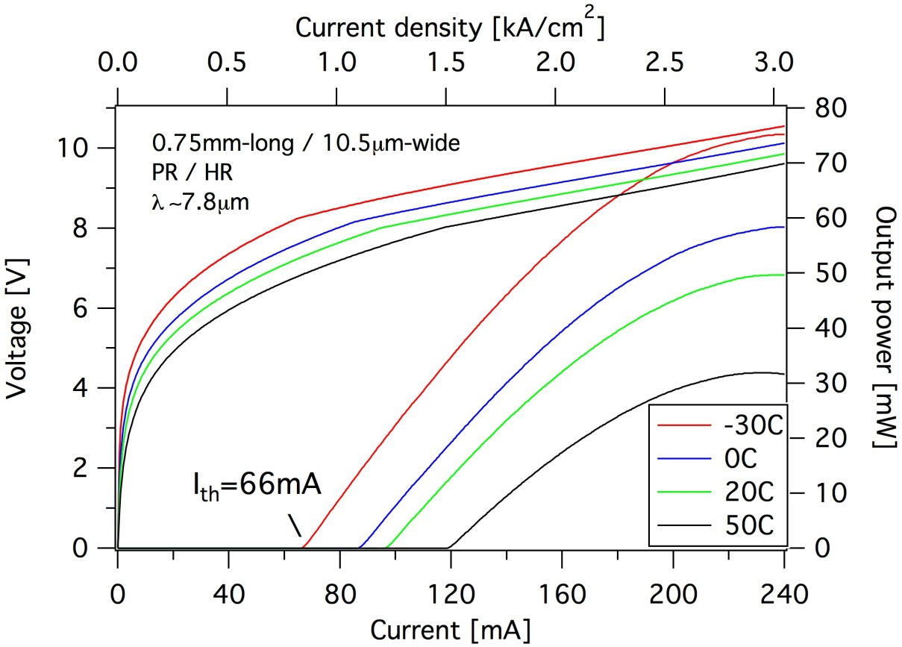
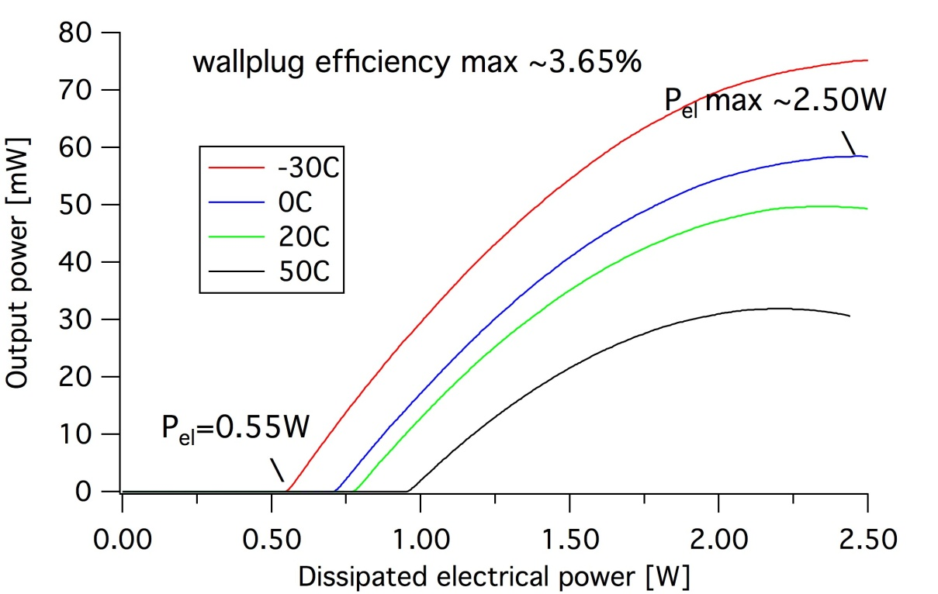
Low-dissipation DFB devices at 7.8m
    Very low threshold current : 66 mA
    Very low threshold power : 0.55 W
    Pmax > 70 mW / huge dynamical range
Alfredo Bismuto
08.09.2014
29

Slide 30
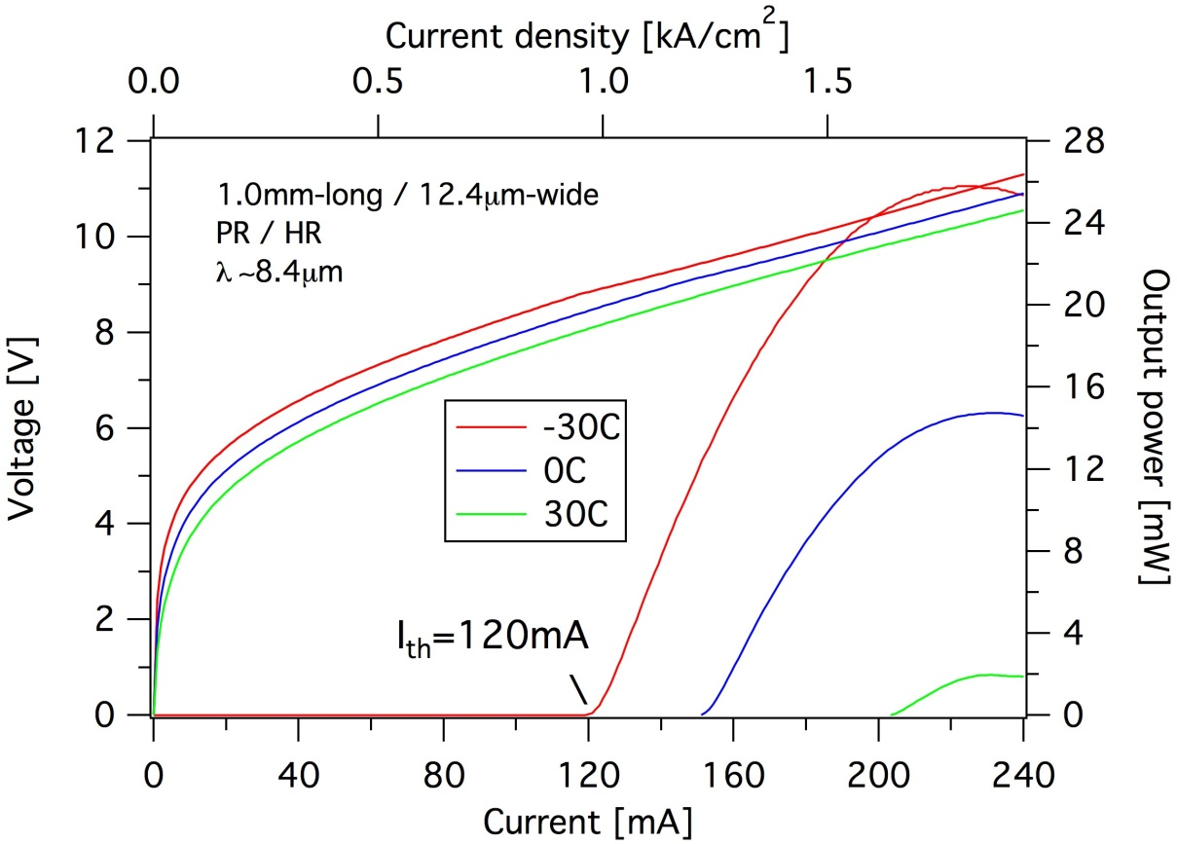
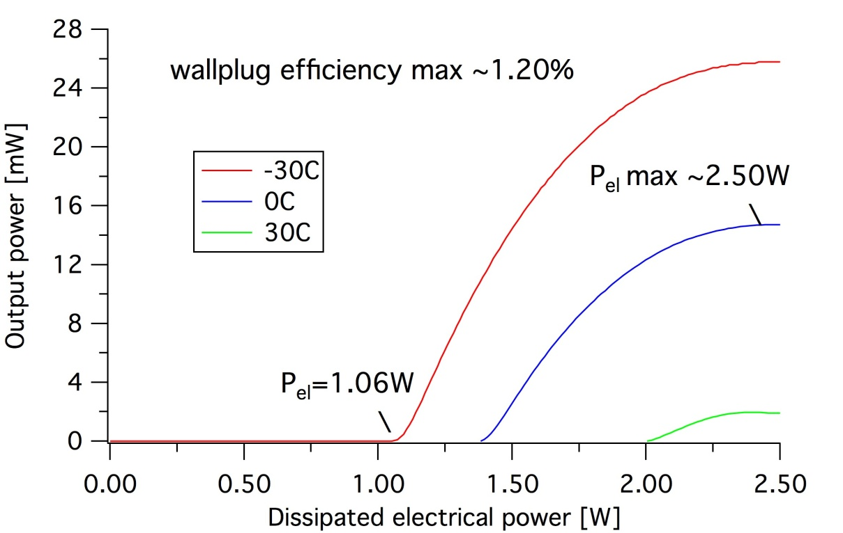
Low-dissipation DFB devices at 8.4m
    did not lase while uncoated/HR !
    As for the 4.9 µm case the design is too little doped
    low threshold power : 1.06W
Alfredo Bismuto
08.09.2014
30

Slide 31
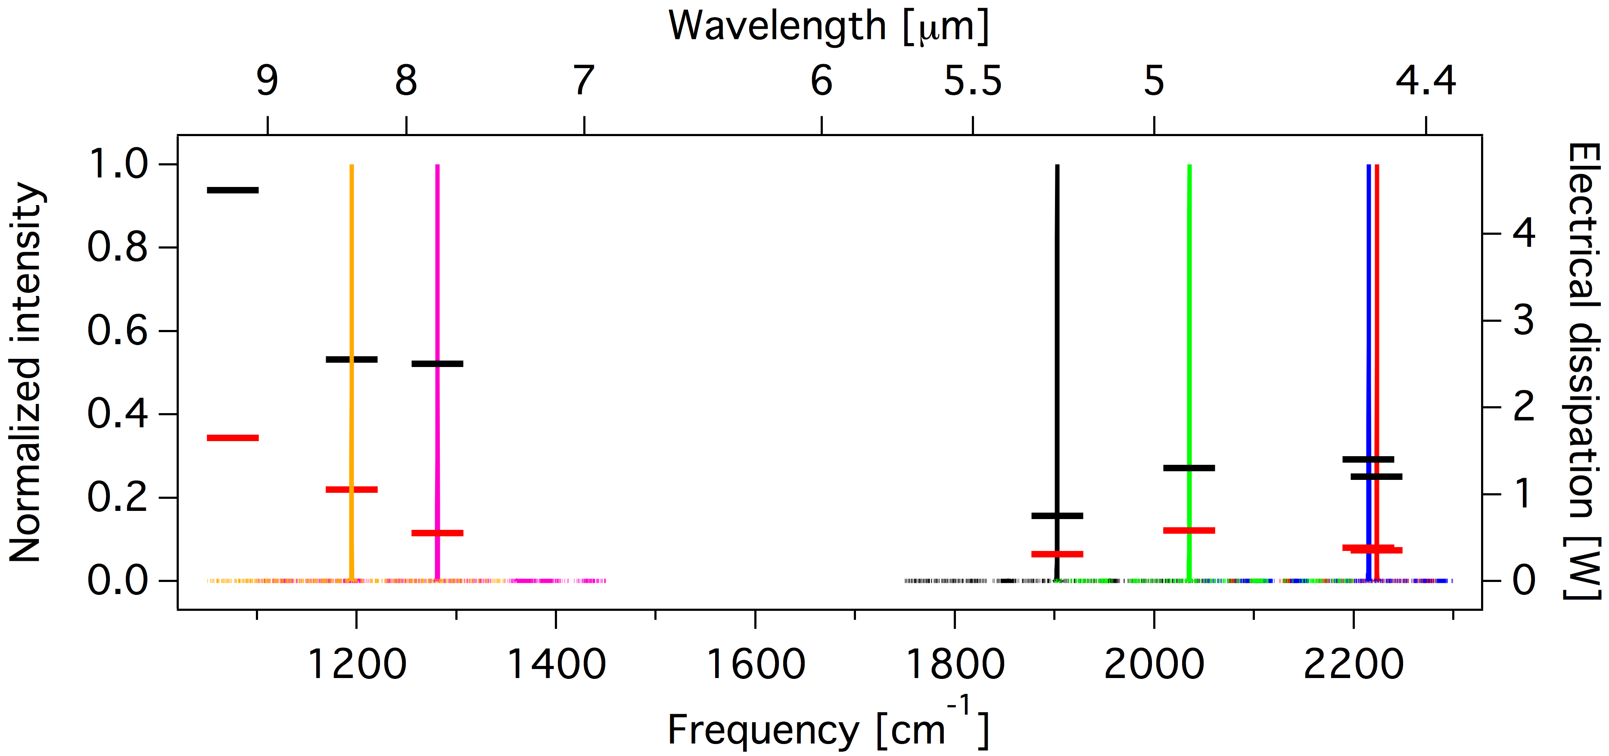
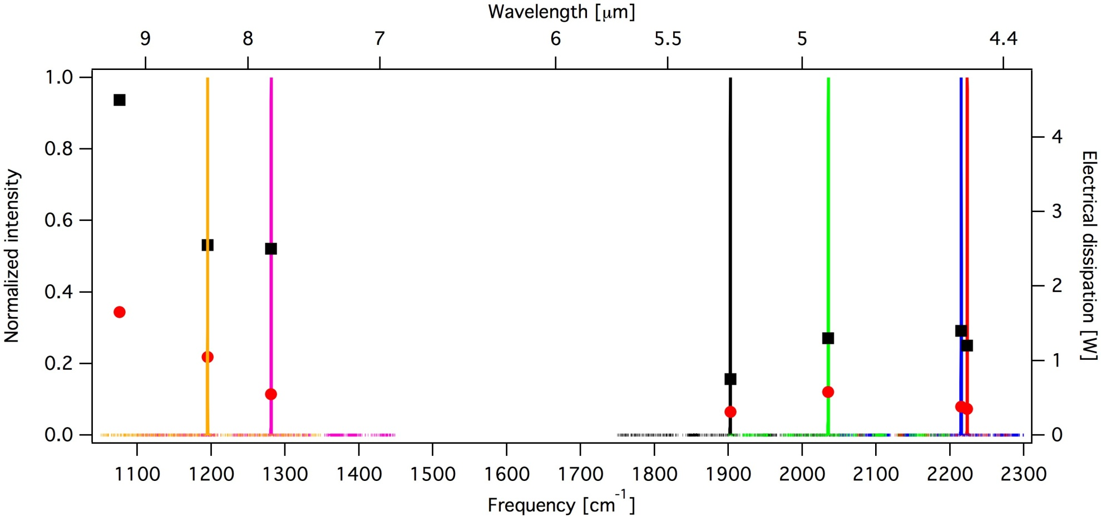
Low consumption devices (9.3 µm)
preliminary results at 9.3m (only HR on back facet)
FF coating being developed
Alfredo Bismuto
08.09.2014
31

Slide 32
Low consumption devices
Can we package this devices in low-dissipation packages?
Alfredo Bismuto
08.09.2014
32

Slide 33
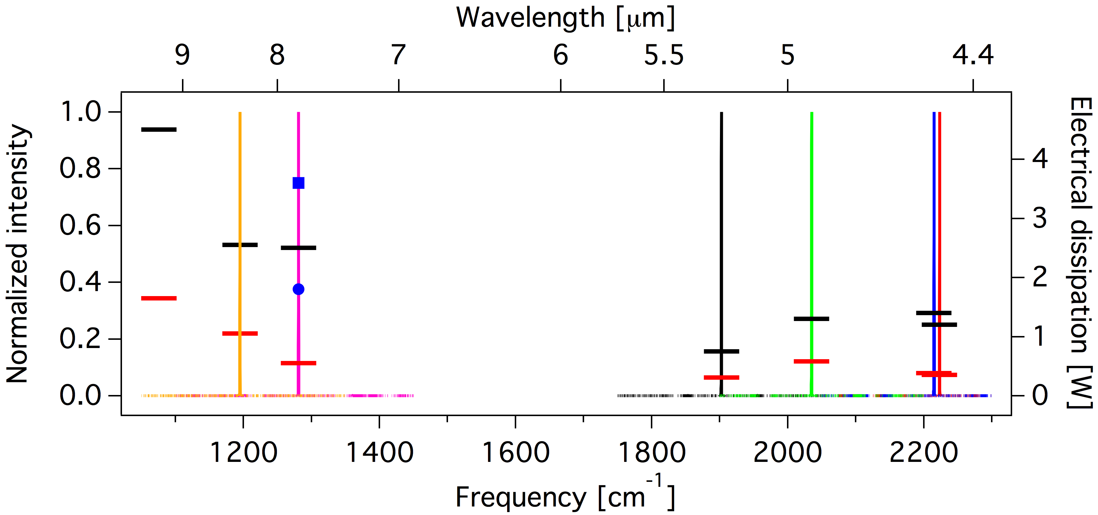
DFB devices at 7.8m in TO3-L (dissipation level)
Device sold in TO-3 package
(older generation device)
    blue : uncoated device in a TO3-L
Alfredo Bismuto
08.09.2014
33

Slide 34
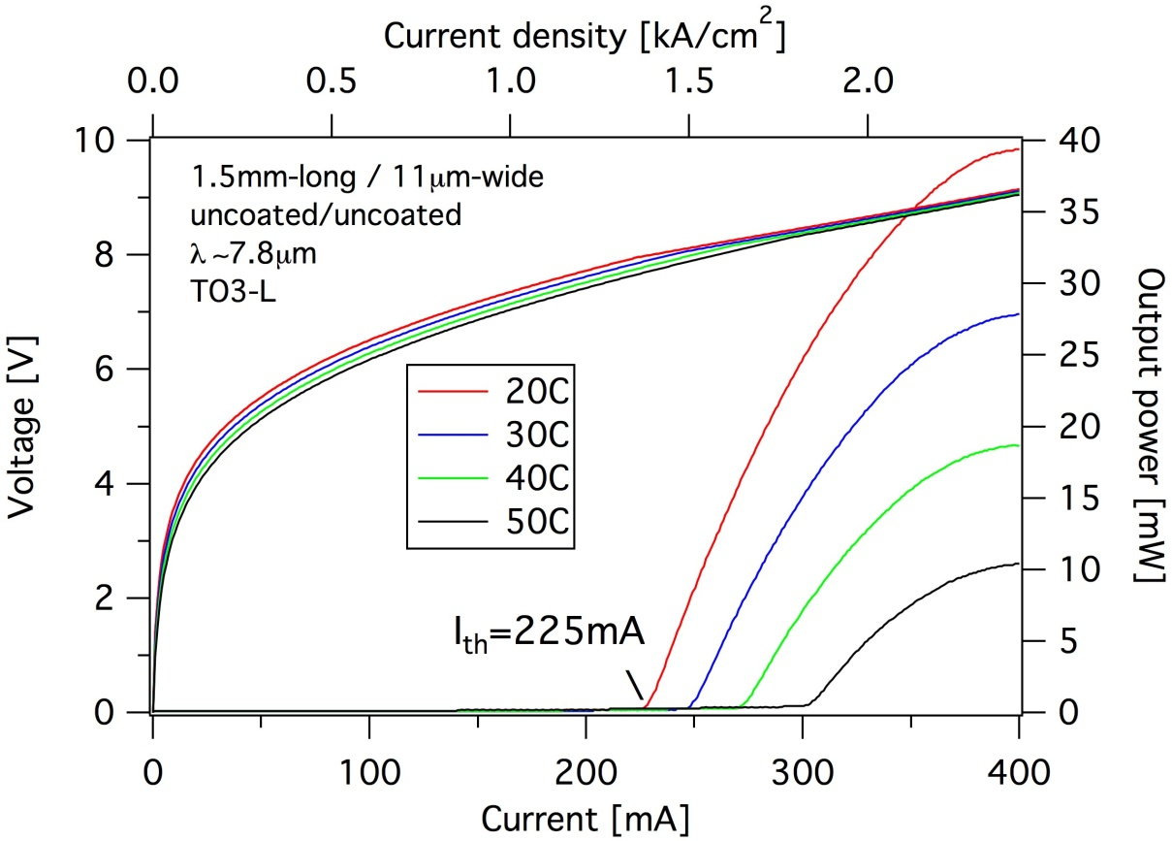
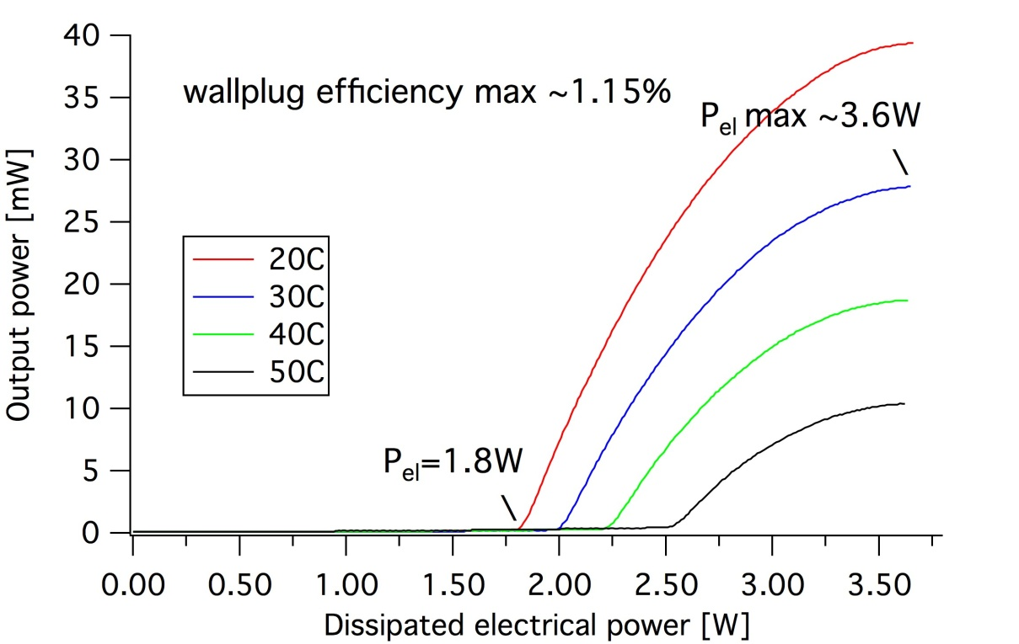
DFB devices at 7.8m in TO3-L
    higher currents but CW operation in TO3-L
    max electrical power : up to 3.6W
Alfredo Bismuto
08.09.2014
34

Slide 35
DFB devices at 7.8m in TO3-L (dissipation level)
    blue : uncoated device in a TO3-L
Alfredo Bismuto
08.09.2014
35

Slide 36
DFB devices at 7.8m in TO3-L (dissipation level)
Smaller packages are
being investigated
Alfredo Bismuto
08.09.2014
36

Slide 37
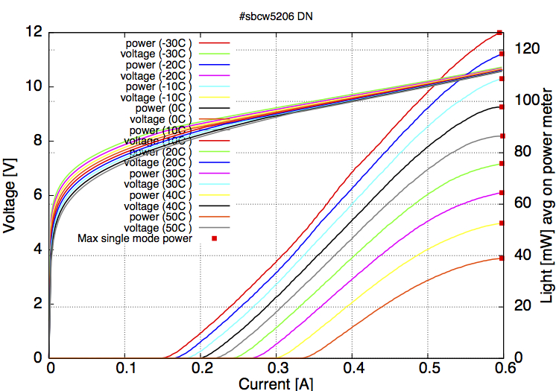
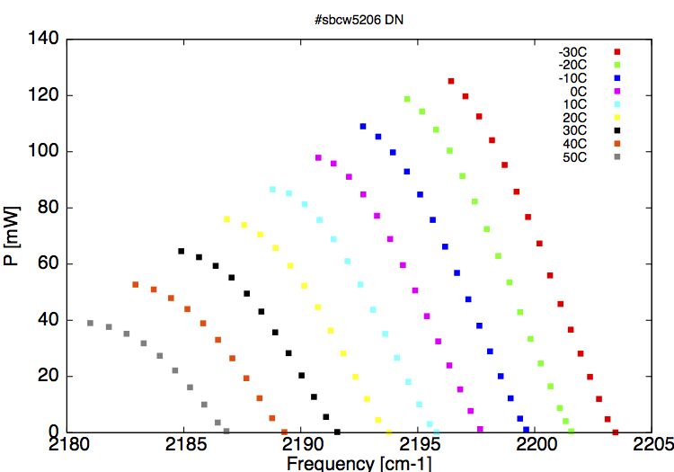
High power DFB devices
High-power device at 4.56 µm
~ 80mW/facet at RT / still > 40mW/facet at 50C
P_{el} max < 6.4W
Single mode across the full range
Alfredo Bismuto
08.09.2014
37

Slide 38
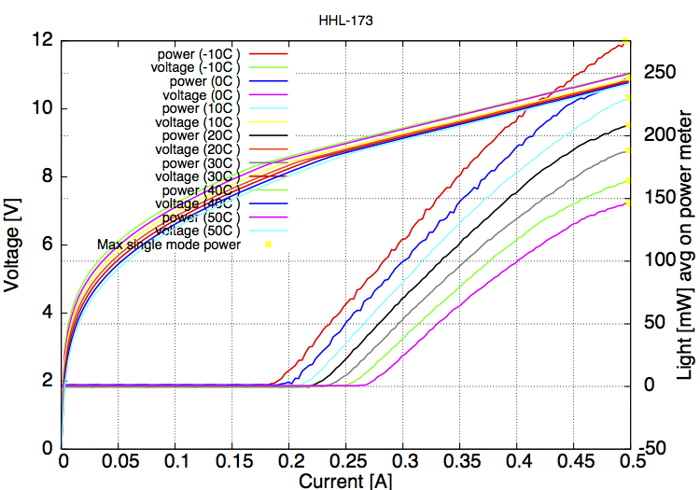
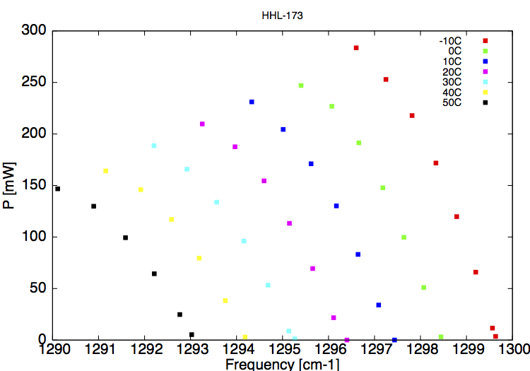
High power DFB devices
High-power device at 7.72 µm
~ 200mW at RT / still >140mW at 50C
P_{el} max < 5.5W
Single mode across the full range
Alfredo Bismuto
08.09.2014
38

Slide 39
Conclusion and next steps
  Low-dissipation DFB lasers between 4.5 and 9.3 µm with T_{op up to >50C}
  High-power DFB using the same fabrication process (140mW at 50C episide-up)
  Soon to be expanded from 3.3 µm to 14 µm
  Genetic optimisation of the active region design to increase the efficiency
  Broad gain optimisation for cw operation
  Cloud simulation capability
Alfredo Bismuto
08.09.2014
39

Slide 40
Conclusion and next steps
  Low-dissipation DFB lasers between 4.5 and 9.3 µm with T_{op} up to >50C
  High-power DFB using the same fabrication process (140mW at 50C episide-up)
  Soon to be expanded from 3.3 µm to 14 µm
  Genetic optimisation of the active region design to increase the efficiency
  Broad gain optimisation for cw operation
  Cloud simulation capability
Thank you for your attention
Alfredo Bismuto
08.09.2014
40

Slide 41
How to improve QCLs?
Better wallplug efficiency, higher powers, broader gain
Technology
  Growth and processing
Design
  Local optimization yields contradictory results
  Try and error very expensive
Reliable simulation tool
Alfredo Bismuto
14.07.2014
41

Slide 42
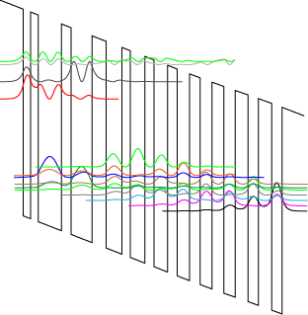
QCL design
Extraction barrier
e⁻
Injection barrier
Electron injection
e⁻
Active region
Injector
Alfredo Bismuto
14.07.2014
42

Slide 43
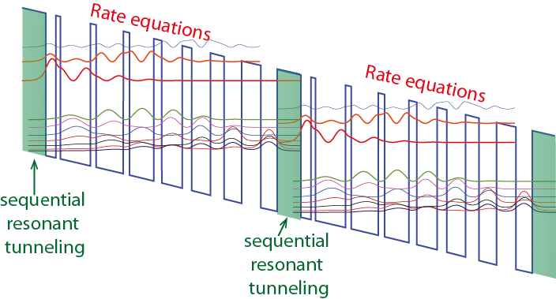
Design tool
Density matrix formalism
Reliable in the whole Mid-IR range
Able to predict optical
power-current-voltage curves
¹ H. Willenberg et al., Phys. Rev. B. 67, 085315 (2003)
² R. Terazzi et al., New J. Phys. 12, 033045 (2010)
Alfredo Bismuto
14.07.2014
43

Slide 44
Quantum cascade laser
The scattering mechanisms implemented in the computation
LO-Phonons
Interface roughness
Alloy disorder
Ionized impurities (Dopants)‏
Missing interactions:
Electron-electron
LA-Phonon
Program input parameters
waveguide losses
laser width
laser length
¹ Unuma et al., J. Appl. Phys. 93, 1586 (2003)
Alfredo Bismuto
14.07.2014
44

Slide 45
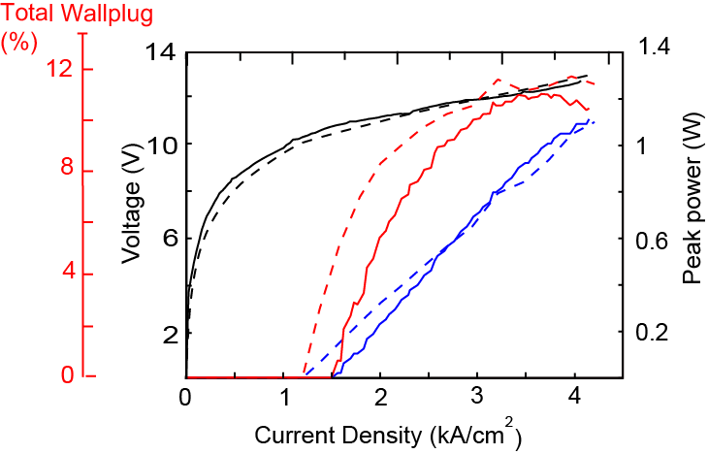
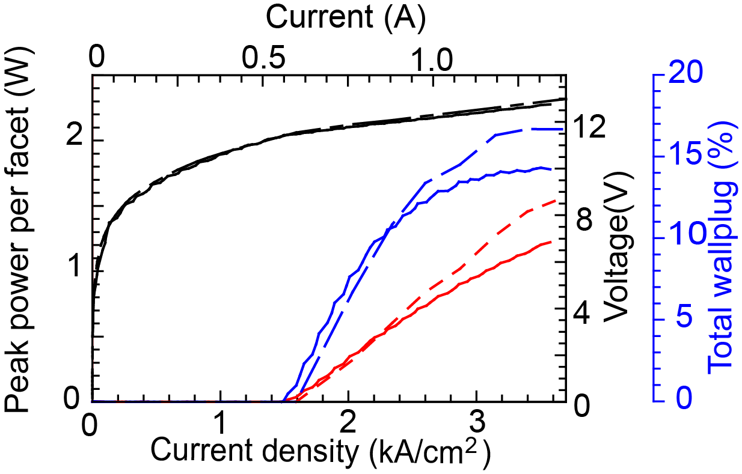
Examples
λ= 8.5 µm**
λ= 4.5 µm*
Reliable across the whole Mid-IR range (4-10 µm )
In the 3-4 µm range intervalley scattering missing
* A. Bismuto et al., Appl. Phys. Lett. 98, 091105 (2011)
** A. Bismuto et al., Appl. Phys. Lett. 96, 141105 (2010)
Alfredo Bismuto
14.07.2014
45

Slide 46
Toward genetic optimization
Simulation tool able to predict actual laser performance
Too many parameters to control manually (~20 layers)
Use of genetic algorithms (fully automized)
Merit function selection
Wallplug efficiency
Use of ETH Cluster (BRUTUS, 10000 cores)
Currently using Amazon cloud service
QCL designer
Now processing..
80%..
Alfredo Bismuto
14.07.2014
46

Slide 47
Toward genetic optimization
Starting point: Bound to continuum design at 4.6 µm
Q. Yang et Al., Appl. Phys. Lett. 93, 251110 (2008)
Random variation of the reference design
(less than 20%)
Best designs used to create the new
population (Darwin’s law)
33000 individuals per population
32 designs selected to create the new
generation
A. Bismuto et al., APL 101, 021103 (2012)
Alfredo Bismuto
14.07.2014
47

Slide 48
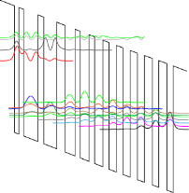


Toward genetic optimization
....
optimized
design
1st generation
2nd generation
3rd generation
....
Alfredo Bismuto
Alfredo Bismuto
14.07.2014
48
48

Slide 49


Merit function: Wallplug efficiency
Unstable pathological structures were excluded
(e.g. coherent transport of electrons over unphysical lengths)
Structure in the average position of the best generation selected
A. Bismuto et al., APL 101, 021103 (2012)
Alfredo Bismuto
14.07.2014
49

Slide 50


Designs comparison
Emission wavelength kept constant
Lower alignement voltage, higher gain
A. Bismuto et al., APL 101, 021103 (2012)
Alfredo Bismuto
14.07.2014
50

Slide 51
Designs comparison
Alfredo Bismuto
14.07.2014
51

Slide 53


Light-current-voltage
Simulations
Measurements
Lower alignment voltage
8.5 µm wide, 4.9 mm long laser
Higher power
Smaller threshold
A. Bismuto et al., APL 101, 021103 (2012)
Alfredo Bismuto
Alfredo Bismuto
14.07.2014
53
53

Slide 54



Wallplug improvement
The optimized design shows
higher efficiency
growth optimization has to be performed
also on the optimized design
A. Bismuto et al., APL 101, 021103 (2012)
Alfredo Bismuto
Alfredo Bismuto
14.07.2014
54
54

Slide 55
Wallplug improvement
The optimized design shows
higher efficiency
growth optimization has to be performed
also on the optimized design
A. Bismuto et al., APL 101, 021103 (2012)
Alfredo Bismuto
Alfredo Bismuto
14.07.2014
55
55

Slide 56
Wallplug improvement
The optimized design shows
higher efficiency
growth optimization as to be performed
also on the optimized design
A. Bismuto et al., APL 101, 021103 (2012)
Alfredo Bismuto
Alfredo Bismuto
14.07.2014
56
56
56

Slide 57
Quantum cascade laser
The scattering mechanisms implemented in the computation
LO-Phonons
Interface roughness
Alloy disorder
Ionized impurities (Dopants)‏
Interface roughness has
a major impact on laser
performance
How to improve the quality of the interfaces...
¹ Unuma et al., J. Appl. Phys. 93, 1586 (2003)
Alfredo Bismuto
14.07.2014
57

Slide 58


Epitaxy: Interfaces
STM cross-section
Cut across interfaces
Interfaces are
graded (over 3-4ML)
rough
P. Offerman et al., Appl. Phys. Lett. 83, 4131 (2003)
Alfredo Bismuto
14.07.2014
58

Slide 59



Interface roughness
Most relevant scattering mechanism in mid-IR quantum cascade lasers
average step
height
correlation
length
Historically, focused on the minimization of
the emission broadening
Recently high performance broad gain
lasers were presented ^{1,2}
..Is emission broadening the right parameter?
¹ A.Bismuto et al., Appl. Phys. Lett. 96, 141105 (2010)
² Y. Yao et al., New J. Phys. 97, 081115 (2010)
³ Unuma et al., J. Appl. Phys. 93, 1586 (2003)
Alfredo Bismuto
14.07.2014
59

Slide 60

How to modify the correlation length?
Growth temperature
Correlation length (Λ)
Smaller effect temperature dependence of step height (Δ)
4.6 µm
Same processing
T=475 °C
T=515 °C
T=525 °C
three wells design
Diagonal design more sensitive to the interface roughness
Alfredo Bismuto
14.07.2014
60

Slide 61

How to modify the correlation length?
Growth temperature
Correlation length (Λ)
Smaller effect temperature dependence of step height (Δ)
Same processing
T=475 °C
T=515 °C
T=525 °C
Growth conditions are modified to systematically
vary interface roughness
Alfredo Bismuto
14.07.2014
61

Slide 62




Simulated performance
FWHM luminescence
Current at roll-over
Slope efficiency
Threshold current density
¹ A.Bismuto et al., Appl. Phys. Lett. 98, 091105 (2011)
Alfredo Bismuto
14.07.2014
62

Slide 63
Simulated performance
FWHM luminescence
Current at roll-over
Slope efficiency
Threshold current density
Model fails to predict emission linewidths
¹ A.Bismuto et al., Appl. Phys. Lett. 98, 091105 (2011)
Alfredo Bismuto
14.07.2014
63

Slide 64
Simulated performance
Model fails to predict emission linewidths
FWHM luminescence
Current at roll-over
Slope efficiency
Threshold current density
Best laser performance for Λ ~ 90 A
¹ A.Bismuto et al., Appl. Phys. Lett. 98, 091105 (2011)
Alfredo Bismuto
14.07.2014
64

Slide 65


How to justify laser behavior ?
Lifetimes
Population inversion
Lower lasing state shows a minimum
corrisponding to best laser performance
Population inversion
shows a maximum
resonance corresponding to qΛ~1
(q exchanged wavevector during intersubband transition)
(transition energy of 34 meV)
Alfredo Bismuto
14.07.2014
65

Slide 66

Best sample
Light-current-voltage
J_{th} vs. Temperature
Simulated curves (dashed)
Measured curves
Alfredo Bismuto
14.07.2014
66

Slide 67






QC lasers and electronics
Bare chips
NS
AlN submount (3x6mm)
TC3
Driver kits
Alfredo Bismuto
08.09.2014
67

Slide 68


Low-dissipation DFB devices at 4.5 m
    opt power up to 48mW
    P_{el} max ~1.4W
Alfredo Bismuto
08.09.2014
68

Slide 69


Low-dissipation DFB devices at 5.25m
    very low threshold power : 0.31W
    P_{el max} < 0.75W
Alfredo Bismuto
08.09.2014
69

Slide 70


Fabrication process
Front facet
Buried grating
Electroplated Au
InP
Insulating
InP
AR
InGaAs
Insulating
InP
InP
Most of QCLs have 5-15 W of electrical dissipation
Up to 100 W are needed to control the temperature
*Courtesy of B. Hinkov, ETHZ
Alfredo Bismuto
08.09.2014
70

Slide 71

BH Fabrication process
Importance of the fabrication process:
Optical losses
Thermal conductance
Device yield
Spectral purity (DFBs)
Alfredo Bismuto
08.09.2014
71

Slide 72
Let Us Meet Again
We welcome all to our future group conferences of Omics group international
Please visit:
www.omicsgroup.com
www.Conferenceseries.com
http://optics.conferenceseries.com/

