Slide 1
Erythema gyratum repens secondary to acute myeloblastic leukemia
Presented by Alexandre Malek MD
Infectious Diseases Department
Saint Joseph University, Faculty of Medicine/ Hotel Dieu de France Hospital, Beirut, Lebanon

Slide 2
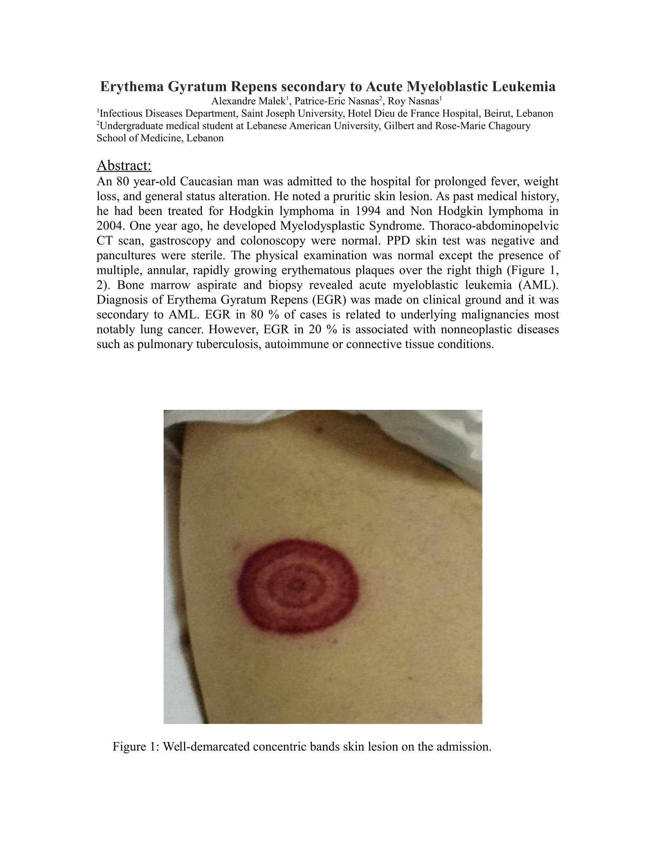

Slide 3
Plan
Case Presentation
Review of Literature
References

Slide 4
Case Presentation
An 80 year-old Caucasian man
Prolonged fever, weight loss, and general status alteration
Pruritic skin lesion

Slide 5
Past Medical History
Hodgkin lymphoma treated in 1994.
Non Hodgkin lymphoma treated in 2004.
Myelodysplastic Syndrome since one year.

Slide 6
Past surgical history: None
Past social history: Ex-smoker
Allergies: No known drugs or food allergies
Home Medications: Paracetamol
No recent travel
No history of contact with sick persons
ROS: Nothing to mention, except skin pruritic lesion

Slide 7
Physical examination
Vital signs:
HR: 96/min BP: 100/60 mmHg Temp: 38.8°C SpO2: 97% RR: 18/min
Patient was conscious, cooperate, and oriented
Heart, Pulmonary, and abdominal exams were unremarkable
No palpable lymph nodes (Cervical, axillary, Supraclavicular, inguinal, and femoral)
Musculoskeletal exam: normal
Cutaneous examination: Presence of concentric, annular erythematous bands on the right thigh (Image 1,2)

Slide 8
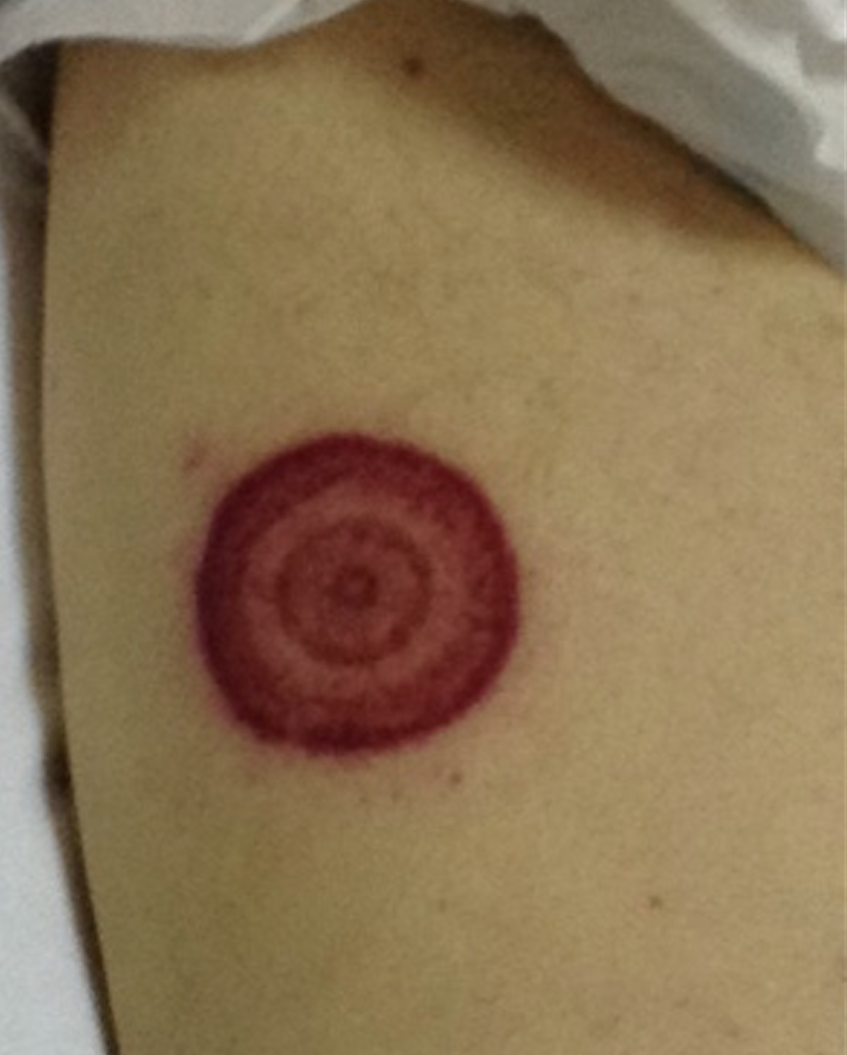
Skin image 1: On admission
Well-demarcated concentric bands skin lesion

Slide 9
Laboratory exam
WBC: 18000 x 10⁹/L ESR 65 mm/hr CRP 40 mg/L
Hbg: 10 g/dl Hct 30%
Platelets: 65000 x 10⁹/L
Coagulation studies: Normal
BUN/Creatinine/Liver Function tests: normal
Multiple Blood cultures, urine culture: Sterile
Viral and Bacterial Serology (HIV, HBV, HCV, HSV1-2, Lyme disease): Negative
Autoimmune antibodies panel: Negative
Quantiferon and PPD skin test: Negative
ETT: No Valvular vegetation

Slide 10
Thoraco-abdominopelvic CT scan
Hepatosplenomegaly
No lymph nodes
No Lungs lesions or nodules
No intestinal lesions
No deep abscess

Slide 11
Work up for Bicytopenia
Peripheral blood smear: Revealed 40% of circulating Blast cells
Bone marrow aspiration and biopsy: Confirm the diagnosis of:
Acute Myeloblastic Leukemia, M2 Subtype

Slide 12
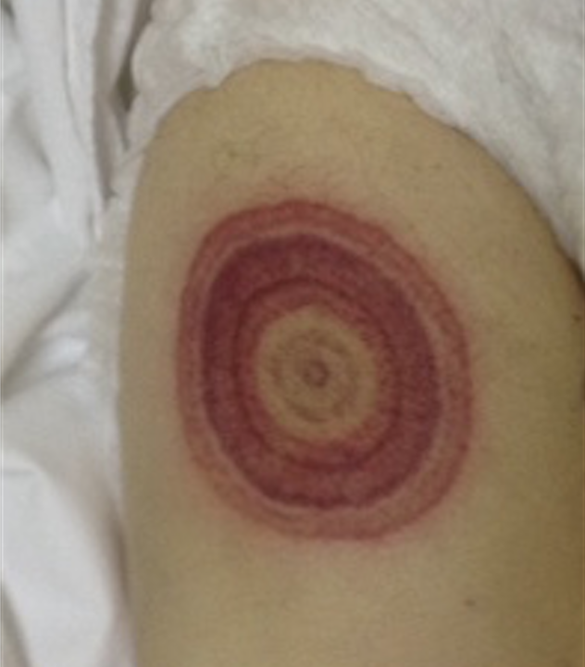
Day 2 Evolution of skin lesion
Rapidly growing serpiginous erythematous bands

Slide 13
Clinical diagnosis of:
Erythema gyratum repens
(EGR)

Slide 14
Work-up for EGR and treatment
Gastroscopy: Normal ( No esophageal tumor)
Colonoscopy: Normal
Treatment by chemotherapy for AML is considered.

Slide 15
Review of Literature
Introduction:
The first case of EGR was described by Gammel et al. in 1952 in woman who presented with pruritic skin eruption associated with breast cancer
The rash is characterized by multiple concentric erythematous bands, with a wood grain appearance and scaling edge. It affects mainly the trunk and extremities sparing hands, feet and face
Sometimes, rash is rapidly growing by 1 cm/day along with serpiginous pattern.
Pruritus may be a prominent symptom

Slide 16
The pathophysiology of erythema gyratum repens is unknown, although an immune response is postulated.
The cutaneous eruption may precede, occur with, or follow the diagnosis of malignancy.

Slide 17
Diagnosis
Based on clinical ground and characteristic skin lesion
No specific microscopic features on skin biopsy: Focal parakeratosis, mild hyperkeratosis, acanthosis, spongiosis and a superficial perivascular lymphocytic infiltrate
Biopsy is useful to rule out other possible mimicking annular diseases.

Slide 18
EGR related disorder
Erythema gyratum repens in 82% of cases is secondary to internal malignancy
It is most commonly associated with bronchial, esophageal, and breast cancer
Eubanks, Leigh Ellen, Elizabeth Mcburney, and Richard Reed. "Erythema gyratum repens." American Journal of the Medical Sciences 321.5 (2001): 302-305.

Slide 19
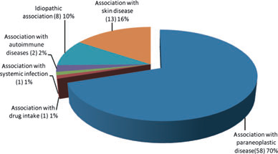
Conditions associated with erythema gyratum repens (83 cases)
Rongioletti, Franco, V. Fausti, and Aurora Parodi. "Erythema gyratum repens is not an obligate paraneoplastic disease: a systematic review of the literature and personal experience." Journal of the European Academy of Dermatology and Venereology 28.1 (2014): 112-115.

Slide 20
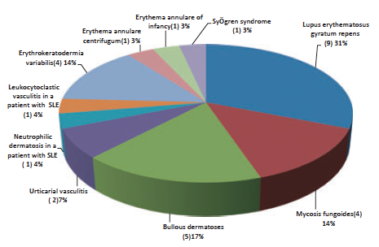
Diseases mimicking erythema gyratum repens (29 cases)
Rongioletti, Franco, V. Fausti, and Aurora Parodi. "Erythema gyratum repens is not an obligate paraneoplastic disease: a systematic review of the literature and personal experience." Journal of the European Academy of Dermatology and Venereology 28.1 (2014): 112-115.

Slide 21
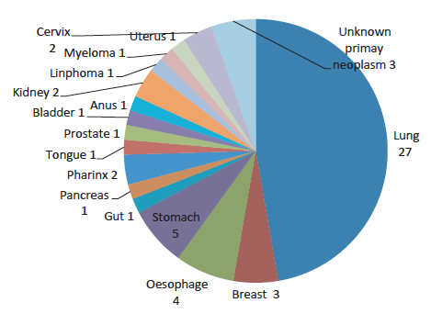
Neoplasms associated with EGR (58 cases)
Rongioletti, Franco, V. Fausti, and Aurora Parodi. "Erythema gyratum repens is not an obligate paraneoplastic disease: a systematic review of the literature and personal experience." Journal of the European Academy of Dermatology and Venereology 28.1 (2014): 112-115.

Slide 22
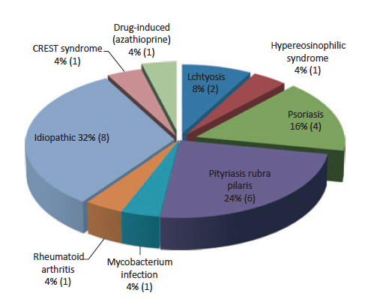
Diseases associated with non-paraneoplastic erythema gyratum repens (25 cases)
Rongioletti, Franco, V. Fausti, and Aurora Parodi. "Erythema gyratum repens is not an obligate paraneoplastic disease: a systematic review of the literature and personal experience." Journal of the European Academy of Dermatology and Venereology 28.1 (2014): 112-115.

Slide 23
Treatment
The management principle of EGR is the treatment of underlying disorder
Different dermatologic and immunosuppressive therapies have been used to treat EGR
Systemic steroids are frequently ineffective
Topical steroids, vitamin A, and azathioprine have also failed to relieve skin manifestations

Slide 24
Improvement often correlates with successful treatment of underlying disease

Slide 25
Conclusion
To the best of our knowledge and based of literature, our patient’s case is the first case reported of:
Erythema Gyratum Repens secondary to Acute Myeloblastic Leukemia

Slide 26
References
1- Gammel, John A. "Erythema gyratum repens: skin manifestations in patient with carcinoma of breast." AMA archives of dermatology and syphilology 66.4 (1952): 494-505
2- Gore, Marina, and Michael E. Winters. "Erythema gyratum repens: A rare paraneoplastic rash." Western Journal of Emergency Medicine 12.4 (2011): 556.
3-Appell, Melanie Lewitt, William Q. Ward, and Stephen K. Tyring. "Erythema gyratum repens a cutaneous marker of malignancy." Cancer 62.3 (1988): 548-550.
4-Campbell, Lauren, et al. "Erythema gyratum repens without associated malignancy." Journal of the American Academy of Dermatology 65.1 (2011): e22-e23
5-Eubanks, Leigh Ellen, Elizabeth Mcburney, and Richard Reed. "Erythema gyratum repens." American Journal of the Medical Sciences 321.5 (2001): 302-305.
6-Rongioletti, Franco, V. Fausti, and Aurora Parodi. "Erythema gyratum repens is not an obligate paraneoplastic disease: a systematic review of the literature and personal experience." Journal of the European Academy of Dermatology and Venereology 28.1 (2014): 112-115.

Slide 27

Thank you for your attention

