Slide 1
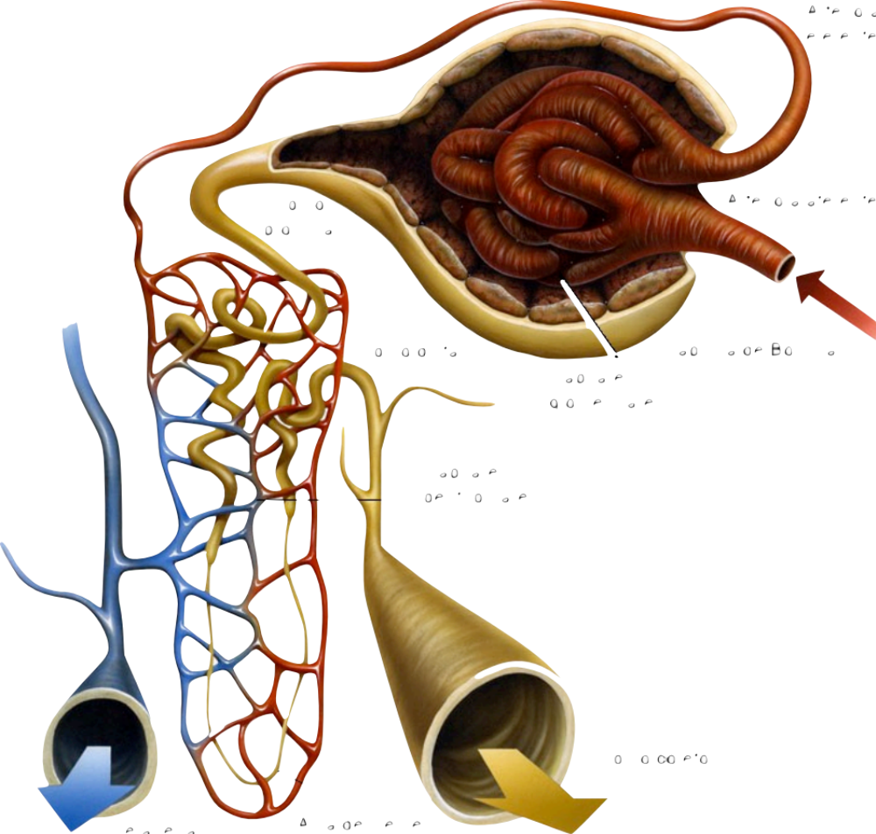
Renal Function after Coronary Artery Bypass Graft Using Dexmedetomidine
MD PhD Alexandre Fabricio Martucci
MD PhD Yara Marcondes Machado Castiglia
No conflicts
Open Journal of Anesthesiology, 2013, 3, 421-426
Notes:
Good morning, I appreciate the invitation and the presence of you all. My name is Alexandre, I am here to present my work, Renal function after coronary artery bypass graft using dexmedetomidine

Slide 2
Introduction
Renal Function is often compromised after CABG - Incidence is up to 31%
The need for RRT is around1%
Compromised renal function increases morbidity and mortality
Stallwood et al., 2004; Tolpin et al., 2011

Slide 3
Pathophysiology
Causes
  Low Cardiac Output
  Hypoperfusion e renal ischaemia
  Non pulsatile flow (CPB)
  Hypothermia and rewarming
  Vascular small thrombus
  Inflammatory response
  Diabetes Mellitus
  Age above 65 years
  Emergency Surgery
Sear, 2005; Rosner & Okusa, 2006; Nussmeier et al., 2009
Notes:
The pathophysiology includes: Cardiopulmonary Bypass

Slide 4
Cardiopulmonary Bypass
SIRS
Hypothermia
pH
Circuits and membranes
Hypotension
Non-pulsatile flow
Hemodilution
Sear, 2005; Nussmeier et al., 2009
Notes:
The cardiopulmonary bypass is known as responsible for SIRS, including products that may be deleterious to the kidneysuch as endotelin, elastase, free radicals superoxides. Even hemodilution can contribute for some kind of kisney damage

Slide 5
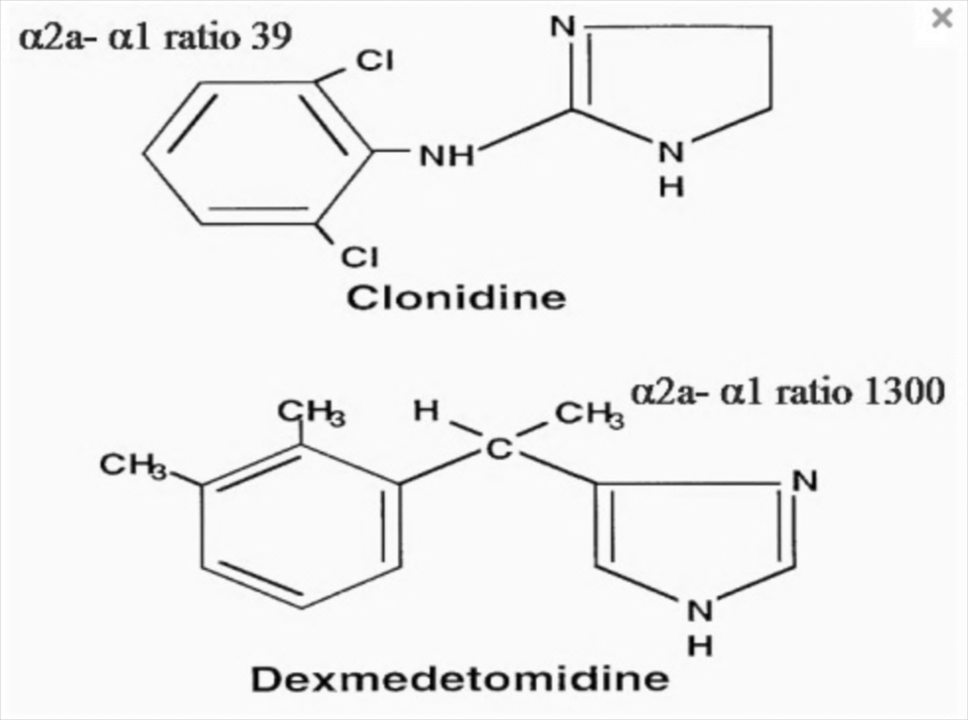
Dexmedetomidine (DEX)
D-enantiomer of medetomidine
α-2:α-1 -1600:1
Do not interact with GABA – less respiratory effects than other anesthetics
0.2 to 0.7 mcg/kg/h
Half-life – 1.5h
Notes:
Initial bolus of 1mcg/kg in 10 minutes has been associated to bradycardia and hipotension

Slide 6
Dexmedetomidine (DEX)
Sedation, anxiolysis, analgesia e hypnosis
⬇ serum concentration (NA e Adr)
Good hemodynamic stability
⬆ urinary output
Cloud eventually have protective effects
Jalonen et al., 2007; Marangoni et al., 2007; Gu et al., 2011
Notes:
Gu and coleagues, usng rats, showed organ protection for ischaemia
There is few clinical studies with DEX
There was thoug one big studt using clonidin

Slide 7
Kulka et al., 1996
Clonidine
α-2 agonist
4mcg/kg IV (high dose)
⬇ Sympathetic response
⇧ urinary flow
Maintain [ADH]
⇧ Creatinine Clearance at first night
3rd night - clearances were the same
Notes:
A clonidina é menos potente que a dex em sua afinidade alfa 2 com uma relação de aprox 200:1.
Kulka e col estudaram a clonidina na dose de
Isso pode acontecer porque o alfa 2 inibe a ação do ADH e asYes aumenta a excreção de água livre, dando uma falsa impressão de melhora na função renal, já que na terceira noite os clearances eram iguais.

Slide 8
New Biomarkers
KIM -1(Kidney Injury Molecule)
NAG (N-acetyl-B-D-glucosaminidase)
NGAL (Neutrophil Gelatinase Associated Lipocalin)
IL-18 (Interleucine 18)
Cistatin C
AKI is still defined by serum creatinine and urinary output
Notes:
New biomarkers have been studied, like KIM 1, Nag, Ngal, IL-18, Cistatin C, the problem is that AKI definition is still based on SCr and urinary output

Slide 9
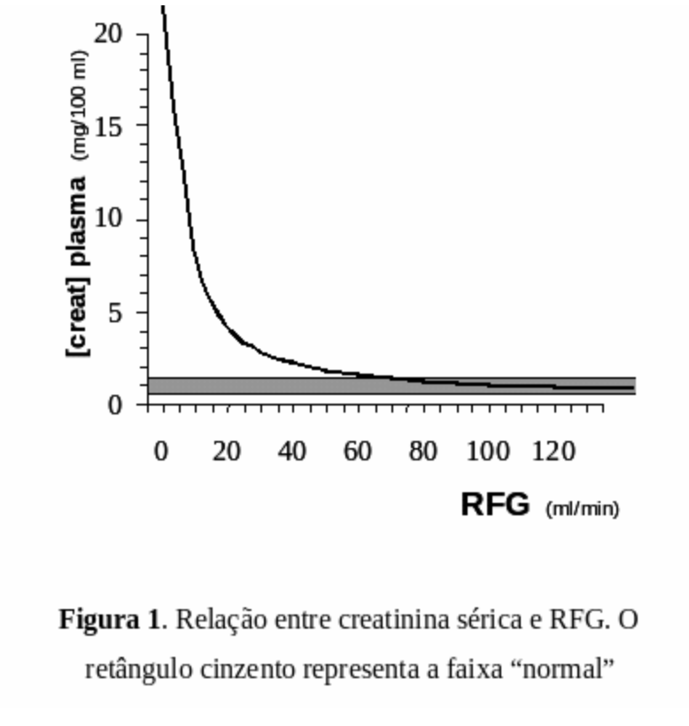
Creatinine
Serum Creatinine
  Filtered
  Secreted – small amounts
  Not reabsorbed
  Late biomarker
Oliguria – 400mL/d
Notes:
Low cost, easy measurement, but it is a late biomarker
Oliguria is another clinical data that may contribute to the diagnosis of AKI, but it’s absence does not exclude the diagnosis
Apparently, 400mL per day is the minimum necessary to eliminate urea, sodium and potassium
In this graph we can see that small elevations on SCr means a substantial loss in GFR

Slide 10
Renal Function
ARI – Significative Loss of renal function
AKI – Wider concept
Notes:
Acute renal insuficiency is different than AKI. When we study renal function we find both definitions. ARI means Significative Loss of renal function. Means that the patient kidneys are unable do their daily function
But, not all patients with kidney impairment are in ARI
AKI – is a wider concept

Slide 11
Acute Kidney Injury Network (AKIN)
AKIN criteria
Stage | Serum creatinine | Diuresis
1 | ⇧ Of serum creatinine ≥ 0.3mg/dL or value higher than 150 to 200% | < 0.5mL/kg/h longer than 6h
2 | ⇧ Of serum creatinine ≥ 200 a 300% | < 0.5mL/kg/h longer than 12 h
3 | ⇧ serum creatinine > 300% | < 0.3 mL/kg/h longer than 24h or anuria longer than 12 h
Mehta et al., 2007
Notes:
A definição mais recente de AKI foi desenvolvida pela AKIN e publicada pela primeira vez neste trabalho do Dr Ravindra Mehta. E colab
Esta definição usa variações da creatinina e do débito urinário para classificar a AKI em 3 estágios
Estágio 1...
Estágio 2
Estágio 3

Slide 12
Purpose
Evaluate the renal function after CABG using DEX

Slide 13
Method
Ethics Commitee
Written informed consent was waived - retrospective
Groups
G_{control} – No CPB and no DEX
G_{DEX} – No CPB with DEX
G_{CPB} – Patients with CPB and no DEX
G_{CPB+DEX} – Patients with CPB and DEX
Notes:
Dex has been added to anaesthesia protocol in 2011 and by the end of the year we collected the data to perform this work
We divided the patients in 4 groups according to DEX and Cardio Pulmonary Bypass

Slide 14
Methods
Data were collected by reviewing electronic records
Included
  All patients submitted to CABG between 2008 e 2011
Excluded
  Emergncy surgery
  CAT < 72h
  α2 agonists use
  Patients – SCr ≥ 2.0mg/dL before surgery
  Incomplete data
Notes:
Fizemos coleta de dados através de prontuário eletrônico
Between january 2008 and december 2011

Slide 15
Monitoring
ECG
SO2
Capnography
Gas Analyzer
Invasive Arterial Pressure (MAP)
Central venous pressure
Temperature
Urinary output

Slide 16
Anaesthesia
Protocol
Groups w/o DEX
  Venous line
  3 to 5 mg of midazolam
  Radial arterial line (MAP)
  20 to 30 mcg/kg of fentanil, etomidate 0.3mg/kg and pancuronium 0.08mg/kg
  Maintenance with isoflurane titrated according to hemodynamic response

Slide 17
Anaesthesia
Protocol
Groups w/o DEX
  Venous line
  3 to 5 mg of midazolam
  Radial arterial line
  DEX 0.5mcg/kg/h
  10 to 20 mcg/kg of fentanil, etomidate 0.3mg/kg and pancuronium 0.08mg/kg
  Maintenance with isoflurane titrated according to hemodynamic response

Slide 18
Anaesthesia
MAP was kept between 60 to 90mmHg
Short episodes of hypotension were treated with small bolus of ephedrine or metaraminol
Longer episodes were treated with noradrenaline - continuous infusion
Hyipertension and isoflurane > 1.3 CAM were treated with nitroglycerine or nitroprusside

Slide 19
Method
Measured de Scr at 4 time points
  Before surgery (control) - Mpre
  MiPO
  PO 24h
  PO 48h
Difference CrS ≥ 0.3mg/dL = AKi +
Difference CrS < 0.3mg/dL= AKI –
Urinary output was not evaluated
Notes:
The method is very easy, whenever there was a serum creatinine difference greater than 0.3, we considered AKI + and urinary output was not evaluated beacause of missing data

Slide 20
Creatinine
Men - 1.3mg/dL – 115µmol/L
Women – 1.1mg/dL – 97µmol/L
Poor kidney outcome when CrS> 2.0mg/dL - 177µmol/L
We also assessed risk for AKI in patients with altered preoperative SCr (values between 1.1 mg/dl and 2.0 mg/dl for women or 1.3 mg/dl and 2.0 mg/dl for men) compared to patients with normal SCr
Hirose et al., 2001; Stafford-Smith et al., 2009
Notes:
We know that SCr values are different for men and women, up to 1,3 and 1,1Nós sabemos que os valores normais de creatinina são de até 1,3 nos homens e até 1,1 nas mulheres
Segundo esse trabalho de Hirose de 2001 e com referência do próprio Miller neste capítulo do Stafford Smith em 2009, Pacientes com creatinina sérica maior que 2,0mg tem maiores chances de complicações renais comparado com pacientes com creatinina sérica menor. Parece que 2,0mg é ponto de corte razoável para de pior prognóstico renal.
----- Meeting Notes (25/02/13 08:16) -----
AsYes eliminamos todos os pacientes do estudo com creatinina maior que 2,0 e testamos se aqueles pacientes com creatinina alterada, valores entre 1,1 para mulheres e 1,3 para homens teve influência na incidência de AKI
15 min

Slide 21
Análise Estatística
The statistical analysis aimed to test whether there was significant difference in incidence of AKI when using DEX, thus we separated patients who underwent CPB from those who did not. We considered Student t-test for independent samples in comparing two groups with re-spect to quantitative variables. We considered Fisher exact and Chi-square tests in assessing the association between qualitative variables. Values were considered statistically significant at p < 0.05

Slide 22
Results and Discussion
Evaluated 543 patients
Excluded 257
Distributed 286 in 4 grupos
  G_{control} w/o CPB and w/o DEX 55
  G_{DEX} w/o CPB and w/ DEX 24
  G_{CPB} CPB and w/o DEX 157
  G_{CPB+DEX} CPB and DEX 50

Slide 23
Excluded | n
Emergency surgery | 25
Reoperation same day | 2
Absent Creatinine 24h | 25
Absent Creatinine 48h | 70
Absent Creatinine before surgery | 5
Death up to 48h | 23
Cat < 72h before surgery | 76
Serum Creatinine ≥ 2,0mg/dL | 29
Alfa-2 agonists use | 1
Other incomplete data | 2

Slide 24
‪Homogeneity‬
H‪omogeneity‬
‬CrS before surgery
  Age
  Weight
  Gender
  Hypertension
  DM

Slide 25
‪Homogeneity‬ pre-operatory SCr
W/ CPB
  Student t-test
SCr Pre-operatory
DEX | n | Average | Median | Std Deviation
No | 157 | 1.20 | 1.18 | 0.28
Yes | 50 | 1.14 | 1.15 | 0.24
p= 0.171
W/O CPB
  Student t-test
SCr Pre-operatory
DEX | n | Average | Median | Std Deviation
No | 55 | 1.11 | 1.10 | 0.28
Yes | 24 | 1.08 | 1.13 | 0.23
p= 0.649

Slide 26
Homogeneity for Age
W/ CPB
  Student t-test
Age
DEX | n | Average | Median | Std Deviation
No | 157 | 64 | 64 | 9.0
Yes | 50 | 64.4 | 65 | 9.8
p= 0.755
W/O CPB
  Student t-test
Age
DEX | n | Average | Median | Std Deviation
No | 55 | 61.8 | 65 | 11.9
Yes | 24 | 65.5 | 67 | 7.2
p= 0.097

Slide 27
Homogeneity for Weight
W/ CPB
  Student t-test
Peso
DEX | n | Average | Median | Std Deviation
No | 157 | 74.7 | 73 | 13.4
Yes | 50 | 72.8 | 72.5 | 11.7
p= 0.347
W/O CPB
  Student t-test
Peso
DEX | n | Average | Median | Std Deviation
No | 55 | 73.8 | 73 | 13.8
Yes | 24 | 73.2 | 72.5 | 15.7
p= 0.862

Slide 28
Homogeneity for Gender
W/ CPB
  Qui-square
W/O CPB
  Qui-square
SEXO
DEX | Female | Male
No | 51 32.5% | 106 67.5%
Yes | 20 40% | 30 60%
p= 0.330 | 71 pcts | 136 pcts
SEXO
DEX | Female | Male
No | 27 49.1% | 28 50.9%
Yes | 10 41.7% | 14 58.3%
p= 0.543 | 37 pcts | 42 pcts

Slide 29
Homogeneity for Hypertension
W/ CPB
  Qui-square
W/O CPB
  Fisher
Hypertension
DEX | No | Yes
No | 18 11.5% | 139 88.5%
Yes | 7 14% | 43 86%
p= 0.632 | 25 pcts | 182 pcts
Hypertension
DEX | No | Yes
No | 4 7.3% | 51 92.7%
Yes | 3 12.5% | 21 87.5%
p= 0.699 | 7 pcts | 72 pcts

Slide 30
Homogeneity for DM
W/ CPB
  Qui-square
W/O CPB
  Qui-square
DM
DEX | No | Yes
No | 104 66.2% | 53 33.8%
Yes | 29% 58% | 21 42%
p= 0.290 | 133 pctes | 74 pctes
DM
DEX | No | Yes
No | 44 80% | 1 20%
Yes | 15 62.5% | 9 37.5%
p= 0.100 | 59 pctes | 20 pctes

Slide 31
Association between Gender and AKI
W/ CPB
  Qui-square
W/O CPB
  Fisher
Gender
AKI | Female | Male
No | 56 78.9% | 106 77.9%
Yes | 15 21.1% | 30 22.1%
p= 0.877 | 71 pctes | 136 pctes
Gender
AKI | Female | Male
No | 33 89.2% | 40 95.2%
Yes | 4 10.8% | 2 4.8%
p= 0.411 | 37 pctes | 42 pctes

Slide 32
Association between altered CrS and AKI
Com CPB
  Qui-square
Sem CPB
  Fisher
SCr Pre-operatory
AKI | Altered | Normal
No | 58 75.3% | 104 80%
Yes | 19 24.7% | 26 20%
p= 0.431 | 77 pcts | 130 pcts
SCr Pre-operatory
AKI | Altered | Normal
No | 21 95.5% | 52 91.2%
Yes | 1 4.5% | 5 8.8%
p= 0.672 | 22 pcts | 57 pcts

Slide 33
Association between Hypertension and AKI
W/ CPB
  Qui-square
W/O CPB
  Fisher
Hypertension
AKI | No | Yes
No | 22 88% | 140 76.9%
Yes | 3 12% | 42 23.1%
p= 0.208 | 25 pctes | 182 pctes
Hypertension
AKI | No | Yes
No | 7 100% | 66 91.7%
Yes | 0 0% | 6 8.3%
p= 1,00 | 7 pctes | 72 pctes

Slide 34
Association between DM and AKI
W/ CPB
  Qui-quadrado
W/O CPB
  Fisher
DM
AKI | No | Yes
No | 105 78.9% | 57 77%
Yes | 28 21.1% | 17 23%
p= 0.748 | 133 pctes | 74 pctes
DM
AKI | No | Yes
No | 53 89.8% | 20 100%
Yes | 6 10.2% | 0 0%
p= 0.195 | 59 pctes | 20 pctes

Slide 35
Association between Weight and AKI
W/ CPB
  Student t-test
Weight
AKI | n | Average | Median | Std Deviation
No | 162 | 73.4 | 72 | 12.1
Yes | 45 | 77.4 | 78 | 15.4
p= 0.067
W/O CPB
  Student t-test
Weight
AKI | n | Average | Median | Std Deviation
No | 73 | 73.6 | 74 | 14.7
Yes | 6 | 73.2 | 69.5 | 9.0
p= 0.912

Slide 36
Association between Age and AKI
W/ CPB
  Student t-test
Age
AKI | n | Average | Median | Std Deviation
No | 162 | 63.7 | 64 | 9.4
Yes | 45 | 65.6 | 68 | 8.3
p= 0.224
W/O CPB
  Student t-test
Age
AKI | n | Average | Median | Std Deviation
No | 73 | 62.3 | 65 | 10.8
Yes | 6 | 71 | 71 | 5.4
p= 0.008

Slide 37
AGE
250g – 190g - 80 years elderly
Glomerular Sclerosis– 1/3 dos glomérulos aos 70 anos
⬇ do RFG – 140 para 77mL/min/1.73m²
1/3 envelhecimento bem sucedido, alterações podem ser evitáveis
Lindeman, 1985; Lindeman e Goldman, 1986
Notes:
Envelhecimento cursa com alterações renais. O peso médio renal de um adulto jovem passa de 250g para 190g em um paciente de 80 anos.
Em um paciente de 70 anos, cerca de 1/3 dos glomérulos sofreram esclerose
e a queda do ritmo de filtração glomerular é substancial, de 140 para cerca de 77ml/min/1,73m2
Porém, cerca de 1/3 dos pacientes tem um envelhecimento chamado bem sucedido, sugerindo que algumas dessas alterações possam ser de alguma forma evitáveis. Em nosso trabalho, como na literatura encontramos resultados de associação e No associação da idade com AKI pós operatória.

Slide 38
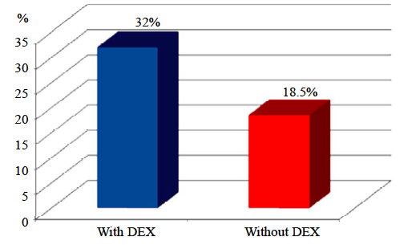
Patients with CPB
Percentage of acute kidney injury cases in patients who were submitted to CPB according to DEX use (p = 0.043; beta error of 0.273).
Notes:
O Resultado interessantísYeso deste trabalho, está nos próximos slides, nós encontramos maior incidência de AKI nos pacientes com uso de DEX tanto nos grupo com CPB quanto no grupo sem CPB
Neste slide, de pacientes com CPB, podemos perceber que a incidência de AKI nos pacientes que usaram DEX foi de 32% contra 18,5% nos pacientes que No usaram.
Nosso p=0,043 associado a um erro beta de 0,273 nos permite dizer que houve associação entre AKI e o uso de DEX para os pacientes com CPB

Slide 39
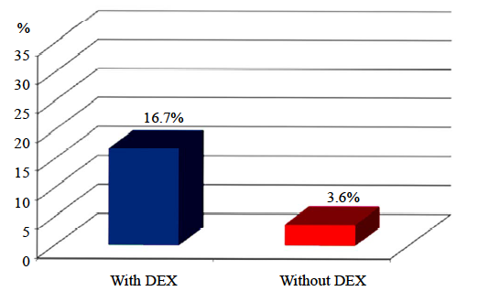
Patients without CPB
Percentage of cases with acute kidney injury (AKI) according to DEX use in patients who were not submitted CPB (p = 0.066; beta error of 0.831).
Notes:
Já, para os pacientes sem CPB, apesar de encontrarmos uma diferença razoável, de 16,7% contra 3,6%, encontramos um p=0,066. Isso seria suficiente para dizer que existe uma tendência a significância estatística se tivéssemos um erro beta menor.

Slide 40
Conclusion
In conclusion, albeit with a small sample, we observed that DEX behaved as an independent risk factor for in-creased incidence of Acute Kidney Injury after CABG in patients who used CPB. For the non-CPB group, our sample was too limited to reach a conclusion.

Slide 41
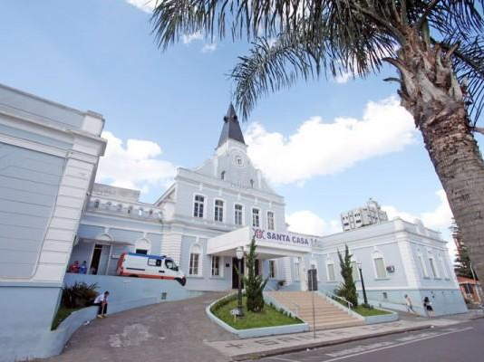

Slide 42

Thank you

