Slide 1
About OMICS Group
OMICS Group International is an amalgamation of Open Access publications and worldwide international science conferences and events. Established in the year 2007 with the sole aim of making the information on Sciences and technology ‘Open Access’, OMICS Group publishes 400 online open access scholarly journals in all aspects of Science, Engineering, Management and Technology journals. OMICS Group has been instrumental in taking the knowledge on Science & technology to the doorsteps of ordinary men and women. Research Scholars, Students, Libraries, Educational Institutions, Research centers and the industry are main stakeholders that benefitted greatly from this knowledge dissemination. OMICS Group also organizes 300 International conferences annually across the globe, where knowledge transfer takes place through debates, round table discussions, poster presentations, workshops, symposia and exhibitions.

Slide 2
About OMICS Group Conferences
OMICS Group International is a pioneer and leading science event organizer, which publishes around 400 open access journals and conducts over 300 Medical, Clinical, Engineering, Life Sciences, Phrama scientific conferences all over the globe annually with the support of more than 1000 scientific associations and 30,000 editorial board members and 3.5 million followers to its credit.
OMICS Group has organized 500 conferences, workshops and national symposiums across the major cities including San Francisco, Las Vegas, San Antonio, Omaha, Orlando, Raleigh, Santa Clara, Chicago, Philadelphia, Baltimore, United Kingdom, Valencia, Dubai, Beijing, Hyderabad, Bengaluru and Mumbai.

Slide 3
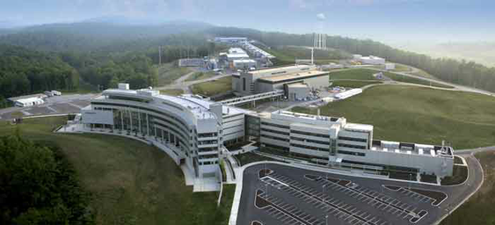

Atomically-resolved imaging of surfaces of complex oxide thin films grown by laser-MBE
Alexander Tselev
Oak Ridge National Laboratory,
Oak Ridge, TN, USA

Slide 4
What complex oxides offer
Superconductivity
Colossal magnetoresistance
Ferromagnetism (spintronics)
Ferroelectricity
Multiferroism
Metal-insulator transitions
Tunability by strain
Memristive bahavior
Can be integrated with existing Si-based technologies
Use in electrochemical energy storage and conversion systems
Notes:
Introduction. Symmetry breaking at interfaces between dissimilar materials is at the origin of many unique properties associated with complex oxides. With decreasing thickness, properties of ultrathin films are more and more determined by both surface and interface with the substrate. Functionality of many complex oxide materials even in bulk (e.g., those used in electrochemical systems) strongly depends on properties of the surface. Therefore, understanding and control of properties and interfaces is a key challenge in the complex oxide material science and physics.
SrRuO₃ is a complex oxide, metallic itinerant ferromagnet. It possesses a number of important physical properties, some of which are not fully understood, one example being thickness-dependent metal-to-insulator transition. On the other hand, SrRuO₃ is widely used as a bottom electrode material in devices based on perovskite-related oxides, such as ferroelectric non-volatile random access memory arrays. With demand for shrinking device size and, consequently, reduced ferroelectric film thickness, more nanoscale and atomic-level information is needed about SrRuO₃ surface properties to control interface of SrRuO₃ with layers on top of it and to correctly understand its influence on properties of devices and structures.
Thus far, there are no published successful attempts to image surface of SrRuO₃ with atomic resolution, except one recent work (J. Shin, et al., ACS Nano, 4, 4190 (2010)). Here, we report in situ STM imaging of PLD-grown SrRuO₃ thin films. The film growth conditions are nearly identical to those used for growth of bottom electrodes. Depending on slightly varying preparation conditions, we observe different structures on the surfaces of as-grown SrRuO₃ films.

Slide 5
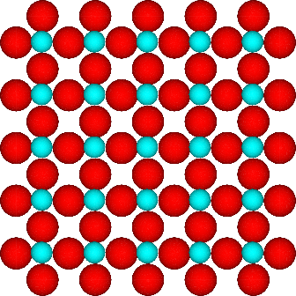
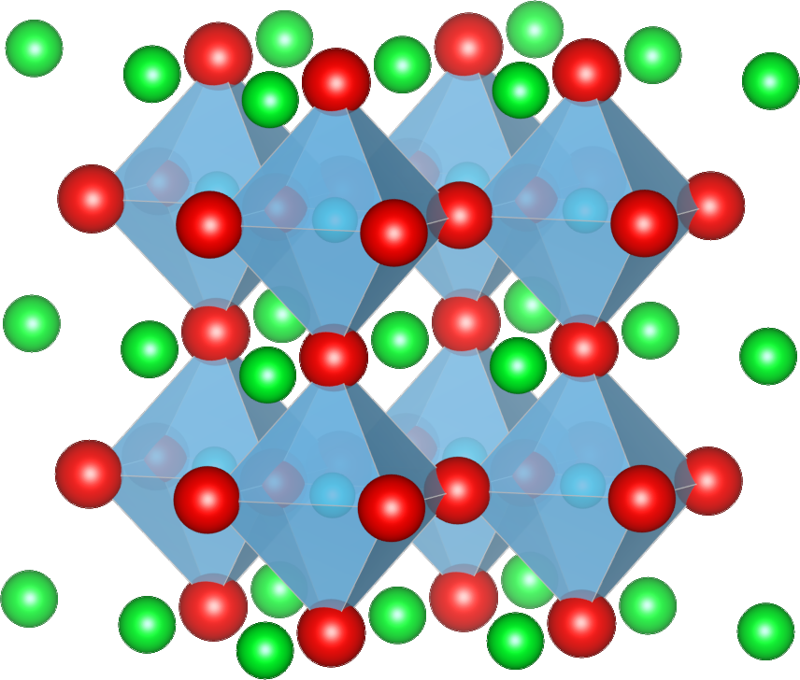
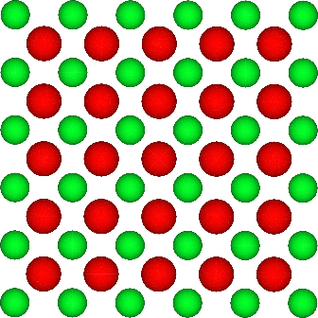
Perovskite structure
ABO₃
BO₂
AO
SrTiO₃

Slide 6
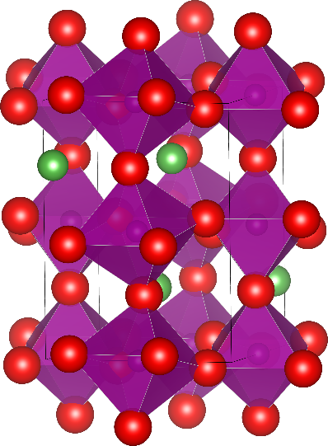
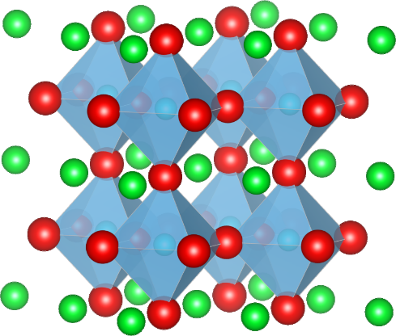
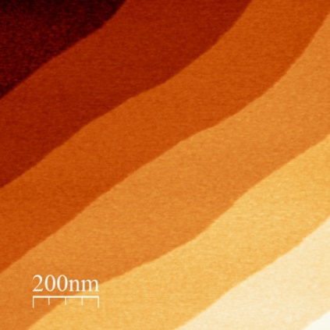
Epitaxial film growth
Growth at:
elevated substrate temperatures
650-850 °C &
in oxygen atmosphere 1-300 mTorr
LaMnO₃
B-terminated single-crystalline substrate
BO₂
SrTiO₃
Atomic force microscopy image
substrate

Slide 7
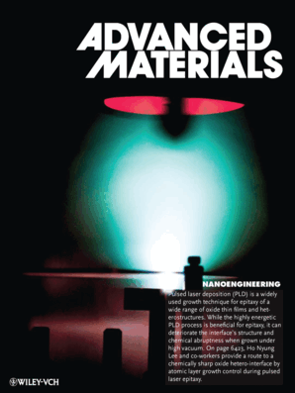
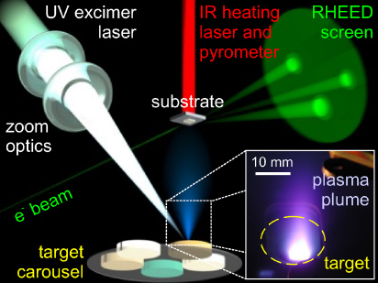
Pulsed Laser Deposition
Reflective High-Energy Electron diffraction
The schematic is from: M. Opel,
J. Phys. D 45, 033001 (2012)
Adv. Mat. cover Dec 2012, connected to a paper from an ORNL group

Slide 8
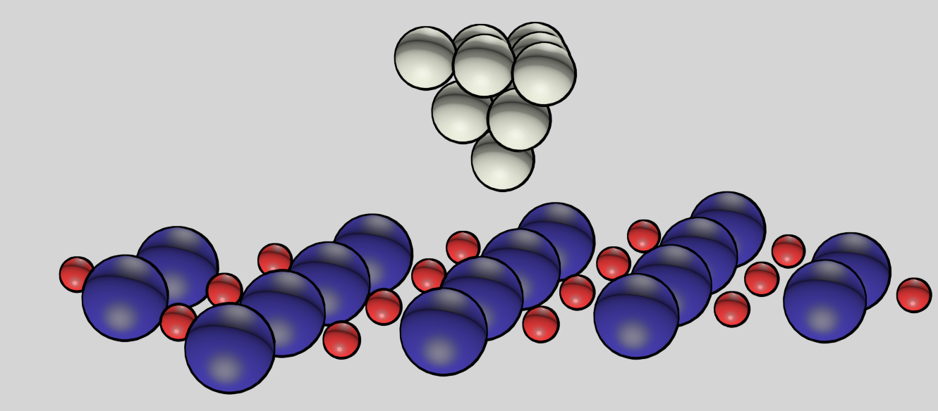
Scanning tunneling microscopy
A
STM tip
last atom
+
e⁻
-
Atomic resolution is generally very difficult to achieve on PLD-grown films

Slide 9
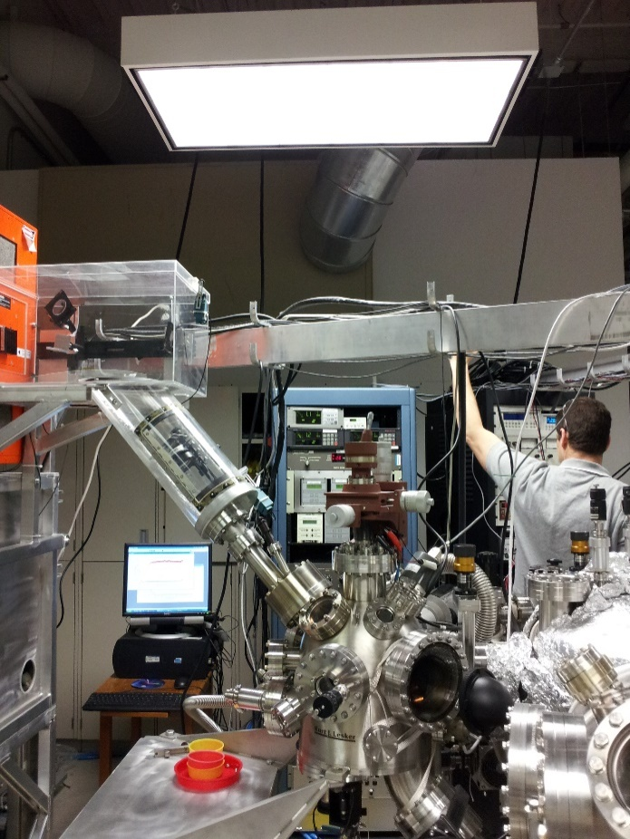
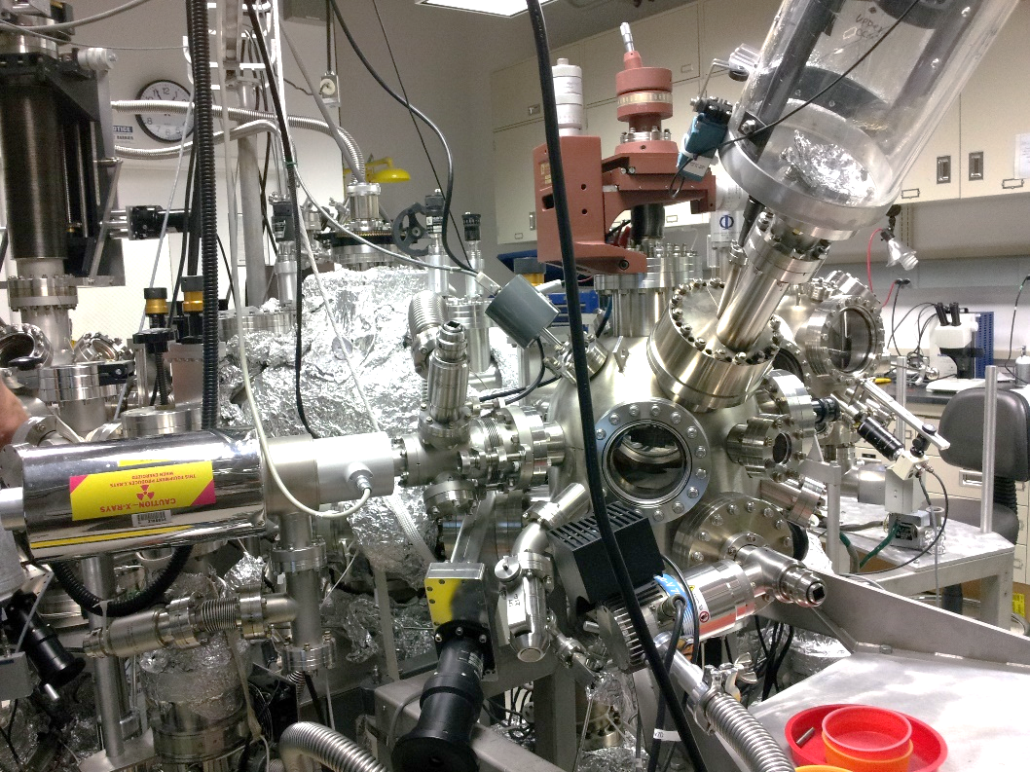
NanoTransport system at CNMS
analysis
chamber
http://www.cnms.ornl.gov
transfer
chamber
Excimer laser
SPM
chamber
STM
AFM
in
UHV
RHEED gun
growth
chamber
Growth
chamber

Slide 10
SrRuO₃
Widely used as a metal electrode

Slide 11
Samples
PLD
Undoped SrTiO₃ (100) substrates / TiO₂ termination
In-situ RHEED
P_{O2} = 100 mTorr
9nm / 23u.c.
T = 690 °C
7.5nm / 15 u.c.
15 min. anneal
T = 650 °C
9nm / 23u.c.
15 min. anneal
Transfer to the STM chamber right after film growth

Slide 12

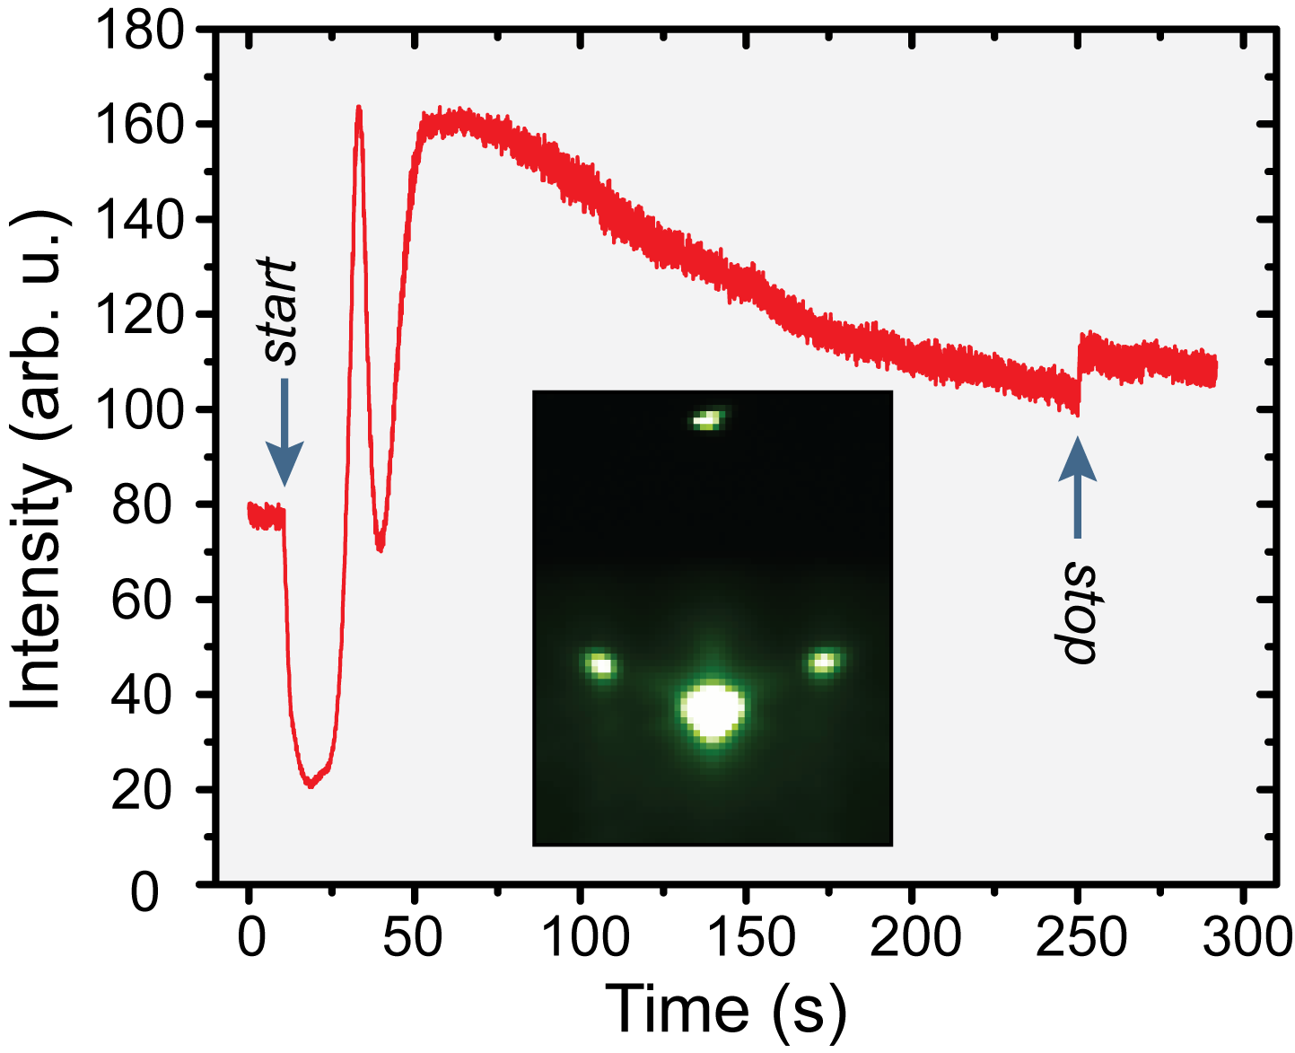
Film growth
AMF topography
1 μm × 1 μm
RHEED
RMS Roughness = 55 pm
Substrate selection:
RMS roughness < 70 pm
Growth modes:
690 °C – step-flow
650°C – step-flow/island-formation

Slide 13
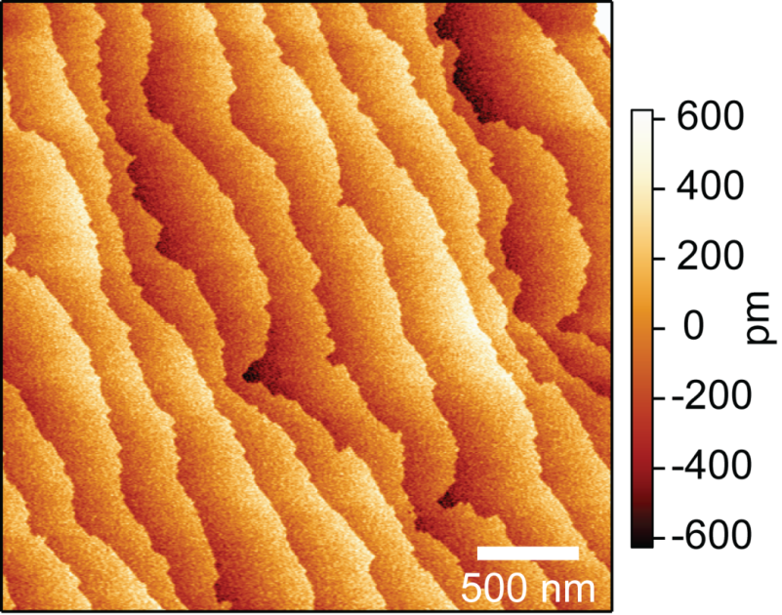
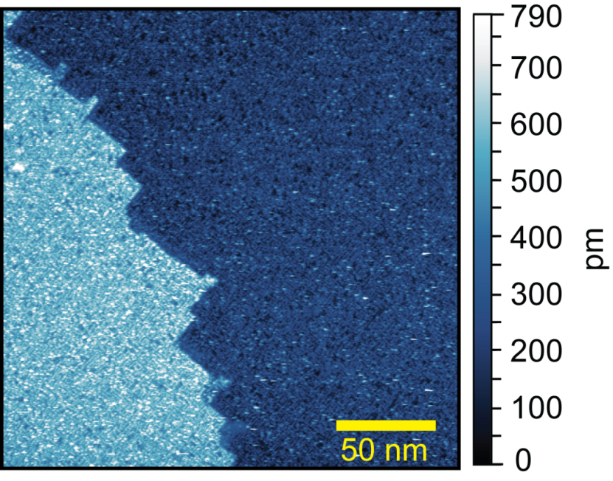
Film surface: larger scale
ex-situ AFM (topography)
in-situ STM
3 μm × 3 μm
690 °C, no anneal

Slide 14
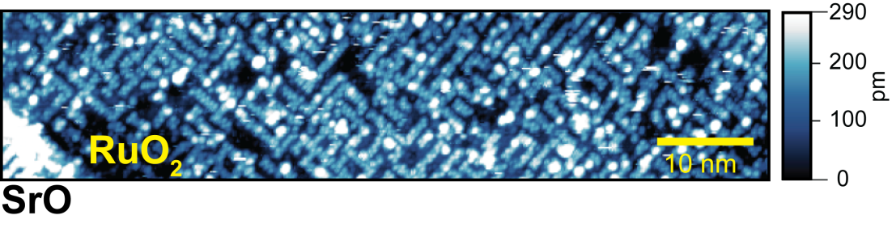
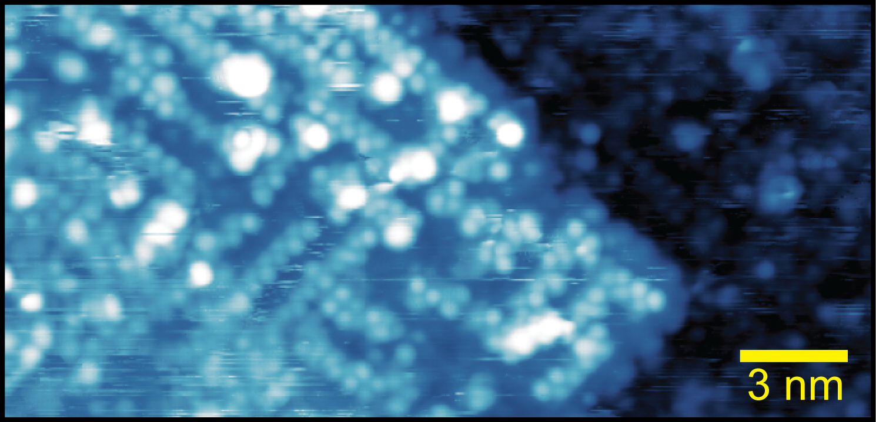
Competing surface patterns
690 °C,
no ann.
rectangular
zigzag
rectangular

Slide 15
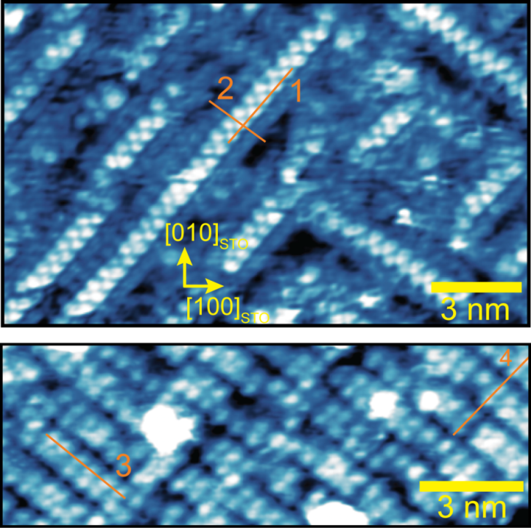
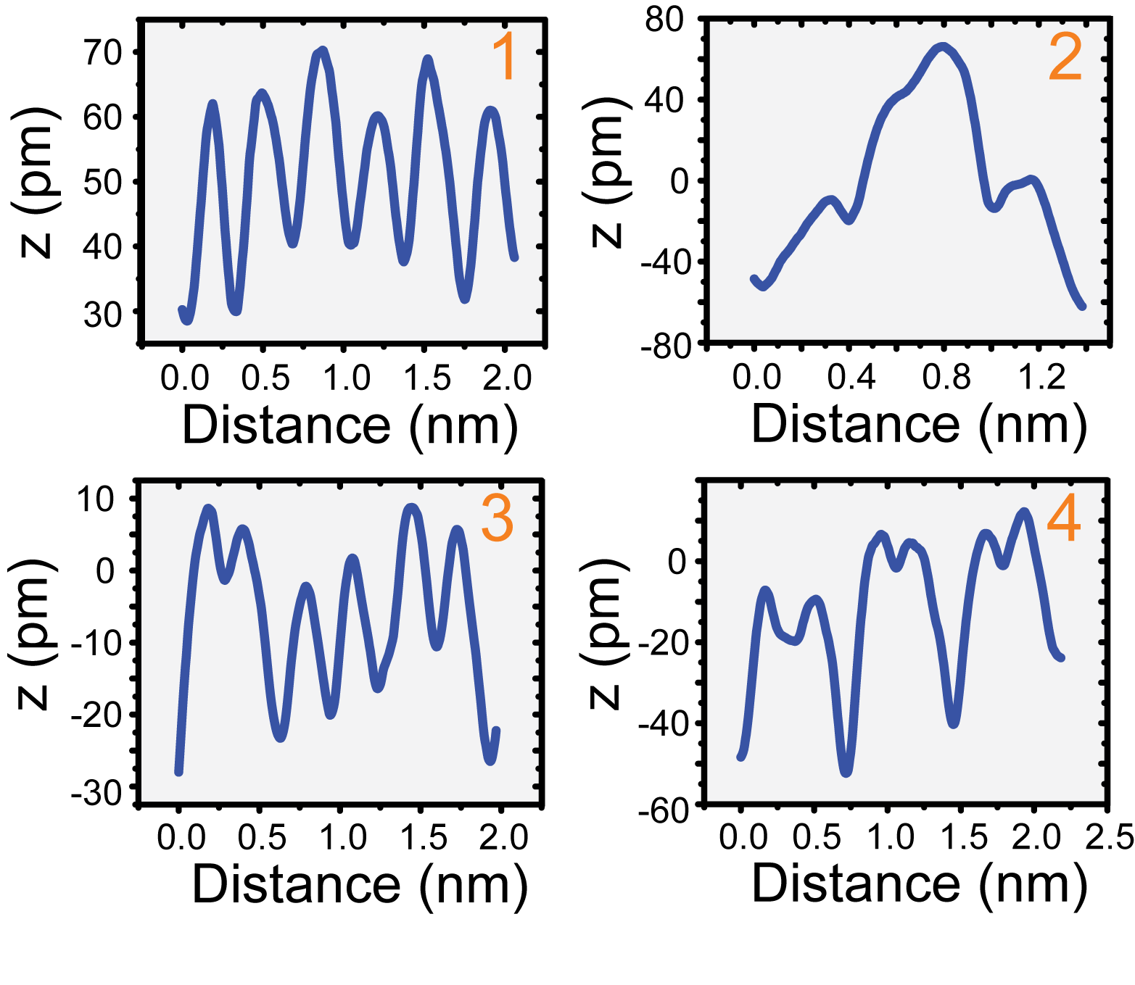
Zigzag and rectangular patterns
650 °C, ann.
690 °C, ann.

Slide 16
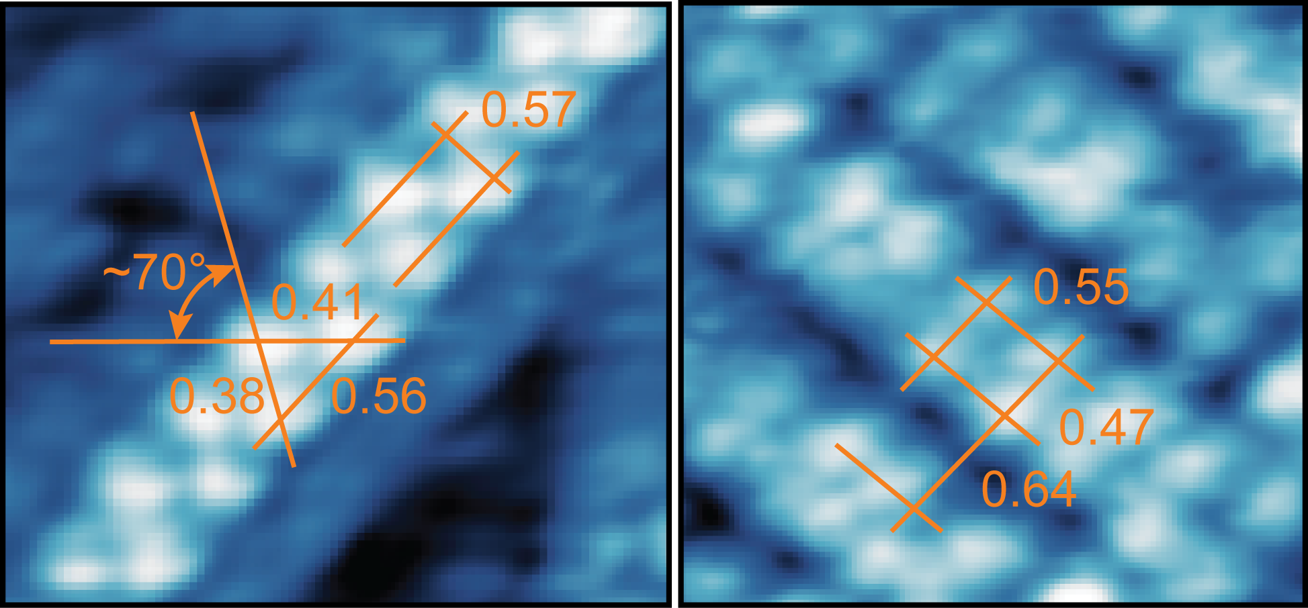
Zigzag and rectangular patterns
zigzag
rectangular

Slide 17
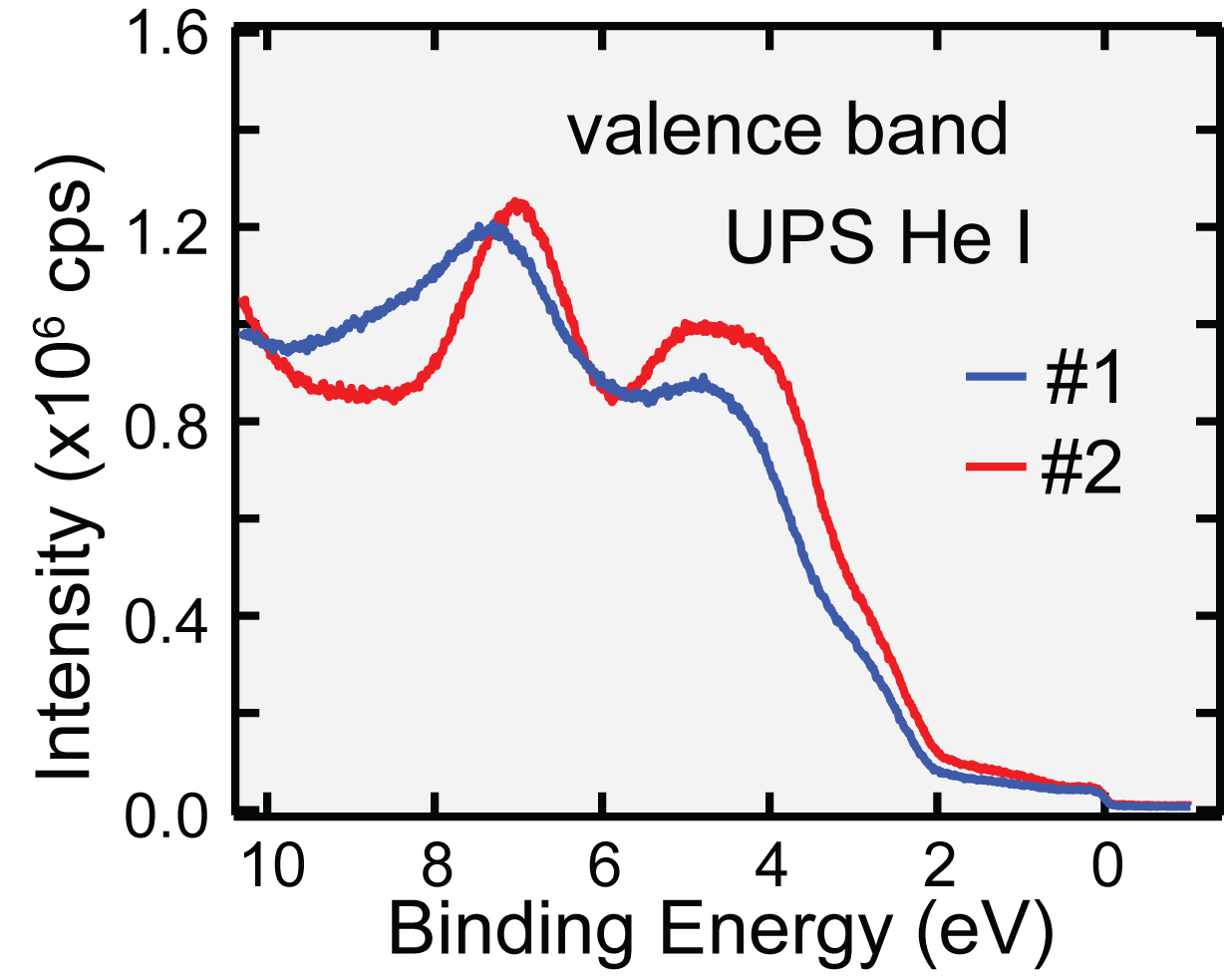
In-situ UPS
#2:
rectangular
#1:
zigzag
O 2p
Ru 4d

Slide 18
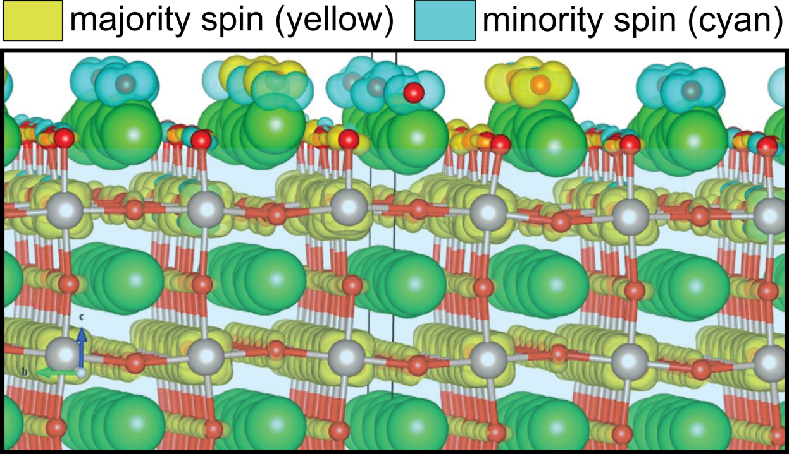
Surface spin-glass behavior
Isosurfaces of magnetization densities
Isosurfaces of magnetization densities
Randomly oriented local spins from O_{ad} p-orbitals

Slide 19
La_{5/8}Ca_{3/8}MnO₃
Classical Colossal magnetoresistance material

Slide 20
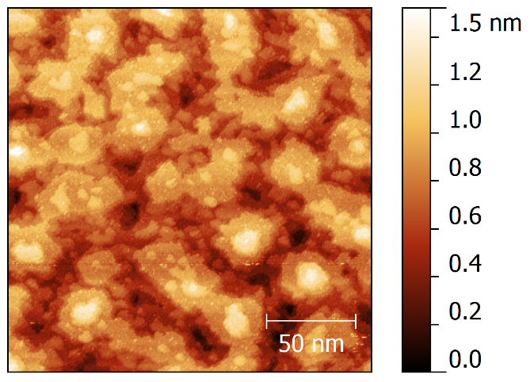
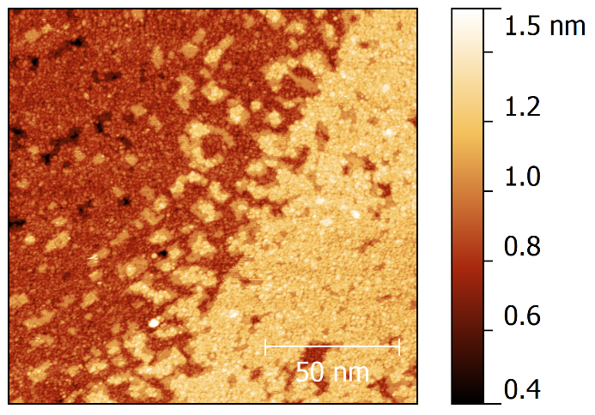
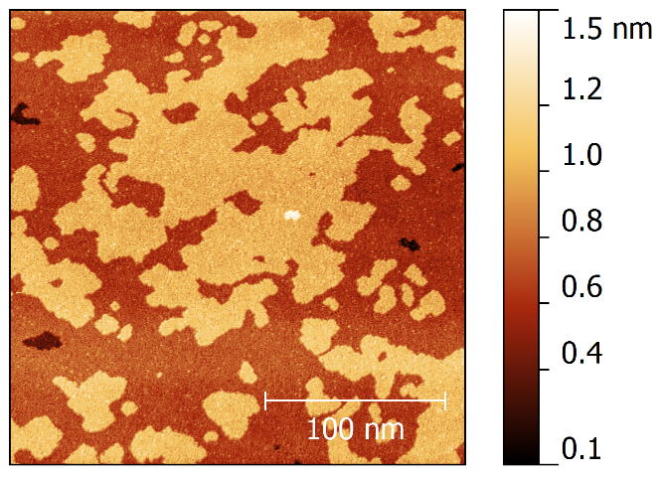
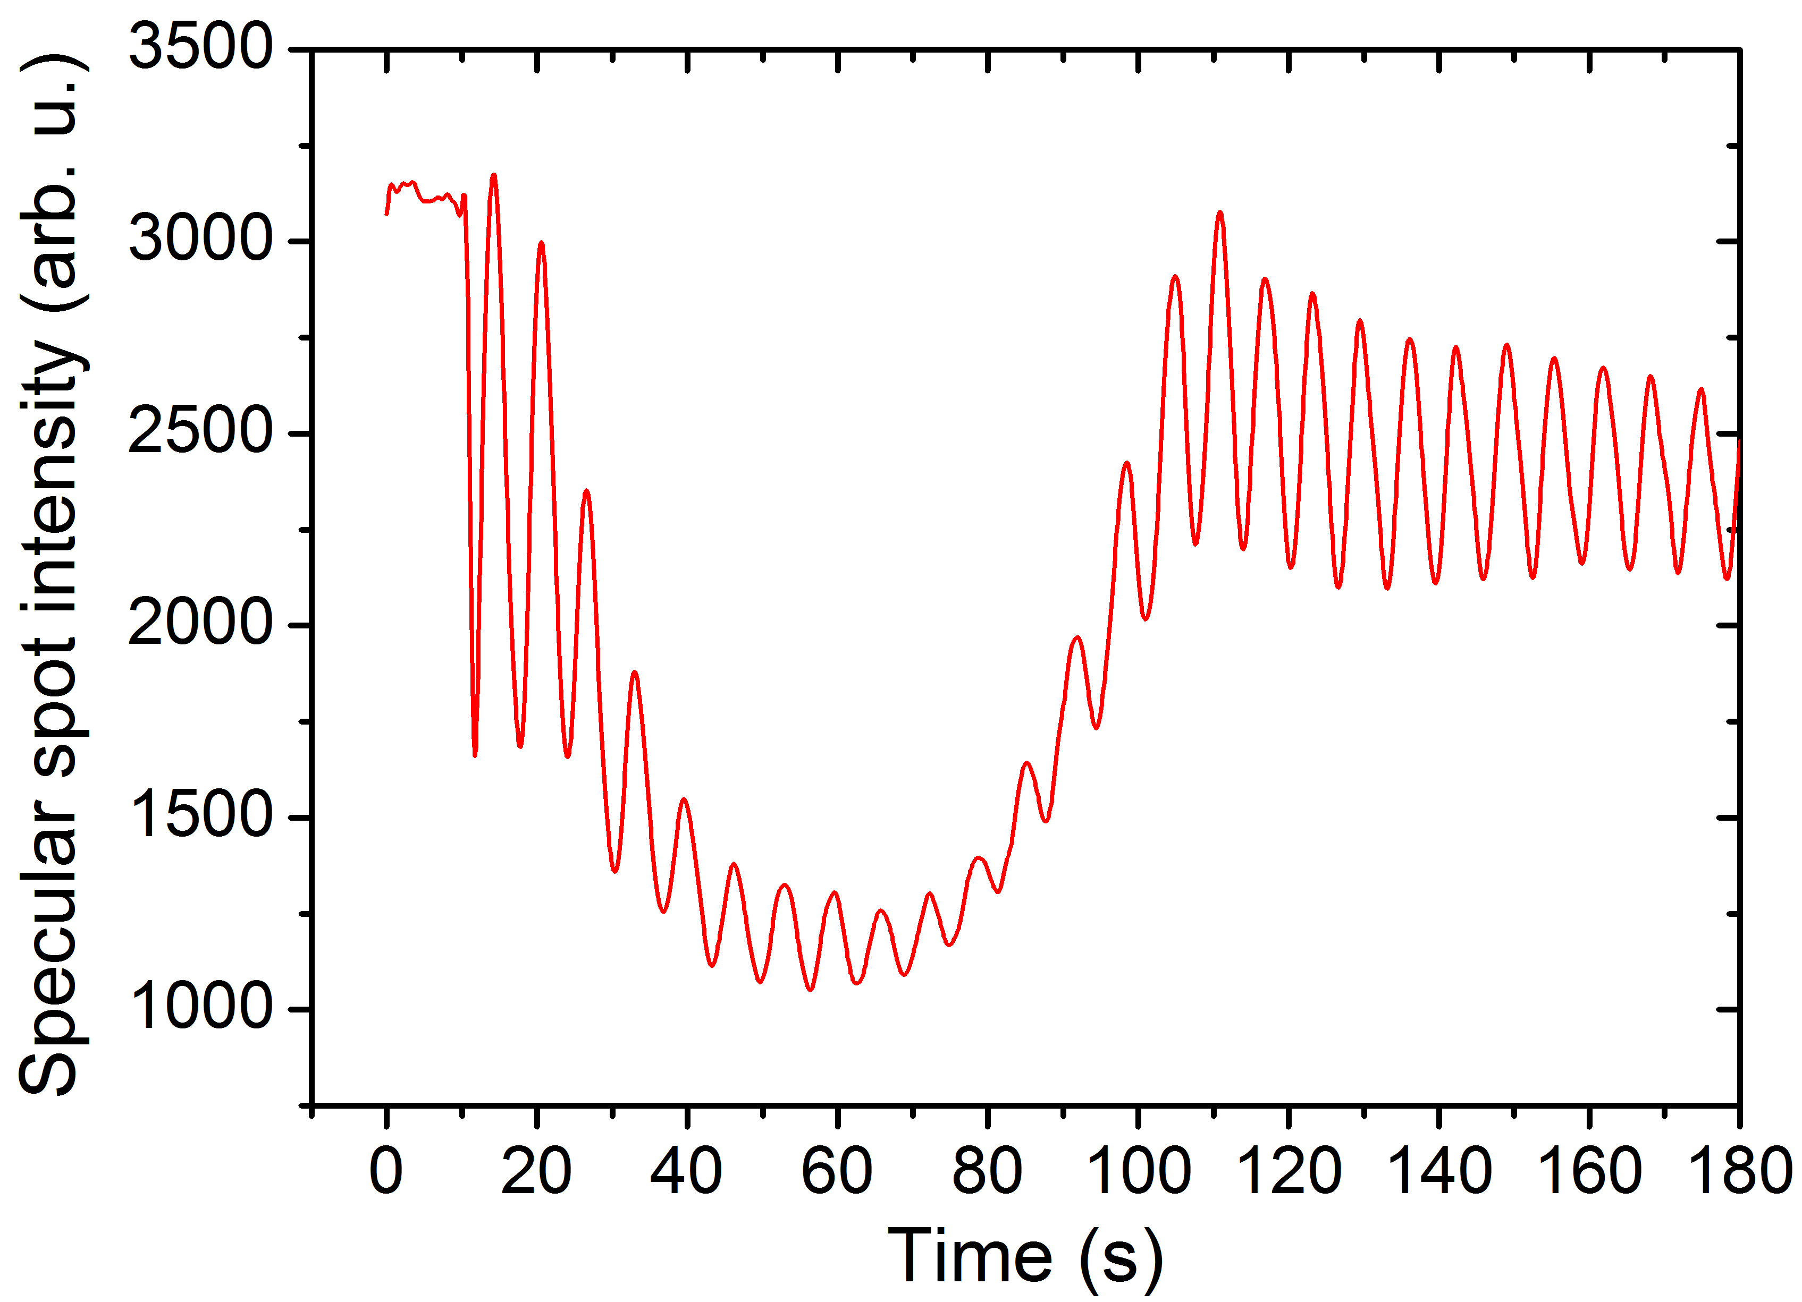
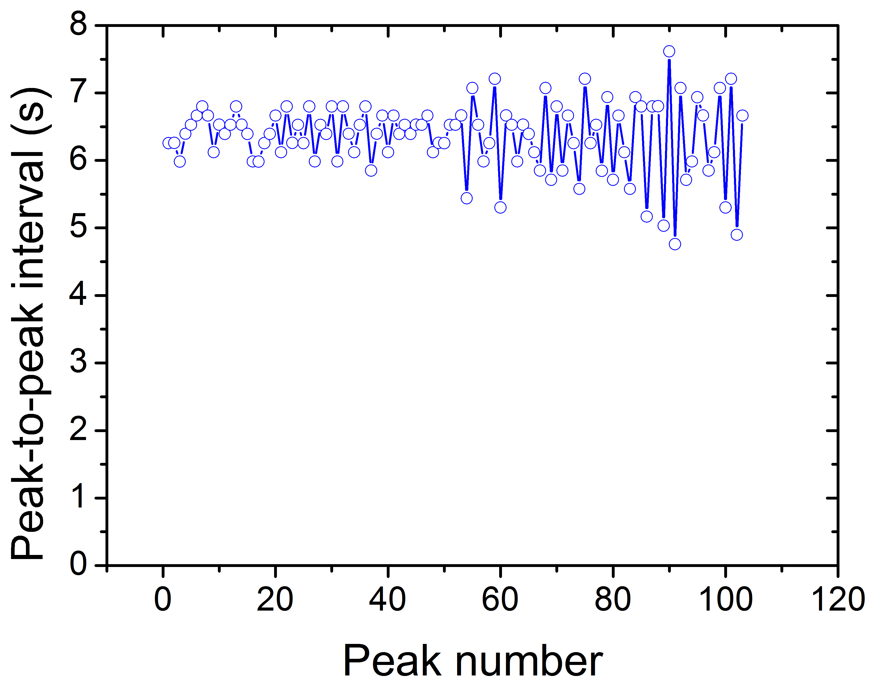
Evolution of surface morphology
16 u.c.
25 u.c.
250 u.c.
Here are 103 periods of RHEED oscillations.

Slide 21
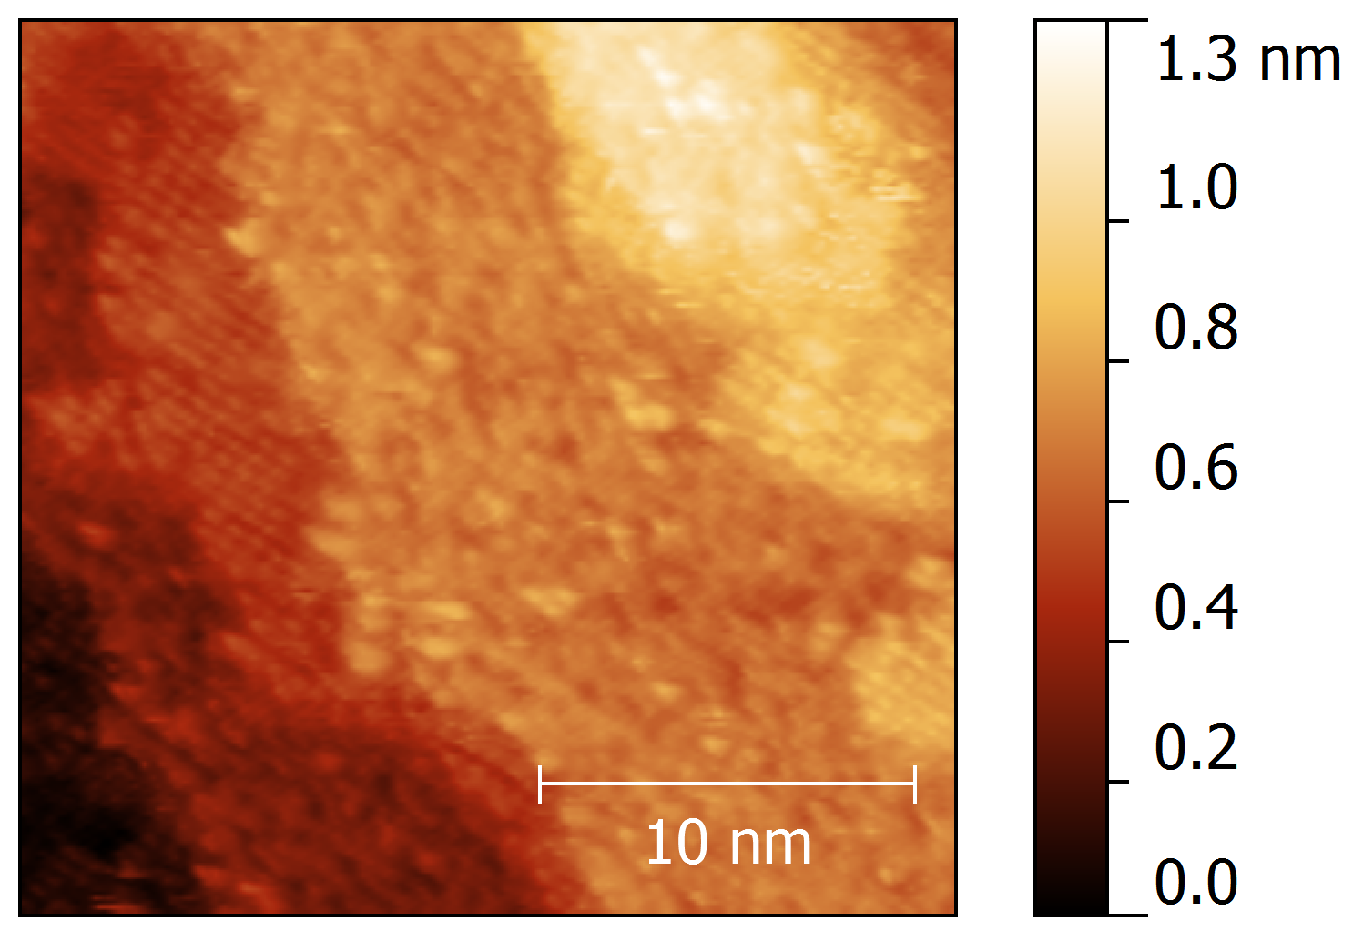
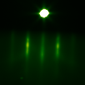
16 u.c. on SrTiO₃
(√2 x √2)R45° reconstruction
Up to 7 u.c. layers can be seen.
Two terminations: ordered and disordered.
V_{t} = -1.8 V, I_{t} = 40-90 pA, T = 297 K

Slide 22
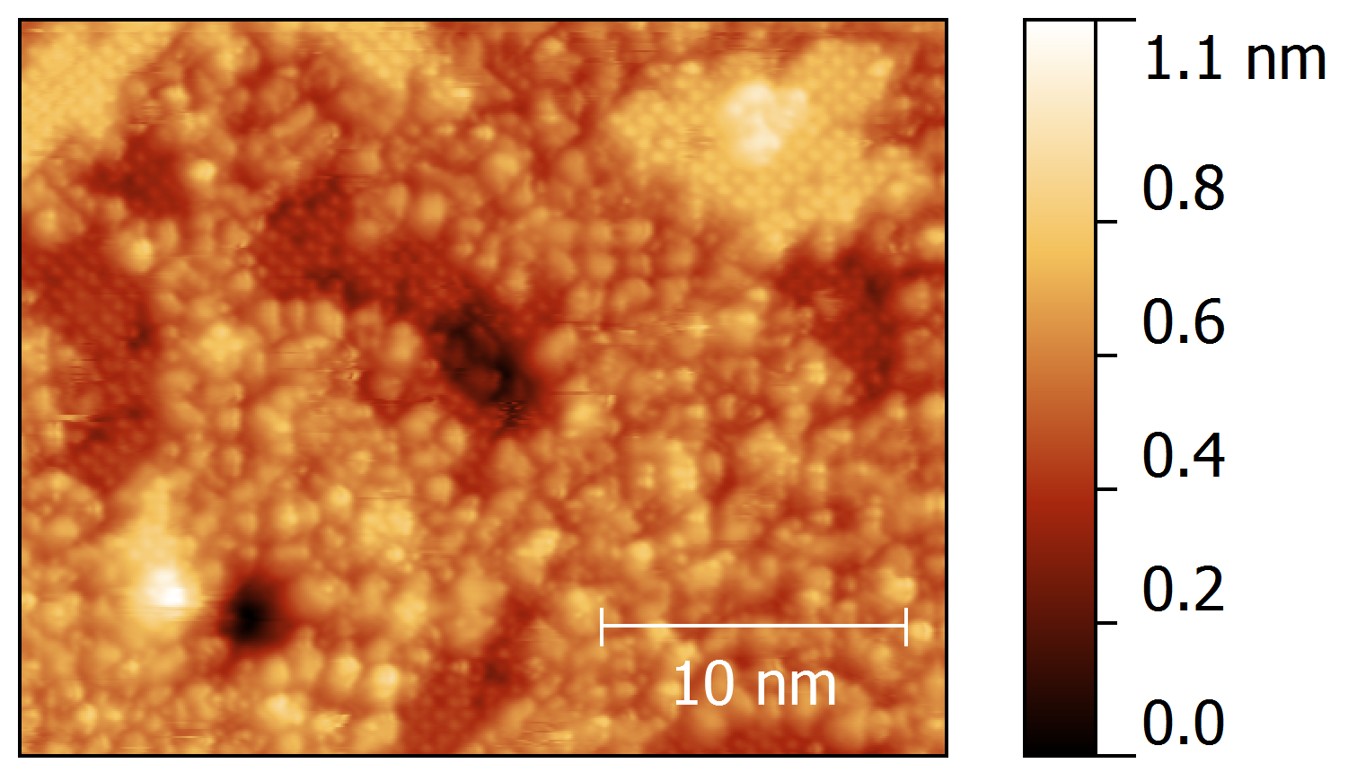
25 u.c. on SrTiO₃
Appear after anneals in oxygen (at 400 °C for 30 min.) as well as after fast cooling (150 °C/min.) to room temperature.
No significant change after anneals in vacuum at 450 ° C for 30 min.

Slide 23
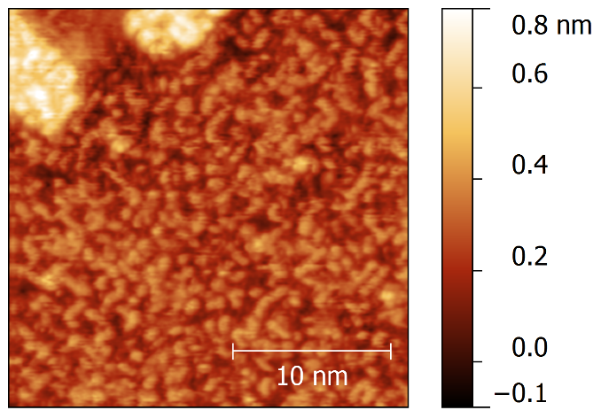
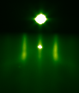
250 u.c. on SrTiO₃
Up to 3 u.c. layers can be seen.
One termination: disordered.
Nearly perfects layer-by-layer growth.
X-ray: film is coherently strained to STO.

Slide 24
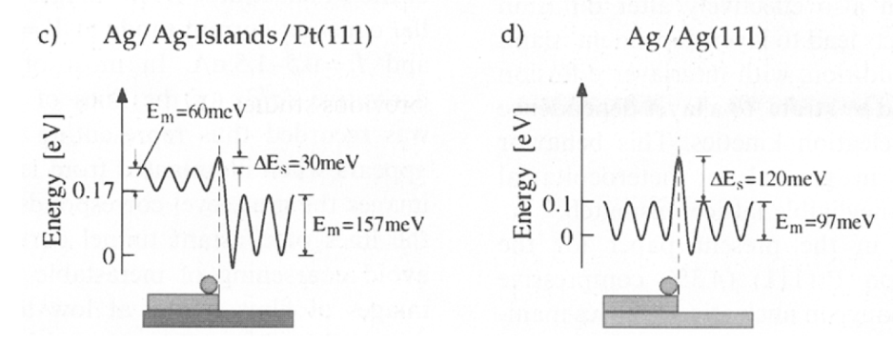
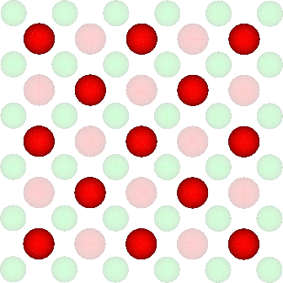
Interpretation of the growth evolution
Dependence of the barrier for interlayer adatom transport (Ehrlich-Schwoebel barrier) on strain.
Tensile strain increases the barrier.
Ag-on-Pt (111) as an example
½ of oxygen atoms is visible on A-termination
K. Bromann et al., PRL 75, 677 (1995)

Slide 25
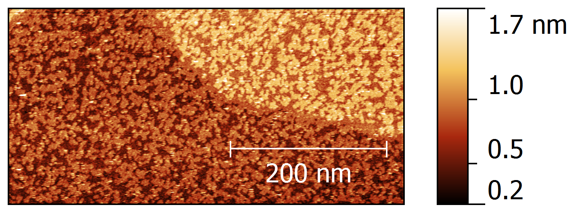

25 u.c. on B-terminated NbGaO₃ – single termination
NbGaO₃ (110)
-0.13%
One, disordered, termination
25 u.c.

Slide 26


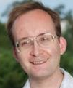

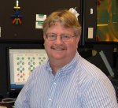
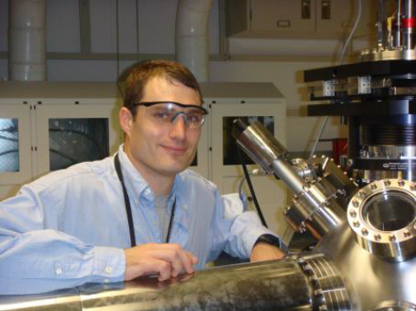
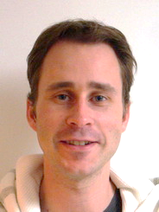

Acknowledgement
Funding:
Division of Materials Sciences and Engineering, Office of Basic Energy Sciences, U.S. DOE
Division of Scientific User Facilities, U.S. DOE.
P. Ganesh
Zhen Gai
Lian Qiao
Sergei Kalinin
Art Baddorf
Mike Biegalski
Wolter Siemons
Rama Vasudevan

Slide 27
Let Us Meet Again
We welcome you all to our future conferences of OMICS Group International
Please Visit:
http://materialsscience.conferenceseries.com/
Contact us at
materialsscience.conference@omicsgroup.us
materialsscience@omicsgroup.com

