Slide 1


Kunjin replicon-based vaccine candidate against Ebola virus
AID
Australian Infectious Diseases research centre
The University of Queensland
QIMR Berghofer
Alexander A Khromykh

Slide 2
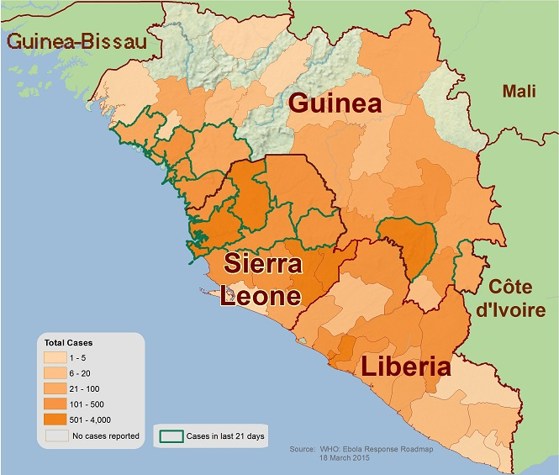
Ebola virus (EBOV) outbreak in West Africa 2014-2015
Country Total cases Death
Guinea 3787 2517
Liberia 10673 4808
Sierra Leone 13264 3949
Nigeria 20 8
Mali 8 6
Total* 277 52 11288
*data as of 24 July 2015
Still ~30 new cases per week, mainly in Guinea and Sierra Leone

Slide 3
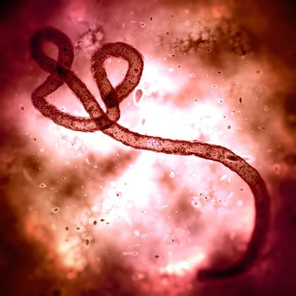
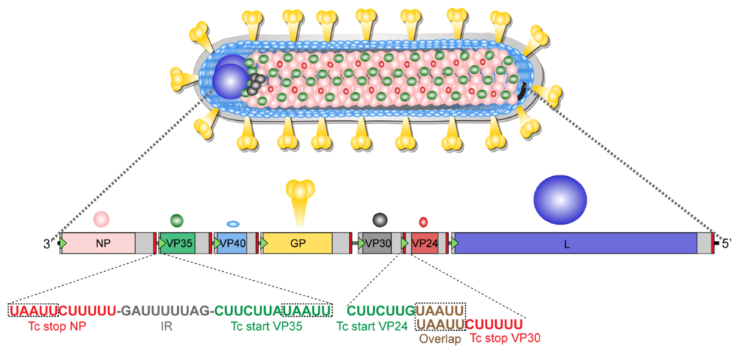
Ebola virus (EBOV)
Zaire EBOV (EBOV) is one of 5 viruses in genus Ebolavirus, four of which including EBOV cause severe often fatal hemorrhagic fever in humans and other mammals
It is the cause of current epidemic in West Africa
It has ssRNA genome of ~19kb, coding for 7 proteins
GP is the main viral glycoprotein inducing virus-neutralizing antibodies

Slide 4
Ebola vaccines
Vaccines undergoing clinical trials in West Africa –completed Phase 2 and commenced Phase 3:
- cAd3-EBO Z – attenuated chimpanzee adenovirus encoding EBOV GP
- VSV-EBOV – vesicular stomatitis virus encoding EBOV GP
Other vaccines under various stages of development:
- AdVac/MVA-BN – prime-boost with adenovirus and modified vaccinia virus Ankara encoding filovirus GPs –Phase 1 trials in January 2015 in UK, Phase 2 trials commenced in July 2015 in UK and France
- Recombinant EBOV GP nanoparticle vaccine (Novavax Inc) – Phase 1 trials commenced in February 2015 in Australia
- Adenovirus type 5-EBOV GP-2014 vaccine – Phase 1 trials completed in China
- Human Parainfluenza virus type 3-EBOV GP vaccine – completed primate trials
- Inactivated whole virus EBOVΔVP30 vaccine – completed primate trials
- Kunjin-EBOV GP replicon VLP vaccine – completed primate trials

Slide 5
Kunjin virus replicons as vaccine vectors
Kunjin is a naturally attenuated strain of West Nile virus endemic in Australia
It circulates primarily in mosquito-bird transmission cycle with accidental infections of humans and horses
It has + strand ssRNA genome of ~11kb coding for 3 structural and 7 nonstructural genes
Deletion of the majority of structural gene region results in replicon RNA capable of amplifying itself
Insertion of various heterologous genes (HGs) in place of deleted structural region of replicon RNA allows their sustained, high level expression
Replicon RNA encoding HGs can be produced in vitro, in vivo from plasmid DNA, or packaged into virus like particles (VLPs) by structural proteins produced in trans in packaging cells
Structural
Nonstructural
5'UTR
C
prM
E
1
2A 2B 3 4A 4B 5
3'UTR
Viral RNA
SP6
Replicon RNA
SP6
2,247 nts
NS1 - NS5

Slide 6
KUN replicon-based vaccines – mode of action
CMV
HG~KUN replicon
HG~KUN replicon
DNA
Nucleus
Cytoplasm
VLPs
CMV
HG ~KUN replicon
DNA
HG~KUN replicon
RNA
Transcription
RNA Pol II
HG~KUN replicon
HG~KUN replicon
dsRNA
RNA
gag~KUN replicon
IFNα/β
gag~KUN replicon
gag~KUN replicon
HG~KUN replicon
Replicase
Replicase
Replicase
Replicase
Replicase
Replicase
Replicase
Replicase
HG product
Ab and CD8+ T cell
immunity

Slide 7
Heterologous proteins produced by KUN replicon vectors
Cytoplasmic reporter proteins
CAT, GFP, Cherry, β-gal, Luciferase, nano-Luc
Cytoplasmic viral proteins
HCV core, HCV NS3, HPV E7, RSV M2, HIV Gag, SIV Gag, Ebola NP, Ebola VP40
Viral glycoproteins
VSV G, RSV F, Ebola GP
Secreted cytokines
GM-CSF, IL-10, IL-12, IL-15
Pijlman et al., EOBT, 2006

Slide 8
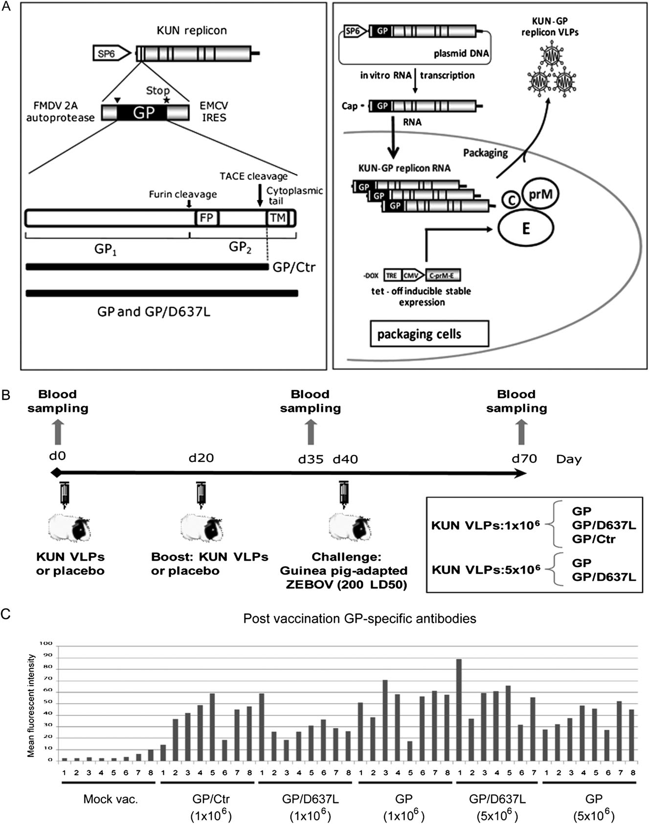
Design of KUN-GP replicon vaccine constructs
Enhanced GP shedding, reduced GP cytotoxicity,
improved replicon VLP yield
D637L
Reynard, … Khromykh, Volchkov. Journal of Infectious Diseases, 2011

Slide 9
Production of KUN-GP replicon VLPs in packaging cells
Tetracycline
Tetracycline
Tetracycline
GP~KUN replicon
Nucleus
Cytoplasm
RNA
transfection
TRE
CMV
CprME
DNA
GP~KUN replicon
Transcription
RNA Pol II
CprME
RNA
GP~KUN replicon
GP~KUN replicon
GP~KUN replicon
GP~KUN replicon
CprME
E
Replicase
prM
E
E
Replicase
GP~KUN replicon
Replicase
Replicase
prM
prM
Replicase
C
Replicase
Replicase
C
C
Replicase
GP~KUN replicon
Packaging
GP~KUN replicon
KUN structural
proteins
~10⁵⁻⁷VLPs/ml

Slide 10
Guinea pig vaccination with KUN-GP replicon VLP vaccine and challenge with Zaire EBOV
Reynard, … Khromykh, Volchkov. Journal of Infectious Diseases, 2011

Slide 11
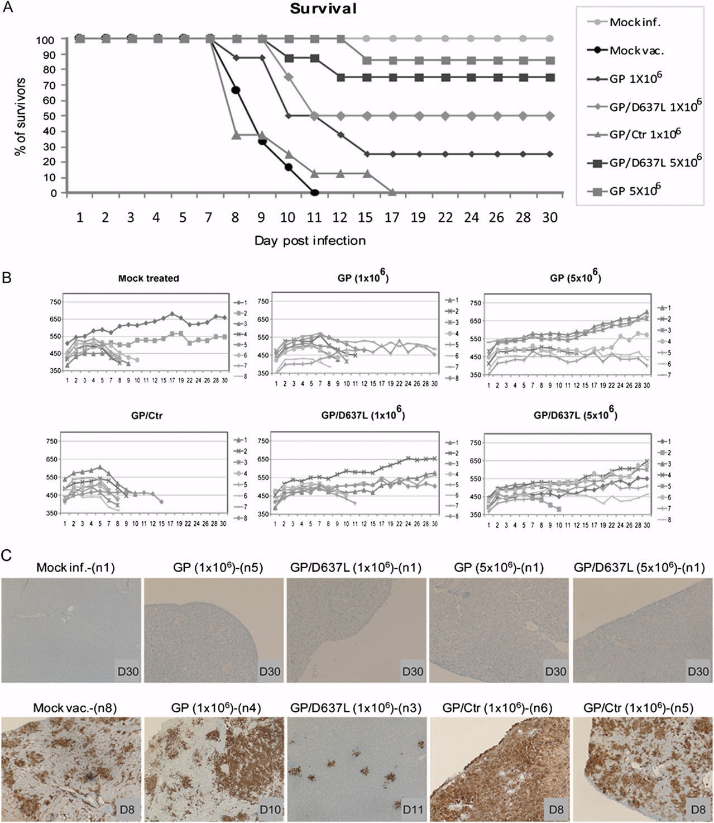
KUN-GP replicon VLP vaccine protects guinea pigs against EBOV infection
Mock infected
GP, 5x10⁶
GP/D637L, 5x10⁶
GP/D637L, 10⁶
GP, 10⁶
Mock vaccine
GP/Ctr, 10⁶
Reynard, … Khromykh, Volchkov. Journal of Infectious Diseases, 2011

Slide 12
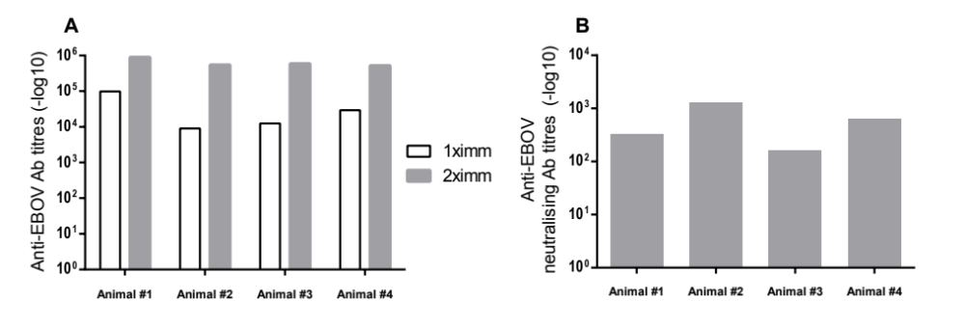
KUN-GP replicon VLP vaccine induces high titres of anti-GP and EBOV-neutralizing antibodies in African green monkeys
ELISA titres
EBOVs-neutralizing titres after second immunization
Two s.c. immunizations with 10⁹ KUN-GP replicon VLPs 4 weeks apart
Pyankov, … Khromykh. Journal of Infectious Diseases, 2015, March 2. jiv019 (epub ahead of print)

Slide 13
KUN-EBOB GP vaccine protects 3 out of 4 immunized primates from challenge with Zaire EBOV
★
★
★
Succumbed to infection
Pyankov, … Khromykh. Journal of Infectious Diseases, 2015, March 2. jiv019 (epub ahead of print)

Slide 14
Boosting with KUN-GP replicon VLPs generates high-titre anti-GP antibodies in horses
2 horses – Chloe (C) and Flicka (F),
immunizations and serum/plasma collection performed at PlasVacc Pty Ltd, Brisbane
Day 0
1st GP DNA
4mg, i.m.
Day 14
2nd GP DNA
4mg, i.m.
Day 55
3rd GP DNA
4mg, i.m.
Day 91
4th GP DNA
4mg, i.m.
Day 176
KUN-GP VLP
3x10⁹ , s.c.
Day 135
Day 189
Baseline serum
Serum
Serum
Serum
Serum
Serum,
Plasma collected

Slide 15
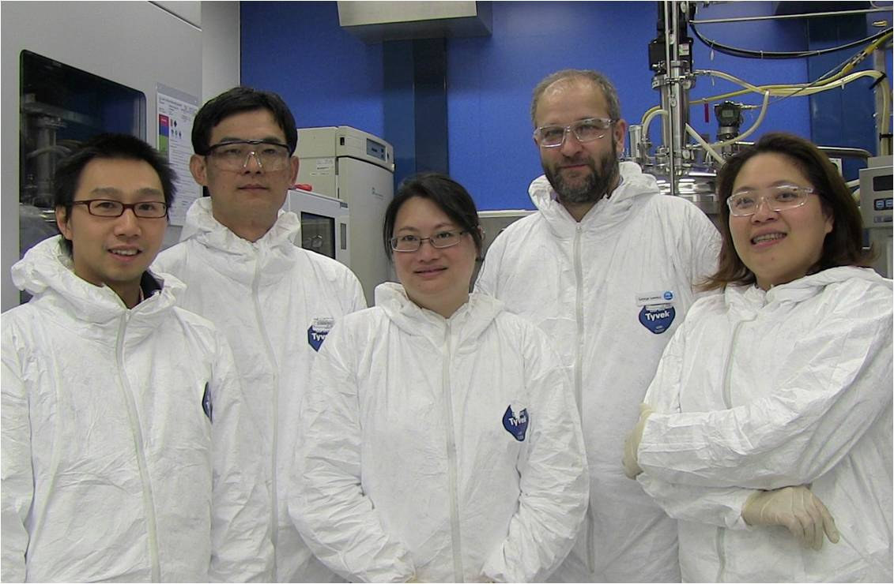
Equine plasma processing
NCRIS Recombinant Protein Production Facility, CSIRO
George Lovrecz
Louis Lu
Tram Phan
Tam Pham
Mylihn La

Slide 16
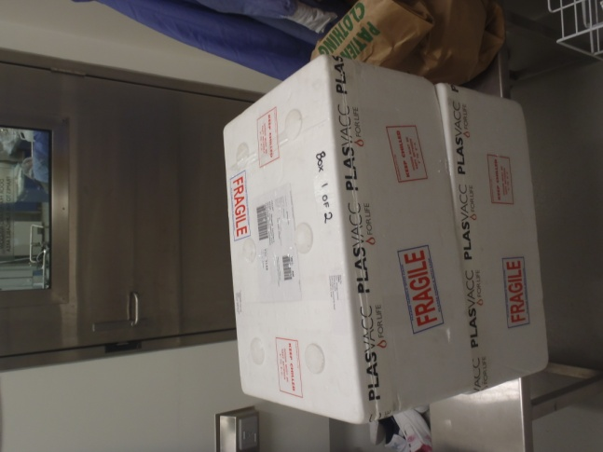
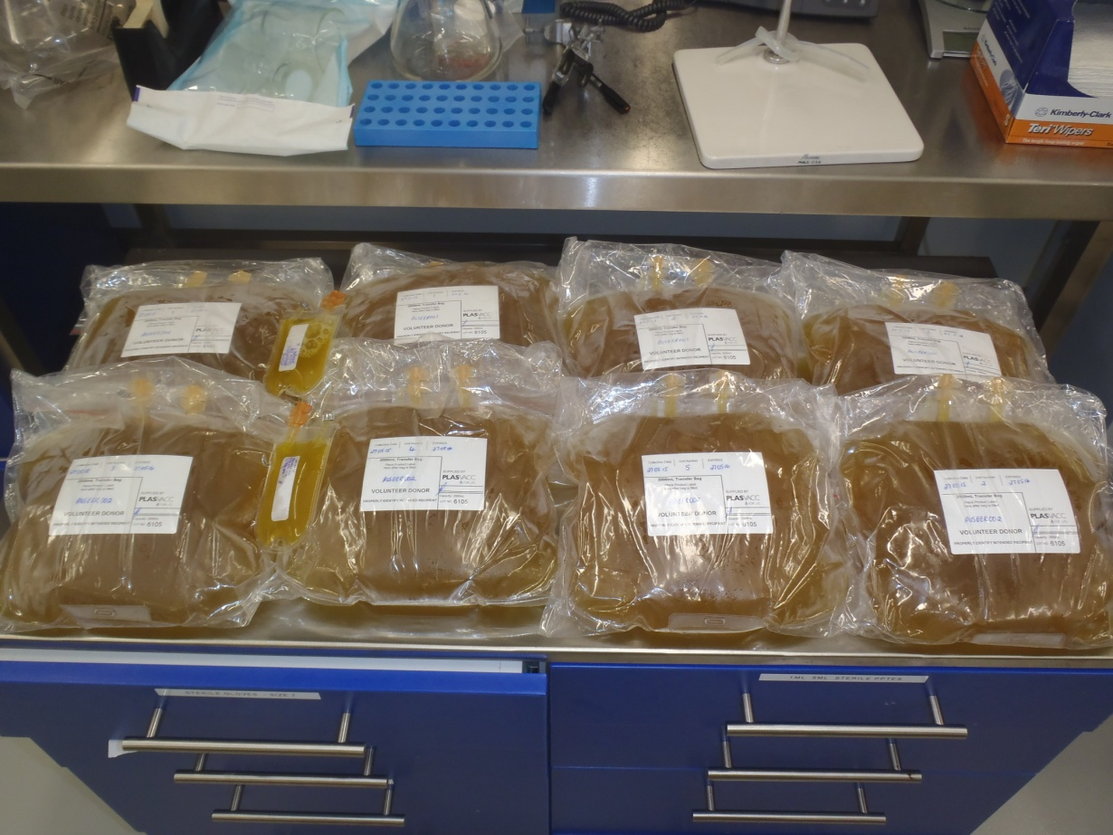
Receiving plasma
16L of horse plasma from PlasVacc (10L from Chloe + 6L from Flicka)

Slide 17
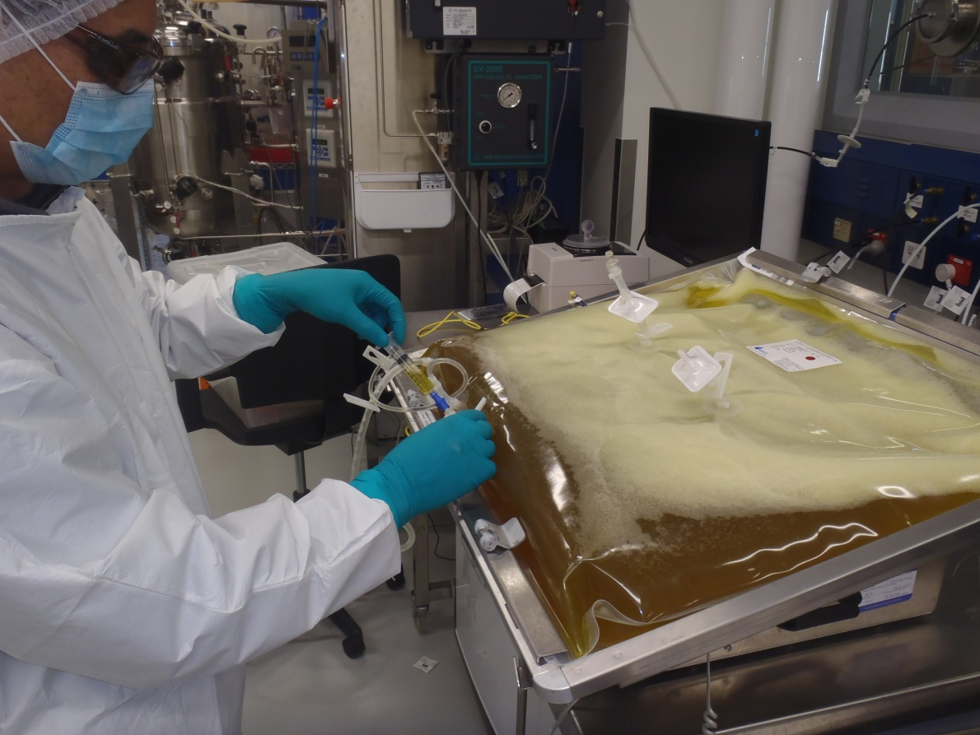
Transfer to Wave single-use bags

Slide 18
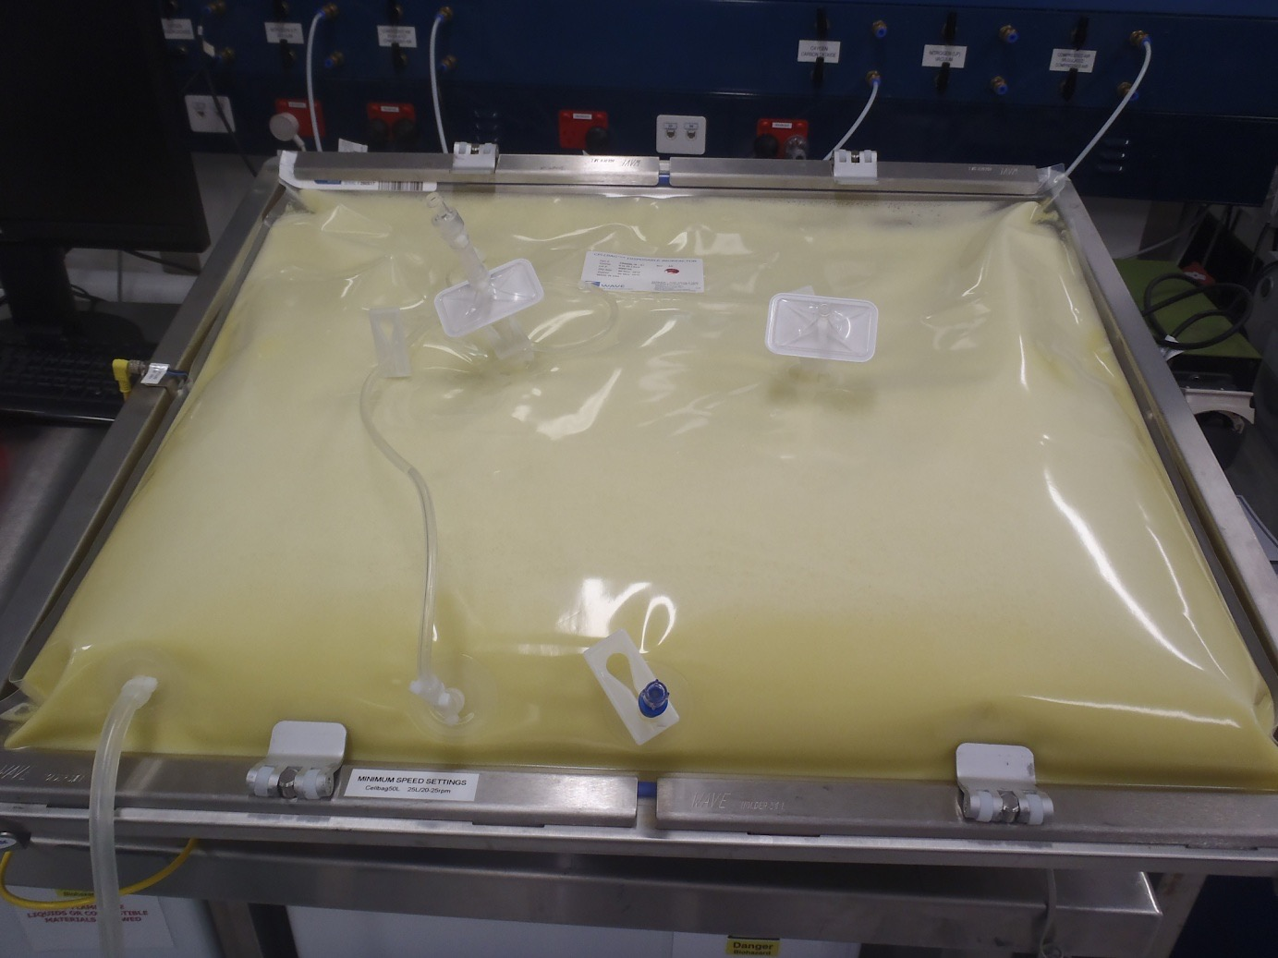
After caprylic acid addition

Slide 19
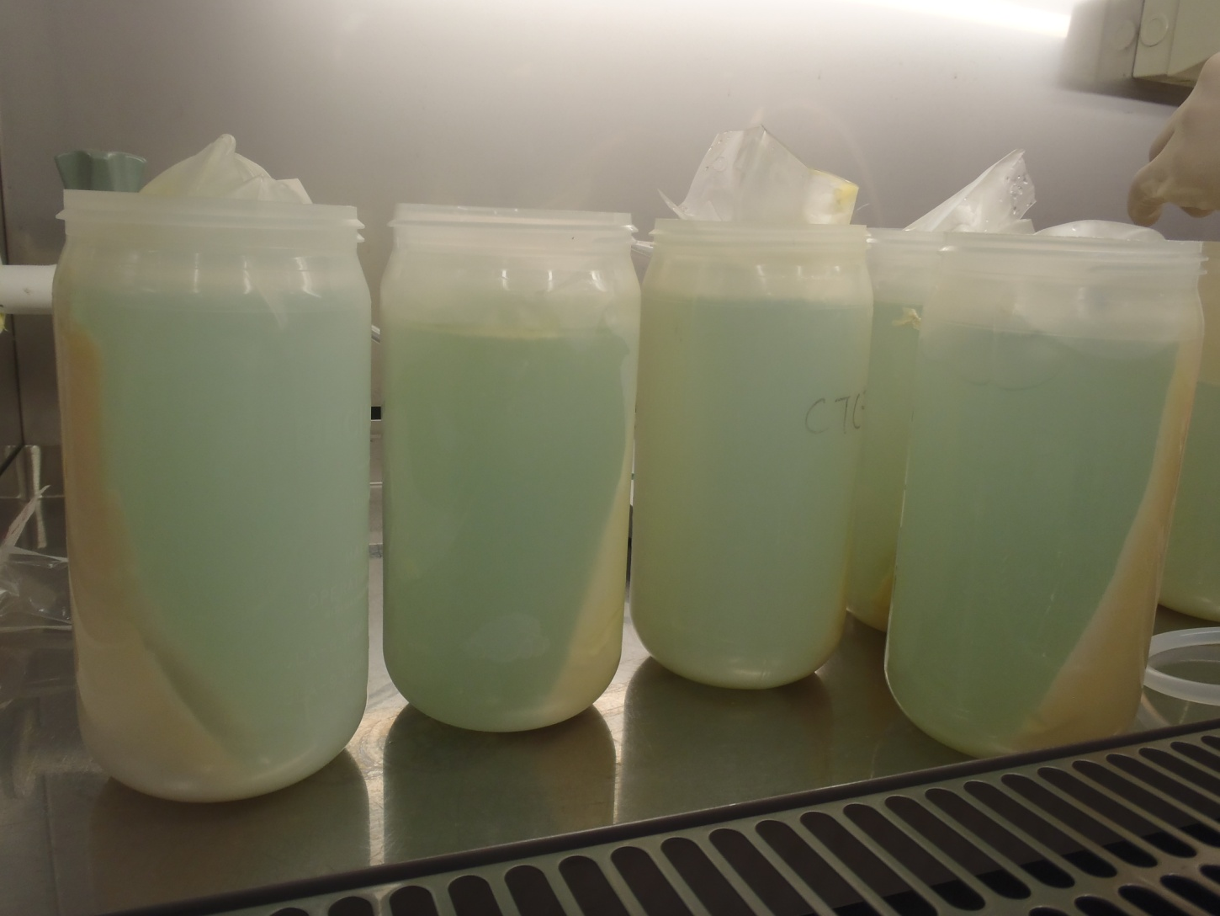
After centrifugation

Slide 20
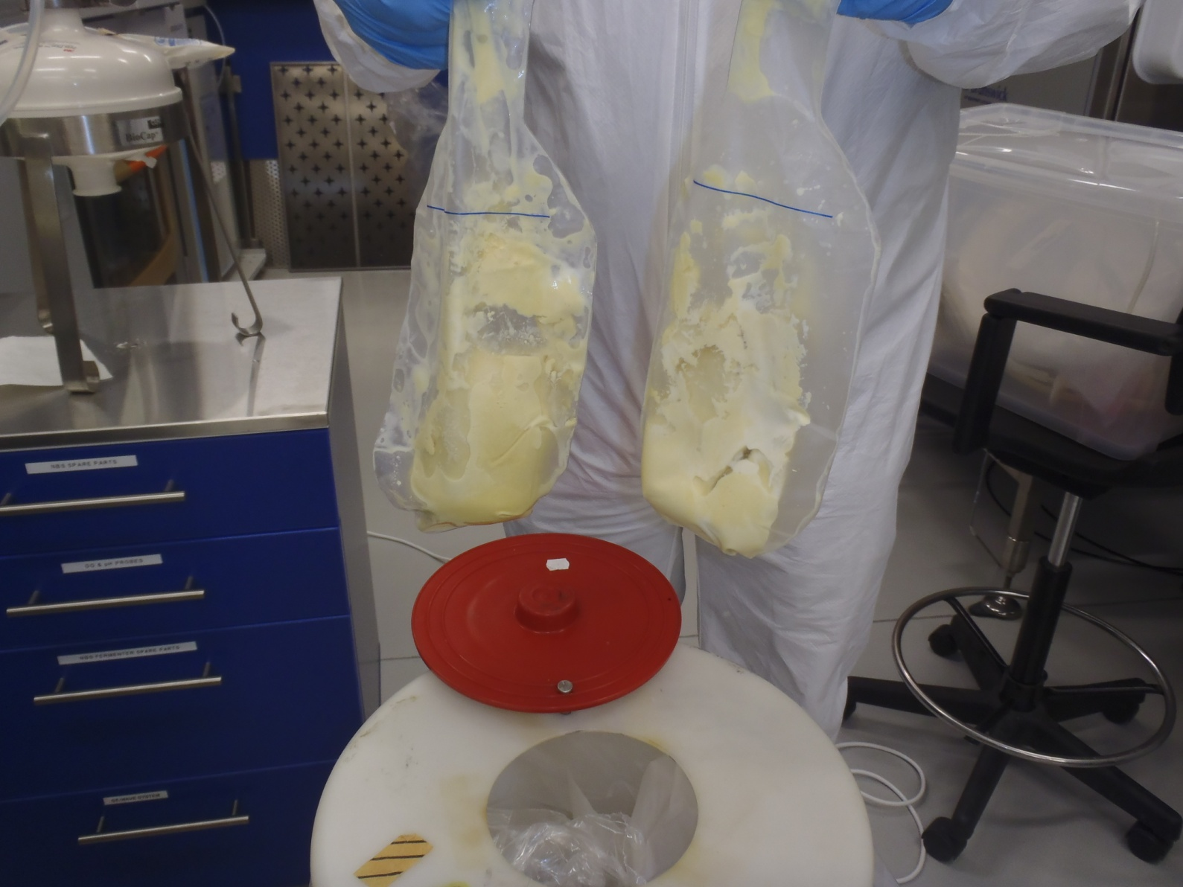
Precipitated proteins and lipids

Slide 21
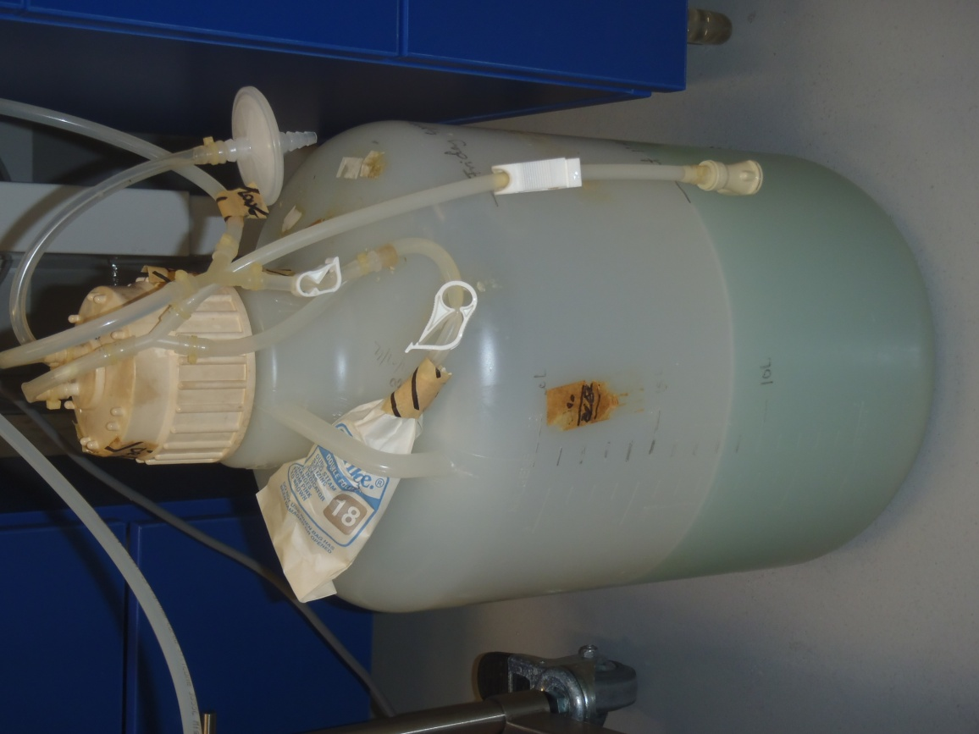
Un-clarified supernatant

Slide 22
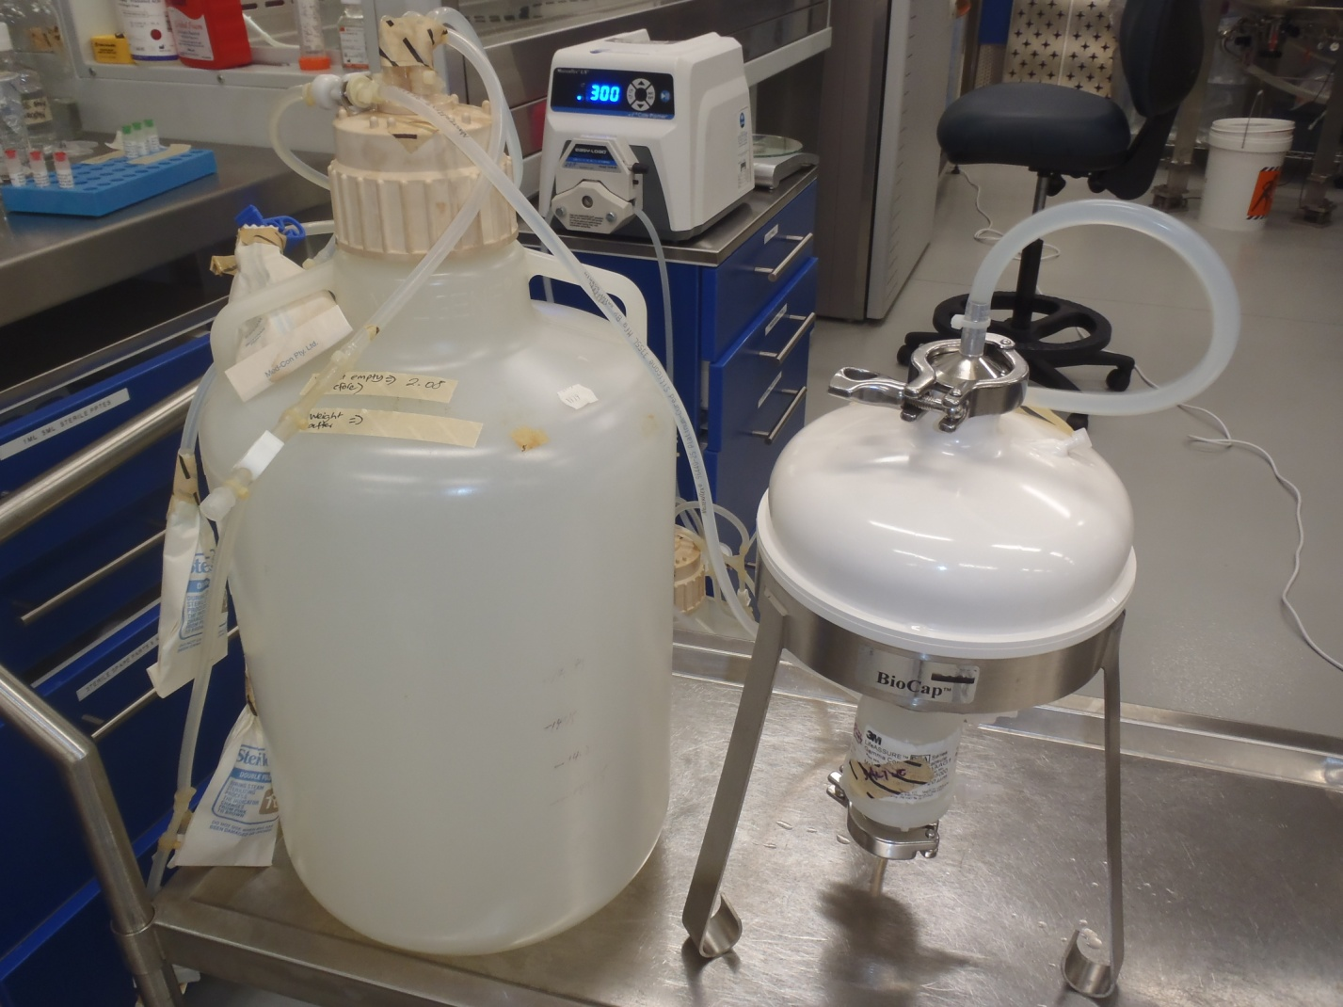
Supernatant filtration

Slide 23
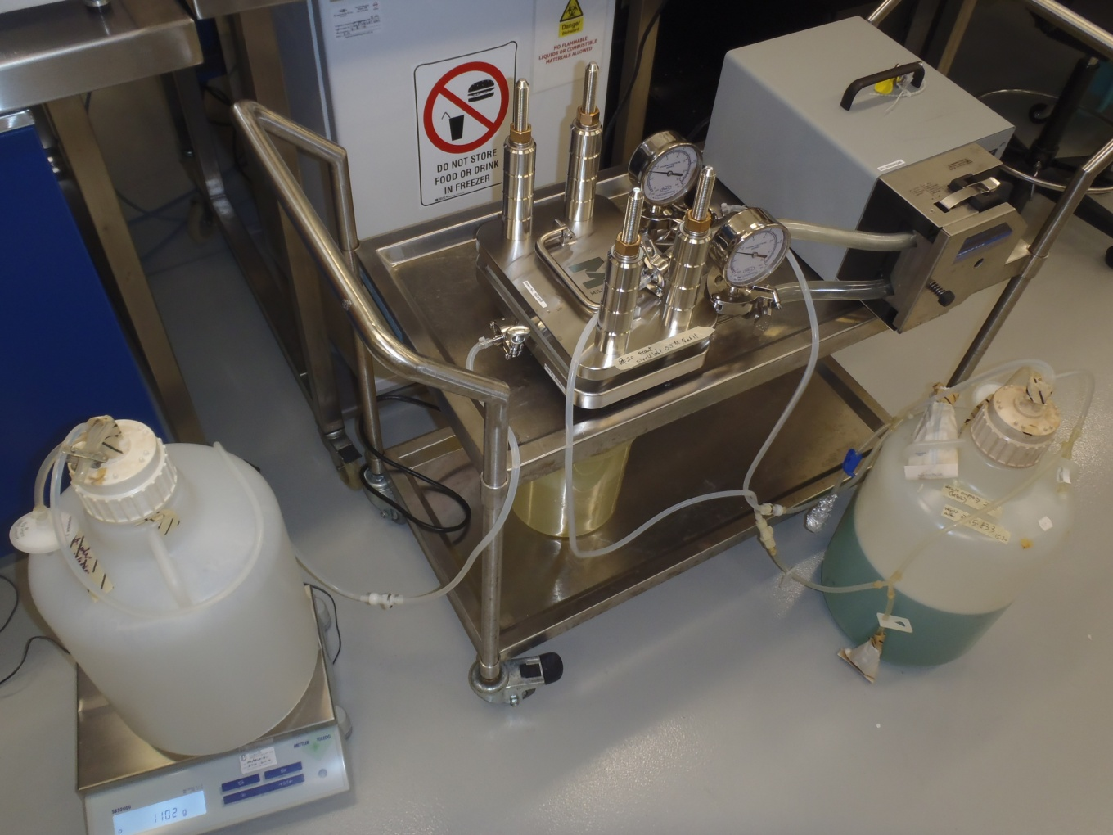
Dialysis and concentration using TFF

Slide 24
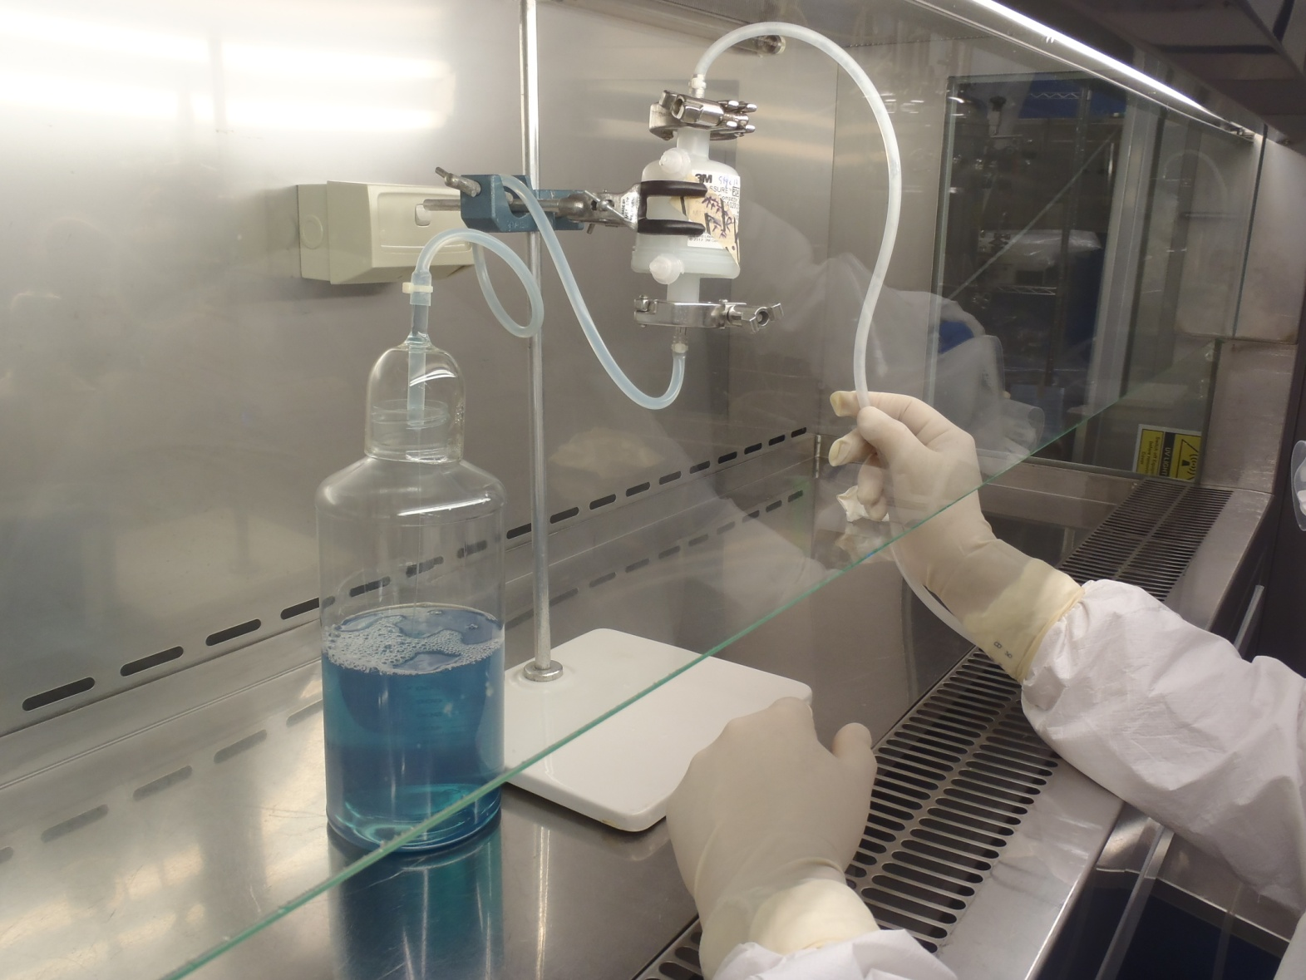
Sterile filtration after TFF

Slide 25
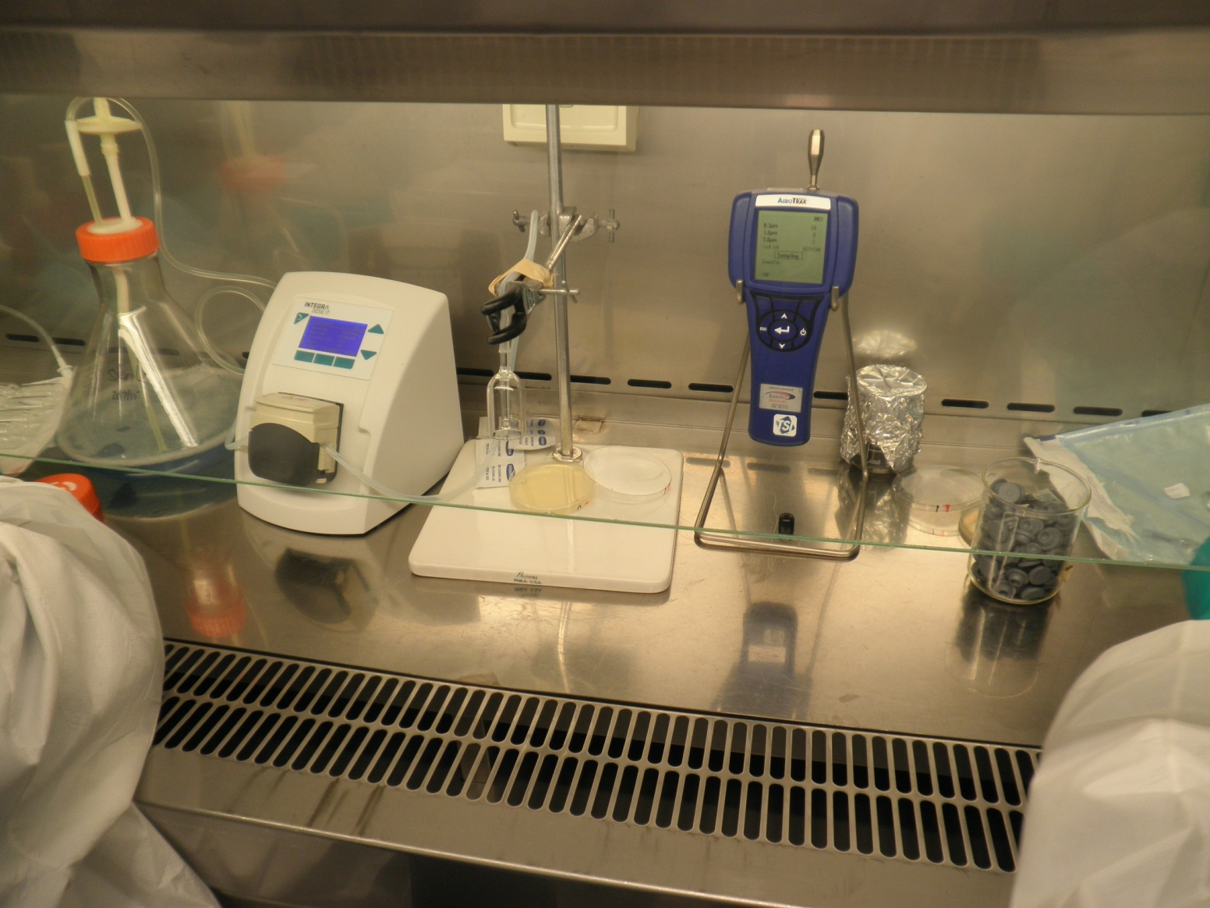
Aliquoting

Slide 26
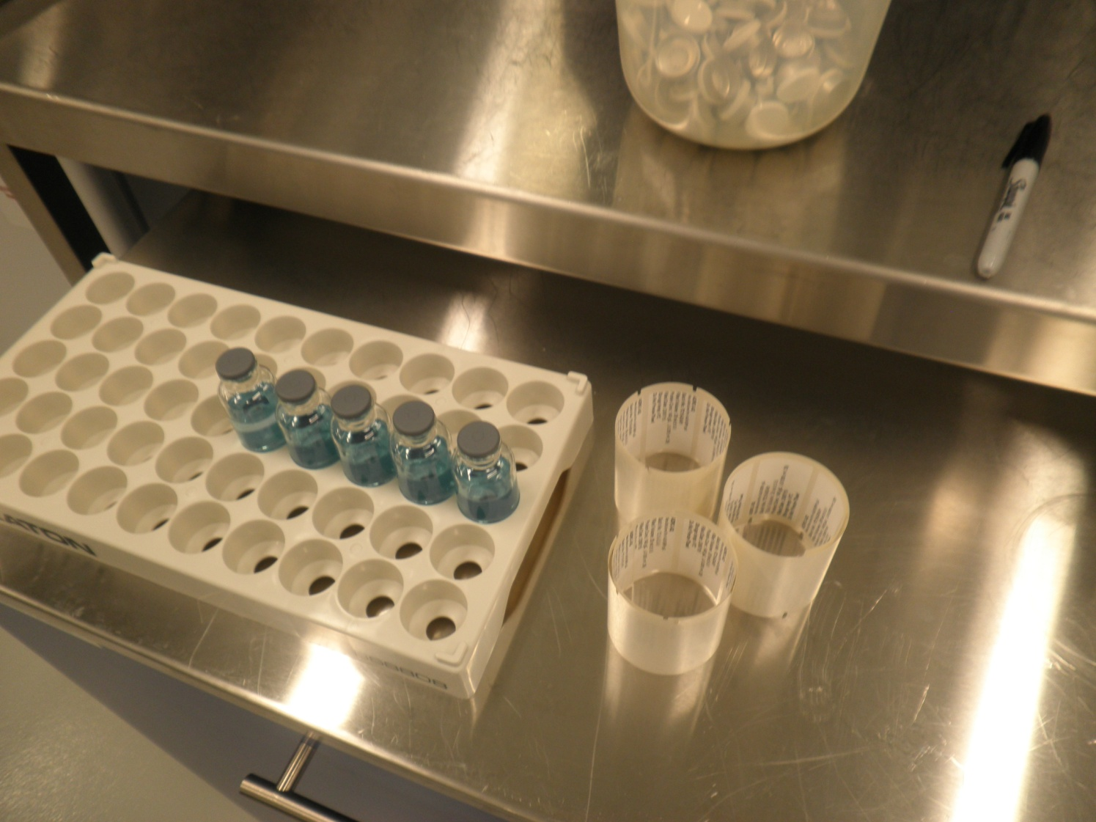
First five vials…

Slide 27
Caprylic acid concentration and purification of horse plasma produces high titre anti-GP IgG
16L of plasma was purified and concentrated to 1.2L (140g/L) of IgG

Slide 28
Conclusions
D637L mutant of EBOV GP is less cytotoxic than wt GP and allows generation of higher titres of KUN-GP replicon VLPs
Two immunizations with 5x10⁶ KUN-GP (both wt and D637L) replicon VLPs protected 75-85% of Guiney pigs from lethal infection with Guiney pig-adapted EBOV
Two immunizations with 10⁹ KUN GP/D637L replicon VLPs induced high titres of anti-GP antibodies and protected 75% of African green monkeys from lethal infection with Zaire EBOV
Boosting with KUN-GP/D637L replicon VLPs significantly increased anti-GP titres in horses pre-immunized with GP-expressing plasmid DNA
High titre purified anti-GP horse IgG have been produced for further trials in animals as anti-EBOV therapeutic

Slide 29
Acknowledgments
UQ- Khromykh lab
Jason Leung*
Vladislav Mokhonov*
Ekaterina Mokhonova*
Ying Xiang Setoh
Judy Edmonds
Gabor Pali
* Former lab members
INSERM, Lyon, France
Victor Volchkov
Olivier Reynard
Valentina Volchkova
UQ- Young lab
Keith Chappell
Daniel Watterson
State Centre for Virology and Biotechnology “Vector”, Russia
Oleg Pyankov
Olga Pyankova
Sergey Bodnev
Vladislav Solodkyi
Stepan Pyankov
Alexander Agafonov
QIMR
Andreas Suhrbier
PLasVacc Pty Ltd
Shane Belford
NCRIS Recombinant Protein Production Facility, CSIRO
George Lovrecz
Tam Pham
Tram Phan
Mylinh La
Louis Lu
Funding:
NIH RO21 grant
AID UQ-QIMR seed grant

