Slide 1

PGMD: a comprehensive pharmacogenomic database for personalized medicine and drug discovery
Alexander Kaplun, PhD

Slide 2
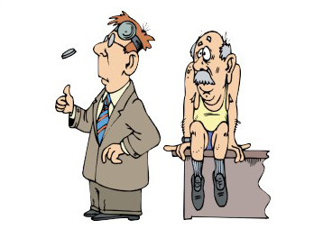
Got diagnosed. Now what?
Notes:
There are multiple approaches a physician can use to come with treatment strategy appropriate for a patient and some of them are more effective then others

Slide 3
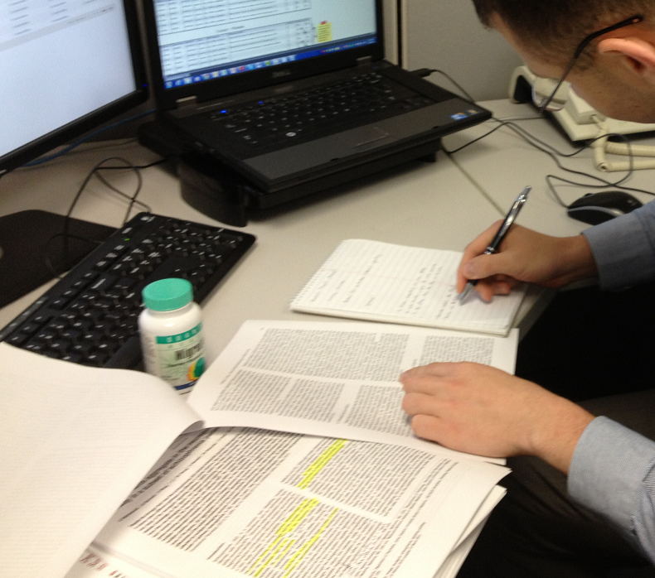
PGMDTM
Comprehensive pharmacogenomic database
PGx/ADME panels
FDA and EMA approved drugs containing PGx labels
Associations from 6500+ publications from 500+ journals studying >1400 drugs
Notes:
Dual curation (manual)
“publications studying how the genetic makeup of individuals contribute to drug response”

Slide 4
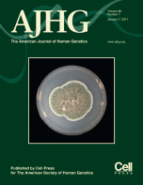
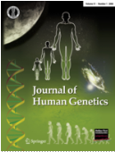
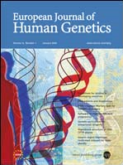
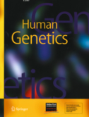

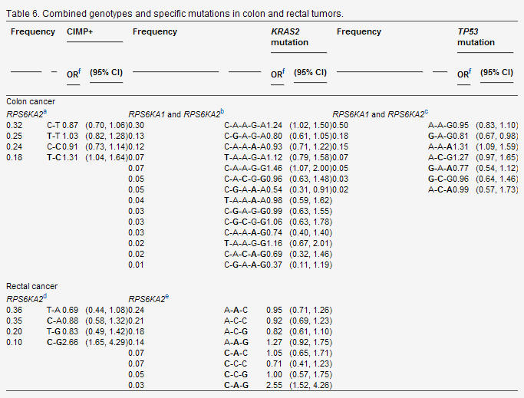

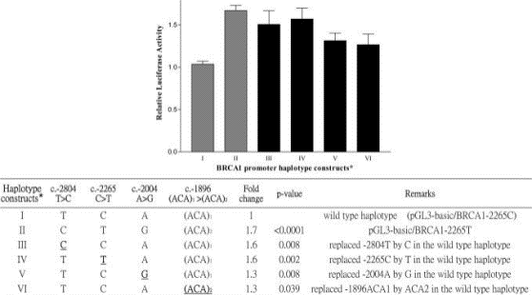
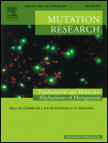
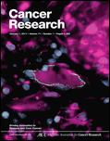
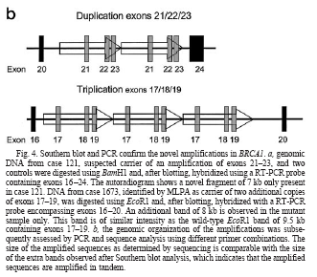
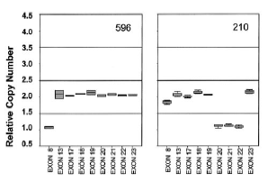
A comprehensive source of PGx data
Focus on peer-reviewed scientific
literature
Experimental results are extracted by
highly trained genetic experts
Content is updated 4x per year

Slide 5
PGMD: PharmacoGenomic Mutation Database
Facilitates
mapping of variants onto genome at position or genotype level
Associations from 6500+ publications from 500+ journals studying >1400 drugs
Genotype/haplotype specific findings
  Median dose requirement of warfarin in patients with CYP2C9*1/CYP2C9*3 haplotype is 2.6 mg
Statistical significance
  p-value - .001
  Relative Risk, Hazards Ratio, 95% Confidence Interval when available
Study details (All studies are in vivo)
  22 cases with A/C genotype, 159 subjects studied, Design - Clinical Trial
  Pop: European Continental Ancestry Group, Age: 24-95, Treatment: All patients are treated with 0.5 mg to 10 mg/day of warfarin
A/C
Notes:
This is only a subset of the types of data we provide for each variant

Slide 6
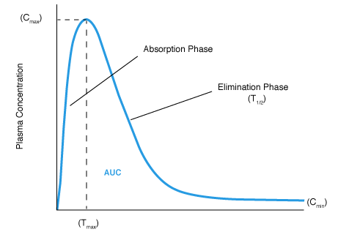
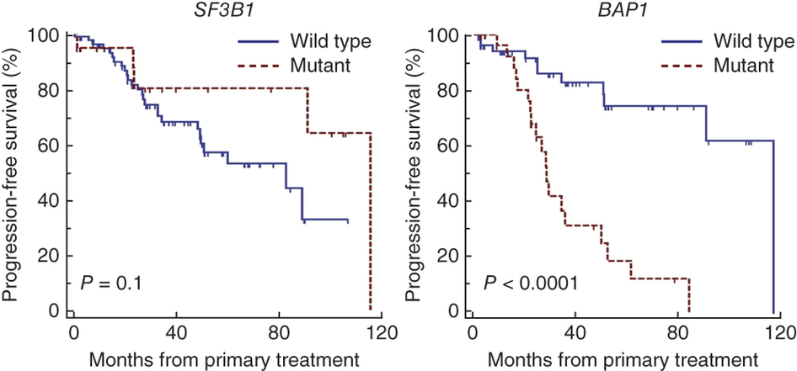
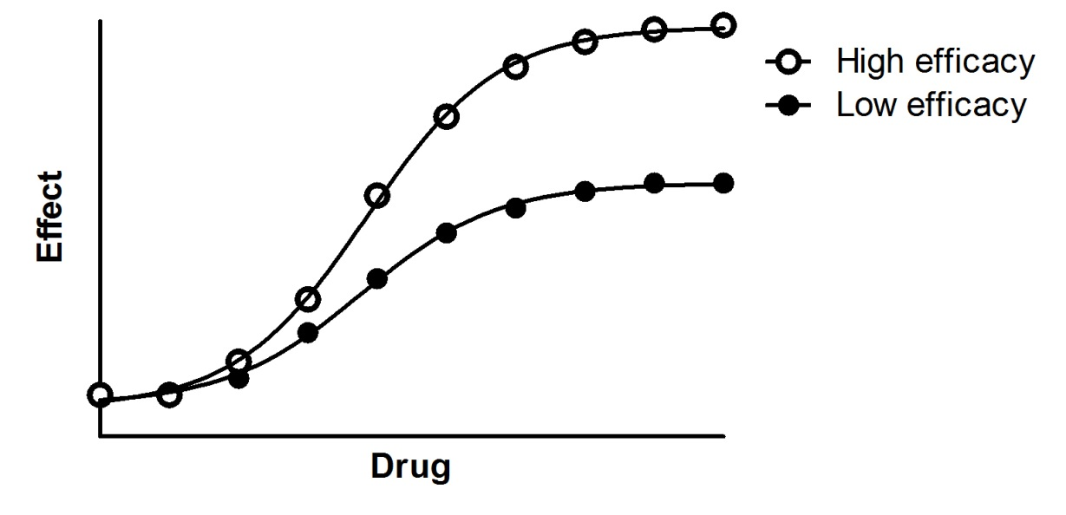
Types of evidence
Notes:
We record evidence of treatment outcome, pharmacokinetics, pharmacodynamics and drug response.

Slide 7
Linkage Disequilibrium
HapMap D’, LOD, and R² scores
Computed for all PGMD sites
  Includes between non-PGMD sites

Slide 8
Allele frequencies
Major sources including:
  EVS
  1000 Genomes
  HapMap

Slide 9
Delivery models
Online
  PGMD Web Interface
Download
  MySQL database
  TSV
  BED
  GFF
Custom Pipeline Integration

Slide 10
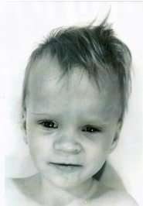
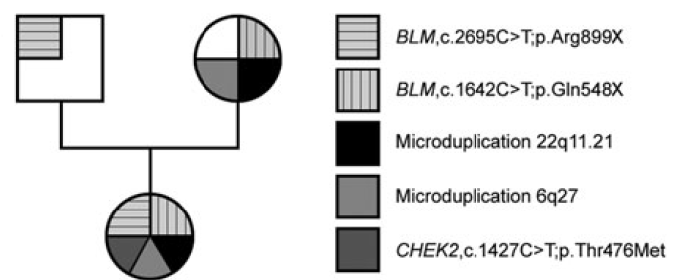
Patient with complex genotype
Notes:
the de-novo CHEK2 variant may increase cancer risk in the patient
the 22q11.2 duplication may increase cancer risk in the patient and enhance the effect of intellectual disabiltiy. By itself it will not produce detectable phenotype, as we can see it in the patient‘s mother, but in combination with Bloom it strongly enhances the effect.
We‘re at the end of our detective story here.

Slide 11
Genome Trax™
Track | Release 2015.1
HGMD® inherited disease mutations | 146,581
HGMD® imputed mutations | 14,570
Pharmacogenomic Variants | 806,806
GWAS Catalogue | 18,735
COSMIC somatic disease mutations | 2,626,811
ClinVar | 127,638
TRANSFAC® experimentally verified TFBS | 15,330
ChIP-seq Transcription Factor Binding Sites | 9,178,528
Predicted TF@DNase I hypersensitivity sites | 10,732,462
miRNA gene sites | 2,735
PTMs (Post-Translational Modifications) | 35,079
PROTEOME ™ disease genes | 14,905
PROTEOME ™ Drug target genes | 2,976
PROTEOME ™ Pathway genes | 2,057
HGMD® disease genes | 27,257
SIFT &Polyphen predictions, conservation | 88,986,833
EVS allele frequencies | 3,663,071
Allele frequency from 1000 Genomes | 12,330,177
dbSNP common SNPs | 13,604,359
dbSNP | 60,879,061
Disease causing variants
Regulatory variants
Candidate Genes
Function prediction & frequency
Over 190 million annotations total

Slide 12
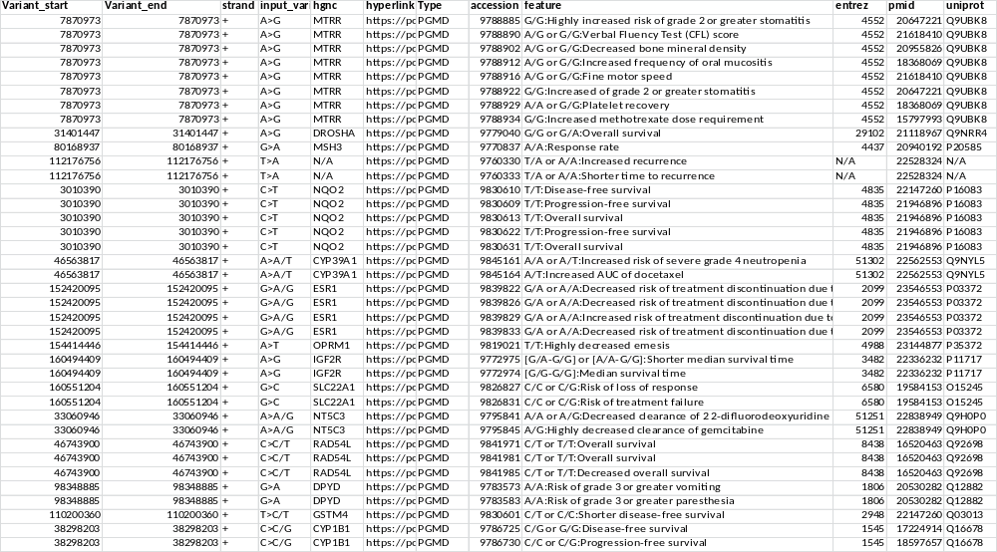
PGMD analysis of the patient’s exome
Notes:
We know that this patient has predisposition to cancer and it would be useful to her physicians to have treatment strategy ready if she develops another cancer

Slide 13
The result: 171 PGx variants
Notes:
171 pgx variants related to different diseases, depression to diabetes

Slide 14
54 of them are cancer therapy related

Slide 15
54 of them are cancer therapy related
NON-SMALL-CELL LUNG CANCER

Slide 16
54 of them are cancer therapy related
NON-SMALL-CELL LUNG CANCER
PLATINUM COMPOUNDS

Slide 17
54 of them are cancer therapy related
NON-SMALL-CELL LUNG CANCER
PLATINUM COMPOUNDS
GEMCITABINE

Slide 18
54 of them are cancer therapy related
NON-SMALL-CELL LUNG CANCER
PLATINUM COMPOUNDS
GEMCITABINE
BREAST CANCER

Slide 19
54 of them are cancer therapy related
NON-SMALL-CELL LUNG CANCER
PLATINUM COMPOUNDS
GEMCITABINE
BREAST CANCER
DOCETAXEL OR OTHER TAXANES
ADJUVANT AROMATASE INHIBITOR THERAPY

Slide 20
54 of them are cancer therapy related
NON-SMALL-CELL LUNG CANCER
PLATINUM COMPOUNDS
GEMCITABINE
BREAST CANCER
DOCETAXEL OR OTHER TAXANES
ADJUVANT AROMATASE INHIBITOR THERAPY
COLORECTAL CANCER

Slide 21
54 of them are cancer therapy related
NON-SMALL-CELL LUNG CANCER
PLATINUM COMPOUNDS
GEMCITABINE
BREAST CANCER
DOCETAXEL OR OTHER TAXANES
ADJUVANT AROMATASE INHIBITOR THERAPY
COLORECTAL CANCER
FOLFOX PROTOCOL

Slide 22
54 of them are cancer therapy related
MULTIPLE CANCERS

Slide 23
54 of them are cancer therapy related
MULTIPLE CANCERS
METHOTREXATE (needs higher dose)
ANTHRACYCLINES (more side effects)

Slide 24
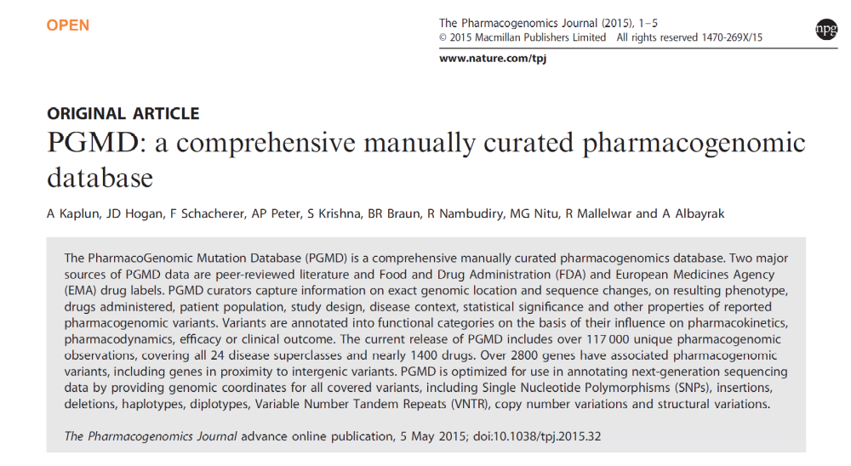

Slide 25


