Slide 1
Global Carbon Cycle.
Interactions of photosynthesis and
Earth crust processes
A.A. Ivlev
Russian State Agrarian University
of K.A. Timiryazev
Moscow, Russia

Slide 2
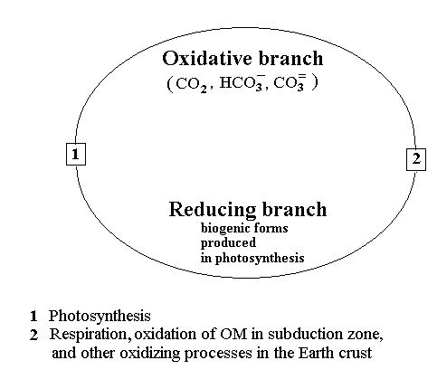
What is global carbon cycle?

Slide 3
Global carbon cycle system

Slide 4
Two geological concepts make the grounds for carbon cycle model:
1. Plate tectonics model (Flint, 1973; Monin, 1977)
2. Orogenic cycles model (Rutten, 1971)
The new approach to carbon cycle model combines two concepts and suggests:
Lithospheric plates movement is irregular and determines pulsating CO2 injections into “atmosphere – hydrosphere” system.
In orogenic period plates move quickly and collisions are frequent. In geosynclynal period plates move slowly and collisions are rare.

Slide 5
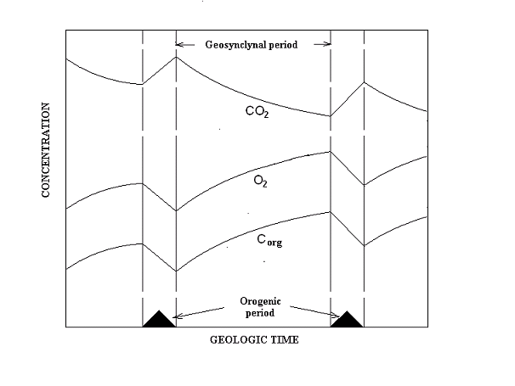

Dynamics of some global carbon cycle parameters

Slide 6
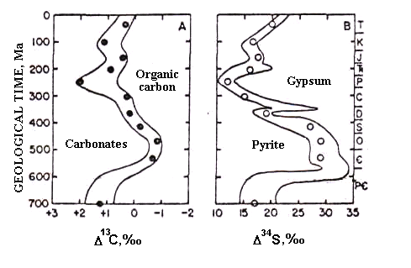
Argument 1. Carbon and sulfur cycles coupling

Slide 7
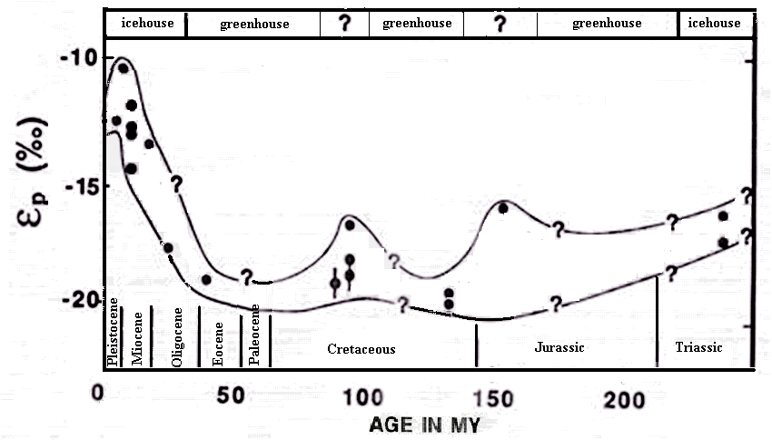
Argument 2. Climatic correlations

Slide 8
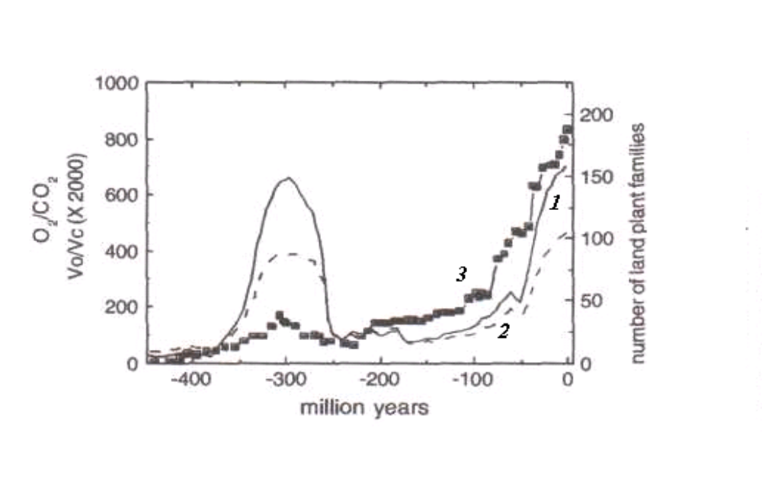
Argument 3. Correlation of biodiversity rate with oxygen concentration

Slide 9
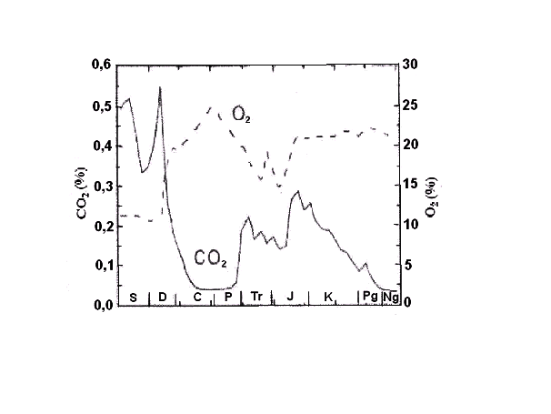
Argument 6 Anti-phase dynamics of atmospheric CO2 and
oxygen in geological time (Igamberdiev & Lee, 2006)

Slide 10
Argument 7. Similar dynamics of atmospheric oxygen and burial
organic carbon rate

Slide 11
Argument 8. Geological correlations

Slide 12
nt.
The conclusions
Global carbon cycle is considered as a transfer of the element from one geospheres to another under the control of redox state of the element.
The transition of carbon from the oxidative to the reduced state is provided by photosynthesis. The reverse transition is realized through the numerous oxidation processes. The main contributor to oxidation of organic matter is the sulfate reduction in the subduction zones.
According to the model, global carbon cycle and photosynthesis appeared simultaneously and developed synchronously. Their evolution was followed by decrease in CO₂ and by growth of O₂ concentrations in the atmosphere and by accumulation of organic matter in the Earth deposits.
Carbon and sulfur cycle are coupled through the sulfate reduction occurring in subduction zone

Slide 13
Thank you for your attention

