Slide 1
Low cost fabrication of organic semiconductor monolayer via Organic Solid-Solid Wetting Deposition (OSWD): physico-chemical basics, controllability, process capability
11.08.2015
Alexander Eberle

Slide 2
Outline
Solid-solid wetting
Organic solid-solid wetting deposition
The role of the dispersing agent
Possible prospective applications of OSWD

Slide 3
Question
„What is solid-solid-wetting?“

Slide 4
Solid-solid wetting
Published 1985 (J. Haber) / 1988 (H. Knözinger)
Assembly of monolayers after heating up > 450 °C
No surface- or gas-phase-diffusion, no chemical reactions
Slope in the surface free energy, like a waterdrop wetting a surface
 | Active phase
Substrate | CrO_{x} | MnO_{x} | VO_{x} | WO_{x} | NbO_{x} | TaO_{x} | MoO_{x} | ZrO_{x}
Anatas | X | X | X | X | X | X | X | X
Al₂O₃ | X | X | X |  | X | X |  | X
SiO₂ |  |  |  |  | X | X
F. Bertinchamps, C. Grégoire, E. M. Gaigneaux: „Systematic investigation of supported transition metal oxide based formulations for the catalytic oxidative elimination of (chloro)-aromatics; Applied Catalysis B: Environmental 2006

Slide 5
Advancement
Organic solid-solid wetting deposition
F. Trixler, T. Markert, M. Lackinger, F. Jamitzky, W.M. Heckl: „Supramolecular self-assembly initiated by solid-solid wetting“; Chemistry – a European Journal 2007, 13, 7785-7790

Slide 6
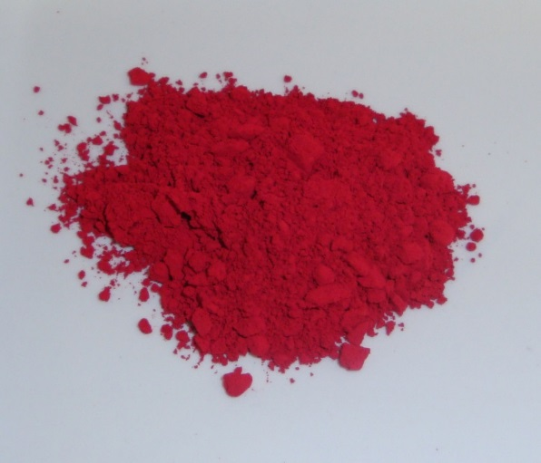
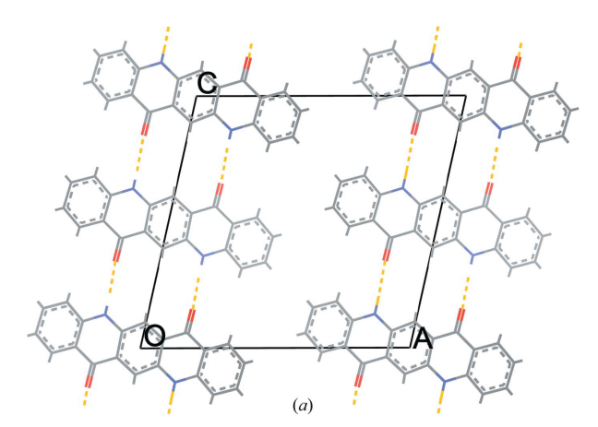
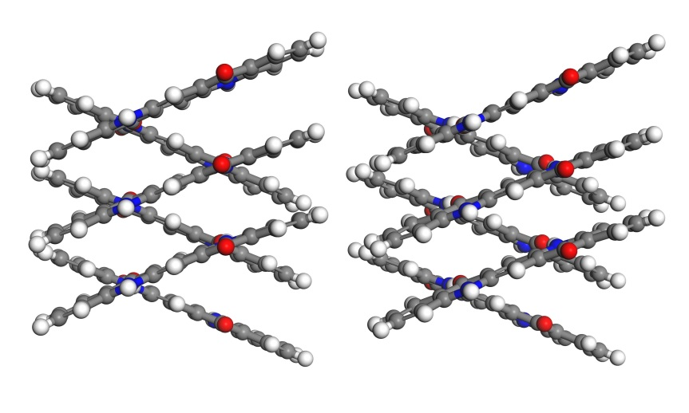
γ-Quinacridone
γ Quinacridone
SEM picture of γQAC Nanocrystals
Nanocrystals built up by hydrogen-bonds
3D structure of γQAC nanocrystals

Slide 7
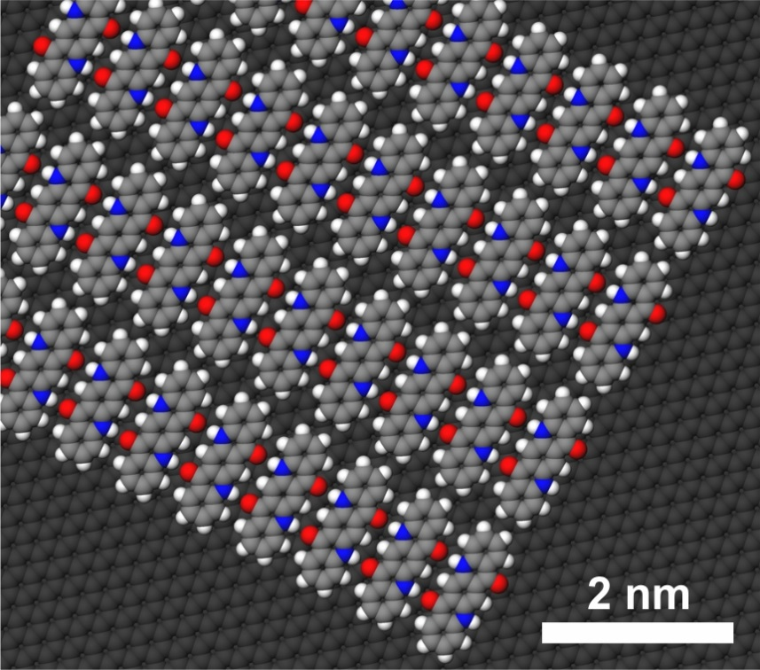
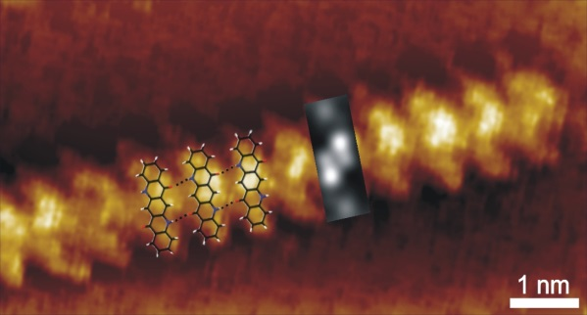
OSWD
2D-Model: γQAC on HOPG
STM-picture:
8CB & γ-Quinacridone
γQAC: STM & DFT

Slide 8
Advantages of OSWD
Ambient conditions
Organic semiconductors
No need for solubility
Domain growth, size & structure can be directed & engineered

Slide 9
Question
„Does the dispersing agent affect the coverage and structure of the QAC arrays?“

Slide 10
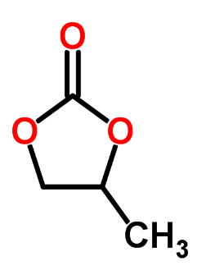
Class 1: Good OSWD
Propylene carbonate + γQAC
Water + γQAC + KOH (pH 8)

Slide 11
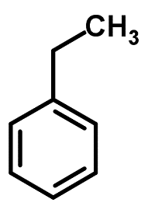
Class 2: Medium OSWD
Ethylbenzene + γQAC
Water + γQAC

Slide 12
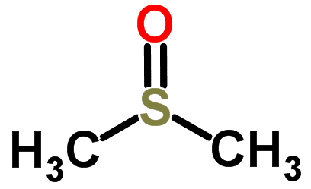

Class 3: No OSWD
Dimethyl sulfoxide+ γQAC
Dodecane + γQAC

Slide 13
Summary
The dispersing agent directs the monolayer properties
The chemical structure of the dispersing agent does hardly affect the OSWD
Neither do the physical properties viscosity, vapor pressure, surface tension, permittivity

Slide 14
Question
„What parameter directs the surface coverage rate?“

Slide 15
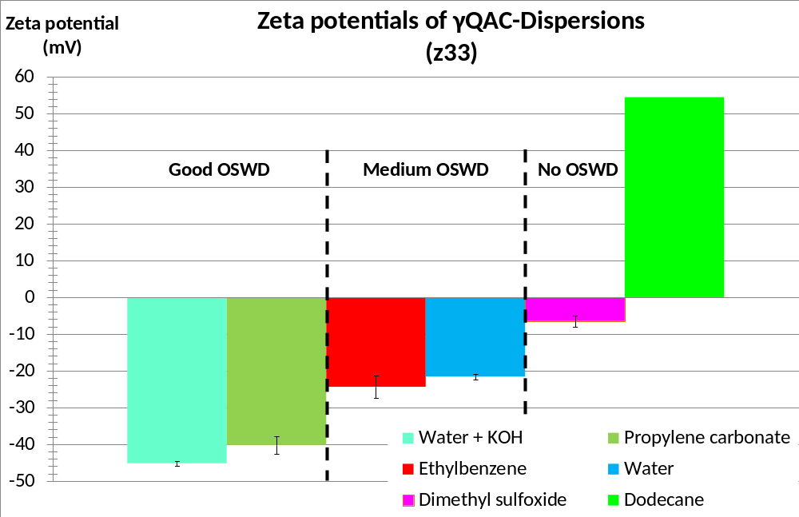
The monolayer coverage fits to the zeta potential (z33)

Slide 16
Question
„How might solid-solid wetting work under ambient conditions?“

Slide 17
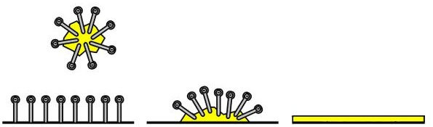
Functional principle of the dispersing agent
dispersion → physisorption → monolayer
Due to the solvation in the dispersing agent the nanocrystals gain a zeta potential
The zetapotential changes the surface free energy, hence the interfacial tension
If adhesion > cohesion, then the molecule mobility enables self-assembly

Slide 18
Question
„What might be possible prospective applications of OSWD?“

Slide 19
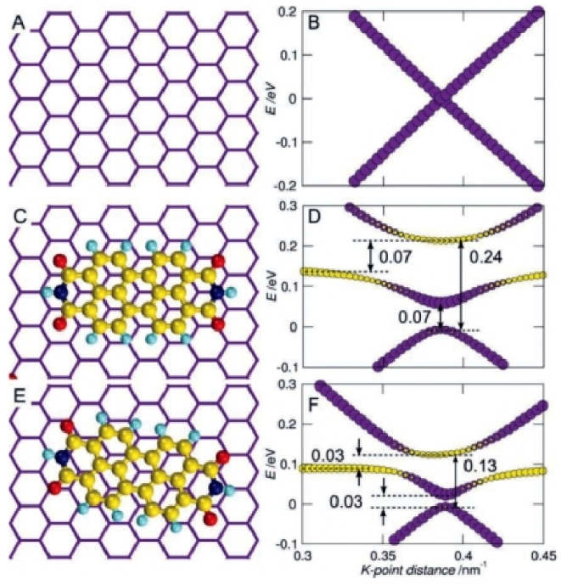
Outlook band gap engineering
Graphene / PTCDI
Left: Positions to each other
Right: band gap structure
H. Medina, Y.-C. Lin, D. Obergfell, P.-W. Chiu: „Tuning of charge densities in graphene by molecule doping“; Advanced Functional Materials 2011
Band gap depends on chemical- and domain structure of the semiconductor → engineering possible

Slide 20
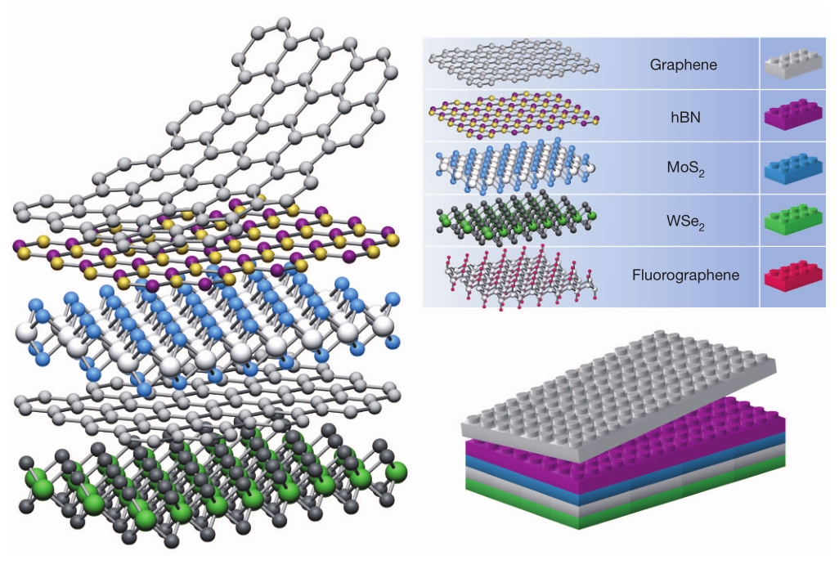
Outlook
Van der Waals heterostructures
A. K. Geim, I. V. Grigorieva: „Van der waals heterostructures”; Nature 2013
Assembly of Van der Waals heterostructures imaginable

Slide 21
Double structures
Water + Disodium phosphate – γQAC
Propylene carbonate – γQAC
Double structures can already be assembled

Slide 22
Take home message
OSWD offers the possibility for cheap a large-scale production of directable and engineerable monomolecular semiconductor layers with an huge spectrum of possible organic semiconductors, substrates and application possibilities

Slide 23
Acknowledgement
Frank Trixler
Michaela Wenner
Volker Diete-Wendl
Klaus Macknapp
Martina Zeiler (PTS)
Veronika Schömig (TUM)

Slide 24
Directed domain growth voltage pulse
Aceton – γQAC
Aceton – γQAC
pulse 4,96 V

Slide 25
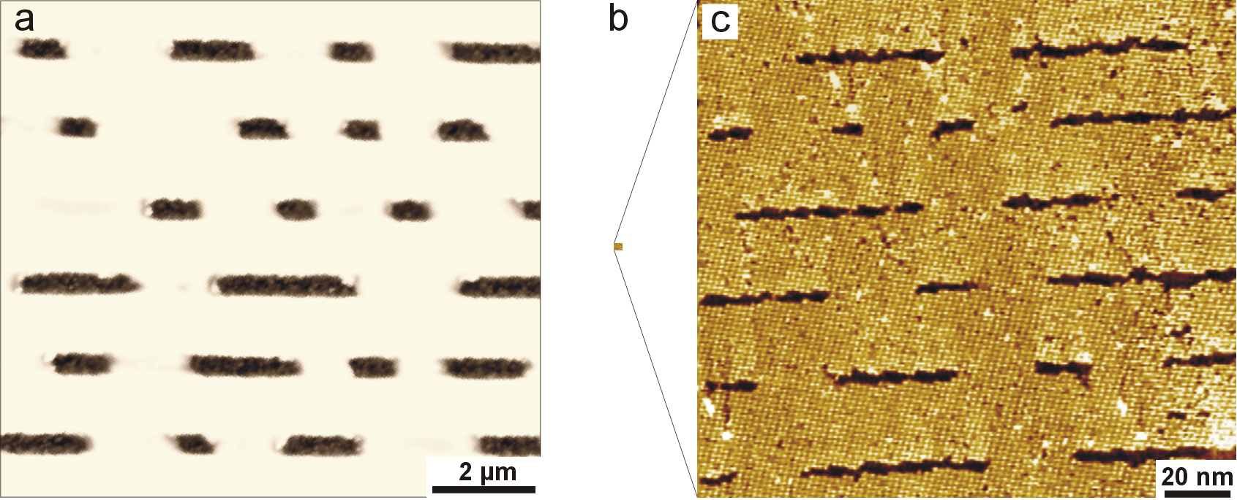
Nanomanipulation
CD - structures
Manipulated structures in PTCDA domain
Possible way to build up nano-circuits

Slide 26
Directed domain growth
Electric field
H2O + NaCl + γQAC
1 Scans, change in scan direction, another 2 scans

Slide 27
Directed domain growth
Mechanical pressure
8CB – γQAC
before comminute
8CB – γQAC
after comminute

Slide 28
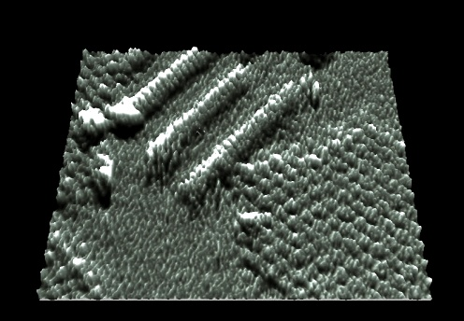
Directed growth
Locally induced co-adsorption
QAC
PTCDA
Two domains of different pigments at the same time

Slide 29
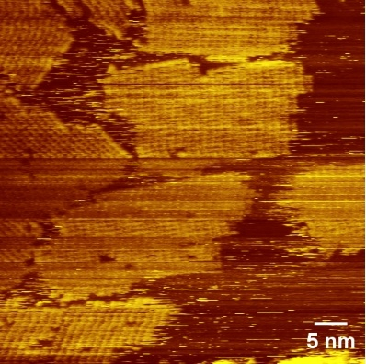
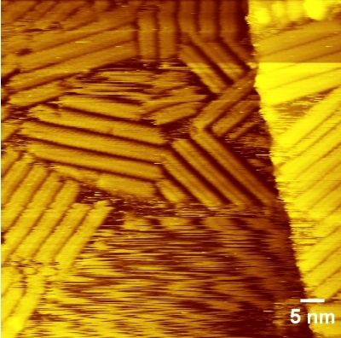
Directed domain growth dispersing agent
Additional
8CB
Olic acid
homogeneous Flavanthrone domains
8CB
Flavanthrone in double series structure

Slide 30
Directed domain growth
Mechanical pressure
γQAC without liquid phase
After comminute

Slide 31
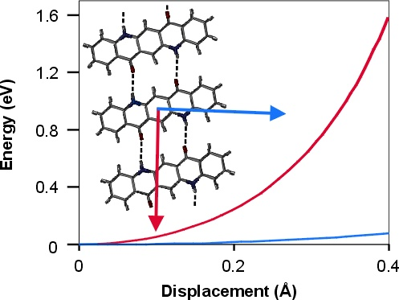
Richtungsänderung der Domänen
Molekül-Ketten-Stabilität vs. Auslenkung mittels STM-Spitze
Die Bindungsenergie der Molekülkette ist richtungsabhängig

Slide 32
Pure γQAC, heated up to 240 °C on graphit substrate

Slide 33
OSWD: Applicability
Pigments | Dispersing agents | Substrates
γ-Quinacridone (γQAC) | 6CB (4´-Hexyl-4-biphenylcarbonitril) | Graphite
β-Quinacridone | 7CB (4´-Heptyl-4-biphenyl-carbonitril) | Graphene
Dimethyl-Quinacridone | 8CB (4´-N-Octylbiphenyl-4-carbonitril) | Carbon Nanotubes
Dichloro-Quinacridone | Oelic acid | MoS₂
Quinacridone-Chinon | Vitamin K1
Alizarin-Komplex | Alkyd resin
Acridone | Ethyl acetate
Perinone | Diethylene glycol
Flavanthrone | 2-Propanol
Indanthrone | Acetone
Me-PTCDI | Glycerol
PTCDA | Propylene carbonate
Phthalocyanine Pentacene | Water Ethylbenzene Propane-1,2-diol Anisole Dimethyl sulfoxide 3-Methyl-1-Butanol
During my Ph.D.
OSWD: So far observed with 14 pigments and 18 different dispersing agents on 4 substrates

Slide 34
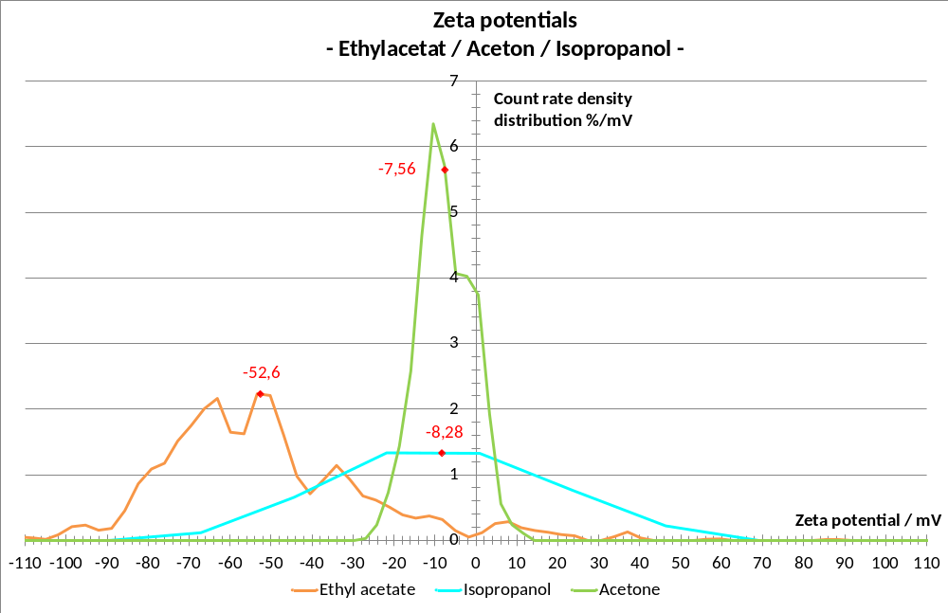
The Zeta potential is related to a distribution

Slide 35
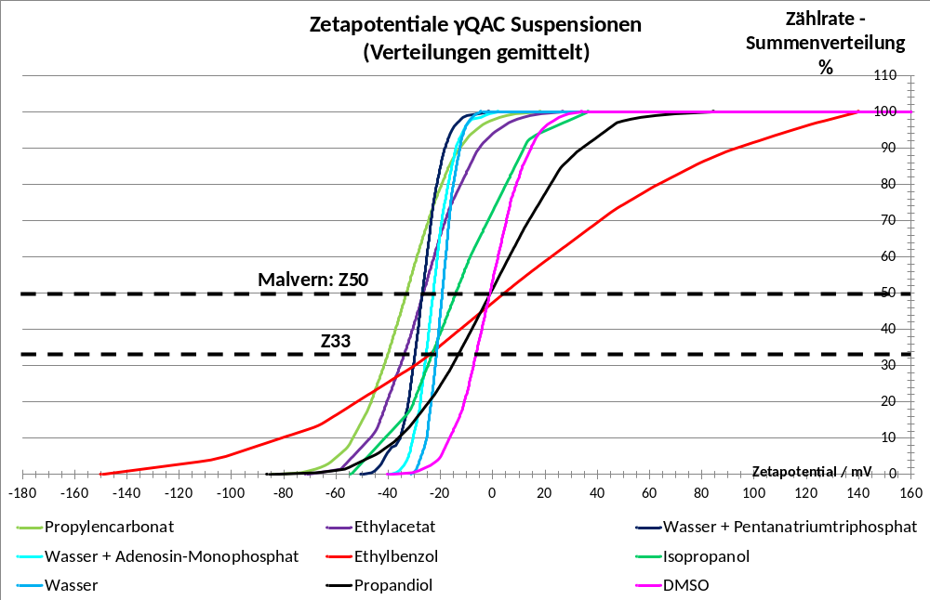
Unterschied Z50 – Z33

Slide 36
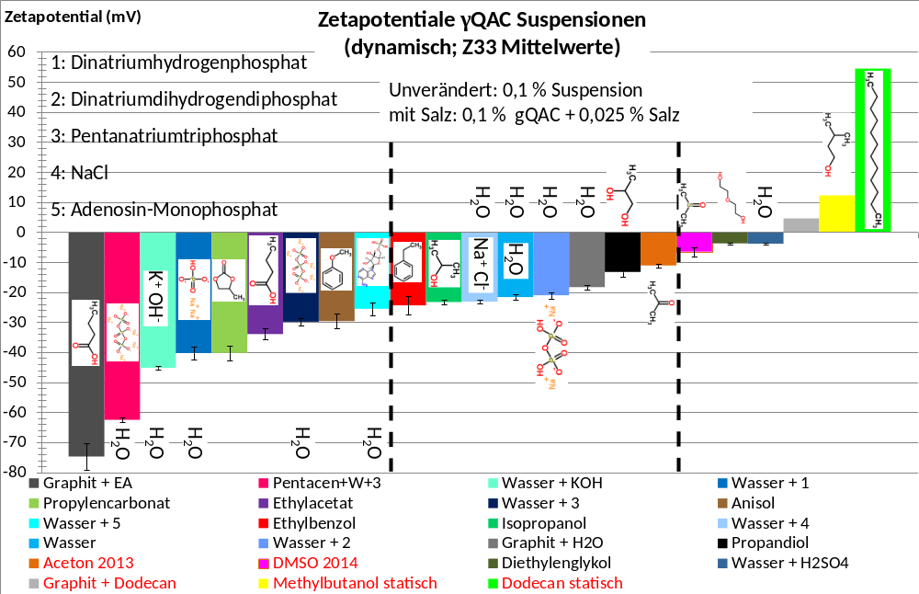

Slide 37
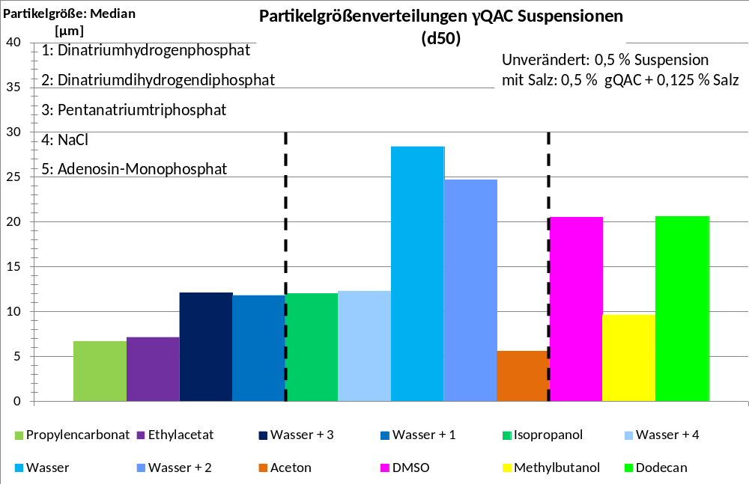

Slide 38
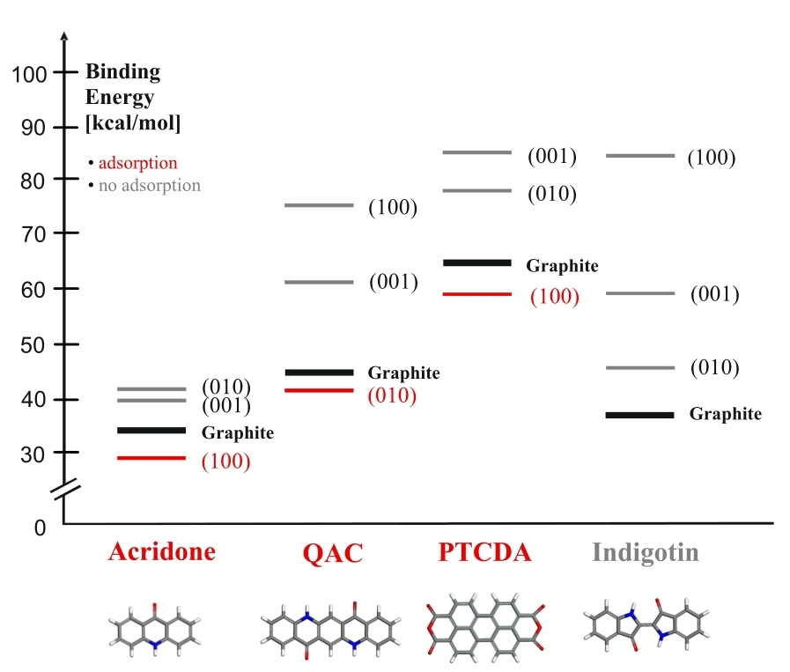
Force field calculation
Dreiding force field
Theory proof:
Acridone / QAC / PTCDA: adhesion > cohesion
Indigotin: no OSWD

Slide 39
Liquid p. d. vs. solid-solid w.
8CB – Phthalocyanin
Monolayer
liquid phase deposition
8CB – γQAC
Domains
solid-solid wetting

Slide 40
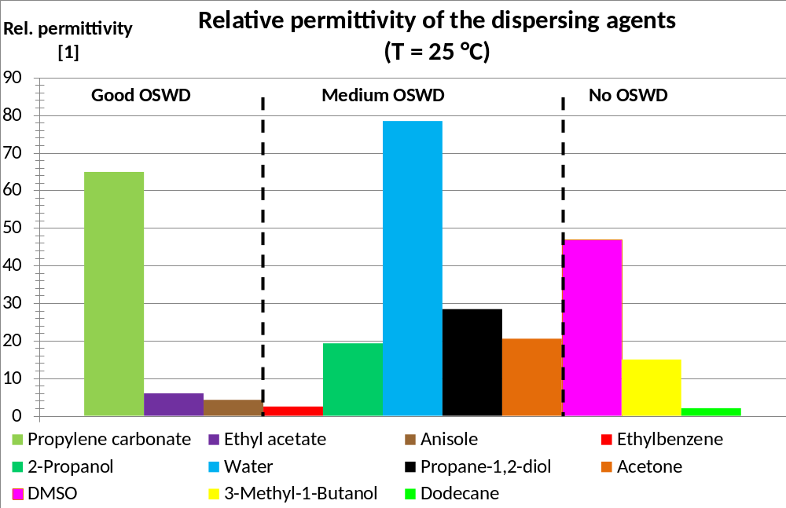

Slide 41
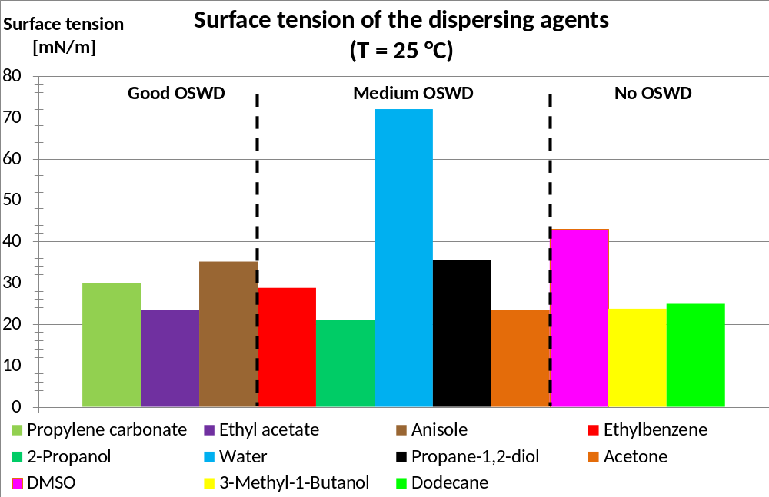

Slide 42
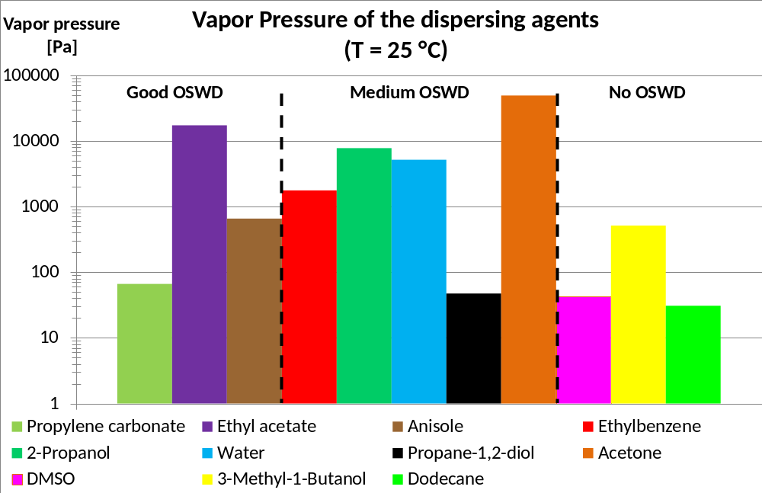

Slide 43
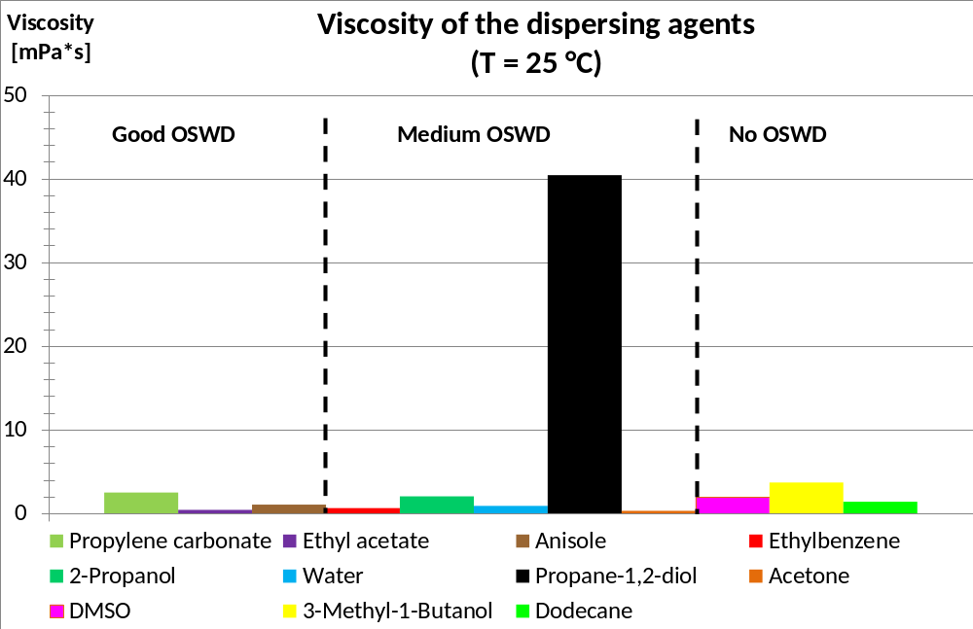

Slide 44
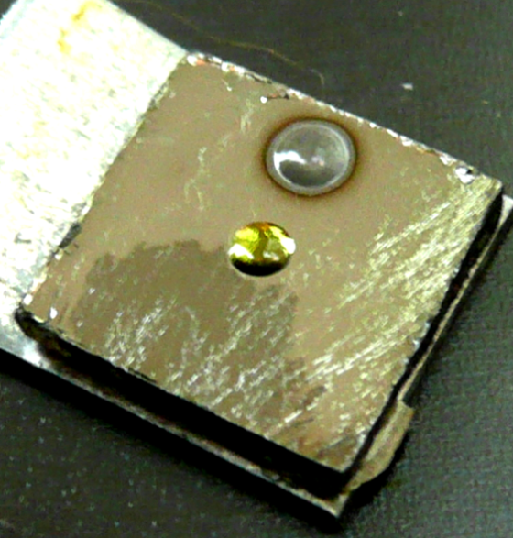
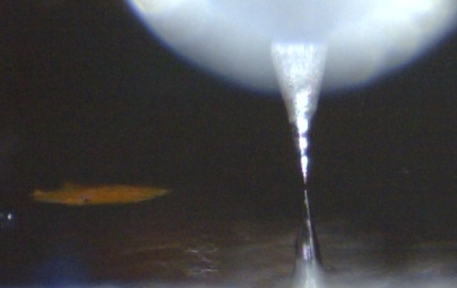
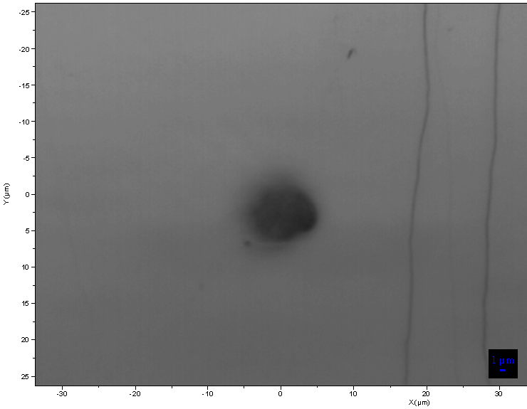
Directed growth
Dispersing agents
8 CB
Vitamin K1
Oelic acid
Different dispersing agents offer different manufacturing techniques
E.g.: dip-pen (OSWD confirmed via STM)
10 µm

