Slide 1
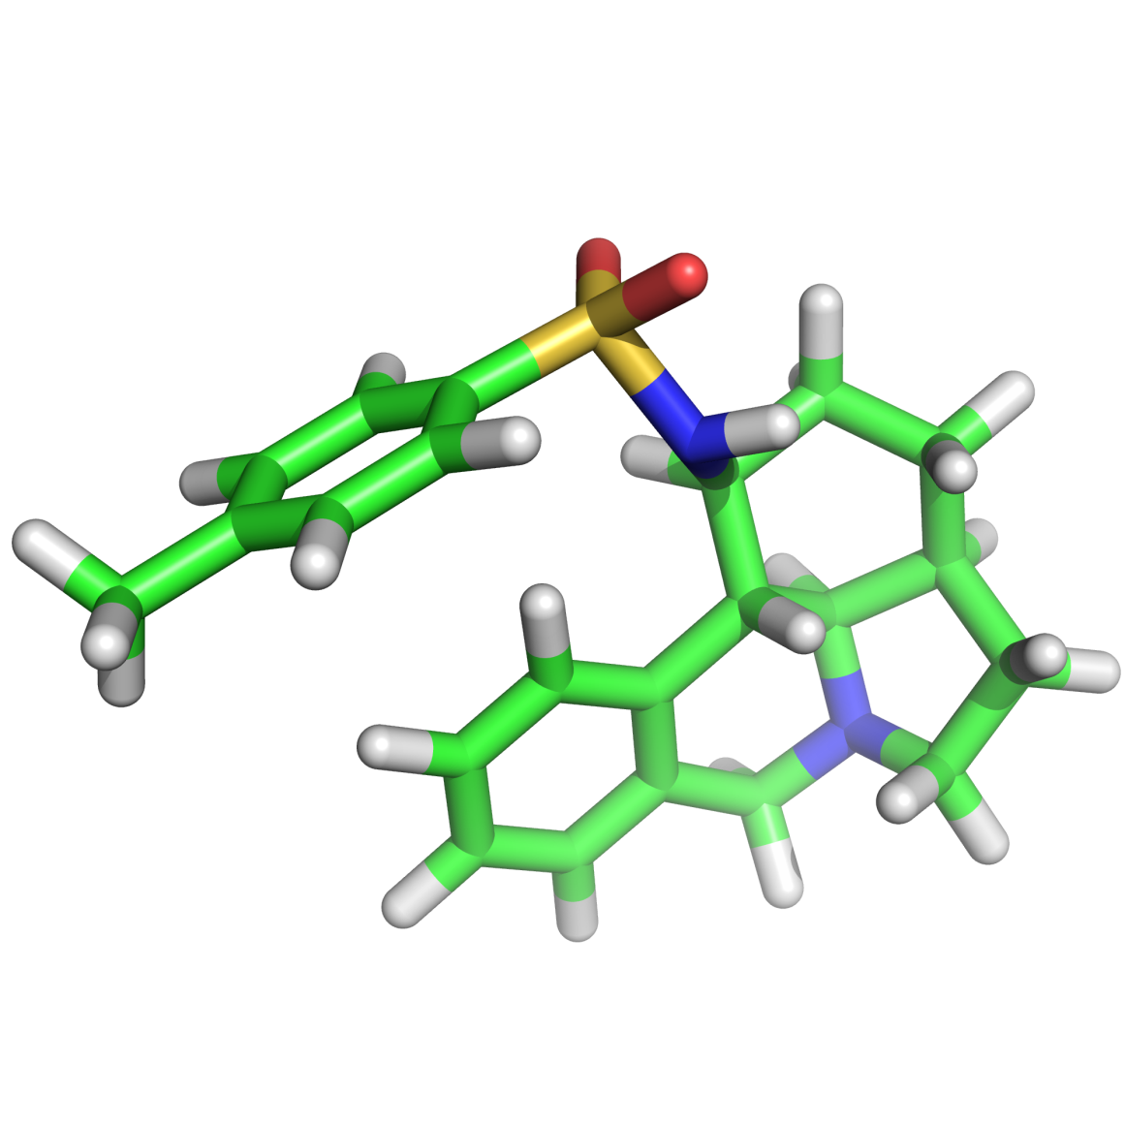

Hydrogen Bonding Catalysis and the Synthesis of Unnatural Biomolecules
Dr A. J. Andre Cobb
University of Reading.
a.j.a.cobb@reading.ac.uk

Slide 2
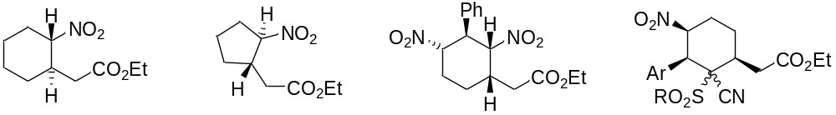
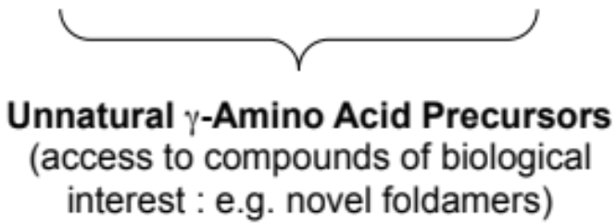
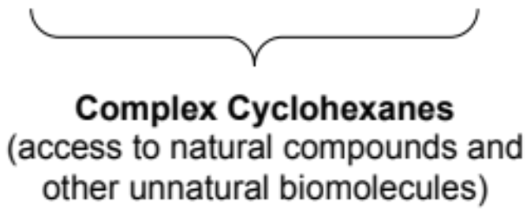
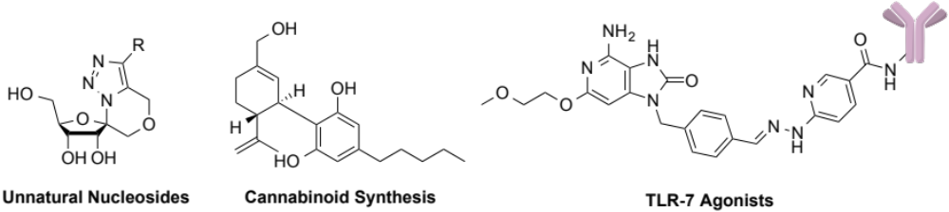
Group Research
Asymmetric Organocatalysis
Chemical Biology and Medicinal Chemistry

Slide 3
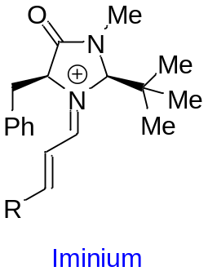
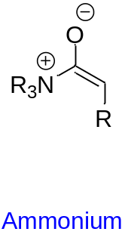
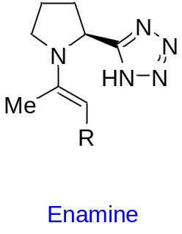
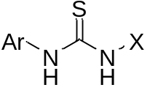
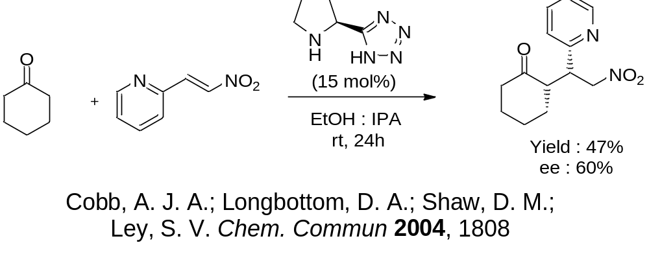
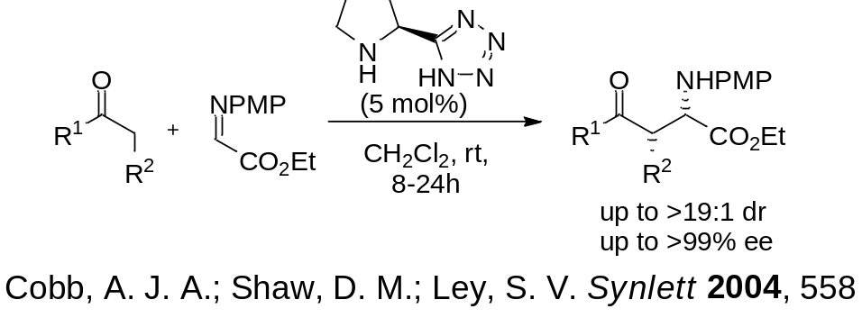
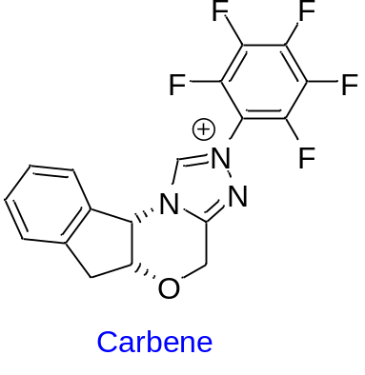
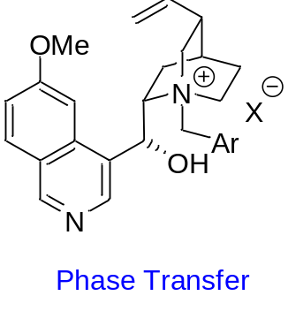
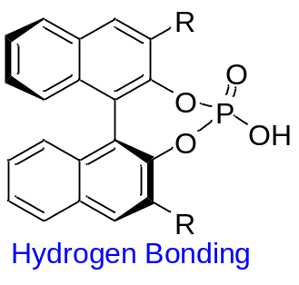
Asymmetric Organocatalysis
Organocatalysis : the use of small organic molecules to catalyze organic transformations.

Slide 4
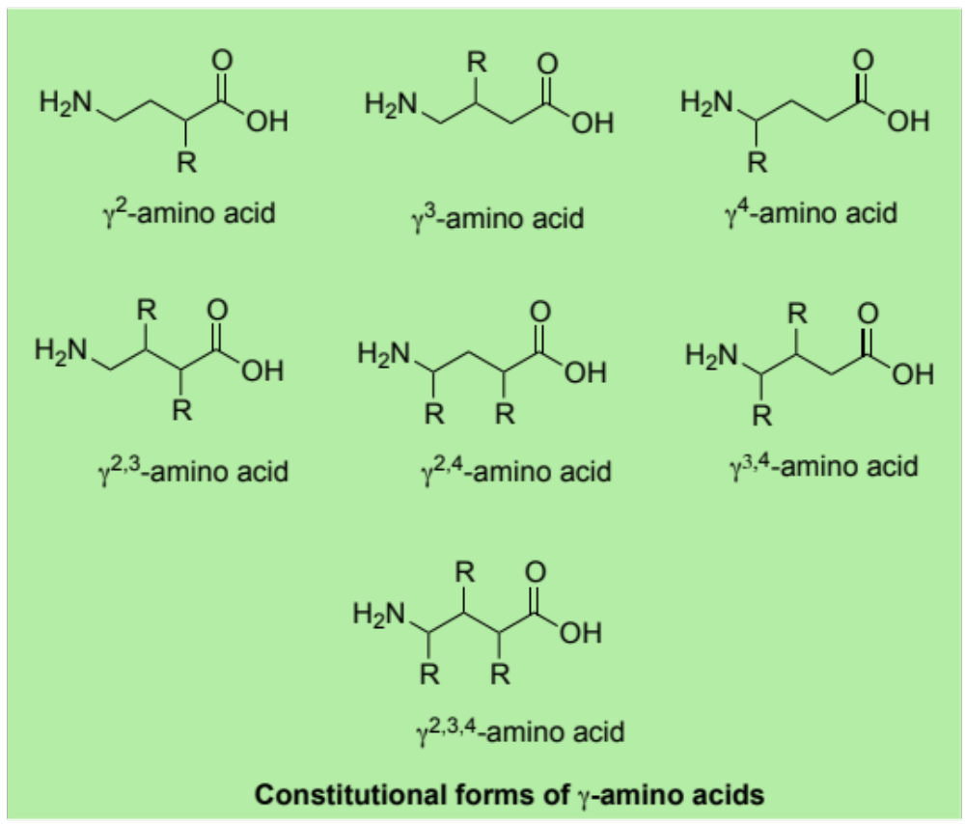
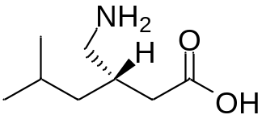
Organocatalytic Access to γ-Amino Acids
Biologically important class of molecule.
E.g. Lyrica (pregabalin), an anticonvulsant used in the treatment of epilepsy
Difficult class of compound to make enantioselectively.
Can organocatalysis address this?

Slide 5
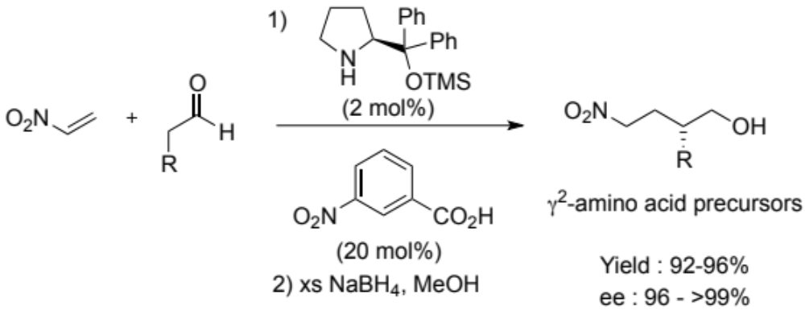
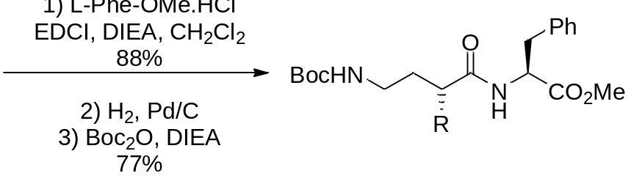
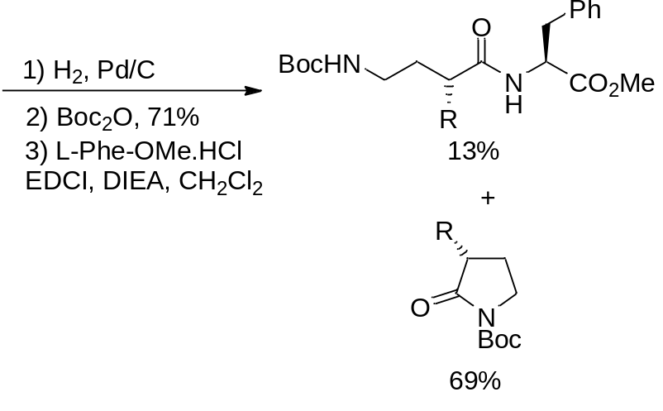
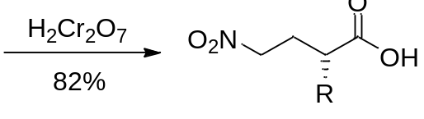
Organocatalytic Access to γ-Amino Acids
via Enamines
Chi, Y.; Guo, L.; Kopf, N. A.; Gellman, S. H. J. Am. Chem. Soc. 2008, 130, 5608.

Slide 6
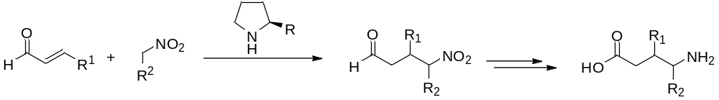
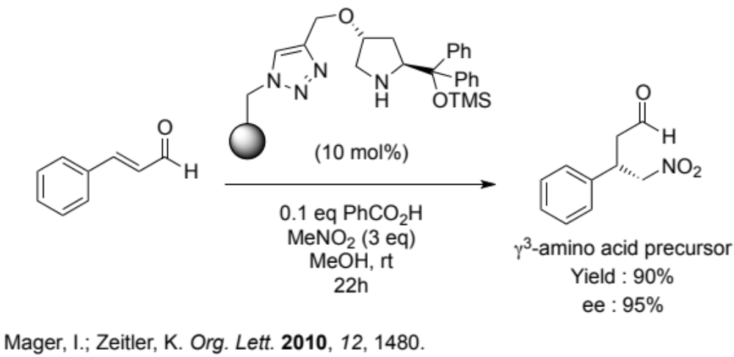
Organocatalytic Access to γ-Amino Acids
Via Iminium ion

Slide 7
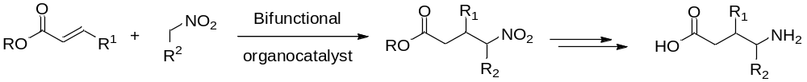
Organocatalytic Access to γ-Amino Acids
Addition of nitronate onto conjugated ester using bifunctional catalysis

Slide 8
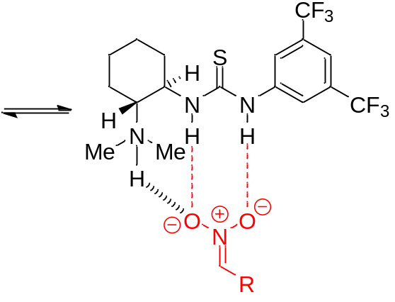
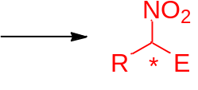

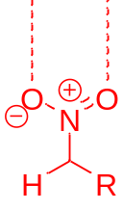
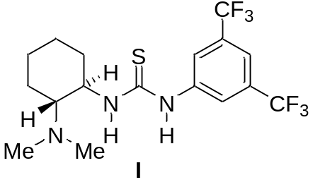

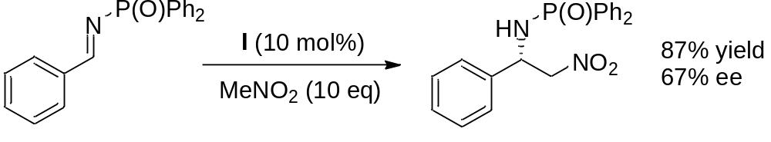
H-Bonding Catalysis
Bifunctional thiourea catalysts
Okino, T.; Nakamura, S.; Furukawa, T.; Takemoto, Y. Org. Lett. 2003, 5, 625.

Slide 9
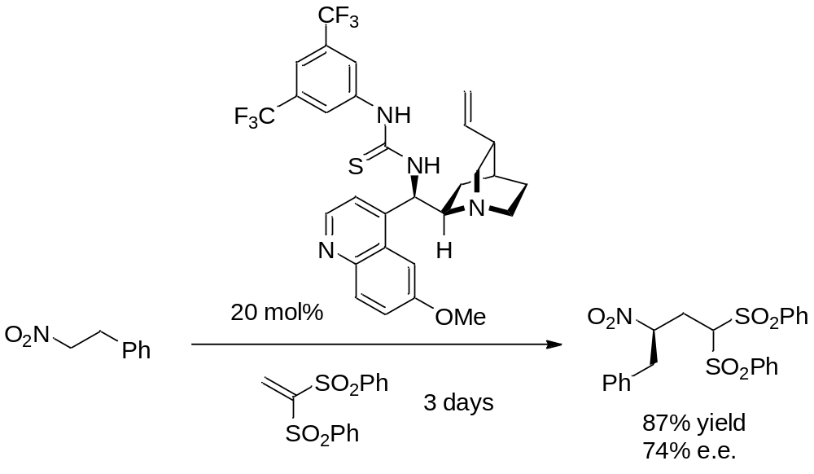
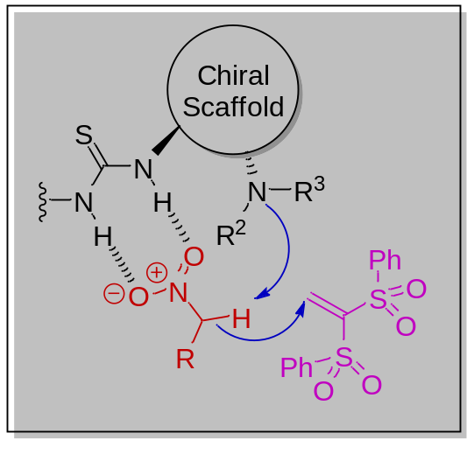
H-Bonding Catalysis
Michael Additions with Bifunctional Organocatalysts
Zhu, Q.; Lu, Y. Org. Lett. 2009, 11, 1721.

Slide 10
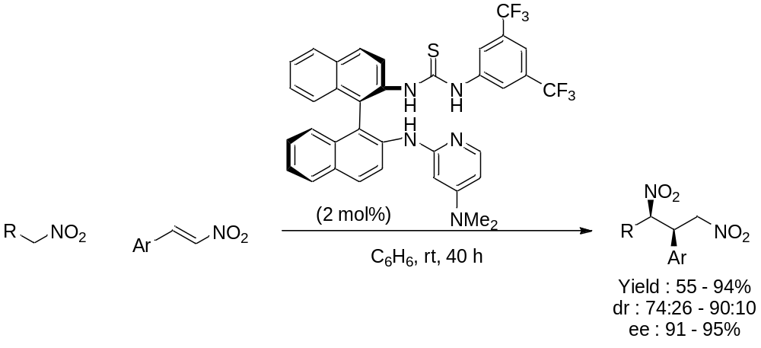
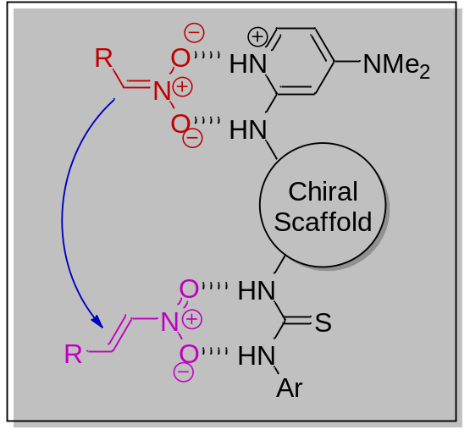
H-Bonding Catalysis
Michael Additions with Bifunctional Organocatalysts
Rabalakos, C.; Wulff, W. D. J. Am. Chem. Soc. 2008, 130, 13524

Slide 11
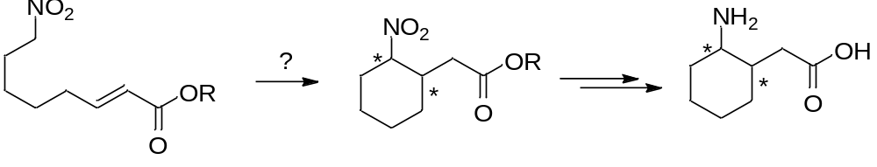
Intramolecular Reactivity?
No examples of nitronates reacting intramolecularly using bifunctional catalysis
Would lead to cyclic γ-amino acids.
Conjugated esters rare in organocatalysis as Michael acceptors

Slide 12
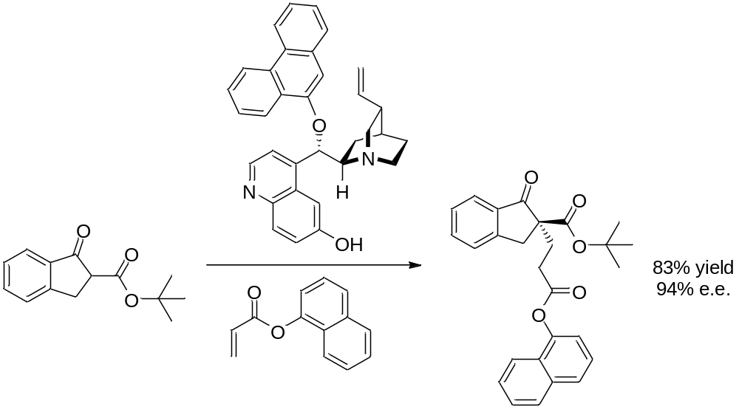
Conjugated Esters as Electrophiles
Rigby, C. L.; Dixon, D. J. Chem. Commun. 2008, 3798.

Slide 13
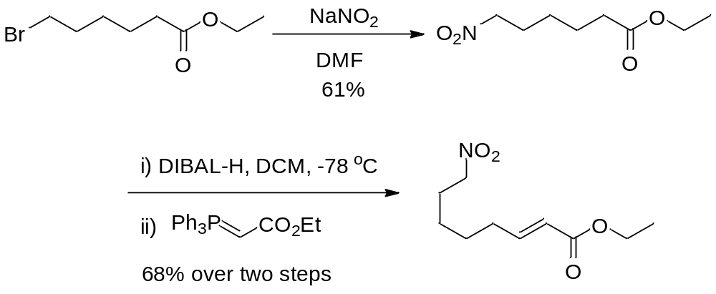
Intramolecular Reaction of Nitronates onto Conjugated Esters
Substrate synthesis

Slide 14
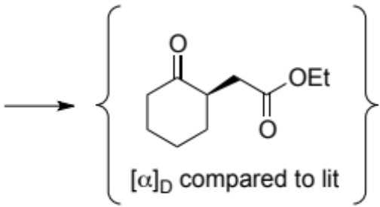
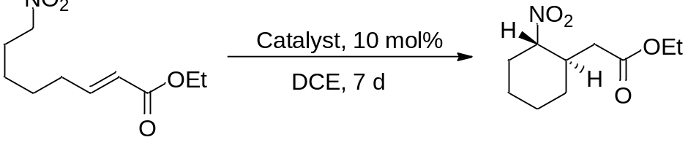
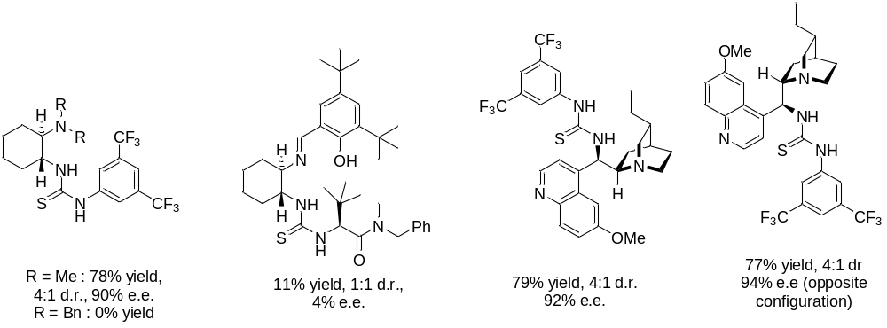
Bifuntional Catalyst Screen

Slide 15
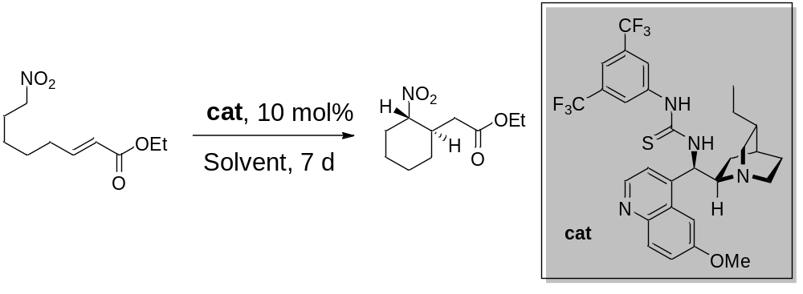
Solvent Screen
Entry | Solvent | Yield | d.r. | e.e. (%)
1 | THF | 67 | >19:1 | 95
2 | C₆H₆ | 71 | 2:1 | 96
3 | CH₂Cl₂ | 83 | >19:1 | 95
4 | H₂O | 51 | 9:1 | 95
5 | MeCN | 87 | >19:1 | 95
6 | None | 80 | 5:1 | 96

Slide 16
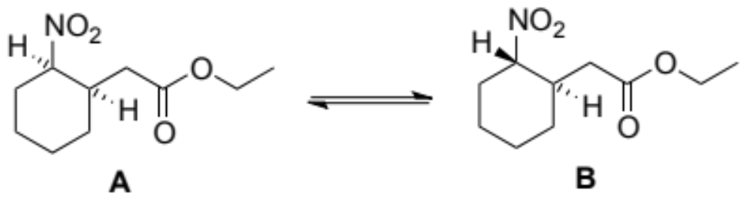
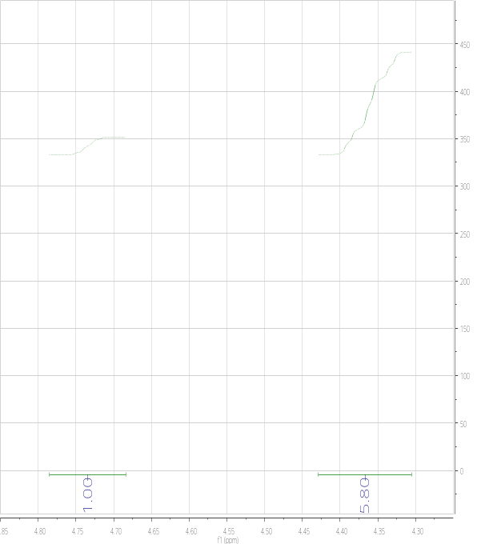

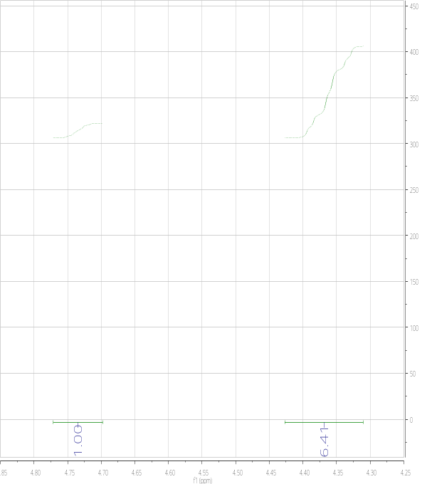
A note on diastereoselectivity
Reaction time is important
1 day, 1:5.8
3 day2, 1:6.1
6 days, 1:6.4

Slide 17
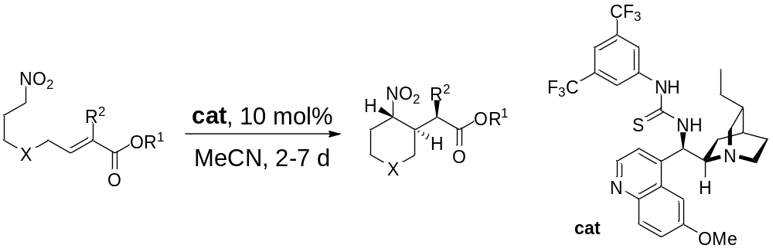
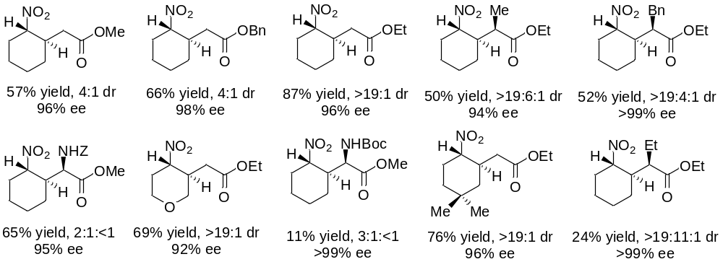
Substrate Scope

Slide 18
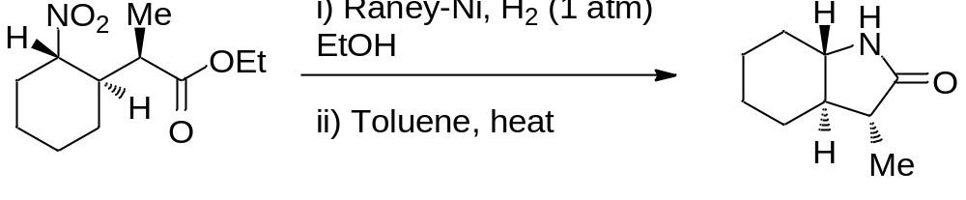
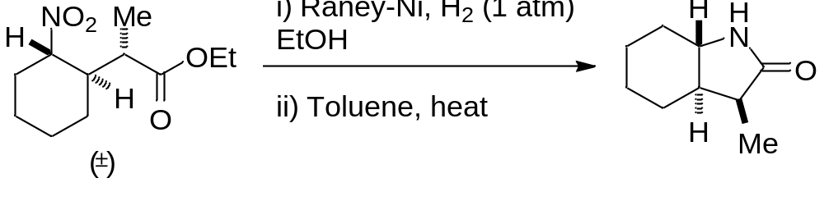
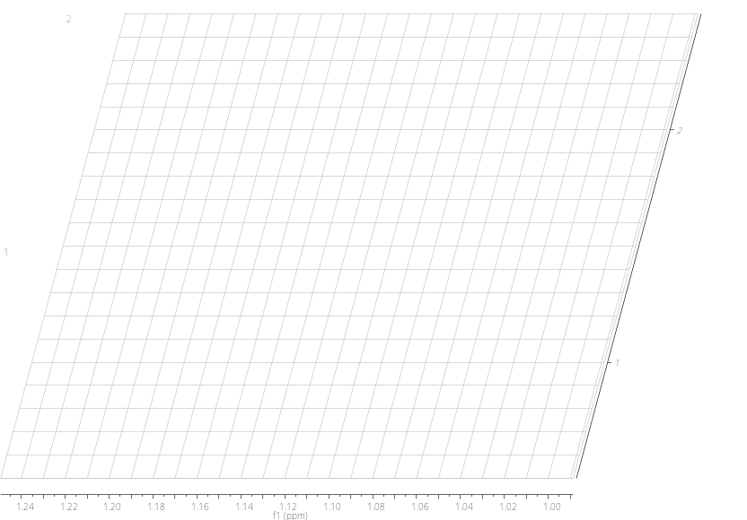
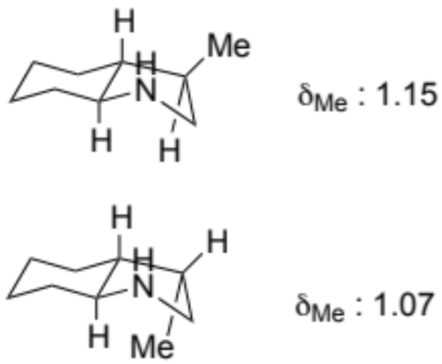
Stereochemical Assignment

Slide 19
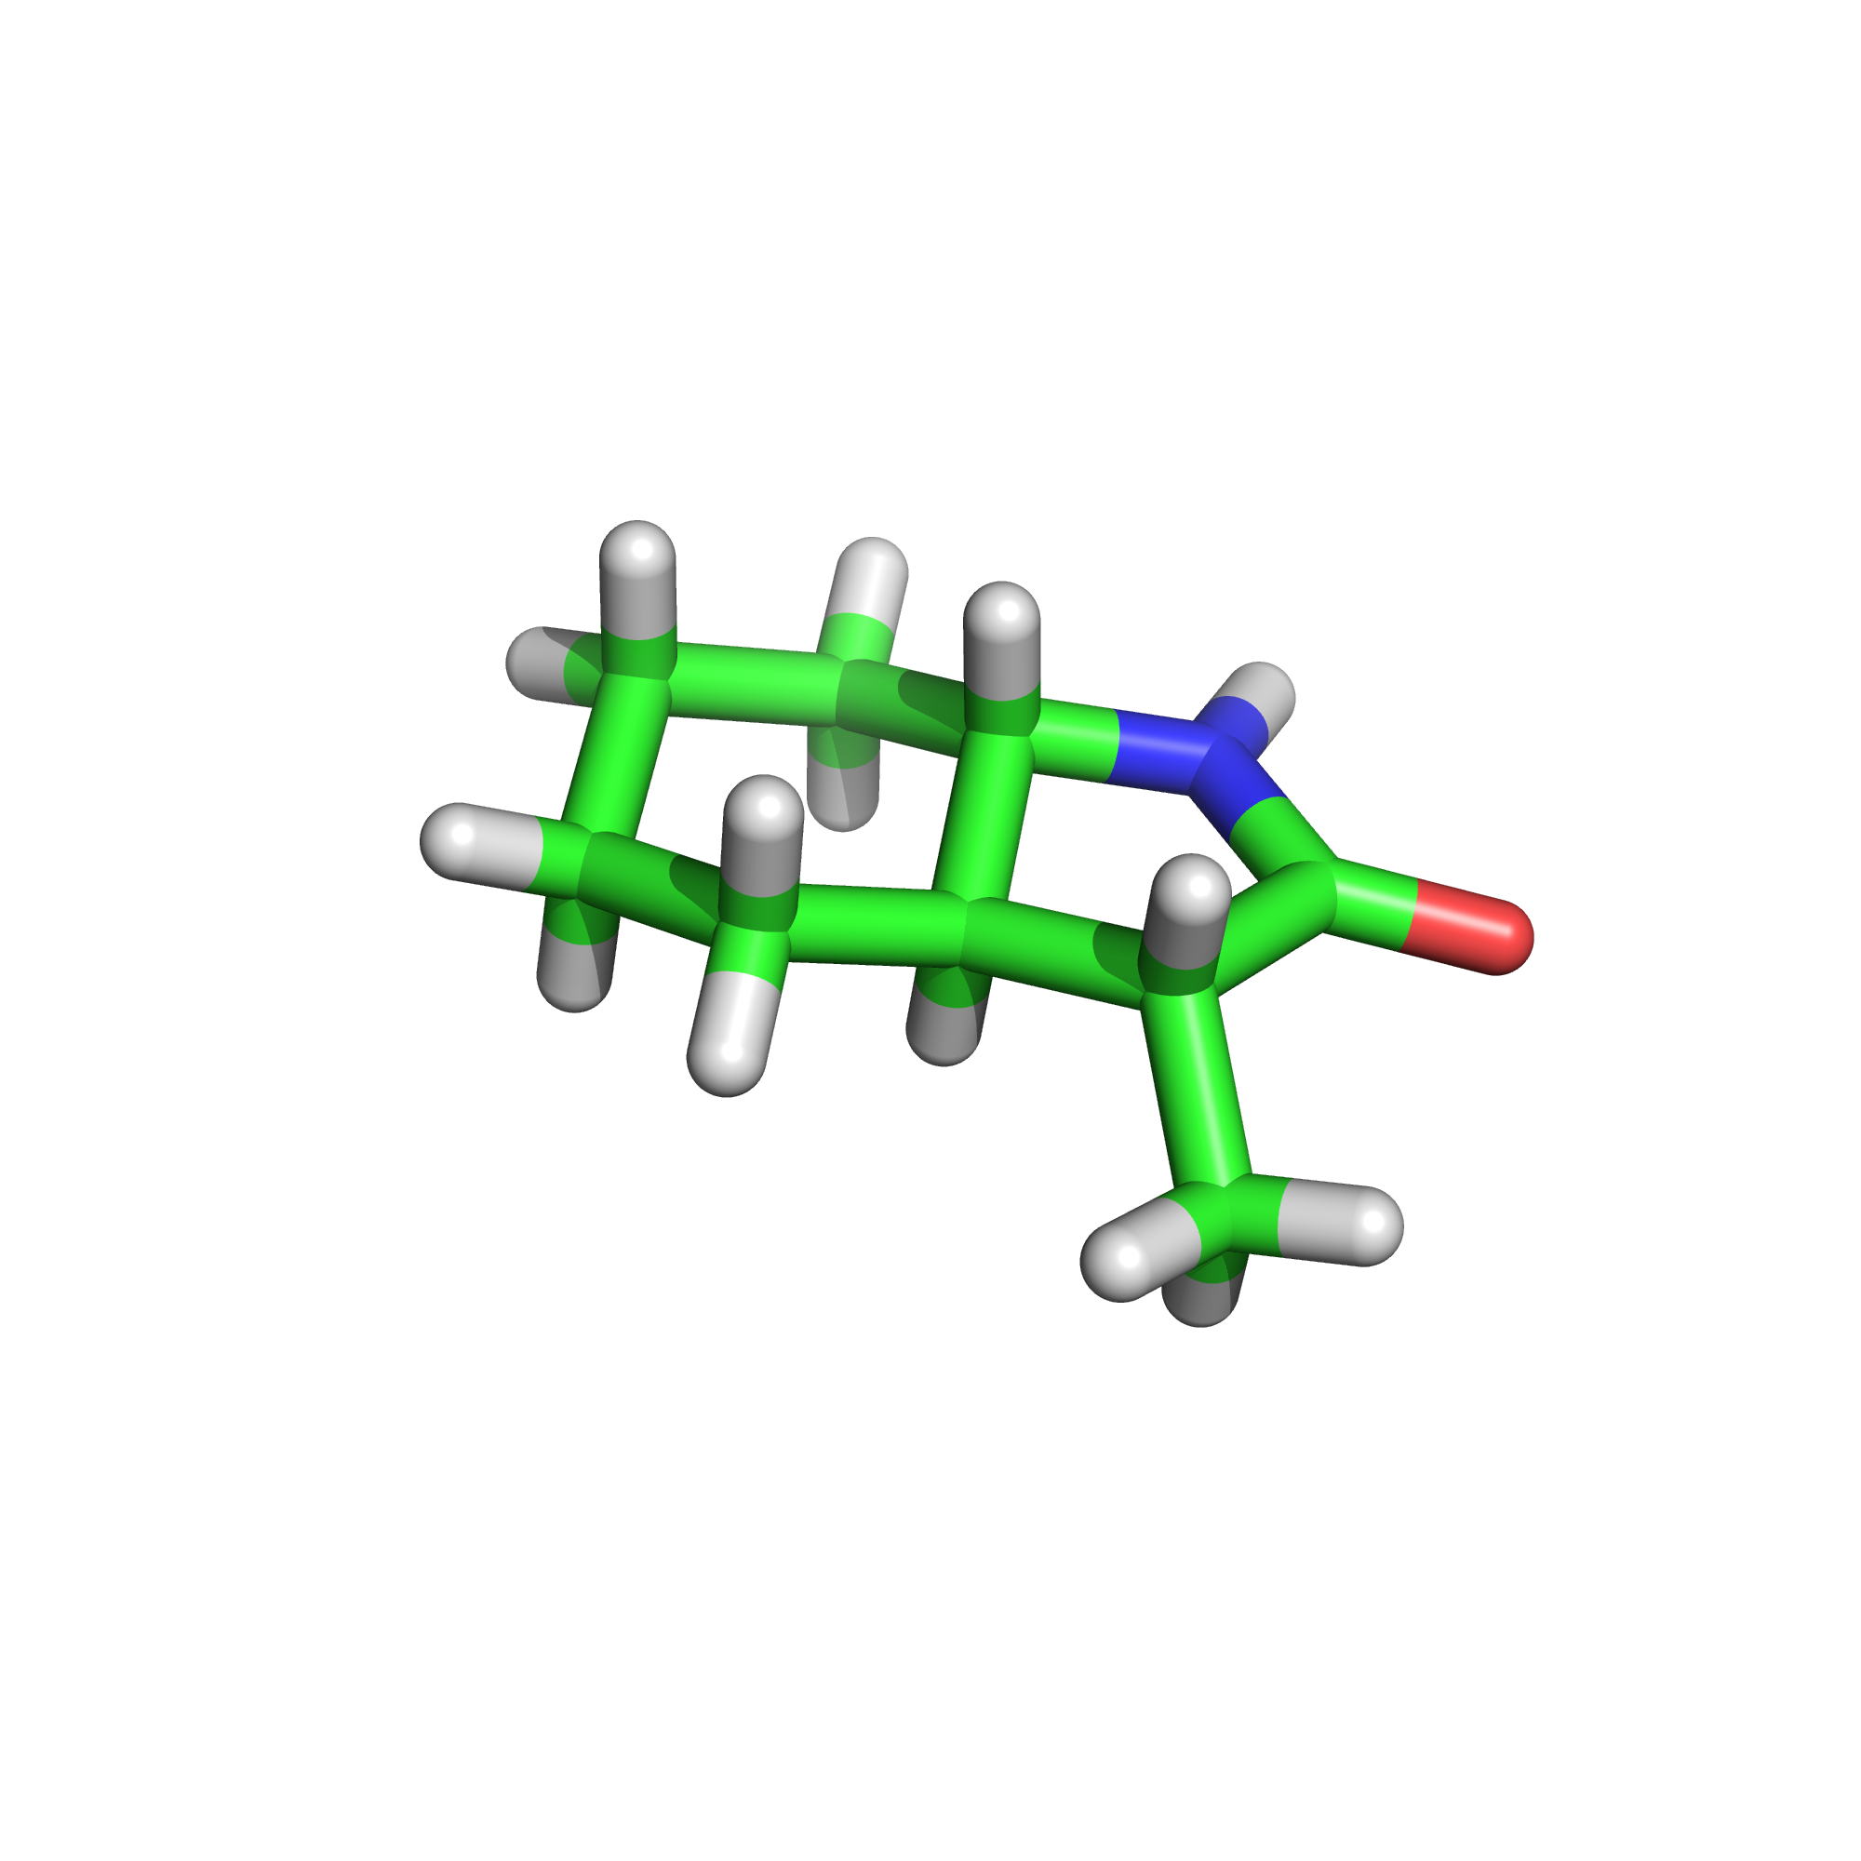
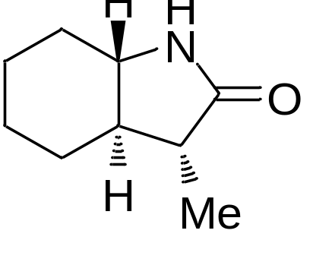
Stereochemical Assignment

Slide 20

But…..
Z-esters do not work as well
What is going on?

Slide 21



Proposed mode of action
Nodes, W. J.; Nutt, D. R.; Chippindale, A. M.; Cobb, A. J. A. J. Am. Chem. Soc. 2009, 131, 16016

Slide 22




More complex systems?
Can we use the same mode of catalysis to generate more complex 6-membered systems?
Domino reactivity?
Cobb, A. J. A. Chapter 1 : Enantioselective Organocatalyzed Reactions (Ed. Mahrwald: Springer 2011)

Slide 23






Domino Reactivity

Slide 24


Catalyst Screen

Slide 25


Absolute Crystal Structure
Major diastereoisomer

Slide 26

Solvent Screen for the Domino Reaction
Entry | Solvent | % yield^{a,b} | % Conversion^{b} | dr^{c} | ee^{c,d}
1 | CH₂Cl₂ | 74 | 100 | 82.29:17.71 | >99(74)
2 | CH₃CN | 82 | 99 | 53.51:46.49 | >99(89)
3 | C₂H₄Cl₂ | 74 | 100 | 61.83:38.17 | >99(87)
4 | Toluene | 60 | 98 | 68.24:31.76 | >99(88)
5 | CH₃OH | 57 | 94 | 41.08:58.92 | >99(80)
6 | THF | 74 | 89 | 58.98:41.02 | >99(87)
7 | Water | 63 | 83 | 54.76:45.24 | >99(90)

Slide 27



Substrate Scope for the Domino Reaction

Slide 28


Substrates with five contiguous stereocentres

Slide 29

Mechanistic Insights

Slide 30


Slide 31


Synthesis of an α-lycorane-like compound
Rajkumar, S.; Shankland, K.; Brown, G. D.; Cobb, A. J. A.
Chem. Sci. 2012, 3, 584.

Slide 32


Sulfone Variation on the Domino Reaction

Slide 33





Napthyl substrate
Rajkumar, S.; Shankland, K.; Goodman, J. M.; Cobb, A. J. A. Org. Lett. 2013, 15,1386

Slide 34



Development of a Novel Cyclopropanation
Background
Cobb et al Org. Lett. 2013, 15, 1386
Concept

Slide 35


Cyclopropanation : Catalyst Screen
Entry | Cat | Yield | dr | Ee (%)
1 | I | 10 | >19:1 | 36
2 | II | 12 | >19:1 | 0
3 | III | 21 | >19:1 | 9
4 | IV | 17 | >19:1 | 59
5 | V | 31 | >19:1 | 0
6 | VI | 8 | >19:1 | 0
7 | VII | 12 | >19:1 | 72

Slide 36

Cyclopropanation : Base Screen
Entry | Base | Eq | T, ºC | Time, h | Yield, % | Ee
1 | Na₂CO₃ | 1 | 20 | 16 | 92 | 70
2 | Cs₂CO₃ | 1 | 20 | 16 | 86 | 7
3 | K₂CO₃ | 0.5 | 20 | 16 | 88 | 72
4 | K₂CO₃ | 1 | 20 | 16 | 90 | 70
5 | K₂CO₃ | 2 | 20 | 16 | 92 | 69
6 | K₂CO₃ | 4 | 20 | 16 | 90 | 67
7 | K₂CO₃ | 1 | -10 | 96 | 92 | 76

Slide 37










Substrate Scope for the Cyclopropanation
Entry, Product, Yield, ee%, (ee% after single recrystallisation)
92% yield 76% ee (80%) | >99% yield 82% ee (92%) | >99% yield 82% ee (96%)
94% yield 78% ee (89%) | 96% yield 80% ee (83%) | 73% yield 60% ee (60%)
91% yield 61% ee (90%) | 88% yield 58% ee (76%) | 94% yield 60% ee (nd)

Slide 38

Absolute Configuration

Slide 39








Rationale for Selectivity

Slide 40









Applications of Adducts 1
Rapid Access to δ³-amino acids (5 steps, one of which is cyanosulfone formation, and two are to expose the C-terminus and N-terminus).

Slide 41

Applications of Adducts 2
Aitken, L. A.; Hammond, L. E.; Shankland, K.; Brown, G. D.; Cobb, A. J. A. Chem. Commun. 2015, DOI: 10.1039/C5CC05158D

Slide 42

Acknowledgements
William J. Nodes
Rajkumar Sundaram
Lewis S. Aitken
Lisa E. Hammond
Dr Ann M. Chippindale (Reading)
Dr Kenneth Shankland (Reading)
Dr David R. Nutt (Reading)
Dr Geoff D. Brown (Reading)
Dr Jonathan Goodman (Cambridge)
EPSRC
GW Pharmaceuticals
Felix Foundation
EPSRC Mass Spec Facility, University of Swansea
University of Reading

