Slide 1

Lung Neuroendocrine Tumors:
Where is PTEN?
Alex Soltermann

Slide 2
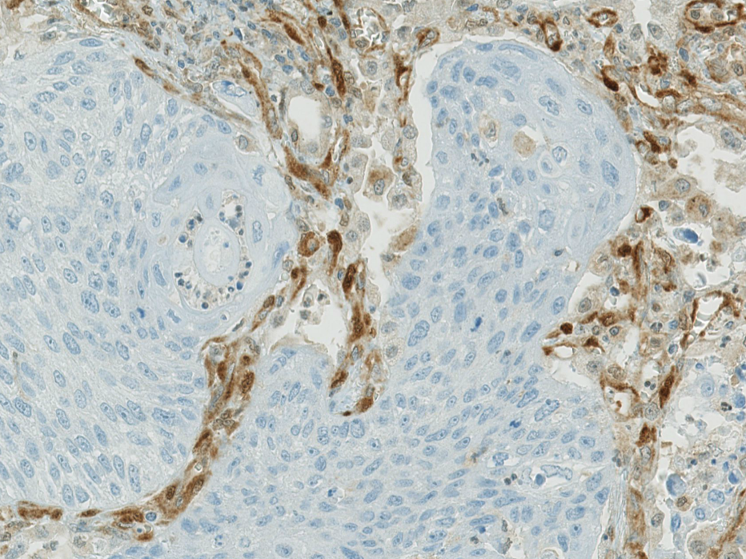
PTEN (phosphatase and tensin homolog)
Lung squamous cell carcinoma
PTEN
Located on 10q23
Tumor suppressor
403 aa protein
No alternative!
Cells ultrasensitive to dosage alterations

Slide 3
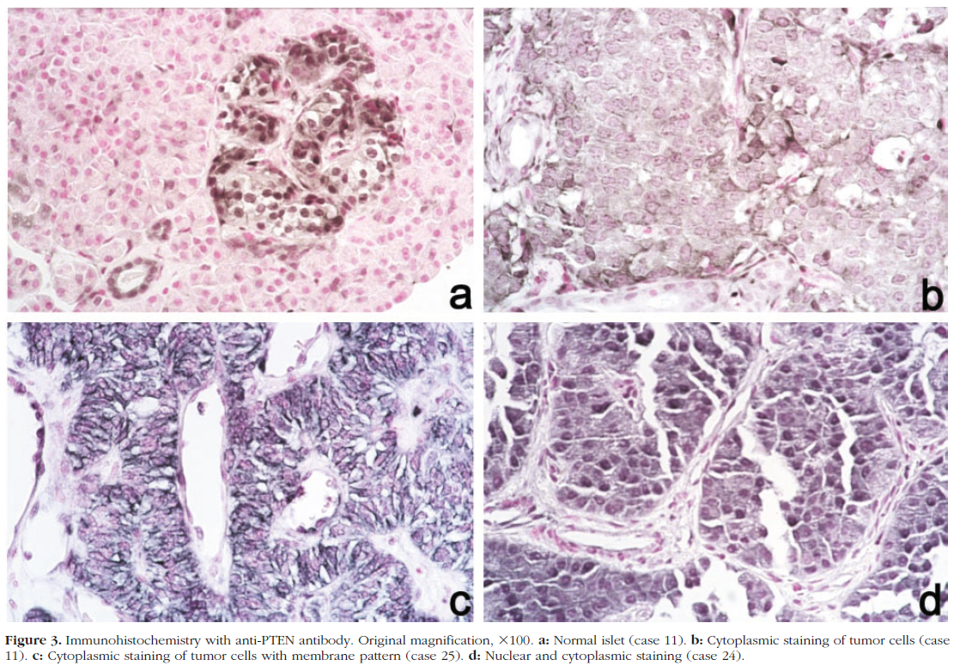
Tumoral PTEN is cytosolic, normal nuclear
Perren,
Am J Pathol 2000
Endocrine pancreatic tumors: PTEN cytosolic; Normal pancreatic islet cells: PTEN nuclear
→ Intracellular compartmentalization of PTEN protein
Due to post-translational modifications? Artifact of immunhistochemistry?

Slide 4
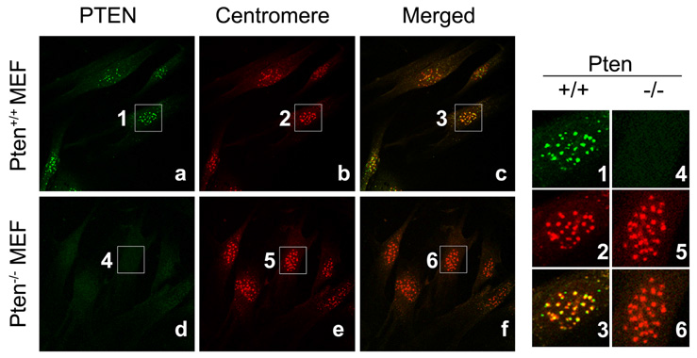
In the nucleus, PTEN is a guardian of the genome
Cell 2007
NEDD4-1 is a proto-oncogenic ubiquitin ligase for PTEN (Wang)
Ubiquitination regulates PTEN nuclear import and tumor suppression (Trotman)
Essential roles for nuclear PTEN in maintaining chromosomal integrity (Shen)

Slide 5
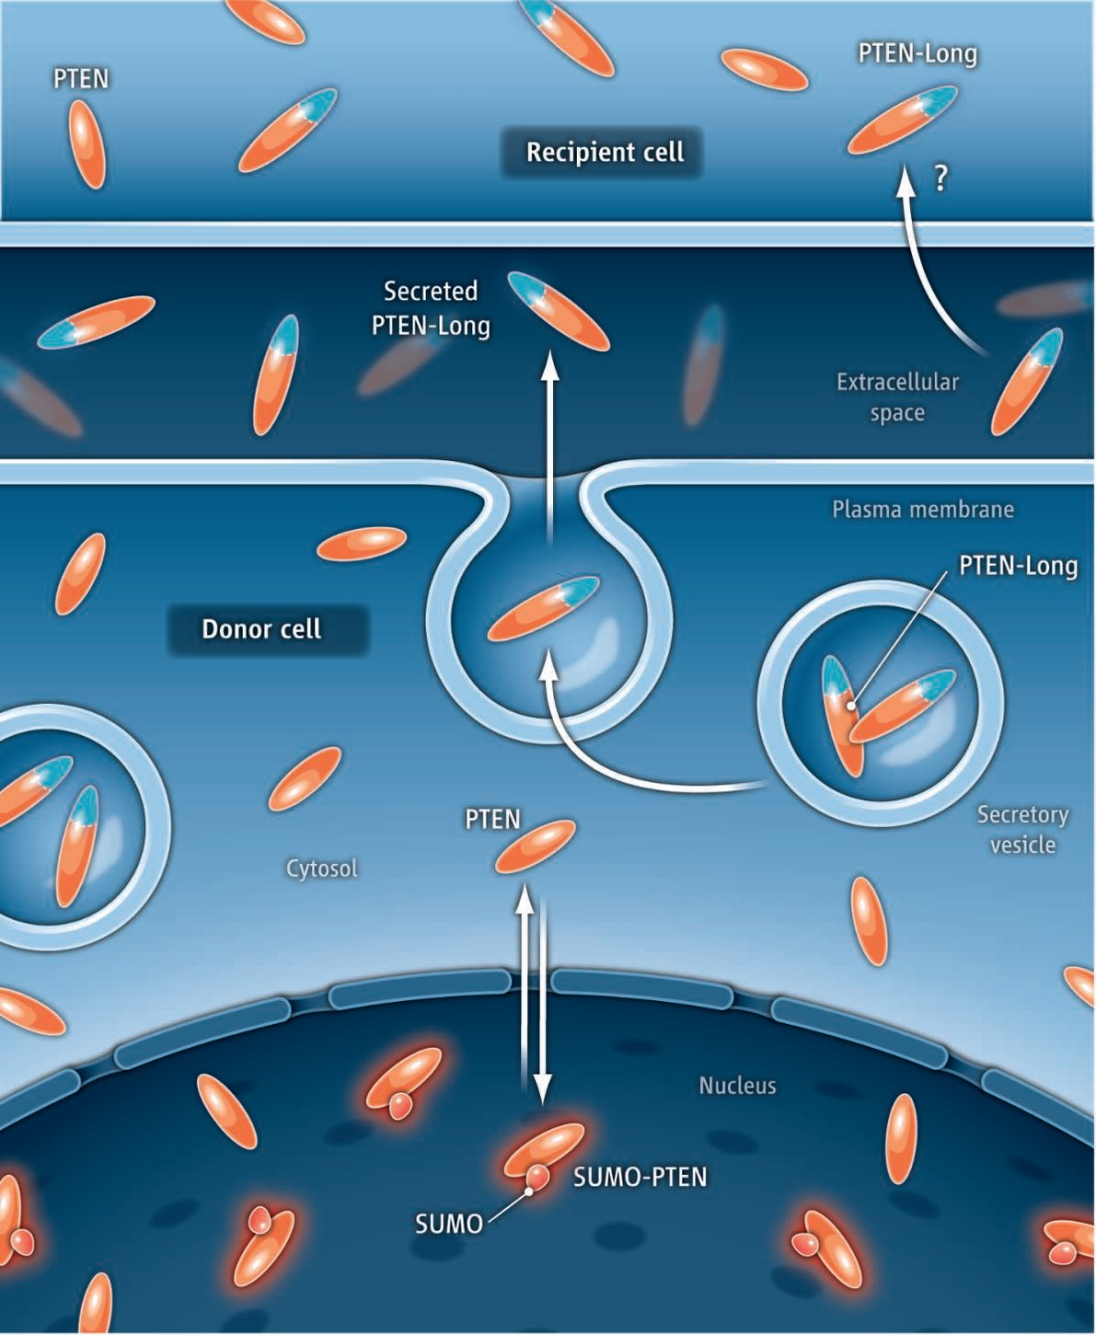
PTEN post-translational modifications
PTEN-Ubiquitin (76 aa)
PTEN mono-Ub is stable in the nucleus
PTEN poly-Ub is degraded in the cytosol via the proteasome
Ubiquitin-Specific Protease 7
PTEN-SUMO (100 aa)
Small Ubiquitin-like Modifier
PTEN-SUMO retained in nucleus
DNA damage reduces sumoylation and nuclear localisation
PTEN Poly-Ub
USP-7
PTEN Mono-Ub
Faesen Molecular Cell 2011, Bassi + Leslie Science 2013

Slide 6
PTEN function in cytosol and nucleus

Slide 7
What is the oncologic relevance of this?
If there is a PTEN protein loss in the nucleus
Then the genome becomes unstable and sensitive to DNA damage
Then platinum, forming DNA adducts, may be more effective
If there is a PTEN protein loss in the cytosol
Then the PI3K-Akt survival pathway is hyperactive
Then PI3K inhibitors may be more effective
→ Combination of platinum + PI3K-inhibitor

Slide 8
Lung NET cohort: Patients and methods
Cohort
University + Triemli Hospital Zürich, Technical University München
TMA: n = 192 patients; 2 tumor tissue cores from surgical specimens
58 typical carcinoids, 42 atypical carcinoids, 32 large cell neuroendocrine carcinomas, 60 small cell lung carcinomas
Immunohistochemistry + FISH
PTEN (S.C./A.S.), SUMO-2/3 (for sumoylation), USP-7 (for ubiquitination)
H-Score (0 to 300): Intensity (0, 1, 2 or 3) x Frequency (0, 1-10, 11-50, 51-100%)
Mouse monoclonal Ab clone 6H2.1 DAKO anti-PTEN
Vysis LSI Abbott PTEN FISH probe
Collaud, BMC Cancer 2015

Slide 9
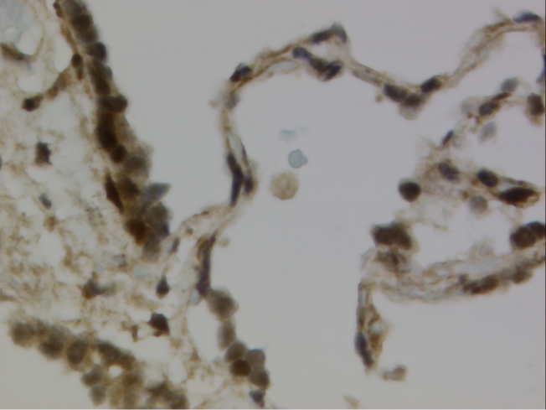
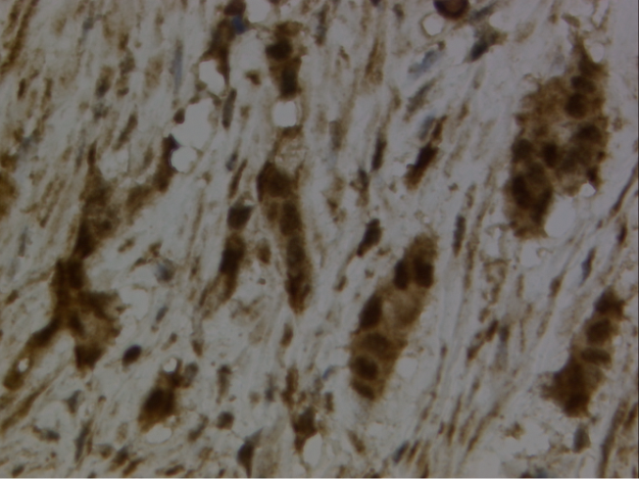
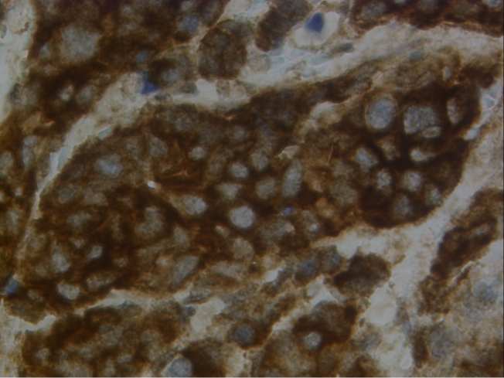
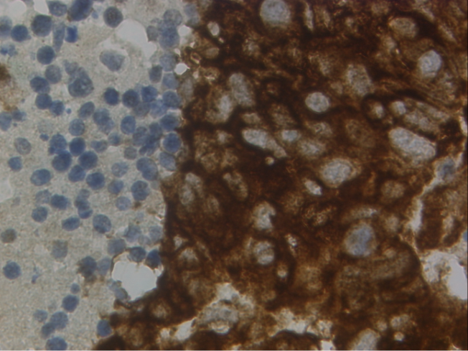
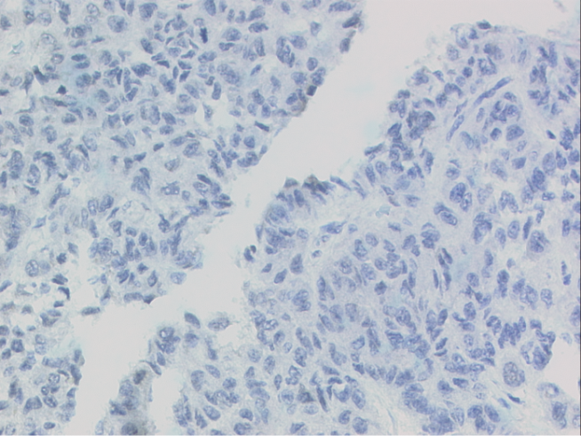
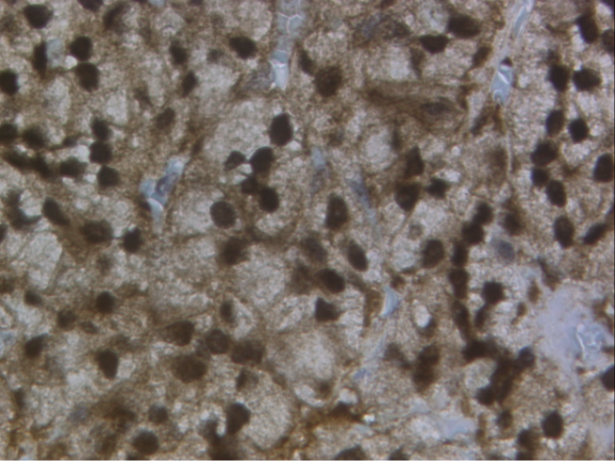
PTEN immunohistochemistry
Normal Lung
Appendix Carcinoid
Small Cell Lung Ca
Large Cell Neuroendo Ca
Typical Carcinoid
Typical Carcinoid

Slide 10
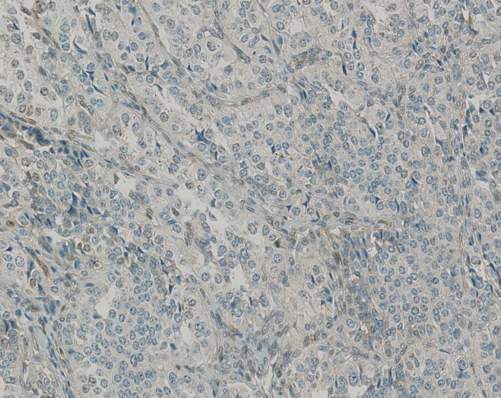
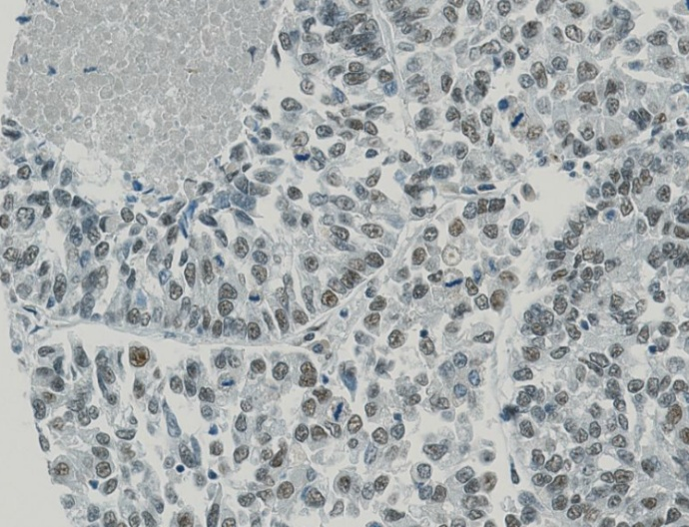
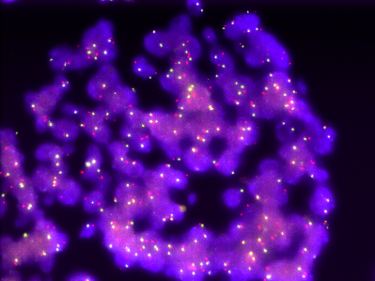
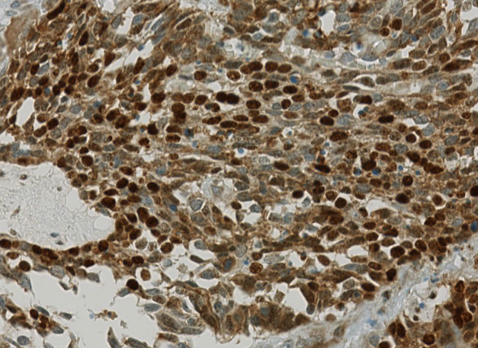
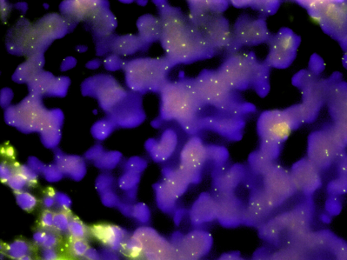
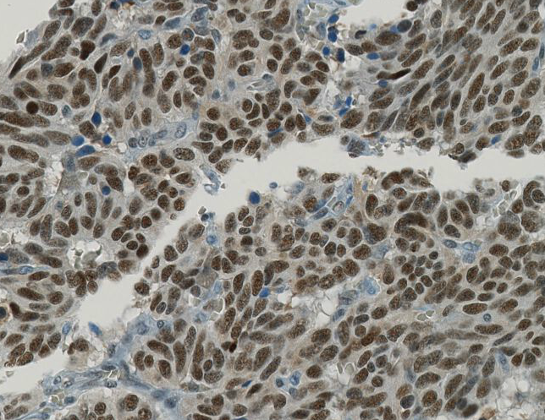
SUMO-2/3 and USP-7 IHC, PTEN FISH
TC: SUMO Nucl 0, Cyto 0
LCNEC: USP7 Nucl 1x50
PTEN norm
SCLC: SUMO Nucl 3x100, Cyto 2x100
AC: USP7 Nucl 3x100
PTEN del

Slide 11
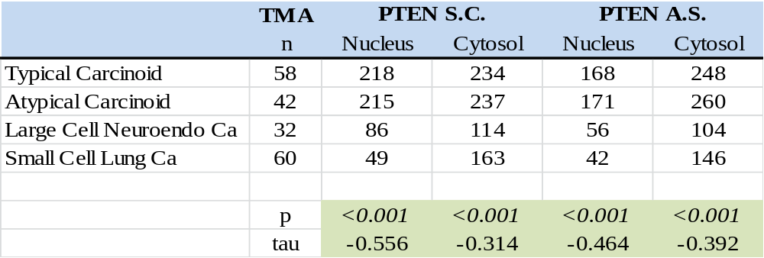
Decrease of PTEN protein in high grade lung NET
SCLC may show a preferential loss of nuclear PTEN in comparison to LCNEC

Slide 12
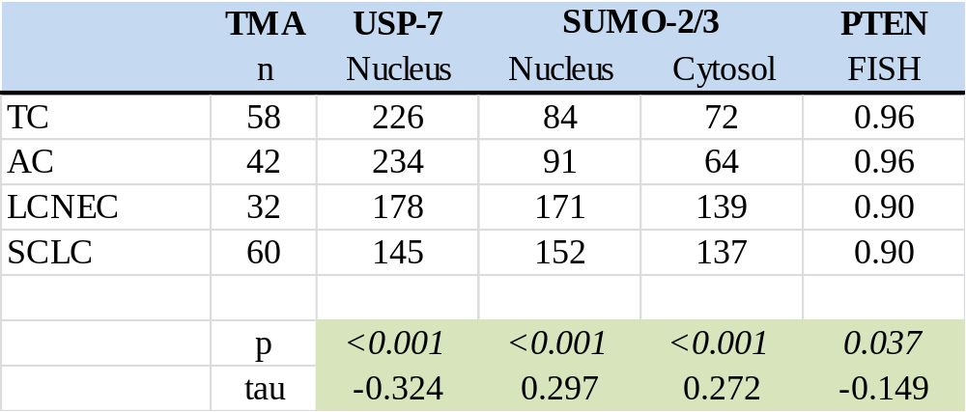
Decrease of USP-7 and PTEN gene deletion but increase of SUMO-2/3 in high grade lung NET
Sumo-2/3 goes inverse with PTEN, e.g. due to a sequestration mechanism

Slide 13
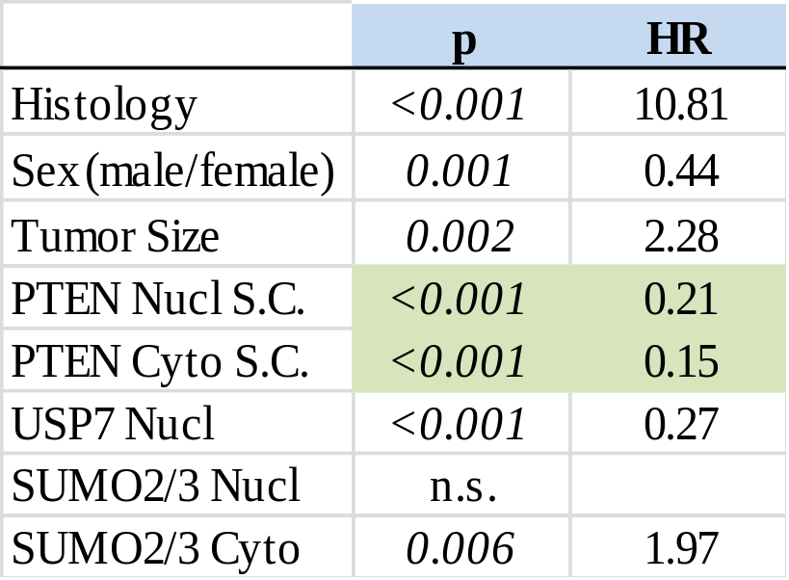
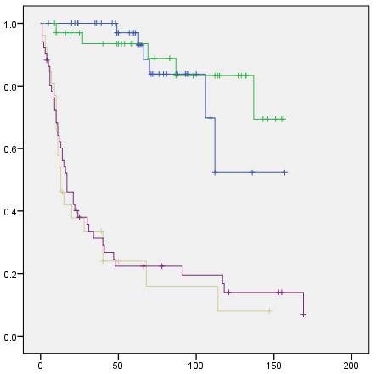
PTEN loss correlates with decreased survival
All Histologies
TC
AC
LCNEC
SCLC
p<0.001

Slide 14
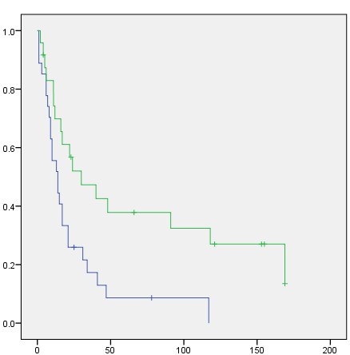
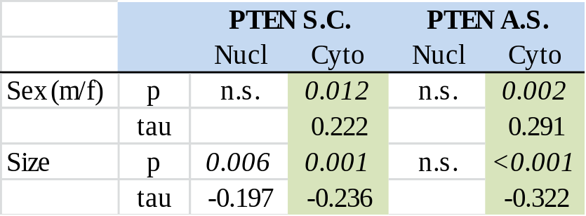
Subgroup analysis: Pooled carcinoids and SCLC
Pooled carcinoids
SCLC
PTEN cyto S.C. high n=24, events=17
PTEN cyto S.C. low n=27, events=25
Cytosolic PTEN loss occurs in male carcinoid patients with large tumors
SCLC with cytosolic PTEN loss are particularly dismal
p=0.010

Slide 15
Conclusions
Post-translational modifications regulate the subcellular localization of the PTEN protein
High grade lung NET present a PTEN loss in nucleus and cytosol
Subsets of SCLC and carcinoids with pronounced PTEN loss likely have a dismal prognosis

Slide 16
Outlook:
Lungscape 002 PTEN
NSCLC by ETOP

Slide 17

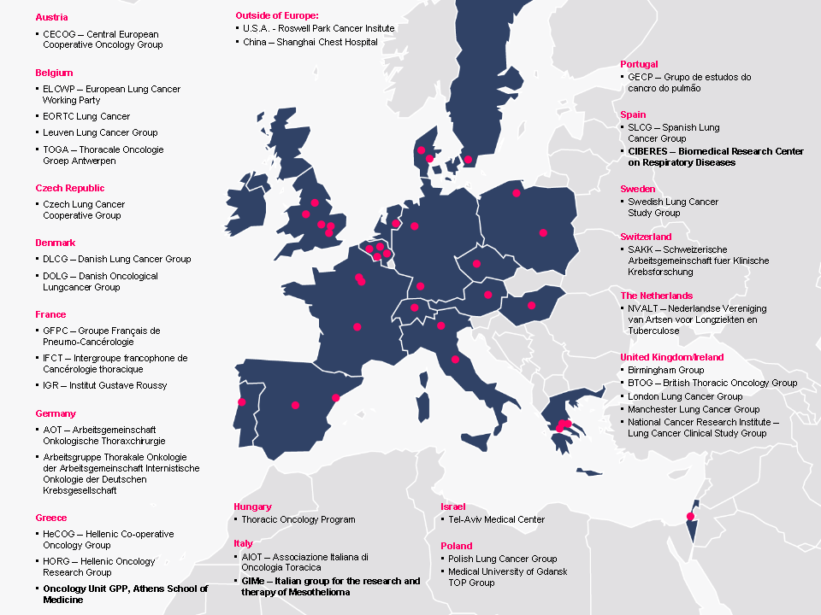
European Thoracic Oncology Platform, etop-eu.org
2400 chemo-naïve resected NSCLC patients, 100 tissue microarrays
Centralized database, but local lab assays

Slide 18
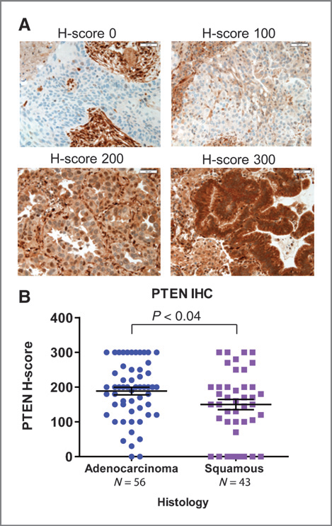
PTEN IHC in non-small cell lung carcinoma
PTEN loss in 21% Squam Cell Ca (n=43) and 4% Adeno Ca (n=56)
Cell Signaling RmAb 138G6 anti-PTEN
Spoerke, Clin Cancer Res, 2012 Genentech
PTEN loss in 59% Squam Cell Ca (n=44) and 34% Adeno Ca (n=94)
PTEN loss is an independent prognostic marker in early-stage I/II resected Adeno Ca (HR 2.68 for DFS) with 138G6
Yanagawa , J Thorac Oncol, 2012
→ What is the best protocol for PTEN IHC?
Pallares, Mod Pathol 2005; Carvalho, Acta Histochem 2013; Maiques Hum Pathol 2014

Slide 19
PTEN External Quality Assessment (EQA)
Part A: Webbook with whole sections
12 cases: 5 PTEN+ and 5 PTEN- surgical specimens (lung ca, endometrium ca, prostate ca, glioblastoma) as well as PTEN+ and PTEN- cell line
MmAb 6H2.1 DAKO Cytomation, 1:100, Leica Bond
RmAb 138G6 Cell Signaling, 1:200, Ventana Benchmark
RmAb 218 Spring Bioscience, 1:100 Ventana Benchmark
ETOP pathologists : Aarhus, Aberdeen, Amsterdam VU, Amsterdam NKI, Basel, Chieti, Gdansk, Dublin, Heidelberg, Leuven, Maastricht, Manchester, Roswell Park, Valencia, Vall d’Hebron, Zürich. H-scoring on computer
Part B: Tissue microarray with 4 cores/case
Local staining with SP218 anti-PTEN and H-scoring of total tumoral PTEN
Computer score using positive pixel account algorithm on Image J

Slide 20
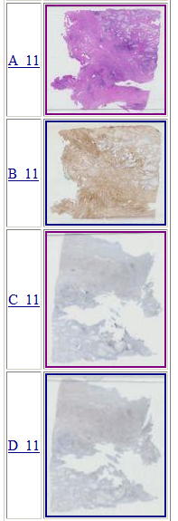
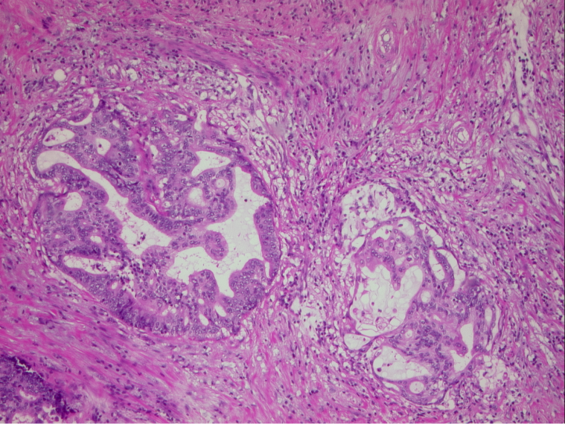
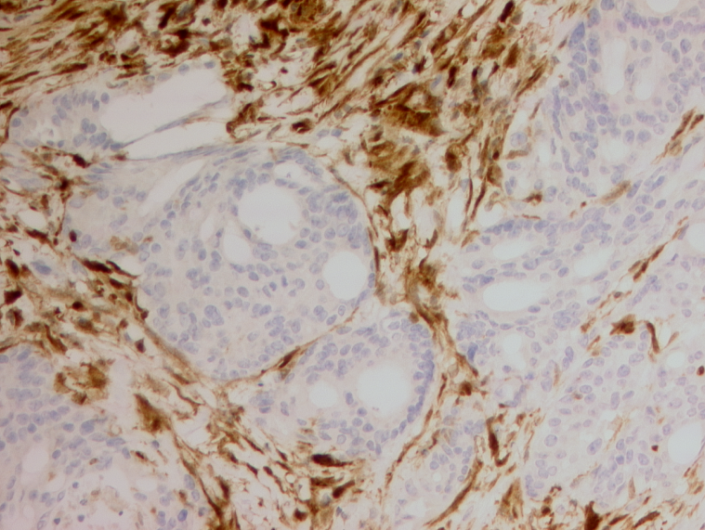
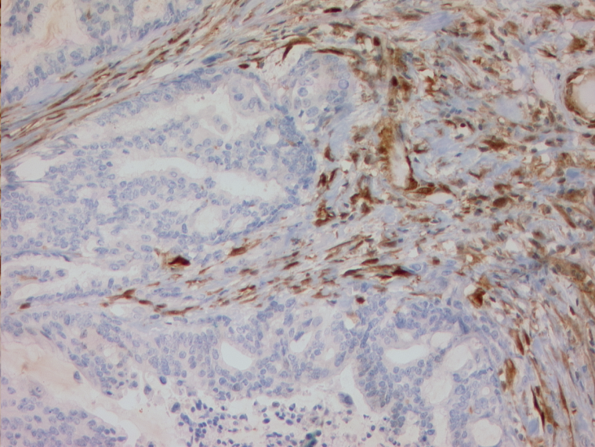
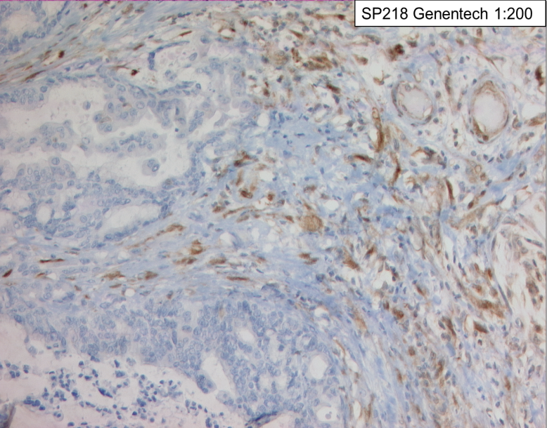
Webbook: Mucinous Endometrium Ca
A
B
C
D
A: H&E B: DAKO 6H2.1 C: CST 138G6 D: SP 218

Slide 21
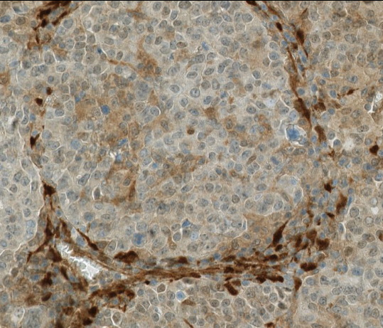
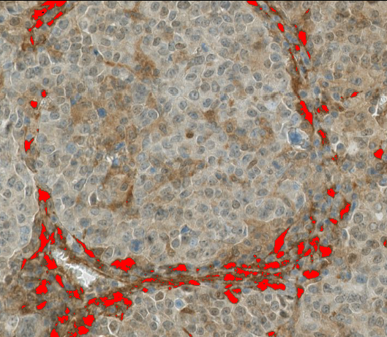
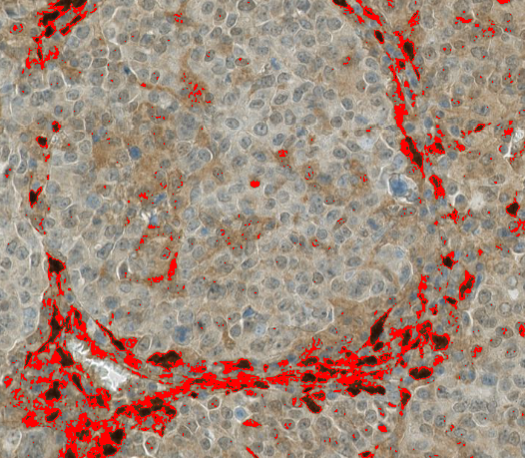
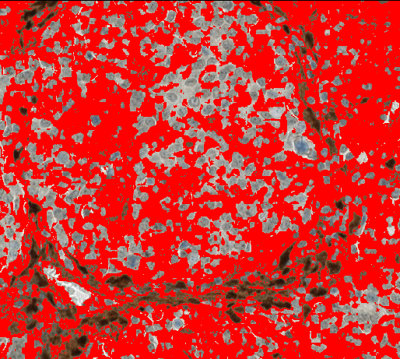
Set color threshold on Image J
Color threshold for intensity score 3, 2, 1 set by 3 pathologists
Intensity score 3
Intensity score 2
Intensity score 1

Slide 22



Thanks
Pathology Zürich, Basel, Bern, Triemli, St. Gallen: Andrej Atanassoff, Lukas Bubendorf, Ruben Casanova, Paul Komminoth, Christian Oehlschlegel, Aurel Perren, Undine Rulle, Verena Tischler, Holger Moch
Thoracic Surgery USZ: Stéphane Collaud, Walter Weder
ETOP: Rolf Stahel, Rosita Kammler, Thomas Geiger
Genentech/Roche: Katja Schulze, Hartmut Koeppen

