Slide 1


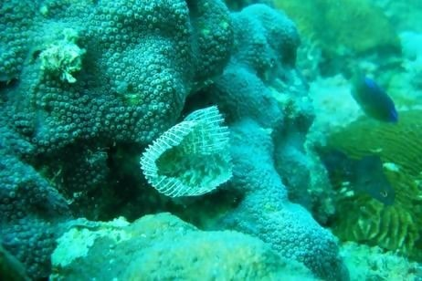


Silica-Based Matrixes for Drug Delivery:
Ready for a Prime Time?
Dr. Alex Nivorozhkin
Neo-Advent Technologies LLC, USA

Slide 2
Traditional Uses of Amorphous Silica in Pharma
Three Different Physical Attributes:
-Shape/Size/ Porosity
Non-Porous | Particle Size | Applications | Function
Spherical | 5-50 microns | Tablets | Flow, Anticaking
Fumed (Branched) | 0.1-1 microns | Gels, Semisolids | Viscosity Modifier
Porous | Particle Size | Applications | Function
Spherical | 5-50 nm | Tablets | Filler, Oil/Wax Absorbing
Silicagel | 5-50 microns | Dessication | Moisture Absorbing

Slide 3
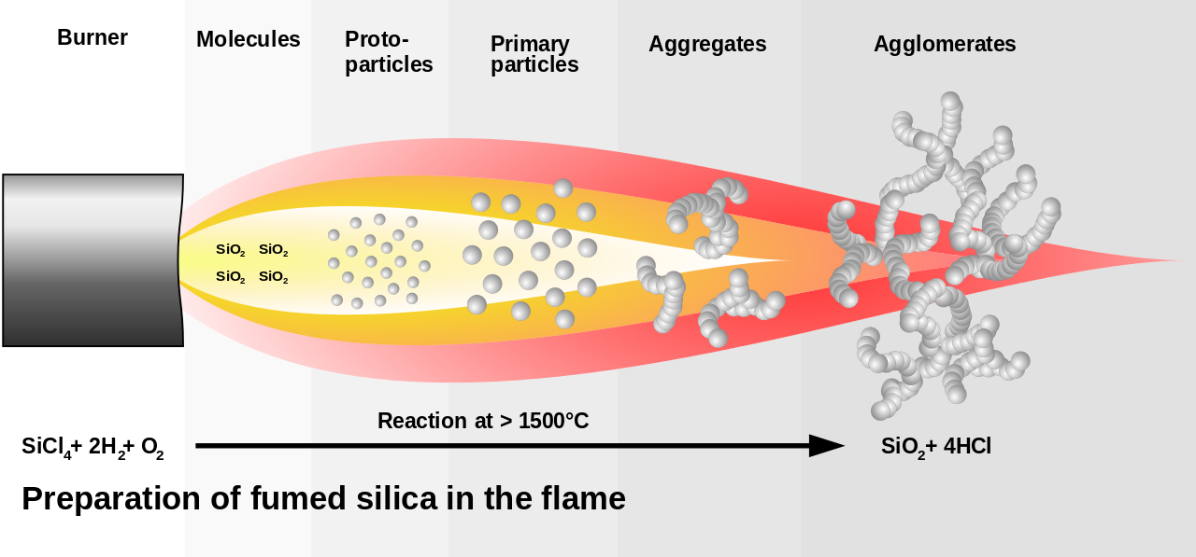
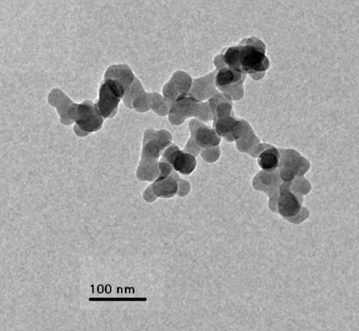
Fumed Silica – Viscosity Modifier

Slide 4
Key Pathways to Producing the Silica
Silicagel, Precipitated Silica
Na₂Si₃O₇ + H₂SO₄ → 3 SiO₂ + Na₂SO₄ + H₂O
(different pH ranges, the product dehydrated )
Sol-Gel process
Si(OEt)₄→ SiO₂ (basic or acid hydrolysis)
Mesoporous Silica (MSN, Pore Size 2-50 nm)
Si(OEt)₄→ SiO₂ in the presence of templating surfactant

Slide 5
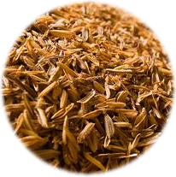
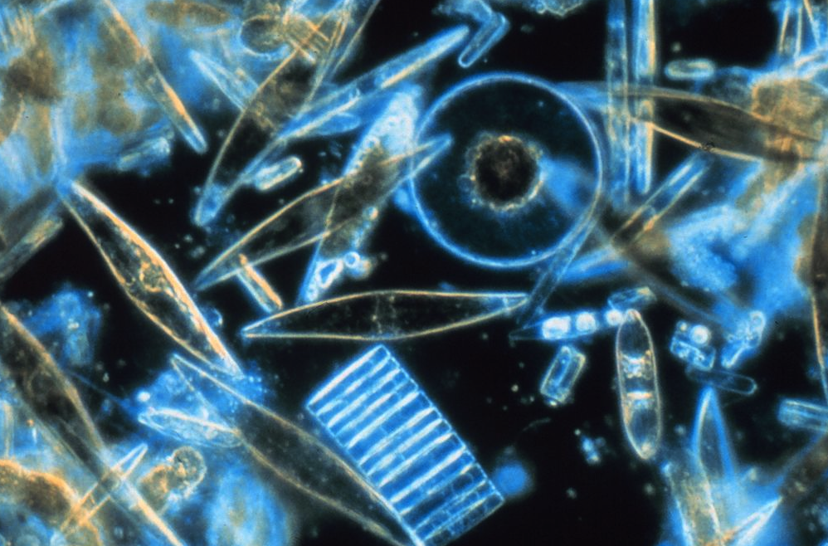
Toxicology of Silica
Plenty in nature (structural material), but not in humans
When used orally up to 5 g/kg is safe
SNP are more toxic
  Toxicity depends on size, charge, shape
  Role of increased solubility with decreased size?
  Lack of good in vitro-in vivo correlations

Slide 6
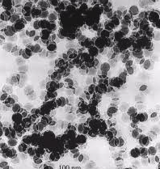
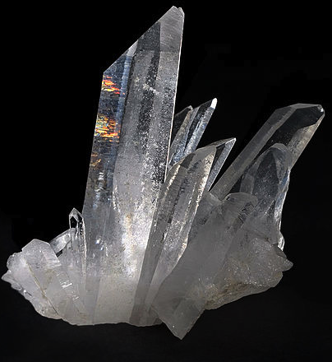
Solubility of Silica
Amorphous
Crystalline Forms
pH-dependent, increase at pH>9
Equilibrium solubility of Nonporous silica -70 ppm vs. Porous -120 ppm
Si(OH)₄ is excreted with urine
at 1.8 mg/day
Soluble thru conversion to Si(OH)₄
Insoluble at ambient conditions
1 ppm at 400 ºC
Very stable

Slide 7

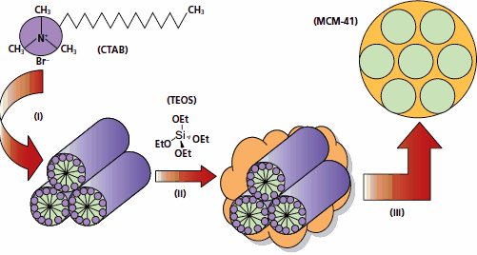
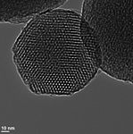
Mesoporous Silica Nanomaterials (MSN)
Key Properties of MSN
Preparation of MSN
Ordered pore structure (2-50 nm)
Huge pore surface/volume
(1 cm³/g, 1000 m²/g)
Commercial Availability
MCM-41 (Aldrich $563/25 g)
Liquid Crystalline Templating
(“Mobil Process”, 1992)
Variations in surfactant, inorganic framework, conditions

Slide 8
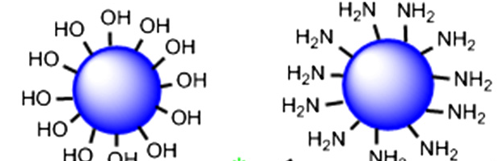
SNP Surface Reactivity
Covalent Attachment Options
Drug-SNP Conjugates
Negative Zeta-potential for unmodified SNP
Protonated amino groups after modification with 3-aminopropyl triethoxysilane
Convenient general chemistry
Can it match potential for Polymer-Drug conjugates?
Can it be produced economically: concentration limits, washout steps, density of conjugation?

Slide 9
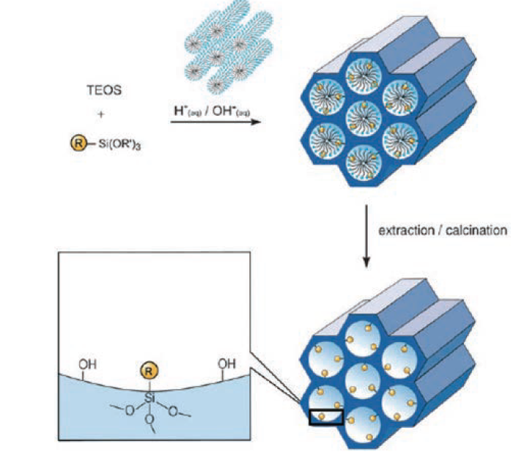
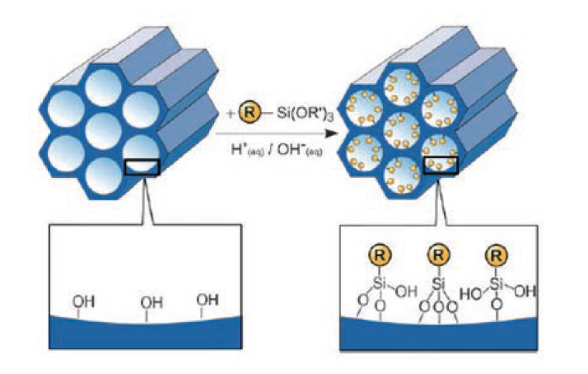
Surface Functionalization
Co-condensation (one-pot)
Grafting Method
Versatile post-process method
Possible pore clogging
More homogeneous Distribution
Maybe difficult to fit into the prep

Slide 10
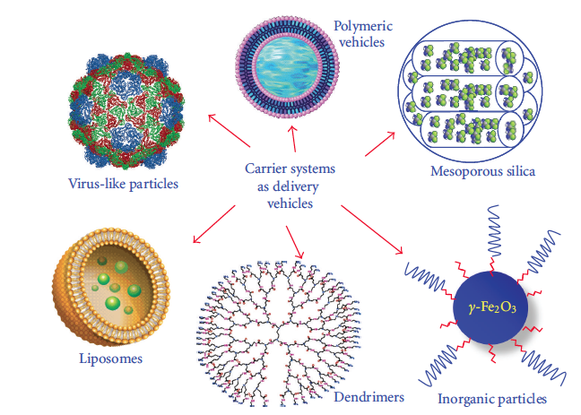
Drug Delivery Modalities

Slide 11
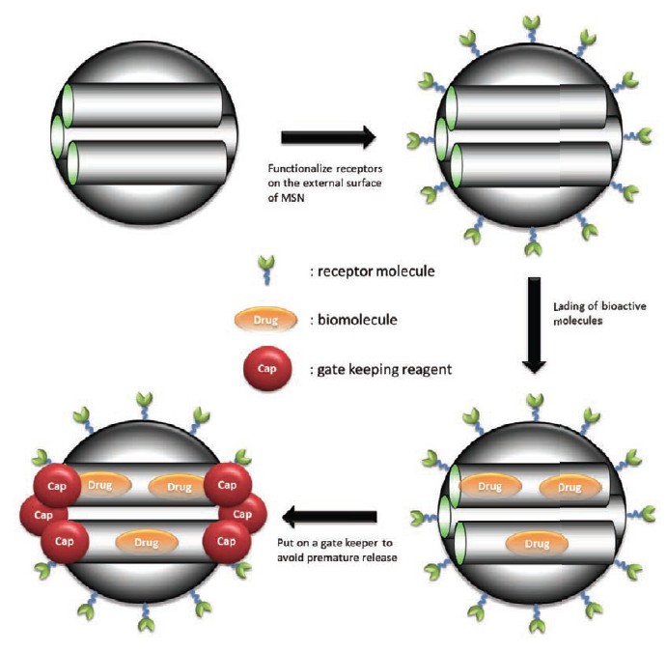
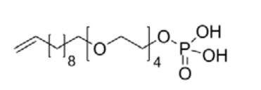
MSN-based Drug Delivery Vehicle
Challenges
Pore-loading with Capping
Hydrophilic surface (-Si-OH), low loading of hydrophobic drugs (many cancer, CNS leads) ca. 1%
Hydrophobic surface modification results in sluggish and incomplete release
Filling the pores with surfactant improves loading and release

Slide 12
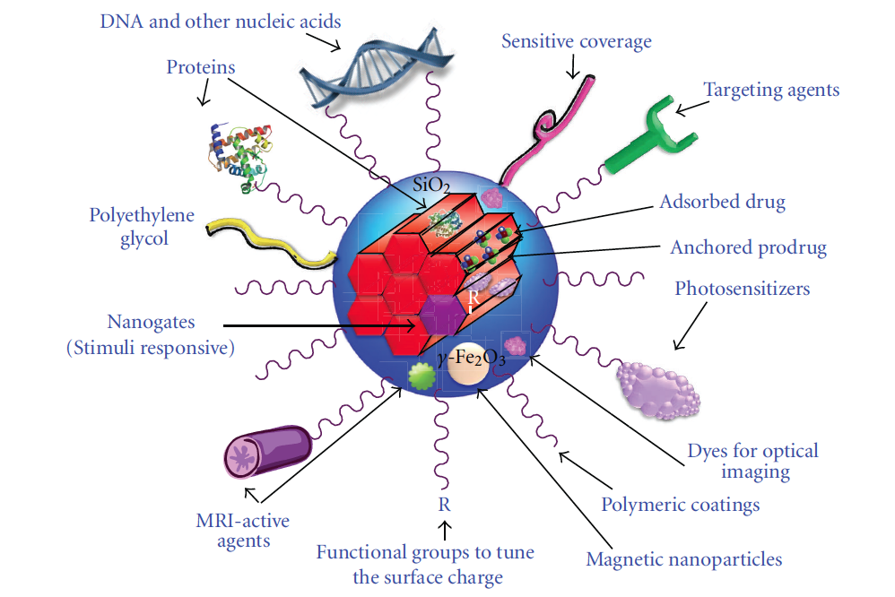
MSN as Multifunctional Nanoplatform
Functionalization Domains:
Silica framework
Mesopores
Outermost surface
of nanoparticles
Combination approach

Slide 13
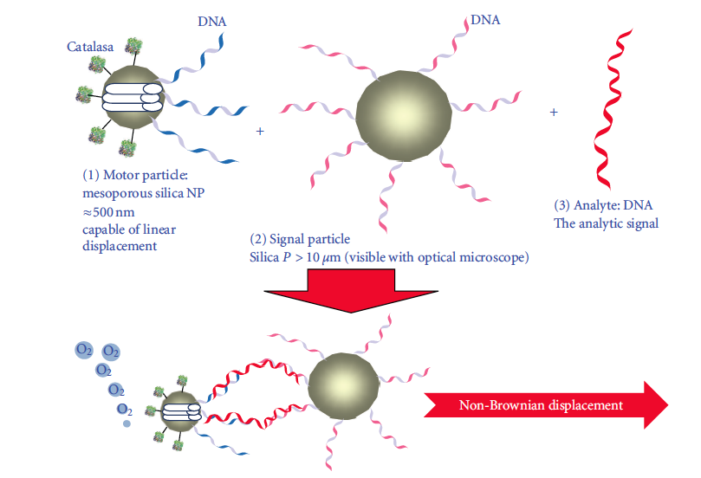
MSN Nanomotor for DNA Capture
M. Vallet-Regi, Small, 2012

Slide 14
What the Future Holds?
Potential
Challenges
Possibly low toxic
May be cheap
Versatile and compatible with various chemistries
Could be commercially as successful as liposomes?
New Development Products
Poorly soluble potent drugs (complement to non-MSN)
Imaging
Targeted delivery
Delivery of biologics (little explored)
Stimuli-triggered delivery
Toxicity, particularly long-term
Manufacturing
Low drug loads
“Smart” approaches bring add-on issues, may be all of the above
Driving Forces
Solid industrial base
Advances in silica applications other than pharma, i.e. catalysis, ink, polymers
Need for new drug delivery technologies

Slide 15



Thank You
Alex Nivorozhkin, Ph.D.
Founder, COO
Neo-Advent Technologies LLC, 410 Great Road, Littleton, MA 1-508-970-4858
www.neo-adventtec.com
Co-Chair
Formulation Drug Delivery
Committee, Massachusetts Biotechnology Council, Boston
Acknowledgements
Mr. Nelson Landrau
Dr. Ken Avery
Unilever, Port Sunlight, UK
Dr. Craig Jones
Dr. James Merrington
Dr. David Mealing

