Slide 1
About OMICS Group
OMICS Group International is an amalgamation of Open Access publications and worldwide international science conferences and events. Established in the year 2007 with the sole aim of making the information on Sciences and technology ‘Open Access’, OMICS Group publishes 400 online open access scholarly journals in all aspects of Science, Engineering, Management and Technology journals. OMICS Group has been instrumental in taking the knowledge on Science & technology to the doorsteps of ordinary men and women. Research Scholars, Students, Libraries, Educational Institutions, Research centers and the industry are main stakeholders that benefitted greatly from this knowledge dissemination. OMICS Group also organizes 300 International conferences annually across the globe, where knowledge transfer takes place through debates, round table discussions, poster presentations, workshops, symposia and exhibitions.

Slide 2
About OMICS Group Conferences
OMICS Group International is a pioneer and leading science event organizer, which publishes around 400 open access journals and conducts over 300 Medical, Clinical, Engineering, Life Sciences, Phrama scientific conferences all over the globe annually with the support of more than 1000 scientific associations and 30,000 editorial board members and 3.5 million followers to its credit.
OMICS Group has organized 500 conferences, workshops and national symposiums across the major cities including San Francisco, Las Vegas, San Antonio, Omaha, Orlando, Raleigh, Santa Clara, Chicago, Philadelphia, Baltimore, United Kingdom, Valencia, Dubai, Beijing, Hyderabad, Bengaluru and Mumbai.

Slide 3



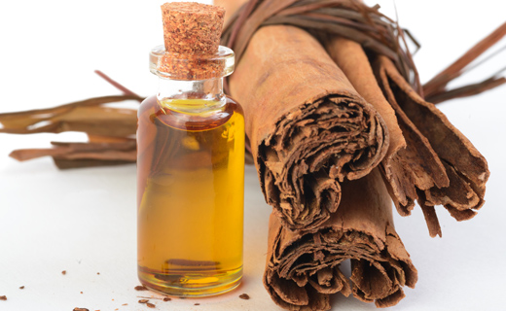

CINNAMON ESSENTIAL OIL AND ITS MAJOR CONSTITUENT CINNAMALDEHYDE CAUSED REMARKABLE RELAXATION ON ISOLATED HUMAN CORPUS CAVERNOSUM
Alev TOSUN¹, Serap GUR^{2*}, Didem YILMAZ², Ecem KAYA³, Alp OZGUR AKDEMIR⁴
¹Department of Pharmacognosy, Faculty of Pharmacy, Ankara University, Ankara, Turkey
²Department of Pharmacology, Faculty of Pharmacy, Ankara University, Ankara, Turkey
³Department of Biochemistry, Faculty of Pharmacy, Ankara University, Ankara, Turkey
⁴Department of Urology, Ankara Numune Education and Research Hospital, Ankara, Turkey
2nd International Conference and Exhibition on
Pharmacognosy, Phytochemistry & Natural Products
August 25-27, 2014 DoubleTree By Hilton Beijing CHINA

Slide 4
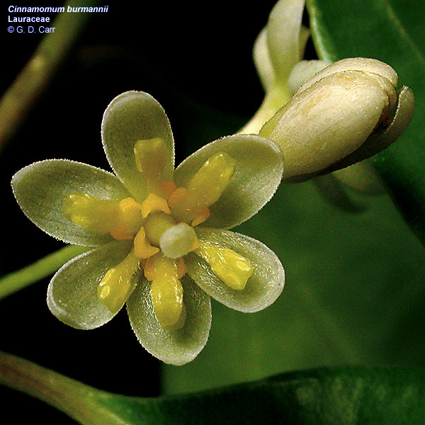
Lauraceae/Laurel Family
♦30 to 50 genera and about 3000 species
♦ Warm temperature and tropical regions
♦ Southeast Asia and South America
♦ Nearly all aromatic woody/evergreen trees and shrubs
♦ Drupes fruit
-Essential oils
-Medicinal importance
-Spices
♦ Best-known species of particular commercial value:
-Cinnamomum
-Cassia
-Camphor laurel
-Laurus
-Persea

Slide 5
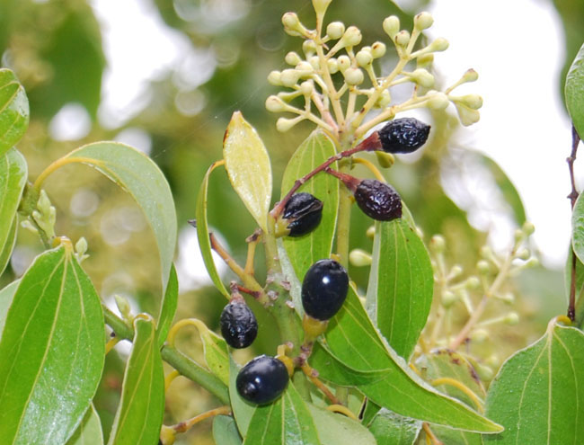
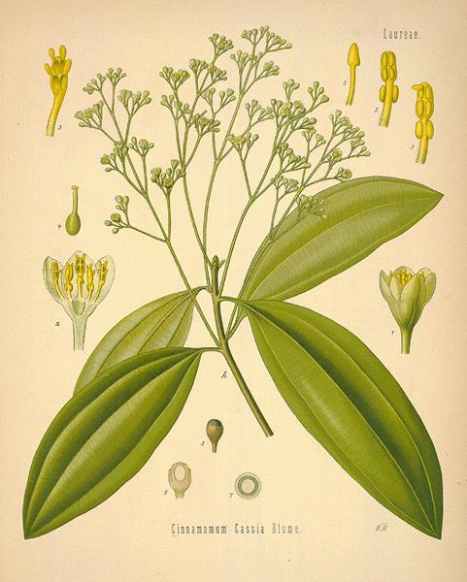
♦Cinnamon---famous Lauraceae family genus,
♦Evergreen tree of the tropical medicine
♦Approximately 250-300 species, all over the world
Cinnamomum cassia
Chinese medicine
China, Korea and Japan, Eastern Asia--deciduous tree
Spice
Flavoring agent
-Reducing the risk of colon cancer
-Preventing bleeding
-Increasing the blood circulation in the uterus
-Immunomodulator, Anti-viral
-Dyspepsia, gastritis, diabetes mellitus
-Inflammatory diseases

Slide 6
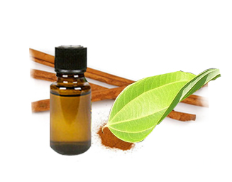
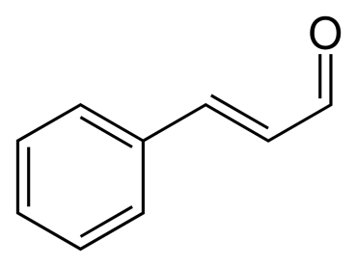
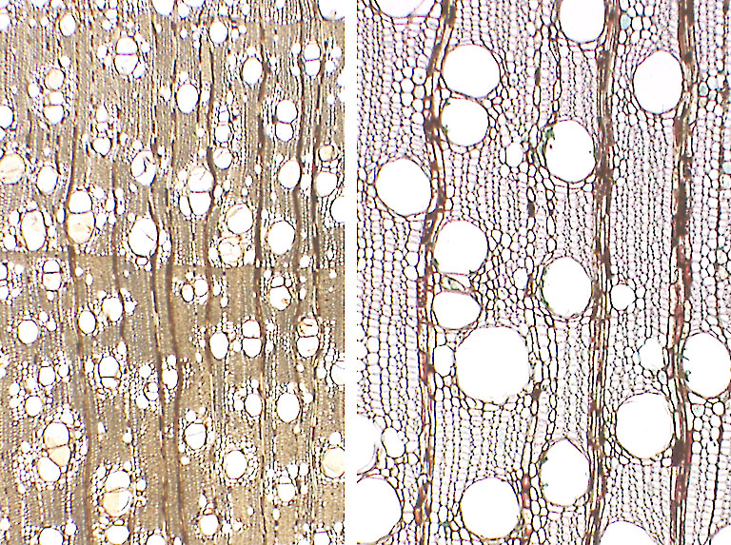
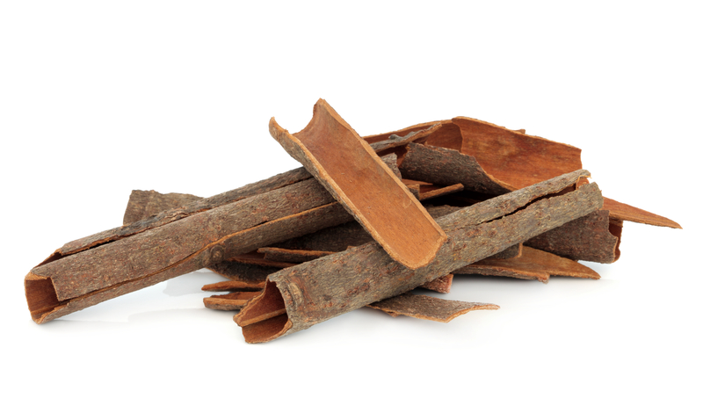
Cinnamaldehyde, cinnamic acid, cinnamate in the essential oil
Procyanidins, catechins in cinnamon bark

Slide 7
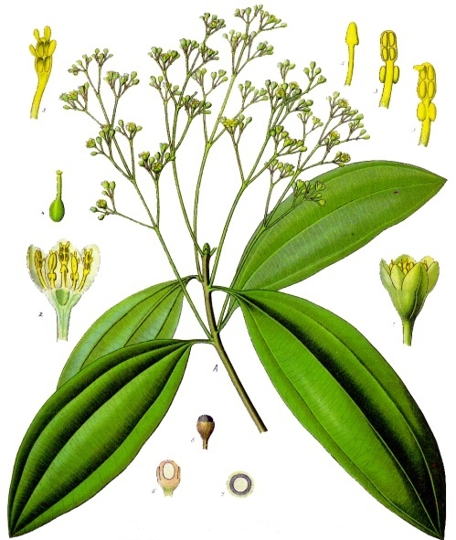

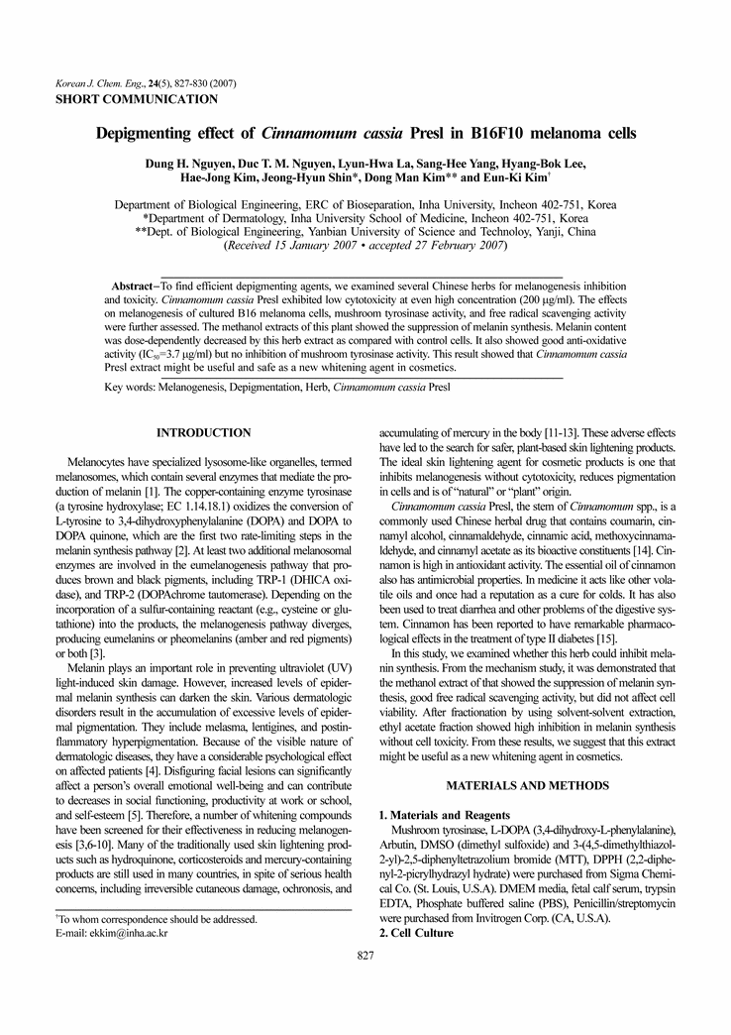
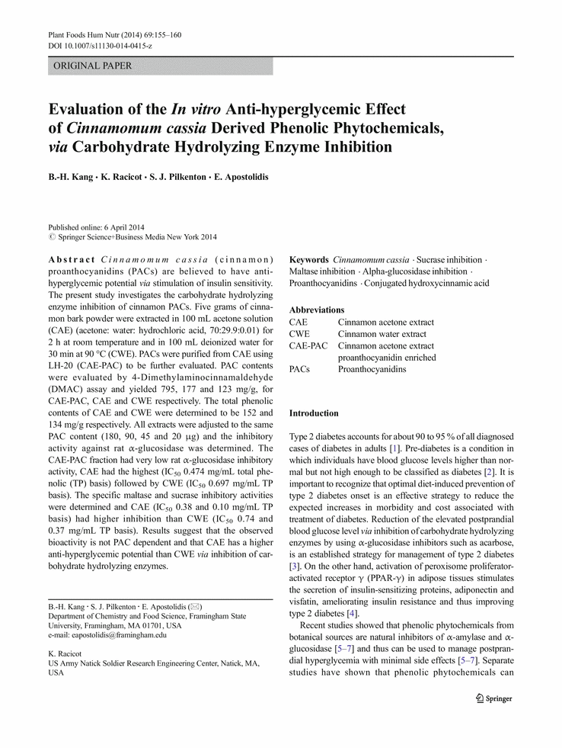
♦Antioxidant Activity
♦ Anti-inflammatory Activity
♦ Antimicrobial Activity
♦ Anticancer Activity
♦ Erectile Dysfunction
♦ Cardiovascular Diseases
♦ Neurological Disorders
♦ Diabetes Mellitus
Kang et al., 2014; Boaduo et al., 2014; Rao & Gan, 2014; Kang et al., 2014; Goswami et al., 2013; Chang et al., 2013; Yu et al., 2012; Lee et al., 2005; Reddy et al., 2004

Slide 8


ED is male dysfunction and inability of the male to attain and maintain erection of the penis sufficient to permit satisfactory sexual intercourse.
Many enzymes and inhibitors
cGMP inhibitors

Slide 9



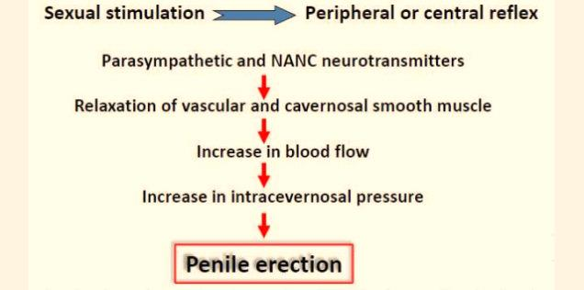


Slide 10
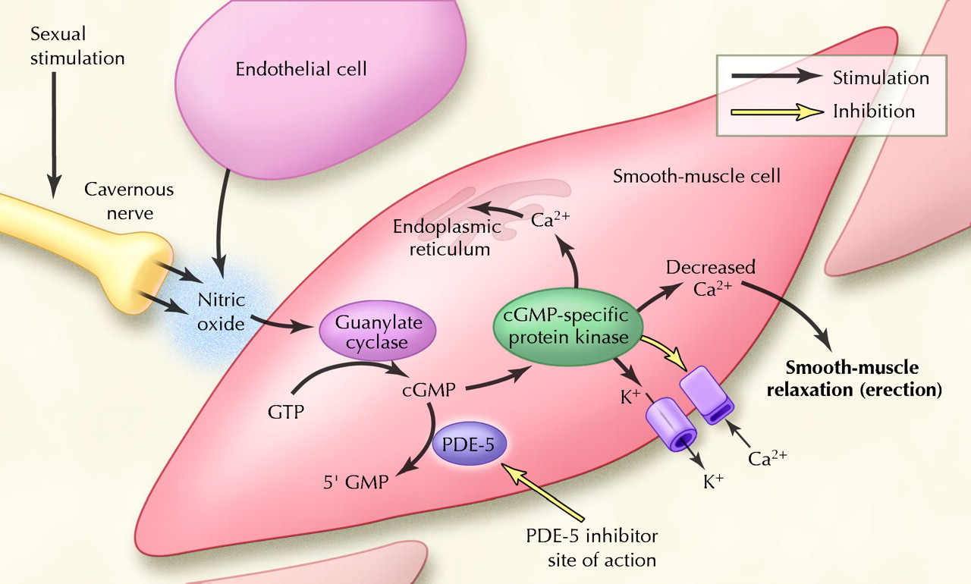
The nitric oxide is released from nerve endings or from endothelial cells and activates a cascade reaction, which ultimately leads to an increased cellular concentration of cGMP

Slide 11

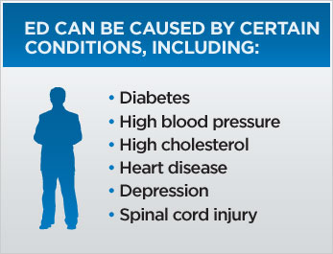

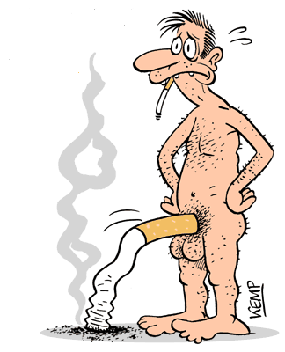
Decades ago, many scientists consider that the majority of ED could be attributed to psycological factors.

Slide 12
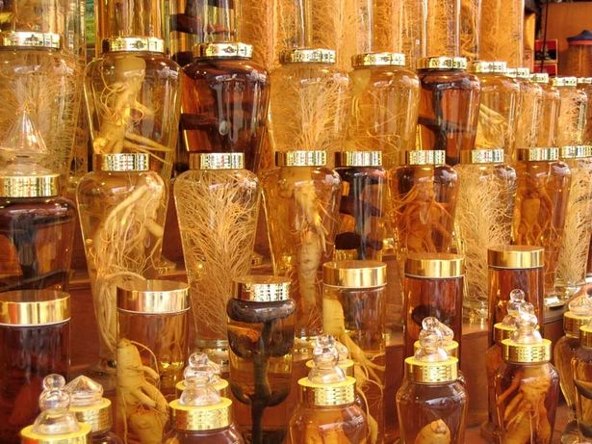
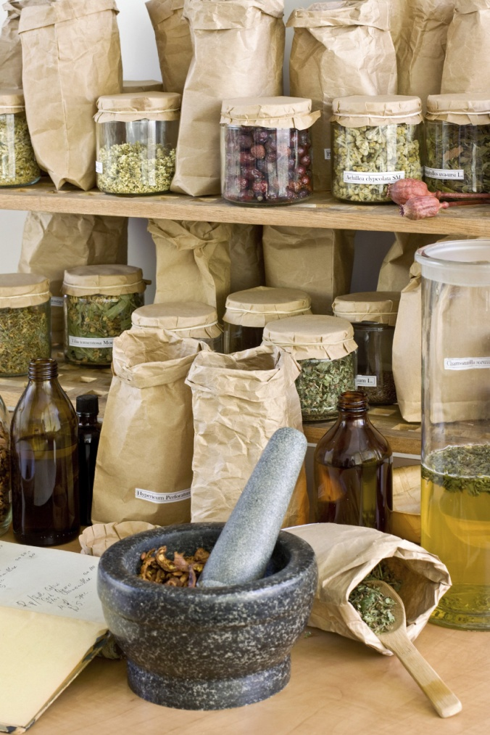

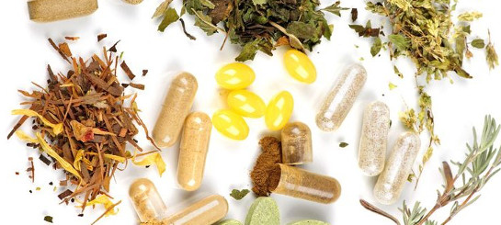
For many years, plants have played an important role to cure sexual disorders as much as for various type of disorders..…..

Slide 13
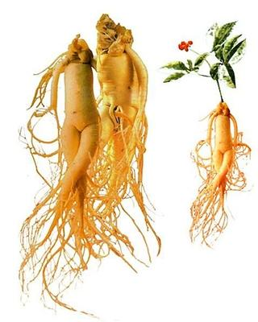
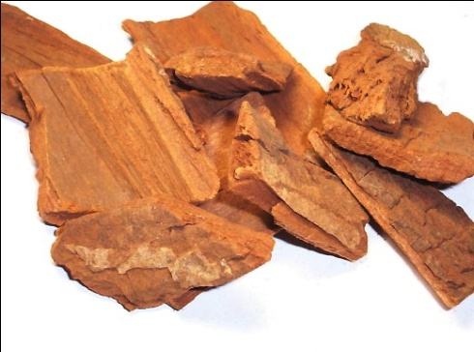

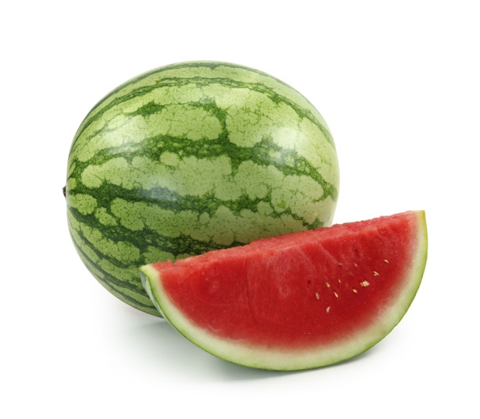
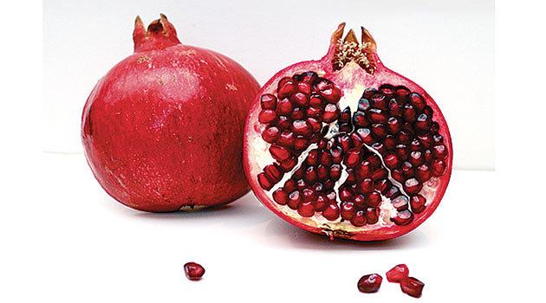
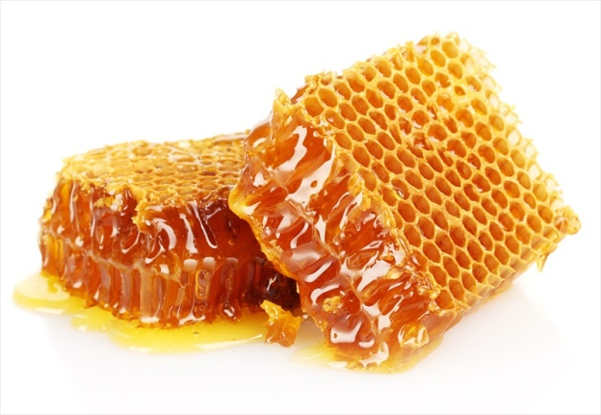

Yohimba bark
Panax ginseng
Punica granatum
Water Melon
Honey
Ginkgo

Slide 14
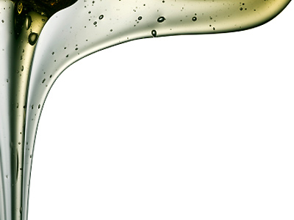
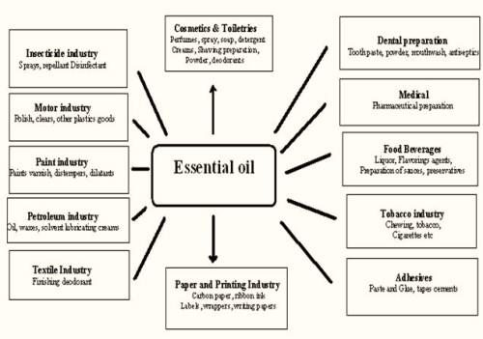
Essential oils are the most important and effective plant secondary metabolites including many type of biological effects.

Slide 15
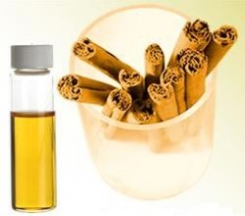


AIM
♦Analyses of the cinnamon oil (Cinnamomum cassia Blume) by GC and GC/MS
♦Identify the major components
♦Evaluation the relaxation effects of oil and its major compound on isolated human corpus cavernosum smooth muscle (CCSM).

Slide 16

MATERIALS AND METHODS
Material
-The cinnamon oil has been supplied from a commercial company
-It has been stored in a freezer till the experiments have been performed
Gas Chromatography and Mass Spectroscopy (GC/MS)
-Analyses of the essential oil were performed using GC/FID and GC/MS
-Gas chromatography analyses were carried out on an Agilent Technologies (Palo Alto, CA, USA) gas chromatograph model 7890A equipped with flame ionization detector
-The individual peaks were identified by comparison of their retention indices (relative to C9–C25 n-alkanes for HP-5MS column) with those of authentic samples and with the literature as well as by comparing their mass spectra with the Wiley 275 MS library (Wiley, New York, USA) and NIST98 (Gaithersburg, Germany) mass spectral database

Slide 17
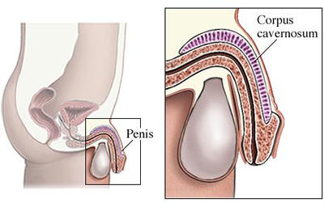
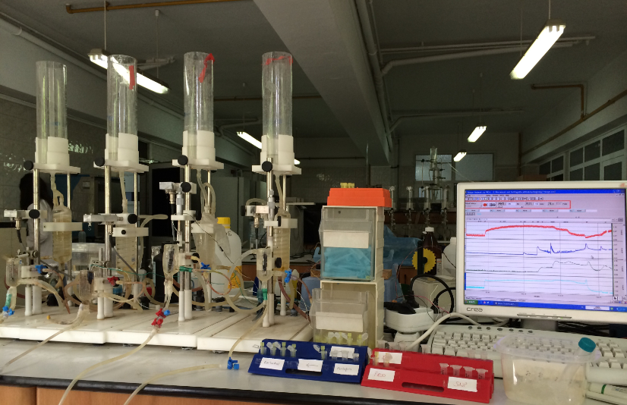
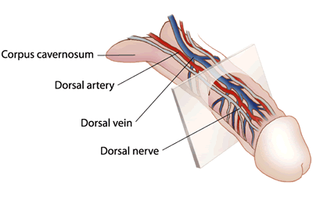
MATERIALS AND METHODS
ISOMETRIC TENSION MEASUREMENT IN THE IN VITRO STUDIES
Strips of human corpus cavernosum tissues
(1 × 1 × 6 mm) immersed in 20-mL organ chambers
The strips connected to a force transducer
1 g tension applied
Force recorded on a Grass Transducer
Isolated corpus cavernosum

Slide 18

RESULTS
In essential oil analysis, identified compounds representing %99.3 of the oil of cinnamon. The cinnamaldehyde (96.9%) has been found as major one in the oil of cinnamon.
The GC/MS analysis of the essential oil from Cinnamomum cassia blume
Peak number | Compounds | RRI | Area %
1 | Benzaldehyde | 965 | 0.3%
2 | Phenylacetaldehyde | 1048 | 0.2%
3 | trans-Cinnamic aldehyde | 1277 | 96.9%
4 | trans-Cinnamic acid | 1457 | 1.9%

Slide 19
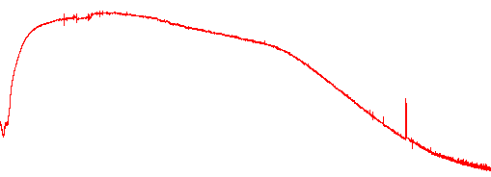
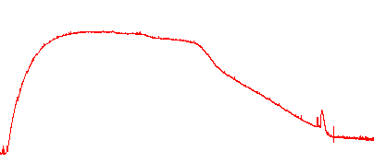
RESULTS
5 min
Cinnamon essential oil (CEO)
1g
25µL
50µL
100µL
PE (10µM)
Cinnamaldehyde (CA)
25µL
50µL
100 µL
PE (10µM)
Traces of cinnamon essential oil (CEO) and cinnamaldehyde (CA) after precontraction with phenylephrine (PE, 10 µM) in human corpus cavernosum

Slide 20
RESULTS
Cinnamon essential oil (CEO) dose- response curve in the absence and presence of the non spesific NO-synthase inhibitor, L-NAME

Slide 21
RESULTS
Cinnamon essential oil (CEO) dose response curve in the absence and presence of the soluble guanylate cyclase inhibitor, ODQ

Slide 22
RESULTS
Cinnamaldehyde (CA) dose- response curve in the absence and presence of the non spesific NO-syntase inhibitor, L-NAME (100 µM)

Slide 23
RESULTS
Cinnamon essential oil (CEO) dose response curve in the absence and presence of the soluble guanylate cyclase inhibitor, ODQ (30 µM)

Slide 24

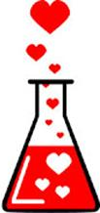
Conclusions
As seen CEO and CA’s long-lasting relaxation response was not attenuated by nitric oxide synthase (NOS) inhibitor L-NAME , and -soluble guanylyl cyclase inhibitor.
CEO and CA in vivo causes augmented penile tone and extended relaxation of the corpus cavernosum in vitro.
This does not happen via NO−sGC signaling.
Future studies are warranted to investigate this constituents on the erectile dysfunction conditions

Slide 25

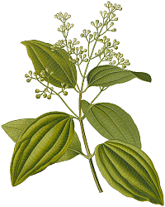
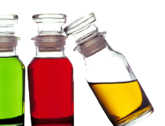
Thank you for your attention

Slide 26
Lets Meet again at Pharmacognosy-2015
3rd International Conference and Exhibition on Pharmacognosy, Phytochemistry and Natural Products
October 26-28, 2015 Hyderabad, India
Theme: Advanced trends for the future of Herbal Drugs and Products
Website: http://pharmacognosy-phytochemistry-natural-products.pharmaceuticalconferences.com/

