Slide 1


A novel synthetic antimicrobial peptide for the cure of Gram-negative infections. Mechanism of action, efficacy in vivo, toxicity, biodistribution and resistance selection
Alessandro Pini
pinia@unisi.it
Department of Medical Biotechnology
University of Siena
Italy
SetLance srl
Toscana Life Sciences
Italy

Slide 2

The new AMP M33
M33 is a novel non natural antimicrobial peptide discovered at the University of Siena. It is under development for the set up of a new antibacterial drug.
PIPELINE OF DRUG DEVELOPMENT FROM LAB TO MARKET
Research
Development
Commercialization
MARKET
Target
identification
and
acquisition
Preclinical
and
pharmacology
Process devel.
Launch
and
marketing
Lead
generation
Lead
optimization
and
Clinical trials
manufacturing
1
2
3
4
5
6
7
8
9
10
TIME (Y)
M33

Slide 3
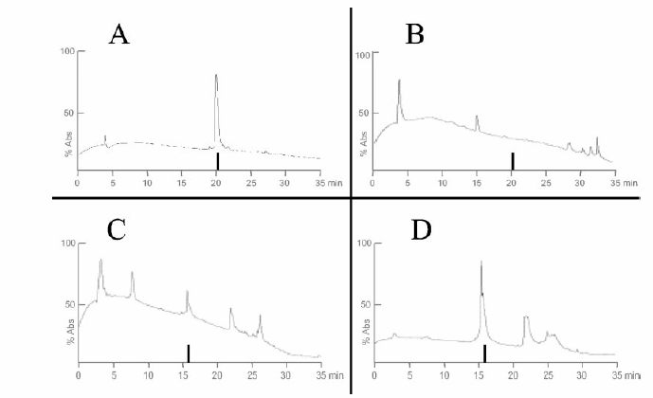
Technology
O
NH
Tetrabranched (MAP) peptides acquire high resistance to protease activity making these molecules good candidates for in vivo use.
H
N
NH
Monomeric
peptide
H
O
N
H
O
O
NH
NH
Tetrabranched
peptide
monomeric
monomeric
peptide
peptide
incubated
monomeric
incubated
monomeric
peptide
peptide
incubated
incubated
in
in
serum
serum
at 2 h
in
at 2 h
in
serum
serum
at 0 h
at 0 h
Bracci et al., 2002, Biochemistry-US
Bracci et al., 2003, J Biol Chem
Lozzi et al., 2003, Chem Biol
Pini et al., 2005, Antimicrob Agents Chemother
Pini et al., 2006, Biochem J
Falciani et al., 2007, Mol Cancer Therapeut
Falciani et al., 2007, Chem Biol Drug Des
Pini et al., 2007, J Pept Sci
Pini et al., 2008, Cur Prot Pept Sci
Falciani et al., 2009, Exp Opin Biol Ther
Pini et al., 2010, FASEB J
Falciani et al., 2010, Curr Cancer Drug Targets
Falciani et al., 2010, ChemMedChem
Falciani et al., 2011, ChemMedChem
Pini et al., 2012, AminoAcids
Falciani et al., 2012, PLOS One
Falciani et al., 2013, J Med Chem
MAP peptide
MAP peptide
incubated
MAP peptide
incubated
MAP peptide
incubated
incubated
in
in
serum
serum
at 24 h
in
at 24 h
in
serum
serum
at 0 h
at 0 h
HPLC profiles of monomeric and tetrabranched peptides
incubated in serum

Slide 4

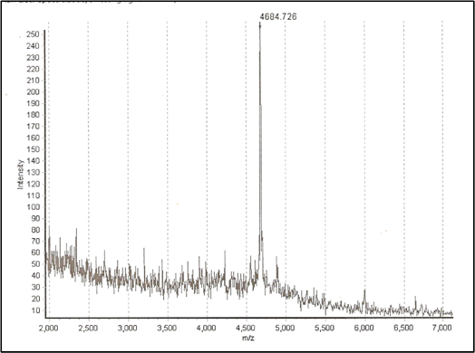
Identification and optimization of
new antimicrobial peptides
QKKIRVRLSA (M6)
Pini et al., 2005; Pini et al., 2007
KKIRVRLSA (M33)
Pini et al., 2010; Pini et al., 2012
M6 lot1
M6 lot2
M6 lot3
PyroM6
M33
M33 lot 1
M33 lot 2
M33 lot 3
100
phage library selection
80
60
40
%CFU/ml E.coli
20
0
3
6,25
12,5
25
50
-20
peptide [µg/ml]
Antimicrobial activity
Antimicrobial activity
different
peptide
species
M6
M33
HPLC profile
HPLC profile

Slide 5
Antimicrobial activity
Pini et al., 2010, FASEB J; Pini et al., 2012, AminoAcids
MICs (μM) of M33 in comparison with polymyxin B against bacterial strains representative of several pathogenic species, including MDR strains of clinical origin
Species and strains | Resistanceª | MIC (μM)
 |  | M33 | Polymyxin B
Pseudomonas aeruginosa ATCC 27853 | Reference strain, wild type | 1.5 | 1.5
P. aeruginosa PAO-1 | Reference strain, wild type | 1.5 | 1.5
P. aeruginosa VR-143/97 | FQ^{r} AG^{r} ESC^{r} NEM^{r} (MBL/VIM-1) | 1.5 | 1.5
P. aeruginosa SC-MDr03-06^{b} | FQ^{r} AG^{r} ESC^{r} NEM^{r} | 3 | 1.5
P. aeruginosa SC-VMr04-05^{b} | FQ^{r} AG^{r} ESC^{r} NEM^{r} | 3 | 1.5
P. aeruginosa SC-DMr05-04^{b} | FQ^{r} AG^{r} ESC^{r} NEM^{r} | 1.5 | 1.5
P. aeruginosa SC-BGr12-02^{b} | FQ^{r} AG^{r} ESC^{r} NEM^{r} | 1.5 | 1.5
P. aeruginosa EF-OBG6-1^{b} | FQ^{r} AG^{r} ESC^{r} NEM^{r} (MBL/IMP-13) | 1.5 | 0.7
P. aeruginosa SC-MDm03-02^{b,c} | FQ^{r} AG^{r} ESC^{r} NEM^{r} | 3 | 1.5
P. aeruginosa SC-GMm03-05^{b,c} | FQ^{r} AG^{r} ESC^{r} NEM^{r} | 1.5 | 1.5
P. aeruginosa SC-CNm03-07^{b,c} | FQ^{r} AG^{r} ESC^{r} NEM^{r} | 0.3 | 0.7
Klebsiella pneumoniae ATCC 13833 | Reference strain, wild type | 1.5 | 0.7
K. pneumoniae 7086042 | FQ^{r} AG^{r} ESC^{r} NEM^{r} (MBL/VIM-1) | 3 | 1.5
K. pneumoniae C8-27 | FQ^{r} AG^{r} ESC^{r} ETP^{r} (ESBL/CTX-M-15) | 1.5 | 0.7
K. pneumoniae FIPP-1 | FQ^{r} AG^{r} ESC^{r} NEM^{r} (MBL/KPC-3) | 3 | 1.5
Escherichia coli ATCC 25922 | Reference strain, wild type | 1.5 | 0.7
E. coli W03BG0025 | FQ^{r} AG^{r} ESC^{r} (ESBL/CTX-M-15) | 0.7 | 0.7
Enterobacter aerogenes W03BG0067 | AG^{r} ESC^{r} (ESBL/SHV-5) | 1.5 | 0.7
Enterobacter cloacae W03AN0041 | ESC^{r} (ESBL/SHV-12) | 1.5 | 0.7
Acinetobacter baumannii RUH 134 | Reference strain, European clone II | 1.5 | 1.5
A. baumannii RUH 875 | Reference strain, European clone I | 3 | 1.5
A. baumannii MR157 | FQ^{r} AG^{r} ESC^{r} NEM^{r} (OXA/OXA-58) | 3 | 1.5
Staphylococcus aureus ATCC 29213 | Reference strain, PEN^{r} | 6 | 96
S. aureus 3851 | MR VAN^{i} | 6 | 96
aTested strains included either reference strains (indicated) or clinical isolates (mostly showing an MDR phenotype); relevant resistance traits and resistance mechanisms are indicated: FQr, resistant to fluoroquinolones; AGr, resistant to aminoglycosides (gentamicin, amikacin, and/or tobramycin); ESCr, resistant to expanded-spectrum cephalosporins; NEMr, resistance to carbapenems (imipenem and/or meropenem), ETPr resistance to ertapenem; ESBL, extended spectrum β-lactamase; MBL, metallo-β-lactamase; OXA, oxacillinase; MR methicillin-resistant; PENr resistance to penicillin; VANi, vancomycin-intermediate;
bClinical isolates from Cystic Fibrosis patients
cMucoid phenotype

Slide 6
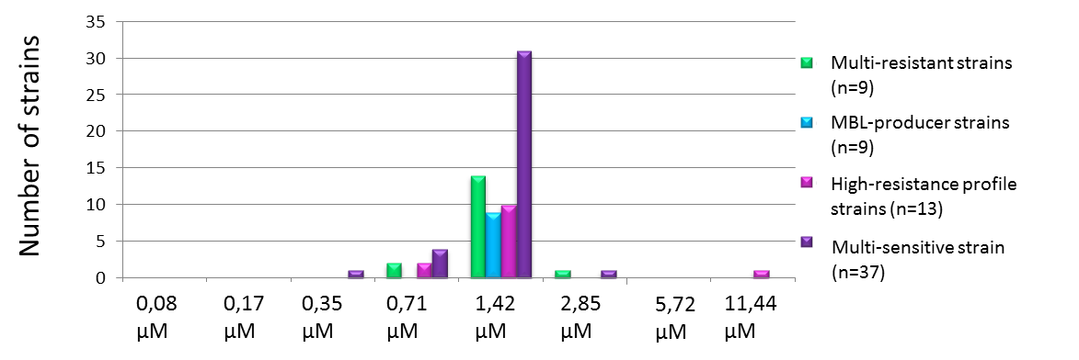
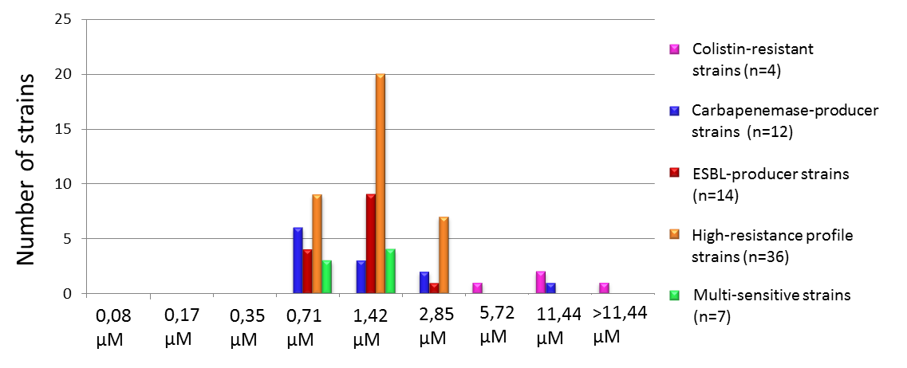
MIC 50 and 90 for P. aeruginosa and K. pneumoniae
Specie batterica | MIC 50 | MIC 90
Pseudomonas aeruginosa, 76 strains | 1,4 μM | 1,4 μM
Klebsiella pneumoniae, 73 strains | 1,4 µM | 2,8 µM
MIC value distribution with correlation to P. aeruginosa bacterial resistance profile.
MIC value distribution with correlation to K. pneumoniae bacterial resistance profile.

Slide 7
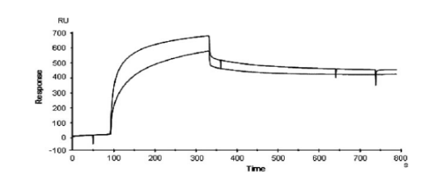
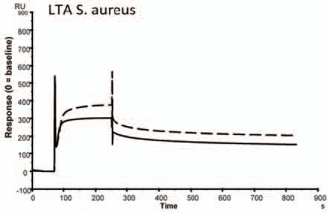
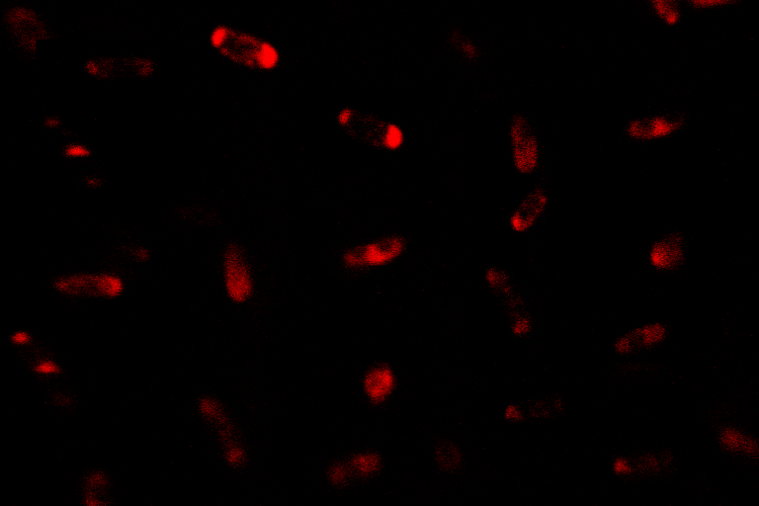
Mechanism of action
TWO STEPS MECHANISM
LPS binding
Pini et al., 2007
1- LPS and LTA recognition and binding
KD = 3.17e–9
LTA binding
Falciani et al., 2012
M33
Confocal laser microscopy
Pini et al., 2007
2 – Bacteria membrane is crossed and impaired
CLSM experiments showed that rhodamine-labelled M33 is able to enter the cells within 5 minutes from incubation

Slide 8
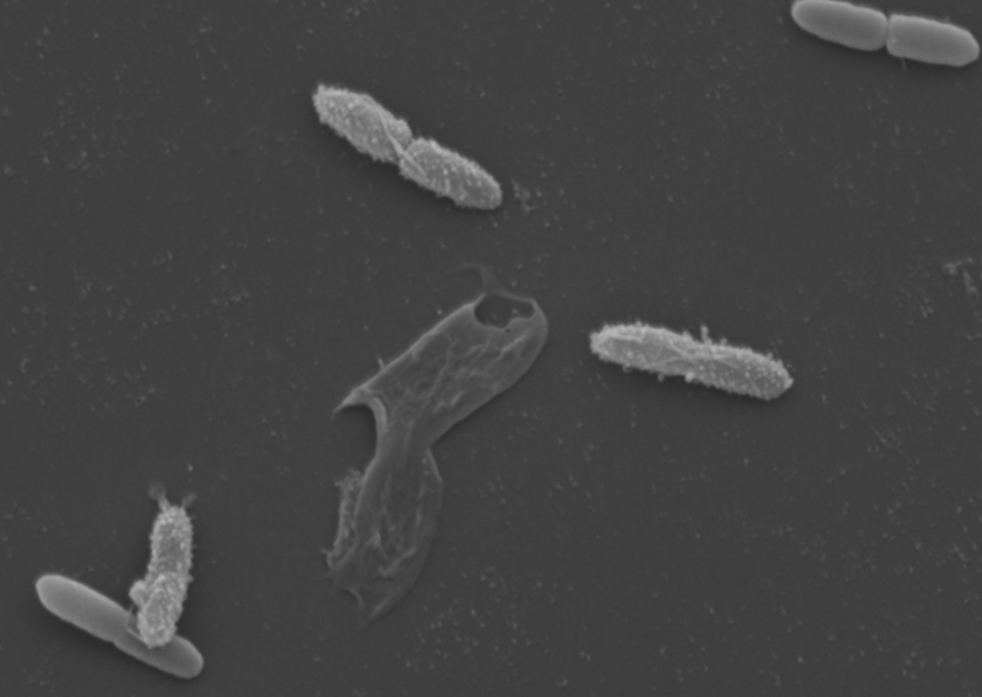
Transmission Electron Microscopy
Scanning Electron Microscopy
Pseudomonas aeruginosa incubate with M33 1.5 µM (MIC value)

Slide 9
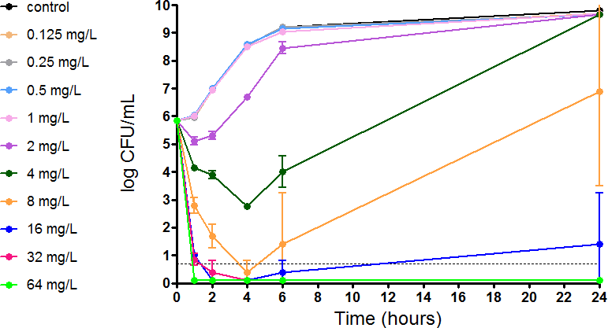
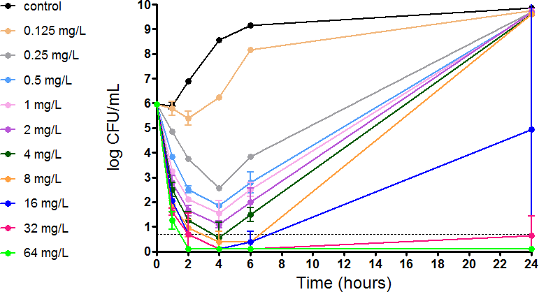
Time Killing Kinetics
Time Kill Kinetics of a K. pneumoniae-ESBL resistant isolate and M33. M33 shows concentration-dependent killing activity.
Time Kill Kinetics of a K. pneumoniae-ESBL resistant isolate and Colistin. M33 shows concentration-dependent killing activity.
M33-resistant mutants were not found, while Colistin resistant mutants were found at the same time

Slide 10
Bacterial resistance to M33
Manuscript in preparation
M33-resistant mutants selection was attempted in vitro using the M33-susceptible (MIC 0.35 µM) and colistin-susceptible (MIC 0.15 µM) K. pneumoniae strain KKBO-1 (Cannatelli et al., 2013) by plating cells on M33-containing medium. Colistin-containing plates were also used as control for the selection of colistin-resistant mutants. With this approach, colistin-resistant mutants were selected at a frequency of approximately 1 x 10⁻⁷, while no mutant strains could be selected for M33 using an inoculum up to 5 x 10⁹ CFU (i.e. selection frequency of resistant mutants was < 5 x 10⁻⁹). Results of these experiments suggested a significantly lower M33 propensity for resistance selection with respect to colistin (at least 500 fold lower for M33).
Frequency
of
colistin
-
resistant
clones
Frequency
of M33
-
resistant
clones
1 X 10⁻⁷
< 5 X 10⁻⁹

Slide 11
Neutralization of LPS
Pini et al., 2010, FASEB J
Inhibition of TNF-α release by LPS neutralization. Raw 264.7 (mouse leukaemic monocyte macrophage cells) were incubated with LPS from P. aeruginosa and Klebsiella pneumonie and M33. Triangles indicates incubation with LPS and different concentrations of M33. Squares indicates incubation with M33 only.

Slide 12






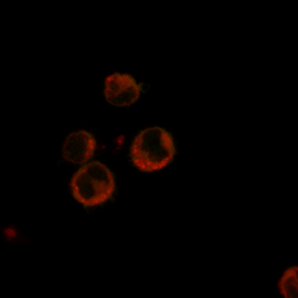
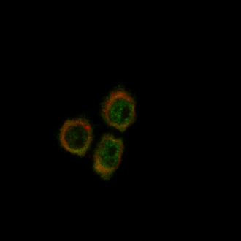
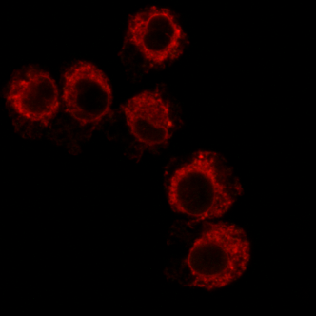







Anti-inflammatory activity
Manuscript in preparation
Gene expression
(P. aeruginosa or K. pneumoniae)
NFkB Protein production
Control
LPS Klebsiella
LPS Klebsiella with M33
LPS Klebsiella
LPS Klebsiella with M33
LPS Pseudomonas
LPS Pseudomonas with M33
Control
NFκB
TNF-α
100%
69%
100%
64%
IL1-β
100%
59%
100%
27%
iNOS
100%
17%
100%
16%
MIP1
100%
71%
100%
37%
MIP2
100%
100%
100%
58%
Control
LPS Pseudomonas
LPS Pseudomonas with M33
Cells incubated with LPS or with LPS and M33
Control = cells not incubated. LPS Pseudomonas = cells stimulated with LPS and producing NFkB (green signal). LPS Pseudomonas with M33 = cells incubated with LPS and M33 where the green signal is disappeared
Gene expression (E. coli)
Control
LPS E. coli
LPS E. coli with M33
TNF-a
TNF-α is the most important cytokine involved in systemic inflammation and is implicated in acute phase reaction
IL1-beta is an important mediator of the inflammatory response, and is involved in a variety of cellular activities
iNOS is a proximate cause of septic shock
MIP1 and MIP2 are among the major factors produced by macrophages after they are stimulated with bacterial endotoxins
NF-κB is involved in cellular responses to several stimuli including bacterial or viral antigens.
Cox-2 is an enzyme that acts to speed up the production prostaglandins that play a key role in in promoting inflammation.
IL1-b
iNOS
MIP1
MIP2

Slide 13
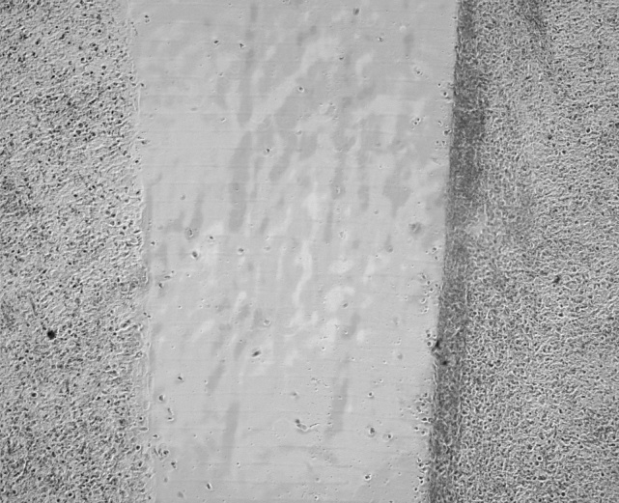
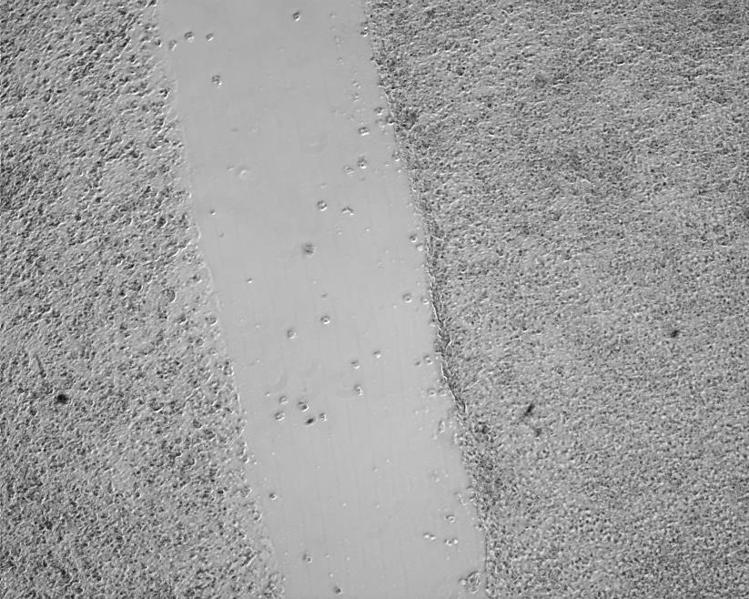
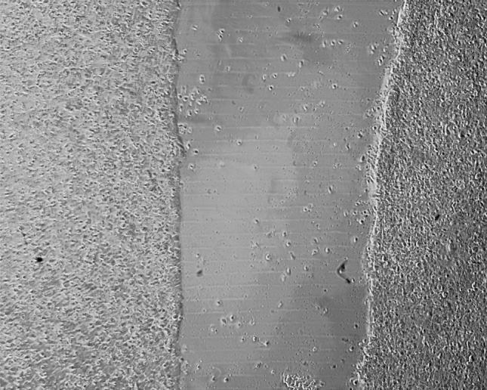
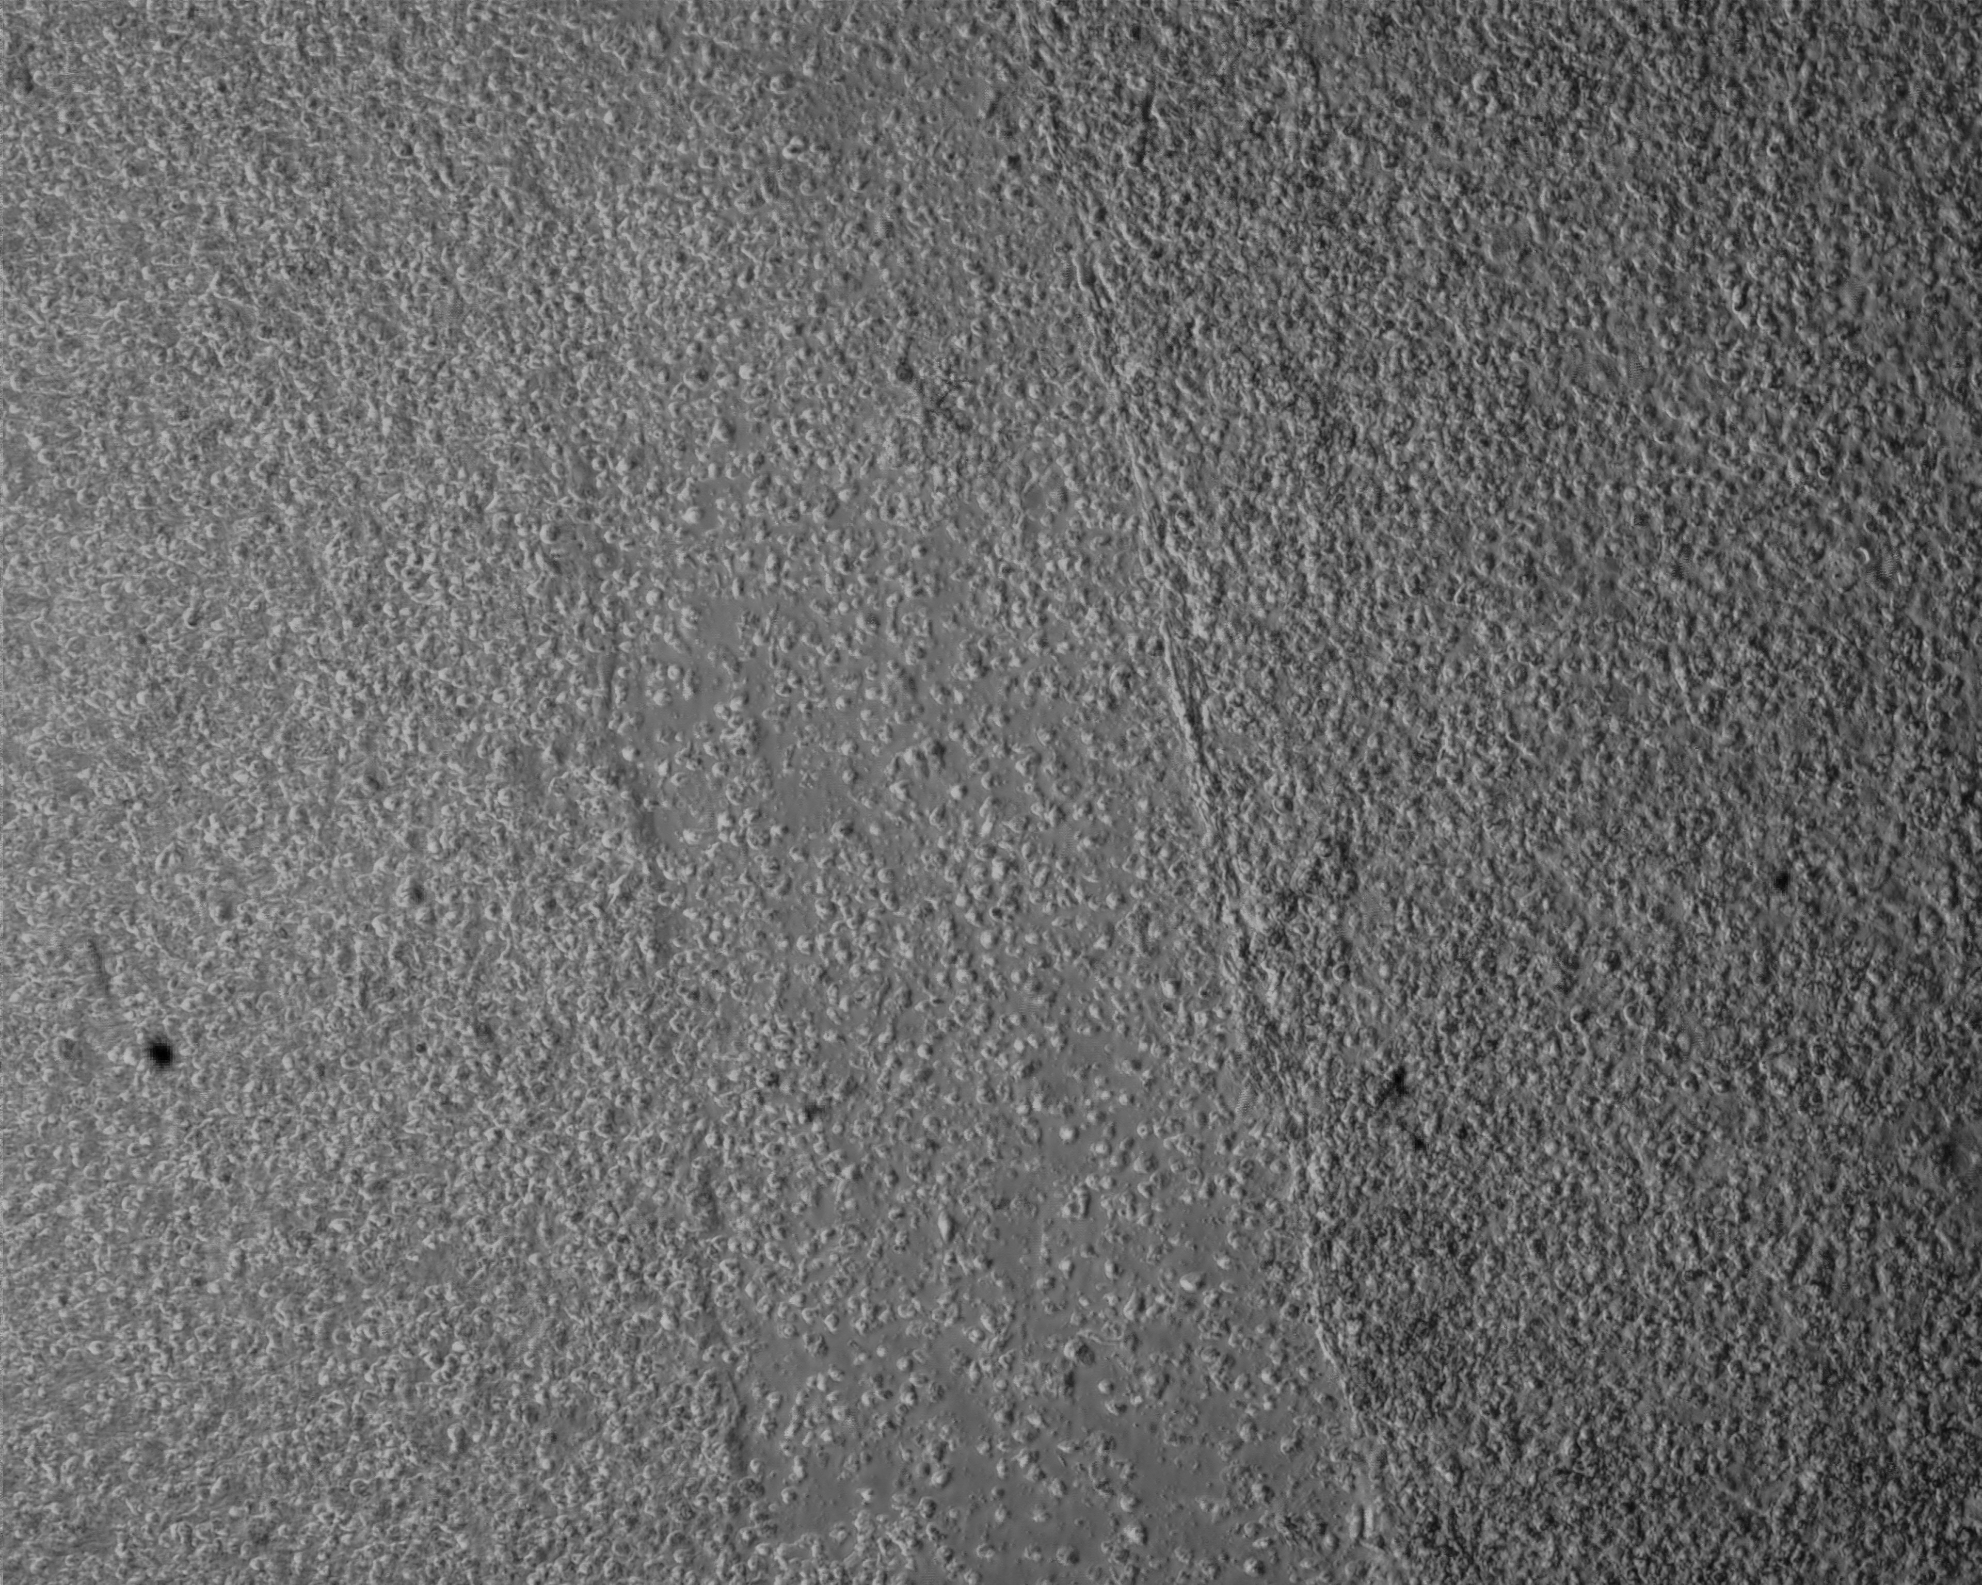
Wound Healing
Manuscript in preparation
Keratinocyte culture with wound in the cell carpet and treatment with M33
Control culture
Culture treated with M33
Time 0
44%
28%
Time 24
37%
0%

Slide 14
In vivo activity – The sepsis animal model
Manuscript in preparation
PEG4
M33PEG4
5mg/Kg
20%
M33
5mg/Kg

Slide 15
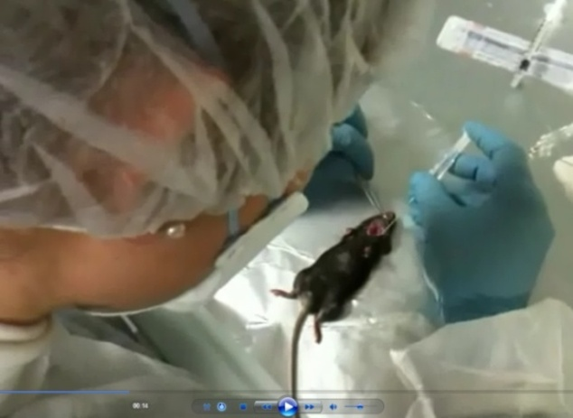
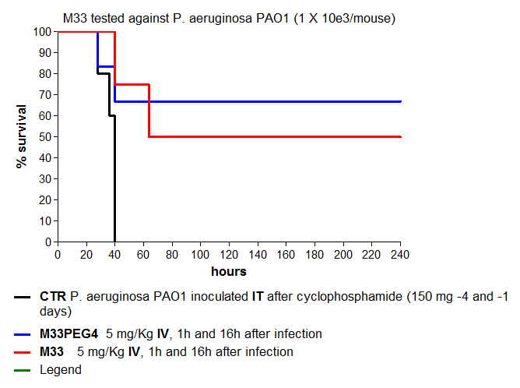
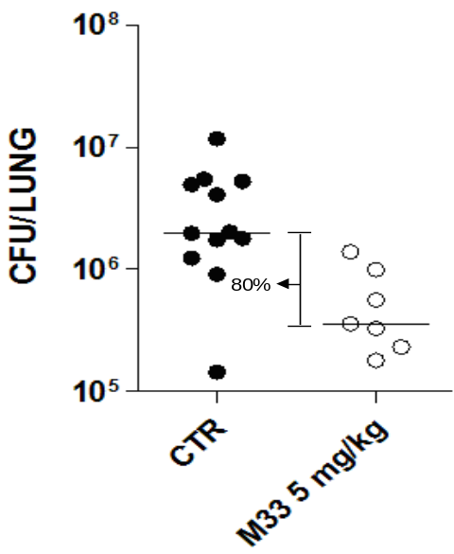
In vivo activity – The lung infection model
Manuscript in preparation
M33PEG4
5mg/Kg
M33
5mg/Kg
Number of CFU present in lungs of animals infected IT with P. aeruginosa and then treated IT with M33

Slide 16
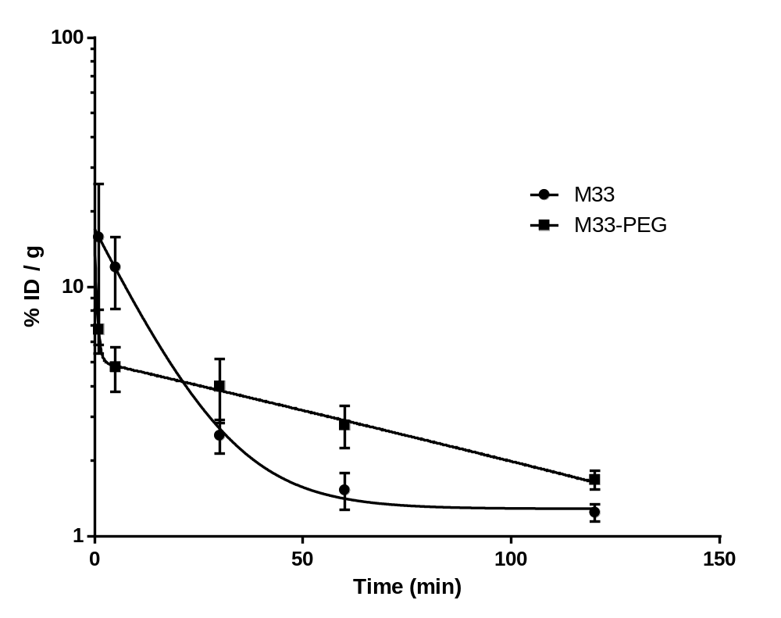
In vivo activity – Plasma clearance
Manuscript in preparation
Concentration of [¹²⁵I]SET-M33L and [¹²⁵I]SET-M33L-PEG in plasma, expressed as % ID/g, at different time points after administration of the labeled species. Calculated half-life is around 10 min for M33 and 70 min for M33-PEG

Slide 17
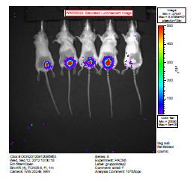
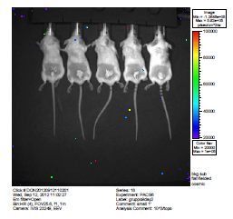
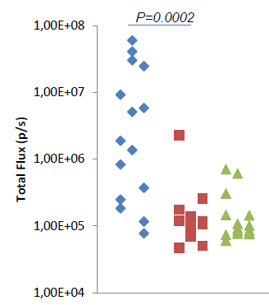

In vivo activity – The skin infection model
Manuscript in preparation
Animals abraded and infected with P. aeruginosa. Then treated with M33 in cream 1 day after infection
Controls
M33 treated
Controls
M33 treated

Slide 18







Preliminary acute toxicity IV
40 mg/Kg
20 mg/Kg
M33
M33
t 10 min
t 24h
t 48 h
t 72 h
t 96 h
t 10 min
t 24h
t 48 h
t 72 h
t 96 h
M33-PEG
M33-PEG
t 10 min
t 24h
t 48 h
t 72 h
t 96 h
t 10 min
t 24h
t 48 h
t 72 h
t 96 h
COLISTIN
COLISTIN
t 10 min
t 24h
t 48 h
t 72 h
t 96 h
t 10 min
t 24h
t 48 h
t 72 h
t 96 h
10 mg/Kg
M33
t 10 min
t 24h
t 48 h
t 72 h
t 96 h
M33-PEG
mouse without signs
mouse with manifest signs
t 10 min
t 24h
t 48 h
t 72 h
t 96 h
LEGEND
mouse with mild signs
mouse dead for toxicity
COLISTIN
t 10 min
t 24h
t 48 h
t 72 h
t 96 h

Slide 19

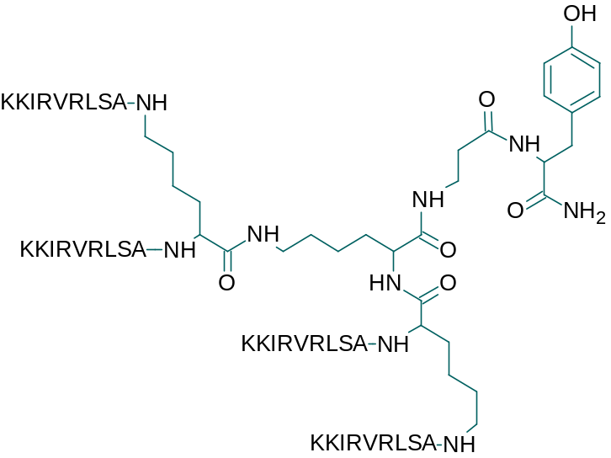
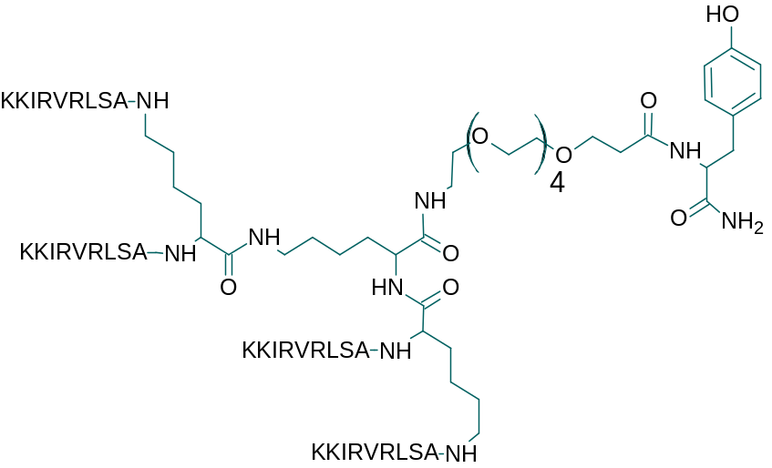
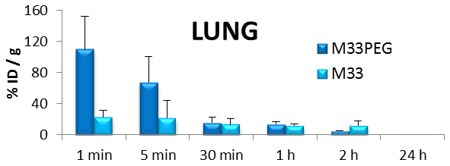
Preliminary biodistribution
Synthesis of M33 and M33-Peg with tyrosine for iodination (¹²⁵I) and preliminary biodistribution studies in rodents
M33
M33-Peg

Slide 20
In progress
Preclinical Development
Bioanalytical method set up
GLP production of M33
Pharmacokinetics and biodistribution
Safety pharmacology in rodents and non rodents
Research and back up molecules
Animal model of K. pneumoniae infection and M33 treatment
Conjugation with nanoparticles and formulation for delivery in lungs
Broadening spectrum of activity using M33 with D-aminoacids
Preliminary efficacy and toxicity with M33-D

Slide 21












Department of Biochemical Sciences A. Rossi Fanelli
University of Rome 1
Medical Biotechnology Department
University of Siena
Maria Luisa Mangoni
Vincenzo Luca
Biochemistry Section
Microbiology Section
Department of Experimental Medicine
University of Perugia
Anna Vecchiarelli
Donatella Pietrella
Luisa Bracci
Jlenia Brunetti
Stefano Bindi
Luisa Lozzi
Silvia Scali
Giulia Roscia
Elisa Ibba
Leila Quercini
Lorenzo Depau
Giulia Riolo
Elisabetta Mandarini
Gian Maria Rossolini
Simona Pollini
Antonio Cannatelli
Chiara Falciani
Federica Ceccherini
Martina Onori
Erasmus MC
Rotterdam, The Netherlands
John Hays
Irma Bakker
FP7
San Sebastian, Spain
Unai Cossio
Vanessa Gomez-Vallejo
Maria Puigivila
Jordi Llop Roig
MIUR

