Slide 1



www.biochemlab.it
Neural activity is pivotal for myelin growth

Slide 2
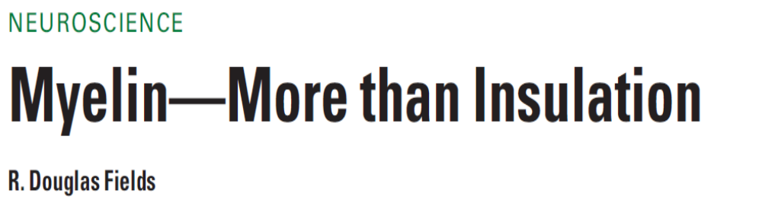
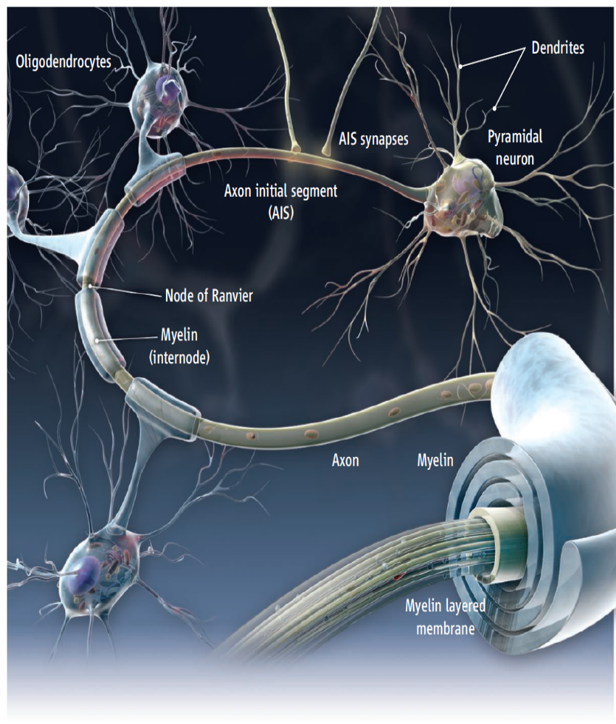
- NIH, Bethesda
…Myelin organizes the very structure of network connectivity, facilitates
modes of nervous system function beyond the neuron doctrine, and regulates the timing of information flow through individual circuits. It is certainly time to set aside the frayed metaphor of myelin as insulation and appreciate the more fascinating reality.

Slide 3

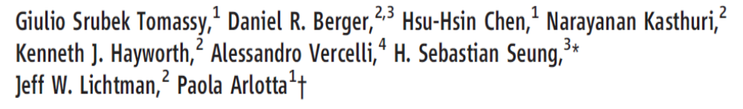
1- Harvard University – Cambridge – USA
4- Neuroscience Institute of Turin - Italy
…We find that individual neurons have distinct longitudinal distribution of myelin.
Neurons in the superficial layers displayed the most diversified profiles, including a new pattern where myelinated segments are interspersed with long, unmyelinated tracts…

Slide 4
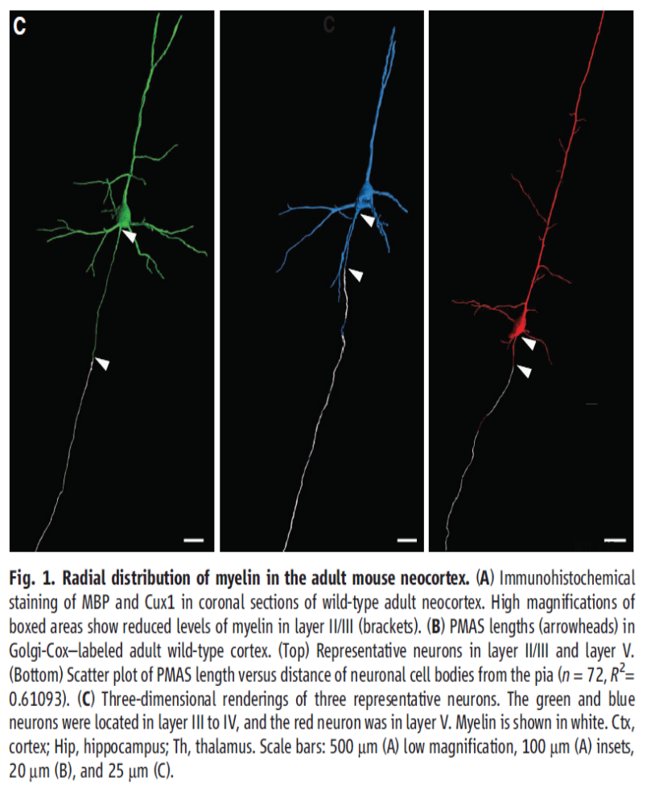
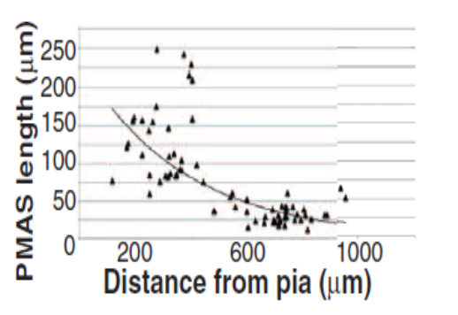
Mouse somatosensory cortex
Neocortex
Layer III-IV
Neocortex
Layer V
PMAS: Premyelin Axonal Segment

Slide 5
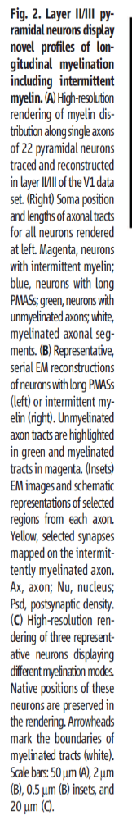
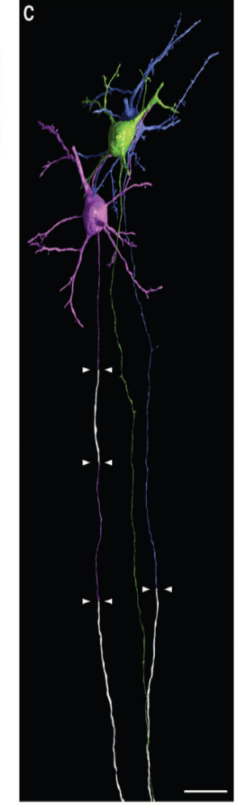
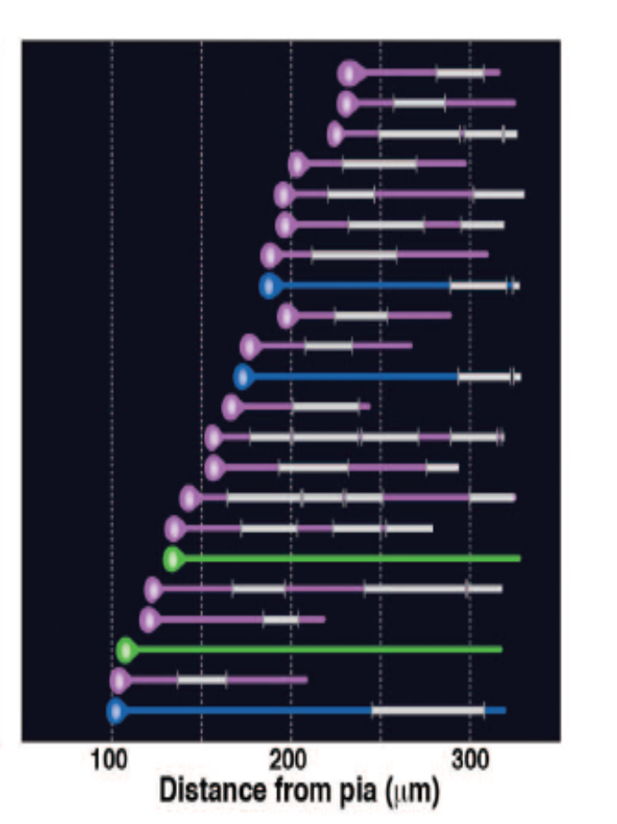
Neuroni con mielina intermittente
Neuroni con esteso PMAS
Tratti mielinati
Neuroni con assone non-mielinato

Slide 6
(2)
Naural activity trigger myelin growth

Slide 7
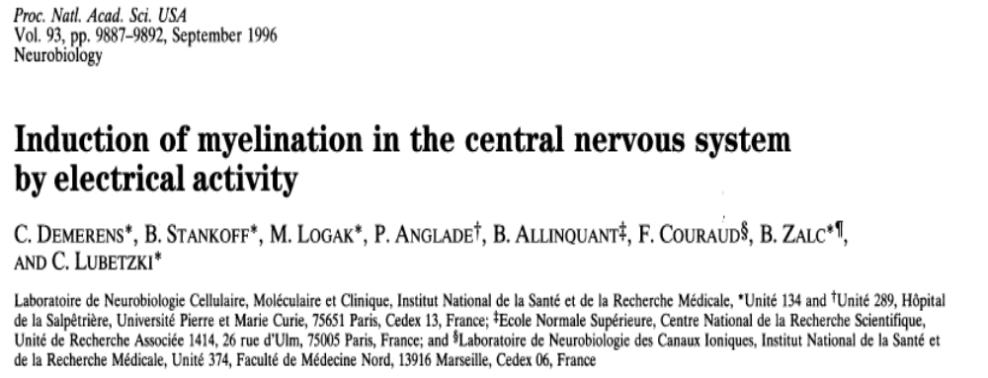
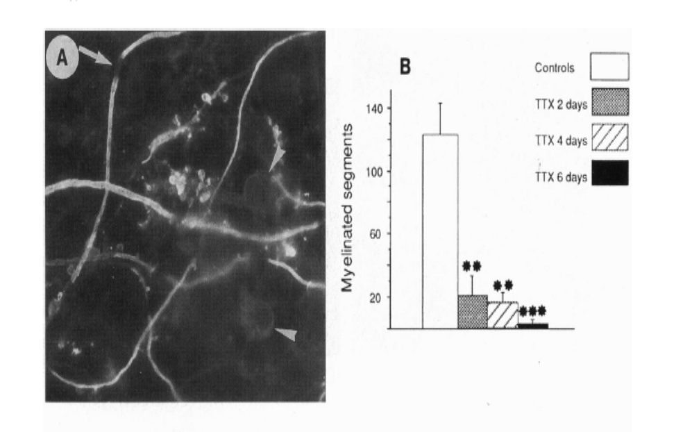
Report 1
tetrodotoxin which can blocks the firing of neurons.

Slide 8
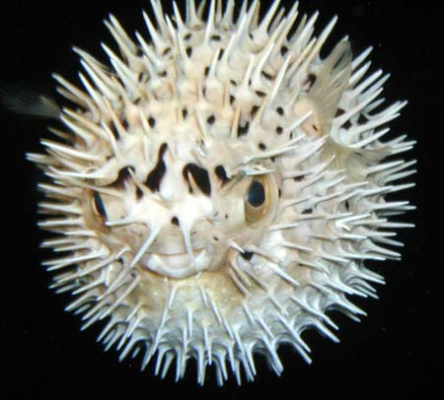
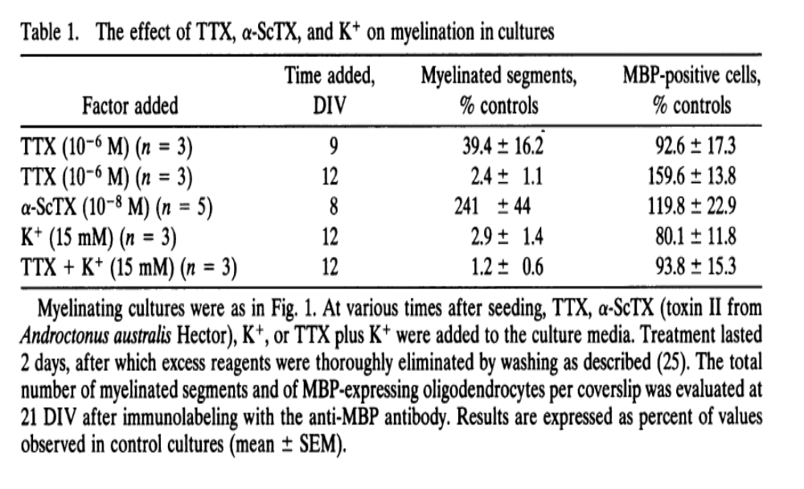
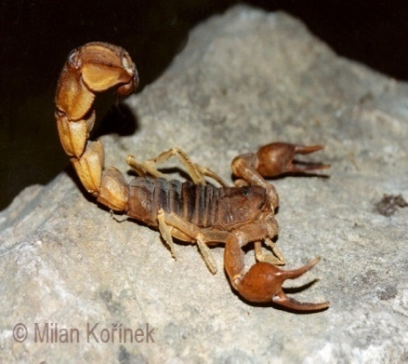
Tetrodotoxin (TTX) blocks the firing of neurons.
α-scorpion toxin (α-ScTX) increase the firing of neurons.

Slide 9

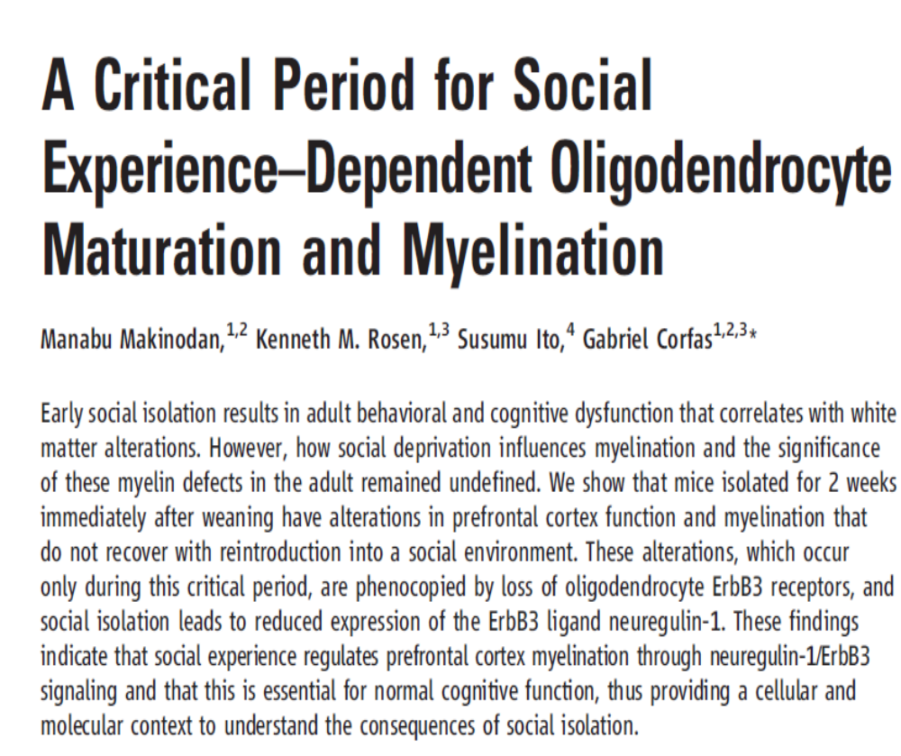
Report 2
14 september 2012

Slide 10
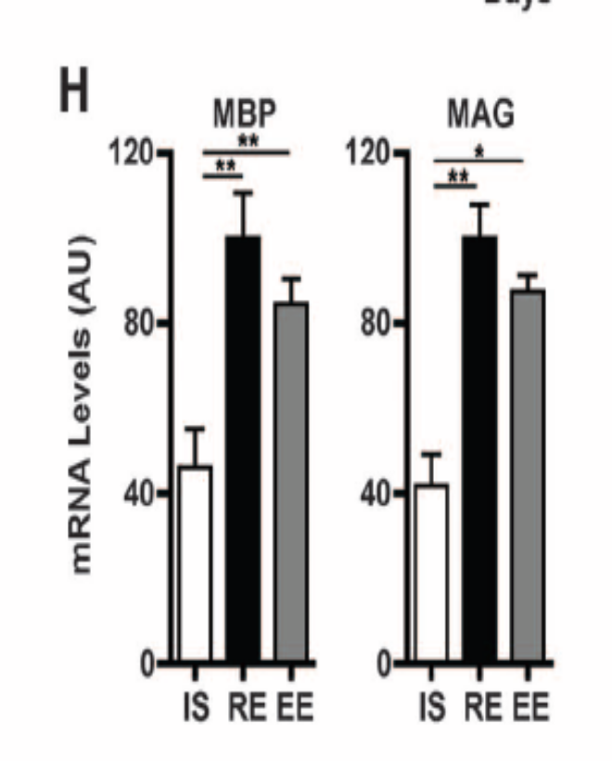
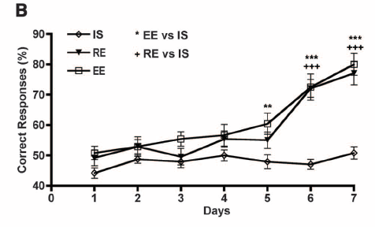
Working Memory
IS = Insulated Starting at P21;
RE = Regular Environment
EE = Enriched Environment

Slide 11

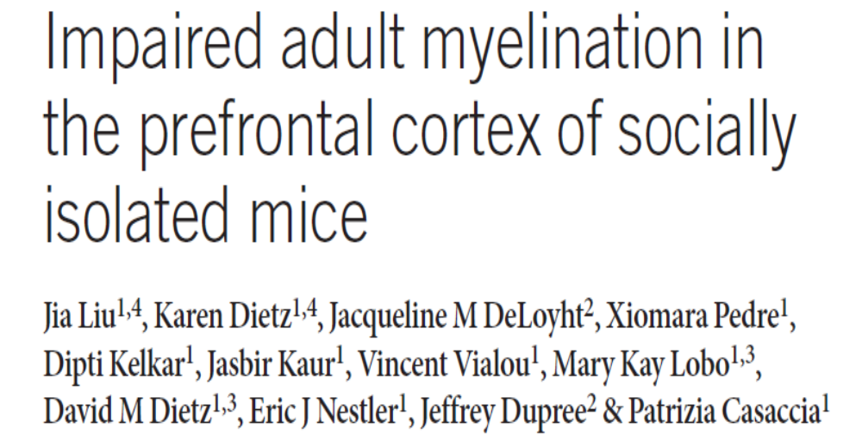

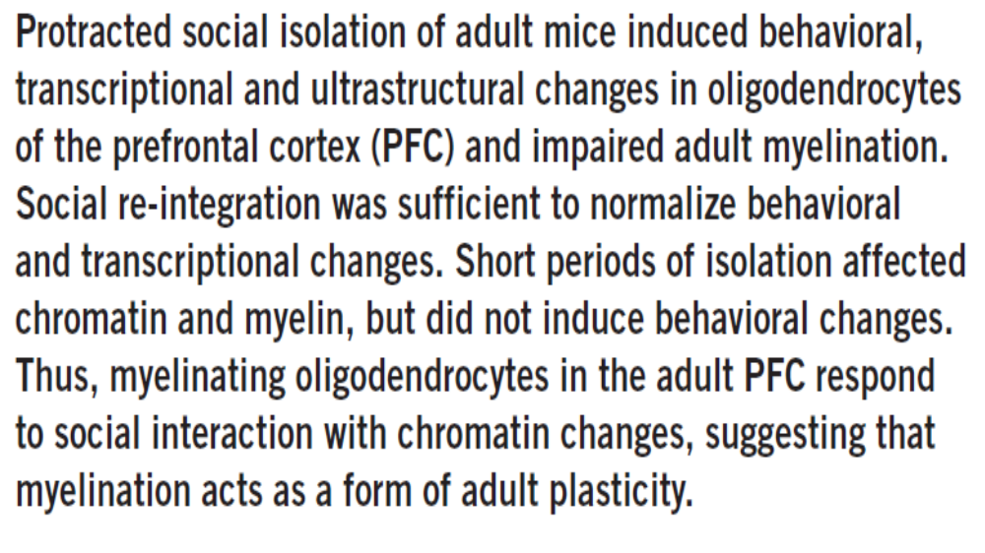
Report 3
December 2012
Patrizia Casaccia, Mount Sinai Hospital New York

Slide 12
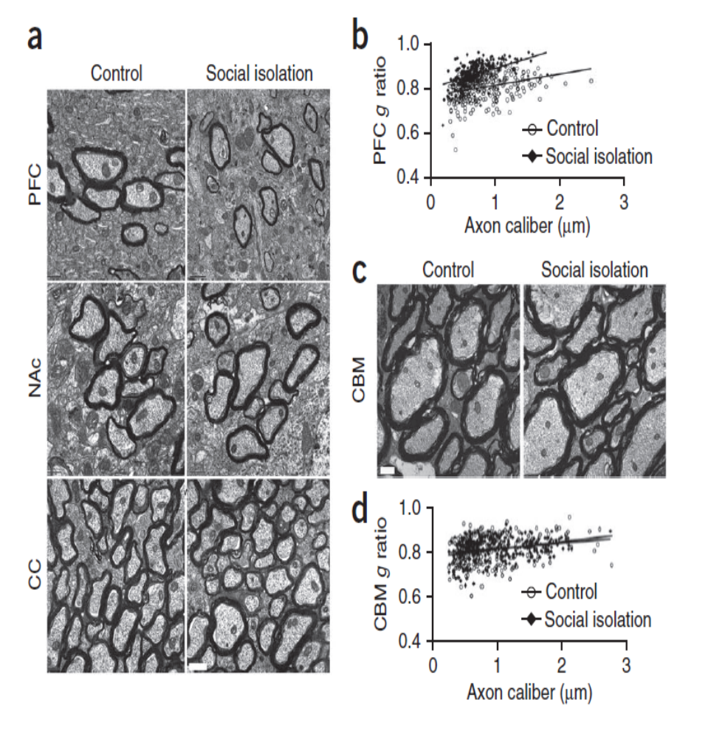
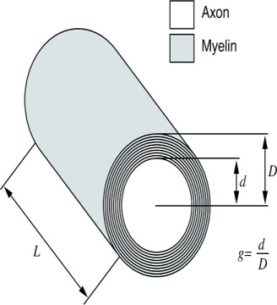
Prefrontal Cortex
Nucleus Accumbens
Cerebellum
Corpus Callosum

Slide 13

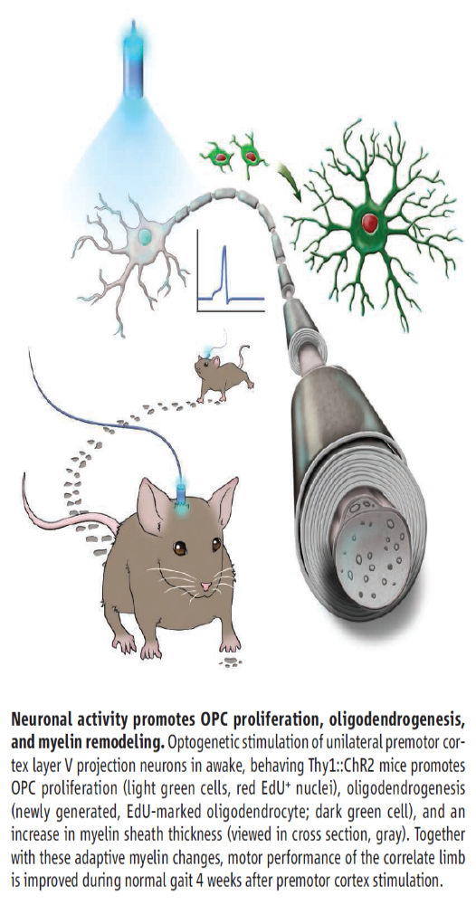
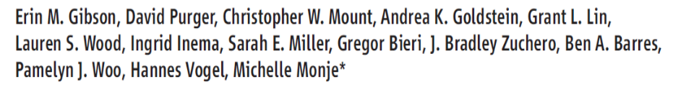
Report 4
Stanford University – USA
We use in vivo optogenetic techniques in awake, behaving mice to provide direct evidence that neuronal activity regulates changes in myelinforming cells within an active circuit.
We used an optogenetic mouse model in which 470-nm light delivered near the brain surface stimulates the excitatory opsin channelrhodopsin expressed by cortical layer V projection neurons.
Results: Optogenetic stimulation of cortical layer V projection neurons resulted in robust proliferation of OPCs within the premotor circuit, from the deep layers of the premotor cortex to the subcortical projections through the corpus callosum.

Slide 14
Conclusion: Neuronal activity regulates OPC proliferation, differentiation, and myelin remodeling in the murine brain with accompanying changes in behavioral function.
Taken together, these findings suggest that adaptive changes in myelin-forming cells represent a type of behaviorally relevant neural plasticity, raising numerous conceptual and mechanistic questions.
Mechanisms regulating myelin plasticity may be important for adaptive neural function.

Slide 15
Morelli A et al - 07/21/2014 –Science
Comment to a papers of Field, Tomassy, Gibson:
In his comment on the paper by Tomassy et al.(1), Douglas Fields (2) said:” It is certainly time to set aside the frayed metaphor of myelin as insulation and appreciate the more fascinating reality”. The revolutionary data demonstrated that myelination is not homogeneous: there appear to exist large tracts of bare axons and the length of the axonal initial segment was unexpectedly long. This does not fall in the "neuron doctrine". Fields (2) associates this anomaly to a possible amplification of connectivity. However, it is difficult to imagine that the fine and behaviourally relevant neural plasticity and “complex forms of network integration” should be accompanied by a slowing down of conduction. This is in fact what we should expect with a too long node of Ranvier, which may hinder the progression of the action potential. The time seems ripe to abandon a vision of myelin based on a metaphor and accept a new epistemological paradigm more consistent with the observational data, and less theory laden. (i) chronically demyelinated axons eventually degenerate, which prompted (3) to propose a new trophic role for myelin; (ii) myelin conducts aerobic respiration, which rose the idea that the trophic role for myelin is to energetically support the axon (4). Symptoms in Multiple Sclerosis (3) would be a consequence of the loss of this support (5). In your perspective on a recent optogenetic approach on cortical neurons of freely moving mouse (6) you suggested that neuronal activity regulates myelin remodelling. Cognitive activity stimulates myelin deposition (7,8). The idea of the "electrical insulator" and of a closed electrical circuit (9) in the axon dates nearly a century Fields himself observed: “nerve impulses are not transmitted as electrons are conducted through a copper wire”.
→ Do you think that we are in view of a new paradigm for Myelin function? ←
A. MORELLI, S. RAVERA, D. CALZIA, M. BARTOLUCCI, C. ROSANO, D. SERPICO, M. BALESTRINO, I. PANFOLI
1 G S Tomassy et al., Science 344, 319 (Apr 18, 2014)
2 RD Fields, Science 344, 264 (Apr 18, 2014)
3 KA Nave, BD Trapp, An Rev Neurosci 31, 535 (2008)
4 A Morelli et al. Cell Biochem Biophys (2011)
5 S Ravera et al, Biochimie 95, 1991 (2013)
6 EM Gibson et al., Science 344, 1252304 (2014)

Slide 16
Preliminar date on growth and OXPHOS function of myelin trigger by sociality

Slide 17
Attività Complessi Respiratori Mielina Topi Isolati /Socializzati

Slide 18
Produzione ATP da mielina topi isolati/socializzati

Slide 19
Consumo Ossigeno da mielina topi isolati/socializzati

Slide 20
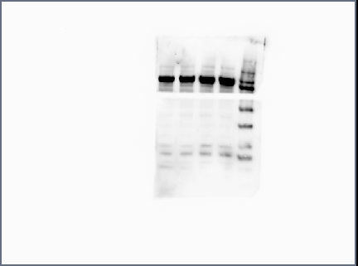
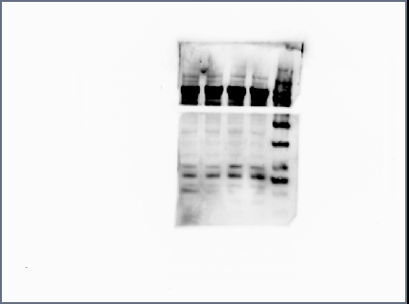
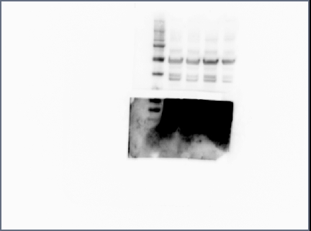
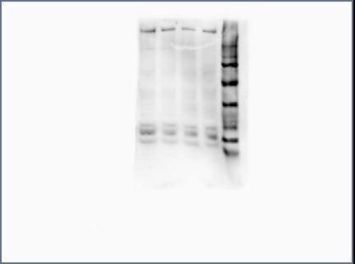
MAG
98 kDa
MBP
20 kDa
18 kDa
ATP synthase (β subunit)
53 kDa
COX IV (Complex 4)
35 kDa
ND4L (Complex 1)
15 kDa
C20 I20 C40 I40

Slide 23
MAG
98 kDa
MBP
20 kDa
18 kDa
ATP synthase (β subunit)
53 kDa
COX IV (Complex 4)
35 kDa
ND4L (Complex 1)
15 kDa
Ctrl Isolati Iso + Gal
 | MAG | MBP (20 KD) | MBP (18 KD) | ATP synthase | COX IV | ND4L
Ctrl | 13,5 | 19,6 | 16 | 10,6 | 8,8 | 7,9
Isolati | 10,8 | 15,6 | 9,7 | 4,9 | 6,7 | 4
Isolati + Galattosio | 13,8 | 15,5 | 10,7 | 13,2 | 5,9 | 4,5

Slide 24
A B

Slide 25
Hypothesis on neuron survival by means of myelination:
In most of vertebrate, at birth, neuron have not myelin.
An intense firing depletes ATP and Adenosine store up triggering oligodendrocyte development (by means of purinergic receptor P1) and myelin production. Myelin makes ATP by OXPHOS and may deliver it to axon through the gap-junctions.
With ATP neurons survive.
Without ATP neurons degenerate.

Slide 26
(3)
Myelin and memory

Slide 27
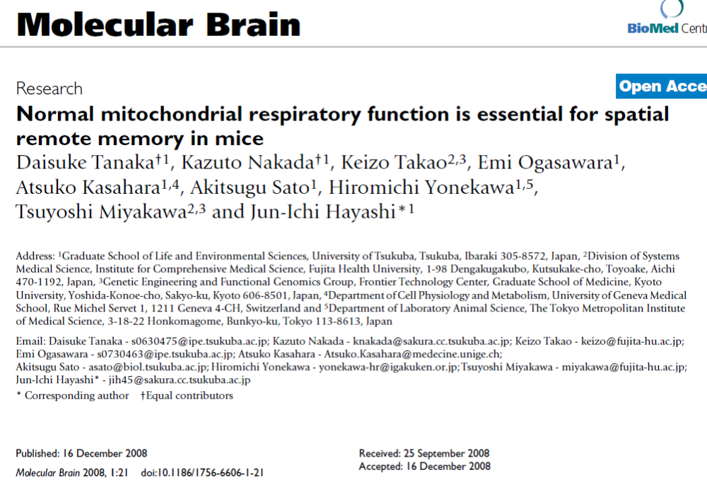
December 2008

Slide 28
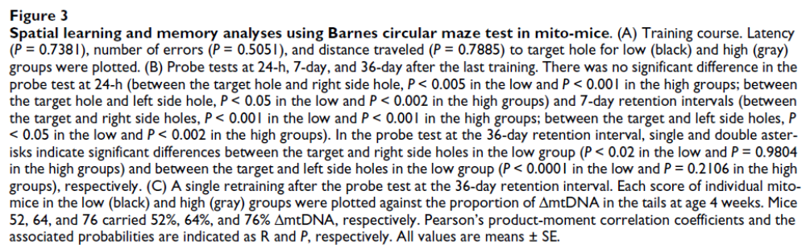

Slide 29
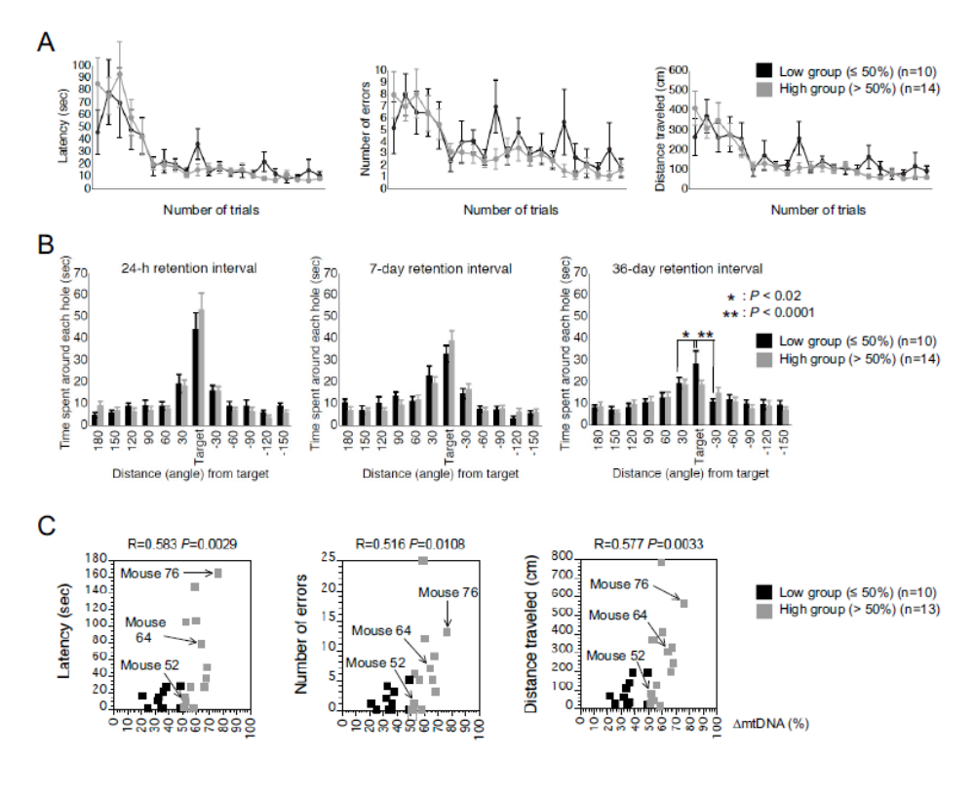
Training course
Probe test
36-day after

Slide 30
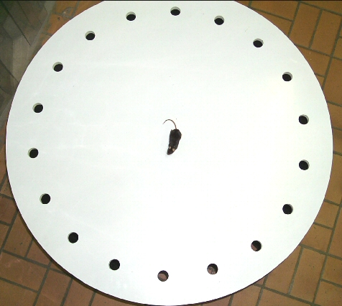
http://en.wikipedia.org/wiki/Barnes_maze
The Barnes maze is a tool used in psychological laboratory experiments to measure spatial learning and memory. The test subjects are usually rodents such as mice or lab rats, which either serve as a
control or may have some genetic variable or deficiency present in them which will cause them to react differently to the maze.
Video: http://www.youtube.com/watch?v=MBwoYJ7MdI8

Slide 31
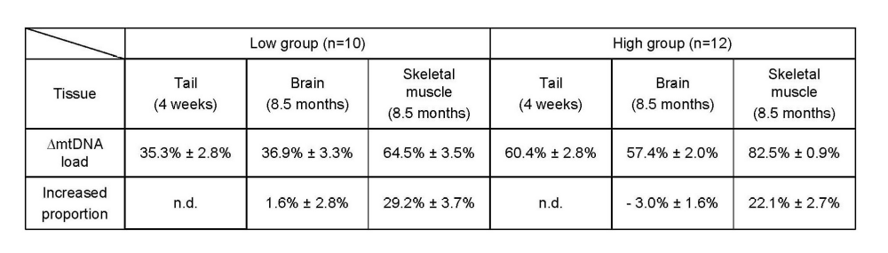
B) Relationship between mitochondrial respiratory function and phenotypic expression of impaired spatial remote memory

Slide 32
These researches conclude that the spatial memory is very compromized, because the proteins codified by mitochondrial DNA are loose.
We therefore succeeded for the first time in showing experimental evidence that a high load of pathogenically mutated mtDNA and the resultant mitochondrial respiration deficiencies, in the absence of severe mitochondrial disease phenotypes, are responsible for the impairment of spatial remote memory.

Slide 33
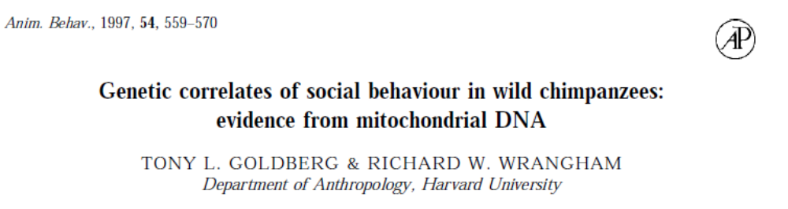


Parental trasmission of behaviour

Slide 34



Slide 35

(4)
Assumptions on the energetic basis of sleep

Slide 36
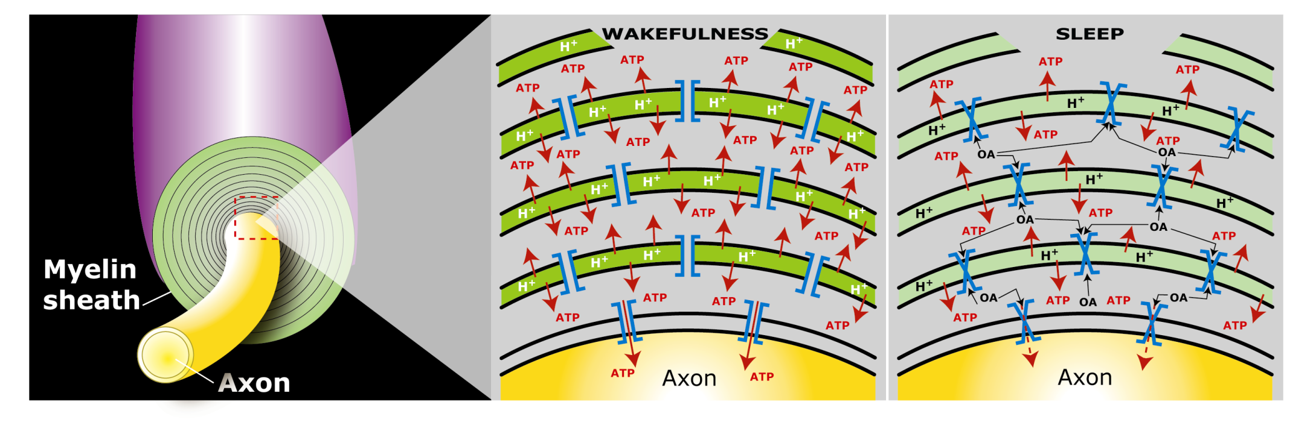
Does sleep serve to "recharge“ myelin?
Model of myelin sheath containing Myelin Basic Protein with function of laminar chemiosmotic buffer: a hypothesis on the role of MBP in the basic mechanisms of sleep / wake
OA = Oleammide
Notes:
36

Slide 37
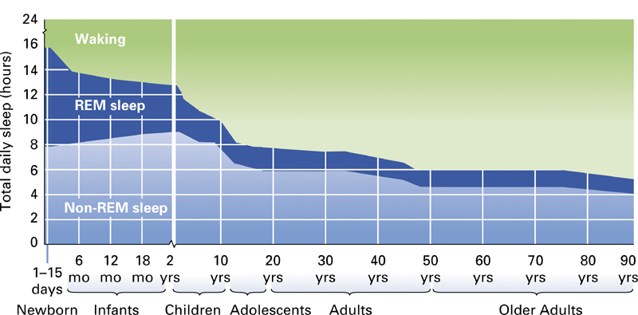
Sleep Across the Human Life Span
Fig. 3.18

Slide 38
The cognitive ability increases with myelin
The hours of sleep decrease as the myelin increases
100 %
16 h
16 h
Content % in myelin in white matter
(referred to the maximum content)
Necessary sleep hours
8 h
8 h
20 40 60 AGE (years)

Slide 39
The sleep:
For the vast majority of biological functions, there is a satisfactory explanation, connecting the structure of the organ to its function and vice versa. For i.e. a muscle exerts a mechanical action, as there are molecules that slide over each other and receive chemical energy from other molecules and clearly identified
For the brain we do not know how it used the considerable energy it uses. About sleep, which is one of the most striking features of the brain, we have no explanation to date.
It 'been said that if sleep did not have a solid functional justification, it would be an extravagance of evolution and / or nature itself.
Among the many theories about sleep, the energetic one is still considered the most, but its molecular and functional evidence, if any, is absolutely to define and / or to discover.

Slide 40
During sleep, glucose burning is almost the same as during wakefulness.
It’s known that during sleep the nervous system as a whole consumes less energy.
It’s possible that the excess energy is accumulated in the form of protons stored in solution in neutral lipid and/or in myelin basic protein
Notes:
40

Slide 41
Sleep Neuro-energetics
Kalinchuk AV, ei al. Local energy depletion in the basal forebrain increases sleep.
Eur J Neurosci 2003;17(4):863-9.
Energy depletion in localized brain areas seems to mimick sleep need³¹: interestingly, infusion of 2,4-dinitrophenol (DNP), an uncoupler which prevents the synthesis of ATP, in the basal forebrain of rats induced increases in non-REM sleep that was comparable to those induced by sleep deprivation.
Oleamide Synthesizing Activity from Rat Kidney
IDENTIFICATION AS CYTOCHROME C
William J. Driscoll, Shalini Chaturvedi, and Gregory P. Mueller
THE JOURNAL OF BIOLOGICAL CHEMISTRY , August 3, 2007
Naturally occurring oleamide was shown to accumulate in the cerebrospinal fluid of sleep deprived cats and to produce a profound sleep-like state when administered to rodents.. These findings led to the proposal that oleamide directly contributes to the biochemical mechanisms underlying the drive to sleep . More recently,
oleamide was reported to modulate gap junctions.
Notes:
41

Slide 42
Soleep-Memory: Conclusions
During the conscious waking the energy demand exceeds that mechanically possible. There is a conscious activity in neocortical gray matter that utilizes most of the energy produced at the time by burning / breathing. Then there is a discernible physical activity of the unconscious in the white matter that extabilishes a huge number of connections between different sites of the cortex
This activity during waking consumes the energy reserves represented by the accumulation of protons in the chemiosmotic laminar buffer of myelin and the feeling of sleep is due to poor energy supply fed by the axon myelin.
neuronal activity requires a lot of energy intake. Biological systems use chemical energy in the form of ATP.
With sleep we refill the proton and the myelin is energized, because the available energy is almost equal to that of wakefulness but during sleep it is mostly devoted to recharging, since the needs of the conscious system have decreased significantly.
It can be assumed that the memory is an energization of axonal connections by the white matter, in light of the fact that sleep strengthens the memory.
Notes:
42

Slide 43
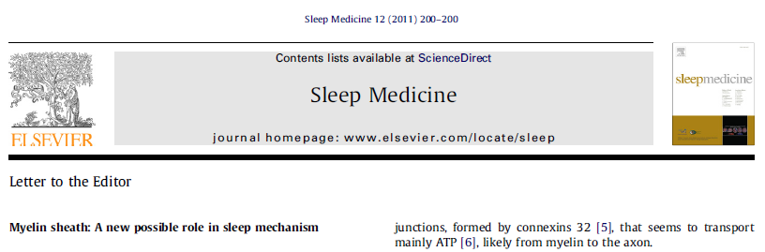
from Morelli, Ravera & Panfoli
Myelin sheath, the multilayered membrane produced by oligodendrocytes, plays a pivotal role in the axon surrounding, allowing the nerve to transmit its impulses rapidly. However, there is growing evidence
that myelin has also an as yet unexplained neuro-trophic role. We reported that the respiratory chain components are expressed in myelin, outside of mitochondria [1]. These components would generate a proton gradient across myelin membranes to support ATP synthesis by an Fo-F1 ATP synthase. This may explain how in demyelinising diseases, as Multiple Sclerosis (MS), myelin loss causes an axonal necrosis.
Recently, Gallup et al [2] described sleep problems and frequent yawning in MS patients. During sleep, the glucose consumption by brain is very similar to that in wakefulness, even though the neuronal energetic demand is low. We have envisaged an involvement of myelin sheath. Imagine that myelin sheath acts as a proton (H+) buffer capacitor, thank to the abundance of myelin basic protein (MBP) and phospholipids, whose exceptional buffering capacity of phospholipids was demonstrated [3].

Slide 44
This potential would be used by myelin to produce energy, during the wake period. In turn, sleep would be induced by a “discharge” of H+ in myelin sheath and wakefulness by a “complete recharge” of myelin sheath. The sleep need correlates to age. In fact, newborn and children have a higher sleep need than the adults. This may depend on myelinogenesis, that begins after born and goes on until 22-25 years age. Under these conditions, myelin may be less competent in accumulating energy= H+ and generate the need for sleep. Interestingly, sleep is also regulated by oleamide, an endogenous hypnotic compound that increases before the sleep, decreases before the wake up and is accumulated in cerebral spinal fluid of sleep-deprived animals [4]. Interestingly, oleamide closes the myelin gap junction, formed by connexin 32 [5], that seem to transport mainly ATP [6], likely from myelin to the axon.

Slide 45
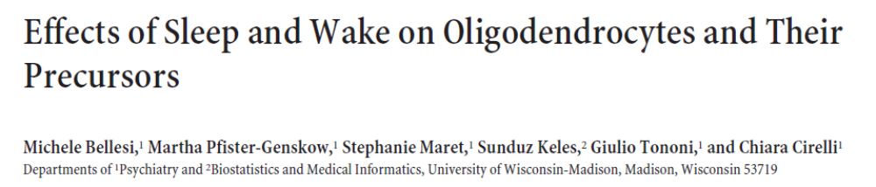
The Journal of Neuroscience, September 4, 2013 • 33(36):14288 –14300
Previous studies of differential gene expression in sleep and wake pooled transcripts from all brain cells showed that several genes expressed at higher levels during sleep are involved in the synthesis/maintenance of membranes in general and of myelin in particular, a surprising finding given the reported slow turnover of many myelin components…

