Slide 1
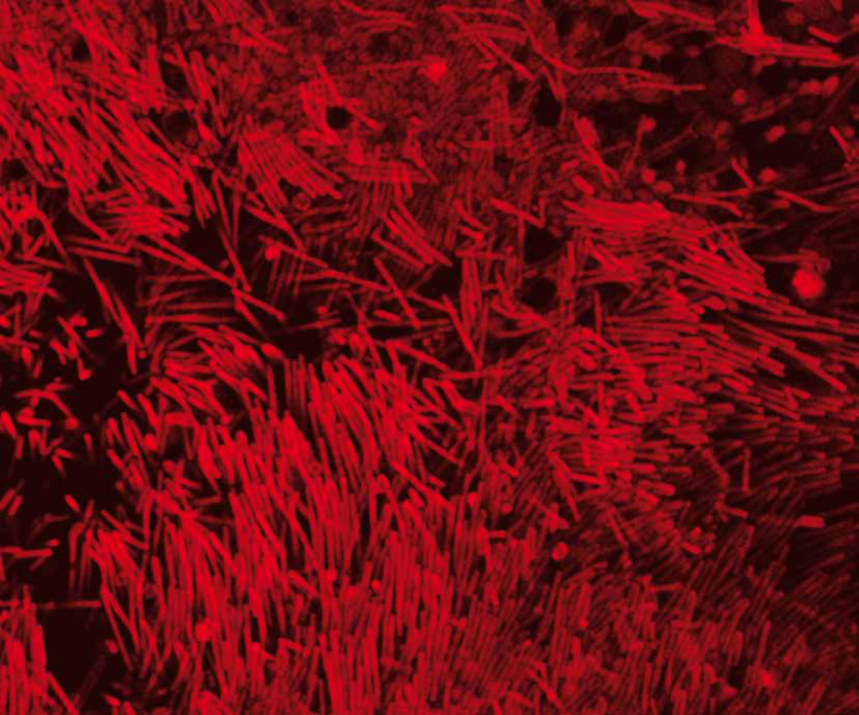
FINDING OF MYELIN ENERGETIC FUNCTION SUPPORTING THE AXONAL NERVOUS CONDUCTION: PERSPECTIVES IN NEUROLOGY.
Neurology 2015 – Rome, july 2015 – 28
Alessandro Morelli – University of Genova (www.biochemlab.it)

Slide 2
1)
ATP Production in the mitochondria and in the myelin

Slide 3
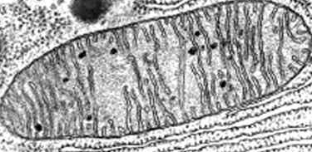
Mitochondria (and thylacoid disks) are considered the exclusive site of aerobic ATP synthesis. Is it true?
It is well known that in vitro mitochondria produce few ATP and that there is the need to energize them with pyruvate (and to add cyclosporin-A, etc.), which seems anomalous.
Moreover other cellular processes (DNA duplication, proteic synthesis, etc.) can procede in vitro with the same if not higher efficiency than in vivo.

Slide 4
The ATP production in mitochondria, isolated from several cell types wich, in the best experimental conditions, is about
7- 8 nmol ATP /min / mg protein
Overall Oxygen (atomic) consumption for a tissue (muscle at rest ) is
3 nmole/min/mg prot.
With a P/O ratio = 2,36 the ATP production is:
~7 nmol ATP /min / mg protein
So muscle shuld be made only by mitochondria…
Otherwise…

Slide 5
Considering that brain consumes much more oxygen than the other tissues it must have a great mitochondrial number. Instead…:
Neuronal mitochondria:
Are fewer than in the other tissues.
Have smaller dimensions.
Have smaller cristal surface.
Notes:
5

Slide 6
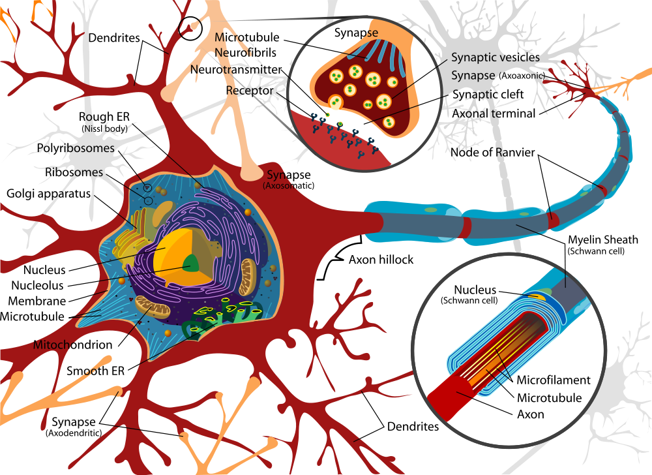
Soma: appropriate space to the putative breathing lamellar structures (Nissl Substance)
Axon: little space suitable
For the putative breathing lamellar structures

Slide 7

Myelin produce ~ 30 nmol ATP/min/mg (purified mitochondria only ~ 6 nmol ATP/min/mg .
ATP production in myelin is’nt inbited by external ATP. Otherwise at very low concentration external ATP inibite strongly ATP production by mitochondria.

Slide 8
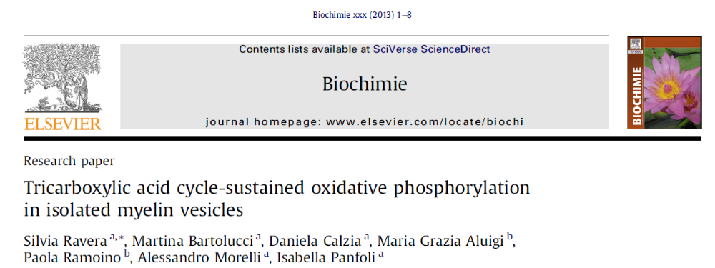
Biochimie. - 2013 Nov;95(11):1991-8. doi: 10.1016/j.biochi.2013.07.003.

Slide 9
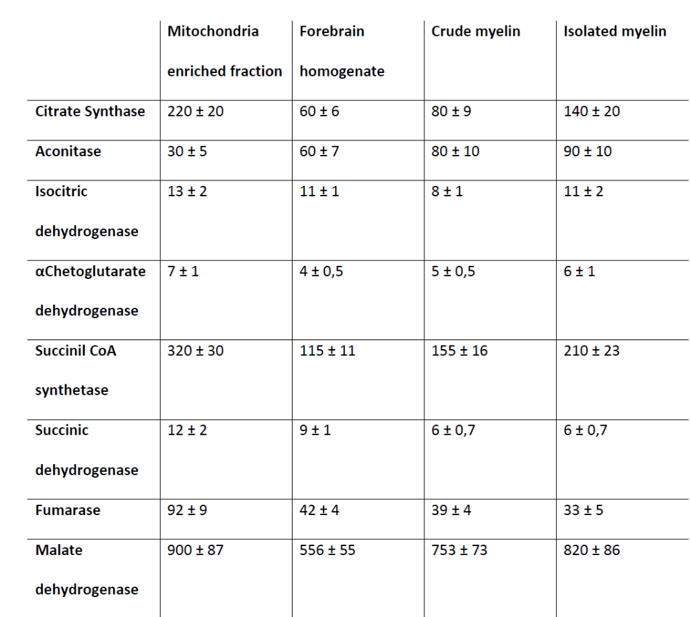

Slide 10
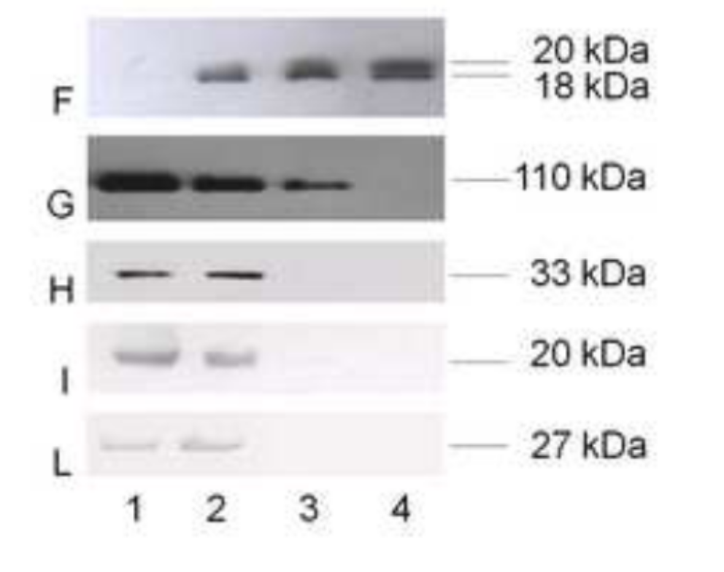
Mitochondrial contamination excluded in purified myelin
MBP
Na+/K+ ATPase
ANT
TIM
AK3
Cyclic Nucleotide Phosphodiesterase (CNP) abundant in myelin born with sequence for importation in mitochondria
mitochondria-enriched fraction
forebrain homogenate
crude myelin fraction
isolated myelin fraction

Slide 11
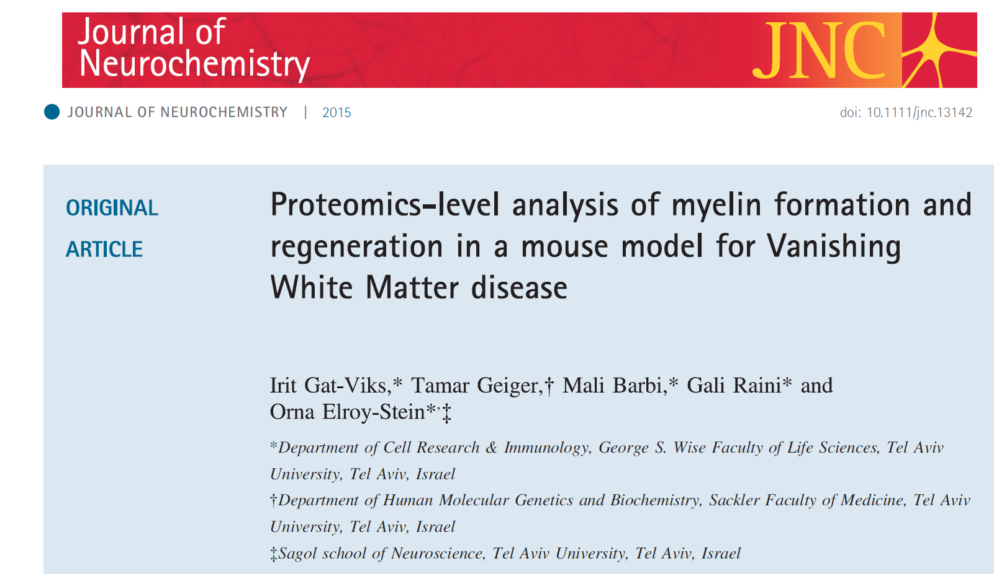
… The absence of other mitochondrial proteins in myelin vesicles ruled out mitochondrial contamination and led to an intriguing hypothesis that myelin sheaths may be able to perform aerobic metabolism by extra-mitochondrial
oxidative phosphorylation, to produce ATP and provide it to axons via gap junctions (Morelli et al. 2011).**
**

Slide 12
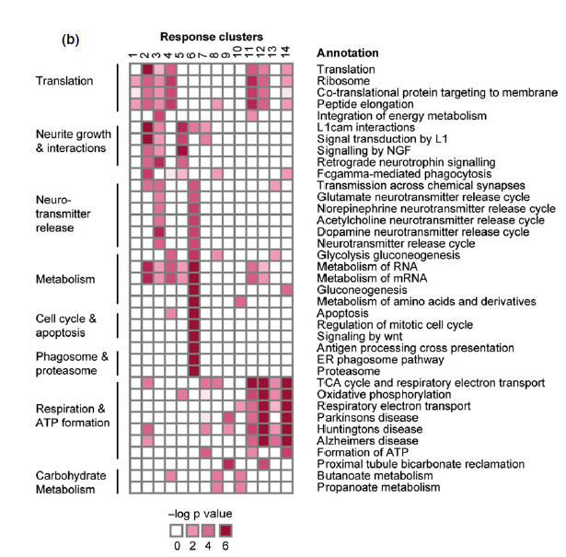
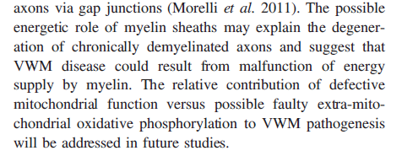

Slide 13
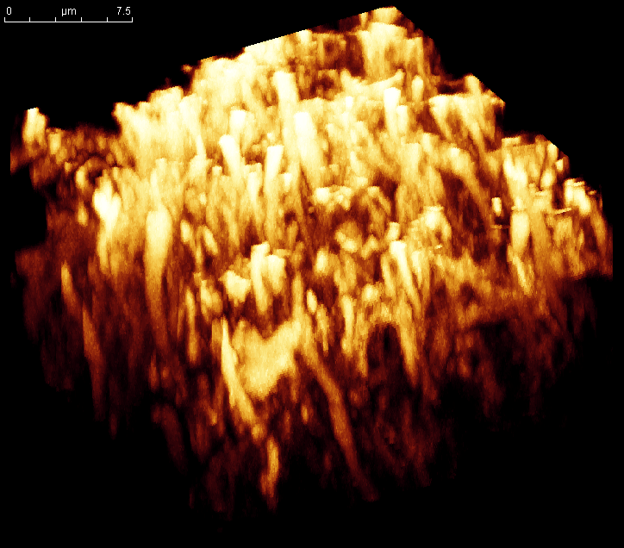
By a new technique that we have developed (Bianchini, 2008), myelin vesicles and optical nerves were incubated with MitoTracker Deep Red 633, a fluorescent dye that stains actively respiring membranes. After incubation, the samples were analyzed by CLSM.

Slide 14
(2)
Aerobic ATP synthesis in peripheric nervous system
Notes:
14

Slide 15
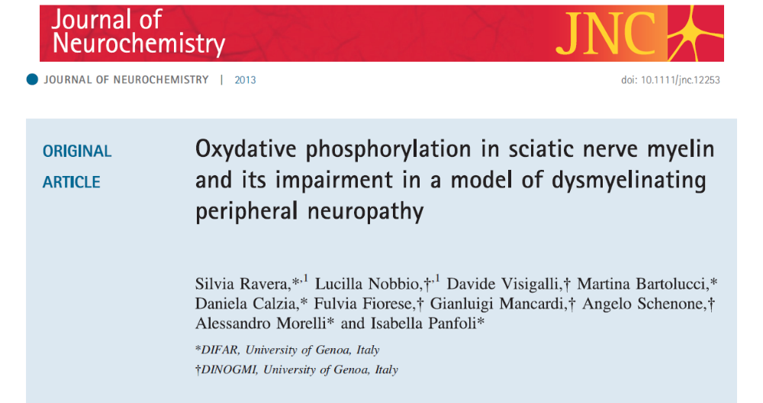
May 2013

Slide 16
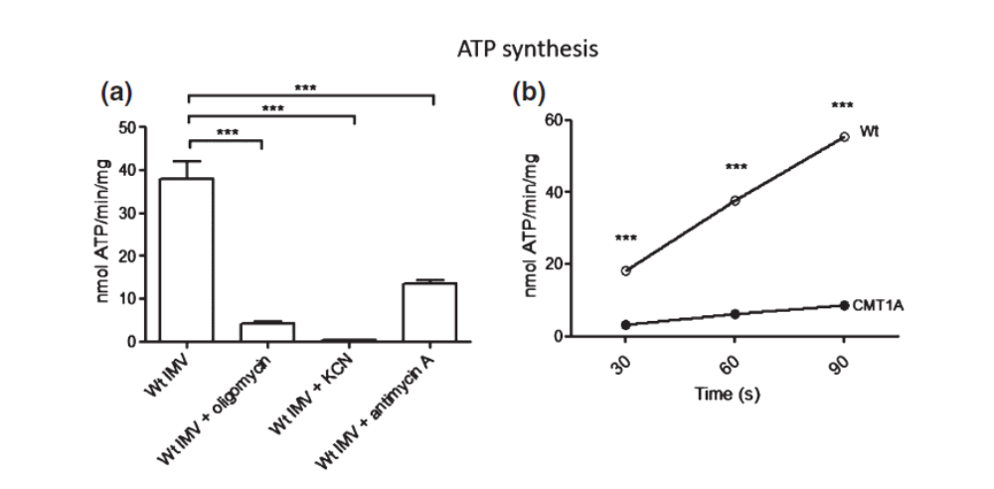
ATP Synthesis in Sciatic nerve-derived isolated myelin vesicles (IMV) from Wt and dysmyelinating peripheral neuropathy (CMT1A) rats

Slide 17
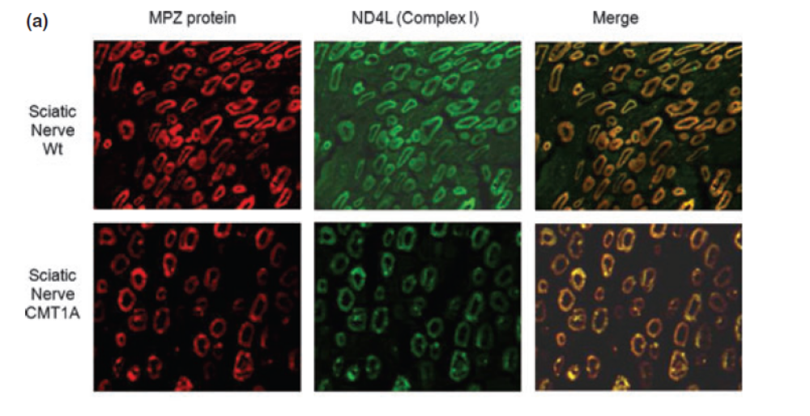
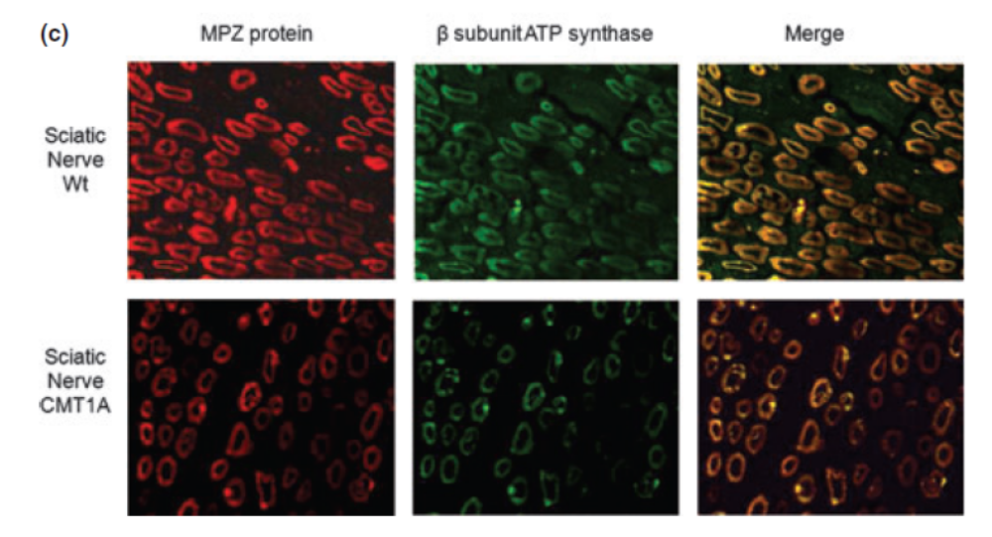

Slide 18
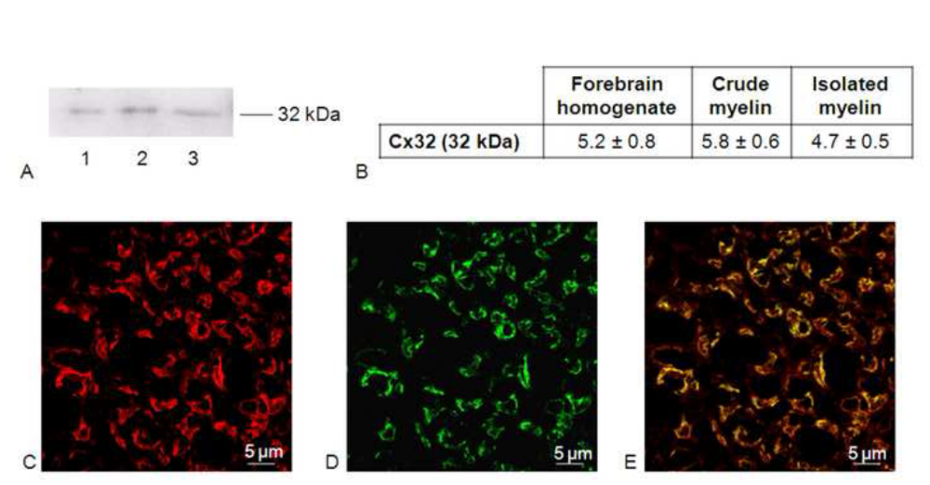
Gap-junction in myelin
immunohystochemically stained with Ab against MBP
immunohystochemically stained with Ab against MBP
immunohystochemically stained with Ab against Cx32
Merge

Slide 19
(3)
Hypothesis of molecular mechanism in respiring/energizing
myelin sheath
Notes:
19

Slide 20
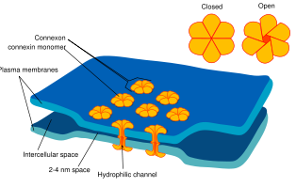
GAP JUNCTIONS :
Structures that allow the transport of molecules throught two cells, by mass action. Considering that ATP is very concentrated in the cell it is possible hypothesize that connexins could transport ATP.

Slide 21
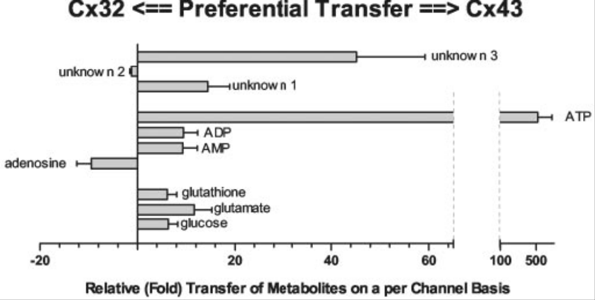
Gap Junctions between Cells Expressing Connexin 43 or 32 Show Inverse Permselectivity to Adenosine and ATP
Gary S. Goldberg‡§, Alonso P. Moreno¶, and Paul D. Lampe
From the ‡Department of Physiology and Biophysics, State University of New York, Stony Brook, New York 11794-8661,
the ¶Krannert Institute of Cardiology, Indiana University School of Medicine, Indianapolis, Indiana 46202, and
Fred Hutchinson Cancer Research Center, Seattle, Washington 98109
THE JOURNAL OF BIOLOGICAL CHEMISTRY Vol. 277, No. 39, Issue of September 27, pp. 36725–36730, 2002.
Notes:
21

Slide 22
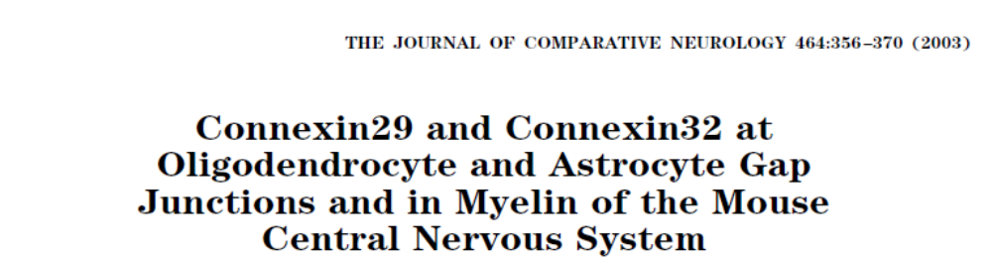
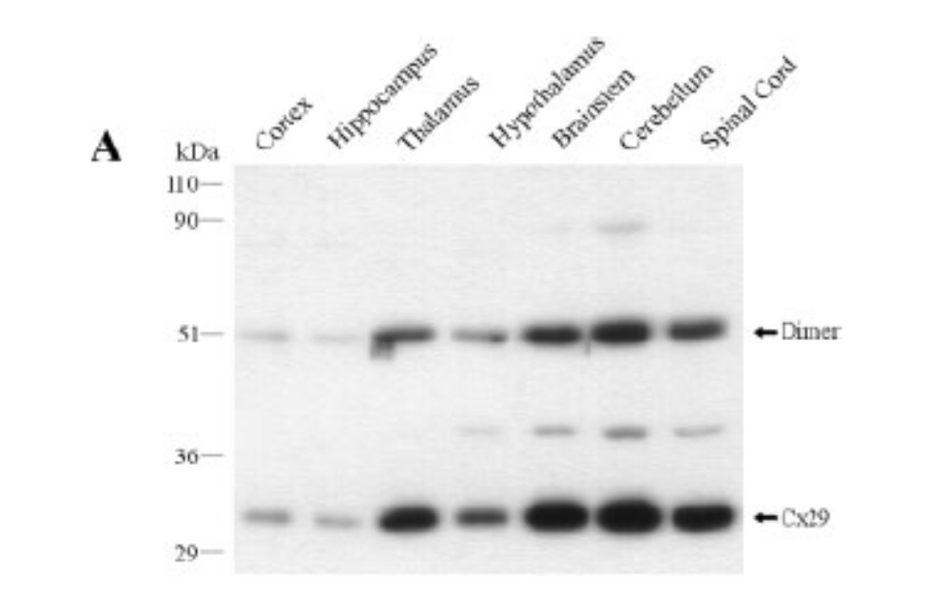
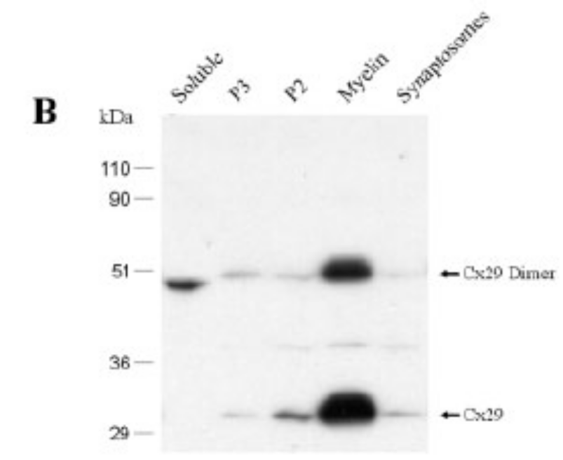
Myelin is rich in Gap-Junctions
Microsomal membrane
mitochondrial/synaptosomal

Slide 23
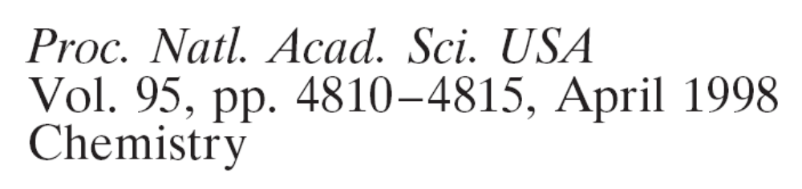
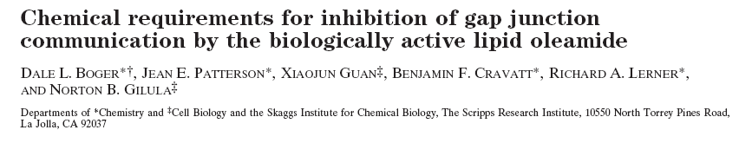
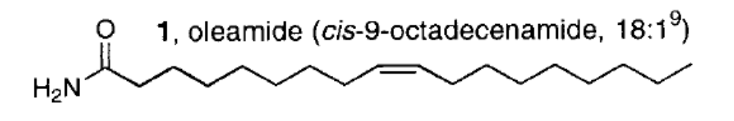
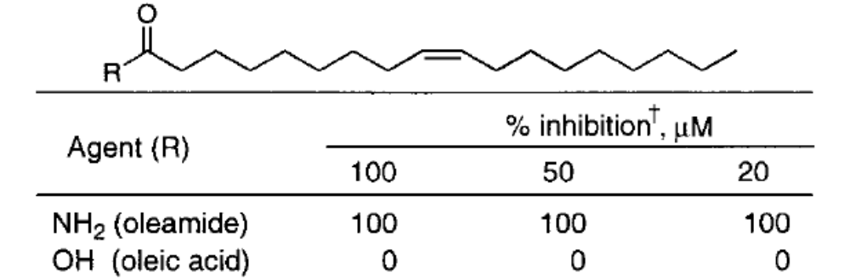
Notes:
23

Slide 24
Test of ATP production with Oleamide, an inhibitor of Gap-Junctions
Sample | ATP produced (nmol/min/mg)
Myelin vesicles (+ DMSO) | 35 ± 3.0
Myelin vesicles + Oleamide 50 μM (in DMSO) | 5 ± 0,4
Myelin vesicles + Oleic Acid 50 μM (in DMSO) | 35 ± 3.0
Notes:
24

Slide 25
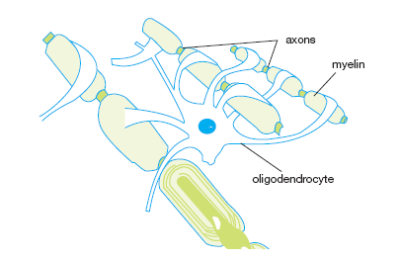

Slide 26

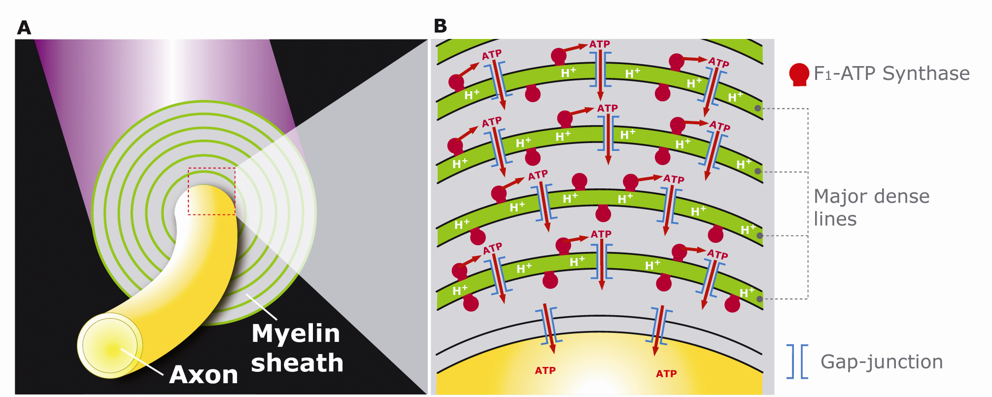
Notes:
26

Slide 27
Hypothesis of Energized Myelin Sheath
ATP
ADP+P_{i}
Oxidadive
Phosphorilation
F_{o}F₁
ATPSynthase
H⁺
H⁺
Proton Translocation coupled to
Nanomachine
ATP synthase
Gap junction
AXON
ATP
ADP+P_{i}
Na⁺,K⁺ -ATPase pump

Slide 28
(4)
Hypotheses on Proton movementation in biological membrane
Notes:
28

Slide 29
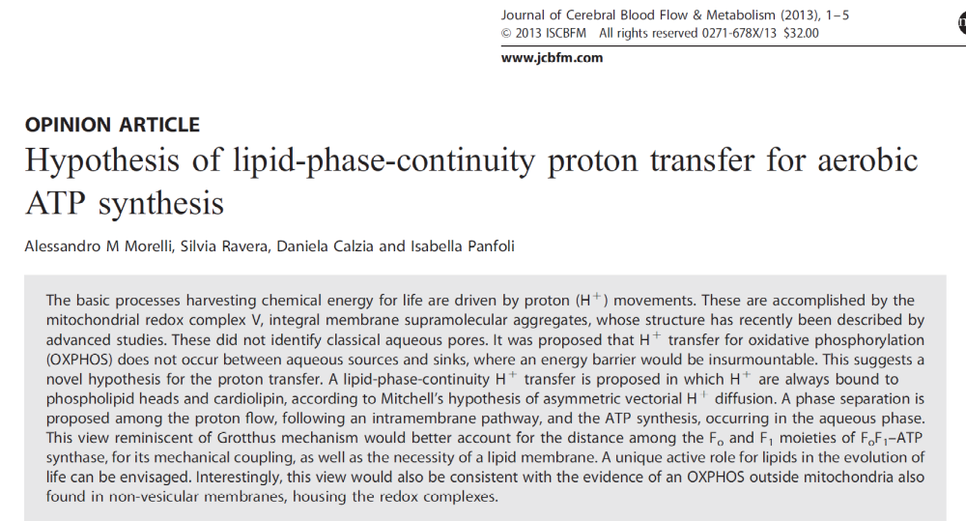
Journal of Cerebral Blood Flow & Metabolism
12 sept 2013
29

Slide 30
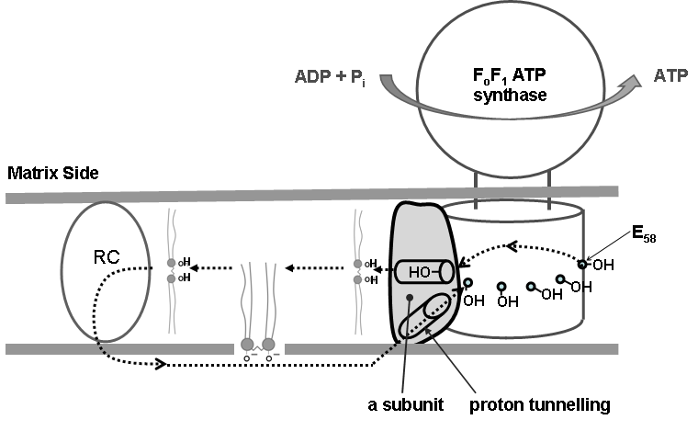
RC : Respiratory Complex
H⁺

Slide 31
This model is consistent with the observed be-face operativity of ATP-Synthase in myelin
ADP + Pi
ATP
I
H⁺
H⁺
H⁺
I
H⁺
Respiratory complex
ATP
ADP + Pi

Slide 32
(5)
Support of Nerve Conduction By Respiring Myelin Sheath

Slide 33
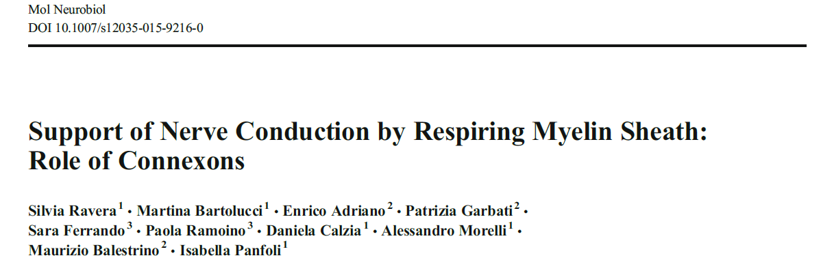
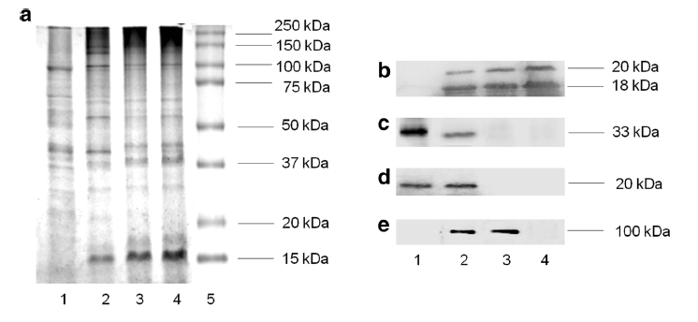
Mol Neurobiol. 2015 Jun 2. [Epub ahead of print]
1- Mitochondria
2 – Forebrain homogenate
3 – Crude myelin fraction.
4 – Isolated myelin
Western blot against:
Myelin Basic Protein
Adenine Nucleotide translocase
Translocase Inner Membrane
Na/K ATP ase

Slide 34
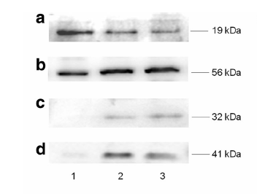
Western Blot anti Cox IV
anti β subunit ATP synthase
anti Connexine 32
anti Connexine 43
Forebrain homog
Mitochondria
Isolated Myelin

Slide 35
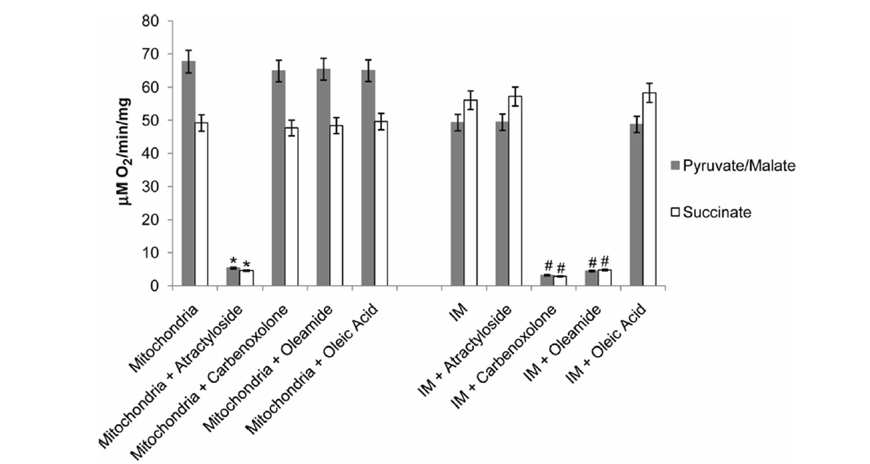
Mitochondria
Isolated Myelin

Slide 36
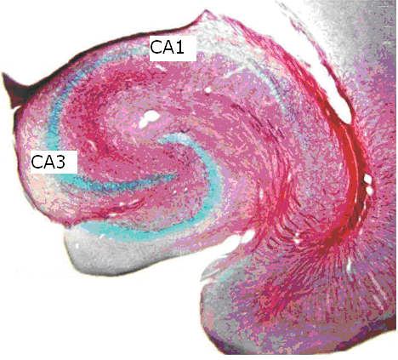
WE USED AS EXPERIMENTAL MODEL THE STIMULATION AND RECORDING OF 'NERVOUS IMPULSE AT THE SCHAFFER COLLATERAL , A CENTRAL NERVOUS MYELINATED PATHWAY
rat hippocampus stained with Black Gold, a dye specific for myelin that stains it deep red. The arrow indicates the Schaffer collateral, intensely colored. The figure shows that this pathway is myelinated (modified from: Cellular and Molecular Life Sciences 61 (9):1082-1094, 2004)
Adriano, Perasso, Ravera, Gandolfo, Mancardi, Panfoli, Morelli, Balestrino - 2009

Slide 37
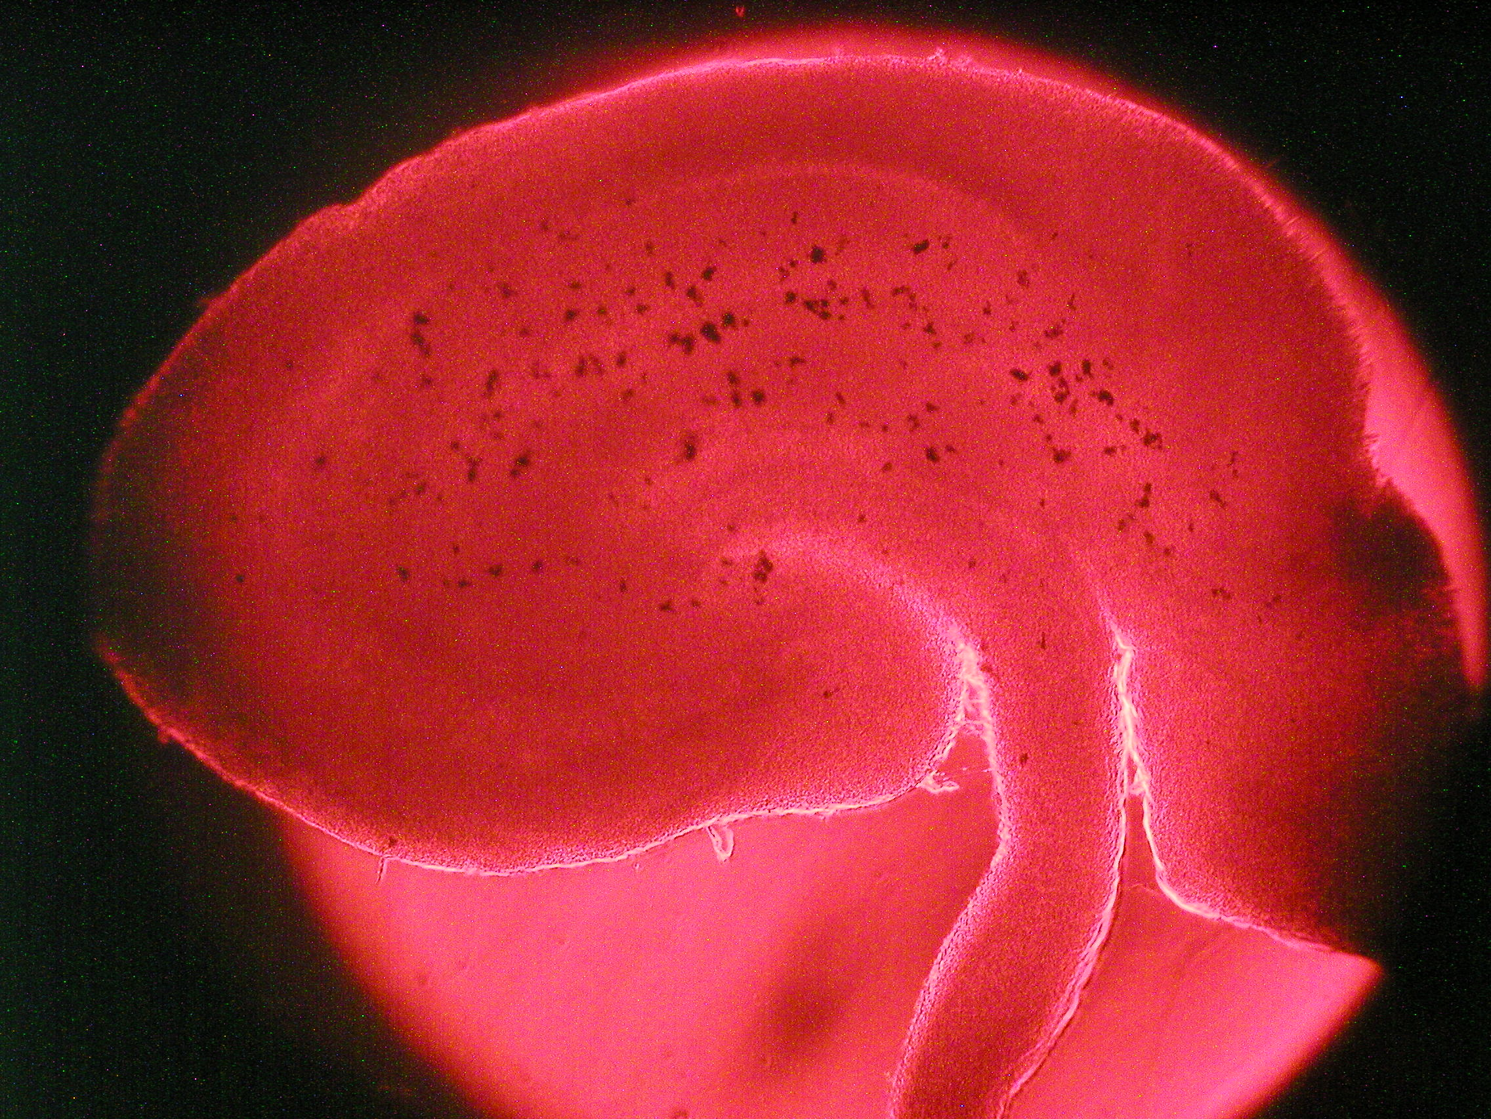
Stimulation and recording
Adriano, Perasso, Ravera, Gandolfo, Mancardi, Panfoli, Morelli, Balestrino - 2009

Slide 38
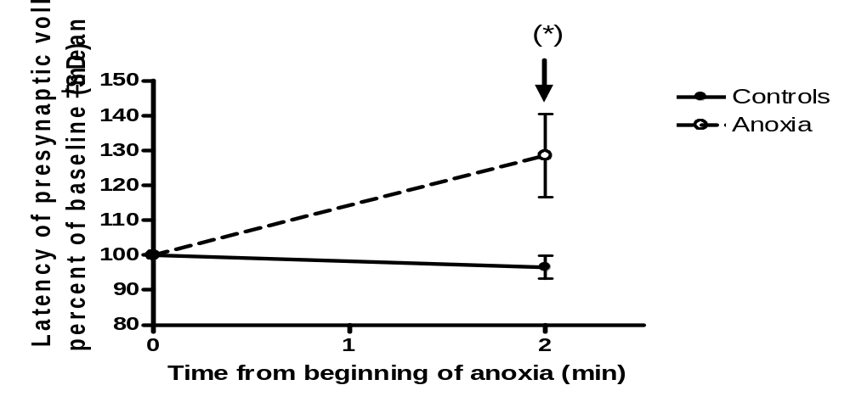
Anoxia and velocity of conduction
Adriano, Perasso, Ravera, Gandolfo, Mancardi, Panfoli, Morelli, Balestrino - 2009

Slide 39
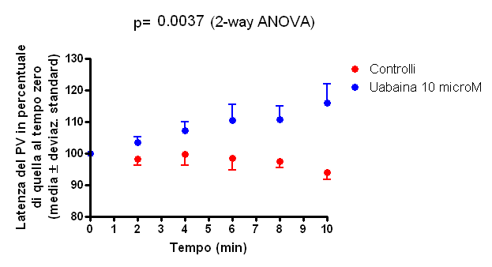
Inhibition of Na / K ATPase with uabaina reproduces the effects of ischemia and slows the conduction velocity in the Schaffer collateral
Adriano, Perasso, Ravera, Gandolfo, Mancardi, Panfoli, Morelli, Balestrino - 2009

Slide 40
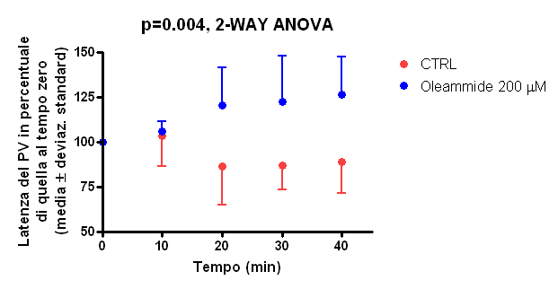
The experiment mimics the effect of ouabain and 'ischemia: Blocking of Gap-Junctions between neurons and glia with Oleammide is compatible with a transfer of ATP from glia to axons.
Adriano, Perasso, Ravera, Gandolfo, Mancardi, Panfoli, Morelli, Balestrino - 2009

Slide 41
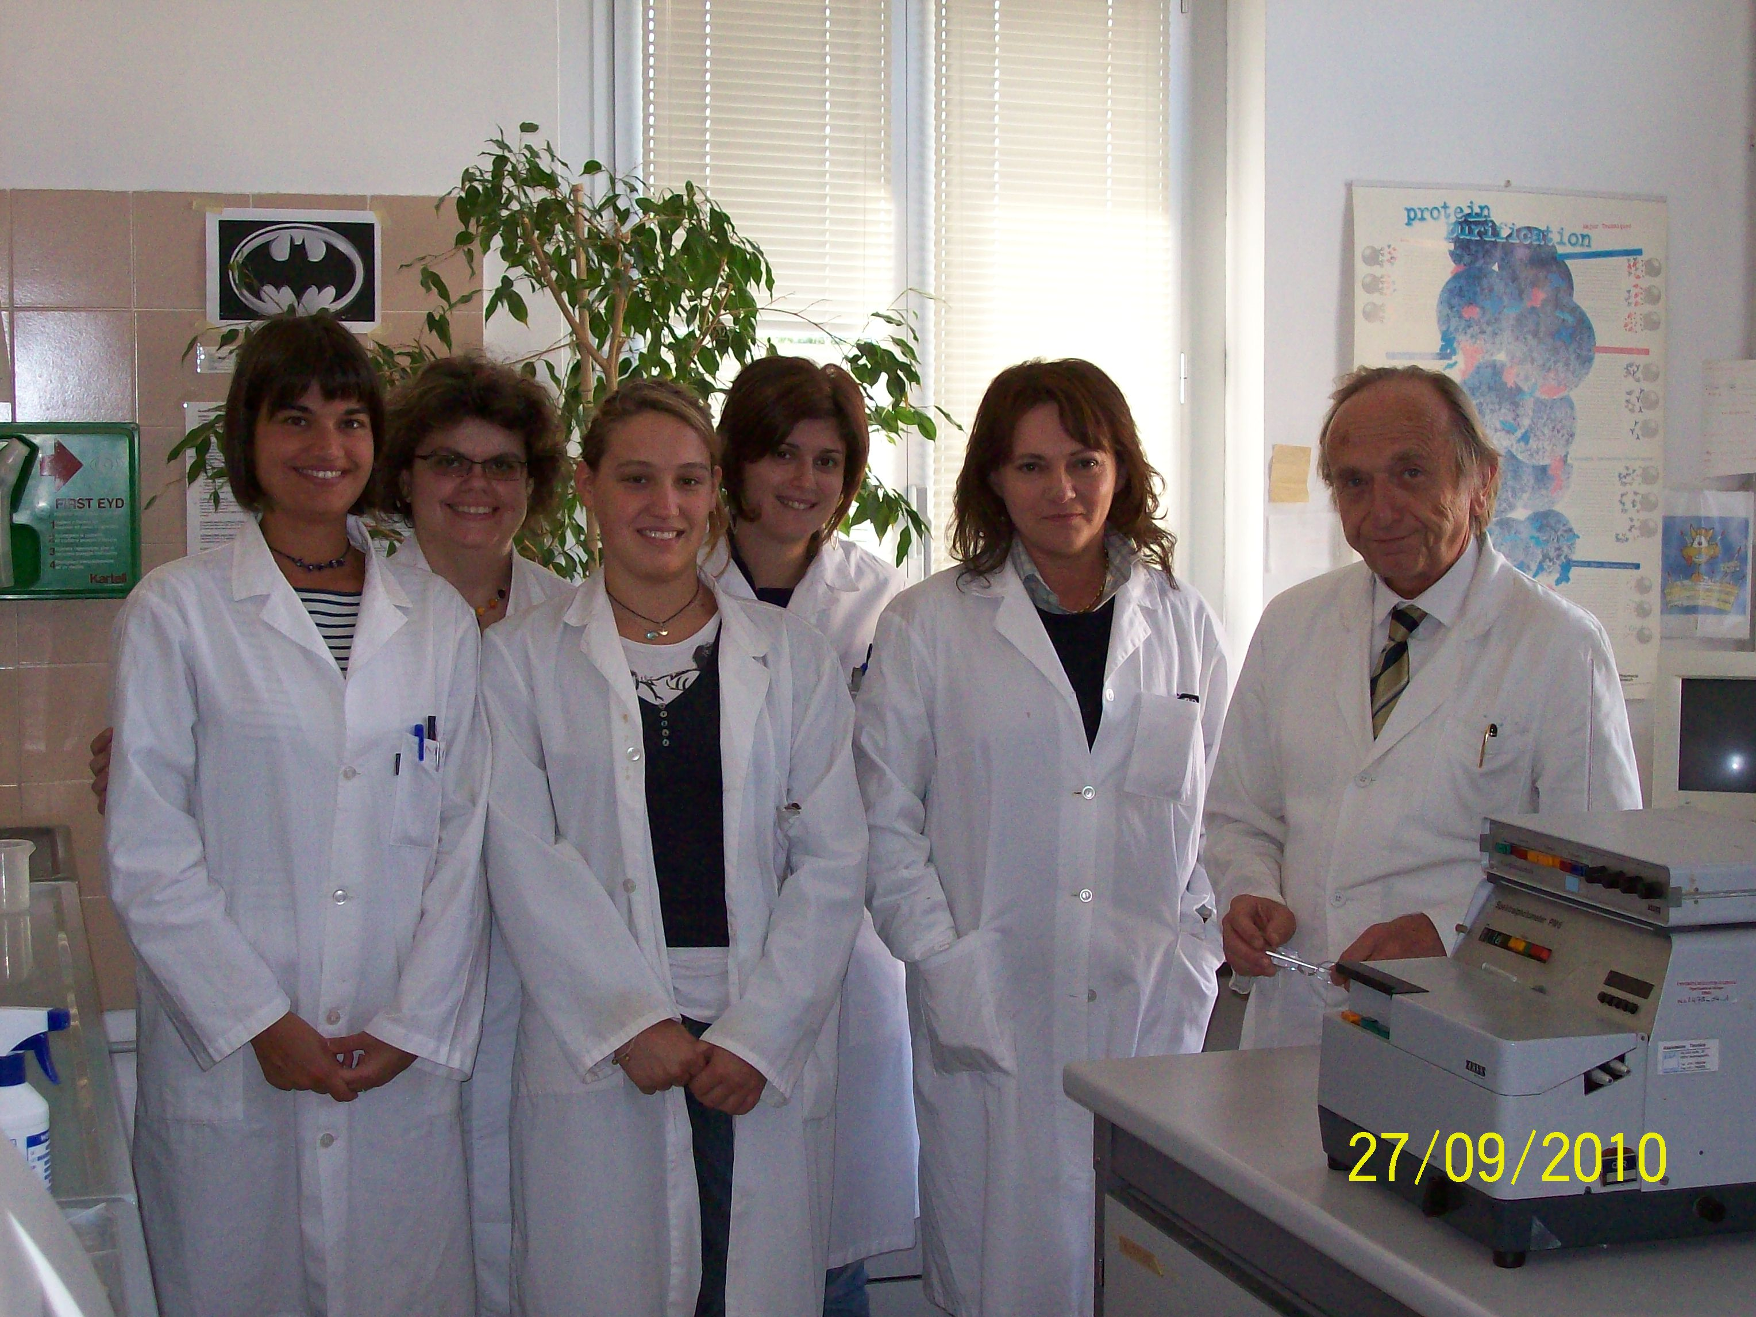

Slide 42
Acknowledgements:
Isabella Panfoli, Silvia Ravera, Daniela Calzia, Martina Bartolucci
Dip.to di Farmacia, Università di Genova
Mario Pestarino, Simona Candiani
Dip.to di Scienze della Terra, dell’Ambiente e della Vita - Genova
Camillo Rosano
Centro di Biotecnologie Avanzate (CBA) - Genova
Gian Luigi Mancardi, Carlo Traverso, Angelo Schenone,
Maurizio Balestrino, Enrico Adriano
Dip.to di Neuroscience, Oftalmologia e Genetica, Università di Genova
Carlo Tacchetti, Katia Cortese
Dip.to di Medicina Sperimentale, Università di Genova
Vito Pistoia, Giovanni Candiano, Elisa Ferretti
Istituto Giannina Gaslini – Genova
Lucia Manni, Federico Caicci
Dipartimento di Biologia - Padova
Notes:
42

