Slide 1


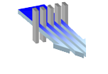

Nanochannel Systems for Universal Drug and Cell delivery
August 17th, 2015
Alessandro Grattoni, Ph.D.
Chairman and Professor,
Department of Nanomedicine
Houston Methodist Research Institute, Houston

Slide 2
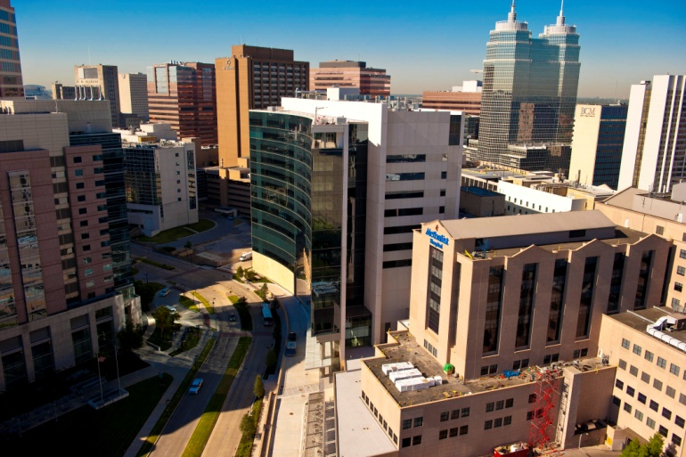
Houston Methodist Research Institute
Houston Methodist
Research Institute
Hospital Based
Conceived for translational research
In the heart of TMC
from its inception focused on: Cutting-edge technologies
Service to the community

Slide 3
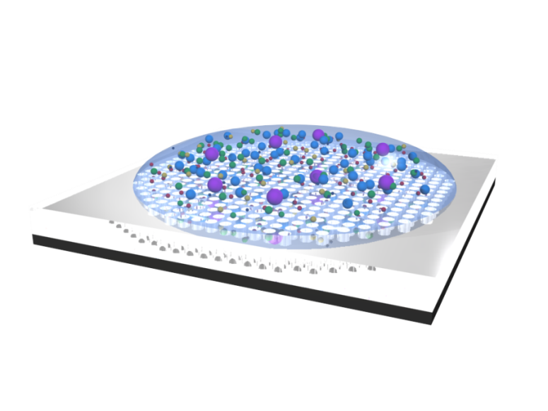
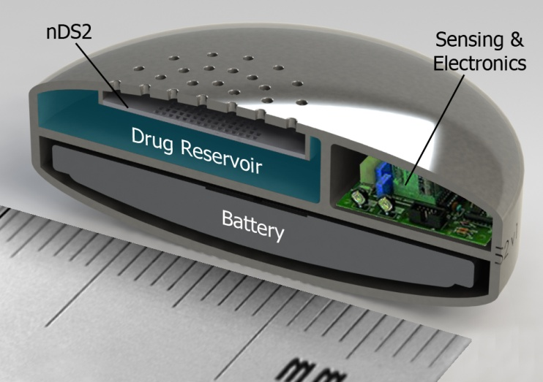
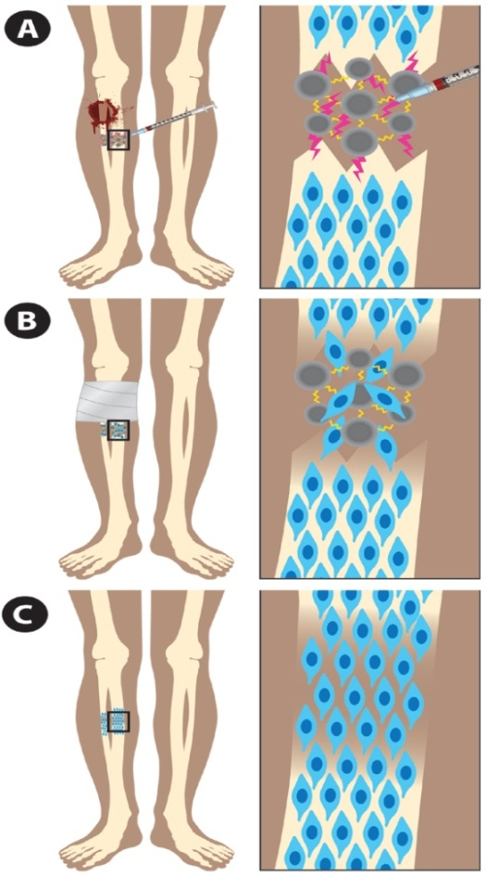
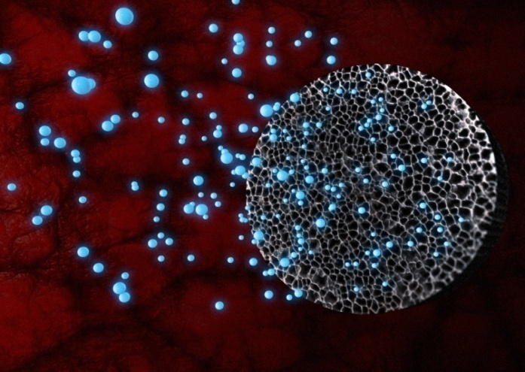
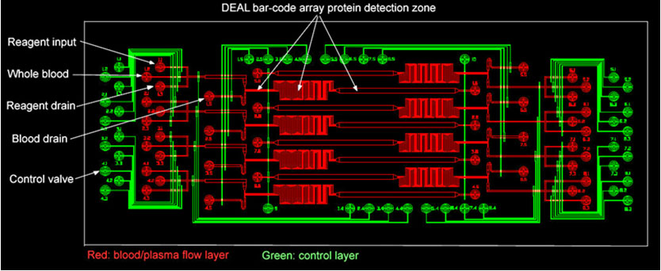
Department of Nanomedicine
nDS – nanochannel Delivery Systems
Tissue Regeneration -
Smart Polymers for drug and cell delivery
Proteomic Chip Diagnostics
Microfluidics V-chips Lab on a chip - Cell analysis and molecule Detection
Multistage Vectors for Targeted Drug Delivery

Slide 4
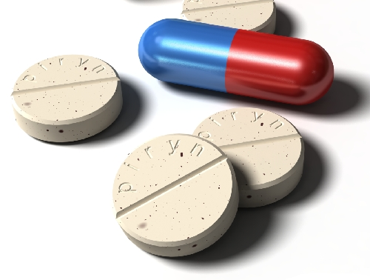
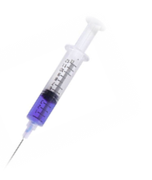
The Need for Alternative Drug Delivery Strategies
Conventional
Administration
Required: Constant Administration
Required: Controlled Kinetics
Toxicity
Toxicity
Toxicity
Plasma concentration versus time
Therapeutic Range
Therapeutic Range
Therapeutic Range
Diminished Activity
Diminished Activity
Diminished Activity
I.V.
Bolus
I.V.
Bolus
Time
Time
Time
Multiple Injection
Low efficacy
Large drug doses
Side effects
Poor quality of life
Controlled Release Profile
Enabling Chronotherapy.
Constant Release Rate
Improved efficacy.
Reduction of the drug dose.
Reduction of side effects
Improvement of quality of life

Slide 5
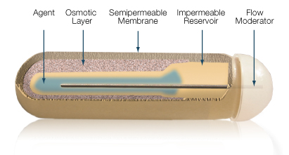
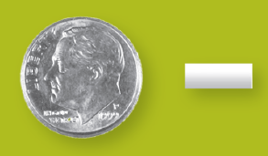
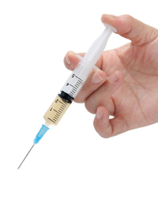
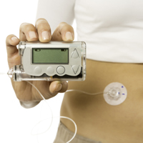
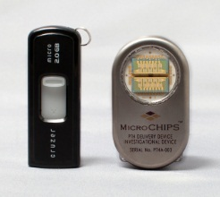
Existing Technologies
Osmotic Pumps
Biodegradable Polymers
Long-acting depots
Wearable External Pumps
MicroCHIP devices

Slide 6
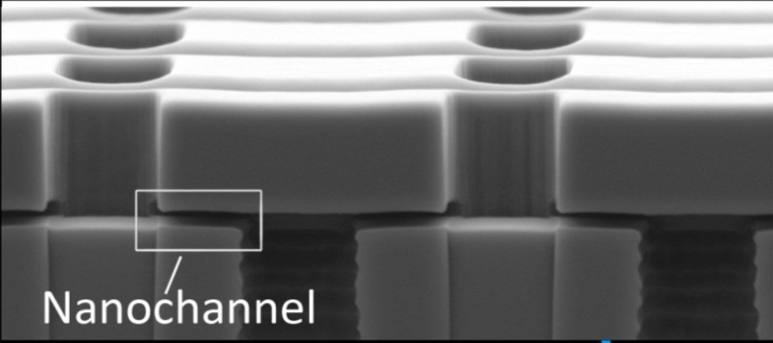
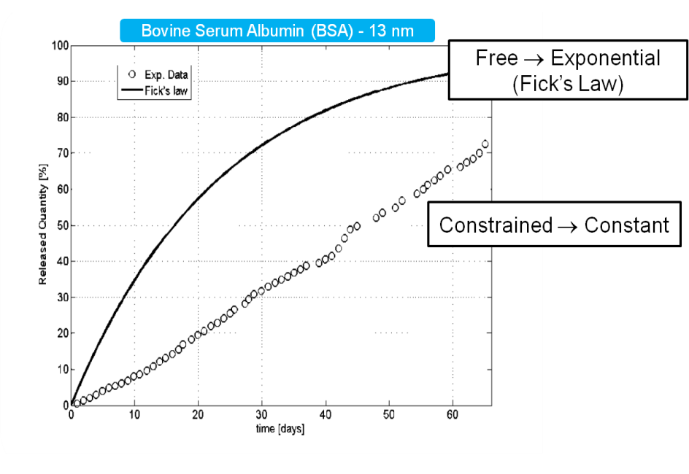
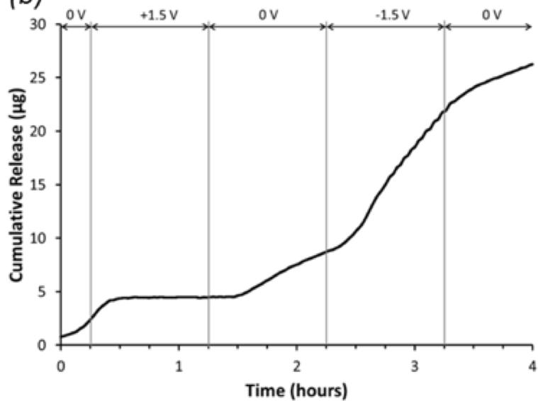
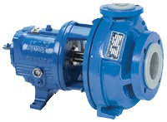
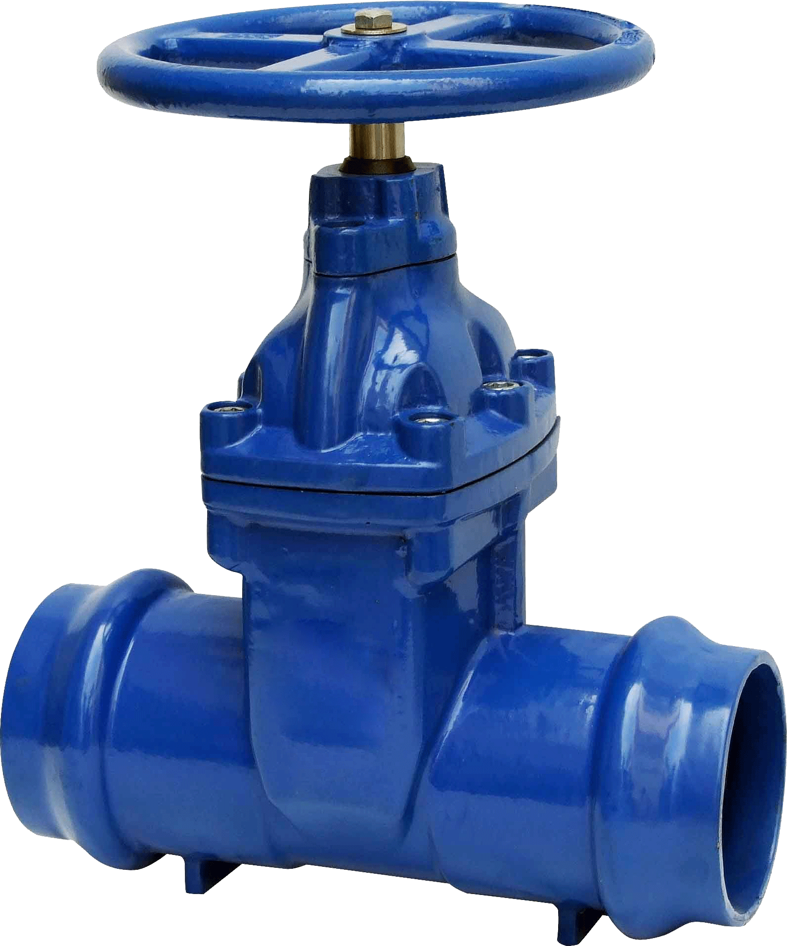
Nanochannels
No Need for Pumps!
Opportunity: Fluids at the nanoscale do not follow continuum-based laws of mass transport
Hypothesis: hindered-diffusion, electro-osmosis, ionic concentration polarization can be used to achieve controlled molecular transport across nanochannels.
Diffusion
Electrokinetic Transport
Increase
Constant
mass transport
Re-activate
Interrupt
No Pumps
No Valves

Slide 7
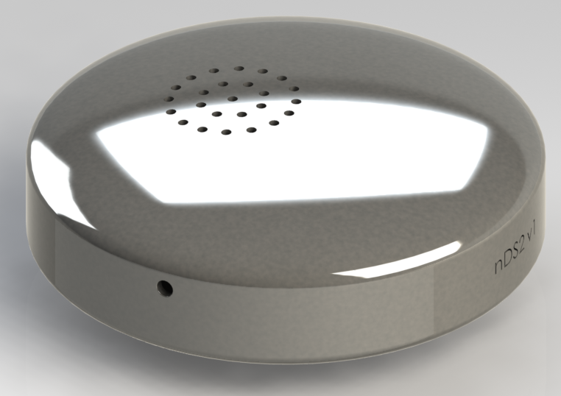
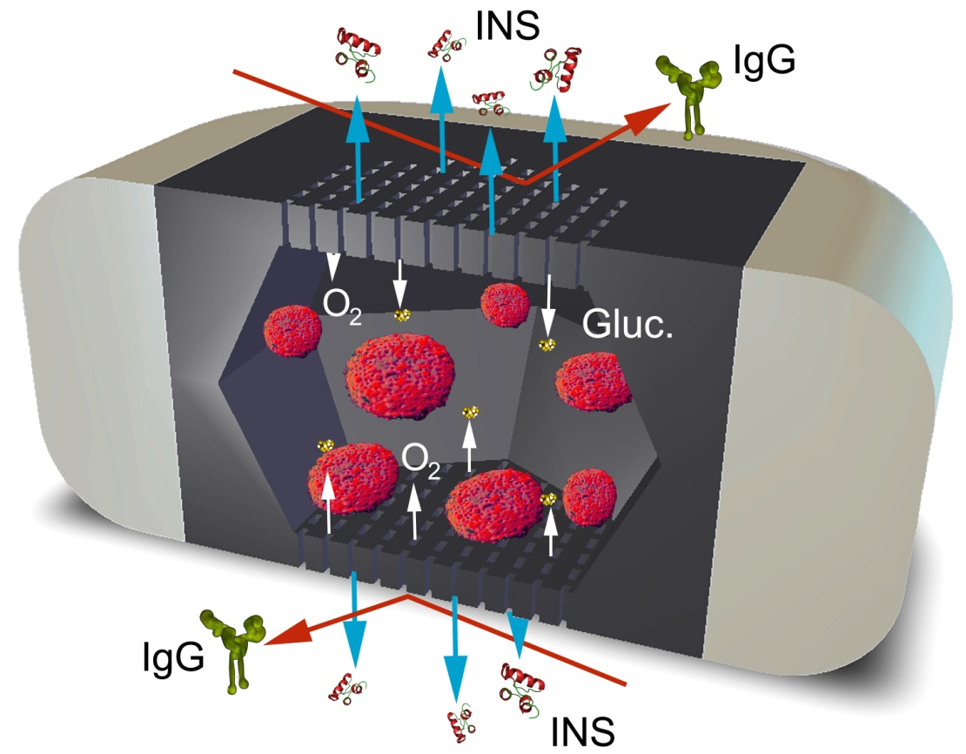
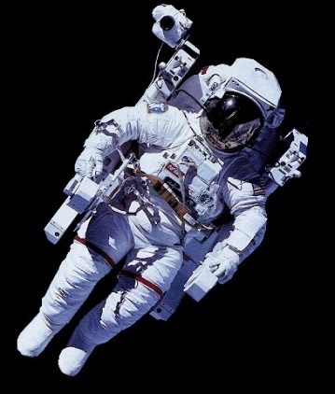
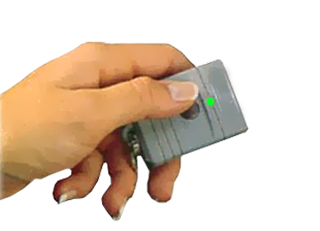
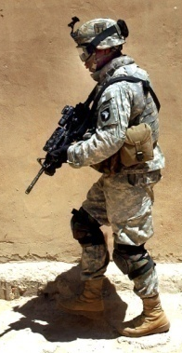
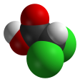

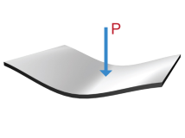
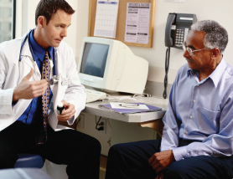
nDS Project
Objectives
development of silicon based nanochannel membranes for:
1. Passive and Active release of molecules, drug and nanoparticles form implants, over extended period of time.
2. Cell Transplantation
nDS1 Constant Release
Concentration-driven transport
nDS NanoGland
Cell Transplantation
nDS2 Active ad-hoc Release
Electrokinetic transport

Slide 8
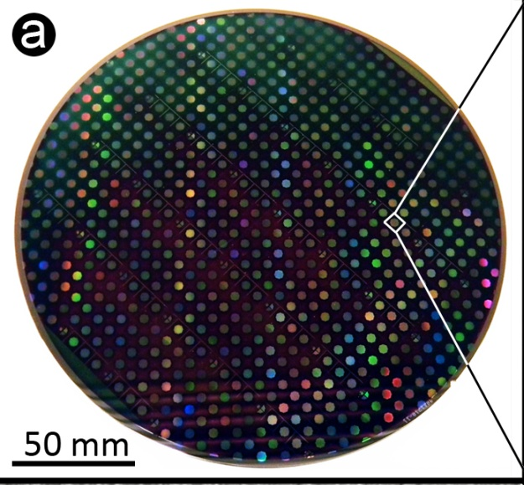
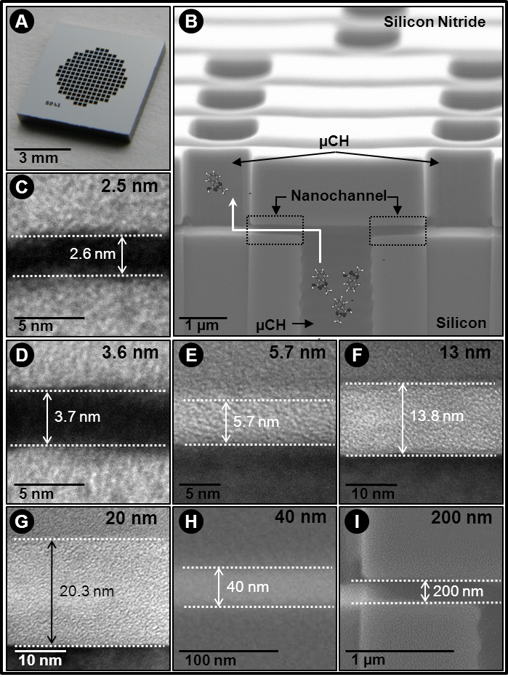
Nanochannel Membrane
Grattoni, Fine et al. Lab Chip, 2010
Grattoni et al. Pharma. Res., 2010

Slide 9
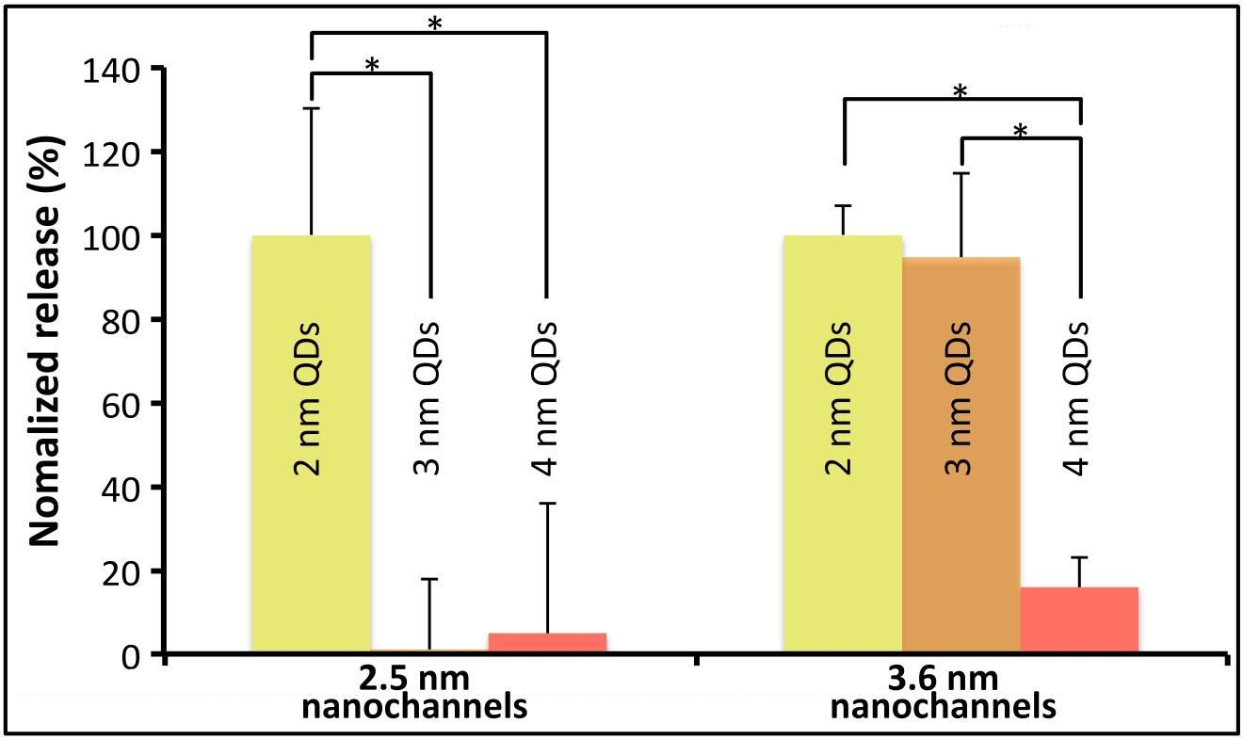
Ultraselective Filtration

Slide 10
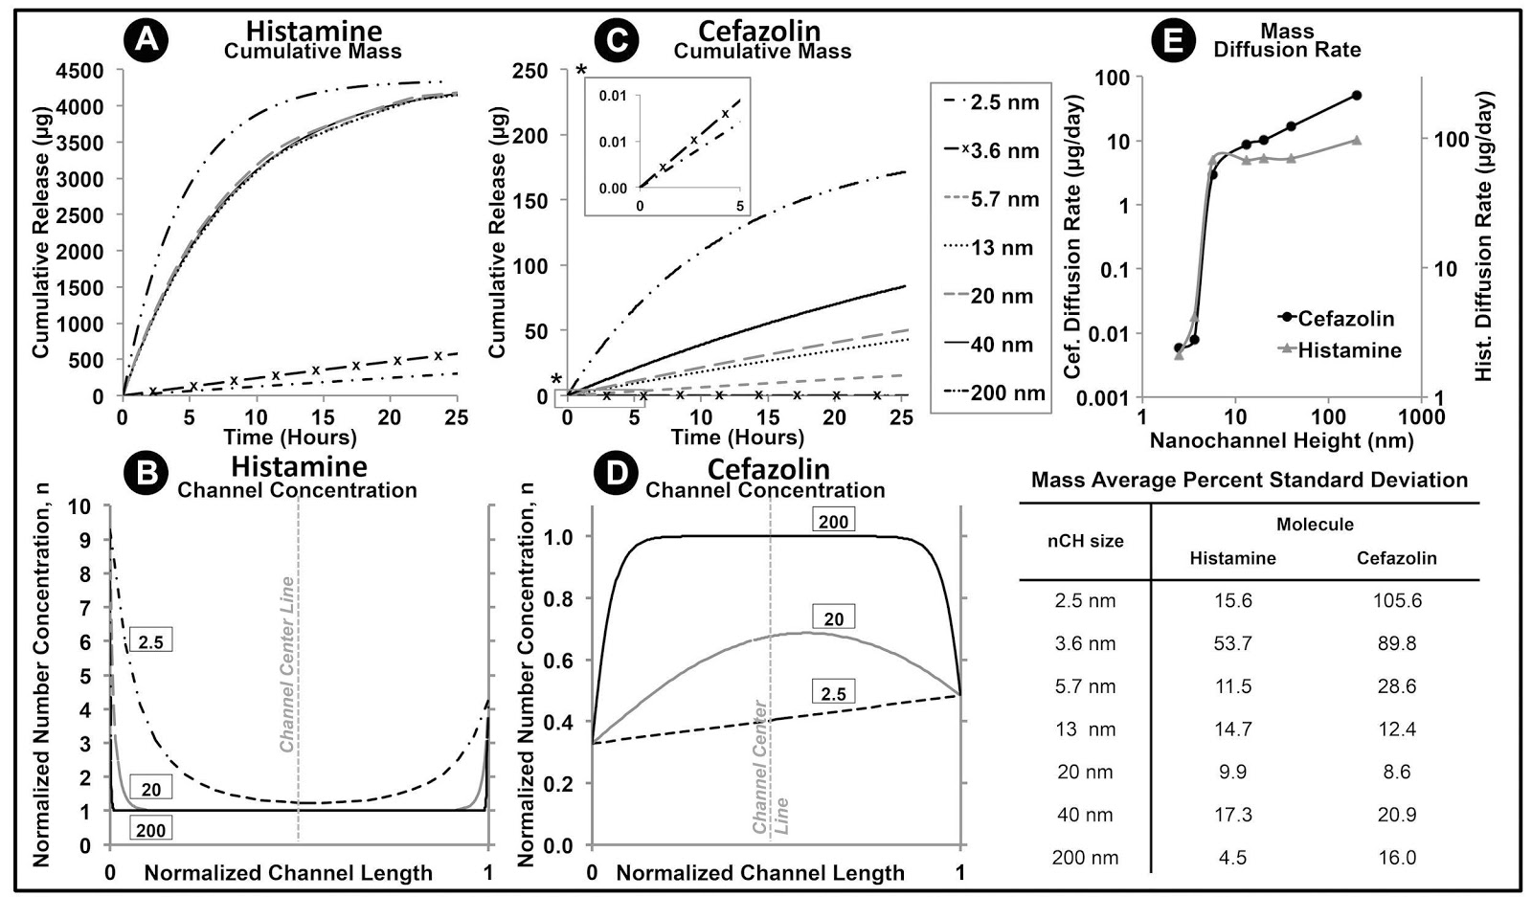
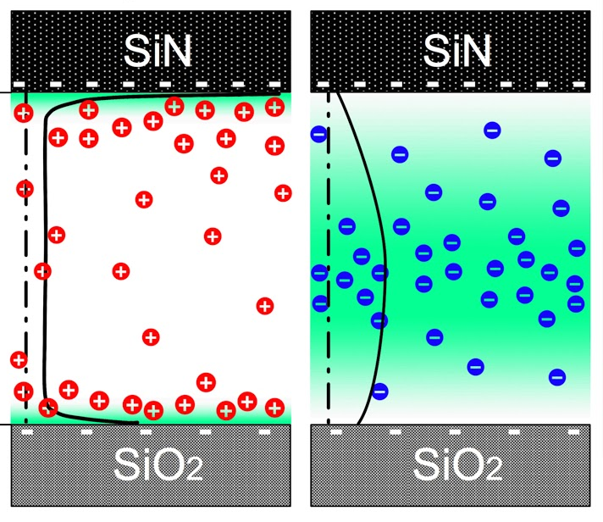
Gated vs Near-Surface Diffusion
+
-
200 nm
5.7, 13,
20, 40 nm
200 nm
40 nm
2.5 nm
3.6 nm
20 nm
13 nm
5.7 nm
2.5, 3.6 nm
Grattoni et al. ACS Nano, 2011

Slide 11
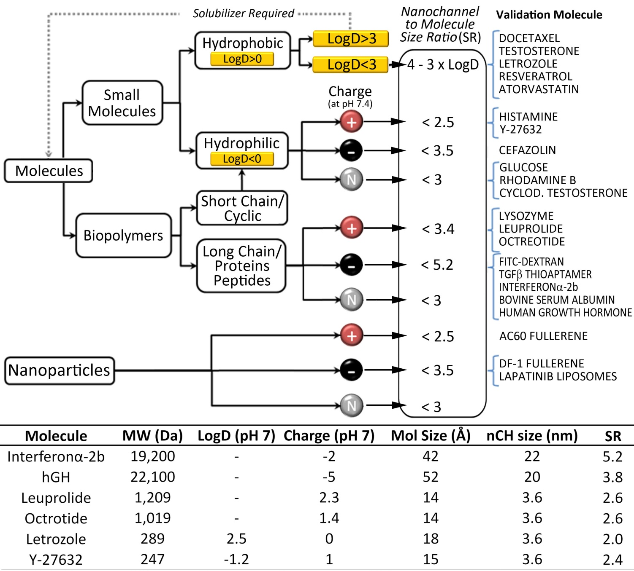
Rational Selection
Ferrati et al. J. Controlled Release, 2013

Slide 12
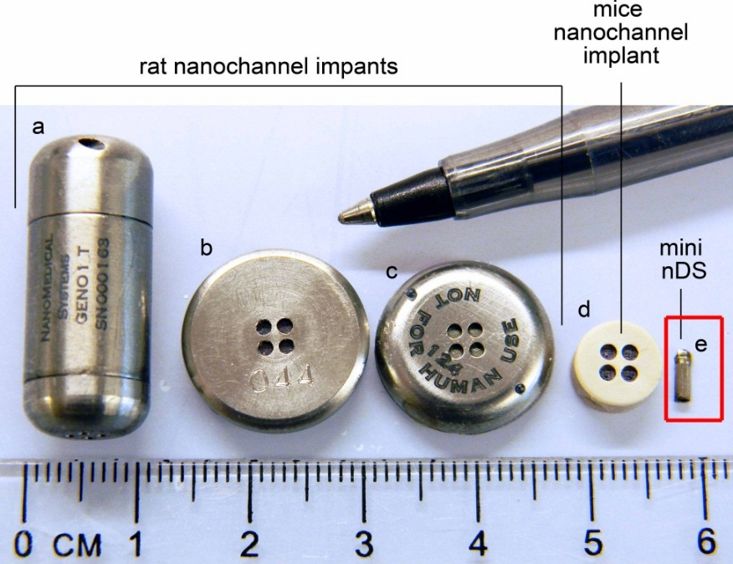
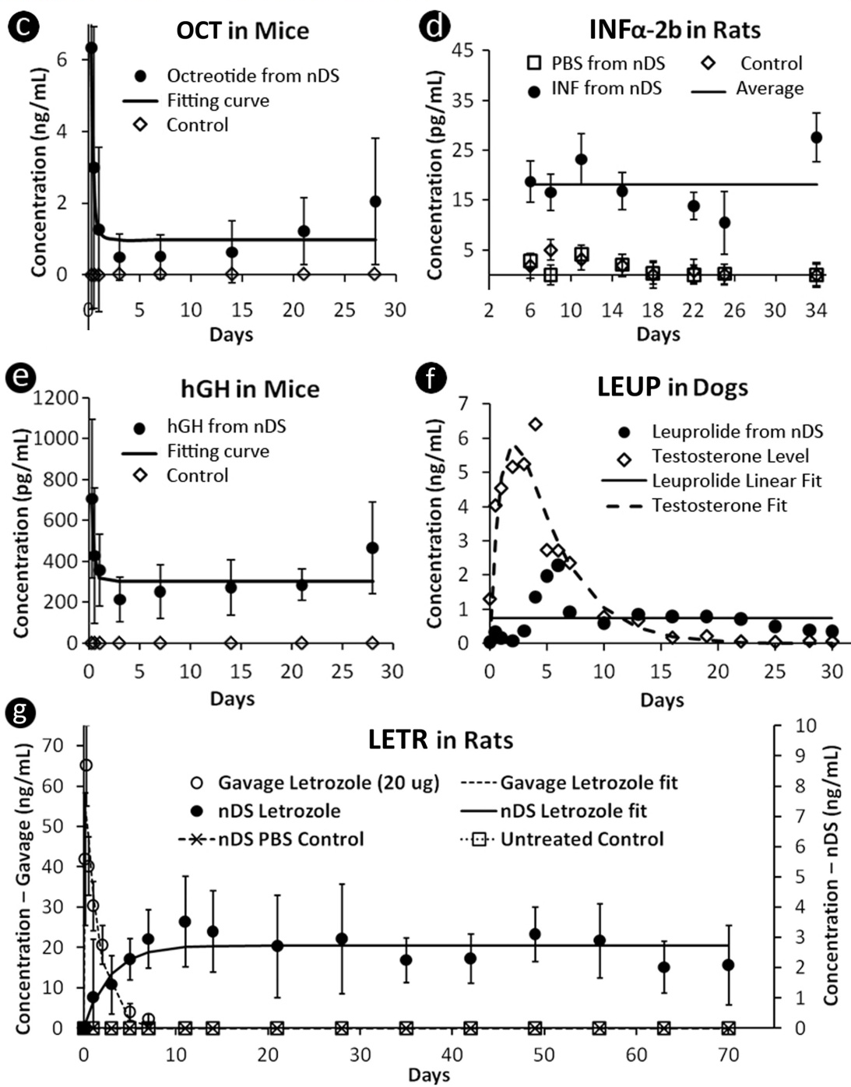
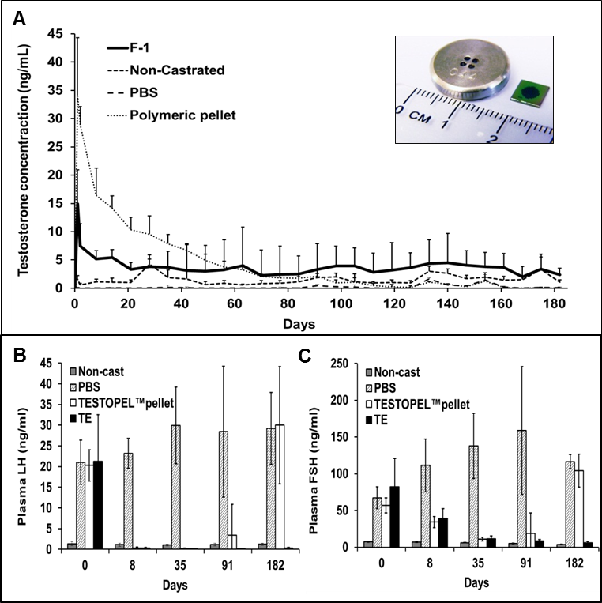
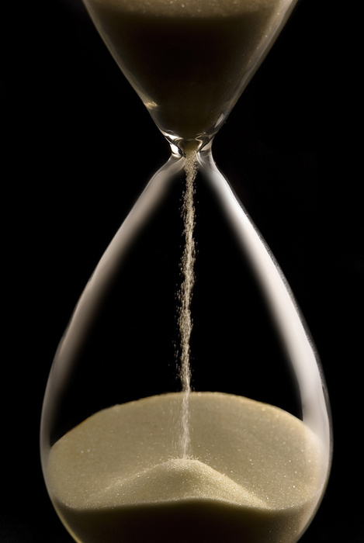
in vivo Constant Release of Drugs
Testosterone
Nicolov et al. J. Urology, 2014
Ferrati et al. J. Controlled Release, 2013
Ferrati et al. Advanced Healthcare Materials, 2014

Slide 13
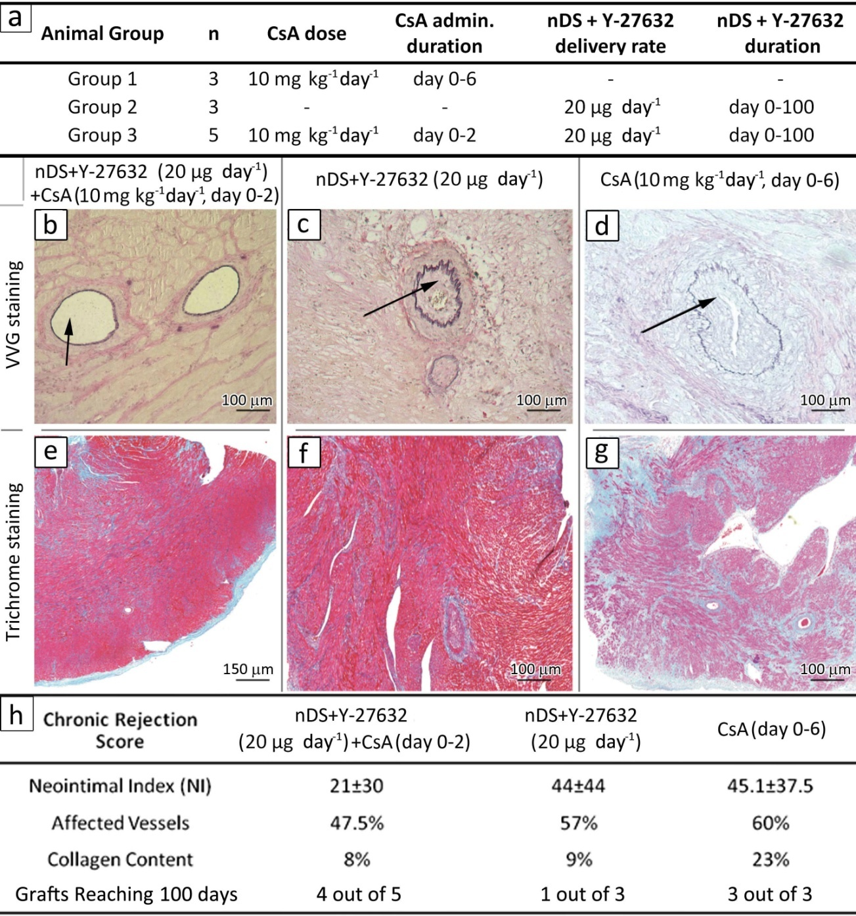
Constant Release of RhoA Inhibitor Abrogates Chronic Rejection in Heart-Tranplanted Rats
Ghobrial, Li, Grattoni, Kloc
RhoA is a GTPase that a role in T-cells immune response by promoting structural re-arrangments such as formation of focal points and actin fiber regulation which are critical for movement of T cells during rejection processes→ Role in Chronic Rejection
Ferrati et al. J. Controlled Release, 2013

Slide 14
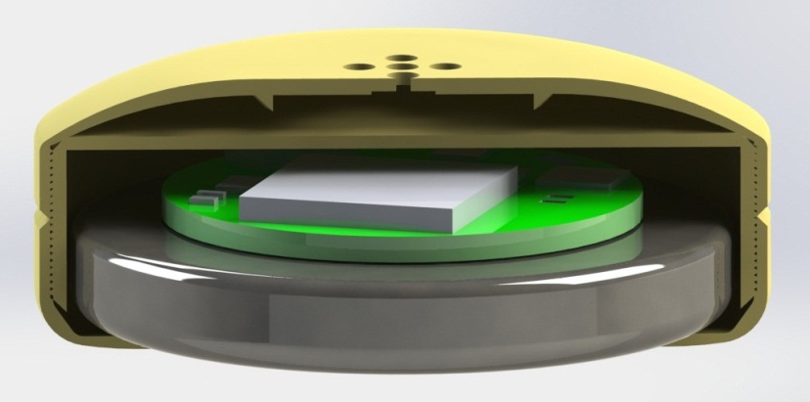
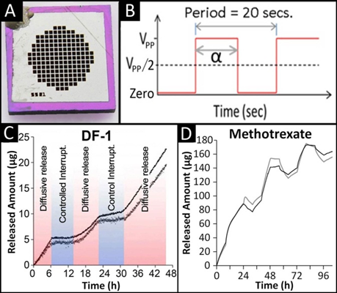
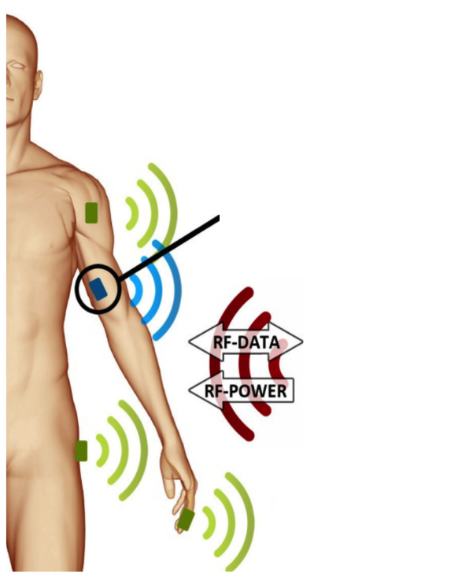
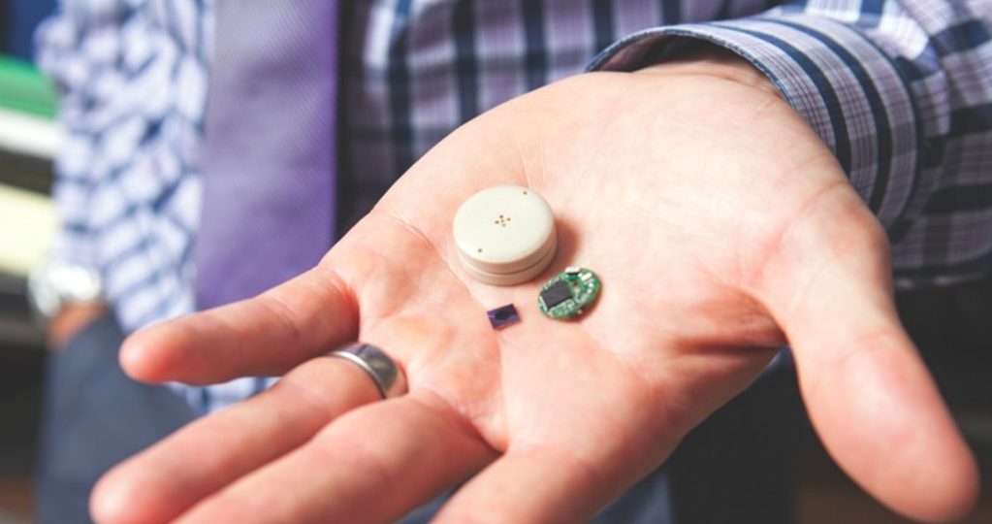
RF-Remotely Controlled nanochannel Delivery System (nDS2)
Membrane housing
Drug Reservoir
Bluetooth Circuit
Battery

Slide 15
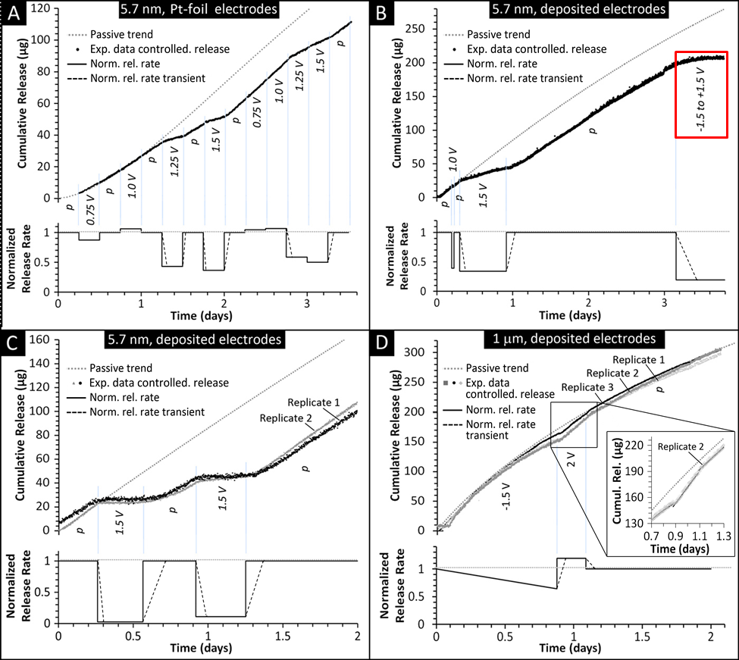
Tunable Release Results
Geninatti, et al.
Nanoscale, 2015

Slide 16
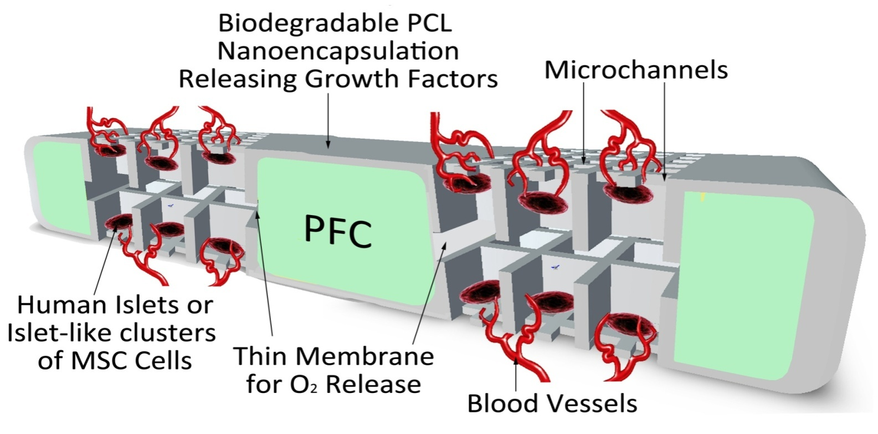
Pancreatic Islets Autotransplantation
The success of human islet auto-transplantation has been hampered by several obstacles resulting in an exceedingly high rate of primary non-function and graft loss
Loss of islet viability during isolation
Failure to vascularize or to form protective matrix
Failure in recreating a physiological-like environment
A novel approach: The Degradable NanoGland
Gaber, Grattoni, Sabek
Notes:
The Degradable Islet NanoGland, is our objective to address the issue of islet transplantation
Providing a temporary architecture to keep the transplanted islets in an environment geometrically more physiological
Supporting the vascularization through delivery of growth factor
Supporting Islet with oxygenation through polyfluorocarbon
Allowing for a short term degradation of the encapsulation (45 days) to allow for the simultaneous revascularization of the graft

Slide 17
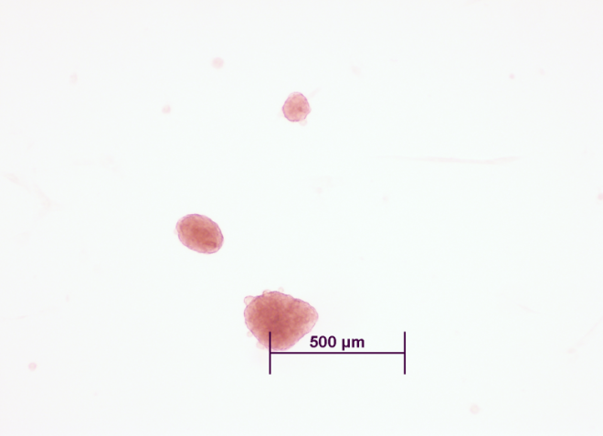
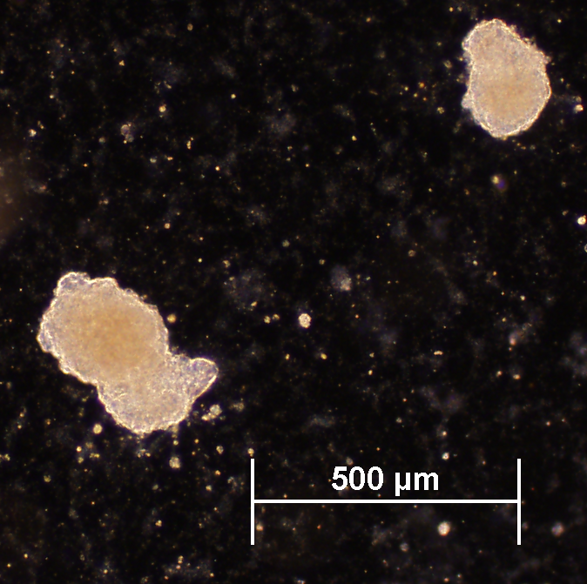
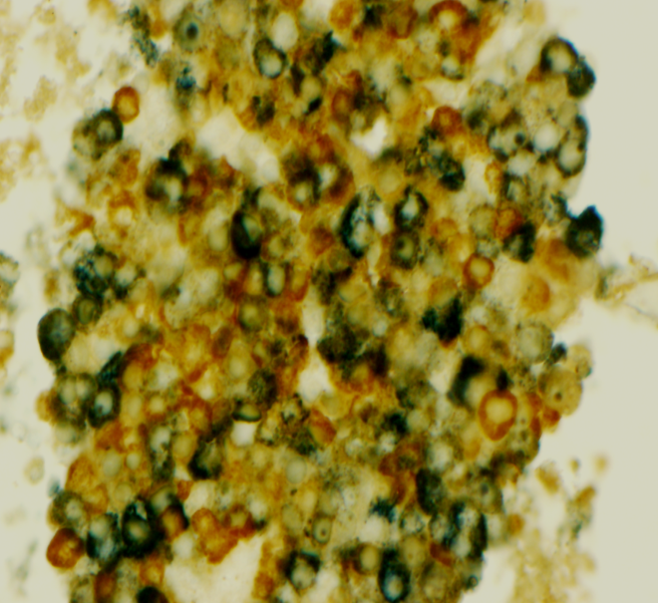
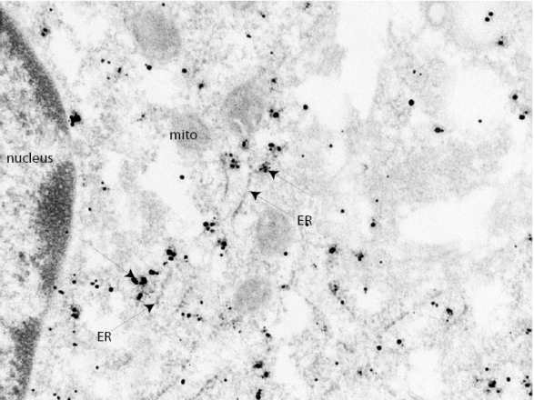
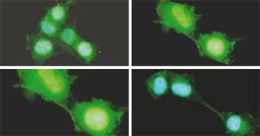
Bone Marrow derived cells (MSC) differentiated into Islet Like Clusters of cells producing insulin, glucagon and C-peptide
Human MSC differentiated to islet-like clusters
Human Islets (prep 11390)
Differentiated Islet Like Cluster stained for Insulin (blue) & Glucagon (red)
C-peptide staining
Notes:
Bone Marrow derived cells (MSC) differentiated into functional islet-like structure. Insulin, glucagon and c-peptide are markers of functionality and the differentiated cells stained for all of them.

Slide 18
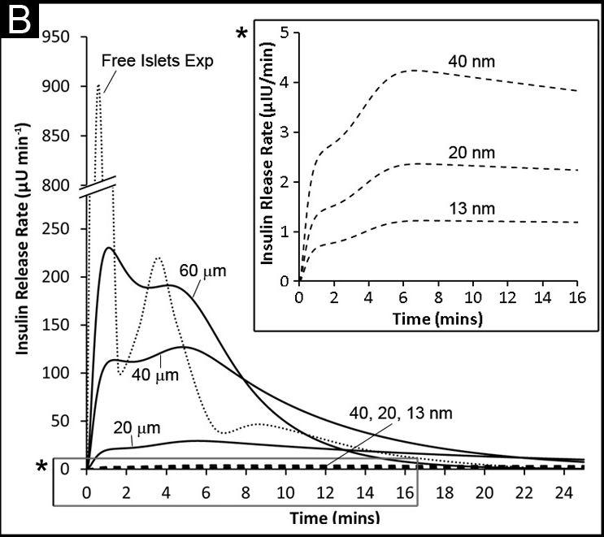



Rational Engineering of NanoGlands
Ferrati et al. Advanced Healthcare Materials, 2013
Notes:
Schematic and SEM micrografts of the Silicon non-degradable NanoGland presenting through microchannel in size equal to 20, 40 and 60 um
To allow for potential vessel formation through the membrane
The graph illustrates the results of islet viability and glucose stimulated insulin secretion (measured by the Stimulation Index)
This study was performed in vitro for almost one month into cell culture by spiking the supernatant outside the nanogland with glucose and measuring the produced insulin content in the supernatant. This was done at time 0 and after 27 days to see if islet suffered inside the NanoGland.
A good stimulation index >1 was obtained for all microchannel sizes even after 27 days of testing.
The lower index related to 60 um channels is attributed to the loss of small islets from the 60 um channels.

Slide 19


NanoGland In vivo Results
NanoGlands were loaded with human islets and implanted subcutaneously in nude mice.
After 4 months , islets were retrieved from NanoGlands . Islets viability and mice endothelial cell infiltration in the NanoGlands were evaluated.
Ferrati et al. Advanced Healthcare Materials, 2013
Notes:
Nanoglands were loaded with human islets and implanted subcutaneously in nude mice together with a VEG-F releasing disc.
After 4 months other islets were retrieved from Nanoglands and we looked at both viability and mice endothelial cell infiltration in the NanoGlands.
The Islets were still viable (TUNEL staining ,G), capable of producing insulin (A and staining D-F) and the blue stain (I) specific for mice endothelial cell demonstrated that infiltration occurred (a good sign for through-NanoGland revascularization of transplant). The gross examination of the tissue surrounding the NanoGland show vascularization (B) and minimal fibrosis ©.

Slide 20



Challenges of Studying
Constrained Molecular Transport
At nanoscale coupled interaction effects take over the molecular transport.
  Interactions
  Adsorption
  Size & Shape
  Charges
  Osmosis
Challenge: decoupling single effects at nanoscale.
Makes the difference
Molecular Dynamics
New Physics
Lysozyme - 13 nm
Prediction For Personalized Therapy
Pimpinelli et al. Applied Physics Letters, 2013
Ziemys et al. J. Computational Physics, 2011

Slide 21







Hypothesis & Approach
Hypothesis
Microgravity will allow to scale-up from Nano to Micro,
and to shine light into decoupled nanoscale effects in a tightly controlled experimental setup.
Approach
Microscopy analysis of fluorescent
microparticles in micro-confinement
Benefits
Reduced complexity
Improved capabilities and analysis
Greater control of size & shape
Controlled surface
Micro-nanoparticles
Size (μm): 1, 4
Silicon Microchannel
Depth (μm): 2.5 - 10
1 µm fluorescent
microparticles

Slide 22

Acknowledgments
Grattoni’s Laboratory
Department of Nanomedicine
Silvia Ferrati, PhD
Eugenia Nicolov, Ph.D.
Giancarlo Canavese, Ph.D.
Giacomo Bruno, M.S.
Lyle Hood, Ph.D.
Thomas Geninatti, Ph.D.
Usha Tekkedath, Ph.D.
Marco Farina, M.S.
Jeffrey Schmulen, M.S.
Carly Figueira, Ph.D.
Jenaro Huidiboro, Ph.D.
Celeste Marcato, B.S.
Elena Riscaldina, B.S.
Funding:∼$4.3M
CASIS
NIH-NIGMS
DOD
NASA
NanoMedical Systems
Vivian L. Smith Foundation
Nancy Owens Memorial Foundation
Golfers Against Cancer
Chad Brinkley
Kenneth Shields
John Shubert
Collaborators
Fazle Hussain, Ph.D.
A. Osama Gaber, M.D.
Daniel Fraga, M.S.
Omaima Sabek, Ph.D
Mark Ghobrial, M.D
Powel Brown, M.D.
Ganesh Palapattu, M.D.
Mohit Khera, M.D.
Sandeep Agarwal, M.D.
Christine Beeton, Ph.D.
Xian Li, M.D.
Sunil Krishnan, M.D.
NanoMedical Systems
Randy Goodall, Ph.D.
Sharath Hosali, Ph.D.,
Lee Hudson, Ph.D,

