Slide 1


Integral utilization of lignocellulosic materials; residues of the agriculture and agri-food industry
Alejandro Rodríguez
Chemical Engineering Department,
University of Córdoba
Notes:
Good morning and thank you to be here. My name is Alejandro Rodríguez and I am going to talk about Integral utilization of lignocellulosic materials, residues of the agriculture and agri-food industry

Slide 2
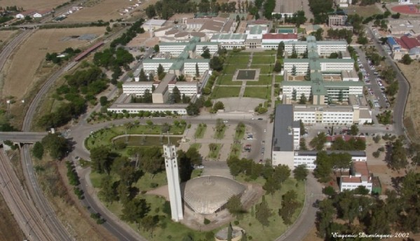
World Congress and Expo on Recycling
July 20-22, 2015
Chemical Engineering Department,
Science Faculty, University of Córdoba
Building Marie Curie
Notes:
I work in a group which started in 1985 researching in lignocellulosic materials. My research group work in Chemical Engineering Department in the University of Córdoba. We are placed in building Marie Curie in the Campus of Rabanales

Slide 3
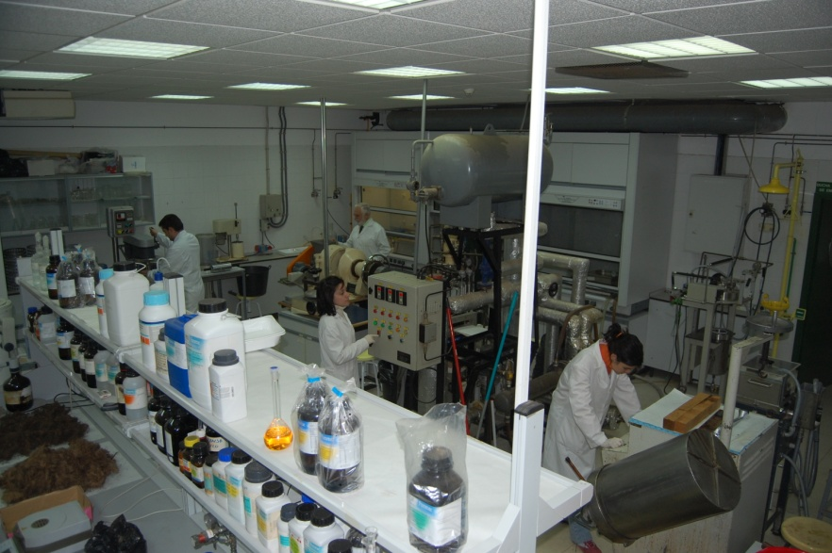
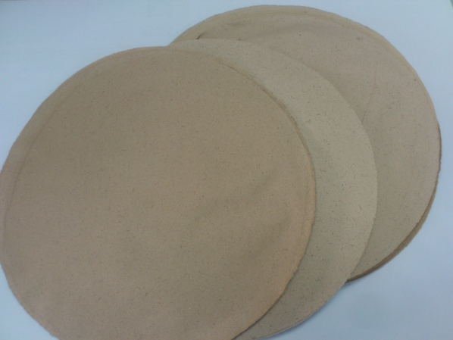
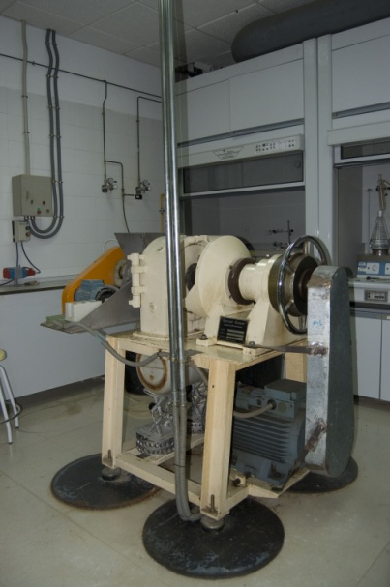
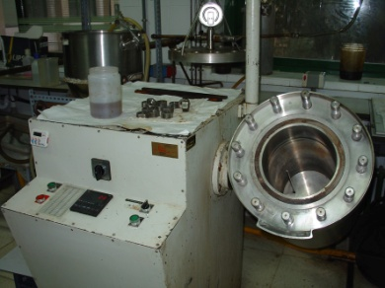
World Congress and Expo on Recycling
July 20-22, 2015
Luis Jiménez Alcaide→ founder of the original research line. Professor of Chemical Engineering since 1995.
Alejandro Rodríguez Pascual→ Director of the group, Lecturer of the Chemical Engineering Department.
Ana Requejo Silva→ PhD from the University of Córdoba, currently enjoys a Hub Talent scholarship at the University of Natural Resources and Life Sciences (BOKU), Austria
Fátima Vargas González→ PhD student.
Eduardo Espinosa Victor→ PhD student.
Juan Domínguez Robles→ PhD student.
Notes:
Nowdays the group are integrated by two permanent staff; Luis Jiménez, founder of the group and professor of Chemical Engineering, and me, lecturer in the same department. Also belong to the group one post doctoral student and 3 pre doctoral students

Slide 4
World Congress and Expo on Recycling
July 20-22, 2015
RESEARCH LINE
Biorefinery of lignocellulosic materials from agricultural and agri-food activity
Production of cellulosic pulps from agricultural residues and agri-food industry (cereals straw, vine shoots, sorghum stalks, sugar cane bagasse, olive tree prunnings, orange tree prunnings, empty fruit bunches (EFB), and plants of rapid growth (leucaena, tagasaste, paulownia, hesperaloe, etc.)
Fractionation processes in order to obtain two fractions from the lignocellulosic materials: one rich in cellulose and lignin and other one rich in hemicellulose.
Production of bioethanol.
Black liquor (rich in lignin) separation and characterization
Production of lignocellulosicnanofibres from fibers of cellulose of agro-industrial waste.
Notes:
In this research line we are focused on the production of ….; fractionation processes…; production of bioethanol…; separation of the black liquor and production of lignocellulosicnanofibers

Slide 5

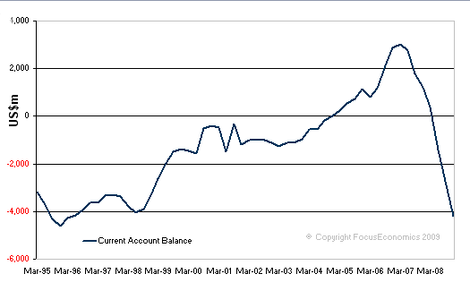
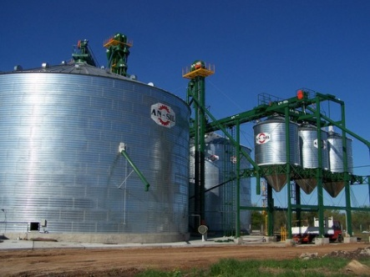
World Congress and Expo on Recycling
July 20-22, 2015
PROPER USE OF NATURAL RESOURCES
SUSTAINABLE ECONOMY
THE BEST QUANTITY
OF WASTE IS 0
SOCIAL ASPECTS
INDUSTRIAL ACTIVITY
ECONOMIC BENEFITS
Notes:
Sustainable development is a concept that is gaining more and more importance in our society, putting into practice in all social aspects including industrial production. One of the pillars of sustainable development is the sustainable economy, which moves towards a comprehensive use of natural resources. To achieve this goal it is necessary to value by-products and waste generated in the different activities such as agriculture and agro-industrial processes. Industrial activity has always been focused on the manufacturing of products that meet the requirements of customers demanded in the market, but in recent times the environmental component has been incorporated into production since the society is more aware and convinced with the need to consume products that have been obtained using environmentally friendly processes

Slide 6
World Congress and Expo on Recycling
July 20-22, 2015
LIGNOCELLULOSIC
BIOMASS
Forest-based materials, 70 % of the total lignocellulosic materials
Agricultural origin
Agro-Industrial origin
Urban origin, papers or paperboard of cellulosic composition
Notes:
The origin of the biomass lignocellulosic could be clasified as follow: forest…

Slide 7
World Congress and Expo on Recycling
July 20-22, 2015
LIGNOCELLULOSIC BIOMASS
Agricultural and industrial origin
Agricultural waste, such as cereals straw, pruning of fruit trees, etc.
Species of rapid growth such as paulownia, tagasaste, hesperaloe, etc.
Residues of agro-alimentary industries as, sugar cane bagasse, empty fruit bunches, etc.
No tree species, as flax, jute, hemp, etc.
Notes:
The agricultural and industrial biomass lignocellulosic has its origin in

Slide 8
World Congress and Expo on Recycling
July 20-22, 2015
Assuming that 1 kilogram of product generates between 0.8-1 kg of waste
Each year are generated large amounts of waste, with a great potential of application due its composition

Slide 9
World Congress and Expo on Recycling
July 20-22, 2015
LIGNOCELLULOSIC BIOMASS COMPOSITION
Organic
Substances
99.5-90%
Carbohydrates
70-80%
Cellulose
40-50%
Polysaccharides
Hemicellulose
Aromatic Substances
(lignin)
30-20%
Extractives Substances
4-0 %
Pentoses
Hexoses
Resins
Waxes
Pectins
Mineral
Substances
(0.5-1%)
Notes:
The potential application of lignocellulosic biomass is due to the composition that it presents. In general it is mainly composed of organic substances, around 90-99.5%, being the difference to 100 mineral substances. Around 70-80% of the organic substances are carbohydrates, 30-20% aromatic substances (lignin) and extractives as resins, waxes and pectins. The mainly fraction of the carbohydrates is cellulose (40-50%)

Slide 10
World Congress and Expo on Recycling
July 20-22, 2015
2013 → 2780,7 *10⁶ tonnes
Notes:
In this table we can see the evolution in the world production of cereals…two thousand millions tonnes in two thousand thirteen

Slide 11
World Congress and Expo on Recycling
July 20-22, 2015
Jemp, flax, jute, abaca, sisal, etc.
Notes:
fibre crops primary with 31 thousands tonnes in 2011

Slide 12
World Congress and Expo on Recycling
July 20-22, 2015
Olives, palm, jojoba, coconuts, etc. 200 *10⁶ tonnes
Notes:
and oilcrops primary with one hundred ninety seven millions tonnes in 2013

Slide 13
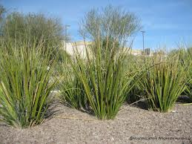
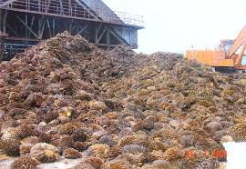
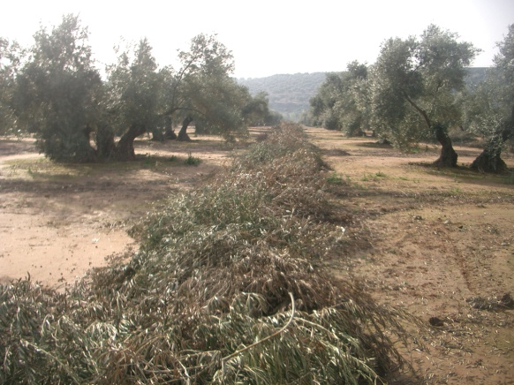
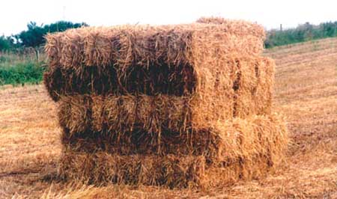
World Congress and Expo on Recycling
July 20-22, 2015
LIGNOCELLULOSIC BIOMASS
(agricultural and industrial origin)
Organic soil amendment
Feed for animals
Burnt in the field causing pollution and risk of fire (CO₂ emissions)
Notes:
Up to date the main uses of the biomass are: …and in the major of the cases these residues are burnt in the field causing pollution and risk of fire (and also CO2 emissions). This type of uses generates few economic benefits, so it is necessary to valorize them in order to improve the economical balance of the activity

Slide 14
EFB, cereals straw, olive tree prunings, etc.
RESIDUES FROM AGRICULTURAL ACTIVITY AND AGRI-FOOD INDUSTRY
Heat and
Energy
Bioethanol production
Chemical Characterization
Optimization of the operational variables
Hydrothermal Treatment
LCNF
Pulping processes
Soda
Organosolv
Kraft
Cellulosic pulps production
Solvents and reagents separation
Lignin separation
Optimization
Separation
Optimization of the operational variables
Lignin
Others products
Valorization
Notes:
An scheme of the biorefinery could be the following, first a chemical characterization of the raw material. This scheme is based on the three main fractions of the biomass, cellulose, hemicellulose and lignin. It could be possible to obtain bioethanol from original raw material and after an hydrothermal treatment. Or use the cellulose fraction to produce cellulosic fibers for pulp, paper production and nanofibers production. To use lignin is necessary a separation process.
I am going to focused my presentation mainly on the cellulose fraction, showing the results for different pulping processes over different raw materials. After that I will show brieftly few results about the use of these raw material to produce heat and energy and also bioethanol, hemicellulose fractionation and lignonanofibers

Slide 15
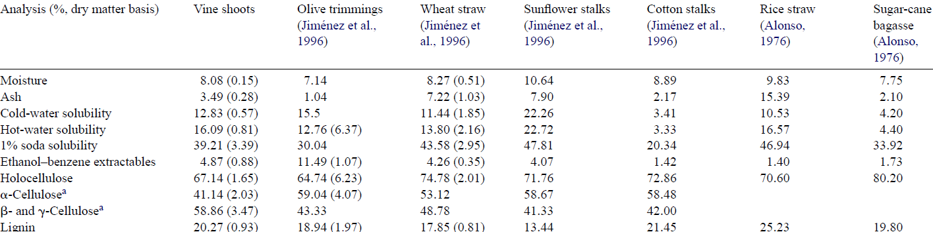
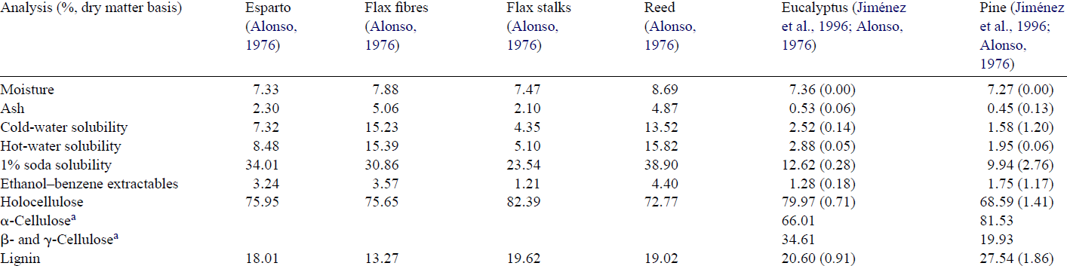
World Congress and Expo on Recycling
July 20-22, 2015
CELLULOSE
Jiménez et al., 2006, Industrial Crops and Products 23, 122-130

Slide 16
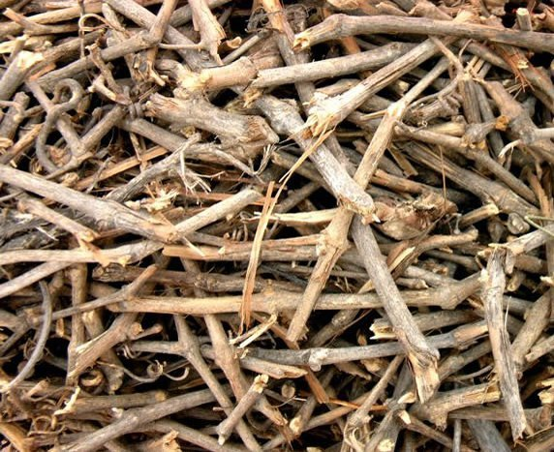
World Congress and Expo on Recycling
July 20-22, 2015
CELLULOSE
Soda
process
NaOH 12%
Sulphity 20%
170 ºC
60 min
L/S 6
Kraft
process
NaOH 12%
170 ºC
60 min
L/S 6
VINE SHOOTS
Yield 32.1 %
Ash 4.36 %
Holocellulose 79.4 %
α-cellulose 70.0 %
Lignin 24.1 %
Yield 29.2 %
Ash 3.93 %
Holocellulose 84.2 %
α-cellulose 73.7 %
Lignin 17.2 %
Jiménez et al., 2006, Industrial Crops and Products 23, 122-130
Notes:
An scheme of the biorefinery could be the following, first a chemical characterization of the raw material. This scheme is based on the three main fractions of the biomass, cellulose, hemicellulose and lignin. It could be possible to obtain bioethanol from original raw material and after an hydrothermal treatment. Or use the cellulose fraction to produce cellulosic fibers for pulp, paper production and nanofibers production. To use lignin is necessary a separation process.
I am going to focused my presentation mainly on the cellulose fraction, showing the results for different pulping processes over different raw materials. After that I will show brieftly few results about the use of these raw material to produce heat and energy and also bioethanol, hemicellulose frationation and lignonanofibers

Slide 17
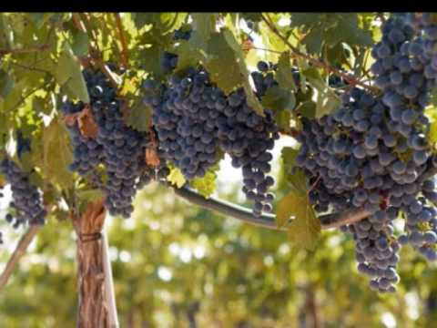
World Congress and Expo on Recycling
July 20-22, 2015
CELLULOSE
Physical properties of papersheets made with vine shoots as raw material
Pulp | Schopper Riegler ºSR | Breaking length m | Stretch % | Burst Index, kN/g | Tear Index, mNm²/g
Soda | 21 | 659 | 1.89 | 1.01 | 0.9
Kraft | 25 | 1316 | 4.72 | 1.63 | 1.59
Jiménez et al., 2006, Industrial Crops and Products 23, 122-130

Slide 18
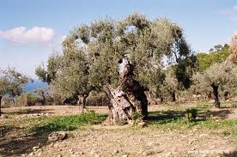
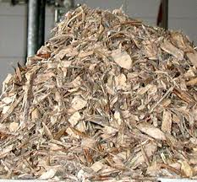
World Congress and Expo on Recycling
July 20-22, 2015
CELLULOSE
Holocellulose 61.5 %
α-cellulose 35.7 %
Lignin 19.7 %
Yield 49.1 %
Kappa Number 109.7
Breaking length 556.7 m
Burst Index 24.20 kN/g
Tear Index 0.9 mNm²/g
OLIVE
TREE
PRUNINGS
NaOH 15%
180 ºC
60 min
L/S 6
Jiménez et al., 2004, Holzforschung, 58pp 122-128

Slide 19
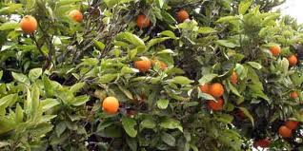
World Congress and Expo on Recycling
July 20-22, 2015
CELLULOSE
Ash 3.4 %
Holocellulose 73.2 %
α-cellulose 48.0 %
Lignin 19.95 %
Kraft-AQ
process
Soda-AQ
process
NaOH 10-16%
Sulphity 20%
155-185 ºC
40-90 min
L/S 8
AQ 1%
ORANGE TREE
PRUNINGS
NaOH 10-16%
155-185 ºC
40-90 min
L/S 8
AQ 1%
González et al., 2013, BioResources, 8(4),
5622-5634
AFTER REFINING PROCESS
Yield 51.7 %
ºSR 51.5
TI 62.76 Nm/g
TeI 2.83 mNm²/g
Yield 53.8 %
ºSR 64.6
TI 91.1 Nm/g
TeI 3.19 mNm²/g

Slide 20
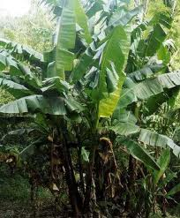
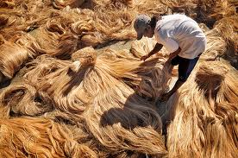
World Congress and Expo on Recycling
July 20-22, 2015
CELLULOSE
ABACA
Raw material | Ash, % | Lignin, % | Holocellulose, % | α-cellulose, %
Abaca | 1.35 | 10.4 | 87.9 | 67.9
“Soda process”
5-10% NaOH
150-170ºC
15-45 min
L/S ratio = 6:1
Raw material | Yield % | Kappa Number | Viscosity mL/g | Breaking length m | Stretch Index % | Tear Index mNm²/g
Abaca | 72.8-78 | 10.6-35.7 | 1121-1411 | 4874-5231 | 4.30-4.76 | 14.2-18.3
Jiménez et al., 2005, Bioresource Technology 96 977-983
Notes:
Abaca, popularly known as “Manila hemp”, originated from the Philippines and was later introduced in Central and South America (particularly Ecuador). The global production of abaca fibre in 1999 was 83 000 t.
The uses of abaca are associated to the high strength of its fibres: fishing nets, high-quality safety paper, banknote paper, diapers, machine filters, hospital textiles, bible paper, carbon paper, cigarette paper and condenser paper.
Abaca is usually cooked with soda or neutral sulphite. The latter provides pulp yields of 58–72% by using sodium sulphite concentrations of 16–18% and temperatures from 150 to 170 °C. This material has also been subjected to thermomechanical, chemomechanical, cold soda and neutral sulphite semi-chemical processes for improved yield.
In recent studies, abaca fibres has been pulped with the soda process, and the resulting pulp bleached with ECF and TCF sequences.

Slide 21
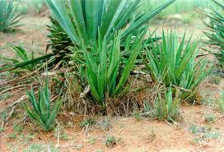
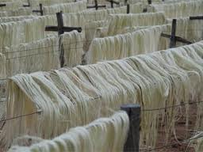
World Congress and Expo on Recycling
July 20-22, 2015
CELLULOSE
Hesperaloe funifera
Raw material | Ash, % | Lignin, % | Holocellulose, % | α-cellulose, %
Hesperaloe funifera | 5.9 | 7.9 | 74.1 | 52.3
10 % NaOH, 1% AQ
155ºC, 30 min
L/S 8
Raw material | Yield% | Kappa Number | Viscosity mL/g | Tensile index Nm/g | Stretch index % | Burst index kN/G | Tear index mNm²/g
Hesperaloe funifera | 48.3 | 15.2 | 737 | 83.6 | 3.8 | 7.34 | 3.20
Sánchez et al., 2010, Biomass and Bioenergy, 34, 1471-1480
Notes:
H. funifera is a plant of the family Agavaceae up to 80 cm tall and 1.0–1.2 m wide with long leaves up to 5 cm wide and 2–3 cm thick. All species in its genus originated in Mexico and its neighbouring USA regions, where it is used mainly for ornamental purposes. Hesperaloe has very modest irrigation requirements by effect of its using the acid metabolism of Crassulaceans (CAM) for photosynthesis. Its plants fix carbon dioxide and transpire water more
strongly at night than during the day; also, because their coefficient of transpiration is lower at night, they use water highly efficiently. Based on these properties, Hesperaloe might be an effective cellulose raw material in arid zones precluding cultivation of other species

Slide 22
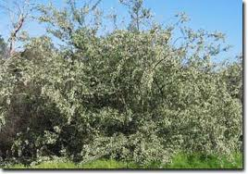
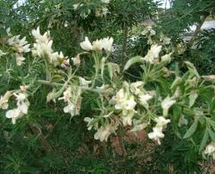
World Congress and Expo on Recycling
July 20-22, 2015
CELLULOSE
TAGASASTE
Raw material | Ash, % | Lignin, % | Holocellulose, % | α-cellulose, %
Tagasaste | 0.9 | 18.5 | 80.3 | 40.4
16% NaOH
180ºC, 60 min
L/S 8:1
Raw material | Yield, % | Kappa Number | Brightness, %
Tagasaste | 41.2 | 26.5 | 30.3
Alfaro et al., 2010, Bioresource Technology, 101, 7635-7640

Slide 23
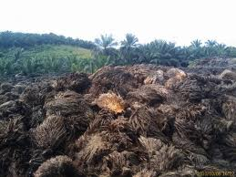
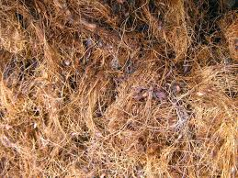
World Congress and Expo on Recycling
July 20-22, 2015
CELLULOSE
EFB
Raw material | Ash, % | Lignin, % | Holocellulose, % | α-cellulose, %
EFB | 3.2 | 24.5 | 67.0 | 47.9
10-20% NaOH
155ºC – 185ºC
30 - 90 min
L/S 4:1 - 8:1
% AQ 0 - 1
Raw ma-terial | Yield, % | Kappa Number | Visco-sity, mL/g | Tensile index, Nm/g | Stretch,% | Burst index, Kpam²/g | Tear index, mNm²/g | Bright-ness, %
EFB | 29-46.3 | 15.8-74.3 | 282-849 | 8.7-25.8 | 1.24-2.97 | 0.49-1.90 | 0.26-0.55 | 44.7-65.1
Jiménez et al., 2009, Bioresource Technology, 100, 1262-1267

Slide 24
World Congress and Expo on Recycling
July 20-22, 2015
CELLULOSE
CEREAL STRAWS
Raw material | Alcohol extractives, % | Ash, % | α-cellulose, % | Hemicellulose, % | Lignin, %
Oats | 6.4 | 7.00 | 37.9 | 37.7 | 16.6
Maize | 6.8 | 5.95 | 44.0 | 30.7 | 18.2
Rapeseed | 7.9 | 6.38 | 37.0 | 36.5 | 17.2
Barley | 8.1 | 9.49 | 34.0 | 27.7 | 16.3
Wheat | 5.2 | 7.72 | 39.7 | 30.6 | 17.7

Slide 25
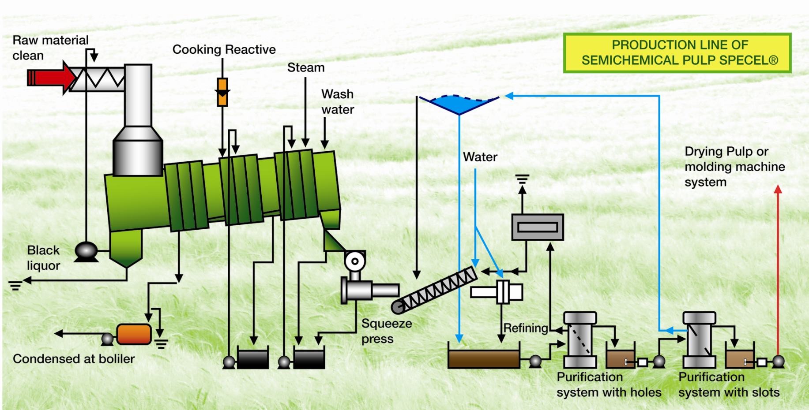
World Congress and Expo on Recycling
July 20-22, 2015
CELLULOSE
CEREAL STRAWS
NaOH 7%
100 ºC
150 min,
L/S 10
Notes:
An scheme of the biorefinery could be the following, first a chemical characterization of the raw material. This scheme is based on the three main fractions of the biomass, cellulose, hemicellulose and lignin. It could be possible to obtain bioethanol from original raw material and after an hydrothermal treatment. Or use the cellulose fraction to produce cellulosic fibers for pulp, paper production and nanofibers production. To use lignin is necessary a separation process.
I am going to focused my presentation mainly on the cellulose fraction, showing the results for different pulping processes over different raw materials. After that I will show brieftly few results about the use of these raw material to produce heat and energy and also bioethanol, hemicellulose frationation and lignonanofibers

Slide 26
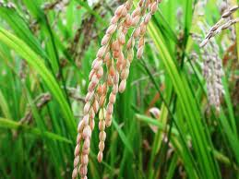
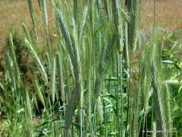
World Congress and Expo on Recycling
July 20-22, 2015
CELLULOSE
CEREAL STRAWS
Raw material | Yield, % | Beating Degree, ºSR | Kappa number | Viscosity, mL/g
Oats | 66.9 | 36 | 71.5 | 465
Maize | 65.5 | 47 | 56.7 | 996
Rapeseed | 63.1 | 29 | 115.1 | 184
Barley | 65.6 | 61 | 57.5 | 468
Wheat | 70.0 | 51 | 38.6 | 536
Notes:
An scheme of the biorefinery could be the following, first a chemical characterization of the raw material. This scheme is based on the three main fractions of the biomass, cellulose, hemicellulose and lignin. It could be possible to obtain bioethanol from original raw material and after an hydrothermal treatment. Or use the cellulose fraction to produce cellulosic fibers for pulp, paper production and nanofibers production. To use lignin is necessary a separation process.
I am going to focused my presentation mainly on the cellulose fraction, showing the results for different pulping processes over different raw materials. After that I will show brieftly few results about the use of these raw material to produce heat and energy and also bioethanol, hemicellulose frationation and lignonanofibers

Slide 27
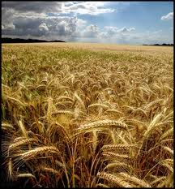
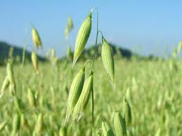
World Congress and Expo on Recycling
July 20-22, 2015
CELLULOSE
CEREAL STRAWS
Raw material | Tensile index, Nm/g | Stretch index,% | Burst index, kN/g | Tear index, mNm²/g | Brightness, %
Oats | 64.0 | 1.84 | 2.966 | 2.049 | 57.1
Maize | 68.2 | 1.85 | 3.284 | 2.837 | 60.2
Rapeseed | 42.8 | 1.21 | 1.630 | 2.207 | 64.3
Barley | 63.9 | 1.75 | 3.169 | 2.300 | 55.7
Wheat | 43.5 | 2.71 | 2.330 | 2.620 | 60.0
Notes:
An scheme of the biorefinery could be the following, first a chemical characterization of the raw material. This scheme is based on the three main fractions of the biomass, cellulose, hemicellulose and lignin. It could be possible to obtain bioethanol from original raw material and after an hydrothermal treatment. Or use the cellulose fraction to produce cellulosic fibers for pulp, paper production and nanofibers production. To use lignin is necessary a separation process.
I am going to focused my presentation mainly on the cellulose fraction, showing the results for different pulping processes over different raw materials. After that I will show brieftly few results about the use of these raw material to produce heat and energy and also bioethanol, hemicellulose frationation and lignonanofibers

Slide 28
World Congress and Expo on Recycling
July 20-22, 2015
HEMICELLULOSE
Hydrothermal treatment
Optimal
conditions
190 ºC
15 min
L/S 9
Rice straw
150 – 190 ºC
0 – 20 min
L/S 6 – 10
Glucose 1.92 g/L
Xylose 3.97 g/L
Arabinose 0.99 g/L
Acetic acid 1.96 g/L
Rodríguezet al., 2009, Bioresource Technology, 100, 4863-4866
Hydrothermal treatment
catalyzed
150 – 190 ºC
0 – 20 min
0 – 0.5% H₂SO₄
L/S 8
Optimal
conditions
170 ºC
20 min
L/S 8
Hesperaloe
funifera
Glucose 4.62 %
Xylose 10.56 %
Arabinose 1.28 %
Sánchezet al., 2011, Biochemical Engineering Journal 56,130-136

Slide 29
World Congress and Expo on Recycling
July 20-22, 2015
HEMICELLULOSE
Optimal
conditions
186 ºC
18 min
L/S 7
0.1 % H₂SO₄
Hydrothermal treatment
Olive tree
prunings
150 – 190 ºC
0 – 20 min
L/S 6 – 8
0.1 – 0.5% H₂SO₄
Requejoet al., 2012, BioResources 7(1), 118-134
Glucose 5.33 %
Arabinose 2.76 %
190 ºC
15 min
L/S 6
0.1 % H₂SO₄
Hydrothermal treatment
catalyzed
150 – 190 ºC
0 – 20 min
0 – 0.5% H₂SO₄
L/S 6 – 8
Optimal
conditions
Empty fruit
bunches
Glucose 3.12 g/L
Xylose 4.0 g/L
Arabinose 2.35 g/L
Acetic acid 2.28 g/L
Ferreret al., 2013, Bioresource Technology, 129, 506-511

Slide 30
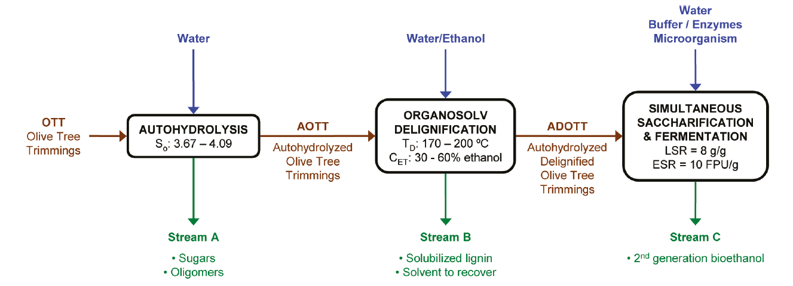
World Congress and Expo on Recycling
July 20-22, 2015
BIOETHANOL
OLIVE TREE PRUNINGS
Ethanol concentration of fermented media reached values up to 39 g/L
Requejoet al., 2011, Energy and Fuel, 25(10), 4803-4810

Slide 31
World Congress and Expo on Recycling
July 20-22, 2015
Combustion: Calorific Value (CV)
Lignocellulosic Material | kJ/kg
Main fraction of orange tree prunings | 18,626
Residual fraction of orange tree prunings | 16,870
Main fraction of olive tree prunings | 19,110
Residual fraction of olive tree prunings | 18,699
Hesperaloe funifera | 17,57
EFB | 19,045
Banana | 17,751
Notes:
The use of different raw materials, olive tree prunings, orange tree prunings, EFB, hesperaloe and banana to produce heat and energy were investigated. A good values of calorific value were obtained

Slide 32
World Congress and Expo on Recycling
July 20-22, 2015
Fuel | CV (MkJ/t) | Fuel cost (€/t) | Heat unit cost (€/MkJ)
Main fraction of orange tree prunings | 18.63 | 60 | 3.22
Residual fraction of orange tree prunings | 16.87 | 30 | 1.78
Main fraction of olive tree prunings | 19.11 | 60 | 3.14
Residual fraction of olive tree prunings | 18.70 | 30 | 1.60
Hesperaloe funifera | 17.76 | 60 | 3.38
EFB | 19.05 | 30 | 1.57
Banana | 17.75 | 60 | 3.38
Mineral coke | 25.94 | 100 | 3.86
Diesel heating | 37.67 | 800 | 21.24
Commercial propane | 43.89 | 1.650 | 37.59
Notes:
This table shows a comparison between different fuels, in terms of calorific value, fuel cost per tonn and cost of the heat unit. It could be observed than the residual fraction of olive and orange tree prunings, have a lower heat unit cost than others, that is because in this case the cost of collecting and transportation have not been taking into account for considering these materials as a residue of the pulping processes.

Slide 33
World Congress and Expo on Recycling
July 20-22, 2015
LIGNONANOFIBERS
UNBLEACHED
(high lignin values vs bleached pulps)
WHEAT STRAW CELLULOSIC FIBERS
SPECEL© PROCESS
MECHANICAL TREATMENT
PFI refiner until 90ºSR
TEMPO OXIDATION
NaClO + TEMPO + NaBr
ENZYMATIC HYDROLYSIS
PFI refiner 4000 rpm + endoglucanase FiberCare®
LIGNOCELLULOSICNANOFIBERS
(LCNF)

Slide 34
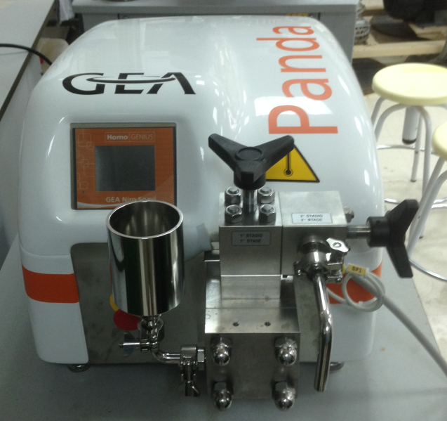
World Congress and Expo on Recycling
July 20-22, 2015
LIGNONANOFIBERS
MECHANICAL TREATMENT
TEMPO
OXIDATION
ENZYMATIC
HYDROLYSIS
4 times at 300 bars
3 times at 600 bars
3 times at 900 bars

Slide 35
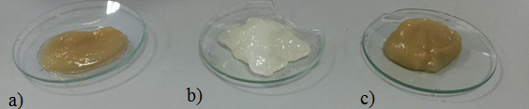
World Congress and Expo on Recycling
July 20-22, 2015
a) Enzymatic Hydrolysis, b) TEMPO, c) Mechanical Treatment
LNFC | Cost (€/kg)
TEMPO | 205.61
Enzymatic Hydrolysis | 13.64
Mechanical Treatment | 2.24

Slide 36
World Congress and Expo on Recycling
July 20-22, 2015
CONCLUSIONS
It is possible to use the agriculture residues to obtain differents products
In some cases the yield of the process is not so high (but at least reduce the quantity of the residue)
It is possible to apply to a raw material the full biorefinery scheme
WEAKNESSES –> problems with the cost of harvesting and transport because the raw materials are localized in large areas. In some cases, the established processes do not allow to introduce these new processes

Slide 37
THANK YOU
FOR YOUR
ATTENTION
a.rodriguez@uco.es
https://arpascual2013.wordpress.com/
http://orcid.org/0000-0001-8196-5848

