Slide 1
Wealth, education, early feeding and overweight: can we draw a relationship?
Alberto Prieto
Patrick Detzel
Linda Jongstra

Slide 2
Content

Slide 3
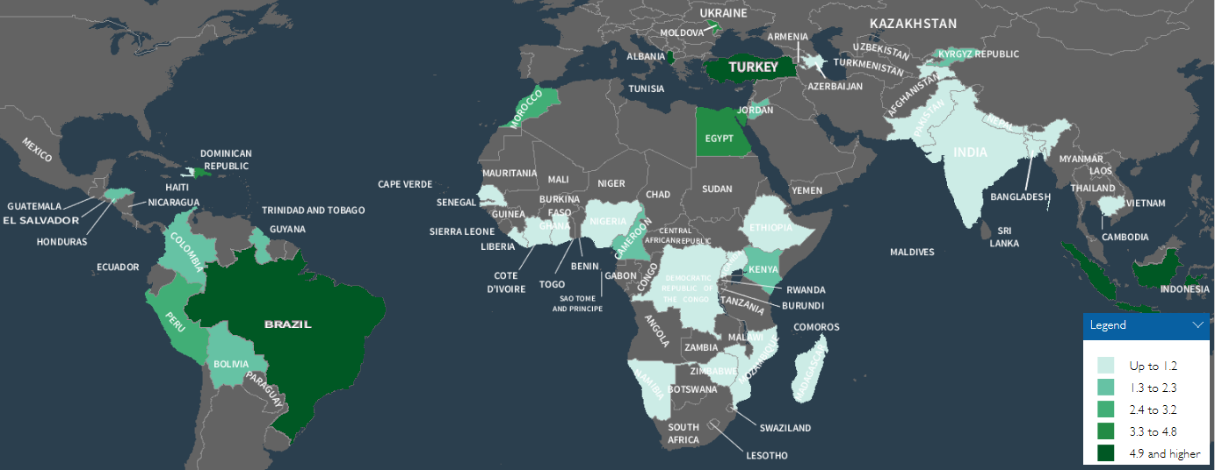

Overweight prevalence children under five latest DHS surveys
Notes:
Percentage of children overweight (above +2 SD of weight for age according to the WHO standard) children under five latest selected DHS surveys + Brazil.
Years: 2006-2015 80,103 children 6-36 months (6% overweight/obese)

Slide 4
Prevalence of Children overweight in the world
Notes:
Prevalence doesnt give the complete picture/ size of the problem. Number of overweight children higher in developing compared to developed countries.
Overweight prevalence among children aged under 5 years has risen between 1990 and 2014, from 4.8% to 6.1%
The number of overweight children in lower middle-income countries has more than doubled over that period, from 7.5 million to 15.5 million. (source?)

Slide 5
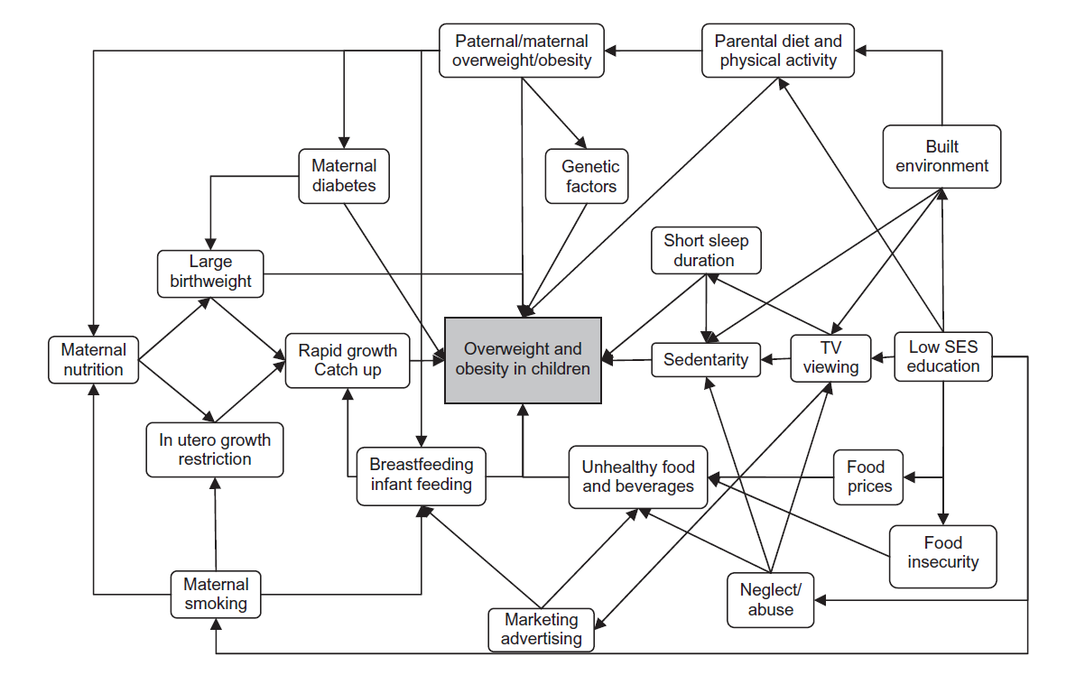
Complex web potential determinants child overweight (Monasta 2010)
Notes:
Monasta, L., Batty, G. D., Cattaneo, A., Lutje, V., Ronfani, L., Van Lenthe, F. J., Brug, J. "Early-Life Determinants of Overweight and Obesity: A Review of Systematic Reviews." Obes Rev 11, no. 10 (2010): 695-708.
22 reviews, but only 5 from developing countries, nevertheless it seems that the associated variables do not differ from stunting in this countries. Furthermore studies determining variables of overweight in developing countries show similar results.

Slide 6
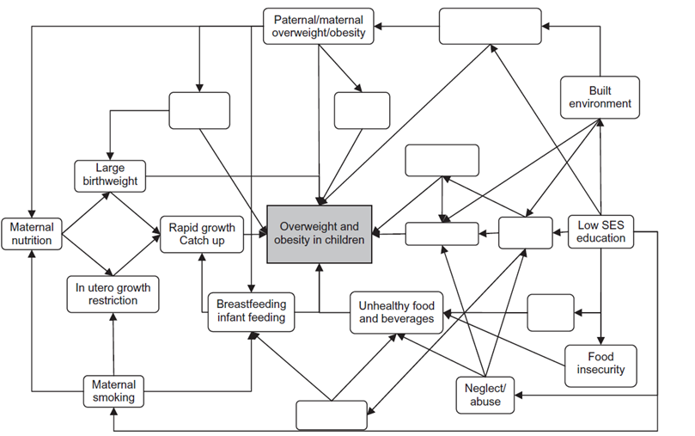
Determinants available from DHS data (Monasta 2010)
Notes:
Monasta, L., Batty, G. D., Cattaneo, A., Lutje, V., Ronfani, L., Van Lenthe, F. J., Brug, J. "Early-Life Determinants of Overweight and Obesity: A Review of Systematic Reviews." Obes Rev 11, no. 10 (2010): 695-708.
22 reviews, but only 5 from developing countries, nevertheless it seems that the associated variables do not differ from stunting in this countries. Furthermore studies determining variables of overweight in developing countries show similar results.
Determinants associated with childhood overweight:
Birth weight: High birthweight associated with BAZ (BMI for age) till 2 years vs low birthweight associated with BMI>25 in adults (1,16). Overweight mom effect on low birthweight child (86).
Maternal overweigt: Maternal overweight associated with both education level, SES, breastfeeding duration and initiation + child nutrition status (104,105,108)
Breastfeeding: Breastfeeding initiation (late) and duration (short) associated with childhood overweight. This in their turn was associated with higher educated mothers and urban residence (35-38,40)
Education: High education level associated with overweight in low income countries, turnover in middle income countries visible (reduced effect child health upon education level) Steeper increase overweight in SES transition in low educated level mom (108)
SES: Overweight increases per SES quintile in low income countries, middle income countries the association is mixed

Slide 7
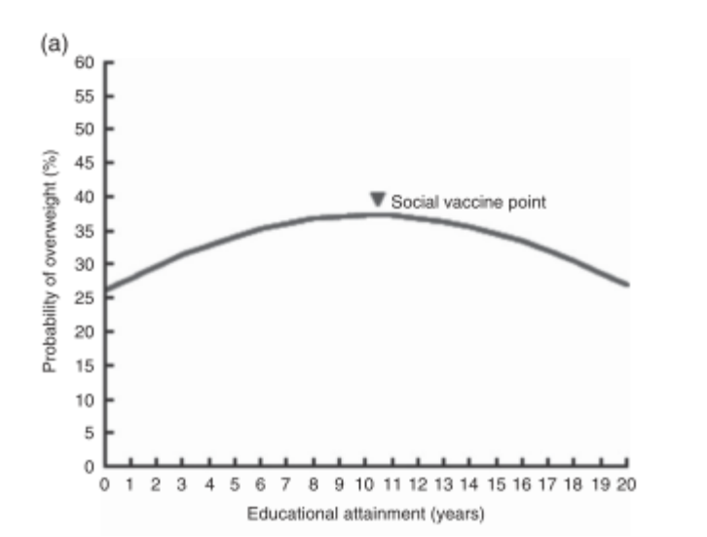
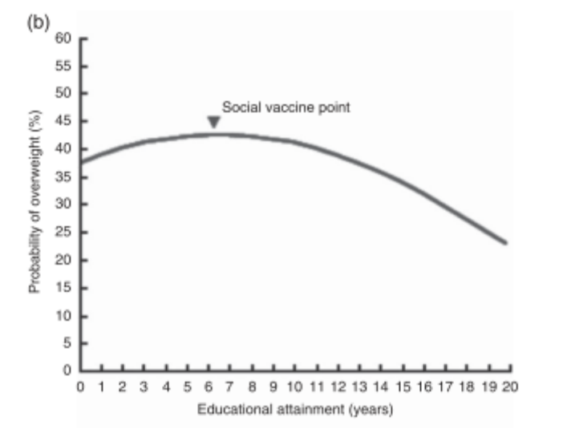
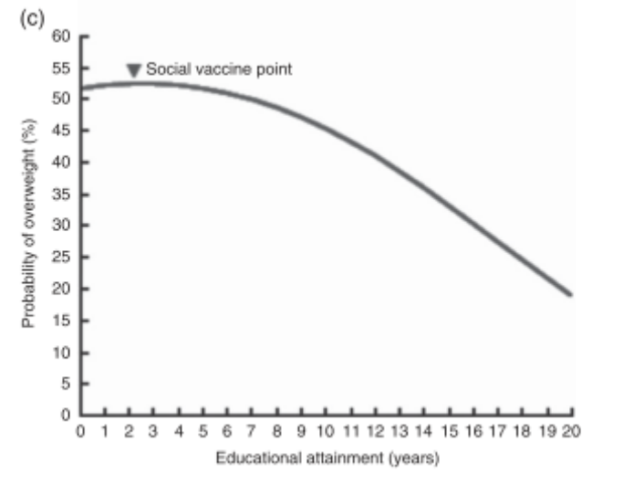
Woman education level and overweight (Jeon, Salinas, & Baker, 2015)
Shift in attitude / believe
Shift attitude, belief & purchasing power
Notes:
Jeon, H., Salinas, D., & Baker, D. P. (2015). Non-linear education gradient across the nutrition transition: mothers' overweight and the population education transition. Public Health Nutr, 18(17), 3172-3182.
Years of schooling and effect on probability overweight in low and middle income countries different per nutrition transition.
Fig. 3 Curvilinear gradient of the education–mother’s
overweight association by nutrition transition (NT) status* (a,
low NT status; b, medium NT status; c, high NT status; model
3, Table 3) among mothers of reproductive age (15–49 years;
n 143 258) across twenty-two administrations of the
Demographic and Health Survey in nine Latin American/
Caribbean countries. *The division into different NT statuses
is based on the average percentage of NT status in the
sampled countries. Low NT status indicates the group with 2 SD
below the average NT, medium NT status represents the
average group of NT, and high NT status denotes the group
with 2 SD above the average NT

Slide 8
Data, surveys and methods used
Multilevel regression analysis
78 DHS datasets (2000-20014)
Brazil (market country interest)
Country and year fixe-effects (other controlling factors)
Binary logistic panel regression on overweight (BMI>2sd)
Notes:
Jeon, H., Salinas, D., & Baker, D. P. (2015). Non-linear education gradient across the nutrition transition: mothers' overweight and the population education transition. Public Health Nutr, 18(17), 3172-3182.
Years of schooling and effect on probability overweight in low and middle income countries different per nutrition transition.
Fig. 3 Curvilinear gradient of the education–mother’s
overweight association by nutrition transition (NT) status* (a,
low NT status; b, medium NT status; c, high NT status; model
3, Table 3) among mothers of reproductive age (15–49 years;
n 143 258) across twenty-two administrations of the
Demographic and Health Survey in nine Latin American/
Caribbean countries. *The division into different NT statuses
is based on the average percentage of NT status in the
sampled countries. Low NT status indicates the group with 2 SD
below the average NT, medium NT status represents the
average group of NT, and high NT status denotes the group
with 2 SD above the average NT

Slide 9

What is the effect of maternal education on infant overweight/ obesity?
Determination other maternal factors
Possible role of food categories on overweight?
Characteristics of mothers analysed
    Young mothers
    Primary/secundary/higher education
    Current working status
    Wanted pregnancy
    Anemic status
    Smoking
    Household wealth
    Access to sanitation

Slide 10
Results

Slide 11
Wealth status associated with child overweight
Regression coefficients: maternal factors
Mother
Seducation | 1.21*** | 1.21***
 | (0.05) | (0.08)
work_current | 0.92*** | 0.92*
 | (0.02) | (0.04)
Wpregnancy | 1.12*** | 1.11**
 | (0.03) | (0.05)
Household_characteristics
wealth index | 1.01** | 1.01
 | (0.00) | (0.00)
urban | 1.07** | 1.08
 | (0.03) | (0.06)
Observations | 80,103 | 77,381
Significance level: *** p<0.01, ** p<0.05, * p<0.1

Slide 12
Maternal factors associated with overweight
Regression coefficients: maternal factors
Mother
Seducation | 1.21*** | 1.21***
 | (0.05) | (0.08)
work_current | 0.92*** | 0.92*
 | (0.02) | (0.04)
Wpregnancy | 1.12*** | 1.11**
 | (0.03) | (0.05)
Household_characteristics
wealth index | 1.01** | 1.01
 | (0.00) | (0.00)
urban | 1.07** | 1.08
 | (0.03) | (0.06)
Observations | 80,103 | 77,381
Significance level: *** p<0.01, ** p<0.05, * p<0.1

Slide 13
Feeding practices associated with overweight
Regression coefficients: feeding practices
Food_intake_24hrs_before
breastfed | 0.90*** | 0.91**
 | (0.03) | (0.04)
gave child baby formula | 0.96 | 0.92
 | (0.04) | (0.06)
gave child baby cereal | 0.90*** | 0.89**
 | (0.03) | (0.05)
meatandfish | 0.93*** | 0.95
 | (0.02) | (0.04)
Observations | 80,103 | 77,381
Significance level: *** p<0.01, ** p<0.05, * p<0.1

Slide 14
Key messages
Different associations between maternal education and childhood overweight found between countries economic development
Within country association maternal education level and childhood overweight risk depends on both area (urban) and SES status.
Mothers’ overweight remains highly associated with children overweight.
No association found for dietary diversity score/ food groups and maternal education level on under five overweight
Effect fortified baby cereal on child feeding status not clearified, double burden in population
Restructure DHS food intake data needed to monitor high caloric foods in population

Slide 15
Limitations
DHS only contains cross sectional analysis
Included age group might be to young to explore potential effect
24 hrs recall doesn’t reflect exact dietary intake (duration intake fortified foods, food preparation)
Food diversity score assesses dietary quality, not (excess) caloric intake
Different food group specification needed to monitor snacks/ high caloric intake in population
Lack micronutrient intake data

