Slide 1



Characterisation of spent sulfite liquor and its valorisation using Aspen Plus® simulation software
Alberto Coz¹, Carlos Arce¹, Ana I Portilla¹, Cristina Rueda¹, Gema Ruiz¹, Juan M. Romero-García², Eulogio Castro²
¹Green Engineering and Resources research group www.geruc.es, University of Cantabria, 39005, Spain
²Department of Chemical, Environmental and Materials Engineering, Universidad de Jaén, 23071, Spain
conferenceseries.com
World Bioenergy Congress and Expo, Rome, June 13-14, 2016

Slide 2


Contents:
Introduction
Objective
Methods
Results
Conclusions
conferenceseries.com
World Bioenergy Congress and Expo, Rome, June 13-14, 2016

Slide 3
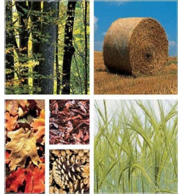
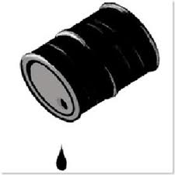
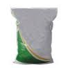
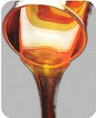
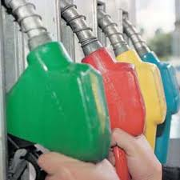
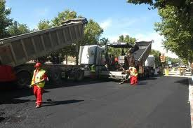
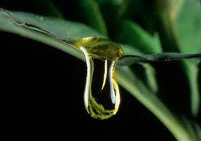
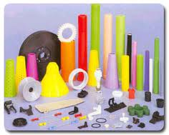
Biorefinery
Oil
Biomass
Energetic crops
Lignocellulosic waste
Refinery
Biorefinery
Biorefinery
Fuels
Products
Biofuels
Other (bio) products
Biomass
Pre-treatment
Detoxification
Fermentation
Product purification
Final
products
conferenceseries.com
World Bioenergy Congress and Expo, Rome, June 13-14, 2016
Notes:
3

Slide 4
Biorefinery in pulp and paper mills
Wood
TRADITIONAL PULP AND PAPER MILL
Cellulose
Pulp
Fuel
Spent liquor (waste material)
Wood
BIOREFINERY PULP AND PAPER MILL
Cellulose
Pulp
Fuel
Liquor
Biorefinery
Biofuels
Power
Bioproducts
Woody
biomass
Pulping process
Detoxification
Fermentation
Purification
Products
conferenceseries.com
World Bioenergy Congress and Expo, Rome, June 13-14, 2016

Slide 5
Biorefinery in pulp and paper mills
Pulping | Feedstock | Cooking Conditions | Yields (%) | Grade | Pulp properties
Refiner mechanical, RMP(Mechanical) | Softwood | No cooking ramp, chemicals or pretreatment is needed | 85-95 | corrugated paper | -
Thermomechanical, TMP(Mechanical) | Softwood | Heating ramp 1-10 min to 110-140 ºC; no chemicals or pretreatment is used | 93-95 | corrugated paper | -
Organosolv (Chemical) | Softwood and hardwood | 40-60 % ethylenglycol at 180-200 ºC for 30 to 90 min | 31-40 | paper | kappa: 25.5-27.5; α-cellulose: 21.2-33.7 %
Kraft (Chemical) | Softwood and hardwood | White liquor containing NaOH and Na₂S; pre-heating ramp: 85 min up to 80 ºC; cooking temperature 165-170 ºC; dwell time: 95-180 min; 4:1 liquor-to-wood ratio | 40-47 | paper | brightness 28.9 %; kappa 26.8 1000-1100 mL/g
Prehydrolysis kraft (Chemical) | Softwood and hardwood | Cooking with steam prehydrolysis: prehydrolysis at 150-170 ºC, 45-90 min; pH after hydrolysis 3.3-3.7; Total time: 300-350 min | 35-39 | dissolving | brightness 26.2-44.4 %; kappa 20.7-7.8; 1024-1211 mL/g
Acid sulphite (Chemical) | Softwood and hardwood | pH: 1.2-1.5, 80 % free SO₂-20 % bound SO₂, bases of Ca, Mg, Na or NH₃ can be used; pre-heated liquor: 70-80 ºC; dwell temperature 130ºC-145 ºC; pressure: 5,5-7 bar; 7 hours; liquor-to-wood ratio 4:1 | 35 -51 | dissolving | brightness 48.4-57.4 %; kappa: 5-7; 680-760 mL/g; alpha-cellulose > 88%
Woody
biomass
Pulping process
Detoxification
Fermentation
Purification
Products
conferenceseries.com
World Bioenergy Congress and Expo, Rome, June 13-14, 2016

Slide 6
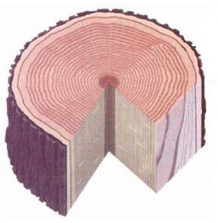
Biorefinery in pulp and paper mills
Lignin
Cellulose
Phenolics
Lignosulphonates
Hydroxymethylfurfural
Hemicellulose
Others
Tanins, Terpenes
Resins
Heavy metals
Furfural
5-Hydroxymethylfurfural
Acids
Physico-chemical: Liquid-liquid extraction
Adsorption (activated carbon, ion exchange resin…)
Membrane operations.
Thermal: Evaporation
Biological: Enzymatic processes
Woody
biomass
Pulping process
Detoxification
Fermentation
Purification
Products
conferenceseries.com
World Bioenergy Congress and Expo, Rome, June 13-14, 2016

Slide 7
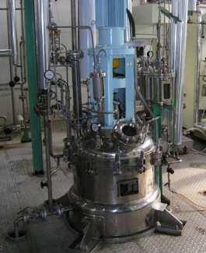
Biorefinery in pulp and paper mills
Use of microorganisms as bacteria, fungi to produce useful products
C₆H₁₂O₆ → 2 C₂H₅OH + 2 CO₂
Influence of the sugar compound (C6 → C5)
Metabolism paths
Products:
- Biofuels: ethanol, butanol
- Hydrogen
- Xylitol
- etc.
Woody
biomass
Pulping process
Detoxification
Fermentation
Purification
Products
conferenceseries.com
World Bioenergy Congress and Expo, Rome, June 13-14, 2016

Slide 8

Biorefinery in pulp and paper mills
Product(s)
Equilibrium Separations: distillation, liquid-liquid extraction, supercritical fluid extraction.
Affinity-Based Separations: adsorption, ion exchange, simulated moving bed technologies.
Membrane Based Separations: microfiltration, ultrafiltration and diafiltration, nanofiltration, membrane pervaporation, and membrane distillation.
Solid-liquid Separations: conventional filtration and solid-liquid extraction.
Hybrid/Integrated Reaction-Separation Systems: membrane bioreactors, extractive fermentation, reactive distillation, reactive absorption.
Woody
biomass
Pulping process
Detoxification
Fermentation
Purification
Products
conferenceseries.com
World Bioenergy Congress and Expo, Rome, June 13-14, 2016

Slide 9
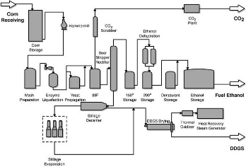
Biorefinery in pulp and paper mills
Unit operations
Initial composition of the streams
Thermodynamic characteristics
Mathematical equations per unit operation
Input parameters from experimental
Reactions involved
Simulation of the entire process
Software: Aspen Plus®
Mathematical modelling (simulation of the process)
Woody
biomass
Pulping process
Detoxification
Fermentation
Purification
Products
conferenceseries.com
World Bioenergy Congress and Expo, Rome, June 13-14, 2016

Slide 10
Contents:
Introduction
Objective
Methods
Results
Conclusions
conferenceseries.com
World Bioenergy Congress and Expo, Rome, June 13-14, 2016

Slide 11
Objectives
Wood
TRADITIONAL SULPHITE PULP MILL
Cellulose
Dissolving Pulp
Fuel
Spent liquor (waste material)
Wood
BIOREFINERY
Cellulose
Dissolving Pulp
Fuel
Liquor
Biorefinery
Alternatives
Characterisation of a spent sulphite liquor
Bibliographical analysis to conclude with the best alternatives of valorisation
Simulate the best alternatives by Aspen Plus®
conferenceseries.com
World Bioenergy Congress and Expo, Rome, June 13-14, 2016

Slide 12
Contents:
Introduction
Objective
Methods
Results
Conclusions
conferenceseries.com
World Bioenergy Congress and Expo, Rome, June 13-14, 2016

Slide 13
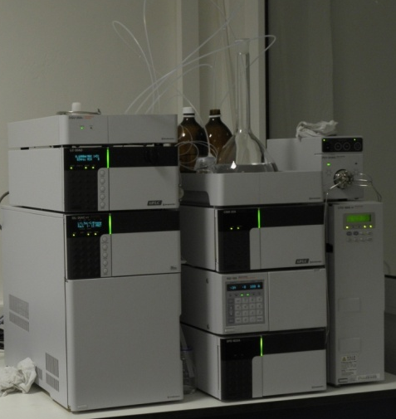
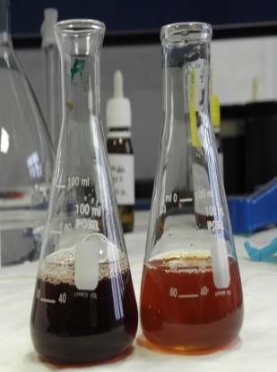
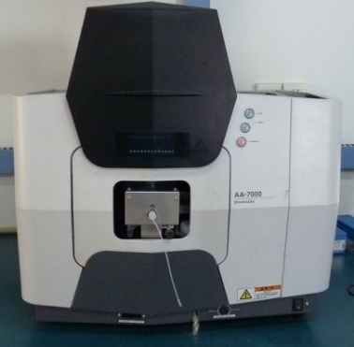
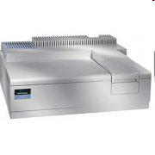
Methods: characterisation
Physical properties | Norm
pH | SM 423
Density and viscosity | ASTM-D-1298 UNE-EN ISO 3104
Dry matter | SM 209C
Suspended solids | SM 209C
Ash | Tappi 211 and 423
Chemical parameters | Technique
Lignosulphonates | UV-VIS
Phenolics (OH) | UV-VIS
Individual Sugar | HPLC
Other components and inhibitors | HPLC
Metals and other elements | ICP-MS
conferenceseries.com
World Bioenergy Congress and Expo, Rome, June 13-14, 2016

Slide 14

Methods: simulation
Aspen Plus is the market-leading chemical process optimisation software used by the bulk, fine, specialty, & biochemical industries, as well as the polymers industry for the design, operation, and optimisation of safe, profitable manufacturing facilities
Component ID | Type | Component name | Alias
GLUCOSE | Conventional | DEXTROSE | C6H12O6
XYLOSE | Conventional | XYLOSE | C5H10O5-D2
ARABINOS | Conventional | ARABINOSE | C5H10O5-D1
MANNOSE | Conventional | MANNOSE | C6H12O6-N5
GALACTOS | Conventional | D-GALACTOSE | C6H12O6-N2
FURFURAL | Conventional | FURFURAL | C5H4O2
HMF | Conventional | 5-HYDROXYMETHYLFURFURAL | C6H6O3-N5
NITROGEN | Conventional | NITROGEN | N2
OXYGEN | Conventional | OXYGEN | O2
CO2 | Conventional | CARBON-DIOXIDE | CO2
AMMONIA | Conventional | AMMONIA | H3N
WATER | Conventional | WATER | H2O
HAC | Conventional | ACETIC-ACID | C2H4O2-1
BIOMASS | Solid
METHANE | Conventional | METHANE | CH4
BIOPHB | Solid
PHB | Solid
ETHANOL | Conventional | ETHANOL | C2H6O-2
XYLITOL | Conventional
H2SO4 | Conventional | SULPHURIC-ACID | H2SO4
Wood components defined by National Renewable Energy Laboratory (NREL) database
Other components defined by Aspen Plus® data bank.
conferenceseries.com
World Bioenergy Congress and Expo, Rome, June 13-14, 2016

Slide 15
Methods: simulation
Aspen Plus is the market-leading chemical process optimisation software used by the bulk, fine, specialty, & biochemical industries, as well as the polymers industry for the design, operation, and optimisation of safe, profitable manufacturing facilities
Aspen module | Real module | Description
Flash2 | Flash, evaporator or other single-stage separator | Vapor-liquid or vapor-liquid-liquid equilibrium calculation
Heater | Heater, cooler, valves, pumps | Determines the thermal and phase condition of a mixture with one or more inlet streams
Mixer | Mixer | Combines material streams (or heat streams or work streams) into one stream
Rstoic | Reactor | Can model reaction occurring simultaneously or sequentially and perform product selectivity and heat of reaction calculations
Ryield | Reactor | Can model reactions by specifying reaction yields and the stoichiometry is either unknown or not important
Ssplit | Divider | Combines material streams and divides the resulting stream into two or more streams
Swasher | Solids washer | Recovers dissolved components from an entrained liquid of a solid stream
Wood components defined by National Renewable Energy Laboratory (NREL) database
Other components defined by Aspen Plus® data bank.
Simulations developed in Aspen Plus using laboratory scale data
conferenceseries.com
World Bioenergy Congress and Expo, Rome, June 13-14, 2016

Slide 16
Contents:
Introduction
Objective
Methods
Results
Conclusions
conferenceseries.com
World Bioenergy Congress and Expo, Rome, June 13-14, 2016

Slide 17

Results: characterisation
Wood chips
Fresh liquor
Spent sulphite liquor
DIGESTERS
STORAGE TANKS
Dissolving pulp
Unbleached pulp
Spent liquor
BLEACHING
3040-VG
DRYING
3020-VG
WASHING
BLEACHING
WASHING
BLEACHING
conferenceseries.com
World Bioenergy Congress and Expo, Rome, June 13-14, 2016

Slide 18
Results: characterisation
Physical properties | Value
pH | 1.81 ± 0.01
Density | 1067 g/L
Viscosity | 1.87 ± 0.02 cP
Dry matter | 15.10 ± 0.69
Ash 500ºC Ash 900ºC | 1.85 ± 0.07 % 1.12 ± 0.06 %
Inhibitors from cellulose and hemicellulose | Value
Acetic acid | 10.19 g/L
Formic acid | 1.26 g/L
Levulinic acid | 0.06 g/L
Methanol | 0.17 g/L
Ethanol | 0.05 g/L
Furfural | 0.55 g/L
HMF | 0.01 g/L
Sugars | Value
Cellobiose | 10.86 g/L
Glucose | 6.37 g/L
Arabinose | 0.97 g/L
Xylose | 27.14 g/L
Mannose | 0.95 g/L
Galactose | 1.18 g/L
Total sugar content | 47.47 g/L
Inhibitors from lignin | Value
Lignosulphonates | 52.80 ± 1.01 d.m. %
Phenolics (OH) | 0.18 ± 0.02 d.m. %
conferenceseries.com
World Bioenergy Congress and Expo, Rome, June 13-14, 2016

Slide 19
Results: characterisation
Physical properties | Value
pH | 1.81 ± 0.01
Density | 1067 g/L
Viscosity | 1.87 ± 0.02 cP
Dry matter | 15.10 ± 0.69
Ash 500ºC Ash 900ºC | 1.85 ± 0.07 % 1.12 ± 0.06 %
Inhibitors from cellulose and hemicellulose | Value
Acetic acid | 10.19 g/L
Formic acid | 1.26 g/L
Levulinic acid | 0.06 g/L
Methanol | 0.17 g/L
Ethanol | 0.05 g/L
Furfural | 0.55 g/L
HMF | 0.01 g/L
6.3 %
Sugars | Value
Cellobiose | 10.86 g/L
Glucose | 6.37 g/L
Arabinose | 0.97 g/L
Xylose | 27.14 g/L
Mannose | 0.95 g/L
Galactose | 1.18 g/L
Total sugar content | 47.47 g/L
Inhibitors from lignin | Value
Lignosulphonates | 52.80 ± 1.01 d.m. %
Phenolics (OH) | 0.18 ± 0.02 d.m. %
29.5 %
conferenceseries.com
World Bioenergy Congress and Expo, Rome, June 13-14, 2016

Slide 20
Results: characterisation
Element | Value
Na | 189 mg/L
Mg | 5290 mg/L
Al | 4.19 mg/L
Si | 6.2 mg/L
K | 355 mg/L
Ca | 504 mg/L
Mn | 48.6 mg/L
Fe | 26.8 mg/L
Ba | 0.175 mg/L
Sr | 3.35 mg/L
Element | Value
Cr | 111 μg/L
Co | 56.2 μg/L
Ni | 485 μg/L
Cu | 75.4 μg/L
Zn | 2720 μg/L
Pb | 16.4 μg/L
As | 40.4 μg/L
Mo | 9.6 μg/L
V | 38.3 μg/L
Sb | 3.93 μg/L
Se | 13 μg/L
conferenceseries.com
World Bioenergy Congress and Expo, Rome, June 13-14, 2016

Slide 21
Results: biorefinery alternatives
Spent sulfite liquor
̴ 52% Lignosulphonates
Unbleached pulp
̴ 30% Sugars
Product | Process | Application | References
Lignosulphonates | Using lignosulphonates directly | Auxiliary substance / additive | Chakrabarty et al. (2009), Restolho et al., (2009), Ringena et al. (2005)
Ethanol | Xylose/glucose/arabinose fermentation | Alternative fuel | Xavier et al. (2010), Panagiotopoulos et al. (2009), Martín et al. (2002), Sanchez and Cardona (2008), Keating et al. (2006)
PHBs | Glucose/xylose/arabinose fermentation | Synthetic polymers | Fernandes (2010); Schreiner (2009), Mumtaz et al. (2010), Vlysidis et al. (2013)
Xylitol | Xylose catalytic hidrogenation Xylose fermentation | Sugar substitute for diabetics | Nair and Zhao (2010); Fouad (2010), Saha (2003), Lai and Bura (2012)
Furfural | Dehydration of 5C sugars | Raw material in other chemical processes | Zeitsch (2000), Mamman et al. (2008)
conferenceseries.com
World Bioenergy Congress and Expo, Rome, June 13-14, 2016

Slide 22
New implementation
SEPARATION
Ethanol
PHBs
Furfural
Xylitol
Existing process
Sugar
Detoxification/purification
CONVERSION
Wood
Fresh liquor
Others
Lignosulphonates
DigesteRs
EvaporaTORS
Dissolving pulp
STORAGE TanKs
BLEACHING
Pulp
Spent liquor
3040-VG
3020-VG
DRYING
WASHING
BLEACHING
WASHING
BLEACHING
conferenceseries.com
World Bioenergy Congress and Expo, Rome, June 13-14, 2016

Slide 23
Results: biorefinery alternatives
Woody
biomass
Pulping process
Detoxification
Fermentation
Purification
Ethanol
Xylitol
Furfural
PHBs
Detoxification
Physico-chemical: Liquid-liquid extraction
Adsorption (activated carbon, ion exchange resin)
Membrane operations.
Thermal: Evaporation
Biological: Enzymatic processes
Anionic resins with or without overliming in the case of ethanol, xylitol and furfural
With no detoxification step in the case of PHBs
conferenceseries.com
World Bioenergy Congress and Expo, Rome, June 13-14, 2016

Slide 24
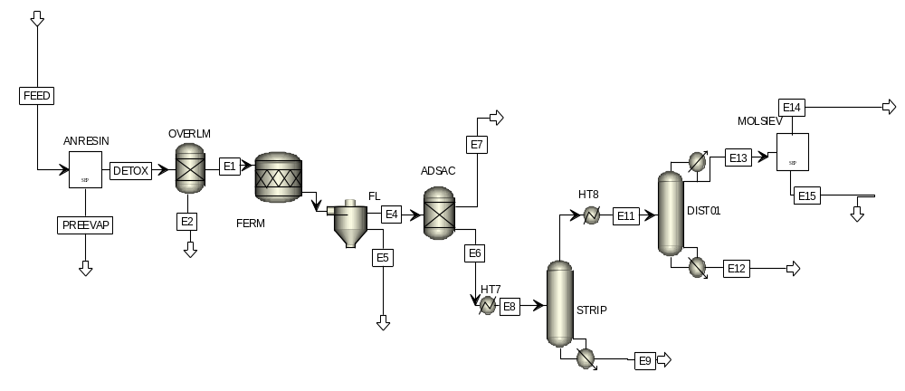
Results: biorefinery alternatives
Woody
biomass
Pulping process
Detoxification
Fermentation
Purification
Ethanol
Xylitol
Furfural
PHBs
Aspen tech®: bioethanol
conferenceseries.com
World Bioenergy Congress and Expo, Rome, June 13-14, 2016

Slide 25
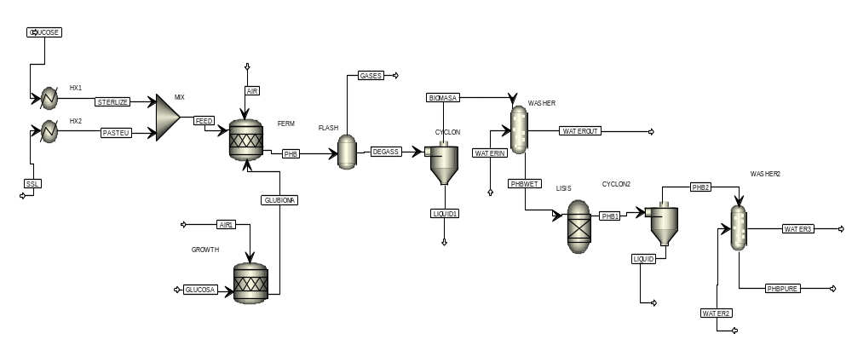
Results: biorefinery alternatives
Woody
biomass
Pulping process
Detoxification
Fermentation
Purification
Ethanol
Xylitol
Furfural
PHBs
Aspen tech®: PHBs
conferenceseries.com
World Bioenergy Congress and Expo, Rome, June 13-14, 2016

Slide 26
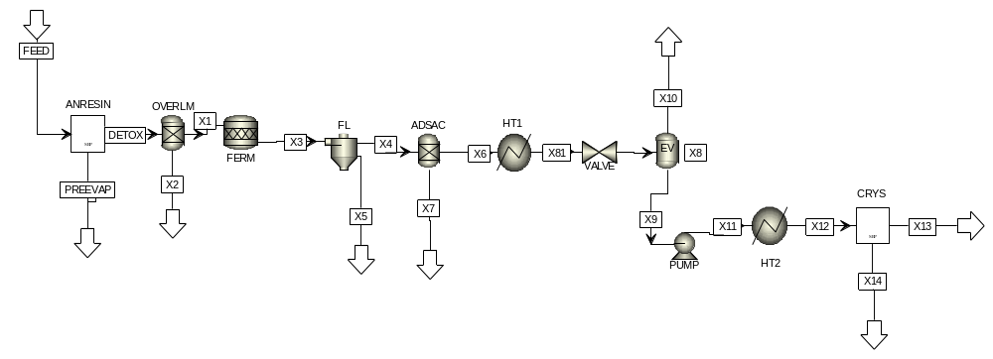
Results: biorefinery alternatives
Woody
biomass
Pulping process
Detoxification
Fermentation
Purification
Ethanol
Xylitol
Furfural
PHBs
Aspen tech®: xylitol
conferenceseries.com
World Bioenergy Congress and Expo, Rome, June 13-14, 2016

Slide 27
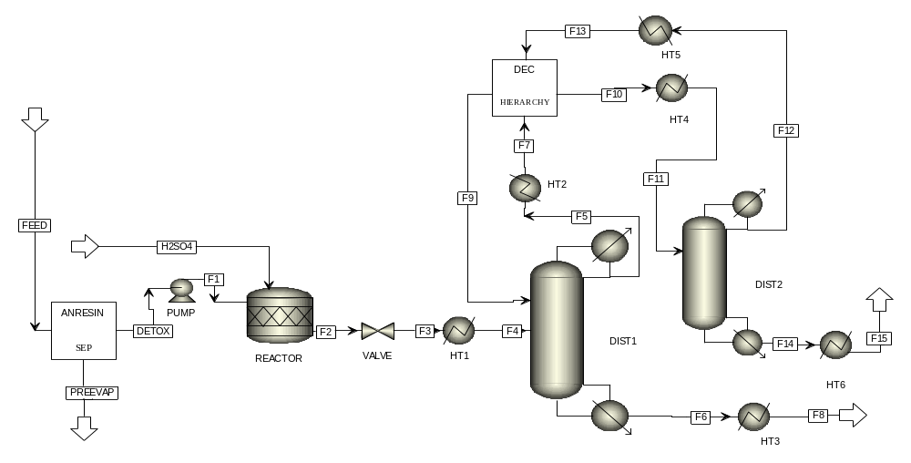
Results: biorefinery alternatives
Woody
biomass
Pulping process
Detoxification
Conversion
Purification
Ethanol
Xylitol
Furfural
PHBs
Aspen tech®: furfural
conferenceseries.com
World Bioenergy Congress and Expo, Rome, June 13-14, 2016

Slide 28
Results: biorefinery alternatives
With detoxification techniques → Anionic Resins and Overliming
conferenceseries.com
World Bioenergy Congress and Expo, Rome, June 13-14, 2016

Slide 29
Results: biorefinery alternatives
Without detoxification techniques
conferenceseries.com
World Bioenergy Congress and Expo, Rome, June 13-14, 2016

Slide 30
Contents:
Introduction
Objective
Methods
Results
Conclusions
conferenceseries.com
World Bioenergy Congress and Expo, Rome, June 13-14, 2016

Slide 31
Conclusions
Characterisation and valorisation options of a waste material from sulphite pulping was carried out.
- Due to the composition, lignosulphonates (about 52%) and xylitol, ethanol, furfural and PHBs from sugars (about 30%) were selected.
Different detoxification methods were assessed in order to recover the maximum quantity of sugars for further biorefinery processes
- The best results were obtained using overliming and anionic resins since the highest quantity of sugars as well as the minor inhibitors are recovered. However, overliming does not remove lignosulphonates properly.
Three different processes have been evaluated in order to transform the sugars into value added products: furfural, xylitol and ethanol.
- PHBs and Xylitol are recommended as future alternatives of biorefinery
conferenceseries.com
World Bioenergy Congress and Expo, Rome, June 13-14, 2016

Slide 32




Thank you for your attention
Alberto Coz
University of Cantabria
coza@unican.es
Financial support for this research by KBBE-2012-6-311935 research project.
www.brigit-project.eu
conferenceseries.com
World Bioenergy Congress and Expo, Rome, June 13-14, 2016
Notes:
32

