Slide 1

Rethinking the Application of Engineering:
Structural Analysis of Economic Impact Risk Propagation in Infra_Structures.
Dr. Albert Owusu
PhD; M.Sc. (Proj Mgt); M. E (Civil Eng.); B.Sc.(Civil Eng.); PMI. MNZSEE.
E-mail:
ahowusu@gmail.com
Telephone: +61 42 3366 042

Slide 2
Objectives of Presentation
Exhibit a Model Impact Propagation
Illustrate Structural concept application
Show convergence between Structural & Economic concepts
To encourage Engineers to take interest and explore Engineering applications in other disciplines.

Slide 3
What is Infra_Structure
Network of a nation’s assets which runs the economy. Examples:
  Transport Infrastructure(road, air, sea, rail, etc)
  Energy & Power Grid
  Communication (Telephone, internet, etc )
  The Environment (Ecosystem & Biodiversity)
  Banking & Finance,
  Generally:
  public assets and services
  natural assets and natural resource-based industries

Slide 4
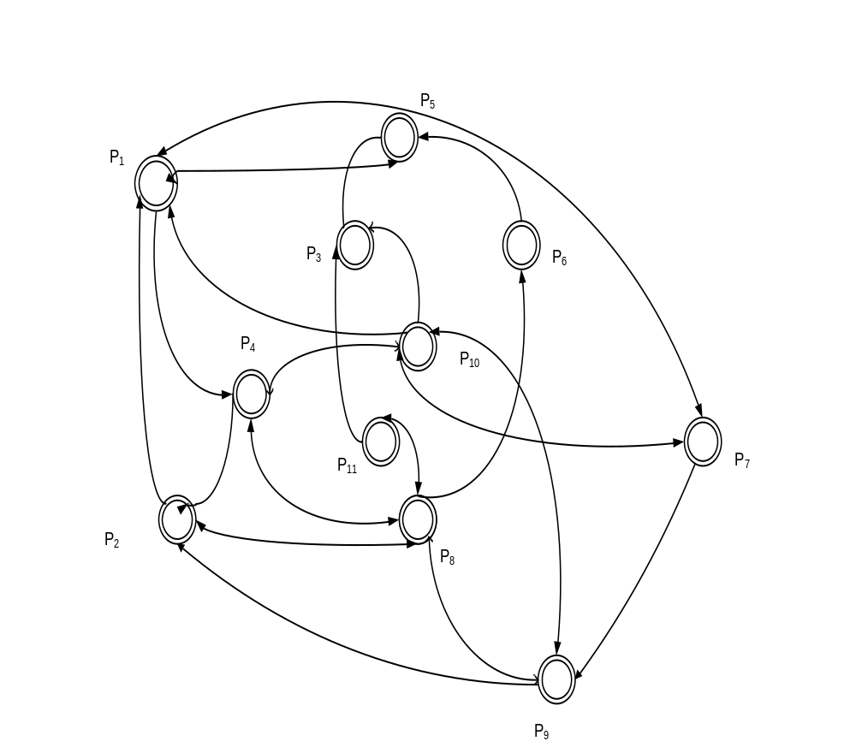
Infra-structures Connectivity
Interdependent , Dependent,
Isolated

Slide 5
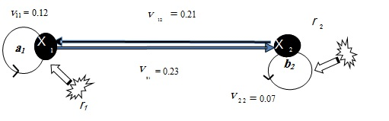
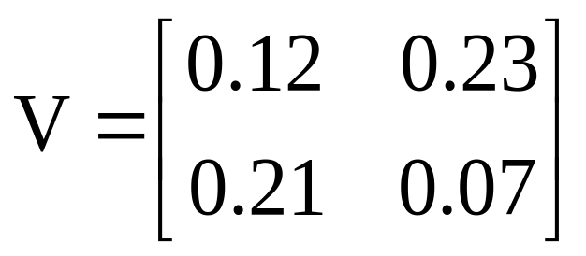
Model Impact Transfer
 |  | (a₁) x₁ | (b₂) x₂
Power & Grid Telecommunication | (a₁) x₁ | 0.12 | 0.23
 | (b₂) x₂ | 0.21 | 0.07

Slide 6
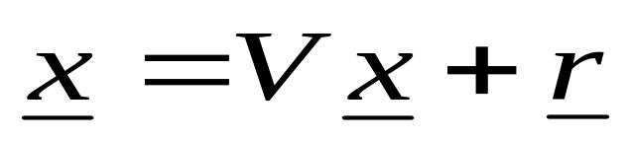
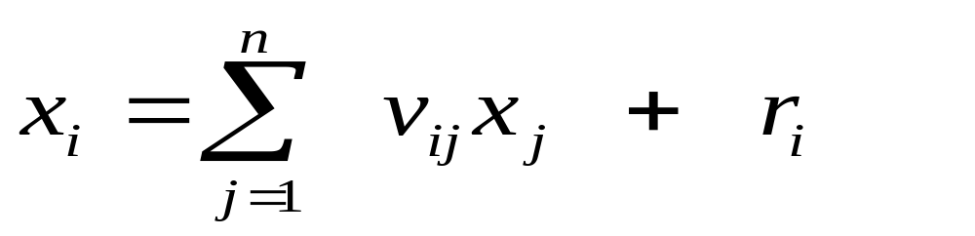
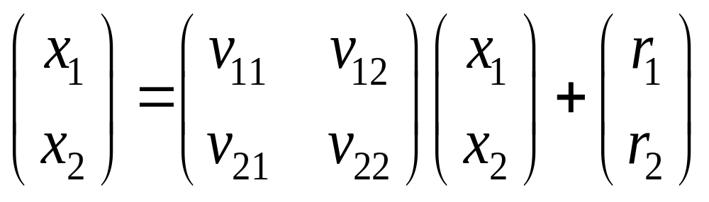
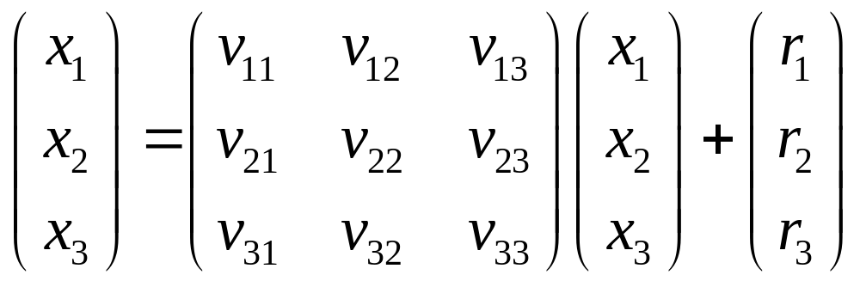
Wassily Leontief's Economic Model
v₁₁
X₁
r₁
v₁₂
v₃₁
v₂₁
v₁₃
v₂₃
v₂₂
X₂
X₃
v₃₃
r₂
v₃₂
r₃
THREE CONNECTED INFRASTRUCTURES

Slide 7

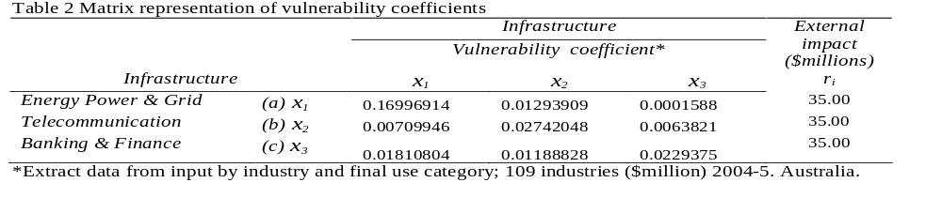

Slide 8
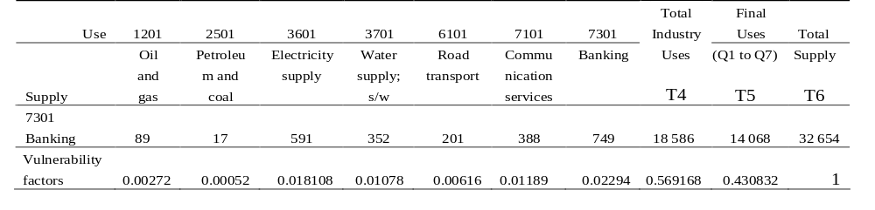
EXTRACT DATA FROM INPUT OUTPUT BY INFRASTRUCTURES
 | USE | 1201 | 2501 | 2701 | 3601 | 3701 | 4201 | 6101 | 7101 | 7301 | 8601
 |  | Oil and gas | Petroleum and coal products | Iron and steel | Electricity supply | Water supply; sewerage and drainage services | Construction trade services | Road transport | Communication services | Banking | Health services
SUPPLY
1201 | Oil and gas | 509 | 12 863 | 123 | 923 | 0 | 0 | 4 | 77 | 0 | 34
2501 | Petroleum and coal products | 144 | 658 | 176 | 372 | 116 | 374 | 3 574 | 516 | 0 | 131
2701 | Iron and steel | 51 | 0 | 3 377 | 50 | 41 | 868 | 13 | 27 | 0 | 11
3601 | Electricity supply | 79 | 37 | 437 | 3 745 | 231 | 51 | 67 | 285 | 4 | 146
3701 | Water supply; sewerage and drainage services | 1 | 13 | 58 | 59 | 327 | 29 | 183 | 187 | 1 | 53
4201 | Construction trade services | 88 | 169 | 31 | 1 161 | 313 | 22 586 | 21 | 1 367 | 0 | 19
6101 | Road transport | 42 | 67 | 431 | 168 | 48 | 724 | 1 611 | 500 | 4 | 189
7101 | Communication services | 28 | 62 | 69 | 317 | 106 | 158 | 1 054 | 1 223 | 285 | 566
7301 | Banking | 89 | 17 | 19 | 591 | 352 | 311 | 201 | 388 | 749 | 562
8601 | Health services | 0 | 1 | 1 | 2 | 4 | 0 | 0 | 86 | 0 | 381

Slide 9
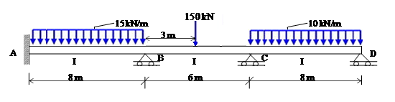
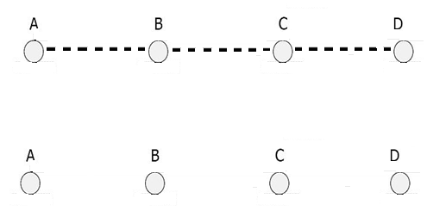

STRUCTURAL ANALYSIS ANALOGY
MOMENT DISTRIBUTION
A model structure with impact loads (Total = 350kN)
Model Infrastructure Network System: Supports (infrastructures) and Beams (links)
Model Network System: Distributing factors (Vulnerability Coefficients).

Slide 10

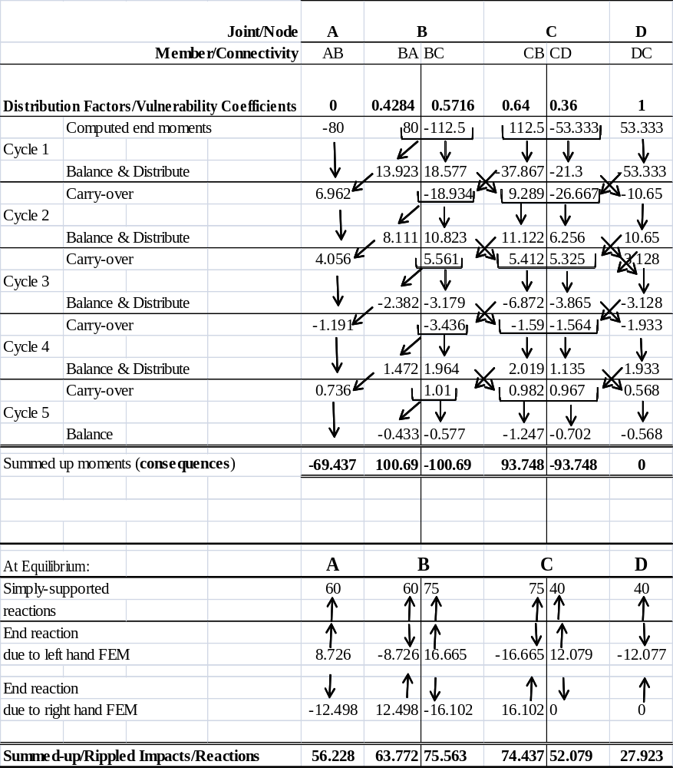
MOMENT DISTRIBUTION
=IMPACT PROPAGATION

Slide 11
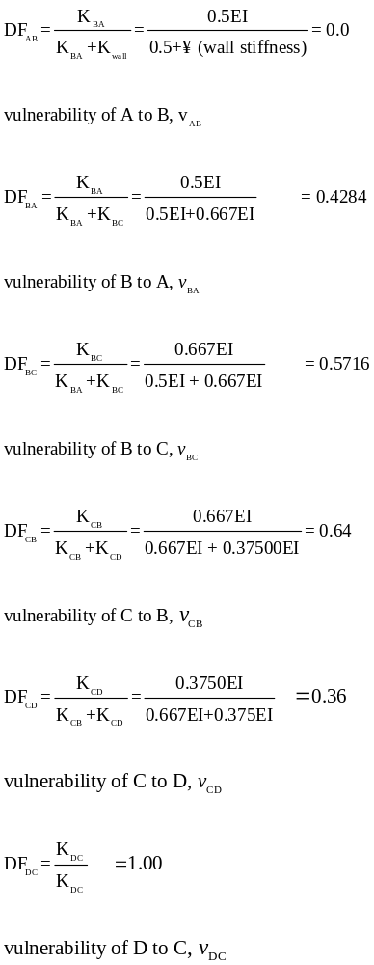
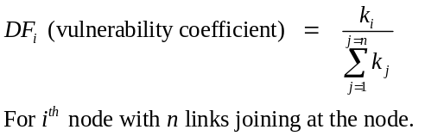

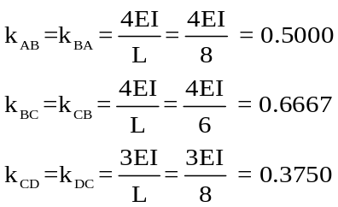
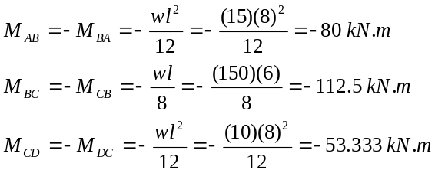
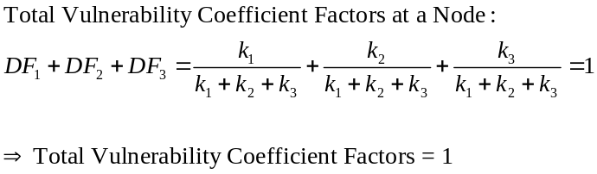
Stiffness factors (Vulnerability factors)
Stiffness
By definition it can be written as Eq. (5-33):
:

Slide 12
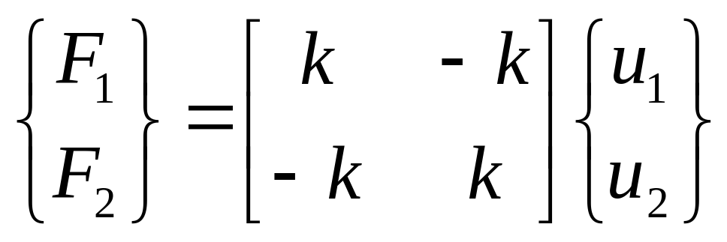
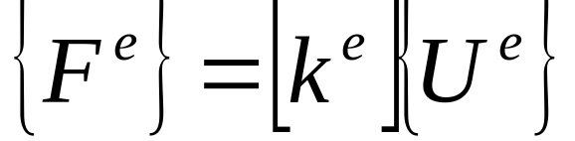
k
1
2
F₂, u₂
F₁, u₁
spring with nodes 1 and 2 has stiffness k
axial displacements at nodes = u₁, u₂
axial forces at nodes = F₁, F₂

Slide 13

Example

Slide 14

QUESTION TIME

