Slide 1



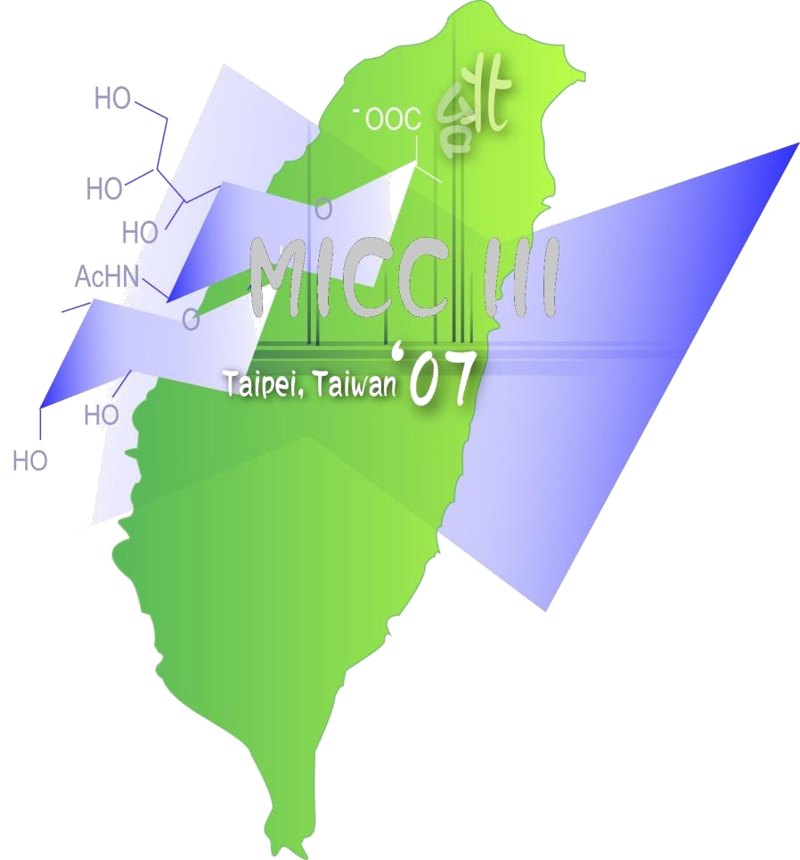


Roles of Polyvalency in
the Mechanism of Glyco Recognition.
An Important Direction toward the Future Glycosciences¹
2
Albert M. Wu
Glyco-Immunochemistry Research Laboratory Institute of Molecular and Cellular Biology College of Medicine
Chang-Gung University² Kwei-san, Tao-yuan, 333, Taiwan
Albert M. Wu
¹ The Molecular Immunology of Complex Carbohydrates – 3 , 2011, 99-116, Springer, New York.
² Located at 20 km south-west of Taipei, Midpoint, between Taipei-Taoyuan Airport
Glycobiology, Philadelphia,
Aug. 10-12, 15’

Slide 2
Introduction
A milestone of Glycans and Carbohydrate Binding Proteins for Half a Century (1/2)
Before 1960 – It is a Pre Complex Carbohydrates (C C) Era - An Unknown world of Glycans and Recognitions of Carbohydrate-binding Proteins (Abs and Lectins) - it is also at an age of their incubation period.
Glycoworld between 1960-1990 – It is an Era of Complex Carbohydrates and Lectin / Ab - Carbohydrate interactions for 30 years
Glycoworld after 1990 – An Era of Glycobiology Combination of glycoimmunochemistry recognition and biology
Glycoworld from structural complex carbohydrate to functional roles after 2015 - An Era of Glyco/Recognition- universe
Roles of polyvalency of glycotopes and cryptopes in recognition processes, especially the biological roles of their resulting conformations.

Slide 3
Introduction
The Milestone of Glycans and Carbohydrate Binding Proteins
after Half a Century (2/2)
Glycoworld after 2015 - An Era of Glycan and Lectin - universe
The unknown areas of glycan have to be continuously explored and/or these projects that have to be a long term study. These are :
① Roles of polyvalency of glycotopes and cryptopes in recognition processes, especially the biological roles of their resulting conformations.
② Role of sulfate in dynamic Glycobiology;
③ Mechanisms of microbial infections;
④ Bacterial fimbriae lectin-recognition processes;
⑤ Glyco factors involved in the mechanisms of inflammation;
⑥ Role of glycans in aging;
⑦ Glycobiology of stem cells;
⑧ Carbohydrate-carbohydrate interactions, etc.
3

Slide 4
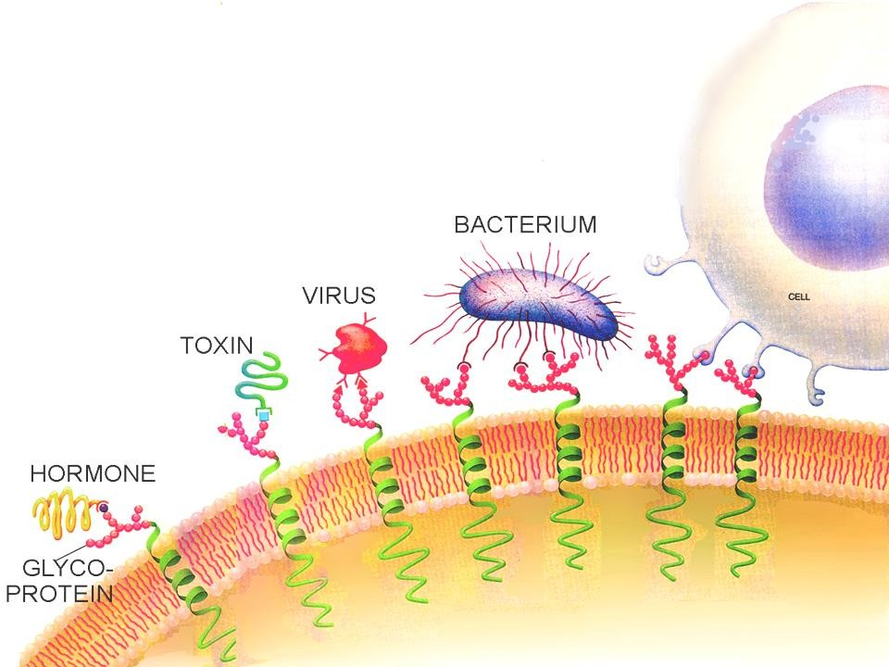

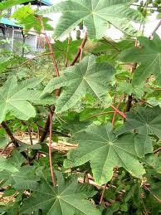
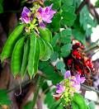
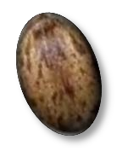
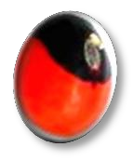
Lectins are carbohydrate binding proteins or glycoproteins of non-immune origin, present in plants, microbes, animals
and humans which specifically bind defined monosugars or oligosaccharide structures
Toxic plant seeds
GSL is not illustrated
4
Sharon N., Lis H. : Carbohydrates in Cell Recognition;
SCIENTIFIC AMERICAN Jan. 1993

Slide 5
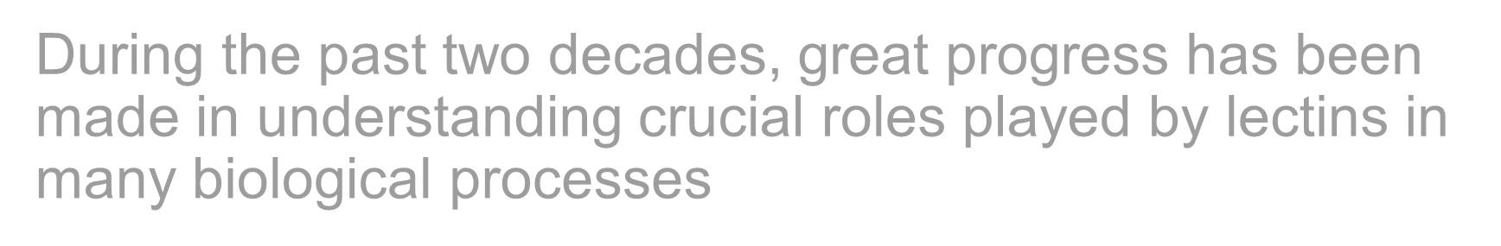



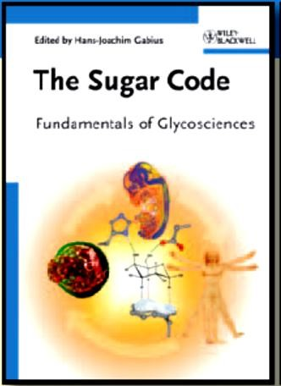

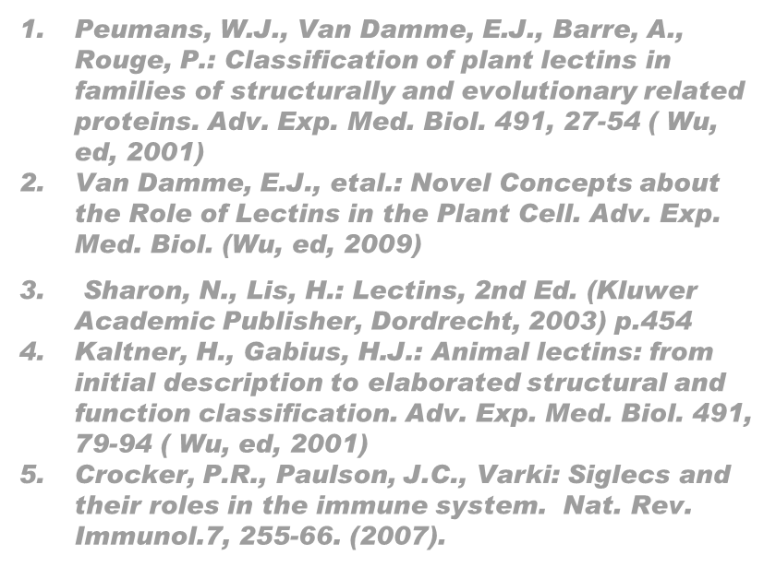


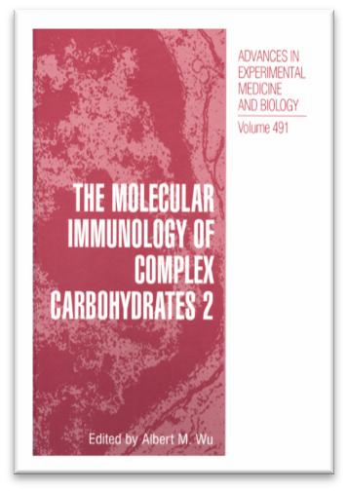
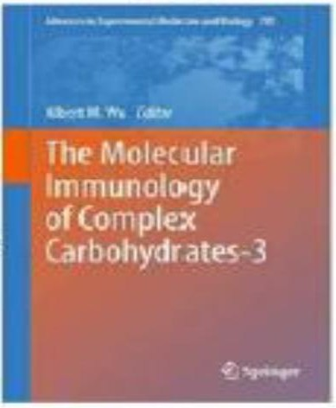
During the past two decades, great progress has been made in understanding crucial roles played by lectins in many biological processes
Suggested Articles
Peumans, W.J., Van Damme, E.J., Barre, A., Rouge, P.: Classification of plant lectins in families of structurally and evolutionary related proteins. Adv. Exp. Med. Biol. 491, 27-54 ( Wu, ed, 2001)
Van Damme, E.J., etal.: Novel Concepts about the Role of Lectins in the Plant Cell. Adv. Exp. Med. Biol. (Wu, ed, 2009)
Sharon, N., Lis, H.: Lectins, 2nd Ed. (Kluwer
Academic Publisher, Dordrecht, 2003) p.454
Kaltner, H., Gabius, H.J.: Animal lectins: from initial description to elaborated structural and function classification. Adv. Exp. Med. Biol. 491, 79-94 ( Wu, ed, 2001)
Crocker, P.R., Paulson, J.C., Varki: Siglecs and their roles in the immune system. Nat. Rev. Immunol.7, 255-66. (2007).

Slide 6
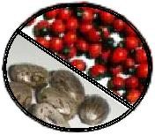
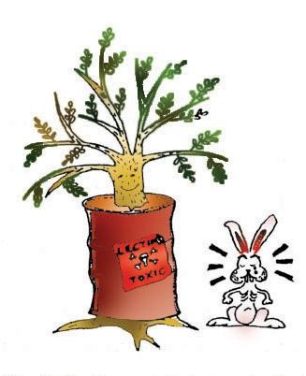

Functional Roles of Lectins (1)
AP
RC
PLANT seeds
Lectin protects plants against herbivorous, chewing animals and also prevent microbial invasion
Reproduced with permission from Peumans & Van Damme, 1995; copyright 1995, American Society of Plant Biologists
Abrin and Abrin-related toxins, Ricin and ricin-related toxins have been reported to protect plant s against herbivorous animals, and/or phytophagous invertebrate (Peumans, W. J. et al., 2001)

Slide 7
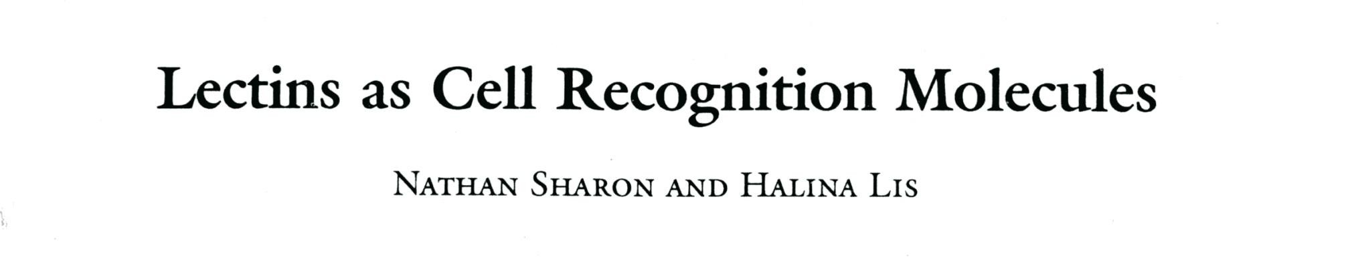
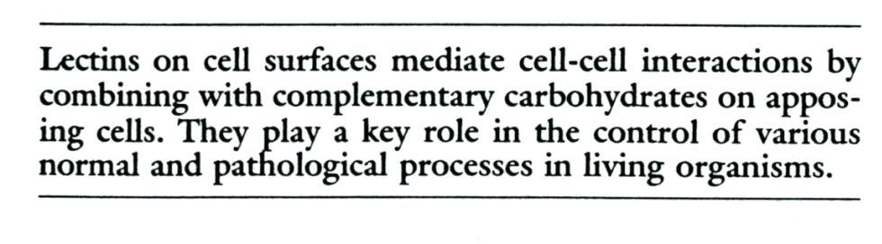
Functional Roles of Lectins (2)
*
such as fertilization, embryogenesis, cell migration, organ formation, immune defense, and microbial infection. Improper function of cell recognition may cause disease.
*Science, 1989 246,227

Slide 8
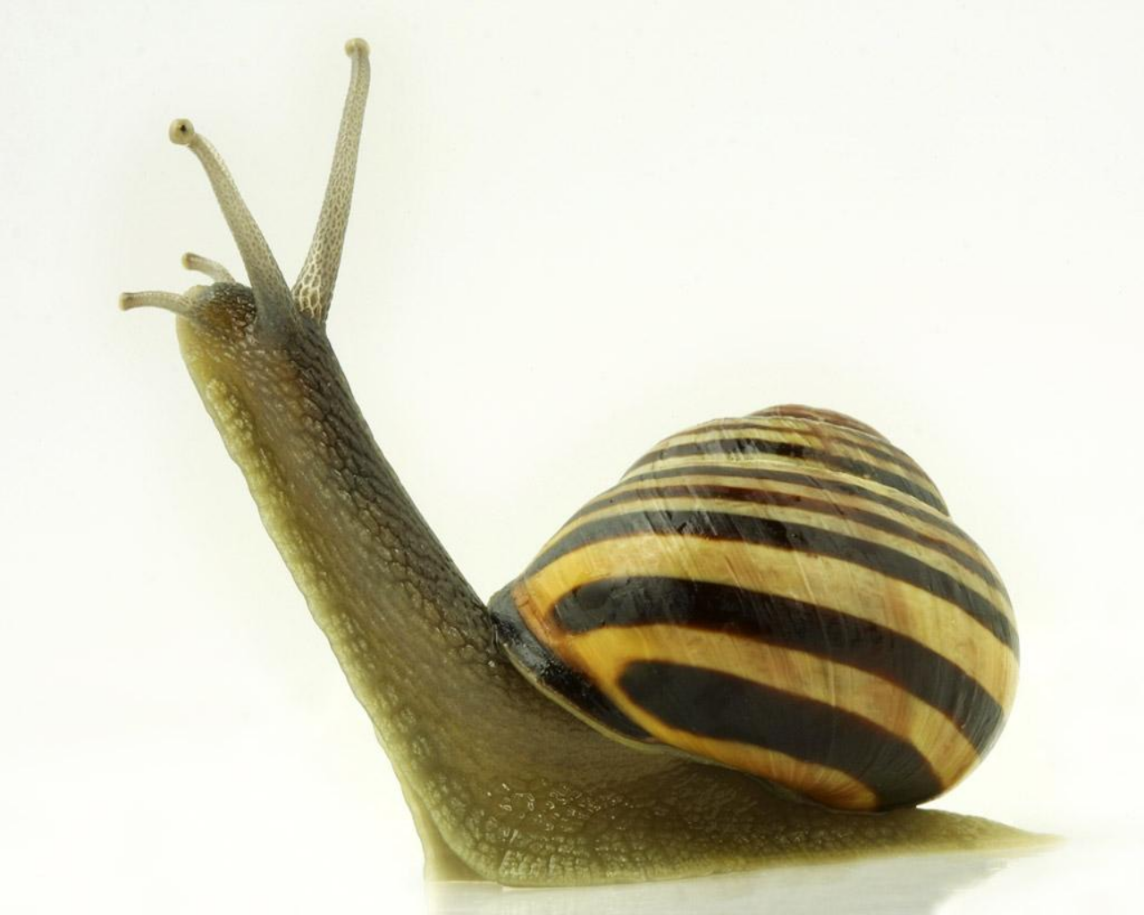

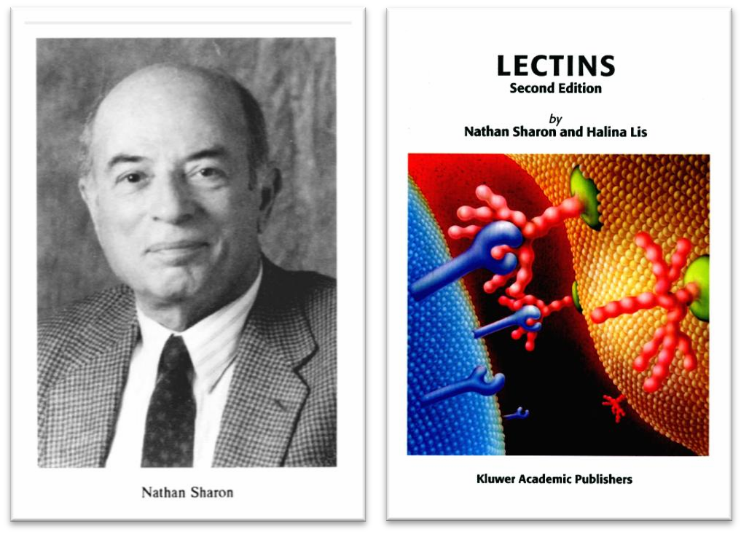
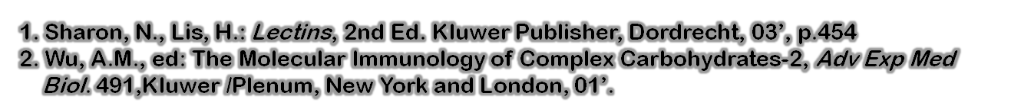
The hallmark of lectins is the ability to bind carbohydrates specially and reversibly.
Understanding the properties and functions of lectins, as well as using them for diverse purposes, requires knowledge of this specificity.

Slide 9
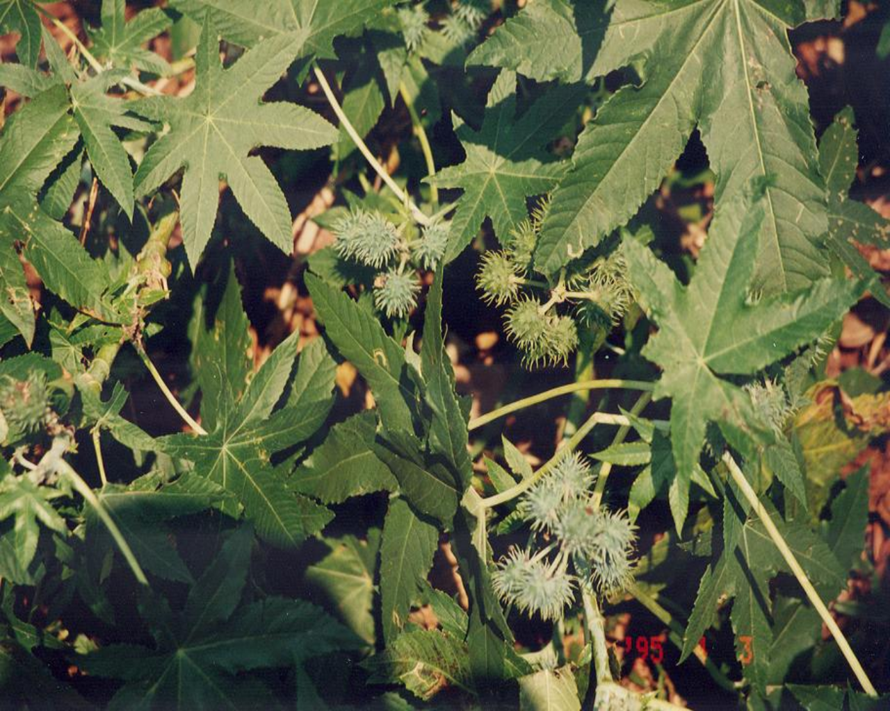
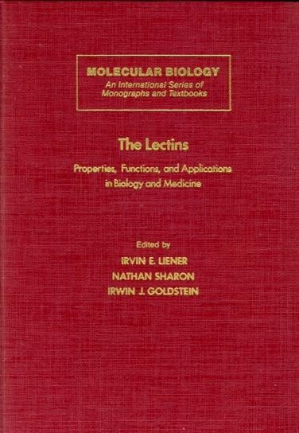
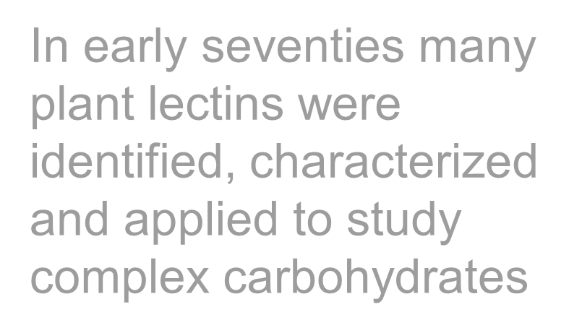







































































In early seventies many plant lectins were identified, characterized and applied to study complex carbohydrates
Liener, I.E., Sharon, N., Goldstein, I.J., eds. :The lectins: Properties, functions and applications in biology and medicine. Orlando, FL: Academic Press. 1986
Wu, A.M., ed: The Molecular Immunology of Complex Carbohydrates-2, Adv Exp Med Biol. 491, Kluwer/ Plenum, New York and London, 01’.
9

Slide 10
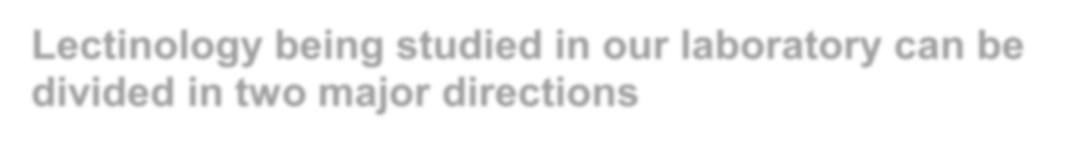

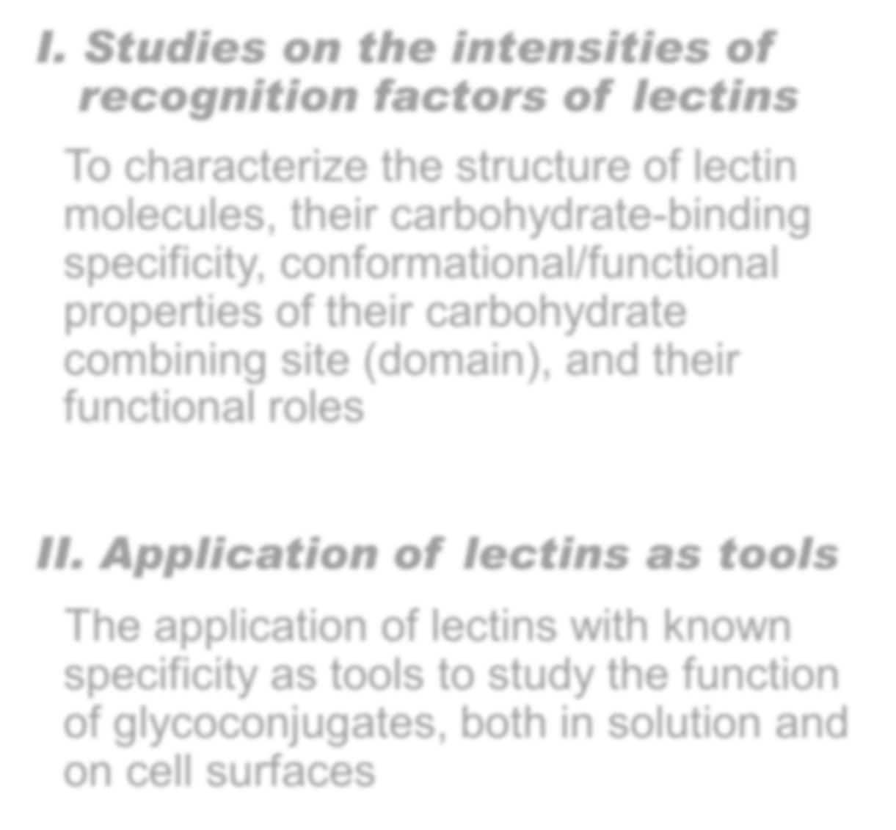

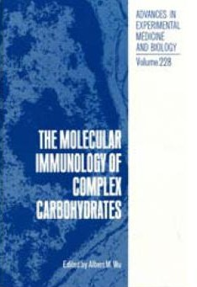
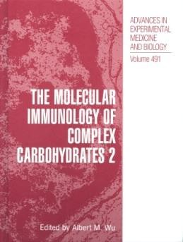
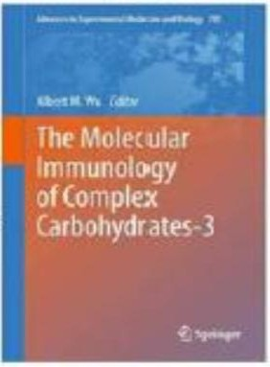
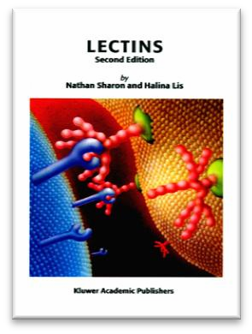
Lectinology being studied in our laboratory can be
divided in two major directions
Studies on the intensities of
recognition factors of lectins
To characterize the structure of lectin molecules, their carbohydrate-binding specificity, conformational/functional properties of their carbohydrate combining site (domain), and their functional roles
Application of lectins as tools
The application of lectins with known specificity as tools to study the function of glycoconjugates, both in solution and on cell surfaces

Slide 11
To obtain a comprehensive recognition profile of a
lectin the following aspects have to be considered:
I. From the glycan structural aspects :
Epimers and anomers of a sugar
Monosaccharide specificity
(Gal, GalNAc, GlcNAc, Man, LFuc, and Sialic acid)
Reactivities toward mammalian disaccharides and Tn structural units
(in decreasing order)
The most active ligand
Simple multivalent or cluster effect of carbohydrate structured unit
such as
Tn glycopeptides and multi-antennary glycotopes to inhibit binding
Complex polyvalent or multi- effects present in macromolecules with known glycotopes
Glyco-macromolecules, such as THGP (polyvalent GalNAcβ1→4)
and Asialo PSM (polyvalent T/Tn)
(iii)
(vi)
II. From the methods used to study can provide different angles and views to look into carbohydrate-lectin interactions.

Slide 12


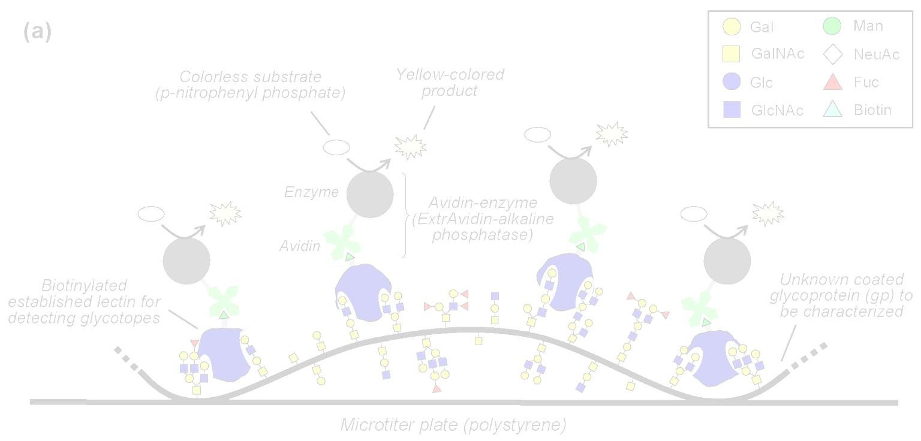
Methodology
The methods of measuring lectin-carbohydrate interactions which are used for determination of carbohydrate specificity of lectins are
A.
Traditional (classical) methods
a. Hemagglutination-inhibition assay
At Kabat’s lab and worldwide for hundred years.
One of the natural and inexpensive ways to study
polyvalency
b. Quantitative precipitation/precipitin-inhibition assays
(QPA/QQPIA) 1960-1995 (Kabat and Wu’s lab)
B. Current Approach
Enzyme-Linked LectinoSorbent Assay (ELLSA)
From 1994 to present at Wu’s lab
One of the easy and budget ways to study polyvalency

Slide 13
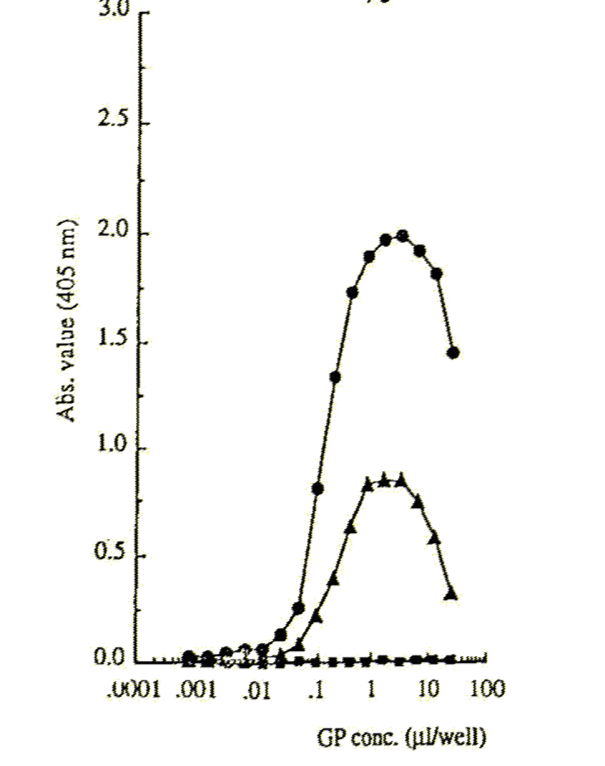
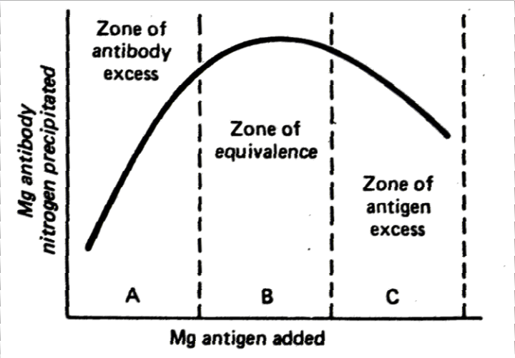
The interaction profile of ELLSA is similar to that of QPA
Interaction of lectins with THGP* analyzed by ELLSA Read at 30 min, Lectin conc.=0.05 μg/well
APA
The main zones of antigen-antibody
reaction in QPA
RCA1
PNA
* Tamm–Horsfall urinary glycoprotein

Slide 14
However, different lectins were found to recognize different saccharide sequences as their own receptor sites, although they are considered to be identical in terms of monosaccharide specificity
For example, T (Galβ1→3GalNAc) specific lectins
Binding Contributions GalNAc Gal
Monosaccharide Specificities
GalNAc > Gal GalNAc >> Gal
Agaricus bisporus (ABA)
Maclura pomifera (MPA)
+++++
++++
-
+
(3) Arachis hypogaea (PNA)
Gal >>> GalNAc
inactive
-
+++++
(4) Abrus precatorius (APA)
Gal > GalNAc
+
++++

Slide 15

Expression of the Recognition profile of Gal and
GalNAc Reactive Lectins — Historical Aspect
Until the early seventies, the carbohydrate specificity of
lectins were mainly determined by the ability of
Monosaccharides: Gal, GalNAc, GlcNAc, Man and/or Their glycosides: Me-αGal, Me-βGal, p-NO2Ph-αGal,.
p-NO2Ph-βGal
to inhibit lectin-induced hemagglutination

Slide 16



Effect of polyvalency of glycotopes in
glycan on lectin-glycoform interaction
During the past three decades, it has been observed that many multi-branched oligosaccharides exhibit a significant increment in lectin binding reactivity as compared to their linear counterparts. Based on the results of previous studies, the concept of glycoside cluster effect can be classified into two groups:

Slide 17



The ‘multi-antennary or simple glycoside cluster effect’ as in
reaction of galactosides with hepatic lectin and tri-antennary II sequences reactive with a galectin from chicken liver (CG- 16), or Tn glycopeptides The molecular sizes of these ligands are usually less than 1.5×10⁴.
The ‘high-density polyvalent or complex glycoside cluster effect’, such as polyvalent Tn in asialo OSM which generates an enhancement in affinity with VVL-B₄ by 3.3×10⁵ and 4.5×10³ times over Gal and GalNAc, respectively, and is about 1000 times more active than monomeric Tn. The much stronger inhibition of RCA₁ by a panel of cyst glycoproteins than by disaccharides and galactose is shown.

Slide 18
Glycan structural units and recognition codes
Abbreviation and Structure of Disaccharide Structural Units and Tn Epitope Used to Express Carbohydrate Specificity of Gal and GalNAc Reactive Lectins
Human Blood Groups: A (GalNAcα1→3Gal), B (Galα1→3Gal)
Tumor Markers: F (GalNAcα1→3GalNAc), T (Galβ1→3GalNAc)
Tn (GalNAcα1→Ser/Thr)
Toxic and Microbial Agglutinin Receptors: E (Galα1→4Gal)
P/S (GalNAcβ1→3/4Gal)
(4) Other structural units:
I/II (Galβ1→3/4GlcNAc), L (Galβ1→4Glc)
All, expect L_{β}, P_{α}, F_{β} and T_{β}, are present in Glycoproteins.
All, except Tn determinant, T_{α} and F_{α} , provide essential ligands for lectin binding and are found in the carbohydrate moieties of Glycosphingolipids.

Slide 19


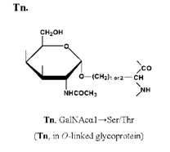
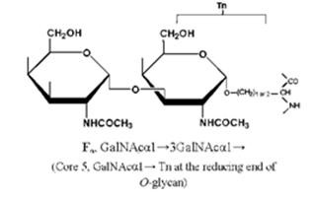
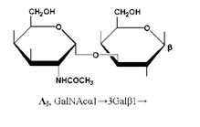
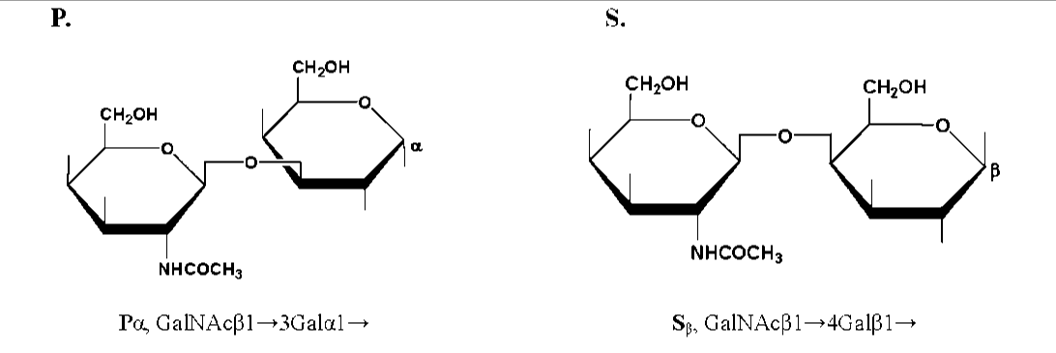
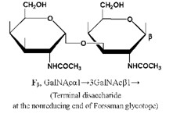
Figure 1a. Mammalian glycoconjugates structural units used to express and classify the carbohydrate specificity of lectins
19

Slide 20

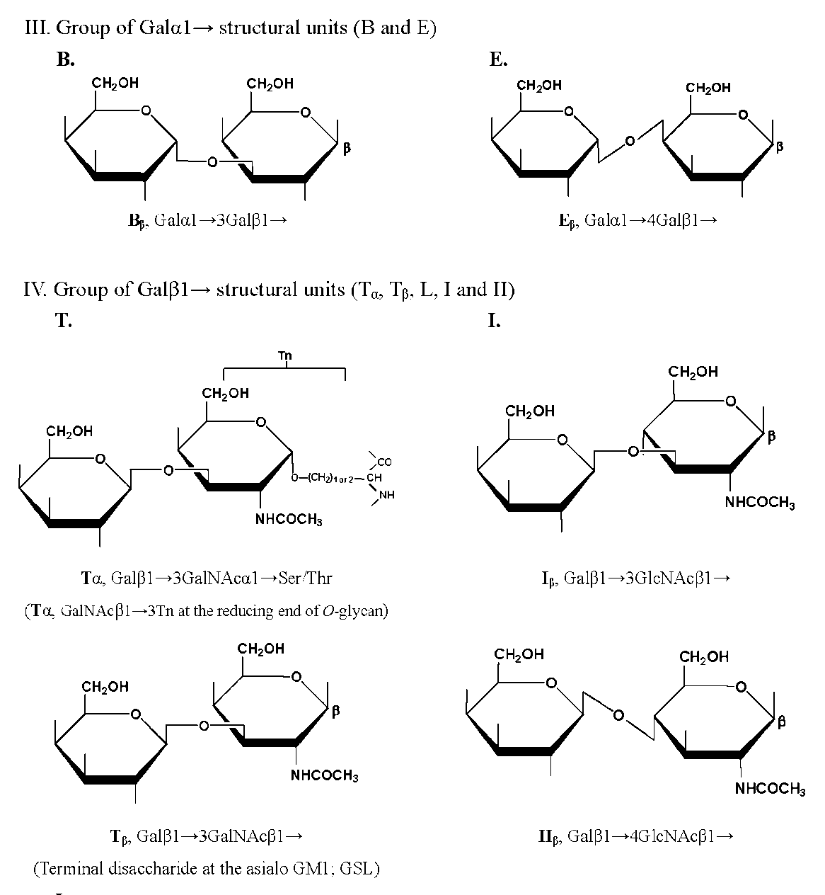
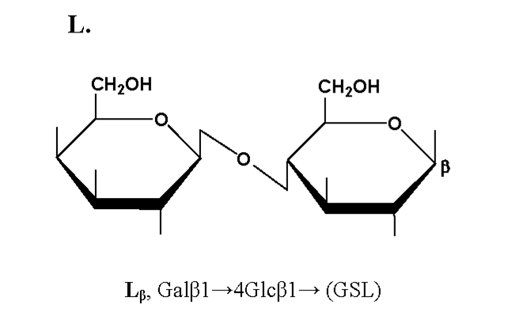
Figure 1b. Mammalian glycoconjugates structural units used to express and classify the carbohydrate specificity of lectins
19

Slide 21
Table 1a. Carbohydrate structural units in mammalian
glycoproteins and glycosphingolipids
 | Codesª | Structural units | Sources
I.. GalNAcα1→series
1 | F ^{F}penta- | GalNAcα1→3GalNAc GalNAcα1→3GalNAcβ1→3Galα1→4Galβ1→4Glc | Forssman pentasaccharide. Animal tissue antigens and human oncofetal glycotopes, mainly in glycosphingolipids.
 | F_{α} | GalNAcα1→3GalNAcα1→Ser/Thr of protein core | In O-linked glycoproteins core.
 | F_{β} | GalNAcα1→3GalNAcβ1→ | Glycotope at the nonreducing end of F_{penta-}.
2 | A | GalNAcα1→3Gal | Human blood group A related di-saccharide.
 | A_{h} | GalNAcα1→3[LFucα1→2]Gal | Human blood group A related tri-saccharide.
3 | Tn | GalNAcα1→Ser/Thr of protein core | Tn antigen, only in O-linked glycoproteins.
II. GalNAcβ1→series
4 | P P_{α} | GalNAcβ1→3Gal GalNAcβ1→3Galα1→ | Blood group P related disaccharide; glycotope at the nonreducing end of globoside.
5 | S S_{β} | GalNAcβ1→4Gal GalNAcβ1→4Galβ1→ | Brain and asialo-GM₂ disaccharide; human blood group Sd(a+) related disaccharide in most human urine secretions, Tamm-Horsfall glycoprotein.
ªα, β: anomer of sugars; m: multivalent, and Tri: tri-antennary.
19

Slide 22
Table 1b. Carbohydrate structural units in mammalian glycoproteins and glycosphingolipids
 | Codesª | Structural units | Sources
III. Galβ1→series
6 | T _{α} | Galβ1→3GalNAcα1→Ser/Thr of protein core | The mucin-type sugar sequence on the human erythrocyte membrane.
7 | I I_{β} | Galβ1→3GlcNAc Galβ1→3GlcNAcβ1→ | Human blood group precursor type I and II carbohydrate sequences. Branched or linear repeated II sequence is part of blood group I and i epitopes. I and II are precursors of ABH and Leª, Le^{b}, Le^{x}, Le^{y} blood group active antigens. Most of the lectins reactive with II are also reactive with I. Lectin Tri-II and mII determinants are present at the nonreducing end of the carbohydrate chains derived from N- and O-glycans.
8 | II II_{β} Tri-II mII | Galβ1→4GlcNAc Galβ1→4GlcNAcβ1→ Triantennary Galβ1→4GlcNAc Multivalent Galβ1→4GlcNAc
9 | L L_{β} | Galβ1→4Glc Galβ1→4Glcβ1→ | Constituent of mammalian milk. Lactosyl ceramides in brain and part of carbohydrate structures in gangliosides.
IV. Galα1→series
10 | B B_{h} | Galα1→3Gal Galα1→3[LFucα1→2]Gal | Human blood group B related di-saccharide. Human blood group B related tri-saccharide.
11 | E | Galα1→4Gal | Blood group p^{k} and P₁ active disaccharide. Sheep hydatid cyst glycoproteins, salivary glycoproteins of the Chinese swiftlet, glycosphingolipids in human erythrocytes, and small intestine.
ªα, β: anomer of sugars; m: multivalent, and Tri: tri-antennary.
22

Slide 23
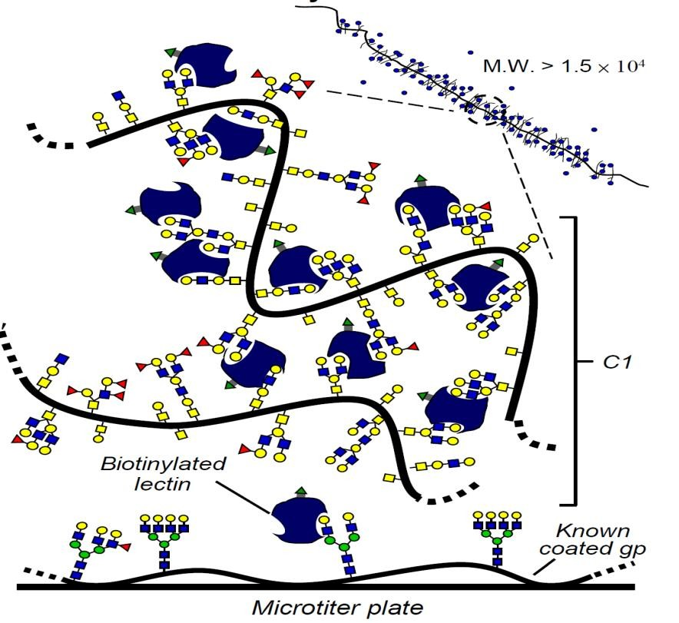
Recognition Intensities of Mammalian Structural Units, Ligand Cluster and Polyvalency in the Abrus precatorius agglutinin, Ricinus communis agglutinins and Glycoprotein Interaction
23

Slide 24
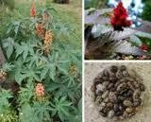

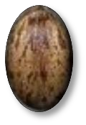
Abrus precatorius agglutinins (APA) / Ricinus communis
agglutinins (RCA)
Abrus precatorius (Jequirity bean) seeds Ricinus communis (castor bean) seeds
Separated by Sepharose 4B and DEAD-cellulose column chromatography
Abrin-a Abrin-b Abrin-c Abrin-d
The higher toxic and less agglutinin fractions
The less agglutinin activity
Abrus precatorius
agglutinin
(APA)
Ricin, RCA₆₀
RCA₁, RCA₁₂₀
Highly toxic
Less toxic
Less toxicity and high agglutinin fraction
¹ Lin J.Y. et al., Toxicon 19 (1981) 41–45
24

Slide 25
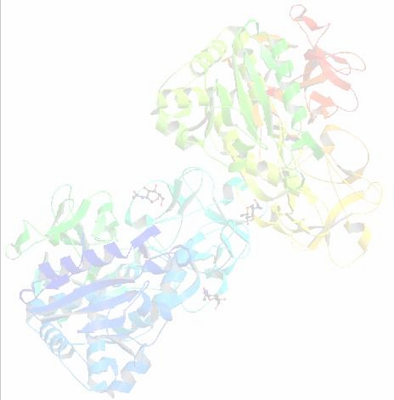
Abrus precatorius agglutinin (APA)
Type 2 RIP (ribosome inactivating protein).¹
Molecular mass 130 kDa: consists of two sets of toxic subunit chain A (30 kDa) and lectin active subunit chain B (31 kDa).²
Lectin active B chain is crucial for determining the target cells of APA. Following B chain binding to cell-surface glyco-receptors, the A chain
enters cells through lectin mediated endocytosis and subsequently
inhibits protein synthesis by catalytically inactivating the ribosomes.³
APA crystal structure²
(Resolution 2.6 Å )
¹ Liu C.L. et al., J. Biol. Chem. 275 (2000) 1897–2001
² Cheng J. et al., DOI:10.2210/pdb2zr1/pdb
³ Peumans W.J. et al.,, FASEB J. 15 (2001) 1493–1506

Slide 26
Forty Years of Progress in the Carbohydrate
Recognition Profiles of Abrus precatorius agglutinin (APA)
Year
Recognition factors
Recognition activity
1.
1975¹
Monosaccharides
Gal > GalNAc
2.
1981
2
Anomers
D-Galpβ1→
3.
1992³
Oligosaccharides and mammalian glyco- structural units
Galβ1-3GalNAc (T) > Galβ1-3/4GlcNAc (I/II)
T - Thomsen-Friedenreich antigen I/II - blood group precursor type I or type II disaccharide
4.
Until 2008
(?)
Clustering and polyvalency of mammalian glyco- structural units
☹
Not available
¹ Wei C.H. et al., J. Biol. Chem. 250 (1975) 4790–4795; ² Kahn M.I. et al., Eur. J. Biochem. 115 (1981) 149–152;
³ Wu A.M. et al., J. Biol. Chem. 267 (1992) 19130–19139

Slide 27
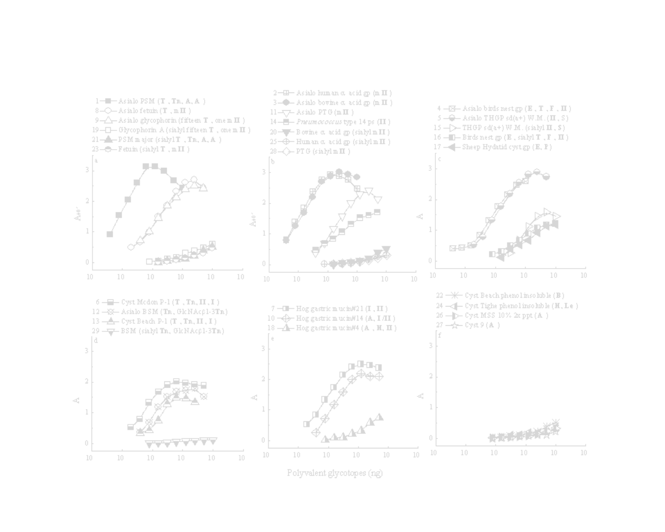
Interaction Intensities of APA and RCA₁ to Different Polyvalent Glycotopes Analyzed by ELLSA
Curve no | Polyvalent glycotopes (Lectin determinants^{b}; blood group activity) | Quantity for 1.5 units of A₄₀₅ (ng) | Maximum A₄₀₅ reading^{c} | Binding Intensity^{c}
1 | Asialo PSM (T_{α}, Tn, A, A_{h}) | 0.8 | 3.1 | +++++
2 | Asialo human α₁ acid gp (mII_{β}) | 1.0 | 2.9 | +++++
3 | Asialo bovine α₁ acid gp (mII_{β}) | 1.2 | 3.0 | +++++
4 | Asialo birds nest gp (E_{β}, T_{α}, F_{α}, II_{β}) | 8.0 | 2.6 | +++++
8 | Asialo fetuin (T_{α}, mII_{β}) | 16.0 | 2.7 | +++++
16 | Birds nest gp (E_{β}, sialyl T_{α}, F_{α}, II_{β}) | - | 1.2 | ++
20 | Bovine α₁ acid gp (sialyl mII_{β}) | - | 0.6 | +
21 | PSM major (sialyl Tn, T_{α}, A, A_{h}) | - | 0.5 | +
23 | Fetuin (sialyl T_{α}, mII_{β}) | - | 0.5 | +
25 | Human α₁ acid gp (sialyl mII_{β}) | - | 0.3 | ±
ª4 ng of biotinylated APA was added to various polyvalent glycotopes containing gps/ps, ranging from 0.01 ng to 1 μg /ml.
^{b}The bolded symbols in parenthesis indicate the human blood group activity and/or lectin determinants.
^{c}The results were interpreted according to the spectrophotometric absorbance value at 405nm (A₄₀₅) after 2 h incubation as
follows: +++++ (A₄₀₅ ≥ 2.5), ++++ (2.5 >A₄₀₅ ≥ 2.0), +++ (2.0 > A₄₀₅≥ 1.5), ++ (1.5 > A₄₀₅≥ 1.0), + (1.0 > A₄₀₅ ≥ 0.5), ± (0.5 > A₄₀₅ ≥
0.2), and - (A₄₀₅< 0.2)

Slide 28
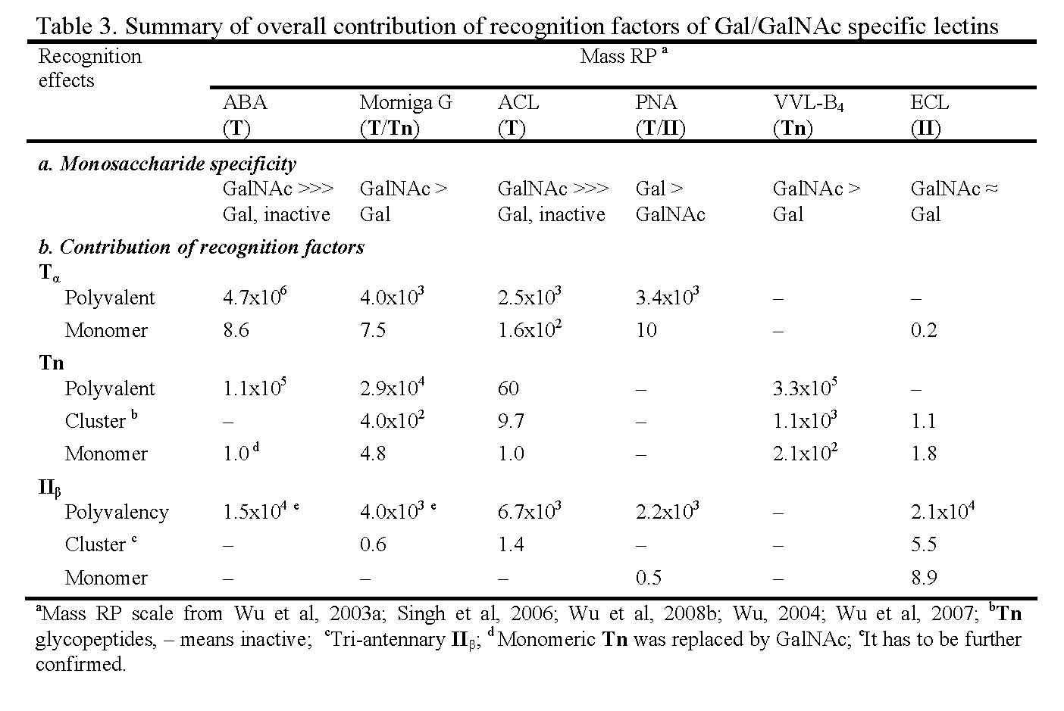

Slide 29
Binding Profile of APA-Polyvalent Glycotopes Interaction
1 Reacted best
Polyvalent T_{α}, E_{β} and II_{β} containing gps
[0.8–8.0 ng of gps were required to reach 1.5 A₄₀₅ unit
within 2 h]
2
Reacted strongly
High-density polyvalent containing gps
II_{β} T_{α}
and glycotopes
[10.0–30.0 ng of gps were required to reach 1.5 A₄₀₅ unit within 2 h]
3
Reacted moderately or negligibly
Insufficient amount or masked I_{β} / II_{β} and T_{α} glycotope containing gps and human blood group ABH and Lewis antigen containing gps.
4
Reacted poorly
Sialylated T_{α} / II_{β} glycotopes

Slide 30
Summary of Intensities of Polyvalent Glycotopes in APA Recognition Process Obtained from Inhibition Assay
1
Most effective polyvalent glycotopes
Polyvalent T_{α}, I_{β} /II_{β} and E_{β} containing gps
[ < 10 ng to produce 50% inhibition of the APA-plate coated asialo fetuin interaction]
10³–10⁴ times more potent than the monomeric counterparts (T, I,
II, E) and Gal.
2
Strongly reactive
polyvalent glycotopes
High-density polyvalent II_{β} containing gps, human blood group
ABH(O) precursors equivalent gps
[20-90 ng to produce 50% inhibition]
3
Other recognizable glycotopes
Partially cryptic II_{β} glycotopes masked by Galα1- (cyst Beach phenol insoluble), GalNAcα1- (Hog gastric mucin#14), GalNAcβ1- (Sheep Hydatid cyst gp; asialo THGP sd(a+) WM)
4
Poorly reactive polyvalent glycotopes
Cryptic T_{α} and II_{β} glycans glycosylated by sialic acid
5
Inactive or weakly reactive polyvalent glycotopes
Polyvalent Tn and GlcNAc1-3Tn glycotope containing gp
30

Slide 31
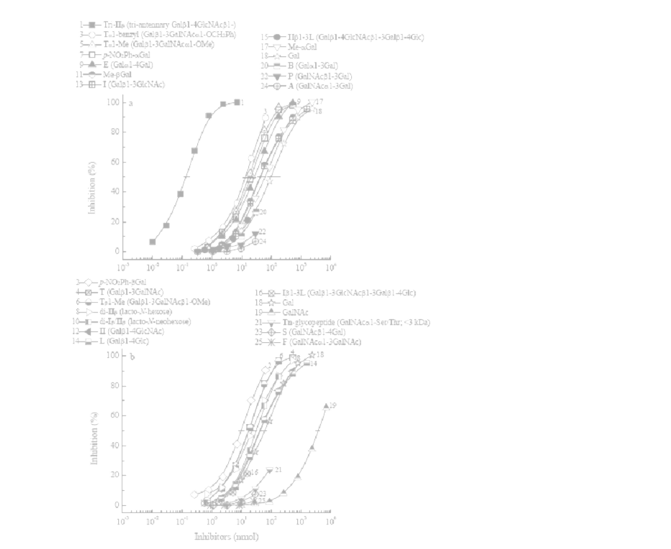
Roles of Active Ligands, Hydrophobicity and Tri-
antennary II_{β} in APA Recognition
Curve no. | Inhibitors | Quantity giving 50% inhibition (nmol) | Molar Relative potency
1 | Galβ1-4GlcNAcβ1-2Man │ α1-6 Galβ1-4GlcNAcβ1-2Manα1-3Manβ1-4GlcNAcβ1-4GlcNAcβ1-N-Asn │ β1-4 Galβ1-3/4GlcNAc Tri-antennary N-glycopeptide (tri-II_{β}) | 0.14 | 7.1 x 10²
4 | Galβ1-GalNAc (T) | 18.0 | 5.5
8 | Galβ1-4GlcNAc │β1-6 Galβ1-4Glc │β1-3 Lacto-N-hexose (di-II_{β}) Galβ1-4GlcNAc [LNH; IIβ1-3(IIβ1-6L)] | 25.0 | 4.0
9 | Galα1-4Gal (E) | 27.0 | 3.7
10 | Galβ1-4GlcNAc _{│β1-6} ªThe inhibitory a curves and are ^{Galβ1-4Glc} giving 50% inhibit │β1-3 Lacto-N-neohexose (di-I_{β}/II_{β}) ^{b}Molar relative po Galβ1-3GlcNAc [LNnH; Iβ1-3(IIβ1-6L)] ^{inhibition is take} 50% inhibition. | 30.0 ctivities were estimated f expressed as the amou ion. Total volume was 50 tency =moles of Gal (cur n as unity/mole of sacch | 3.3 rom the inhibitio nt of saccharide μl. ve no. 18) for 50 aride required f
12 | Galβ1-4GlcNAc (II) ^{c}_{The inhibitory} | pote4n0ci.e0s of inactive | o2r.4 less activ
13 | saccharides are Galβ1-3GlcNAc (I) _{sugars tested tha} | expressed as the max t yield⁴¹in.h⁰ibition (in parent | imum amount he²s^{.4}is) below 50
18 | Gal | 100.0 | 1.0
19 | GalNAc | 3800.0 | 0.02
n s
%
or
e of
%.

Slide 32
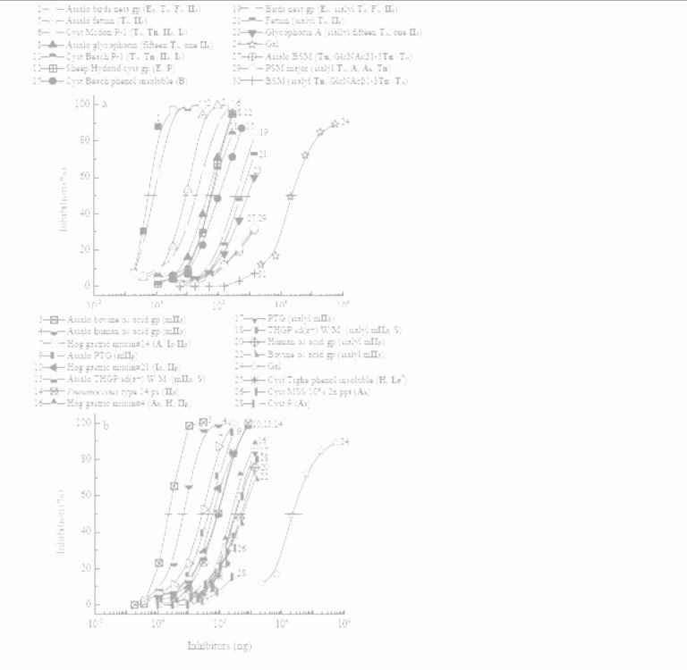
Intensities of Polyvalent Glycotopes in APA Recognition
Process Obtained from Inhibition Assay
Curve no. | Inhibitors | Quantity giving 50% inhibition (ng) | Mass RP*
1 | Asialo PSM (T_{α}, A, A_{h}, Tn) | 0.6 | 3.0 x 10⁴
2 | Asialo birds nest gp (E_{β}, T_{α}, F_{α}, II_{β}) | 0.8 | 2.2 x 10⁴
3 | Asialo bovine α₁ acid gp (mII_{β}) | 2.5 | 7.3 x 10³
4 | Asialo human α₁ acid gp (mII_{β}) | 7.0 | 2.6 x 10³
5 | Asialo fetuin (T_{α}, mII_{β}) | 9.0 | 2.0 x 10³
6 | Tri-antennary N-glycopeptide (tri-II_{β}) | 2.9x 10² | 60.6
7 | Galβ1-3GalNAc (T) | 6.9 x 10³ | 2.6
8 | Galα1-4Gal (E) | 9_{a}.3 x 10³ The inhibitory activities | wer^{2.1} timated fro e es
9 | Galβ1-4GlcNAc (II) | the inhibition curves in a 4 ¹t.h⁵e^{x} a¹m⁰ ount of inhibitor | nd are expressed s (¹n.g¹) giving 50
10 | Galβ1-3GlcNAc (I) | inhibition. Total volume w 1.6 x 10⁴ ^{b}Mass relative potency | as 50 μl. 1.1 =mass of Gal (cur
11 | Gal | no. 24₄) for 50% inhi ¹u^{.8}ni^{x}ty/¹m⁰ass of inhibitor | bition is taken req¹u^{.0}ired for 50
2009
1
Polyvalent
& Tri-II_{β}
1992²
Structural units/mono- saccharides
m
as
%
ve
as
%
inhibition.
¹ Wu A.M. et al., Mol. Immunol., 46 (2009) 3427-3437
² Wu A.M. et al., J. Biol. Chem. 267 (1992) 19130–19139
*Mass RP, Mass Relative Potency
^{c}The in₄hibitory potencies of inactive ₄or less
1 / 11 = 3.0x10 1.2x10
active gp;
s ar1 / 7 =
e expressed as the maximum
7 / 1 = 2.6
amount of inhibitors tested that yield inhibition
(in parenthesi
s) below 50%.

Slide 33


Progress in the Carbohydrate Recognition Profile of APA
Year Recognition factors Activity
1975¹ Monosaccharides Gal > GalNAc
1981² Anomers Galβ1→
3. 1992³
Oligosaccharides and mammalian glyco- structural units
Galβ1-3GalNAc (T) > Galβ1-3/4GlcNAc (I/II)ª
T - Thomsen-Friedenreich antigen I/II - blood group precursor type I or type II disaccharide
Gal (β anomer at non-reducing end;
configuration of C-2) >> GalNAc (less-active)ª
4. 2009⁴
(a) Monosaccharide (subtope) and submolecule specificity
Glyco-structural units
Clustering and polyvalency of mammalian glyco- structural units
Galβ1-3GalNAcα/β1- (T_{α}/T_{β}) > Galα1-4Gal (E_{β})
> Galβ1-3/4GlcNAc (I/II)ª
Polyvalent T_{α}, II_{β}/I_{β} and E_{β} >> tri-antennary II_{β} >
monomeric T, T, I and II > Gal > GalNAc (weak)^{b}
ª Molar RP; ^{b} Mass RP
¹ Wei C.H. et al., J. Biol. Chem. 250 (1975) 4790–4795
² Kahn M.I. et al., Eur. J. Biochem. 115 (1981) 149–152
³ Wu A.M. et al., J. Biol. Chem. 267 (1992) 19130–19139
⁴ Wu A.M. et al., Mol. Immonol., 46 (2009) 3427-3437
33

Slide 34
Summary of polyvalency study for
Abrus precatorius agglutinin (APA)
Poly-T_{α} (3.0x10⁴) >> Tri-II_{β} (60.6) > T (2.6) > II/I, Gal (1.0)*
2009 by 1992
Mol. Immunol., 46: 3427-3437
i. T / Gal : 2.6 / 1.0 = 2.6 (by 1992)
ii. PolyTα / Gal : 3.0 x 10⁴ (after 2009)
iii. PolyTα / Τ : 3.0 x 10⁴ / 2.6 = 1.2 x 10⁴ (after 2009)
Similar approach as can be applied to abrin-a, RCA ₁ and other lectins
J. Biol. Chem., 267: 19130-19139
*Recognition intensity expressed by Mass RP

Slide 35
Summary (1/4)
More methods used to study recognition factors of a lectin reveal more comprehensive views of the recognition profiles.
  Hemagglutination-inhibition assay;
  Quantitative precipitation/precipitin-
inhibition assays;
  Enzyme-linked lectinosorbent –inhibition assay
(ELLSA);
etc.

Slide 36
Summary (2/4)
In the processes of the mechanism glycan recognition, six recognition factors in glycans were involved : They are :
  several epimers and anomers of sugars;
  Monosaccharide specificity (Gal, GalNAc, GlcNAc, Man, LFuc, and
Sialic acid) ;
  Reactivities toward mammalian disaccharides and Tn structural units
(in decreasing order) ;
  The most active ligand ;
  Simple multivalent or cluster effect of carbohydrate structured unit such as Tn glycopeptides and multi-antennary glycotopes to inhibit binding ;
  Complex polyvalent or multi- effects present in macromolecules with
known glycotopes, in which

Slide 37
Summary (3/4)
Polyvalency of glycotopes and its resulting conformational features as the critical recognition factors in lectin-carbohydrate interactions
This should be one of important directions toward the transforming glycosciences for centuries.

Slide 38


Summary (4/4)
Q : In the book of Transforming
Glycoscience (Left):
Does it cover the following subjects ?
Recognition Codes
Polyvalency of glycotopes
Carbohydrate-carbohydrate
interactions
A: If it is not very much,
Let’s emphasize on the aspects.
Thanks.
38

Slide 39

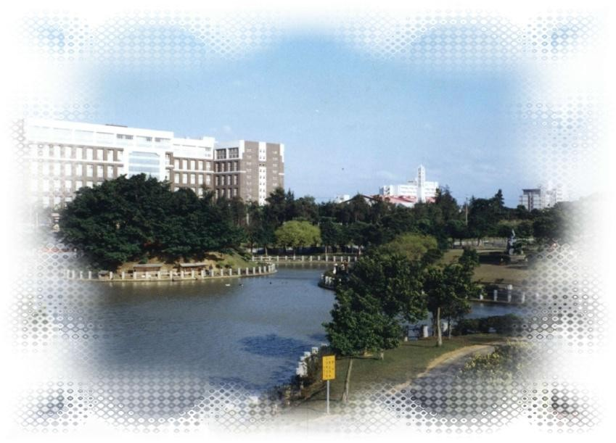
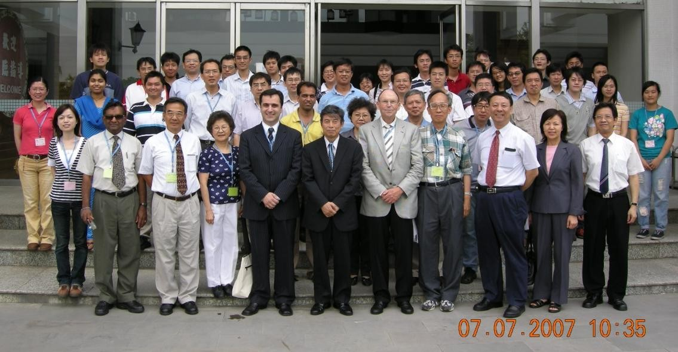

Complex Carbohydrates & Medicine Workshop -5
College of Medicine, Chang-Gung University
Tao-Yuan, Taiwan. July 7, 07’
Participants of the Complex Carbohydrates & Medicine Workshop -5
College of Medicine, Chang-Gung University
Tao-Yuan, Taiwan. July 7, 07’
39

Slide 40
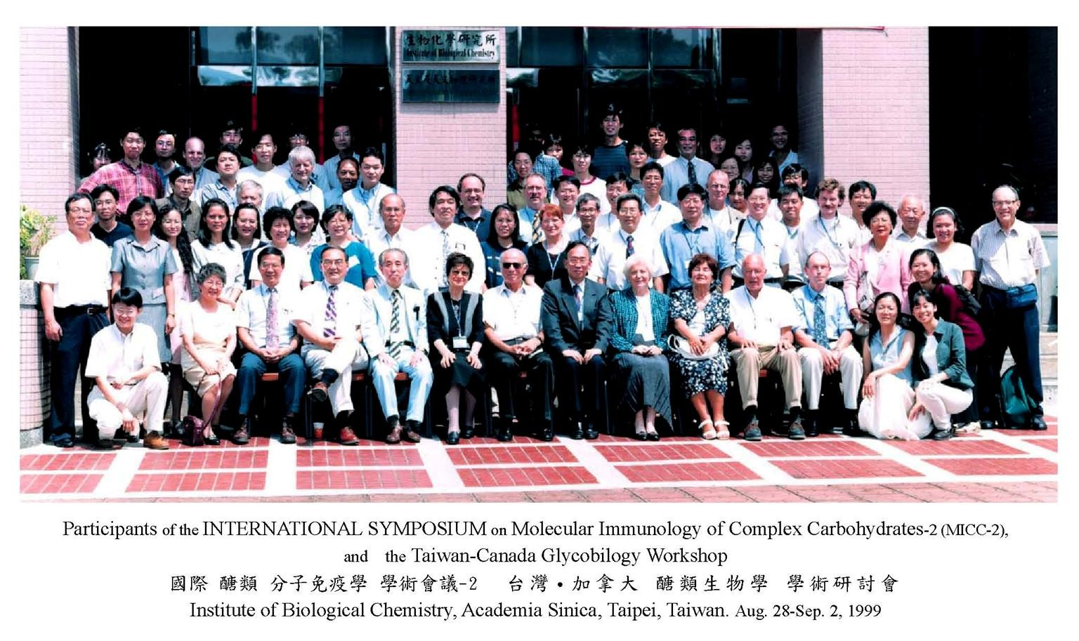
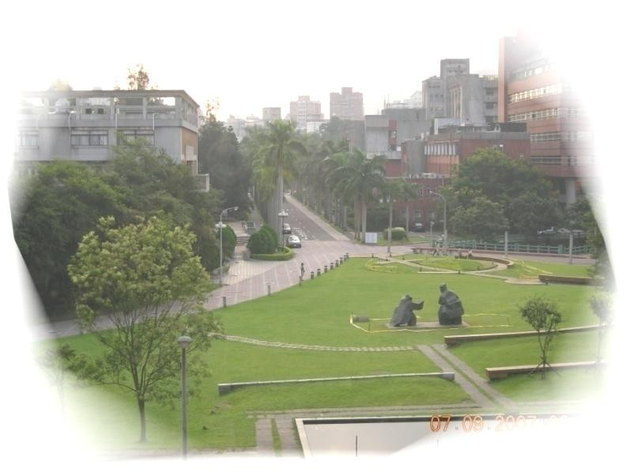
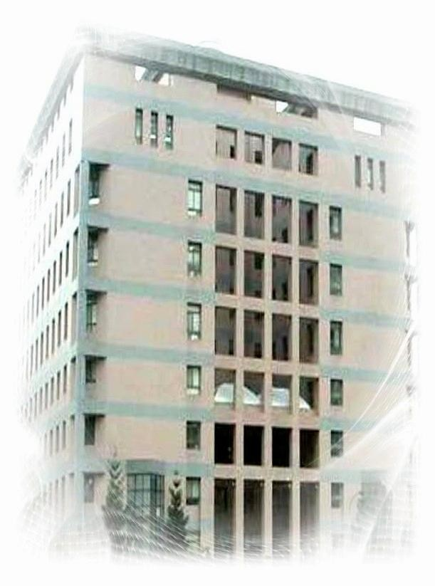


Participants of the INTERNATIONAL SYMPOSIUM on Molecular Immunology of Complex Carbohydrates-3 (MICC-3) Institute of Biological Chemistry, Academia Sinica,
Taipei, Taiwan. July 8-12, 07’
40

Slide 41



MICC-2 An Excellent Textbook !
2002 傑出教科書!!

Slide 42


Slide 43


Slide 44
Molecular Immunology of Complex Carbohydrates – 4 (MICC-4) will be held in Taipei, Taiwan and Angkor, Cambodia between April 11 – 18, 16’.
Theme of this symposium : Glyco recognitions in medicine, Lectin/MoAb recognition index, Polyvalency of glycotopes / glycoconjugates, Glycobiology in diseases.
You are cordially welcome to join us.

Slide 45

Molecular Immunology Complex Carbohydrates - 4 (MICC-4) will be held in Taipei, Taiwan and Angkor, Cambodia between April
11 – 18, 16’.
You are cordially welcome to join us.

Slide 46


Acknowledgements
This work was supported by MICCs Forever Foundation,
Kwei-san, Tao-yuan, 15’ and partially by Grants from the Chang- Gung Medical Research Project (CMRPD No. 330225 and 170441), and The National Science Council (NSC 97-2320-B-182-020 and 97- 2628-B-182-002), Taipei, Taiwan.

Slide 47




See you again

