Slide 1
Prevention: The Answer for Bacterial Resistance
Bioscience, 2016. Germany.
Email: alancriollo@gmail.com

Slide 2


Slide 3


A Growing Crisis Worldwide
In the European Union, antibiotic resistance causes 25,000 death per year
In the United States antibiotic resistance causes more than 23,000 death per year...
Antimicrobial Resistance Global Report WHO 2014

Slide 4
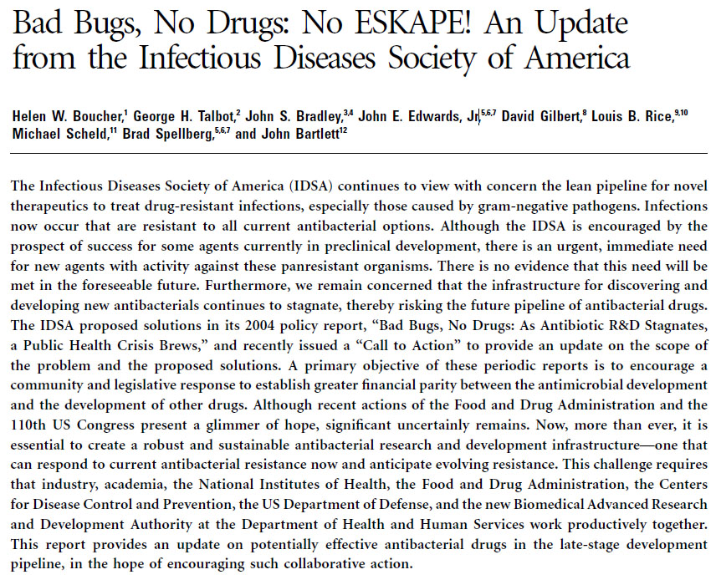
E.S.K.A.P.E.
Enterococcus faecium.
Staphylococcus aureus.
Klebsiella pneumoniae .
Acinetobacter baumannii.
Pseudomona aeruginosa.
Enterobacter spp.
Staphylococcus aureus (MRSA).
Klebsiella pneumoniae (KPC).
Acinetobacter baumannii (MDR).

Slide 5
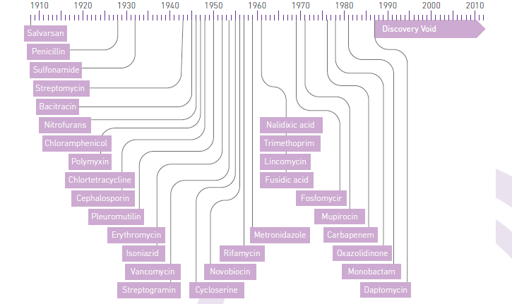
Discovery Void
Antimicrobial Resistance Global Report WHO 2014

Slide 6
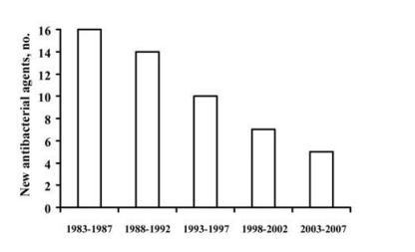
Development of New Drugs
Boucher, H. W., Talbot, G. H., Bradley, J. S., Edwards, J. E., Gilbert, D., Rice, L. B., ... & Bartlett, J. (2009). Bad bugs, no drugs: no ESKAPE! An update from the Infectious Diseases Society of America. Clinical Infectious Diseases, 48(1), 1-12.

Slide 7
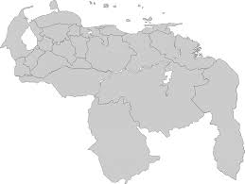
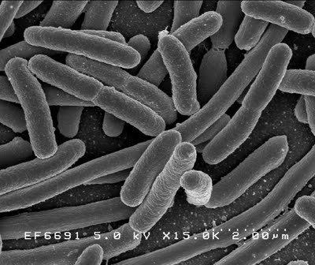
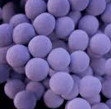
Venezuela Panorama

Slide 8
Methicillin-Resistant S. aureus
http://provenra.cloudapp.net/graficos-reportes. July 216

Slide 9
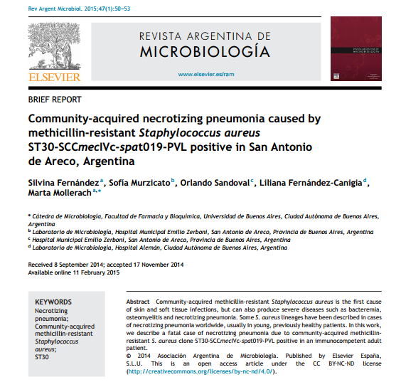
MRSA community acquired

Slide 10
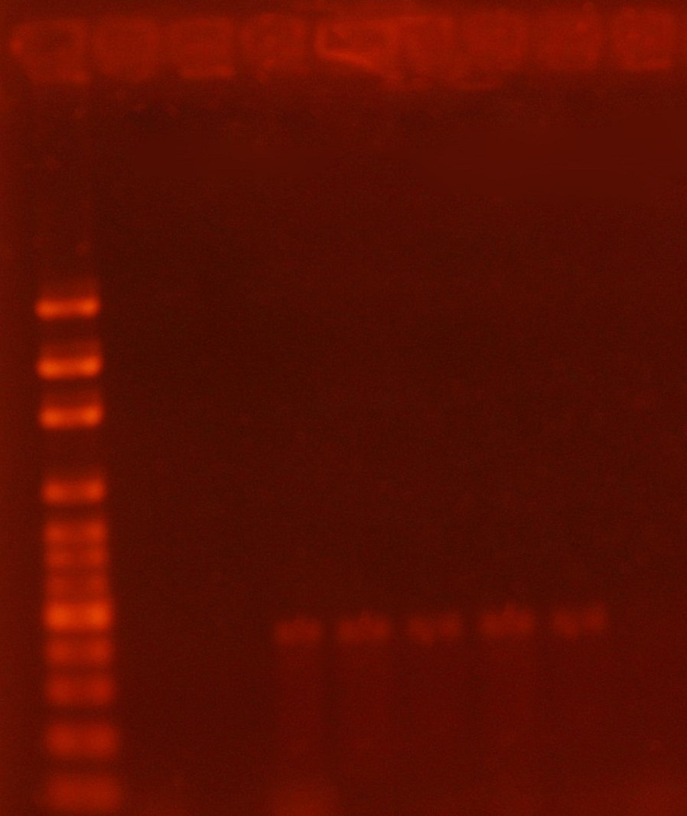
MRSA Community Acquired
1 2 3 4 5 6 7 8 9
LuKS-LuKF
433 pb
500 pb
400 pb
Alan R. Criollo Ródiz; Luis C. Torres. Determination of the virulence factor Panton Valentine leukocidin in methicillin-resistant Staphylococcus aureus (MRSA) from community-acquired infections. Universidad Central de Venezuela. 2011.

Slide 11
K. pneumoniae carbapenem resistant Venezuela
http://provenra.cloudapp.net/graficos-reportes. July 2016

Slide 12

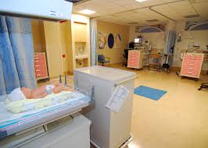
K. pneumoniae carbapenem resistant. HCC
ICU: 34% BLEE+ / 4% KPC
PICU: 16% BLEE+ / 3% KPC

Slide 13
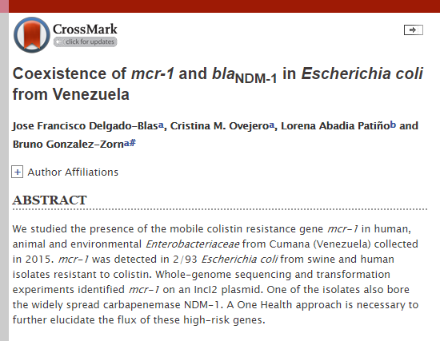
Alarming Situation
2016, American Society for Microbiology.

Slide 14
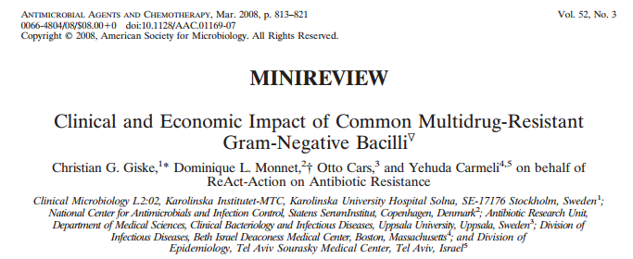
Length of Stay (LOS) and Risk of Death

Slide 15
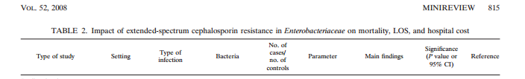
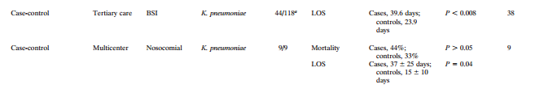
Length of Stay (LOS) and Risk of Death

Slide 16
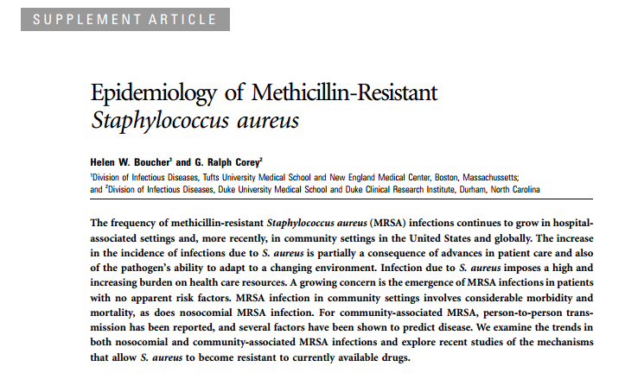
Mortality Risk with MRSA

Slide 17

Prevention Method1

Slide 18
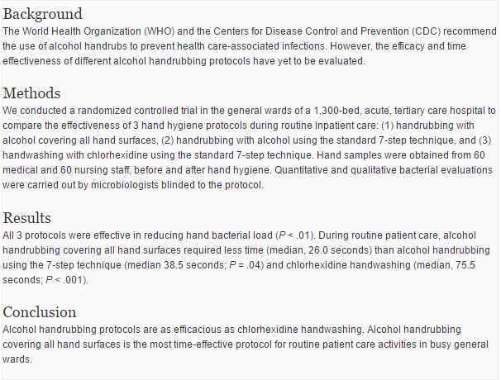
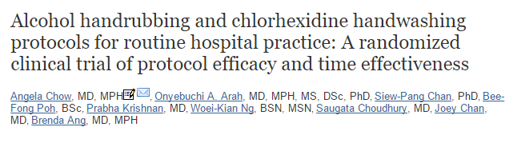
Prevention Methods

Slide 19

Prevention Methods
Girou at col. 2012.
  Reduction of the contamination level: 75%
  Handwashing spent: 23-60 sec
  Handrrubing: 30 sec

Slide 20
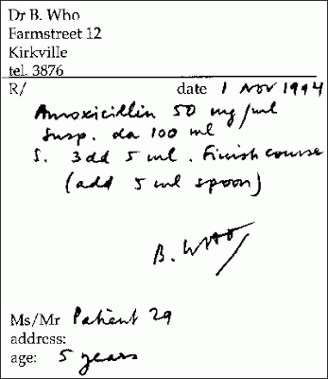
Prevention Method

Slide 21
Prevention Methods 2
New York:
  Multidisciplinary Team
    Result: 60,000$ approx. One year.
Philadelphia:
  Patients Cards.
    Results: 290,000$ approx. Saved.
West Los Angeles Veterans Affairs Medical Center:
  Antimicrobial Usage Suceptibility Data, Cost.
    Results: 50% cost of ATB Decreasing.

Slide 22

Prevention Method 3

Slide 23
Prevention Methods 3
Daytona, Ohio.
  Scher and colleagues restriction: limiting use of cephalosporins.
    Results: Saving $15.36 per case in the 2,094 cases studied.
Brooklyn, New York.
  McGowan and Filand
    Results: Chloramphenicol used decrement.
    From 20,000 g to 3,000g anual.

Slide 24
Summary

Slide 25


Thank you.
      Danke.
            Gracias.

