Slide 1

The utility of biomarkers in CNS drug development
Professor Alan M. Palmer
alan.palmer@Cerebroscience.com
Nov 2009
Notes:
1

Slide 2
Global burden of CNS disorders and CNS medicines research

Slide 3
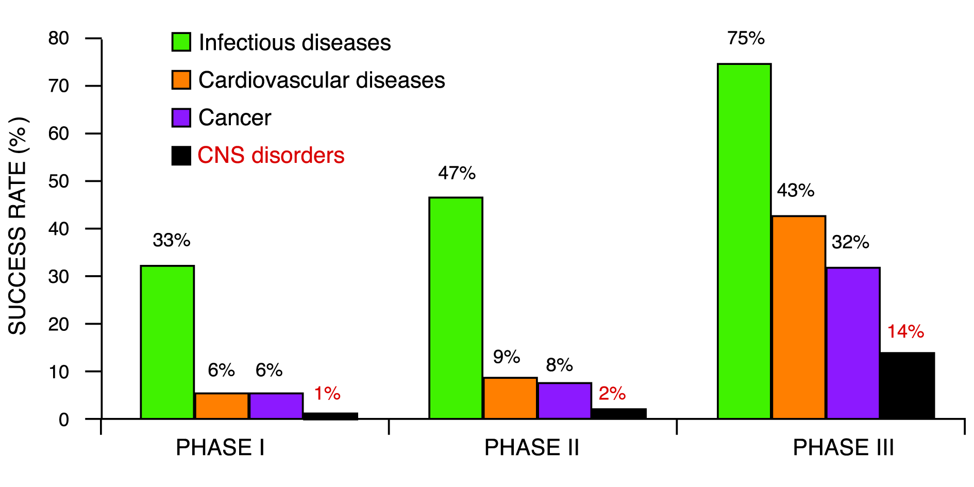
Cumulative success rates to market by therapeutic area

Slide 4
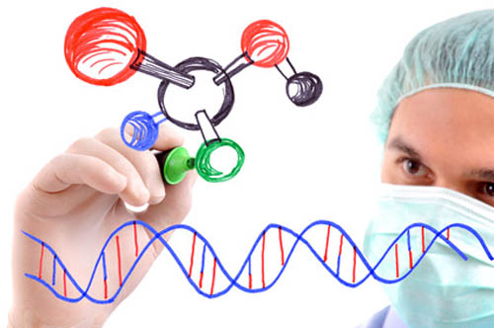
Biomarkers in drug development
A biological variable with a statistically significant relationship with parameters of
  disease states
  drug activity
Biomarker candidate
Biomarker

Slide 5
The utility of biomarkers in CNS drug development
Patient selection and stratification
  Improves the likelihood of patient to respond (or not) to the compound
Target engagement
  Indirect measure of CNS penetration
Pharmacodynamics
  Define the consequences of a compound's interaction with its target
Disease and disease modification
  Biomarkers that correlate with disease progression
Palmer A.M. (2013) The utility of biomarkers in CNS drug development. Drug
Discovery Today, 19: 201-203

Slide 6
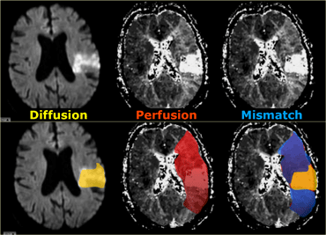

MRI diffusion-perfusion mismatch to select stroke patients with a penumbra
Diffusion
abnormality
Perfusion
abnormality
Penumbra

Slide 7
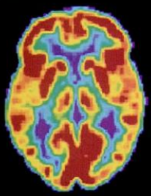
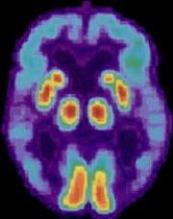
Neuroimaging
Structure
  MRI
Molecular probes of structure
  SPECT
  PET
Functional measures
  [¹⁸F]Fludeoxyglucose
  EEG
  MEG
  fMRI
    Blood oxygen level-dependent contrast

Slide 8
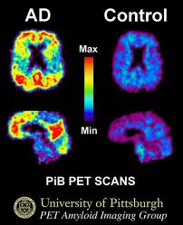
Visualising amyloid plaques in the intact brain
[¹⁸F] Florbetapir
  FDA approval in 2012
  Strictly limited to “ruling out AD”

Slide 9
Defining prodromal disease
Clinically isolated syndrome
Mild cognitive impairment
A transient impairment in motor or sensory function
White matter abnormalities
  shown by MRI
IFNβ drugs and glatiramer delay the conversion of CIS to RRMS
Mild memory loss (MMSE: 26-30)
Some indication of AD pathology
  Increased CSF [Aβ₄₂]
  PET amyloid imaging
  Cortical/hippocampal atrophy (MRI)
  Pyramidal cell loss (FDG-PET)
  Increased CSF [Tau]
Palmer AM (2013)
Br J Clin Pharmacol 78: 33-43
Sperling et al (2013)
Nat Rev Neurol. 9: 54–58

Slide 10
Clinical trials of premanifest AD
(autosomal dominant AD)
Sponsor | Drug candidate | Selection | Outcome measures
Alzheimer’s Prevention Initiative | Crenezumab | PS1-positive subjects within 10 years before apparent cognitive decline | PET- Aβ PET-FDG Structural MRI Cognitive tests
Dominantly Inherited Alzheimer Network | Solanezumab and gantenerumab | Confirmed family pedigree for autosomal dominant AD (mutations in APP, PS1 and PS2) | PET- Aβ PET-FDG Structural MRI Cognitive tests

Slide 11
Conﬁdence in patient selection in Phase 2b studies
Cook D et al (2014)

Slide 12
The utility of biomarkers in CNS drug development
Patient selection and stratification
  Improves the likelihood of patient to respond (or not) to the compound
Target engagement
  Indirect measure of CNS penetration
Pharmacodynamics
  Define the consequences of a compound's interaction with its target
Disease an d disease modification
  Biomarkers that correlate with disease progression
Palmer A.M. (2013) The utility of biomarkers in CNS drug development. Drug
Discovery Today, 19: 201-203

Slide 13
The blood-brain barrier
Paul Ehrlich (1884-1915)
Tryptan blue
Tryptan blue
Blood
CSF
Blood
CSF
Brain
Brain
Palmer AM (2010) The blood-brain barrier. Neurobiol. Disease, 37: 1-2

Slide 14
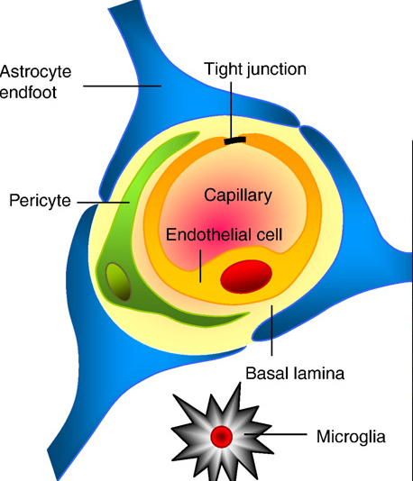
The blood-brain barrier (BBB)
Separates the blood and brain compartments
It severely constrains potential CNS therapeutics
Generally, blood biomarkers do not reflect drug activity in the brain
Palmer AM and Alavijeh MS (2013) Overview of Experimental Models of the Blood-Brain Barrier in CNS Drug Discovery. Current Protocols in Pharmacology 62:7.15.1–7.15.30

Slide 15
Interstitial fluid is the key compartment for CNS drugs
CSF
Interstitial
fluid
Blood
Receptor
Brain tissue

Slide 16
The three pillars of success
Morgan P et al (2012)
3 pillars
Brain ISF concentration is key
Tissue exposure
Target engagement
Pharmacodynamic action
 | Blood | Brain
Animal | ✓ | ✓
Human | ✓ | ?
Blood
Brain
ISF
PD effect

Slide 17
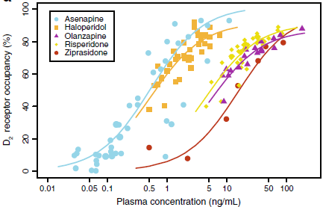
Target engagement de Greef R. et al (2011)
Notes:
in the imaging striatal dopamine D2 receptors in patients with schizophrenia using [¹¹C]raclopride PET, ascending doses of up to 80% receptor occupancy were progressively more effective in relieving delusions and hallucinations, whereas doses above an 80% occupancy were not associated with therapeutic benefit, only an increase in extrapyramidal side effects

Slide 18
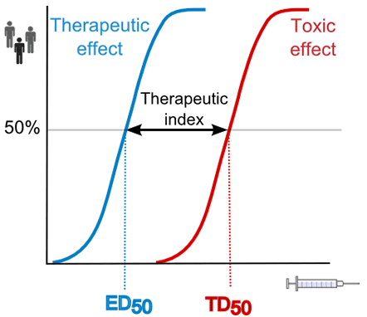
Pharmacodynamic biomarkers
Biochemical
Physiological
Behavioural
Imaging

Slide 19
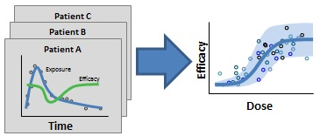
A PK-PD relationship is essential for successful CNS medicines research

Slide 20
The utility of biomarkers in CNS drug development
Patient selection and stratification
  Improves the likelihood of patient to respond (or not) to the compound
Target engagement
  Indirect measure of CNS penetration
Pharmacodynamics
  Define the consequences of a compound's interaction with its target
Disease and disease modification
  Biomarkers that correlate with disease progression
Palmer A.M. (2013) The utility of biomarkers in CNS drug development. Drug
Discovery Today, 19: 201-203

Slide 21
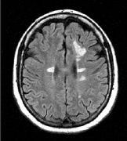
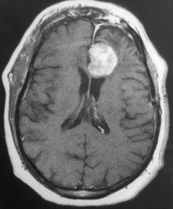
MRI has revolutionised the diagnosis and management of MS
Diagnosis
  Greater accuracy and precision
  The MacDonald criteria: more weight to MRI data
Can measure:
    White matter damage
    Grey matter damage
    BBB breakdown
    New lesion formation
Used as:
  Primary endpoint in POC clinical trials
  Surrogate endpoint in Phase III trials
Palmer A.M. (2012) Pharmacotherapeuetic options for the treatment of multiple sclerosis. Clin. Med. Insights:Therapeutics, 4: 1 -24

Slide 22
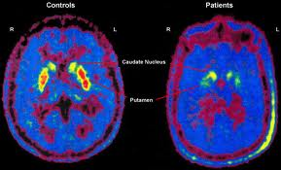
Receptor occupancy studies
Measurement of disease activity
Loss of dopaminergic neurons from the striatum of the intact brain of a PD patient
Striatum
Substantia
nigra

Slide 23
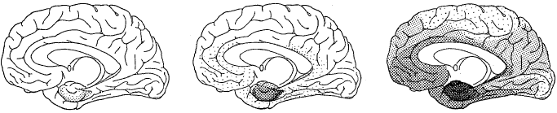
The progression of Alzheimer’s disease
Mild
Moderate
MMSE: 10-19
Severe
0-9
Episodic memory
MMSE: 20-25
Entorhinal cortex (ECX)
ECX + cortex + LC, RN, nbM
Executive function + working memory
Cortical association areas + amygdala + thalamus,+ striatum
Extensive deficits not restricted to cognition

Slide 24
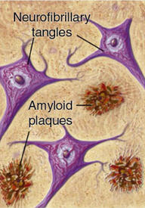
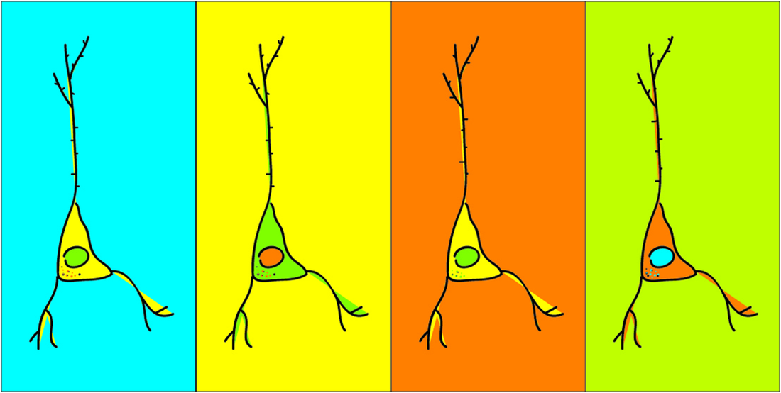
The three cardinal pathologies of Alzheimer’s disease
Plaques and tangles
Pyramidal cell loss
70% of all neurons
  Corticocortical pathways
  Corticofugal pathways

Slide 25
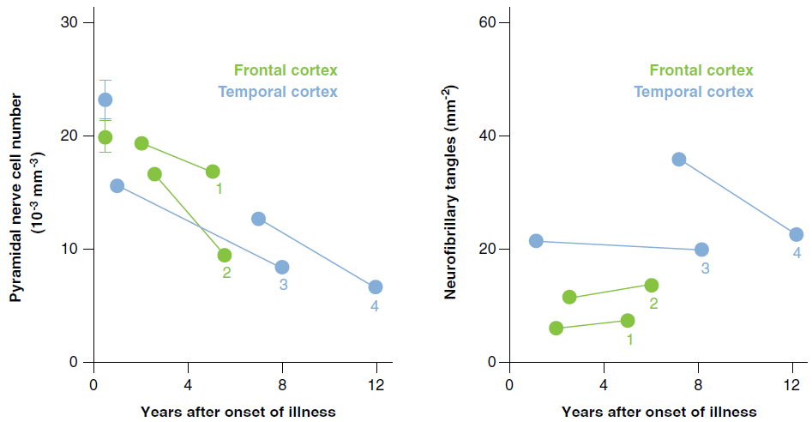
The loss of pyramidal cells is progressive (Mann D et al 1988)

Slide 26
Correlations between neuropathology and clinical measures
Clinical measure | Plaques | Tangles | Pyramidal cells In layer III | Pyramidal cells in layer V
Clinical rating* | x | x | ✓ | ✓
WAIS verbal | ✓ | ✓ | ✓ | ✓
WAIS performance | x | x | ✓ | ✓
Token test | x | ✓ | ✓ | ✓
Visual reaction time | x | x | ✓ | ✓
*A rating of magnitude of dementia (0-9)
- Language (0-3)
- Perceptuo-spatial functions (0-3)
- Memory (0-3)
Neary, D. et al. (1986) Alzheimer’s disease: a correlative study.
J. Neurol. Neurosurg.Psychiatry 49, 229–237

Slide 27
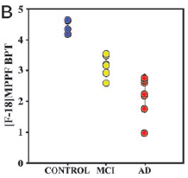
PET markers of pyramidal cells and tangles
[¹⁸F]MPPF hippocampal binding
Tau ligands
  [¹⁸F]-T808
  [¹⁸F]-THK523
  [¹¹C]PBB3
Kepe et al (2006) Serotonin 1A receptors in the living brain of Alzheimer’s disease patients Proc. Natl. Acad. Sci. 103: 702-707

Slide 28
The utility of biomarkers in CNS drug development
Patient selection and stratification
  Improves homogeneity of patient population
Target engagement
  Indirect measure of brain penetration
Pharmacodynamics
  PK-PD relationship
Disease and disease modification
  Surrogate markers of disease progression

Slide 29
The utility of biomarker in AD clinical trials
Method | Biomarker | Utility
MRI (manual) | Hippocampal volume (and rate of atrophy) | Diagnosis, patient stratification, disease modification
MRI (automated) | Whole brain volume | Diagnosis, patient stratification, disease modification
fMRI | Blood oxygen-dependent level signal | Diagnosis, patient stratification
FDG-PET | Glucose uptake | Diagnosis, patient stratification, disease modification
Amyloid PET | Amyloid | Diagnosis, patient stratification, disease modification, target engagement
Aβ in CSF | Amyloid | Diagnosis, patient stratification, disease modification, target engagement
Tau in CSF | Tau | Diagnosis, patient stratification, disease modification, target engagement

Slide 30
Summary and future prospects
Biomarkers have the potential to:
  Reduce clinical trial time
  Increase the power of clinical trials
  Improve diagnosis, including for prodromal (and premanifest) disease
  Establish the optimal dosing regimen
Genomics, proteomics, metabonomics are providing many biomarker candidates
The clinical need for effective biomarkers is huge
  Particularly for biomarkers of disease progression

