Slide 1
Title: Designing Reproductive/Juvenile Animal Studies to Reduce Animal Use, while maximizing human translation
Alan M. Hoberman, Ph.D., DABT, ATS
Charles River Laboratories, Horsham, PA, USA
BioScience 2016 – Berlin – September 12, 2016
Discovering, Innovating and Engineering Biological Science
EVERY STEP OF THE WAY

Slide 2
EVERY STEP OF THE WAY
Founded in 1947 By Dr. Henry Foster
A leading, full-service drug discovery and early-stage development company
Our scientists worked on ~50% of the drugs approved by the FDA in the past 2 years
DISCOVERY
CLINICAL SUPPORT
BASIC RESEARCH
SAFETY ASSESMENT
MANUFACTURING
Notes:
At Charles River, we are passionate about our role in improving the quality of people’s lives. Our mission, our excellent science and our strong sense of purpose guide us in all that we do, and we approach each day with the knowledge that our work helps to improve the health and well-being of our families, friends and colleagues across the globe. Our collective efforts as One Charles River are the key to our success, and we know that every job and every person is important. Every day, each of us strives to make a difference in whatever way we can.

Slide 3
Agenda
The Non-Clinical Process to IND and NDA
  Drug Discovery and Safety Assessment
  Selection of Appropriate Species
  Pathways to 3Rs - Study Design Improvements - Rodents and rabbits
    Developmental, Reproductive, and Juvenile Toxicity uses 65% of animals
    Designs that eliminate 35% of the small animals required
  Pathways to 3Rs - Study Design Improvements - Non-Human Primates
    Designs that eliminate 50% of the NHPs required
    Procedural Improvements
      Microsampling
  Advantages to study interpretation for large and small animal studies
  Advantages in the reduction of animal usage

Slide 4
Preclinical Development to Support Clinical Trials and Marketing
Each preclinical program is unique
  No “one size fits all”
Preclinical programs dependent on:
  Drug type, indication, treatment duration
Common goal
  Protect human volunteers/patients
Data from preclinical studies essential for:
  Characterizing toxic effects
    Target organs, dose dependence, reversibility
  Guiding clinical development
    Initial starting dose, dose escalation, clinical monitoring

Slide 5
THE DRUG DEVELOPMENT PROCESS
Identify Lead Compounds
Research and Discovery
Preclinical
Phase I
Phase II
Phase
III
Traditional IND
PK and Safety
Exploratory IND
PD and PK
IND
Juvenile Planning - EU
Regimen/Safety/Efficacy
Juvenile Planning - US
Definitive or “Pivotal” Safety / Efficacy
DART
NDA
Marketing Approval
PK: Pharmacokinetics
PD: Pharmacodynamics

Slide 6
Guidance Documents Available
Regional regulatory guidance
  FDA, EMA, JMHLW
ICH
  International Conference on Harmonisation of Technical Requirements for Registration of Pharmaceuticals for Human Use
  Established in 1990 to standardize drug development requirement between Europe, Japan, and US

Slide 7
Select Guidance Documents
ICH M3(R2)
  Nonclinical Safety Studies for the Conduct of Human Clinical Trials and Marketing Authorization for Pharmaceuticals
ICH S6(R1)
  Preclinical Safety Evaluation of Biotechnology-Derived Pharmaceuticals
ICH S9
  Nonclinical Evaluation for Anticancer Pharmaceuticals
Other topics
  Carcinogenicity (S1A-S1C), genotoxicity (S2), reproductive toxicology (S5), safety pharmacology (S7A-S7B), immunotoxicology (S8)

Slide 8
Preclinical Development
Small Molecules Drugs vs. Biologics
Fundamental differences necessitate different approaches to preclinical development
Key questions:
  What are the fundamental differences?
  What animal species are appropriate?
  What studies are needed to initiate Phase 1, support continued clinical development, support approval (NDA/BLA)?

Slide 9
Fundamental Differences
Small Molecules
  Chemically synthesized
  Low molecular weight
    Extensive distribution
  Metabolism can be a concern
    Reactive metabolites
  Immunogenicity not typically a concern
Biologics
  From living cells
  High molecular weight
    Limited distribution
  Metabolism not a concern
    Amino acids
  Immunogenicity can be a concern

Slide 10
Fundamental Differences
Small Molecules
  Less targeted
    Off-target toxicities
    Toxicity from parent drug or metabolites
  Generally active in many species
Biologics
  Highly targeted
    Effects related to desired target
    Exaggerated pharmacology
  Activity limited to ‘relevant species’
    Frequently only nonhuman primates

Slide 11
Appropriate Animal Species
Overarching principle: 2 mammalian species, 1 rodent and
1 non-rodent (ICH M3)
Small molecules
  2 species, typically rat and dog
    Selection based on metabolism, drug class effects, etc.
For biologics: Only relevant species
  Often just 1 species, typically NHP
    Selection based on biological relevance
      “A relevant species is one in which the test material is pharmacologically active” (ICH S6)
  Identification of relevant species, a step-wise approach
    In silico comparison of sequence homology
    In vitro comparison of binding affinities, receptor occupancy, cell-based activity
    In vivo activity

Slide 12
Study Timing: Non-GLP
 |  | Required?
Study Type | Goal | SMD | Biologic
Pharmacology/ pharmacodynamics | See below | Yes | Yes
Pharmacokinetics | See below | No* | No*
Lead optimization toxicology | See below | No* | No*
Pilot toxicology / DRF | See below | No* | No*
*But highly recommended

Slide 13
Pharmacology/pharmacodynamics
Required for IND submission: YES
  The pharmacology component of the IND Pharm/Tox section
Goals
  Understanding activity
    Mechanism of action, binding affinity, in vitro and in vivo potency
  Establish POC for intended therapeutic effect
  For biologics, identify appropriate toxicology species
    Comparative binding profile
      e.g., flow cytometry, BIACORE
    Comparative activity profile
      e.g., cell based assays, cytokine stimulation

Slide 14
Pharmacokinetics
Required for IND submission: NO
  But valuable
  Toxicokinetic evaluation required on all GLP toxicology studies
Goals
  Establish exposure profile to identify appropriate dose schedule for GLP toxicology studies
  Evaluate effect of formulation(s) on exposure

Slide 15
Pilot Toxicology / Dose Range Finding (DRF)
Required for IND submission: NO
  But valuable
Goals
  Identify appropriate dose levels for GLP toxicology studies
  Identify toxicity profile
  Identify additional endpoints for incorporation into GLP toxicology studies
    E.g. cytokine release
  Incorporate experimental endpoints
    E.g. receptor occupancy

Slide 16
Study Timing: IND-Enabling (GLP)
 |  | Required?
Study Type | Timing | SMD | Biologic
Genotoxicity Bacterial mutation (Ames) In vitro chromosomal aberration In vivo chromosomal aberration | Prior to Phase 1 Prior to Phase 1 Prior to Phase 2 | Yes | No
General toxicology | Prior to Ph. 1, 2, 3 | Yes | Yes
Safety pharmacology Cardiovascular Respiratory CNS | Prior to Phase 1 | Yes | Product specific
Tissue cross-reactivity | Prior to Phase 1 | No | mAb’s only

Slide 17
General Toxicology Studies
Goals
  Determine target organs
  Establish dose response
  Evaluate reversibility of toxicities
  Influence clinical trial design
    Establish inclusion/exclusion criteria
    Determine safe starting dose and dose escalation scheme for clinical trials
    Establish endpoints for monitoring
  Identify exposure profile (toxicokinetics)
    Toxicokinetic evaluation required for all GLP toxicology studies

Slide 18
General Toxicology Studies
General design considerations
  Route of administration: intended clinical route
    Clinical route and a systemic route generally needed for topical and ocular products
  Dosing frequency
    At least equal to the clinical frequency
    Comparison of animal and human kinetics should be considered once human data is available
  Recovery animals
    Inclusion of additional animals for a non-dosing period in at least one study (typically IND-enabling studies) at at least one dose level (typically high dose and control) is required
      To assess reversibility of toxic effects
      Currently debate regarding value/necessity of recovery animals

Slide 19
General Toxicology Studies
General design considerations
  Dosing duration
    Typically 1 month to support Ph. 1, 3 months to support Ph. 2, 6 or 9 months to support Ph. 3 and beyond
    ICH M3 recommendations
Maximum Duration of Clinical Trial | Recommended Minimum Duration of Toxicology Studies
 | Rodents | Non-rodents
≤ 2 weeks | 2 weeks | 2 weeks
2 wk. < X < 6 mo. | Same as clinical duration | Same as clinical duration
> 6 mo. | 6 mo. | 9 mo.

Slide 20
General Toxicology Studies
General design considerations
  Study groups
    Control: vehicle treated
    Low dose:
      Often defines NOAEL (no observable adverse effect level)
    High dose:
      Overtly toxic (but non-lethal) dose to identify dose-limiting toxicity OR
      Limit dose (applies to SMDs, 1-2 g/kg/day) OR
      Maximum feasible dose OR
      Maximum pharmacological effect (applies to some biologics) OR
      Other considerations
      Goal: 10-20x (or greater) anticipated therapeutic dose
    Mid dose:
      Appropriate dose between low and high doses to establish dose response

Slide 21
General Toxicology Studies
General design considerations
  Typical group sizes
Study Duration | Rodent | Non-Rodent
≤ 28 days | Main study: 10/sex/group (80 total) Recovery: 5/sex/group (20 total) | Main study: 3/sex/group (24 total) Recovery: 2/sex/group (8 total*)
≥ 13 weeks | Main study: 15/sex/group (120 total) Recovery: 5/sex/group (20 total) | Main study: 4/sex/group (32 total) Recovery: 2/sex/group (8 total*)
*Recovery often limited to control and high dose groups

Slide 22
General Toxicology Studies
Study endpoints
  General observations
  Food consumption
  Body weight
  Clinical pathology (clinical chemistry, hematology, coagulation, urinalysis)
  Organ weights
  Histopathology
  Toxicokinetics
  Immunogenicity (biologics)
  Other endpoints as appropriate
    Immunotoxicity, cytokine release, etc.

Slide 23
Study Timing: Beyond the IND (GLP)
Study Type | Timing | Small Molecule | Biologic
Metabolism | Prior to Phase 2 | Yes | No
Reproductive toxicology Embryo-fetal development Male fertility Female fertility Pre/post natal development | Prior to Phase 3 Prior to Phase 3 Prior to Phase 3 Prior to NDA | Generally yes | Product specific; modified approach for NHP
Carcinogenicity | Prior to NDA | Yes (chronic drugs) | Generally no
Pediatric investigation plan* | Prior to Phase 2/3 | Yes | Yes
*PIP required prior to Phase 2 in EU, prior to Phase 3 in US/Japan

Slide 24
Pathways to 3Rs
Study Design Improvements
Rodents and Rabbits

Slide 25
Reproductive and Developmental Effects
Male – Female
Gametes
Senescence
A
Premating to
Conception
B
Zygote
Reproductive
Life
Conception to
Implantation
C
Embryo
Implantation to Closure
of Hard Palate
D
Hard Palate Closure to
End of Pregnancy
Fetus
E
Birth to
Weaning
Weaning to
Sexual Maturity
F
Mating/fertility
Christian, 2001
A
Juvenile
Adolescence/puberty

Slide 26
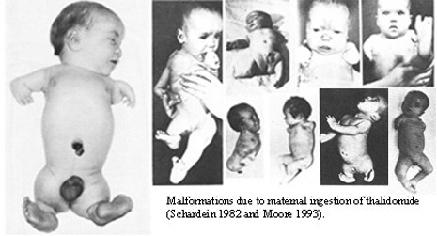
Why is this field important?
Thalidomide Tragedy
Sedative-hypnotic that produced over 5000 children with birth defects

Slide 27
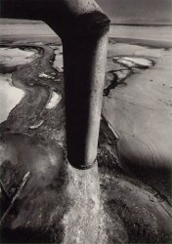
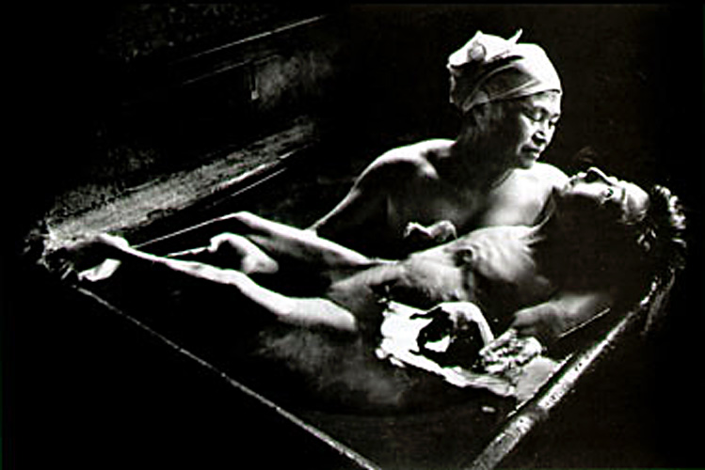
Why is this field important?
Methyl Mercury Tragedy
Chisso Corp. Chemical Wastage, W. Eugene Smith (1972) taken from http://science.education.nih.gov
Minamata Bay in Japan
Chisso Corporation responsible for polluting the Minamata Bay from 1932-1968
Hundreds of babies were born with neurological deficits
Tomoko Uemura in Her Bath, W. Eugene Smith (1971) taken from Minolta Photography

Slide 28
Thalidomide to ICH S5
Approximate Animal Use: 10,640
Studies conducted for US, UK and Japan:
  Segment I
    UK: 2400 rodents
    US and Japan: 1100 rodents
  Segment II
    UK and US: 1100 rodents, 720 rabbits
    Japan: 2300 rodents, 720 rabbits
  Segment III
    US, UK and Japan: 2300 rodents

Slide 29
Post-ICH S5
Approximate Animal Use: 5220
Studies conducted for US, UK and Japan:
  Segment I
    1100 rodents
  Segment II
    1100 rodents, 720 rabbits
  Segment III
    2300 rodents

Slide 30
Where do we go from here?

Slide 31
Reproductive Toxicology
ICH Guidelines S5A - Choice of Studies
1. Rodent Fertility and Early Embryonic Toxicity Study
Pre-mating
Mate
GD 6
Euthanized
GD 13/21
Measures effects on fertility and early establishment of pregnancy
2. Rodent Fertility and Embryo-Fetal Toxicity Study
Pre-mating
Mate
GD 17
Euthanized
GD 21
Measures effect on fertility, early establishment of pregnancy and organogenesis
Notes:
31
The next few slides show the study designs and the dosing period as laid down in the ICH guidelines S5A.
There are 2 choices for examining fertility and embrofetal development in the rat.
1. Examines fertility and early establishment of pregnancy and the 2nd looks additionally at the period of organogenesis.
In both designs, Males are dosed for 4 weeks prior to pairing, females for 15 days.
M & F dosed during the mating period (max 3 weeks). Females dosed to either Day 6 of pregnancy (implantation) or Day 17 of pregnancy (closure of hard palate), males dosed until termination.
Extending treatment to Day 17 adds nothing to time taken to run study, only to evaluation phase
Females killed Day 21 - caesar and detailed fetal exams are also conducted.
Males killed after females.
If problems with females, males can be re-mated with untreated females to see if M or F problem.

Slide 32
Further Reductions
Fertility
Combined Segment I/II
  Reduction of 1100 animals
Adding Male Fertility Assessments to other studies
  Some suggest combining with 28-day or 90-day study
    Not recommended because most compounds do not make it to Phase III testing when this study would be needed.
    With 10 rodents/group the study is not powered sufficiently for fertility evaluations which would need an additional 10 rodents/group
    Waiting later would provide for better dosage selection.

Slide 33
Reproductive Toxicology
ICH Guidelines S5A - Choice of Studies
3. Rodent and rabbit embryo-fetal toxicity study
Pre-mating
Mate
GD 6/7 (rabbits)
GD 6/7 (rats)
GD 19 (rabbits)
GD 17 (rats)
Euthanized
GD 29 rabbits
GD 21 rats
Also known as teratology or organogenesis studies.
Assess effects of compound on development of offspring from implantation through closure of the hard palate, i.e., the period of organogenesis.
Notes:
33
Embryofetal development studies are used to assess the effect of compound on the development of offspring during the period of organogenesis.
In the EFD study, animals are dosed from the day of implantation to closure of the hard palate.
Mouse Day 6 to Day 15 Killed Day 18
Days of implantation and palate closure vary between species and strains
Rabbit /rat EFD: Mate rabbits (do preg test); pregnant rabbits dosed from Day 8 (implantation) to Day 20 (closure of hard palate) of pregnancy. Killed at term on Day 30. Caesar..

Slide 34
Further Reductions
Developmental Toxicity – 2 Species Required
Importance of Dosage-Range (DRF) Studies
  These studies ensure that at the dosage levels used there will be sufficient numbers of fetuses for evaluation.
  Moving into a full study and having no litters produced wastes 20 to 25 animals/group.
  TK data is important for dosage level selection in the full study.
  Rabbits - no need for satellites.
  Suggestion:
    Evaluate TK data in the DRF and will not have to repeat in the full GLP study.

Slide 35
Further Reductions
Developmental Toxicity – 2 Species Required
Utility of in vitro Developmental Toxicity Testing:
  Move to eliminate 1 of 2 species for the developmental toxicity assessment.
  Suggestion: 1 species and an in vitro test.
  Question: Whether or not the assays are ready for regulatory use?
    Probably not at this time.
    But may be valuable in mechanism or screening evaluations.
  Data being collected on rat vs. rabbit developmental toxicity
    What do we gain from using both species?

Slide 36
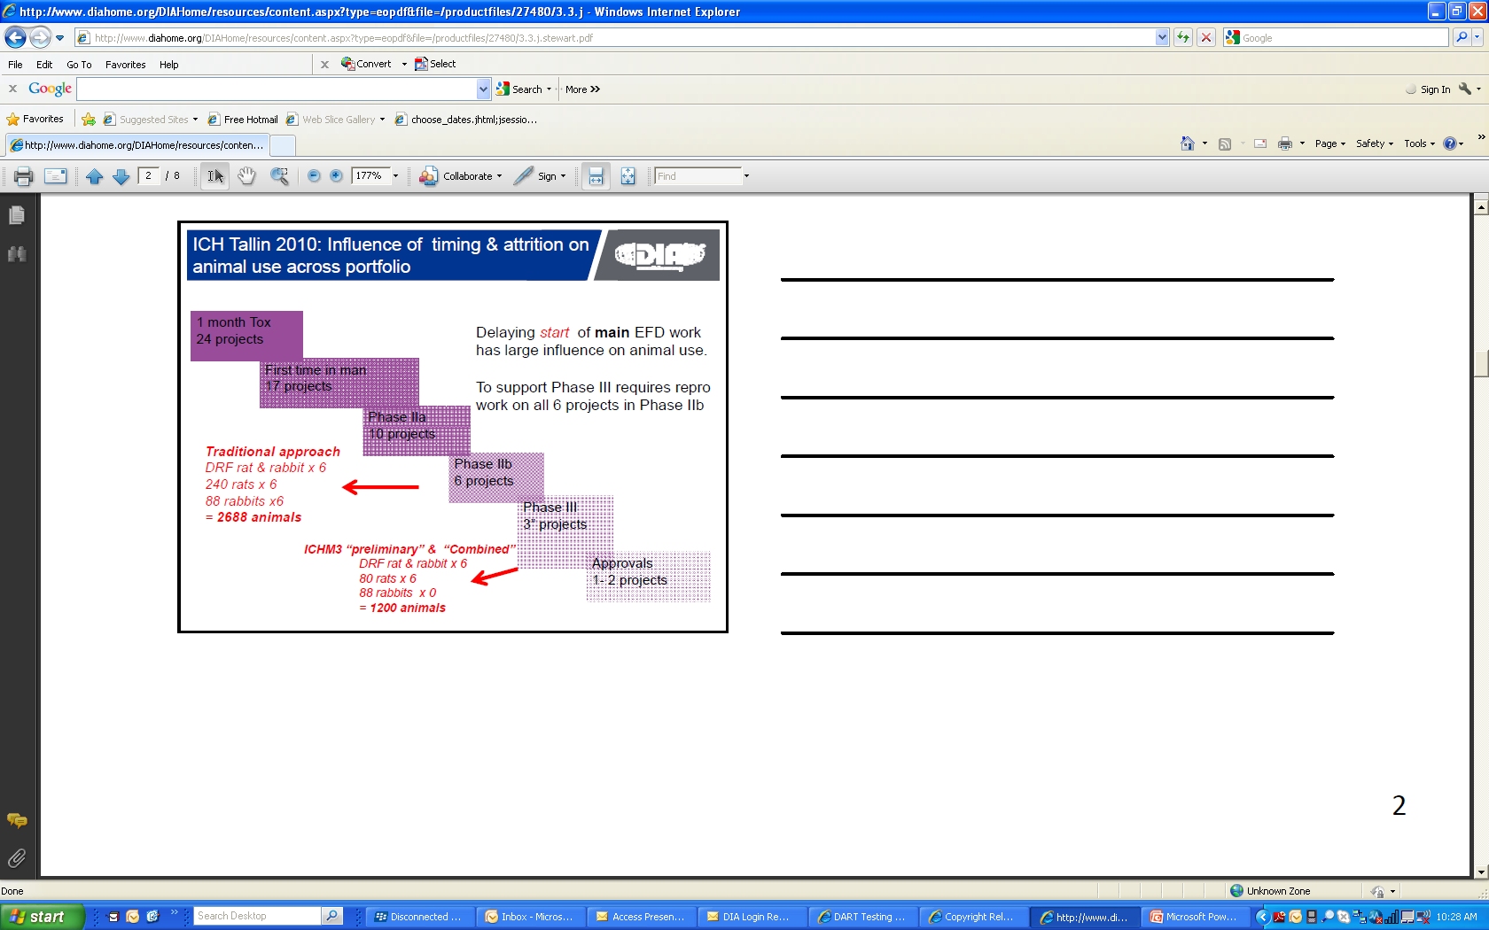
Effect of Timing of Studies – ICH M3
Stewart, 2011

Slide 37
Things We Need to Leverage
Advantage of DART work is that it starts after Phase I so human data on dose levels and PK data should be available.
In vitro metabolism work can help us determine the best species for testing.
In vitro developmental toxicity assays?
Use of surrogates for biologics?
Transgenic mice – knock-in and knock-outs?

Slide 38
Reproductive Toxicology
ICH Guidelines S5A - Choice of Studies
4. Rodent pre-and postnatal developmental toxicity study
Lactation
Pre-mating
Mate
GD 6
Parturition
(GD 21/22)
Weaning
(LD 21)
Examines effect of the test material on late fetal development through parturition and to weaning.
Usually extended to assessing sexual maturation, learning and memory and mating performance of the F1 generation (the offspring born to the dams that were administered the compound).
Notes:
38
Pre & post natal studies determines the effect of the test material on late fetal development through parturition to weaning
These studies includes repeat dosing during organogenesis, because certain effects on this stage may not be evident until examination of live offspring
Also provides information on reversibility of any effects that may have been seen in the embryofetal study
It can also extend to assessing the mating performance of the F1 generation (the offspring born to the dams that were dosed with the compound
Rat pre&post natal
Females dosed from Day 7 (implantation) of pregnancy to Day 22, allowed to litter. Dose females until litter day 22. Assess development of pups.

Slide 39
Further Reductions
Peri-Postnatal Studies
Using control group pups that would normally be euthanized at weaning for:
  Juvenile toxicity study.
  Adding evaluations of developmental immunotoxicity, neurotoxicity, and other endpoints for functional evaluations from in utero and/or lactation exposure.

Slide 40
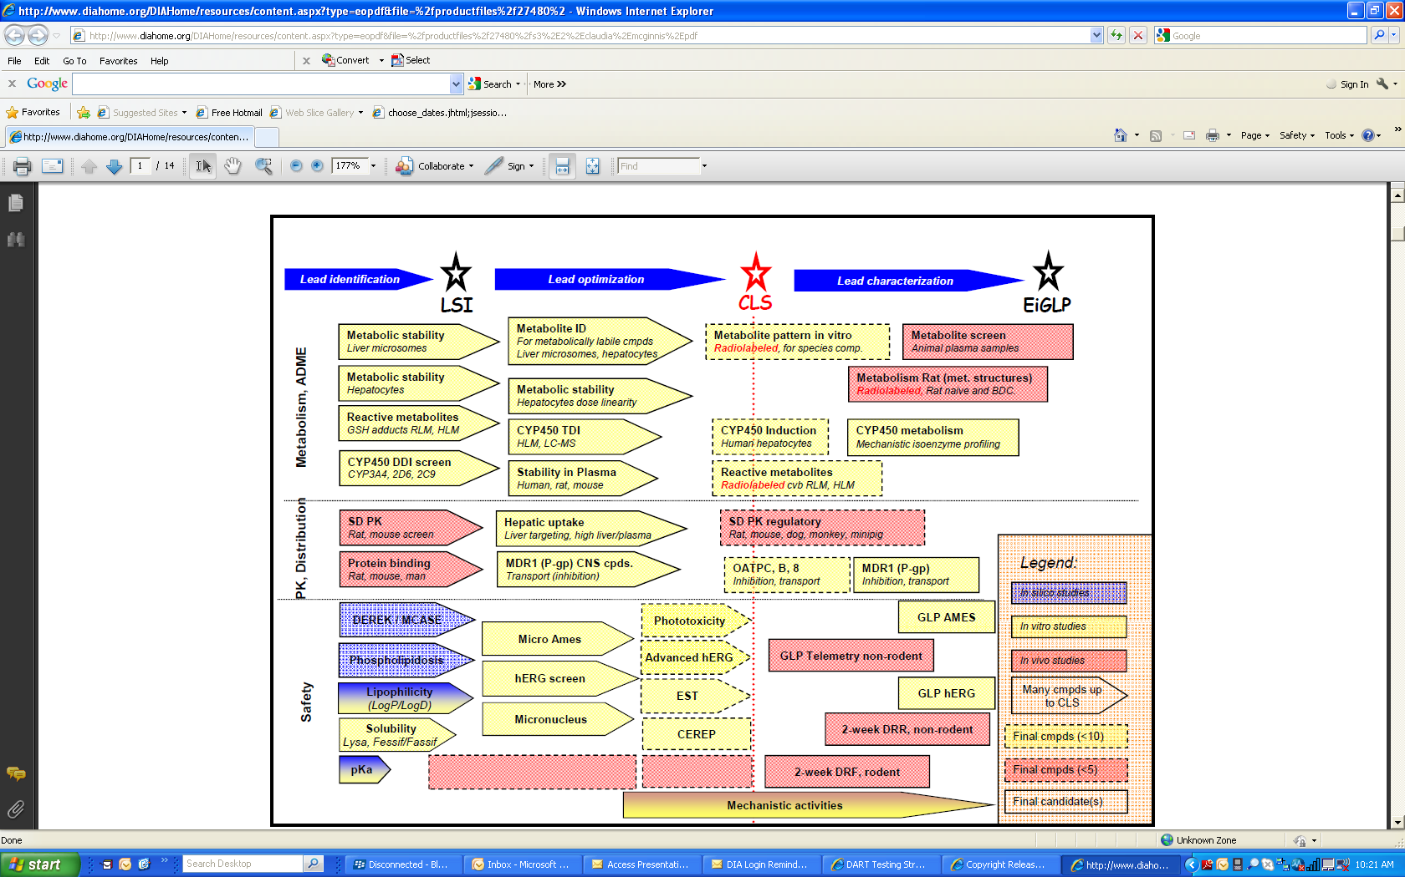
Lead- ID, Optimization, Characterization McGinnis, 2011

Slide 41
Other Useful Information
Look for and use information to design study:
  In vitro Metabolism
    Should include rabbits; many companies only test rats, mice, NHP, dogs and/or human microsomes.
  In Vivo Metabolism
  Secondary and Safety Pharmacology studies
    Identifies receptors and target organs.
    Aids in understanding the effects of exaggerated pharmacology when testing in normal animals.
  Phase I/IIa clinical trials data
    Blood levels and effect levels in man

Slide 42
Other Useful Information
Low toxicity
  Combine all 3 segments in the rodent into one study (similar to a one-generation study)
  Described in the S5 guideline
  Possible reduction of approximately 2300 animals

Slide 43
Pathways to 3Rs
Study Design Improvements
Non-Human Primates

Slide 44
Male Reproduction Stand-Alone Study
(non-mating, sexually mature)
Treatment
Recovery
Week -3
Day 1
Month 3
Month 4
Usually include:
Sperm count, motility
and morphology
Testes volume
Testosterone
Duration spermatogenesis ~45d
Necropsy
Organ weights
Histopathology (option for spermatogenesis eval.)
Typically n=26 NHPs

Slide 45
Male Reproduction in Chronic Toxicity Study
(3, 6, 9 Months)
Dosing
Recovery
Week -3
Day 1
Month 3
Month 4
As needed (ICH S6):
Sperm count, motility
and morphology (at necropsy?)
Testes volume
Testosterone
Duration spermatogenesis ~45d
Necropsy
Organ weights
Histopathology (option: evaluate spermatogenesis)

Slide 46
Female Reproduction Stand-Alone Study
(non-mating, sexually mature)
Observation
Cycles
Treatment
Cycles
Recovery
(1+ cycle)
1
2
3
4
5
6
7
Synchronize dosing to menstrual cycle?
Average NHP cycle length 28-32 days
Necropsy
Organ weights
Histopathology
Usually include:
Menstrual cycles (vaginal swabs)
Hormones:
  Blood samples every 2-3 days, 3 cycles
  (Pre, EOD, EOR)
  Measure E/P (LH/FSH optional)
Typically n=26 NHPs

Slide 47
Female Reproduction in Chronic Toxicity Study
(3, 6, 9 Months)
Observation
Cycles
Treatment
Cycles
Recovery
(1+ cycle)
1
2
3
4
5
6
7
Dosing not synchronized to menstrual cycle
Average NHP cycle length 28-32 days
Necropsy
Organ weights
Histopathology
As needed (ICH S6):
Menstrual cycles (vaginal swabs)
Hormones:
  Blood samples 3x/week for 6 weeks (Pre, EOD, EOR)
  Measure E/P (LH/FSH optional)

Slide 48
Embryo-Fetal Developmental Study (EFD)
Treatment
Pregnancy Monitoring
GD 0
GD 18-20
GD 50
GD 100
Cycle
check
2 months
Mating
Confirm
pregnancy
(ultrasound)
End of
major
organogenesis
C-section
Placenta
Maternal blood
Cord blood
Amniotic fluid
Fetal exams
External
Visceral
Skeletal
Note: extend dosing?
(e.g., MAb’s)
  Biologics: Immunologic Testing
  Flow cytometry (mother)
  Immunoglobulins (mother)
  Immunohistochemistry (fetus)

Slide 49
Pre-Postnatal Development Study (PPND)
Treatment/
Pregnancy Monitoring
Nursing/Behavior
GD0
GD18-20
GD160
PP 3-12M
Cycle
checks
2-3 months
Mating
Confirm
pregnancy
(ultrasound)
Delivery
Mothers: blood/milk
Infants: blood,
physical exams,
neurobehavior
Infant necropsy
Standard tox: clinical signs, BW, TK, clin path, necropsy/histo
Immunologic: flow cytometry, Ig’s, TDAR (KLH), NK cell, IHC
Specialized: fetal measures, infant behavior/learning

Slide 50
Future Vision for NHP DART (2008 SOT)
Can a single, well designed study suffice?
PPN with EFD evaluations conducted postnatal
  No C-sections
  Conduct “fetal” evaluations in infants
    Skeletal exams by radiograph (Month 1)
    External and visceral exams part of necropsy
Use 50% fewer animals + time/cost savings, compared with running separate EFD and PPN studies
Approach defined by ICH and accepted by FDA

Slide 51
NHP Enhanced PPND Study Design (ePPND)
Nursing/Behavior
Treatment/
Pregnancy Monitoring
Skeletal Eval
(Radiograph)
(1 Week or
1 Month)
External Assessment/
Morphometric Eval
(Birth, 1, 3, 6 Months)
Necropsy:
External/
Visceral
Eval
GD0
GD18-20
GD160
PP 3-12M
Cycle
checks
2-3 months
Mating
Confirm
pregnancy
(ultrasound)
Delivery
Mothers: blood/milk
Infants: blood,
physical exams,
neurobehavior
Infant necropsy
Notes:
Target 10-12 live births

Slide 52
Current Trends: ICH S6 (R2)
EFD and PPND
  Combined design as single study (ePPND) acceptable
  2 groups (control + one dose group) may be OK
PPND and ePPND
  Re-use of control maternal animals is encouraged
  Neurobehavior can be limited to clinical behavioral observations (‘instrumental learning’ needs 9M postnatal and not recommended)

Slide 53
Power Analysis of NHP ePPND
Jarvis P et al. (2009) Birth Defects Research (Part B) 89:175-187.
Analysis important to ongoing ICH S6 revision
Guidances provided
  Group size (pregnancies) needed for adequate number of surviving infants (80% probability of 11 live infants if start with 20 pregnancies/group)
  Power of results outcome (81% power to detect 3-fold change in fetal/infant survival if start with 20 pregnancies/group)

Slide 54
Pathways to 3Rs
Procedure Improvements

Slide 55
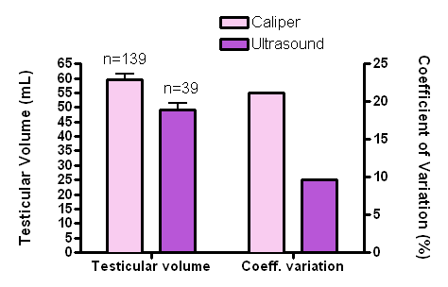
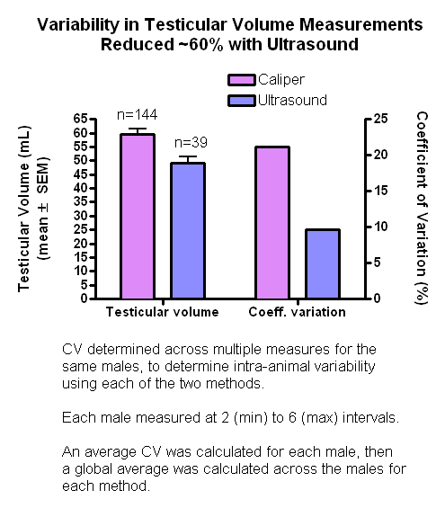
Realizing Method Improvement for Improved Data Quality
J Meyer, C Brockus, A Huff, G Chellman (2010) Teratology Society poster

Slide 56
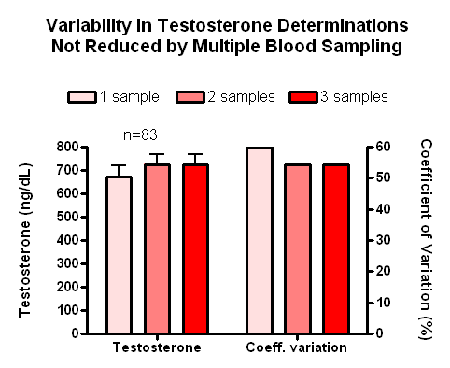
Exploring Method Improvement for Improved Data Quality
J Meyer, C Brockus, A Huff, G Chellman (2010) Teratology Society poster

Slide 57
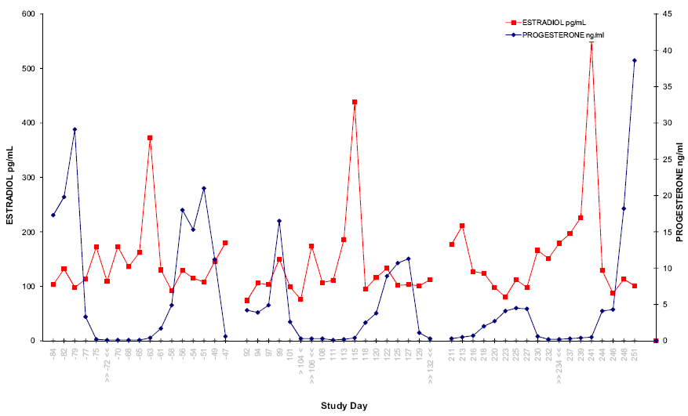
Need for Ovarian Hormone Data to Interpret Menstrual Cycling in NHP
Ovulation in absence of mense
Prestudy
Dosing
Recovery
J Meyer, G Chellman and ONPRC (2011) Teratology Society poster

Slide 58
Microsampling
3R’s program
TK samples have been identified as largest influence on rodent numbers in regulated toxicology
Translation between toxicology end points and exposure data – TK from main study animals
Release blood for other investigations
Exposure data in different study designs
Reduce animal stress

Slide 59
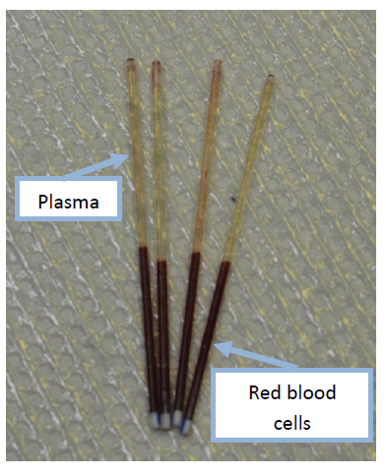
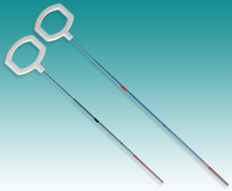
Microsampling
The use of specialised capillaries
Thixotropic Gel

Slide 60
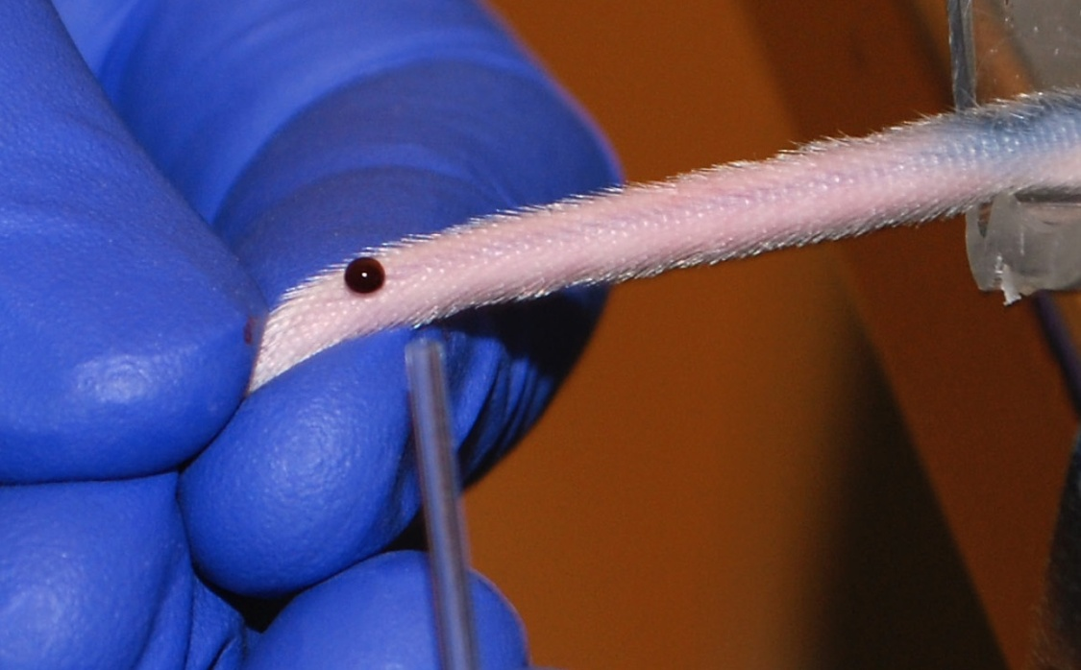
Microsampling - Technique
Use K₂EDTA hematocrit tube (32 µL)

Slide 61
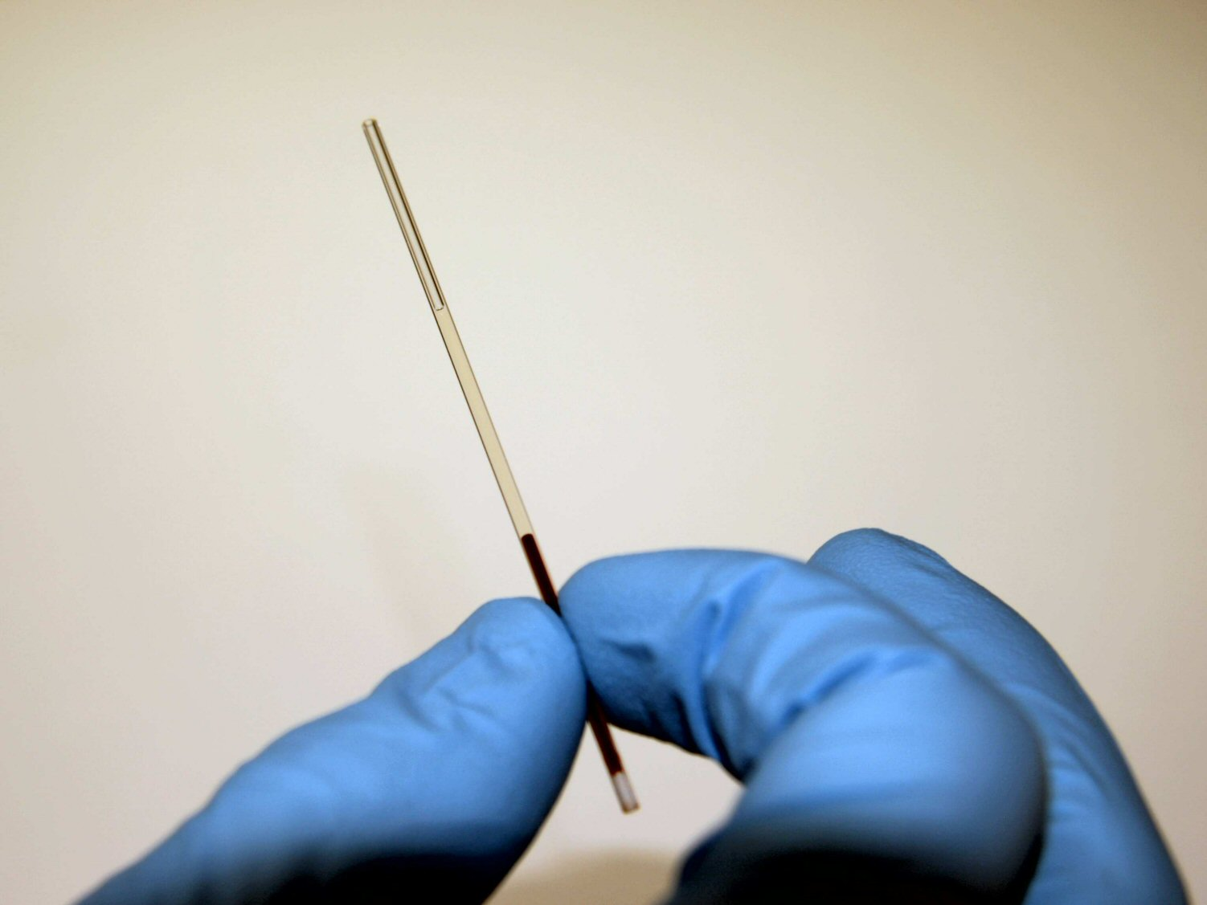
Microsampling - Technique
Seal with wax and centrifuge

Slide 62
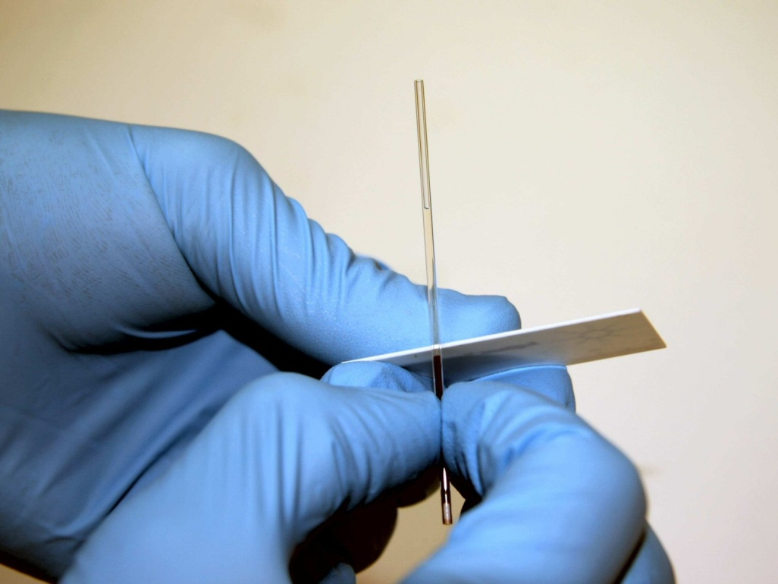
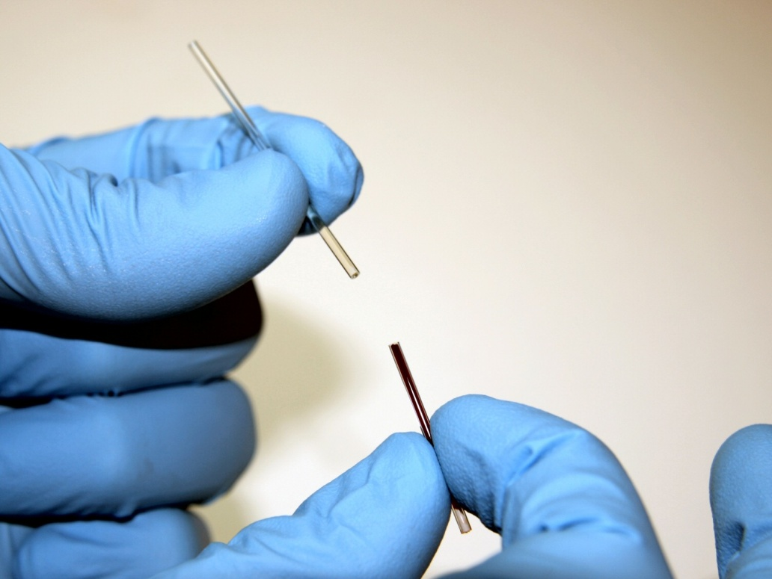
Microsampling - Technique
Cut hematocrit tube to separate plasma

Slide 63
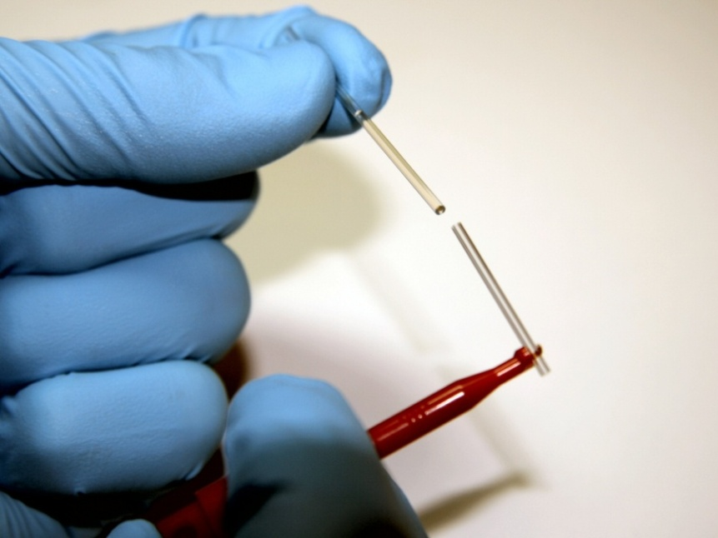
Microsampling - Technique
Transfer plasma sample to an exact volume (8 µL) microcapillary end to end tube (microcapillary can be placed in tube and stored frozen at this stage)
Possibility of smaller plasma volumes (4 µL)

Slide 64
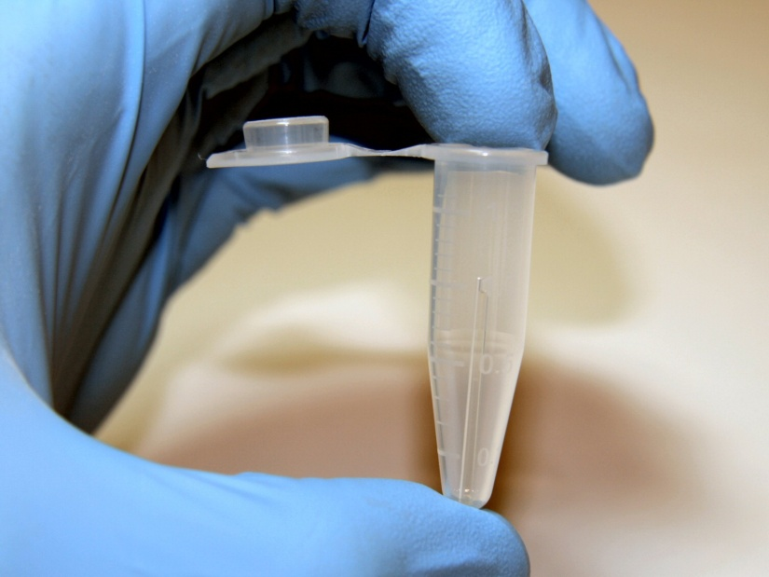
Microsampling - Technique
Wash plasma sample into tube with exact volume of diluent for subsequent storage and analysis of a fraction

Slide 65
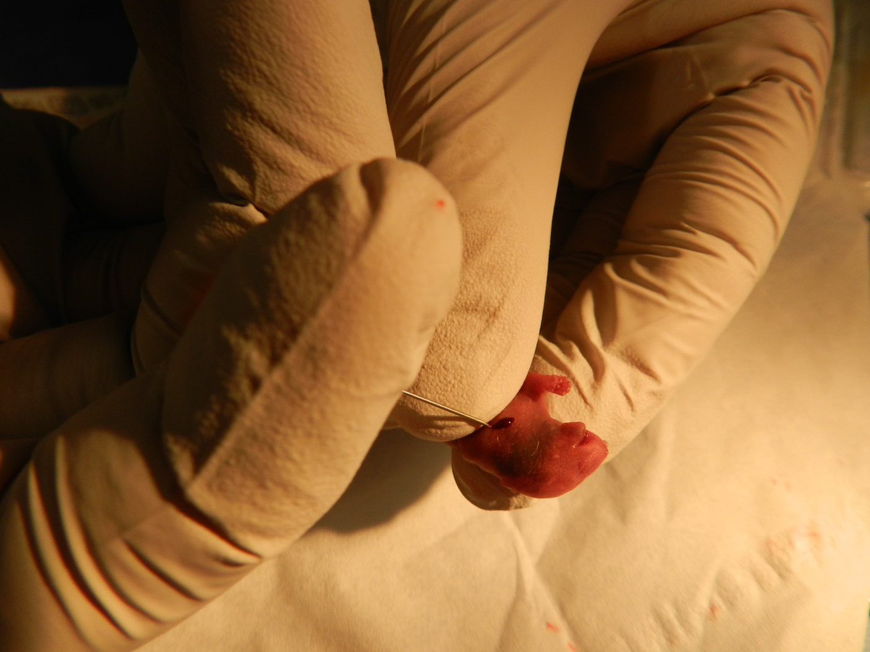
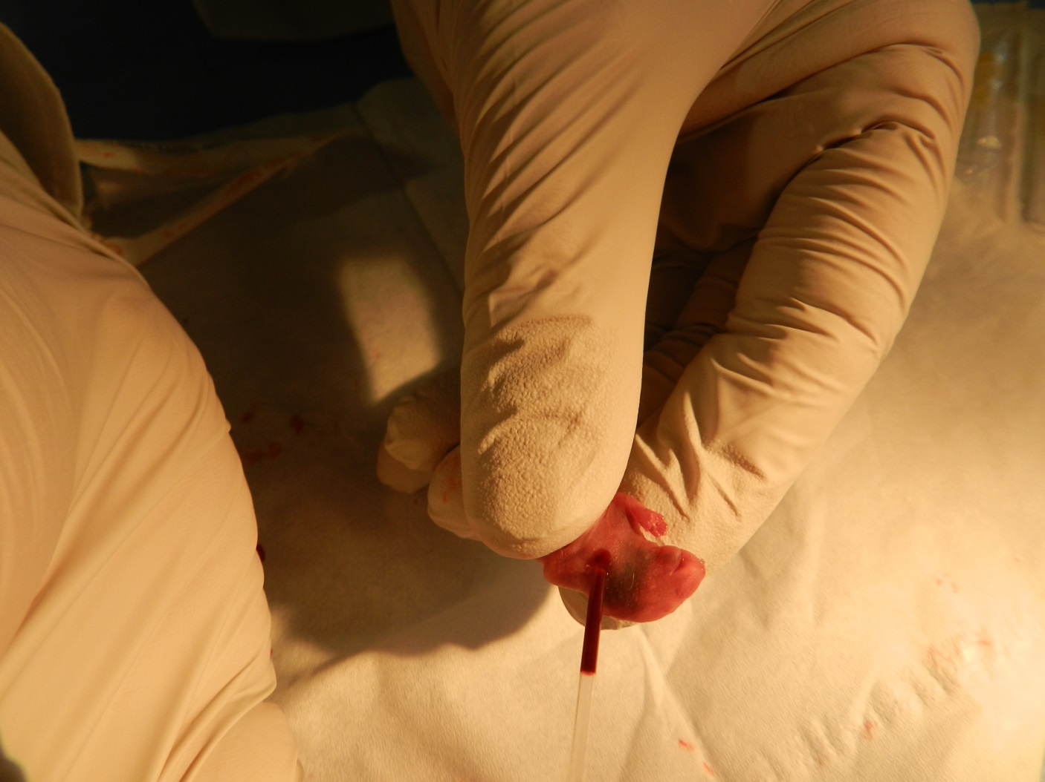

Slide 66
Microsampling from the rat fetus
• Microsampling performed GD 20 by autopsy technicians immediately after blood sampling of the dam
• Blood taken from each available fetus in-situ immediately after excising from the amniotic sac
• Blood drawn into hematocrit K₂EDTA capillaries following puncture of the jugular vein
60 μL capillary (either 30 or 60 μL possible) and 25G needle
• The filled capillary blocked at the entrance with a wax plug and an end-cap

Slide 67
Bioanalytical considerations
Assay sensitivity
  Should not be a problem in most cases
Sample size
  10µl is a standard aliquot for Bioanalysis
  2 µl would be ¼ of the diluted sample
Regulatory acceptance
  Plasma (and serum) are accepted matrices

Slide 68
Microsampling
What are the benefits in Large Molecule Studies?
  Increasing blood draws in NHP studies
    Clinical chemistry, hematology, coagulation, PD markers, Bioanalysis, ADA, immune function tests etc.
    DART studies and sampling from juveniles
  The ability in mouse and rat studies to sample TK and ADA samples from the same animal
  Increased use of transgenic mouse models for biologic drug development
  Permits the increase in the number of assessments required for TK analysis e.g., ADC

Slide 69
Some Basic Rules to Remember
  Animal studies are for hazard assessment.
  Risk assessment
    Uses hazard assessment data as one component.
  Selective developmental toxicity.
    It’s what makes Thalidomide so dangerous and aspirin safe when used properly.
  Extrapolate across species based on blood levels.
  All endpoints need to be considered the same.
    Malformations are just 1 of 4 endpoints that are important.
    Embryo/fetal death, growth retardation, functional deficit.

Slide 70
Some Final Thoughts
Role of the Study Director
  Ensure that the protocol and final report contain good information for justifying doses selected
Role of the Regulatory Reviewer
  Ensure that we (i.e., industry, regulatory agencies) are not just checking the box, but doing what is good science for a particular product.
Consider in vitro tests in the developmental toxicity testing profile.
  As we refine these tests, they will become more useful in our decision-making process, but companies afraid of false positives

Slide 71
Conclusions
Significant reductions in animal usage has been made from the Thalidomide tragedy to today.
Study design considerations that can further reduce small animal usage:
  Female fertility combined with Developmental Toxicity in rodents
  Dosage-range studies
    Getting the right information from fewer animals.
  How many pregnant animals per group do you really need?
  Blood sampling from main study vs. satellite animals.
  New sampling techniques requiring smaller blood volumes (e.g., dried blood spot).
  Compounds with low toxicity – one study

Slide 72
Other Important Considerations
Each preclinical program is unique
  No “one size fits all”
Specialized approaches
  Life-threatening indications, dermal products, ocular products, imaging agents
Importance of assay development
  Dose solution analysis, serum/plasma drug concentration, immunogenicity
Test article supply
  Can be a concern for pre-IND studies
Communication/coordination between preclinical and clinical development is essential
  Route of administration (ROA), dosing frequency, duration
Utilize available resources
  Guidance documents, regulatory agencies, colleagues/internal experts, consultants

Slide 73
Thank You

Slide 74
CONTACT US
Alan M. Hoberman, PhD, DABT, Fellow ATS
Alan.hoberman@crl.com
A
Address:
251 Ballardvale Street
Wilmington, MA
01887
Website:
www.criver.com
Email:
askcharlesriver@crl.com
Phone:
877.CRIVER.1

Slide 75

Implementation of the 3Rs at Charles River
Internal Working Group
Intranet 3Rs page
Intranet CR 3Rs team site
Mandatory 3 module 3Rs training for Study Directors
Articles in Newsletter
Notes:
The Charles River Executive Committee established the 3Rs Working Group in 2011 to increase the focus on the 3Rs: Replacement, Reduction and Refinement; throughout Charles River businesses.
Intranet 3Rs page provides information on 3Rs activities within Charles River as well as providing links on the 3Rs external to Charles River.
Intranet CR 3Rs team site is for Scientific staff interested in the 3Rs at Charles River, current offerings and those in development, They can find detailed information on this Team Site.
Articles in Newsletter highlight how the 3Rs are being implemented at CR – audience is the general CR employee
(3Rs Mark owned by CR)

Slide 76

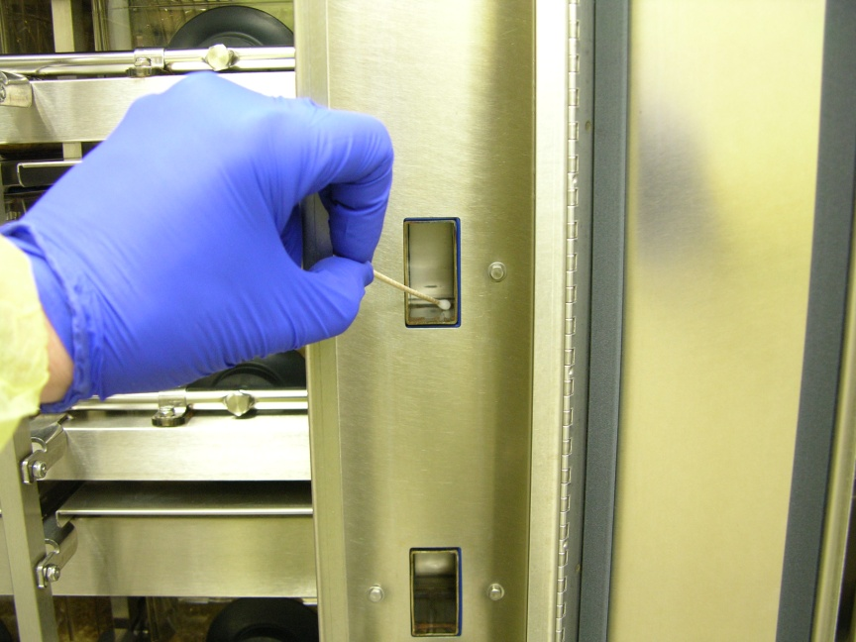
Implementation of the 3Rs at Charles River
Reduction & Replacement - Increase molecular diagnostics for health monitoring of CR colonies
  Dried Blood Spot
    Survival blood collection of sentinels or colony animals (augments or replaces sentinels)
  PCR
    Direct agent detection anywhere dust collections
    Replacement – no animals required
    Refinement – sentinel animals are not repeatedly stressed through exposure to unfamiliar scents though exposure to dirty bedding.
    Reduction – workload and costs of sentinels but also possibility to inadvertently contaminate (fomite transmission through handling) other animals on the IVC rack by exposing them to potential pathogens carried by sentinels

Slide 77
Implementation of the 3Rs at Charles River
Replacement –
  Utilization of in vitro technologies
    in vitro assays for skin penetration have almost totally replaced animals in cosmetic, agrochemical, chemical testing and some pharma testing as well
    in vitro assay (EpiSkin) assay for skin irritation
    DPRA assay for skin sensitization in validation stages
    EpiOcular, HCE and BCOP in use or validation stages for ocular toxicity
    MucilAir ™ model for inhalation toxicology screening
    3T3 NRU Phototox Test
    Genetox
      Bacterial Mutation Assay (Ames) and Ames MPF
      Mouse Lymphoma, chromosomal aberrations and in vitro micronucleus
      BlueScreen
    Validation of zebra fish assay for embryotoxicity
    To mention just a few!

Slide 78
Regulatory – Adverse Outcome Pathways
Not a new concept (eg Genetox)
  Bacterial (Ames)
  Mammalian
    MLA, chromosomal aberrations, in vitro MNT
  Positive – stop – replacement
  Negative – go - screen
  In vivo MNT – final test, should contain only negatives
These give us decision trees, following are some typical examples already used.

Slide 79
Photosafety Decision Tree
3T3 NRU ASSAY
POSITIVE
NEGATIVE
PRECLINICAL
IN VIVO TESTING
STOP, or LABEL
NO FURTHER
TESTING
POSITIVE
CLINICAL
TESTING
NEGATIVE
Notes:
The photosafety decision tree allows for multiple approaches, as outlined in the ICH S10 guidance for the Photosafety Evaluation of Pharmaceuticals. If the test material fulfills one or more of these criteria; absorbs between 290 and 700 nm, distributes sufficiently to sun exposed tissues (skin or eye) and generates a reactive molecular species following absorption of UV or visible light, then photosafety evaluation is recommended. The first step is the in vitro 3T3 neutral red phototoxicity test. If this is negative, in general no further testing is necessary. If positive, development can be stopped, the drug labeled as having phototoxic potential, or preclinical in vivo testing performed. If this is negative, no further testing is required. If positive, development can be stopped, the drug labeled as having phototoxic potential, or clinical testing performed. If negative, then there is no photosafety liability. If positive, then development can be stopped or the drug labeled as having phototoxic potential. Early consultation with CRL experts at the Horsham PA site is the best approach when addressing photosafety issues.

Slide 80
Dermal Absorption Decision Tree
OECD 428 in vitro skin penetration
Pharmaceutical – formulation selection
Cosmetic/ consumer
Agrochemical
SCREEN
DIRECT REPLACEMENT
DIRECT REPLACEMENT or SCREEN
AGROCHEMICAL
ACCEPTABLE MOS
UNACCEPTABLE MOS
REPLACEMENT
SCREEN
NO FURTHER
TESTING IS NEEDED
CONDUCT
IN VIVO TESTING

Slide 81
Integrated Cardiovascular
Safety Assessment Decision Tree
REPLACEMENT
hERG
STOP
NEGATIVE
POSITIVE
Assess MoS
in vivo
NEGATIVE
in vitro/ ex vivo
REPLACEMENT

Slide 82
Ocular Irritation Decision Tree
MatTek EpiOcular or Skin Ethic HCE
BCOP
EPA/ industry proposal for household chemicals
IN VITRO ASSAYS
ACCEPTABLE MOS
UNACCEPTABLE MOS
REPLACEMENT
SCREEN
NO FURTHER
TESTING IS NEEDED
CONDUCT
IN VIVO TESTING
REPLACEMENT

Slide 83
Implementation of the 3Rs at Charles River
Reduction
  Enhanced male and female reproduction studies in NHPs
  Enhanced PPND Study designs
  Measurement of endocrine parameters via survival blood sampling rather than terminal time points
  in vivo micronucleus assay integrated into 28 or 14 day studies rather than done as stand alone test
    Use of positive control stock slides to reduce positive control groups
  Working with customers to identify opportunities to increase balanced gender selection for studies to decrease “surplus” animals produced to meet ‘uni-gender’ requirements and address NIH focus on cross gender studies

Slide 84
Implementation of the 3Rs at Charles River
Refinements
  Use of one handed jugular blood collection in rats
  Juvenile studies - addition of microsampling and one handed jugular blood collection in rats
  Enhanced nhp socialization strategies to almost eliminate conspecific injury in nhps
  Increased social housing of rodents at all CR PCS sites
  Use of microsampling for large animal studies
  Enhanced caging
    Solid bottom caging for rodents in PA (addition of tunnel washer)
    EU rabbit caging MTL

Slide 85
Summary
A strong program of animal welfare:
  Begins with people;
  Has a strong and ongoing training program which includes topics in animal welfare;
  Establishes an open environment where employees are empowered to contribute to a culture of caring;
  Recognizes excellence;
  Develops ways to harmonize “best practices”;
  Is committed to ongoing enhancements of animal environments;
  Looks for ways to implement the 3rs and
  Reaches out to others to share ideas about programs to enhance animal welfare and the 3Rs.

Slide 86

Good Animal Welfare =
Meeting our obligation to the animals
Meeting our obligation to each other
Meeting our obligation to the company
Meeting our obligation to the sponsors through good science and better results
Meeting our obligation to the public, who allows us to use animals

Slide 87
References
Chellman GC et al. 2009. Developmental and reproductive toxicology studies in nonhuman primates. Birth Defects Research (Part B) 86:446-462.
Chapman et al. 2009 Preclinical development of monoclonal antibodies: Considerations for the use of non-human primates. Landes Bioscience 1(5):505-516.
Martin P and Weinbauer GF. 2010. Developmental toxicity testing of biopharmaceutical in nonhuman primates: Previous experience and future directions. Int J Toxicol 29(6):552-568.
Cappon GD et al. 2011 Power analysis of learning and memory data from a NHP ePPND study. Toxicologist

Slide 88
CONTACT US
Alan M. Hoberman, PhD, DABT, Fellow ATS
Alan.hoberman@crl.com
A
Address:
251 Ballardvale Street
Wilmington, MA
01887
Website:
www.criver.com
Email:
askcharlesriver@crl.com
Phone:
877.CRIVER.1

