Slide 1
SEPSIS IN CIRRHOSIS
EMERGING CONCEPTS IN PATHOGENESIS, DIAGNOSIS AND MANAGEMENT.
Prof. ALAAELDIN IBRAHIM (M.D)
Prof. of Medicine
Former Chair of GI/Liver Decision
University of Benha, Egypt
ECM of APASL, EASL,ASGE member
Chair of Public Health committee and liver Awareness Program, APASL
Consultant at ACDS, Abu Dhabi, UAE

Slide 2
Disclosures
International speaker for APASL

Slide 3
Introduction

Slide 4
Background
Sepsis in cirrhotics portend grave prognosis.
Even as science has grown vastly and understanding of sepsis has broadened, the mortality associated with this condition in cirrhosis is still quite high.

Slide 5
Aim Of The lecture
In this lecture, a comprehensive discussion on emerging concepts in pathogenesis of sepsis in the light of cirrhosis has been made
The diagnosis and current cutting edge management of this fatal condition and future treatment modalities are discussed, so as to entertain a holistic management in the critically ill cirrhotic.

Slide 6
INTRODUCTION - DEFINING SEPSIS
The word sepsis comes from Greek meaning ‘decay’ or ‘to putrefy’.
Sepsis is an aftermath of the host micro-organism interaction.

Slide 7
INTRODUCTION - DEFINING SEPSIS
This interaction progresses through various levels, to ultimately culminate into multiple organ dysfunction syndrome (MODS).
Systemic inflammatory response is the initial response to invasion by microorganism.
The step wise progression includes infection by an organism, induction of systemic inflammatory response syndrome (SIRS),→ sepsis,→ severe sepsis, → septic shock and finally, →multiple organ system dysfunction.

Slide 8
INTRODUCTION - DEFINING SEPSIS
Bone et al provided simplified definitions for:
- Sepsis, as SIRS plus infection,
- Severe sepsis as sepsis associated with organ dysfunction, hypoperfusion, or hypotension,
- Septic shock as sepsis with arterial hypotension, despite adequate fluid resuscitation.
Bone RC,etal. Chest. 1992 Jun; 101(6):1644-55.

Slide 9
INTRODUCTION - DEFINING SEPSIS
Not all patients harbouring infection have sepsis.
In fact, a large proportion of patients develop SIRS are secondary to non-infective causes such as acute pancreatitis, severe burns, trauma, transplant organ rejection and autoimmune diseases.
This has resulted in a divide which has sepsis on one side and sterile inflammation on the other.

Slide 10
INTRODUCTION - DEFINING SEPSIS
If we were to define sepsis by the presence of SIRS criteria plus an infection (proven or suspected), then almost every acutely ill patient meeting the SIRS criteria, has sepsis and sepsis becomes synonymous with infection.

Slide 11
INTRODUCTION - DEFINING SEPSIS
Recently, at the Merinoff Symposium on sepsis, the latest perception of sepsis was defined.
Here it was defined as: life threatening condition that arose when the body’s response to an infection damages its own tissues and organs.
Czura CJ. Mol Med. 2010 May-Jun;16 (5-6):157-8.

Slide 12
STERILE INFLAMMATION

Slide 13
STERILE INFLAMMATION
Sterile inflammation has similarity to microbial induced inflammation and involves recruitment of neutrophils and macrophages that result in pro-inflammatory and anti-inflammatory cytokines and chemokines.
Uncontrolled sterile inflammation leads to tissue damage and organ failure.
This is by way of reactive species formation that results in tissue destruction and fibroblast proliferation with aberrant collagen deposition and fibrosis.

Slide 14
STERILE INFLAMMATION
Specialized receptors termed: pattern recognition receptors (PRRs) mediate micro-organism sensing, resulting in pro-inflammatory cytokine dysregulation.
They sense structural moieties found in the invading organism which are called: pathogen associated molecular patterns or PAMPs.
Takeuchi, O., et al 140, 805– 820 (2010).

Slide 15
STERILE INFLAMMATION
There are 5 classes of PRR’s that include:
(1) TLRs: Toll like receptors (transmembrane proteins at the cell surface/in endosomes),
(2) RIG LRs: (located intracellularly),
(3) NOD LRs: (located in the cytoplasm),
(4) CLRs: C type lectin receptors: (transmembrane receptors with carbohydrate binding domain) and absence in melanoma
(5) AIM2 LRs, consisting of pyrin domain and DNA binding domain involved in intracellular microbial DNA detection) like receptors.

Slide 16
STERILE INFLAMMATION
Activation of these receptors promote down-stream signalling pathways like: nuclear factor kB, mitogen activated protein kinase MAPK and type I interferon INF1 resulting in up-regulation of pro- inflammatory cytokine and chemokines.
Apart from infectious particles, PRR recognizes non infectious agents also that cause tissue destruction and other endogenous molecules released during cell injury.
These endogenous molecules are termed damage associated molecular patterns or DAMPs and are host derived non microbial stimuli that activate pro- inflammatory pathways.
Zhang, Q. et al.. Nature 464, 104–107 (2010)

Slide 17
STERILE INFLAMMATION
Even though heterogeneous, DAMPs still promote uniform sterile inflammatory responses to stimuli by PPR activation, direct activation of inflammation by receptors that are not conventionally associated with microbial recognition through release of intracellular cytokines.
Toll like receptors recognize endogenous molecules apart from PAMPs.
These matrix and include: intracellular proteins like heat shock protein HSP , S100 protein, uric acid, HMGB2 and nucleic acids as well as extracellular components like hyluronan and heparin.

Slide 18
STERILE INFLAMMATION
TLR4 mediates inflammatory responses to free fatty acids, which are elevated in cytokine production within the sterile environment of liver.
This activation is mediated by mediators of sterile inflammation through IL-1 receptor.
In animal models, deficiency of IL- 1 receptor decreased neutrophilic activity and inflammation in liver after acetaminophen induced damage.

Slide 19
STERILE INFLAMMATION AND THE INFLAMMASOME

Slide 20
STERILE INFLAMMATION AND THE INFLAMMASOME
The inflammasome is a multiprotein complex which consists of a (1) sensor and an (2) adapter protein and (3) the inflammatory protease caspase-1.
Ultimate effect in inflammasome assembly is: activation of caspase-1 which in turn leads to activation of interleukin-1β and IL-18.
The receptors that are associated with inflammasome formation are 4 in number and include: 3 Nod like receptor family proteins NLR (NLRP1 NLRP3 and NLRC4) and AIM2, a receptor of HIN family of proteins.
Out of these, NLRP3 inflammasome formation is of utmost importance and has been studied extensively.
Duewell, P. et al.. Nature 464, 1357–1361 (2010).

Slide 21
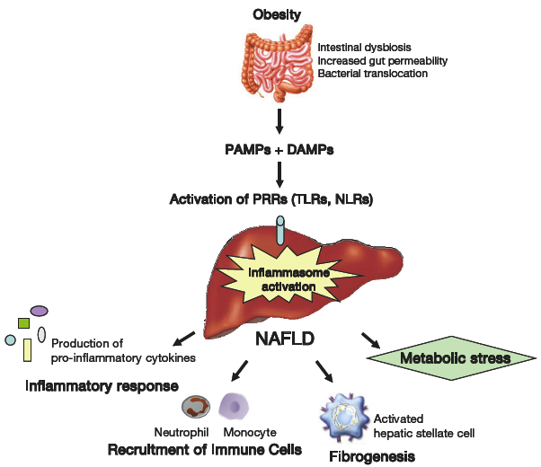

Slide 22
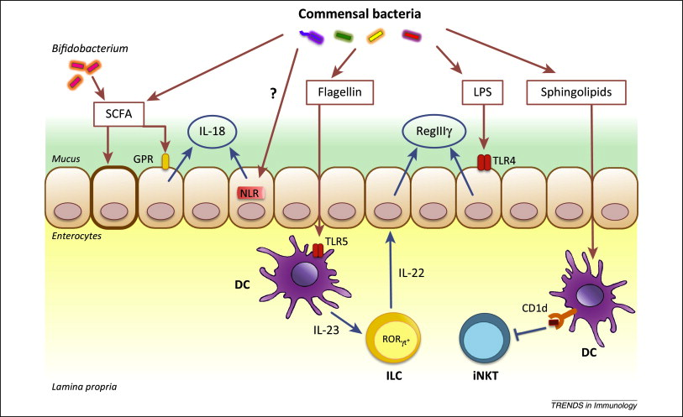

Slide 23
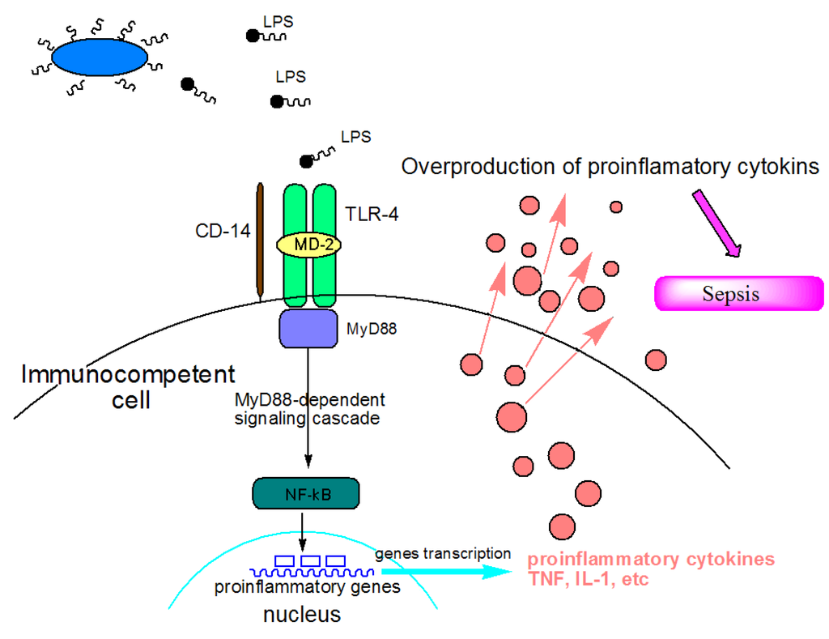

Slide 24
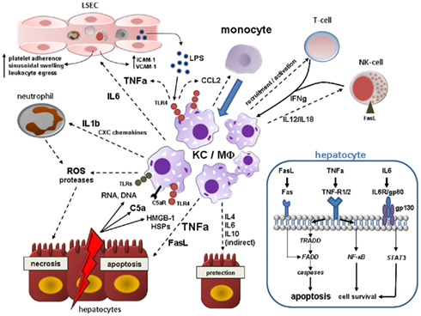

Slide 25
SEPSIS IN CIRRHOSIS

Slide 26
SEPSIS IN CIRRHOSIS incidence and Prevalence
The annual incidence of sepsis is 300 in 100,000 patients or 1 in 100 hospital admission for any cause.
In cirrhosis, sepsis is present in 30 to 50% of hospital admissions.
In hospital, 15 to 35% of cirrhosis patients develop nosocomial sepsis in comparison to 5 to 7% seen with general population.

Slide 27
SEPSIS IN CIRRHOSIS
Mechanisms of immunity impairments in cirrhotics
(1) Down regulation of monocytic human leukocyte antigen DR expression (mHLA-DR).
(2) Impairment in antigen presentation.
(3) Lower complement levels.
(4) Macrophage dysfunction due to weak Fc receptor mediated bacterial clearance all impair immunity in liver disease.
It has been shown that neutrophilic phagocytic activity and intracellular killing is decreased in patients of cirrhosis.

Slide 28
SEPSIS IN CIRRHOSIS
Bacterial Infections in cirrhotics
The most common bacterial infection in cirrhosis is: spontaneous bacterial peritonitis (SBP, 25 to 30%) followed by genitourinary infections (UTI, 20 to 25%), pneumonia (20%) and soft tissue infections (11 to 12%).
Around three fourths of infections in cirrhosis are related to gram negative bacteria.

Slide 29
SEPSIS IN CIRRHOSIS
Cirrhosis patients on antibiotic prophylaxis and compared to general population, those who undergo invasive procedures are at risk of developing gram positive infections.
Prevelance of bacteruria is around 18% in cirrhotics.
Community acquired pneumonia, similar infections are associated with: (1) multi lobar involvement, (2) hepatic encephalopathy and (3) multi organ failure.

Slide 30
LIVER FAILURE AND SEPSIS

Slide 31
Liver failure begets sepsis begets liver failure

Slide 32
LIVER FAILURE AND SEPSIS
TLR-4 in cirrhotics
In the event of sepsis initiation, the initial proinflammatory host response is exaggerated.
In animal models, the TLR-4 activation by Gram negative bacilli product, most importantly lipopolysaccharides induces heavy circulating levels of IL- 6 and TNF-α

Slide 35
LIVER FAILURE AND SEPSIS
Defective imunity in cirrhotics
(1) This TNF-α production is higher in Child C cirrhosis than in Child B or A, proving a point that: underlying severity of liver disease drives excessive innate immune response that is uncontrollable.
(2) There occurs a reduction of inhibitor IL-1 receptor associated kinase M in monocytes of cirrhosis patients which lead to excessive production of TNF-α.
(3) Monocytes in end stage liver disease are defective in lipopolysaccharide induced anti-inflammatory cytokine, IL-10.

Slide 36
LIVER FAILURE AND SEPSIS
Sepsis due to Gram + cocci
With regards to: Gram positive cocci sepsis, the inflammatory starts with the TLR2 signalling.
Monocytes in such scenario produce excess of IL-8, as a response to Gram positive infection, due to response against the bacterial by product lipotecholic acid and peptidoglycan.

Slide 37
LIVER FAILURE AND SEPSIS
Anti-apoptotic pathway NF-KB
In the wake of excessive TNF-α production, the normal hepatocytes are protected by the anti-apoptotic pathway, NF-kB.
The deficiency of such a pathway in cirrhosis (due to inhibition of translation of NF-kB dependent anti-apoptotic messenger RNA, secondary to endoplasmic reticulum stress) promotes hepatocyte death.

Slide 38
LIVER FAILURE AND SEPSIS
LPS & Endothelin-1
Lipopolysaccharides mediate endothelin 1 mediated neutrophil infiltration and hepatocyte necrosis.
Hence two major pathways,: (1) TNF- α related apoptosis and (2) endothelin – 1 mediated hepatocyte necrosis function to severely worsen liver failure in sepsis, in both, endoplasmic reticulum stress plays a major role.

Slide 39
LIVER FAILURE AND SEPSIS
The Heart
The hyperdynamic state in cirrhosis, with
high cardiac output,
(3) low arterial pressure and
(4) low peripheral vascular resistance is further worsened in the wake of sepsis.
This leads to → profound left ventricular dysfunction leads to shock.

Slide 40
LIVER FAILURE AND SEPSIS
The Kidney
Renal failure is a major component of multi organ failure in cirrhosis.
In patients with SBP, 33% have associated renal failure.
There occurs, pre renal acute kidney injury in sepsis due to relatively low arterial volumes damage the renal vasculature and eventually leading to parenchymal insult.

Slide 41
LIVER FAILURE AND SEPSIS
Organs in septic cirrhosis patients
In the lung: in septic cirrhosis patients, the antimicrobial activity, alteration of T lymphocyte subsets and increased capillary permeability, pulmonary baseline cellular functions are altered, there is reduction in alveolar macrophage.
In the blood: Tissue factor activation in severe sepsis promotes deficiency of factors V, VII, X, prothrombin, protein C, anti thrombin and thrombocytopenia in cirrhotic patients.
In the Brain: Cerebral tissue dysfunction in cirrhosis and severe sepsis can be allocated to the high circulating TNF-α, IL-6 and IL-8 and increase in toxic metabolite levels such as ammonia
In the heart: there is profound left ventricular dysfunction leading to shock.
In the Kidney :Renal failure is a major component In sepsis, pre and its pathophysiology in sepsis is similar to convention.

Slide 42
Diagnosis of sepsis

Slide 43
DIAGNOSIS OF SEPSIS
Serumprocalcitonin (PCT) is a precursor of the calcitonin hormone and is synthesized by the thyroid C cells.
Under normal conditions: the serum levels of PCT are below 0.1 ng/mL.
In the presence of bacterial sepsis: PCT synthesis occurs in various extra thyroidal neuroendocrinal sites.
Elefsiniotis IS et al.. Eur J GastroenterolHepatol2006; 18: 525–30.

Slide 44
DIAGNOSIS OF SEPSIS
PCT levels in Sepsis
Bacterial infections are strongly associated with rise in PCT, rather than viral or fungal infections.
In the presence of bacterial infections, the PCT rise occurs at four hours after the onset of systemic illness and peaks between 8 to 24 hours.
No specific cut off for PCT has been recommended to confidently confirm the presence of bacterial sepsis in cirrhosis patients and therein lies the dilemma in using this modality as the single most test of choice.

Slide 45
DIAGNOSIS OF SEPSIS
CRP levels in Sepsis
The C reactive protein CRP, on the other hand, rises slowly and peaks only after 36 hours after endotoxemia.
Procalcitonin clears rapidly (half life 24 hours) from the circulation, as against CRP, which takes many days after the systemic illness to normalize.
Cervoni JP, etal J Hepatol. 2012 Jun; 56(6):1299-304.
Lazzarotto C, et al.. Ann Hepatol2013;12:599-607.

Slide 46
DIAGNOSIS OF SEPSIS
Papp and coworkers in 2011 performed a large study on 368 patients of cirrhosis with bacterial infections, to provide insights on the most valuable acute phase reactants in diagnosis of sepsis in cirrhosis.
They concluded in their study that: “C-reactive protein (CRP) alone, in titers more than 10 mg/dL was sufficient to predict presence of bacterial infections in cirrhosis”.

Slide 47
DIAGNOSIS OF SEPSIS
Biomarkers in sepsis
Several biomarkers, other than CRP and PCT have been proposed to have good utility in sepsis.
^{These include:}
^{- Adrenomedullin,}
^{- Resistin,}
^{- Pro-vassopressin or}
⁻ Copeptin, various interleukins,
- Trigger receptor expressed on myeloid cells-1 (TREM-1) –
^{- Eosinophil counts.}
These are found to be useful within research modules but utility in day to day clinical use has not been yet validated
.
Lazzarotto C, et al. Ann Hepatol2013;12:599-607.

Slide 48
DIAGNOSIS OF SEPSIS
Other markers of sepsis that have been studied include eosinopenia, in which, Abidi and colleagues found that with an AUROC of 0.89, “serial eosinophil count reaching a cut off of 50 cells/mm3 was found to be helpful in delineating infected from non infected”.
Abidi K etal.Crit Care 2008; 12:R59

Slide 49
DIAGNOSIS OF SEPSIS
^{Serum phospholipase A2}
^{In} another study, serum phospholipase A2 and PCT was found to be noninferior to CRP with regards to early bacteremia in patients of sepsis.

Slide 50
Diagnosis of Sepsis
^{APTT}
Another important finding in diagnosing early sepsis is the dynamic variation of activated partial thromboplastin (APTT) time waveforms.
Chopin N, et al, Crit Care Med 2006; 34: 1654–60.

Slide 51
DIAGNOSIS OF SEPSIS
Waveforms
The specificity of a biphasic waveform was found to be between 92% and 98% for diagnosis of sepsis at admission.
This was further validated against CRP and PCT in by Chopin and colleagues.
They found that: the biphasic variation in APTT was more useful than CRP or PCT in differentiating severe sepsis from septic shock during initial 3 days of admission (specificity 91% and negative predictive value 98%).
By combining PCT with APTT variation, “the sensitivity could go up to 98% in diagnosing patients of sepsis”.
Zakariah AN, et al.. Crit Care Med 2008; 36: 1507–12.

Slide 52
DIAGNOSIS OF SEPSIS
Pro-adrenomedullin and pro-vasopressin
Pro-adrenomedullin (p-ADM) and pro-vasopressin (or copeptin) was found to be significantly elevated in patients who died of septic shock in a study by Guigant and coworkers.
The combined use of two biomarkers has been long touted as : “the best way to predict sepsis in a patient”, as it has been shown with pro-ADM and endothelin precursor which had a higher prognostic accuracy than CRP and had comparable power with APACHE scores.
Guignant C, et al,. Intensive Care Med 2009; 35: 1859–67

Slide 53
Thromboelastography (TEG)
Studies currently have also looked into the utility of thromboelastography (TEG) in diagnosing early sepsis and differentiating sepsis from SIRS.
In a meta analysis by Muller and co-workers, it was shown that hyper and hypo-coagulability were both associated with disseminated intravascular coagulation.
Earlier detection of fibrinolysis by TEG, differentiated early sepsis from SIRS.
The presence of progressive hypo-coagulation associated with sepsis portrayed a poor prognosis.

Slide 54
DIAGNOSIS OF SEPSIS
Predictor of mortality

Slide 55
DIAGNOSIS OF SEPSIS, Predictor of mortality
Pro-ANP and Pro-BNP
Pro-atrial natriuretic peptide (pro-ANP) and pro-brain natriuretic peptide (pro- BNP) measured on days: 0,2 and and 4 respectively has been shown to be: independent predictors of mortality on multivariate analysis of patients in severe sepsis progressing to shock.
Ueda S, et al. Shock 2006; 26: 134–9.

Slide 56
DIAGNOSIS OF SEPSIS, Predictor of mortality
MMP, IL-6, IL-8
Even though: markers such as matrix metalloproteinases (MMP-9, TIMP-1, TIMP-2) and interleukins (IL-6 and IL-8) were also found to be elevated in patients of sepsis and septic shock.
Their validity in diagnosing presence of sepsis was not as comparable to PCT and are better predictors of death.
Hoffmann U, et al. Scand J Infect Dis 2006; 38: 867–72.

Slide 57
DIAGNOSIS OF SEPSIS, , Predictor of mortality
TGF-
In a study by Wu and colleagues, transforming growth factor- (TGF-) was found to be:
“an independent predictor of mortality” in severe sepsis.
Wu HP, et al J Formos Med Assoc2009; 108: 20–7.

Slide 58
DIAGNOSIS OF SEPSIS, Predictor of mortality
Resistin
Another new marker of mortality in sepsis is Resistin.
This marker has been found to be independently related with prediction of morality in critically ill patients with and without sepsis.
Sunde-Cullberg J, et al. Crit Care Med 2007; 35: 1536–42.

Slide 59
DIAGNOSIS OF SEPSIS, Predictor of mortality
Presepsin
Presepsin is a novel biomarker that has been found to be useful in diagnosis and prognostication of sepsis.
In multiple studies, it has been shown that presepsin has a better prognostication power and diagnosing ability than CRP, PCT and IL- 6.
Naitoh K SK,et al. Sepsis 2010, 14(Suppl 2):19.

Slide 60
DIAGNOSIS OF SEPSIS, Predictor of mortality
Presepsin
Plasma presepsin concentration can now be measured using commercially available kits (Pathfast, Mitsubishi Chemical Medience Corp, Tokyo, Japan) and is based on a chemiluminiscent enzyme immunoassay.
The results can be obtained within minutes
Agilli M, et al. J Invest Biochem. 2012

Slide 61
THE CONCEPT OF SEPSIS IN TREATMENT

Slide 62
THE CONCEPT OF SEPSIS IN TREATMENT
Infections are classified as:
(1) community acquired
(2) nosocomial in the general where in the term “health care related infection” was highlighted.
This is defined as: an recent contact with the health care system, during the preceeding 30 days, or was hospitalized for at least 2 days or underwent surgery at least 3 months before current infection.
Dellinger RP, et al : 2012. Crit Care Med 2013; 41:580-637.

Slide 63
THE CONCEPT OF SEPSIS IN TREATMENT
The health care related infection is associated with: - more severity
- multi drug resistance
- have worse prognosis
- have different guidelines for treatment.
Dellinger RP, et al : 2012. Crit Care Med 2013; 41:580-637.

Slide 64
THE CONCEPT OF SEPSIS IN TREATMENT
“Multi-drug resistance” has been defined when the pathogen includes:
Methicillin resistant Staphylococcus aureus (MRSA).
(2) Acinetobacterbaumannii.
(3) Extended spectrum β-lactamase producing Enterobacteria.
(4) Any bacteria resistant to at least 3 classes of anti microbial agents
^{Manuela Merli, et al} Journal of Hepatology, Volume 56, Issue 4, April 2012

Slide 65
THE CONCEPT OF SEPSIS IN TREATMENT
Since sepsis is a condition involving heterogeneity, treatment of sepsis cannot be applied on a fixed basis for every patient.
Therefore: (1) a broader approach has been identified and (2) important point of view decisions are made, tailored to the patient profile.
It is important for us to know: the natural history of sepsis in treating sepsis and preventing early dysfunction.
^{Jalan R} et al Hepatol.2014 Jun;60(6):1310-24.

Slide 66
THE CONCEPT OF SEPSIS IN TREATMENT
This aspect of sepsis is poorly studied and becomes an unmet need in the management of sepsis.
Identifying early physiological and biochemical signs is currently the only armamentarium physicians have, in the fight against sepsis
Acevedo J, et al. Hepatol Int. 2013;7:72–9.

Slide 67
The Golden Window

Slide 68
THE CONCEPT OF SEPSIS IN TREATMENT
Identification of “Golden Window” period for timely antibiotic therapy is also important
Every one hour delay in providing antibiotics lead to a 6% increase in mortality rates in sepsis patients.
This is even higher in cirrhotics with sepsis because of underlying immune dysfunction.

Slide 69
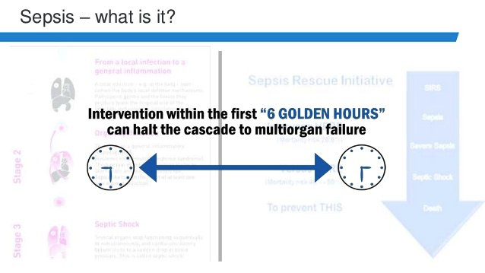

Slide 70
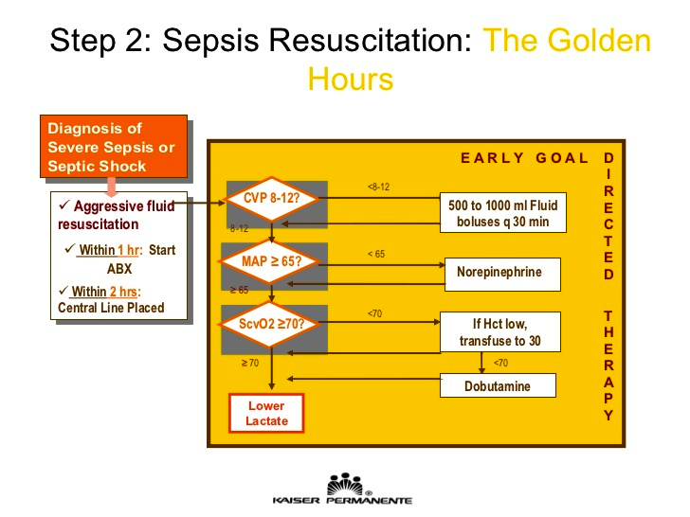

Slide 71
Care Bundles

Slide 72
THE CONCEPT OF SEPSIS IN TREATMENT
Care Bundles
Early goal directed treatment and hemodynamic support, as put forth by Surviving Sepsis Campaign in the form of ‘Care Bundles’ are currently the best way to manage sepsis.
The treatment of sepsis with regards to care bundle approach is briefly outlined below.
First and foremost step in the management of sepsis is to identify at risk patients for sepsis

Slide 73
THE CONCEPT OF SEPSIS IN TREATMENT
Care Bundles
This identification includes combination of physiological parameters and/or biochemical measures (for example, serum lactate has been associated with early mortality – levels >4mmol/L and < 2mmol/L has a mortality of 40% and <15% respectively).
Scoring systems for recognition of at risk patients have been formulated.

Slide 74
‘Track and Trigger’ system

Slide 75
THE CONCEPT OF SEPSIS IN TREATMENT
Track and Trigger
The use of ‘Track and Trigger’ system is important in compartmentalization of patients for applying level of care and frequency of monitoring.
This system uses summation points from scoring systems (called Early Warning Signs), trend of these points and degrees of deviation of single parameter within these scores.

Slide 76
THE CONCEPT OF SEPSIS IN TREATMENT
Care Bundles
Care Bundles (CB) are organised into 2 phases – resuscitation and management and needs to be completed within 3h and 6h.
Treatment of sepsis does not only depend on managing the underlying infective etiology.
Host response and genetic variation leading to response also play a big role in sepsis.

Slide 77
A. Sepsis resuscitation bundle
This is a combination of objectives that: must be completed within 3 hours in patients:
1) Measurement of serum lactate
2) Blood cultures prior to starting antibiotics
3) Usage of broad-spectrum antibiotic within the 1st hour in cases of suspected septic shock or severe sepsis
4) Treating hypotension and/or elevated lactate with fluids.

Slide 78
A. Sepsis resuscitation bundle
Crystalloids are said to be the fluid of choice.
About 30ml/kg of crystalloids can be given or an equivalent of colloid.
In cases where much larger amounts of crystalloids need to be used, colloids can be used up front

Slide 79
A. Sepsis resuscitation bundle
Goals during the first 3 hours
Goals during first 3 h include:
(1) Central venous pressure (CVP) between 8-12 mm of Hg.
(2) Mean arterial pressure (MAP) ≥ 65 mm of Hg.
(3) Urine output ≥ 0.5mL/kg/hr.
(4) Central venous or mixed venous oxygen saturation 70% or 65% respectively and in patients of elevated lactate.
Clearance of lactate per say is an important independent goal.

Slide 80
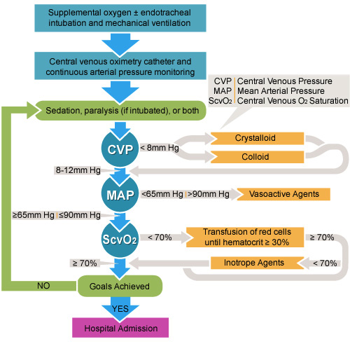

Slide 81
B. Sepsis management bundle
In this bundle, the objectives must be completed with 6h for patients with parameters similar to defined above.
The components include :
1) Vasopressors use (for hypotension that does not respond to initial fluid resuscitation) to maintain a mean arterial pressure (MAP) ≥65 mm Hg
2) In the event of persistent arterial hypotension despite volume resuscitation (septic shock) or initial lactate ≥4 mmol/L (36 mg/dL). Measure central venouspressure (CVP) and measure central venous oxygen saturation (ScvO2)
3) Remeasure lactate if initial lactate was elevated
4) Targets for quantitative resuscitation include: (1) CVP of ≥8 mm Hg;(2) ScvO2 of ≥70%, or (3) mixed venous saturation more than 65% and (4) normalization of lactate.

Slide 82
B. Sepsis management bundle
Noradrenaline
Regarding the use of vasopressor, the target of therapy is to maintain a MAP ≥ 65 mm of Hg.
Noradrenaline is the first choice vasopressor and adrenaline can be added when an additional agent is required to maintain adequate MAP maintain adequate MAP.

Slide 83
B. Sepsis management bundle
Vasopressin
Vasopressin, at 0.03 units /minute infusion can be additionally given with noradrenaline for improving MAP or decreasing noradrenaline dose.
Vasopressin is not recommended for single agent management in septic shock.

Slide 84
B. Sepsis management bundle
Dopamine and Phenylephrine
Dopamine can be used alternative to noradrenaline in patients with low risk of tachyarrythmias and/or bradycardia.
When a septic patient develops serious arrhythmias with high cardiac output and persistently low blood pressure, phenylephrine can be used as salvage therapy.
There is “no role” for low dose dopamine for renal function improvement.

Slide 85
B. Sepsis management bundle
Dobutamine
With regards to inotropic therapy, dobutamine infused up to 20 micrograms/kg/minute can be added to the vasopressor in the presence of myocardial dysfunction (high cardiac filling pressures and low cardiac output with hypoperfusion, in the presence of adequate filling pressures and normal MAP)

Slide 86
B. Sepsis management bundle
IV hydrcortisone
If the patient still remains in shock even after all the above measures, then use of intravenous hydrocortisone is warranted, in continuous infusion, 200mg /day.
This can be tapered and stopped once vasopressor support has been discontinued.
Steroid therapy should not be used in sepsis in the absence of shock.

Slide 87
The Antibitic Therapy

Slide 88
ANTIBIOTIC THERAPY OF SEPSIS IN CIRRHOSIS
Studies report prevalence variedly, depending on community antibiotic practices and infected, whereas the same, in cirrhotic population is 30 to 34% which can increase to 45% in the event of acute gastrointestinal bleeding.
Cultures are positive in around 60 to 70% of cases.
The commonest organisms causing community acquired infections are: (1) Gram negative bacilli (Eschrichia coli) in 75%, (2) Gram positive cocci in 20% and (3) Anerobes in 3.2%.
These figures are reversed in the nosocomial setting in the presence of fluroquinolone 70%.

Slide 89
ANTIBIOTIC THERAPY OF SEPSIS IN CIRRHOSIS
Multi drug resistance (MDR) is currently a big problem in the hospital setting and as prophylaxis and invasive procedures, where by Gram positive cocci are predominant (38 to much as 64% of cirrhosis patients in hospital are afflicted by MDR strains currently.
Fungal infections occur in about 15% of cirrhotics.
With every one hour delay in initiating empirical antibiotics in cirrhotics with severe sepsis, the survival is decreased by 7.6%, as shown by a retrospective study by Kumar and co-workers.

Slide 90
ANTIBIOTIC THERAPY OF SEPSIS IN CIRRHOSIS
Duration of Antibiotic therapy
It is important to know that empiric antimicrobial therapy with one or more agents that have activity against all likely pathogens need to be started as per clinical suspicion of foci, with good penetration at the doubtful site of infection.
Empiric therapy should not be continued for more than 5 days and early de-escalation is most important.
Total therapy of antimicrobials has to be from 7 to 10 days.
Longer duration can be under taken in the event of slow clinical responses as in : (1) Neutropenic patients and (2) Patients with immune dysfunction

Slide 91
ANTIBIOTIC THERAPY OF SEPSIS IN CIRRHOSIS
Procalcitonin guided antibiotic de-escalation is currently practised by many centres worldwide.

Slide 92
ANTIBIOTIC THERAPY OF SEPSIS IN CIRRHOSIS
Oral and GI Decontamination
Selective oral and digestive tract decontamination can be introduced as a method to reduce ventilator associated pneumonia in mechanically ventilated patients.
The agent of choice is chlorhexidine gluconate for oral decontamination.
Rifaximin has been routinely used in critically ill cirrhosis patients to combat gut derived bacteremia, but needs validation from larger studies.

Slide 93
ANTIBIOTIC THERAPY OF SEPSIS IN CIRRHOSIS
Tigecyclin
Tigecycline is a new antibiotic, a activity includes: methicillin resistant Staphylococcus aureus, Vancomycin sensitive and Carbapenemase producing Enterobacteria.
The role of Tigecycline in cirrhosis is still not delineated

Slide 94
ANTIBIOTIC THERAPY OF SEPSIS IN CIRRHOSIS
Glycyclin
Patients who are on third generation quinolone prophylaxis are more prone to developing these resistant infections.
Re definition population and a holistic antibiotic protocol need to be followed by hospitals, whereby, glycylcycline is a good option for management of MDR infections.

Slide 95
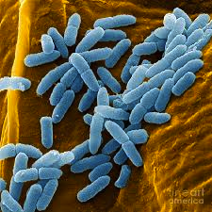
What about Pseudomonas infection
In sepsis with cirrhosis ??

Slide 96
ANTIBIOTIC THERAPY OF SEPSIS IN CIRRHOSIS
Pseudomonas infection
In cirrhosis patients, Pseudomonas infection must be treated with a combination of two separate classes of anti Pseudomonal antibiotics.

Slide 97
ANTIBIOTIC THERAPY OF SEPSIS IN CIRRHOSIS
Pseudomonas infection
Tobramycin or Amikacin and Colistin along with Carbapenem or Ceftazidime.
Carbapenem resistant Pseudomonas infection is a dreadful.
A combination of intravenous antibiotics may be required, but chances of renal failure is very real in this situation.

Slide 98
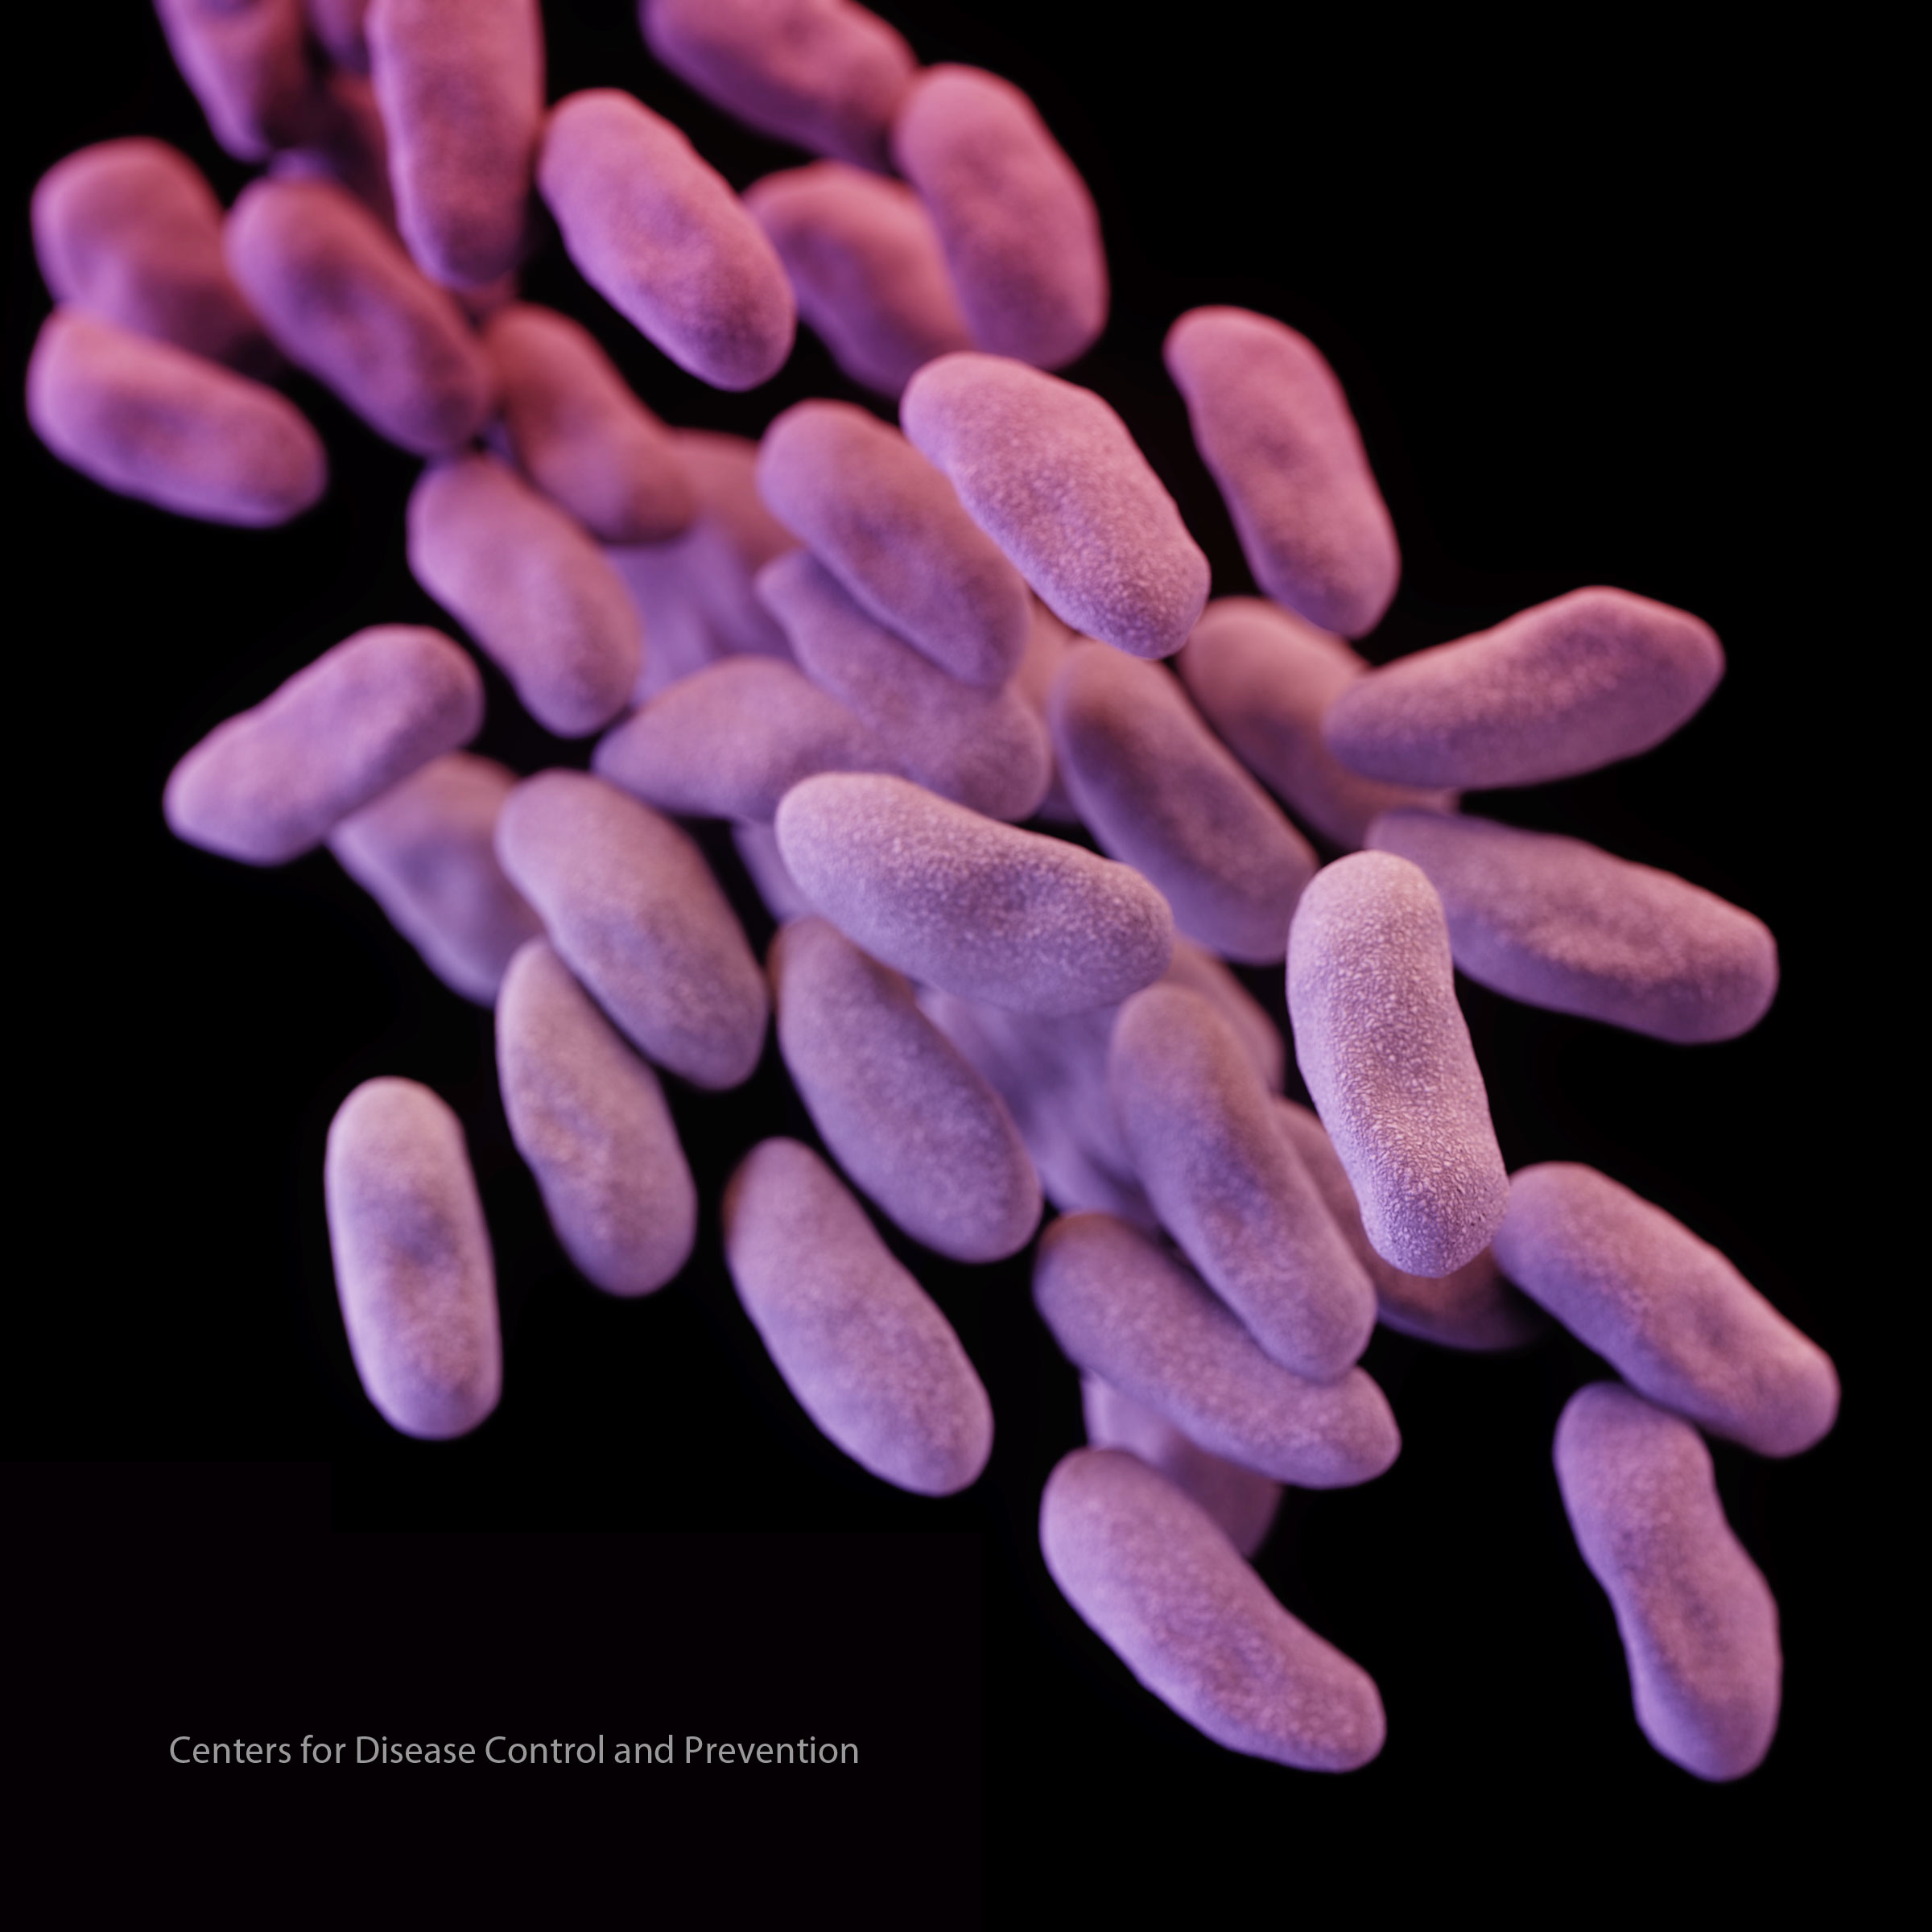
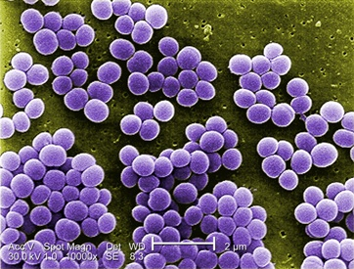
What about !! Vancomycin resistant Enterococci
and
Staphylococcus aureus ??

Slide 99
ANTIBIOTIC THERAPY OF SEPSIS IN CIRRHOSIS
Linezolid and Daptomycin
Newer antibiotics like Linezolid and Daptomycin can be used against Vancomycin resistant Enterococci and Staphylococcus aureus.
Daptomycin is a poor antibiotic in treatment of pneumonia in cirrhosis patients, as because the drug gets inactivated by lung surfactant.

Slide 100
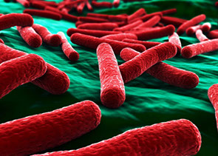
What about !!!Carbapenemase producing Enterobacteria?

Slide 101
Carbapenemase producing Enterobacteria
Carbapenemase producing Enterobacteria is one of the most difficult to treat infection.
Tigecycline and or Amikacin or Colistin can be utilized in this situation, but: their safety and efficacy in cirrhosis patients are still not well defined.

Slide 102

What about IV Albumin therapy in sepsis of cirrhotics ????

Slide 103
Albumin THERAPY OF SEPSIS IN CIRRHOSIS
The use of albumin infusion in spontaneous peritonitis is well known to improve survival by prevention of renal dysfunction.
Guevara and co-workers studied the utility of albumin infusions in infections other than spontaneous bacterial peritonitis and concluded that: in comparison with standard antibiotic therapy alone, albumin together with antimicrobials showed beneficial effects on circulatory and renal parameter and promoted survival benefit.
Mónica Guevara,et Journal of Hepatology, Volume 57, Issue 4, October 2012

Slide 104
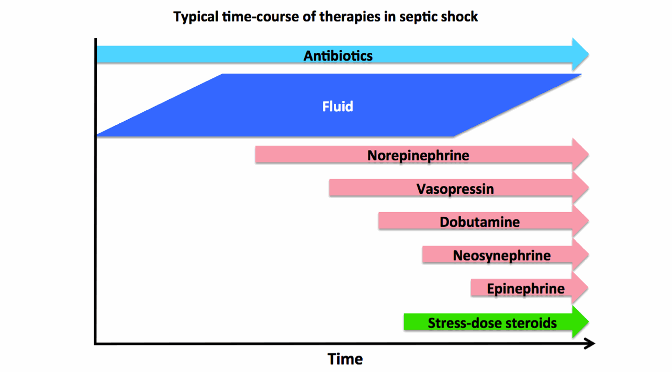

Slide 105
The New Comers
3-5 years
The Revolutionary Agents

Slide 106
Immunomodulatory Cytokines
(1) Interleukin – 7 (IL-7)
(2) Interleukin-15 (IL-15)
108. Vassena, L. et al. (2012). PLoSPathog. 8, e1002636
Inoue, S. et al. (2010). J. Immunol. 184, 1401–1409

Slide 107
(1) Interleukin – 7 (IL-7)
This is a pleuripotent cytokine produced by stromal cells.
Required for:
(1) T cell development and its homeostasis. IL-17 mutations lead to severe combined deficiency syndrome.
(2) Augments expression of adhesion molecules, lymphocyte associated antigen (LFA)-1 and very late antigen (VLA)-4 promoting lymphocyte migration to infection sites.
Delayed type hypersensitivity (a response very strongly reduced in septic patients) is restored with IL-7 use. IL-7 doubles the number of circulating CD4+ and CD8+ cells (but not T regulatory cells) and increases spleen and peripheral lymph nodal size.

Slide 108
(2) Interleukin-15 (IL-15)
L-15 is also a pleuripotent cytokine essential for natural killer (NK) cell development, functioning and sustenance.
NK cell cytotoxic activity is augmented in the presence of IL-15, which also regulates memory CD8+ T cells, epithelial γδ T cell survival, activation and proliferation of naive CD8+ T cells by T cell receptor stimulation and B cell proliferation with antibody production.

Slide 109
(2) Interleukin-15 (IL-15)
Unlike IL-7, IL-15 has highly potent immunostimulatory and robust NK cell, NKT cells, CD8+ T cells and dendritic cell proliferative activity.
IL-15 has been studied in pre clinical models of sepsis, whereby it was shown that its use curbed apoptosis of immune competent cells by augmented bcl-2 expression and improved survival and reduced sepsis induced muscle wasting.

Slide 110
Granulocyte Macrophage Colony Stimulating Factor
(GM-CSF)
Meisel, C. et al. (2009) G. Am. J. Respir. Crit. Care Med. 180, 640–648

Slide 111
Granulocyte Macrophage Colony Stimulating Factor
(GM-CSF)
GM-CSF is a promising cytokine which has the potential to improve immune paralysis in septic patient.
(1) Defective neutrophilic function, including bacterial clearance,(2) Reduced reactive oxygen species production and(3) Reduced chemotaxis, the first line of defence in control of invading pathogens is one of the most important aspect of immune paralysis.
This leads to increased susceptibility towards secondary infections (nosocomial).

Slide 112
Granulocyte Macrophage Colony Stimulating Factor
(GM-CSF)
Apart from this, monocytes secrete decreased amounts of proinflammatory cytokines such as TNF-α and IL-6 and has impaired antigen presentation.
The use of GM-CSF in phase II trials showed that:
(1) There is robust enhancement of neutophil numbers
(2) Boosting of pathogen clearance, leading to
(3) Reduced severity of illness score,
(4) Shortening of time on mechanical ventilation
(5) Improved proinflammatory responses.
GM-CSF use in pediatric sepsis trials showed that improvement in TNF-α augmented activity decreased nosocomial infections

Slide 113
Co-inhibitory cell surface molecules

Slide 114
Co-inhibitory cell surface molecules
A new group of immune regulatory molecules known as co-inhibitory cell surface molecule family is of great interest in management of sepsis related immune paralysis.
They have been considered negative regulators of T cell receptor mediated activation and cytokine release (adaptive immunity).

Slide 115
(1) Programmed Cell Death -1 (PD)-1 and PD receptor ligand -1 (PD-L1)
Topalian, S.L. et al. (2012). N. Engl. J. Med. 366, 2443–2454
Chang, K.C. et al. (2013). Crit. Care 17, R85
Zhu, W. et al. (2013) Mediators Inflamm. 2013, 361501

Slide 116
Programmed Cell Death -1 (PD)-1 and PD receptor ligand -1 (PD-L1)
In animal models, PD-1 deficient mice were shown to have:
^{(1) Lower bacterial load}
(2) Robust anti inflammatory responses
(3) Were protected from sepsis related mortality/morbidity.
These same effects were shown when septic animals were treated with neutralizing antibody to PD-1 leading to decreased lymphocyte apoptosis.

Slide 117
Programmed Cell Death -1 (PD)-1 and PD receptor ligand -1 (PD-L1)
The evidence that circulating PD-1 and PD-L1 concentrations in severe sepsis and trauma patients also sheds light on the fact that these can also be used as biomarkers in assessing immune paralytic state.

Slide 118
(2) B and T lymphocyte attenuator( BTLA) and CTLA-4

Slide 119
B and T lymphocyte attenuator (BTLA) and CTLA-4
Expression of CTLA-4 increases on CD4+/CD8+ and regulatory T cells in the cecal ligation and puncture (CLP) animal sepsis model and the use of anti CTLA-4 treatment was associated with overall improvement in sepsis related lymphocyte apoptosis and survival in secondary fungal infection in immunosuppressed mice.
Anti BTLA, similarly was shown to improve survival in septic mouse model and in LPS induced endotoxic shock model.
The increased BTLA expression on CD4+ T cells was shown to promote nosocomial infections and longer duration of hospital stay.
Hotchkiss, R.S. et al. (2013). Lancet Infect. Dis. 13, 260–268

Slide 120
Conclusion

Slide 121
Conclusion
Sepsis is a dynamic state that encompass proinflammation, antiinflammation and immune paralysis that when dysregulated, lead to early or late mortality. The current sepsis guidelines have improved patient outcomes, helping treating physicians win a few battles, but never the war.

Slide 122
Conclusion
Timely use of rational antibiotics, lesser threshold for using using multiple antibiotics in the wake of severe uncontrolled sepsis along with intensive critical care support still forms the base of sepsis management in cirrhosis patients, together with aggressive source identification.

Slide 123
Conclusion
When it comes to use of these novel agents in therapy against sepsis, we must first define the group that would receive maximum benefit from this therapy first, followed by ideal dosing and time for dosing. Even in general population with sepsis, these agents are still in the early blooming phase and their use in cirrhotics with severe sepsis is a matter that need to be seen, but one that could be worth waiting for.

Slide 124
Please Remember

Slide 125
Please Remember
RPRs
PAMPs
TLRs
RIG
NOD
CLRs
AIMS
NF-kB
MAPK
INF-1
DAMP

Slide 126
Please remember
HSP
Capses-1
IL-1B
IL-8
IL-6
TNF-a
Endothelin

Slide 127
Please remember
PCT
CRP
Adrenomedullin
Resistin
PVP
Copeptin
TREM
MMP-9
TGF-B

Slide 128


