Slide 1

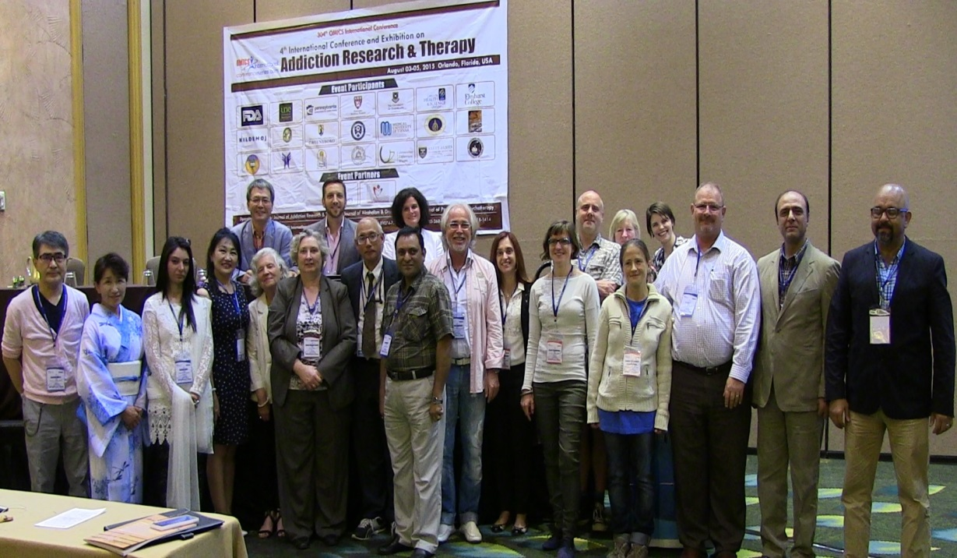
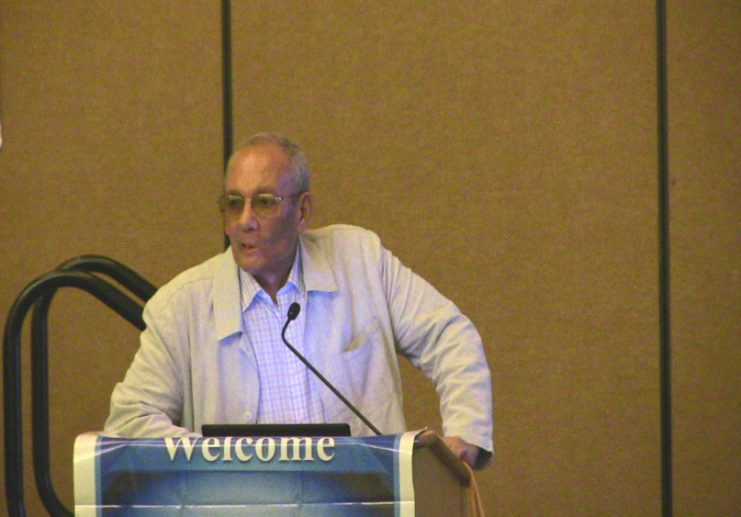
Addiction Therapy 2015
Florida, USA
August 03-08, 2015
Alaaeldin A Elkoussi

Slide 2
“Toxicological and social hazards of solvent inhalant abuse”
Alaaeldin ElKoussi , Ph.D
Department of Pharmacology, College of Medicine,
Assiut University, Assiut, EGYPT
alaaeldine@hotmail.com.

Slide 3
Today, inhalation of volatile substances is practiced worldwide although there is marked variability in the type and pattern
of substances abused.
Although research concerning inhalant abuse epidemiology, neurobiology, treatment and prevention has accelerated in recent years; still they remain the least-studied class of psychoactive agents.

Slide 4
WHAT ARE THE INHALANTS ?
Inhalants are breathable vapors or gases that produce psycho- active effects when abused.
They include:
Volatile organic solvents
Fuel gases
Nitrites
Anesthetic gases

Slide 5
EXAMPLES OF INHALANTS
Volatile Solvents AND Gases:
Glue, Paint Thinner, Gasoline, Gas Lighters, Nail Polish Remover, Correction Fluid.
Aerosols: hair sprays
Anesthetics: Nitrous Oxide, Ether
Nitrites: Amyl, butyl and Isobutyl Nitrites. (Room Odorizers)

Slide 6
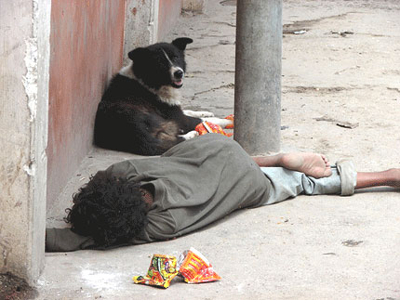
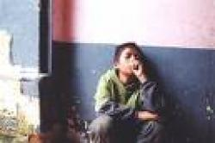
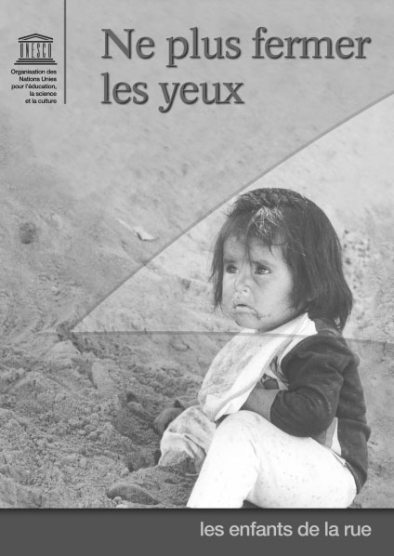
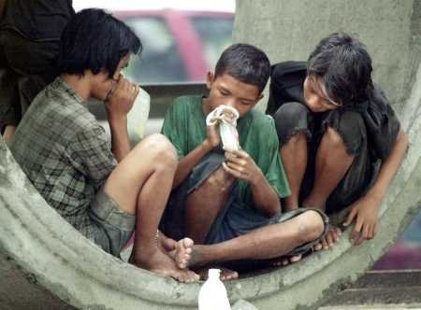
IN MOST COUNTRIES
INHALANTS ARE THE CHEAP TOXIC ADDICTING SUBSTANCES OF THE POOR!!
WHO CARES??

Slide 7
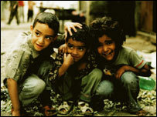
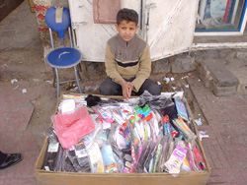
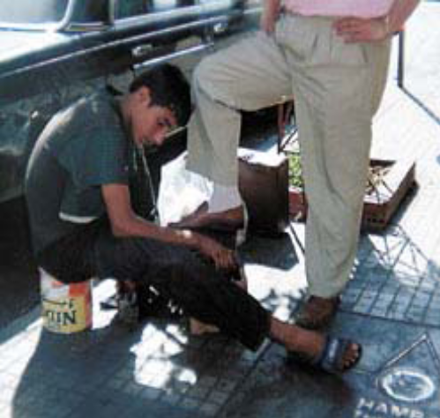
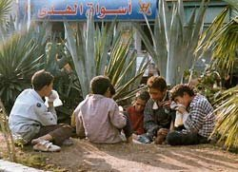
Most Common Among Innocent Neglected Street Children

Slide 8
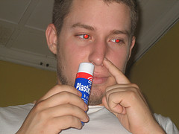
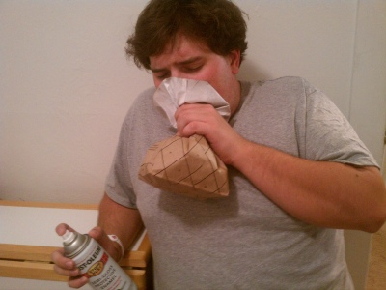
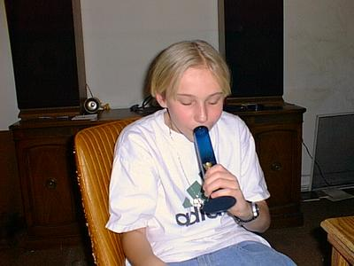
NOT Always The Case in Developed Countries !!!

Slide 9
WHY INHALANTS ARE
THE MOST DANGEROUS?
Readily Available and Easily Obtained
Easily Concealed
Cheap
Popular
More common among Adolescents and Children

Slide 10
WHY INHALANTS ARE
THE MOST DANGEROUS?
Not Illegal !!
Stepping Stone/Gateway to Other Dangerous Addicting substances
Extremely Toxic
Severe Withdrawal Symptoms
No Available Treatment Methods
Detoxification is very difficult
Relapses are Very High

Slide 11
PREVALENCE IN DIFFERENT COUNTRIES
According to the 2005 World Drug Report, 52
North America has the highest rate of inhalant treatment admissions (18%)
Eastern Europe (5%)
Africa and South America (4%)
Australia/New Zealand and Asia (2%)
and Western Europe (1%).

Slide 12
Size and Patterns of Solvent inhalant Abuse in Different Countries
USA
22 MILLIONS reported a history of VSM
SOUTH AMERICA :
Life time prevalence range from:
2.67% in Paraguay
16.55% in Brazil.
More prevalence among street children and high school students.

Slide 13
Size and Patterns of Solvent inhalant Abuse in Different Countries
MEXICO
1% In the general population ,
7% among high school students and more among street children
UPPER EGYPT:
91% of street children, one third of those
Misusing glue.

Slide 14
Size and Patterns of Solvent inhalant Abuse in Different Countries
CLOMBIA :
School children (mean age: 14.8 years) reported:
16% VSM Exposure Opportunity, 3% past year use, 7-10% positive VSM intentions.
EASTERN SLOVAKIA:
90% Of Roma (gypsy) worker youth were chronic toluene users. 15% of users younger than 10 y/o..75%between 10 and 25 y/o.

Slide 15
Size and Patterns of Solvent inhalant Abuse in Different Countries
ISRAEL:
Past month use reported by 7.5% of school students
age 12-18 together with illicit drug use, smoking,
internet gambling, being drinking and school
truancy (nonappearance /absence from school)
INDIA:
Whitener fluid containing toluene among homeless children .
mean age 12.8 years (6-14 y/o).
most children used other substances consequently: tobacco, alcohol, cannabis, heroin (less extent).

Slide 16
Size and Patterns of Solvent inhalant Abuse in Different Countries
9. NIGERIA
Lifetime, annual, and current prevalence of inhalant use among selected Nigerian secondary school students:
Lifetime use 25.7%
Use in past year 13.4%
Use in past month 20%

Slide 17
Size and Patterns of Solvent inhalant Abuse in Different Countries
10. South Africa.
out of 1,234 male and 602 female students, 13 percent and 5 percent, respectively, had used an inhalant at least once.
Use in the past month was reported to be 1.5 percent and 1.2 percent,
Three males (0.2 percent) used inhalants daily or nearly daily.
Of the 198 males who used inhalants [in the past year], 86 percent sniffed petrol, 1.5 percent glue, 4 percent aerosols and 8.5 percent did not specify the substance used.
Only about 32 percent of the males and 42 percent of the females regarded inhalants as harmful. Most did not know that inhalants caused any harm to users. Similar responses were recorded for other drugs, including tobacco and alcohol.

Slide 18
Size and Patterns of Solvent inhalant Abuse in Different Countries
12. JAPAN
Solvent abuse among high school children in Chiba Prefecture near Tokyo. 1.5% of all students reported use of solvents at least once in the past.
This percent might be an underestimate, since the survey was conducted among students who were in classrooms at the time of the survey and these might have been relatively healthy students who attend school on a regular basis.
Many solvent abusers are thought to be absent or dropouts from school.
The survey also suggested that nonusers have more satisfying school and family lives than solvent users.

Slide 19
SUBSTANCES MISUSED IN DIFFERENT COUNTRIES
DEVELOPED COUNTRIES
Shoe polish
Toluene
Amyl nitrite
Correction fluid
Glue
Gasoline
Halothane
Spray paints
Nitrous oxide
Propane
Other aerosole sprays
OTHER COUNTIRES
Gasoline/ Petrol
Toluene
Glue
Car exhaust
Kerosene
Paint thinner
Lighter fluid
Sprays
Ether
Chloroform
Nitrous oxide

Slide 20
MOST COMMON Motives and perceptions in different countries
It is not illegal
does not subject abusers to arrest by the police
It is cheep and easily available
To attain "social freedom"
To break "social barriers", or "norms"
To improve abusers self-esteem
They make abusers forget their problems
Experimenting
Some abusers consider It a proof of masculinity

Slide 21
MOST COMMON Motives and perceptions in different countries
Increased activity level,
Enhanced physical strength
Decreased shyness
Intentional decreased appetite
Sleep induction
Feeling good
Getting a high, numbing of physical and psychological pain
Feeling dreamy and lighthearted
Overcoming sadness and negative feelings
Avoiding withdrawal
Enjoying the sweet taste and fruity smell

Slide 22
Sequence of events Immediately
Following Inhalation
Rapid Absorption/Lipid soluble
Instants Rush
Euphoria
CNS Depression
Loosing Touch with Surroundings
Loss of Self-Control
Violent Behavior

Slide 23
Sequence of Events Immediately
Following Inhalation
Nausea
Unconsciousness
Giddiness
Loss of Inhibition
Loss of appetite
Hallucinations (In Higher doses)
Sudden Death

Slide 24
Other signs and Common
TOXIC ACTIONS
Loss of motor skills
Slurred Speech
Tachycardia and Palpitations/ Bradycarida
Seizures
Vomiting , diarrhea
Abdominal pain

Slide 25
Other signs and Common
TOXIC ACTIONS
Dryness and Redness Around the Mouth and Nose
Paints or Stains on Body or Clothing
Chemical Breath Odor
Drunk, Dizzy
Sneezing
Coughing

Slide 26
Other signs and Common
TOXIC ACTIONS
Wheezing
Excessive Salivation
Anxiety, Excitability and Irritability
Suffocation
Fire-related Injury
Coma, Brain Damage and Lead Poisoning
SUDDEN SNIFFING DEATH SYNDROME (SSDS)

Slide 27
GENERAL HAZARDS
The majority of abusers do not know that SVA is harmful >85%
It is mainly among youth who are the future
Cheap, available and toxic legal substances
Economic, Socioeconomic, Health and Security risks
Gateway to other addicting substances
Abusers are Future drug dealers
Unawareness from authorities and public
No strict actions are taken
No prevention, control or treatment strategies
NEED FOR Evaluation-driven research

Slide 28
SOME HARMS!!!
Burning of lungs
Tuberculosis & other infections
Stomach ailment
Kidney stones
Vomiting blood
Blackened teeth
Constriction of the heart !!
Weak bones
Weight loss
Reduced thinking power
Aggressive behavior and violence
Changed appearance
Money loss
Involvement in risky & criminal activities.

Slide 29
RISK FACTORS
Domestic violence
Dictatorial father
Divorced parents
Presence of step parents
Migrant status
Substance abuse in the family
Association with delinquent peers.
Poverty

Slide 30
Sequence of Actions Immediately
Following Inhalation
Rapid Absorption/Lipid soluble
Instants Rush
Euphoria
CNS Depression
Loosing Touch with Surroundings
Loss of Self-Control
Violent Behavior

Slide 31
Sequence of Actions Immediately
Following Inhalation
Nausea
Unconsciousness
Giddiness
Loss of Inhibition
Loss of appetite
Hallucinations (In Higher doses)
Sudden Death

Slide 32
OUR STUDIES
MAIN OBJECTIVES
Investigate the magnitude of substance abuse among street children in Upper Egypt.
Track the trends and patterns of abuse among street children .
Identify the chemical , toxicological and neurotoxicological properties of the cheapest and most commonly abused substance which is a glue called "Kolla".

Slide 33
Data Collection
Methods included:
Self-report surveys,
Interviews
Informant reports
Case study methods,
Questionnaires
Focus group discussions

Slide 34
Chemical & Pharmacological Investigation of the Most Commonly Abused Inhalant “KOLLA”
Physicochemical properties of "Kolla" using GC-MS.
Effect of "Kolla" Inhalation on Locomotor Activity
Effect on motor coordination (Rotarod Test)
Effect on lipid peroxidation
Histopathological changes in kidney , liver and brain
Effect on brain glutamate
Other CNS & CV effects & toxicity.

Slide 35
Chemicla Analysis of
“Kolla”
Analysis by (GC/MS)
Percent recovery | Concentration (mg/g) (+S.D.) | Parameter
98.13 | 28.861(±0.015) | Toluene
99.29 | 23.621 (±0.024) | P-Xyline
101.89 | 12.512 (±0.029) | Pseudocumene
98.33 | 6.183 (±0.022) | Cumene
101.55 | 5.899 (±0.031) | Ethylbenzene
99.38 | 5.111(±0.029) | n-Hexane
100.05 | 4.190 (±0.030) | n-Octane
98.55 | 2.572 (±0.017) | Decane
100.38 | 3.617 (±0.020) | n-propylbenzene
102.08 | 2.980 (±0.011) | n-Nonane
98.55 | 1.555 (± 0.016) | Dodecane
99.03 | 0.886 (±0.016) | Pyrrolidine
101.28 | 0.247 (±0.021 | Isobutylbenzene
101.15 | 1.455 (±0.033) | Undecane

Slide 36
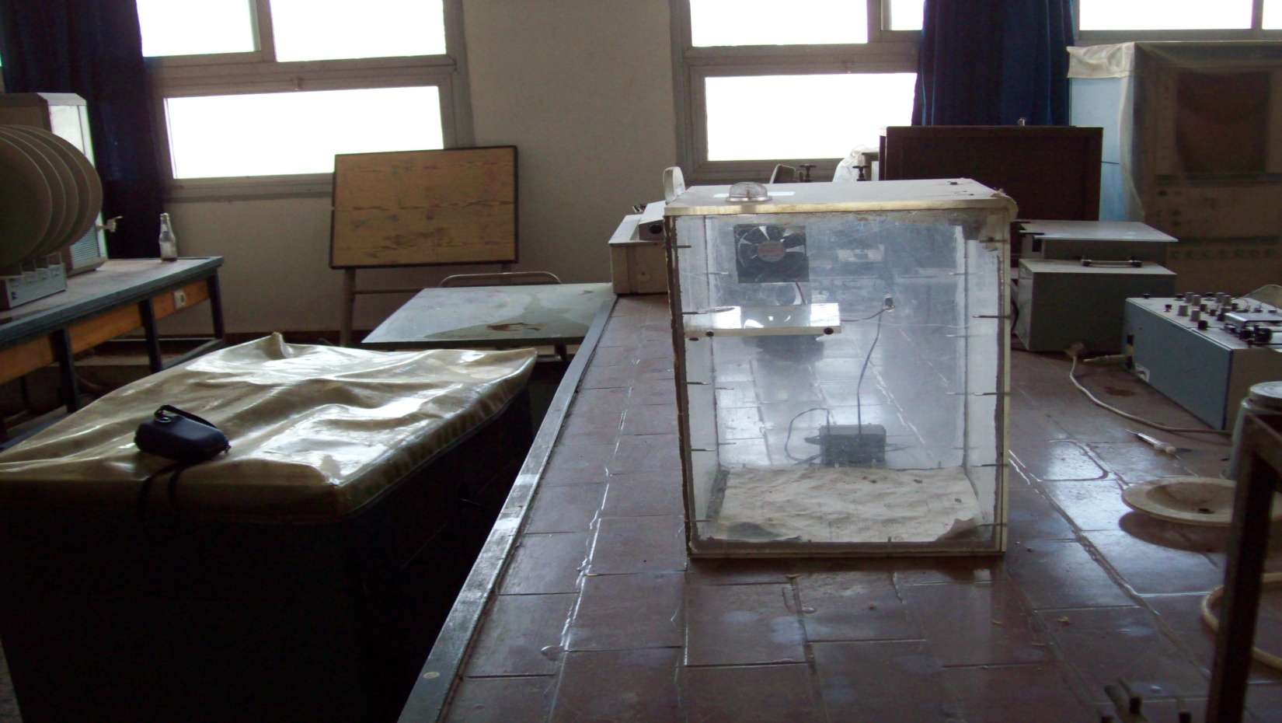
Pharmacological & Toxicological
The Inhalation Box

Slide 37

Pharmacological & Toxicological
Results

Slide 38
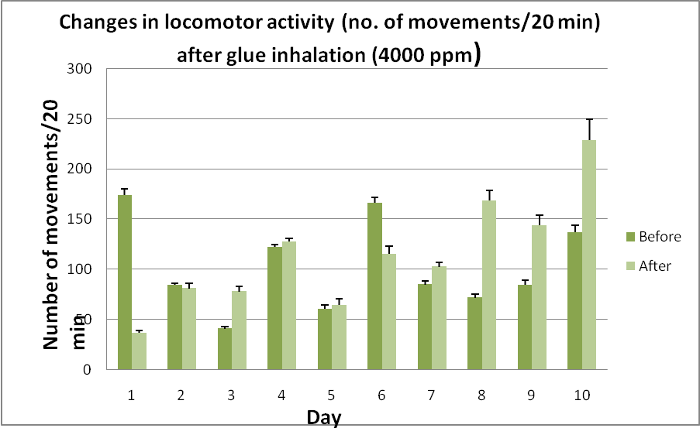
Pharmacological & Toxicological
Results

Slide 39

Pharmacological & Toxicological
Results

Slide 40
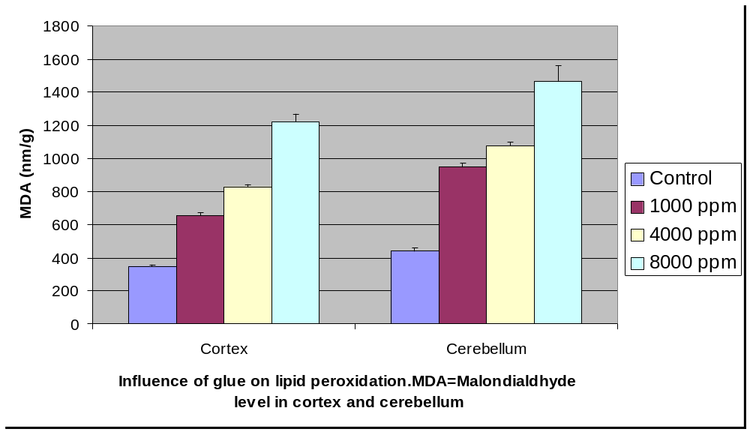
Effect on lipid peroxidation

Slide 41
CONCLUSIONS
The exact number of street children either in Egypt or in its upper (southern) part is still hard to determine.
A vast majority of the street children in Upper Egypt abuse a glue called "Kolla" on habitual basis without knowing anything about its hazards to their health.
The street children use the glue because: it is not illegal and does not subject them to arrest by the police, because it is cheep and easily available and to attain "social freedom", to break "social barriers", or "norms" and to improve their self-esteem.
Chemical analysis of "Kolla" revealed that it contains more than 10 inhaled toxic substances. This mixture of solvents has more toxic effects than individual solvent. Toluene represents large percentage of glue (28.861mg/g glue), other substances are present as n-Hexane, n-Octane, Ethylbenzene and p-Xylene.
.

Slide 42
CONCLUSIONS
Repeated daily inhalation of "Kolla" for 10 days exerted a biphasic response on locomotor activity of rats with an initial depression followed by inhalation.
"Kolla" increases MDA level in some brain regions as cortex and cerebellum indicating its deleterious effect on lipid peroxidation.
Repeated daily inhalation of "Kolla" for 10 days exerted a biphasic response on locomotor activity of rats with an initial depression followed by inhalation. "Kolla" increases MDA level in some brain regions as cortex and cerebellum indicating its deleterious effect on lipid peroxidation
Further investigations are currently carried out to determine the effects of "Kolla" on glutamate level in brain as well as its histopathological toxicity effects on liver, brain and kidney of experimental animals.

Slide 43
THANK YOU !!!

Slide 44

Meet the eminent gathering once again at
Addiction Therapy 2016
Miami, USA
October 06-08, 2016
Addiction Therapy 2016
Website: addictiontherapy.conferenceseries.com

