Slide 1

Current Advances In Irrigation
Dr Ala Al-Dameh
DCLINDENT (Otago, NZ) BDS (Otago, NZ)
Specialist Endodontist – Al Noor Hospital

Slide 2


Slide 3


Slide 4
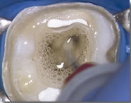

Slide 5
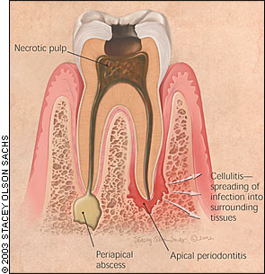
Notes:
The success of endodontic treatment depends on the eradication of microbes (If present) from the root-canal system and prevention of re-infection

Slide 6
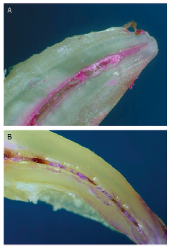
Notes:
The root canal is shaped with hand and rotary instruments under constant irrigation to remove the inflamed and necrotic tissue/biofilms/ and other debris from the root canal space. The main goal of instrumentation is to facilitate effective irrigation, disinfection and filling

Slide 7
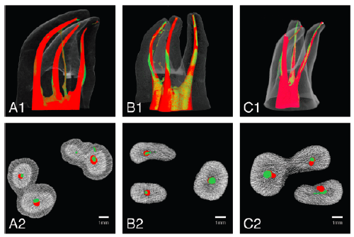
Post-operative
Pre-operative
Peters 2004
Notes:
Several studies using advanced techniques such as microcomputed tomography (micro CT) scanning have demonstrated that proportionally large areas of the main root canal wall remain untouched by the instruments emphasizing the importance of cheminal means of cleaning and disinfecting all areas of the root canal.

Slide 8
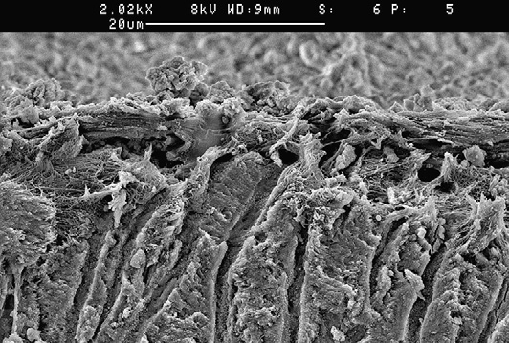
Notes:
A scanning electron microscopy image of dentin surface covered by predentine and other organic debris in an uninstrumented canal area.

Slide 9
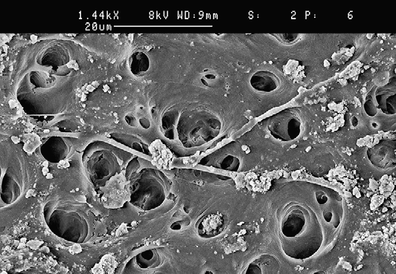
Notes:
Area of uninstrumented root-canal wall.

Slide 10
Desired functions of irrigating solutions
Washing action
Lubricant
Dissolve inorganic tissue (dentine)
Dissolve organic matter (dentine collagen, pulp tissue, biofilm)
Kill bacteria and yeasts (in biofilm)
No caustic or cytotoxic effects
Do not weaken tooth structure
Notes:
Irrigation has a central role in endodontic treatment. During and after instrumentation, the irrigants facilitate removal of microorganisms, tissue remnants and dentine chips from the root canal through a flushing mechanism. Irrigants can also help prevent packing of the hard and soft tissue in the apical root canal and extrusion of infected material into the periapical area.
Some irrigating solutions dissolve either organic or inorganic tissue in the root canal. In addition, several irrigating solutions have antimicrobial activity and actively kill bacteria and yeasts when introduced in direct contact with the microorganisms. However, several irrigating solutions also have cytotoxic potential, and they may cause severe pain if they gain access into the periapical tissues.
An optimal irrigant should have all or most of the positive characteristics listed here, but none of the negative or harmful properties. None of the available irrigating solutions can be regarded as optimal. Using a combination of products in the correct irrigation sequence contributes to a successful treatment outcome.

Slide 11
Irrigation Solutions
Sodium Hypochlorite
HOCl is responsible for the antibacterial activity
Commonly used in concentrations between 0.5% and 6%
Potent antimicrobial agent
It effectively dissolves pulpal remnants and collagen
It is the only root-canal irrigant of those in general use that dissolves necrotic and vital organic tissue
Notes:
Sodium hypochlorite (NaOCl) is the most popular irrigating solution. Hypochlorous acid is responsible for the antibacterial activity; the hypochlorite OCl ion is less effective than the undissolved HOCl.
At acidic and neutral pH, chlorine exists predominantly as HOCl, whereas at high pH of 9 and above, OCl predominates.
Hypochloric acid is a potent antimicrobial agent, killing most bacteria instantly on direct contact. It disrupts several vital functions of the microbial cell, resulting in cell death. It is the only root-canal irrigant of those in general use that dissolves necrotic and vital organic tissue
It is difficult to imagine successful irrigation of the root canal without hypochlorite.

Slide 12
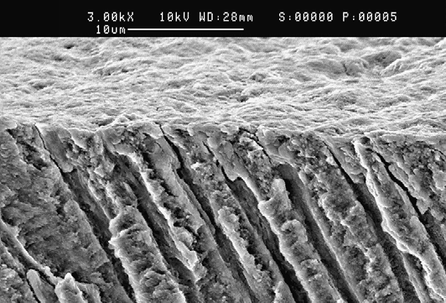
Smear Layer
Notes:
Cross section of root dentin covered by the smear layer created by instrumentation. Notice smear plugs in dentin canals. There are some limitations of sodium hypochlorite. it alone does not remove the smear layer, it affects the organic part of the smear layer, making its complete removal possible by subsequent irrigation with EDTA or citric acid (CA) and we will talk about this later on.

Slide 13
Irrigation Solutions
Weaknesses of Sodium Hypochlorite
Unpleasant taste & toxicity
It affects only the organic part of the smear layer
Presence of inflammatory exudate, tissue remnants & microbial biomass consumes NaOCl and weakens its effect
Can have a detrimental effect on dentine elasticity & flexural strength???
Notes:
Other weaknesses of sodium hypochlorite is that it has unpleasant taste and toxicity,,, presence of organic matter (inflammatory exudate, tissue remnants, microbial biomass) consumes NaOCl and weakens its effect. Therefore, continuous irrigation and time are important factors for the effectiveness of hypochlorite.
it has been shown that long-term exposure of dentine to a high conc NaOCl can have a detrimental effect on dentine elasticity & flexural strength. Although there are no clinical data on this phenomenon, it raises the question of whether hypochlorite in some situations may increase the risk of vertical root fracture.
In summary, sodium hypochlorite is the most important irrigating solution and the only one capable of dissolving organic tissue, including biofilm and the organic part of the smear layer. It should be used throughout the instrumentation phase. However,use of hypochlorite as the final rinse following EDTA or CA rapidly produces severe erosion of the canal-wall dentin and should probably be avoided.

Slide 14
Irrigation Solutions
EDTA & CA
Dissolve inorganic material including hydroxyapatite
They have little or no effect on organic tissue and alone they do not have antibacterial activity
EDTA and CA are used for 2 to 3 minutes at the end of instrumentation & after NaOCl
Notes:
Complete cleaning of the root-canal system requires the use of irrigants that dissolve organic and inorganic material. As hypochlorite is active only against the former, other substances must be used to complete the removal of the smear layer and dentin debris.
EDTA and CA are used for 2 to 3 minutes at the end of instrumentation and after NaOCl irrigation. Removal of the smear layer by EDTA or CA improves the antibacterial effect of locally used disinfecting agents in deeper layers of dentin

Slide 15
Irrigation Solutions
Chlorhexidine Digluconate (CHX)
Continued antimicrobial effect (Substantivity)
No bad smell or strong irritation to periapical tissues
It has no tissue-dissolving capability
CHX 2% may be a good choice for maximized antibacterial effect at the end of the chemomechanical preparation
Notes:
Chlorhexidine digluconate (CHX) is widely used in disinfection in dentistry because of its good antimicrobial activity. it has gained considerable popularity in endodontics as an irrigating solution and as an intracanal medicament. One of the reasons for the popularity of CHX is its substantivity (ie, continued antimicrobial effect), because CHX binds to hard tissue and remains antimicrobial.
CHX does not possess some of the undesired characteristics of sodium hypochlorite (ie, bad smell and strong irritation to periapical tissues). However, CHX has no tissue-dissolving capability and therefore it cannot replace sodium hypochlorite.
CHX does not cause erosion of dentin like NaOCl does as the final rinse after EDTA, and therefore 2% CHX may be a good choice for maximized antibacterial effect at the end of the chemomechanical preparation

Slide 16
Irrigation Solutions
Interactions Between Irrigating Solutions
Hypochlorite & EDTA
Notes:
Hypochlorite and EDTA are the 2 most commonly used irrigating solutions. As they have different characteristics and tasks, it has been tempting to use them as a mixture.
However, EDTA (and CA) instantaneously reduces the amount of chlorine when mixed with sodium hypochlorite, resulting in the loss of NaOCl activity. Thus, these solutions should not be mixed

Slide 17
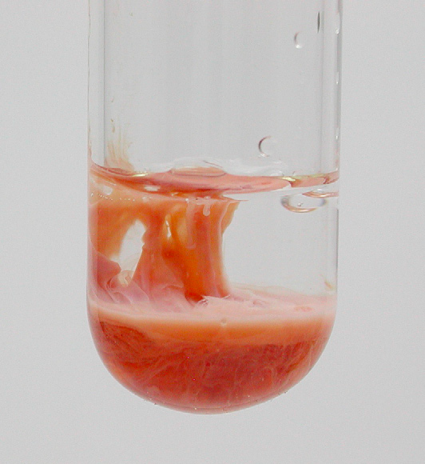
CHX & NaOCl
Notes:
CHX has no tissue-dissolving activity and there have been efforts to combine CHX with hypochlorite for added benefits from the 2 solutions. However, CHX and NaOCl are not soluble in each other; a brownish-orange precipitate is formed when they are mixed.
The characteristics of the precipitate and the liquid phase have not been thoroughly examined, but the precipitate prevents the clinical use of the mixture.

Slide 18
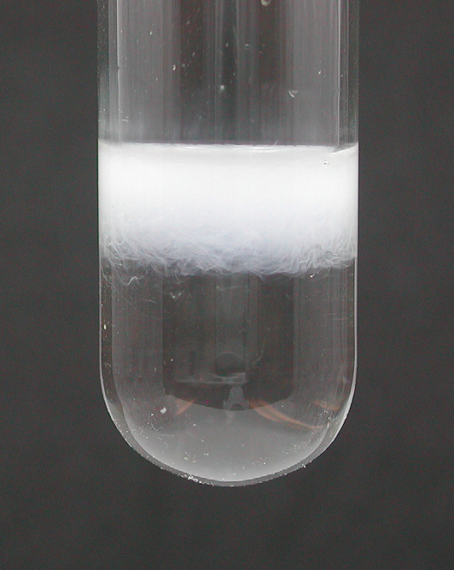
CHX & EDTA
Notes:
Mixing CHX and EDTA immediately produces a white precipitate. Although the properties of the mixture and the cleared supernatant have not been thoroughly studied, it seems that the ability of EDTA to remove the smear layer is reduced

Slide 19
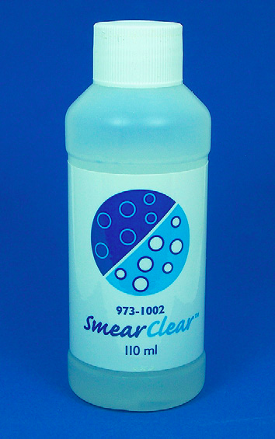
Irrigation Solutions
Combination Products
Notes:
several combination products are on the market, many with some evidence of improved activity and function. Surface active agents have been added to several different types of irrigants to lower their surface tension and to improve their penetration in the root canal
In the hope of better smear-layer removal, detergents have been added to some EDTA preparations (eg, SmearClear)

Slide 20
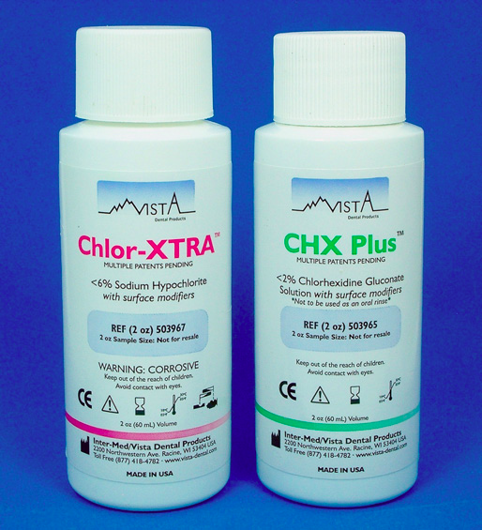
Irrigation Solutions
Notes:
Chlor-Xtra: detergent added to NaOCl. Detergent addition has been shown to increase the speed of tissue dissolution by hypochlorite. No data are available on whether dentin penetration is also improved. CHX Plus another combination product of chlorhexidine & surface active agents

Slide 21
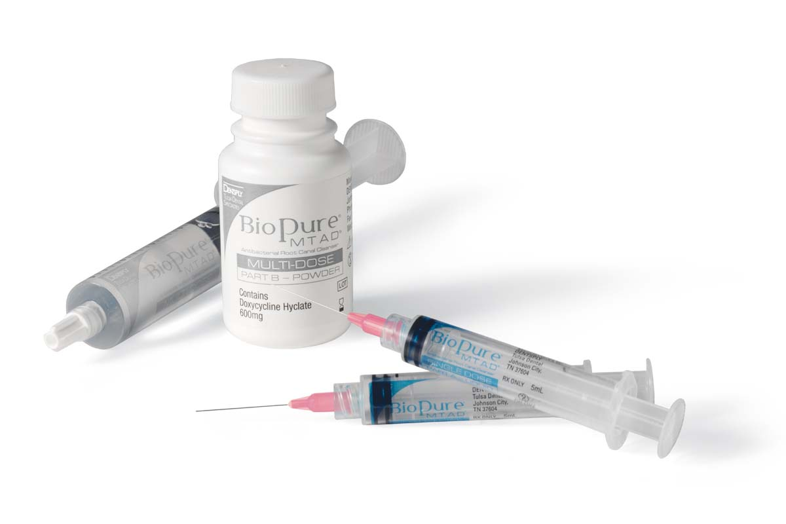
Irrigation Solutions
Notes:
MTAD (a mixture of tetracycline isomer, acid, and detergent, and Tetraclean are new combination products for root-canal irrigation that contain an antibiotic, doxycycline. They are designed primarily for smear-layer removal with added antimicrobial activity. Although a mixture containing an antibiotic may have good short-term and long-term effects, concerns have been expressed regarding the use of tetracycline (doxycycline) because of possible resistance to the antibiotic and staining of the tooth hard tissue

Slide 22
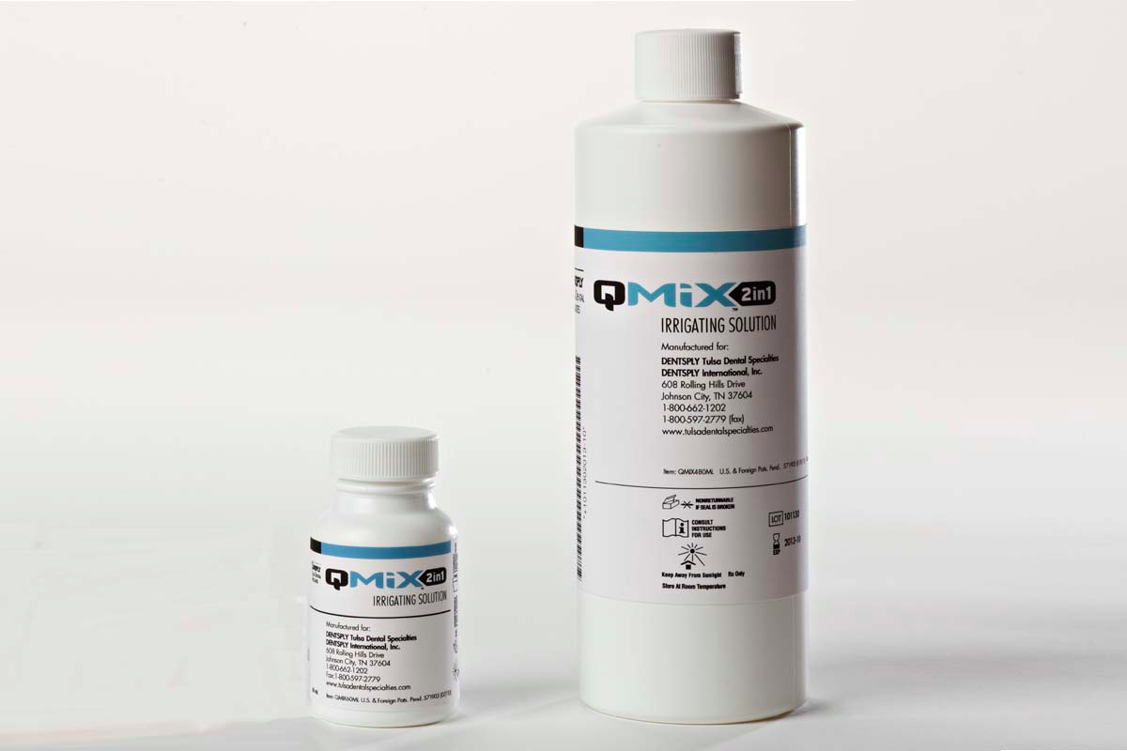
Irrigation Solutions

Slide 23
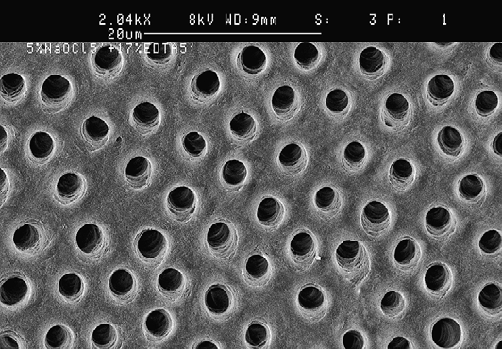
Challenges of Irrigation
Smear Layer
NaOCl +EDTA
Notes:
Removal of the smear layer is straightforward and predictable when the correct irrigants are used. Relying on EDTA alone or other irrigants with activity against the inorganic matter only, however, results in incomplete removal of the layer. Therefore, use of hypochlorite during instrumentation cannot be omitted.
We can see in the image instrumented canal wall after removal of the smear layer by NaOCl and EDTA
The smear layer is created only on areas touched by the instruments. Delivery of irrigants to these areas is usually unproblematic, with the possible exception of the most apical canal, depending on canal morphology and the techniques/equipment used for irrigation. However, careless irrigation, with needles introduced only to the coronal and middle parts of the root canal, is likely to result in incomplete removal of the smear layer in the apical root canal.

Slide 24
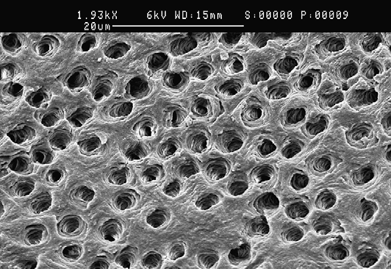
Challenges of Irrigation
Dentine Erosion
Notes:
One of the goals of endodontic treatment is to protect the tooth structure so that the physical procedures and chemical treatments do not cause weakening of the dentin/root. A few in vitro studies have shown that long-term exposure to high concentrations of hypochlorite can lead to considerable reduction in the flexural strength and elastic modus of dentin.
However, even short-term irrigation with hypochlorite after EDTA or CA at the end of chemomechanical preparation causes strong erosion of the canal-wall surface dentin. So it is best to avoid NaOCl irrigation after demineralization agents, Instead, chlorhexidine irrigation could be used for additional disinfection at the end of the treatment.

Slide 25
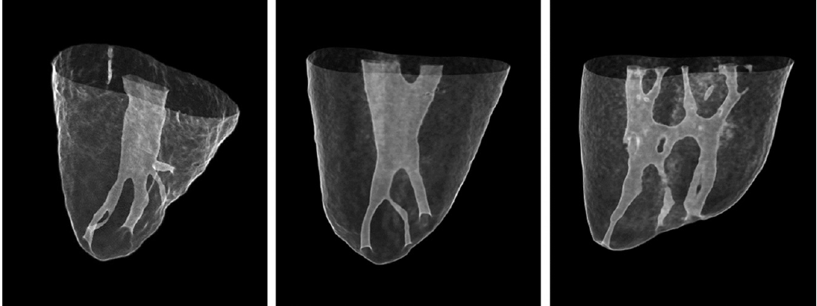
Challenges of Irrigation
Cleaning of Uninstrumented Parts of the Root-canal System
Notes:
Irrigation is most feasible in the instrumented areas because the irrigation needle can follow the smooth path created by the instruments. Cleaning and removing of necrotic tissue, debris, and biofilms from untouched areas rely completely on chemical means, and sufficient use of sodium hypochlorite is the key factor in obtaining the desired results in these areas

Slide 26
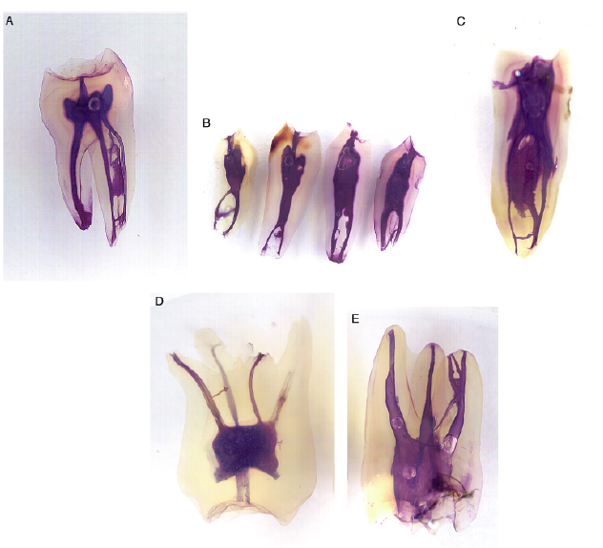

Slide 27
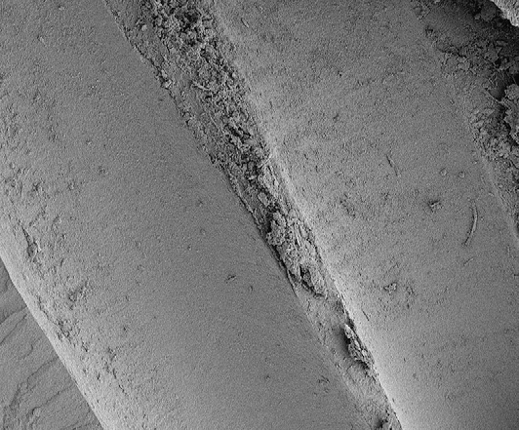
Challenges of Irrigation
debris
Notes:
A recent study showed that untouched areas, in particular anastomoses between canals, are frequently packed with debris during instrumentation.
Although at present it is not known how these debris can best be removed (if at all), it is likely that physical agitation (eg, ultrasound) and the use of demineralizing agents are needed in addition to hypochlorite.

Slide 28
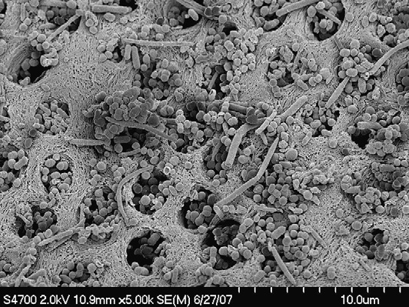
Challenges of Irrigation
Biofilm
Notes:
Biofilm can be removed or eliminated through the following methods: mechanical removal by instruments (effective only in some areas of the root canal); dissolution by hypochlorite; and detachment by ultrasonic energy. Other chemical means, such as chlorhexidine, can kill biofilm bacteria if allowed a long enough contact time. However, as they lack tissue-dissolving ability, the dead microbial biomass stays in the canal if not removed mechanically or dissolved by hypochlorite.
Any remaining organic matter, microbes, or vital or necrotic tissue jeopardizes the integrity of the seal of the root filling. Therefore the goal of the treatment is not only to kill the microbes in the root canal but also to remove them as completely as possible.

Slide 29
Challenges of Irrigation
Safety versus Effectiveness in the Apical Root Canal
Irrigation
Safety
Effectiveness
Notes:
Irrigation must maintain a balance between 2 important goals: safety and effectiveness. This point is particularly true with the most important irrigant, sodium hypochlorite, but other irrigants can also cause pain and other problems if they gain access to the periapical tissues. Effectiveness is often jeopardized in the apical root canal by restricting anatomy and valid safety concerns. However, the eradication of the microbes in the apical canal should be of key importance to the success of endodontic treatment. Sufficient exchange of hypochlorite and other irrigants in this area while
keeping the apical pressure of the solutions minimal is the obvious goal of irrigation of the apical root canal.
A better understanding of fluid dynamics and the development of new needle designs and equipment for irrigant delivery are the 2 important areas to deal with in the challenges of irrigating the most apical part of the canal

Slide 30
COMPUTATIONAL FLUID DYNAMICS IN THE ROOT-CANAL SPACE
Computational fluid dynamics (CFD) is a new approach in endodontic research to improve our understanding of fluid dynamics in the special anatomic environment of the root canal.
Notes:
Computational fluid dynamics (CFD) is a new approach in endodontic research to improve our understanding of fluid dynamics in the special anatomic environment of the root canal. CFD is the science that focuses on predicting fluid flow and related phenomena by solving the mathematical equations that govern these processes

Slide 31
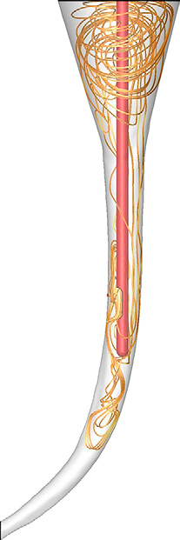
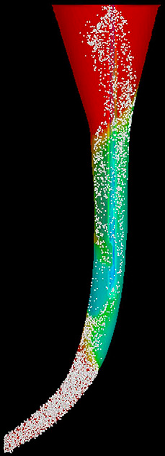
Streamline
Particle Tracking
Notes:
Particle tracking during irrigation simulated CFD model,
The CFD model can be used to evaluate and predict specific parameters such as Streamline: provides visualization of the irrigant flow in the canal

Slide 32
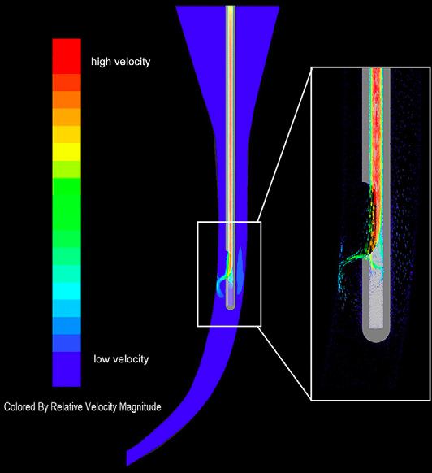
Velocity distribution of irrigant flow
Notes:
CFD can be used to evaluate velocity distribution of irrigant flow in the root canal.
The irrigant velocity on the canal wall is considered a highly significant factor in determining the replacement of the irrigant in certain parts of the root canal and in the flush effect, therefore directly influencing the effectiveness of irrigation.
Some of the goals of CFD studies in endodontics are to improve needle-tip design for effective & safe delivery of the irrigant and to optimize the exchange of irrigating solutions in the peripheral parts of the canal system

Slide 33
Irrigation Devices & Techniques
Notes:
The effectiveness and safety of irrigation depends on the means of delivery. Traditionally, irrigation has been performed with a plastic syringe and an open-ended needle into the canal space. An increasing number of novel needle-tip designs and equipment are emerging in an effort to better address the challenges of irrigation.

Slide 34
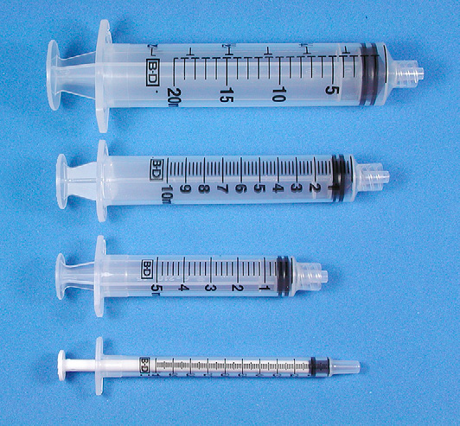
Irrigation Devices & Techniques
Notes:
Although large-volume syringes potentially allow some time-savings, they are more difficult to control for pressure and accidents may happen. Therefore, to maximize safety and control, use of 1- to 5-mL syringes is recommended instead of the larger ones. All syringes for endodontic irrigation must have a Luer-Lok design. Because of the chemical reactions between many irrigants, separate syringes should be used for each solution.

Slide 35
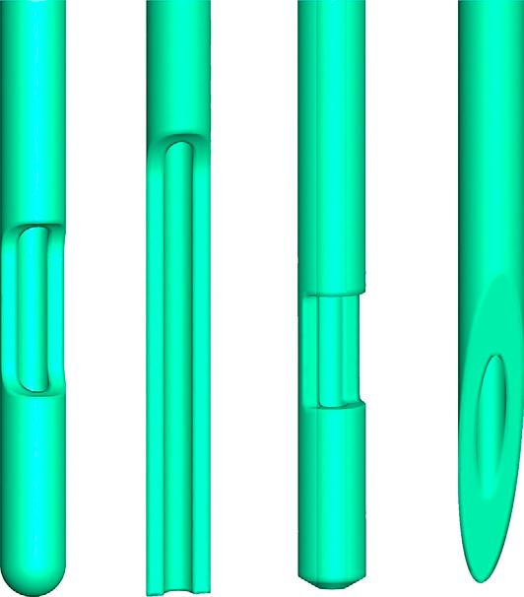
Irrigation Devices & Techniques
Notes:
Although 25-gauge needles were commonplace for endodontic irrigation a few years ago, they were first replaced by 27-G needles, now 30-G and even 31-G needles are taking over for routine use in irrigation. Several studies have shown that the irrigant has only a limited effect beyond the tip
of the needle because of the dead-water zone or sometimes air bubbles in the apical root canal, which prevent apical penetration of the solution.
However, although the smaller needles allow delivery of the irrigant close to the apex, this is not without safety
concerns. Several modifications of the needle-tip design have been introduced in recent years to facilitate effectiveness and minimize safety risks

Slide 36
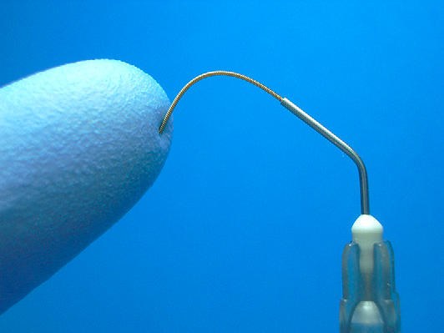
Irrigation Devices & Techniques
Notes:
Flexiglide needle for irrigation also easily follows curved canals

Slide 37
Irrigation Devices & Techniques
Gutta-percha points
Notes:
One of the techniques used to facilitate penetration of solutions in the canal includes the use of apically fitting gutta-percha cones in an up-and-down motion at the working length. Although this facilitates the exchange of the apical solution, the overall volume of fresh solution in the apical canal is likely to remain small. However, the benefits of gutta-percha point assisted irrigation have been shown in several studies

Slide 38
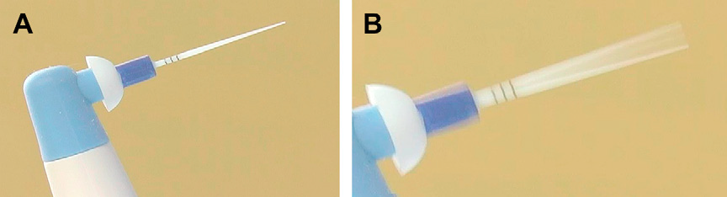
Irrigation Devices & Techniques
EndoActivator
(Advanced Endodontics, Santa Barbara, CA, USA)
Notes:
EndoActivator is a new type of irrigation facilitator. It is based on sonic vibration of a plastic tip in the root canal. The system has 3 different sizes of tips that are easily attached (snap-on) to the handpiece that creates the sonic vibrations. EndoActivator does not deliver new irrigant to the canal but it facilitates the penetration and renewal of the irrigant in the canal. There are studies indicated that the use of EndoActivator
facilitates irrigant penetration and mechanical cleansing compared with needle irrigation, with no increase in the risk of irrigant extrusion through the apex.

Slide 39
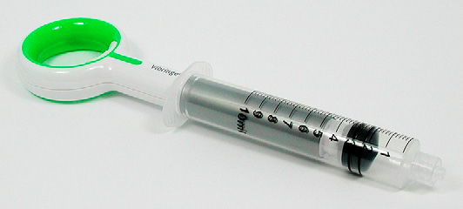
Irrigation Devices & Techniques
Vibringe
(Vibringe BV, Amsterdam, The Netherlands)
Notes:
Vibringe is a new sonic irrigation system that combines battery-driven vibrations with manually operated irrigation of the root canal. Vibringe uses the traditional type of syringe/needle delivery but adds sonic vibration. No studies can be found on Medline.

Slide 40
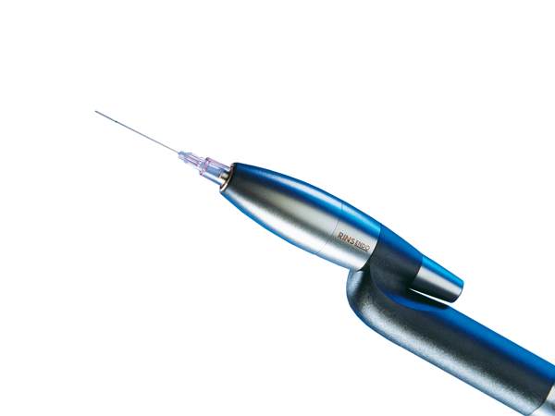
Irrigation Devices & Techniques
RinsEndo
(Durr Dental Co)
Notes:
The RinsEndo system is based on a pressure-suction mechanism. A study of the safety of several irrigation systems reported that the risk of overirrigation was comparable with manual and RinsEndo irrigation, but higher than with EndoActivator or the EndoVac system.
Not enough data are available to draw conclusions about the benefits and possible risks of the RinsEndo system

Slide 41
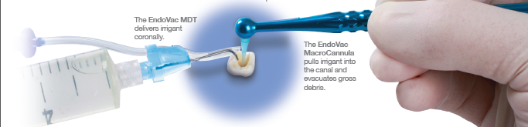
Irrigation Devices & Techniques
EndoVac
(Discus Dental, Culver City, CA, USA)
Notes:
EndoVac represents a novel approach to irrigation as, instead of delivering the irrigant through the needle, the EndoVac system is based on a negative-pressure approach whereby the irrigant placed in the pulp chamber is sucked down the root canal and back up again through a thin needle with a special design.

Slide 42
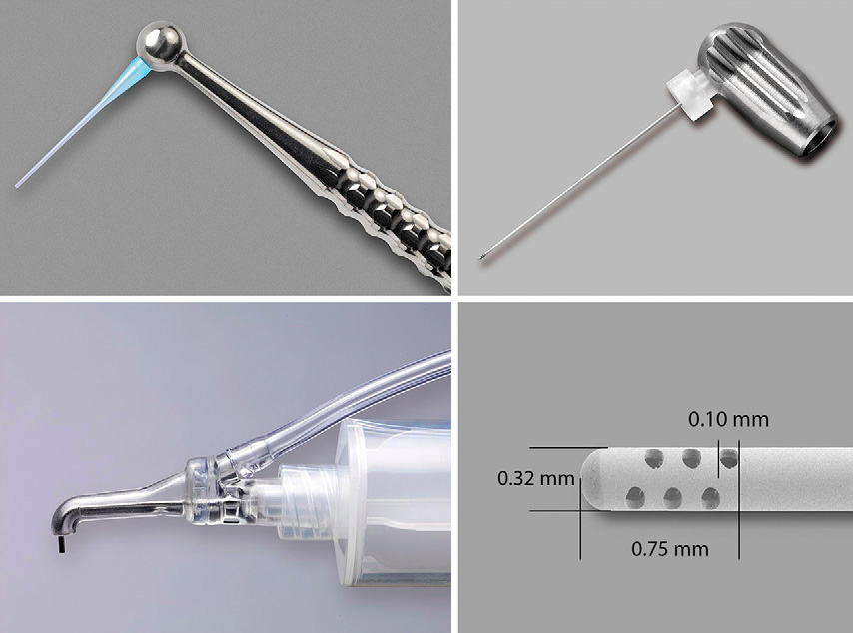
Macrocannula
Microcannula
Master Delivery Tip
Notes:
Irrigant is delivered into the access chamber and a very fine needle connected to the dental unit’s suction device is placed into the root canal. Excess irrigant from the access cavity is then transported apically and ultimately removed via suction. FIRST a macrocannula removes coronal debris. In this step, the MacroCannula and the Master Delivery Tip are used at the same time. It is helpful to have a dental assistant deliver the irrigant with the MDT while the clinician works the MacroCannula up and down each canal.

Slide 43
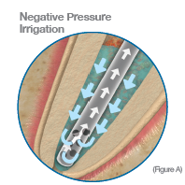
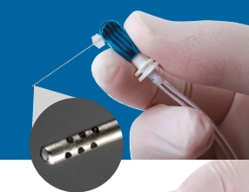
Notes:
Subsequently a microcannula removes particles lodged close to WL.
There is evidence that, compared with traditional needle irrigation and some other systems, the EndoVac system lowers the risks associated with irrigation close to the apical foramen considerably. Another advantage of the reversed flow of irrigants may be good apical cleaning at the 1-mm level and a strong antibacterial effect when hypochlorite is used, as shown by studies

Slide 44
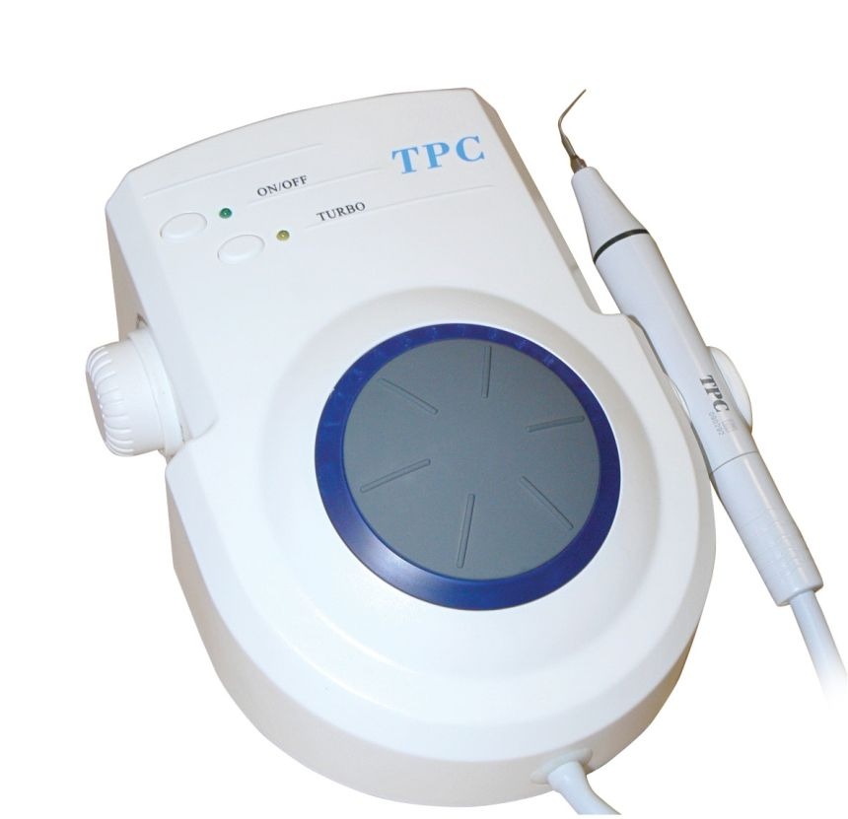
Irrigation Devices & Techniques
Ultrasound
Notes:
The use of ultrasonic energy for cleaning of the root canal and to facilitate disinfection has a long history in endodontics.
Studies concluded that ultrasonics, together with an irrigant, contributed o a better cleaning of the root-canal system than irrigation and hand-instrumentation alone.
Ultrasonic files must have free movement in the canal without making contact with the canal wall to work effectively.

Slide 45
Conclusion
Irrigation has a key role in successful endodontic treatment
Although NaOCl is the most important irrigating solution, no single irrigant can accomplish all the tasks required by irrigation. Detailed understanding of the mode of action of various solutions is important for optimal irrigation
New developments such as CFD and mechanical devices will help to advance safe and effective irrigation
Notes:
Although hypochlorite is the most important irrigating solution, no single irrigant can accomplish all the tasks required by irrigation. Detailed understanding of the mode of action of various solutions is important for optimal irrigation

Slide 46


