Slide 1
Trauma to the Gravid Uterus
Akram M Fayed, MD, ABIM
Associate Professor , Department of Critical Care Medicine,
Faculty of Medicine,
University of Alexandria, Egypt
amfayed@gmail.com

Slide 2
Overview
Background
Epidemiology
What is Unique to Pregnancy?
Evaluation and Management of Major Trauma in Pregnancy
Outcome

Slide 3

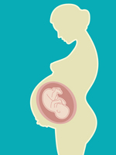
Notes:
- Evaluation of the pregnant trauma patient presents unique challenges since the presence of a fetus means that there are two patients potentially at risk, both of whom require evaluation and management.
- Knowledge of pregnancy-related anatomic and physiologic changes is also important in the evaluation and management of these women.

Slide 4

Notes:
Physicians dealing with trauma and Critical Care should pay a great attention to the recovery of all members of the family

Slide 5
Background
Trauma is a major contributor to maternal mortality, and is the leading
cause of pregnancy-associated maternal deaths in the USA (1) .
In 2002, there were 4.1 injury-related hospitalizations of pregnant
women per 1000 deliveries in the United States (2)
Motor vehicle crashes and domestic/intimate partner violence account
for most cases of maternal trauma,
Falls, burns, homicide, suicide, penetrating trauma, and toxic exposure
account for the majority of the remainder (3)
Am J Public Health. 2005;95(3):471.
Am J Obstet Gynecol. 2007;196(2):161.e1
Am J Obstet Gynecol. 2013;209(1):1.

Slide 6
Background
In fact, pregnancy appears to be a risk factor for being assaulted.
Between 1993 and 1998, homicide was the leading cause of death
among pregnant or recently pregnant women in Maryland and accounted
for 20 percent of these deaths, but it was only the fifth leading cause of
death among non pregnant women (1)
(1) JAMA. 2001;285(11):1455.

Slide 7
Background
In another American series, 5 percent of female homicide victims were
murdered while pregnant (1)
An epidemiologic study reported an increased risk of motor vehicle
crashes in the second trimester compared with prepregnancy (6.5 versus
4.6 events per 1000 drivers annually; RR 1.42, 95% CI 1.32-1.53), but a
causal relationship is unproven (2)
Obstet Gynecol. 2002;100(1):27
CMAJ. 2014 Jul;186(10):742-50. Epub 2014 May 12.

Slide 8
Pregnancy appears to increase the risk of falling, possibly because of increased joint laxity, weight gain, a change in the center of gravity, and other anatomical changes. Alterations in sway responses to perturbations have been reported in the third trimester in healthy women with uncomplicated pregnancies [9].
Background
Pregnancy appears to increase the risk of falling (1)
  Increased joint laxity,
  Weight gain,
  A change in the center of gravity, and
  other anatomical changes
J Biomech. 2010 Aug;43(12):2434-9

Slide 9

The Pyramids at night

Slide 10
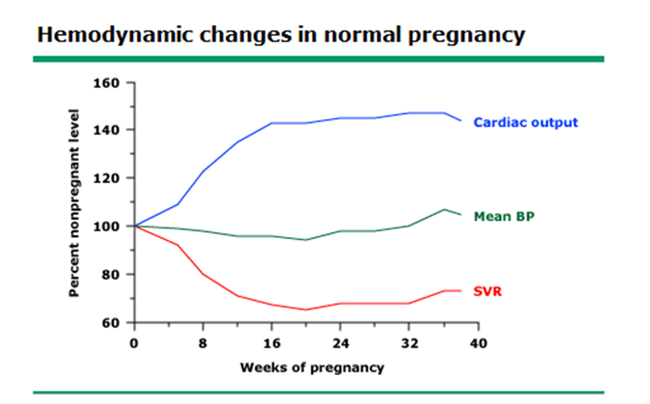
Pregnancy appears to increase the risk of falling, possibly because of increased joint laxity, weight gain, a change in the center of gravity, and other anatomical changes. Alterations in sway responses to perturbations have been reported in the third trimester in healthy women with uncomplicated pregnancies [9].
Pregnancy- Specific Changes
Cardiovascular
Notes:
Cardiovascular system – Cardiac output progressively increases beginning in the first trimester; most of the increase occurs by 20 weeks of gestation (figure 1A-C). Heart rate increases by approximately 15 beats per minute beginning in the first trimester, while systolic and diastolic blood pressure decrease by a mean of 10 mmHg due to reduced systemic vascular resistance. The blood pressure nadir occurs at about 28 weeks of gestation, after which blood pressure slowly rises back to its prepregnancy baseline. (See "Maternal cardiovascular and hemodynamic adaptations to pregnancy".)
The heart is rotated toward the left, resulting in a 15 to 20º left axis deviation. Other findings, which can be normal, include transient ST segment and T wave changes, the presence of a Q wave and inverted T waves in lead III, an attenuated Q wave in lead AVF, and inverted T waves in leads V1, V2 and, occasionally, V3.

Slide 11
Pregnancy appears to increase the risk of falling, possibly because of increased joint laxity, weight gain, a change in the center of gravity, and other anatomical changes. Alterations in sway responses to perturbations have been reported in the third trimester in healthy women with uncomplicated pregnancies [9].
Pregnancy- Specific Changes
Cardiovascular
The heart is rotated toward the left, resulting in a 15 to 20º left axis
deviation.
Other EKG findings:
- Transient ST segment and T wave changes,
Q wave and inverted T waves in lead III,
An attenuated Q wave in lead AVF, and
Inverted T waves in leads V1, V2 and, occasionally, V3.

Slide 12
Pregnancy appears to increase the risk of falling, possibly because of increased joint laxity, weight gain, a change in the center of gravity, and other anatomical changes. Alterations in sway responses to perturbations have been reported in the third trimester in healthy women with uncomplicated pregnancies [9].
Pregnancy- Specific Changes
Pulmonary system
Lung volume changes occur by 20 weeks of gestation and include
a decrease in functional residual capacity and an increase in tidal volume
There is no change in FEV1 or in respiratory rate
Respiratory alkalosis due to physiologic hyperventilation with a
compensatory metabolic acidosis also occurs during pregnancy

Slide 13
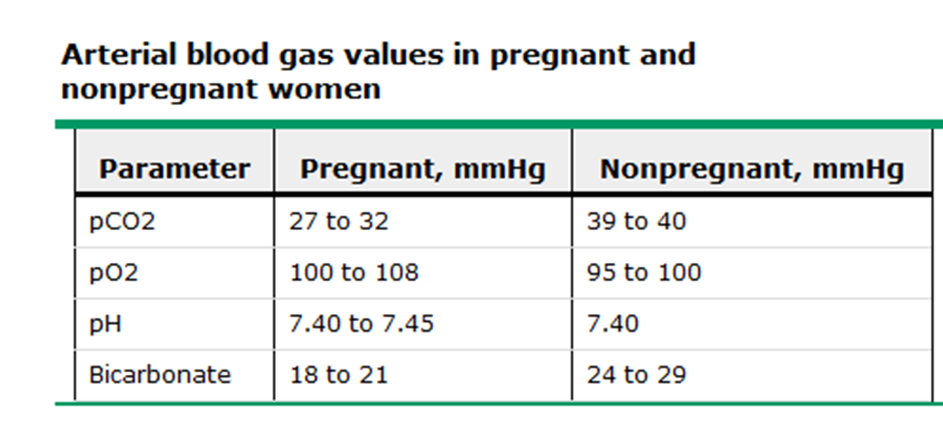
Pregnancy appears to increase the risk of falling, possibly because of increased joint laxity, weight gain, a change in the center of gravity, and other anatomical changes. Alterations in sway responses to perturbations have been reported in the third trimester in healthy women with uncomplicated pregnancies [9].
Pregnancy- Specific Changes
Pulmonary system

Slide 14
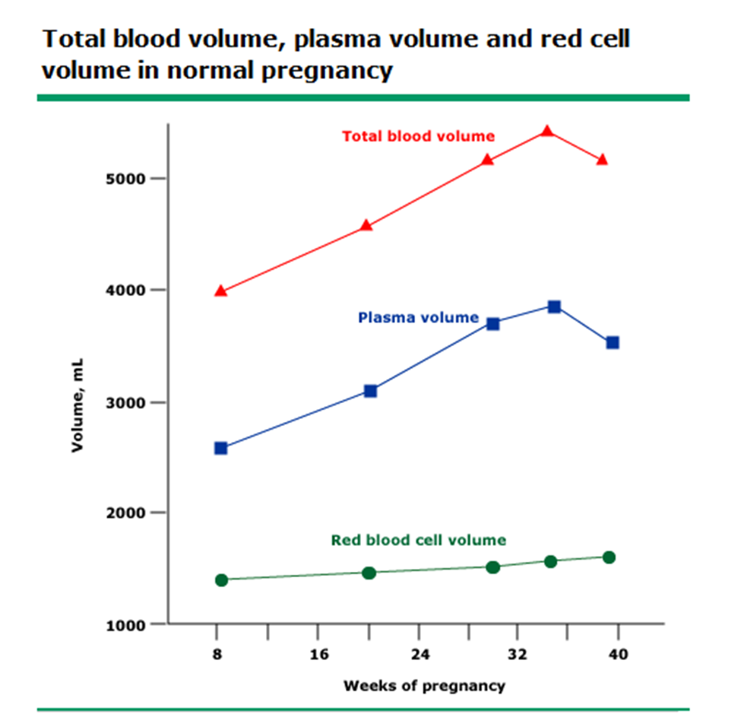
Pregnancy appears to increase the risk of falling, possibly because of increased joint laxity, weight gain, a change in the center of gravity, and other anatomical changes. Alterations in sway responses to perturbations have been reported in the third trimester in healthy women with uncomplicated pregnancies [9].
Pregnancy- Specific Changes
Hematological system
Notes:
The plasma volume of pregnant women increases by 45 percent over
that of nonpregnant women beginning at six to eight weeks of gestation.
A dilutional (physiologic) anemia of pregnancy results from a greater
rise in plasma volume compared to red cell volume.
Hemoglobin levels as low as 10.5 g/dL are considered normal in
pregnant women and not suggestive of anemia/hemorrhage
The normal pregnant woman's white blood cell count ranges from 6000 to 16,000 cell/mm3 in the first and second trimesters, and may rise as high as 20,000 to 30,000 cells/mm3 during labor. Thus, leukocytosis can be a normal finding in pregnant women. A normal fibrinogen concentration in pregnancy is greater than 200mg/dL.
A fibrinogen <200 mg/dL and thrombocytopenia suggest disseminated intravascular coagulation (DIC), a complication of severe abruption. (See 'Abruptio placentae'below.)

Slide 15
Pregnancy appears to increase the risk of falling, possibly because of increased joint laxity, weight gain, a change in the center of gravity, and other anatomical changes. Alterations in sway responses to perturbations have been reported in the third trimester in healthy women with uncomplicated pregnancies [9].
Pregnancy- Specific Changes
Hematological system
The normal pregnant woman's white blood cell count ranges from
6000 to 16,000 cell/mm3 in the first and second trimesters, and may rise
as high as 20,000 to 30,000 cells/mm3 during labor.
Thus, leukocytosis can be a normal finding in pregnant women
A normal fibrinogen concentration in pregnancy is > 200mg/dL.
A fibrinogen <200 mg/dL and thrombocytopenia suggest (DIC), a
complication of severe abruption

Slide 16
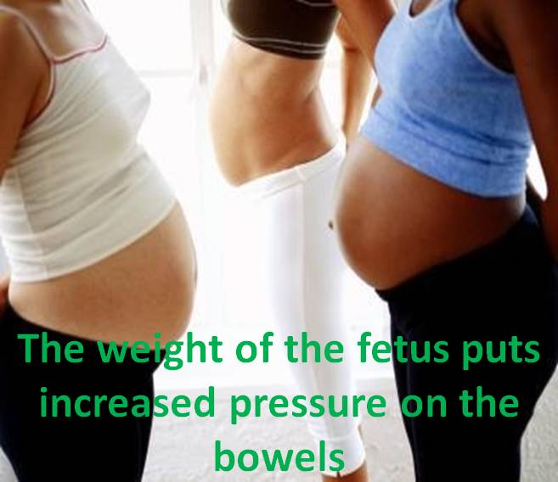
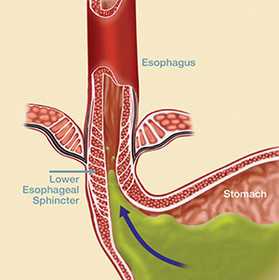
Pregnancy appears to increase the risk of falling, possibly because of increased joint laxity, weight gain, a change in the center of gravity, and other anatomical changes. Alterations in sway responses to perturbations have been reported in the third trimester in healthy women with uncomplicated pregnancies [9].
Pregnancy- Specific Changes
Gastrointestinal system
Pregnant women are predisposed to gastric aspiration due to:
Notes:
Pregnant women are predisposed to gastric aspiration due to:
Increased intraabdominal pressure and
Relaxation of the lower esophageal sphincter

Slide 17
Pregnancy appears to increase the risk of falling, possibly because of increased joint laxity, weight gain, a change in the center of gravity, and other anatomical changes. Alterations in sway responses to perturbations have been reported in the third trimester in healthy women with uncomplicated pregnancies [9].
Pregnancy- Specific Changes
Renal system
The glomerular hyperfiltration results in a normal reduction in the plasma
creatinine concentration to about 0.4 to 0.5 mg/dL
A "normal" level of 0.8 mg/dL during pregnancy represents a mild
decline in renal function

Slide 18
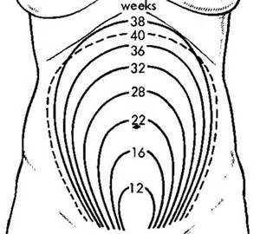
Pregnancy appears to increase the risk of falling, possibly because of increased joint laxity, weight gain, a change in the center of gravity, and other anatomical changes. Alterations in sway responses to perturbations have been reported in the third trimester in healthy women with uncomplicated pregnancies [9].
Pregnancy- Specific Changes
Increased risk of IVC compression
Notes:
Increased risk of IVC compression — The uterus reaches the level of the maternal umbilicus by approximately 20 weeks of gestation, at which point, it is large enough to compress the inferior vena cava (IVC) when the woman is supine and result in up to a 30 percent reduction in cardiac output [10]. The subsequent reduction in preload results in a significant fall in stroke volume. Healthy women compensate for this phenomenon by increasing systemic vascular resistance and heart rate, but many become hypotensive, diaphoretic, lightheaded, and nauseous. (See "Maternal cardiovascular and hemodynamic adaptations to pregnancy".)
Displacing the uterus to the left, off the vena cava, is critical to restoring cardiac output. This is best accomplished by placing the woman on her left side, but putting a wedge or rolled towel under her right side, or adjusting her platform to a 30º left lateral tilt is also useful. Left-sided tilt should be utilized whenever possible for all women after 20 weeks of gestation during trauma evaluation or during surger

Slide 19
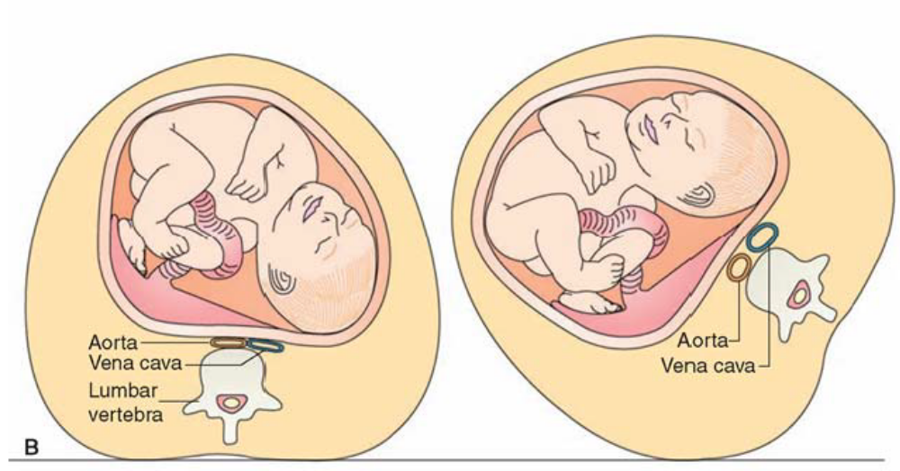
Pregnancy appears to increase the risk of falling, possibly because of increased joint laxity, weight gain, a change in the center of gravity, and other anatomical changes. Alterations in sway responses to perturbations have been reported in the third trimester in healthy women with uncomplicated pregnancies [9].
Pregnancy- Specific Changes
Increased risk of IVC compression
Notes:
Increased risk of IVC compression — The uterus reaches the level of the maternal umbilicus by approximately 20 weeks of gestation, at which point, it is large enough to compress the inferior vena cava (IVC) when the woman is supine and result in up to a 30 percent reduction in cardiac output [10]. The subsequent reduction in preload results in a significant fall in stroke volume. Healthy women compensate for this phenomenon by increasing systemic vascular resistance and heart rate, but many become hypotensive, diaphoretic, lightheaded, and nauseous. (See "Maternal cardiovascular and hemodynamic adaptations to pregnancy".)
Displacing the uterus to the left, off the vena cava, is critical to restoring cardiac output. This is best accomplished by placing the woman on her left side, but putting a wedge or rolled towel under her right side, or adjusting her platform to a 30º left lateral tilt is also useful. Left-sided tilt should be utilized whenever possible for all women after 20 weeks of gestation during trauma evaluation or during surger

Slide 20
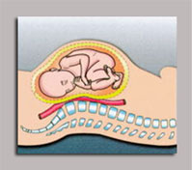
Cardiopulmonary resuscitation — External chest compression is more difficult during pregnancy because of reduced chest compliance in pregnant women [11]. External chest compression for cardiac arrest may not be effective in the late second and third trimesters because aortocaval compression in the supine position significantly reduces cardiac output (see above) [12]. In some instances, emptying the uterus by performing a cesarean delivery is required to perform effective cardiopulmonary resuscitation and save the mother's life [13]. Several studies have suggested that the best fetal and maternal outcomes are achieved if a cesarean delivery is performed within four to five minutes of a cardiac arrest if maternal resuscitation has not been successful [12-15]
Cardiopulmonary resuscitation — External chest compression is more difficult during pregnancy because of reduced chest compliance in pregnant women [11]. External chest compression for cardiac arrest may not be effective in the late second and third trimesters because aortocaval compression in the supine position significantly reduces cardiac output (see above) [12]. In some instances, emptying the uterus by performing a cesarean delivery is required to perform effective cardiopulmonary resuscitation and save the mother's life [13]. Several studies have suggested that the best fetal and maternal outcomes are achieved if a cesarean delivery is performed within four to five minutes of a cardiac arrest if maternal resuscitation has not been successful [12-15]
Pregnancy appears to increase the risk of falling, possibly because of increased joint laxity, weight gain, a change in the center of gravity, and other anatomical changes. Alterations in sway responses to perturbations have been reported in the third trimester in healthy women with uncomplicated pregnancies [9].
Pregnancy- Specific Changes
Cardiopulmonary resuscitation
External chest compression is more difficult during pregnancy
because of reduced chest compliance in pregnant women
Notes:
External chest compression for cardiac arrest may not be effective in
the late second and third trimesters because aortocaval compression in
the supine position significantly reduces cardiac output [12].

Slide 21
Cardiopulmonary resuscitation — External chest compression is more difficult during pregnancy because of reduced chest compliance in pregnant women [11]. External chest compression for cardiac arrest may not be effective in the late second and third trimesters because aortocaval compression in the supine position significantly reduces cardiac output (see above) [12]. In some instances, emptying the uterus by performing a cesarean delivery is required to perform effective cardiopulmonary resuscitation and save the mother's life [13]. Several studies have suggested that the best fetal and maternal outcomes are achieved if a cesarean delivery is performed within four to five minutes of a cardiac arrest if maternal resuscitation has not been successful [12-15]
Cardiopulmonary resuscitation — External chest compression is more difficult during pregnancy because of reduced chest compliance in pregnant women [11]. External chest compression for cardiac arrest may not be effective in the late second and third trimesters because aortocaval compression in the supine position significantly reduces cardiac output (see above) [12]. In some instances, emptying the uterus by performing a cesarean delivery is required to perform effective cardiopulmonary resuscitation and save the mother's life [13]. Several studies have suggested that the best fetal and maternal outcomes are achieved if a cesarean delivery is performed within four to five minutes of a cardiac arrest if maternal resuscitation has not been successful [12-15]
Pregnancy appears to increase the risk of falling, possibly because of increased joint laxity, weight gain, a change in the center of gravity, and other anatomical changes. Alterations in sway responses to perturbations have been reported in the third trimester in healthy women with uncomplicated pregnancies [9].
Pregnancy- Specific Changes
Cardiopulmonary resuscitation
In some instances, emptying the uterus by performing a cesarean
delivery is required to perform effective cardiopulmonary resuscitation
and save the mother's life (1)
Several studies have suggested that the best fetal and maternal
outcomes are achieved if a cesarean delivery is performed within four
to five minutes of a cardiac arrest if maternal resuscitation has not been
successful (2)
(1) Obstet Gynecol. 1986;68(4):571.
(2) Am J Obstet Gynecol. 2005;192(6):1916.

Slide 22
Cardiopulmonary resuscitation — External chest compression is more difficult during pregnancy because of reduced chest compliance in pregnant women [11]. External chest compression for cardiac arrest may not be effective in the late second and third trimesters because aortocaval compression in the supine position significantly reduces cardiac output (see above) [12]. In some instances, emptying the uterus by performing a cesarean delivery is required to perform effective cardiopulmonary resuscitation and save the mother's life [13]. Several studies have suggested that the best fetal and maternal outcomes are achieved if a cesarean delivery is performed within four to five minutes of a cardiac arrest if maternal resuscitation has not been successful [12-15]
Cardiopulmonary resuscitation — External chest compression is more difficult during pregnancy because of reduced chest compliance in pregnant women [11]. External chest compression for cardiac arrest may not be effective in the late second and third trimesters because aortocaval compression in the supine position significantly reduces cardiac output (see above) [12]. In some instances, emptying the uterus by performing a cesarean delivery is required to perform effective cardiopulmonary resuscitation and save the mother's life [13]. Several studies have suggested that the best fetal and maternal outcomes are achieved if a cesarean delivery is performed within four to five minutes of a cardiac arrest if maternal resuscitation has not been successful [12-15]
Pregnancy appears to increase the risk of falling, possibly because of increased joint laxity, weight gain, a change in the center of gravity, and other anatomical changes. Alterations in sway responses to perturbations have been reported in the third trimester in healthy women with uncomplicated pregnancies [9].
Pregnancy- Specific Changes
Increased vascularity and blood flow
The dilated pelvic vasculature increases the risk of retroperitoneal
hemorrhage from abdominal or pelvic injury (1)
Rapid exsanguination can occur since blood flow to the uterus is as
high as 600 mL/min.
(1) Obstet Gynecol Clin North Am. 1999;26(3):459.

Slide 23
Cardiopulmonary resuscitation — External chest compression is more difficult during pregnancy because of reduced chest compliance in pregnant women [11]. External chest compression for cardiac arrest may not be effective in the late second and third trimesters because aortocaval compression in the supine position significantly reduces cardiac output (see above) [12]. In some instances, emptying the uterus by performing a cesarean delivery is required to perform effective cardiopulmonary resuscitation and save the mother's life [13]. Several studies have suggested that the best fetal and maternal outcomes are achieved if a cesarean delivery is performed within four to five minutes of a cardiac arrest if maternal resuscitation has not been successful [12-15]
Cardiopulmonary resuscitation — External chest compression is more difficult during pregnancy because of reduced chest compliance in pregnant women [11]. External chest compression for cardiac arrest may not be effective in the late second and third trimesters because aortocaval compression in the supine position significantly reduces cardiac output (see above) [12]. In some instances, emptying the uterus by performing a cesarean delivery is required to perform effective cardiopulmonary resuscitation and save the mother's life [13]. Several studies have suggested that the best fetal and maternal outcomes are achieved if a cesarean delivery is performed within four to five minutes of a cardiac arrest if maternal resuscitation has not been successful [12-15]
Pregnancy appears to increase the risk of falling, possibly because of increased joint laxity, weight gain, a change in the center of gravity, and other anatomical changes. Alterations in sway responses to perturbations have been reported in the third trimester in healthy women with uncomplicated pregnancies [9].
Pregnancy- Specific Changes
Increased vascularity and blood flow
Fetal oxygenation is dependent, in part, upon uterine blood flow.
Uterine blood flow is not autoregulated, thus a decrease in maternal
SBP can cause a significant fall in uterine blood flow, and in turn, fetal
oxygenation
Uterine blood flow can also be reduced from vasoconstriction related
to drugs or maternal hypercarbia or hypocarbia

Slide 24
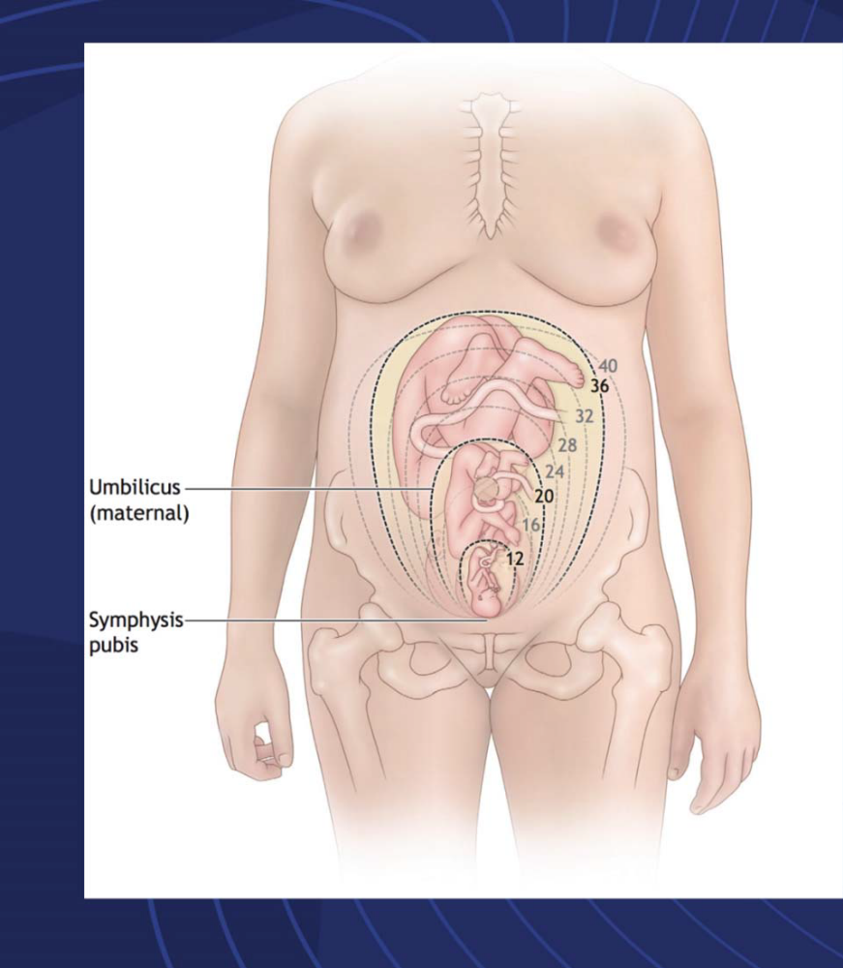
Cardiopulmonary resuscitation — External chest compression is more difficult during pregnancy because of reduced chest compliance in pregnant women [11]. External chest compression for cardiac arrest may not be effective in the late second and third trimesters because aortocaval compression in the supine position significantly reduces cardiac output (see above) [12]. In some instances, emptying the uterus by performing a cesarean delivery is required to perform effective cardiopulmonary resuscitation and save the mother's life [13]. Several studies have suggested that the best fetal and maternal outcomes are achieved if a cesarean delivery is performed within four to five minutes of a cardiac arrest if maternal resuscitation has not been successful [12-15]
Cardiopulmonary resuscitation — External chest compression is more difficult during pregnancy because of reduced chest compliance in pregnant women [11]. External chest compression for cardiac arrest may not be effective in the late second and third trimesters because aortocaval compression in the supine position significantly reduces cardiac output (see above) [12]. In some instances, emptying the uterus by performing a cesarean delivery is required to perform effective cardiopulmonary resuscitation and save the mother's life [13]. Several studies have suggested that the best fetal and maternal outcomes are achieved if a cesarean delivery is performed within four to five minutes of a cardiac arrest if maternal resuscitation has not been successful [12-15]
Pregnancy appears to increase the risk of falling, possibly because of increased joint laxity, weight gain, a change in the center of gravity, and other anatomical changes. Alterations in sway responses to perturbations have been reported in the third trimester in healthy women with uncomplicated pregnancies [9].
Pregnancy- Specific Changes
Uterine size changes
First Trimester
Intrapelvic and thick walled
Uterus
Fetus is protected from direct
Injury
- Abortion and Isoimmunization
Notes:
Risks in red

Slide 25
Cardiopulmonary resuscitation — External chest compression is more difficult during pregnancy because of reduced chest compliance in pregnant women [11]. External chest compression for cardiac arrest may not be effective in the late second and third trimesters because aortocaval compression in the supine position significantly reduces cardiac output (see above) [12]. In some instances, emptying the uterus by performing a cesarean delivery is required to perform effective cardiopulmonary resuscitation and save the mother's life [13]. Several studies have suggested that the best fetal and maternal outcomes are achieved if a cesarean delivery is performed within four to five minutes of a cardiac arrest if maternal resuscitation has not been successful [12-15]
Cardiopulmonary resuscitation — External chest compression is more difficult during pregnancy because of reduced chest compliance in pregnant women [11]. External chest compression for cardiac arrest may not be effective in the late second and third trimesters because aortocaval compression in the supine position significantly reduces cardiac output (see above) [12]. In some instances, emptying the uterus by performing a cesarean delivery is required to perform effective cardiopulmonary resuscitation and save the mother's life [13]. Several studies have suggested that the best fetal and maternal outcomes are achieved if a cesarean delivery is performed within four to five minutes of a cardiac arrest if maternal resuscitation has not been successful [12-15]
Pregnancy appears to increase the risk of falling, possibly because of increased joint laxity, weight gain, a change in the center of gravity, and other anatomical changes. Alterations in sway responses to perturbations have been reported in the third trimester in healthy women with uncomplicated pregnancies [9].
Pregnancy- Specific Changes
Uterine size changes
Second Trimester
Extrapelvic uterus
Large volume of amniotic fluid
Placental Abruption
Amniotic fluid embolization
Isoimmunization
Notes:
Risks in red

Slide 26
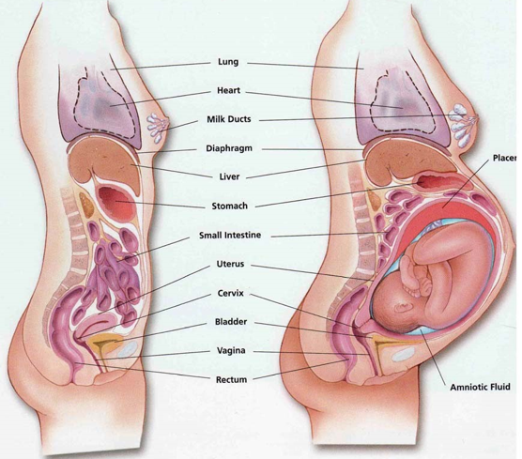
Cardiopulmonary resuscitation — External chest compression is more difficult during pregnancy because of reduced chest compliance in pregnant women [11]. External chest compression for cardiac arrest may not be effective in the late second and third trimesters because aortocaval compression in the supine position significantly reduces cardiac output (see above) [12]. In some instances, emptying the uterus by performing a cesarean delivery is required to perform effective cardiopulmonary resuscitation and save the mother's life [13]. Several studies have suggested that the best fetal and maternal outcomes are achieved if a cesarean delivery is performed within four to five minutes of a cardiac arrest if maternal resuscitation has not been successful [12-15]
Cardiopulmonary resuscitation — External chest compression is more difficult during pregnancy because of reduced chest compliance in pregnant women [11]. External chest compression for cardiac arrest may not be effective in the late second and third trimesters because aortocaval compression in the supine position significantly reduces cardiac output (see above) [12]. In some instances, emptying the uterus by performing a cesarean delivery is required to perform effective cardiopulmonary resuscitation and save the mother's life [13]. Several studies have suggested that the best fetal and maternal outcomes are achieved if a cesarean delivery is performed within four to five minutes of a cardiac arrest if maternal resuscitation has not been successful [12-15]
Pregnancy appears to increase the risk of falling, possibly because of increased joint laxity, weight gain, a change in the center of gravity, and other anatomical changes. Alterations in sway responses to perturbations have been reported in the third trimester in healthy women with uncomplicated pregnancies [9].
Pregnancy- Specific Changes
Uterine size changes
Third Trimester
Thin walled uterus
Displacement of maternal
abdominal viscera
- IVC compression
Pelvic fractures with maternal
Hemorrhage and direct fetal injury
Amniotic fluid embolization
Placental abruption
Isoimmunization
Notes:
However, penetrating injuries above the uterine fundus are likely to
damage the bowel for the same reason (1)
The enlarged uterus also shields retroperitoneal structures from
penetrating abdominal trauma.
Rebound tenderness and guarding may be less prominent than in
nonpregnant women because the gravid uterus lifts and stretches the
anterior abdominal wall, potentially impeding contact between areas of
inflammation and parietal peritoneum.
Pregnancy alters the pattern of maternal injury such that pregnant
women are more likely than nonpregnant women to sustain abdominal
trauma (1)
The enlarged uterus reduces the risk of visceral injury after lower
abdominal penetrating injuries by displacing the bowel cephalad and
laterally

Slide 27
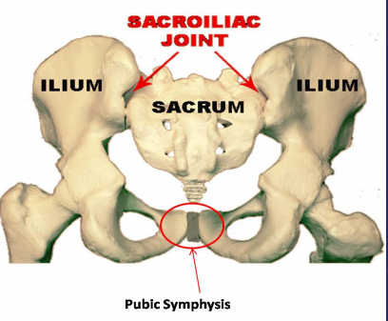
Cardiopulmonary resuscitation — External chest compression is more difficult during pregnancy because of reduced chest compliance in pregnant women [11]. External chest compression for cardiac arrest may not be effective in the late second and third trimesters because aortocaval compression in the supine position significantly reduces cardiac output (see above) [12]. In some instances, emptying the uterus by performing a cesarean delivery is required to perform effective cardiopulmonary resuscitation and save the mother's life [13]. Several studies have suggested that the best fetal and maternal outcomes are achieved if a cesarean delivery is performed within four to five minutes of a cardiac arrest if maternal resuscitation has not been successful [12-15]
Cardiopulmonary resuscitation — External chest compression is more difficult during pregnancy because of reduced chest compliance in pregnant women [11]. External chest compression for cardiac arrest may not be effective in the late second and third trimesters because aortocaval compression in the supine position significantly reduces cardiac output (see above) [12]. In some instances, emptying the uterus by performing a cesarean delivery is required to perform effective cardiopulmonary resuscitation and save the mother's life [13]. Several studies have suggested that the best fetal and maternal outcomes are achieved if a cesarean delivery is performed within four to five minutes of a cardiac arrest if maternal resuscitation has not been successful [12-15]
Pregnancy appears to increase the risk of falling, possibly because of increased joint laxity, weight gain, a change in the center of gravity, and other anatomical changes. Alterations in sway responses to perturbations have been reported in the third trimester in healthy women with uncomplicated pregnancies [9].
Pregnancy- Specific Changes
Changes in the pelvis
Pelvic ligaments soften
  Pelvic widening
  Lordosis
  Shift in the center of gravity

Slide 28

Nile River in Aswan

Slide 29
Cardiopulmonary resuscitation — External chest compression is more difficult during pregnancy because of reduced chest compliance in pregnant women [11]. External chest compression for cardiac arrest may not be effective in the late second and third trimesters because aortocaval compression in the supine position significantly reduces cardiac output (see above) [12]. In some instances, emptying the uterus by performing a cesarean delivery is required to perform effective cardiopulmonary resuscitation and save the mother's life [13]. Several studies have suggested that the best fetal and maternal outcomes are achieved if a cesarean delivery is performed within four to five minutes of a cardiac arrest if maternal resuscitation has not been successful [12-15]
Cardiopulmonary resuscitation — External chest compression is more difficult during pregnancy because of reduced chest compliance in pregnant women [11]. External chest compression for cardiac arrest may not be effective in the late second and third trimesters because aortocaval compression in the supine position significantly reduces cardiac output (see above) [12]. In some instances, emptying the uterus by performing a cesarean delivery is required to perform effective cardiopulmonary resuscitation and save the mother's life [13]. Several studies have suggested that the best fetal and maternal outcomes are achieved if a cesarean delivery is performed within four to five minutes of a cardiac arrest if maternal resuscitation has not been successful [12-15]
Pregnancy appears to increase the risk of falling, possibly because of increased joint laxity, weight gain, a change in the center of gravity, and other anatomical changes. Alterations in sway responses to perturbations have been reported in the third trimester in healthy women with uncomplicated pregnancies [9].
Mechanism of injury
Most mechanism of injury are similar to those in the nonpregnant patient
However, certain differences must be recognized in the pregnant patients
As pregnancy progresses, the chance of accidental injury increases
by the end of third trimester
Minor trauma occurs more frequently than at any other time during
female adulthood
Alterations of the centre of gravity caused by the enlarged uterus, as
also the pelvic ligament laxity are responsible for the gait instability which
causes pregnant women to be more susceptible to injury by falls

Slide 30
Cardiopulmonary resuscitation — External chest compression is more difficult during pregnancy because of reduced chest compliance in pregnant women [11]. External chest compression for cardiac arrest may not be effective in the late second and third trimesters because aortocaval compression in the supine position significantly reduces cardiac output (see above) [12]. In some instances, emptying the uterus by performing a cesarean delivery is required to perform effective cardiopulmonary resuscitation and save the mother's life [13]. Several studies have suggested that the best fetal and maternal outcomes are achieved if a cesarean delivery is performed within four to five minutes of a cardiac arrest if maternal resuscitation has not been successful [12-15]
Cardiopulmonary resuscitation — External chest compression is more difficult during pregnancy because of reduced chest compliance in pregnant women [11]. External chest compression for cardiac arrest may not be effective in the late second and third trimesters because aortocaval compression in the supine position significantly reduces cardiac output (see above) [12]. In some instances, emptying the uterus by performing a cesarean delivery is required to perform effective cardiopulmonary resuscitation and save the mother's life [13]. Several studies have suggested that the best fetal and maternal outcomes are achieved if a cesarean delivery is performed within four to five minutes of a cardiac arrest if maternal resuscitation has not been successful [12-15]
Pregnancy appears to increase the risk of falling, possibly because of increased joint laxity, weight gain, a change in the center of gravity, and other anatomical changes. Alterations in sway responses to perturbations have been reported in the third trimester in healthy women with uncomplicated pregnancies [9].
Types of trauma
Blunt abdominal trauma
  40% >>> Motor vehicle accidents
  30% >>> Falls
  20% >>> Interpersonal violence

Slide 31
Cardiopulmonary resuscitation — External chest compression is more difficult during pregnancy because of reduced chest compliance in pregnant women [11]. External chest compression for cardiac arrest may not be effective in the late second and third trimesters because aortocaval compression in the supine position significantly reduces cardiac output (see above) [12]. In some instances, emptying the uterus by performing a cesarean delivery is required to perform effective cardiopulmonary resuscitation and save the mother's life [13]. Several studies have suggested that the best fetal and maternal outcomes are achieved if a cesarean delivery is performed within four to five minutes of a cardiac arrest if maternal resuscitation has not been successful [12-15]
Cardiopulmonary resuscitation — External chest compression is more difficult during pregnancy because of reduced chest compliance in pregnant women [11]. External chest compression for cardiac arrest may not be effective in the late second and third trimesters because aortocaval compression in the supine position significantly reduces cardiac output (see above) [12]. In some instances, emptying the uterus by performing a cesarean delivery is required to perform effective cardiopulmonary resuscitation and save the mother's life [13]. Several studies have suggested that the best fetal and maternal outcomes are achieved if a cesarean delivery is performed within four to five minutes of a cardiac arrest if maternal resuscitation has not been successful [12-15]
Pregnancy appears to increase the risk of falling, possibly because of increased joint laxity, weight gain, a change in the center of gravity, and other anatomical changes. Alterations in sway responses to perturbations have been reported in the third trimester in healthy women with uncomplicated pregnancies [9].
Types of trauma
Blunt abdominal trauma
As pregnancy progresses, the enlarged uterus looses the protection
of the bony pelvis, but the amniotic fluid provides some protection for the
fetus by absorbing the thrust of blunt trauma, dissipating the force of the
blow by transmitting it equally in all directions.
However, the pelvic vessels are engorged due to increased
intravascular volume in pregnancy and thus there may be increased
chances of retroperitoneal hemorrhage as a result of blunt abdominal
trauma

Slide 32
Cardiopulmonary resuscitation — External chest compression is more difficult during pregnancy because of reduced chest compliance in pregnant women [11]. External chest compression for cardiac arrest may not be effective in the late second and third trimesters because aortocaval compression in the supine position significantly reduces cardiac output (see above) [12]. In some instances, emptying the uterus by performing a cesarean delivery is required to perform effective cardiopulmonary resuscitation and save the mother's life [13]. Several studies have suggested that the best fetal and maternal outcomes are achieved if a cesarean delivery is performed within four to five minutes of a cardiac arrest if maternal resuscitation has not been successful [12-15]
Cardiopulmonary resuscitation — External chest compression is more difficult during pregnancy because of reduced chest compliance in pregnant women [11]. External chest compression for cardiac arrest may not be effective in the late second and third trimesters because aortocaval compression in the supine position significantly reduces cardiac output (see above) [12]. In some instances, emptying the uterus by performing a cesarean delivery is required to perform effective cardiopulmonary resuscitation and save the mother's life [13]. Several studies have suggested that the best fetal and maternal outcomes are achieved if a cesarean delivery is performed within four to five minutes of a cardiac arrest if maternal resuscitation has not been successful [12-15]
Pregnancy appears to increase the risk of falling, possibly because of increased joint laxity, weight gain, a change in the center of gravity, and other anatomical changes. Alterations in sway responses to perturbations have been reported in the third trimester in healthy women with uncomplicated pregnancies [9].
Types of trauma
Blunt abdominal trauma
The rate of fetal mortality after maternal blunt trauma is 3.4 to 38%
mostly from:
  Placental abruption,
  Maternal shock, and
  Maternal death
Regardless of the apparent severity of injury in blunt trauma, all
pregnant women should be evaluated in a medical setting
Grossman NB. Am Family physician 2004; 70: 1303-10

Slide 33
Cardiopulmonary resuscitation — External chest compression is more difficult during pregnancy because of reduced chest compliance in pregnant women [11]. External chest compression for cardiac arrest may not be effective in the late second and third trimesters because aortocaval compression in the supine position significantly reduces cardiac output (see above) [12]. In some instances, emptying the uterus by performing a cesarean delivery is required to perform effective cardiopulmonary resuscitation and save the mother's life [13]. Several studies have suggested that the best fetal and maternal outcomes are achieved if a cesarean delivery is performed within four to five minutes of a cardiac arrest if maternal resuscitation has not been successful [12-15]
Cardiopulmonary resuscitation — External chest compression is more difficult during pregnancy because of reduced chest compliance in pregnant women [11]. External chest compression for cardiac arrest may not be effective in the late second and third trimesters because aortocaval compression in the supine position significantly reduces cardiac output (see above) [12]. In some instances, emptying the uterus by performing a cesarean delivery is required to perform effective cardiopulmonary resuscitation and save the mother's life [13]. Several studies have suggested that the best fetal and maternal outcomes are achieved if a cesarean delivery is performed within four to five minutes of a cardiac arrest if maternal resuscitation has not been successful [12-15]
Pregnancy appears to increase the risk of falling, possibly because of increased joint laxity, weight gain, a change in the center of gravity, and other anatomical changes. Alterations in sway responses to perturbations have been reported in the third trimester in healthy women with uncomplicated pregnancies [9].
Types of trauma
Penetrating trauma
Gunshot and stab wounds
Fetal and maternal morbidity and mortality are significantly different
Maternal mortality occurs in < 5% of cases of penetrating trauma
During the progress of pregnancy, intra-abdominal organs change their
positions
Stone IK. Obst and Gynecol Cl N Am 1999; 26: 459-67

Slide 34
Cardiopulmonary resuscitation — External chest compression is more difficult during pregnancy because of reduced chest compliance in pregnant women [11]. External chest compression for cardiac arrest may not be effective in the late second and third trimesters because aortocaval compression in the supine position significantly reduces cardiac output (see above) [12]. In some instances, emptying the uterus by performing a cesarean delivery is required to perform effective cardiopulmonary resuscitation and save the mother's life [13]. Several studies have suggested that the best fetal and maternal outcomes are achieved if a cesarean delivery is performed within four to five minutes of a cardiac arrest if maternal resuscitation has not been successful [12-15]
Cardiopulmonary resuscitation — External chest compression is more difficult during pregnancy because of reduced chest compliance in pregnant women [11]. External chest compression for cardiac arrest may not be effective in the late second and third trimesters because aortocaval compression in the supine position significantly reduces cardiac output (see above) [12]. In some instances, emptying the uterus by performing a cesarean delivery is required to perform effective cardiopulmonary resuscitation and save the mother's life [13]. Several studies have suggested that the best fetal and maternal outcomes are achieved if a cesarean delivery is performed within four to five minutes of a cardiac arrest if maternal resuscitation has not been successful [12-15]
Pregnancy appears to increase the risk of falling, possibly because of increased joint laxity, weight gain, a change in the center of gravity, and other anatomical changes. Alterations in sway responses to perturbations have been reported in the third trimester in healthy women with uncomplicated pregnancies [9].
Types of trauma
Penetrating trauma
Because the bowel is pushed upward by the enlarged uterus,
penetrating injury to the upper part of the abdomen is more likely to be
associated with multiple gastrointestinal injuries
During the third trimester, injuries to the lower quadrants of the
abdomen almost exclusively involve the uterus
This may be advantageous to the women because the uterus and
the amniotic fluid absorb most of the energy of the penetrating object,
resulting in less destruction of other organs
Grossman NB. Am Family physician 2004; 70: 1303-10

Slide 35
Cardiopulmonary resuscitation — External chest compression is more difficult during pregnancy because of reduced chest compliance in pregnant women [11]. External chest compression for cardiac arrest may not be effective in the late second and third trimesters because aortocaval compression in the supine position significantly reduces cardiac output (see above) [12]. In some instances, emptying the uterus by performing a cesarean delivery is required to perform effective cardiopulmonary resuscitation and save the mother's life [13]. Several studies have suggested that the best fetal and maternal outcomes are achieved if a cesarean delivery is performed within four to five minutes of a cardiac arrest if maternal resuscitation has not been successful [12-15]
Cardiopulmonary resuscitation — External chest compression is more difficult during pregnancy because of reduced chest compliance in pregnant women [11]. External chest compression for cardiac arrest may not be effective in the late second and third trimesters because aortocaval compression in the supine position significantly reduces cardiac output (see above) [12]. In some instances, emptying the uterus by performing a cesarean delivery is required to perform effective cardiopulmonary resuscitation and save the mother's life [13]. Several studies have suggested that the best fetal and maternal outcomes are achieved if a cesarean delivery is performed within four to five minutes of a cardiac arrest if maternal resuscitation has not been successful [12-15]
Pregnancy appears to increase the risk of falling, possibly because of increased joint laxity, weight gain, a change in the center of gravity, and other anatomical changes. Alterations in sway responses to perturbations have been reported in the third trimester in healthy women with uncomplicated pregnancies [9].
Types of trauma
The head injured patient
The most frequent causes of trauma- related maternal death in pregnancy
  Head and neck injuries,
  Respiratory failure, and
  Hypovolemic shock

Slide 36
Cardiopulmonary resuscitation — External chest compression is more difficult during pregnancy because of reduced chest compliance in pregnant women [11]. External chest compression for cardiac arrest may not be effective in the late second and third trimesters because aortocaval compression in the supine position significantly reduces cardiac output (see above) [12]. In some instances, emptying the uterus by performing a cesarean delivery is required to perform effective cardiopulmonary resuscitation and save the mother's life [13]. Several studies have suggested that the best fetal and maternal outcomes are achieved if a cesarean delivery is performed within four to five minutes of a cardiac arrest if maternal resuscitation has not been successful [12-15]
Cardiopulmonary resuscitation — External chest compression is more difficult during pregnancy because of reduced chest compliance in pregnant women [11]. External chest compression for cardiac arrest may not be effective in the late second and third trimesters because aortocaval compression in the supine position significantly reduces cardiac output (see above) [12]. In some instances, emptying the uterus by performing a cesarean delivery is required to perform effective cardiopulmonary resuscitation and save the mother's life [13]. Several studies have suggested that the best fetal and maternal outcomes are achieved if a cesarean delivery is performed within four to five minutes of a cardiac arrest if maternal resuscitation has not been successful [12-15]
Pregnancy appears to increase the risk of falling, possibly because of increased joint laxity, weight gain, a change in the center of gravity, and other anatomical changes. Alterations in sway responses to perturbations have been reported in the third trimester in healthy women with uncomplicated pregnancies [9].
Types of trauma
The head injured patient
Increased likelihood of suffering from:
Elevated ICP
Cervical fracture(s)
Difficult airway
Hypovolemia; IVC compression
Decreased level of consciousness
Full stomach; aspiration
Hypoxemia
Notes:
If direct laryngoscopy is deemed necessary, an “inline
stabilization” of the head and neck by an assistant to
prevent extension and rotation of the cervical spine is
indicated. Otherwise, direct laryngoscopy should be avoided,
and fiberoptic (awake fiberoptic) intubation of the trachea
should be considered.9 It has been established that trauma
victims with a Glasgow Coma Scale of 8 or less usually
require intubation and mechanical ventilation for both airway
control and control of ICP. Suxamethonium induced increase
in ICP has been grossly exaggerated.23
The ABC (airway, breathing, circulation) of
resuscitation should always be an initial highest priority,
which often proves life-saving for both the parturient and
the fetus.7

Slide 37
Cardiopulmonary resuscitation — External chest compression is more difficult during pregnancy because of reduced chest compliance in pregnant women [11]. External chest compression for cardiac arrest may not be effective in the late second and third trimesters because aortocaval compression in the supine position significantly reduces cardiac output (see above) [12]. In some instances, emptying the uterus by performing a cesarean delivery is required to perform effective cardiopulmonary resuscitation and save the mother's life [13]. Several studies have suggested that the best fetal and maternal outcomes are achieved if a cesarean delivery is performed within four to five minutes of a cardiac arrest if maternal resuscitation has not been successful [12-15]
Cardiopulmonary resuscitation — External chest compression is more difficult during pregnancy because of reduced chest compliance in pregnant women [11]. External chest compression for cardiac arrest may not be effective in the late second and third trimesters because aortocaval compression in the supine position significantly reduces cardiac output (see above) [12]. In some instances, emptying the uterus by performing a cesarean delivery is required to perform effective cardiopulmonary resuscitation and save the mother's life [13]. Several studies have suggested that the best fetal and maternal outcomes are achieved if a cesarean delivery is performed within four to five minutes of a cardiac arrest if maternal resuscitation has not been successful [12-15]
Pregnancy appears to increase the risk of falling, possibly because of increased joint laxity, weight gain, a change in the center of gravity, and other anatomical changes. Alterations in sway responses to perturbations have been reported in the third trimester in healthy women with uncomplicated pregnancies [9].
Types of trauma
Burns
Thermal injury:
About 5-10% of pregnant women suffer from thermal injury
The rule of nine is used to determine the percentage of total body
surface area (TBSA) involved, keeping in mind that the large abdominal
surface in near term patients counts for a large percentage of TBSA
The fetal death depends upon the general physical condition of the
woman and the TBSA involved

Slide 38
Cardiopulmonary resuscitation — External chest compression is more difficult during pregnancy because of reduced chest compliance in pregnant women [11]. External chest compression for cardiac arrest may not be effective in the late second and third trimesters because aortocaval compression in the supine position significantly reduces cardiac output (see above) [12]. In some instances, emptying the uterus by performing a cesarean delivery is required to perform effective cardiopulmonary resuscitation and save the mother's life [13]. Several studies have suggested that the best fetal and maternal outcomes are achieved if a cesarean delivery is performed within four to five minutes of a cardiac arrest if maternal resuscitation has not been successful [12-15]
Cardiopulmonary resuscitation — External chest compression is more difficult during pregnancy because of reduced chest compliance in pregnant women [11]. External chest compression for cardiac arrest may not be effective in the late second and third trimesters because aortocaval compression in the supine position significantly reduces cardiac output (see above) [12]. In some instances, emptying the uterus by performing a cesarean delivery is required to perform effective cardiopulmonary resuscitation and save the mother's life [13]. Several studies have suggested that the best fetal and maternal outcomes are achieved if a cesarean delivery is performed within four to five minutes of a cardiac arrest if maternal resuscitation has not been successful [12-15]
Pregnancy appears to increase the risk of falling, possibly because of increased joint laxity, weight gain, a change in the center of gravity, and other anatomical changes. Alterations in sway responses to perturbations have been reported in the third trimester in healthy women with uncomplicated pregnancies [9].
Types of trauma
Burns
Direct inhalational injury
Upper airway edema, which can lead to life threatening airway
obstruction
However, lower airways can also be injured by exposure to smoke or
toxic products of combustion
Major burn can alter pulmonary function even in the absence of direct
lung injury
Notes:
Is usually manifested as
upper airway edema, which can lead to life threatening
airway obstruction. However, lower airways can also be
injured by exposure to smoke or toxic products of
combustion. Many patients with inhalational injury, however,
do not demonstrate any signs until several hours postexposure.
Major burn can alter pulmonary function even in
the absence of direct lung injury

Slide 39
Cardiopulmonary resuscitation — External chest compression is more difficult during pregnancy because of reduced chest compliance in pregnant women [11]. External chest compression for cardiac arrest may not be effective in the late second and third trimesters because aortocaval compression in the supine position significantly reduces cardiac output (see above) [12]. In some instances, emptying the uterus by performing a cesarean delivery is required to perform effective cardiopulmonary resuscitation and save the mother's life [13]. Several studies have suggested that the best fetal and maternal outcomes are achieved if a cesarean delivery is performed within four to five minutes of a cardiac arrest if maternal resuscitation has not been successful [12-15]
Cardiopulmonary resuscitation — External chest compression is more difficult during pregnancy because of reduced chest compliance in pregnant women [11]. External chest compression for cardiac arrest may not be effective in the late second and third trimesters because aortocaval compression in the supine position significantly reduces cardiac output (see above) [12]. In some instances, emptying the uterus by performing a cesarean delivery is required to perform effective cardiopulmonary resuscitation and save the mother's life [13]. Several studies have suggested that the best fetal and maternal outcomes are achieved if a cesarean delivery is performed within four to five minutes of a cardiac arrest if maternal resuscitation has not been successful [12-15]
Pregnancy appears to increase the risk of falling, possibly because of increased joint laxity, weight gain, a change in the center of gravity, and other anatomical changes. Alterations in sway responses to perturbations have been reported in the third trimester in healthy women with uncomplicated pregnancies [9].
Types of trauma
Burns
Electrical injury:
Physical damage to the woman is caused by direct effect of heat
generated by the current as well as associated trauma
The type of current, its path through the body, and voltage also affect
the type of injury.
Notes:
Electrical injury: Physical damage to the woman is
caused by direct effect of heat generated by the current as
well as associated trauma. The type of current, its path
through the body, and voltage also affect the type of injury.
Most victims of electrical injury have multisystem trauma
due to violent muscle contraction, skeletal fractures due to
fall, and neurologic damage. The fetus is immersed in
amniotic fluid, which is an excellent conductor of
electrical charge. Thus, the fetus is at greater risk than the
mother.

Slide 40
Cardiopulmonary resuscitation — External chest compression is more difficult during pregnancy because of reduced chest compliance in pregnant women [11]. External chest compression for cardiac arrest may not be effective in the late second and third trimesters because aortocaval compression in the supine position significantly reduces cardiac output (see above) [12]. In some instances, emptying the uterus by performing a cesarean delivery is required to perform effective cardiopulmonary resuscitation and save the mother's life [13]. Several studies have suggested that the best fetal and maternal outcomes are achieved if a cesarean delivery is performed within four to five minutes of a cardiac arrest if maternal resuscitation has not been successful [12-15]
Cardiopulmonary resuscitation — External chest compression is more difficult during pregnancy because of reduced chest compliance in pregnant women [11]. External chest compression for cardiac arrest may not be effective in the late second and third trimesters because aortocaval compression in the supine position significantly reduces cardiac output (see above) [12]. In some instances, emptying the uterus by performing a cesarean delivery is required to perform effective cardiopulmonary resuscitation and save the mother's life [13]. Several studies have suggested that the best fetal and maternal outcomes are achieved if a cesarean delivery is performed within four to five minutes of a cardiac arrest if maternal resuscitation has not been successful [12-15]
Pregnancy appears to increase the risk of falling, possibly because of increased joint laxity, weight gain, a change in the center of gravity, and other anatomical changes. Alterations in sway responses to perturbations have been reported in the third trimester in healthy women with uncomplicated pregnancies [9].
Types of trauma
Burns
Electrical injury:
Most victims of electrical injury have multisystem trauma due to violent
muscle contraction, skeletal fractures due to fall, and neurologic damage
The fetus is immersed in amniotic fluid, which is an excellent conductor
of electrical charge
Thus, the fetus is at greater risk than the mother.
Notes:
Electrical injury: Physical damage to the woman is
caused by direct effect of heat generated by the current as
well as associated trauma. The type of current, its path
through the body, and voltage also affect the type of injury.
Most victims of electrical injury have multisystem trauma
due to violent muscle contraction, skeletal fractures due to
fall, and neurologic damage. The fetus is immersed in
amniotic fluid, which is an excellent conductor of
electrical charge. Thus, the fetus is at greater risk than the
mother.

Slide 41
Cardiopulmonary resuscitation — External chest compression is more difficult during pregnancy because of reduced chest compliance in pregnant women [11]. External chest compression for cardiac arrest may not be effective in the late second and third trimesters because aortocaval compression in the supine position significantly reduces cardiac output (see above) [12]. In some instances, emptying the uterus by performing a cesarean delivery is required to perform effective cardiopulmonary resuscitation and save the mother's life [13]. Several studies have suggested that the best fetal and maternal outcomes are achieved if a cesarean delivery is performed within four to five minutes of a cardiac arrest if maternal resuscitation has not been successful [12-15]
Cardiopulmonary resuscitation — External chest compression is more difficult during pregnancy because of reduced chest compliance in pregnant women [11]. External chest compression for cardiac arrest may not be effective in the late second and third trimesters because aortocaval compression in the supine position significantly reduces cardiac output (see above) [12]. In some instances, emptying the uterus by performing a cesarean delivery is required to perform effective cardiopulmonary resuscitation and save the mother's life [13]. Several studies have suggested that the best fetal and maternal outcomes are achieved if a cesarean delivery is performed within four to five minutes of a cardiac arrest if maternal resuscitation has not been successful [12-15]
Pregnancy appears to increase the risk of falling, possibly because of increased joint laxity, weight gain, a change in the center of gravity, and other anatomical changes. Alterations in sway responses to perturbations have been reported in the third trimester in healthy women with uncomplicated pregnancies [9].
Severity of injuries
Severity of maternal injuries determines not only maternal but also
fetal outcome
Therefore, the method of treatment also is dependent on the severity
of maternal injuries
All traumatized pregnant women with major injuries require admission
to a hospital where surgical as well as obstetric facilities are available due
to high rate of mortality
Notes:
Severity of maternal injuries determines not only maternal but also
fetal outcome.
Therefore, the method of treatment also is dependant on the severity
of maternal injuries.
All traumatized pregnant women with major injuries require admission
to a hospital where surgical as well as obstetric facilities are available due
to high rate of mortality

Slide 42
Cardiopulmonary resuscitation — External chest compression is more difficult during pregnancy because of reduced chest compliance in pregnant women [11]. External chest compression for cardiac arrest may not be effective in the late second and third trimesters because aortocaval compression in the supine position significantly reduces cardiac output (see above) [12]. In some instances, emptying the uterus by performing a cesarean delivery is required to perform effective cardiopulmonary resuscitation and save the mother's life [13]. Several studies have suggested that the best fetal and maternal outcomes are achieved if a cesarean delivery is performed within four to five minutes of a cardiac arrest if maternal resuscitation has not been successful [12-15]
Cardiopulmonary resuscitation — External chest compression is more difficult during pregnancy because of reduced chest compliance in pregnant women [11]. External chest compression for cardiac arrest may not be effective in the late second and third trimesters because aortocaval compression in the supine position significantly reduces cardiac output (see above) [12]. In some instances, emptying the uterus by performing a cesarean delivery is required to perform effective cardiopulmonary resuscitation and save the mother's life [13]. Several studies have suggested that the best fetal and maternal outcomes are achieved if a cesarean delivery is performed within four to five minutes of a cardiac arrest if maternal resuscitation has not been successful [12-15]
Pregnancy appears to increase the risk of falling, possibly because of increased joint laxity, weight gain, a change in the center of gravity, and other anatomical changes. Alterations in sway responses to perturbations have been reported in the third trimester in healthy women with uncomplicated pregnancies [9].
Severity of injuries
Even, the pregnant woman with minor injuries should be carefully
observed since occasionally even minor injuries are associated with such
complications as feto-maternal hemorrhage (the presence of fetal RBCs
in the maternal circulation)
Direct fetal injuries usually tend to occur in late pregnancy, and are
typically associated with serious maternal trauma
Notes:
Even, the pregnant woman with minor injuries should be carefully
observed since occasionally even minor injuries are associated with such
complications as fetomaternal hemorrhage (the presence of fetal RBCs
in the maternal circulation)
Direct fetal injuries usually tend to occur in late pregnancy, and are
typically associated with serious maternal trauma

Slide 44
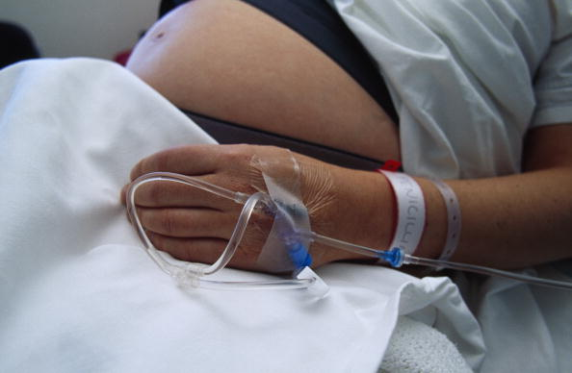
Cardiopulmonary resuscitation — External chest compression is more difficult during pregnancy because of reduced chest compliance in pregnant women [11]. External chest compression for cardiac arrest may not be effective in the late second and third trimesters because aortocaval compression in the supine position significantly reduces cardiac output (see above) [12]. In some instances, emptying the uterus by performing a cesarean delivery is required to perform effective cardiopulmonary resuscitation and save the mother's life [13]. Several studies have suggested that the best fetal and maternal outcomes are achieved if a cesarean delivery is performed within four to five minutes of a cardiac arrest if maternal resuscitation has not been successful [12-15]
Cardiopulmonary resuscitation — External chest compression is more difficult during pregnancy because of reduced chest compliance in pregnant women [11]. External chest compression for cardiac arrest may not be effective in the late second and third trimesters because aortocaval compression in the supine position significantly reduces cardiac output (see above) [12]. In some instances, emptying the uterus by performing a cesarean delivery is required to perform effective cardiopulmonary resuscitation and save the mother's life [13]. Several studies have suggested that the best fetal and maternal outcomes are achieved if a cesarean delivery is performed within four to five minutes of a cardiac arrest if maternal resuscitation has not been successful [12-15]
Pregnancy appears to increase the risk of falling, possibly because of increased joint laxity, weight gain, a change in the center of gravity, and other anatomical changes. Alterations in sway responses to perturbations have been reported in the third trimester in healthy women with uncomplicated pregnancies [9].
Management
Volume replacement
Notes:
One or two large bore (e.g, 14 or 16 gauge) intravenous lines in women
who may have been seriously injured.
Volume replacement is preferable to vasopressors for blood pressure
support since vasopressors can reduce uterine blood flow

Slide 45
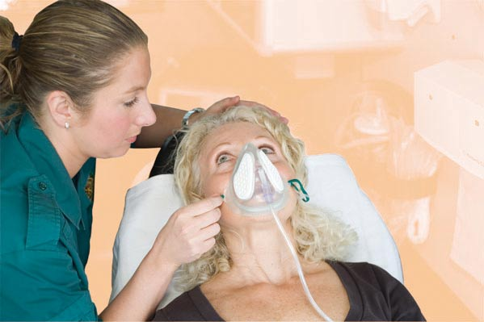
Cardiopulmonary resuscitation — External chest compression is more difficult during pregnancy because of reduced chest compliance in pregnant women [11]. External chest compression for cardiac arrest may not be effective in the late second and third trimesters because aortocaval compression in the supine position significantly reduces cardiac output (see above) [12]. In some instances, emptying the uterus by performing a cesarean delivery is required to perform effective cardiopulmonary resuscitation and save the mother's life [13]. Several studies have suggested that the best fetal and maternal outcomes are achieved if a cesarean delivery is performed within four to five minutes of a cardiac arrest if maternal resuscitation has not been successful [12-15]
Cardiopulmonary resuscitation — External chest compression is more difficult during pregnancy because of reduced chest compliance in pregnant women [11]. External chest compression for cardiac arrest may not be effective in the late second and third trimesters because aortocaval compression in the supine position significantly reduces cardiac output (see above) [12]. In some instances, emptying the uterus by performing a cesarean delivery is required to perform effective cardiopulmonary resuscitation and save the mother's life [13]. Several studies have suggested that the best fetal and maternal outcomes are achieved if a cesarean delivery is performed within four to five minutes of a cardiac arrest if maternal resuscitation has not been successful [12-15]
Pregnancy appears to increase the risk of falling, possibly because of increased joint laxity, weight gain, a change in the center of gravity, and other anatomical changes. Alterations in sway responses to perturbations have been reported in the third trimester in healthy women with uncomplicated pregnancies [9].
Management
Respiratory support
Notes:
Management
Respiratory support — Oxygen supplementation should be used liberally, as anoxia develops more quickly in pregnant women. Maternal oxygen saturation (SaO2) should be maintained at greater than 95 percent during pregnancy, which is in excess of the oxygen delivery needs of the mother. If SaO2 falls below 95 percent, an arterial blood gas is obtained to measure PaO2. Maternal PaO2 greater than 70 mmHg is desirable to maintain a favorable oxygen diffusion gradient from the maternal to the fetal side of the placenta. Early intubation after preoxygenation is recommended if adequate maternal oxygenation has not been achieved
If SaO2 falls below 95 percent, an arterial blood gas is obtained to
measure PaO2.
Maternal PaO2 greater than 70 mmHg is desirable to maintain a
favorable oxygen diffusion gradient from the maternal to the fetal side of
the placenta
Early intubation after preoxygenation is recommended if adequate
maternal oxygenation has not been achieved

Slide 46
Cardiopulmonary resuscitation — External chest compression is more difficult during pregnancy because of reduced chest compliance in pregnant women [11]. External chest compression for cardiac arrest may not be effective in the late second and third trimesters because aortocaval compression in the supine position significantly reduces cardiac output (see above) [12]. In some instances, emptying the uterus by performing a cesarean delivery is required to perform effective cardiopulmonary resuscitation and save the mother's life [13]. Several studies have suggested that the best fetal and maternal outcomes are achieved if a cesarean delivery is performed within four to five minutes of a cardiac arrest if maternal resuscitation has not been successful [12-15]
Cardiopulmonary resuscitation — External chest compression is more difficult during pregnancy because of reduced chest compliance in pregnant women [11]. External chest compression for cardiac arrest may not be effective in the late second and third trimesters because aortocaval compression in the supine position significantly reduces cardiac output (see above) [12]. In some instances, emptying the uterus by performing a cesarean delivery is required to perform effective cardiopulmonary resuscitation and save the mother's life [13]. Several studies have suggested that the best fetal and maternal outcomes are achieved if a cesarean delivery is performed within four to five minutes of a cardiac arrest if maternal resuscitation has not been successful [12-15]
Pregnancy appears to increase the risk of falling, possibly because of increased joint laxity, weight gain, a change in the center of gravity, and other anatomical changes. Alterations in sway responses to perturbations have been reported in the third trimester in healthy women with uncomplicated pregnancies [9].
Management
Respiratory support
Airway edema is more common in pregnant women and can contribute
to difficult intubation.
Difficulty securing the airway, along with the decreased lower esophageal
tone, are the primary factors that increase the risk of aspiration.
Applying cricoid pressure to prevent aspiration of gastric contents until
the airway has been protected with a cuffed endotracheal tube

Slide 47
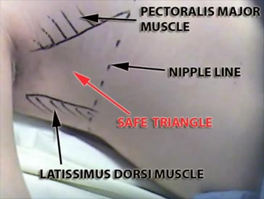
Cardiopulmonary resuscitation — External chest compression is more difficult during pregnancy because of reduced chest compliance in pregnant women [11]. External chest compression for cardiac arrest may not be effective in the late second and third trimesters because aortocaval compression in the supine position significantly reduces cardiac output (see above) [12]. In some instances, emptying the uterus by performing a cesarean delivery is required to perform effective cardiopulmonary resuscitation and save the mother's life [13]. Several studies have suggested that the best fetal and maternal outcomes are achieved if a cesarean delivery is performed within four to five minutes of a cardiac arrest if maternal resuscitation has not been successful [12-15]
Cardiopulmonary resuscitation — External chest compression is more difficult during pregnancy because of reduced chest compliance in pregnant women [11]. External chest compression for cardiac arrest may not be effective in the late second and third trimesters because aortocaval compression in the supine position significantly reduces cardiac output (see above) [12]. In some instances, emptying the uterus by performing a cesarean delivery is required to perform effective cardiopulmonary resuscitation and save the mother's life [13]. Several studies have suggested that the best fetal and maternal outcomes are achieved if a cesarean delivery is performed within four to five minutes of a cardiac arrest if maternal resuscitation has not been successful [12-15]
Pregnancy appears to increase the risk of falling, possibly because of increased joint laxity, weight gain, a change in the center of gravity, and other anatomical changes. Alterations in sway responses to perturbations have been reported in the third trimester in healthy women with uncomplicated pregnancies [9].
Management
Respiratory support
Notes:
If a chest tube is placed, the physician should keep in mind that the
diaphragm is elevated in pregnancy
Some authors suggest placing the thoracostomy tube one to two
intercostal spaces above the usual landmark of the fifth intercostal space

Slide 48
Cardiopulmonary resuscitation — External chest compression is more difficult during pregnancy because of reduced chest compliance in pregnant women [11]. External chest compression for cardiac arrest may not be effective in the late second and third trimesters because aortocaval compression in the supine position significantly reduces cardiac output (see above) [12]. In some instances, emptying the uterus by performing a cesarean delivery is required to perform effective cardiopulmonary resuscitation and save the mother's life [13]. Several studies have suggested that the best fetal and maternal outcomes are achieved if a cesarean delivery is performed within four to five minutes of a cardiac arrest if maternal resuscitation has not been successful [12-15]
Cardiopulmonary resuscitation — External chest compression is more difficult during pregnancy because of reduced chest compliance in pregnant women [11]. External chest compression for cardiac arrest may not be effective in the late second and third trimesters because aortocaval compression in the supine position significantly reduces cardiac output (see above) [12]. In some instances, emptying the uterus by performing a cesarean delivery is required to perform effective cardiopulmonary resuscitation and save the mother's life [13]. Several studies have suggested that the best fetal and maternal outcomes are achieved if a cesarean delivery is performed within four to five minutes of a cardiac arrest if maternal resuscitation has not been successful [12-15]
Pregnancy appears to increase the risk of falling, possibly because of increased joint laxity, weight gain, a change in the center of gravity, and other anatomical changes. Alterations in sway responses to perturbations have been reported in the third trimester in healthy women with uncomplicated pregnancies [9].
Management
Indications for urgent cesarean delivery
Imminent maternal death,
CPR that has not been effective within four minutes, or
A stable mother with a non reassuring fetal heart rate tracing
A cesarean delivery may also be necessary during laparotomy for repair
of maternal injuries if the gravid uterus prevents adequate surgical exposure

Slide 49
Cardiopulmonary resuscitation — External chest compression is more difficult during pregnancy because of reduced chest compliance in pregnant women [11]. External chest compression for cardiac arrest may not be effective in the late second and third trimesters because aortocaval compression in the supine position significantly reduces cardiac output (see above) [12]. In some instances, emptying the uterus by performing a cesarean delivery is required to perform effective cardiopulmonary resuscitation and save the mother's life [13]. Several studies have suggested that the best fetal and maternal outcomes are achieved if a cesarean delivery is performed within four to five minutes of a cardiac arrest if maternal resuscitation has not been successful [12-15]
Cardiopulmonary resuscitation — External chest compression is more difficult during pregnancy because of reduced chest compliance in pregnant women [11]. External chest compression for cardiac arrest may not be effective in the late second and third trimesters because aortocaval compression in the supine position significantly reduces cardiac output (see above) [12]. In some instances, emptying the uterus by performing a cesarean delivery is required to perform effective cardiopulmonary resuscitation and save the mother's life [13]. Several studies have suggested that the best fetal and maternal outcomes are achieved if a cesarean delivery is performed within four to five minutes of a cardiac arrest if maternal resuscitation has not been successful [12-15]
Pregnancy appears to increase the risk of falling, possibly because of increased joint laxity, weight gain, a change in the center of gravity, and other anatomical changes. Alterations in sway responses to perturbations have been reported in the third trimester in healthy women with uncomplicated pregnancies [9].
Management
The rationale for urgent cesarean delivery
Irreversible brain damage can occur in non pregnant individuals after
four to six minutes of anoxia
Pregnant women become anoxic sooner than nonpregnant women
because of decreased functional residual capacity
If the uterine fundus ≥4 fingerbreadths above the umbilicus, ineffective
resuscitation efforts may become effective when the uterus is no longer
gravid and potentially causing aortocaval compression
Intact fetal survival diminishes as the time between maternal death and
delivery lengthen

Slide 50
Cardiopulmonary resuscitation — External chest compression is more difficult during pregnancy because of reduced chest compliance in pregnant women [11]. External chest compression for cardiac arrest may not be effective in the late second and third trimesters because aortocaval compression in the supine position significantly reduces cardiac output (see above) [12]. In some instances, emptying the uterus by performing a cesarean delivery is required to perform effective cardiopulmonary resuscitation and save the mother's life [13]. Several studies have suggested that the best fetal and maternal outcomes are achieved if a cesarean delivery is performed within four to five minutes of a cardiac arrest if maternal resuscitation has not been successful [12-15]
Cardiopulmonary resuscitation — External chest compression is more difficult during pregnancy because of reduced chest compliance in pregnant women [11]. External chest compression for cardiac arrest may not be effective in the late second and third trimesters because aortocaval compression in the supine position significantly reduces cardiac output (see above) [12]. In some instances, emptying the uterus by performing a cesarean delivery is required to perform effective cardiopulmonary resuscitation and save the mother's life [13]. Several studies have suggested that the best fetal and maternal outcomes are achieved if a cesarean delivery is performed within four to five minutes of a cardiac arrest if maternal resuscitation has not been successful [12-15]
Pregnancy appears to increase the risk of falling, possibly because of increased joint laxity, weight gain, a change in the center of gravity, and other anatomical changes. Alterations in sway responses to perturbations have been reported in the third trimester in healthy women with uncomplicated pregnancies [9].
Management
Blunt abdominal trauma
If the patient is awake, alert, hemodynamically stable, and free of
abdominal pain or tenderness and signs of external trauma, intraabdominal
injury is highly unlikely
In other patients, ultrasound examination to look for free fluid in the
pelvis/abdomen appears to be useful in determining whether blunt trauma
caused intraabdominal bleeding
If peritoneal lavage is performed, an open technique superior to the
uterine fundus has been recommended after placement of a nasogastric
tube and bladder catheter

Slide 51
Cardiopulmonary resuscitation — External chest compression is more difficult during pregnancy because of reduced chest compliance in pregnant women [11]. External chest compression for cardiac arrest may not be effective in the late second and third trimesters because aortocaval compression in the supine position significantly reduces cardiac output (see above) [12]. In some instances, emptying the uterus by performing a cesarean delivery is required to perform effective cardiopulmonary resuscitation and save the mother's life [13]. Several studies have suggested that the best fetal and maternal outcomes are achieved if a cesarean delivery is performed within four to five minutes of a cardiac arrest if maternal resuscitation has not been successful [12-15]
Cardiopulmonary resuscitation — External chest compression is more difficult during pregnancy because of reduced chest compliance in pregnant women [11]. External chest compression for cardiac arrest may not be effective in the late second and third trimesters because aortocaval compression in the supine position significantly reduces cardiac output (see above) [12]. In some instances, emptying the uterus by performing a cesarean delivery is required to perform effective cardiopulmonary resuscitation and save the mother's life [13]. Several studies have suggested that the best fetal and maternal outcomes are achieved if a cesarean delivery is performed within four to five minutes of a cardiac arrest if maternal resuscitation has not been successful [12-15]
Pregnancy appears to increase the risk of falling, possibly because of increased joint laxity, weight gain, a change in the center of gravity, and other anatomical changes. Alterations in sway responses to perturbations have been reported in the third trimester in healthy women with uncomplicated pregnancies [9].
Management
Burns
Burns are managed as in non pregnant women
Prompt aggressive fluid resuscitation,
Early supplemental oxygen with a low threshold for MV support,
Early delivery of the fetus if the pregnancy is in the third trimester and
total body surface area is >50 percent, and
High suspicion for venous thrombosis and sepsis with early and
aggressive treatment

Slide 52
Cardiopulmonary resuscitation — External chest compression is more difficult during pregnancy because of reduced chest compliance in pregnant women [11]. External chest compression for cardiac arrest may not be effective in the late second and third trimesters because aortocaval compression in the supine position significantly reduces cardiac output (see above) [12]. In some instances, emptying the uterus by performing a cesarean delivery is required to perform effective cardiopulmonary resuscitation and save the mother's life [13]. Several studies have suggested that the best fetal and maternal outcomes are achieved if a cesarean delivery is performed within four to five minutes of a cardiac arrest if maternal resuscitation has not been successful [12-15]
Cardiopulmonary resuscitation — External chest compression is more difficult during pregnancy because of reduced chest compliance in pregnant women [11]. External chest compression for cardiac arrest may not be effective in the late second and third trimesters because aortocaval compression in the supine position significantly reduces cardiac output (see above) [12]. In some instances, emptying the uterus by performing a cesarean delivery is required to perform effective cardiopulmonary resuscitation and save the mother's life [13]. Several studies have suggested that the best fetal and maternal outcomes are achieved if a cesarean delivery is performed within four to five minutes of a cardiac arrest if maternal resuscitation has not been successful [12-15]
Pregnancy appears to increase the risk of falling, possibly because of increased joint laxity, weight gain, a change in the center of gravity, and other anatomical changes. Alterations in sway responses to perturbations have been reported in the third trimester in healthy women with uncomplicated pregnancies [9].
Management
Obstetrical issues
Uterine rupture
Sharp or blunt abdominal trauma can lead to uterine rupture
  Rare (0.6%) – severe trauma
Signs and symptoms include:
  Shock,
  Non-reassuring fetal heart rate tracing or fetal death,
  Uterine tenderness,
  Peritoneal irritation, and
  Vaginal bleeding

Slide 53
Cardiopulmonary resuscitation — External chest compression is more difficult during pregnancy because of reduced chest compliance in pregnant women [11]. External chest compression for cardiac arrest may not be effective in the late second and third trimesters because aortocaval compression in the supine position significantly reduces cardiac output (see above) [12]. In some instances, emptying the uterus by performing a cesarean delivery is required to perform effective cardiopulmonary resuscitation and save the mother's life [13]. Several studies have suggested that the best fetal and maternal outcomes are achieved if a cesarean delivery is performed within four to five minutes of a cardiac arrest if maternal resuscitation has not been successful [12-15]
Cardiopulmonary resuscitation — External chest compression is more difficult during pregnancy because of reduced chest compliance in pregnant women [11]. External chest compression for cardiac arrest may not be effective in the late second and third trimesters because aortocaval compression in the supine position significantly reduces cardiac output (see above) [12]. In some instances, emptying the uterus by performing a cesarean delivery is required to perform effective cardiopulmonary resuscitation and save the mother's life [13]. Several studies have suggested that the best fetal and maternal outcomes are achieved if a cesarean delivery is performed within four to five minutes of a cardiac arrest if maternal resuscitation has not been successful [12-15]
Pregnancy appears to increase the risk of falling, possibly because of increased joint laxity, weight gain, a change in the center of gravity, and other anatomical changes. Alterations in sway responses to perturbations have been reported in the third trimester in healthy women with uncomplicated pregnancies [9].
Management
Obstetrical issues
Penetrating abdominal trauma
In contrast to nonpregnant victims of abdominal penetrating trauma
where immediate surgical exploration is the most common management
approach
In pregnancy, the decision to proceed immediately to surgical exploration
is based on:
  Location of the injury (upper or lower abdomen) and
  The uterine size,
  Maternal and fetal vital signs.
Notes:
Gunshot wounds are more common than stab wounds in pregnancy and, interestingly, death from gunshot or stab wounds is less common in the pregnant than nonpregnant victim [10]. The decreased risk of death is likely related to anatomic changes: the enlarged uterus displaces visceral organs superiorly. As a result, upper abdominal penetrating trauma is more likely to injure maternal bowel, while lower abdominal penetrating trauma is more likely to injure the uterus and or fetus.

Slide 54
Cardiopulmonary resuscitation — External chest compression is more difficult during pregnancy because of reduced chest compliance in pregnant women [11]. External chest compression for cardiac arrest may not be effective in the late second and third trimesters because aortocaval compression in the supine position significantly reduces cardiac output (see above) [12]. In some instances, emptying the uterus by performing a cesarean delivery is required to perform effective cardiopulmonary resuscitation and save the mother's life [13]. Several studies have suggested that the best fetal and maternal outcomes are achieved if a cesarean delivery is performed within four to five minutes of a cardiac arrest if maternal resuscitation has not been successful [12-15]
Cardiopulmonary resuscitation — External chest compression is more difficult during pregnancy because of reduced chest compliance in pregnant women [11]. External chest compression for cardiac arrest may not be effective in the late second and third trimesters because aortocaval compression in the supine position significantly reduces cardiac output (see above) [12]. In some instances, emptying the uterus by performing a cesarean delivery is required to perform effective cardiopulmonary resuscitation and save the mother's life [13]. Several studies have suggested that the best fetal and maternal outcomes are achieved if a cesarean delivery is performed within four to five minutes of a cardiac arrest if maternal resuscitation has not been successful [12-15]
Pregnancy appears to increase the risk of falling, possibly because of increased joint laxity, weight gain, a change in the center of gravity, and other anatomical changes. Alterations in sway responses to perturbations have been reported in the third trimester in healthy women with uncomplicated pregnancies [9].
Management
Obstetrical issues
Penetrating abdominal trauma
  If the injury is in the upper abdomen, then surgical exploration is
  generally the best approach
  If the injury is in the lower abdomen and mother and fetus are stable,
  then a more conservative approach, including observation, laparoscopy,
  and wound exploration, is reasonable

Slide 55
Cardiopulmonary resuscitation — External chest compression is more difficult during pregnancy because of reduced chest compliance in pregnant women [11]. External chest compression for cardiac arrest may not be effective in the late second and third trimesters because aortocaval compression in the supine position significantly reduces cardiac output (see above) [12]. In some instances, emptying the uterus by performing a cesarean delivery is required to perform effective cardiopulmonary resuscitation and save the mother's life [13]. Several studies have suggested that the best fetal and maternal outcomes are achieved if a cesarean delivery is performed within four to five minutes of a cardiac arrest if maternal resuscitation has not been successful [12-15]
Cardiopulmonary resuscitation — External chest compression is more difficult during pregnancy because of reduced chest compliance in pregnant women [11]. External chest compression for cardiac arrest may not be effective in the late second and third trimesters because aortocaval compression in the supine position significantly reduces cardiac output (see above) [12]. In some instances, emptying the uterus by performing a cesarean delivery is required to perform effective cardiopulmonary resuscitation and save the mother's life [13]. Several studies have suggested that the best fetal and maternal outcomes are achieved if a cesarean delivery is performed within four to five minutes of a cardiac arrest if maternal resuscitation has not been successful [12-15]
Pregnancy appears to increase the risk of falling, possibly because of increased joint laxity, weight gain, a change in the center of gravity, and other anatomical changes. Alterations in sway responses to perturbations have been reported in the third trimester in healthy women with uncomplicated pregnancies [9].
Management
Obstetrical issues
Placental Abruption
Most common blunt injury
Up to 50% in severe trauma, 3% minor trauma
Shearing effect and separation between placenta and the uterus
Flexible myometrium / inflexible placenta
May have vaginal bleeding and tenderness
Fetal monitoring most sensitive for fetal distress
U/S specific but not sensitive, detects 50% of the cases

Slide 56
Cardiopulmonary resuscitation — External chest compression is more difficult during pregnancy because of reduced chest compliance in pregnant women [11]. External chest compression for cardiac arrest may not be effective in the late second and third trimesters because aortocaval compression in the supine position significantly reduces cardiac output (see above) [12]. In some instances, emptying the uterus by performing a cesarean delivery is required to perform effective cardiopulmonary resuscitation and save the mother's life [13]. Several studies have suggested that the best fetal and maternal outcomes are achieved if a cesarean delivery is performed within four to five minutes of a cardiac arrest if maternal resuscitation has not been successful [12-15]
Cardiopulmonary resuscitation — External chest compression is more difficult during pregnancy because of reduced chest compliance in pregnant women [11]. External chest compression for cardiac arrest may not be effective in the late second and third trimesters because aortocaval compression in the supine position significantly reduces cardiac output (see above) [12]. In some instances, emptying the uterus by performing a cesarean delivery is required to perform effective cardiopulmonary resuscitation and save the mother's life [13]. Several studies have suggested that the best fetal and maternal outcomes are achieved if a cesarean delivery is performed within four to five minutes of a cardiac arrest if maternal resuscitation has not been successful [12-15]
Pregnancy appears to increase the risk of falling, possibly because of increased joint laxity, weight gain, a change in the center of gravity, and other anatomical changes. Alterations in sway responses to perturbations have been reported in the third trimester in healthy women with uncomplicated pregnancies [9].
Management
Obstetrical issues
Maternal-Fetal Hemorrhage
  Increases with trimester (3%, 12%, 45%)
  4-5x more common in injured pregnant women
  Causes isoimmunization and fetal death
  Rhogam for Rh- mother

Slide 57
Cardiopulmonary resuscitation — External chest compression is more difficult during pregnancy because of reduced chest compliance in pregnant women [11]. External chest compression for cardiac arrest may not be effective in the late second and third trimesters because aortocaval compression in the supine position significantly reduces cardiac output (see above) [12]. In some instances, emptying the uterus by performing a cesarean delivery is required to perform effective cardiopulmonary resuscitation and save the mother's life [13]. Several studies have suggested that the best fetal and maternal outcomes are achieved if a cesarean delivery is performed within four to five minutes of a cardiac arrest if maternal resuscitation has not been successful [12-15]
Cardiopulmonary resuscitation — External chest compression is more difficult during pregnancy because of reduced chest compliance in pregnant women [11]. External chest compression for cardiac arrest may not be effective in the late second and third trimesters because aortocaval compression in the supine position significantly reduces cardiac output (see above) [12]. In some instances, emptying the uterus by performing a cesarean delivery is required to perform effective cardiopulmonary resuscitation and save the mother's life [13]. Several studies have suggested that the best fetal and maternal outcomes are achieved if a cesarean delivery is performed within four to five minutes of a cardiac arrest if maternal resuscitation has not been successful [12-15]
Pregnancy appears to increase the risk of falling, possibly because of increased joint laxity, weight gain, a change in the center of gravity, and other anatomical changes. Alterations in sway responses to perturbations have been reported in the third trimester in healthy women with uncomplicated pregnancies [9].
Management
Obstetrical issues
Preterm labor and premature rupture of membranes:
The possibility of preterm labor or premature rupture of membranes
should also be considered in the evaluation of these patients
Vaginal delivery:
Pelvic fractures do not necessarily preclude vaginal delivery, unless
displacement obstructs fetal descent

Slide 58
Cardiopulmonary resuscitation — External chest compression is more difficult during pregnancy because of reduced chest compliance in pregnant women [11]. External chest compression for cardiac arrest may not be effective in the late second and third trimesters because aortocaval compression in the supine position significantly reduces cardiac output (see above) [12]. In some instances, emptying the uterus by performing a cesarean delivery is required to perform effective cardiopulmonary resuscitation and save the mother's life [13]. Several studies have suggested that the best fetal and maternal outcomes are achieved if a cesarean delivery is performed within four to five minutes of a cardiac arrest if maternal resuscitation has not been successful [12-15]
Cardiopulmonary resuscitation — External chest compression is more difficult during pregnancy because of reduced chest compliance in pregnant women [11]. External chest compression for cardiac arrest may not be effective in the late second and third trimesters because aortocaval compression in the supine position significantly reduces cardiac output (see above) [12]. In some instances, emptying the uterus by performing a cesarean delivery is required to perform effective cardiopulmonary resuscitation and save the mother's life [13]. Several studies have suggested that the best fetal and maternal outcomes are achieved if a cesarean delivery is performed within four to five minutes of a cardiac arrest if maternal resuscitation has not been successful [12-15]
Pregnancy appears to increase the risk of falling, possibly because of increased joint laxity, weight gain, a change in the center of gravity, and other anatomical changes. Alterations in sway responses to perturbations have been reported in the third trimester in healthy women with uncomplicated pregnancies [9].
OUTCOME
Potential consequences of major trauma during pregnancy include:
Maternal injury or death
Fetal injury or death
Pregnancy complications: abruption, preterm delivery, premature rupture
of membranes
Any of the complications of major trauma in the nonpregnant woman
Maternal mortality as a result of trauma is not increased by pregnancy,
Mortality is less compared to non pregnant women of similar age with
equivalent injuries

Slide 59
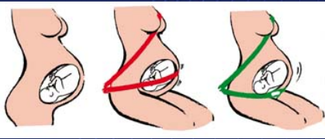
Cardiopulmonary resuscitation — External chest compression is more difficult during pregnancy because of reduced chest compliance in pregnant women [11]. External chest compression for cardiac arrest may not be effective in the late second and third trimesters because aortocaval compression in the supine position significantly reduces cardiac output (see above) [12]. In some instances, emptying the uterus by performing a cesarean delivery is required to perform effective cardiopulmonary resuscitation and save the mother's life [13]. Several studies have suggested that the best fetal and maternal outcomes are achieved if a cesarean delivery is performed within four to five minutes of a cardiac arrest if maternal resuscitation has not been successful [12-15]
Cardiopulmonary resuscitation — External chest compression is more difficult during pregnancy because of reduced chest compliance in pregnant women [11]. External chest compression for cardiac arrest may not be effective in the late second and third trimesters because aortocaval compression in the supine position significantly reduces cardiac output (see above) [12]. In some instances, emptying the uterus by performing a cesarean delivery is required to perform effective cardiopulmonary resuscitation and save the mother's life [13]. Several studies have suggested that the best fetal and maternal outcomes are achieved if a cesarean delivery is performed within four to five minutes of a cardiac arrest if maternal resuscitation has not been successful [12-15]
Pregnancy appears to increase the risk of falling, possibly because of increased joint laxity, weight gain, a change in the center of gravity, and other anatomical changes. Alterations in sway responses to perturbations have been reported in the third trimester in healthy women with uncomplicated pregnancies [9].
PREVENTION
Prenatal care should incorporate education about:
Correct seat belt use in pregnancy

Slide 60
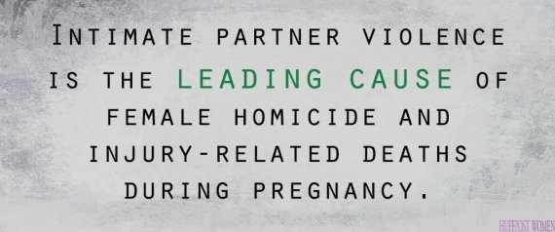

Cardiopulmonary resuscitation — External chest compression is more difficult during pregnancy because of reduced chest compliance in pregnant women [11]. External chest compression for cardiac arrest may not be effective in the late second and third trimesters because aortocaval compression in the supine position significantly reduces cardiac output (see above) [12]. In some instances, emptying the uterus by performing a cesarean delivery is required to perform effective cardiopulmonary resuscitation and save the mother's life [13]. Several studies have suggested that the best fetal and maternal outcomes are achieved if a cesarean delivery is performed within four to five minutes of a cardiac arrest if maternal resuscitation has not been successful [12-15]
Cardiopulmonary resuscitation — External chest compression is more difficult during pregnancy because of reduced chest compliance in pregnant women [11]. External chest compression for cardiac arrest may not be effective in the late second and third trimesters because aortocaval compression in the supine position significantly reduces cardiac output (see above) [12]. In some instances, emptying the uterus by performing a cesarean delivery is required to perform effective cardiopulmonary resuscitation and save the mother's life [13]. Several studies have suggested that the best fetal and maternal outcomes are achieved if a cesarean delivery is performed within four to five minutes of a cardiac arrest if maternal resuscitation has not been successful [12-15]
Pregnancy appears to increase the risk of falling, possibly because of increased joint laxity, weight gain, a change in the center of gravity, and other anatomical changes. Alterations in sway responses to perturbations have been reported in the third trimester in healthy women with uncomplicated pregnancies [9].
PREVENTION
Prenatal care should incorporate education about:
Evaluation for the presence of domestic violence

Slide 61


Cardiopulmonary resuscitation — External chest compression is more difficult during pregnancy because of reduced chest compliance in pregnant women [11]. External chest compression for cardiac arrest may not be effective in the late second and third trimesters because aortocaval compression in the supine position significantly reduces cardiac output (see above) [12]. In some instances, emptying the uterus by performing a cesarean delivery is required to perform effective cardiopulmonary resuscitation and save the mother's life [13]. Several studies have suggested that the best fetal and maternal outcomes are achieved if a cesarean delivery is performed within four to five minutes of a cardiac arrest if maternal resuscitation has not been successful [12-15]
Cardiopulmonary resuscitation — External chest compression is more difficult during pregnancy because of reduced chest compliance in pregnant women [11]. External chest compression for cardiac arrest may not be effective in the late second and third trimesters because aortocaval compression in the supine position significantly reduces cardiac output (see above) [12]. In some instances, emptying the uterus by performing a cesarean delivery is required to perform effective cardiopulmonary resuscitation and save the mother's life [13]. Several studies have suggested that the best fetal and maternal outcomes are achieved if a cesarean delivery is performed within four to five minutes of a cardiac arrest if maternal resuscitation has not been successful [12-15]
Pregnancy appears to increase the risk of falling, possibly because of increased joint laxity, weight gain, a change in the center of gravity, and other anatomical changes. Alterations in sway responses to perturbations have been reported in the third trimester in healthy women with uncomplicated pregnancies [9].
PREVENTION
Drugs and Alcohol Abuse

Slide 62
Thank You

