Slide 1
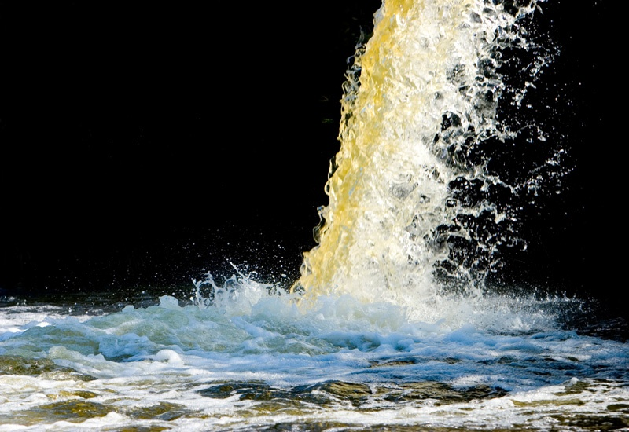

Kinetics of biodegradation of sewage due to addition of Chlorides
DEPARTMENT OF CIVIL ENGINEERING
MALAVIYA NATIONAL INSTITUTE OF TECHNOLOGY JAIPUR
PRESENTED BY:
Prof A. B. Gupta
(Co-author: Sunderramieddy)

Slide 2
Contents:
Introduction
Objectives of the study
Methodology
Results
Conclusions

Slide 3
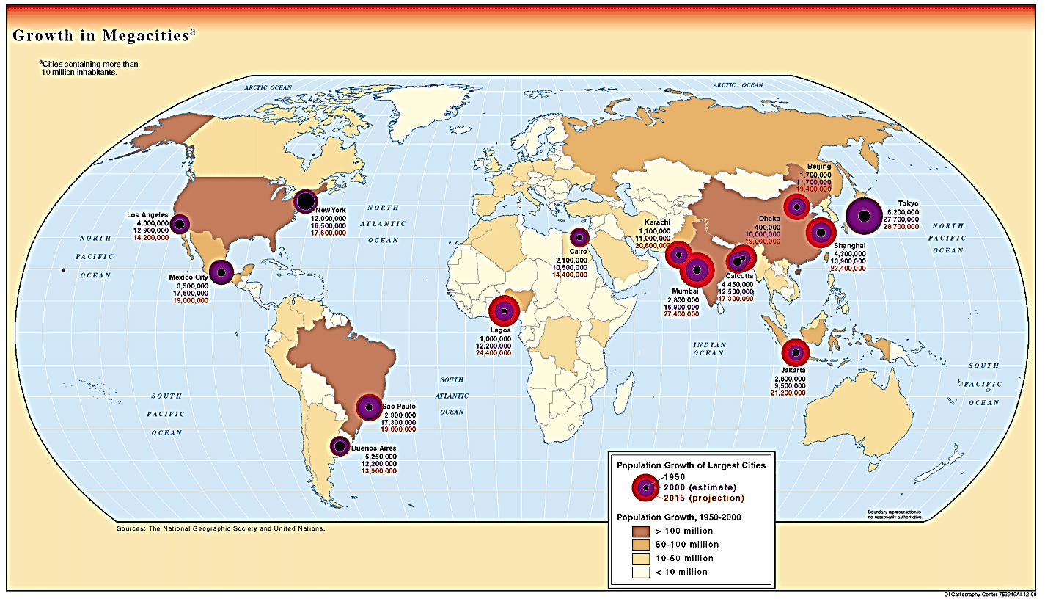
17 coastal megacities covering about 25% of the world's population.
INTRODUCTION

Slide 4
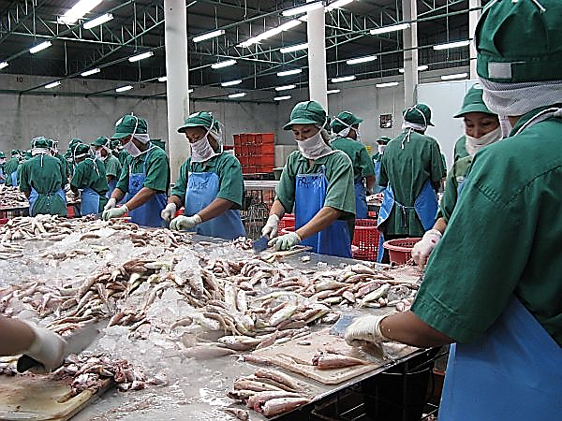
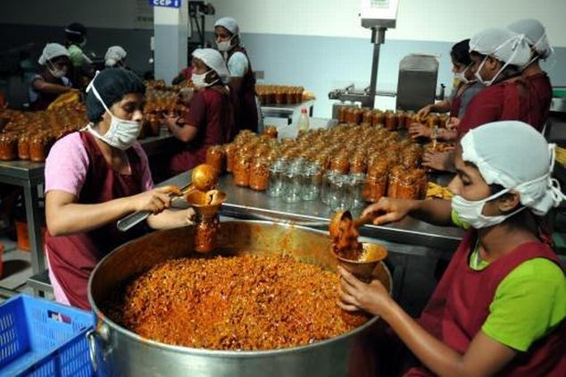
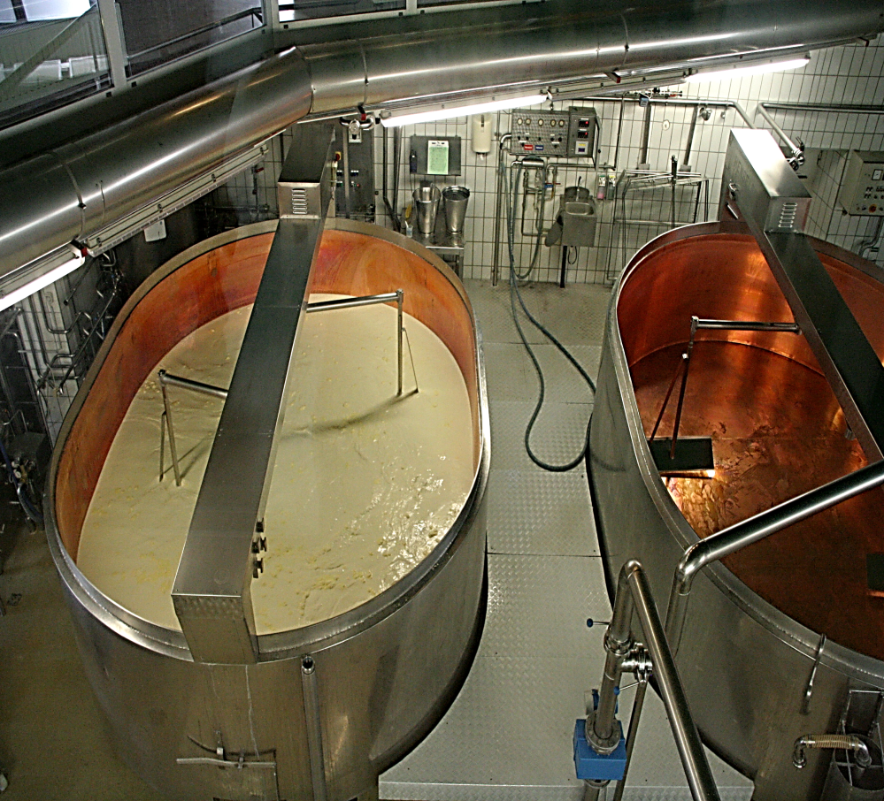
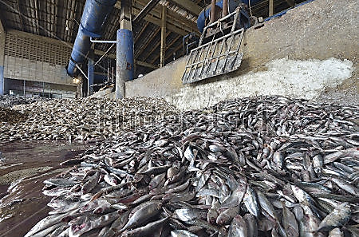

Pickling
Seafood processing industry
Cheese processing
fishmeal manufacturing
vegetable canning

Slide 5
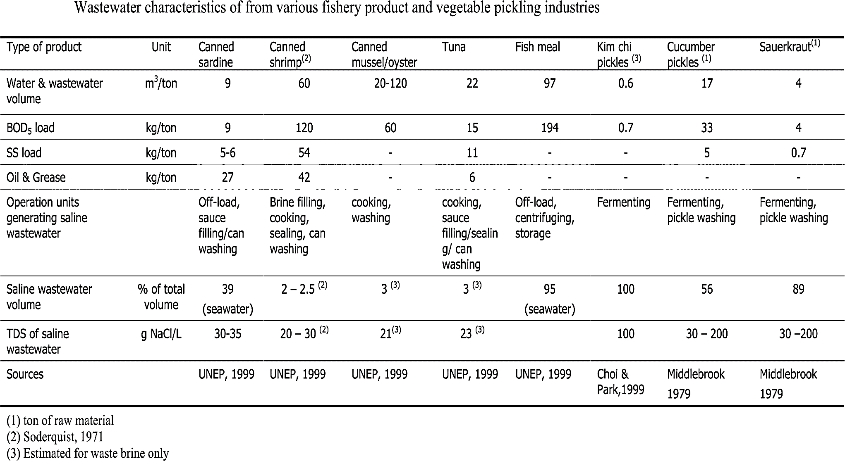
Wastewater characteristics of from various fishery product and vegetable pickling industries (Dan N. P, 2001).

Slide 6
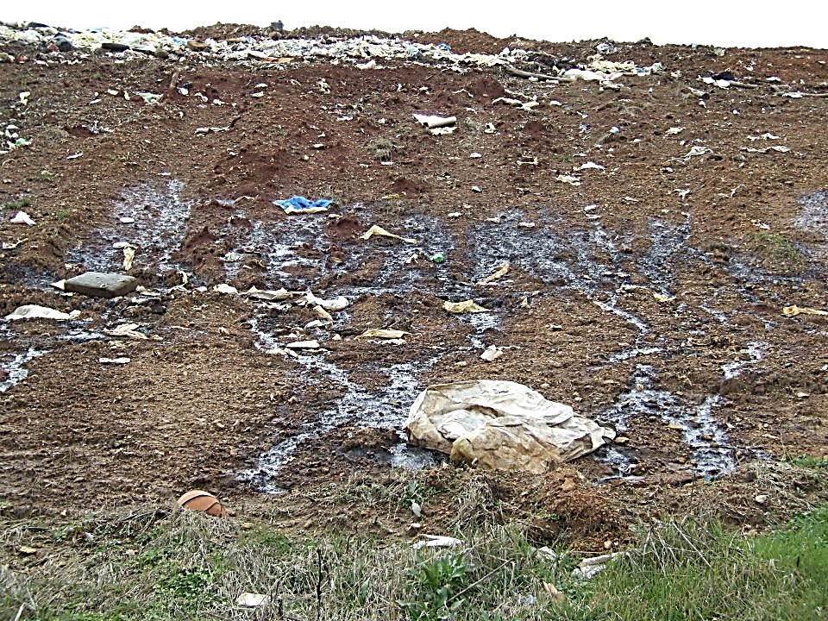
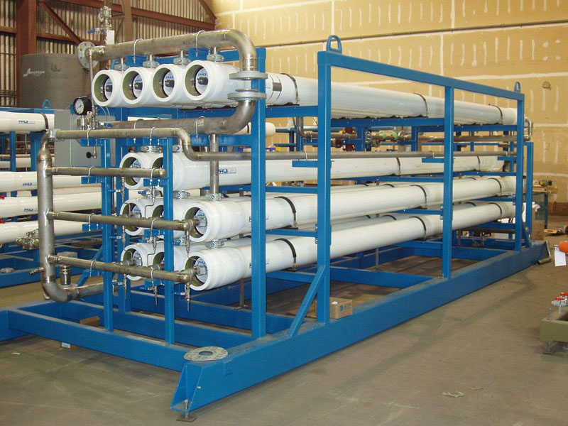
Leachate
Highly saline wastewater is generated during the manufacture of chemicals such as pesticides, pharmaceuticals, herbicides and during oil and gas recovery processes (Henze M et al., 1995). In addition, High salt concentration found in the landfill leachates (Ellouze M et al., 2008).
Characteristics of leachates (Pirbazari, 1996).
Leachate |  | Domestic waste landfill | Hazardous waste landfill
COD | mg/L | 3,050 – 3,450 | 9,000 – 10,500
BOD ₅ | mg/L | 1,505 – 1,710 | 6,950 – 7,500
TOC | mg/L | 905 – 965 | 3,040 – 3,500
SS | mg/L | 460 – 565 | 862 – 946
TDS | mg/L | 5,800 – 6,250 | 22,600 – 25,900
TKN | mg/L | 75 - 84 | 160 – 180
Oil and grease | mg/L | 60 – 80
pH |  | - | 4.3 – 6.0
RO reject

Slide 7
Presence of salinity up to certain concentration (1-2 g/L) has been shown to improve anaerobic sludge digestion, while concentrations over 20 g/L can cause severe osmotic stress in bacteria leading to plasmolysis and/or loss of cell activity (Glenn E., 1995).
High salt content in wastewater is known to significantly reduce the treatment efficiency of conventional activated sludge, nitrification and denitrification processes (Kargi F and Uygur A., 1996).
Effects of high salt concentrations on biological treatment process are of great concern and present a challenge to the environmental engineers for their safe disposal.

Slide 8
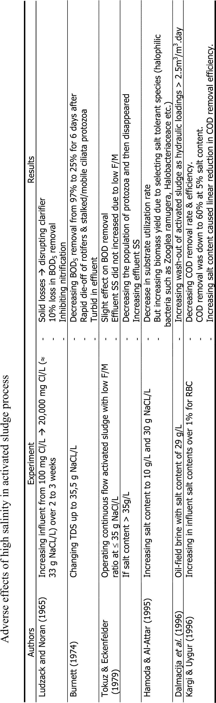
ACTIVATED SLUDGE PROCESS :
Adverse effect of salt on activated sludge process (Dan N. P, 2001).

Slide 9
ANAEROBIC TREATMENT :
Authors Experiment | Results
Baere et al. (1984) AF with surface area of 600 m²/m³ at 30 g NaCl/l - | Decrease in gas production (dropped 65%) TOC removal was decreased from 98% to 70%
- | Decrease in pH from 6.8 to 5.4
at salt content of 60 g/L - | Gas production dropped below 15%
- | TOC removal < 20%
Feijoo et al. (1995) UASB and AF - | Reducing 50% methanogenic activity at salt content > 33 g NaCl /L
- | Shocked at concentrations ranging from 10-21 g NaCl/L for unadapted sludge
Belkin et al. (1993) Anaerobic and aerobic system at - 32 g/L (NaCl) | Low COD removal for whole system (50%). COD removal (70%) could be improved at very low F/M ratio (0.02 for anaerobic and 0.04 for aerobic process
Feijoo et al. (1995) Anaerobic batch digestion - Decreasing 50% of methane activity as increasing. TDS by 10-25 g NaCl/L

Slide 10
Objectives of the study:
To determine the BOD exertion rates of glucose–glutamic acid (GGA) solution mixed with sewage under controlled addition of chlorides of 0 to 20 g/L at 20°C.
To develop a mathematical equation derived from experimental results in order to describe both stimulation as well as inhibitory effects by a single expression and validate it by fitting against secondary data reported in the literature.

Slide 11
METHODOLOGY :
Grab samples of sewage were collected from STP of MNIT Jaipur.
GGA solution of 150 mg/L each was prepared and 6 mL of it was mixed with sewage a controlled manner for making test samples.
Samples having different chloride additions of up to 20 g/L (zero chloride sample means no additional NaCl to the GGA-sewage sample) were prepared using analytical grade NaCl.
BOD test was carried out by as per APHA et al., 2010.
Settled biomass from SST of STP Delawas, Jaipur (based on conventional ASP) was used as “seed” for BOD analysis.

Slide 12
METHODOLOGY …
All experiments were conducted at a temperature of 20°C ±2°C.
For the first, two sets of samples having, 0 to 8 and 0 to 20 g/L of chlorides concentrations, BOD exertion was monitored every day for a 5- day period. However, in the third set having chloride concentrations of 0 to 12 g/L, the BOD exertion was monitored up to three-day period. In addition, in the fourth set of experiments with 10 to 20 g/L of chlorides concentrations, only BOD₅ exertion was monitored.
Trial version of STATISTICA 2014 software was used for data analysis.

Slide 13
Calculation of Kinetic coefficient K
1) THEORETICAL CALCULATIONS OF BOD =
Y=L₀ (1-10^{-(kt/2.303)})
3) ULTIMATE BOD CALCULATIONS:
COD of sewage sample was considered as its ultimate BOD.
The theoretical COD of 373 mg/L as determined from the chemical formula of GGA solution was considered as its ultimate BOD.
(373 mg/L * 6 mL) + (COD of sample mg/L* mL of Sample)
(mL of GGA (6) + mL of sample taken)

Slide 14
RESULTS
TABLE-1 BOD observations at low chloride concentrations of 0 to 0.8 mg/L
Days | Average BOD (mg/L)
 | 0 g/L Chlorides | 0.2 g/L Chlorides | 0.4 g/L Chlorides | 0.60 g/L Chlorides | 0.80 g/L Chlorides
1 | 45 | 51 | 64 | Not observed | Not observed
2 | 55 | 62 | 72 | Not observed | Not observed
3 | 87 | 85 | 90 | Not observed | Not observed
4 | 115 | 117 | 120 | Not observed | Not observed
5 | 126 | 134 | 143 | 147 | 147

Slide 15
TABLE-2 BOD exertion at high chloride concentrations of 0-20 g/L
Days | Average BOD (mg/L)
 | 0 g/L Chlorides | 5 g/L Chlorides | 10 g/L Chlorides | 15 g/L Chlorides | 20 g/L Chlorides
1 | 52 | 60 | 30 | Not observed | Not observed
2 | 85 | 93 | 71 | Not observed | Not observed
3 | 142 | 115 | 129 | Not observed | Not observed
4 | 167 | 186 | 137 | Not observed | Not observed
5 | 194 | 200 | 180 | 131 | 104

Slide 16
FIGURE-1 BOD₅ exertion at different chloride concentrations of 10-20 mg/L

Slide 17
FIGURE-2 BOD exertion at 0, 5, 6, 7 and 8 g/L of chloride concentrations.

Slide 18
Days | Reaction constant (k) per day
 | 0 g/L of Cl | 5 g/L of Cl | 6 g/L of Cl | 7 g/L of Cl | 8 g/L of Cl
1 | 0.11 | 0.2 | 0.16 | 0.17 | 0.14
2 | 0.24 | 0.28 | 0.29 | 0.2 | 0.14
3 | 0.21 | 0.22 | 0.24 | 0.19 | 0.16
4 | 0.19 | 0.21 | 0.22 | 0.16 | 0.15
5 | 0.17 | 0.18 | 0.2 | 0.15 | 0.13
Table-4 BOD exertion rate (k) of the samples at high chloride concentrations of 0 to 20 g/L
Days | Reaction constant (k) per day
 | 0 g/L of Cl | 5 g/L of Cl | 10 g/L of Cl | 15 g/L of Cl | 20 g/L of Cl
1 | 0.16 | 0.19 | 0.09 | Not observed | Not observed
2 | 0.14 | 0.16 | 0.11 | Not observed | Not observed
3 | 0.18 | 0.13 | 0.15 | Not observed | Not observed
4 | 0.16 | 0.19 | 0.12 | Not observed | Not observed
5 | 0.16 | 0.17 | 0.14 | 0.09 | 0.07
Table-3 BOD exertion rate (k) of the samples at varied chloride concentrations of 0 to 8 g/L

Slide 19
Chlorides (X) (g/L) | Ratio (BOD₅ at X g/L Chlorides / BOD₅ at zero Chloride)
0 | 1
0.2 | 1.063
0.4 | 1.134
0.6 | 1.166
0.8 | 1.166
5 | 1.050
6 | 1.111
7 | 0.934
8 | 0.862
10 | 0.918
12 | 0.777
14 | 0.634
15 | 0.675
16 | 0.539
18 | 0.481
20 | 0.498
Table-6 Derived data of BOD exertion ratios at different chloride concentrations

Slide 20
FIGURE- 3 Curve between BOD₅ exertion ratios and chloride concentrations.

Slide 21
Table-7 Observed and Predicted values of variance data under varied chloride concentrations
Author | Chlorides (x) g/L | Observed value in literature |  | Predicted value of BOD₅ mg/L using our model | % Error ((obs-pre)/obs)
 |  | BOD₅ Value at X g/L of Cl | BOD₅ Value of 0 g/L Cl
Shivani et.al., (2012) | 5 | 285 | 337 | 384 | -34.73
 | 10 | 255 | 337 | 291 | -14.11
 | 15 | 200 | 337 | 194 | 3
 | 20 | 221 | 337 | 271 | -22.62
Gotaas (1949) | 0.55 | 272 | 236 | 225 | 17.27
 | 1.65 | 240 | 236 | 250 | -4.166
 | 3.65 | 250 | 236 | 270 | -8
 | 6.4 | 243 | 236 | 258 | -6.17
 | 9.2 | 215 | 236 | 218 | -1.39
 | 13.75 | 236 | 236 | 147 | 37.71
 | 18.35 | 242 | 236 | 151 | 37.60

Slide 22
CONCLUSIONS
Chloride concentrations of up to 0.8 g/L showed stimulation of biodegradation process
Concentrations from 0.8- 6.0 g/L showed no inhibition of biodegradation. This may perhaps be due to the fact up to this salinity, the cells exhibit a higher activity than in the freshwater medium. Microbiological studies for supporting the hypothesis are underway.
Further increase in salinity (7 to 20 g/L of chlorides) restricts the osmo-regulatory processes responsible for the breakdown of organic compounds within the cells of microorganisms. As a result, the kinetic reaction rates of decomposition reactions suffer and show continuous inhibition.
A single third order polynomial curve was able to represent both the stimulation as well as inhibition of the biological process due to the concentration of salt up to 20 g/L.
The results may help formulate strategy for environmentally safe Co-disposal of RO rejects as well as high salt containing industrial wastewaters with sewage.

Slide 23
References
APHA, WPCF, AWWA (2010). Standard methods for the examination of water and wastewater. American Public Health Association, WPCF, AWWA. 21st Ed. NW, DC 2005.
Baere, D. L. A., Devocht, M., Van Assche, P., and Verstraete, W. (1984). Influence of high NaCl and NH₄Cl salt levels on methanogenic associations. Water Res., 18 (5) 543-548.
Belkin, S., Brenner, A. and Abeliovich, A. (1993). Biological treatment of a high salinity chemical industrial wastewater. Wat. Sci. Tech., 27 (7-8), 105-112.
Dan, N. P. (2001). “Biological Treatment of High Salinity Wastewater Using Yeast and Bacterial Systems,” PhD Thesis, Asian Institute of Technology, Bangkok, Thailand.
Ellouze, M., Aloui, F. and Sayadi, S. (2008). Detoxification of Tunisian landfill leachates by selected fungi, J.Hazard. Mater, 150, 642–648.
Feijoo, G., Soto, M., Méndez, R. and Lema, J. M. (1995). Sodium inhibition in the anaerobic digestion process: Antagonism and adaptation phenomena. Enzyme and Microbial Technology, 17, 180-188.
Glenn, E., (1995). Effects of salinity on growth and evapotranspiration of Typha domingensis Pers. Aquatic Botany, 52, 75–91.
Gotaas, H. B. (1949) the effect of sea water on the bio-chemical oxidation of domestic wastewater. Domestic Wastewater Works Journal, 21(5).
Henze, M., Harremoës, P., Jansen J. and Arvin, E. (1995). Wastewater treatment Biological and Chemical Processes. Springer-Verlag, Berlin, Heidelberg, New York.
Kargi F. and Dincer A. R. (1996). Effect of salt content on biological treatment of saline Wastewater by fed-batch operation. Enzyme & Microbial Technology, 19, 529-537
Pirbazari. (1996) Hybrid membrane filtration process for leachate treatment. Wat. Res., 30, 2691-2706.
Shivani, S., Dhage&Amita, A., Dalvi& Damodar, V. and Prabhu. (2012). Reaction kinetics and validity of BOD test for domestic wastewater released in marine ecosystems. Environ Monit Assess, 184, 5301–5310.

Slide 24




