Slide 1
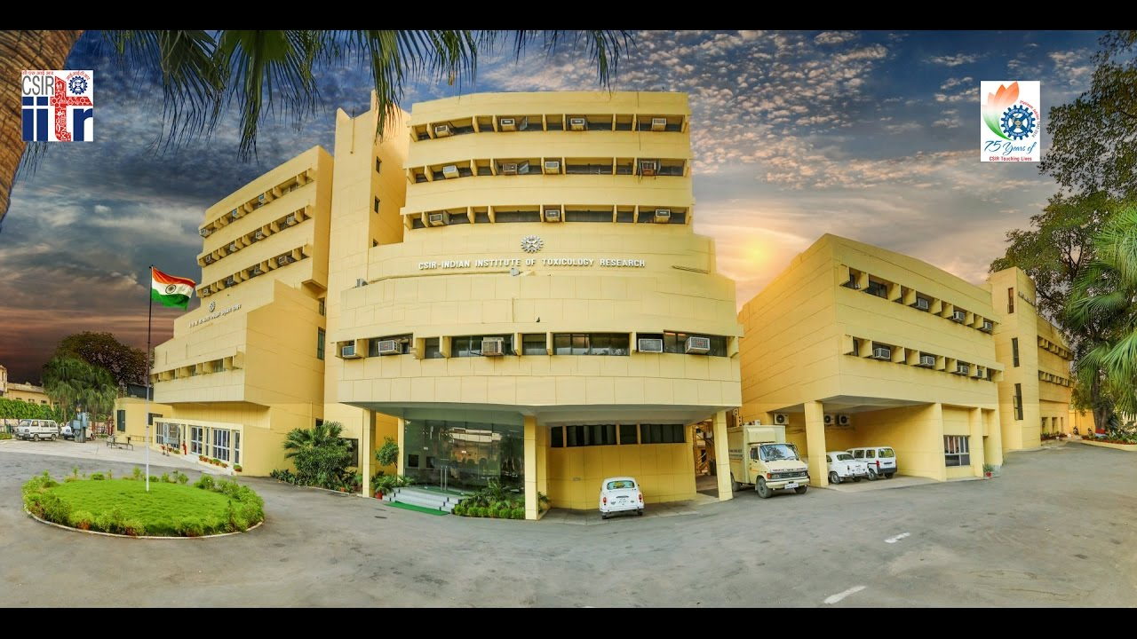
“Superoxide mediated apoptosis in cell organelles by photosensitized 1,2;3,4-dibenzanthracene in HaCaT cells at ambient UV-B and natural sunlight”
Ajeet K. Srivastav
(Senior Research Fellow)
Indian Council of Medical Research, New Delhi, India
&
CSIR-Indian Institute of Toxicology Research ,Lucknow, India

Slide 2

Introduction
Our solar system consists of 7% of ultraviolet radiation (UV-R).
UV radiation (200-400nm), has been divided into UV-A(320-400nm), UV-B(290-320nm) and UV-C(200-290nm) based on skin reactions .
UV-B causes more damage to skin than UV-A because of higher damaging affect to skin DNA. UV-B radiation is the main cause of sunburn and skin cancer (Tornaletti and Pfeifer, 1996).
UV-A is less powerful but it penetrates deeper in the skin. Regular exposure of UV-A causes long term skin injury. It indirectly damage DNA by the ROS generation. While, UV-C is directly absorbed by ozone layer (Solomon et.al., 2008).
HaCaT is a spontaneously transformed aneuploid immortal keratinocyte cell line produced from adult human skin, which is widely used in research (Boukamp et.al., 1988).
Contd….

Slide 3
PAHs are formed during the incomplete burning of coal, oil, gas, wood, domestic / industrial waste, petroleum spillage, tobacco and charbroiled meat. PAHs enter in the environment by volcanoes, forest fire, wood burning and automobiles exhaust. People are exposed to PAHs by breathing, eating, drinking or skin contact. PAHs absorb sunlight in the visible / UV regions and are sensitive to photochemical reactions.
Delhi air 7.7 to 40.1 ng/m³
Agra soil 3.1 μg g−1 to 28.5 μg g−1.
Gomti water 0.65 to 75.57 µg/l and sediment 24.9-601.6 µg/ l .
Air limit 0.02–1.2 ng/m³ (rural) and 0.15–19.3 ng/m³ (urban areas) (Environ. Chem. Lett. 2010).
The Occupational Safety and Health Administration (OSHA) has set a limit of 0.2 milligrams of PAHs per cubic meter of air (0.2 mg/m³).
Benzo(a)pyrene caused lung and skin cancers in laboratory animals. Extracts of various types of smoke containing PAHs caused lung tumors in laboratory animals (Inter. J. of Epid. 2009).

Slide 4
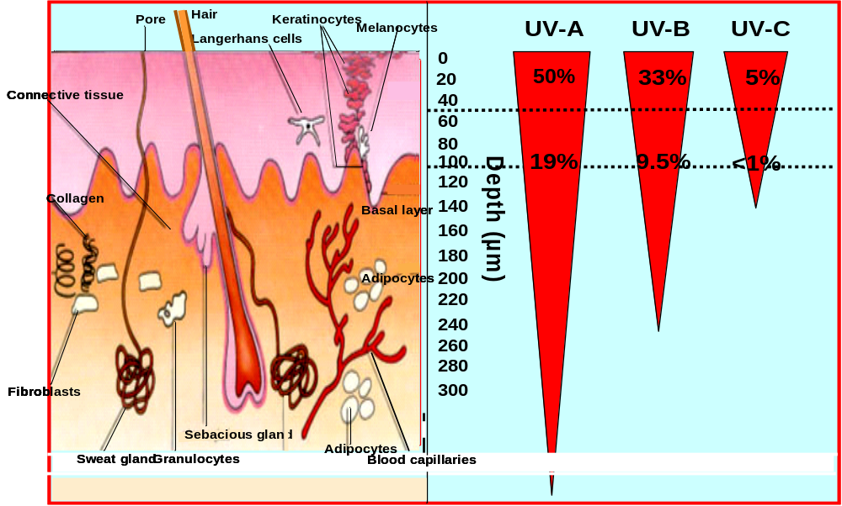
UV-R:classes and percent transmittance in human skin

Slide 5

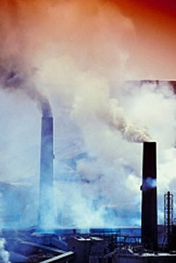
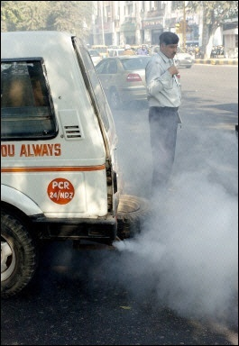
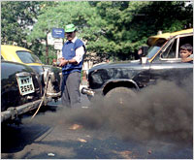
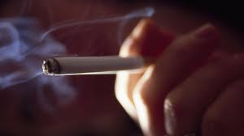
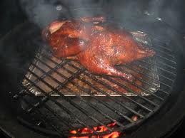

Various sources of PAHs contamination
Industry
Automobile exhaust
Service centre
Smoking
Charbroiled meat
Food preparation

Slide 6
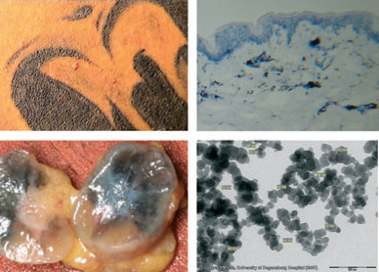
(a)
(b)
(c)
(d)
PAHs contamination in tatoo inks. (a) Tatoo at the back of a subject (b) histology of skin shows penetration of black ink inside dermis (c) section of lymphnode where tatoo ink transported (d) TEM shows accumulation of black ink inside dermis.
Experimental Dermatology, 2010

Slide 7

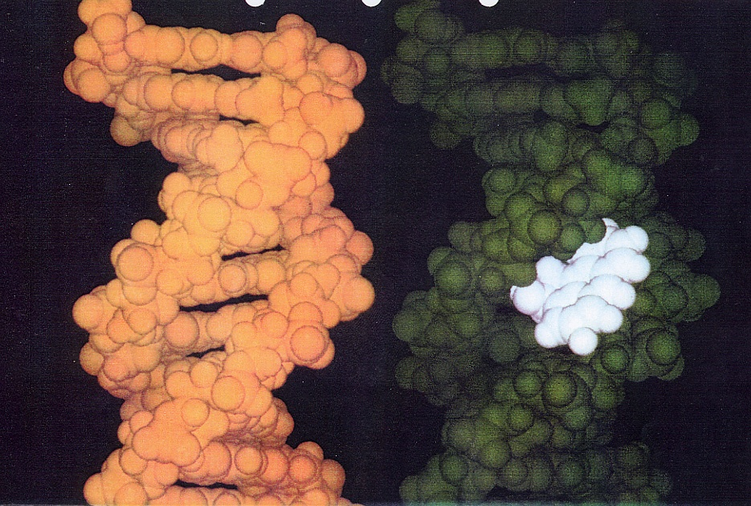
How PAHs damage DNA?
Once between the base pairs, PAHs can react with the bases or with the phosphate backbone of DNA.
In a nutshell, the PAHs bound to DNA can lead to either the breaking of the DNA backbone or to mutations during transcription.
DNA’s structure basically has a bunch of flat molecules stacked on top of each other – and PAHs are also flat.
PAHs can intercalate between the base pairs in DNA
Ref: http://www.atsdr.cdc.gov/tfacts69.html

Slide 8

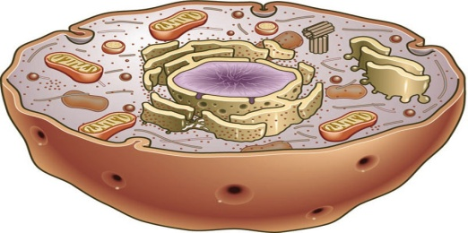
Photochemical Study ( UV-A and UV-B )
Chemical (PAHs)
UV Radiation or sunlight
Excited state chemical (triplet state)
Phototoxic
Absorption spectra & photodegradation study
Energy Transfer to O₂
Fragmentation or ionization
Electron Transfer to O₂
Binding to biomolecules such as DNA
Formation of toxic photoproduct
¹O₂
TYPE II
Oxidation of biomolecules
O₂.-, H₂O₂ & .OH
TYPE I
Oxidation of biomolecules
(lipid or protein or DNA)
Molecular Change
Cell Damage
Contd…

Slide 9
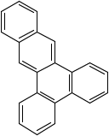
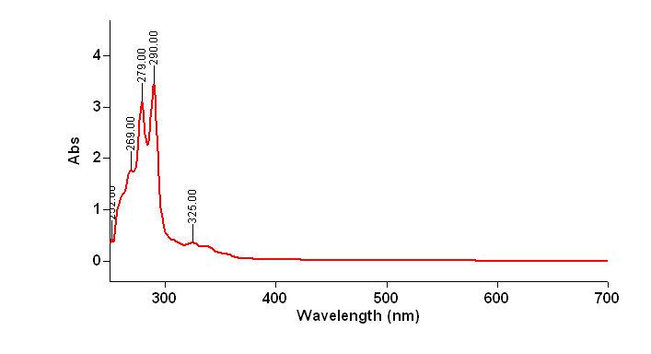
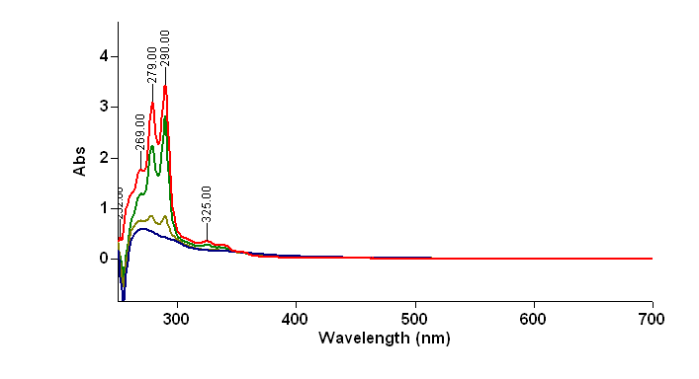
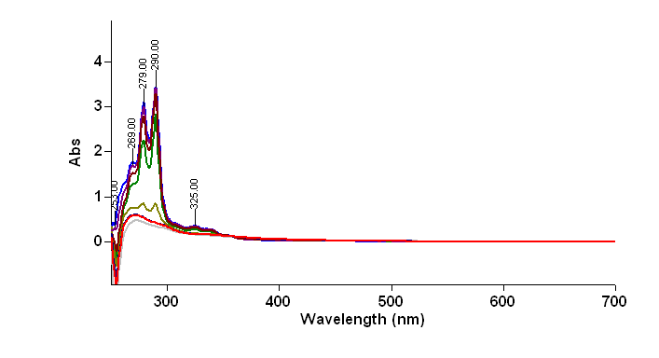
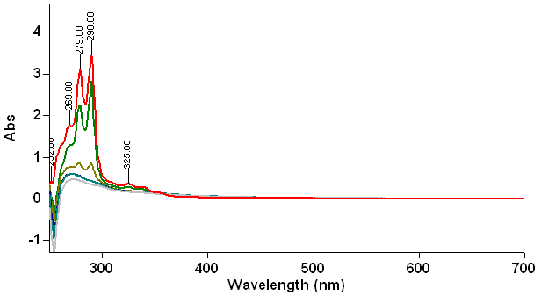
Photodegradation spectra
(a)
(b)
Mol wt-278
DARK
1-3 hr
1,2;3,4 Dibenzanthracene
(c)
(d)
1-4 hr
1- 6 hr

Slide 10
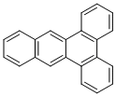
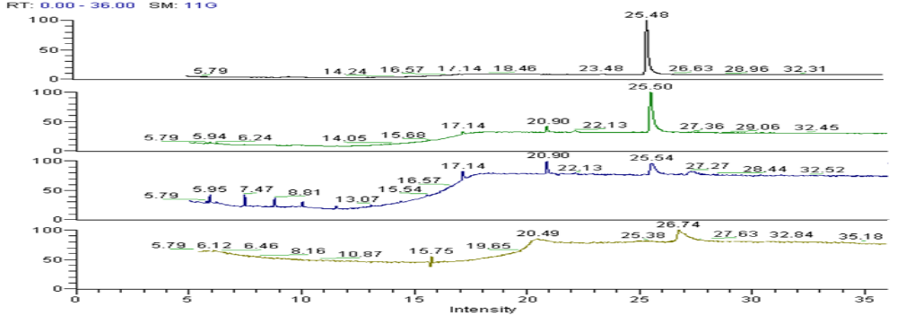

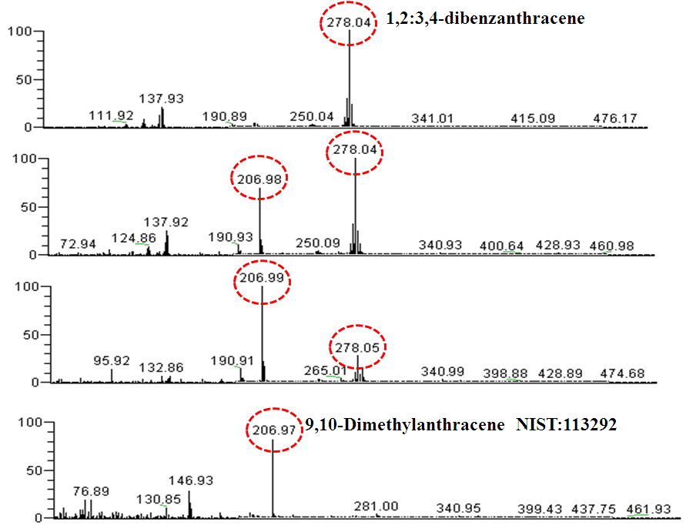
Photoproduct formation
(a)
Dark
1,2:3,4- dibenzanthracene
1Hr
4Hr
6Hr
Relative Abundance
Dark
(b)
1Hr
4Hr
6Hr

Slide 11
(a)
(b)
Δ A at 560nm
**
Δ A at 560nm
**
*
*
**
**
*
*
(c)
Δ A at 260nm
(d)
*
*
*
Δ A at 412nm
*
(e)
*
Δ A at 233nm
*
(f)
(g)
% Quenching
* *
*

Slide 12

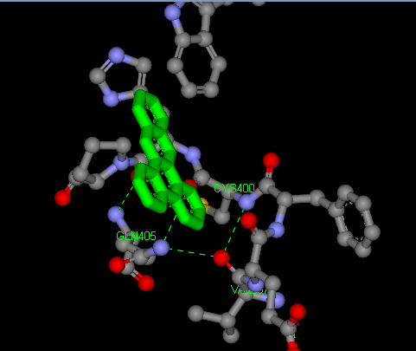
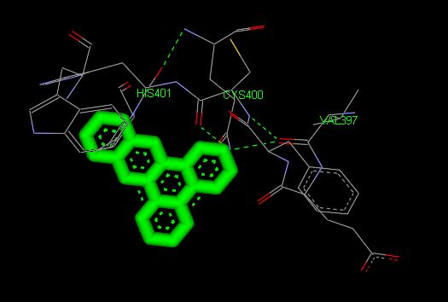
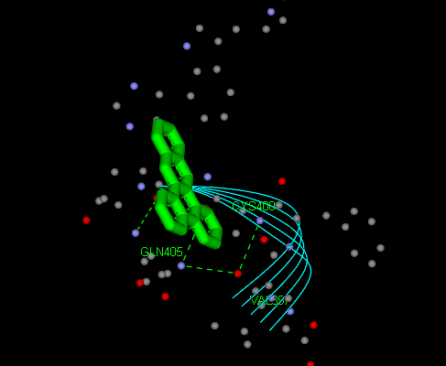
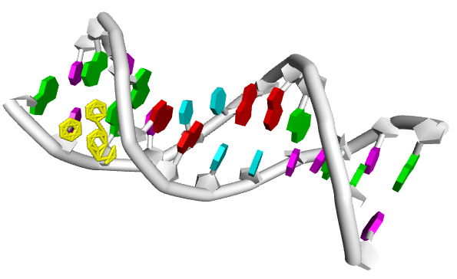
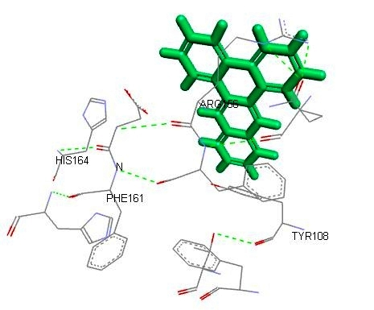
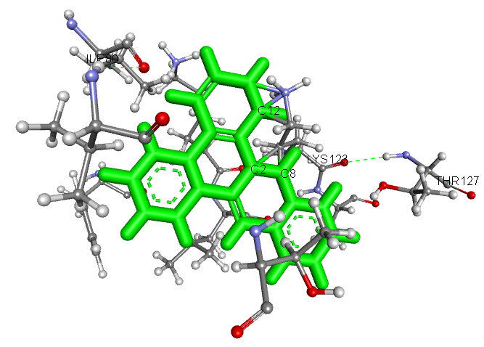
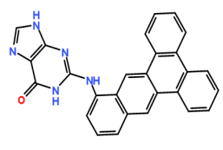
In silico docking
(a)
(b)
(c)
H2 bond
AhR LIGAND
AhR LIGAND
AhR LIGAND
DBA
DBA
DBA
(d)
(e)
(f)
DBA
Bak
Bax
Possible Guanosine Adduct

Slide 13
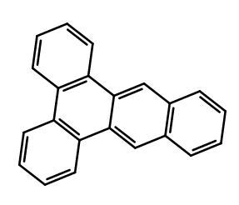
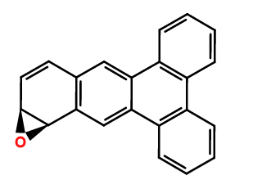
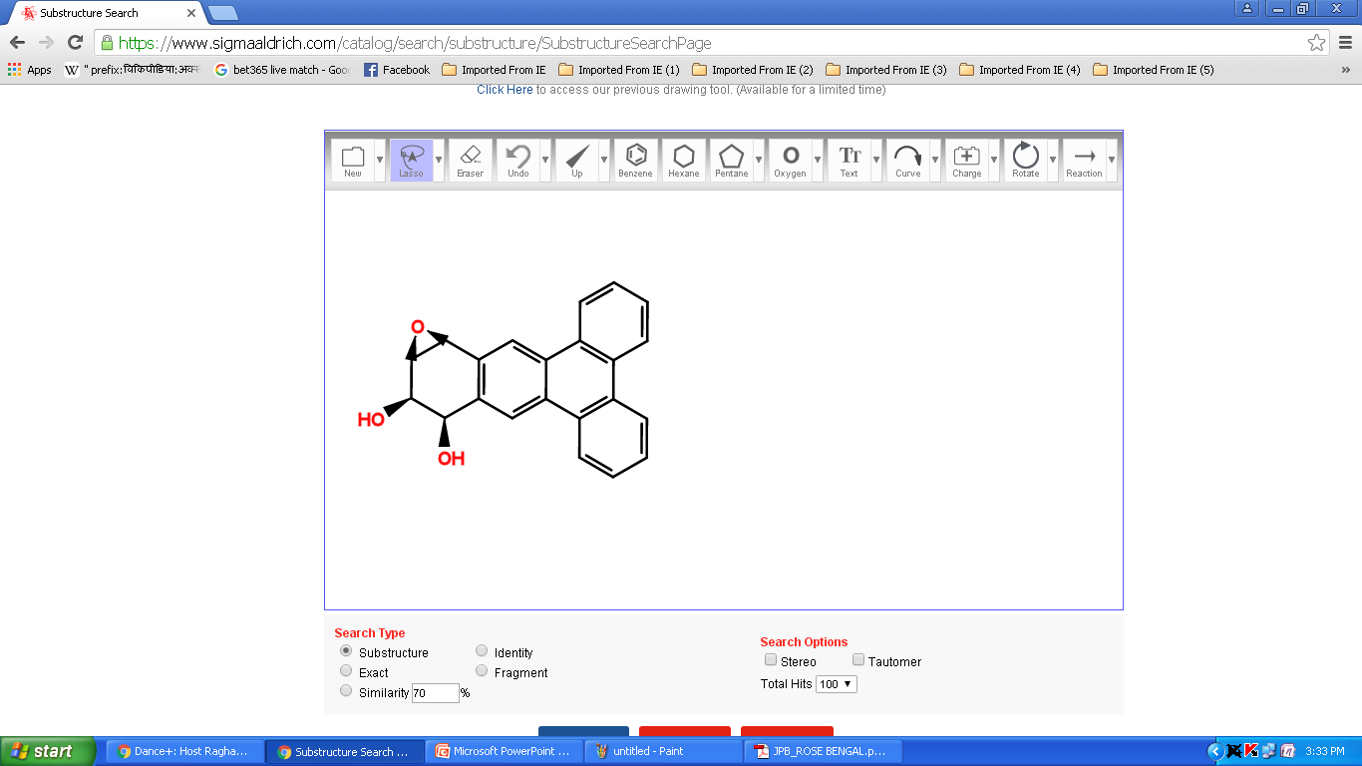
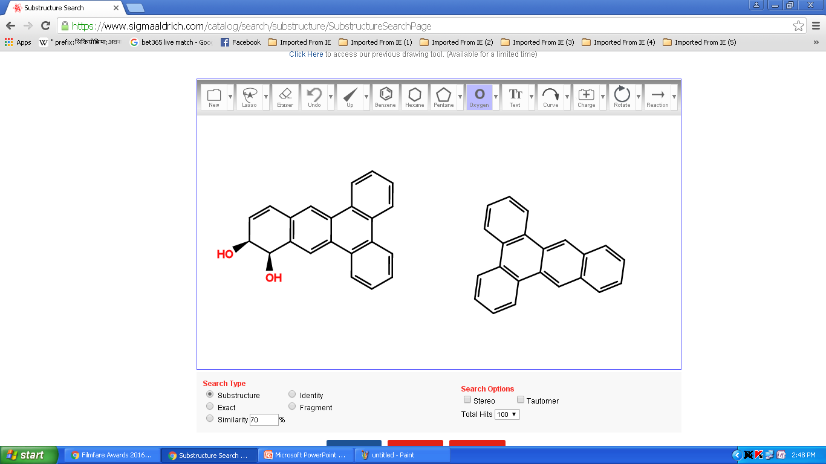
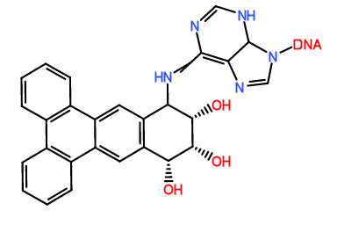
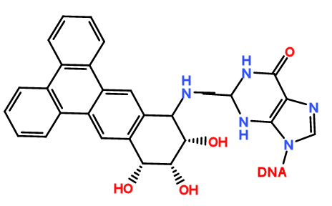
Metabolic pathway
Epoxide
hydrolase
CYP1A1
CYP1A1
DBA
DBA epoxide
DBA dihydrodiol
DBA dihydrodiol epoxide
+ DNA
+
Adenine DBA dihydrodiol epoxide
Guanine DBA dihydrodiol epoxide
Metabolic activation and DNA Adduct formation by DBA

Slide 14
(a)
MTT
*
*
*
*
*
*
*
*
(b)
MTT
% Cell Viability
(c)
*
*
*
MTT
(d)
*
*
*
NRU
*
NIH 3T3
(e)
*
*
*
Dark
UV-B

Slide 15
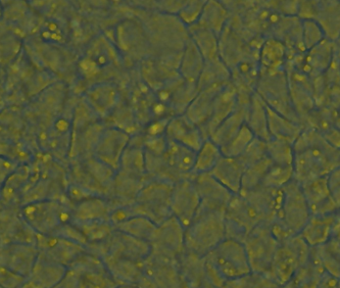
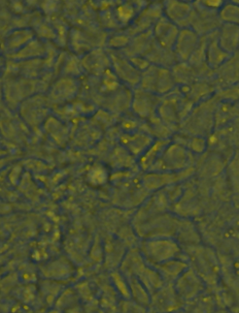
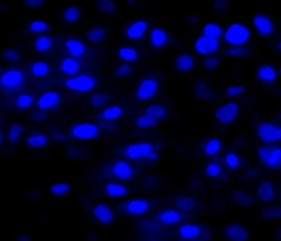
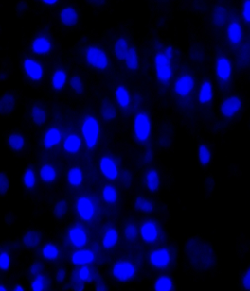
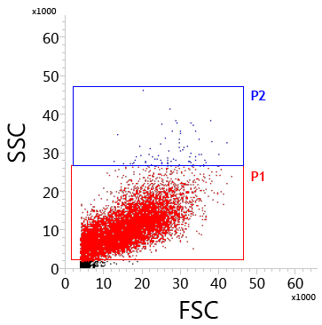
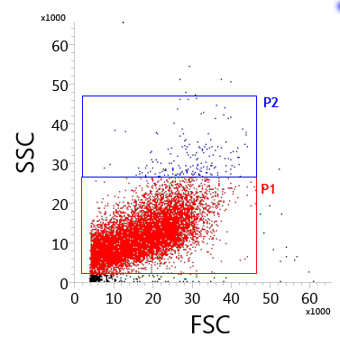
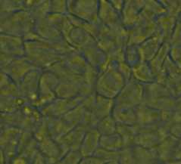
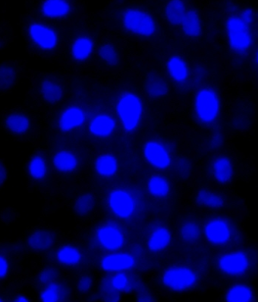
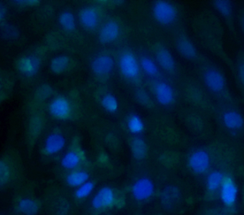
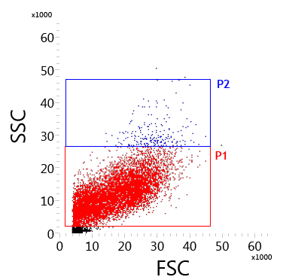
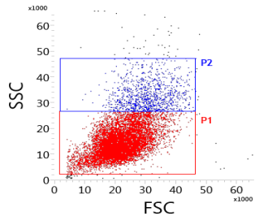
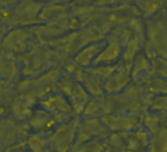
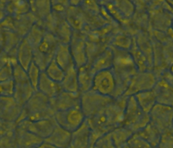
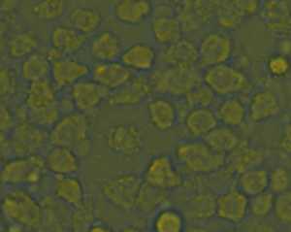
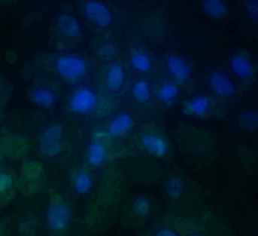
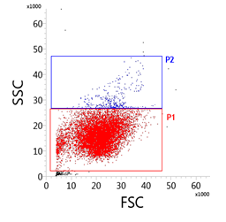
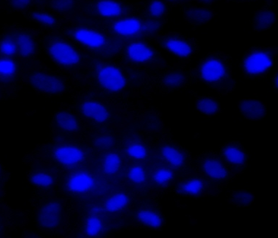
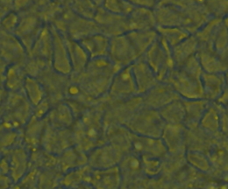
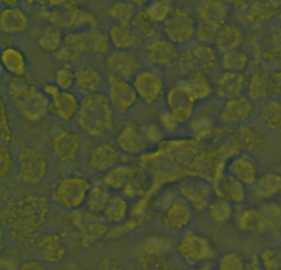




Cells morphology and compound internalization
Dark
(a)
(b)
DAPI/FITC^{DBA}
(c)
Dark
UV-B
Dark
Dark
UV-B
UV-B
Dark
UV-B
Control
DBA +VE
DBA +VE
0.01µg/mL
DBA -VE
DBA -VE
DBA +VE
DBA +VE
0.5µg/mL
DBA -VE
DBA -VE
3%
57 %
DBA +VE
DBA +VE
1µg/mL
DBA -VE
DBA -VE

Slide 16


















(a)
Dark
UV-B
(b)
(c)
Dark
UV-B
Dark
UV-B
Control
Live Cell
Dead Cell
0.01µg/mL
1µg/mL
(d)
(e)
(f)
DCF fluorescence intensity
% Quenching of DCF fluorescence
**
% cell viability

Slide 17
























Intracellular ROS generation
(a)
Green fluorescence-H2DCFDA
(b)
DAPI/DHE
(c)
Mitotracker/H2DCFDA
Dark
UV-B
Dark
UV-B
Dark
UV-B
Control
0.01µg/mL
0.5µg/mL
UV-B+NAC
1µg/mL

Slide 18























Apoptosis detection
(a)
AO/EtBr + AO
(b)
Annexin V+PI
(c)
Dark control
UV control
Dark
UV-B
Dark
UV-B
Control
UV-B 0.01µg/mL
UV-B 0.5µg/mL
0.01µg/mL
(d)
Dark Control
UV Control
0.5µg/mL
AO
AO+PI
AO
AO
UV-B 0.01µg/mL
UV-B 0.5µg/mL
1µg/mL
AO+PI
AO+PI
AO
AO

Slide 19
















Photogenotoxicity
(a)
PI/CPDs
(b)
PI/6-4 PPs
(c)
EtBr
Dark
UV-B
DARK
UV-B
Dark
UV-B
Dark
UV-B
Control
0.01µg/mL
0.5µg/mL
Tail DNA
Tail DNA
1µg/mL

Slide 20


























Genotoxicity , cell cycle arrest and PI uptake
(a)
Giemsa stain
(b)
HoechsT stain
(c)
DARK
UV-B
DARK
UV-B
Dark control
Dark 1µg/mL
UV control
Control
UV 0.01µg/mL
UV 0.5µg/mL
UV 1µg/mL
0.01µg/mL
A
(d)
Dark Control
UV Control
0.5µg/mL
UV-B 0.01µg/mL
A
A
A
C
UV-B 0.5µg/mL
1µg/mL
B
C

Slide 21
















External and internal morphology by TEM and SEM
(a)
(b)
(c)
Dark
UV-B
Dark
UV-B
Control
Dark control
0.01µg/mL
UV-B control
Dividing cell
0.5µg/mL
UV-B 0.01µg/mL
1µg/mL
Micronuclei
UV-B µg/mL

Slide 22
Molecular level study
(a)
Apoptosis associated genes
(c)
(b)
Fold Change
(d)
(e)
(f)
(g)
Cathepsin B
(h)
**
*
**
Fold Change
Fold Change

Slide 23









(a)
Mitochondrial/ER associated Apoptosis Protein
(c)
Lysosomal associated apoptosis protein
Figure.19
UV
0.01PPM
UV
1PPM
UV
0.01PPM
UV
1PPM
DC
UVC
DC
UVC
42Kda
βactin
120Kda
Lamp-1
21Kda
Bax
38Kda
Cathepsin B
23Kda
Bak
93Kda
Calpain-7
26Kda
Bcl-2
Antioxidant Protein response against Oxidative Stress
(d)
12Kda
Cyt-C
DC
UVC
UV
0.01PPM
UV
1PPM
141Kda
Apaf-1
68Kda
Nrf-2
32 Kda
Casp-3
70Kda
Keap-1
46Kda
Caspase-9
Hmox-1
32Kda
42Kda
Caspase-12
Bid
(e)
SSB/DSBs protein markers
22Kda
15Kda
tBid
DC
UVC
UV
0.01PPM
UV
1PPM
(b)
DBA altered protein
17Kda
γ H2A-X
UV
0.01PPM
UV
1PPM
DC
UVC
113Kda
PARP
78Kda
AhR
55Kda
CytP450

Slide 24








Graphical representation
[+] = over expression
[-] = under expression
Natural source
AhR
1,2;3,4 dibenzanthracene
Mol. Wt.-278
200-
700nm
+ Photosensitizer/DBA
Lysosome
ER
Mitochondria
Nucleus
Mutagenic, damage
eye and skin both
sunburn, erytherma and induced apoptosis
in cells at moderate doses
Artificial source
UV-B
Sunburn radiation
290-320nm
Type-1
Photosensitization
O₂^{.-} ,.OH
Photodegraded
ROS
DBA
PS Translocation
9,10 Dimethylanthracene
Mol. Wt-206
Type-1
pH-7
Cytosol
O₂^{.-} ,.OH
From lysosome
Target
Membrane
Damage
Cathepsin-B
Lysosome
Mitochondrial Ca⁺²
overloaded
Oxidative stress
Cathepsin B+
ER
Bid -
tBid +
Mitochondria
stress
Due to Ca⁺²
overload
Bak +
Nucleus
Calpain-7+
Bcl-2 -
Bax +
Cyt-C+
Release of caspases
cascades
Caspase-9 +
Ca⁺²
Release
Apoptosis /
Cornification
Caspase-12+
Caspase-3+

Slide 25
Conclusion
Our findings suggest that DBA is a phototoxic PAHs which caused photosensitization and have photolabile property.
Phototoxicity of DBA was mainly involved through type-1 photodynamic reaction which caused ROS generation and DNA damage mediated cell death.
The present study clearly indicates that photogenotoxic potential of DBA may cause deleterious effects on human skin during solar exposure.
Thus, study suggests the use of photosensitive PAHs should minimized in cosmetics and other health care products for the safety of human beings.

Slide 26



Laboratory Photograph
Acknowledgement
I wish to thank the Director CSIR-IITR Lucknow , INDIA for his support and ICMR -SRF
for financial assistance (Grant 45/07/2016/PHA-BMS).

Slide 27



IMMUNOLOGICAL MODE OF CELL DEATH DUE TO UV-R EXPOSURE
Thank you
Polycyclic aromatic hydrocarbons

Slide 28
References
Solomon et al 2008., “Irreversible climate change due to carbon dioxide emissions” vol. 106 no. 6 doi: 10.1073/pnas.0812721106
Bruno Veyrand, V. Sirot, S. Durand, C. Pollono, P. Marchand, G.D. Pinel, A. 444 Tard, J.C Leblanc and B.L. Bizec (2013). Human dietary exposure to polycyclic 445 aromatic hydrocarbons: Results of the second French Total Diet Study. 446 Environment International, 54; 11-17.
Tornaletti S, Pfeifer GP UV damage and repair mechanisms in mammalian cells Bioessays 1996 Mar;18(3):221-8.
Y. Kang, K.C. Cheung and M.H. Wong (2010). Polycyclic aromatic hydrocarbons 455 (PAHs) in different indoor dusts and their potential cytotoxicity based on two 456 human cell lines. Environ. Inter. 36; 542-547.
P Boukamp, R T Petrussevska, D Breitkreutz, J Hornung, A Markham and N E Fusenig Normal keratinization in a spontaneously immortalized aneuploid human keratinocyte cell line. March 1, 1988 // JCB vol. 106 no. 3 761-771

Slide 29
Lysosome
ER
Mitochondria
Nucleus
[+] = overexpression
[-] = lower expression
Natural source
1,2;3,4 dibenzanthracene
Mol. Wt.-278
200-
700nm
AhR
+ Photosensitizer/DBA
sunburn, erytherma and induced apoptosis
in cells at moderate doses
Mutagenic, damage
eye and skin both
Artificial source
UV-B
Sunburn radiation
DNA damage
290-320nm
Type-1
Photosensitization
O₂^{.-} ,.OH
CPDs
6,4PPs
γH2Ax
Micronuclei
SSBs
Chromatin
fragmentation
Photodegraded
ROS
DBA
PS Translocation
9,10 Dimethylanthracene
Mol. Wt-206
Type-1
pH-7
Cytosol
O₂^{.-} ,.OH
From lysosome
Target
Membrane
Damage
Cathepsin-B
Mitochondrial Ca⁺²
overloaded
Oxidative stress
Lysosome
Cathepsin B+
Bid -
tBid +
ER
Photoirradiated DBA induced apoptotic cell death by involving
Mitochondria + Lysosome + ER and Nucleus
Mitochondria
stress
Due to Ca⁺²
overload
Bak +
Calpain-7+
Bcl-2 -
Bax +
Nucleus
Cyt-C+
SEM
Release of caspases
cascades
Caspase-9 +
Ca⁺²
Nuclear Damage
Release
Caspase-12+
TEM
Cell cycle arrest
AO/ EtBr
PI uptake
AO/PI
Apoptosis /
Cornification
Caspase-3+

