Slide 1

Understanding and Overcoming Chemoresistance in Pancreatic Cancer
Ajay Singh, Ph.D.
University of South Alabama
Mitchell Cancer Institute

Slide 2
Cancer: the emperor of all maladies
Uterine cancer – 81.5%
Breast cancer – 89.2%
Skin cancer – 91.3%
Thyroid cancer – 97.7%
Prostate cancer – 99.2%
Stomach cancer – 37.7%
Brain cancer – 43.5%
Ovarian cancer – 54.2%
Leukemia – 66%
Laryngeal cancer – 60.6%
Oral cancer – 63.2%
Colon cancer – 64.9%
Bone cancer – 66.4%
Colorectal cancer – 66.5%
Cervical cancer – 67.9%
Non-Hodgkin lymphoma - 69.3%
Kidney cancer – 71.8%
Bladder cancer – 79.9%
Pancreatic cancer – 7%
Liver cancer – 16.1%
Lung cancer – 17.4%
Esophageal cancer – 17.3%
Very-very Bad
Bad
5-year survival after diagnosis: ≤20%
5-year survival after diagnosis: ≥ 80%
Very Bad
5-year survival after diagnosis: 30-80%

Slide 3
Pancreatic cancer: facts and figures
One of the leading causes of cancer-related death in all developed countries.
4th leading cause of cancer-related death in the United States, expected to overtake breast cancer to become 3rd on the list by the end of this year, and 2nd by 2030 or earlier.
53,070 people will be diagnosed and 41,780 will die with pancreatic cancer in 2016 in the United States alone
One diagnosis every ~9.9 minutes, and one death every ̴12.5 minutes
(Siegel et al., CA Cancer J Clin, 2016)

Slide 4
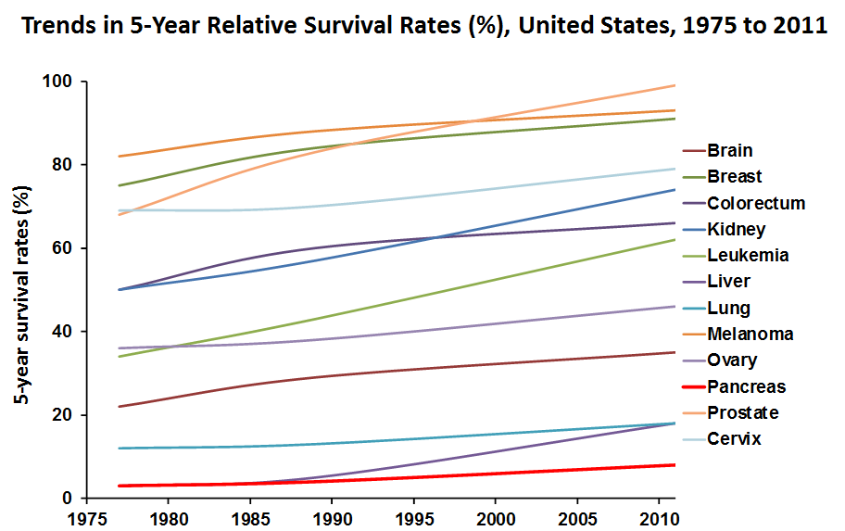
Pancreatic cancer: facts and figures
Racial disparity- African Americans experience greater pancreatic cancer death rate (≈ 32%) than Caucasians.
Regardless of the racial background, most patients (60-80%) die within one year after diagnosis.
Five year survival has remained at 3-8% for nearly past four decades.
(Siegel et al., CA Cancer J Clin, 2016)

Slide 5
Why pancreatic cancer is so deadly?
Lack of awareness; Cryptic progression- lack of symptoms- late diagnosis.
    In most cases, pancreatic cancer is either locally advanced or has already metastasized to distant organs at the time of diagnosis.
Ineffective treatments: Chemotherapy is the option for advanced disease (≥ 80%) - but it is only minimally effective. Severe side-effects.
  Gemcitabine- Standard of care as a single agent; first FDA-approved drug for pancreatic cancer patients
  Erlotinib + Gemcitabine; Abraxane (nab-paclitaxel) + Gemcitabine
  FOLFIRINOX (fluorouracil, leucovorin, irinotecan and oxaliplatin)
Notes:
One simple reason is that nobody cared about it. Incidence was less or maybe not, maybe people succumbed to it (and still do today) without ever knowing that they have it.

Slide 6
Bottom-line is…………
Trend continues toward increase in pancreatic cancer incidence and mortality.
Pancreatic cancer continues to be diagnosed at a late stage due to lack of early diagnosis.
No effective therapy is yet available.
Need
To identify novel biomarkers and approaches for early detection and prevention
Develop effective (target-based) therapeutic approaches
Notes:
One simple reason is that nobody cared about it. Incidence was less or maybe not, maybe people succumbed to it (and still do today) without ever knowing that they have it.

Slide 7
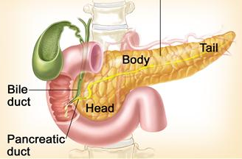
Biology of pancreatic Cancer
Acinar cells
Ductal Cells
Exocrine cells
Endocrine cells
Islet cells
  Exocrine [more common (≈ 95%) and deadly- acinar cell or ductal cell carcinoma]
  Endocrine [less aggressive- pancreatic neuroendocrine tumors or PNETs]
www.cancer.gov
Notes:
Pancreas is located deep inside the abdomen, behind the liver and spleen
Performs both exocrine and endocrine functions. Acinar cells produce pancreatic juice, which is delivered to the duodenum through pancreatic ducts.
Islets cells produce pancreatic hormones (insulin and glucagon)

Slide 8
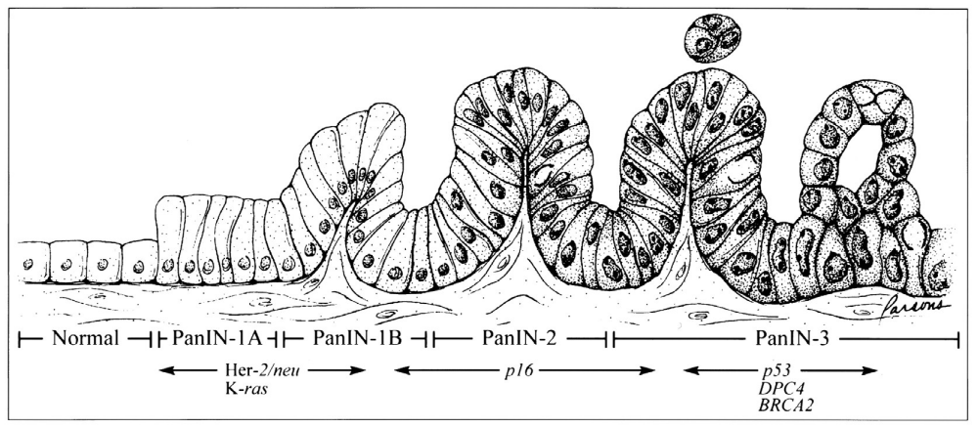
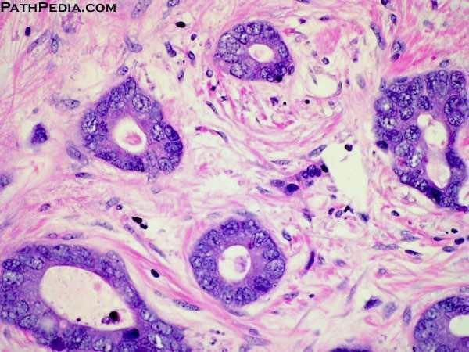
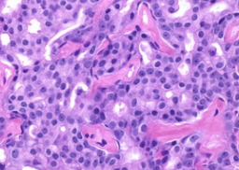
Progression model of pancreatic cancer
IDAC
(Hrubun et al., 2001)
Pancreatic Tumor
Prostate Tumor
Notes:
A decade back, Hruban et al proposed a clinical progression model of pancreatic cancer. They suggested that transformation of a normal cells to invasive cancer cells progresses through pre-cancerous stages- PanIN1A, PanIN1B, PanIN2 and PanIN3. Based on molecular analysis of these lesions, they identified genetic changes that occur during these stages. Validity of this model has been tested in several genetically engineered mouse models and since then we have identified many other genetic, epigenetic and transcriptomic changes that occur during pancreatic cancer progression.
Under real setting, it looks something like this..

Slide 9

Progression model of pancreatic cancer- updated
Normal PanIN-1A PanIN-1B PanIN-2 PanIN-3 Invasive Carcinoma
K-ras mutation, Her-2/neu, CXCR4, SHH & MUC4 overexpression
Inactivation of CDKN2A/Ink4A/p16
MUC1 overexpression
p53, SMAD4/DPC4, BRCA2 inactivation
miR-21 ( ), miR-155 ( ), miR-182 ( ), miR-296-5p ( )
miR-196b ( )
Stroma-associated changes: Collagen ( ), Fibronectin ( ), Galectin 1 ( ), CXCL12 ( ),), etc.
Endothelial cells/ Blood vessel
Quiescent PSCs
Activated PSCs
ECM
MDSC
Immune cells

Slide 10
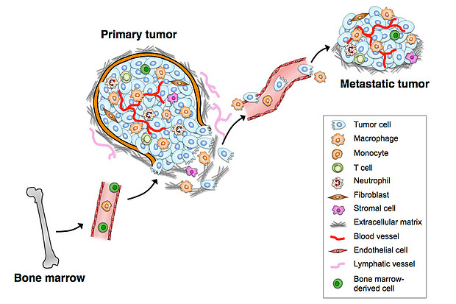
Tumor Micro-Environment (TME): an emerging target for cancer therapy
Cells in the TME at the primary or metastatic sites produce several growth or chemotactic factors, which facilitate tumor growth, chemotactic-movement, secondary establishments, and likely therapeutic outcome.

Slide 11
Tumor-microenvironment and chemoresistance
Extrinsic de novo resistance factor, protects tumor cells containing “intrinsic mutations”.
    Physical barrier (impacting drug delivery)
    Neutralizer (metabolism, acidified environment reduces drug efficacy through ion trapping)
    Active bi-directional tumor-stromal cross-talk (promotes acquired chemoresistance by impacting cellular signaling and facilitates escape mechanisms- ultimately give rise to more complex resistant phenotypes)
Notes:
Recent data suggest an important role for tumor microenvironment in the development and maintenance of resistance to classic chemotherapeutic and targeted therapies.

Slide 12
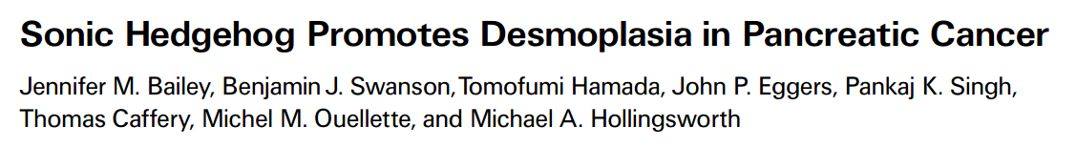

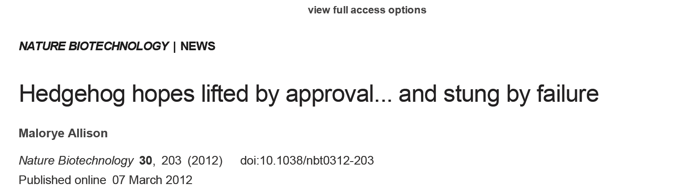
Knowledge gained so far…..

Slide 13








Progression model of pancreatic cancer- updated
Normal PanIN-1A PanIN-1B PanIN-2 PanIN-3 Invasive Carcinoma
CXCR4
CXCL12
K-ras mutation, Her-2/neu, CXCR4, SHH & MUC4 overexpression
Inactivation of CDKN2A/Ink4A/p16
MUC1 overexpression
p53, SMAD4/DPC4, BRCA2 inactivation
miR-21 ( ), miR-155 ( ), miR-182 ( ), miR-296-5p ( )
miR-196b ( )
Stroma-associated changes: Collagen ( ), Fibronectin ( ), Galectin 1 ( ), CXCL12 ( ),), etc.
Endothelial cells/ Blood vessel
Quiescent PSCs
Activated PSCs
ECM
MDSC
Immune cells

Slide 14
CXCL12 or stromal cell-derived factor-1 (SDF-1)
Progression model of pancreatic cancer- updated
It is a member of chemokine family- abundantly produced by the pancreatic stromal cells and at the site of pancreatic cancer cell metastasis.
It binds to two chemokine receptors (CXCR4 and CXCR7).
Both CXCR4 and CXCR7 are expressed in pancreatic cancer cells
Mori et. Al., 2004, Saur et al., 2005

Slide 15
CXCL12/CXCR4 Signaling in pancreatic cancer
Progression model of pancreatic cancer- updated
CXCR4 is also expressed on pancreatic cancer stem cells and is essential for their invasive properties.
CXCL12 is the sole ligand for CXCR4.
CXCL12
Tumor growth & maintenance
Invasion & metastasis
CXCR4
Pancreatic cancer stem cells
Hermann et. al., 2007; Matsuo et. al., 2009

Slide 16
CXCL12
Tumor growth & maintenance
Invasion & metastasis
CXCR4
Hermann et. al., 2007; Matsuo et. al., 2009
Pancreatic cancer stem cells
Does CXCL12/CXCR4 signaling ALSO have a role in chemoresistance of pancreatic cancer?
PART-1

Slide 17
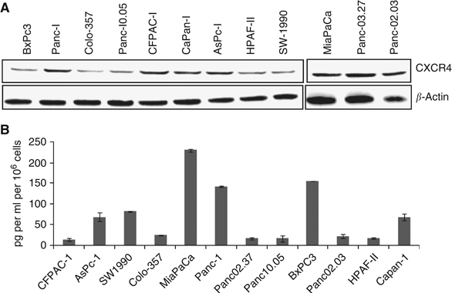
Expression of CXCR4 and CXCL12 in in pancreatic cancer cells
Singh et al., Br J Cancer. 2010;103:1671-9.

Slide 18
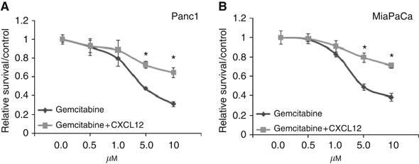
CXCR4 activation rescues pancreatic cancer cells from gemcitabine-induced cytotoxicity
IC50_{GEM}: 4.8µM
IC50_{GEM}: > 10.0 µM (+CXCL12)
IC50_{GEM}: 5.1µM
IC50_{GEM}: > 10.0 µM (+CXCL12)
Singh et al., Br J Cancer. 2010;103:1671-9.

Slide 19
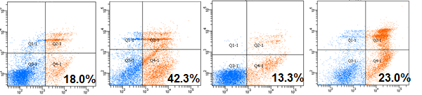
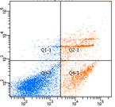
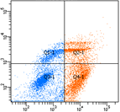
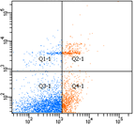
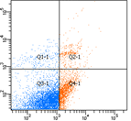
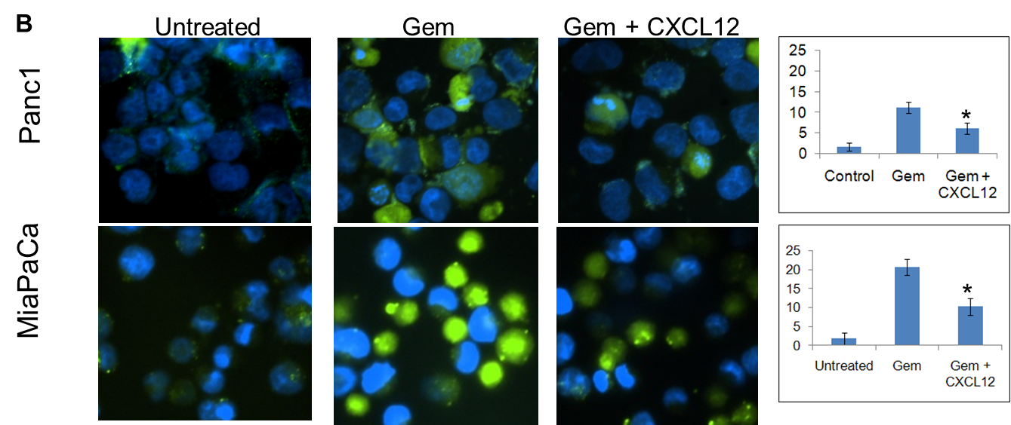
Antiapoptotic effects of CXCL12 treatment on gemcitabine-induced cell death
Vehicle
GEM.
CXCL12
GEM. + CXCL12
7AAD
Panc1
MiaPaCa
12.5%
30.9%
9.1%
16.2%
PE-A
Singh et al., Br J Cancer. 2010;103:1671-9.

Slide 20


CXCL12/CXCR4 signaling potentiates survival signaling to impart chemoresistance
CXCL12
AMD3100
Gβ
CXCR4
Gα
Gγ
ERK
Akt
BAD
Nf-kB
β-Catenin
Bcl2, Survivin
Nf-kB
β-Catenin
Survival
Chemoresistance
Singh el al. 2010, Br. J. Cancer

Slide 21
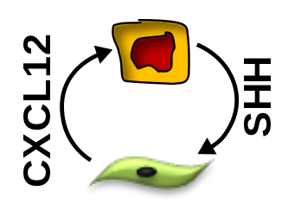
Progression model of pancreatic cancer- updated
Normal PanIN-1A PanIN-1B PanIN-2 PanIN-3 Invasive Carcinoma
CXCR4
K-ras mutation, Her-2/neu, CXCR4, SHH & MUC4 overexpression
Inactivation of CDKN2A/Ink4A/p16
MUC1 overexpression
p53, SMAD4/DPC4, BRCA2 inactivation
miR-21 ( ), miR-155 ( ), miR-182 ( ), miR-296-5p ( )
miR-196b ( )
Stroma-associated changes: Collagen ( ), Fibronectin ( ), Galectin 1 ( ), CXCL12 ( ),), etc.
Endothelial cells/ Blood vessel
Quiescent PSCs
Activated PSCs
ECM
MDSC
Immune cells

Slide 22
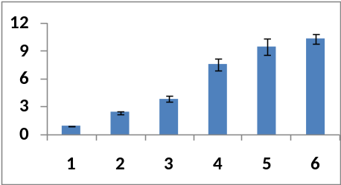
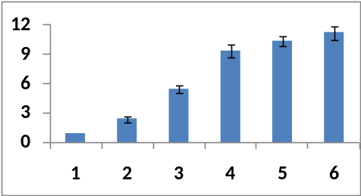
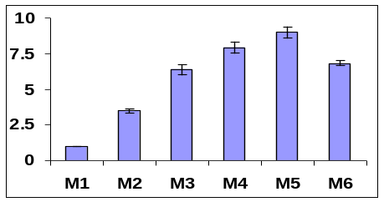
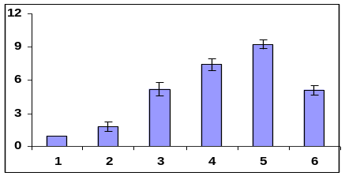
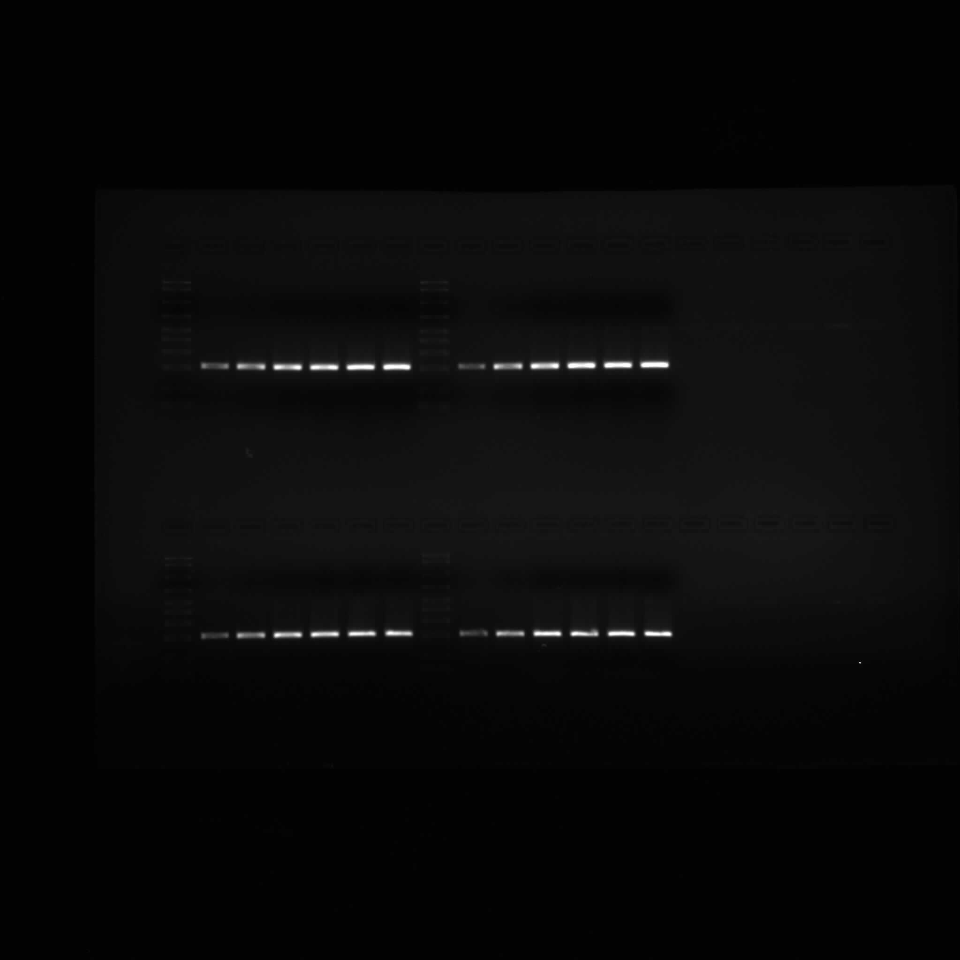
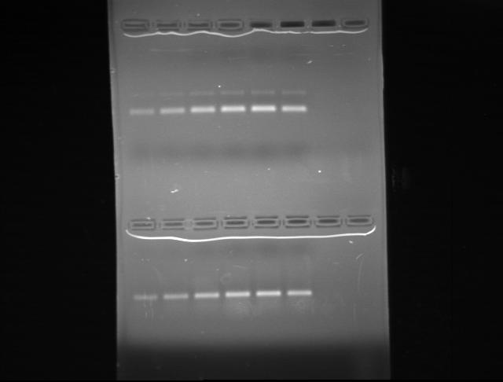
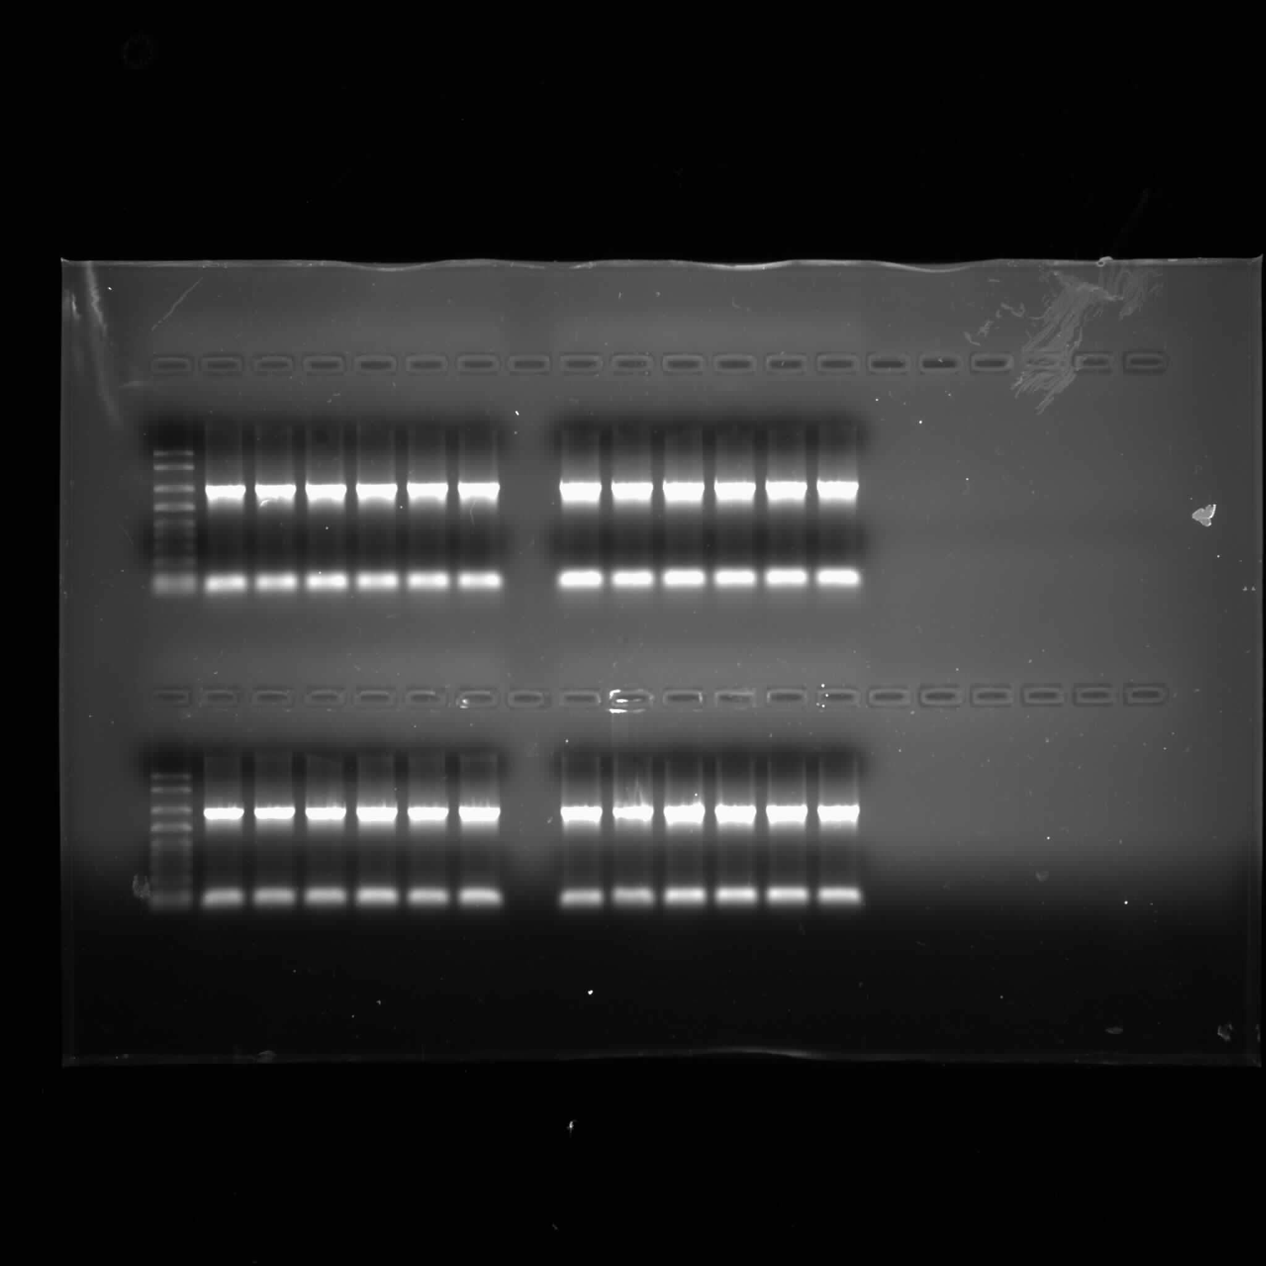
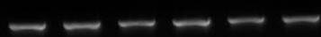
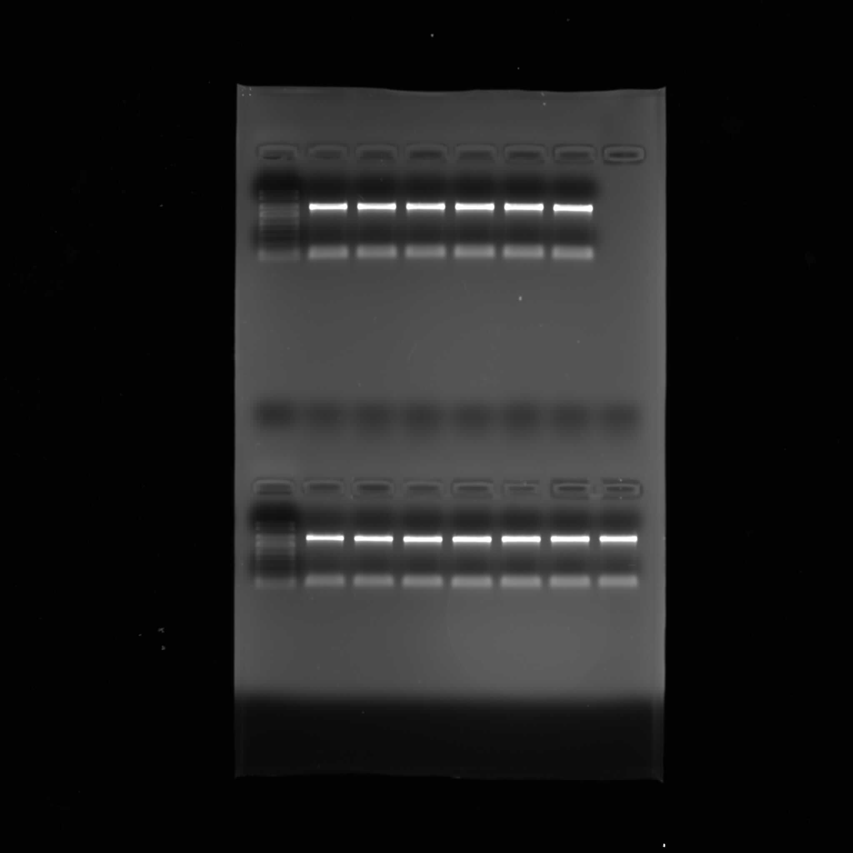




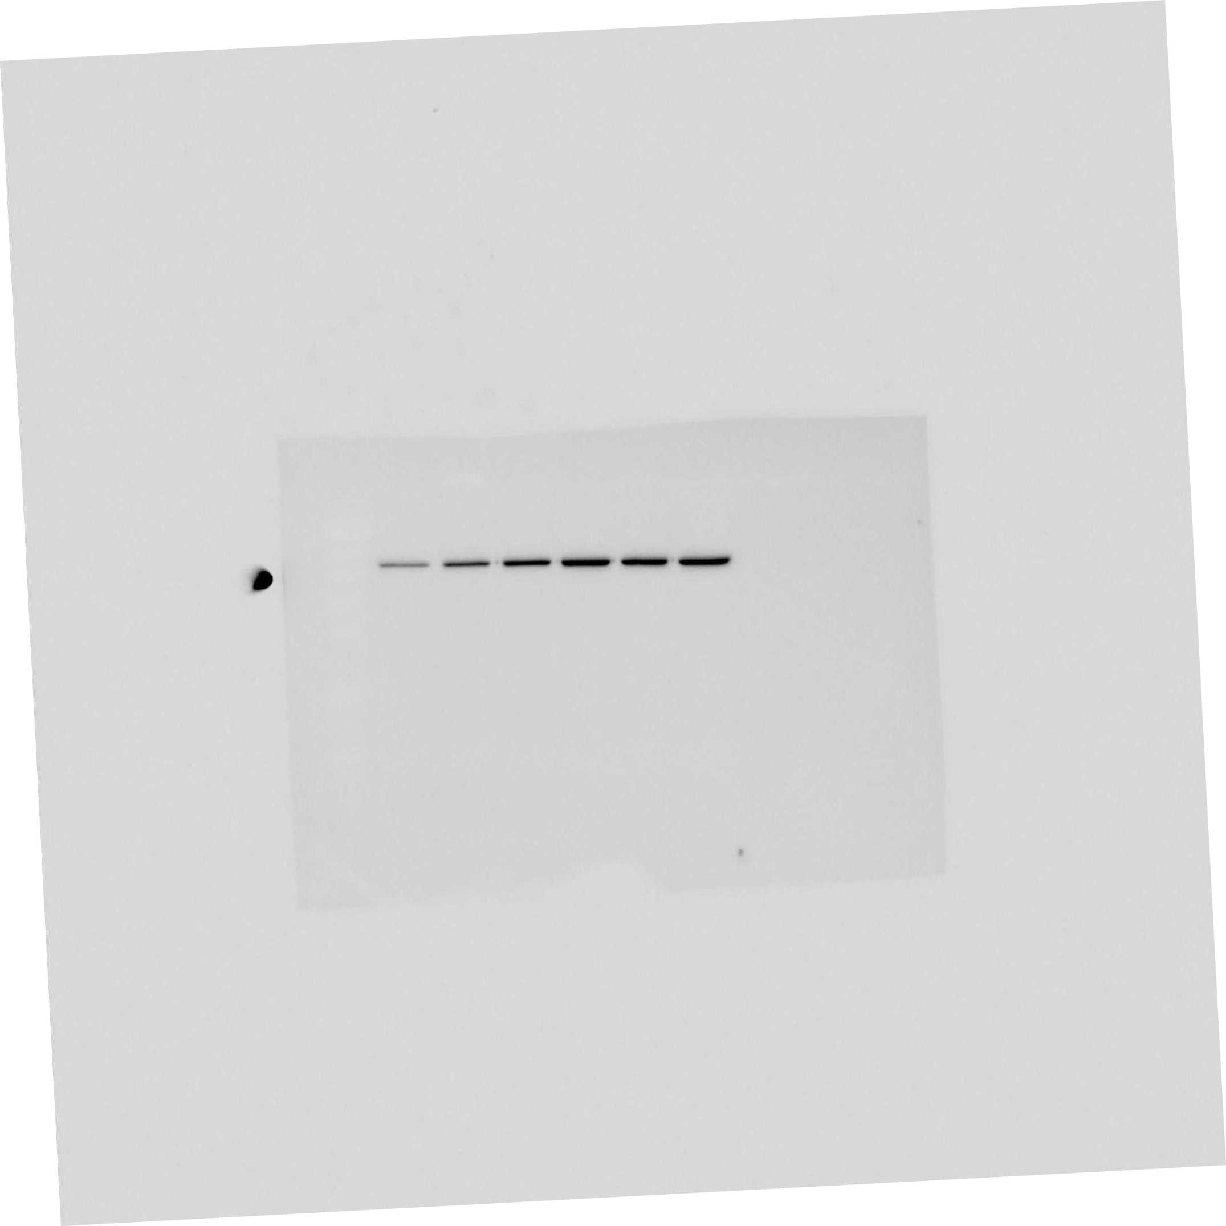
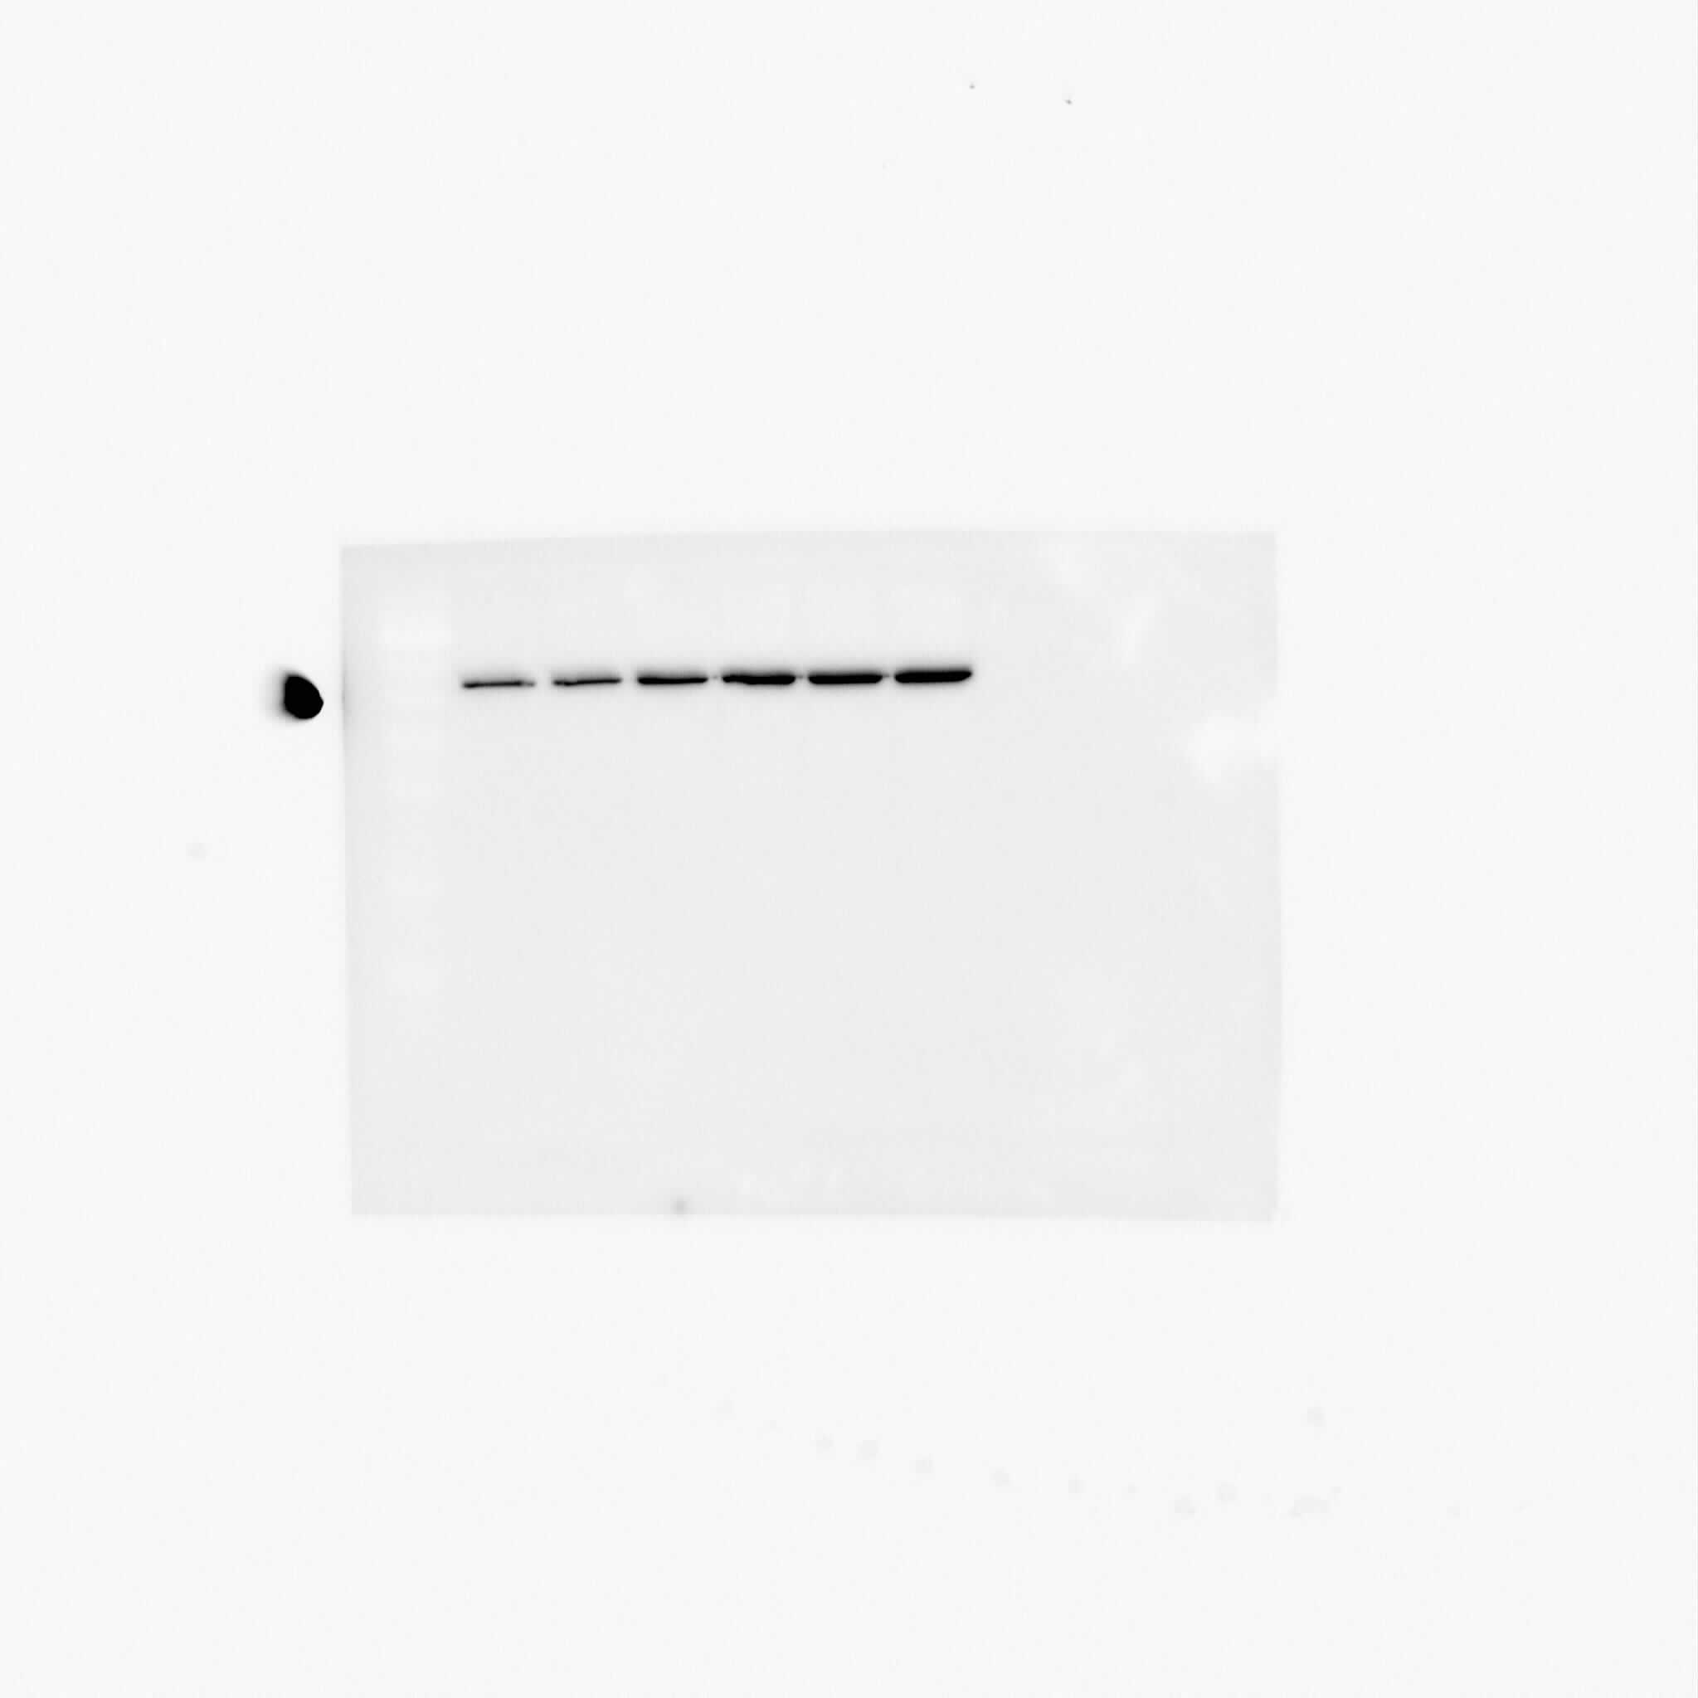
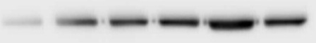


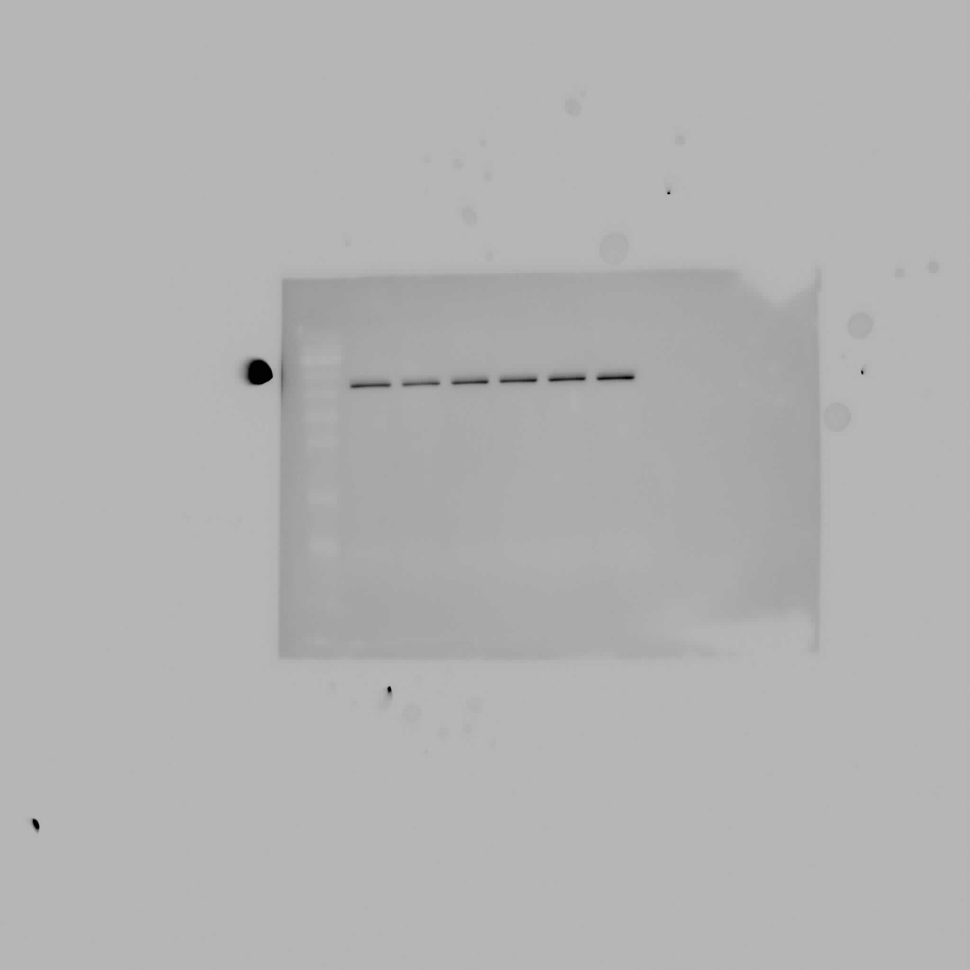
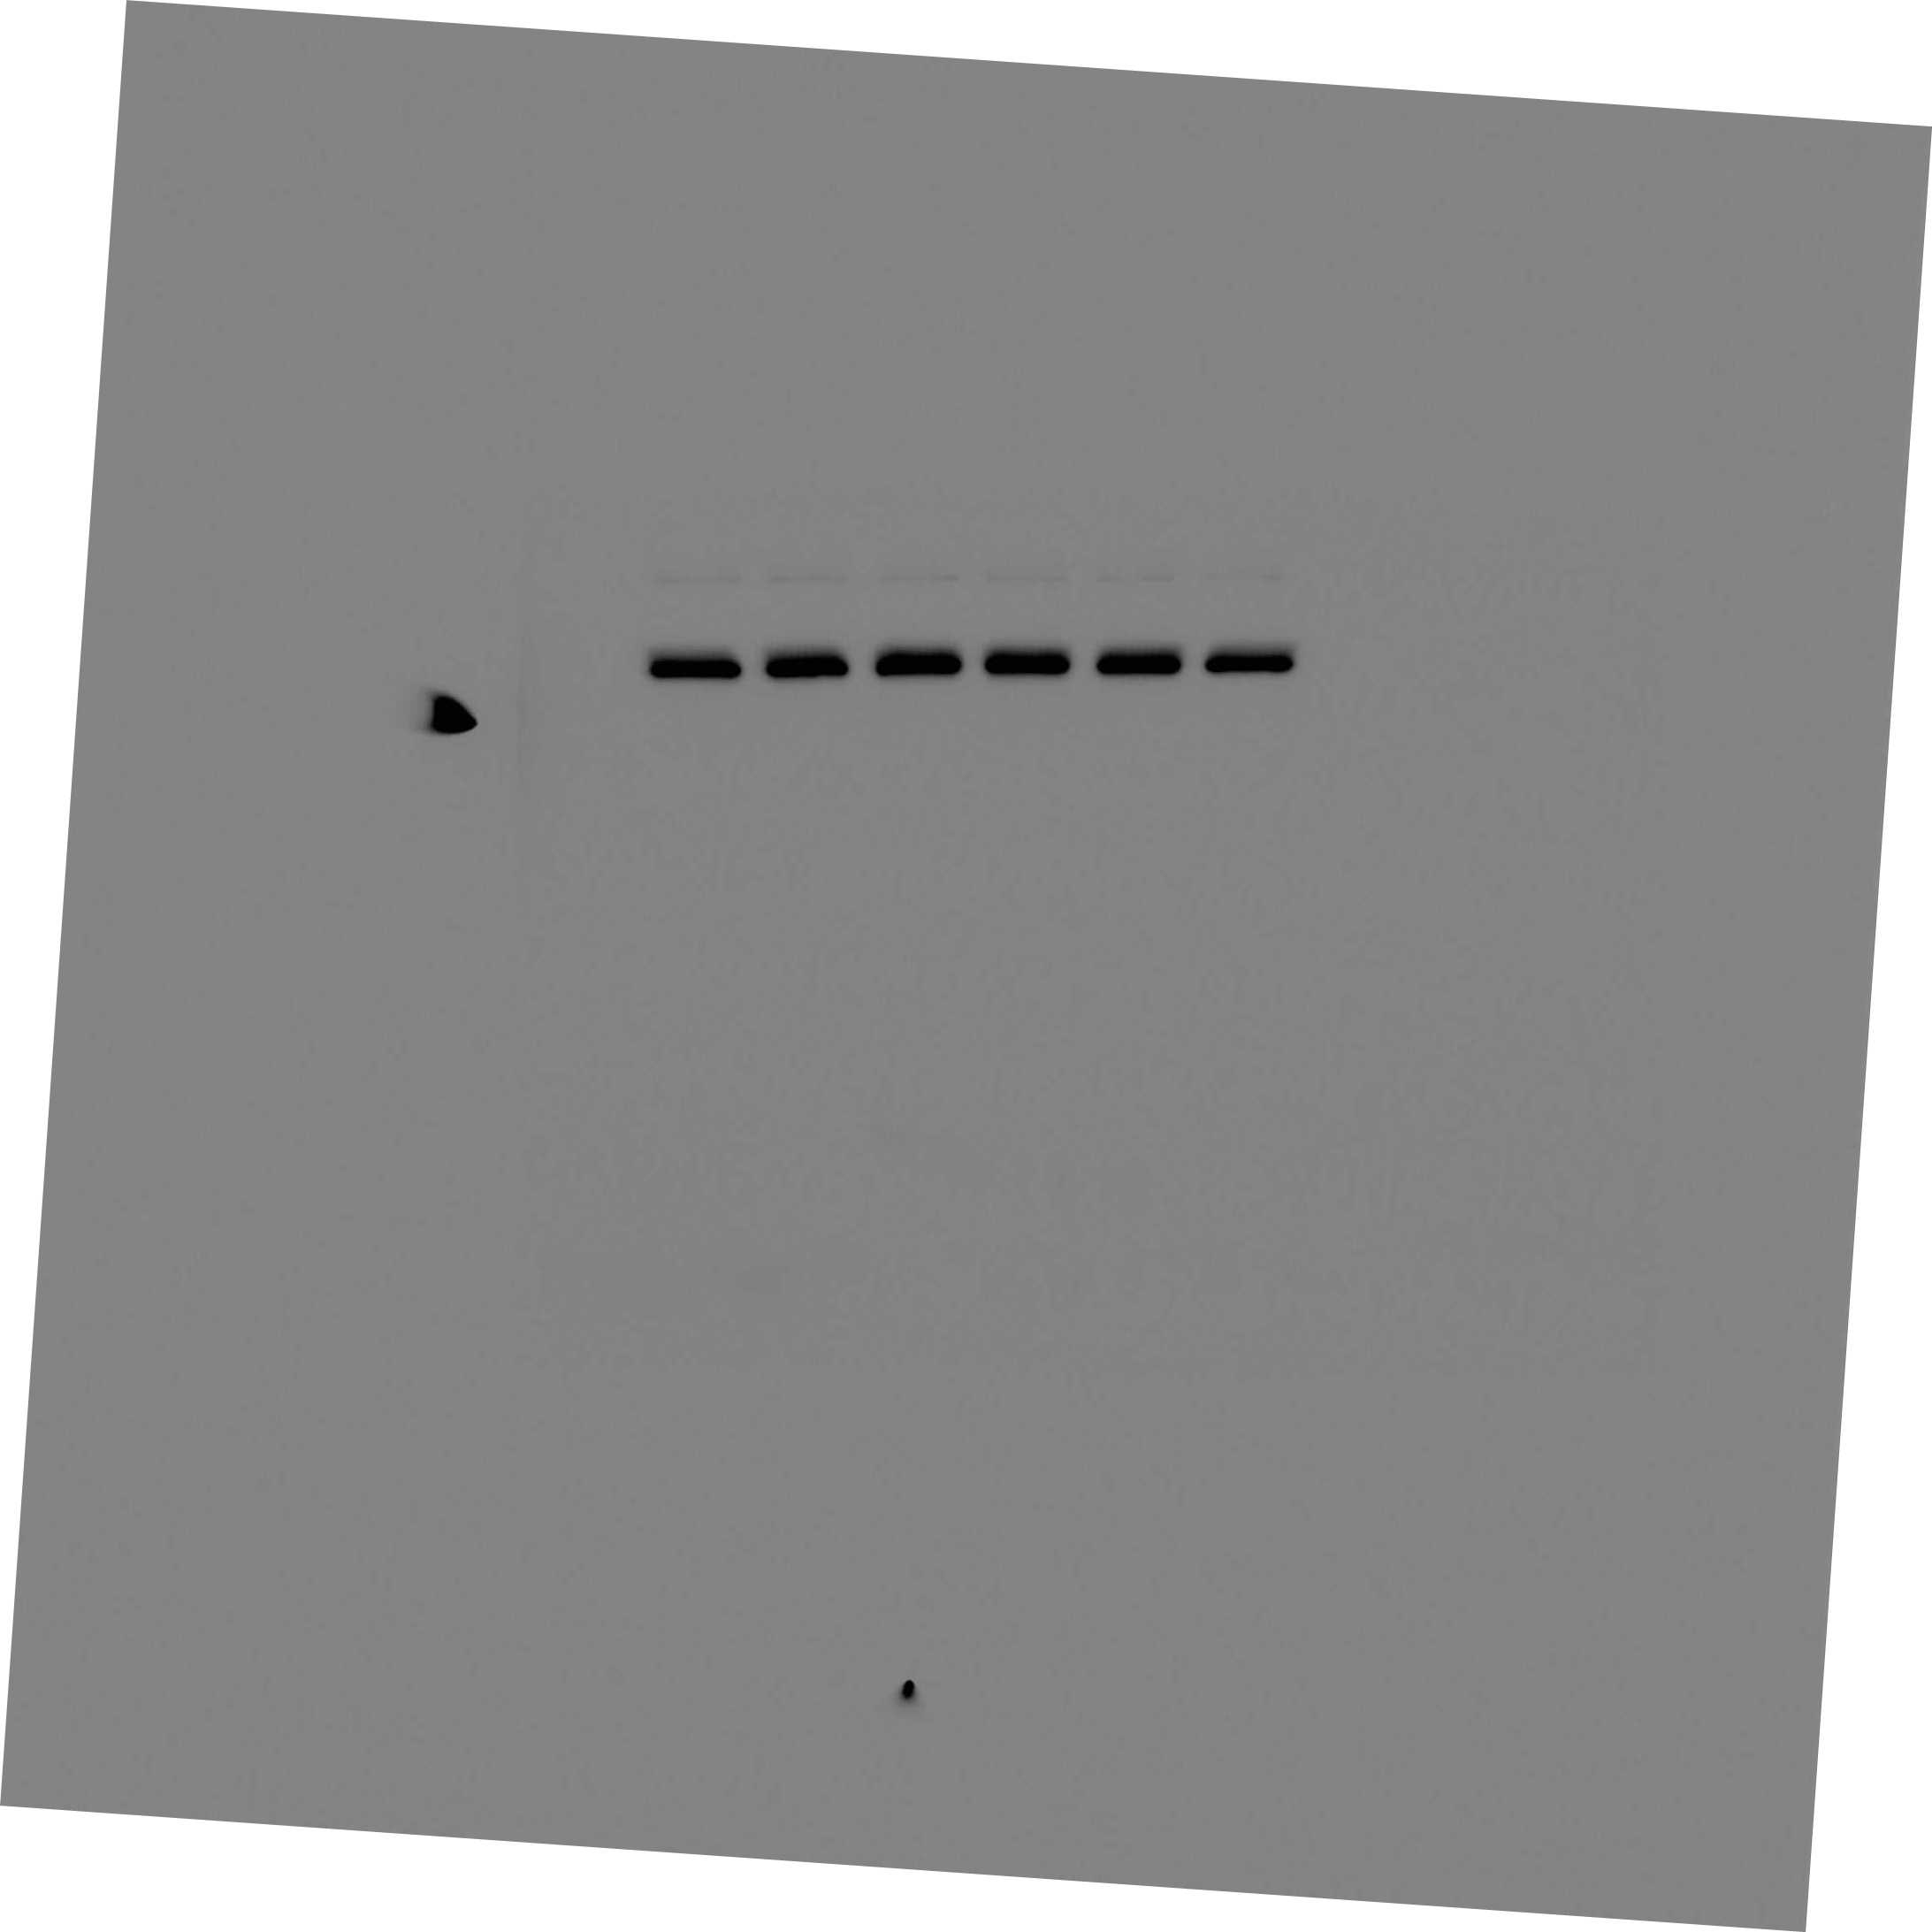
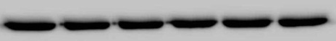
CXCL12 induces the expression of sonic hedgehog (SHH) in pancreatic cancer cells
Dose-dependent
Time-dependent
12
**
Colo357
**
**
**
MiaPaCa
**
**
MiaPaCa
**
**
Colo357
**
9
**
**
**
**
Relative expression
**
6
**
**
**
**
3
**
*
0
SHH
GAPDH
CXCL12 (ng/ml)
0 25 50 100 150 200
0 25 50 100 150 200
0 4 8 16 24 48
0 4 8 16 24 48
12
**
**
**
**
**
**
**
**
**
9
**
**
Relative expression
**
6
**
**
**
**
**
**
3
**
**
0
SHH
β-actin
CXCL12 (ng/ml)
0 25 50 100 150 200
0 25 50 100 150 200
0 4 8 16 24 48
0 4 8 16 24 48
*p<0.05 ; **p<0.01
Singh et al., J Biol Chem. 2012; 287:39115-24.

Slide 23
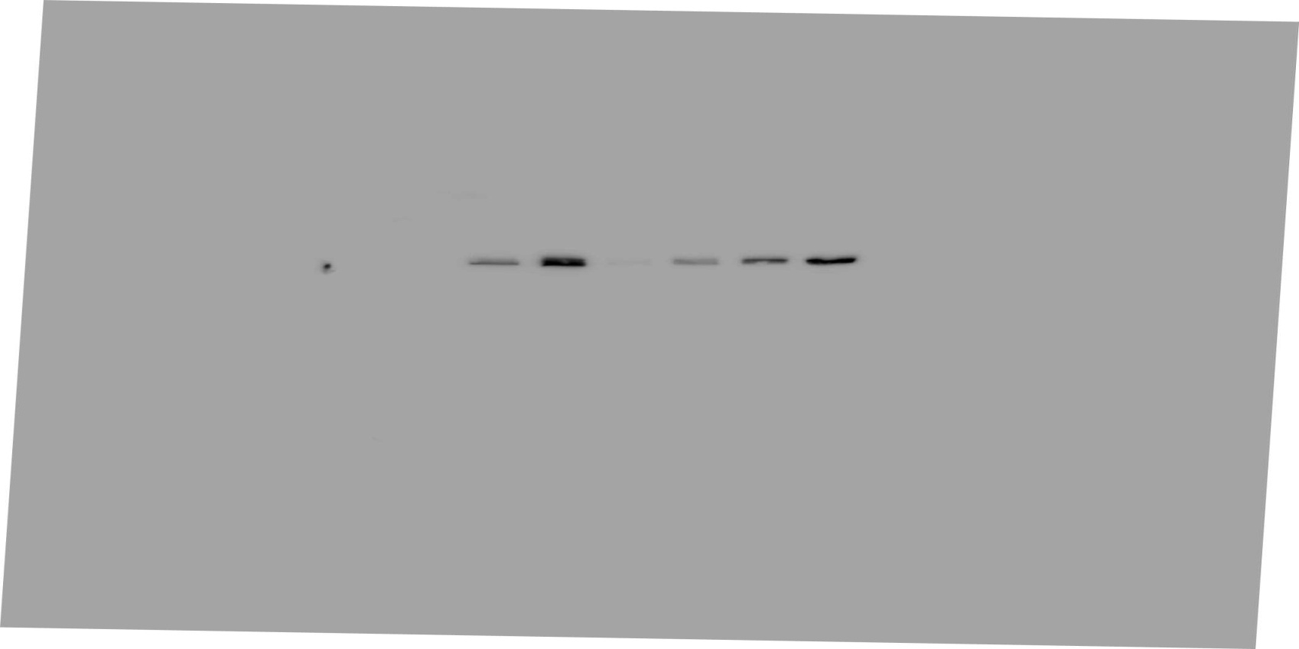

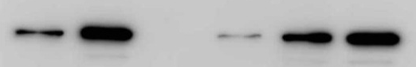

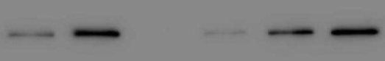
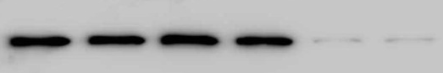


CXCL12-induced expression of sonic hedgehog (SHH) is mediated through CXCR4
NT-siRNA | + | + | - | - | - | -
CXCR4-siRNA | - | - | + | + | - | -
CXCR7-siRNA | - | - | - | - | + | +
CXCL12 | - | + | - | + | - | +
CXCR4
MiaPaCa
CXCR7
SHH
β-actin
CXCR4
Colo357
CXCR7
SHH
β-actin
Singh et al., J Biol Chem. 2012; 287:39115-24.

Slide 24
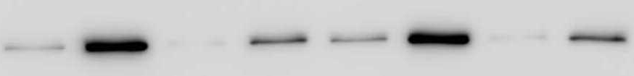
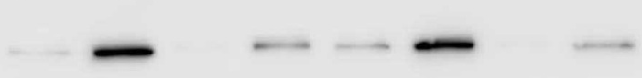
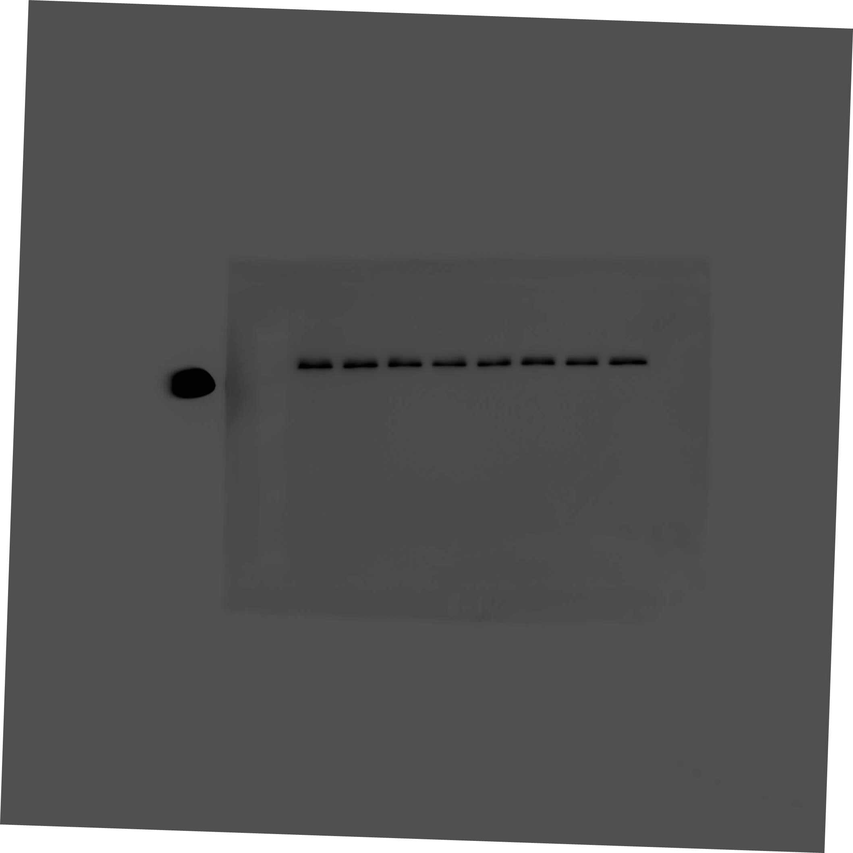
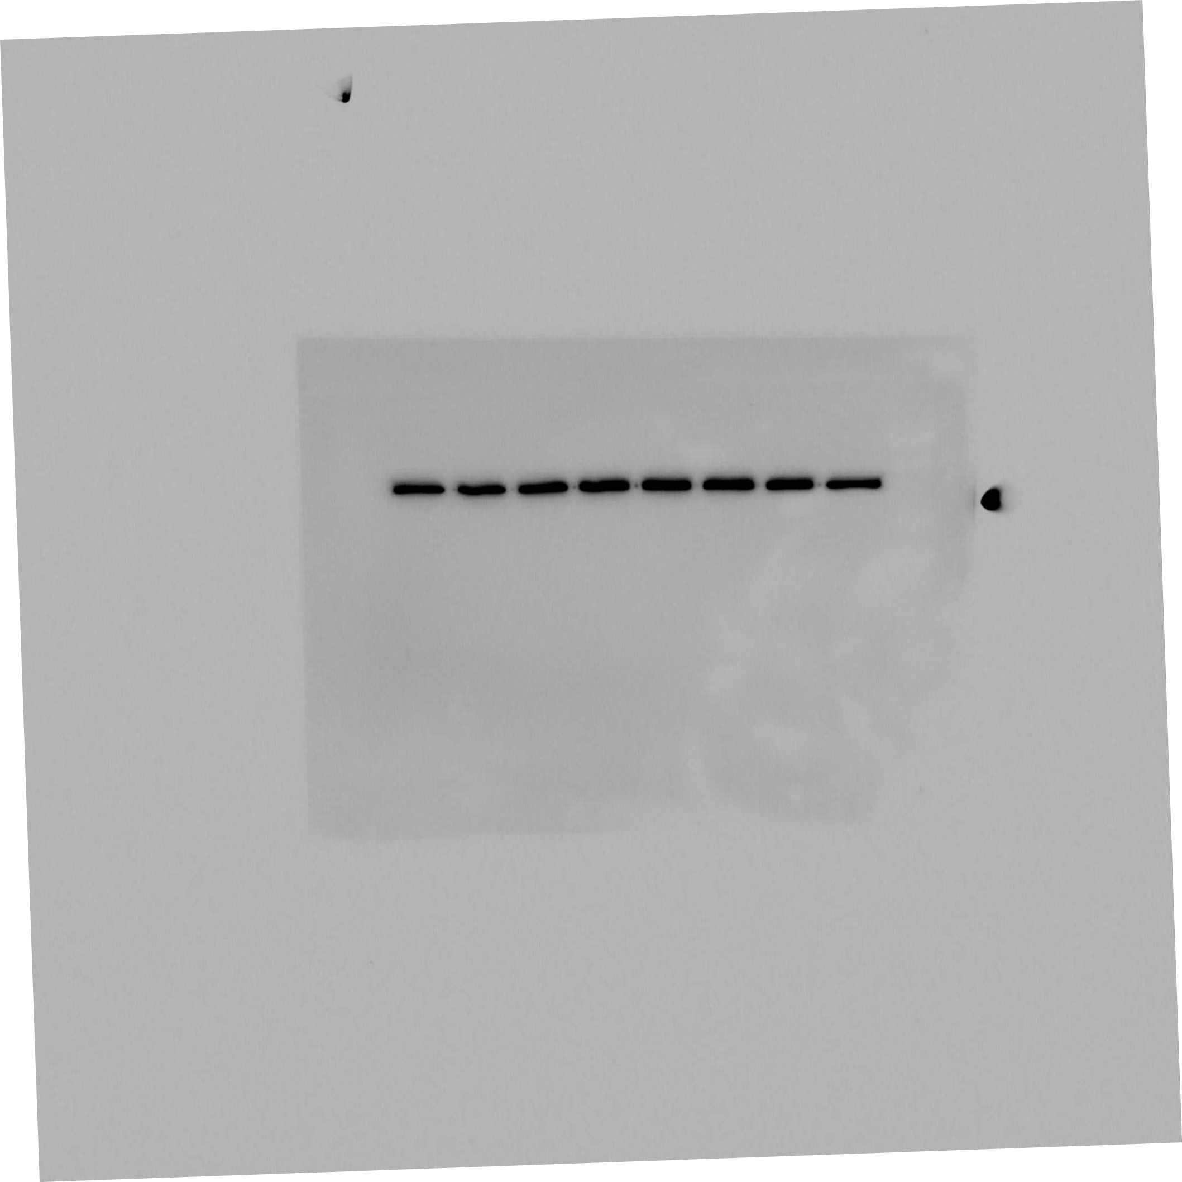
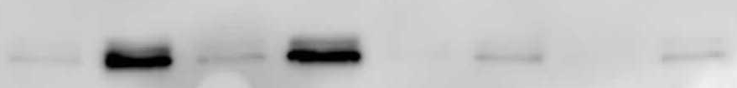
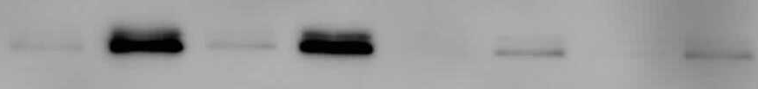
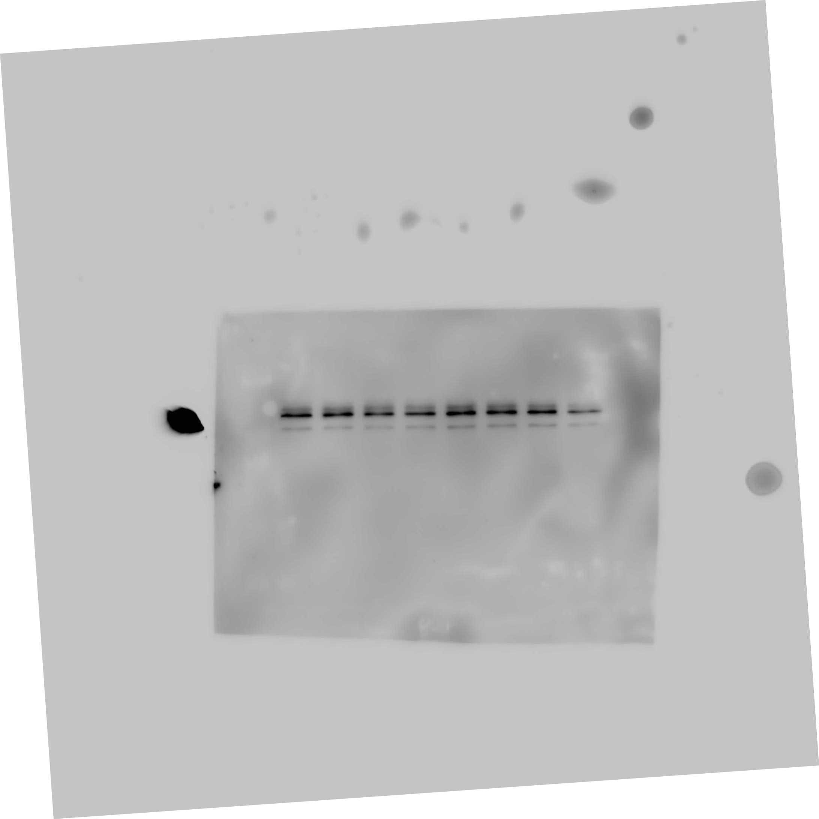
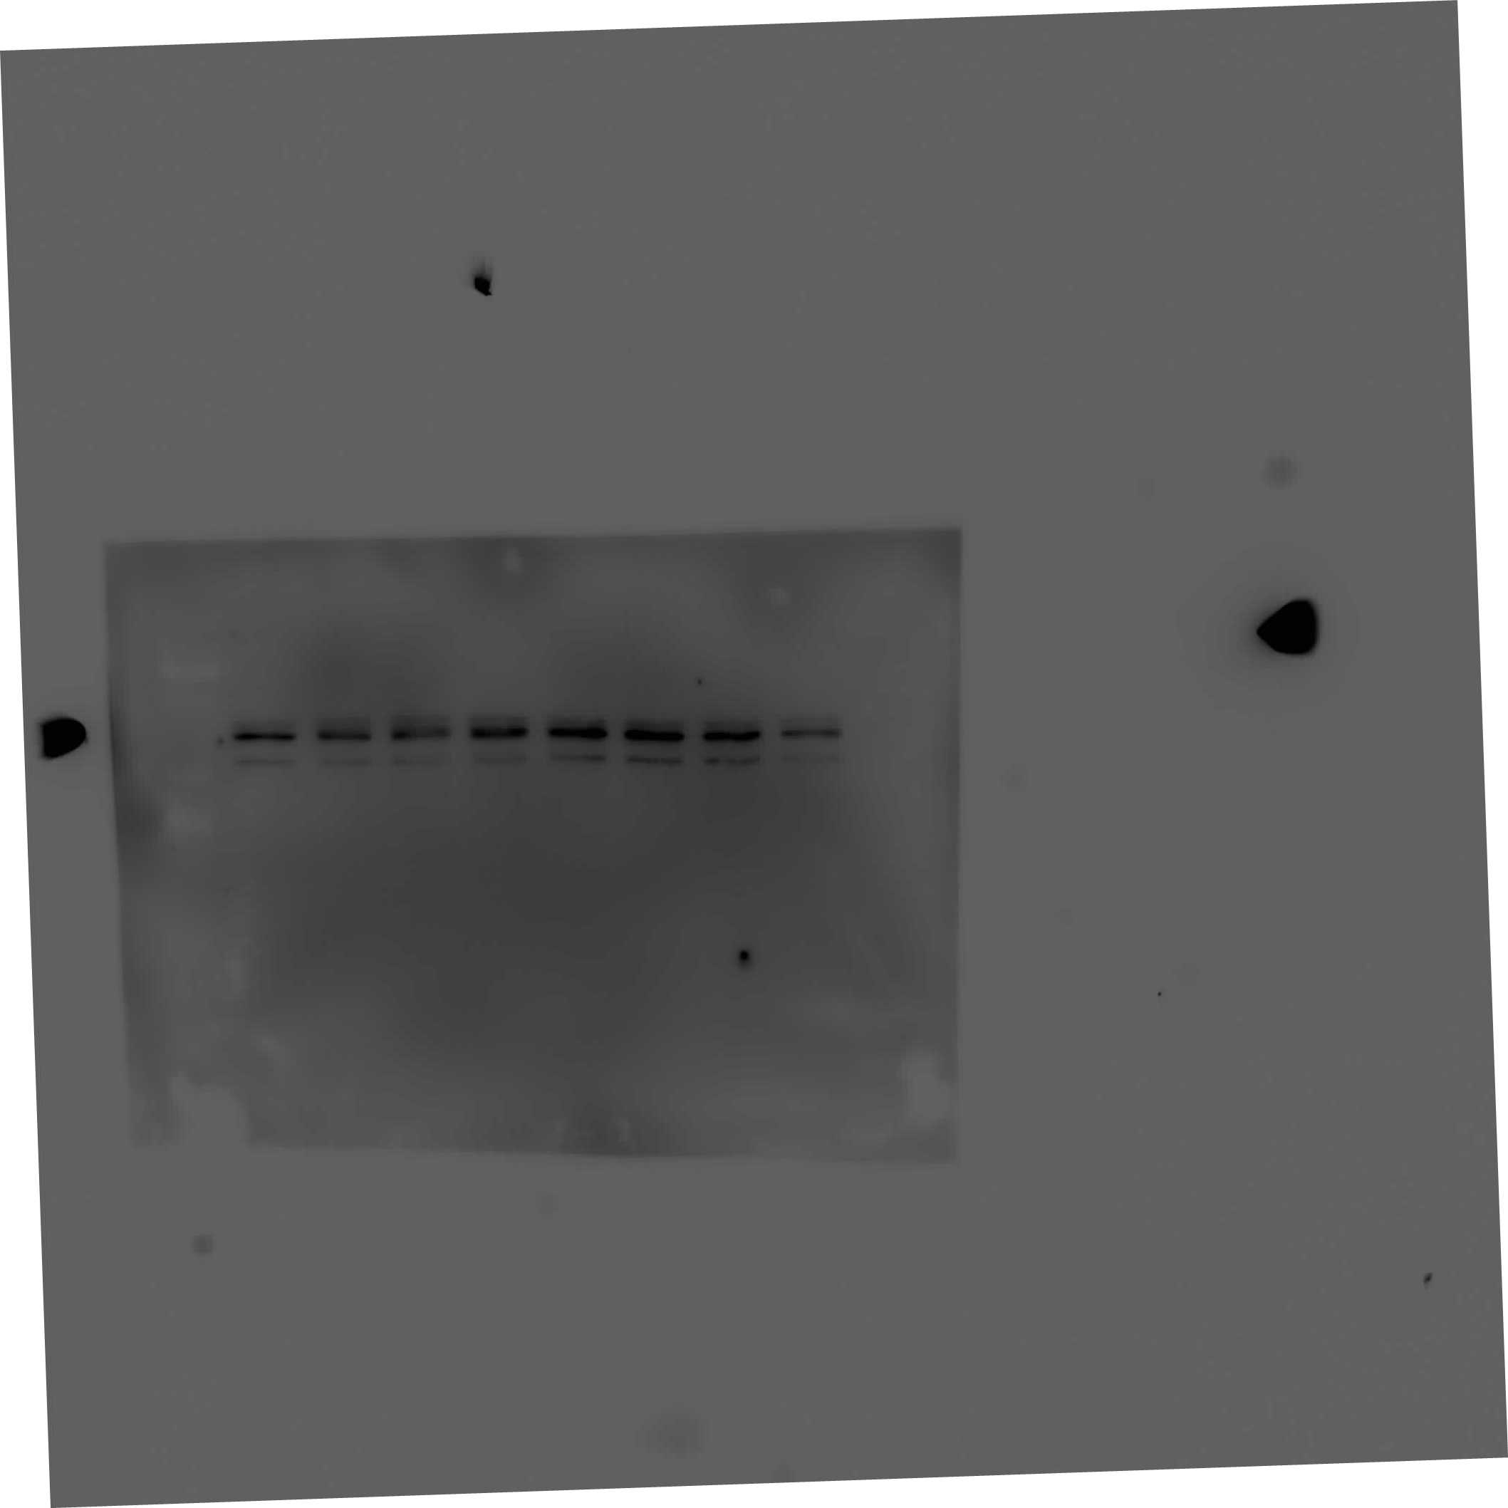
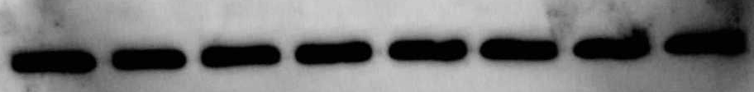
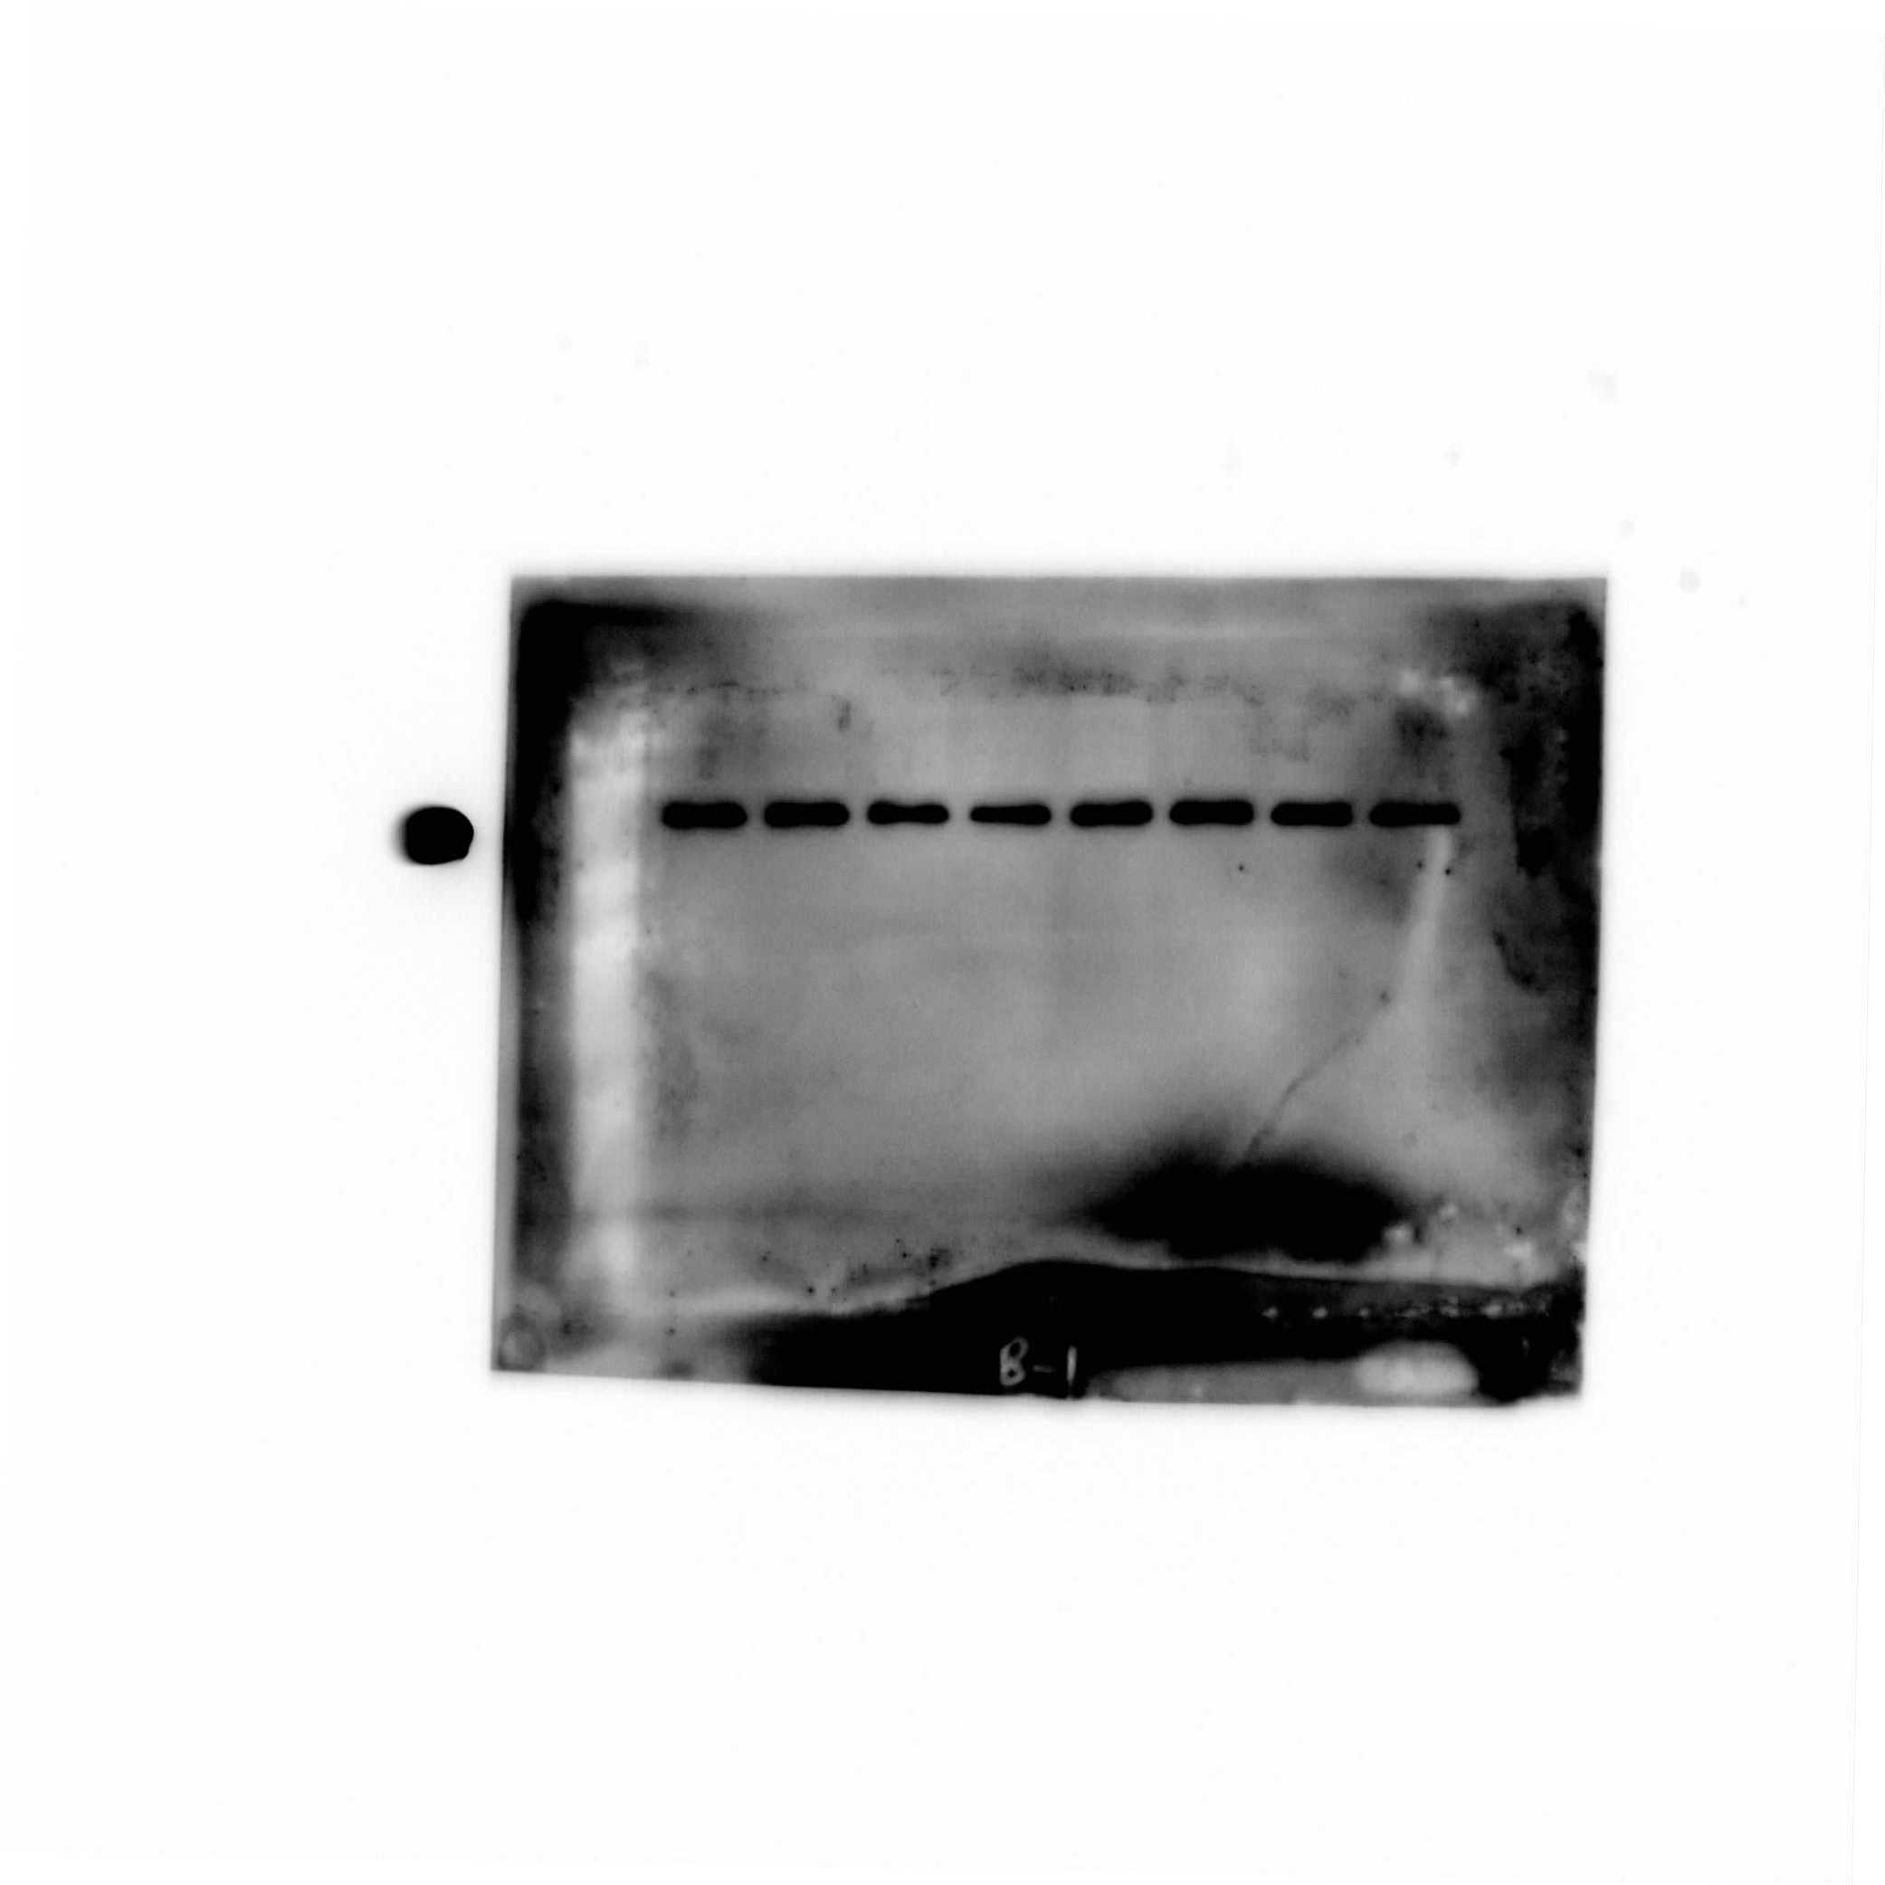
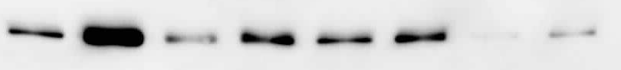



Inhibition of CXCL12-induced Akt and ERK activation abrogates SHH upregulation
MiaPaCa
Colo357
LY294002 | - | - | + | + | - | - | + | +
PD98059 | - | - | - | - | + | + | + | +
CXCL12 | - | + | - | + | - | + | - | +
LY294002 | - | - | + | + | - | - | + | +
PD98059 | - | - | - | - | + | + | + | +
CXCL12 | - | + | - | + | - | + | - | +
p-Akt
p-Akt
Akt
Akt
p-ERK
p-ERK
ERK
ERK
β-actin
β-actin
SHH
SHH
β-actin
β-actin
Singh et al., J Biol Chem. 2012; 287:39115-24.

Slide 25
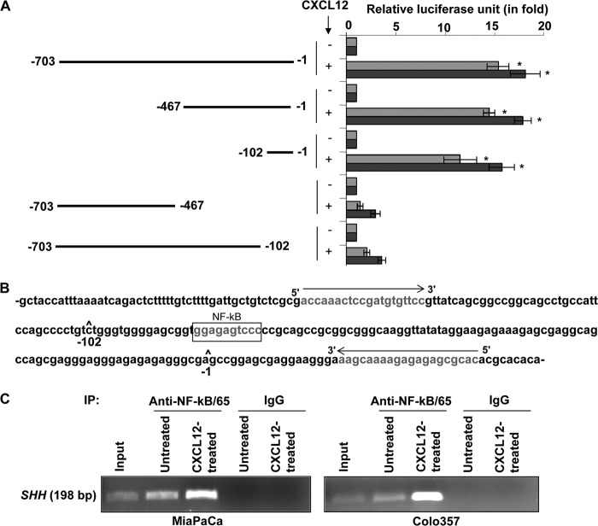
Direct binding of NF-κB to the SHH promoter is essential for CXCL12-induced SHH expression
Singh et al., J Biol Chem. 2012; 287:39115-24.

Slide 26

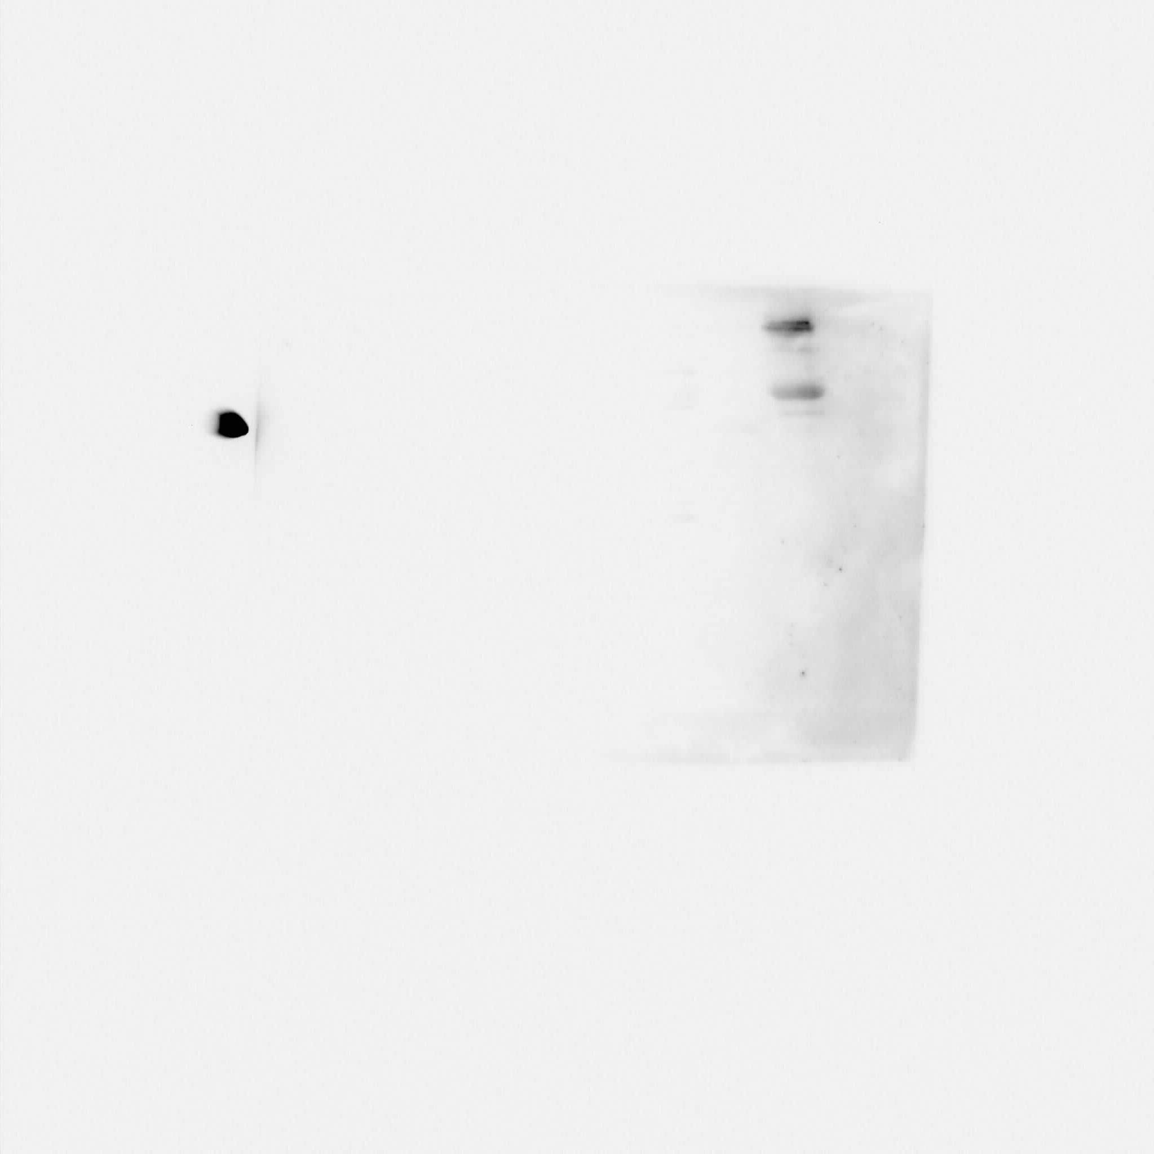
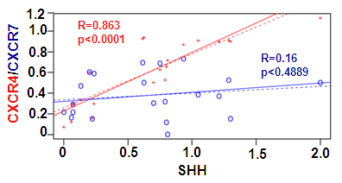










CXCR4 and SHH exhibit correlative expression in pancreatic cancer tissues
N1 N2 N3 N4 N5 N6 N7 +ve
CXCR4
SHH
CXCR7
β-actin
C1 C2 C3 C4 C5 C6 C7 C8 C9 C10 C11 +ve
CXCR4
SHH
CXCR7
β-actin
C12 C13 C14 C15 C16 C17 C18 C19 C20 C21 +ve
CXCR4
SHH
CXCR7
β-actin
Singh et. al., J. Biol. Chem. 2012.

Slide 27






CXCR4 and Hedgehog Signaling-mediated Bi-directional cross-talk
SHH
CXCL12
Ptch
CXCR4
SHH
SHH
CXCR4
SHH
SHH
Ptch
Gβ
Gβ
Gγ
Gα
Gγ
PI3K
Gα
Raf1
Akt
IKK
MEK
SHH
SHH
IkB
ERK
NF-κB
NF-κB
SHH
p
IkB
SHH
NF-κB

Slide 28
Summary- 1
CXCL12 protects pancreatic cancer cells from gemcitabine toxicity through potentiation of survival mechanisms.
CXCL12-induced chemoresistance is mediated through its receptor, CXCR4.
CXCL12, through activation of CXCR4, induces expression of sonic hedgehog in pancreatic cancer cells- and thus, initiating a bi-directional tumor-stromal cross-talk.
Singh et al., 2010, Br. J. Cancer
Singh et al., 2010, Br. J. Cancer
Singh et al., 2012, JBC

Slide 29
How does the chemotherapy impacts cells in tumor and stromal compartments???
PART- 2

Slide 30


Gemcitabine upregulates CXCR4 expression in pancreatic cancer cells counter-defense mechanism against gemcitabine toxicity
Gemcitabine induces CXCR4 expression in human pancreatic cancer cells
Arora et al., J Biol Chem. 2013;288:21197-207.

Slide 31

Gemcitabine-induced CXCR4 expression is ROS-dependent and mediated through NFκB and HIF1α
Arora et al., J Biol Chem. 2013;288:21197-207.

Slide 32

Gemcitabine promotes CXCL12-induced migration and invasion of PC cells
Escape
CXCR4
apoptosis
Gemcitabine
CXCR4 signaling acts as a counter-defense mechanism against gemcitabine toxicity
Arora et al., J Biol Chem. 2013;288:21197-207.

Slide 33


Effect of Gemcitabine on endothelial cells
Relative growth of HUVECs
0 5 10 20
Gemcitabine(µM)
Gemcitabine promotes endothelial cell growth
HUVEC= Human Umbilical Vein Endothelial Cells
Khan et al., 2015, Oncotarget

Slide 34

Gemcitabine induces expression of angiogenesis- associated cytokines/growth factors in PCCs
Khan et al., 2015, Oncotarget

Slide 35

PCCs treated with gemcitabine exhibit increased IL-8 expression and secretion
Khan et al., 2015, Oncotarget

Slide 36

Neutralization of IL-8 abolishes Gem-CM-induced HUVEC proliferation and CLS formation
Khan et al., 2015, Oncotarget

Slide 37

Depletion of IL-8 in Gem-CM decreases motility and invasiveness of endothelial cells
Khan et al., 2015, Oncotarget

Slide 38
Summary- 2
Gemcitabine upregulates CXCR4 expressing suggesting that CXCL12/CXCR4 signaling potentially acts as a counter-defense mechanism.
Gemcitabine also promotes vascularization by promoting the release of angiogenic signals from treated pancreatic cancer cells.
Arora et al., 2013, JBC
Khan et al., 2015, Oncotarget

Slide 39
What if we target Hedgehog and CXCR4 pathways in a combination treatment???
PART- 3

Slide 40
Establishment of pancreatic stellate (PSCs) and cancer cells (PCCs) co-culture
Trans-well chamber
(1µ pore-size)
PSCs
PCCs
PCCs
PCCs
six-well plate
Co-culture allowed to establish for 48 h (lag phase of growth)- media replaced with low serum (5% FBS)- containing media- incubation for 24 h- treatments for 48 h- growth measurement
Treatments- Gemcitabine (5µM), AMD3100 (5µM), GDC-0449 (5µM)
(alone and in combination)

Slide 41



Co-culturing of pancreatic cancer with pancreatic stellate cells develops chemoresistance in pancreatic cancer cells
200
MiaPaCa Colo-357 Panc1
200
200
150
150
150
Viable PCCs (%)
Viable PCCs (%)
100
100
100
Viable PCCs (%)
50
50
50
00
00
PSC/PCC
00
PSC/PCC
PCC/PCC
PSC/PCC
PCC/PCC
PCC/PCC
Notes:
Pancreatic cancer cells (5x10³) were grown in 96-well plates and treated with conditioned media (CM) from pancreatic stellate cells (PSC-CM) or pancreatic cancer cells (PCC-CM) in presence or absence of gemcitabine (5 µM) for 72 h and cell viability was examined by WST-1 assay.

Slide 42


Inhibition of CXCL12/CXCR4 and hedgehog pathways abrogates co-culture-induced chemoresistance in pancreatic cancer cells
MiaPaCa Colo357
A
200
200
150
150
Percent viable PCC
Percent viable PCC
100
100
50
50
00
00
GEM | - | + | - | + | - | + | - | +
AMD | - | - | + | + | - | - | + | +
GDC | - | - | - | - | + | + | + | +
GEM | - | + | - | + | - | + | - | +
AMD | - | - | + | + | - | - | + | +
GDC | - | - | - | - | + | + | + | +

Slide 43
Preclinical evaluation of novel combination therapy for pancreatic cancer
Day 0
Tumor measurement, Randomization into groups and treatment start
Treatment ended
Exp. Ended*
Tumor formation
Gemcitabine, AMD3100 and GDC0449 alone or in combination
Day -7
Orthotopic implantation of PCCs/PSCs
D7
D10
D14
D18
D21
Tumor measurement by in vivo imaging
Final imaging, tumor measurement, analysis of metastasis & drug accumulation
Groups
i) Vehicle (Veh.) A+B+C; ii) Gemcitabine (Gem.) + Veh. B+C; iii) AMD3100 (AMD.) + Veh. A+C; iv) GDC0449 (GDC.) + Veh. A+B; v) AMD. + GDC. + Veh. A; vi) Gem. + AMD. + Veh. C; vii) Gem. + GDC. + Veh. B; viii) Gem. + AMD. + GCD.
Dosage regimen
Veh. A (20 µL/g) or Gem. (100 mg/kg): IP; every 3rd day.
Veh. B (20 µL/g) or AMD. (10 mg/kg): SC; daily.
Veh. C (10 µL/g) or GDC. (100 mg/kg): oral gavage; 2x/day.
(AMD3100= CXCR4 antagonist; GDC0449=Hedgehog inhibitor)
Notes:
* At the end time point, mice of all the groups were administrated with gemcitabine 4 hours prior to sacrifice for uptake measurements. Amount of gemcitabine and its active metabolites (gemcitabine-tri-phosphate) in frozen tissue extracts examined using LC-MS-MS system with the help of Cyprotex US, LLC, Watertown, MA.

Slide 44


































Co-inhibition of CXCR4 and hedgehog pathway enhances chemotherapeutic response in orthotopic mice model
A
GEM | - | + | - | - | - | + | + | +
AMD | - | - | + | - | - | + | - | +
GDC | - | - | - | + | + | - | + | +
B
35
30
25
D21 D14 D7 D0
20
Photons / second (x10⁶)
15
10
05
0
D0 D7 D10 D14 D18 D21

Slide 45


Co-inhibition of CXCR4 and hedgehog pathway enhances chemotherapeutic response in orthotopic mice model
A
10.0
8.0
6.0
End point tumor size (mm²x1000)
4.0
2.0
0
GEM | - | + | - | - | + | + | + | +
AMD | - | - | + | - | - | + | - | +
GDC | - | - | - | + | + | - | + | +
B
2.5
2.0
End point tumor weight (g)
1.5
1.0
0.5
0
GEM | - | + | - | - | + | + | + | +
AMD | - | - | + | - | - | + | - | +
GDC | - | - | - | + | + | - | + | +

Slide 46









Metastatic incidence in mice treated with gemcitabine, CXCR4 antagonist and hedgehog inhibitor
A
10
08
06
Liver metastasis /mouse
Vehicle Gem AMD GDC
04
02
0
Vehicle
Gem+AMD+GDC
Gem.
GDC
AMD
Gem+GDC
Gem+AMD
AMD+GDC
AMD+GDC Gem+AMD Gem+GDC Gem+AMD+GDC
B
10
08
06
Normalized liver metastasis /mouse
04
02
0
Vehicle
Gem+AMD+GDC
Gem.
GDC
AMD
Gem+GDC
Gem+AMD
AMD+GDC

Slide 47
Metastatic incidence in mice treated with gemcitabine, CXCR4 antagonist and hedgehog inhibitor
10
08
06
Tumor volume normalized liver metastasis /mouse
04
02
0
Vehicle
Gem.
AMD
GDC
Gem+AMD+GDC
Gem+AMD
AMD+GDC
Gem+GDC
End point tumor
Notes:
Metastases were normalized by primary tumor mass to determine if treatment of gemcitabine, AMD or GDC alone or in combination has any effect on metastasis independent of its tumor suppressive activity.

Slide 48
Summary- 3
Co-culture of pancreatic stellate cells (PSCs) induces chemoresistance in pancreatic cancer cells.
Co-culture-induced chemoresistance is mediated through cooperative/compensatory actions of CXCL12/CXCR4 and hedgehog pathways.
Combined targeting of CXCL12/CXCR4 and hedgehog pathways produces superior therapeutic outcome in a preclinical model

Slide 49


= tumor cell
Extensive desmoplasia &
Poor vasculature
= stellate cell
Gemcitabine
= blood vessel
= CXCR4
= CXCL12
Scenario 1
(recognized)
Limited drug delivery to the tumor cells leading to poor drug response*
Scenario 2
(unrecognized)
Obstructed spread of the pancreatic tumor cells resulting in locally advanced disease
Reduced desmoplasia
&
Enhanced vasculature
Gemcitabine + Hh inhibitor
Scenario 1
(recognized)
Enhanced drug delivery to the tumor cells leading to disease stabilization/tumor regression*
Scenario 2
(unrecognized)
Selection of chemoresistant cells, upregulation of CXCR4** and tumor vasculature*,*** by gemcitabine and augmentation of tumor cell spread to CXCL12 overexpressing chemoprotective niches (chemoprotection by CXCL12/CXCR4-mediated survival pathways****)
* Olive et al., 2009, Science
** Arora et al., 2013, JBC
*** Khan et al., 2015
**** Singh el al. 2010, Br. J. Cancer
THERAPY FAILURE

Slide 50
Reduced desmoplasia
&
Enhanced vasculature
Gemcitabine + Hh inhibitor + CXCR4 antagonist
Scenario:
Enhanced drug delivery to the tumor cells and suppression of CXCL12/CXCR4-mediated survival pathways leading to sustained and effective disease stabilization/tumor regression
IMPROVED THERAPEUTIC OUTCOME

Slide 51
Conclusion
Tumor-stromal interaction plays important role in pancreatic cancer pathobiology and chemoresistance, and targeting of involved molecular pathways may open up novel therapeutic avenues for effective management of pancreatic cancer.

Slide 52
Future plans
Histopathological and immunohistochemical analyses of mouse xenografts subjected to combination therapy
Use of complementary tumor models: GEM &PDX
Validate the findings in clinical cases
Initiate a clinical trial

Slide 53

Acknowledgements
Lab members
Present
Arun Bhardwaj, Ph.D.
Sumit Arora, Ph.D.
Sanjeev Srivastava, Ph.D.
Haseeb Zubair, Ph.D.
Aslam Khan, Ph.D.
Girijesh Patel, Ph.D.
Shafquat Azim, Ph.D.
Courey Averett, B.S.
Mary Patton, B.S.
Past
Ajay Kumar, Ph.D.
Sudha Talwar, Ph.D.
Vijay Prajapati, Ph.D.
Gurpreet Kaur, Ph.D.
Stephen Hyde, B.S.
Collaborators
Seema Singh, Ph.D. (USA-MCI)
Lewis Pannell, Ph.D. (USA-MCI)
Elliot Carter, M.D. (USA-COM)
Bin Wang, Ph.D. (USA- Statistics)
William Grizzle, M.D. (UAB)
Pankaj Singh, Ph.D. (UNMC)
Madhavi Kadakia, Ph.D. (WSU)
USAMCI core facilities
Funding support ($$$)
NIH/NCI (1R03CA167137, 1R21CA137513, 1R01CA175772, 1U01CA185490)
DoD/US Army (PC110545, PC0739930)
USAMCI

Slide 54
Thank you!!!
and
Questions
" Advances are made by answering questions. Discoveries are made by questioning answers"
Bernard Haisch
Astrophysicist

Slide 55






Immunohistochemical analysis of CXCR4, CXCL12 and SHH in pancreatic tumor tissue sections from KPC mice
10x 40x
SHH CXCL12 CXCR4

Slide 56


