Slide 1

Alignment of atomic inner shell vacancies-a detailed study
Dr Ajay Sharma
Faculty In Physics
Chitkara University-India

Slide 2
Main Points:
Introduction
Methodologies
Theoretical
Experimental
Empirical
3. Results and discussions
4. Conclusion

Slide 3
The unequal population of vacancies in the magnetic sub-states of a state j is termed as alignment of atomic inner shell vacancies.
Introduction:
The fractional difference of ionization cross-sections for m_{j=}3/2 and 1/2 magnetic sub-states of L3 state is represented by alignment or anisotropy parameter A₂

Slide 4
Introduction Contd.
Flugge et al. [Phys. Rev. Lett. 29, 7 (1972)] were the first to study the alignment of atomic inner shell vacancies and exhibited significant anisotropy
Oh and Pratt [Phys. Rev.10, 1198 (1974)] studied alignment and fractional photo-ionization cross-sections corresponding to the ejection from L3 and M3 sub-shells for low Z elements.
Berezhko et al. [J. Phys. B. 11, 1749 (1978)] calculated the angular distribution following the photo-ionization and predicted the maximum and minimum limits of alignment parameter as 0.5 and 0.05.
Kleiman and Lohmann [J. Elect. Spectro. and Rel. Phen. 131, 29 (2003)] have studied the alignment parameter for a several atoms undergoing photo-ionization in inner shells near ionization thresholds using Herman-Skillman wave function.

Slide 5
Introduction Contd.
group I - Kahlon and co-workers [J. Phys. B. 32, 2343 (1999).
Phys. Rev. A 44, 4379 (1991). Phys. Rev. A 43, 1455 (1991).
J. Phys. B 23, 2733 (1990).Pramana 33, 505 (1989).],
group II - Papp and Campbell [J. Phys. B 25, 3765 (1992).],
group III - Ertugrul et al. [Appl. Spectros. Rev.30, 219 (1995).
Nuovo Cimento D17, 993 (1995),
        J.Phys.B 34, 2021 (2001).
XRSpect. 31, 75 (2002).
Rad. Phys. Chem. 67, 605 (2003).]
Group IV-Akkus etal. [Nucl. Inst. Meth. In Phys. Res. B 366 (2016)]
group V - Mehta et al. [Phys. Rev. A 59, 2723 (1999). J. Phys B 32, 3701 (1999). J. Phys. B 34, 613 (2001).],
group VI - Yamaoka et al. [Phys. Rev. A 65, 062713-1 (2002).
J Phys. B 36, 3889 (2003),
J Phys. B 39, 2747 (2006)],
group VII- Tartari et al. [J. Phys. B 36, 843 (2003). ]
group VIII -Barrea et al. [J. Phys. B. 38, 839 (2005).]
group IX -Santra et al. [Phys. Rev. A 75, 022901-1 (2007)].
anisotropic
isotropic

Slide 6
Theoretical formulation (NDA):
Present calculations have been made in a point Coulomb potential using non-relativistic dipole approximation for electron wave functions as the energy range, (near threshold to 60 keV) << mc², satisfies the non-relativistic constraint on photon energies,
A₂=
Where as the single particle radial integral
In the point Coulomb potential, the normalized bound state wave function of the photoelectron is given as

Slide 7
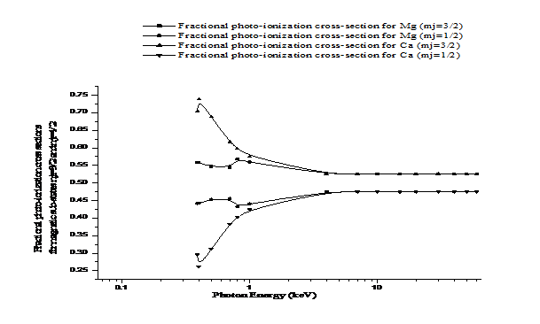
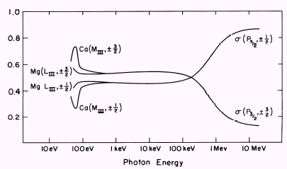
Theoretical formulation (NDA):
For a continuum state, the normalized wave function is
The choice of Coulomb potential in the present circumstances also draws support from Bechler and Pratt[J. Phys. B 32, 2889 (1999).
]

Slide 8
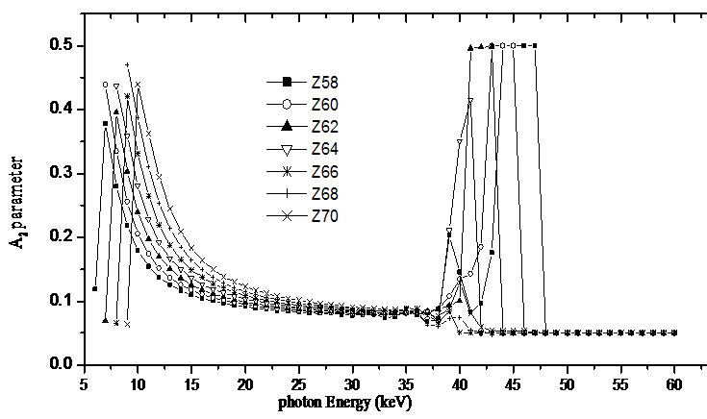
Theoretical formulation (NDA):
After checking the credibility of the present formulation it is further extended for 36 elements La to U, in the energy region near threshold to 60 keV. [Pramana 66, 1111 (2006)]

Slide 9
Theoretical formulation (NDA):
Alignment parameter A₂ is found maximum (~0.5) nearly 1 keV above L3 threshold energy for all the elements and decreasing with photon energy but increasing with Z. At outgoing electron energies ~ (threshold to 20 keV) for most of the elements, A₂ values (≥ 0.1).
In energy range ~ 35 to 60 keV, again some peak structures are found. It is a coincidence that most of the energy region containing the peak structure extends a few keV below and above the K-edge energy of the element.
The occurrence of peak structure in A₂ around K-edge energies seems to have some correspondence with the electron-filling pattern of outer shells of elements. In the region 58 ≤ Z ≤ 70, the filling of 4f shell takes place. Up to Z=63, the 4f shell is half-filled with 7 electrons and it corresponds to the observed peak value (0.5) of A₂ that shifts smoothly towards the lower photon energies up to Z=63. The afterwards decrease in peak value for Z>63 may be correlated with the pairing of 4f electrons.

Slide 10
Theoretical formulation (Screened Coulomb potential derived through Perturbation Theory):
The L shell electrons seems to move in a screened Coulomb field of other electrons in an atom that modifies the earlier considered potential energy.
In order to include the effect of screening, analytical perturbation theory, in a screened Coulomb potential has been applied to study the effect of perturbation and screening on sub-shell alignment.
According to perturbation analytic theory [Phys. Rev. A 14, 1428 (1976)], for non-relativistic radial wave function in a screened Coulomb potential- the potential inside an atom is given as
Here a = Zα and characterize the screening.
The values of V_{k} for elements Z=57 to 92 are obtained by interpolating the screened Coulomb potentials of McEnnan et al.[Phys. Rev. A 13, 532 (1976).]
To check the authenticity of the present method of calculation of A₂, the intermediate steps are compared with our earlier formulation [Pramana 66, 1111 (2006)] of point Coulomb calculations. A close agreement has been obtained among the values of intermediate steps prompted us to calculate alignment for some high Z elements.

Slide 11
Theoretical formulation (Perturbation Theory):
Screened alignment parameter A₂** has been calculated for elements 57≤Z≤92 at incident photon energy varying from L3 threshold to 60 keV. [European J. of chemistry, 1(4) (2010) 381]

Slide 12
Theoretical formulation (Perturbation Theory):
The results show that screening has no effect on the shape of plots of A₂ at lower end of energies and is having max. value.
For elements 58 ≤ Z ≤ 70 in the energy region 43 to 55 keV like the earlier results on A₂, again the peak structures in A₂ appear.
For elements 58≤Z≤ 64 the peak structure is distorted and the gap between two groups of peaks increases, one group shifts comparatively to lower energy and other shifts to higher energy side.
For elements 64 ≤ Z ≤ 70, the peak shifting is less but peak becomes more prominent as compared to the case of without screening.

Slide 13
Experimental Measurements:
The explanations regarding the influences of vacancy alignment in L3 state on subsequent decay processes led to two experimental methods for alignment determination;
Determination from production cross-section ratio for Lα and L groups of x-rays.
Determination from angular distribution measurements.
The measurements were performed in XRF laboratories of Raja Ramanna Center of Advanced Technology (RRCAT), Indore-(India) using a three-dimensional double reflection geometrical set-up in a plane perpendicular to the plane formed by the tube, primary exciter and experimental target to reduces the scattered background.

Slide 14
Experimental Measurements:
Peltier cooled detector
Cu-x-ray tube
90
120
Polarization angle θ
48 mm
60
30
0
Primary exciter
As and Mo
Collimator
50 mm
Experimental target W-74

Slide 15
Experimental Details:
a three-dimensional double reflection geometrical set-up.
In the set-up a Cu K x-ray tube with a 3mm window is used as the parent photon source.
A pellet of As2O3 and a metallic foil of Mo are used, in turn, as primary exciters.
bremstrahlung radiation from the parent source is to be used for excitation of primary exciters.
Thick circular target of Tungsten (99.9 % pure) having thickness 0.527 mg/cm2 was on a solid support inclined at angle of 45° and at a distance of 50 mm from the Primary exciter.
A Peltier cooled detector [10 mm2, Be window thickness 0.5 μm] with FWHM ~240 eV is in vertical configuration to detect the L x-rays emitted from the experimental target.
The detector in the direction of the electric vector corresponds to 0°angle. The angle scan is from 0° to 120° at an interval of 30°.

Slide 16
Typical L x-ray spectrum for various L x-ray peaks (, α, β and γ)
Experimental Measurements:

Slide 17
Solid angle correction:
Experimental Measurements:
Since, the data is obtained at different angles varying the position of the detector from 0°-120° and keeping W target fixed.
Therefore, the effective area of experimental target (W-74) seen by the detector at each angle varied as it was least for detector position at 0° and maximum at 90°.
That is why the number of counts was least at 0° and maximum at 90°.
The solid angle subtended by a surface on the detector is the ratio of the projection of surface ds to the square of the distance d between the two i.e. ω = ds cos θ₁ / d², where θ₁= (90°-θ)/2.

Slide 18
To the time normalized counts the solid angle corrections are applied by dividing the respective counts with Cos (θ₁) factor
Experimental Measurements:
Solid angle correction Cont.:
Projected surface of area
= ds Cos θ₁
d
θ=30°
Detector
θ
θ=0°
Surface
of area = ds
d
90°- θ
Normal to the surface ds
Normal to the projection
θ₁= (90°-θ)/2

Slide 19
Correction for the contribution to L x-rays due to bremsstrahlung radiation scattered from the primary exciters:
Experimental Measurements:
Bremsstrahlung radiations scattered from the exciter and reaching at the experimental target are recorded by placing the detector at the position of tungsten target.
It is found that a lot of Bremsstrahlung is reaching at the experimental target and its spread, in energy from 10.300 to 35.000 keV, contributes to the recorded W L x-rays at 10.676 keV and 17.781 keV energies.
Percentage of the contributed L x-rays to the total individual L x-rays results as;
8.35%, 8.55%, 7.28% and 7.67% for L, Lα, Lβ and Lγ respectively.

Slide 20
COSTER-KRONIG CORRECTION:
Experimental Measurements:
In Mo K x-ray excitations at energy above L3 threshold of W-74, the resulted L3 vacancies also included the vacancies transferred from L1 and L2 sub-shells due to C-K transitions.
The shifting of isotropic vacancies led to the contamination of L3 vacancies.
The correction at Mo K x-ray energy results as = 0.81

Slide 21
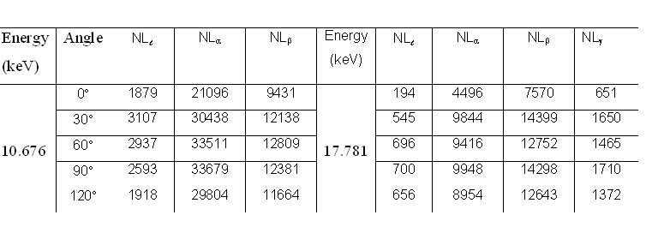
Experimental Measurements:
Table L x-ray counts under different peaks after corrections.

Slide 22
Normalized L x -ray intensities vs. the angle for W-74 at 10.676 keV
Comparative large variation of L x-rays in comparison to L_{α} may find support from the fact that the L group contains only one intense line (L3-M1), but the L_{α} group consists of L_{α1} (L3-M5) and L_{α2} (L3-M4) lines, which have opposite anisotropy. Moreover, L_{β} contains isotropic contributions originating from L₁ and L2 sub-shells.
[Nuclear Instruments and Methods in Physics Research A, 619 (2010) 55.]

Slide 23
Normalized L x -ray intensities vs. polarization angle for W-74 at 17.781 keV
The intensities increase with increase in angle from 0° to 90° and beyond 90° they show fall. Variations in L x-rays are found to be more in comparison to other L x-ray groups.

Slide 24
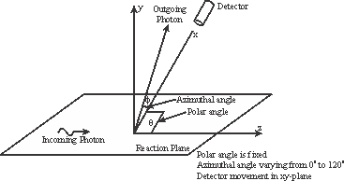
ANGULAR DISTRIBUTION OF L X-RAYS AND ALIGNMENT PARAMETER:
The general expression for the x-ray angular variation is [J. Phys. B. 38, 839 (2005)]
In the present case, the azimuth angle φ varies from 0° to 120° at polar angle θ =90°, therefore, the angular distribution expression becomes as

Slide 25
Alignment parameter A₂ values for different values of φ and keeping θ = 90° as fixed.
Energy (keV) | Azimuthal angle (φ) | A₂ (Experimental) | A₂ (Theoretical)
10.676 | 0° | 0.138(0.014) | 0.151
 | 30° | -0.775(-0.074)
 | 60° | -0.194(-0.019)
 | 90° | 0.153(0.015)
 | 120° | 0.700(0.070)
17.781 | 0° | 0.775(0.078) | 0.169
 | 30° | 0.965(0.097)
 | 60° | 0.250(0.025)
 | 90° | 0.213(0.021)
 | 120° | 0.276(0.028)
These values are nearly closer to our earlier calculated A₂ values listed in column 4 of for W-74 under non-relativistic dipole approximation.
The agreement at energy 10.676 keV between the weighted average and theoretical is with in 0.5 %.
The agreement between the present experimental and theoretical results leads to mutual support between the two.

Slide 26
Experimental and theoretical comparison of anisotropy measurements at 10.676 keV.
Asian J. Chem., Vol. 18, 3335-3339, 2006

Slide 27
Empirical Formulation:
Among the L x-rays from the ionized L sub-shells, both Lα and L groups of L x-rays originate from L3 (2p_{3/2}) state and the Lα group of x-rays is combination of Lα1 and Lα2 lines and their production cross-sections are proportional to relative intensities;
Thus, the ratio σLα /σL is a function of the degree of alignment A₂ as well as of the radiative transition probabilities.
At θ = 90°, for F3α2/ F3α1 = 1/9 for hydrogen like wave functions of 3d and 2p states above expression using the formulation developed in our lab [Rad. Phys. Chem. 51, 357 (1998)] becomes

Slide 28
Comparative values of alignment parameter (A₂) for W-74*
Energy (keV) | Azimuthal angle (φ) | Alignment parameter (A₂)
 |  | (Experimental) | *(Theoretical) | (Empirical)
10.676 | 0° | 0.138(0.014) | 0.151-NDA 0.498-APT | 0.240
 | 30° | -0.775(-0.074)
 | 60° | -0.194(-0.019)
 | 90° | 0.153(0.015)
 | 120° | 0.700(0.070)
Experimentally, excluding the departed A₂₀ values at φ=30° and 120° for 10.676 keV excitation and ignoring the negative sign, the weighted average of remaining values with 10% error comes 0.155 ±0.009.
Comparing the results from theoretical and empirical methods the trends of alignment values are similar though the values are not exactly same.
σ_{Lα}/σ_{L} ratios yield large uncertainties in A₂ parameter, which makes it inappropriate to compare the empirical results with those from theoretical calculations or from experimental angular distribution measurements.
*J. Nuclear Physics, Material Sciences, Radiation and Applications 1, 2013, 83–101.

Slide 29
Conclusion:
Comparison of A₂ for Yb at 59.5 keV with available recent experimental data

Slide 30
Conclusion:
Alignment parameter A₂ values for Yb in the energy range threshold to 60 keV using non-relativistic dipole approximation in a point coulomb potential are in agreement with the empirical values obtained from Mann et al’s intensity ratios and lead to the mutual support.
In Perturbation screened Coulomb potential the alignment parameter A₂ takes maximum value (~0.5) from L3 threshold energy to 60 keV and supports the concept of maximum anisotropy of Berezhko et al.
The experimental alignment/anisotropy values of Akkus et al [Nucl. Inst. Meth. In Phys. Res. B 366 (2016)] at 59.5 keV for Yb also support the concept of vacancy alignment/anisotropy, although their anisotropy values are certainly higher than our theoretical values.
Therefore, more accurate Quantum mechanical interpretations and precise instrumentations are required for measurements of alignment /anisotropy of atomic inner shells.

Slide 31
Thanks

