Slide 1
Thyroid hormone incorporated polycaprolactone nanofibrous material as a
potential wound healing therapeutic
Aishwarya Satish
Biological Materials Laboratory,
CSIR-Central Leather Research Institute,
Chennai, India.

Slide 2
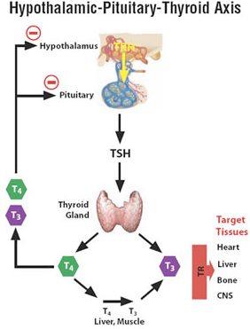
Thyroid hormone
Predominant prohormone is T4
It is converted to Triiodothyronine (T3) by deiodinase enzyme (type I)
Increase BMR, regulate bone growth and neural maturation amongst others

Slide 3
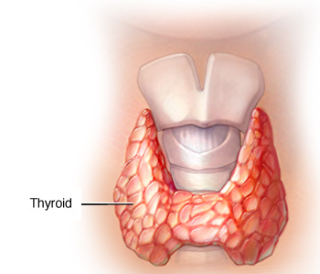
Skin manifestations of thyroid hormone
The typically observed manifestations
  Hypothyroid : Dry, decelerated wound healing and poor scar tissue formation
  Hyperthyroid condition : Skin thinning, collagen formation
Stimulates EGF expression
Promotes hair growth
proliferation of epidermal keratinocytes and dermal fibroblasts

Slide 4
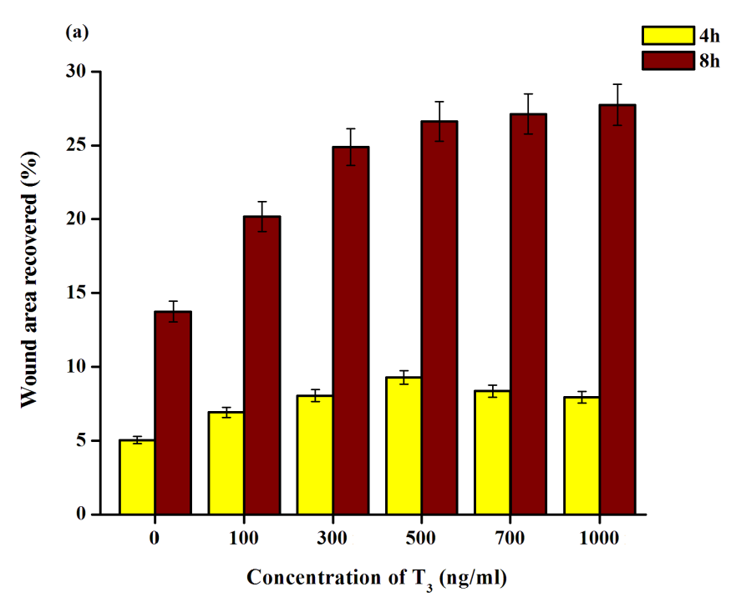
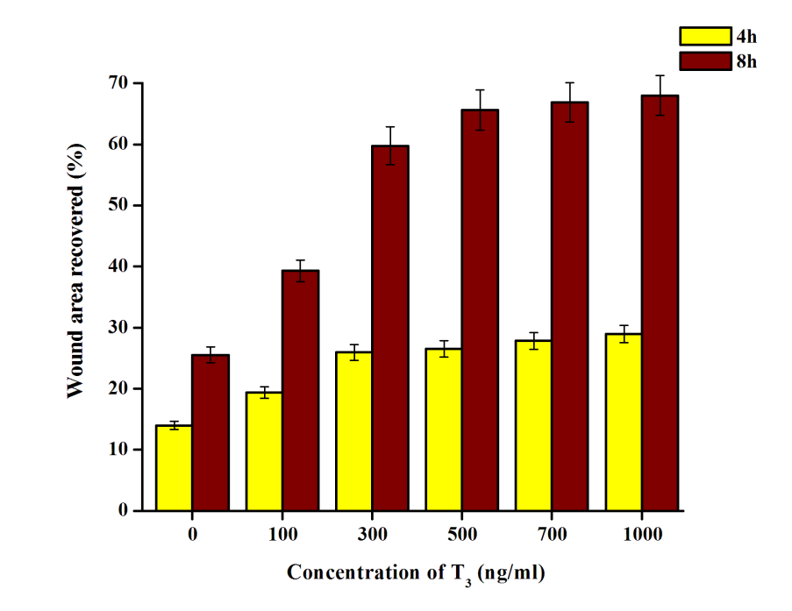
Effect of free T3 on skin cells migration
Keratinocytes
Fibroblasts
Effect of increasing T3 concentrations studied
Results shows high increase in migration rate at 300ng conc. of T3
(b)

Slide 5
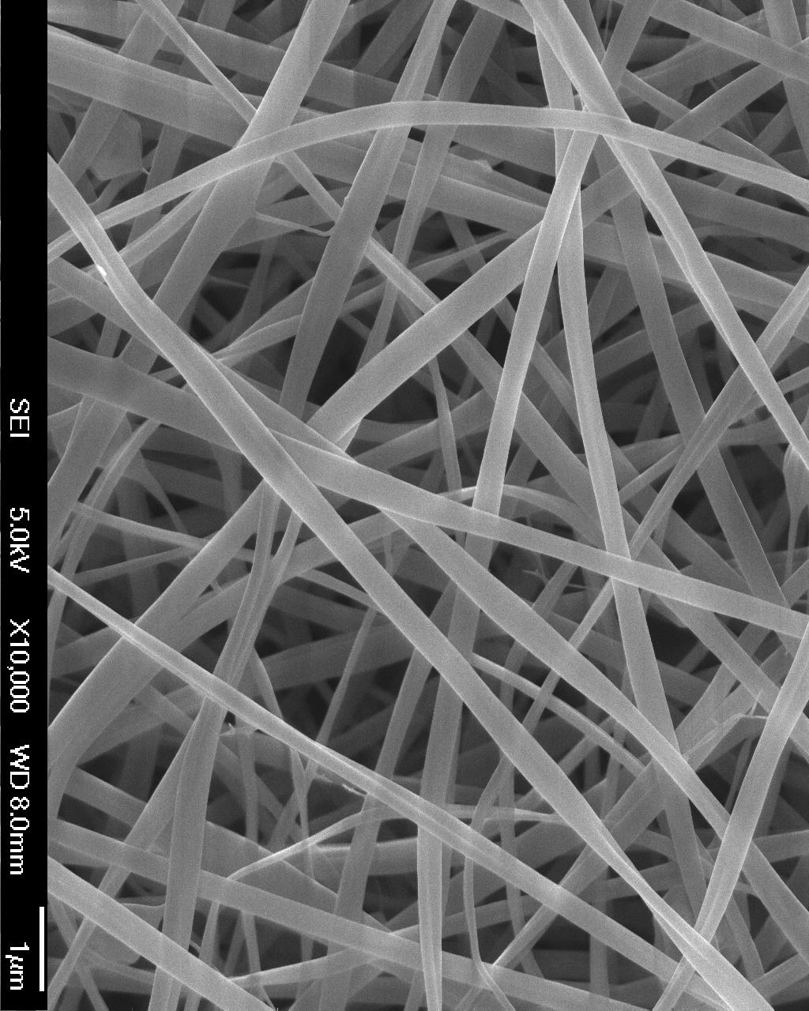
Delivery vehicle: Nanofibrous scaffold
High surface area
Good mechanical properties
Nanometer size range
Ease of biomolecule encapsulation without loss incurred in preparatory stage
Polymer used: PCL
PCL has a slow degradation rate ensuring sustained release of entrapped moiety

Slide 6
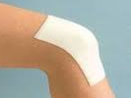
Mode of delivery : Topical
IP or IV induces thyrotoxicosis
Topical delivery of T3 stimulates targeted epidermal and dermal proliferation

Slide 7
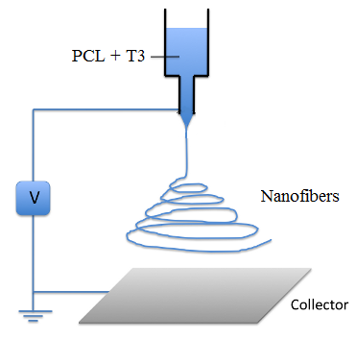
Nanofiber preparation
15% PCL
Varying T3 conc.
  0.25 mg/ml
  0.5 mg/ml
  1 mg/ml
Voltage : 15kV
Collector distance : 15cm

Slide 8
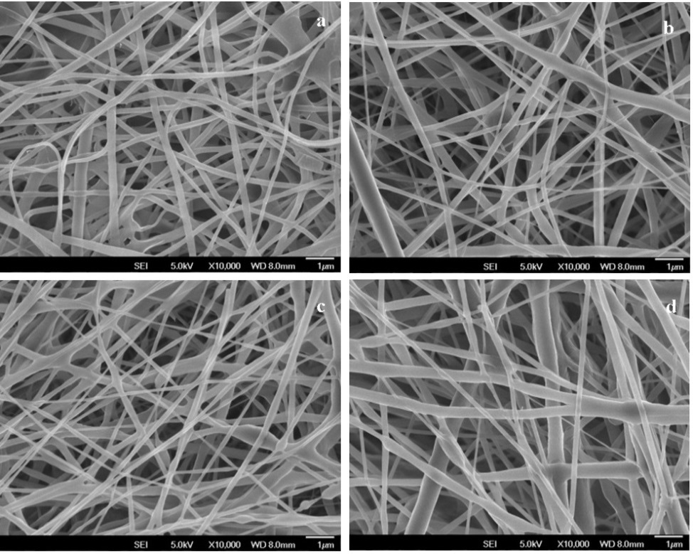
SEM analysis
a PCL Nanofiber
b P/T30.25
c P/T30.5
d P/T31
Morphology : Continuous, smooth, random nanofibers in nanometer size range

Slide 9
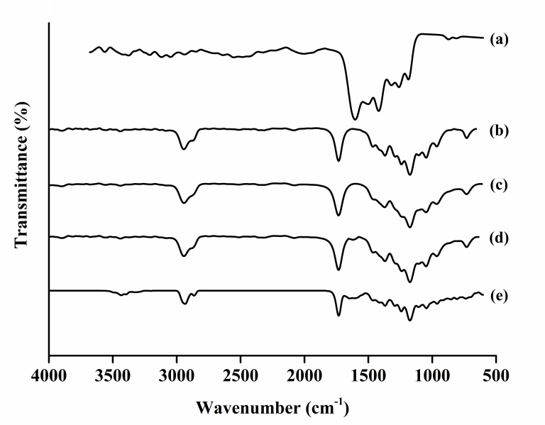
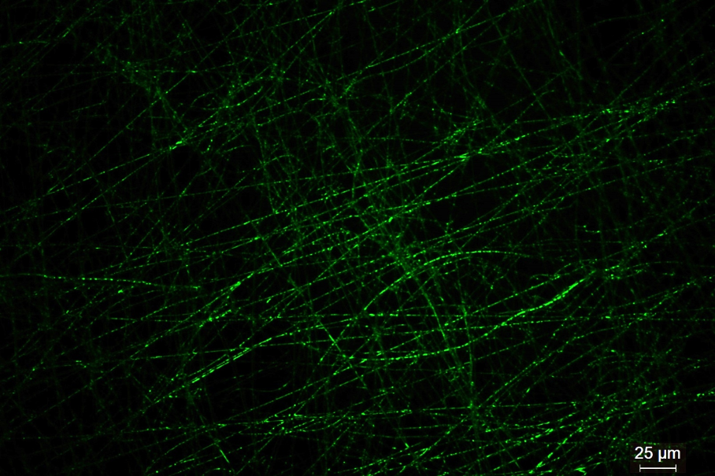
Characterization of nanofibers
FTIR
a T3 powder
b PCL Nanofiber
c P/T30.25
d P/T30.5
e P/T31
P/T31 composite nanofiber with T3-FITC
Confirms the uniform distribution of T3 and its encapsulation

Slide 10
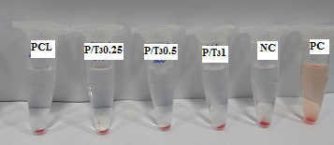
In vitro Hemocompatibility analysis
Samples | % Hemolysis
PCL NF | 3.23
P/T30.25 | 2.33
P/T30.5 | 1.75
P/T31 | 0.58

Slide 11
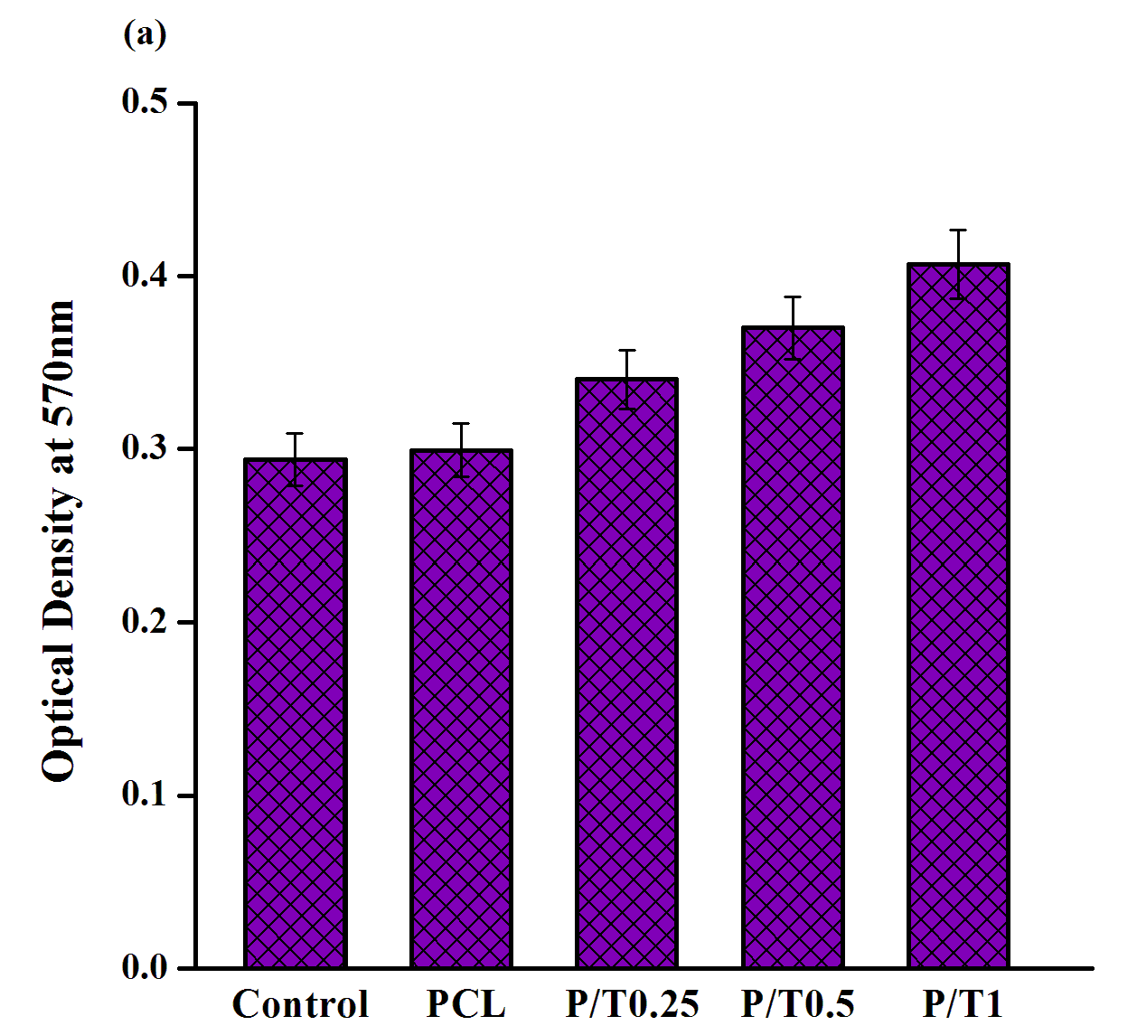
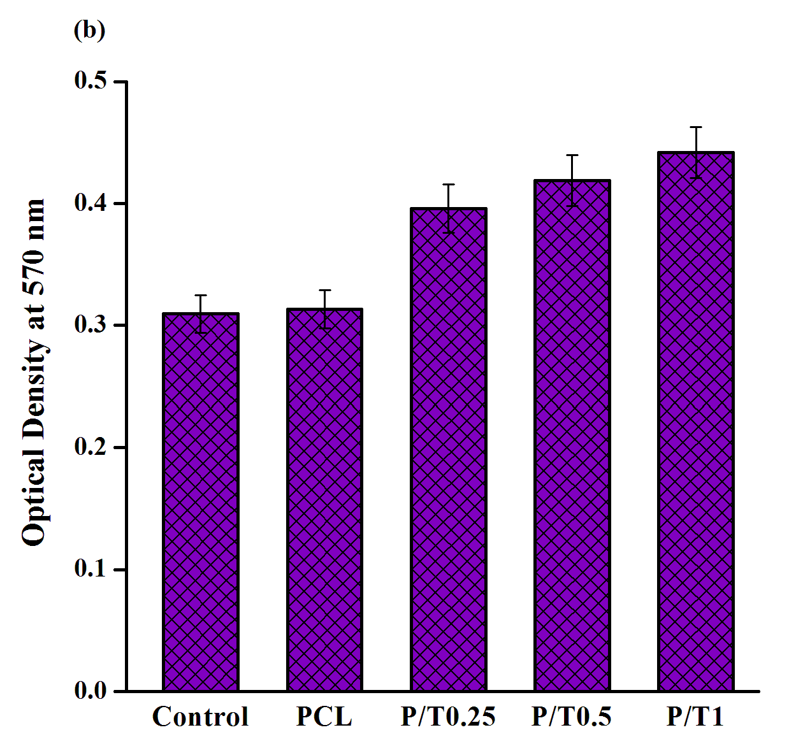
In vitro studies on cell lines
Cell compatibility (MTT)
Keratinocytes Fibroblasts
#
#
*
*
*
P value < 0.03
P value < 0.02
#

Slide 12
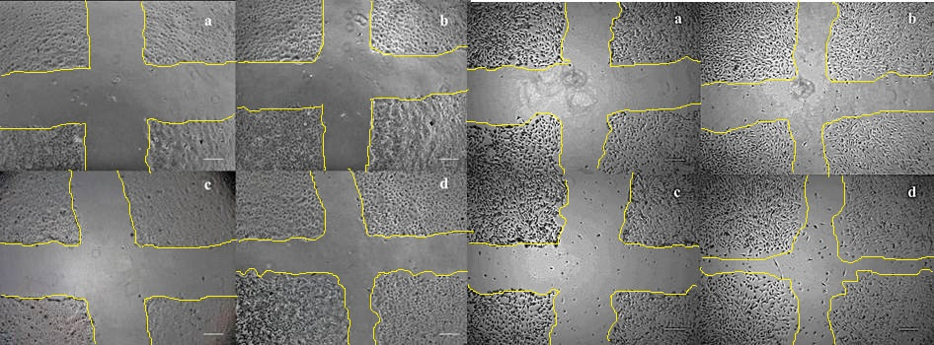
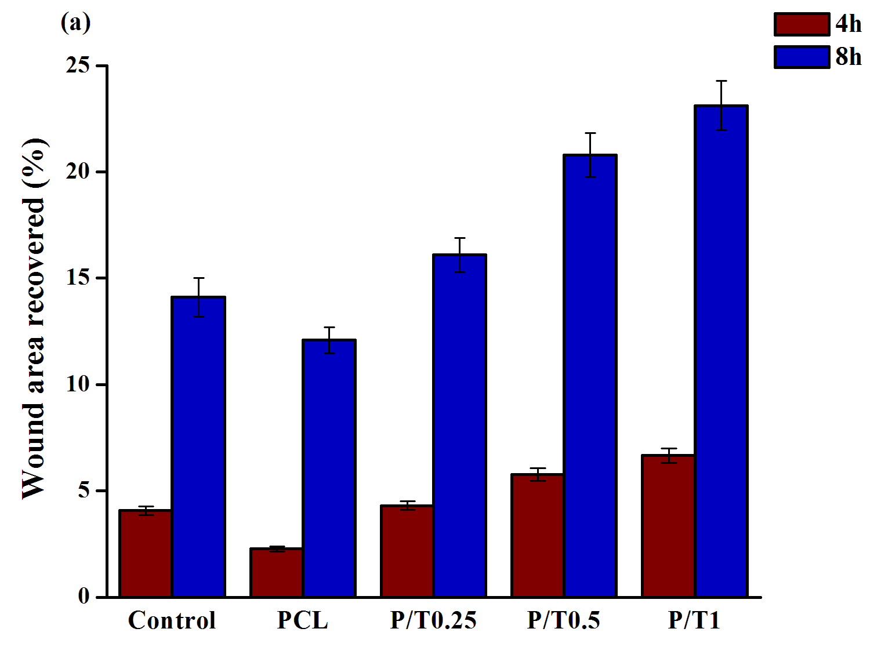
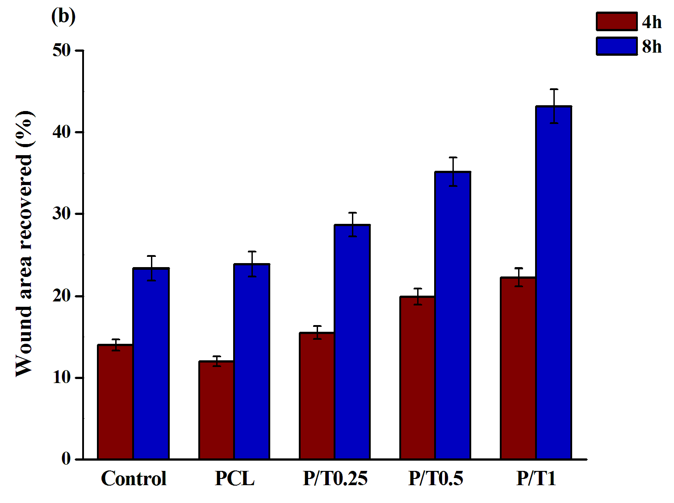
Cell migration
(Scratch wound assay)
Migratory pattern in (a & b) untreated and (c & d) T3-treated cells at (a& c) 0 h and (b & d) 8 h. Scale bar: 100 µm
*
*
Keratinocytes Fibroblasts
*
P value < 0.03
From cell cytotoxicity and migration studies, the P/T31 scaffold was selected for further studies

Slide 13
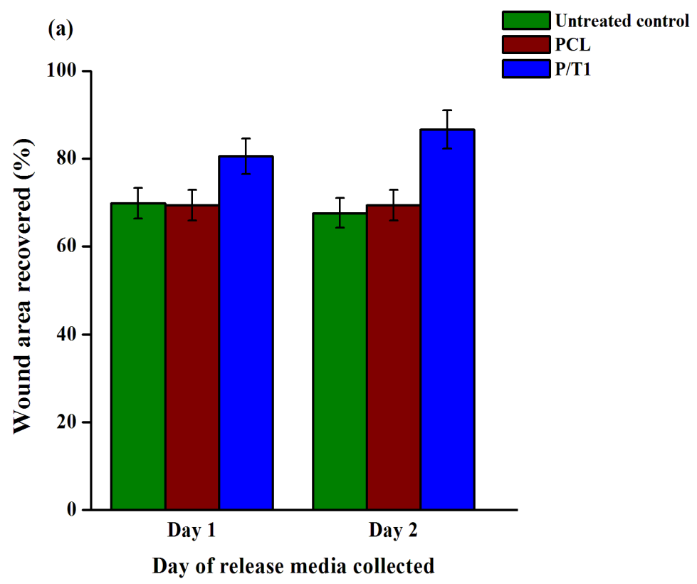
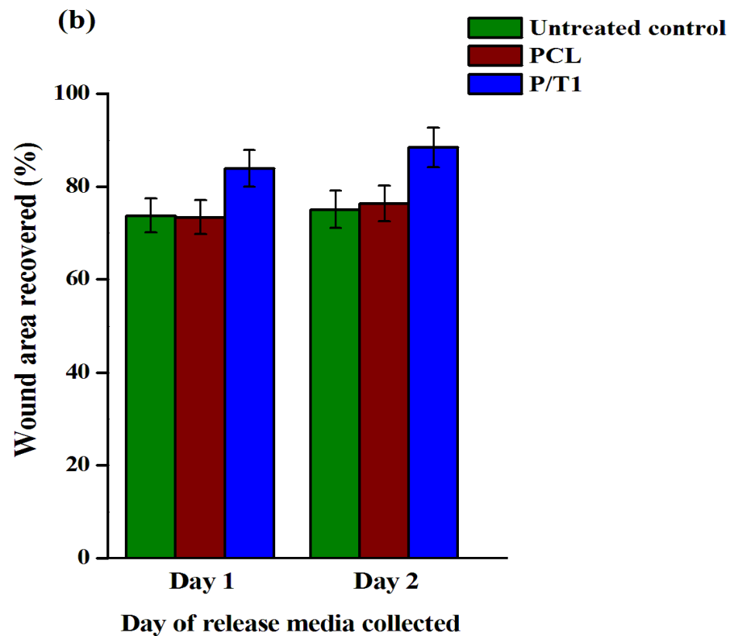
Migration: Mitomycin-C pre-treated cells
To ascertain that the enhancement of migration is proliferation independent
Results show that P/T31 scaffold has accelerated migration even when proliferation is inhibited
Keratinocytes Fibroblasts
#
#
#
P value ≤ 0.05

Slide 14
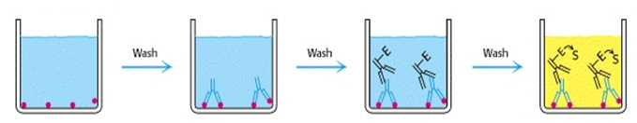
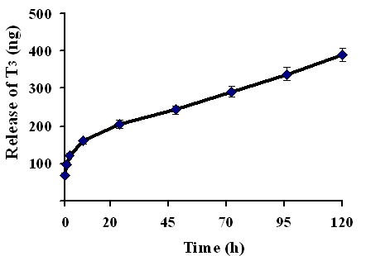
T3 release from P/T31 nanofibers
ELISA (indirect ELISA)
5 day release profile
Sustained release

Slide 15
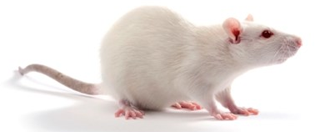
In vivo wound healing in rat model
Thus P/T31 taken for in vivo studies in rat model (full thickness excisional wound )
Groups
  Saline
  PCL
  P/T31
Control group
Treated group

Slide 16
Wound creation and experimentation
3 × 3 cm full thickness excision wounds created on dorsal midline area
Dressing placed and photographed periodically
Wound area measured by tracing the margin using graph sheet
Wound tissue sections collected for staining
Blood sample collected by retro – orbital bleeding at the start and day 16 of the experiment from all 3 groups

Slide 17
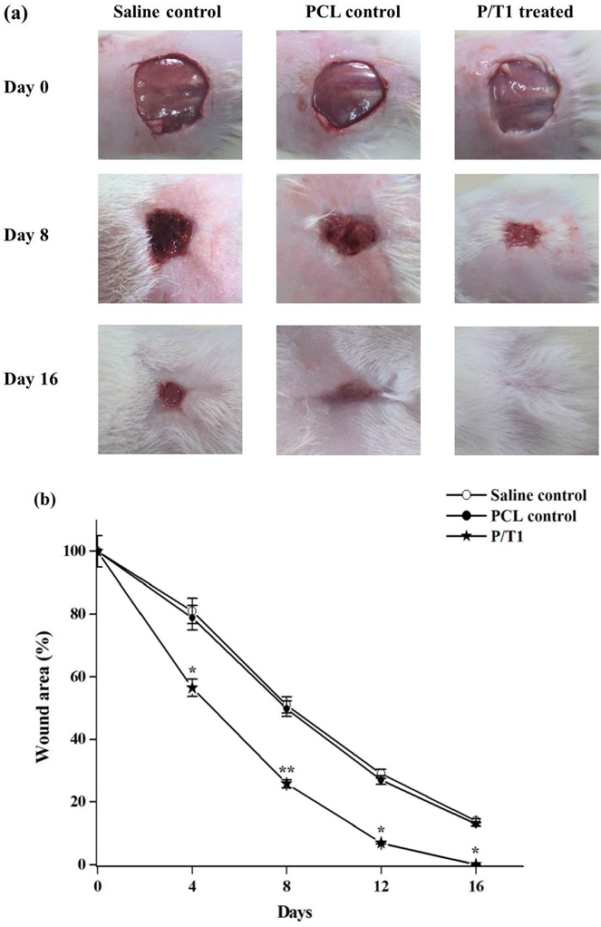
On day 16, P/T31 treated rats showed complete wound healing compared to control
Hair growth was also accelerated in T3 treated rats
*
P value < 0.02
P value < 0.02
**

Slide 18
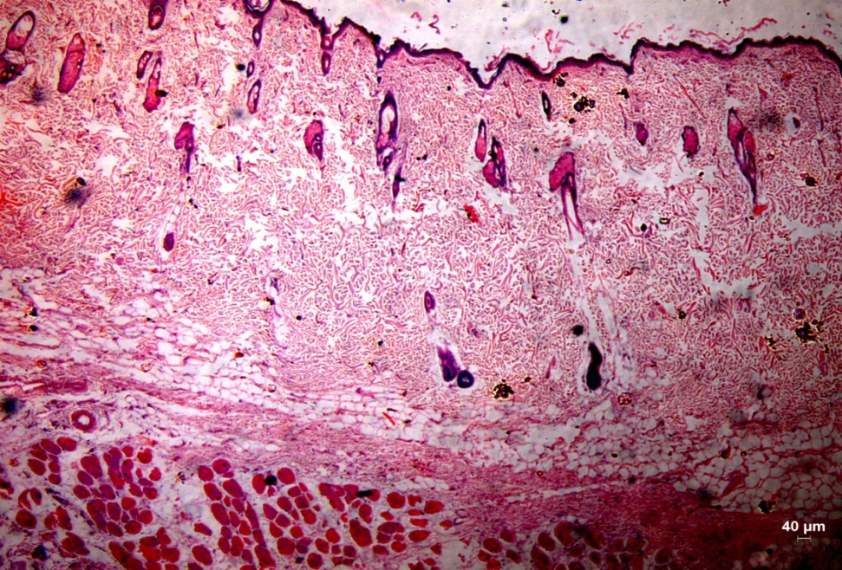
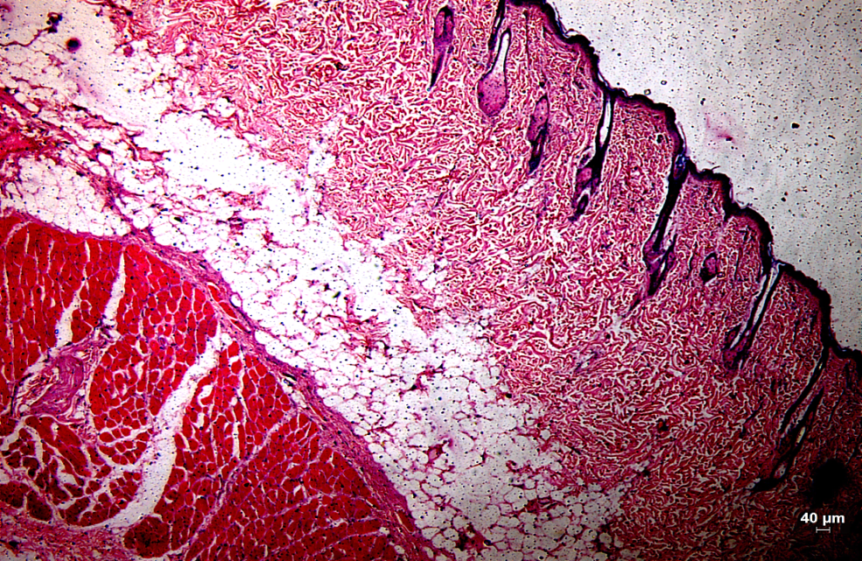
Hematoxylin & Eosin Staining
Tissue section of PCL control treated rat
Tissue section of P/T31 treated rat

Slide 19
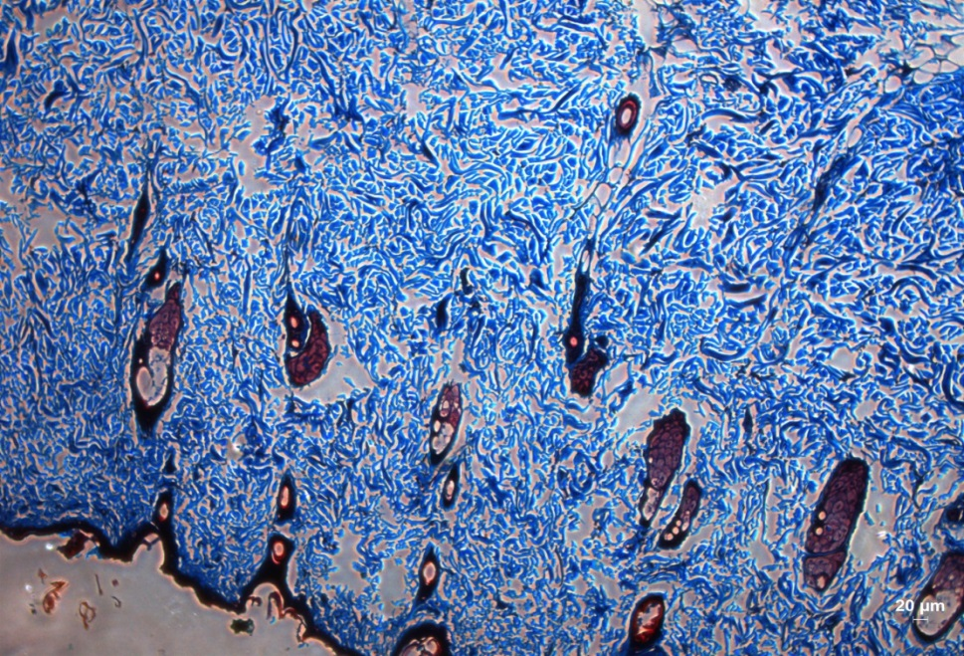
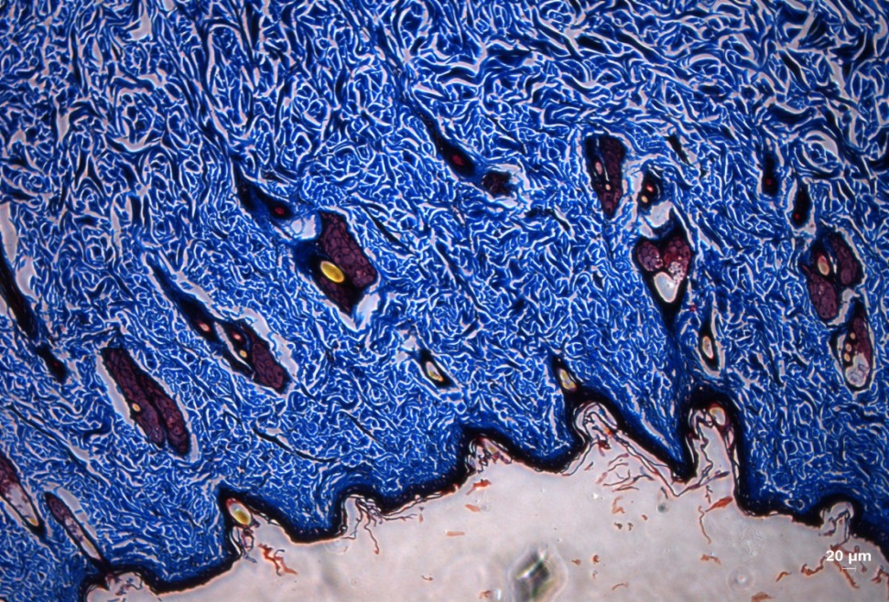
Masson’s Trichrome staining
Tissue section of PCL control treated rat
Tissue section of P/T31 treated rat

Slide 20
Rat serum T3 levels
Blood serum T3 levels
Serum T3 levels 200 ng/dL - 1,000 ng/dL reported to be tolerable
Time of blood collection | Saline | Rats treated with PCL Nanofibers | P/T31 Nanofibers
Prior to Day 0 | 98 ± 8 ng/dL | 109 ± 18 ng/dL | 111 ± 14 ng/dL
Day 16 | 110 ±17 ng/dL | 106 ± 12 ng/dL | 190 ± 24 ng/dL

Slide 21
Conclusion
Potential of T3 in accelerating rate of migration is revealed
Design of a delivery system enabling targeted sustained release, preventing thyrotoxicity
Effectiveness of T3 in wound healing was confirmed in rat model
Can also be extended to diabetic and chronic wounds

Slide 22
Thank you

