Slide 1
Ischaemia in Pancreatic Cancer
Case Study & Literature Review
Dr. Aisha Patel
BSc(Hons) MBBS

Slide 2
Case Study

Slide 3
Case
Female, Age: 50s
Admitted 2 days previously for epigastric pain
Right Leg Pain
  Acute onset of ‘cold and hard’ leg
  Constant pain
  10/10 in severity
  Mild relief with 10mg Oramorph

Slide 4
Case
Past Medical History:
  Recent Diagnosis of Pancreatic Cancer with Liver Mets
  PE & DVT
  Cholycystectomy 20 years ago
Drug History:
  Rivaroxaban 15mg BD – started recently for PE
  Omeprazole 20mg OD
  Zopiclone 3.75mg ON

Slide 5
Case - Examination
Patient rolling around in pain, unable to get comfortable
Lower limb examination
  Neurological
    Right sided Power 2/5 on flexion and extension at the hip
    Right sided Reflexes absent in knee, Plantar neutral
    Right sided loss of sensation below the knee – Sensory level L3
    Left Side Normal
  Vascular
    Right Leg cold and grey
    Right Dorsalis Pedis pulse weak, Left side strong

Slide 6
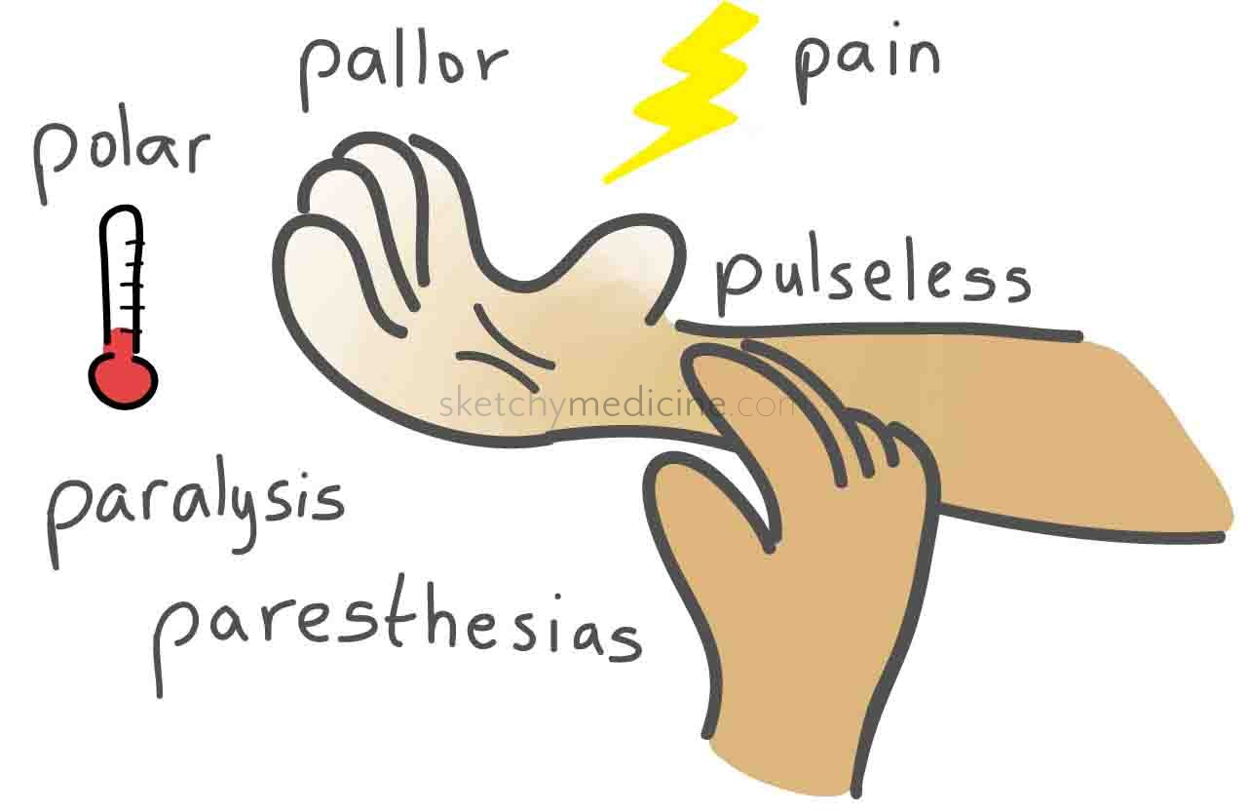
*Picture courtesy of sketchymedicine.com

Slide 7
Case – Differential
?Acute Ischaemia
??Cord compression secondary to spinal metastasis
Clot unlikely as anticoagulated on Rivaroxaban

Slide 8
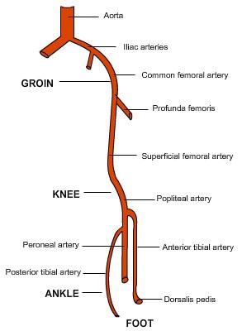
Case – Investigation
CT Angiogram of the Lower Limb – Thrombus or embolus occluding the distal right common femoral artery and origins of both the right profunda and right superficial femoral artery

Slide 9
Case - Diagnosis
Acutely Ischaemic Right Leg secondary to Pancreatic Cancer
Notes:
This was despite full anticoagulation
Unfortunately this patient was deemed unfit for an amputation due to no improvement on a heparin infusion and was therefore made palliative. She died a few days later from sepsis.

Slide 10
Thromboembolism in Pancreatic Cancer - Literature

Slide 11
Venous Thromboembolism (VTE) & Pancreatic Ca
Well recognized complication of cancer
Survival rates in cancer patients with VTE are one third of cancer patients without VTE ^{[1]}
Rates of VTE in Pancreatic Ca = 17-57% ^{[3]}
VTE in Pancreatic Ca, especially early, linked with worsened survival ^{[4,5]}

Slide 12
Mechanism of Prothrombosis in Pancreatic Cancer
Unknown
Microparticles with procoagulation function ^{[6]}
Microparticle – Tissue Factor (MPTF) ^{[7]}
Biomarkers – identification of high risk patients ^{[8]}
Notes:
Increased levels of circulating microparticles with procoagulation function found in people with pancreatic cancer and assoc with increased risk of VTE
More specifically – MPTF found to be assoc with increased risk of VTE and worsened survival

Slide 13
Arterial Thromboembolism & Pancreatic Ca - Literature
Prothrombotic nature of Pancreatic Ca
Very limited research
  One study included arterial thrombosis in assessing thromboembolism^{[9]}
No other case reports or literature regarding acute limb ischaemia
Notes:
One study including arterial thrombois in assessing thromboembolism in pancreatic cancer

Slide 14
Arterial Thromboembolism & Pancreatic Ca - Literature
Thapa et al. – arterial thrombosis could be a presentation of pancreatic hypercoagulability ^{[10]}
  Stroke or PE
  Should consider Pancreatic Cancer in initial presentation of venous and arterial thrombosis

Slide 15
Case Outcome

Slide 16
Case - Outcome
Heparin Infusion
Spreading Ischaemia
Not a candidate for amputation
Palliative
Passed away 2 days later of septicaemia

Slide 17
Learning Points

Slide 18
Learning Points
Case
Prothombotic nature of Pancreatic Ca
Both venous and arterial
Literature
VTE well documented
Limited for arterial thrombosis

Slide 19
Learning Points – Going Forward
Vigilance
Consider Pancreatic Ca in new arterial thrombosis
Awareness of the possibility of arterial thrombosis
Early recognition and diagnosis
Optimize survival

Slide 20
Questions?
References
Balambika, R.G. et al. "368Ovenous Thromboembolism In Cancer Patients – An Elephant In The Room". Ann Oncol 26.suppl 9 (2015): ix111.1-ix111.
Yang, Allison L. and Santhi Swaroop Vege. "Mo1367 Splanchnic Vein Thrombosis In Acute Pancreatitis: A Study In 967 Recent, Direct, Consecutive Admissions At A Tertiary-Care Institution". Gastroenterology 148.4 (2015): S-684.
Habib, Muzzamal et al. “Thromboembolism and anticoagulation in pancreatic cancer” Journal of the Pancreas 14 (2013): 135-137.
Ouaïssi, Mehdi et al. "Impact Of Venous Thromboembolism On The Natural History Of Pancreatic Adenocarcinoma". Hepatobiliary & Pancreatic Diseases International 14.4 (2015): 436-442.
Sánchez Lorenzo, M.L. et al. "1612 Early Venous Thromboembolism Is Associated With Worse Prognosis In Advanced Pancreatic Cancer". European Journal of Cancer 51 (2015): S242.
Campello E. et al “Prothrombotic and prognostic potential of circulating microparticles in pancreatic cancer: A prospective evaluation”. Thrombosis Research 134 (2014): S16.
Bharthuar, Anubha et al. "Circulating Microparticle Tissue Factor, Thromboembolism And Survival In Pancreaticobiliary Cancers". Thrombosis Research 132.2 (2013): 180-184. Web.
Van Es. N. et al “A new microparticle coagulant activity assay to predict venous thromboembolism in patients with pancreatic cancer”. Blood 124 (2014): 21.
Epstein, Andrew S. et al. "Analysis Of Incidence And Clinical Outcomes In Patients With Thromboembolic Events And Invasive Exocrine Pancreatic Cancer". Cancer 118.12 (2011): 3053-3061.
Thapa S. D. et al. “Venous and arterial hypercoagulability as presenting manifestations of pancreatic adenocarcinoma”. Journal of General Internal Medicine 29 (2014): S464.

