Slide 1


Evaluation of health related behaviours and attitudes of women during pregnancy in
Edirne, Turkey
BANU KARAÖZ, Assist. Prof., Izmir University,
School of Health, Izmir, Turkey
AHSEN ŞİRİN, Prof., Zirve University,
Faculty of Health Sciences, Gaziantep, Turkey

Slide 2



Slide 3

A healthy society is only possible if new generations are healthy and maintenance of healthy generations can be achieved by preservation of women’s health including physical, mental and social aspects (1).
Pregnancy, infancy and
childhood bring about certain additional risks (2).

Slide 4
Annually, number of mortality worldwide due to maternal, prenatal and contraceptive causes and complications is more than 500,000 (1, 2). In other words, at least 1,600 women die due to causes associated with birth and pregnancy everyday (1).

Slide 5
Improvement of educational level results in advancements of ages of marriage and birth and women tend to behave more consciously with respect to their health (2, 3).
Hence, primary healthcare for pregnant and women in puerperal period must be provided by well trained Health Care Professional (4).

Slide 6
Descriptive data including age, obstetric history and ethnicity must be taken into account in order to amplify the efficacy of prenatal education (5).
Diminution of amount of medications used during prenatal course was linked with administration of an effective prenatal training (4, 5).

Slide 7
Questionnaires are useful tools to assess healthcare applications, but they have been rarely used for healthcare status of pregnant women (6).
Since nurses are in close communication with pregnant under obstetric follow-up, they may determine the problems in personal and healthcare related issues.

Slide 8
AIm
The aim of the current study was to determine the health related attitudes, behaviour and practices of pregnant and to estimate proper nursing applications that may aid in improvement and promotion of women’s health during pregnancy.

Slide 9
METHODs
This cross-sectional study was performed after the approval of local Institutional Review Board (2014/600-669).
Participants were instructed about the procedures for application of questionnaires in detail and written informed consent was obtained.

Slide 10
This study included 244 pregnant hospitalized in the obstetrics and gynecology department of a tertiary care center between February and May 2014.
Age<18 years, illiteracy, multiple pregnancy, psychiatric disorder and any obstetric complication constituted the criteria for exclusion.

Slide 11
Demographic data and descriptive variables of pregnants were collected using “Personal Identity Questionnaire Form”.
Behaviours, knowledge and attitudes related with health practice during pregnancy were obtained by means of “Health Practice Questionnaire-II” (6).
Health Practice Questionnaire had been validated into Turkish versiyon language by Er and Şirin (7).

Slide 12
These questionnaires were administered based on a face-to-face interview. “Personal Identity Questionnaire Form” was composed of 22 questions that focused on socio-demographic and familial features of the pregnant and their husbands, region setlement, level of income, body-mass index, status of prenatal care, history of venereal disease and whether the husband helped during daily life.
“Health Practice Questionnaire-II” consisted of 34 items that assess the adequacy of health practices in six aspects.

Slide 13
Answers to items 1-17 include 5 “Likert scale” options ranging from “never” to “always”. Scoring was made as follows: (a) Never: 1 point, (b) Rarely: 2 points, (c) Sometimes: 3 points, (d) Often: 4 points, and (e) Always: 5 points.
Lowest and highest scores that can be achieved from questionnaire are 34 and 170, respectively (6).

Slide 14
A high overall score is interpreted in accordance with an improvement of health related behavior and attitude of the pregnant.

Slide 15
Statistical analysis:
Descriptive data was expressed as mean±standard deviation or median (minimum-maximum).
Level of significance was set at p<0.05. Reliability coefficient of HPQ-II was assessed with Cronbach’s alpha and was found to be 0.644. Means and minimum-maximum values for items and variances are 3.025 (1.041-4.525) and 1.433 (0.039-2.614), respectively.
A significant difference had been detected from measurements made from HPQ-II (p<0.001). Hotelling’s T2 test has indicated that there was statistically significant difference between average values obtained from scores of questionnaires (p<0.001).

Slide 16
FINDINGS
Total number of pregnant enrolled in this study was 244 and 5 age groups
No statistically significant difference could be detected between age groups in terms of Health Practice Questionnaire-II scores (p=0.849) (Table 1).

Slide 17
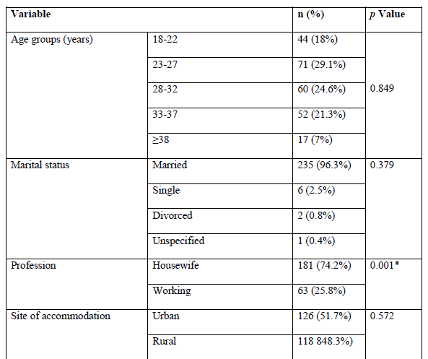
Table 1. Comparative overview of descriptive data groups with respect to their Health Practice Questionnaire-II scores.

Slide 18
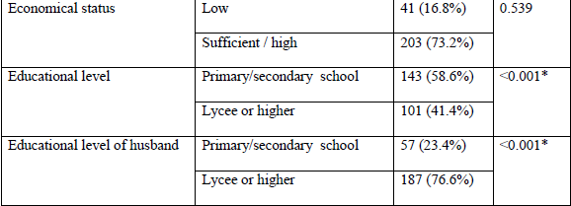
Table 1. Comparative overview of descriptive data groups with respect to their Health Practice Questionnaire-II scores

Slide 19
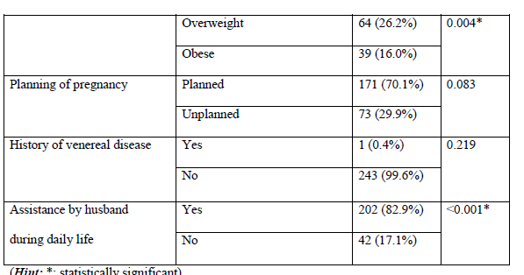
Table 1. Comparative overview of descriptive data groups with respect to their Health Practice Questionnaire-II scores.

Slide 20

A remarkable difference for HPQ-II scores was noted with respect to professions (p=0.001) and educational levels (p<0.001) and body-mass indices (p=0.004) of pregnant as well as educational levels of their husbands (p<0.001).

Slide 21
DISCUSSION
The present study provides crucial insights into the role and importance of communication, education and guidance of pregnant during perinatal care.
From this point of view, nurses constitute a corner stone in the establishment of appropriate communication between pregnant and healthcare personnel.

Slide 22
Achievement of diagnostic, preventive and therapeutic goals in addition to reduction of perinatal morbidity and mortality during pregnancy can be possible by integration of nurses as important elements of healthcare provision.

Slide 23
Not economical status, but body mass index and educational level were associated with higher scores of HPQ-II.
Therefore, appropriate counseling on weight gain and provision and spread of educational facilities may notably promote pregnancy health. In contrary, age or numbers of previous pregnancies displayed no significant impact on HPQ-II scores.

Slide 24
Education is reported to have the most powerful influence on the knowledge score of maternal health.
Educated women are more likely to aware their health status and seek health knowledge.

Slide 25
In the literature, it has been stated that advisory services provided by nurses in addition to physicians may be more beneficial for perinatal outcomes.
In parallel to our findings, higher level of education was associated with better health knowledge in previous reports.

Slide 26
CONCLUSIONS
To conclude, education, employment and support of spouse during daily life seem to improve HPQ-II scores substantially in pregnancy. Promotion of women’s knowledge, attitude and behaviors' on health can be accomplished via education and modification of behaviors'.

Slide 27
Therefore, a greater emphasis must be put on enrichment and effective use of resources, determination of policy definitely, popularization of education for pregnant together with their families.

Slide 28
REFERENCES
1. Perumal N, Cole DC, Ouédraogo HZ, Sindi K, Loechl C, Low J, Levin C, Kiria C, Kurji J, Oyunga M. Health and nutrition knowledge, attitudes and practices of pregnant women attending and not-attending ANC clinics in Western Kenya: a cross-sectional analysis. BMC Pregnancy Childbirth. 2013;13:146.
2. Zhao Q, Kulane A, Gao Y, Xu B. Knowledge and attitude on maternal health care among rural-to-urban migrant women in Shanghai, China. BMC Womens Health. 2009;9:5.
3. Mbada CE, Adebayo OE, Adeyemi AB, Arije OO, Dada OO, Akinwande OA, et al. Knowledge and attitude of Nigerian pregnant women towards antenatal exercise: a crosssectional survey. ISRN Obstet Gynecol. 2014;2014:260539.

Slide 29
4. Masuku SK, Lan SJ. Nutritional knowledge, attitude, and practices among pregnant and lactating women living with HIV in the Manzini region of Swaziland. J Health Popul Nutr. 2014;32:261-269.
5. Cormick G, Kim NA, Rodgers A, Gibbons L, Buekens PM, Belizán JM, Althabe F. Interest of pregnant women in the use of SMS (short message service) text messages for the improvement of perinatal and postnatal care. Reprod Health. 2012;9:9.
6. Lindgren K. Testing the health practices in Pregnancy Questionnaire-II. J Obstet Gynecol Neonatal Nurs. 2005;34:465-472.

Slide 30
7. Er S. Validation of Turkish version of Health Practice Questionnaire II in pregnancy [master’s thesis]. Ege University Institute of Health Sciences, Obstetric and Gynaecology Nursing Program, Izmir, Turkey, 2006.
8. Renkert S, Nutbeam D. Opportunities to improve maternal health literacy through antenatal education: an exploratory study. Health Promotion International. 2001;16:381-388.
9. Bamanikar S, Kee LK. Knowledge, attitude and practice of oral and dental healthcare in pregnant women. Oman Med J. 2013;28:288-291.
10. Anya SE, Hydara A, Jaiteh LE. Antenatal care in The Gambia: missed opportunity for information, education and communication. BMC Pregnancy Childbirth. 2008;8:9.

Slide 31
11. Chemir F, Alemseged F, Workneh D. Satisfaction with focused antenatal care service and associated factors among pregnant women attending focused antenatal care at health centers in Jimma town, Jimma zone, South West Ethiopia; a facility based cross-sectional study triangulated with qualitative study. BMC Res Notes. 2014;7:164.
12. Regassa N. Antenatal and postnatal care service utilization in southern Ethiopia: a population-based study. Afr Health Sci. 2011;11:390-397.

Slide 32

Thanks For Your Attention …

