Slide 1



Preparation and Characterization
of Dexketoprofen Tromethamol Loaded
Eudragit® RS 100 Nanoparticles
Ahmet Alper Öztürk , Evrim Yenilmez, Yasemin Yazan
Anadolu University, Faculty of Pharmacy, Department of Pharmaceutical
Technology, Eskişehir, TURKEY

Slide 2
Flow
Experimental
Methods
Results
NANOTECHNOLOGY, 10-13 AUGUST 2015, FRANKFURT

Slide 3


AIM
Dexketoprofen Tromethamol (DT) + Eudragit® RS 100 (ER)
Incorporation of DT into ER nanoparticles
Characterization studies
NANOTECHNOLOGY, 10-13 AUGUST 2015, FRANKFURT

Slide 4
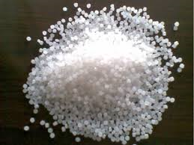
Eudragit® RS 100 (ER)
pH-sensitive
non-biodegradable
positively charged
non-toxic
NANOTECHNOLOGY, 10-13 AUGUST 2015, FRANKFURT

Slide 5
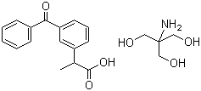
Dexketoprofen Tromethamol (DT)
• non-steroidal anti-inflammatory drug
• dextrorotatory enantiomer of ketoprofen formulated as tromethamine salt
• medicine used in treatment of mild to moderate pain
distribution half-life 0.35 hours
elimination half-life 1.65 hours
NANOTECHNOLOGY, 10-13 AUGUST 2015, FRANKFURT

Slide 6
Orally applied nanoparticles
• stable
• small size
• high surface area
• protect encapsulated drugs from GI environment
• modulate physicochemical characteristics, drug release and biological behavior
NANOTECHNOLOGY, 10-13 AUGUST 2015, FRANKFURT

Slide 7
EXPERIMENTAL
NANOTECHNOLOGY, 10-13 AUGUST 2015, FRANKFURT

Slide 8
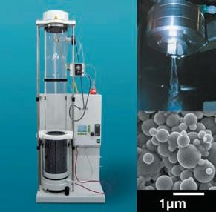

Preparation of ER-DT nanoparticles
Eudragit® RS 100 (ER) 1 g
Dexketoprofen Tromethamol (DT) 0.05 g / 0.1 g / 0.15 g
Methanol 100 mL
Buchi B-90 Nano Spray Dryer
Inlet 120°C
Outlet 54°C
NANOTECHNOLOGY, 10-13 AUGUST 2015, FRANKFURT

Slide 9
Morphology
Particle size
Zeta potential
DSC
XRD, FT-IR, H¹NMR
Characterization
NANOTECHNOLOGY, 10-13 AUGUST 2015, FRANKFURT

Slide 10
DETERMINATION of DT by HPLC
HPLC MODEL: Shimadzu 20-A
COLUMN: C₁₈ (250mm x 4.6 mm id, 5 μM)
MOBILE PHASE: Acetonitril:Methanol (25:75)
WAVELENGTH: 262 nm
INJECTION VOLUME: 20 µL
FLOW RATE: 0.9 mL/min
TEMPERATURE: 25 ̊C
NANOTECHNOLOGY, 10-13 AUGUST 2015, FRANKFURT

Slide 11
ResultS
NANOTECHNOLOGY, 10-13 AUGUST 2015, FRANKFURT

Slide 12

Composition of ER-DT Nanoparticles
Placebo
ER 1 g
DT -
Methanol 100 mL
E RS-1
ER 1 g
DT 0.05 g
Methanol 100 mL
E RS-2
ER 1 g
DT 0.1 g
Methanol 100 mL
E RS-3
ER 1 g
DT 0.15 g
Methanol 100 mL
NANOTECHNOLOGY, 10-13 AUGUST 2015, FRANKFURT

Slide 13

Morphology
E RS-1
E RS-2
E RS-3
DT
Placebo
NANOTECHNOLOGY, 10-13 AUGUST 2015, FRANKFURT

Slide 14
Particle Size, Zeta Potential (n=3, mean±SD)
 | ERS placebo | ERS 1 | ERS 2 | ERS 3
Particle Size | 390.767±18.41 | 538.633±45.784 | 520.733±44.519 | 690.667±60.594
Zeta Potential | -19.33±0.153 | -20.267±0.513 | -21.6±0.3 | -24.3± 0.265
NANOTECHNOLOGY, 10-13 AUGUST 2015, FRANKFURT

Slide 15
Particle Size, Zeta Potential (n=3, mean±SD)
NANOTECHNOLOGY, 10-13 AUGUST 2015, FRANKFURT

Slide 16
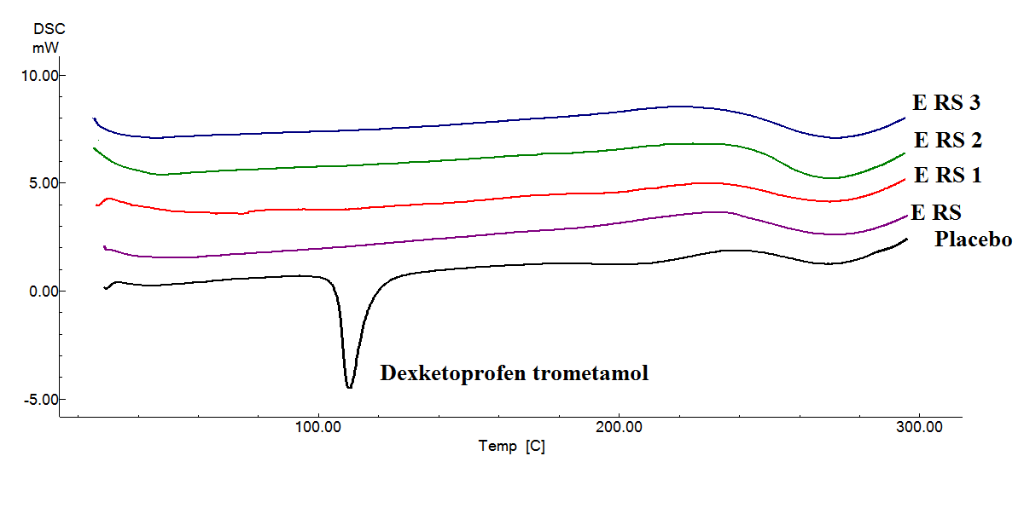
DSC ( Differantial Scanning Calorimeter)
NANOTECHNOLOGY, 10-13 AUGUST 2015, FRANKFURT

Slide 17
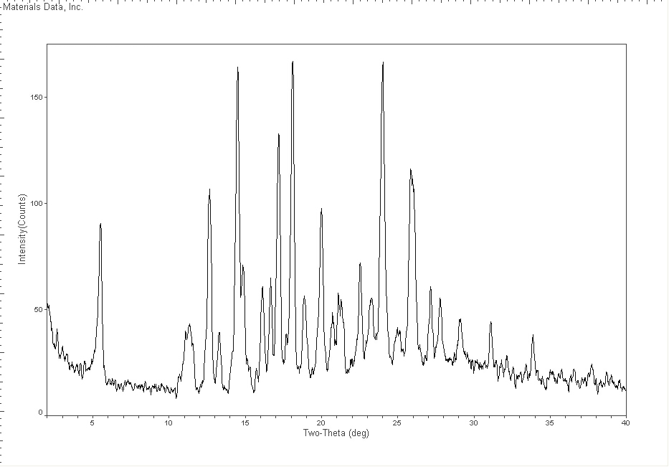
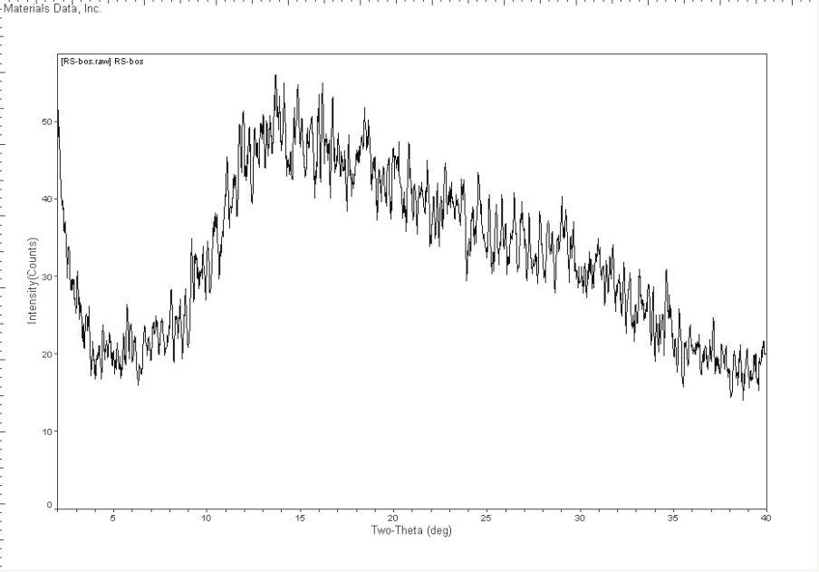
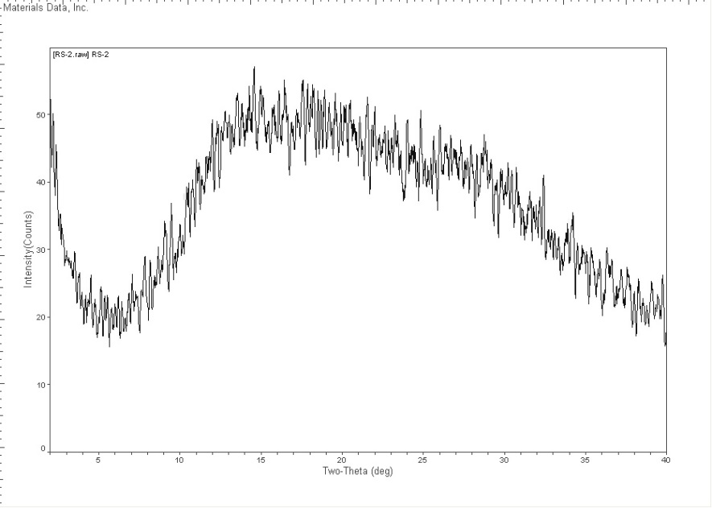

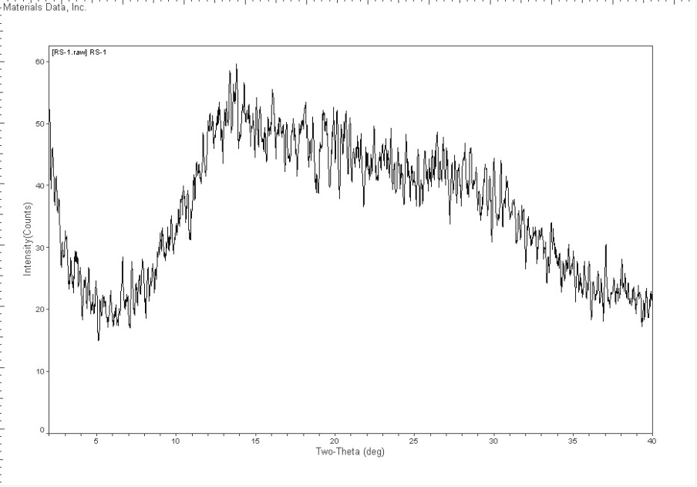
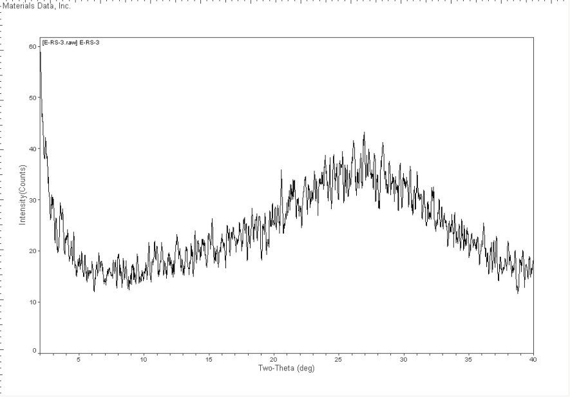
DT
Placebo
E RS-2
E RS-1
E RS-3
XRD
NANOTECHNOLOGY, 10-13 AUGUST 2015, FRANKFURT

Slide 18
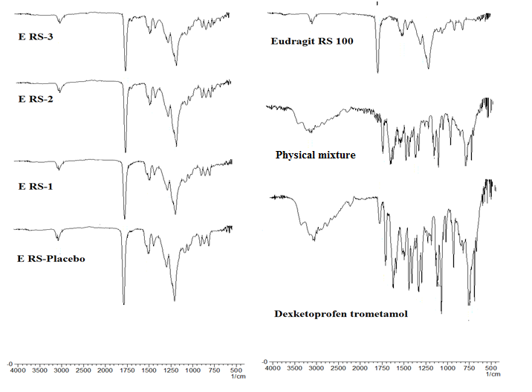
FT-IR

Slide 19
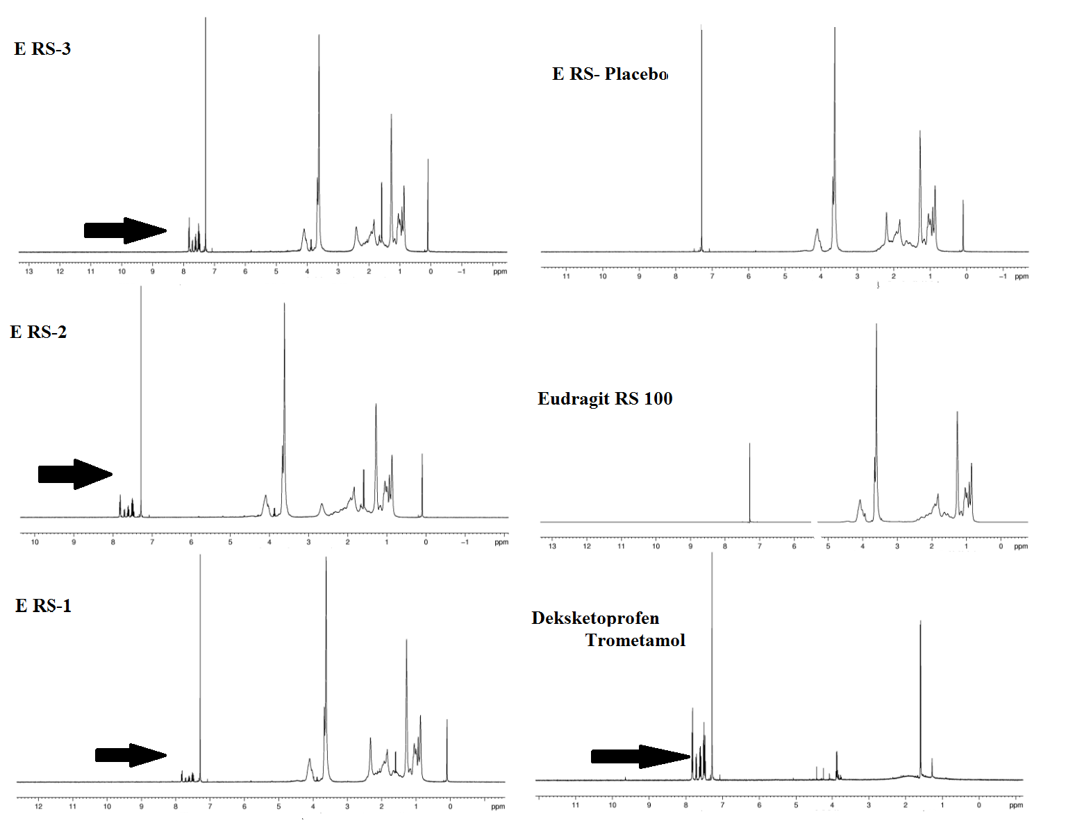
H¹ NMR

Slide 20
Conclusion
NANOTECHNOLOGY, 10-13 AUGUST 2015, FRANKFURT

Slide 21
NANOMETER RANGED PARTICLE SIZE
MOLECULARLY DISPERSED DT
NANOTECHNOLOGY, 10-13 AUGUST 2015, FRANKFURT

Slide 22
Thanks for your attention
: )
aaozturk@anadolu.edu.tr

