Slide 1


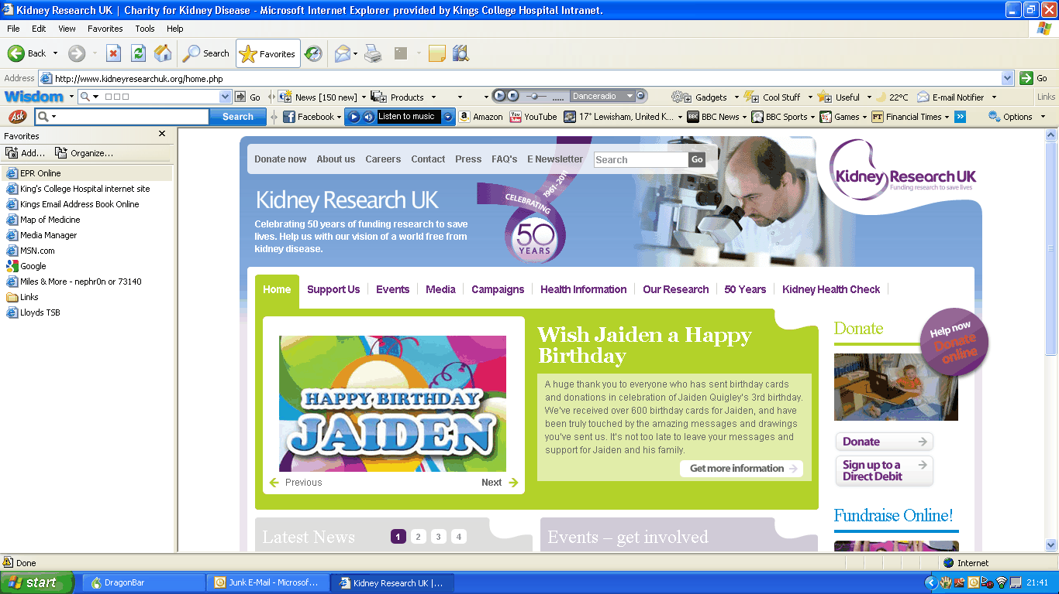
Effects of intravenous iron in chronic kidney disease and cardiac function
Dr. Ahmed Zeidan
Prof. Sunil Bhandari
Iron and the Heart EudraCT Number 2014-004133-16
Notes:
Good afternoon, thank you very much for this opportunity. My presentation is about my current research project which is looking at the effects of .

Slide 2
Aims
Background and Rationale for iron therapy in CKD
Hypothesis
Trial Design
Objectives
  Primary
  Secondary
Notes:
In my presentation I would like to initially start with some background information and talk about the rationale behind iron therapy in CKD.
Touch upon some recent studies that lead us come up with the hypothesis of our study.
Then go through the trial design and what we’re trying to achieve.

Slide 3
Chronic Kidney Disease
Progressive loss of kidney function over a period of months or years
4-6% of the UK adult population and 8-10% in Europe
Serious implications:
Complete kidney failure needing dialysis
Iron deficiency → Anaemia
Increased risk of heart disease.
Notes:
Chronic kidney disease is defined as a progressive loss of kidney function over a period of months or years, regardless of the original kidney disease.
CKD can have serious implications for those affected including a risk of CKD progressing to complete kidney failure
Development of iron deficiency → which may progress to anaemia
And increased risk of heart disease.

Slide 4
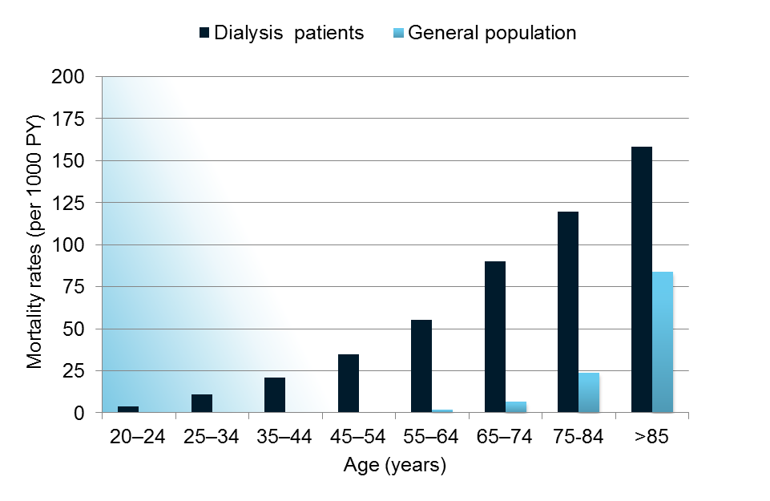


Cardiovascular Mortality in the General Population and in Dialysis Patients
Cardiovascular mortality is very high in CKD patients
CKD=chronic kidney disease; IV=intravenous; PY=person years
de Jager DJ, et al. JAMA 2009;302(16):1782–1789
Notes:
And this is to further the support the statement Ive just made. Data published by De jager in 2009 describing how high the mortality can be from Cardiovascular complications in CKD/Dialysis patients compared to the general popualtion. The gragh shows how end stage renal disease/dialysis patients .
Cardiovascular mortality is considered the main cause of death in patients receiving dialysis and is 10 to 20 times higher in such patients than in the general population.
Patients with chronic kidney disease are at higher mortality risk compared with the general population.1,2 Cardiovascular disease is the most common cause of death in these patients, as noted more than 30 years ago.3 Several studies have shown that cardiovascular disease accounts for 40% to 50% of deaths in patients with end-stage renal disease.4- 6 Cardiovascular mortality risk in patients receiving hemodialysis or peritoneal dialysis is observed to be 10 to 20 times that in the general population.4,6

Slide 5
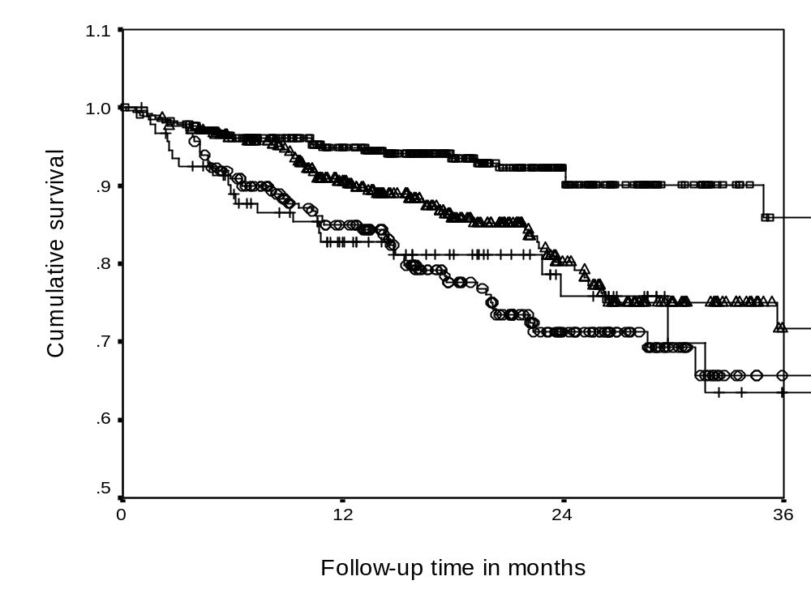
Effect of Renal Dysfunction & Anaemia
on Patient Survival
No RD, no anaemia
RD, no anaemia
No RD, anaemia
RD, anaemia +
De Silva R, Bhandari S et al . European Heart Journal 2005, 27: (5), 569-581
De Silva R, Bhandari S et al. American Journal of Cardiology 98: 3; 391-398. 2006
Notes:
Previously our team has shown how the combination of both renal dysfunction and anaemia can dramatically affect and decrease the survival of patients over time.

Slide 6
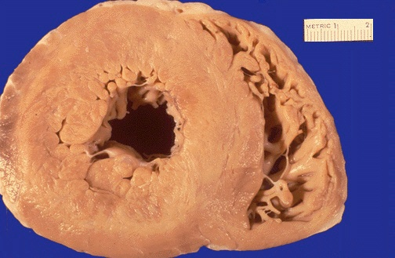
Uraemic Cardiomyopathy in CKD
Pressure and volume Overload
Structural Changes
Fibrosis
LVH
reduced capillary density
Metabolic Changes
Anaemia
energetics
carnitine deficiency
Ischaemic Vulnerability
Iron deficiency
EPO deficiency
Cellular Changes
calcium cycling
GSK-3b/AKT/PIP3K
GLUT4 and IR
Semple D, Bhandari S, Seymour A. Am J Physiology 2012
Bhandari S. Frontiers in Bioscience 2011
Dunja A , Bhandari S, Seymour A. Kidney International 2009
Reddy V, Bhandari S, Seymour JASN 2005
Notes:
Uraemia in CKD can eventually lead to Cardiomyopathy. The process is quite complex involving structural changes metabolic changes and so on.
The heart is subject to adpative and maladaptive changes, eccentric and concentric LVH
Uraemia in CKD can eventually lead to Uraemic cardiomyopathy.
Phenotype specific to the uraemic heart
There are complex changes in uraemia
In terms of
STRUCTURAL CHANGES
Remodelling of the heart – eccentric and concentric Left ventricular hypertrophy as described previously
Reduced capillary density - Alterations in myocyte number
Myocardial fibrosis - Intermyocytic fibrosis
Coronary heart disease./ microvascular disease and macrovascular disease
These all lead to increased risk of hypoxic injury
METABOLIC CHANGES
Abnormal cardiac enegretics with a switch to glucose metabolism - Energy starvation
reduced phosphocreatine/ATP ratio
Reduced stability of energy rich nucleotides
CELLULAR CHANGES
Reduction of insulin mediated glucose uptake
GSK-3b/AKt/PIP3K
Calcium cycling - Abnormal control of intracellular Ca handling in cardiomyocyte
Prolonged recovery of calcium transient leading to impaired relaxation
Altered activity of the insulin dependant glucose transporter GLUT 4
Reduction of inotropic and chronotropic response to α-adrenergic stimulation
Functional effects
Impaired contractile function
Depressed myocyte contractility
Reduced cardiac output
Diminished capillary density with increased inter-capillary distance
Although lots of clinical data- little experimental data exists on uraemic cardiomyopathy looking into the cellular aspects.

Slide 7
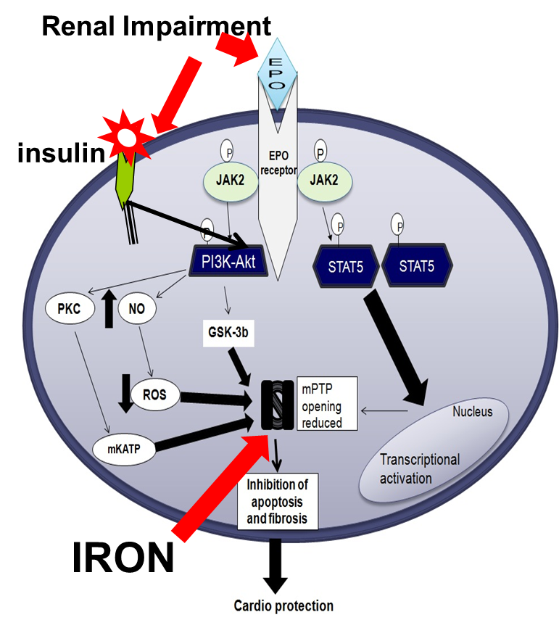
Why iron is important?
Pivotal role in O₂ uptake, transport, storage and metabolism in skeletal and cardiac muscles.
  Iron is important for mitochondrial function - mitochondrial ATP production
Required for Hb production and O2 transport
Also required for:
  catalytic enzymes
  proteins for DNA synthesis
  transport of electrons
  cell respiration
  oxidative phosphorylation
  Tri-carboxylic acid cycle
Modified from Bhandari S Frontiers in Bioscience 2011
Semple D, Bhandari S, Seymour AM Am J Physiol 2012
Taylor D, Seymour A, Bhandari S. Am J Physiology 2014
Notes:
7

Slide 8
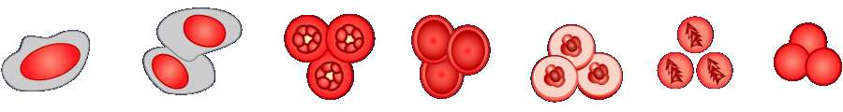
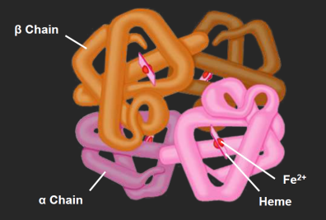
Erythropoiesis in CKD
Erythropoietin
Iron
SCF, IL-1, IL-3,
IL-6, IL-11
SCF, GM-CSF,
IL-3
About 8 Days
Pluripotent
Stem Cell
Burst-Forming Unit-Erythroid Cells (BFU-E)
Colony-Forming
Unit-Erythroid
Cells (CFU-E)
Proerythro-
blasts
Erythro-
blasts
Reticulocytes
RBCs
Papayannopoulou T, et al. In: Hoffman R, et al., ed. Hematology: Basic Principles and Practice. 4th ed. 2005;267-288.
Notes:
This shows the different stages in erythropiesis and the satge at which iron is added to complete the production of mature red blood cells. The lack of iron at this stage leads to hypochromic red blood cells.

Slide 9
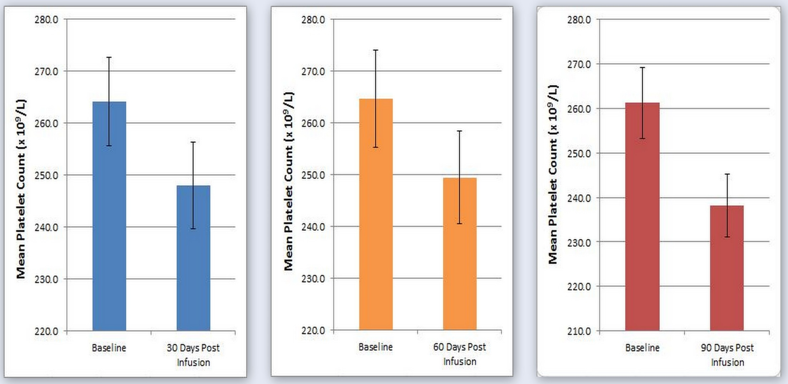
Reduced platelets and Thrombotic Potential
**
p = 0.01
p= 0.03
p<0.001
Post-infusion - Platelets lower at 30, 60 & 90 days versus to baseline: n=204
Hazara A & Bhandari S J Clinical Pharm & Therapeut 2014, doi: 10.1111/jcpt.12218
Notes:
In addition to erythropoiesis, iron also plays a role in reduction of platelet count and thrombotic potential. This was demonstrated by my colleague,

Slide 10
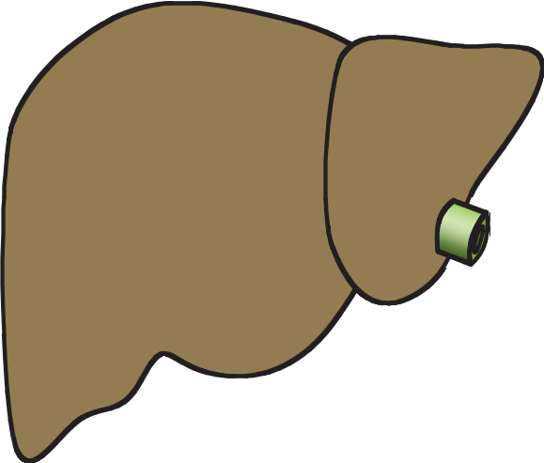
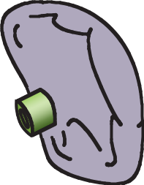
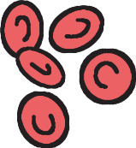
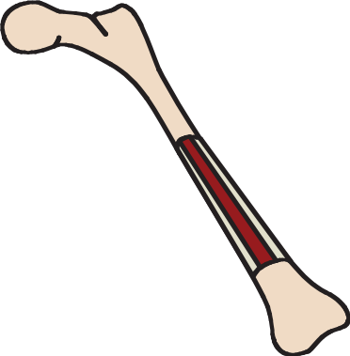
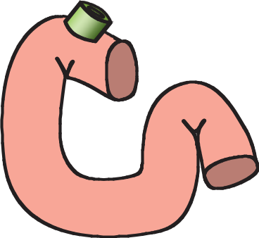
Effect of CKD on regulation of Hepcidin Production
Chronic oxidative Stress
Iron
Inflammation IL-6
BMP 6
Spleen
Liver
Hepcidin
Hepcidin
Red
blood
cells
Hepcidin
Plasma
Fe-Tf
Bone marrow
Duodenum
Ganz T. J Am Soc Nephrol 2007;18:394–400
Katz et al Nature Genetics 2014, 46, 678-84
Notes:
During inflammation, increased hepcidin concentrations cause iron sequestration in macrophages, resulting in hypoferremia and eventually anemia of inflammation. Hepcidin deficiency plays a central role in most iron overload disorders. The role of hepcidin abnormalities in anemias that are associated with renal disease and in resistance to erythropoietic therapies remains to be elucidated.
eRFE leads to hepcidin suppression
Anaemia and EPO stimulates erythroblasts from the bone marrow and via JAK-2 stat5 leads to up regulation of the hormone ERFE (a TNF-alpha like protein) which acts on the liver to inhibit hepcidin – hence it is a potential good measure of erythropoiesis
Remember if the bone marrow is non functional such as in aplastic anaemia then hepcidin will not be affected

Slide 11
Functional Vs Absolute
Functional iron deficiency
Iron stores
⬆ or ⬅➔
Mobilization and transport
⬇
Absolute iron deficiency
Iron stores
⬇
Mobilization and transport
⬇
Notes:
Absolute iron deficiency = serum ferritin < 15 micrograms/L,
Functional iron deficiency: the body contains adequate iron stores but the iron can not be mobilised fast enough to keep pace with the demands of the BM for erythropoiesis
is a state in which there is insufficient iron incorporation into erythroid precursors in the face of apparently adequate body stores, as defined by the presence of stainable iron in the bone m
together with serum ferritin value within normal limits.
Correction of iron deficiency with iron supplementation can reduce the severity of CKD related anemia
The Renal National Service Framework and National Institute for Health and clinical Excellence advocate treatment of anaemia in patients with CKD

Slide 12
Why treat iron deficiency in CKD
The main aims are to improve symptoms and quality of life
        Symptomatic restless legs
        Cognition
        Physical performance
        Exercise tolerance
        Immune function
        reduces platelet count
        Beneficial effects on cardiac function via effects on
        mitochondrial function

Slide 13
The Heart in CKD
Subject to adaptive and maladaptive changes
Concentric and eccentric hypertrophy linked to FGF-23
Switch from fatty acids to glucose metabolism
Iron and erythtropoietin deficiency → Ischaemia
Oxidative stress
Changes in calcium cycling within the moitochondria

Slide 14
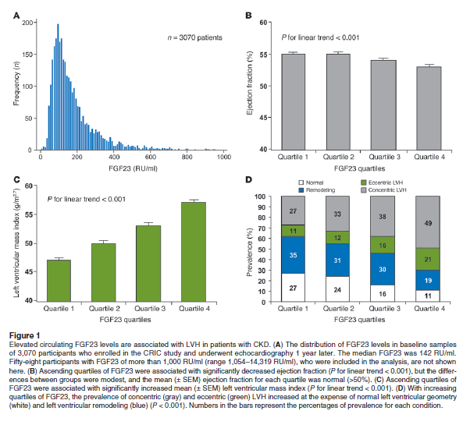
FGF-23, klotho independent induced LVH
Faul C et al; J Clin Invest 2011; 121 (11) : 4393-4408
Notes:
Elevated circulating FGF23 levels are associated with LVH in patients with CKD.

Slide 15
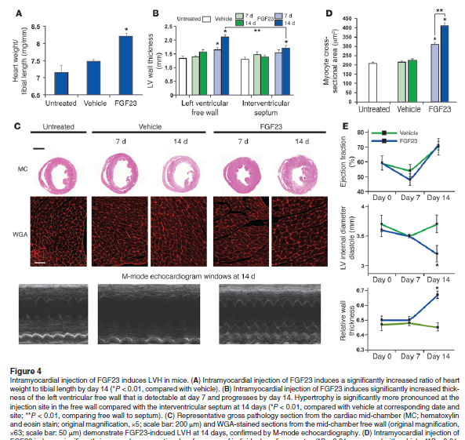
Notes:
Left ventricular hypertrophy (LVH) is an important mechanism of cardiovascular disease in individuals with CKD. Elevated levels of FGF23 have been linked to greater risks of LVH and mortality in patients with CKD, but whether these risks represent causal effects of FGF23 is unknown. Here, we report that elevated FGF23 levels are independently associated with LVH in a large, racially diverse CKD cohort. FGF23 caused pathological hypertrophy of isolated rat cardiomyocytes via FGF receptor-dependent activation of the calcineurin-NFAT signaling pathway, but this effect was independent of klotho, the coreceptor for FGF23 in the kidney and parathyroid glands. Intramyocardial or intravenous injection of FGF23 in wild-type mice resulted in LVH, and klotho-deficient mice demonstrated elevated FGF23 levels and LVH. In an established animal model of CKD, treatment with an FGF-receptor blocker attenuated LVH, although no change in blood pressure was observed. These results unveil a klotho-independent, causal role for FGF23 in the pathogenesis of LVH and suggest that chronically elevated FGF23 levels contribute directly to high rates of LVH and mortality in individuals with CKD.

Slide 16
How to treat iron deficiency of CKD
Oral Iron
More convenient but often insufficient
Intravenous iron
Circumvents the hepcidin system
Relatively poor bioavailability
?False economy
Replenishes and maintains iron stores
Superiority of IV iron over oral has been shown
High [hepcidin] → impaired absorption
Slow Hb response

Slide 17
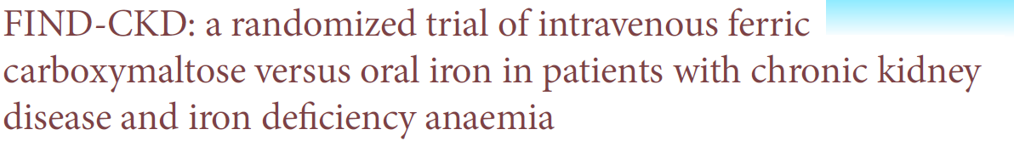
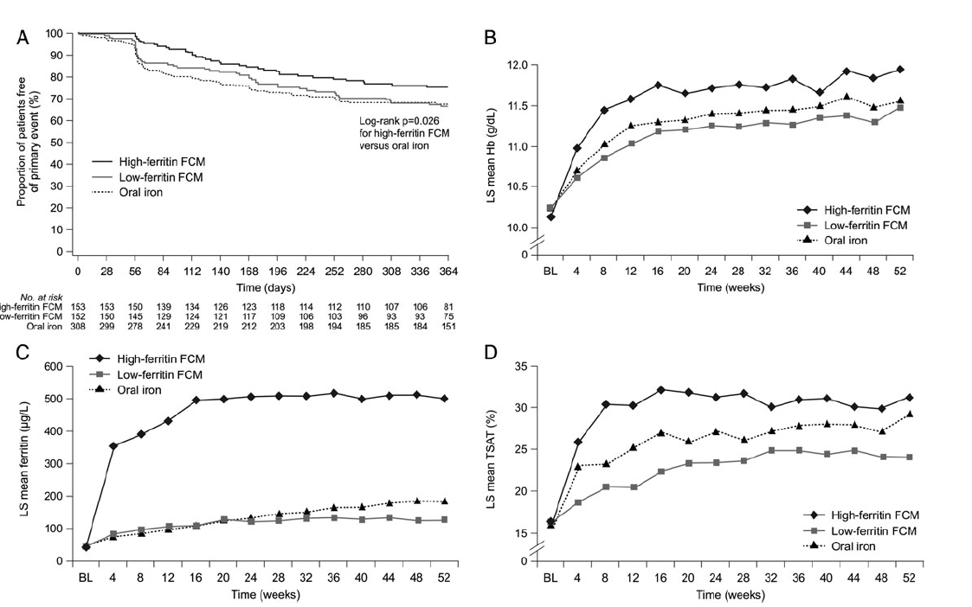
Macdougall I et al FIND –CKD NDT 2014, 29, 2075-2084
Notes:
626 patients with IDA and CKD, randomised to IV ferric carboxymaltose targetting a SF of 400-600 vs 100-200 vs oral iron in a 52 week open label study.
MAIN AIM WAS TO KEEP PATIENTS OFF ESA
- Hb rise in all groups but greatest in high IV iron group and large S/A profile with oral iron
Primary endpoint was time to initiation of other anaemia management (ESA, other iron or transfusion) or a Hb trigger of 2 consecutive values <100g/L
Primary end point in 23.5 % high SF; 32.2% in low SF and 31.8% oral iron group
HR 0.65 (0.44-0.95) p=0,026 for igh SF vs oral iron
Also greater Hb increase with high SF group p=0.014

Slide 18
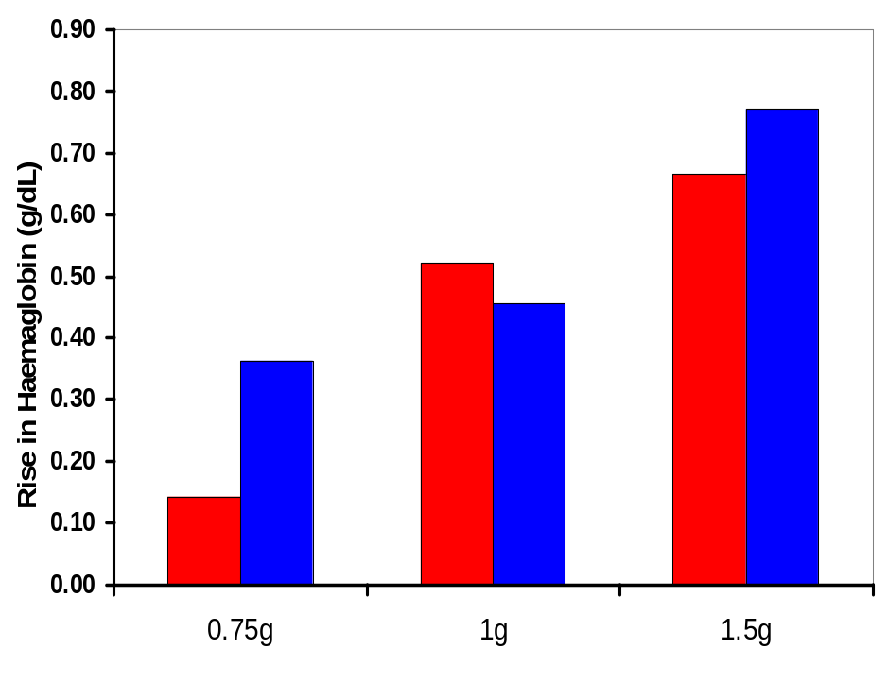
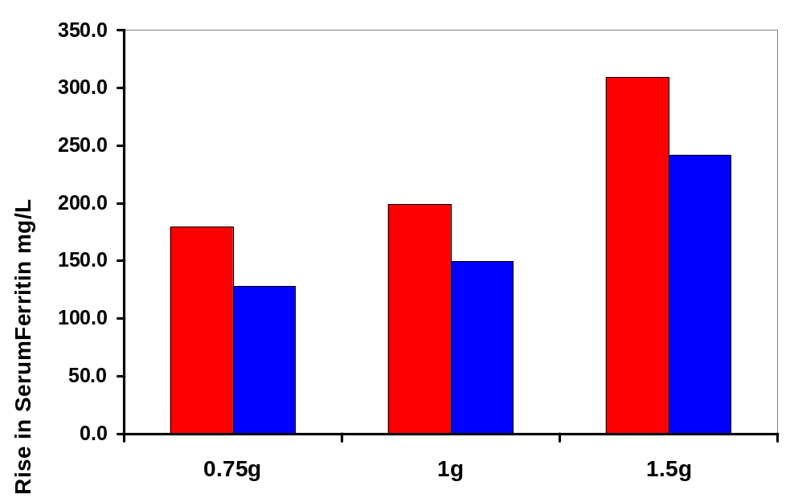
Dose dependent rise in serum ferritin and haemoglobin
at 3 and 6 months post Total Dose Iron infusion in CKD
patients, n=160 patients given LMW iron dextran
3 months
6 months
Bhandari S. (NDT Plus 2012)

Slide 19
When to treat iron deficiency in CKD
Most recommendations in guidelines are ‘suggestions’
Limited compelling evidence for specific Hb targets
KDIGO 2012: Target Hb should not exceed 115 g/L
NICE: Target Hb upper limit of 120 g/L
Should be considered when:
  SF<100 microgram/ml
  Or TS%< 20%
  Or HRC< 6%
  CHr<29g/L
Notes:
there is limited compelling evidence for specific haemoglobin targets and most recommendations within the guidelines are described as being ‘suggested’.
This is especially relevant with the increasing emerging concerns of stroke, thrombosis and cancer risk with the liberal use of ESA’s
CHr) of less than 29g/L offer potentially more reliable assessment of iron deficiency [21-23] and are currently recommended by NICE [21]

Slide 20
Potential Risks of IV Iron
Short Term
Anaphylaxis
labile iron reactions
Longer term
Oxidative stress
Risk of infections
Risk of iron overload
Notes:
US Food and Drug Administration reports on side effects of four iron preparation and concluded that the mortality possibly associated with iron was approximately 0.06–0.32 per million doses sold of each formulation

Slide 21
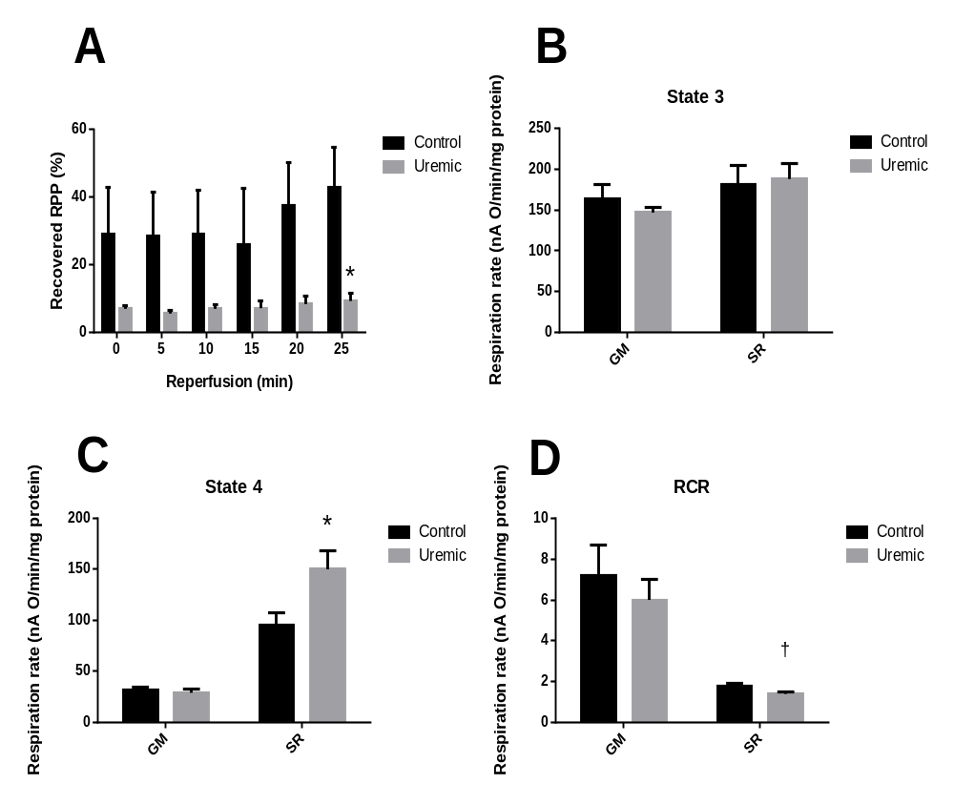
Iron and Mitochondria
Enhanced susceptibility to ischemic injury
Mitochondrial uncoupling
Leads to impaired ATP production and increased mPtP opening
Diminished recovery of respiratory coupling following ischemia reperfusion injury
Enhanced susceptibility to oxidant-induced stress
Increased sensitivity to Ca²⁺ -induced mPTP formation
D Taylor, Seymour A, Bhandari S. Am J Physiology 2014
Notes:
A- expressed as percentage of normoxic rate pressure product; B – ; C – ; D – Respiratory substrates GM 5mM glutamate & 1mM malate; SR 5mM succinate & 1µM rotenone (n=4.) †p < 0.01 vs. respective control; * p < 0.05 vs. respective control.
Perturbations in mitochondrial function combine to predispose the uremic heart to IRI.
Persistent mitochondrial uncoupling may compromise energetic reserve capacity, rendering the uremic heart more vulnerable to metabolic stress. Diminished recovery of respiratory coupling following an IRI insult indicates greater susceptibility of uremic mitochondria to ischaemic stress. Increased sensitivity to IRI-associated oxidant and calcium stressors enhance the propensity to mPTP formation and subsequent catastrophic cellular injury.

Slide 22
Development of HF
⬆ Stage 4 respiration
Uncoupling proteins
Mitochondrial dysfunction
⬆ Transition pore formation
Impaired contractile function of cardiomyocytes
Chronic Anaemia and Fe deficiency
Fluid overload
Notes:
all contributing to cardiovascular risk which are a major cause of mortality in this patient group

Slide 23
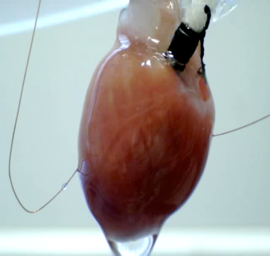

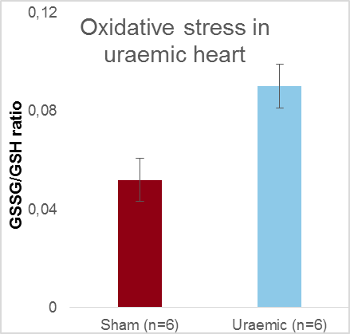
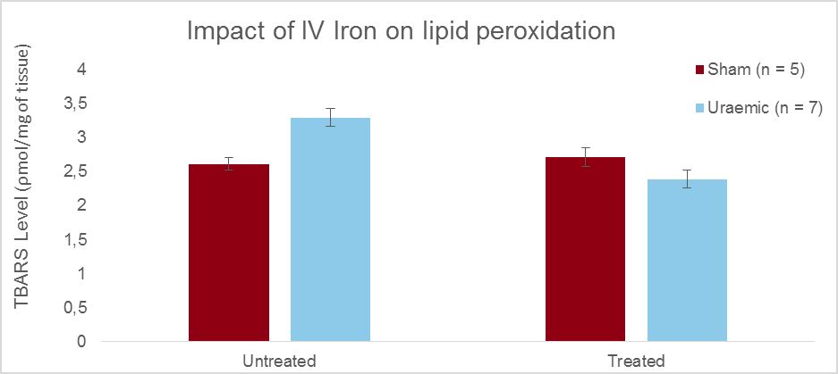
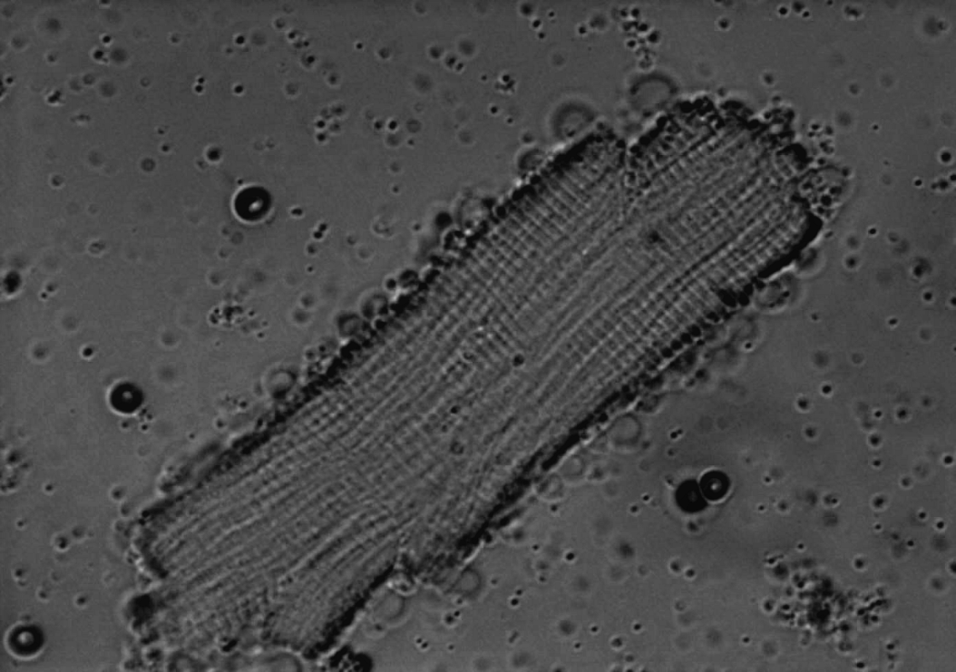
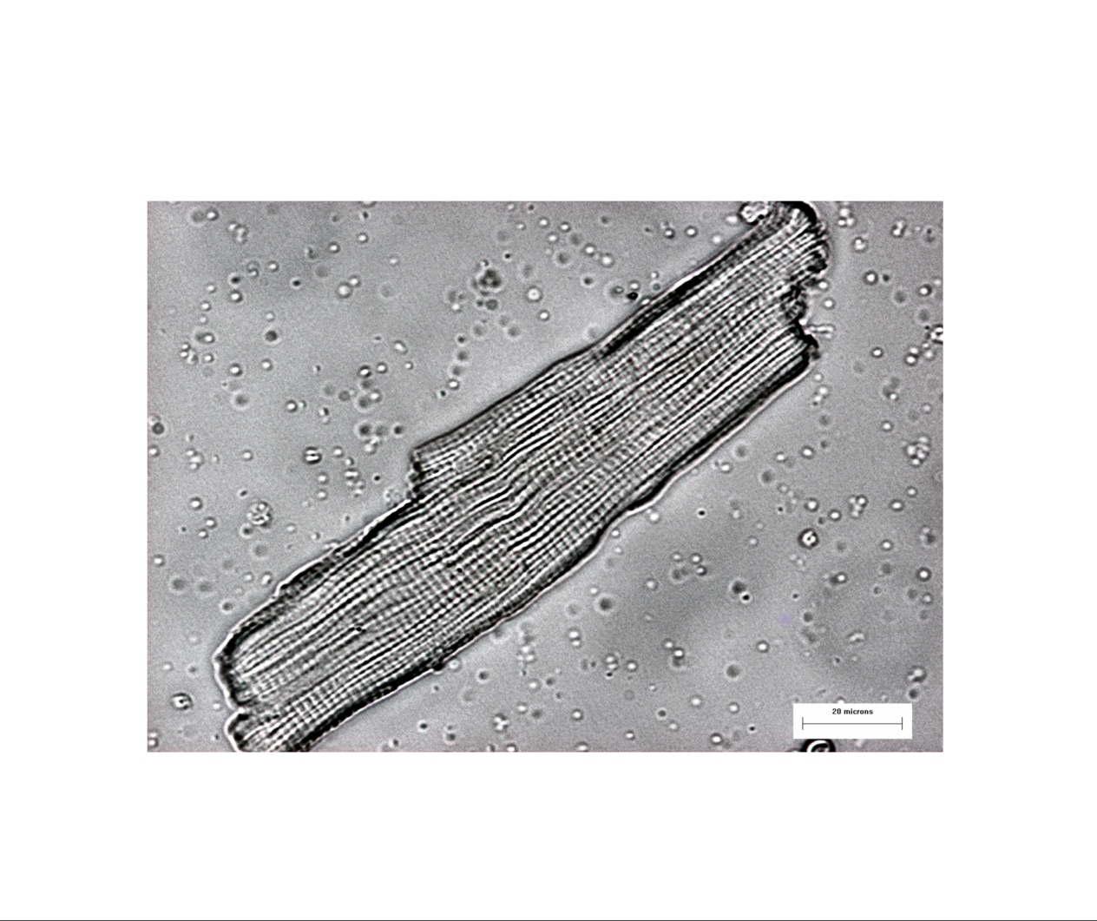
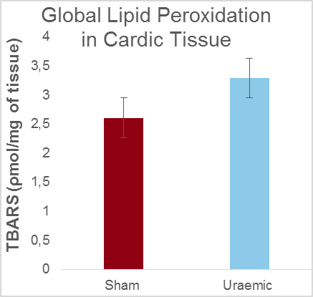
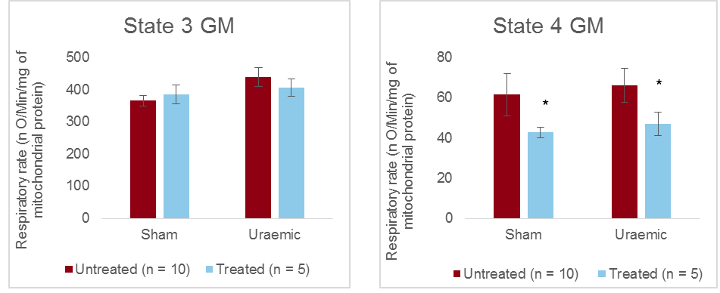
Uraemia – Iron – Oxidative Stress and Mitochondrial Function
Figure 19: Isolated Mitochondrial Respiratory rates in the presence of 5mM glutamate and 1mM malate (GM). Results are presented as mean +/- SEM (*p < 0.05 vs untreated).
Faisal N PhD 2015 unpublished MUST NOT BE COPIED
Notes:
Respiratory function of isolated cardiac mitochondria assessed after 12 weeks.
Oxidative stress evaluated:
thiobarbituric acid-reactive substances (TBARS)
glutathione using HPLC.
Cardiac antioxidant capacity assessed by enzymatic activities of:
Catalase, Superoxide dismutase, Glutathione peroxidase and Glutathione reductase.
Mitochondrial membrane remodelling was investigated by looking at changes in content and structure of the mitochondrial phospholipid, cardiolipin (CL), found almost exclusively in the inner mitochondrial membrane. Preliminary data indicated increased in total CL in the uraemic heart relative to control which accounted for the increased absolute quantities of the prominent acyl chains (linoleate, palmitate, oleate and stearate) (fig 9). However, when the acyl chains constituents were expressed as percentage composition, indicated potential CL remodelling evidenced by increased incorporation of linoleic acid into the CL backbone with parallel reduction of the minor acyl chains (fig 10). Iron therapy did increase CL levels in the uraemic heart (though not significant) (fig 11) and did not appear to have significant impact on CL remodelling (fig 12).

Slide 24
Iron and the Heart
Few studies examined the effects of IV iron in patients with HF, anaemia, iron deficiency, and renal dysfunction
Hypothesis: iron loading leads to improvement in mitochondrial function and hence symptom improvement and cardiac function independent of haemoglobin

Slide 25
Randomised double-blind controlled study of IV iron in CHF (FAIR-HF)
Treatment (IV iron; n=20)
Control (Placebo; n=20)
Baseline
6 months
Baseline
6 months
Hb
10.3±0.6
11.8±0.7*
10.2±0.5
9.8±0.6
Cr Cl
39.8±10.1
44.9±11.0*
37.7±10.2
31.7±10.8
Diuretics
19/20
13/20*
19/20
19/20
CRP
6.1± 3.8
2.3±0.8*
6.6±4.4
6.5±3.7
NYHA
2.9±0.7
2.0±0.2*
2.9±0.6
3.3±0.6
LVEF
31.3±3.7
35.7±4.7*
30.8±1.7
28.8±2.4
Heart rate
78.7±8.2
67.5±8.2*
80.5±8.1
76.3± 10.4
BNP
255.9±124.6
117.5±87.4*
267.5±114.9
450.9±248
MLHFQ
60±5
41±7*
58±6
58±8
6MWT
192.3±60.9
240.1±51.2*
190.7±56.1
184.5±58.5
Hospitalisations
0
0
0
5
Toblli et al , JACC 2007; Okonko et al , JACC 2008.

Slide 26
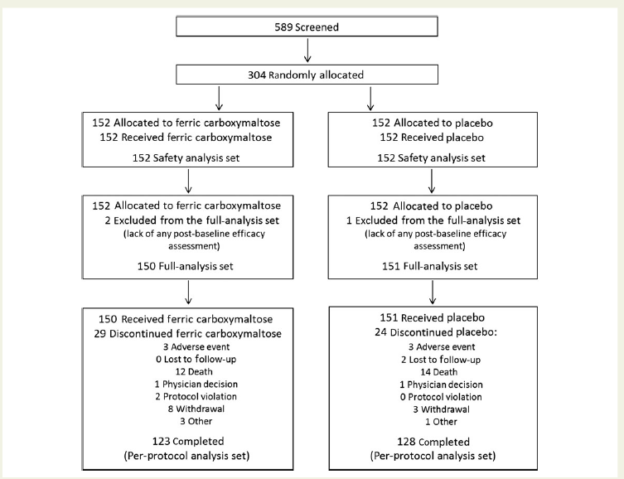
Beneficial effects of long-term intravenous iron therapy with ferric carboxymaltose in patients with symptomatic heart failure and iron deficiency
Ponikowski P et al CONFIRM-HF, Eur Heart J 2014

Slide 27
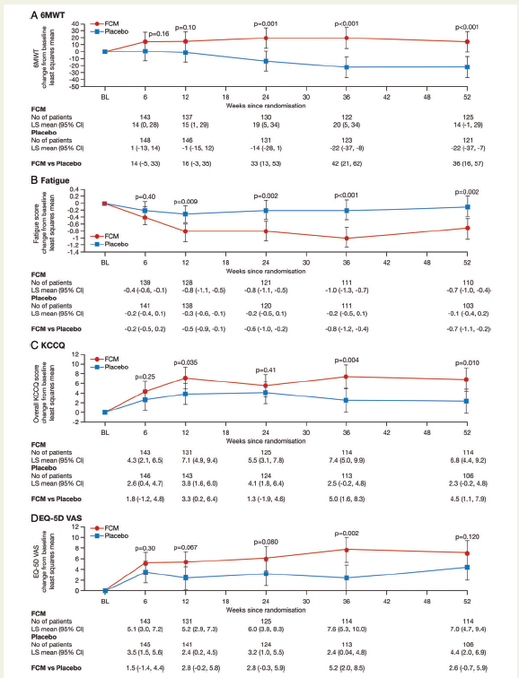
CONFIRM-HF
Treatment of stable, symptomatic,
iron-deficient HF patients with and without anaemia with i.v. iron
Sustainable improvement in functional capacity -6-MWT walking test
concomitant improvement
Improved functional status and quality of life
Reduced risk of hospital admission due to worsening HF
Ponikowski P et al , Eur Heart J 2014
Notes:
CONFIRM-HF was a multi-centre, double-blind, placebo-controlled trial that enrolled 304 ambulatory symptomatic
HF patients with left ventricular ejection fraction ≤45%, elevated natriuretic peptides, and iron deficiency (ferritin
,100 ng/mL or 100–300 ng/mL if transferrin saturation ,20%). Patients were randomized 1 : 1 to treatment with i.v.
iron, as ferric carboxymaltose (FCM, n ¼ 152) or placebo (saline, n ¼ 152) for 52 weeks. The primary end-point was
the change in 6-min-walk-test (6MWT) distance from baseline toWeek 24. Secondary end-points included changes in
New York Heart Association (NYHA) class, Patient Global Assessment (PGA), 6MWT distance, health-related
quality of life (QoL), Fatigue Score atWeeks 6, 12, 24, 36, and 52 and the effect of FCM on the rate of hospitalization
for worsening HF. Treatment with FCM significantly prolonged 6MWT distance at Week 24 (difference FCM vs.
placebo: 33+11 m, P ¼ 0.002). The treatment effect of FCM was consistent in all subgroups and was sustained to
Week 52 (difference FCM vs. placebo: 36+11 m, P , 0.001). Throughout the study, an improvement in NYHA
class, PGA, QoL, and Fatigue Score in patients treated with FCM was detected with statistical significance observed
fromWeek 24 onwards. Treatment with FCM was associated with a significant reduction in the risk of hospitalizations
for worsening HF [hazard ratio (95% confidence interval): 0.39 (0.19–0.82), P ¼ 0.009]. The number of deaths (FCM: 12,
placebo: 14 deaths) and the incidence of adverse events were comparable between both groups.
The CONFIRM-HF study shows that the treatment of stable, symptomatic,
iron-deficient HF patients with i.v. iron (FCM) results in sustainable
improvement in functional capacity as measured over a
1-year period using the 6-MWT walking test. These favourable
results were consistent across all pre-specified subgroups including
patients with and without anaemia. The beneficial effects of
treatment with FCM were confirmed by concomitant improvement
in patients functional status and quality of life throughout the study.
Importantly, patients treated with FCM demonstrated significantly
reduced risk of hospital admission due to worsening HF during
1-year follow-up. Long-term correction of ID with FCM was
supported by a good safety profile and was well-tolerated.

Slide 28
Recap
Iron is central in oxygen uptake, transport, storage and metabolism in both skeletal and cardiac muscle.
Evidence suggest that myocardial energy production is a crucial aspect of cardiac function. The heart consumes large quantities of energy for myofibril contraction and maintenance of ionic gradients. Abnormalities in myocardial energy metabolism develop in uraemic patients. This energy production is dependent on mitochondrial function which is the main source of energy for myocyte contraction.
Previous Experiments in a model of stressed hearts with CKD
  increase in stage 4 respiration
  increase in uncoupling proteins leading to mitochondrial dysfunction
  increase in transition pore formation leading to impaired contractile function of cardiomyocytes.
Therefore a deficiency of iron may lead to impaired mitochondrial function via possible effects on transition pore opening and subsequent inhibition of the pro-survival pathway and activation of apoptotic pathways.

Slide 29
Trial Purpose - Main Research Question - Hypothesis
Examine whether a strategy of IV parenteral iron therapy in patients with stages 3b-5 CKD who are iron deficient (Ferritin < 100 µg/L and/or TS%<20) but NOT anaemic (haemoglobin 110-150g/L) compared to a strategy of continuing current therapy without additional iron therapy lead to:
Improved functional capacity and physical capacity over a one month follow-up period, with reassessment at 3 months:
  6MWT
  qualitative questionnaires (KDQol and MLHF)
  stabilisation or improvement in cardiac function
  hospitalization rates
  haemoglobin levels
Third arm - control group of patients with CKD and no anaemia or iron deficiency will allow for baseline comparison
Fourth arm - healthy patients (patients from the live donor work up program) will also serve as a baseline control (healthy volunteers with no underlying known disease or CKD as judged by their suitability for transplant donation during donor work up).

Slide 30
OTHER EFFICACY OBJECTIVES
Improvement in cardiac structure and function
  speckle tracking ECHO studies
    (addition of physiological monitoring using pulse oximetry and cardiac harness for heart and respiratory rate)
  Change in New York Heart association functional classification (NYHA)
  Cardiac iron loading based on MRI using T2
    single centre in a parallel sub-study (6 patients)
  Improvement in renal function
    eGFR

Slide 31
MECHANISTIC OBJECTIVES
Inflammatory mediators
  IL-6
  IL-8
  IL-10
  CRP
Vasoactive substances (oxidative stress)
  Ian Chetter - MDA, selectins and interleukins - mainly in John Greenmans lab at UoH (Lee Maddern is his post doc who was brilliant at training our research fellows in ELISA techniques etc)
plasma malondialdehyde - MDA
glutathione GSH/GSSH
Endothelial function
  Pulse wave velocity (PWV)
  E and P selectin
Notes:
Mechanistic studies will independently examine processes that may account for the clinical benefit seen in previous observational and randomised studies of iron therapy. The potential benefit of parenteral iron may simply be due to a change in haemoglobin or a more complex effect may be in operation through, for example, altered cardiac remodelling, inflammatory mediators, or vasoactive substances.
In addition, both early and delayed mechanisms involving altered remodelling, inflammatory mediators (anti-inflammatory -via reduced pro-inflammatory cytokines (IL-6 and IL-8)) and pro-inflammatory (via increased IL-1b and reduced IL-10 (anti-inflammatory)), or vasoactive substances (oxidative stress) will be studied.
Biomarker-based measurements to examine the more detailed signalling pathways that are influenced by iron in CKD will be studied. These will include biomarkers of lipid peroxidation and free radical scavengers
• Pulse wave velocity (PWV) a surrogate measure of - Arterial stiffness
• Inflammatory markers - Cytokines - IL-6; IL-8 and IL-10 ad CRP
• E and P selectin endothelial markers
• Oxidative stress markers - plasma malondialdehyde (MDA) and GSH (glutathione) and TBARS activity

Slide 32
Iron and the Heart Study
Exploratory multicentre prospective double blinded randomised controlled pilot trial
The effect of IV iron supplementation (Monofer®)
In Iron deficient but not anaemic patients
With CKD stages 3b or worse
Examining patients’ functional status and cardiac structure and function

Slide 33
Trial Design
An investigator led multi-centre
54 participants with stage 3b or worse CKD with iron deficiency
2 further control groups: 20 with CKD, 10 healthy volunteers
Sufficient size to provide data on feasibility, and likely size and endpoints of a future definitive study.

Slide 34
CKD patients stage 3b-5 with iron deficiency
SF<100; TS<20 and not anaemic
Hb 110-150g/L
18 month recruitment
Eligible for
Study?
No
Excluded
Not Meeting Criteria
Declined
Other Reason
GROUP 4 n=6
Monofer 1000mg
Yes
Unblinded; n=6
Double Blinded Randomise
1:1 ratio, N=54
3 Month Follow-Up
Group 1
Placebo Arm:
IVI Dummy Drug
N=27
Experimental Arm:
IV Monofer 1000mg
N=27
3 month follow-up
GROUP 4
Additional T2* MRI
Baseline 1 and 3 month visits | - | routine tests (eGFR, FBC, BCP, urinary PCR), BP, documentation of adverse events, compliance and changes in medication
Extra tests at visits | - | QOL questionnaire, weight and BMI, 6-minute walk test, ECG, and bloods for C-reactive protein, cystatin-C, NT-proBNP and biomarkers

Slide 35
Group 2
CKD patients stage 3b-5 with NO Anaemia and NO iron deficiency
SF>100; TS>20 and not anaemic
Hb 110-150g/L
Group 3
CONTROL Live Kidney Donors patients with NO iron deficiency
and not anaemic
Hb 110-150g/L
12 month recruitment
Eligible for
Study?
Eligible for
Study?
3 Month Follow-Up for Group 2
Yes
Yes
N=20
N=10
Baseline bloods only
CONTROL Arm
MECHANISTIC STUDY
3 month follow-up
Baseline 1 and 3 month visits | - | routine tests (eGFR, FBC, BCP, urinary PCR), BP, documentation of adverse events, compliance and changes in medication
Extra tests at l visits | - | QOL questionnaire, weight and BMI, 6-minute walk test, ECG, and bloods for C-reactive protein, cystatin-C, NT-proBNP, biomarkers

Slide 36
Eligibility
Key Inclusion Criteria | Key exclusion criteria
Aged ≥18 years (male or female) CKD stage 3b- 5 (eGFR <30mls/minute using the MDRD equation) and not on dialysis therapy Resting blood pressure (BP) ≤160/90 mmHg At least 3 months of specialist renal follow-up at the time of entry into the trial | Aged <18 years Undergoing dialysis therapy Uncontrolled hypertension (>160/90mmHg) or requirement for 5 or more agents to control BP Pregnancy or breastfeeding Non renal anaemia CRP >50

Slide 37
Primary objective
To compare the effect of IV iron versus placebo on changes in physical function based on:
1) 6-minute walk test
2) Qualitative questionnaires
In iron deficient non-anaemic CKD patients.

Slide 38
Secondary Objectives
To explore whether IV iron supplementation compared to placebo in CKD 3b+ patients leads to:
Improvement in cardiac structure and function.
Improvement in vascular endothelial function
Cardiac iron loading
Improvement in markers of oxidative stress
Improvement in renal function

Slide 39
Objectives - End-point
54 patients with eGFR <45ml/min with Hb .110g/L and SF <100 and/or TS<20%
IV Iron
No iron
Primary Endpoint: Difference in co-analysis of:
6MWT and Questionnaires (KD-QOL; MLHF; Restless leg)
Clinical
Speckle Echo, ECG
Hospitalisations
Death and cardiac events
Thrombotic episodes
infection
SAE
Magnetic Resonance Imaging - T2* MRI to measure iron loading in heart pre and after IV iron at baseline post IV iron, 1 month and 1 year follow-up (total of 4 scans per patient)
MECHANISTIC
Pulse wave velocity
E and P selectin
Inflammatory markers
Cytokines - IL-6; IL-8 & IL-10, CRP
Oxidative stress markers
plasma malondialdehyde
glutathione activity.

Slide 40
Questions?

Slide 41
Trial Purpose - Main Research Question - Hypothesis
A reversible abnormality in muscle (cardiac & skeletal) metabolism develops in uraemic patients that is associated with:
impaired cardiac function
impaired skeletal muscle energy metabolism
reported symptoms
Hypothesis
Iron loading leads to improvement in mitochondrial function and hence symptom improvement and cardiac function independent of haemoglobin.

