Slide 1

The Dilemma of the Mycobacterium Avium subspecies Paratuberculosis Infection: In pursue for effective vaccine

Slide 2
Johne’s disease
Johne’s disease is bacterial fatal severe chronic gastroenteritis disease of domestic and wild ruminant like, cattle, sheep, goats, deer, antelope and bison caused by Mycobacterium avium. subsp. paratuberculosis (MAP).
It is becoming clearly evident that MAP has important role in the pathogenesis of Crohn’s disease. These accumulated evidence definitely exert public health concern about consumption of the dairy and meat products.
The disease is distributed world wide and has adverse impact on dairy cattle industry (200 million/year in U.S.A) (Groenendaal, H., et al., J Dairy Sci, 98, 6070, 2014

Slide 3
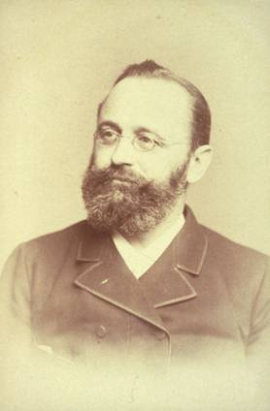
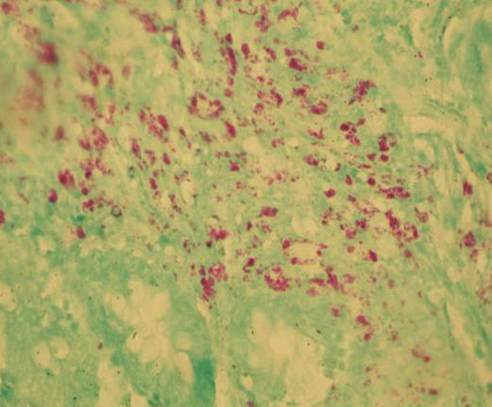
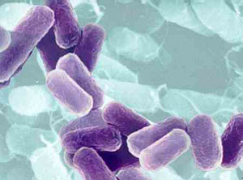
Paratuberculosis (Johne‘s disease)
Heinrich Albert Johne1895
Etiology: M. a. paratuberculosis
Ayele et al., Veterinarni Medicina, 2001, 205-224. http://www.vri.cz/docs/vetmed/46-8-205.pdf

Slide 4
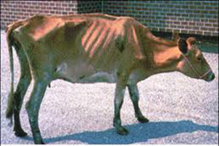
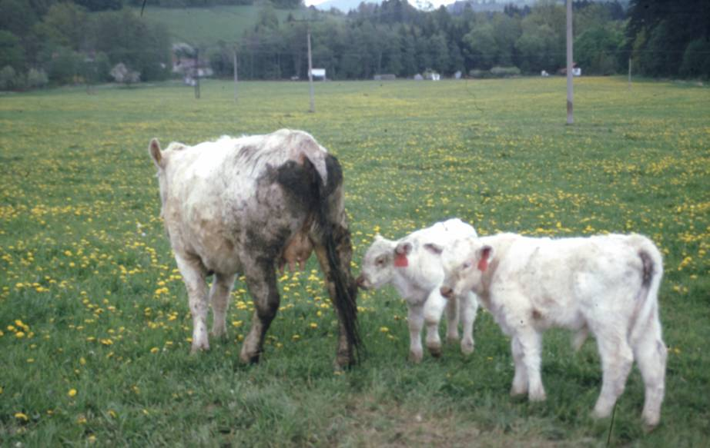
Clinical paratuberculosis in cow

Slide 5
The organism and route of infection
Mycobacterium avium subspecies paratuberculosis (MAP) is acid fast an intracellular slow growing bacillus of 0.51-1.5 μm
slow tendency to grow on solid media supplied with mycobactin (Herrold’s egg yolk medium).
Ingestion of fecal material, milk, or colostrum is the main route of infection. Vertical transmission through utero-placental route may occur. The organism may also transfer by semen of infected bulls.

Slide 6
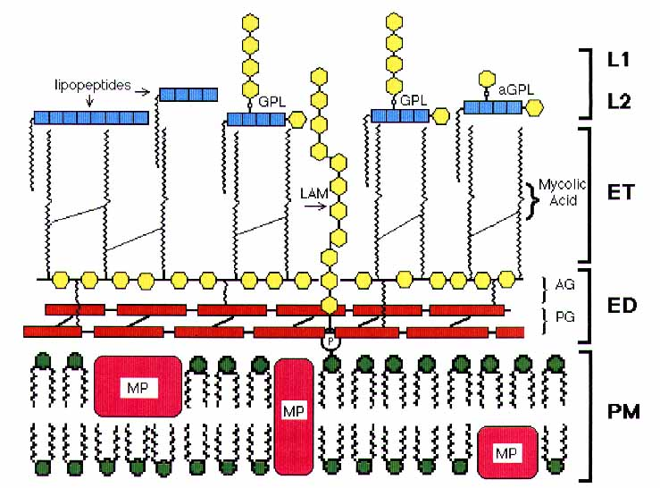
Mycobacterial Cell Wall
Mycobacterial Cell Wall

Slide 7
John’s disease clinical signs and pathological features
The major symptoms of infection are chronic diarrhea, emaciation, decrease milk production, and infertility
Focal lesions are consisted of small granulomas in the ileal and jejuanl lymph nodes.
In diffuse forms, multibacillary lesions are usually seen with sever granulomatous enteritis due to intensive macrophages infection.

Slide 8
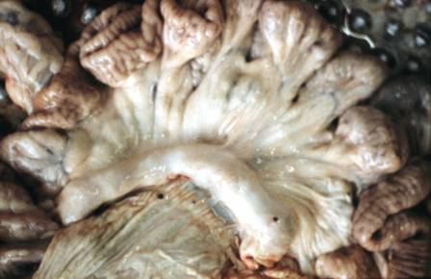
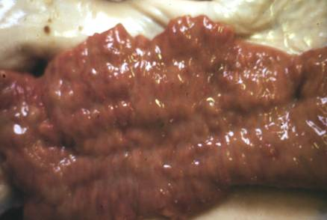
Pathologico-anatomical alterations:
oedema, thickening and corrugation of mucosa
Sheep Cow
Ayele et al., Veterinarni Medicina, 2001, 205-224. http://www.vri.cz/docs/vetmed/46-8-205.pdf

Slide 9
Pathogenesis Transmission Clinical Signs
0 yres
Animal (often calves 0-4 months) infected
No / minimal bacterial shedding
minimal bacterial shedding
MAP establish in intestines
No / minimal reduction in milk yield
Pronounced (intermittent bacterial shedding
2-15 yres
CMI responses
Reduction in milk yield
Humoral immune reactions
Extensive bacterial shedding
Diarrhea (intermittent) weight loss, Death
Tissue destruction and bacterimia
Time relative to time of infection
From : S.S. Nielsen, N. Toft / Veterinary Microbiology 129 (2008) 217–235

Slide 10
The Epidemiology of MAP Infection
Contraction of the infection and development of the clinical signs is influenced by many factors like:
Genetic resistance
Susceptibility to the pathogen
Age at the time of infection
Previous exposure to other environmental mycobacteria
Majority of exposed animals in the heavily contaminated area fail to express any clinical signs (46% of cattle, 51% of sheep, and 50% of goats in a MAP-contaminated environment do not show any signs of infection.
About 19% of cattle, 16% of sheep and 38% of goats succumb to the infection and proceed to the clinical stage.

Slide 11
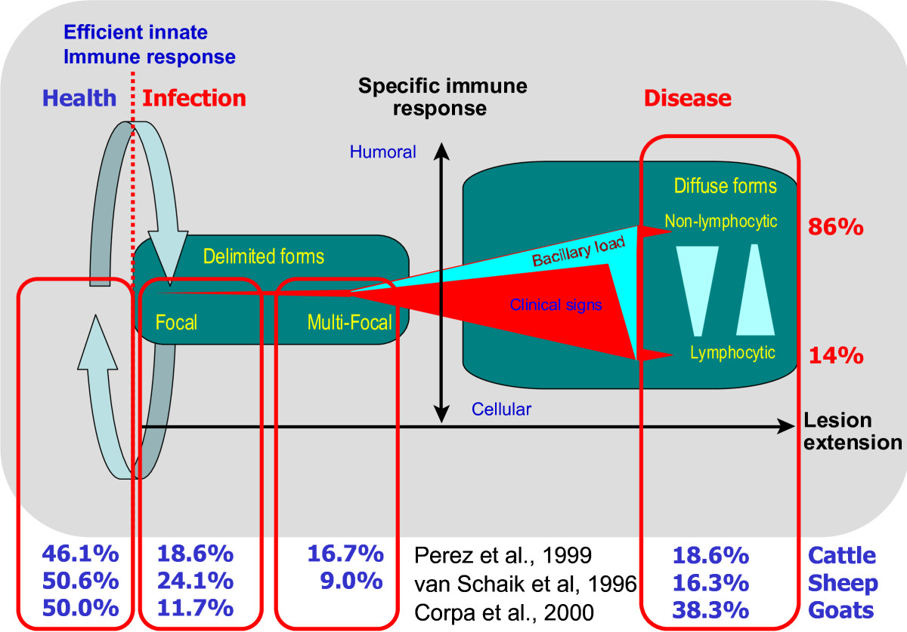
Immunopathological model of paratuberculosis. Continuous exposure of animals to MAP results in a dynamic balance where infection never gets established or is controlled by an efficient innate immune response in about half of the farm population, while in the other half it progresses to subclinical delimited focal or multifocal forms and, in a smaller fraction, to diffuse lymphocytic (cellular or Th1 type) or nonlymphocytic (humoral or Th2 type) forms that will result in open clinical disease. Bastida and Juste Journal of Immune Based Therapies and Vaccines 2011, 9:8

Slide 12
The nature of the immune responses
The host adaptive immune response to MAP infection is somewhat paradoxical.
Immune responses play minor role in control of the infection and reduction of the bacterial shedding with minor positive effect of the CMI and negative effect of humoral responses Ganusov et al. Veterinary Research 2015 46:62 doi:10.1186/s13567-015-0204-1
It was noticed that most of the immune responses to MAP infection are of steady state progression.
MAP pathogenesis indicated that the progression of the disease is associated with a continuous-fold increase in the genes related to the control of innate immunity, adaptive immunity and apoptosis .
MAP pathogenesis pathways mainly influence the lipid hemostasis that affects the:
Maturation of phagosome–lysosome fusion
Cell signaling and apoptosis
Pathways involved in the inflammatory response

Slide 13
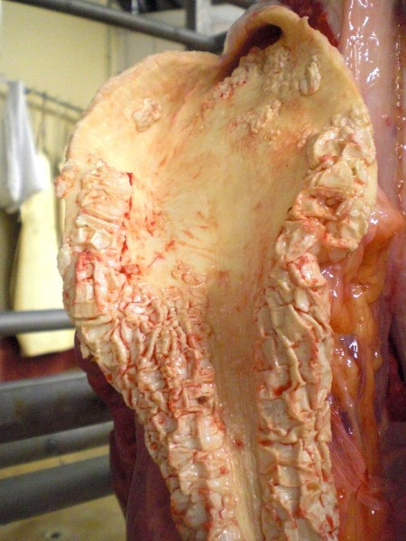
Aortic Mineralization (Atherosclerosis)

Slide 14
Factors Affecting the ELISA sensitivity
The efficacy of the diagnostic tools
several factors influence the sensitivity of ELISA, among the most important factors of these are
Age,
level of shedding in feces. ELISA positive animals could remain fecal culture negative
the mathematical method for calculating the sensitivity.
The sensitivity of ELISA in detecting the infection at the early stage of the infection is about 15%. ELISA sensitivity in moderately shedding animals is only 47-48%. However, it scores 88% in animals with clinical signs (Whitlock et al., 2000).

Slide 15
PCR
PCR proved more practical than ELISA in detecting MAP, however the different shedding patterns render PCR of low predictive value.
Unless it is employed in combination with milk or serum ELISA.

Slide 16
MAP VACCINES

Slide 17
The MAP conventional commercial vaccines
Killed whole cell vaccine:
MAP strain 18: As base of the commercial ( Mycopar) in the USA.
The Gudair a commercial vaccine developed in Spain by for lambs and goat kids is based on strain 316F.
Strain 5889 Bergey strain is an experimental vaccine developed in Hungary. This vaccine is composed of a heat-killed, oil-adjuvant.
Live whole cell attenuated vaccines:
The commercial (Neoparasec) Live modified 316 F strain of MAP (Rhone-Merieux, Lyon, France). A modified version of the vaccine in Britain and Norway was made either from strain 316F or 2E.

Slide 18
The MAP conventional commercial vaccines
Modified whole cell killed and live vaccines:
Killed strain 316F bovine vaccine (Silirum® ) with highly refined mineral oils to reduce the granuloma at site of inoculation.
Live 316F vaccine (AquaVax®) with aqueous suspension.
Killed vaccine made of a combined Strain 18 and killed MAP field-isolate with human rIL-12 adjuvant.
Killed vaccine based on a highly virulent MAP 'Bison-type' field strain adjuvanted in alum or QS21 saponin .

Slide 19
Disadvantages of the MAP conventional vaccines
The immune responses induced by these vaccines interfere with the diagnosis of bovine tuberculosis by:
False-positive results of interferon-γ assay.
Interference with the bovine tuberculosis tuberculin test.
The antibody responses interfere with the ELISA test, a major tool in screening for the MAP prevalence in cattle herds.
The vaccines have minor effect in the reduction of the bacterial shedding

Slide 20
Experimental Subunit Based Vaccines
In aim of overcoming the drawbacks in the conventional vaccines several subunit vaccines were produced with aim of:
Differentiating Infected from Vaccinated Animals (DIVA) properties.
Improved CMI responses
Elimination of the MAP shedding

Slide 21
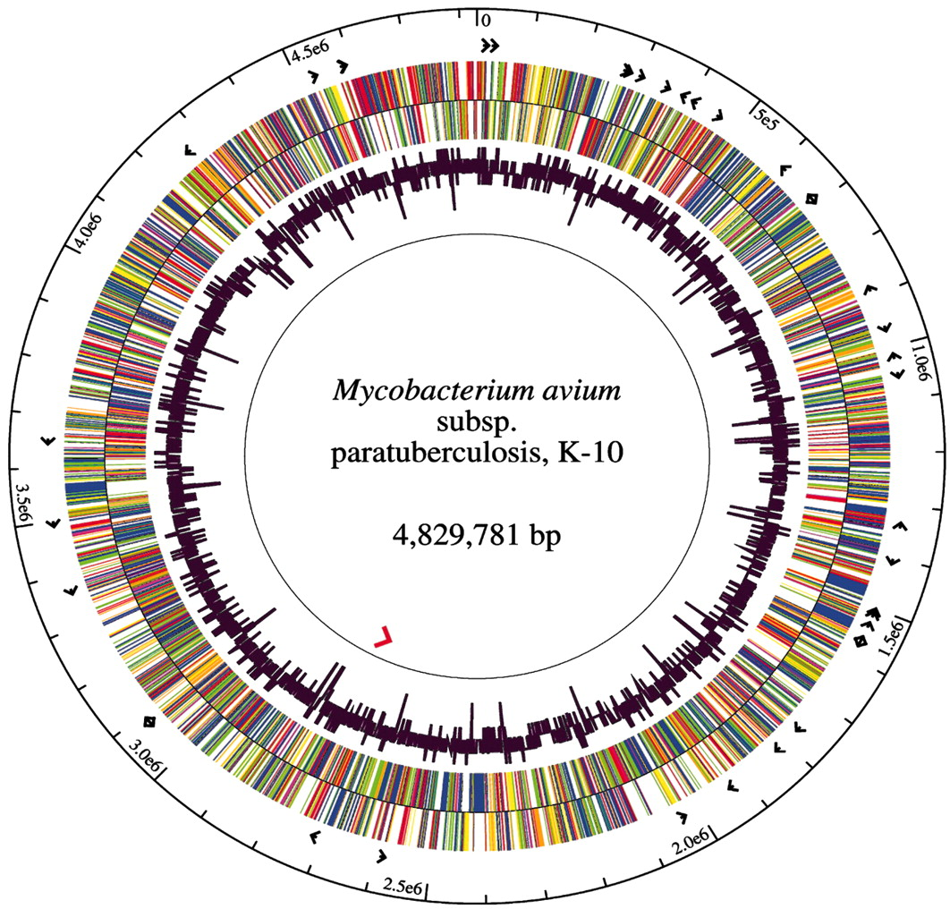
MAP Genome
The genome of K-10 is a single circular chromosome composed of 4.83 × 10⁶ bp coding for 4350 predicted open reading frames.
3000 genes of are homologs to M. tuberculosis .
≈ 266 genes in MAP are predicted to be involved in lipid metabolism.

Slide 22
Immunodominant Th1 antigens:
Ag85A (MAP1609c), Ag85B (MAP0126) and Ag85C (MAP3531c).
Heat-shock protein (Hsp) 65 (GroEL) and Hsp70 (DnaK)
P22 (22 kDa) : a member of LppX/LprAFG family of putative mycobacterial lipoproteins.
MAP1518 and MAP3184 a members of MAP PPE family
Superoxide dismutase (SOD) is a 23-kDa intracellular protein of virulent mycobacteria.
MPP14, a 14-kDa secreted MAP protein.
Alkyl hydroperoxide reductases C (AhpC) and D (AhpD).
Mutants based on virulence factors antigens
MAP mutants of either of the three genes encoding virulence factors pknG , relA and lsr2
DNA vaccines
plasmid DNA encoding MAP0586c and MAP4308c
Adenovirus 5 and modified vaccinia Ankara (MVA) virus, expressing a 95-kDa fusion protein, consisting of fragments of two secreted (MAP 1589c/AphC and MAP 1234/Gsd) and two cell surface (MAP2444c and MAP 1235/Mpa) proteins.

Slide 23
The main drawbacks of the subunit vaccines
Mice as lab animal model for testing most of these subunit vaccines did not reflect satisfactory responses. Which urge the search for suitable model.
Interference with the tuberculin test and the diagnostic tests did not overcome by most of these subunit vaccines.
Shedding remained to be as a major setback to most of these vaccines
Variation in types of the involved antigens and nature of the immune responses hindered the production of the DIVA vaccine.

Slide 24
Conclusion and Recommendations
Despite all the drawbacks, application of the MAP vaccination was shown to have economical advantages.
Major lack of information in understanding the MAP pathogenesis exert serious obstacle for developing efficient vaccine.
The efficient approach in induction of experimental infection still controversial.
The development of efficient diagnostic test with high sensitivity and specificity becoming more urgent to control the MAP infection and aid the vaccination program .
The prospect of effective Johne's disease control is in favor of proper vaccination program.

Slide 25



