Slide 1
An Empirical Study for Exploring Reusable Packaging Attributes
2nd International Conference on Food and Beverage Packaging
Dr Ahmed Babader
Director of Saudi Packaging for Research and Technologies (SPRT)
Director of Services and Environment Standards in Saudi Arabia Standardisation Organisation (SASO)

Slide 2
Outline
Introduction
Literature review
Empirical evidences
Analysis
Results and discussion
Further research

Slide 3

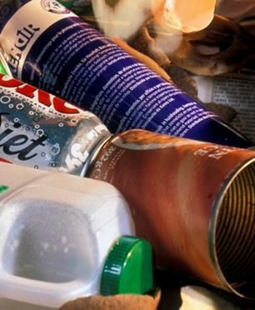
Introduction
The problem of growing waste amounts was first recognised in 1970s.
Waste packaging has old dilemma to environment.
For example, in China, waste packaging represents approximately 15% of municipal solid waste whereas In Sweden, packaging has been recorded as 25% of total household waste in weight and 50% by volume (Jin et al. 2008)

Slide 4
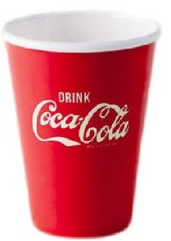
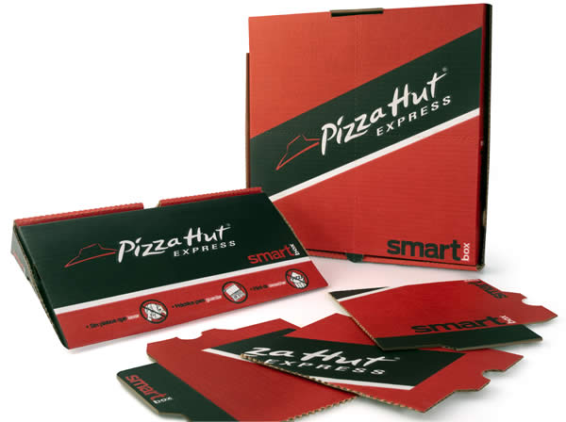
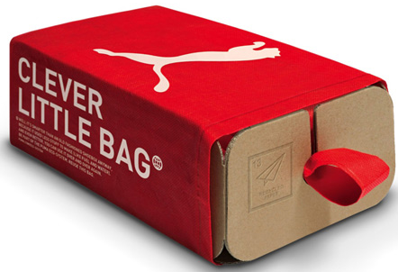
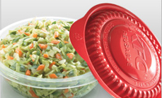
literature Review in packaging attributes
Resources: http://www.elempaque.com/temas/Ecovention-y-SigmaQ-desarrollan-GreenBox,-la-caja-perfecta-de-pizza+4087277 ; http://www.environmentalleader.com/2010/10/01/kfc-rolls-out-reusable-side-container/ ; http://www.visstunred.com/summer.php?view=lids&sub=basic ;
https://www.pinterest.com/nicheecommerce/branding-ideas/

Slide 5
What the attributes that encourage consumers to reuse packaging and move beyond to develop a better understanding of specific reusable packaging attributes in industries’ vision?

Slide 6
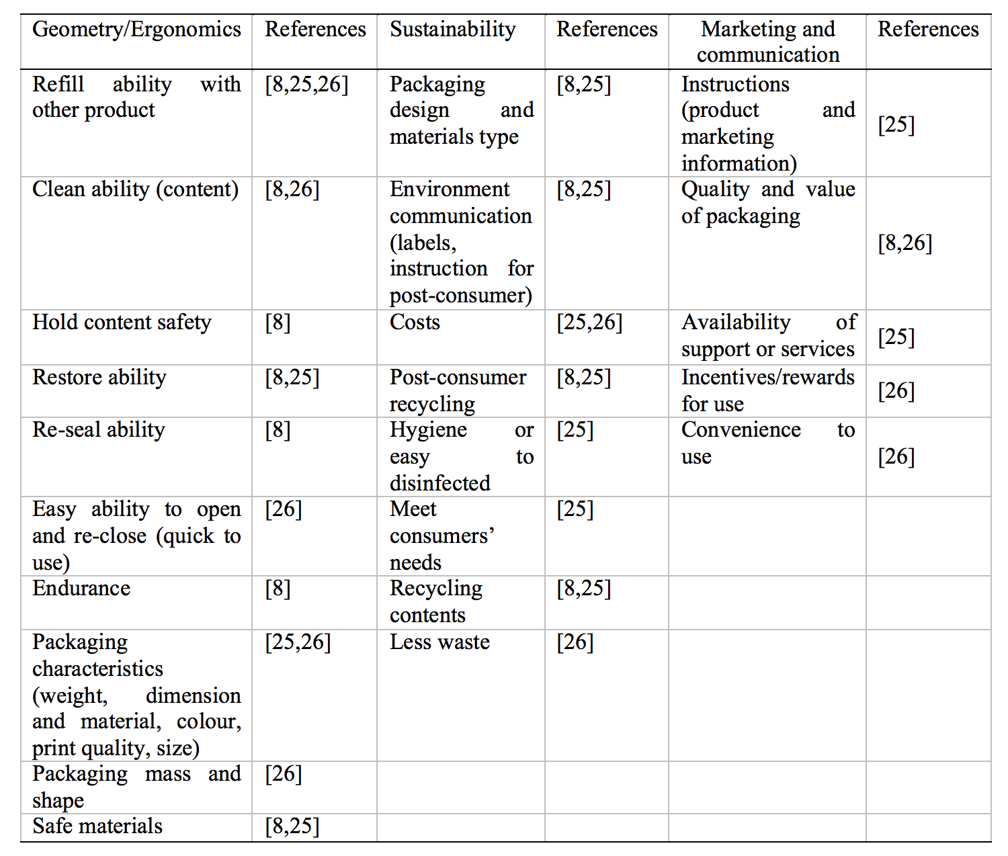
Identification of packaging attributes

Slide 7
An Empirical evidence of discovering reusable packaging attributes
An empirical study on the relationship between packaging design and reusable packaging attributes:
The experts in the field of packaging design and packaging optimisation within industry and academia; the relation of these packaging attributes and reusable packaging.
Questionnaire distributed by experts' email.
The questionnaire has one section at the end for participants’ comments. It does not keep to specific packaging type and gender, age, country but was mainly concentrated on the experts in the field
The questionnaire was piloted with both from university and industries sectors and then refined before being sent to the experts.

Slide 8
An Empirical evidence of discovering reusable packaging attributes
An empirical study on relationship between packaging used for secondary uses and reusable packaging:
The questionnaire consisted of several questions such as product packaging name, what the packaging was reused for and why this packaging was reused, and finally the questionnaire asked respondents to attach photographs of reusable packaging.
The questionnaire does keep to into specific packaging types, rather it gives open choices for answers to questions with any type of packaging that he/she reused.
The questionnaire was piloted with three participants and then refined before the questionnaire link was diffused and ‘codes and coding’ method used to analysis the data.
Questionnaires were sent to 250 households, only 50 of these were fully completed – the others were rejected. The response rate was 20%. The participants received a plain language statement, which explained the research aim and objectives, with the questionnaire link.

Slide 9
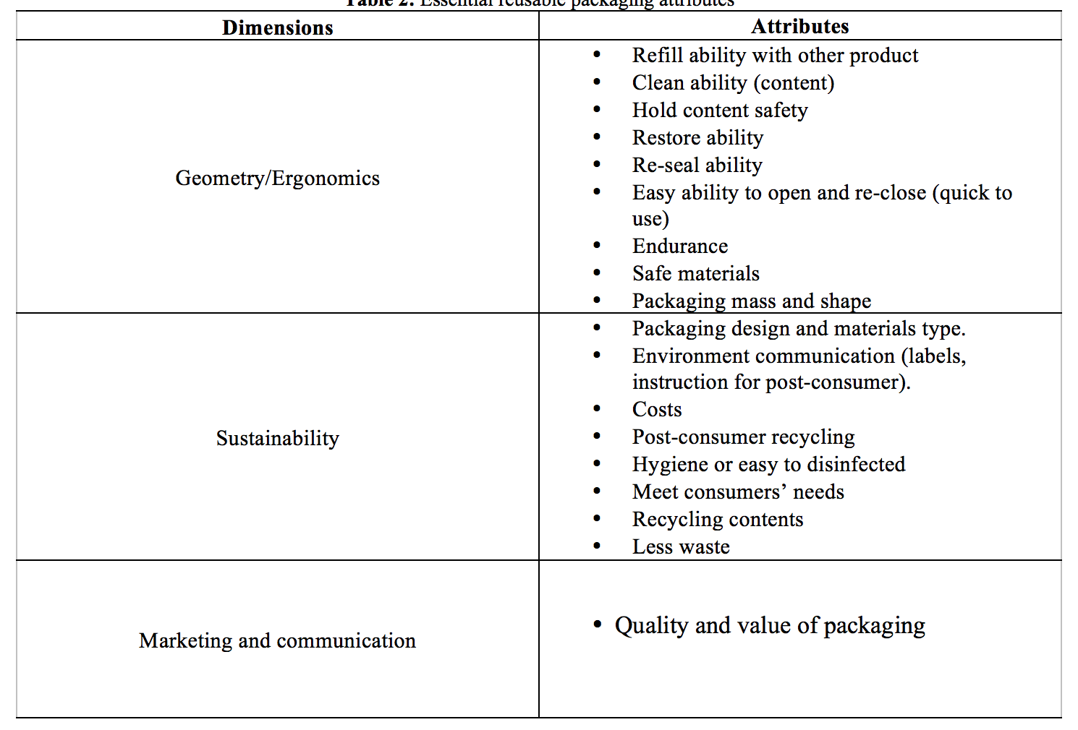
Analysis -Part 1
The weighting the experts give to the importance of geometry, sustainability, marketing and communication related to reusable packaging shows that sustainability is a very essential dimension for reusable packaging, with geometry/ergonomic dimension as an important indicator. However, the marketing and communication dimension scores less.
The results show that 23 packaging attributes are related to reusable packaging and they are classified into two groups: essential and supplementary attributes.
There are 18 essential attributes as defined by experts. which must be considered during the design of reusable packaging; whereas there are 5 supplementary attributes, which could be included during producing reusable packaging.

Slide 10
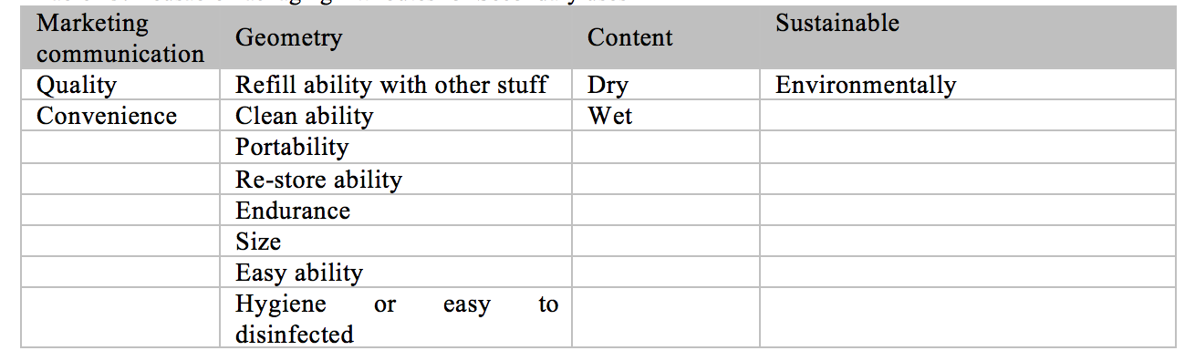
Analysis -Part 2
Consumers who reused packaging did not present any concern if the packaging material has any influence on health.
Packaging that easy to reclose and reopen is more likely to be reused.
Realistic packaging size, which has the ability to be reused, is seen to be more worthwhile for the practice than small packaging, which most consumers are likely to throw as waste.
Portability of packaging which converges with the size and dimension of packaging can lead to ease of carrying and storing packaging.
The results from the questionnaire from packaging used for secondary uses indicate that there is 13 essential reusable packaging attributes.

Slide 11
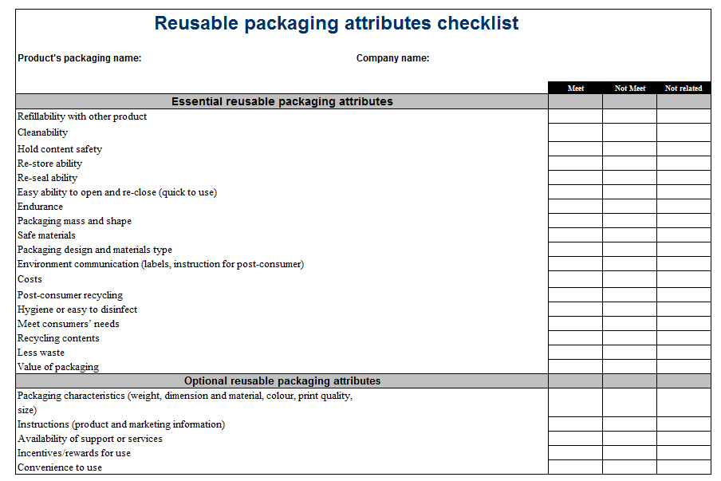
Results

Slide 12
Discussion- Part 1
The reusable packaging checklist is to provide a guideline for the manufacturer/designer who intends to design reusable packaging.
The reusable packaging attributes checklist can help designers/manufacturers in the early phases of packaging design to interpret and understand the reuse of packaging requirements and procedures presented in ‘BS En 13429:2004 reuse of packaging.

Slide 13
Discussion- Part 2
The reusable packaging attributes checklist can be used by companies who seek to improve packaging sustainability performance such as carton companies, beverage companies, etc.
The checklist identifies the open opportunities for improving packaging to meet a sustainable profile and be reusable at the same time.
The checklist can provide valuable information based on social, economic and environment benefits from reusable packaging. Finally, the checklist can contribute to set further packaging goals.

Slide 14
Further research
To discover the environmental impact of reusable packaging attributes in order to explore if reusable packaging result in environmental benefits not only reduce waste packaging but in the other dimensions such as conservation of energy resources, reduction of raw materials, etc. or instead costly burdens for the environment and firm.

Slide 15

Dr Ahmed Babader
E-mail:
BABADER.AHMED@GMAIL.COM
A.BABADER@SASO.GOV.SA
Contact number: +966506658820
+966114232089
Any Questions

