Slide 1
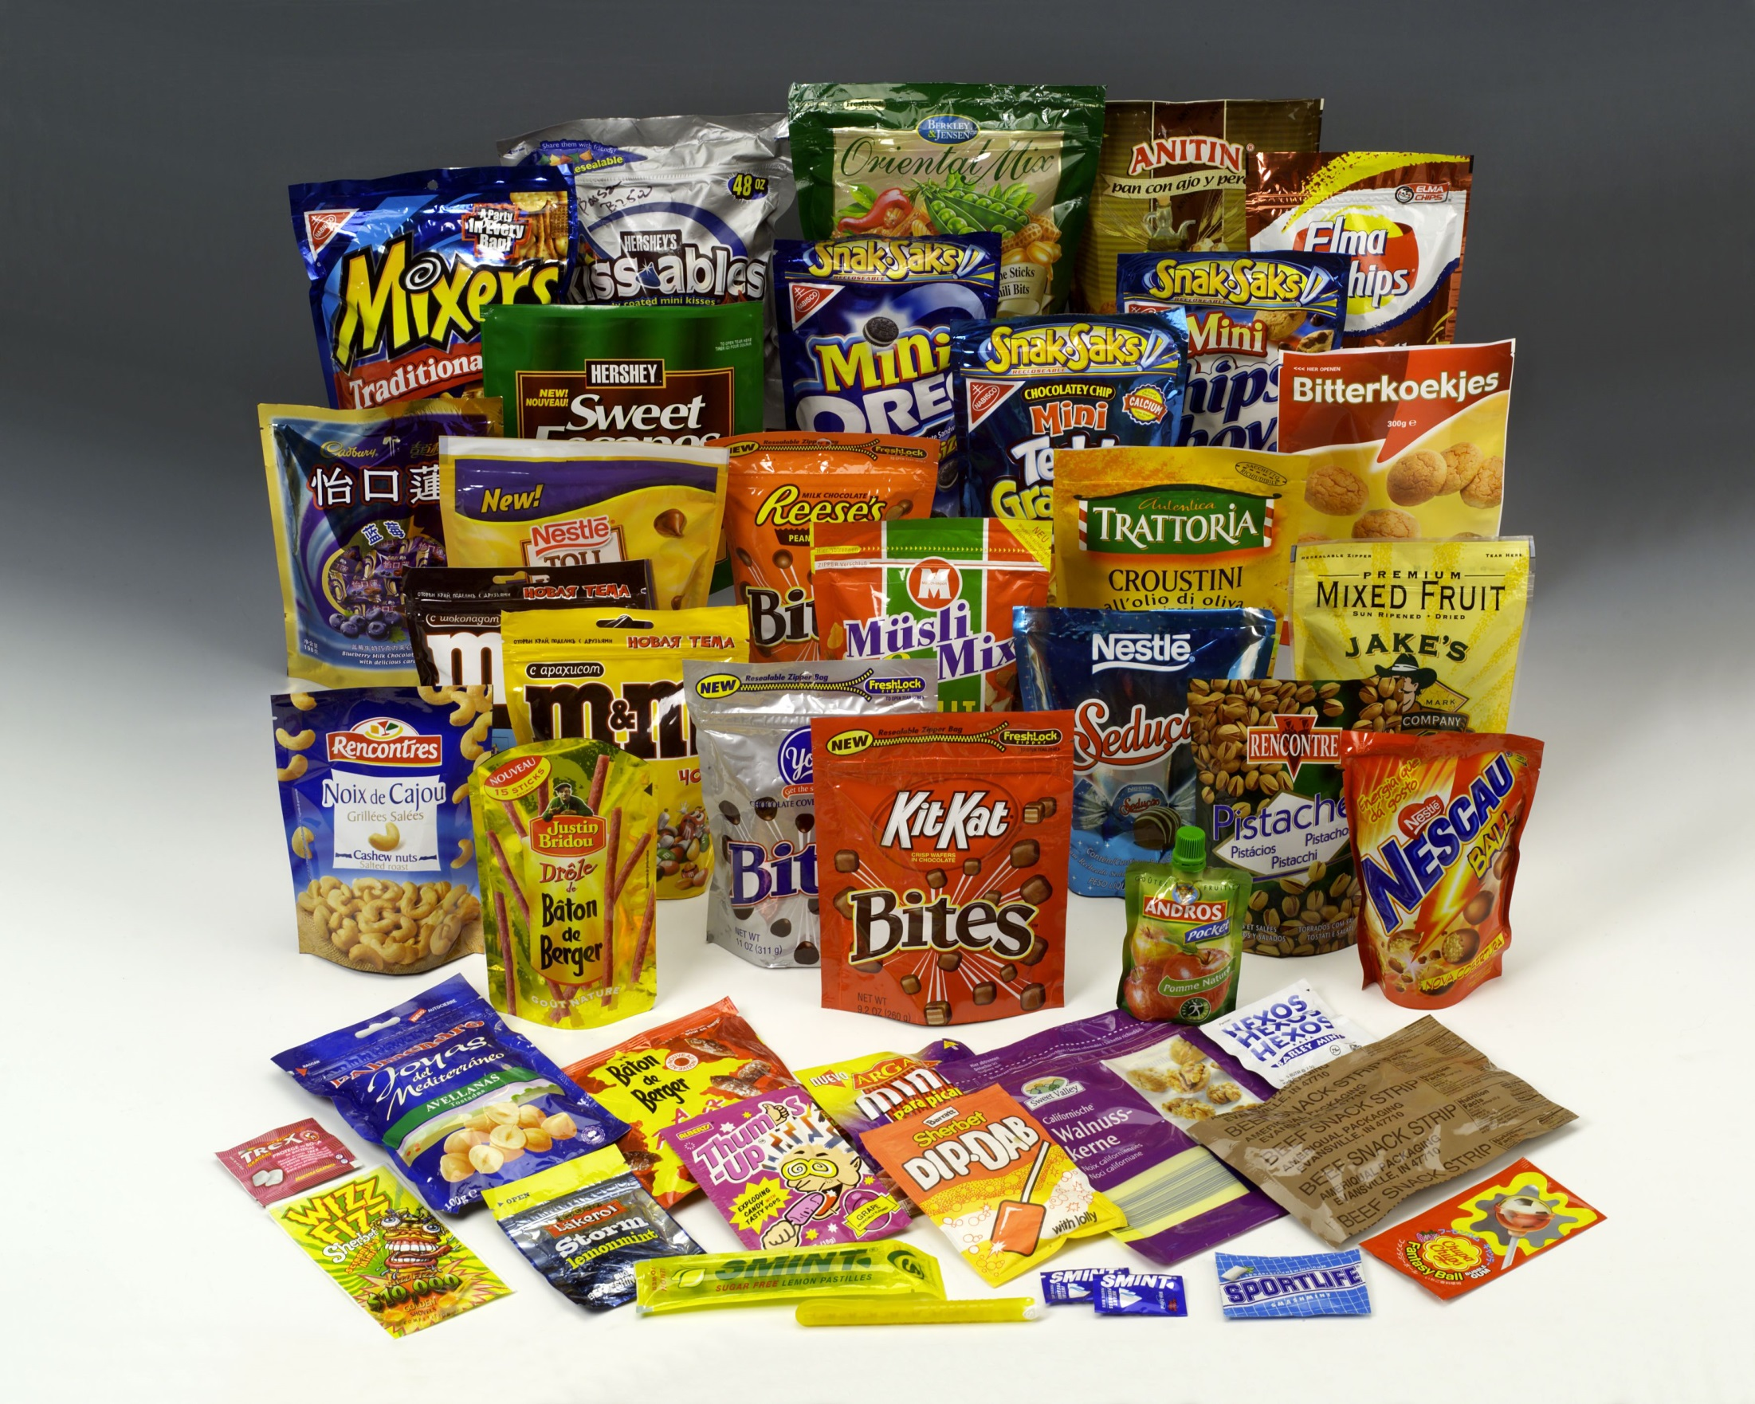
Effect of unacceptable quality Rotogravure printing process on increasing the food waste
“application on a polypropylene printing process”

Slide 2


Agenda
Introduction
Survey
Literature review
Objective
Materials and Procedures
Results and Discussion
Conclusion
Faculty of Applied Arts

Slide 3
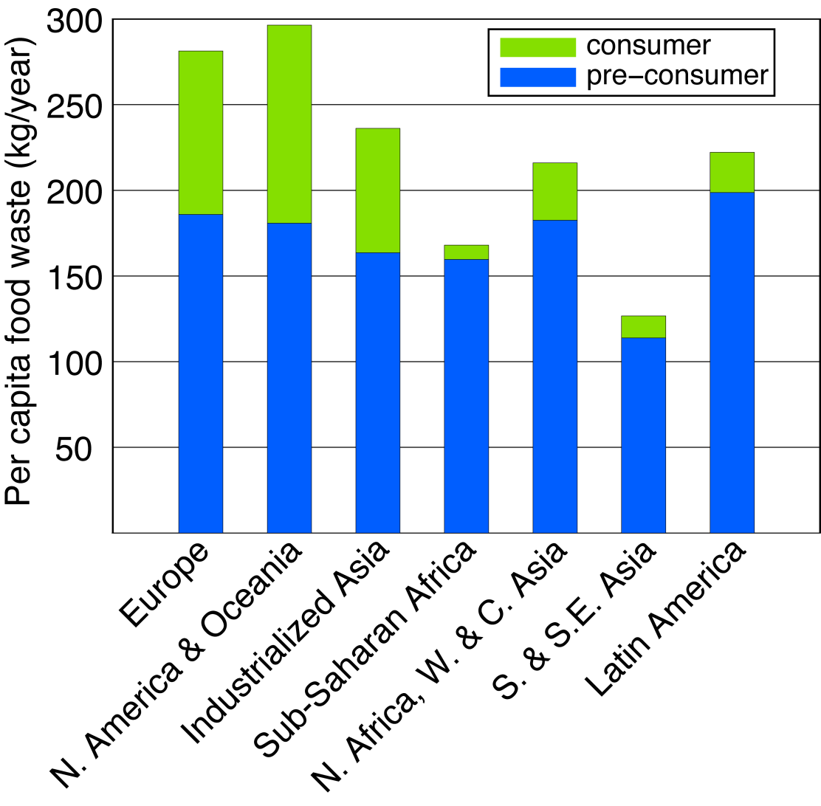

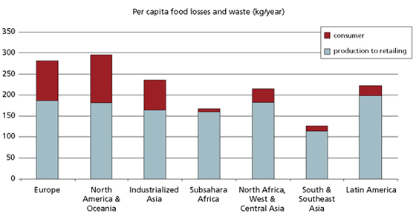
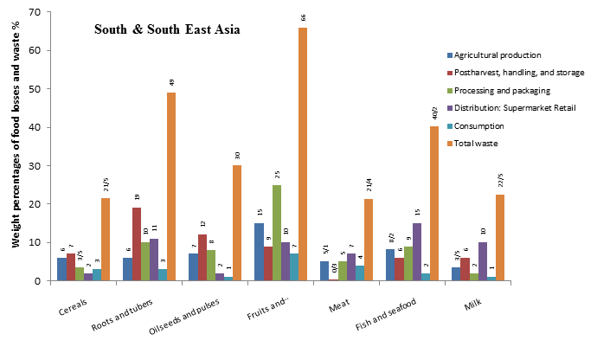
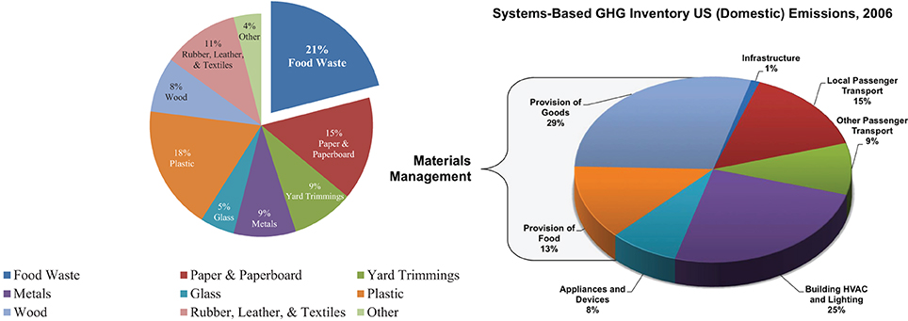
Introduction
Every year around the globe 1.3 billion tons of food is lost or wasted, that is a 1/3 of all food produced for human consumption*.it is one of the point of interest in the whole world at the present time because it leads to environmental problems, famine and starvation.
In fact there are many reasons of wastes one of them is printing problems because a defected printed flexible package make the consumer avoid it and because of that it leads the product to the end of the shelf life even before selling.
( FAO,2011 )
http://www.fao.org/save-food/resources/keyfindings/en/

Slide 4
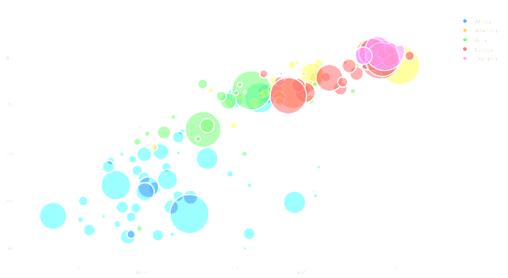
Survey
Why do you AVOID the bad printed pack?
Not fresh
Old product
Bad printing=Bad product
Untrusted company
Cheap product
counterfeited

Slide 5
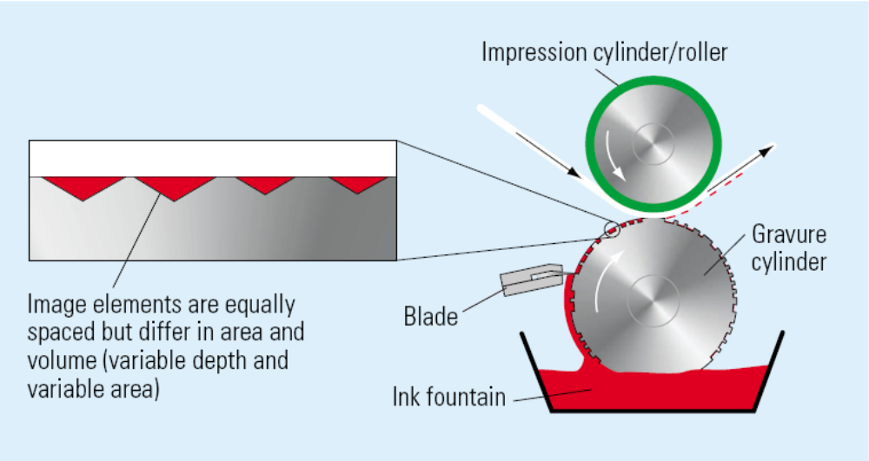
Literature review
Rotogravure printing is one of the best printing methods to print a high quality flexible packages and its benefit of mass production as well,
but the question is how to produce a high quality printed flexible package. So that, the aim of this research is to approach an excellent machine parameters to produce a perfect flexible package.

Slide 6
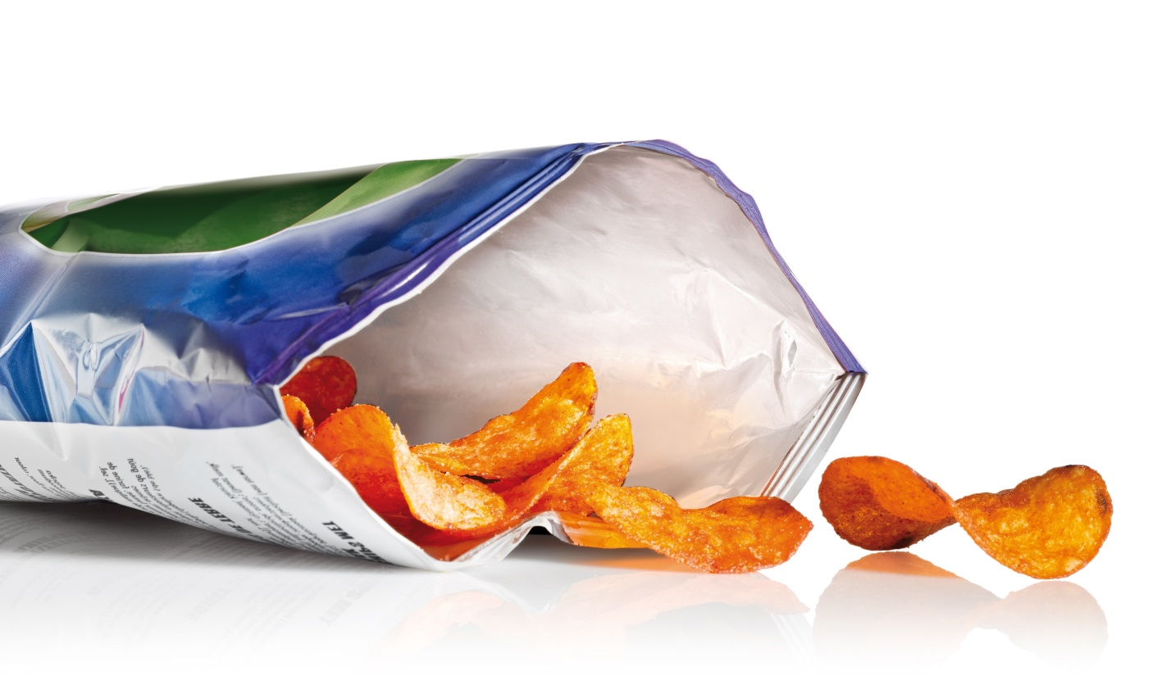
objective
This study is a quality control study that aims to investigate the causes of Printing defects and analyze data to give information about how to control printing parameters which has a great effect on decreasing the food waste because a good printing package is a good selling representative.

Slide 7
Materials and procedures
Six experiments on six different products of food snacks printed on Bi-Oriented Polypropylene ( BOPP ) 20 micron “ as one of the most popular printing material used in the market” at each one of them one parameter changed while all other machine parameters have been fixed, the parameters are:
Machine speed.
Low depth of cell engraving.
A switched off ESA ( Electrostatic Assist ).
Low impress of impression cylinder.
Low impression of doctor-blade.
The effect of low and high ink viscosity.

Slide 8
Results and discussion
Experiment #1
Parameter under study
Increase and decrease the machine speed
COLOR SATURATION

Slide 9
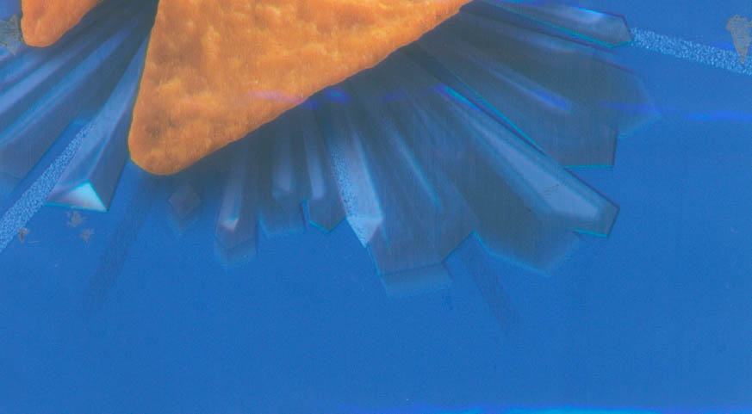
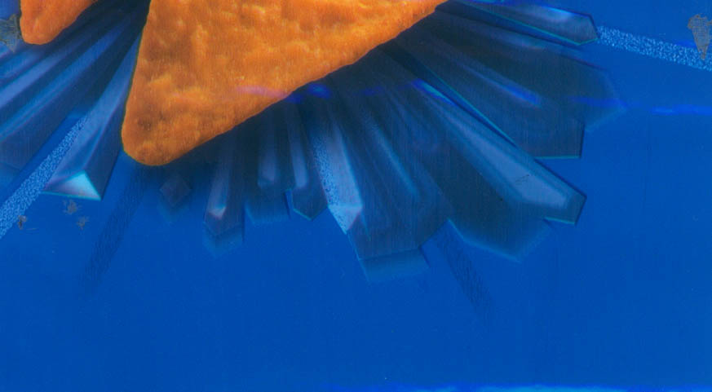
Results and discussion
Experiment #1
Parameter under study
Increase and decrease the machine speed
Machine speed 250 m\m
Machine speed 100 m\m
Pale and thus prevents the customer from the purchase .. may be the product counterfeited

Slide 10
Results and discussion
Experiment #1
Parameter under study
Increase and decrease the machine speed
Analysis of the researcher:
When the machine is operating at low speed, the raw material spent at the Nip area longer than the time of the other when the machine is running high speeds and thus exposed a more ink transfer to the surface of the raw material, hence the saturation chromatography of the printed dot in going to be less.

Slide 11
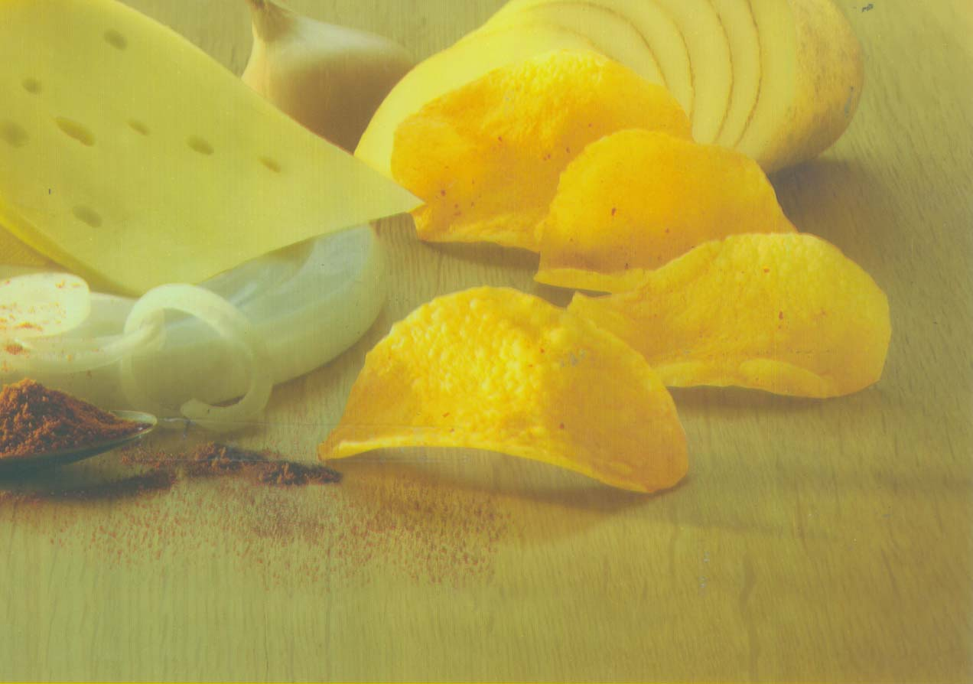
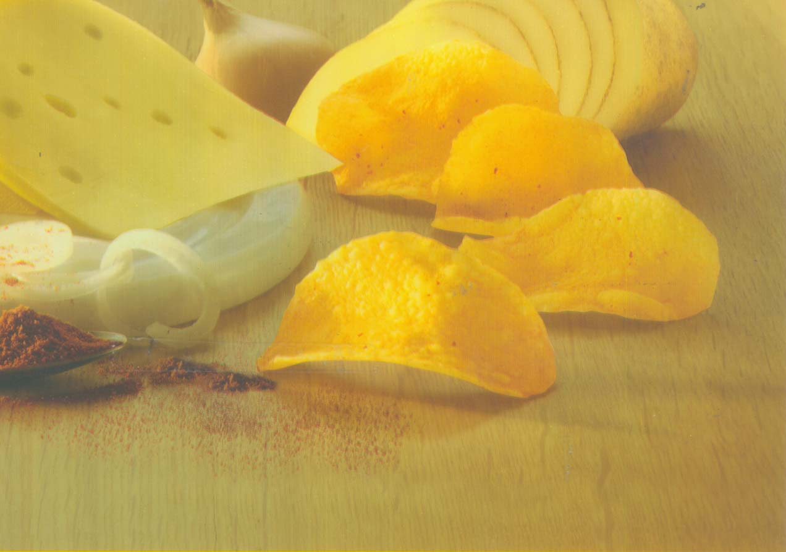
Results and discussion
Experiment #2
Parameter under study
The cell depth decrease
Bad red saturation
Good red saturation
This dull potatoes is an indicator of non-fresh in the customer mind thus prevents the customer from the purchase

Slide 12
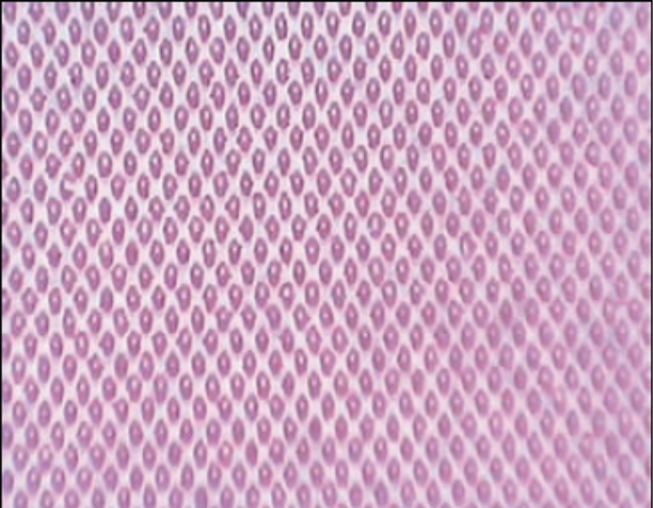
Results and discussion
Experiment #2
Parameter under study
The cell depth decrease
Low cells` depth
High cells` depth

Slide 13
Results and discussion
Experiment #2
Parameter under study
The cell depth decrease
Analysis of the researcher:
It is possible that the problem be started during the cylinder manufacturing, where electroplating of chromium layer was not equal in all surface areas of the cylinder and may be the reason because of the waviness of the printing cylinder so the electromechanical engraving diamond head produce different depths as a result of the differ distance and also the doctor blade might effect the cylinder surface and therefore the cell depth.

Slide 14

Results and discussion
Experiment #3
Parameter under study
Turn-off the ESA
?
Is it an OLD production package

Slide 15
Results and discussion
Experiment #3
Parameter under study
Turn-off the ESA
Analysis of the researcher:
This effect called (Dot-loss, snow effect) appears mostly in high light areas and middle tones and the unsafe solution of these problem is to increase the impression of the impression cylinder or using more hardness rubber layer whereas the best solution is not to impress the raw material to the printing cells but by the lifting of the ink to contact the raw material as the ink tends to take the concave form inside the cell and this is what increases the adhesion to the cell walls and hinders his transfer.

Slide 16
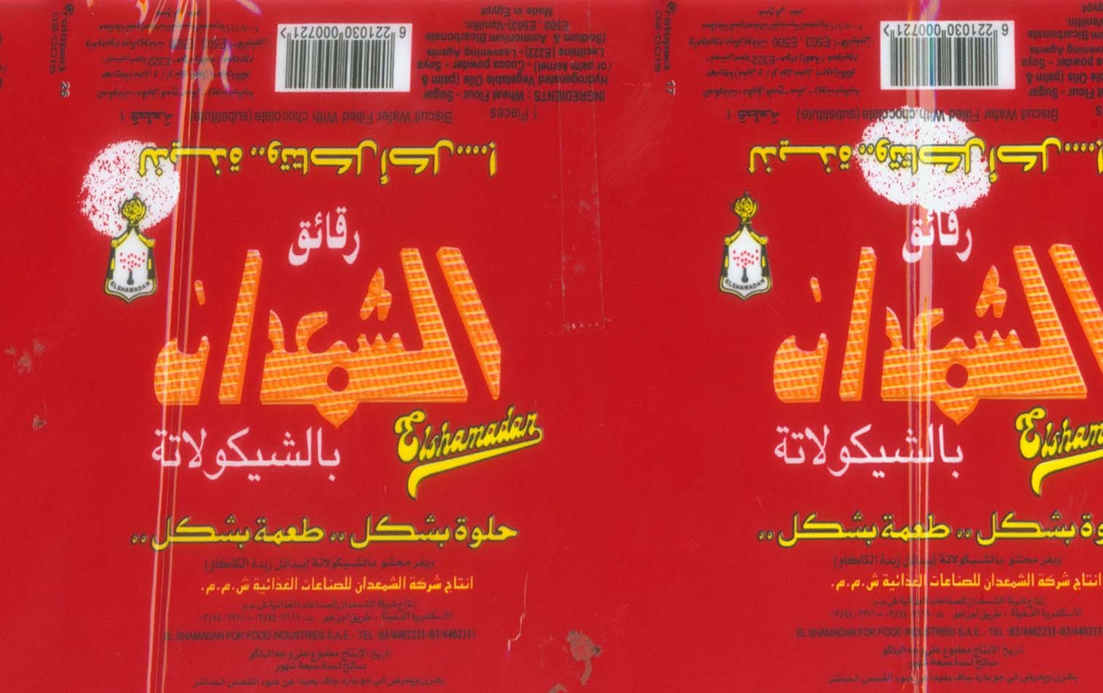
Results and discussion
Experiment #4
Parameter under study
The low Impression of the Impression cylinder

Slide 17
Results and discussion
Experiment #4
Parameter under study
The low Impression of the Impression cylinder

Slide 18
Results and discussion
Experiment #4
Parameter under study
The low Impression of the Impression cylinder
Analysis of the researcher:
Impression cylinder pressures the raw material to cells to enhance the ink's transfer, and with the low pressure force means less chance to transfer ink, the surface of worn cylinders differs in thickness of the rubber layer rubber so the ink cutout area is just a shallow area in the surface requires a higher pressure, of course, this is not a safe solution to the problems of increasing the various pressure and it is best to re-manufacture the impression cylinder.

Slide 19
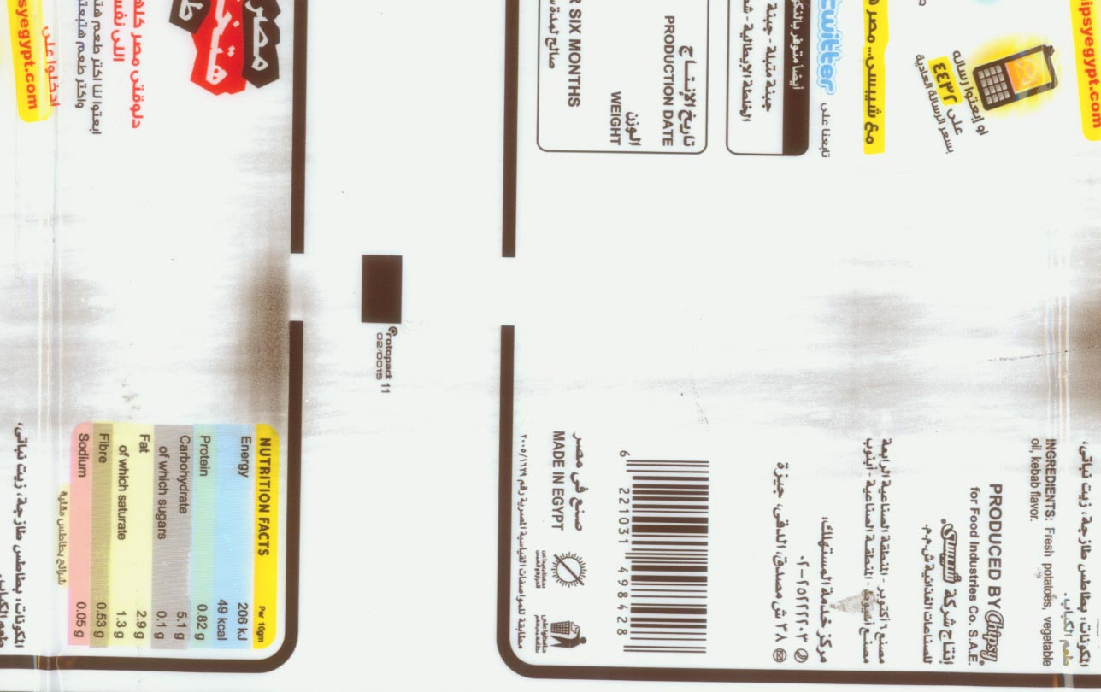
Results and discussion
Experiment #5
Parameter under study
The low Impression of the Doctor blade
Defected pack?? What if the product inside is defected too!!!

Slide 20
Results and discussion
Experiment #5
Parameter under study
The low Impression of the Doctor blade

Slide 21
Results and discussion
Experiment #5
Parameter under study
The low Impression of the Doctor blade

Slide 22
Results and discussion
Experiment #5
Parameter under study
The low Impression of the Doctor blade

Slide 23
Results and discussion
Experiment #5
Parameter under study
The low Impression of the Doctor blade

Slide 24
Results and discussion
Experiment #5
Parameter under study
The low Impression of the Doctor blade
Analysis of the researcher:
Doctor blade must have a known pressure value which suits the machine speed an the printing cylinder circumference and that pressure must remove all the excess ink in the non printing areas and there is another proper reason is that the printing cylinder made with a high slipper surface that make a dysfunction of its job.

Slide 25
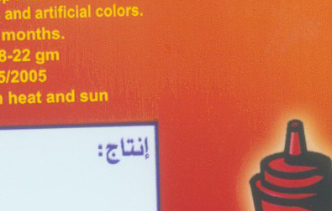
Results and discussion
Experiment #6
Parameter under study
The effect of High and low ink viscosity
A:. High ink viscosity
Untrusted Cheap

Slide 26
Results and discussion
Experiment #6
Parameter under study
The effect of High and low ink viscosity
A:. High ink viscosity

Slide 27
Results and discussion
Experiment #6
Parameter under study
The effect of High and low ink viscosity
A:. High ink viscosity
Analysis of the researcher:
High viscosity inks are harder to flow into cells and out of it because it`s adhere to cell walls.

Slide 28
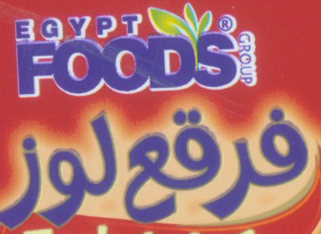
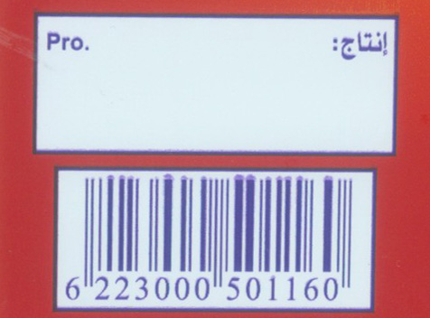
Results and discussion
Experiment #6
Parameter under study
The effect of High and low ink viscosity
B:. Low ink viscosity
Untrusted Cheap

Slide 29
Results and discussion
Experiment #6
Parameter under study
The effect of High and low ink viscosity
B:. Low ink viscosity

Slide 30
Results and discussion
Experiment #6
Parameter under study
The effect of High and low ink viscosity
B:. Low ink viscosity
Analysis of the researcher:
With High machine speeds the centrifugal force of printing cylinder makes the low viscosity inks to bleed once it out from the cell.

Slide 31
Conclusion
Results
Difference of machine speed from high to low makes a differences in color saturation .
Missing dots appears when we don`t use ESA .
A low impression of the impression cylinder leads to a weak ink transfer .
Changing doctor blade parameters effect the printing quality by Mist effect .
Low ink viscosity makes the ink to bleed especially in high machine speeds .
High ink viscosity makes a poor ink transfer in high lights and middle tone dots .

Slide 32
Conclusion
Recommendations
The approved sample have to be taken on the machine high speed to ensure the constancy of colors in all orders.
Printing houses must to include the ESA technology in their machines.
Impression cylinders must be controlled to make sure that the impression is equal on both sides.
Doctor blade parameters have to be controlled together and don’t rely on a single parameter.
Ink viscosity should be between 16’’ and 24’’ ( Zhan cup 2) when printing BOPP.

Slide 33
Thanks for listening
Presenting author details
Full name:
Ahmed Adel Mohamed Zaki
Faculty of Applied Arts
Printing, Publishing and Packaging Dept.
Helwan University
Contact number:
+201095057285
Twitter account
https://twitter.com/dc_ahmed
Linked In account
https://eg.linkedin.com/in/ahmed-adel-98101877
Faculty of Applied Arts

