Slide 1

Breakfast consumption, nutritional, health status, and academic performance among children
Dr. Ahlam B. El Shikieri, PhD, MBA
Associate Professor, Registered Nutritionist
Taibah University, Saudi Arabia

Slide 2

Breakfast consumption, nutritional, health status, and academic performance among children

Slide 3
Contents
Introduction
Definition
Prevalence of breakfast consumption
Breakfast consumption and Health benefits
Barriers to breakfast consumption

Slide 4
Introduction
Consumption of breakfast is often considered as one of the most important health-related behaviours and there has been considerable research into its effects.

Slide 5

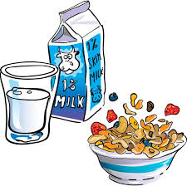
What is Breakfast ?
Breakfast = first meal of the day
The word “Breakfast” means breaking the fast.

Slide 6
Prevalence of Breakfast consumption
Daily breakfast consumption among 11-, 13- and 15-year olds by country and gender (%)
Results from Breakfast consumption and its socio-demographic and lifestyle correlates in schoolchildren in 41 countries participating in the Health Behaviour in School-aged Children study (HBSC)

Slide 7


Slide 9



15 yrs old boys and girls who eat breakfast every school day

Slide 10
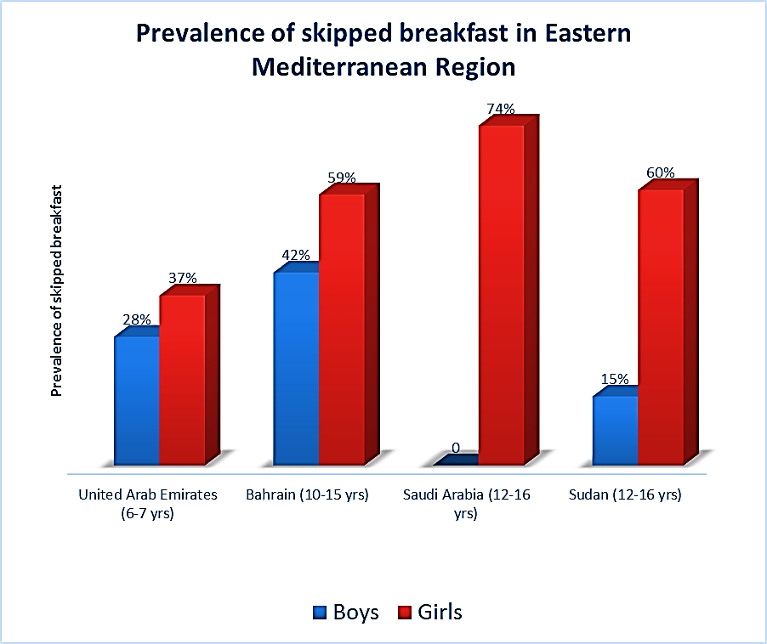
Girls may be more likely to skip breakfast than boys, according to several surveys and studies (as indicated above)

Slide 11

Breakfast consumption and Health benefits

Slide 12
Benefits of a Nutritious Breakfast
An important determinant of a healthful lifestyle is a nutritious breakfast, which:
  influences the composition of subsequent meals,
  regulates energy intake,
  boosts physical activity levels,
  and provides a crucial source of dietary micronutrients.

Slide 13
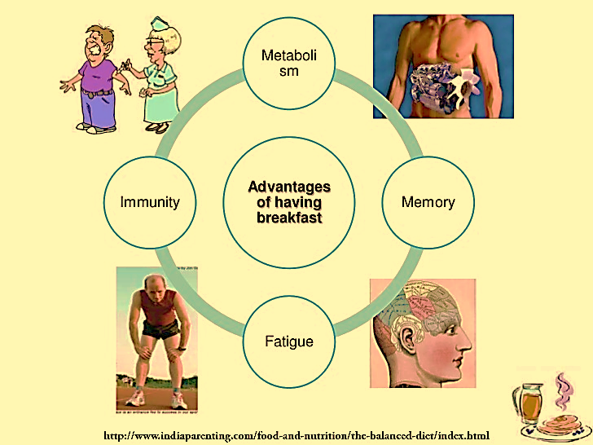

Slide 14
Benefits of a Nutritious Breakfast
There are several health benefits associated with the consumption of breakfast including improved bone health, reduced risk of coronary heart disease, lower fasting insulin, lower total cholesterol etc..
In the current presentation, selected health benefits will be discussed

Slide 15
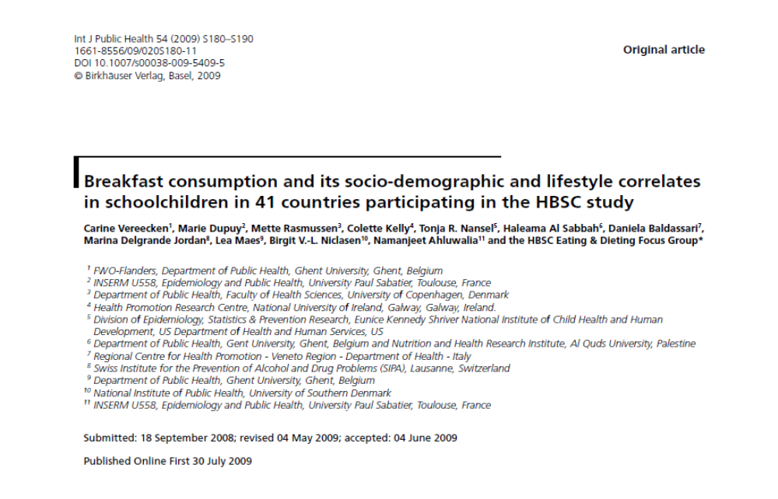

Slide 16
Nutritional adequacy and breakfast consumption
In a research review of 47 studies which examined the association between breakfast consumption and several health-related factors such as nutritional adequacy in children and adolescents it was found:
  that breakfast eaters have higher daily intakes of fibre, calcium, vitamin A, vitamin C, riboflavin, zinc, and iron
  and are more likely to meet nutrient intake recommendations compared to breakfast skippers.

Slide 17
Nutritional adequacy and breakfast consumption
Similar findings were reported in Sudan, where the mean intake of energy, Ca, Fe, Zn, vitamin A, vitamin B₁₂ and folate among children who took their breakfast in school was higher than the breakfast skippers
in an adolescent population the intake of added sugars was higher in breakfast skippers than breakfast consumers.

Slide 18
Energy and nutrient consumption by breakfast skippers in Sudan
Nutrients | Mean ± sd
 | 6-7 yrs | 8-9 yrs | 10-11 yrs
Energy (kcal) | 1751±274 | 1418±531 | 1753±20
Ca(mg) | 809±181 | 699±325 | 432±45
Fe(mg) | 15±7 | 12±6 | 10±2
Vitamin A(µg) | 202±131 | 157±125 | 811±737
Vitamin B₁₂(µg) | 129±56 | 132±163 | 294±410
Folate(µg) | 165±37 | 163±66 | 278±85

Slide 19
Breakfast consumption and Health benefits
Skipping breakfast is also associated with a variety of detrimental outcomes in other studies including:
  dental caries,
  dysmenorrhoea
  and reduced weight control

Slide 20



Breakfast consumption and Health benefits
Skipping breakfast is often coupled with various other unhealthy behaviours.
Adolescents who skip breakfast also tend to indulge in several less healthful dietary behaviours such as increased snacking, irregular eating patterns, and increased intake of low-nutritive-value foods

Slide 21
Breakfast consumption and Health benefits
Those who skip breakfast are also significantly less likely to eat the recommended two servings of fruit or five servings of fruits and vegetables a day and are more likely to omit other meals during the day, which may lead to inadequate energy intakes

Slide 22


Breakfast consumption and Health benefits
Breakfast skipping in adolescents is associated with an increased likelihood to smoke, drink alcohol frequently, and use more coffee and caffeinated sodas than regular breakfast eaters

Slide 23
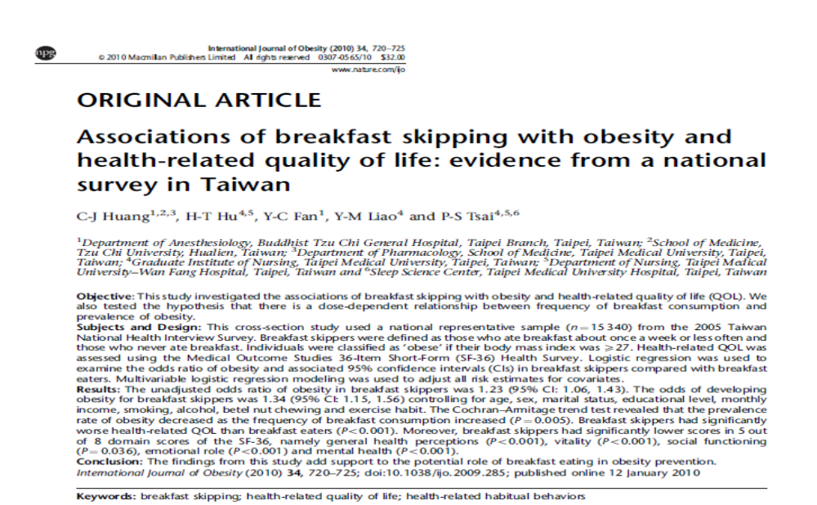

Slide 24
Breakfast consumption and body weight
Numerous observational studies have examined the relationship between breakfast consumption patterns (including frequency and content of breakfast) and body weight and/or body mass index (BMI) in children and adolescents

Slide 25

Breakfast consumption and body weight
Eating breakfast may help prevent weight gain
Studies have also shown that what is actually consumed at breakfast has an effect on the body.
For example, eating cereal or breads for breakfast has been associated with a significantly lower BMI when compared to those who skip breakfast or consume meat and/or eggs for breakfast

Slide 26
Breakfast consumption and body weight
Breakfasts that include ready to eat cereal have been shown to provide more fibre, iron, folic acid, and zinc as well as less fat, sodium, sugar, and cholesterol when compared to non cereal breakfasts
The inclusion of breakfast cereals can also facilitate the consumption of other nutritious foods at breakfast, and displace unhealthy foods such as fats/sweets & meat/eggs

Slide 27
Breakfast consumption and body weight
The main reasons that have been proposed to explain why breakfast skipping is associated with a decreased ability to lose weight have a focus on the assumption that breakfast skipping can lead to over eating later in the day

Slide 28
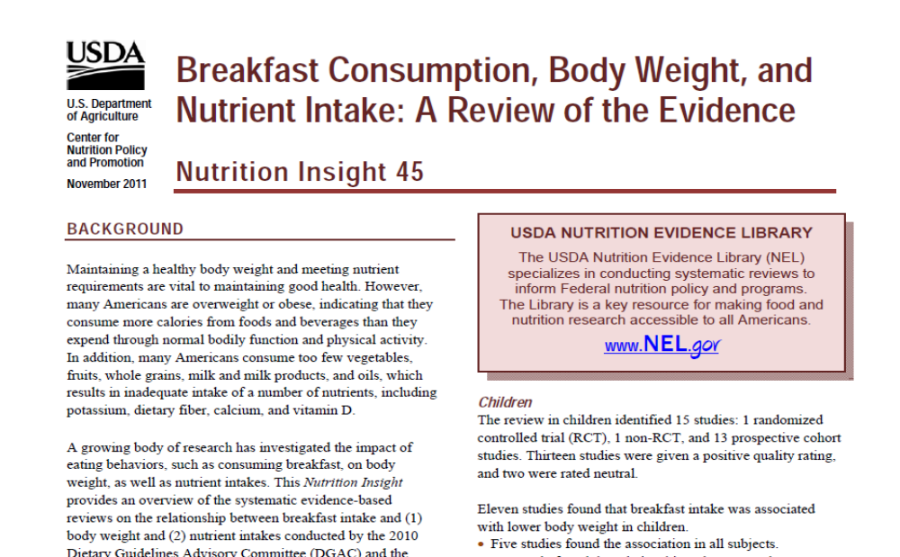

Slide 29
Growing Up Today Study (GUTS)
At baseline, children who never ate breakfast were heavier and more likely to be overweight than children who ate breakfast more consistently.
However, over the first year, overweight children who skipped breakfast had smaller BMI increases than overweight children who ate breakfast daily.
Normal weight children who skipped breakfast tended to have greater BMI increases compared to breakfast eaters, although the finding was not statistically significant

Slide 30


Breakfast consumption and academic performance

Slide 31
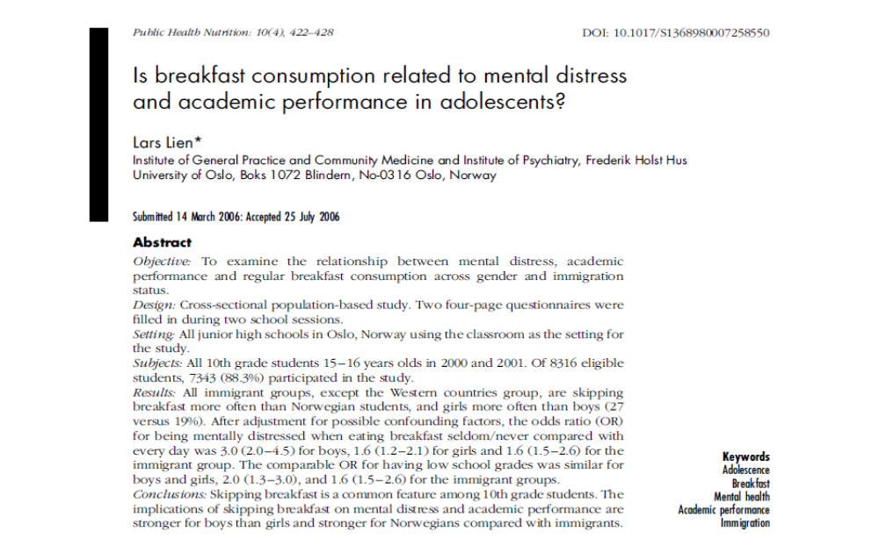

Slide 32

Breakfast consumption and academic performance
A review of 22 studies related to breakfast consumption and academic performance in children and adolescents suggests that eating breakfast may help children do better in school by improving memory, test grades, school attendance, psychosocial function, and mood.
Breakfast may particularly benefit children at nutritional risk

Slide 33
Breakfast consumption and academic performance
Numerous observational studies also showed that eating breakfast has a beneficial effect on academic and achievement school attendance, and tardiness rates
In Saudi Arabia, students who consumed breakfast, performed well in their Science, Mathematics and English
Similar findings were reported in Sudan

Slide 34


Slide 35
Breakfast consumption and memory function
In some experimental studies, eating breakfast was positively associated with several aspects of short-term memory function for various age groups and types of tests.
Specifically, benefits have been reported for recall and episodic memory

Slide 36
Breakfast consumption and stress
Studies suggest that a short fasting may impose greater stress on young children than on adults, resulting in metabolic alterations as various homeostatic mechanisms work to maintain circulating glucose concentrations.

Slide 37
Breakfast consumption and stress
Research has also suggested that individuals who consume a cereal breakfast each day are:
  less depressed,
  less emotionally distressed
  and have lower levels of perceived stress than those who did not eat breakfast each day

Slide 38
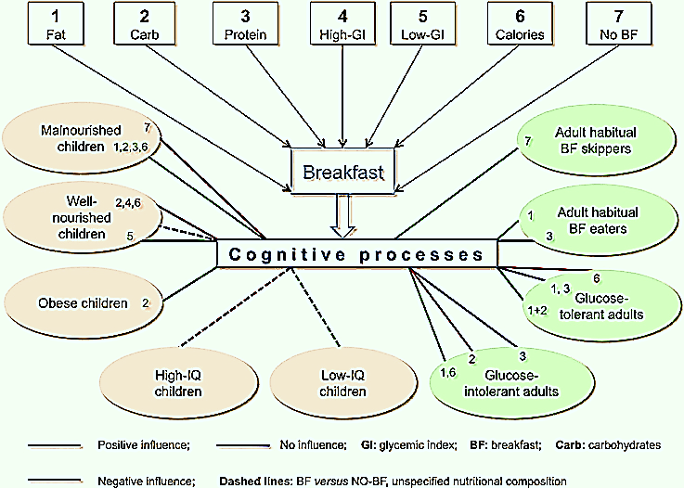
Breakfast and cognitive process

Slide 39
Breakfast consumption and cognitive performance
Theoretically, two biological mechanisms by which breakfast may affect brain function and cognitive test performance have been suggested.
The first involves metabolic changes associated with an overnight fast to maintain the availability of energy and nutrients to the central nervous system
The other involves the long-term beneficial effects that breakfast may have on overall nutrient intake and nutritional status, which could consequently affect cognition

Slide 40
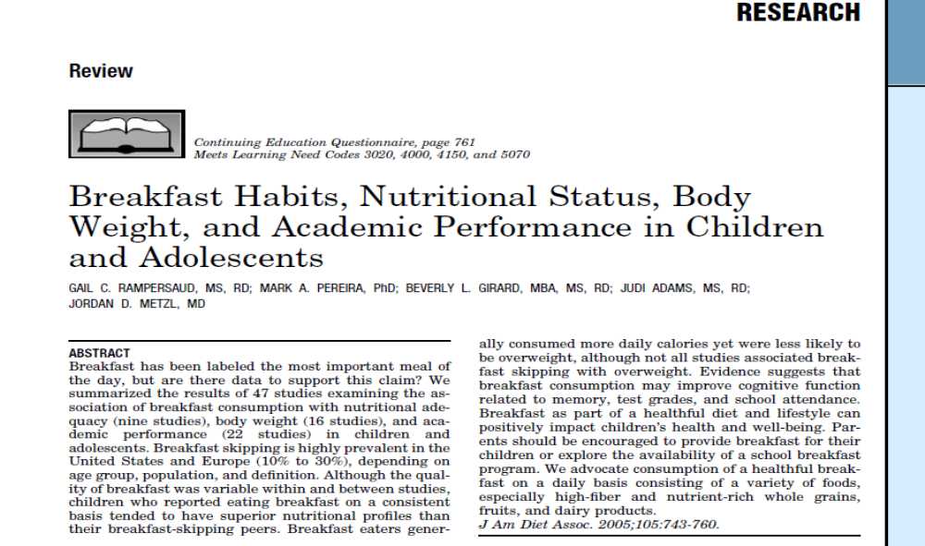

Slide 41



Reasons for Skipping breakfast
School pressure
Habit
Unable to prepare
Away from family
Lack of time
Low SES
Cultural habits
Parental education
Parental occupation
Getting up late for school
Usually not hungry
Follow a special dietary regimen
Food not available

Slide 42
Factors associated with breakfast skipping
Different other factors are also related to breakfast skipping including:
  age (older children more likely skip breakfast),
  gender (girls skip breakfast more often than boys),
  whether parents have breakfast (positive effect),
  and chronotype (breakfast skippers were more often evening chronotypes).

Slide 43
Factors associated with breakfast skipping
Children who go without breakfast may do so because of hectic morning schedules.
Parents may lack time to prepare a nutritious breakfast for their children because of early-morning school bus schedules, long commutes to jobs, and non-traditional work hours.
Adolescents from single parent are more likely to skip breakfast

Slide 44
Factors associated with breakfast skipping
Increased autonomy during adolescence, when breakfast-skipping rises sharply, may play a role in breakfast choices
In one study, adolescents allowed to make their own decisions about what they ate were 25 percent more likely to skip breakfast

Slide 45
Conclusion
Understanding the above factors can help communicators formulate appropriate strategies that encourage more people to reap the benefits of a healthful breakfast.
Implementation of the School Breakfast Program decreased the number of breakfast skippers from 30% to 13%.

Slide 46


Thank you for your time

