Slide 1


Electrochemical simulation:
a powerful tool for the elucidation and study
of drug metabolism reactions.
Agnieszka Potęga, PhD
e-mail: agnieszka.potega@pg.gda.pl
Chemical Faculty
Department of Pharmaceutical Technology and Biochemistry
Laboratory of Chemistry and Biochemistry of Anticancer Drugs
3rd INTERNATIONAL SUMMIT ON TOXICOLOGY & APPLIED PHARMACOLOGY
Chicago, USA, October 20 – 22, 2014

Slide 2

Electrochemical simulation:
a powerful tool for the elucidation and study
of drug metabolism reactions.
Conventional approaches in drug metabolism studies.
Electrochemistry/mass spectrometry for metabolite generation and identification.
The selected results of own studies.
Keywords:
antitumor compounds,
liver cell microsomes,
cytochrome P450,
oxidative drug metabolism,
electrochemical simulation,
mass spectrometry
3rd INTERNATIONAL SUMMIT ON TOXICOLOGY & APPLIED PHARMACOLOGY
Chicago, USA, October 20 – 22, 2014

Slide 3
Degradation pathway of xenobiotics
Xenobiotics (nonpolar, lipophilic)
Phase-I metabolism (activation): oxidation reactions (often catalysed by enzymes of the cytochrome P450 superfamily), reduction and hydrolysis reactions (intermediate metabolites – more polar, less lipophilic)
Phase-II metabolism (detoxification): enzyme-catalysed conjugation reactions with small polar endogenous compounds like tripeptide glutathione, glucuronic acid, sulfate, or glycine (metabolites – polar, water-soluble, easily excreted from the human body in urine or bile)
3rd INTERNATIONAL SUMMIT ON TOXICOLOGY & APPLIED PHARMACOLOGY
Chicago, USA, October 20 – 22, 2014

Slide 4
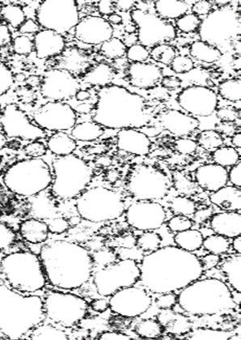
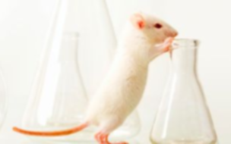
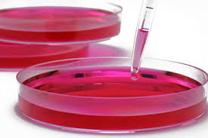
Conventional approaches in drug metabolism studies
In vivo and in vitro methods, using laboratory animals, isolated liver cells (hepatocytes) or microsomes, containing active enzymes,
i.a. the cytochrome P450 system.
laboratory animals
liver cell microsomes
3rd INTERNATIONAL SUMMIT ON TOXICOLOGY & APPLIED PHARMACOLOGY
Chicago, USA, October 20 – 22, 2014

Slide 5
Conventional approaches in drug metabolism studies
Hepatocyte
In vivo and in vitro methods, using laboratory animals, isolated liver cells (hepatocytes) or microsomes, containing active enzymes,
i.a. the cytochrome P450 system.
S9
Microsomes:
CYPs
FMOs
UGTs
GSTs
Cytosol:
dehydrogenases
oxidases
SULTs
GSTs
NATs
Distribution of drug metabolising enzymes in liver cells.
CYP, cytochrome P450 monooxygenase; FMO, flavin-dependent monooxygenase; UGT, UDP-glucuronosyl transferase; GST, glutathione transferase; SULT, sulfotransferase;
NAT, N-acetyltransferase.
Laborious and time consuming.
Metabolites may form adducts with the cell matrix,
hence isolation and identification of reactive metabolites is hampered.
Variations in the expression of cytochrome P450 isoforms in each organism have to be taken into account.
3rd INTERNATIONAL SUMMIT ON TOXICOLOGY & APPLIED PHARMACOLOGY
Chicago, USA, October 20 – 22, 2014

Slide 6
Electrochemistry/mass spectrometry (EC/MS)
EC/MS – a powerful platform to simulate various oxidation and reduction processes.
Electrochemical cell for the simulation of the oxidative and reductive phase-I metabolism.
High potential for screening of single target compounds in phase-II metabolomics studies.
Fast method for direct identification of reactive metabolites because of the absence of biological matrices.
Delivers a redox fingerprint of a (drug) molecule, close to metabolic profile, in a very short time.
3rd INTERNATIONAL SUMMIT ON TOXICOLOGY & APPLIED PHARMACOLOGY
Chicago, USA, October 20 – 22, 2014

Slide 7
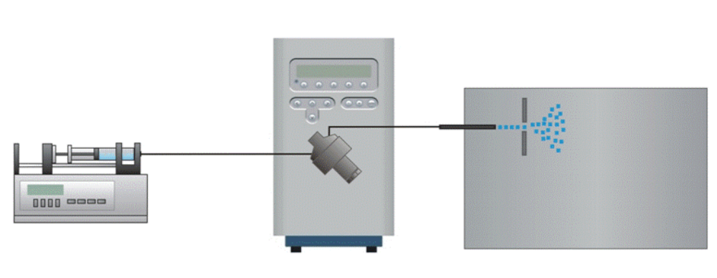
Electrochemistry/mass spectrometry (EC/MS)
Instrumental set-up of EC system
potentiostat
EC/MS – a powerful platform to simulate various oxidation and reduction processes.
Electrochemical cell for the simulation of the oxidative and reductive phase-I metabolism.
High potential for screening of single target compounds in phase-II metabolomics studies.
Fast method for direct identification of reactive metabolites because of the absence of biological matrices.
Delivers a redox fingerprint of a (drug) molecule, close to metabolic profile, in a very short time.
dual syringe
infusion pump
mass spectrometer (MS)
electrochemical thin-layer cell
(EC) – reactor cell
high speed
simplicity
ease of automation
low-cost instrumentation
3rd INTERNATIONAL SUMMIT ON TOXICOLOGY & APPLIED PHARMACOLOGY
Chicago, USA, October 20 – 22, 2014

Slide 8
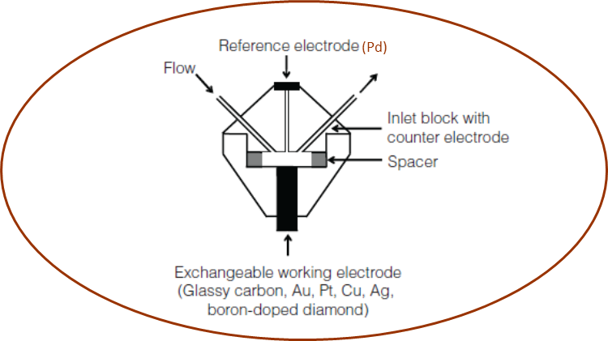
Electrochemistry/mass spectrometry (EC/MS)
Simulation in an amperometric thin-layer cell
EC/MS – a powerful platform to simulate various oxidation and reduction processes.
Pd/H₂
Electrochemical cell for the simulation of the oxidative and reductive phase-I metabolism.
High potential for screening of single target compounds in phase-II metabolomics studies.
Fast method for direct identification of reactive metabolites because of the absence of biological matrices.
Delivers a redox fingerprint of a (drug) molecule, close to metabolic profile, in a very short time.
low adsorption on the electrode surface
easily exchangeable working electrode
3rd INTERNATIONAL SUMMIT ON TOXICOLOGY & APPLIED PHARMACOLOGY
Chicago, USA, October 20 – 22, 2014

Slide 9
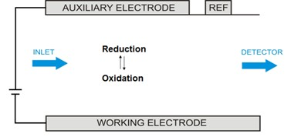

Electrochemistry/mass spectrometry (EC/MS)
Electrochemical reaction
EC/MS – a powerful platform to simulate various oxidation and reduction processes.
Electrochemical cell for the simulation of the oxidative and reductive phase-I metabolism.
High potential for screening of single target compounds in phase-II metabolomics studies.
Fast method for direct identification of reactive metabolites because of the absence of biological matrices.
Delivers a redox fingerprint of a (drug) molecule, close to metabolic profile, in a very short time.
ΔE
3rd INTERNATIONAL SUMMIT ON TOXICOLOGY & APPLIED PHARMACOLOGY
Chicago, USA, October 20 – 22, 2014

Slide 10
Electrochemistry/mass spectrometry (EC/MS)
Set-ups of the most common approaches for the simulation of drug metabolism reactions
EC/MS – a powerful platform to simulate various oxidation and reduction processes.
A
EC/MS system
Potentiostat
MS
detector
Drug
EC cell
Electrochemical cell for the simulation of the oxidative and reductive phase-I metabolism.
High potential for screening of single target compounds in phase-II metabolomics studies.
Fast method for direct identification of reactive metabolites because of the absence of biological matrices.
Delivers a redox fingerprint of a (drug) molecule, close to metabolic profile, in a very short time.
B
EC/LC/MS system
Potentiostat
MS
detector
Drug
EC cell
LC column
Adapted from Baumann et al., Expert Opin Drug Metab Toxicol, 2010
3rd INTERNATIONAL SUMMIT ON TOXICOLOGY & APPLIED PHARMACOLOGY
Chicago, USA, October 20 – 22, 2014

Slide 11
Electrochemistry/mass spectrometry (EC/MS)
Typical phase I reactions and the possibility for their electrochemical simulation
Typical reactions catalysed by cytochrome P450 | Simulation by electrochemistry
Allylic and aliphatic hydroxylation | Succesfully mimicked at high potentials
Benzylic hydroxylation | Sucessfully mimicked, but only in low yields
Desalkylation of amines | Readily mimicked
Desalkylation of ethers and thioethers | Ethers: possible Thioethers: not mimicked
Hydroxylation of aromatics | Possible
Epoxide formation | Not mimicked
Oxidation of heteroatoms (N, S) | Sucessfully mimicked (but N-oxide formation only in low yields)
Alcohol and aldehyde oxidation | Not mimicked
Dehydrogenation | Readily mimicked
EC/MS – a powerful platform to simulate various oxidation and reduction processes.
Electrochemical cell for the simulation of the oxidative and reductive phase-I metabolism.
High potential for screening of single target compounds in phase-II metabolomics studies.
Fast method for direct identification of reactive metabolites because of the absence of biological matrices.
Delivers a redox fingerprint of a (drug) molecule, close to metabolic profile, in a very short time.
Adapted from Lohmann et al., LC-GC Europe, Jan 2010
3rd INTERNATIONAL SUMMIT ON TOXICOLOGY & APPLIED PHARMACOLOGY
Chicago, USA, October 20 – 22, 2014

Slide 12
Electrochemistry/mass spectrometry (EC/MS)
Typical phase I reactions and the possibility for their electrochemical simulation
Typical reactions catalysed by cytochrome P450 | Simulation by electrochemistry
Allylic and aliphatic hydroxylation | Succesfully mimicked at high potentials
Benzylic hydroxylation | Sucessfully mimicked, but only in low yields
Desalkylation of amines | Readily mimicked
Desalkylation of ethers and thioethers | Ethers: possible Thioethers: not mimicked
Hydroxylation of aromatics | Possible
Epoxide formation | Not mimicked
Oxidation of heteroatoms (N, S) | Sucessfully mimicked (but N-oxide formation only in low yields)
Alcohol and aldehyde oxidation | Not mimicked
Dehydrogenation | Readily mimicked
EC/MS – a powerful platform to simulate various oxidation and reduction processes.
Electrochemical cell for the simulation of the oxidative and reductive phase-I metabolism.
High potential for screening of single target compounds in phase-II metabolomics studies.
Fast method for direct identification of reactive metabolites because of the absence of biological matrices.
Delivers a redox fingerprint of a (drug) molecule, close to metabolic profile, in a very short time.
Adapted from Lohmann et al., LC-GC Europe, Jan 2010
3rd INTERNATIONAL SUMMIT ON TOXICOLOGY & APPLIED PHARMACOLOGY
Chicago, USA, October 20 – 22, 2014

Slide 13
RESEARCH OBJECTIVES
Financial support by the National Science Centre (Poland)
(project SONATA No 2012/07/D/NZ7/03395)
Investigation phase-I metabolism of the model antitumor acridine derivatives, C-1311 and C-1748, under electrochemical conditions coupled to mass spectrometry (EC/MS).
Comparison the results obtained by EC/MS with conventional in vitro microsomal approach.
3rd INTERNATIONAL SUMMIT ON TOXICOLOGY & APPLIED PHARMACOLOGY
Chicago, USA, October 20 – 22, 2014

Slide 14
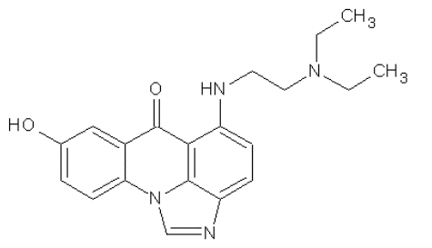
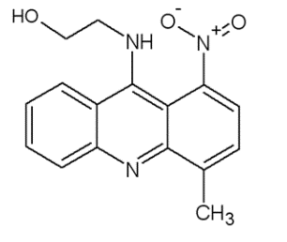
THE STUDIED COMPOUNDS
different structures
various metabolic pathways
5-diethyloaminoethyloamino-8-hydroxyimidazoacridinone
C-1311
9-(2’-hydroxyethyloamino)-4-methylo-1-nitroacridine
C-1748
inhibitor of both topoisomerases and certain receptor kinases, including FMS-like tyrosine kinase FLT3 (Chau et al., 2006; Skwarska et al., 2010)
activity against advanced solid tumors under phase I and II of clinical trials, also tested for the treatment of autoimmune diseases (Capizzi et al., 2008; Isambert et al., 2010)
strong cytotoxic activity against colon cancer cel lines (HCT8 and HT29) (Augustin et al., 2010) and high antitumor activity against several prostate (LnCaP, JCA, PC3, TSU) and colon carcinoma xenografts (HCT8) in nude mice (Chen et al., 2002; Tadi et al., 2007)
low mutagenic potential and slight myelosuppressive properties (Narayanan et al., 2005)
3rd INTERNATIONAL SUMMIT ON TOXICOLOGY & APPLIED PHARMACOLOGY
Chicago, USA, October 20 – 22, 2014

Slide 15
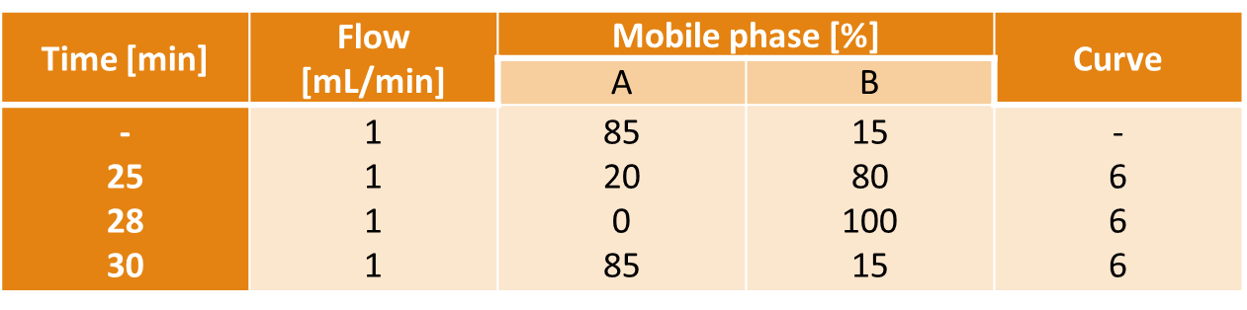
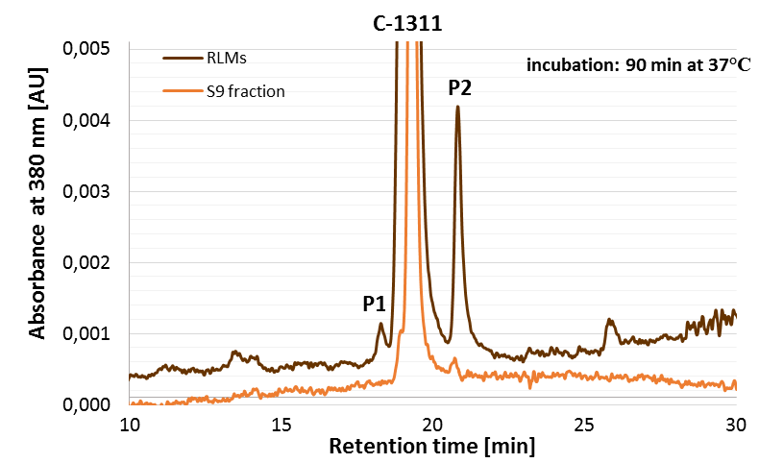
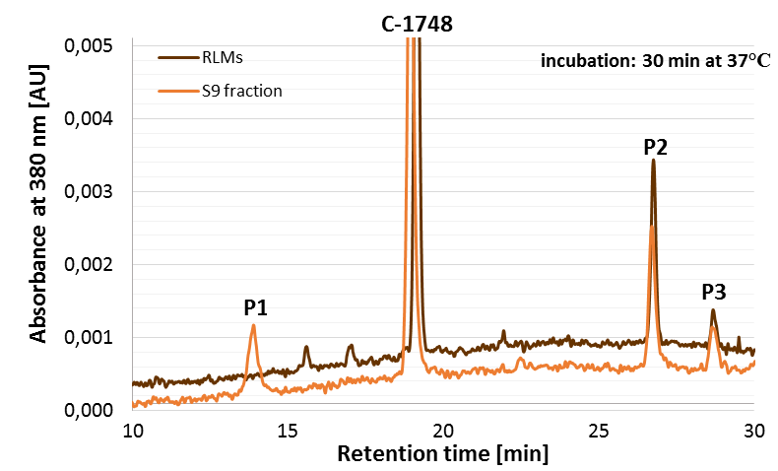
Enzymatic transformations of C-1311 and C-1748
Table: Gradient profile utilized for all HPLC analyses.
A: 50 mM aqueous ammonium formate buffer (pH 3.4) + 5% methanol for HPLC
B: Methanol for HPLC + 5% H₂O
RP-HPLC-DAD/ESI-MS analysis
A
B
Figure: Linear chromatograms of the reaction mictures containing 0.05 mM (A) C-1311 (B) C-1748, 1 mM NADPH and 2 mg/mL microsomal (S9) fraction of liver cells in sodium phosphate buffer (pH7.4).
3rd INTERNATIONAL SUMMIT ON TOXICOLOGY & APPLIED PHARMACOLOGY
Chicago, USA, October 20 – 22, 2014

Slide 16
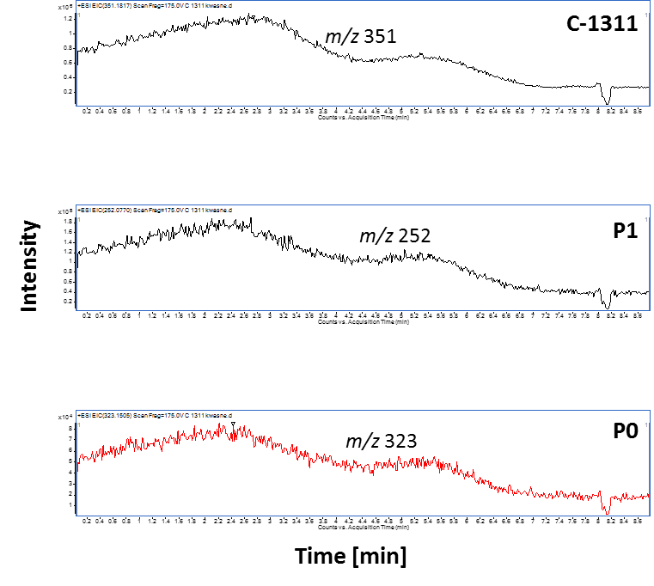
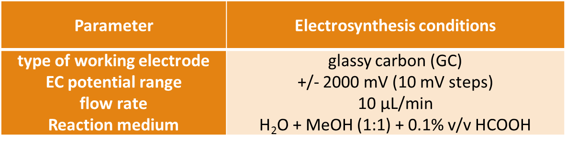
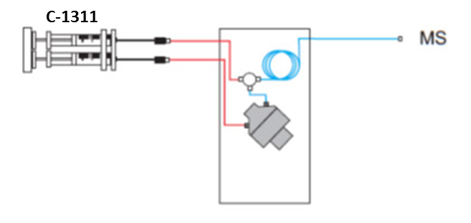
Electrochemical simulation of C-1311 metabolism
Figure: C-1311 abundance vs. electrosynthesis time.
3rd INTERNATIONAL SUMMIT ON TOXICOLOGY & APPLIED PHARMACOLOGY
Chicago, USA, October 20 – 22, 2014

Slide 17
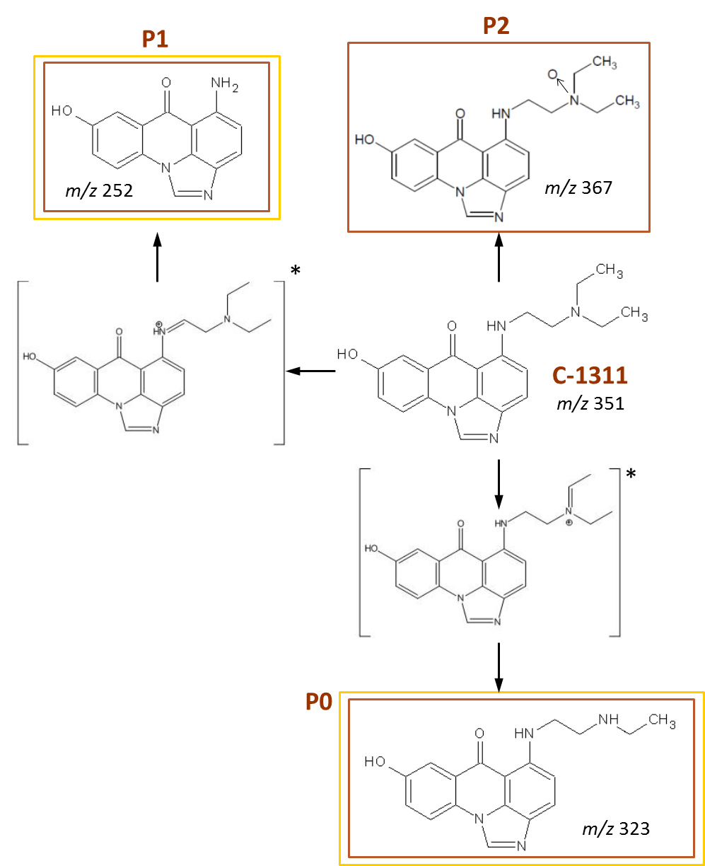
Electrochemical simulation of C-1311 metabolism
Figure: The proposed chemical structures
of C-1311 metabolites obtained in enzymatic (—) and electrochemical (—) system ([ ]* – intermediate product).
3rd INTERNATIONAL SUMMIT ON TOXICOLOGY & APPLIED PHARMACOLOGY
Chicago, USA, October 20 – 22, 2014

Slide 18
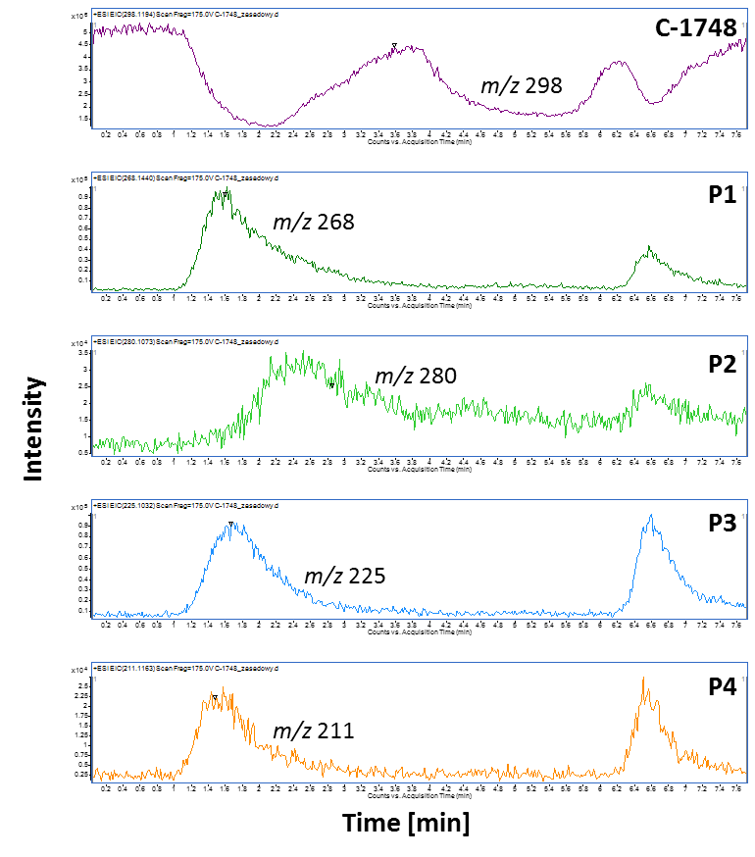


Electrochemical simulation of C-1748 metabolism
Figure: C-1748 abundance vs. electrosynthesis time.
3rd INTERNATIONAL SUMMIT ON TOXICOLOGY & APPLIED PHARMACOLOGY
Chicago, USA, October 20 – 22, 2014

Slide 19
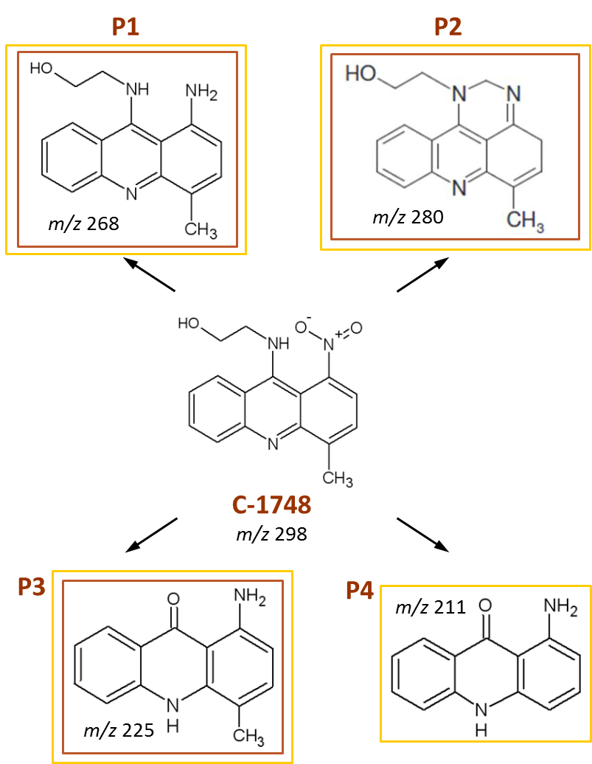
Electrochemical simulation of C-1748 metabolism
Figure: The proposed chemical structures of C-1748 metabolites obtained in enzymatic (—) and electrochemical (—) system.
3rd INTERNATIONAL SUMMIT ON TOXICOLOGY & APPLIED PHARMACOLOGY
Chicago, USA, October 20 – 22, 2014

Slide 20
SUMMARY & CONCLUSIONS
Electrochemical system is very well-suited for the simulation of the oxidative and reductive metabolism
of antitumor acridine derivatives.
Electrochemical conversion of C-1311 and C-1748 into phase-I metabolites was successfully achieved.
  Two main metabolic products of C-1311 (side chain degradation products) and three products of C-1748 were detected both in the conventional enzymatic approach and in the electrochemical simulation.
An additional product of C-1748 (1-aminoacridone) was found only in the electrochemical simulation.
3rd INTERNATIONAL SUMMIT ON TOXICOLOGY & APPLIED PHARMACOLOGY
Chicago, USA, October 20 – 22, 2014

Slide 21
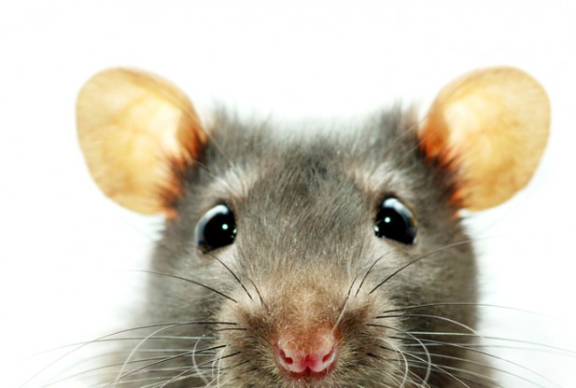
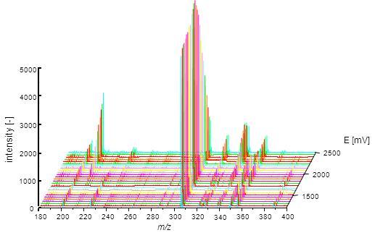
SUMMARY & CONCLUSIONS
The purely instrumental approach, based on electrochemical conversion, is a feasible alternative to the conventional microsomal studies.
3rd INTERNATIONAL SUMMIT ON TOXICOLOGY & APPLIED PHARMACOLOGY
Chicago, USA, October 20 – 22, 2014

Slide 22
Application areas of electrochemistry/mass spectrometry
reduction of
disulfide bridges
oxidative protein
marking
cleaving of
peptide bonds
active substance-
protein binding
coupling EC/MS
oxidative
DNA demage
stability studies
MS signal amplification
metabolism studies
metabolite synthesis
3rd INTERNATIONAL SUMMIT ON TOXICOLOGY & APPLIED PHARMACOLOGY
Chicago, USA, October 20 – 22, 2014

Slide 23
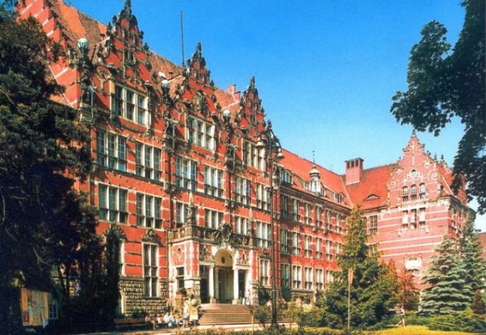
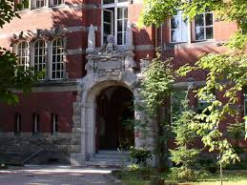
Electrochemical simulation:
a powerful tool for the elucidation and study
of drug metabolism reactions.
Zofia Mazerska¹, Assoc Prof
Weronika Hewelt-Belka², MSc
Olga Siewruk¹
Katarzyna Zapała¹
Chemical Faculty
¹Department of Pharmaceutical Technology and Biochemistry
²Department of Analytical Chemistry
3rd INTERNATIONAL SUMMIT ON TOXICOLOGY & APPLIED PHARMACOLOGY
Chicago, USA, October 20 – 22, 2014

Slide 24


Thank you for your attention!

