Slide 1
Mechanical and Thermal Properties of Propylene Glycol Extended and Paper Waste Sludge Modified Polyurethane Foams
9th World Congress on Materials Science and Engineering
PhD student Agnė Kairytė, dr. Saulius Vaitkus
Scientific Institute of Thermal Insulation
Laboratory of Thermal Insulating Materials

Slide 2
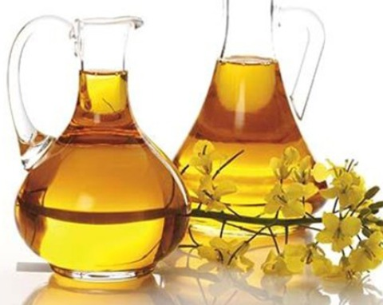

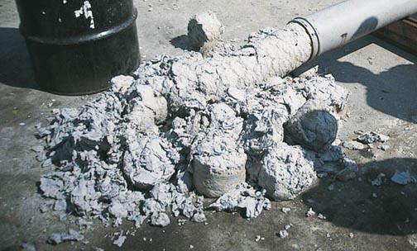
Formulation of the problem and relevance
Low functionality: < 3;
Low flammability, thermal and
mechanical properties.
High initial shrinkage of the
products;
Poor dimensional stability
at higher temperature and
humidity conditions.
Biocatalysis → Biopolyol
Vanduo
High energy consumption during
incineration;
There are no possibilities to use in the
same application area.
Paper production waste sludge (PPWS)

Slide 3
Raw materials
The main raw materials used in the research.
TRADITIONAL:
Polyol – synthesized via chemo enzymatic route from rapeseed oil.
Hardener – 4,4‘- diphenyl methane isocyanate Lupranat M20S (BASF, Germany);
Catalysts – N,N– dimetilethanolamine Lupragen N101 (BASF, Germany) and 1,2–dimetilimidazole Lupragen DMI (BASF, Germany);
Blowing agent – distilled water;
Surfactant – Tegostab B 1048 (Evonik, Germany);
Titanate coupling agent – tris (3,6– diaza) hexanolate TCA-K44 (Capatua Chemicals, China).
FOR THE SOLUTION OF THE PROBLEM:
For dimensional stability– propylene glycol from rapeseed glycerine (RPG). For the improvement of fire resistance and mechanical properties – paper production waste sludge (PPWS).

Slide 4
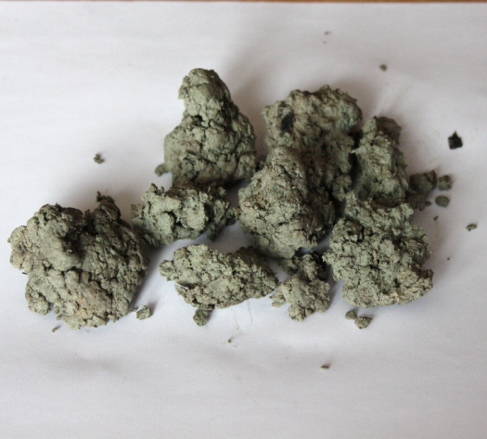
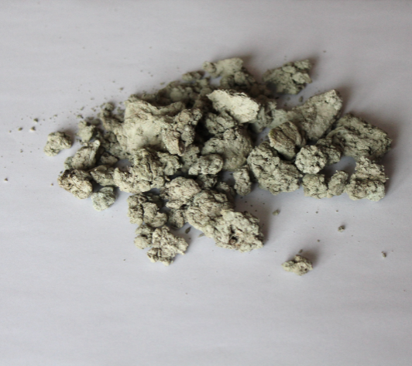
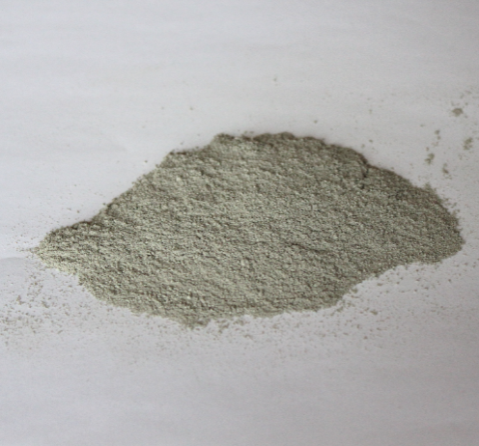
Composition of extended and modified polyurethane foams
Material | Amount, pbw
Polyol | 90
Propylene glycol | 10
Distilled water | 3.0
Lupragen N101 | 1.2
Lupragen DMI | 1.8
Tegostab B 1048 | 2.0
Isocyanate | Index 125
PPWS | 5; 10; 15; 20 wt. %
Moisture of 39%
Drying at 70°C for 24 h
Moisture of 1.5%

Slide 5
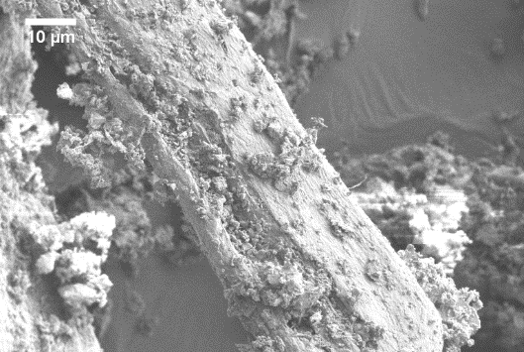
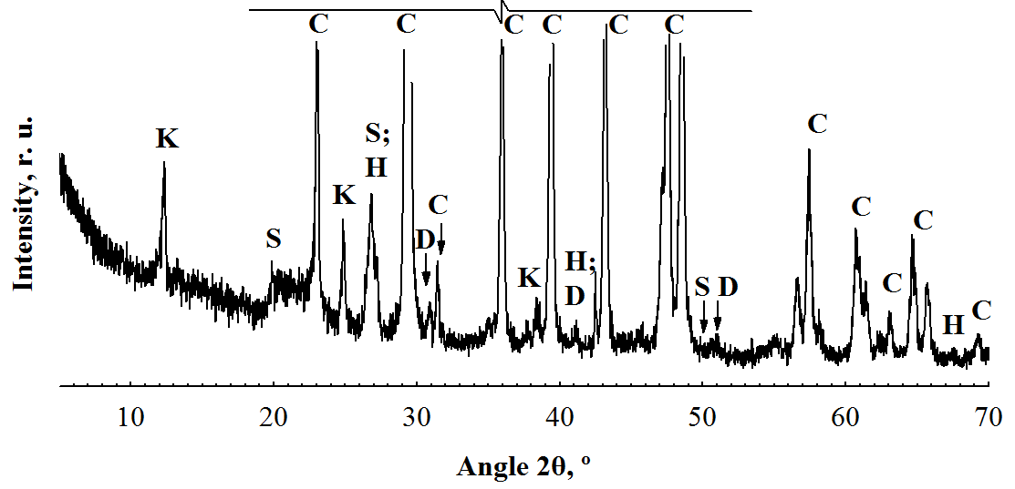
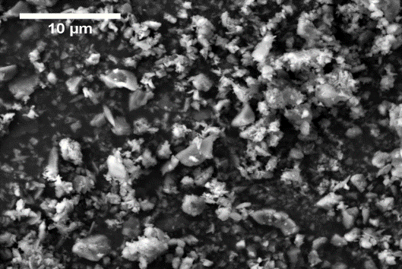
Qualitative and quantitative analyses of PPWS
b)
a)
c)
Fig. 1. Characterisation of PPWS particles: a) X-ray analysis; b) SEM image of organic matter;
c) SEM image of inorganic matter
Table 1. Chemical composition of PPWS
SiO₂, % | Al₂O₃, % | CaO, % | MgO, % | Fe₂O₃, % | Na₂O, % | K₂O, % | SO₃, % | P₂O₅, % | O. d., %
5.8- 6.0 | 4.6- 4.8 | 48.5-49.5 | 0.4- 0.5 | 0.5- 0.6 | 0.03- 0.04 | 0.14-0.15 | 0.17-0.20 | 0.05-0.06 | 21.1-24.3

Slide 6

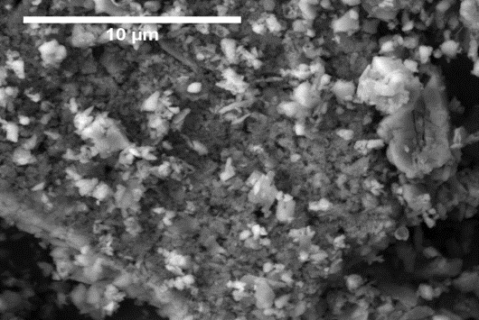
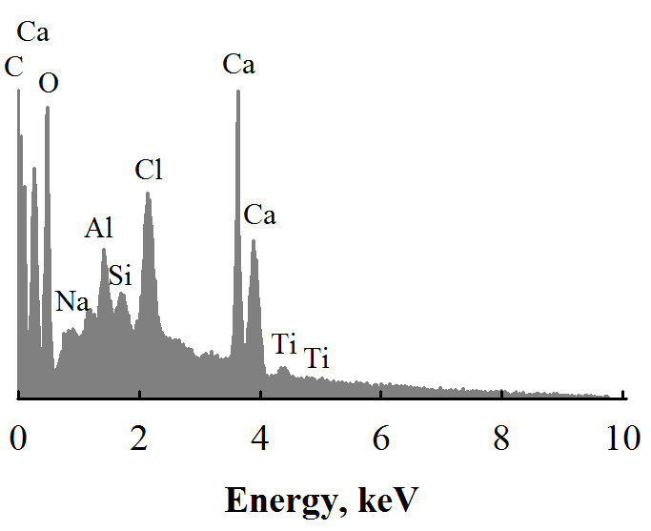
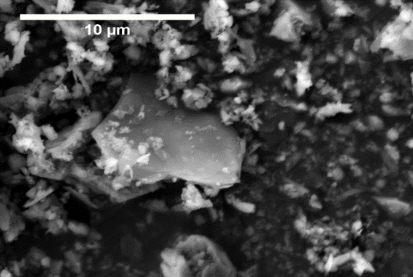
Modification of PPWS particles with titanate coupling agent
Mixing for 30 min
In isopropyl alcohol
Drying for 48 h at
(100±5) ºC
OH
RO
O
Ti
OH
RO
O

Slide 7
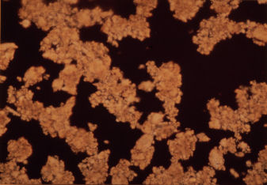
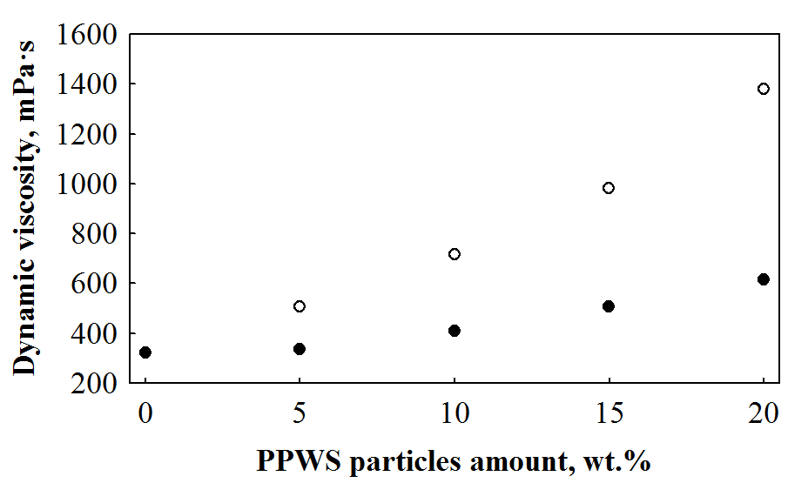
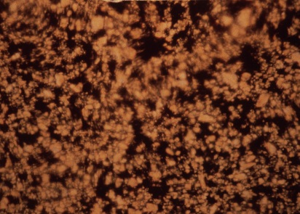
The impact of PPWS particles on mixture viscosity
~432 %
~191 %
Without TCA
Fig. 2. The dependence of forming mixture viscosity of polyurethane foam
on the amount of PPWS particles
With TCA

Slide 8
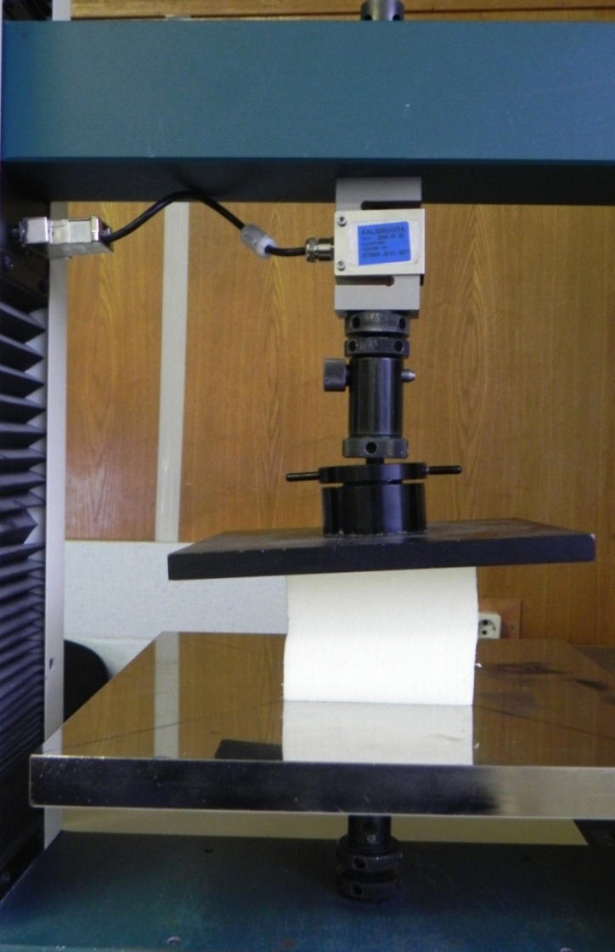
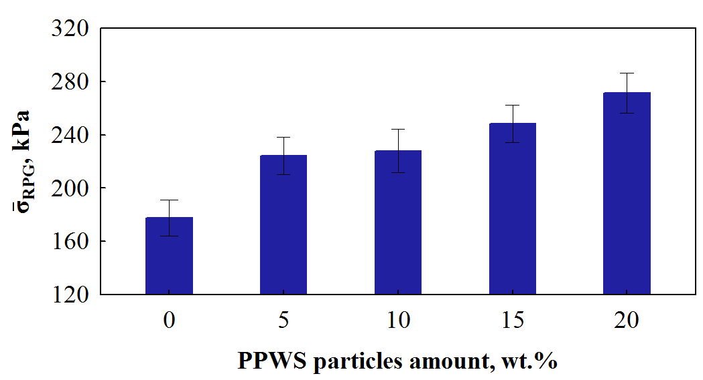
Compressive strength
53%
Fig. 3. The impact of PPWS particles on compressive strength
of polyurethane foams

Slide 9
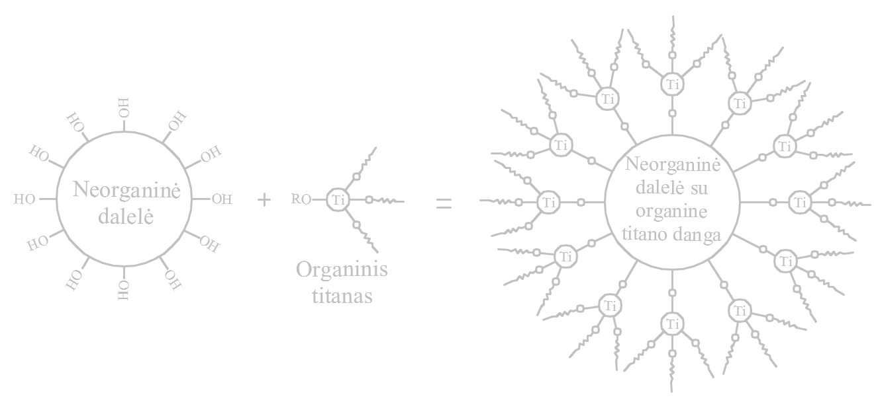
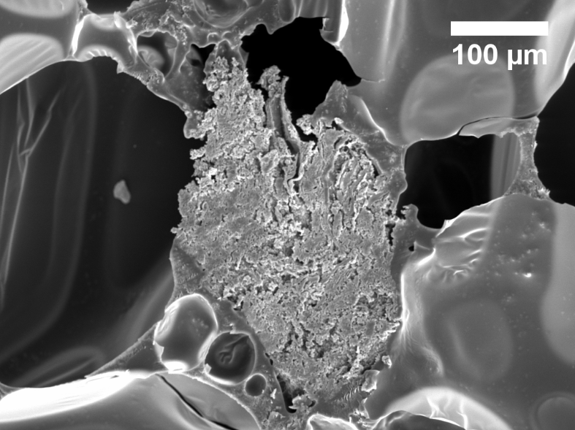
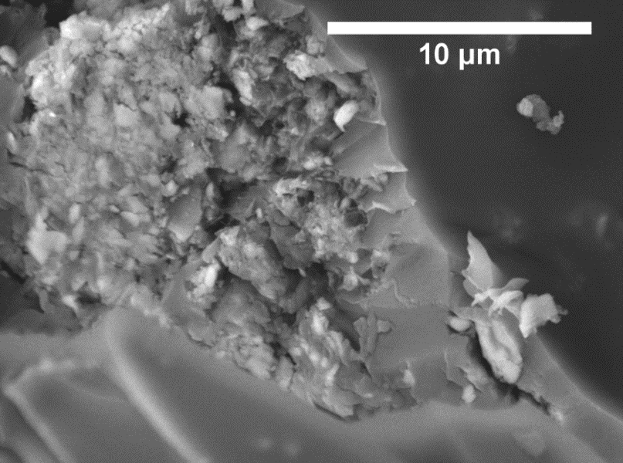
Compressive strength
BEFORE
a)
AFTER
b)
Fig. 4. Interfacial bond between PPWS particle and polymer matrix: a) before coupling (x500); b) after coupling with TCA (x5000)

Slide 10
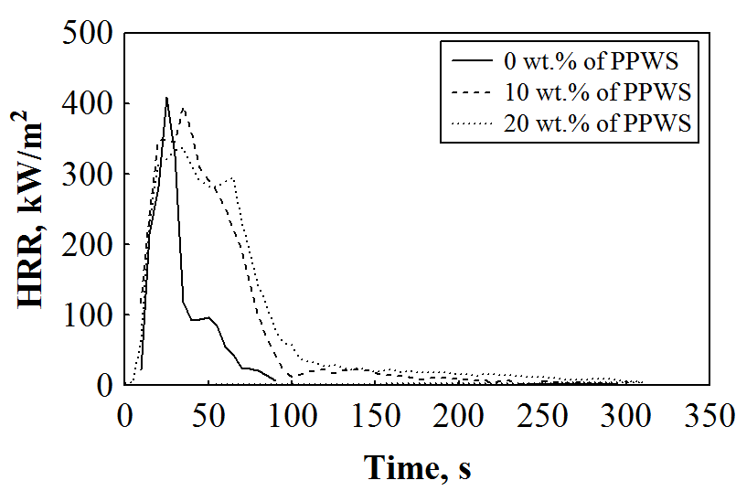
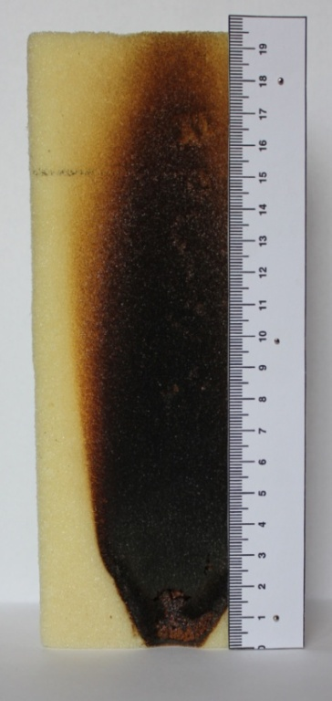
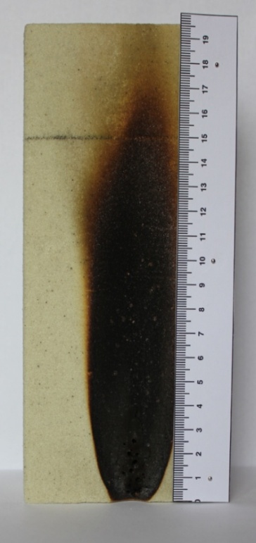
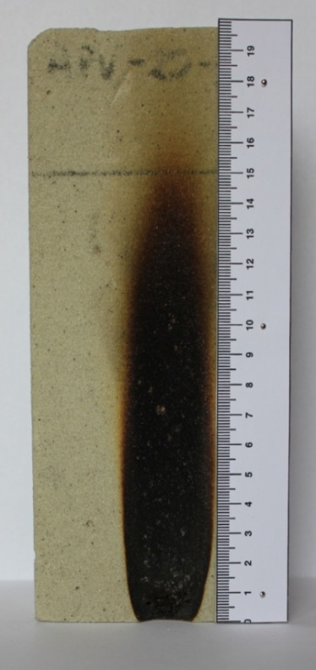
Flammability and ignitability tests
b)
a)
0% of PPWS
10% of PPWS
20% of PPWS
Fig. 5. Modified polyurethane foam after fire resistance tests: a) heat release rate and
b) ignitability
Table 2. Flammability characteristics of RPG extended and PPWS modified polyurethane foams
Parameter | PPWS particles amount, wt.%
 | 0 | 10 | 20
pHRR_{av.}, kW/m² | 372±42 | 373±49 | 353±47
THR_{av.}, MJ/m² | 12.7±3.4 | 22.4±0.7 | 24.2±1.7
TSR_{av.}, m²/m² | 398±65 | 801±62 | 951±69
COY_{av.}, kg/kg | 0.15±0.03 | 0.14±0.01 | 0.13±0.01
CO₂Y_{av.}, kg/kg | 4.4±0.5 | 3.4±0.1 | 3.1±0.2

Slide 11
Conclusions
It is determined that titanate coupling agent forms one molecule-sized layer on the surface of particle, thus 2.3 times reducing the dynamic viscosity of forming mixtures It as well increases the compressive strength from 178 kPa to 271 kPa of polyurethane foam modified with 20 wt.% of PPWS particles.
It is determined that PPWS particles and their agglomerates due to non‑flammable materials act as a barrier for flame spread and sudden heat release in modified polyurethane foams under open flame, therefore, the obtained products are characterised by slower combustion. 20 wt. % of PPWS particles in polyurethane foam reduce heat release rate by 5.1%, carbon monoxide and carbon dioxide yields by, respectively, 13.3% and 29.5%.

