Slide 1





Physio-pathological properties of colon cells are regulated
by the nucleocytoplasmic OGT
Agata Steenackers
CNRS/UMR 8576, Unit of Structural and Functional Glycobiology (UGSF), Lille 1 University , Villeneuve d’Ascq, France

Slide 2
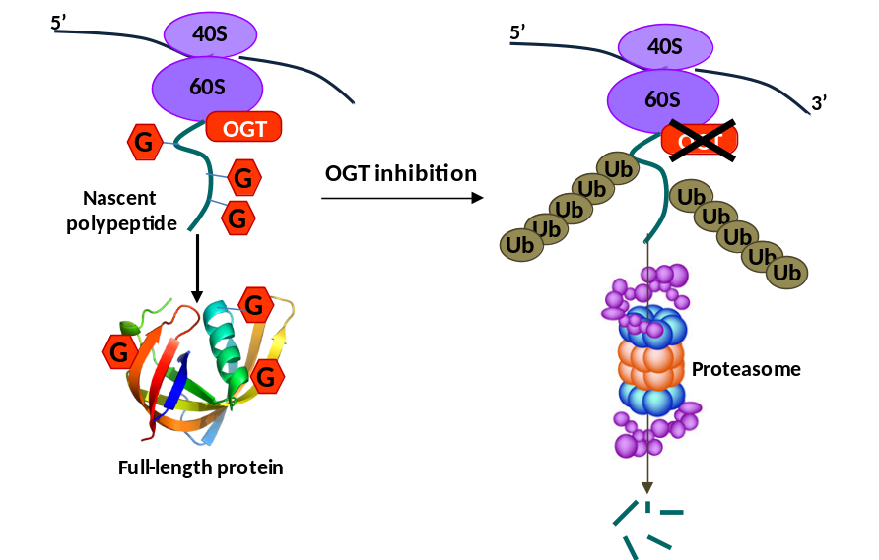
O-GlcNAc modification
O-GlcNAcylation
Phosphorylation
O-GlcNAcylation - dynamic and reversible PTM nucleocytoplasmic and mitochondrial proteins by addition of O-GlcNAc onto Ser/Thr residues
O-GlcNAcylation - controled by OGT and OGA
O-GlcNAcylation interplays with Ser/Thr phosphorylation and regulates fundamental cellular processes eg. cell cycle, cell signaling and protein trafficking
GlcNAc
P
Ser/Thr
Ser/Thr
Ser/Thr
UDP
OGT
UDP-GlcNAc
Pi
PPase
H₂O
Protein
Protein
Protein
H₂O
OGA
GlcNAc
ATP
Kinase
ADP
Cotranslational O-GlcNAcylation
OGT (O-GlcNAc transferase), key and unique regulator of PTM
12 TPRs
G1
InD
G2
ncOGT
Cotranslational O-GlcNAcylation – protection from proteosomal degradation of nascent chains proteins
MSS
9 TPRs
G1
InD
G2
mOGT
2 TPRs
G1
InD
G2
sOGT
TPR
Catalytic Domain

Slide 3
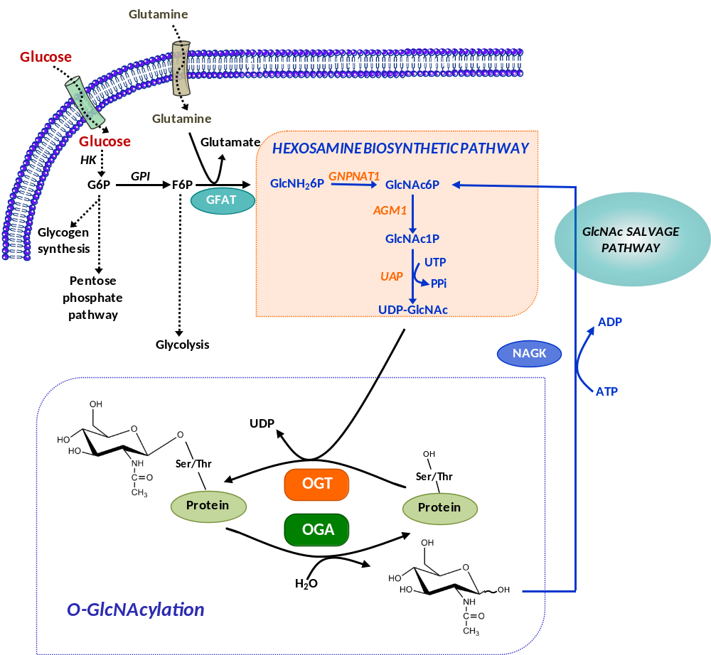
Hexosamine biosynthetic pathway and O-GlcNAcylation
2-3% cellular glucose enter the hexosamine biosynthetic pathway (HBP) to produce UDP-GlcNAc
OGT uses UDP-GlcNAc, from the nutrient dependent HBP
UDP-GlcNAc: nutritional sensor
Upregulation of HBP by increased glucose flux directly elevates UDP-GlcNAc levels as well as intracellular protein O-GlcNAcylation to modulate their localization, stability and activity (β-catenin & CRC)
Glucose flux, UDP-GlcNAc pool are implicated in global O-GlcNAc levels through OGT
What is the role of OGT in cancer development ?

Slide 4
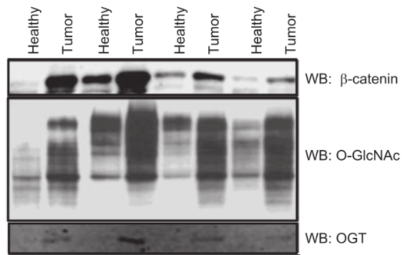
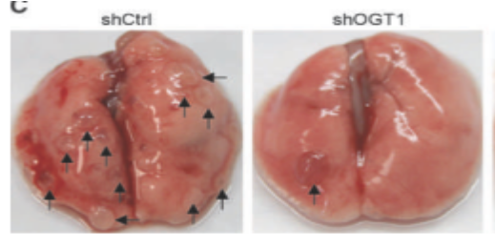

Role the OGT expression in cancers
Overexpression of OGT
Breast cancer :
↗O-GlcNAcylation in cancer tissues/adjacent tissues and in metastatic lymph nodes /breast cancer tissues.
shOGT cell migration/invasion and number of metastatic lung nodules (Gu et al., 2010)
→ important roles in cancer initiation and metastasis.
Prostate cancer :
↗ OGT in cancer tissue/normal epithelium , associated with poor prognosis
↗ OGT and O-GlcNAc levels in cancer cell lines/non-transformed prostate cells
siOGT growth, invasion, angiogenesis and metastasis of prostate cancer cells (Lynch et al., 2012)
Colon cancer :
↗ O-GlcNAcylation of colon cancer tissues /adjacent tissues.
siOGT colony formation of HT29 cells (Mi et al., 2011)
shCtrl
shOGT
3D Culture
Gu et al., 2010
Lynch et al., 2012
Olivier Van-Stichelen et al., 2014
What is the impact of OGT knock-down on biological properties of
colon cell lines?

Slide 5
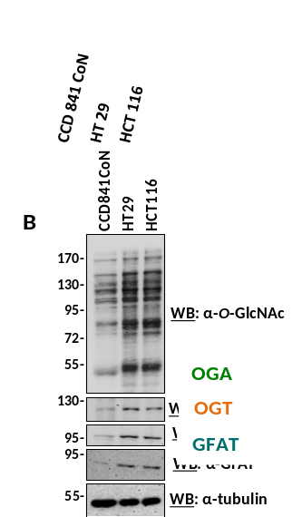
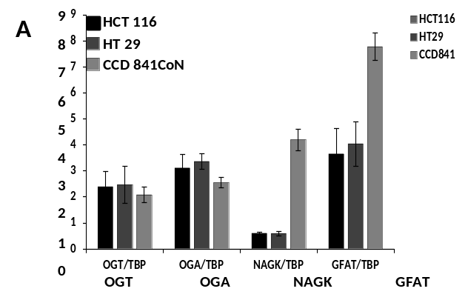
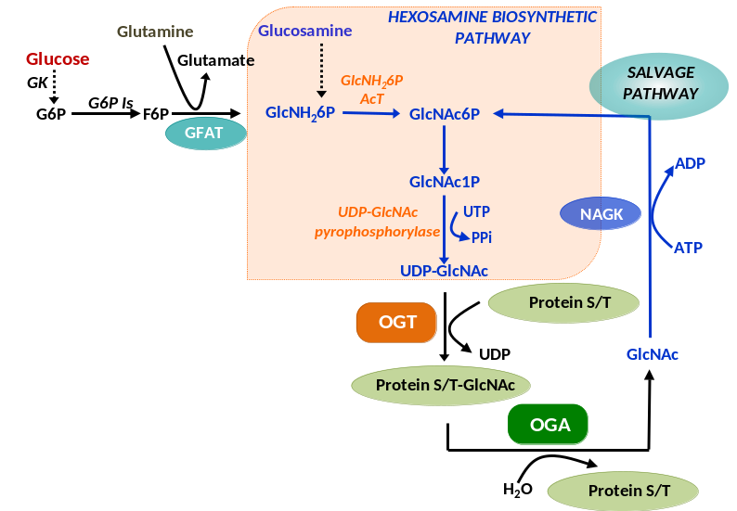
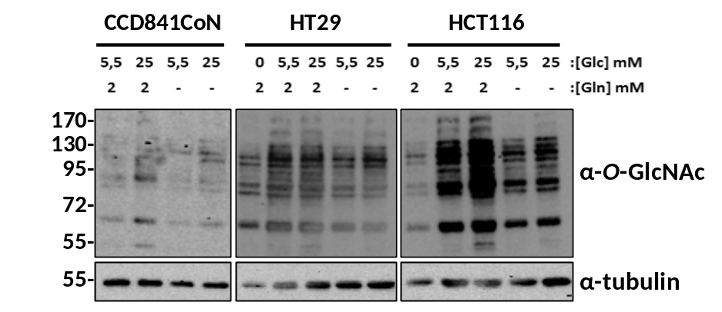
OGT expression and O-GlcNAcylation level in colon cell lines
1.qPCR analysis to the mRNA levels of O-GlcNAc cycling enzymes
2. Western Blot of O-GlcNAc cycling enzymes
mRNA relative expression
No correlation between mRNA profile expression and protein pattern
OGT
OGA
NAGK
GFAT
3. O-GlcNAcylation rate depends on glucose concentration and glutamine
HCT116 colorectal carcinoma, HT29 colorectal adenocarcinoma, CCD841 fetal

Slide 6
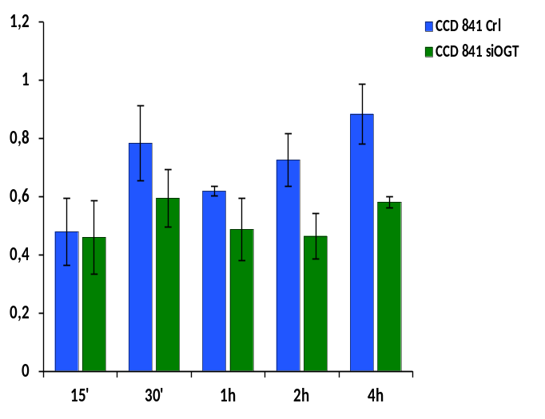
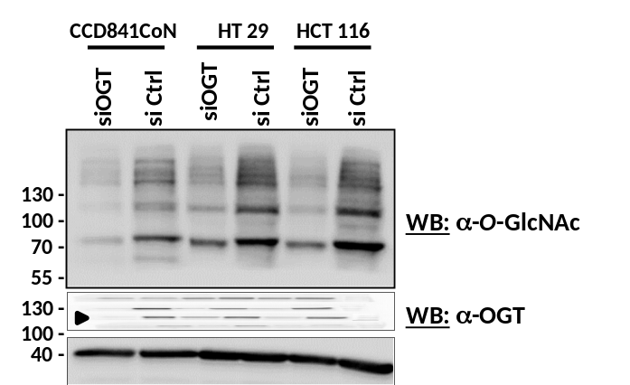
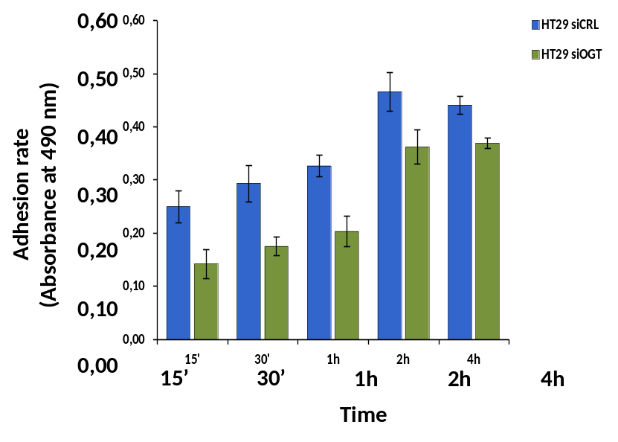
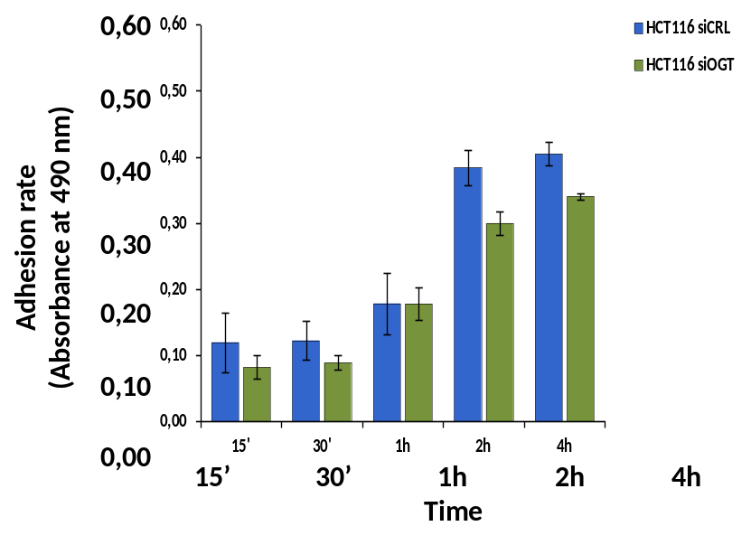
OGT silencing decreased cell adhesion
siCrl
siOGT
OGT silencing reduced OGT expression as well O-GlcNAcylation in the three colon cell lines
1,20
CCD841
1,00
0,80
Adhesion rate
(Absorbance at 490 nm)
0,60
0,40
0,20
n.s. band
0,00
15’
30’
1h
2h
4h
HT29
HCT116

Slide 7
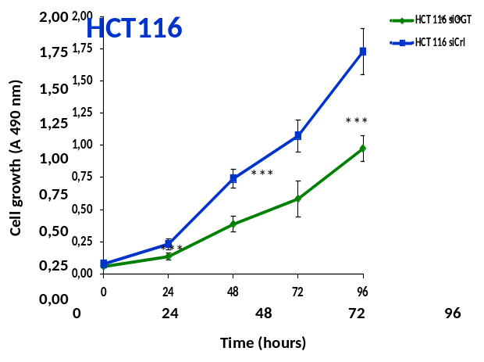
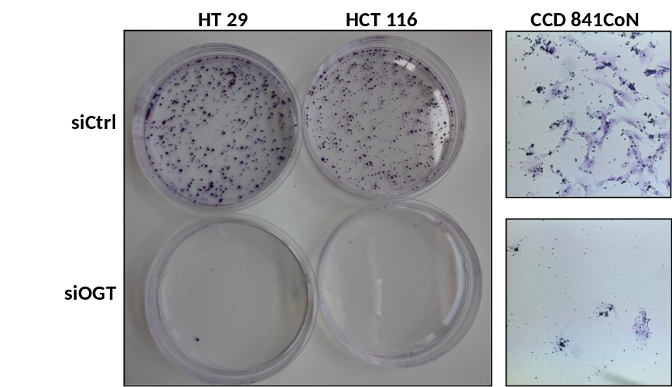
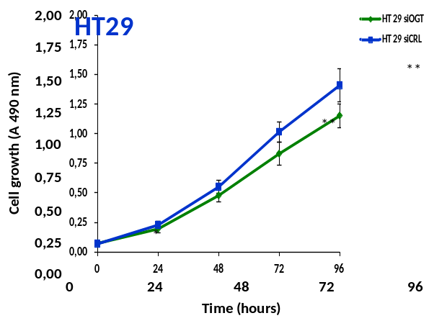
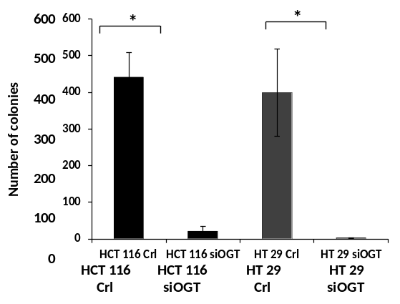
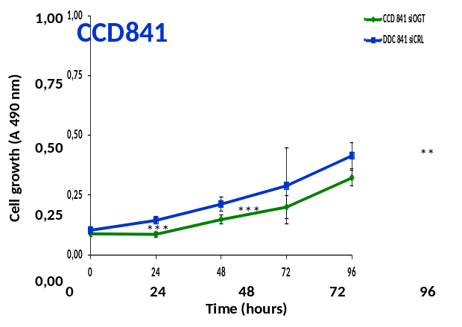
OGT silencing decreases cell proliferation and colony formation
45% decrease
18% decrease
22% decrease
siOGT
siCrl

Slide 8
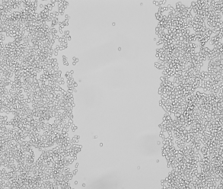
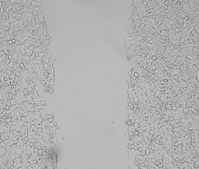
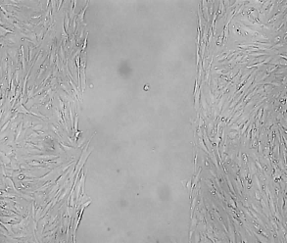
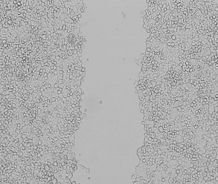
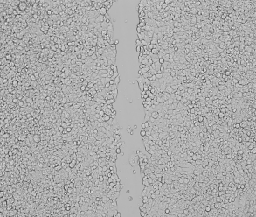
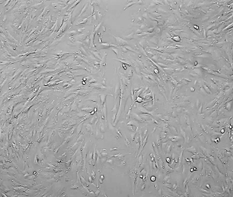
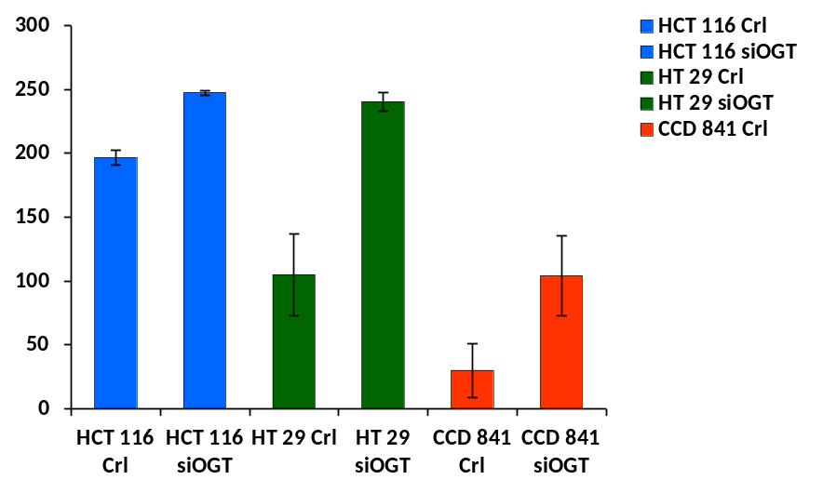
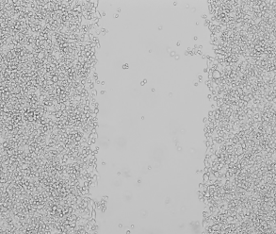
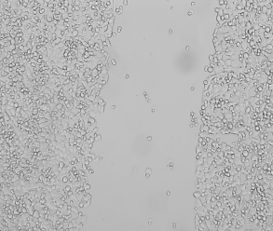
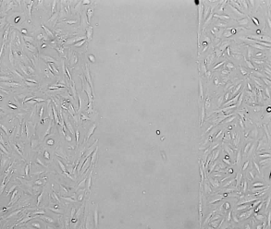
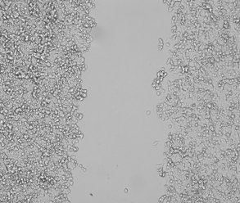
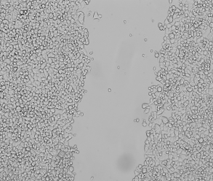
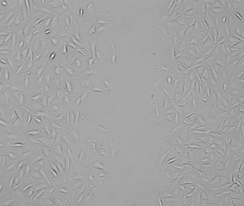
OGT silencing expression inhibited cell migration
HCT 116
HT 29
CCD 841CoN
T=0
siCtrl
314 µm
297 µm
321µm
T=24
***
***
188 µm
60 µm
*
Width (µm) at 24h
T=0
siOGT
315 µm
303 µm
315 µm
T=24
245 µm
230 µm
148 µm
Wound healing assays

Slide 9
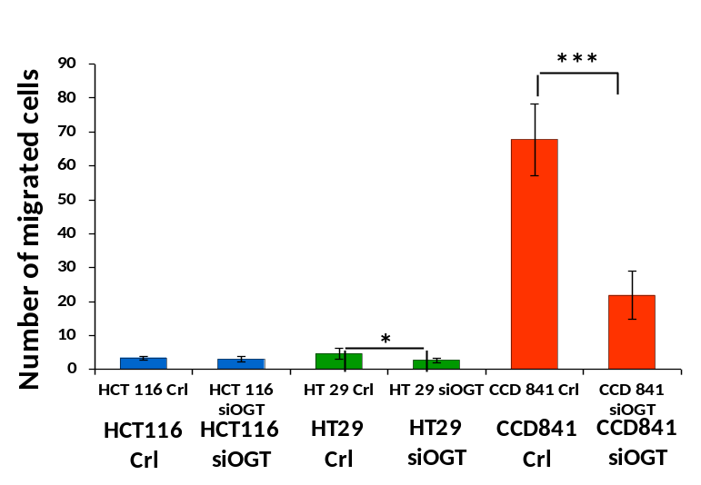
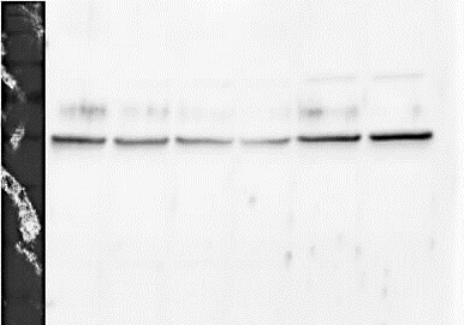
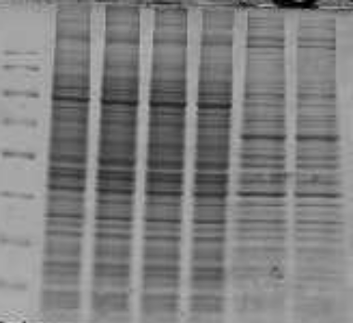
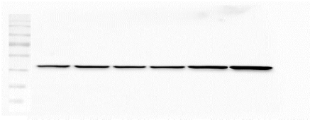
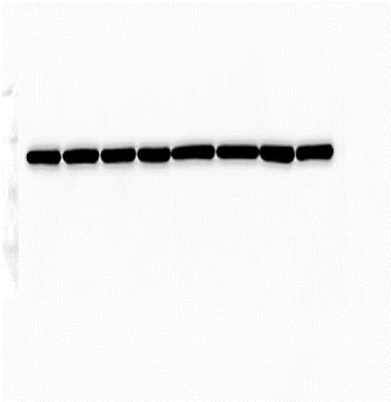
Cell migration and cytoskeletal proteins in colon cell lines
OGT silencing reduced migration of CCD841CoN compared to cancer cell lines using the Transwell system
Cytoskeletal proteins profile
Visualizations the proteins by Bleu Coomassie
HCT 116
HT 29
CCD841CoN
si Ctrl
si Ctrl
si Ctrl
HCT 116
HT 29
CCD841CoN
siOGT
siOGT
siOGT
si Ctrl
si Ctrl
si Ctrl
siOGT
siOGT
siOGT
70 -
WB: β-tubulin
55 -
170 kDa
40 -
130 kDa
100 kDa
70 -
70 kDa
55 -
55 kDa
40 -
WB: actin
40 kDa
35 kDa
55 -
25 kDa
40 -
WB: GAPDH
35 -

Slide 10
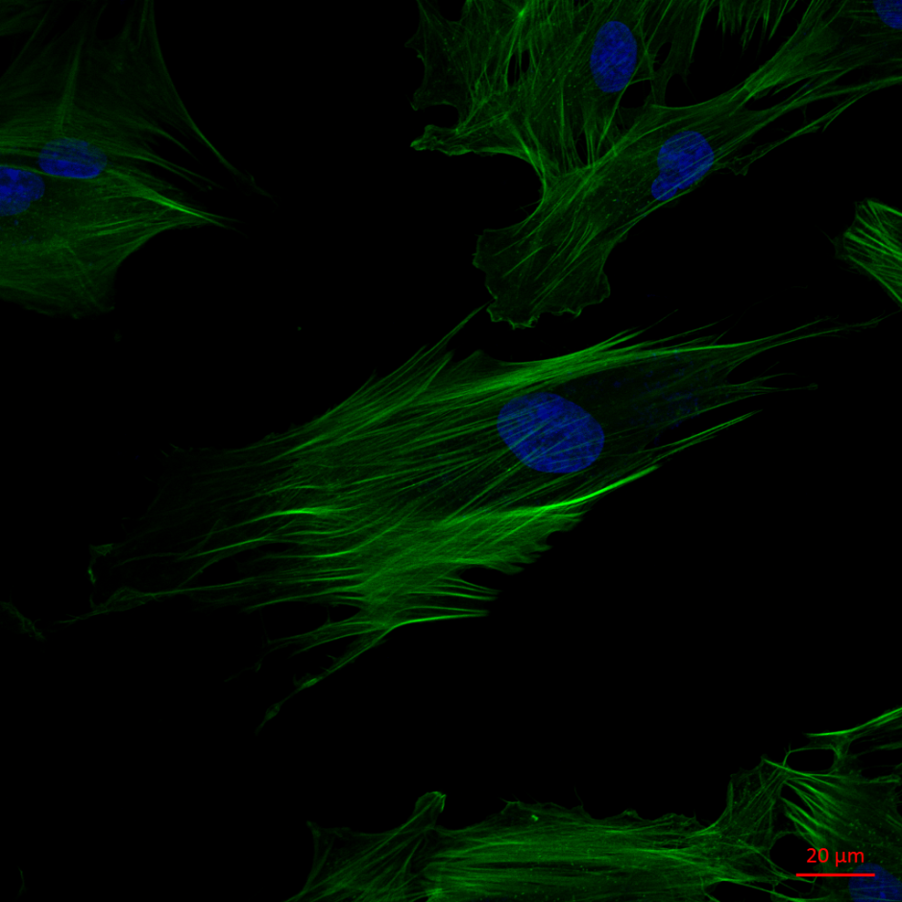
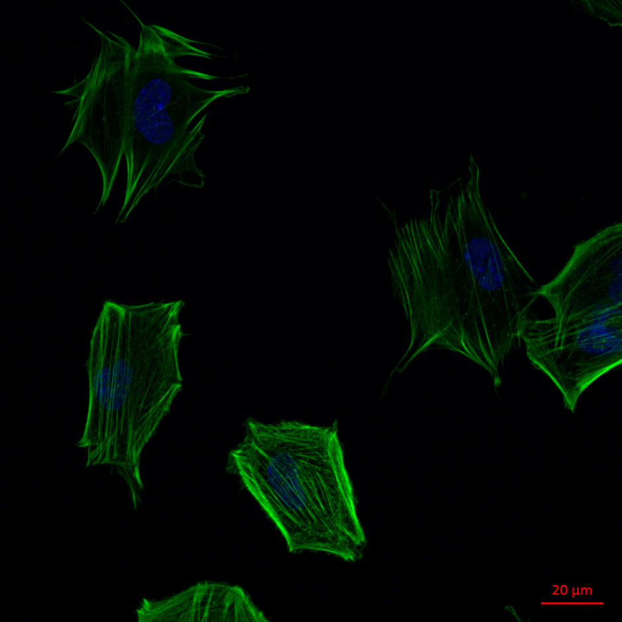
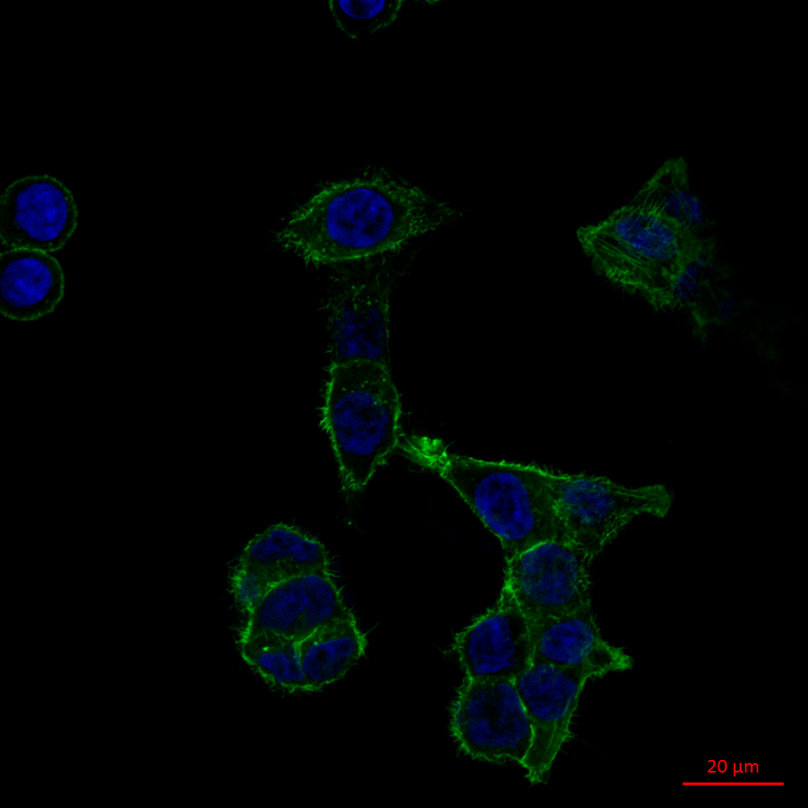
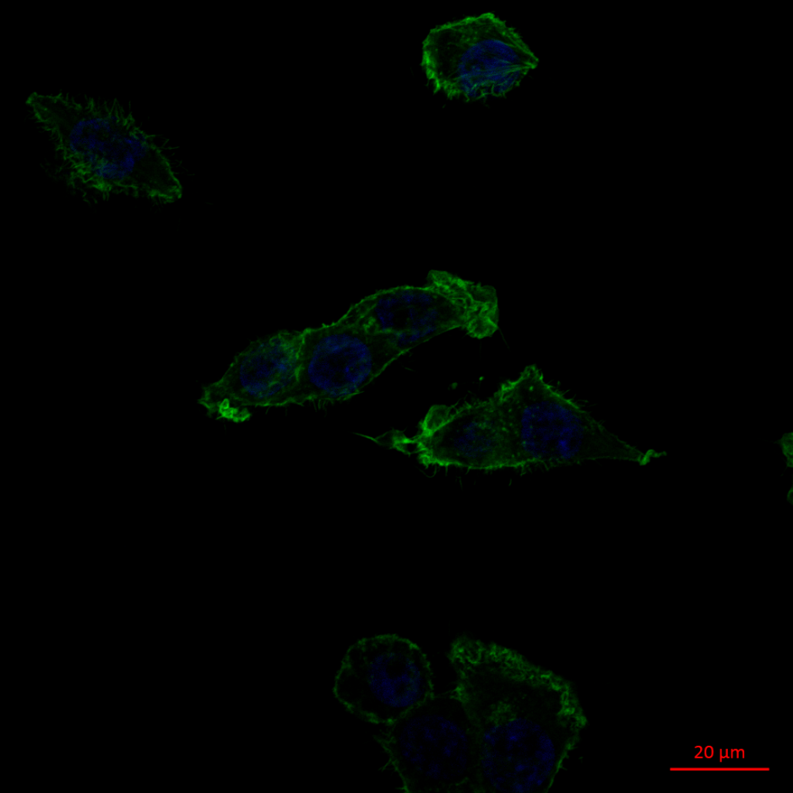
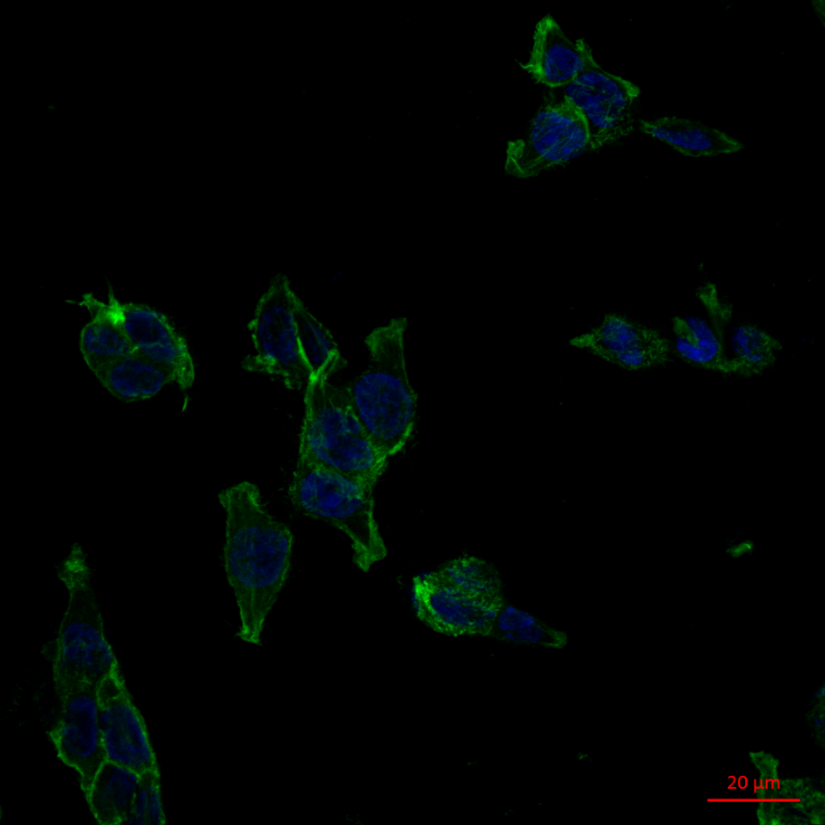
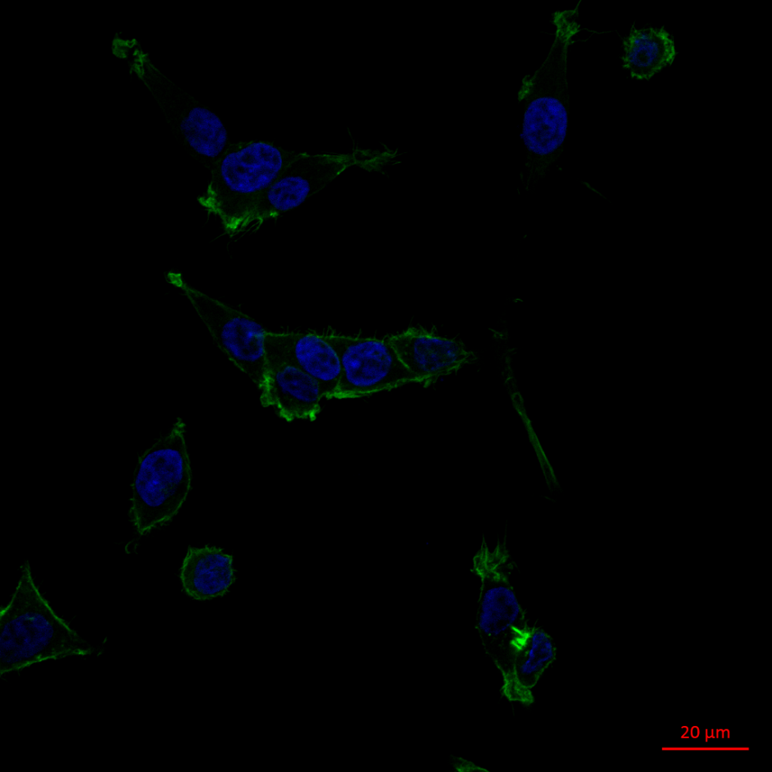
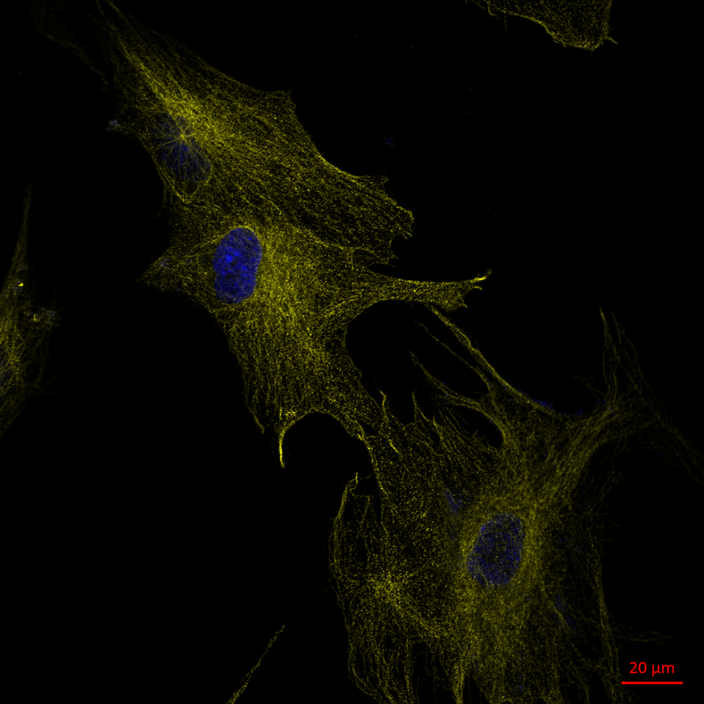
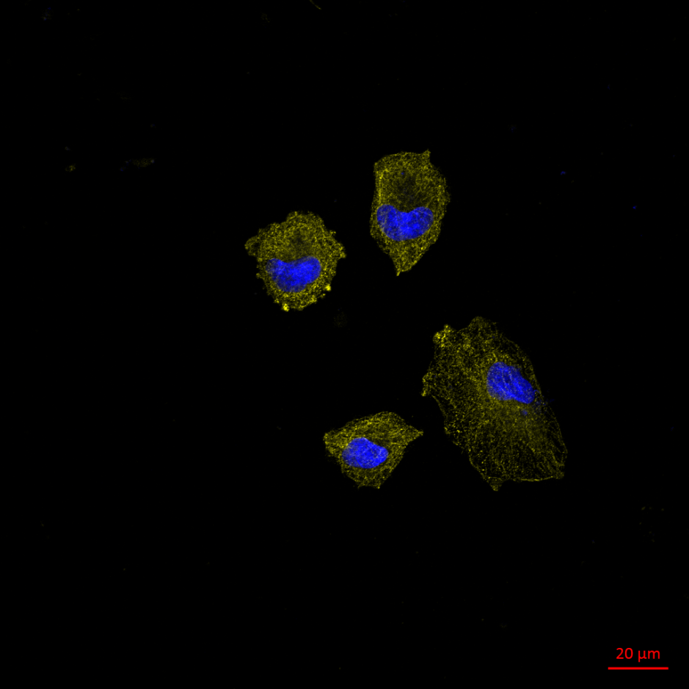
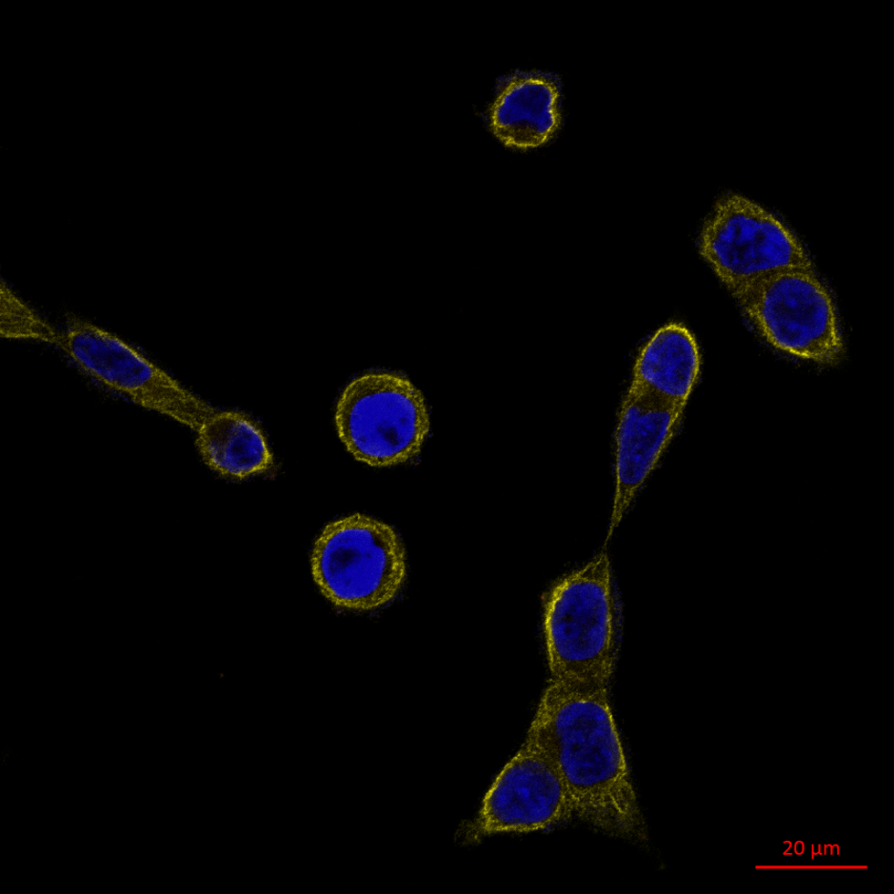
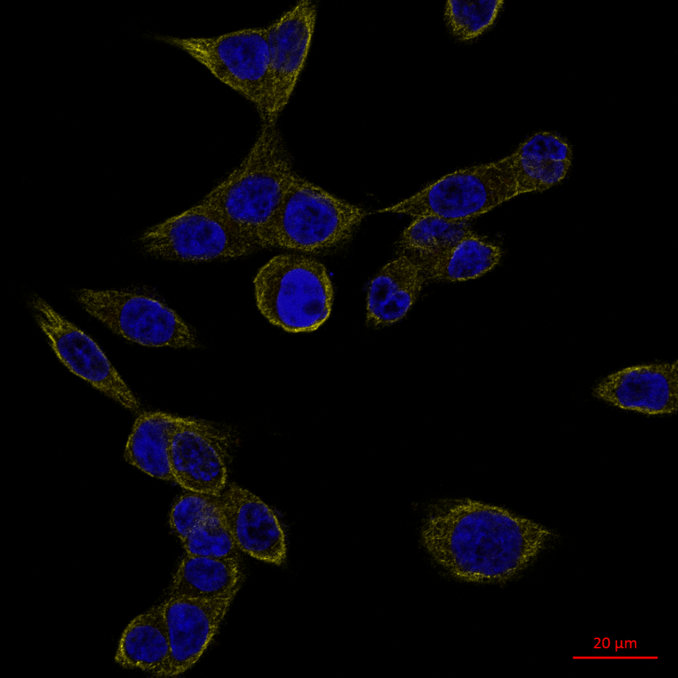
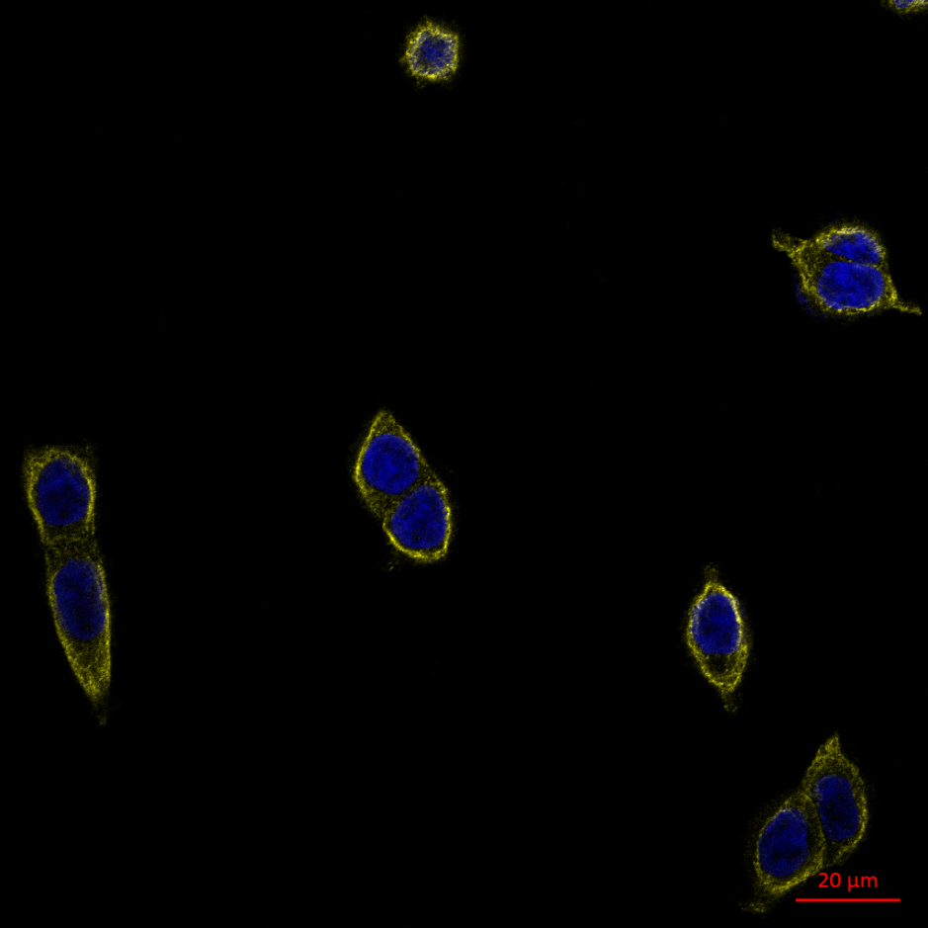
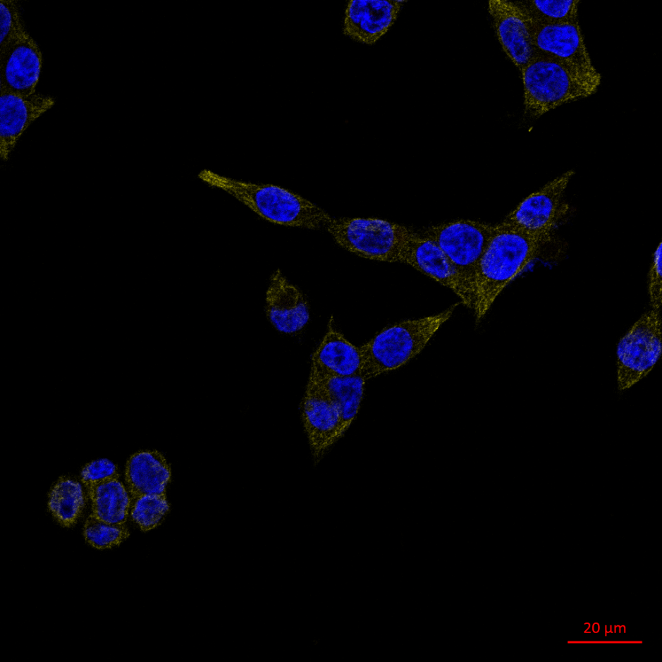
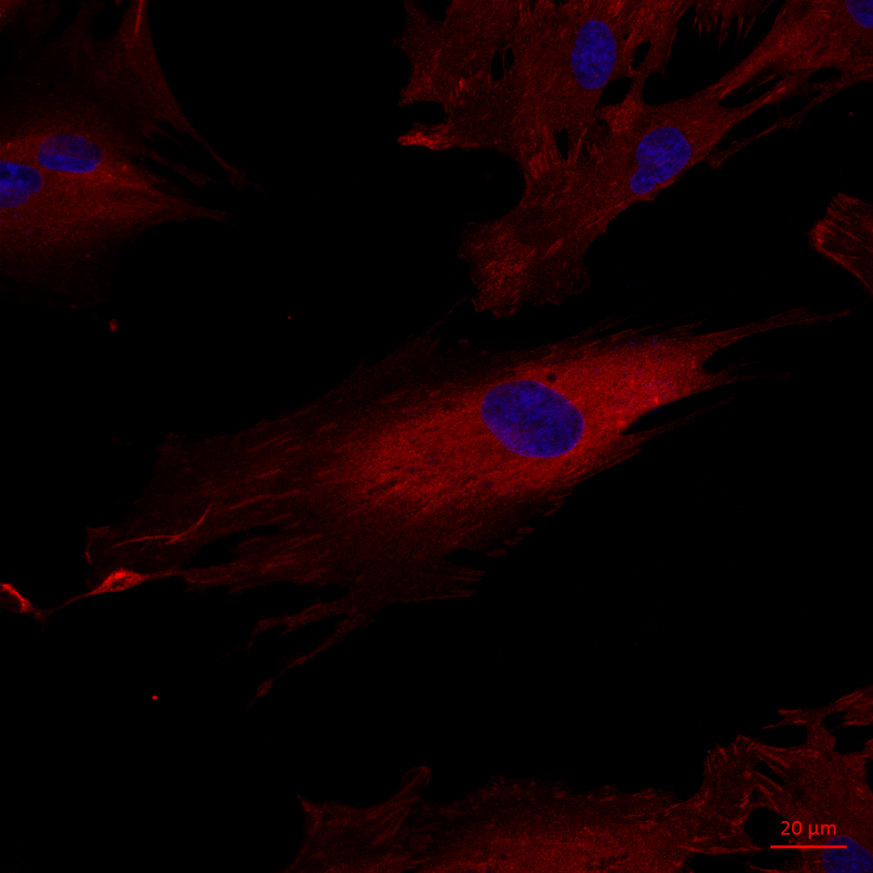
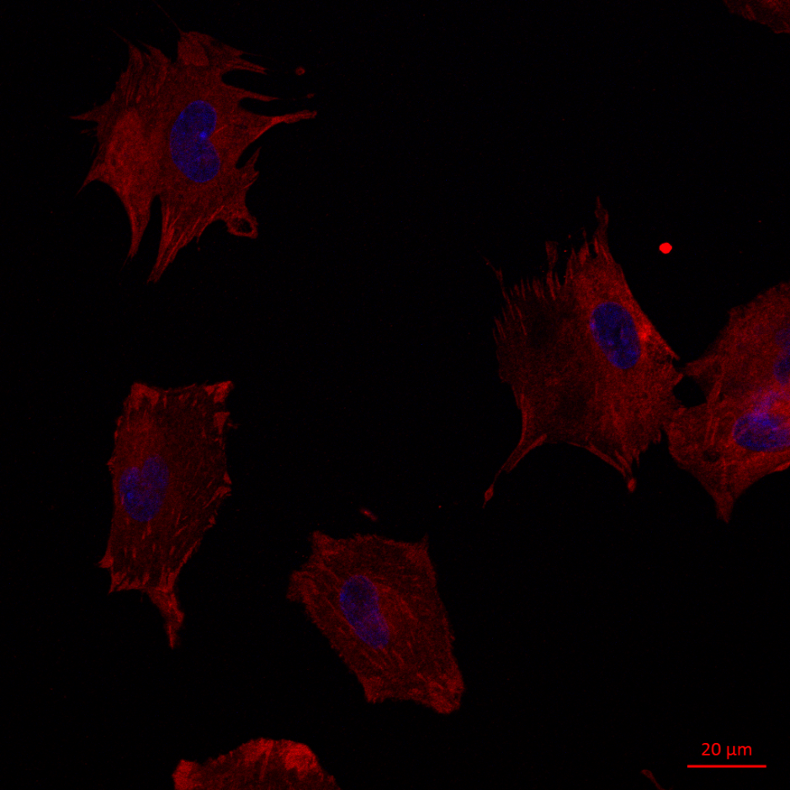
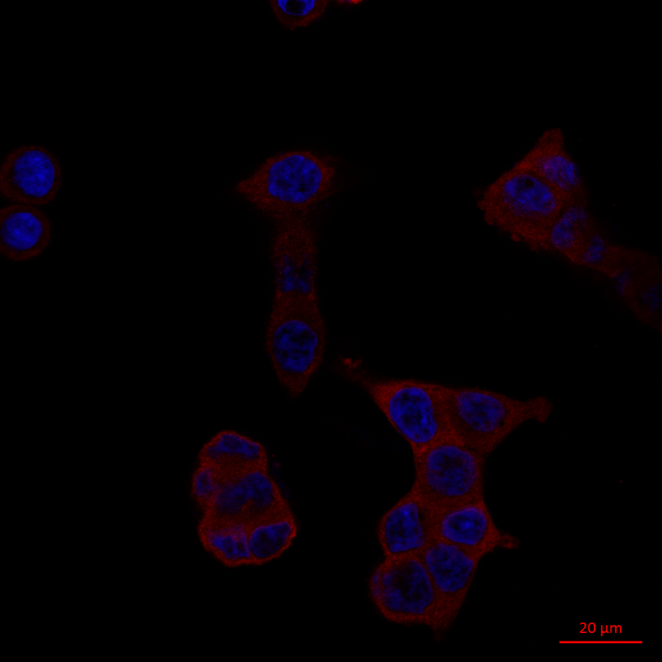



Cytoskeleton network in colon cell lines
CCD 841
HT 29
HCT 116
siCrl
siOGT
siCrl
siOGT
siCrl
siOGT
Actin
Tubulin
Vinculin
OGT silencing greatly affected the cytoskeletal networks and cell morphology, particularly in CCD841CoN cells. The cell shape appeared stocky and stunted whereas the microfilament network, responsible for cell migration, was less extended.

Slide 11
Conclusion
OGT silencing
↘ cell proliferation
↘ cell adhesion
↘ cell migration
OGT silencing decreased O-GlcNAcylation level, proliferation, adhesion and migration of HT29, HCT116 and CCD841 cell lines
We showed that OGT expression is not only necessary for the biological properties of cancer cells but also for normal cells

Slide 12









Previously : O-GlcNAcylation and β-catenin stability
0
5.5
25 Glc (mM)
WB: β-catenin
Glcucose (mM)
APC
Axin
(Olivier Van-Stichelen et al., 2012)
0
5.5
GSK3β
CK1α
25
Ub
Ub
WB: 0-GlcNAc
Glucose ↑ - increased intracellular protein O-GlcNAcylation
Perspectives
In vivo model : fat mice (high carbohydrate diet) and C57Bl6 mice (regular diet) injected with AOM (azoxymethane).
Glc or GlcNH₂ force-feeding
AOM injection
Analysis of OGT andβ-catenin expression, level of O-GlcNAcylation
β-catenin ↗
O-GlcNAcylation ↗
Correlation between nutrition and colorectal cancer development

Slide 13


Acknowledgments
Unit of Structural and Functional Glycobiology, CNRS UMR 8576, Villeneuve d’Ascq
Prof. Tony Lefebvre, Ikram El Yazidi-Belkoura, Vanessa Dehennaut, Anne-Sophie Vercoutter-Edouart, Annick Pierce, Sophie Groux-Degroote, Marlene Mortuaire , Steffi Baldini, Maite Leturcq, Jeanne Vermuse , Moyira Aquino-Gil , Nao Yamakawa
INSERM U908, Lille 1 University, Villeneuve d’Ascq, France
Xuefen Le Bourhis, Sylvain Julien, Leo Aubert
CCMIC platform (BICeL, Campus Lille 1)
Christian Slomianny and Elodie Richard
Thank you for your attention !

Slide 14
Previously :
0
5.5
25 Glc (mM)
WB: β-catenin
Glcucose (mM)
APC
Axin
0
5.5
GSK3β
CK1α
25
Ub
Ub
WB: 0-GlcNAc
Glucose ↑ - increased intracellular protein O-GlcNAcylation

Slide 15

Glutamine
Glucosamine
Glucose
Glutamine
Glucosamine
HEXOSAMINE BIOSYNTHETIC PATHWAY
Glucose
Glutamate
SALVAGE
PATHWAY
GK
GlcNH₂6P
AcT
G6P
G6P Is
GlcNH₂6P
F6P
GlcNAc6P
GFAT
Phospho-GlcNAc mutase
Glycogen synthesis
GlcNAc1P
UDP-GlcNAc pyrophosphorylase
UTP
Pentoses phosphates pathway
PPi
UDP-GlcNAc
ADP
Glycolysis
ATP
UDP
OH
Ser/Thr
OGT
Protein
Ser/Thr
OGA
Protein
OH
H₂O
O-GlcNAcylation

Slide 16


siCrl
siOGT
CCD 841CoN

Slide 17


O-GlcNAcylation and β-catenin stability
Wnt/β-catenin pathway is modified in 90% of cases of colorectal cancers by genetic alteration of β-catenin or one member of the destruction complex: APC, axin, GSK3β or CK1α
Consequence
APC
Axin
GSK3β
CK1α
β-catenin stability→ uncontrolled cell proliferation
Ub
Ub
Previously
Cell culture: high glucose ↗ β-catenin expression (A) and stimulation of cell proliferation (B)
4 O-GlcNAc sites at the N-term of β-catenin: S23/T40/T41/T112
2 of those in the D-box: T40/T41
T41 is key residue for β-catenin degradation
A
B
(Olivier Van-Stichelen et al., 2012)
(Olivier Van-Stichelen et al., 2014)

Slide 18


5’
40S
5’
40S
O-GlcNAcylation
OH
Ser/Thr
60S
3’
60S
3’
OGT
Protein
G
OGT
OGT
G
Ub
Ser/Thr
OGA
Nascent
polypeptide
Ub
Ub
G
Ub
Ub
Ub
Ub
Protein
OH
Ub
Ub
Ub
G
G
Proteasome
O-GlcNAcylation
Phosphorylation
G
GlcNAc
P
Full-length protein
Ser/Thr
Ser/Thr
Ser/Thr
UDP
OGT
UDP-GlcNAc
Pi
PPase
H₂O
Protein
Protein
Protein
H₂O
OGA
GlcNAc
AT
Kinase
Pyrophosphate
OGT (O-GlcNAc transferase), key and unique regulator of PTM
12 TPRs
G1
InD
G2
ncOGT
MSS
9 TPRs
G1
InD
G2
mOGT
2 TPRs
G1
InD
G2
sOGT
TPR
Catalytic Domain

