Slide 1


Gut-brain axis-based biomarkers as predictive tools in testing efficacy of carnosine and carnitine in rodent model of autism
By
Prof. Afaf El-Ansary

Slide 2
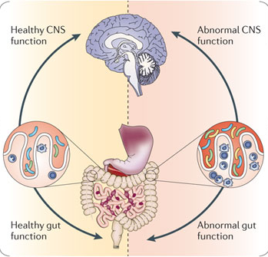
The Gut-brain Axis
Within the first few days of life the human gut is colonized by commensal intestinal microbiota.
Studies show that commensal, probiotic, and pathogenic bacteria in the gastrointestinal tract can activate neural pathways and central nervous system signaling systems.

Slide 3
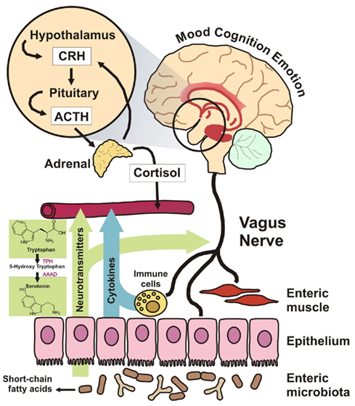
Gut and Brain Tissue
The brain and the gut both develop from the same tissue – during foetal development one part becomes the central nervous system, while the other develops into the enteric nervous system. They are connected via the Vagus nerve.
The gut has a large, semi-autonomous brain, and its endocrine signaling to the entire body is very elaborate.

Slide 4
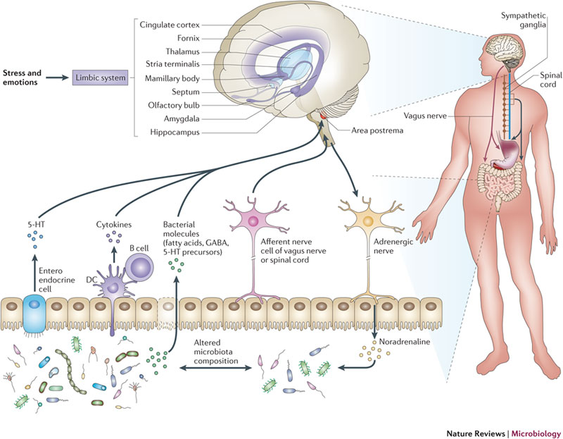
How the Gut-brain Axis works
The microbiome is affected by our experiences and emotions.
In turn microbes in the gut send chemical signals (including neurotransmitters) affecting memory, emotions and behaviour in important parts of the brain.
Gut microbes even alter gene expression in the gut.

Slide 5
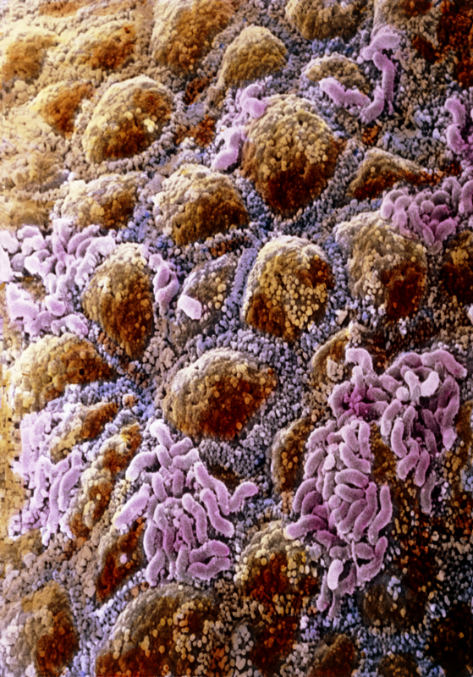
Functions of our digestive microbiome
Aid digestion, synthesize vitamins
Detoxify foreign compounds and help metabolize indigestible compounds
Defend against opportunistic pathogens.
Help programme the functioning of immune cells.
Compounds produced by the microbiome are found throughout the body, where they continue to signal disease.

Slide 6
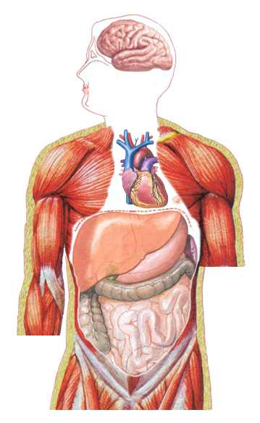
Stress
Pollution
Host genetics
Pharmaceuticals
Microbial exposures
Diet
Psychological status
Major factors affecting our digestive microbiome?
Factors
Community
shaping
the
Gut
Commensals
Pathobionts

Slide 7
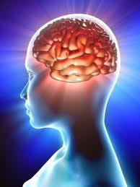
Every day, our brains understand the things we see, smell, hear, taste, touch, and experience. But when someone's brain has trouble interpreting these things, it can make it hard to talk, listen, understand, play, and learn.

Slide 8


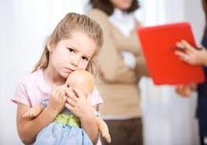
Autism
Autism is a disorder of neural development characterized by impaired social interaction and communication, and by restricted and repetitive behavior.
The prevalence of autism in Saudi Arabia is 18 per 10,000, (Al-Salehi et al.,2009).

Slide 9

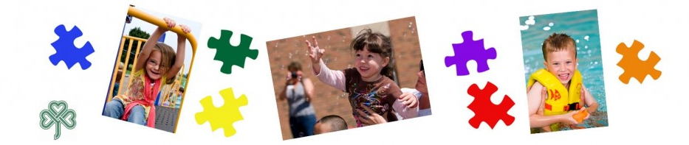
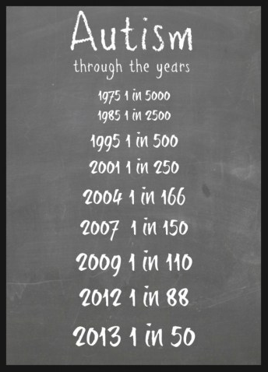
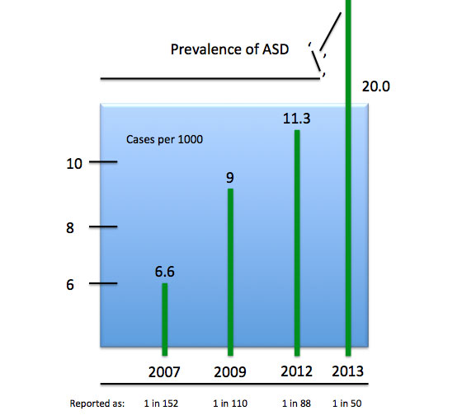
The Centre for systems Change

Slide 10
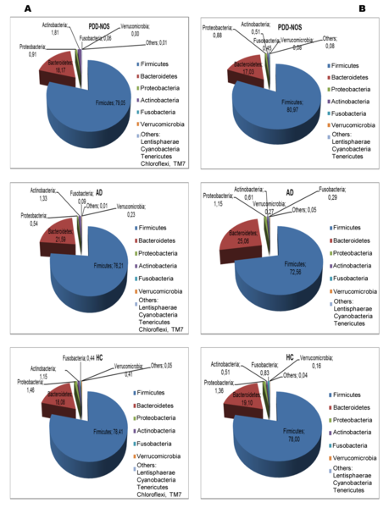

Figure 1. Total and active bacteria found in feces of children.
De Angelis M, Piccolo M, Vannini L, Siragusa S, et al. (2013) Fecal Microbiota and Metabolome of Children with Autism and Pervasive Developmental Disorder Not Otherwise Specified. PLoS ONE 8(10): e76993. doi:10.1371/journal.pone.0076993
http://www.plosone.org/article/info:doi/10.1371/journal.pone.0076993

Slide 11
Brain Complexity
The complexity of the brain itself presents a severe roadblock to identification of useful biomarkers.
In the brain, transcriptomes, proteomes, morphological phenotypes, and interactive connections vary widely within the neurons and glia, while most organs (eg, liver, muscle), cells are more homogenous in their phenotypes, transcriptomes, proteomes, and cellular interactions.
Many attempts at bypassing the problem of tissue availability have used in vitro and animal models of neurological disease. However, given the complexities of human neurological disorders, which often contain significant behavioral components, these models are often imperfect.

Slide 12
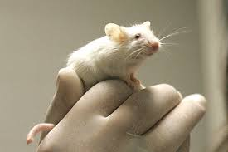
Animal Models
Animal models are essential for translation of drug findings from bench to clinical use. Hence, critical evaluation of the face and predictive validity of these models is important.
Proper design, and reporting of animal model results help to make preclinical data more reproducible and translatable to the clinic.
Design of an animal model strategy is part of the translational plan rather than (a) single experiment(s).
Data from animal models are essential in predicting the clinical outcome for a specific drug in development.

Slide 13
Animal Models
Animal models of neurological disease have successfully and accurately recreated many aspects of human illness in a variety of organisms, from mice to primates, allowing for in‑depth study of neuropathophysiology.
The development and testing of therapeutic interventions for diseases that affect the (CNS)often begin in animal models.
Progress in understanding and treating autism will require translational research efforts to transfer knowledge through successive fields of research from basic scientific discovery to public health impact.

Slide 14
Gut microbiota and autism
A developmentally abnormal gut microbiota may in turn affect both the gut-brain axis and brain development and contribute to the etiology of autism.
Propionic acid (PA) found as a metabolic product of gut bacteria has been reported to mimic/ mediate the neurotoxic effects of autism.
Results from animal studies may guide investigations on human populations toward identifying environmental contaminants that produce or drugs that protect from neurotoxicity.

Slide 15
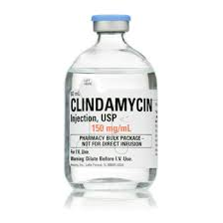
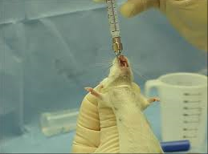
Study Objectives
  In a three successive independent experimental design, we tested the neurotoxic effect of PA either orally administered or biologically induced in clindamycin-treated hamsters.

Slide 16
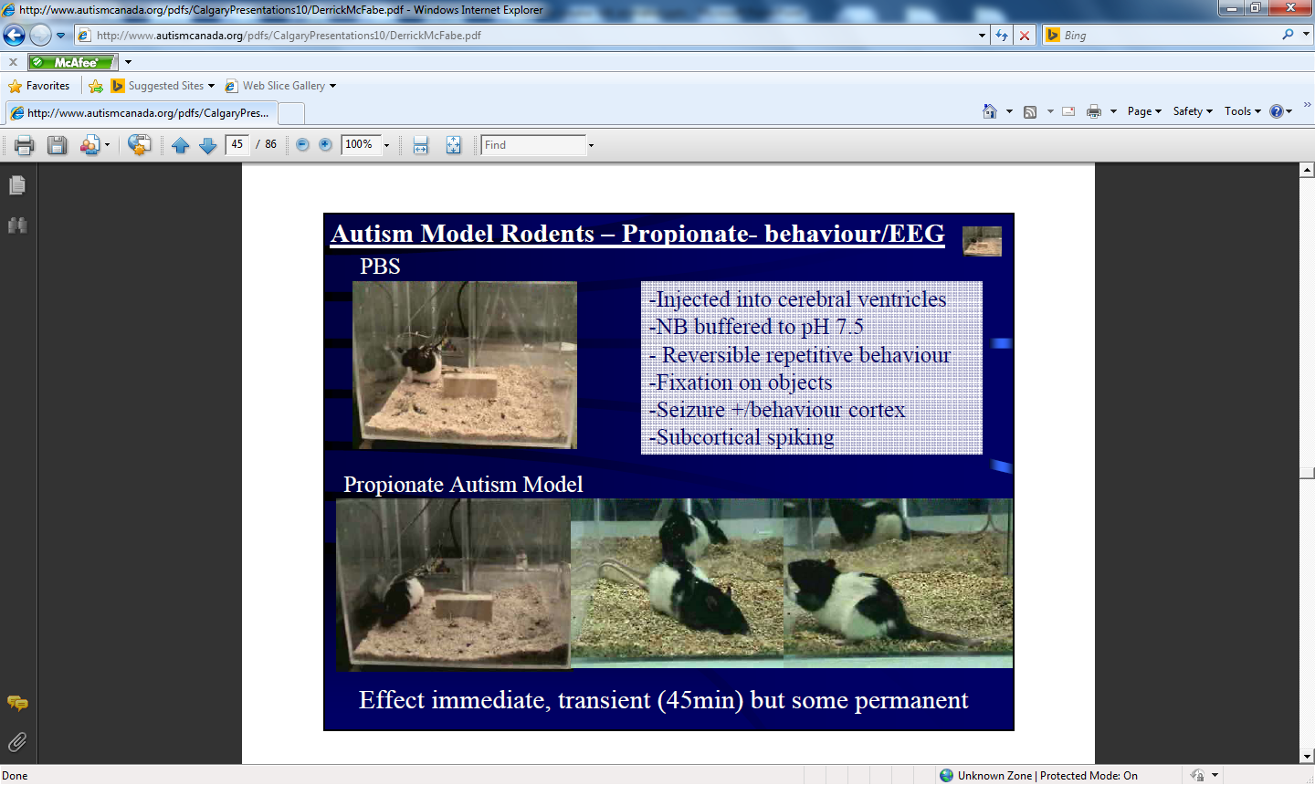
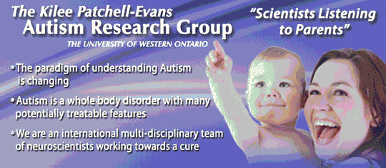


Slide 17
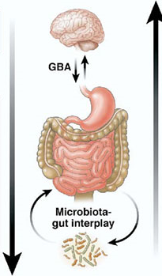
Why oral adminstration was selected???
The oral administration was used to confirm the role of gut-brain axis in the induction of autistic features probably found in treated rats. Additionally, Clindamycin was used to ascertain the role of overgrowth of Clostridia species as PA producer in inducing autistic features in animals.

Slide 18
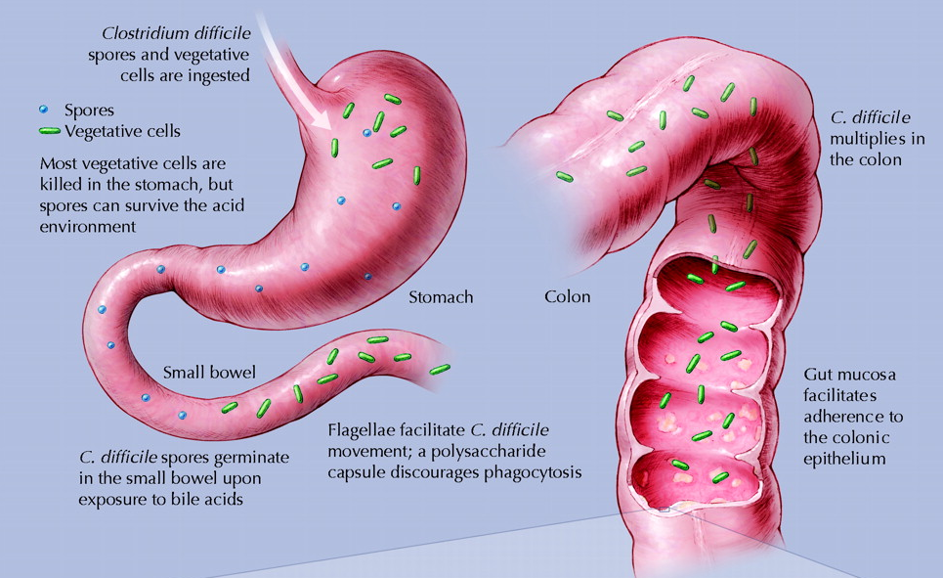
Additionally, clindamycin was used to ascertain the role of overgrowth of Clostridia species as PA producer in inducing biochemical autistic features in animals.

Slide 19
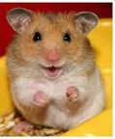
Experimental
A total of 54 young male golden Syrian hamsters weighing approximately 80–100 g (8 weeks of age) were used in the present study.
Animals were randomly allocated to 9 groups of 6 animals each:

Slide 20
a control group that received only phosphate buffered saline;
an oral buffered PA-treated group that was given a neurotoxic dose of 250 mg/kg body weight/day for 3 days.
a clindamycin-treated group that received a single dose (orogastrically) of 30 mg/kg on experiment day 0;
a carnosine-treated group that received a dose of 10 mg/kg body weight/day orally (daily for one week);
a carnitine-treated group that received 50 mg/kg body weight/day orally (daily for one week) and;
four protected groups were given the same doses of carnosine or carnitine for one week followed by PA for 3 days or a single dose of clindamycin as described above.

Slide 21
All groups were kept at a controlled temperature (21 ± 1°C) with ad-libitum access to food and water.
Quantitative stool cultures were collected and tested both aerobically and anaerobically on groups of hamsters receiving clindamycin and the untreated controls. All experiments were performed in accordance with national animal care guidelines and were pre-approved by the faculty ethics committee, King Saud University.

Slide 22
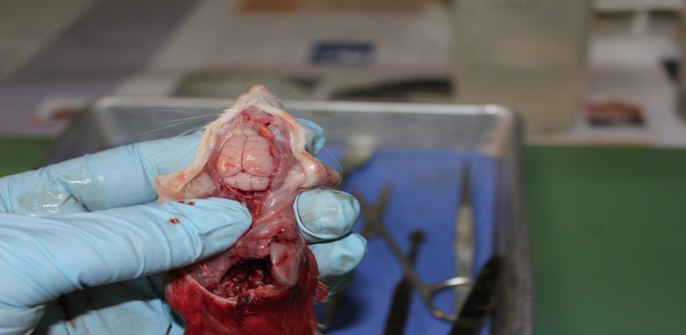
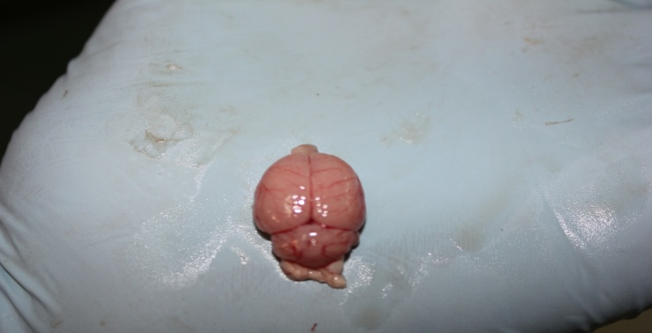
The brain was removed from the skull, homogenized and tissue homogenates were used for the biochemical analyses.

Slide 23
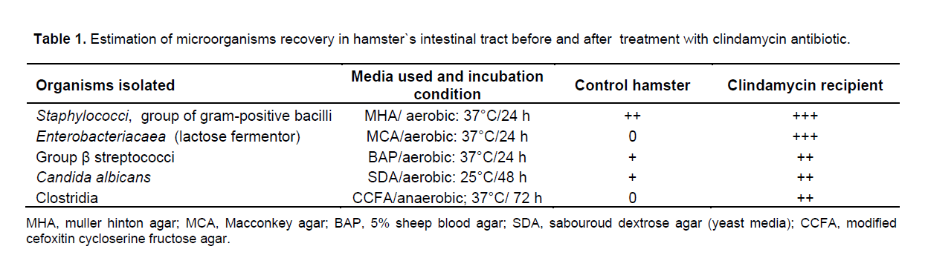

Slide 24
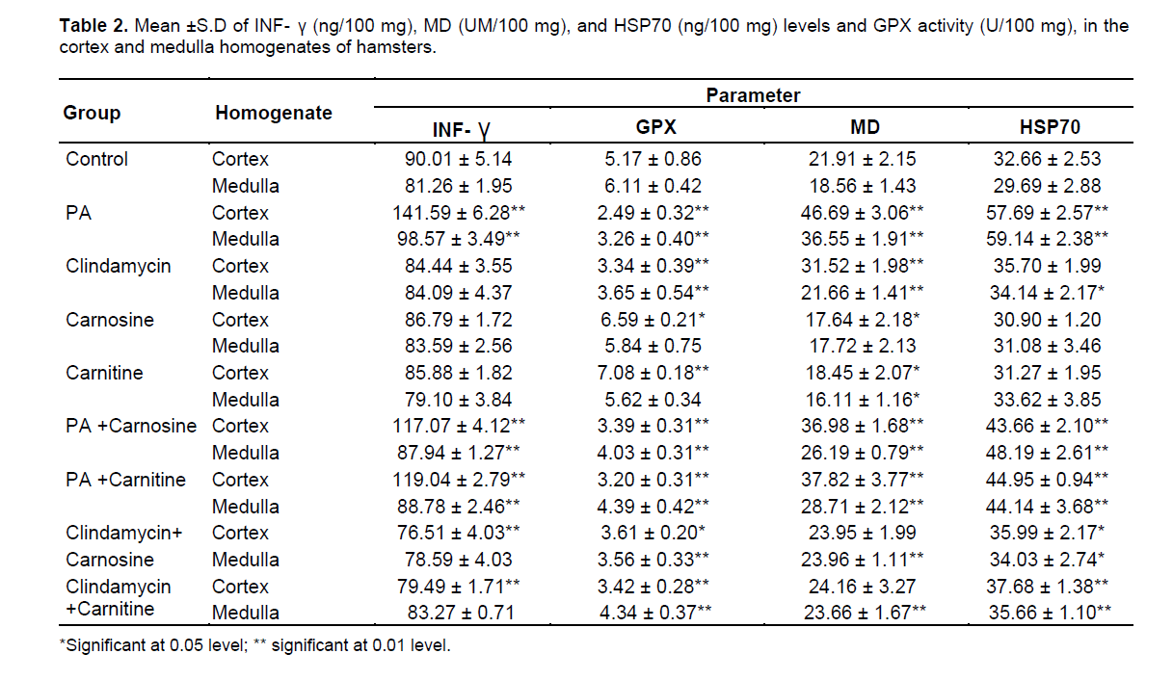

Slide 25
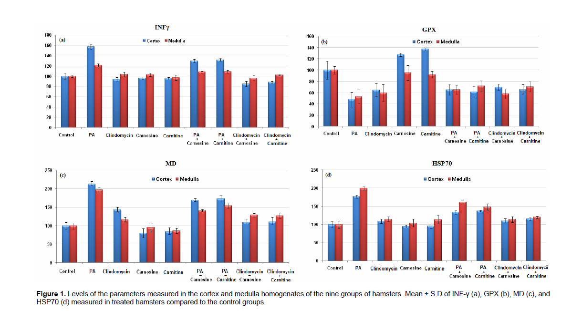

Slide 26
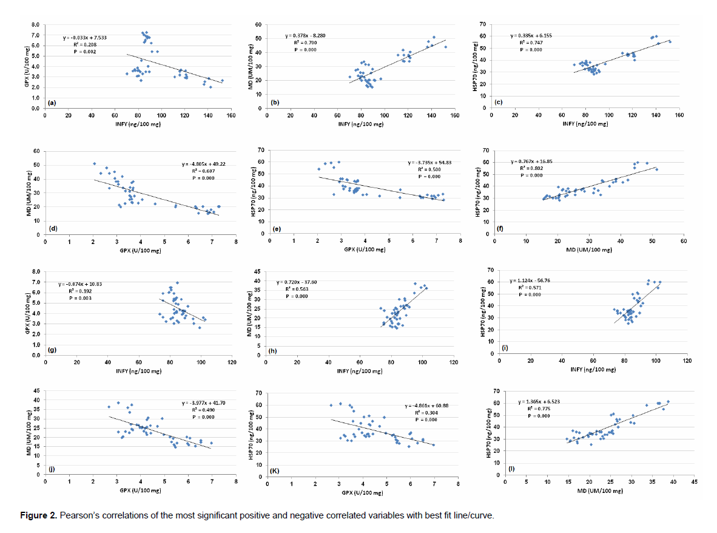

Slide 27
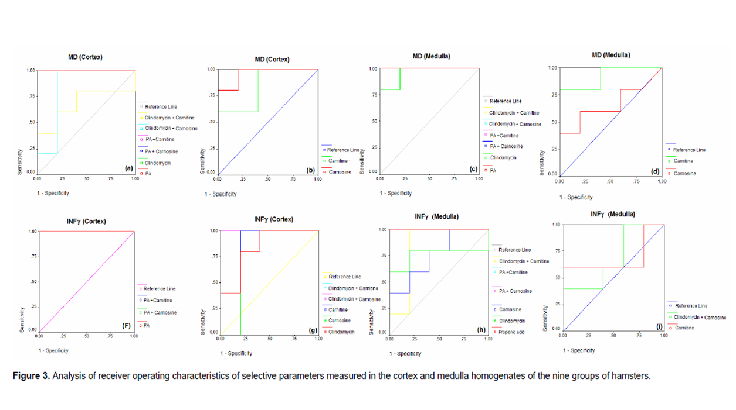

Slide 28
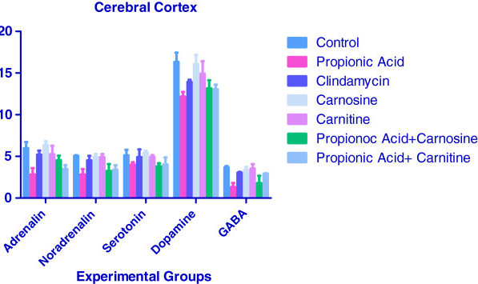
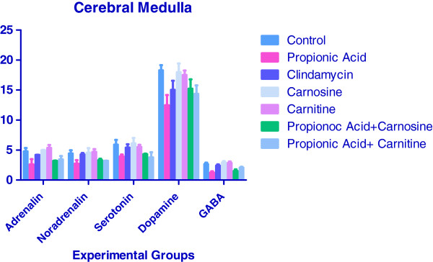

Slide 29
The results of this study lead us to suggest that PA may play a role in ASD by interfering with the neurotransmitters.
Carnosine and carnitine which are known antioxidants cause no significant changes in the levels of neurotransmitters when administered alone to hamsters.
However when administered with PA both carnosine and carnitine tended to restore the altered levels of neurotransmitters to near normal levels.
Therefore carnosine and carnitine may be used as antioxidants as supplements to protect against PA neurotoxicity.

Slide 30
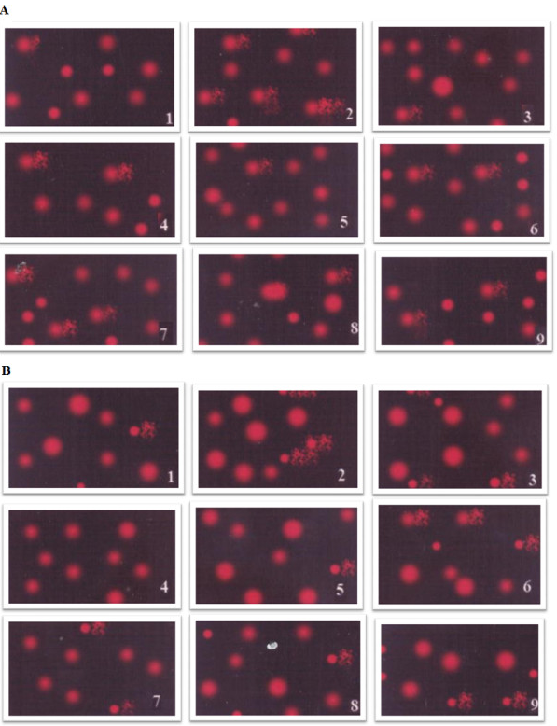
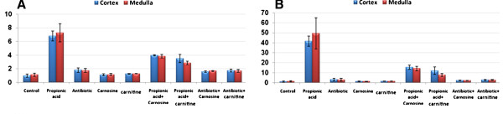

DNA damage (Comet assay)
DNA damage induced in hamster brains (cortex and medulla) by PA or clindamycin-induced bacterial overgrowth together with the protective effects of carnosine and L-carnitine.
Neurotoxic effects of PA, bacterial overgrowth and ameliorating effects of both the supplements could be seen as significant changes in tail length (μm) and tail moments (Arbitrary units) (A &B respectively) It is clear that orally administered PA was more neurotoxic than induced bacterial overgrowth. Carnosine was more protective than carnitine.
Measure of PA or clindamycin-induced DNA damage by comet assay. (A) Photograph showing comet tailing in PA and clindamycine treated hamsters together with the protective effects of carnosine and carnitine in cortex; (B) Photograph showing comet tailing in PA and clindamycine treated hamsters together with the protective effects of carnosine and carnitine in medulla.

Slide 31
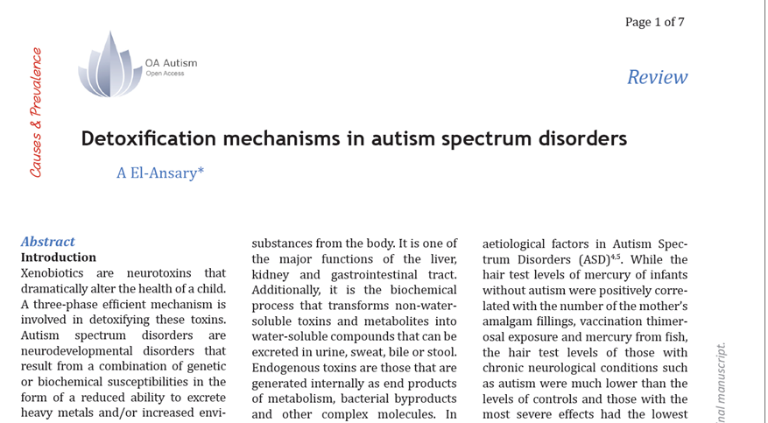
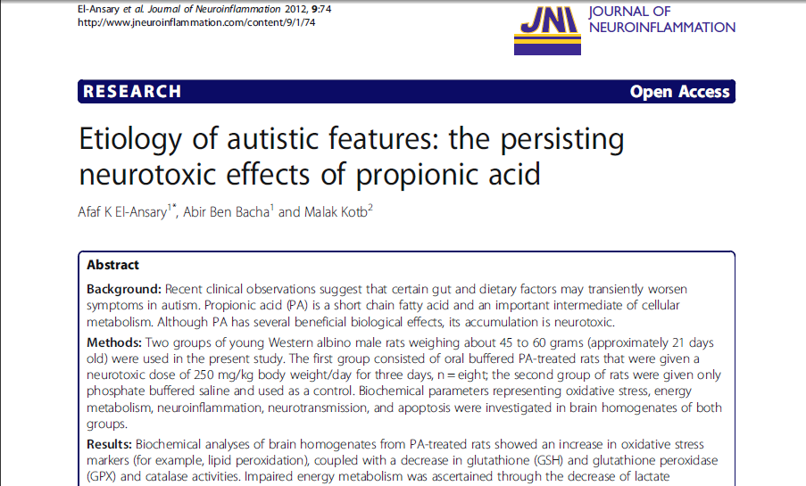

Slide 32
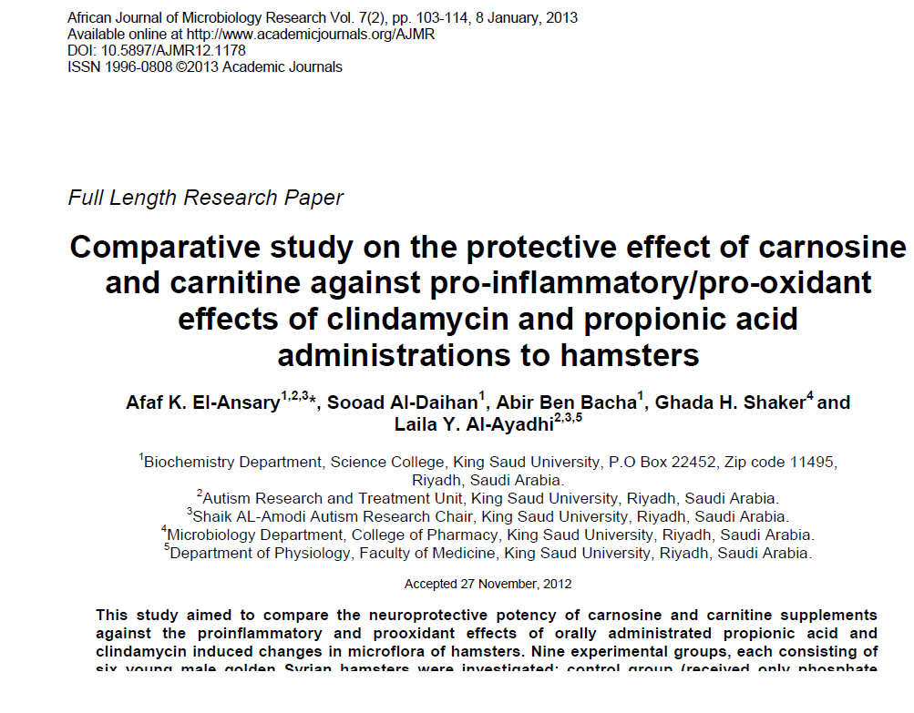
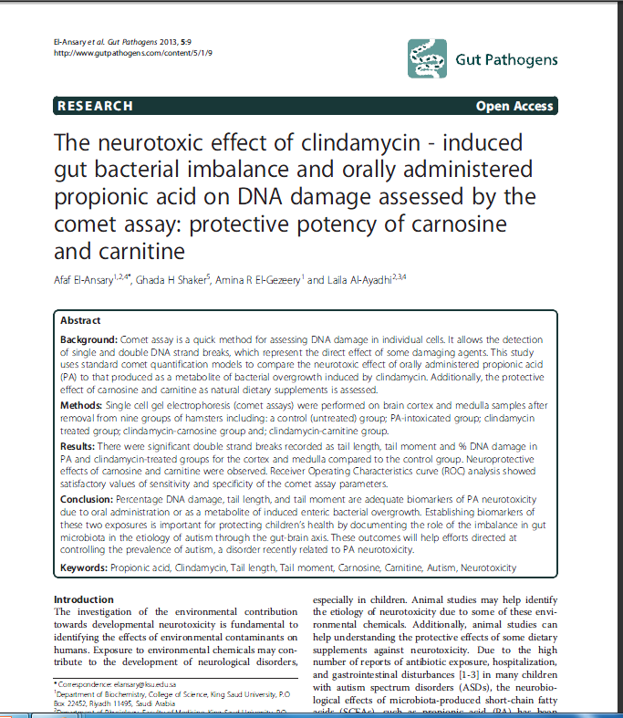
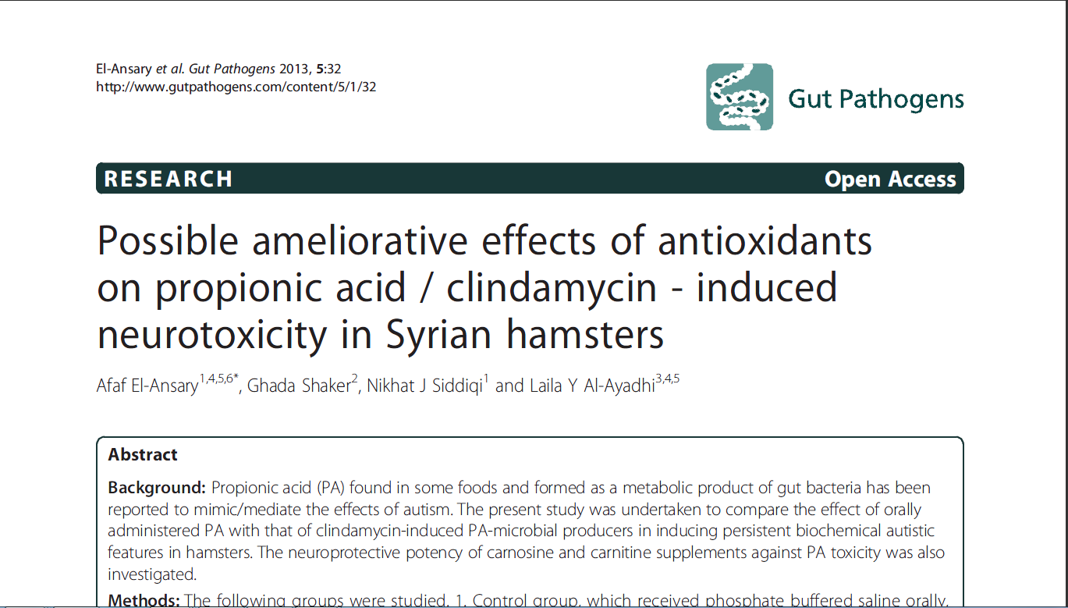

Slide 33
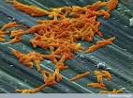
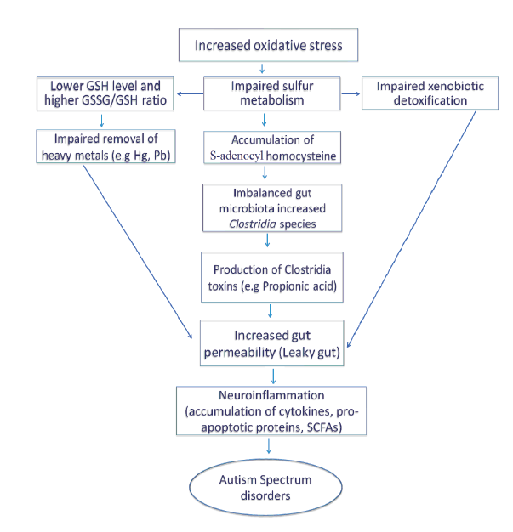
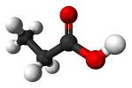
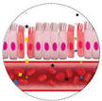
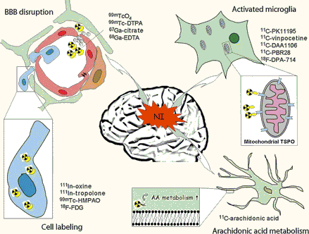

Propionic acid

Slide 34
Where do probiotic come from ??
The micro biota of a newborn develops rapidly after the birth .
It is initially dependent mainly on :
the mother’s micro biota,
mode of delivery,
birth environment
and rarely genetic factors .
The maternal vaginal and intestinal flora constitutes the source of bacteria, which colonizes the intestine of the newborn.
After infancy probiotics are supplied to us by raw foods; lactic acid fermented foods such as yogurt and cheese; and probiotic supplements.

Slide 35
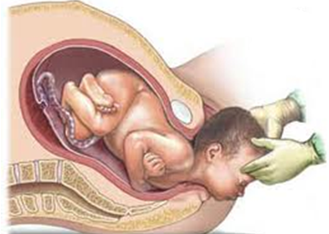
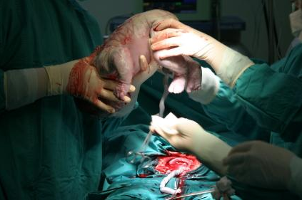
Vaginal delivery and C-section

Slide 36
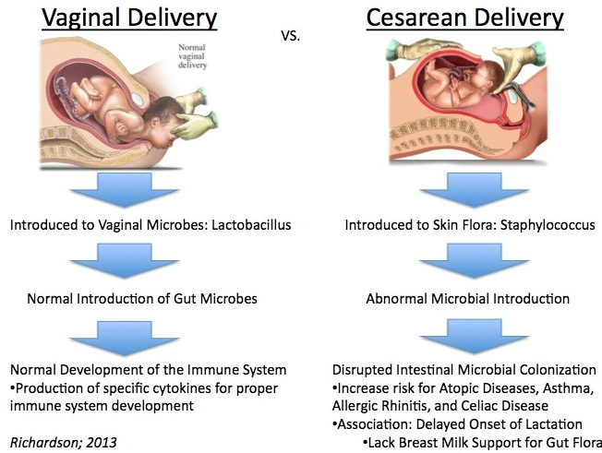

Slide 37
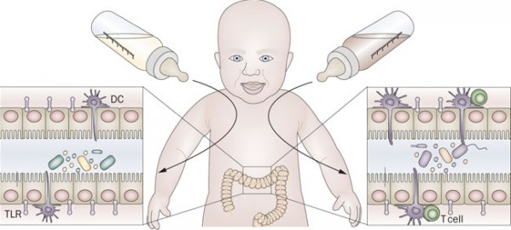
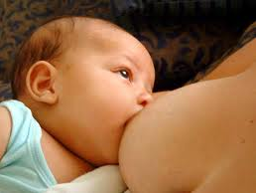
Balanced at birth microbiota

Slide 38
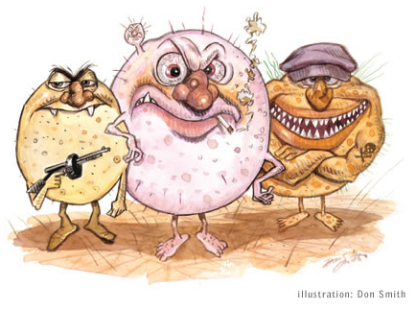
Factors affecting the intestinal microbiota
Any action taken to kill ‘bad’ bacteria essentially kills ‘good’ bacteria as well.
Antibiotics and other drugs intake
Microbial infections
Diet (highly processed, low-fiber foods)
Chronic diarrhea
Stress

Slide 39
Selection of probiotic organism
Safety
Origin
Functional aspects
Survival
Adherence, colonization
Anti-microbial products
Immune stimulation
Genetic stable
Prevention of pathogens

Slide 40
Major pre-requisite properties for a microbe to be accepted as a probiotic are:
It should be non-pathogenic, non-toxic and non-allergic.
It should be capable of surviving and metabolizing in upper G.I. tract secretion in the gut environment e.g. Resistant to low pH, organic acids, bile juice, saliva and gastric acid.
It should be human in origin, genetically stable and capable of remaining viable for long periods.
It should be able to modulate immune response and provide resistance to disease through improved immunity or by the production of antimicrobial substance in the guts.
Contd….

Slide 41
It should have a good adhesion/ colonization to human intestinal tract and influence on gut mucosal permeability.
It should be antagonistic against carcinogenic/ pathogenic organism.
It should posses clinically proven health benefit, e.g. gastrointestinal disorders, persistant diarrhoea, clostridium difficle colitis, antibiotics associated diarrhoea, acute infantile gastroenteritis.
It should have technologic properties for commercial viability such as stability of desired characteristics during processing, storage and transportation.

Slide 42
Advantages of a probiotic
Produce lactic acid- lowers the pH of intestines and inhibiting bacterial villains such as Clostridium, Salmonella, Shigella, E. coli, etc.
Decreases the production of a variety of toxic or carcinogenic metabolites.
Aid absorption of minerals, especially calcium, due to increased intestinal acidity.
Production of β- D- galactosidase enzymes that break down lactose .
Contd….

Slide 43

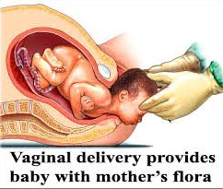
Probiotics in Pregnancy:
Bacterial vaginosis , increases the risk of preterm labour and infant mortality .
Probiotics decrease the risk of bacterial vaginosis and maintain normal lactobacilli vaginal flora

Slide 44
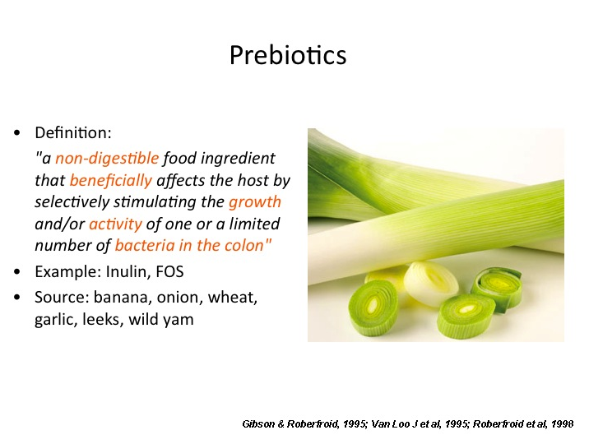
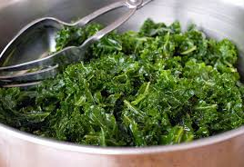
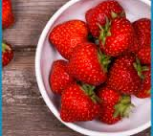

Slide 45

Concept of Probiotics and Prebiotics
Harish and Varghese, 2006

Slide 46
Synbiotics
Synbiotic = Probiotic + Prebiotic
The concept of synbiotics has been proposed to characterize health-enhancing foods and supplements used as functional food ingredients in humans (Gibson, 2004).
Potential synergy between pro- & prebiotics
Improve survival in upper GIT
More efficient implantation
Stimulating effect of Probiotics

Slide 47
Some of the major health benefits of synbiotics
Improved survival of live bacteria in food products, prolonged shelf life,
Increased number of ingested bacteria reaching the colon in a viable form
Activation of metabolism of beneficial bacteria, antagonistic toward pathogenic bacteria
Production of antimicrobial substances (bacteriocins , hydrogen peroxide, organic acids etc)
Immunostimulation
Anti-inflammatory, Anti-mutagenic, Anti-carcinogenic, and production of bioactive compounds (enzymes, vaccines, peptides etc)
(Nagpal et al, 2007)

Slide 48






Probiotic Foods

Slide 49

Probiotics for Autism: Clinical Research
Probiotics for Autism: Clinical Research
Probably the most well-known study into probiotic for autism was that run in 2006 by Professor Glenn Gibson at the University of Reading
40 autistic children all between 4 and 13 years old were randomly separated into a trial group, and a control group. The trial group were given a probiotic supplement with the species Lactobacillus plantarum whilst children in the other group were given placebos.
Comments from parents of participants in the probiotic group included not only reports on digestive health improvements, such as, 'better formed stools' but also potentially mental & behavioural improvements, such as, 'more calm, relaxed, not stressed' and 'improved ability to listen and concentrate'.

Slide 50

L-carnosine supplementation in autism
In the Chez et al study, researchers treated 31 autistic children, ranging from 3 to 12 years in age, with either 400 mg of L-Carnosine, twice a day, or a placebo, for 8 weeks. At the end of the study the children treated with L-Carnosine showed significant improvements in behavior, socialization, and communication, as well as increases in language comprehension based on CARS (Childhood Autism Rating Scale), vocabulary tests (E/ROWPVT) and biweekly parent reports. In the conclusion to their report the researchers state, “Oral supplementation with L-Carnosine resulted in demonstrable improvements in autistic behaviors, as well as increases in language comprehension that reached statistical significance.”

Slide 51
L-carnitine trial in autism
SRCTN54273114
A Clinical Trial of Levocarnitine to Treat Autism Spectrum Disorders
A Prospective Double-Blind, Randomized Clinical Trial of Levocarnitine to Treat Autism Spectrum Disorders
The hypothesis tested in the present study was that blood carnitine levels in patients diagnosed with an ASD have a significant impact on behaviour, cognition, socialization, and health/physical traits associated with an ASD diagnosis. The present prospective, double-blind, placebo controlled trial evaluated whether a standardized treatment regimen of liquid L-carnitine administered to patients diagnosed with an autism spectrum disorder (ASD) on a daily basis for 3-months would result in improved behaviour, cognition, socialization, and health/physical traits associated with an ASD diagnosis.
Autism Research Institute (USA)

Slide 52



