Slide 1

Maintaining patient safety in health IT
Dr Adrian Stavert-Dobson
Notes:
Holding/ title page/ Introduction

Slide 2
We need to talk
Notes:
My story - mistake

Slide 3

Notes:
Impact of mistake, not alone?

Slide 4
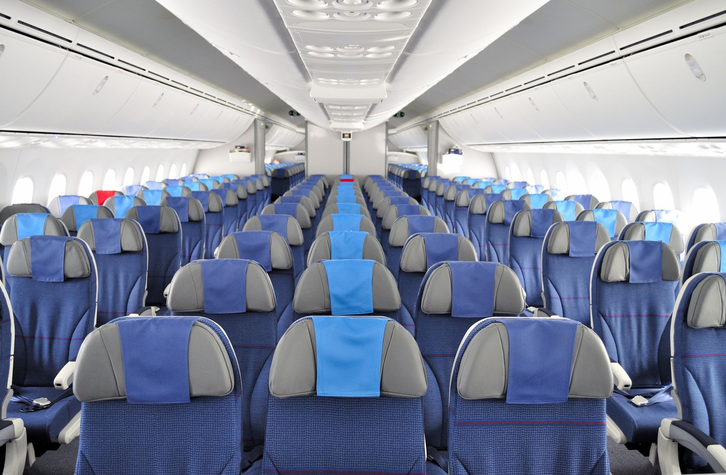
…every day
Notes:
Medical error – To err is human findings

Slide 5
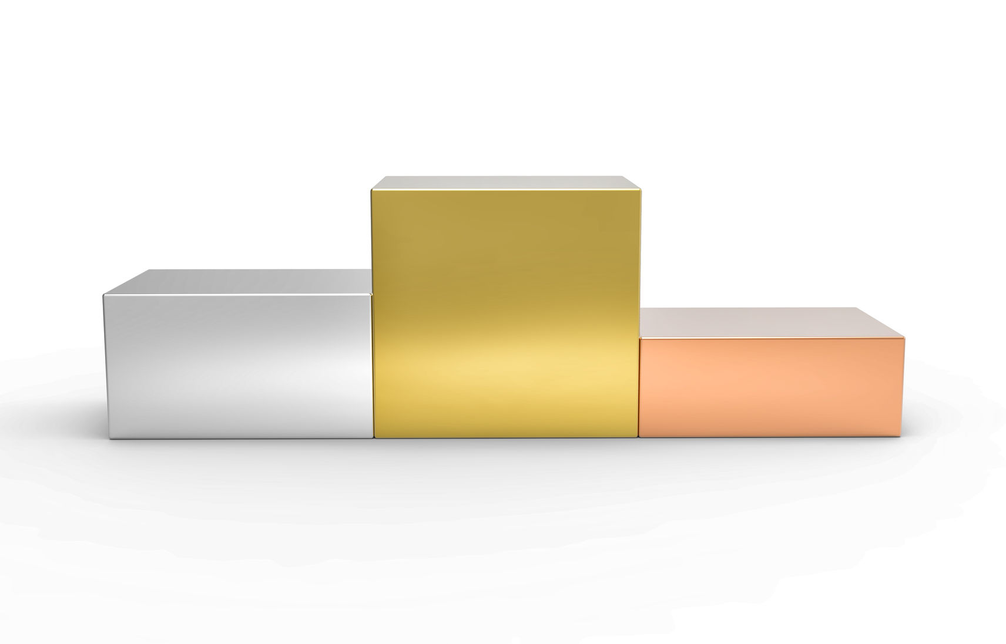
HEART DISEASE
MEDICAL ERROR
CANCER
Notes:
Mackery Paper- Quarter million. 3rd commonest cause of death in US

Slide 6
NHS 3432687246
DOB 23/4/1970
John Smith, Male
27 Acacia Avenue, Leeds, West Yorks
NHS 3432687246
DOB 23/4/1970
John Smith, Male
27 Acacia Avenue, Leeds, West Yorks
NHS 3432687246
DOB 23/4/1970
John Smith, Male
27 Acacia Avenue, Leeds, West Yorks
NHS 3432687246
DOB 23/4/1970
John Smith, Male
27 Acacia Avenue, Leeds, West Yorks
NHS 3432687246
DOB 23/4/1970
John Smith, Male
27 Acacia Avenue, Leeds, West Yorks
NHS 3432687246
DOB 23/4/1970
John Smith, Male
27 Acacia Avenue, Leeds, West Yorks
NHS 3432687246
DOB 23/4/1970
John Smith, Male
27 Acacia Avenue, Leeds, West Yorks
NHS 3432687246
DOB 23/4/1970
John Smith, Male
27 Acacia Avenue, Leeds, West Yorks
NHS 3432687246
DOB 23/4/1970
John Smith, Male
27 Acacia Avenue, Leeds, West Yorks
NHS 3432687246
DOB 23/4/1970
John Smith, Male
27 Acacia Avenue, Leeds, West Yorks
NHS 3432687246
DOB 23/4/1970
John Smith, Male
27 Acacia Avenue, Leeds, West Yorks
NHS 3432687246
DOB 23/4/1970
John Smith, Male
27 Acacia Avenue, Leeds, West Yorks
NHS 3432687246
DOB 23/4/1970
John Smith, Male
27 Acacia Avenue, Leeds, West Yorks
NHS 3432687246
DOB 23/4/1970
John Smith, Male
27 Acacia Avenue, Leeds, West Yorks

Slide 7
NHS 5432524254
DOB 26/2/1968
Peter Smyth, Male
28 High Street, Leeds, West Yorks
NHS 5432524254
DOB 26/2/1968
Peter Smyth, Male
28 High Street, Leeds, West Yorks
NHS 3432687246
DOB 23/4/1970
John Smith, Male
27 Acacia Avenue, Leeds, West Yorks
NHS 3432687246
DOB 23/4/1970
John Smith, Male
27 Acacia Avenue, Leeds, West Yorks
NHS 3432687246
DOB 23/4/1970
John Smith, Male
27 Acacia Avenue, Leeds, West Yorks
NHS 3432687246
DOB 23/4/1970
John Smith, Male
27 Acacia Avenue, Leeds, West Yorks
NHS 3432687246
DOB 23/4/1970
John Smith, Male
27 Acacia Avenue, Leeds, West Yorks
NHS 3432687246
DOB 23/4/1970
John Smith, Male
27 Acacia Avenue, Leeds, West Yorks

Slide 8

“[technology] holds enormous potential for transforming healthcare delivery”
Institute of Medicine. Crossing The Quality Chasm: A new health system for the 21st Century. 2001.
Notes:
Benefits of technology

Slide 9
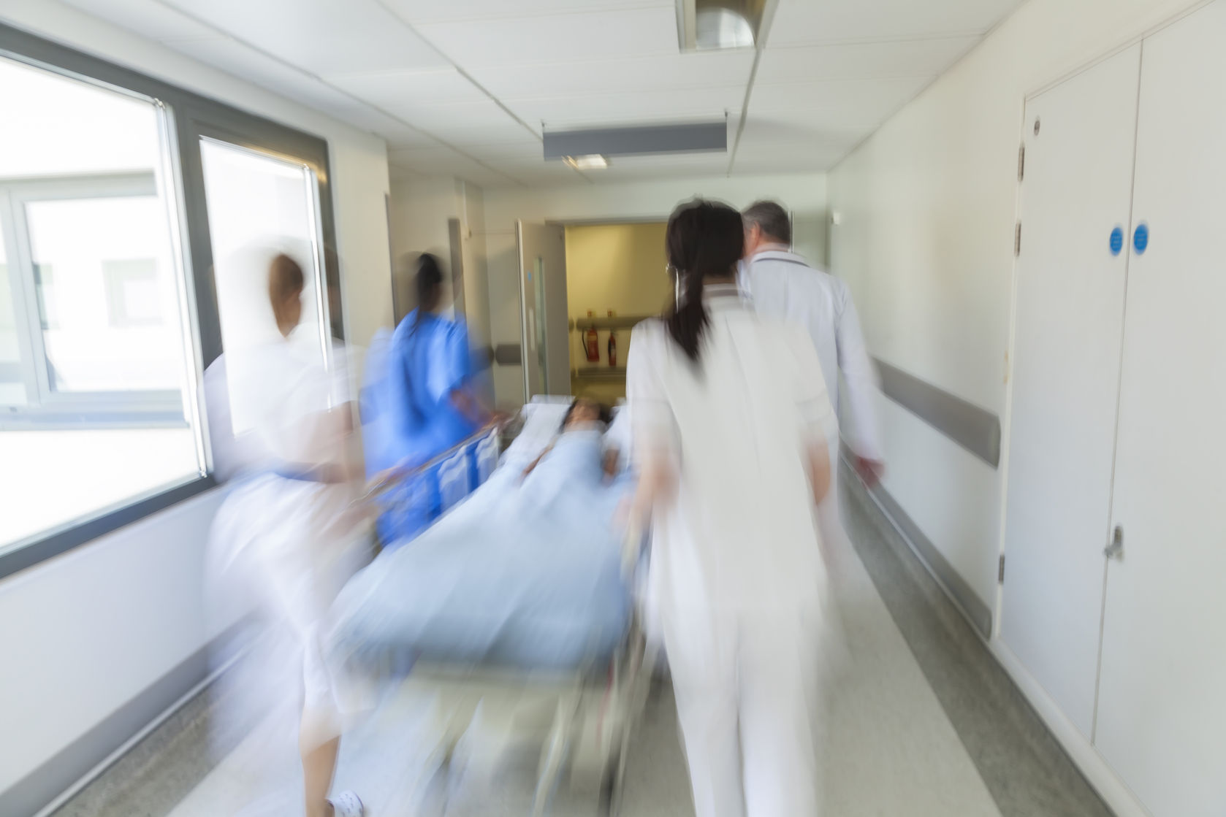
Notes:
Back to the story. Humans are fallible.

Slide 10

“Moving from a paper to an electronic based patient record system would be the single step that would most improve patient safety.”
To Err is Human: Building a Safer Health System, 2000.
Notes:
Turn to technology for safer care. Predictable/ consistent.

Slide 11
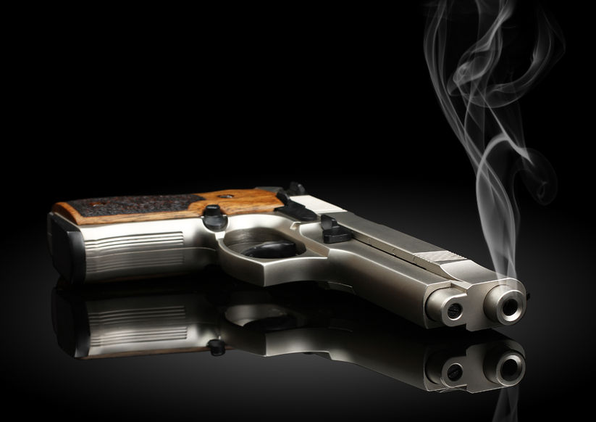

“A computer lets you make more mistakes faster than any invention in human history – with the possible exceptions of hand guns and tequila”
– Mitch Ratcliffe

Slide 12

COMPLEXITY
Notes:
Technology can introduce risk. Complexity.

Slide 13

“We read him stories and sang him songs whilst they stopped giving him drugs. Our little boy died in our arms."
Notes:
Example. 21012 Samuel Starr. Electronic booking system contributor to death.

Slide 14
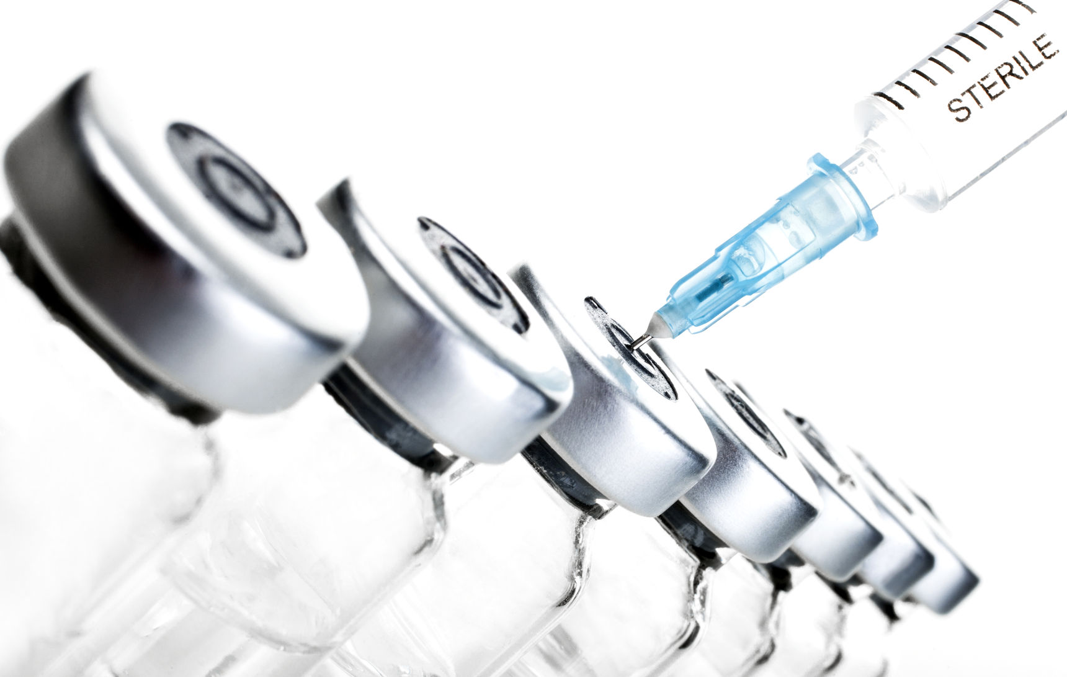
22
Notes:
Not one –off incident. Factors contributing to unsafe circumtances.

Slide 15
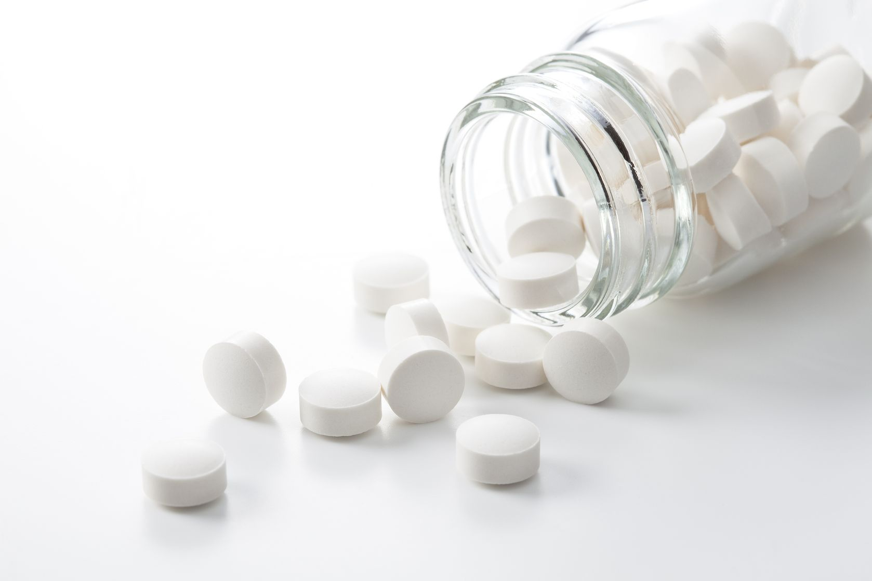
25%
Notes:
2008 US Joint Commission – 25% logged medication incidents involved computer technology.

Slide 16

Notes:
Technology is proliferating, exponential growth. Mustn’t assume safe by default.

Slide 17

Notes:
Medical Device Directive. EU Law. Does not apply to software.

Slide 18

Notes:
No applicable regulations- software/ apps could originate anywhere.

Slide 19

Notes:
Proactive v Reactive safety management. Compare with other industries.

Slide 20

Notes:
Results – Proactive Safety Management. Forecast how safety could be compromised by technology. Measure sin place at design stage to prevent. Examples.

Slide 21

SCCI 0129 and SCCI 0160
Notes:
2012 UK Health & Social Care Information Centre (NHS Digital) 2 Standards SCCI 0129 & SCCI 0160. Instruction Manual.

Slide 22
SCCI 0129 compliance
Clinical Safety Officer
Safety process
Risk assessment
Post-deployment assurance

Slide 23

Notes:
4 requirements of the Standards.

Slide 24

CASE STUDY
Notes:
Northern Territory Project.

Slide 25

BARRIERS
Notes:
Variable uptake. Barriers to this.

Slide 26

TIME TO ACT
Notes:
Early days. No current assessment of effectiveness of standards. Anecdotal reports show transformation.

Slide 27

Notes:
Key to success. Accountability, Methods (Standards), Help/ Learn.
Conclusion- proactively manage clinical risk in health IT. Unlock IT potential. Innovation/ revolutionise care.

Slide 28

www.safehand.co.uk
Dr Adrian Stavert-Dobson

