Slide 1
A Phase Ib Study of CRLX101 in Combination with Weekly Paclitaxel in Platinum-Resistant Ovarian Cancer
Adrian Senderowicz, MD
19 May 2016

Slide 2
Introduction to CRLX101
Nanoparticle-drug conjugates (NDCs) are designed to selectively accumulate in tumor tissue via “leaky” tumor vasculature and accumulate in tumor cells via macropinocytosis
CRLX101 is a novel NDC with camptothecin (CPT) payload
  Inhibitor of topoisomerase I and HIF-1α and HIF-2α
  Over 380 patients have been exposed to CRLX101 (as monotherapy or in combination)
  Antitumor activity in multiple tumors including platinum-refractory ovarian cancer
  Generally well tolerated

Slide 3
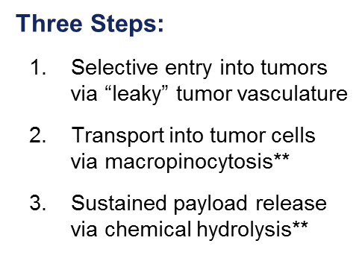
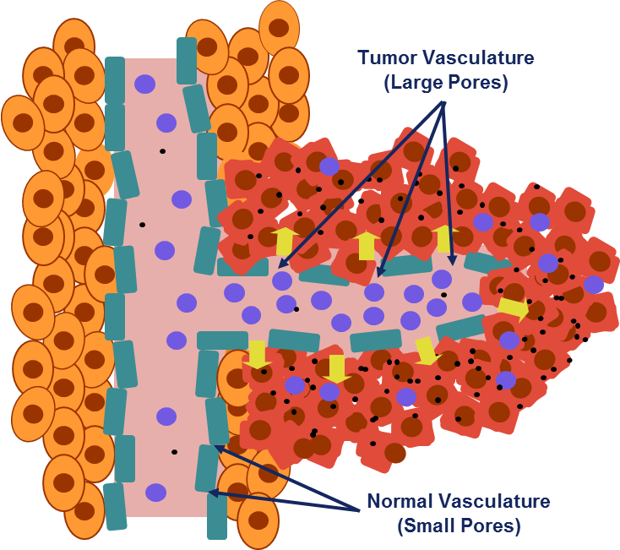
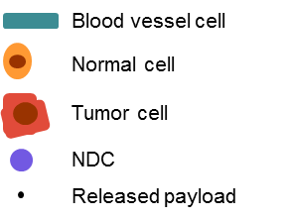
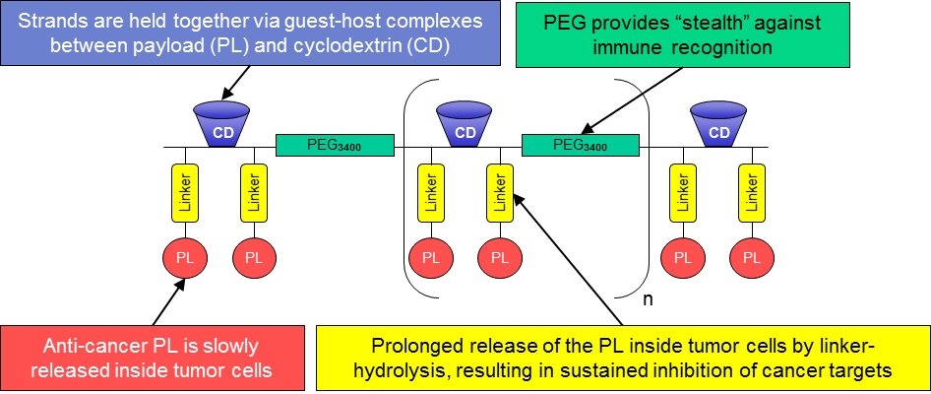

NDCs: Clinically Validated Mechanism of Action*
Guest-host inclusion complex
*PNAS 2016, 113(14):3850-3854.; **Proc. 2015 AACR-NCI-EORTC Mol Targets Cancer Ther Abstract B37.

Slide 4
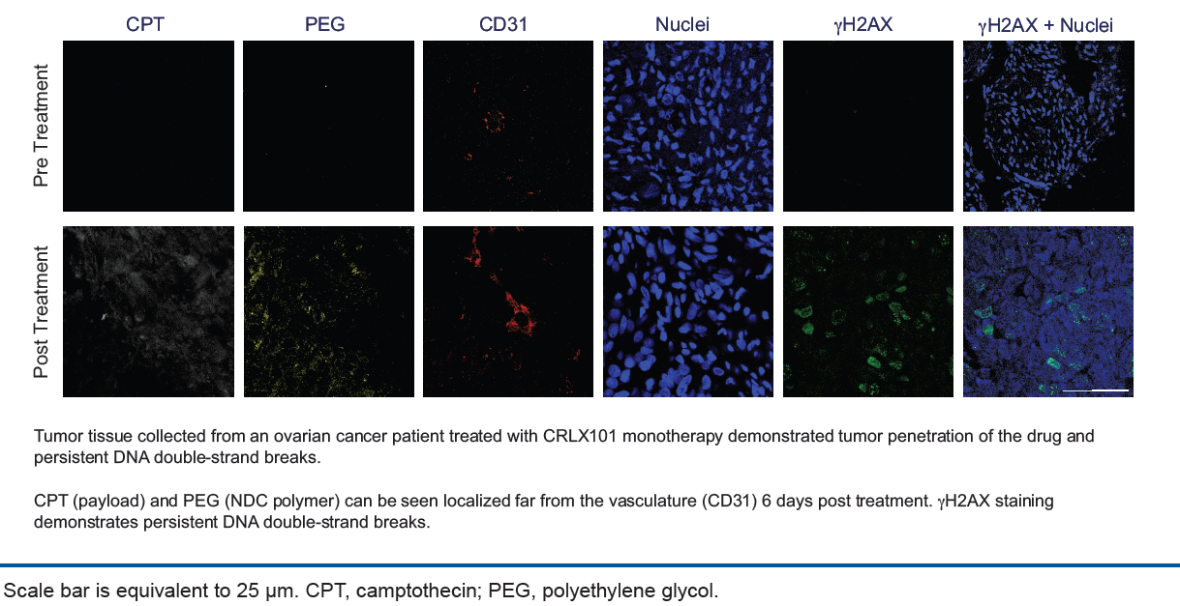
CRLX101 Accumulation and PD Effects
Detection of CRLX101 and DNA damage in ovarian tumor post-treatment *
* Krasner AACR 2016

Slide 5
NDC Platform-Generated Pipeline
PRECLINICAL
PHASE 1
PHASE 2
PHASE 3
CRLX101
Relapsed Renal Cell Carcinoma
CRLX101 + Avastin®
Relapsed Ovarian Cancer
CRLX101 + Avastin; CRLX101 + weekly paclitaxel
Locally Advanced Rectal Cancer
CRLX101 + capecitabine + radiotherapy
Weekly Dosing Solid Tumors
CRLX101; CRLX101 + Avastin
Solid Tumors
CRLX101 + LYNPARZA™
Solid Tumors
CRLX101 + IDO Inhibitors
CRLX301
Solid Tumors
CRLX301 Dose Escalation
Platform has the potential to create additional candidates alone or with partners
Notes:
Our lead candidate, CRLX101, is in three clinical trials designed to allow us to make go / no go decisions to launch randomized trials
a Phase 1b/2 trial at UPenn of CRLX101 plus Avastin in relapsed renal cell carcinoma confirmed that we can combine CRLX101 with Avastin and gave us a strong efficacy signal, so we are starting a randomized trial in relapsed RCC this summer
a Phase 2 trial at MGH and Dana Farber of CRLX101 plus Avastin in relapsed ovarian cancer followed a successful Phase 2 monotherapy trial of CRLX101 at the same hospitals
a Phase 1b/2 trial at UNC of CRLX101 plus Xeloda plus radiation in non-metastatic rectal cancer
Our second candidate, CRLX301, is expected to enter a Phase 1 study by the end of the year
By year-end, we will have 2 compounds in active clinical development from our platform, and we will be evaluating options for a third platform-generated candidate

Slide 6
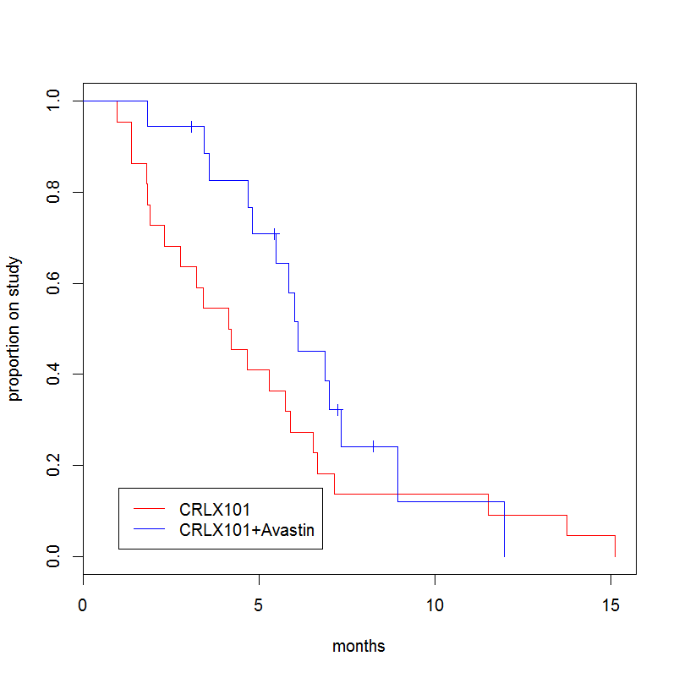
CRLX101 Antitumor Activity in Ovarian Cancer
CRLX101 vs. CRLX101 + Avastin
CRLX101 vs. CRLX101 + Avastin
 | Mono | Combo*
N | 22 | 18
ORR(%) | 14 | 17
SD (%) | 59 | 78
CBR¹ (%) | 73 | 94
PFS6 (%) | 27 | 56
mPFS² (mos.) | 4.2 | 6.2
CA125 Response³ (%) | 23 | 44
¹CBR = PR+CR+SD.
²mPFS: defined as time from first dose to discontinuation of treatment for any reason.
³CA125 Response: decline over baseline ≥ 50%.
Completed stage 1 and met advancement criteria (3/18 PFS6)
No DLTs; combination appears to be generally well tolerated
Data cut-off March 18, 2016
* Krasner et al, AACR 2016.

Slide 7
A Phase Ib Study of CRLX101 in Combination with Weekly Paclitaxel in Platinum-Resistant Ovarian Cancer
Design and Objectives
Objectives
  Primary: Maximum tolerated dose (MTD) of combination
  Secondary: Pharmacokinetics, overall safety, tolerability, and initial signs of clinical antitumor activity
Design
  3 + 3 design with 6 patients expansion at MTD
  2 dose levels planned in combination with full dose weekly paclitaxel
    Dose level 1: CRLX101 12 mg/m² (every other week)
    Dose level 2: CRLX101 15 mg/m² (every other week)
Premeds and IV hydration
  HSR premeds: Dexamethasone and Anti H1/H2 the night before
  IV hydration (1L normal saline over 1 to 2 h) before and after CLRX101 infusion to reduce the potential for cystitis

Slide 8
A Phase Ib Study of CRLX101 in Combination with Weekly Paclitaxel in Platinum-Resistant Ovarian Cancer
Inclusion Criteria:
≥18 years old, histologically/cytologically recurrent or persistent ovarian cancer
>1 prior platinum-based Rx for management of primary disease*
  Patients with only 1 prior cytotoxic regimen (platinum-based regimen for management of primary disease), must have:
    Platinum-free interval of less than 12 months or progressed during platinum-based therapy, or persistent disease after a platinum-based therapy
2 cytotoxic regimens for management of recurrent or persistent disease allowed only if ≤ 1 non-platinum or non-taxane regimen
Adequate organ function, GOG performance status ≤1
Exclusion Criteria:
Prior CRLX101
Prior treatment with weekly paclitaxel for recurrent or persistent disease
  *Initial Rx may include: IP Rx, consolidation, biologic/targeted agents or extended therapy administered after surgical or non-surgical assessment.

Slide 9
A Phase Ib Study of CRLX101 in Combination with Weekly Paclitaxel in Platinum-Resistant Ovarian Cancer
Dose Escalation
 | CRLX101 (mg/m²) (Every other week) Day 1 and 15 | Paclitaxel (mg/m²) (3 weeks on/1 week off) Day 1, 8, and 15 | # of patients treated
Dose level 1 | 12 | 80 | 3
Dose level 2 | 15 | 80 | 6
No dose-limiting toxicities reported at either dose level
RP2D: CRLX101 15 mg/m² (every other week) and paclitaxel 80 mg/m² (3 weeks on/1 week off)
Data cut-off March 17, 2016

Slide 10
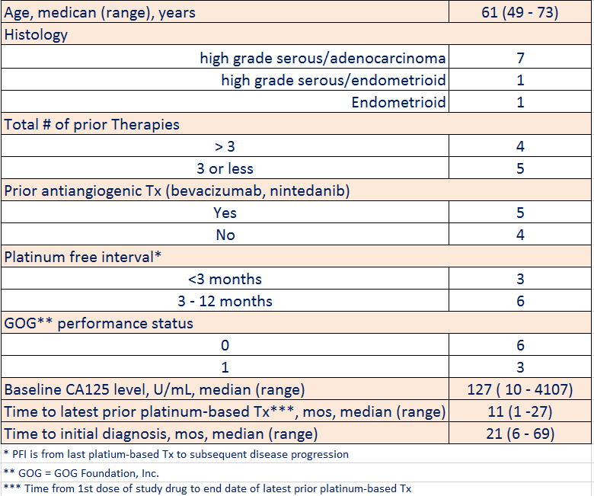
A Phase Ib Study of CRLX101 in Combination with Weekly Paclitaxel in Platinum-Resistant Ovarian Cancer
Patient Characteristics (n=9)

Slide 11
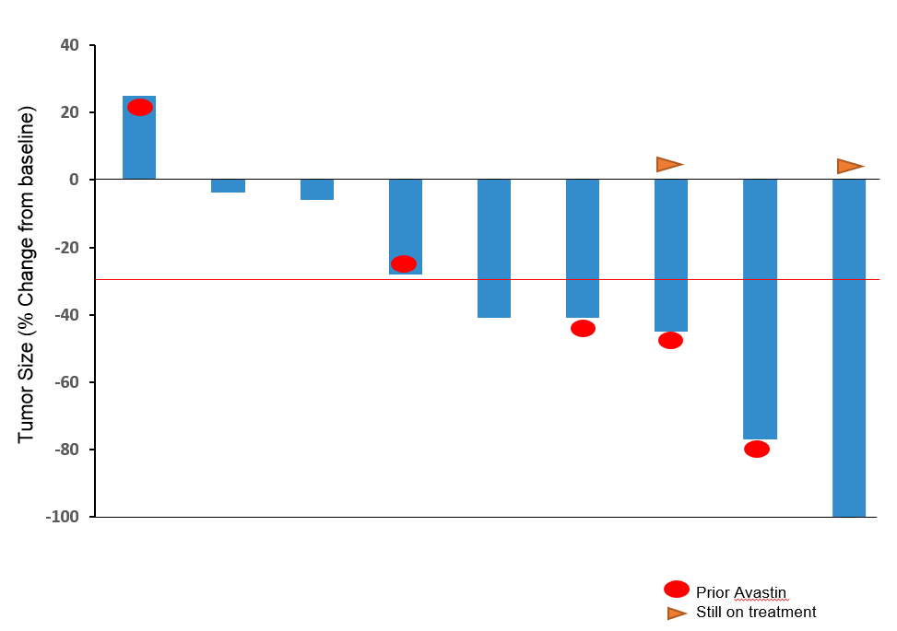
A Phase Ib Study of CRLX101 in Combination with Weekly Paclitaxel in Platinum-Resistant Ovarian Cancer
Changes in the Sum of Longest Diameter (SLD) of Target Lesions from Baseline
Waterfall Plot
Data cut-off March 17, 2016

Slide 12
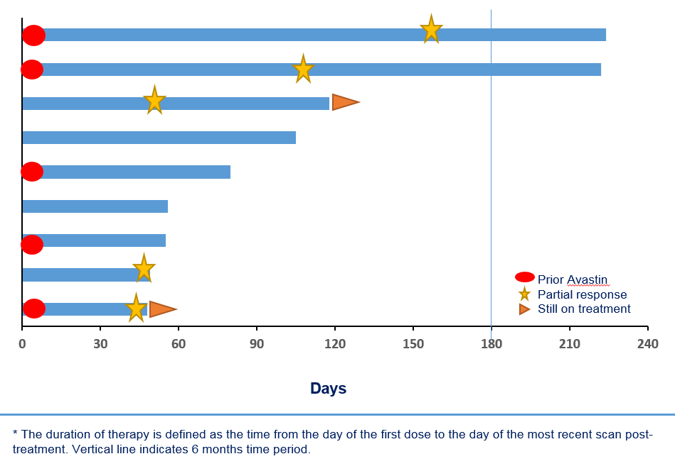
A Phase Ib Study of CRLX101 in Combination with Weekly Paclitaxel in Platinum-Resistant Ovarian Cancer
Duration on Therapy*
Data cut-off March 17, 2016

Slide 13
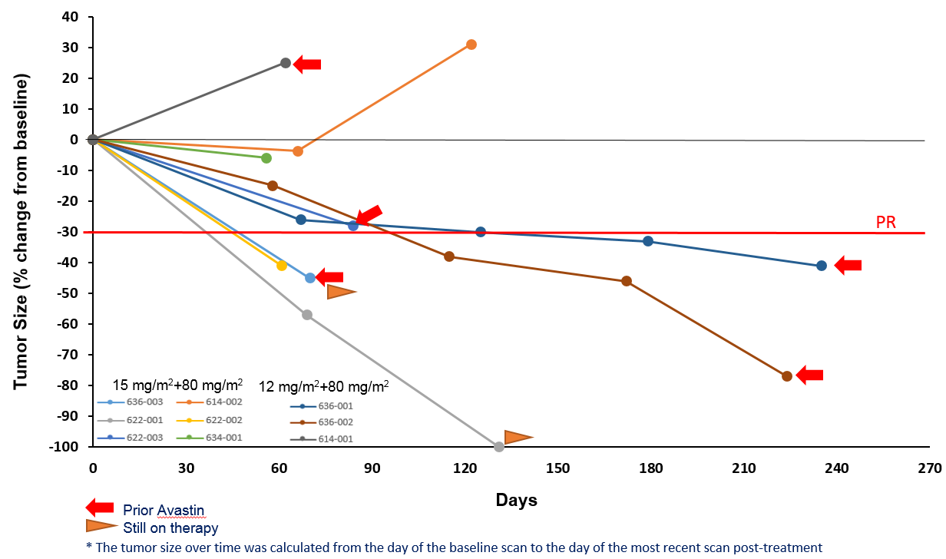
A Phase Ib Study of CRLX101 in Combination with Weekly Paclitaxel in Platinum-Resistant Ovarian Cancer
Change in Tumor Size over Time*
Data cut-off March 17, 2016

Slide 14
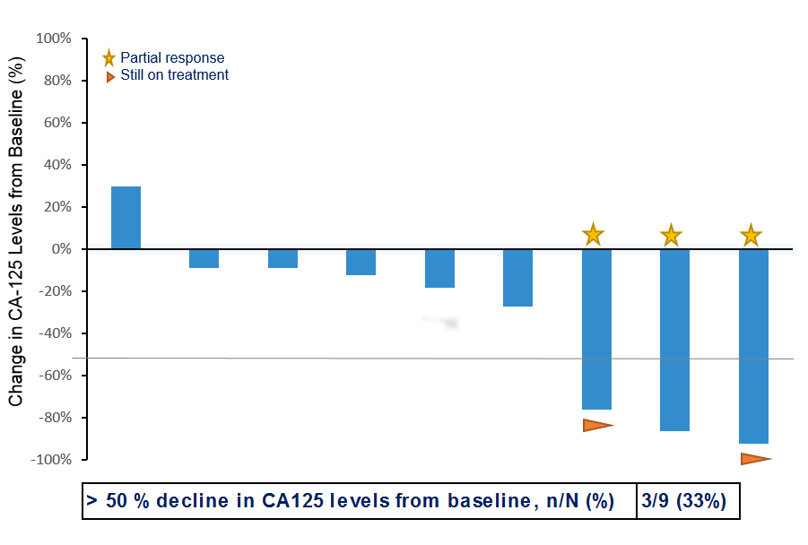
Reductions in CA125 Levels from Baseline
A Phase Ib Study of CRLX101 in Combination with Weekly Paclitaxel in Platinum-Resistant Ovarian Cancer
Data cut-off March 17, 2016

Slide 15
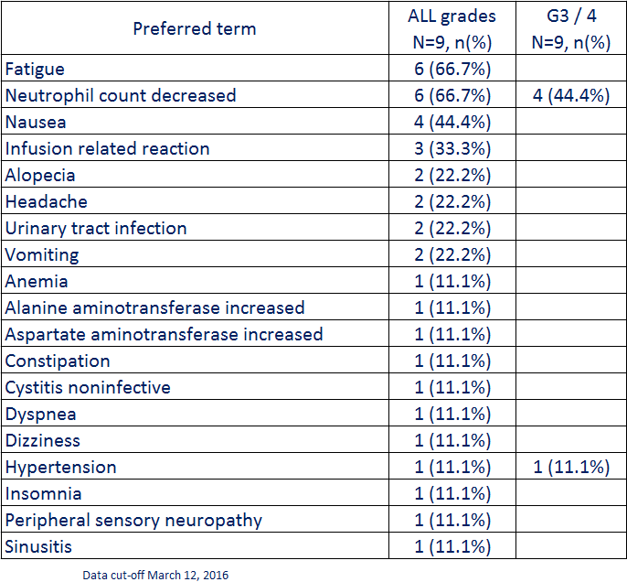
A Phase Ib Study of CRLX101 in Combination with Weekly Paclitaxel in Platinum-Resistant Ovarian Cancer
Treatment Related AEs (>10%)

Slide 16
A Phase Ib Study of CRLX101 in Combination with Weekly Paclitaxel in Platinum-Resistant Ovarian Cancer
Conclusions
MTD: CRLX101 QOW 15 mg/m² and weekly paclitaxel 80 mg/m² (3 weeks on/1 week off)
5 out of 9 patients (56%) had objective responses, including a patient with complete disappearance of tumor with detectable CA125
Combination generally well tolerated; no DLTs observed
Expanded QOW cohort based on antitumor effect observed in first 9 patients
More dose intensive schedule, i.e: weekly (3 weeks on/1 week off) for BOTH CRLX101 and paclitaxel will be tested
References
Clark AJ et al. Proc Natil Acad Sci USA. 2016 Mar 21. [Epub ahead of print]

Slide 17
A Phase Ib Study of CRLX101 in Combination with Weekly Paclitaxel in Platinum-Resistant Ovarian Cancer
Acknowledgements
We thank the patients, their families and caregivers, and the study staff and investigators for their participation. The study is being conducted by Cerulean Pharma in collaboration with the GOG Foundation, Inc.

