Slide 1
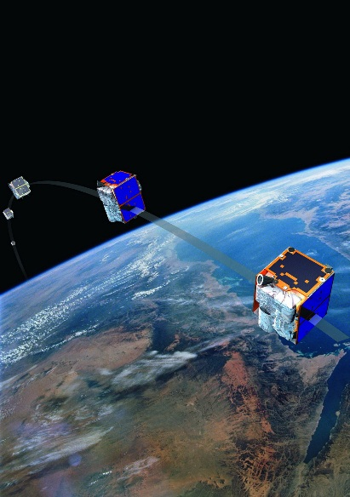
Mass processing of remote sensing data for environmental evaluation in Europe
Lic. Adrián González| Applications Research
BlackBridge | www.blackbridge.com
Earth Science Conference 2014 – 29.07.2014 San Francisco -USA

Slide 2
Project background
2012 - “GIO land” (Copernicus Initial Operations land program)
  Contracted by EU – Technical coordination European Environmental Agency (EEA)
  Methodology and generation of 5 thematic High Resolution Layers on Land Cover characteristics: impervious areas, forests, wetlands, water bodies and grassland of 39 European countries
  Our consortium (Indra, Eurosense and BlackBride) won the bid for Permanent Grassland generation

Slide 3
Opportunity and challenge
Start of project: March 2012
Number of countries to be processed: 39
Area to be covered: about 6 millions km2
Requested overall minimum accuracy: 80%
Project time: 30 months
Time for process development and server set up: 8 month
Real working time less than 18 months
Only chance: automation

Slide 4
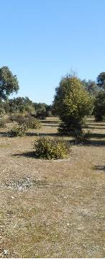
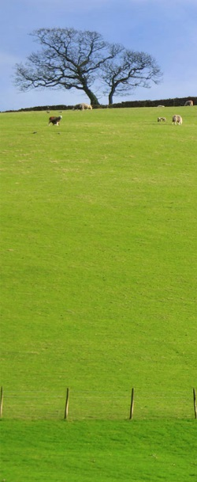
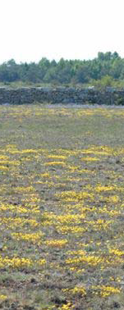
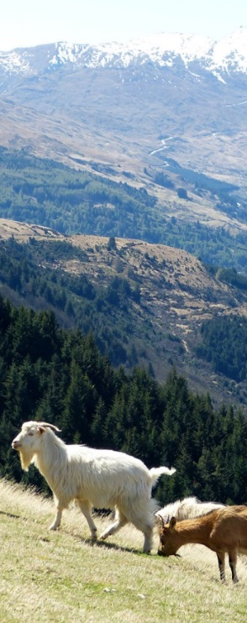
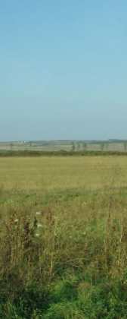
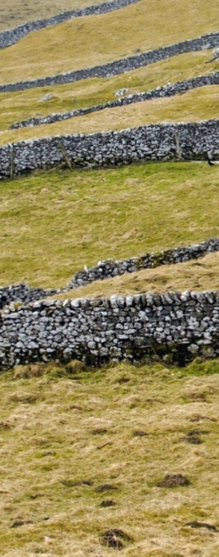
Grassland Monitoring in europe
Permanent grassland HRL product across Europe
Grasslands are highly important for Europe, … and highly variable !!!

Slide 5
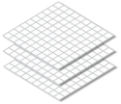



Processing schema
Permanent grassland HRL product across Europe
Multi-Temporal Images in GeoDB
Segmentation
Image Objects
Texture Parameter
Data extraction
Seasonal Statistics
Result
Training
BPP
TOA correction
Min
tn
Max.
Definition of WU
Mean
Decision Tree
Classification
Image Selection & Calculation of bio-physical parameters
t2
Range
t1
Std. Dev
Mad
C5

Slide 6
Technical description of the mass processing (1)
INPUT DATA
Remote sensing image repository over 39 countries
  IRS images – Spatial resolution 20 meters – 140x140 km
  Awifs images – Spatial resolution 60 meters – 370x370 km
  RapidEye images – Spatial resolution 20 m – 25x25 km
  RapidEye images – Spatial resolution 5 m – 25x25 km
  Spot images – Spatial resolution 20 m – 60x60 km
  All images parameters and geometries stored in a Spatial Database to optimize performance

Slide 7

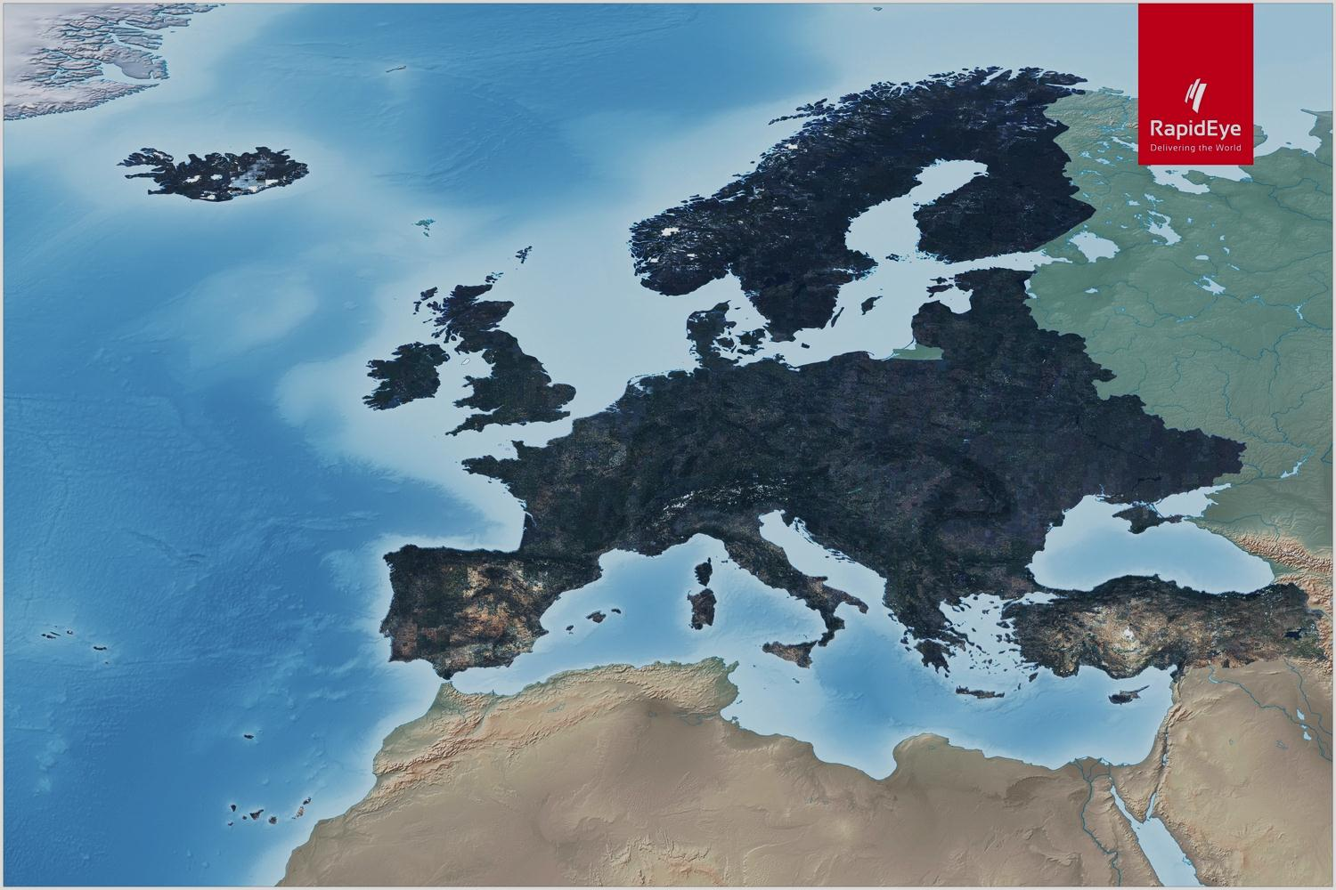
Continent coverages
EU 39 in 24 months

Slide 8
Processing (1)
Multi-Temporal images
IRS
Awifs
RapidEye
Spot
Spatial Database
TOA correction
Definition of the Work Unit (WU)

Slide 9
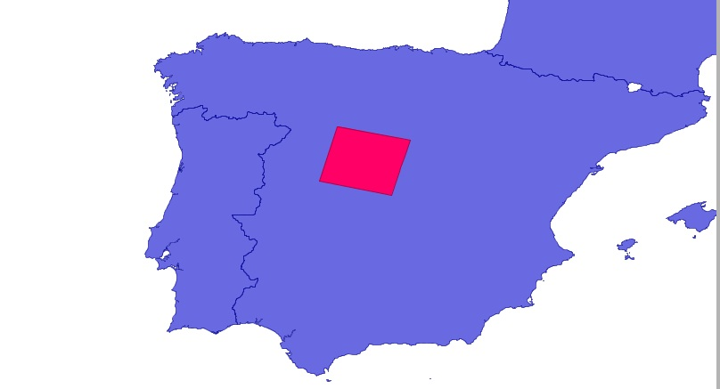
Processing (2) – Definition of the Work unit
Europe divided in Work Units
Core of the processing schema
Work Unit = IRS image from 2012
National projection system used
Boundary used to clip all other images

Slide 10
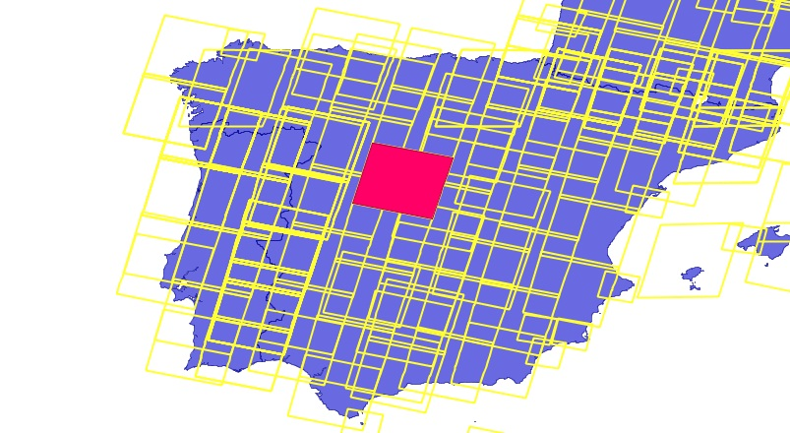
Overview on work units - Spain
Example: Spain – Approx. 120 Work Units

Slide 11
Processing (3)
Image Selection & Calculation of vegetation parameters
Texture parameters
NDVI
PSRI
WI
Brightness
Ground Coverage
NDII
NDVSI
Seasonal Statistics
Min
tn
Max.
Mean
t2
Range
t1
Std. Dev
Mad

Slide 12
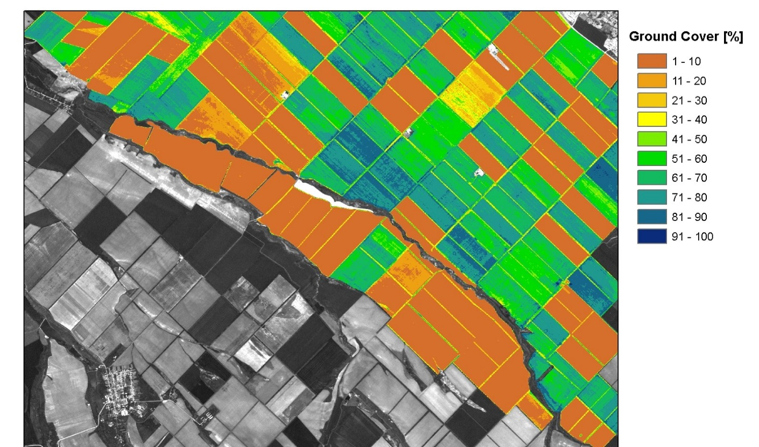
Large Area Mapping of Vegetation Parameters
NDVI
Ground
Cover

Slide 13
Processing (4)
Image Objects
Result
Decision Tree
Classification
Segmentation
Training
C5

Slide 14
Technical description of the mass processing (2)
PROCESSING ENGINE
Hardware
  Dedicated server (16 cores – 32 Gb RAM)
  20 Tb Online storage – 40 Tb Stand by storage
  Production requirements: 24x7
  Dedicated delivery server – Delivery method FTP
  Daily incremental backups

Slide 15
Technical description of the mass processing (3)
PROCESSING ENGINE
Software
  Programming language: Python
  Base on Open Source Libraries (Gdal and OGR)
  About 5000 lines of code in seven different modules
  All software programmed in house

Slide 16
conclusions
All 39 countries in Europe processed
All overseas territories processed
Total project time shortened: from 18 to 14 months
Second run to cover image gaps performed
On site country verification in progress

Slide 17
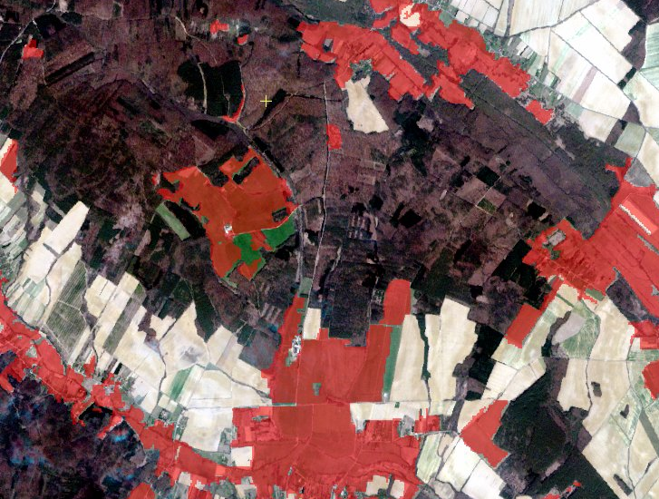
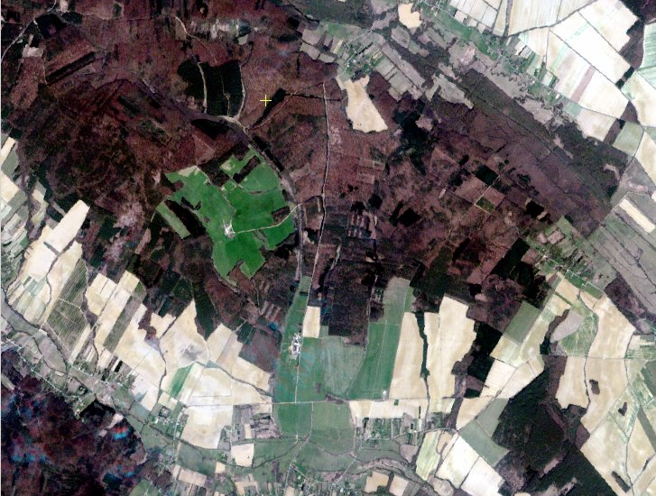
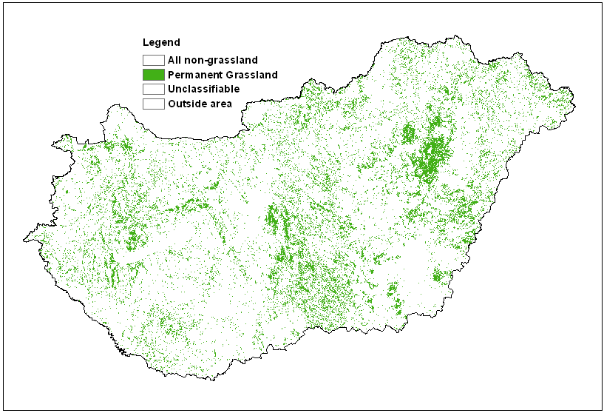
Grassland Monitoring in europe
Overall accuracy for Hungary = 92 %
Notes:
Since it is impossible to show you all the comprehensive results I will show you only two examples .
For Hungary we could achieve a fairly good result with 92% overall accuracy. In general the omission error was always higher than the commission error.

Slide 18
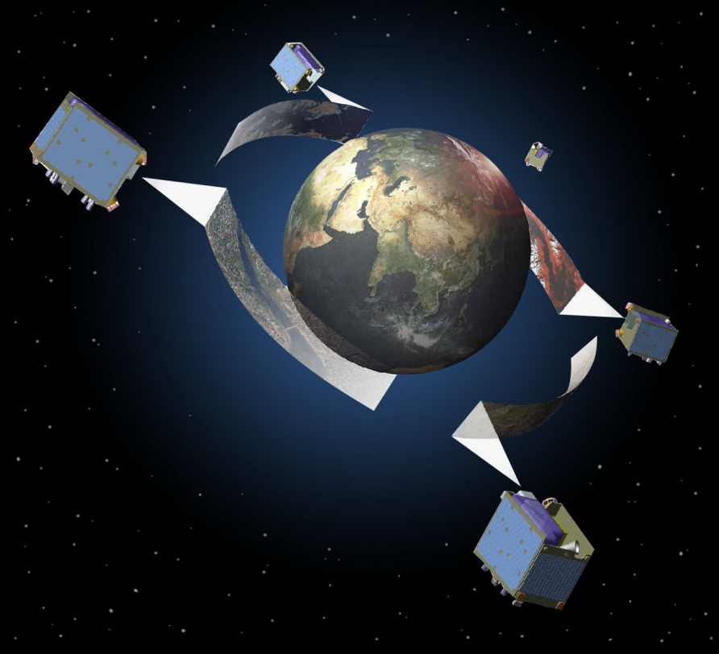


Thanks for your attention
Lic. Adrian Gonzalez
Applications Research
+49 30 609 8300 313
adrian.gonzalez@blackbridge.com

